Slide 1
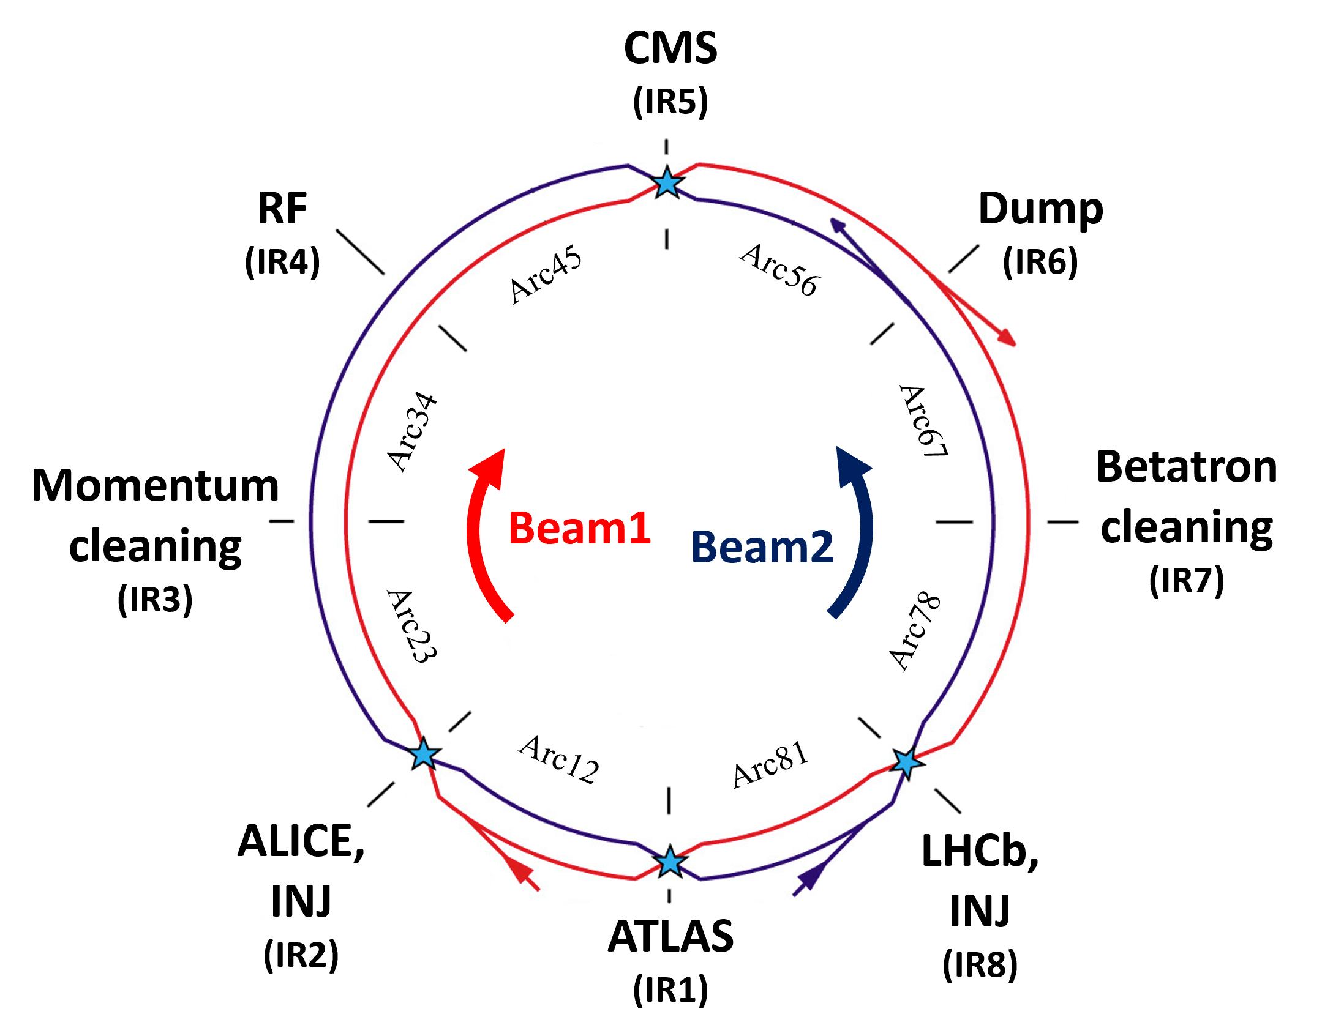
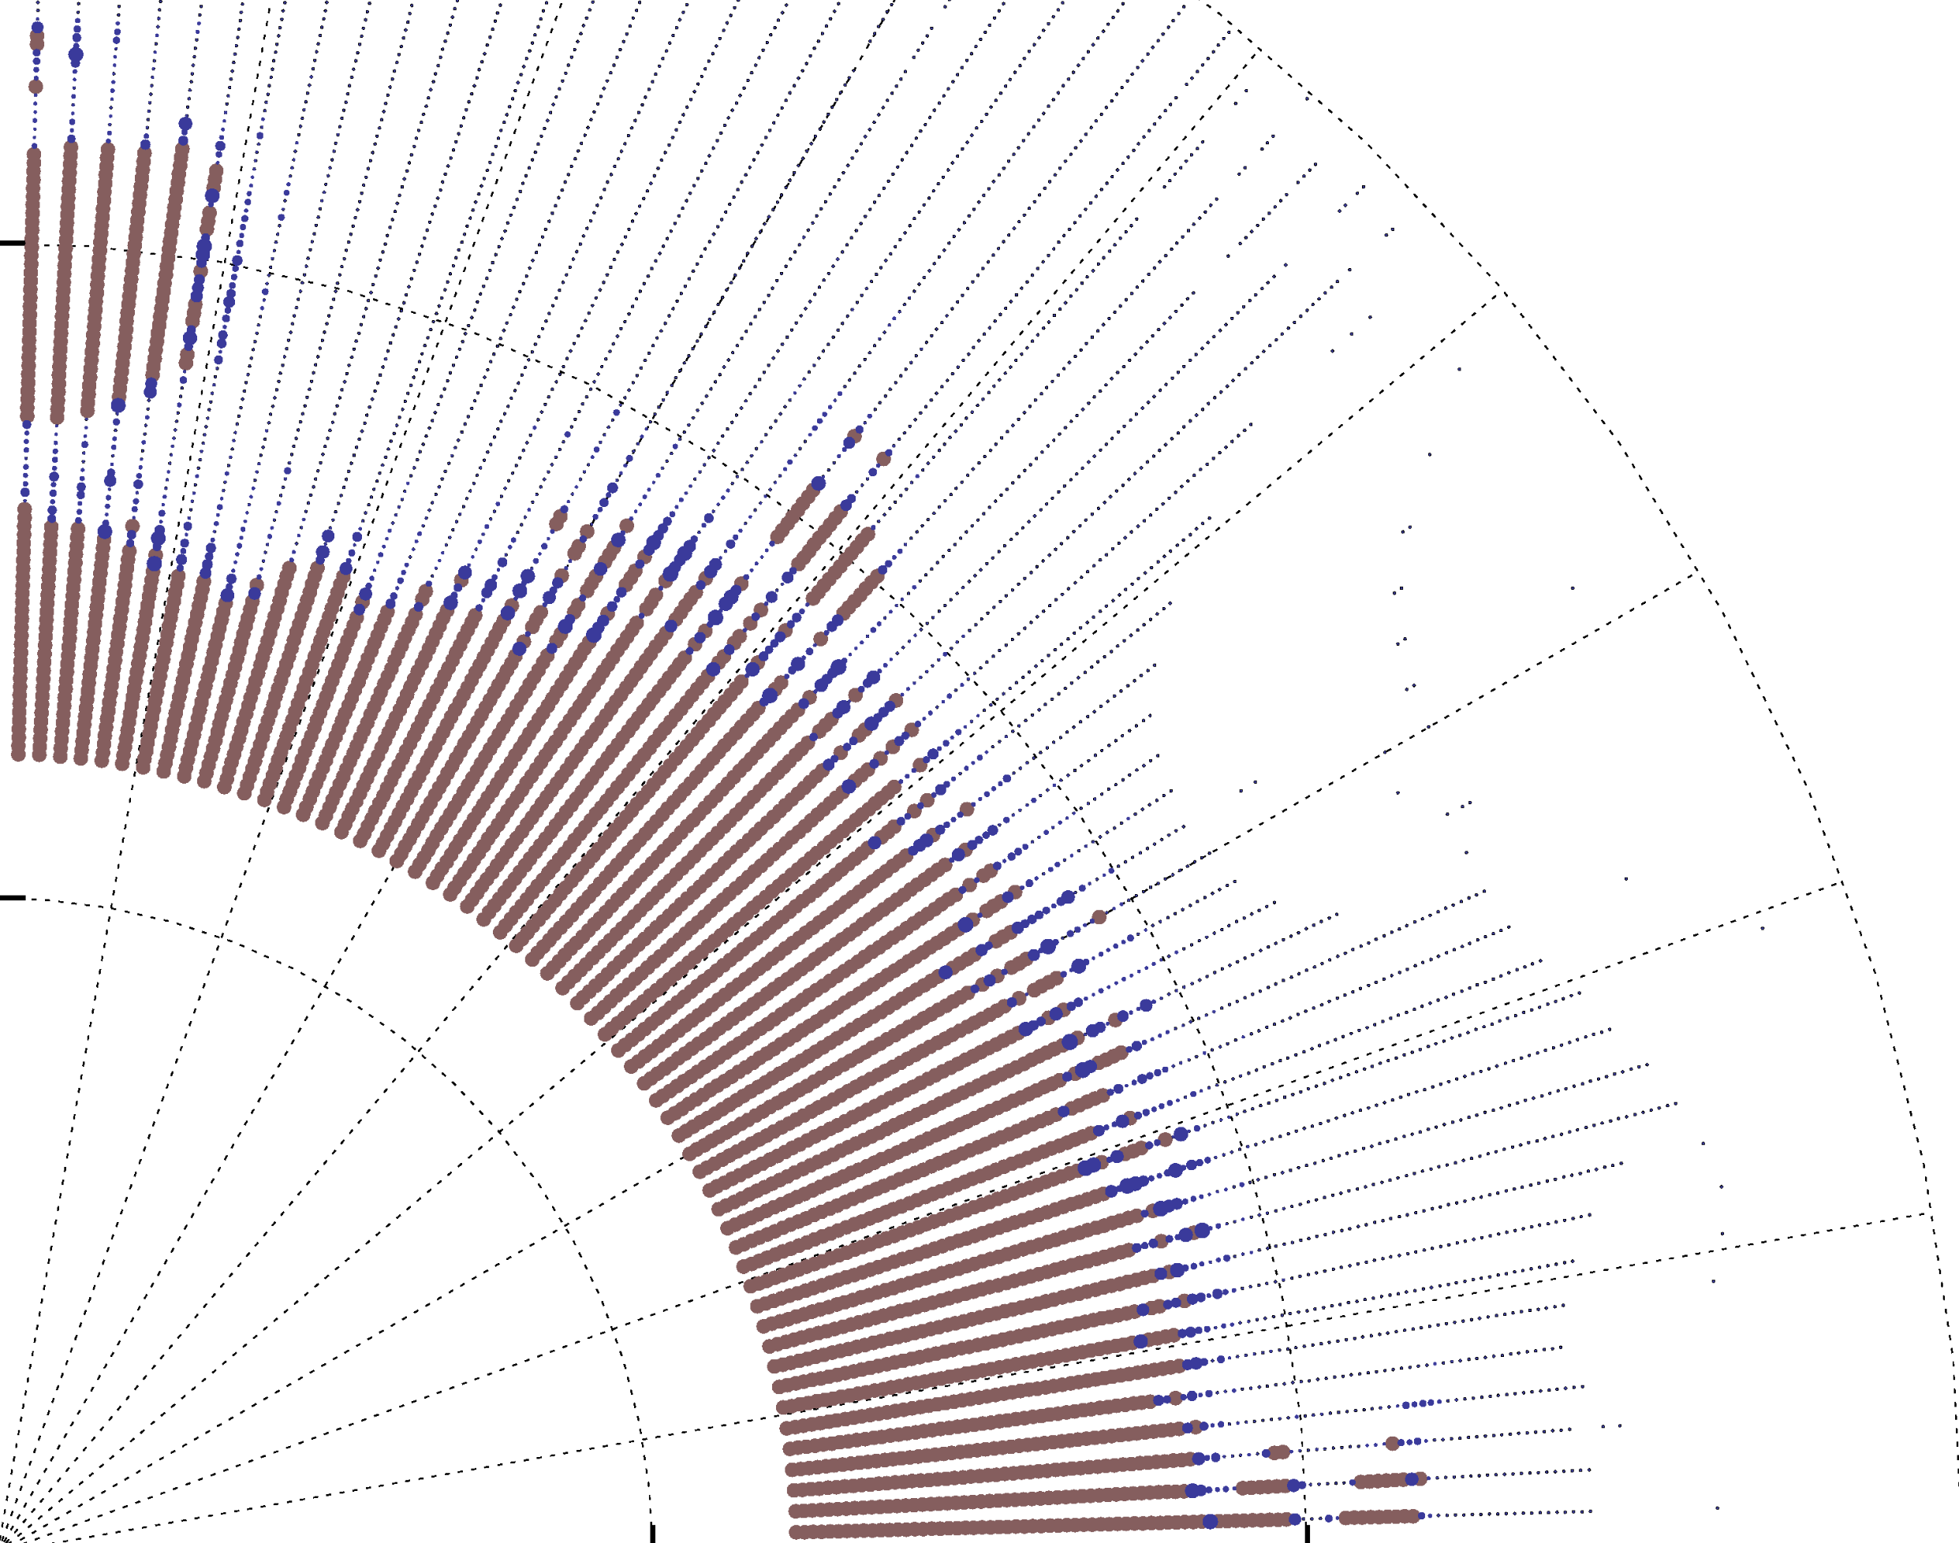


Review of Linear and Nonlinear Optics in the CERN LHC
Ewen Hamish Maclean, CERN
With thanks to the CERN Optics Measurement and Correction team, past and present:
R. Tomás, T. Persson, Y. Angelis, T. Bach, F. Burkhardt, R. Calaga,
F. Carlier J. Cardona, J. Coello, A. Ojeda, F. Chudoba, J. Dilly, U. Karr,
S. Monig, H. Morales, A. Tabares, J. Gray, M. Giovannozzi, E. Fol
V. Ferrentino, M. Garrec, M. Hofer, S. Horney, R. Miyamoto,
W. Van Goethem, E. Hoydalsvik, J. Keintzel, A. Langner,
E. Kravishvili, Y.I. Levinsen, V. Maier, L. Malina, M. McAteer,
C. Nellist, T. Nissinen, K. Paraschou, L. Van Riesen-Haupt,
A.C. Sherman, K. Skoufaris, P.K. Skowronski, F. Soubelet,
M. Stefanelli, G. Vanbavinckhove, E. Waagaard,
A. Wegscheider, S. White, P. Zisopoulos
and the many OP, instrumentation, and LHC experts who support OMC activities

Slide 2
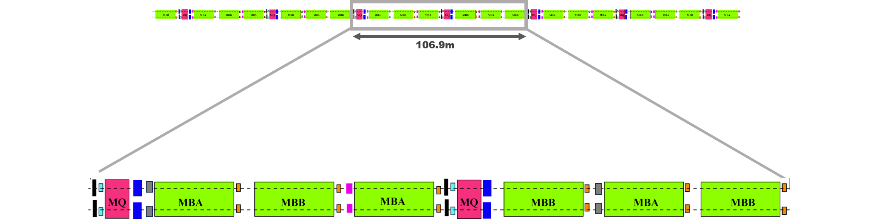
CERN Large Hadron Collider (LHC)
Twin ring 27km collider

Slide 3
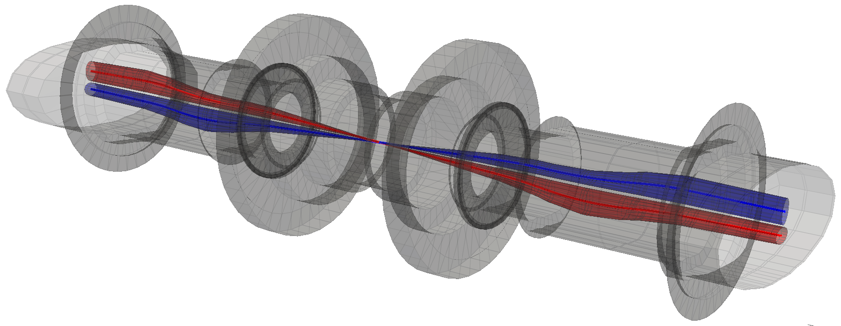
CERN Large Hadron Collider (LHC)
Twin ring 27km collider
8 FODO Arcs
→ Lattice sextupole/octupole for Q’ & Landau damping
→ skew-quads, skew-sextupoles
→ normal sextupole/octupole/decapole correctors
Lattice normal sextupoles,
Skew sextupoles
Main Quads
Main Dipoles
Trim Quads, skew quads,
Lattice octupoles
Normal sextupole correctors
BPMs
Normal octupole/decapole correctors

Slide 4

CERN Large Hadron Collider (LHC)
Twin ring 27km collider
4 experimental insertions (low-$β^{∗}$)
→ normal/skew correctors up to dodecapole
Image:
Szymon Lopaciuk

Slide 5
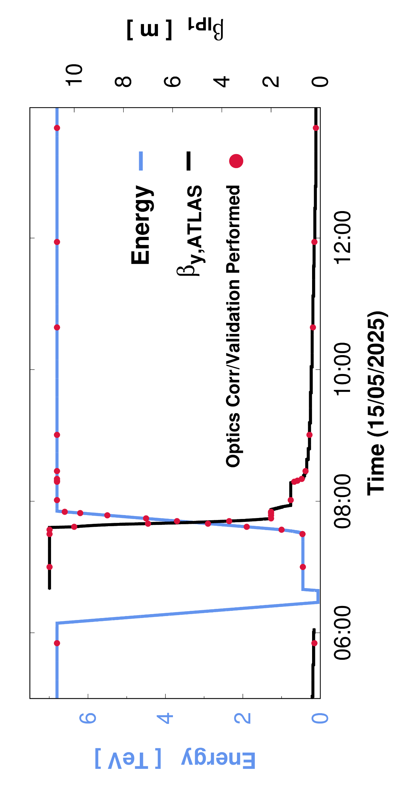

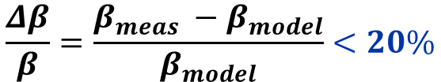
CERN Large Hadron Collider (LHC)
Inject @ 450GeV. Ramp+squeeze to 6.8TeV. $β^{∗}$-levelling down to minimum $β^{∗}$=0.18m
LHC operates with strict optics constraints throughout its cycle
Machine protection demands `β-beating’
$$\frac{Δβ}{β}=\frac{β_{meas} −β_{model}}{β_{model}}<20\%$$
(plus constraints on dispersion, special phase-advances…)
Tolerances must be met before any high intensity setup of the accelerator, In practice performance / luminosity target RMS $Δβ/β$ and $β^{∗}$ control at few %
Typical need to validate/correct > 30 optics configurations each year
Key requirement for optics studies is rapid measurement/correction

Slide 6
LHC Optics Measurement and Correction (OMC)
Linear optics
Linear Coupling
Nonlinear optics

Slide 7
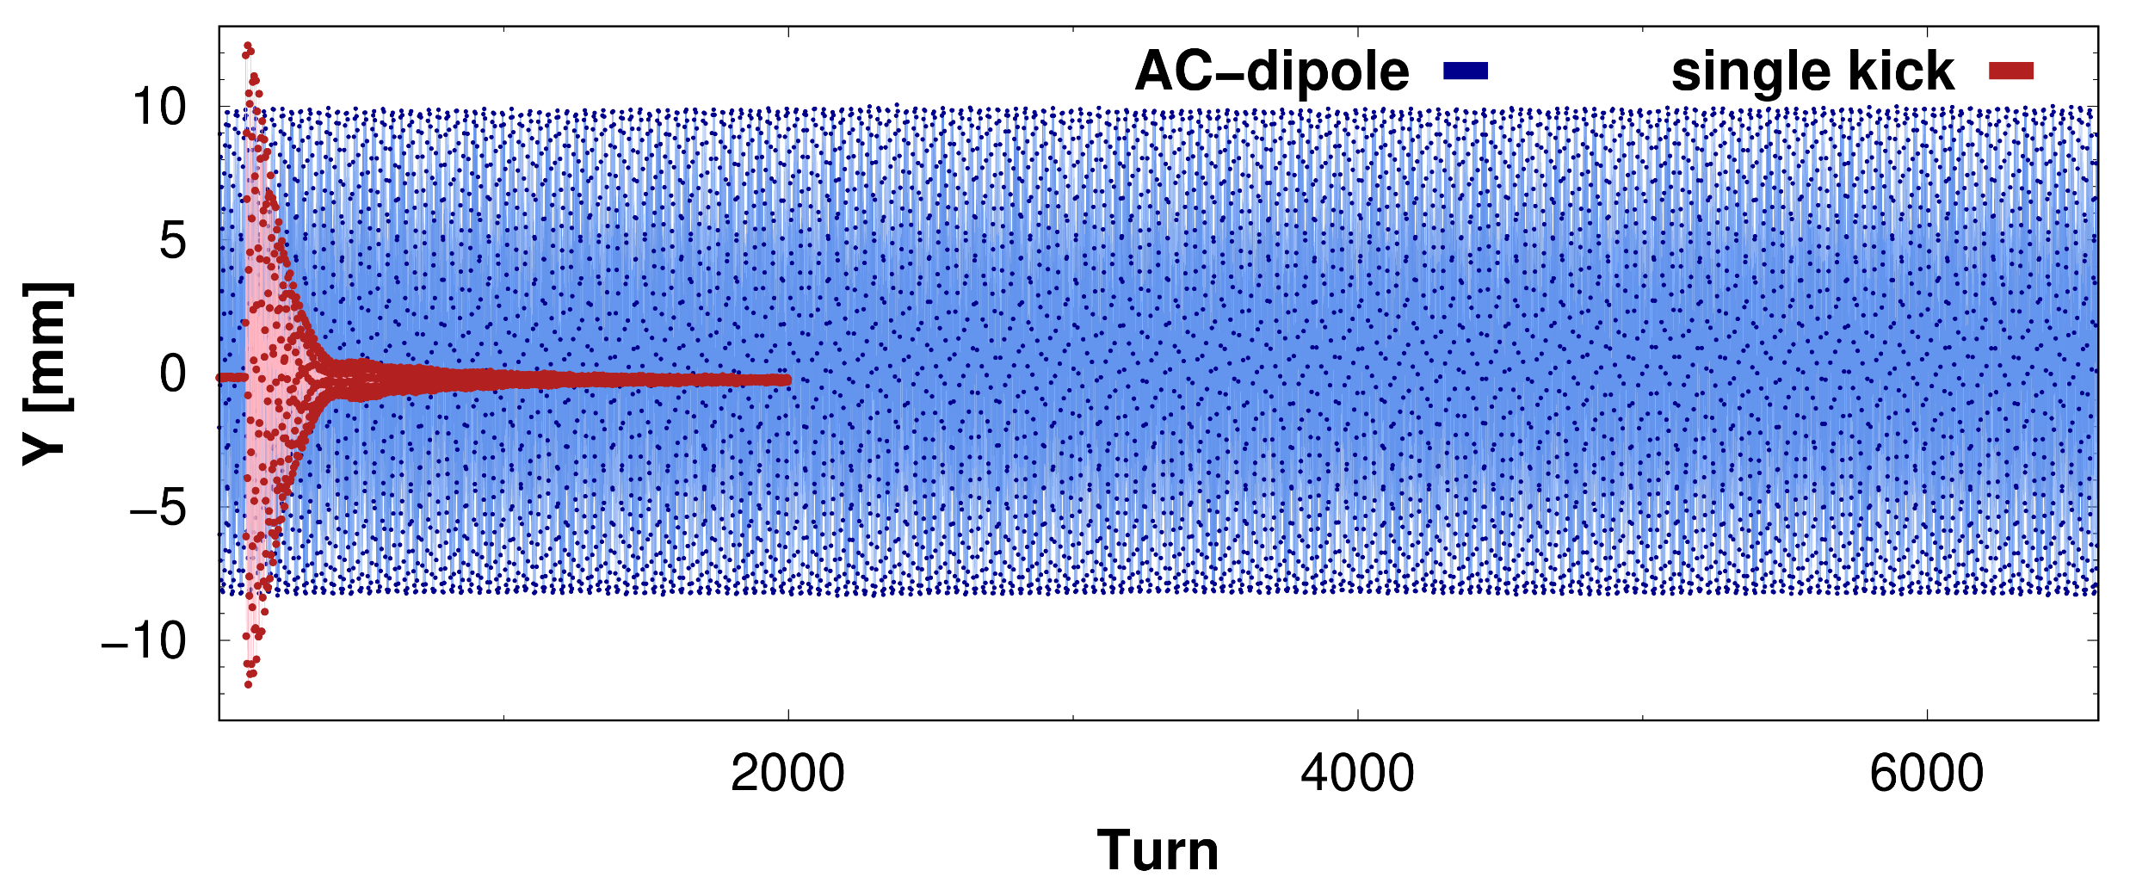
LHC extensively uses optics measurement via AC-dipole kicks
Forced betatron oscillations driven by sinosoidally powered dipole kicker
No decoherence & adiabatic excitation → optics measurement in all BPMs around ring every 2 minutes

Slide 8
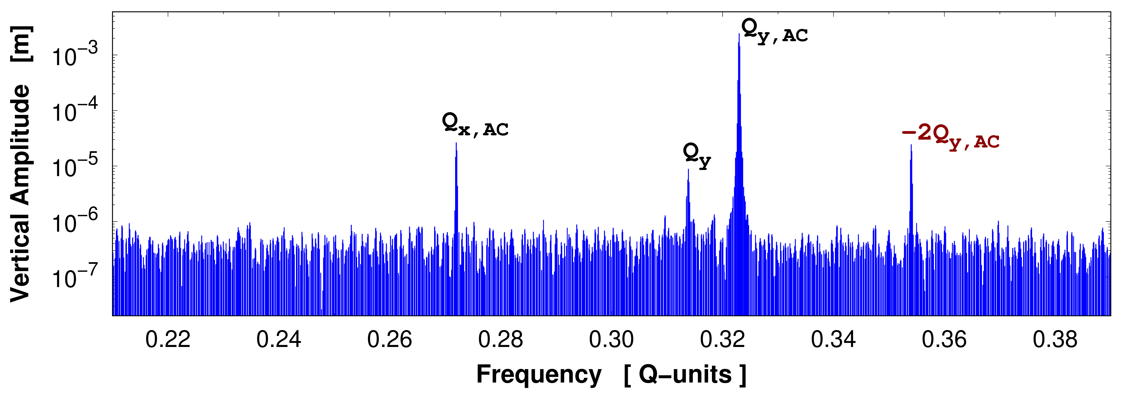
Typical example of measured TbT BPM spectrum from an ACD kick
ACD-peak
Nonlinear resonance
Coupling
Natural tune

Slide 9
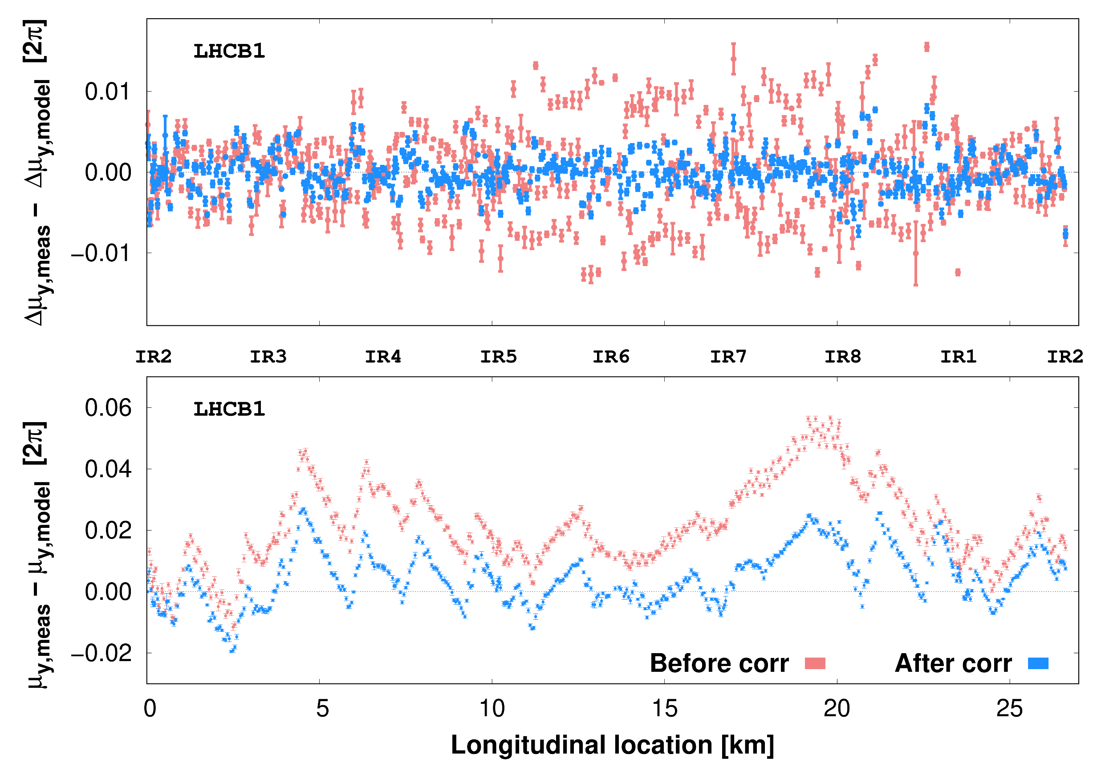
LHC has ≈500 dual-plane BPMs / beam
Many calibration independent observables can be extracted
Measurements of phase-advances between BPMs and around the ring are heavily used for corrections

Slide 10
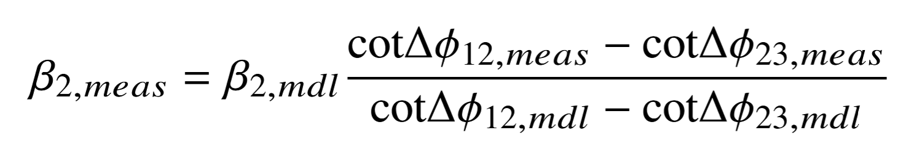
LHC has ≈500 dual-plane BPMs / beam
Many calibration independent observables can be extracted
Measurements of phase-advances between BPMs and around the ring are heavily used for corrections
β measurement utilizes `β-from-phase’ method
Reconstruct β via phase-advances to neighbouring BPMs
BPM calibration independent

Slide 11
LHC has ≈500 dual-plane BPMs / beam
Many calibration independent observables can be extracted
Measurements of phase-advances between BPMs and around the ring are heavily used for corrections
β measurement utilizes `β-from-phase’ method
Reconstruct β via phase-advances to neighbouring BPMs
BPM calibration independent

Slide 12
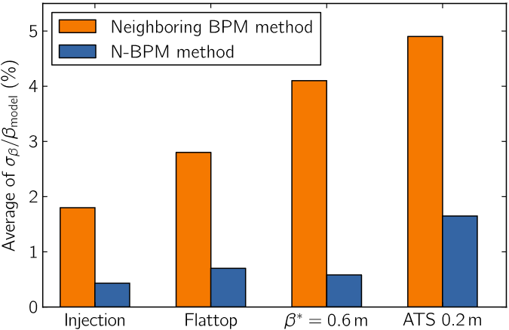
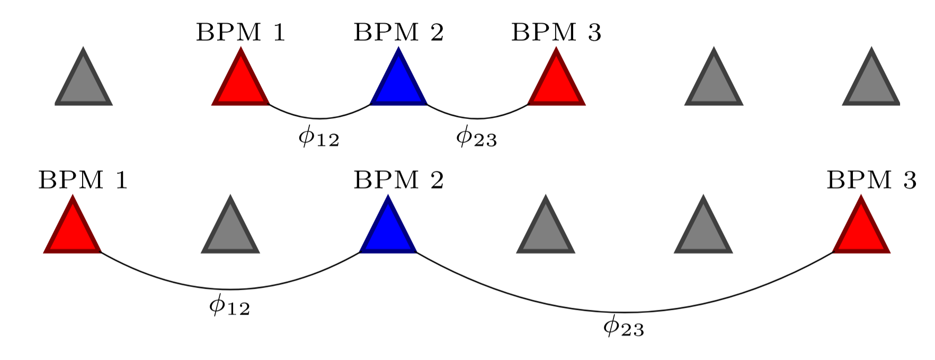
Initially used `3-BPM’ method similar to LEP
Moving to `N-BPM’ method significantly improved reliability of the reconstruction
Weighted combinations over several pairs of nearby BPMs
Much more robust to BPM placement / failure introducing large systematic errors into reconstruction
A.Langner

Slide 13
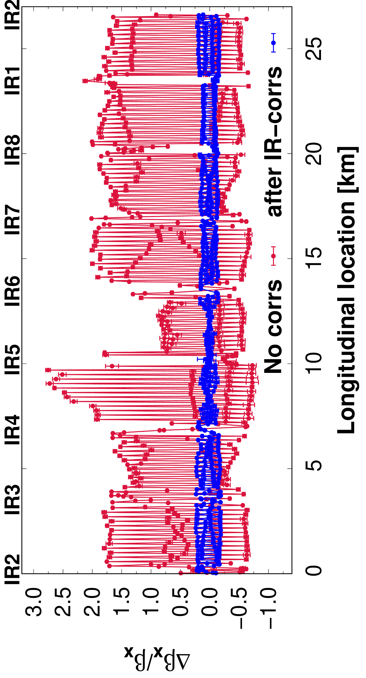
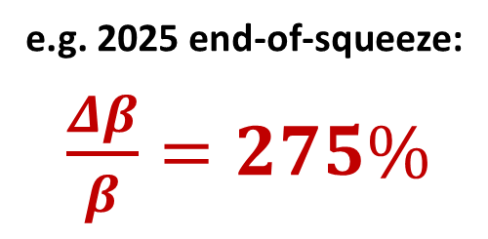
Optics correction essential to meet machine protection/performance targets
e.g. 2025 end-of-squeeze:
$\frac{Δβ}{β}=275\%$
Start with local correction for errors in IR

Slide 14
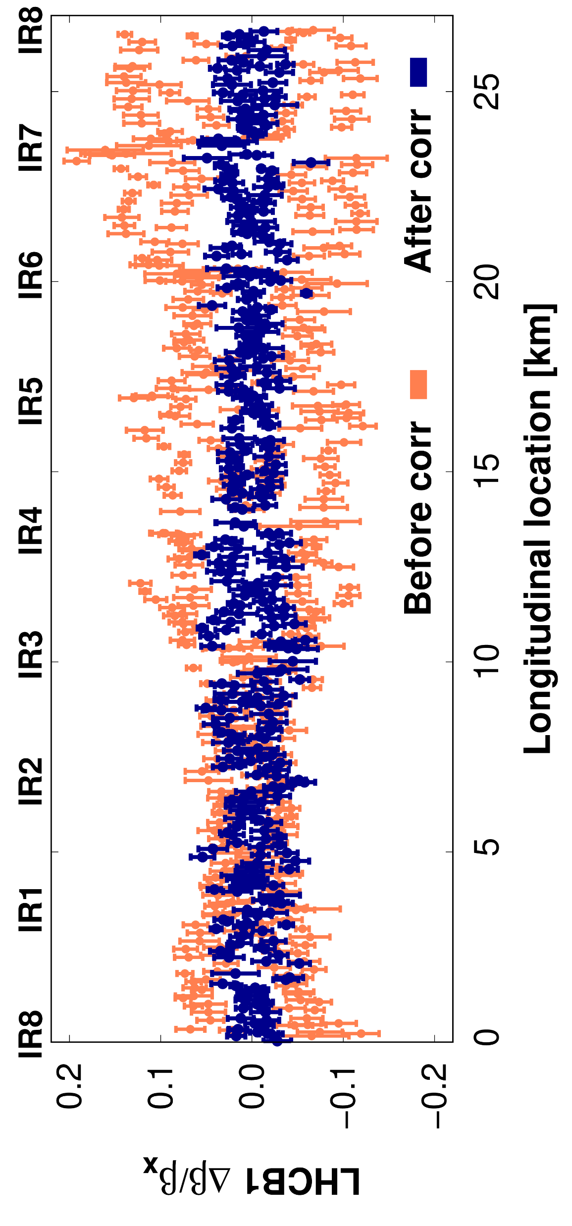
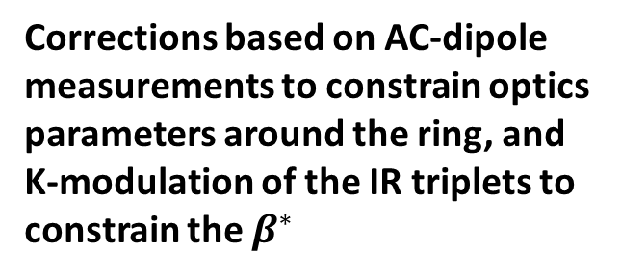
Optics correction essential to meet machine protection/performance targets
Local corrections followed by global response matrix of all quads to minimize various observables
Corrections based on AC-dipole measurements to constrain optics parameters around the ring, and K-modulation of the IR triplets to constrain the $β^{∗}$
Combination of local+global corrections generally allowed us to achieved target β-beat

Slide 15
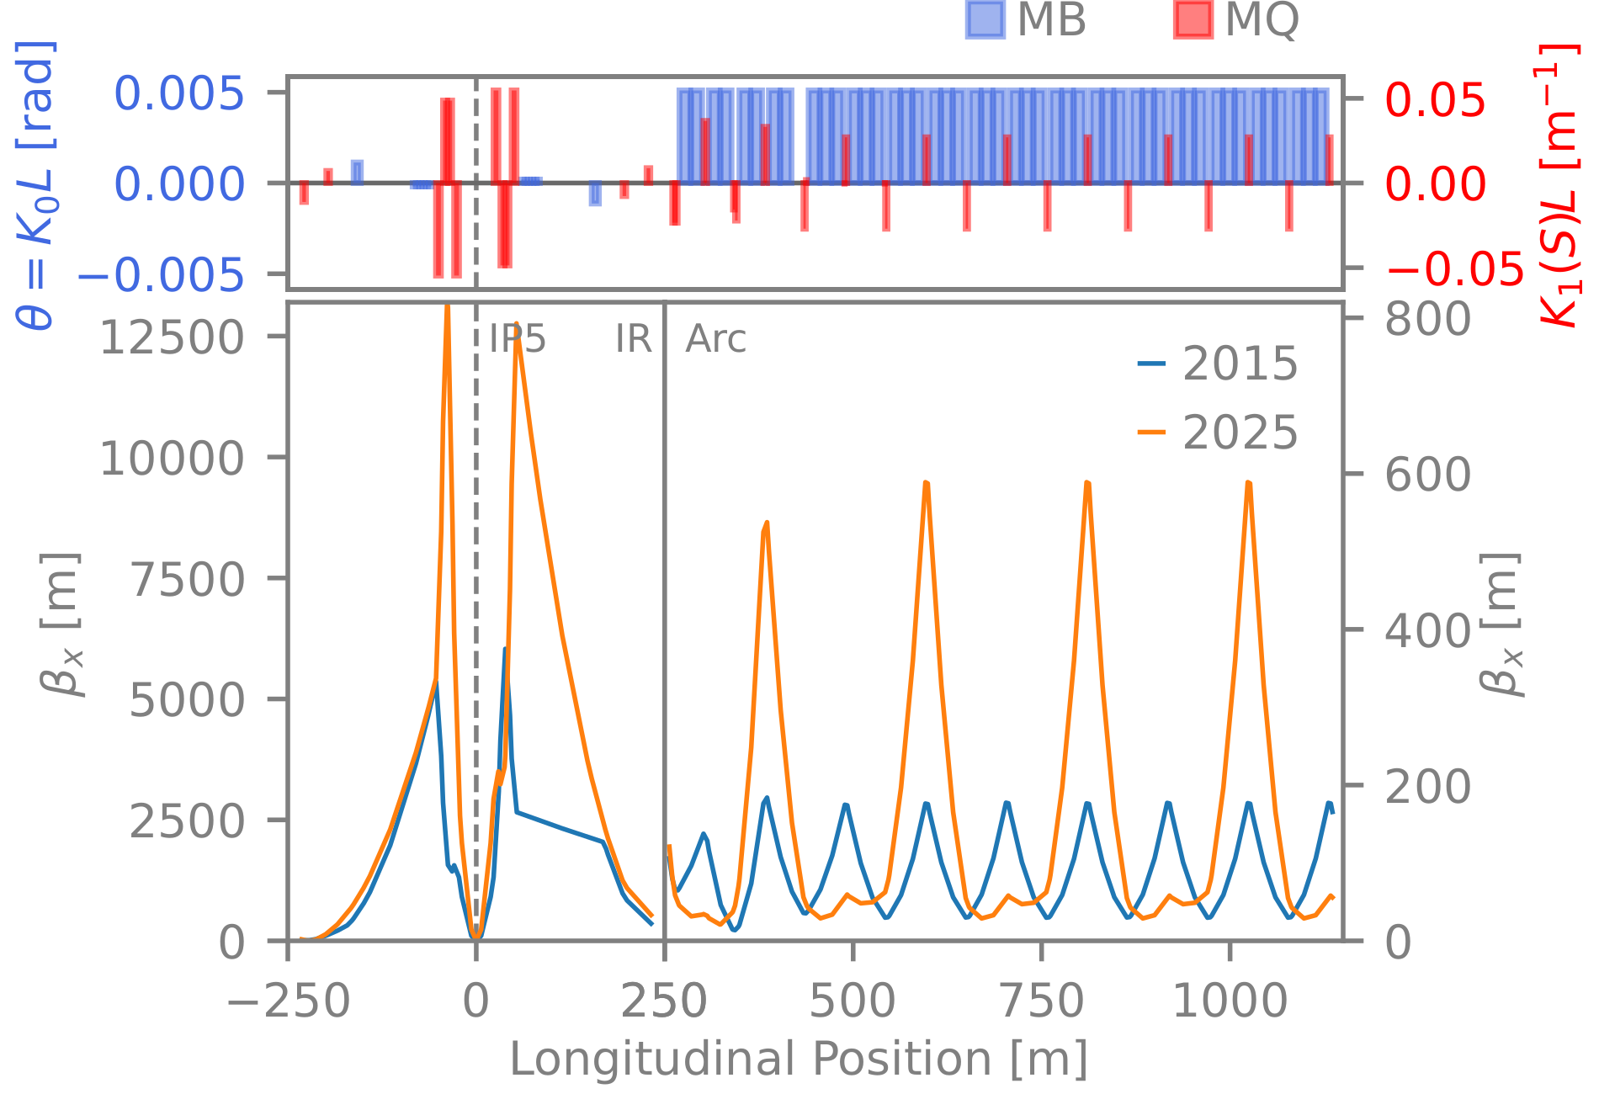
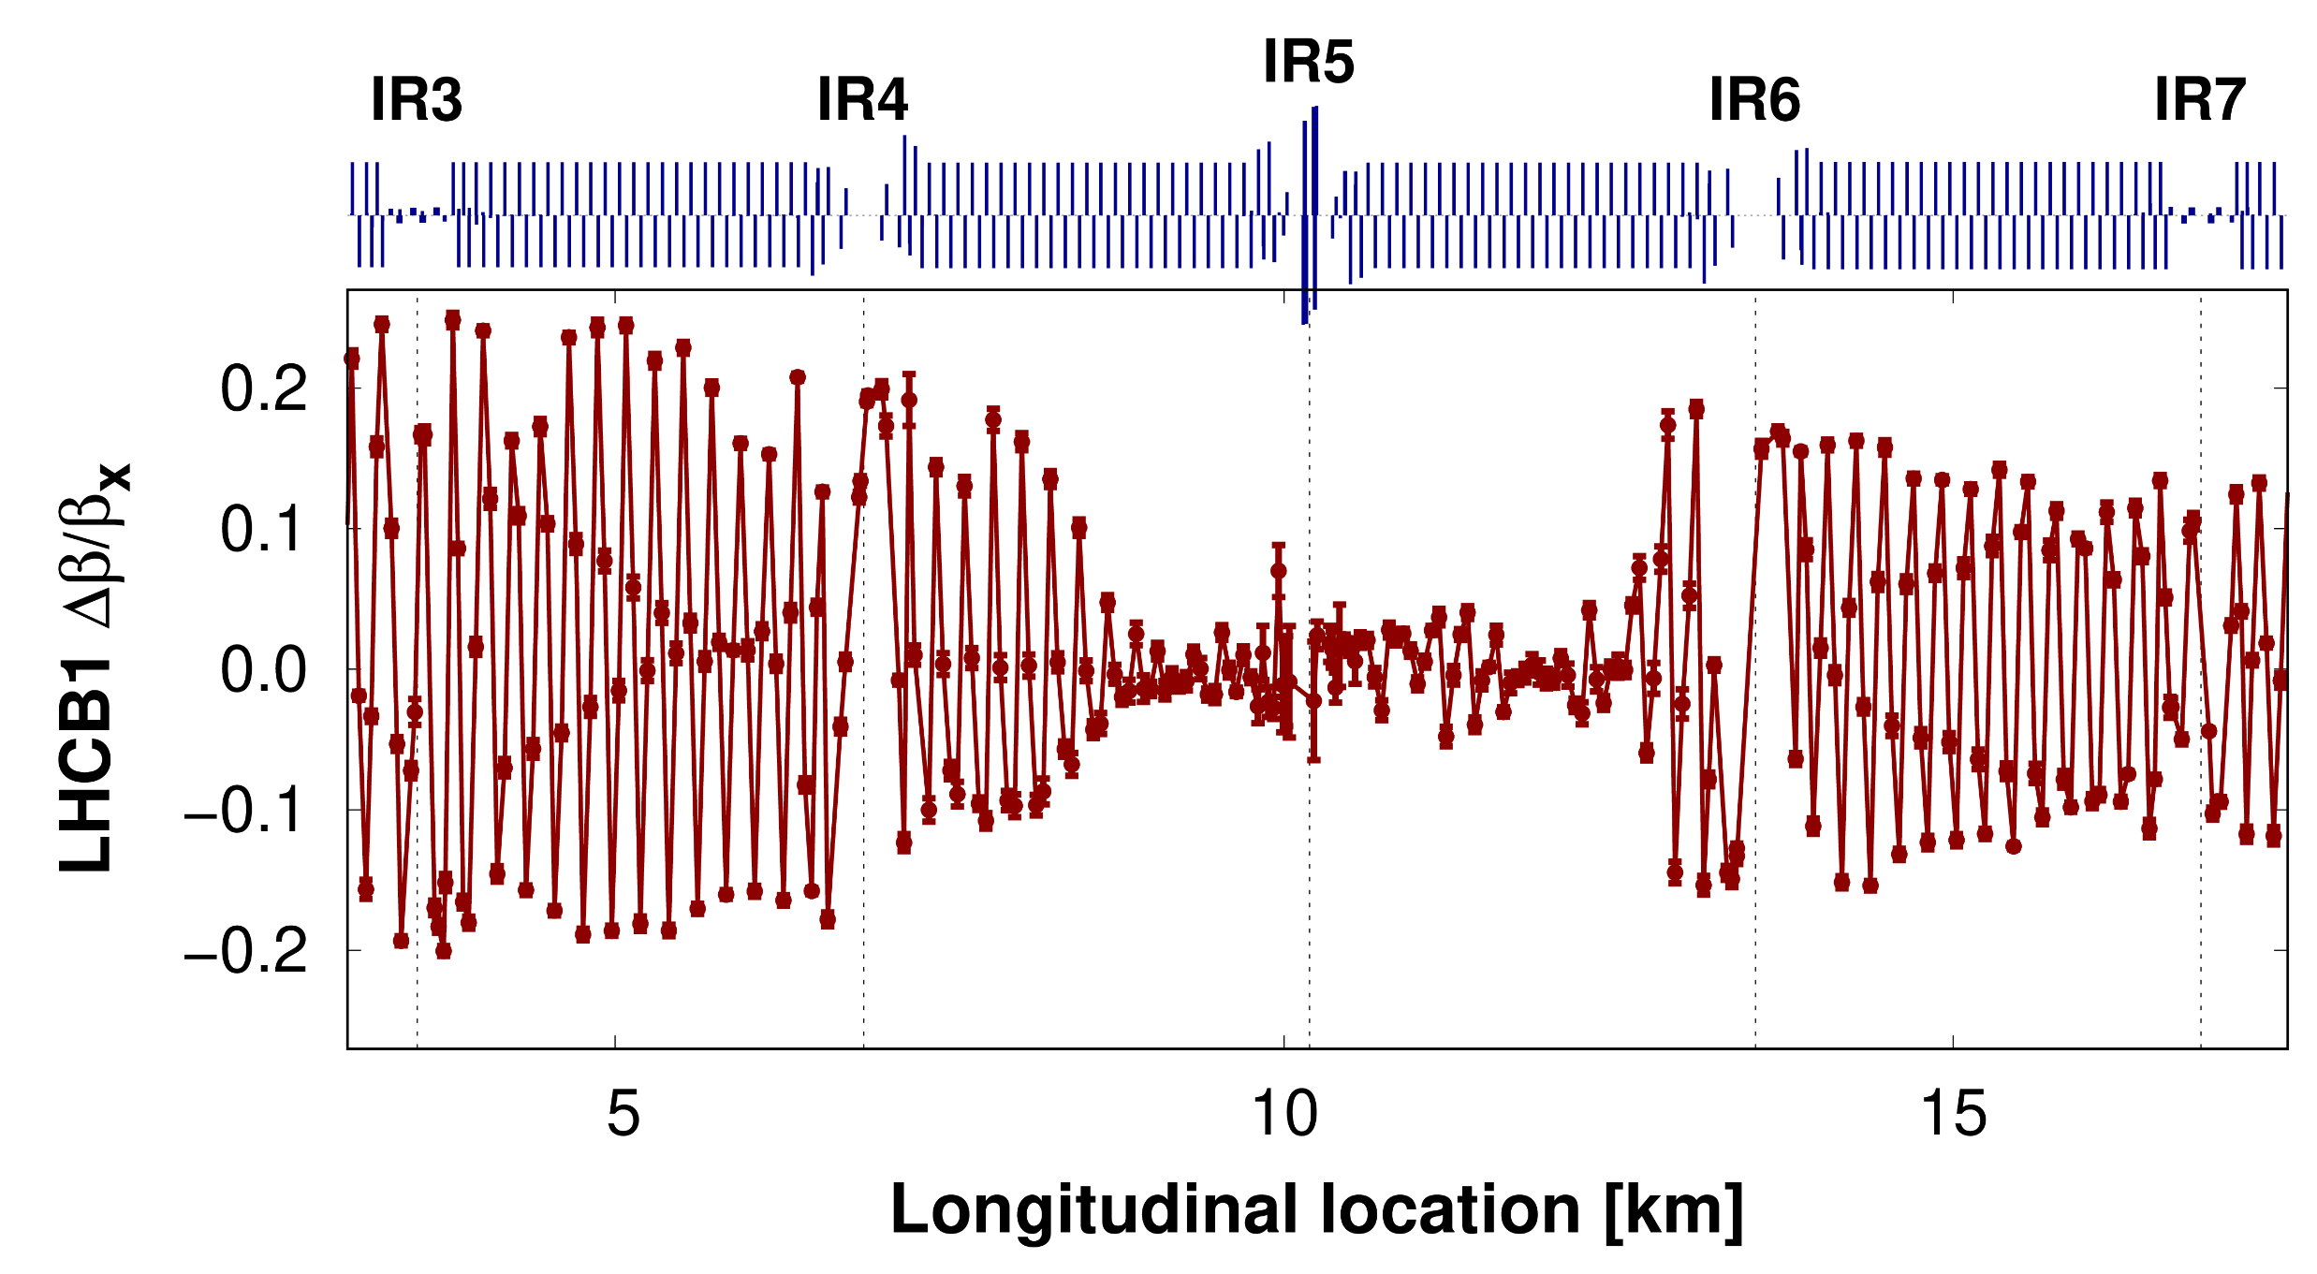
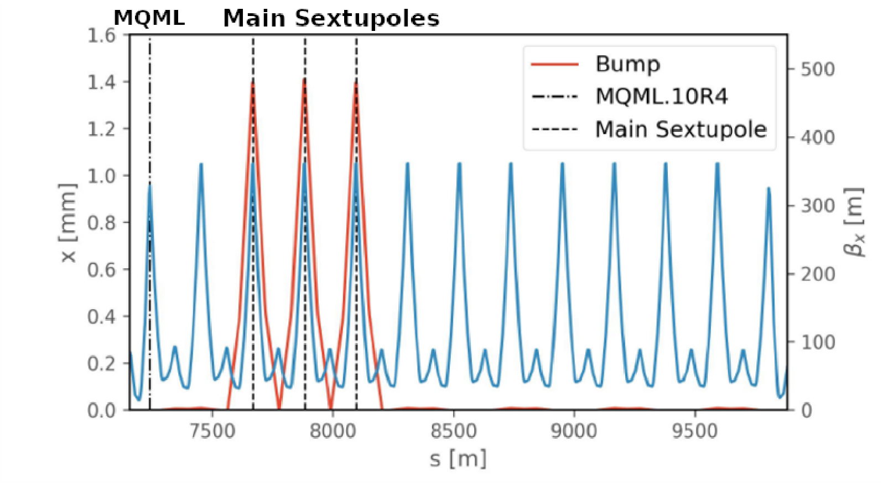
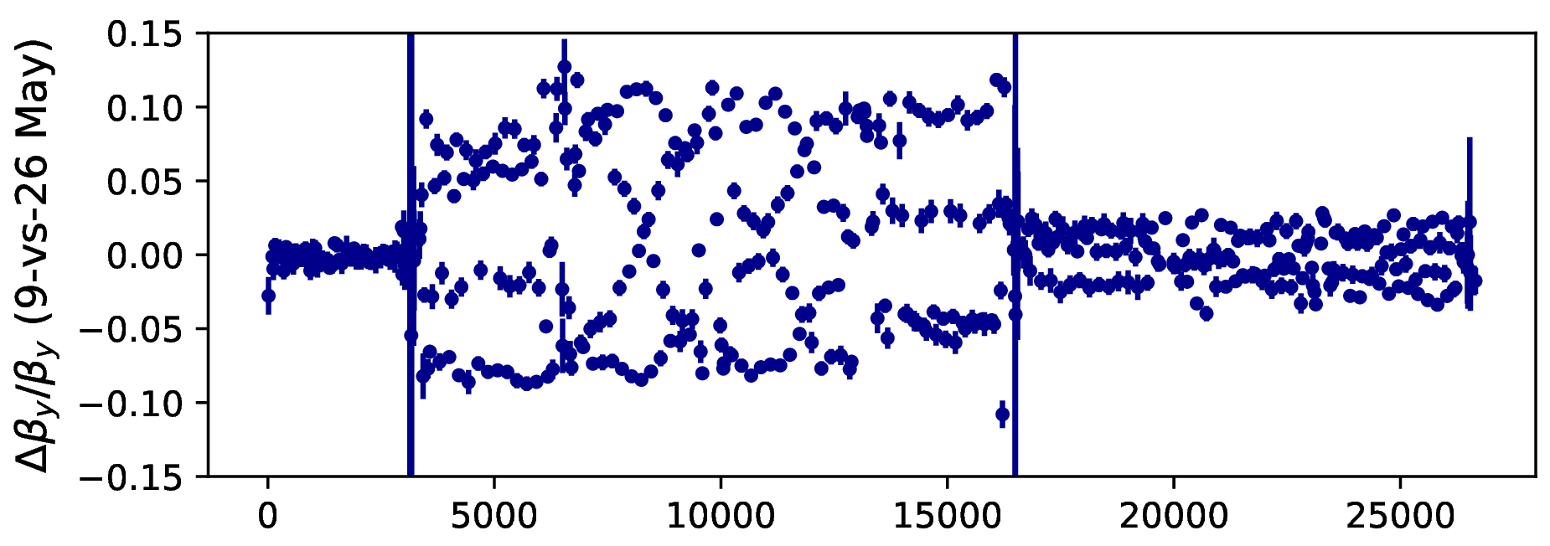
Push to more squeezed-optics introduces new challenges

Slide 16
Higher β-functions in arcs mean local Arc errors become important
Large jumps in β-beat between IRs can’t be corrected with usual quad circuits
Orbit bumps through sextupoles used to make extra local corrections
K.Skoufaris
Y.Angelis

Slide 17
Higher β-functions in IR increase optics sensitivity
Started to observe sudden shifts to β-beat coming from experimental IRs during the commissioning period
Required multiple iterations of the local corrections
Coming from energy shifts during orbit-setup in commissioning
Attempts to better regulate during commissioning ongoing

Slide 18
LHC Optics Measurement and Correction (OMC)
Linear optics
Linear Coupling
Nonlinear optics

Slide 19
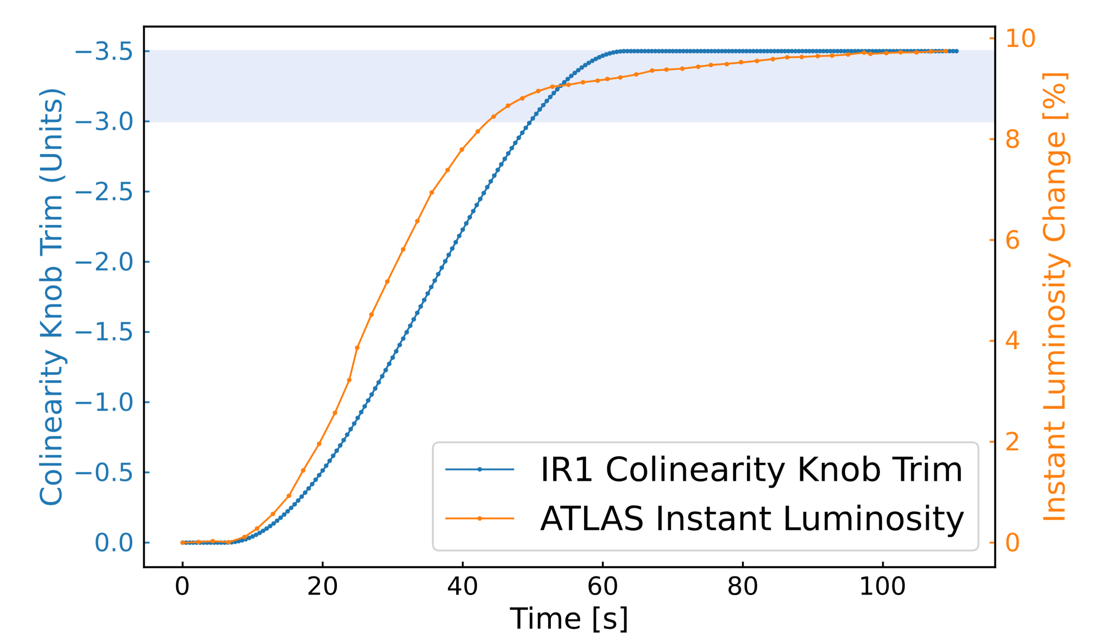
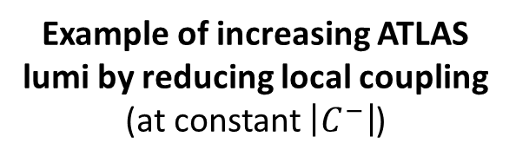
Good control of linear coupling is essential to successful LHC operation
Not just global $\left|C^{−}\right|={ΔQ}_{min}$ → local coupling control is essential
F.Soubelet
Poor correction of local coupling at IP2 caused (temporary) 40% reduction in ALICE luminosity during 2018 ion run
Example of increasing ATLAS lumi by reducing local coupling (at constant $\left|C^{−}\right|$)

Slide 20


Measure local coupling via the Resonance Driving Term (RDT) characterizing the strength of the $(Q_{x}−Q_{y})$ resonance $f_{1001}$
$$|f_{1001}| ✪ AMP$$

Slide 21
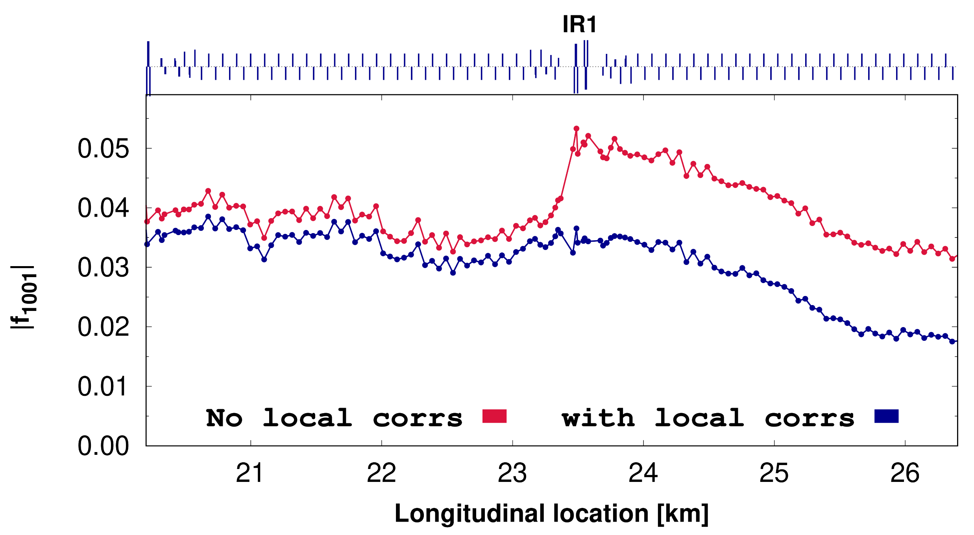
Local coupling corrected in steps
Skew-quadrupoles in IR used to minimize RDT jumps across the insertions

Slide 22
Local coupling corrected in steps
Skew-quadrupoles in IR used to minimize RDT jumps across the insertions
Response matrix of all other skew-quads used to flatten and minimize RDT globally

Slide 23
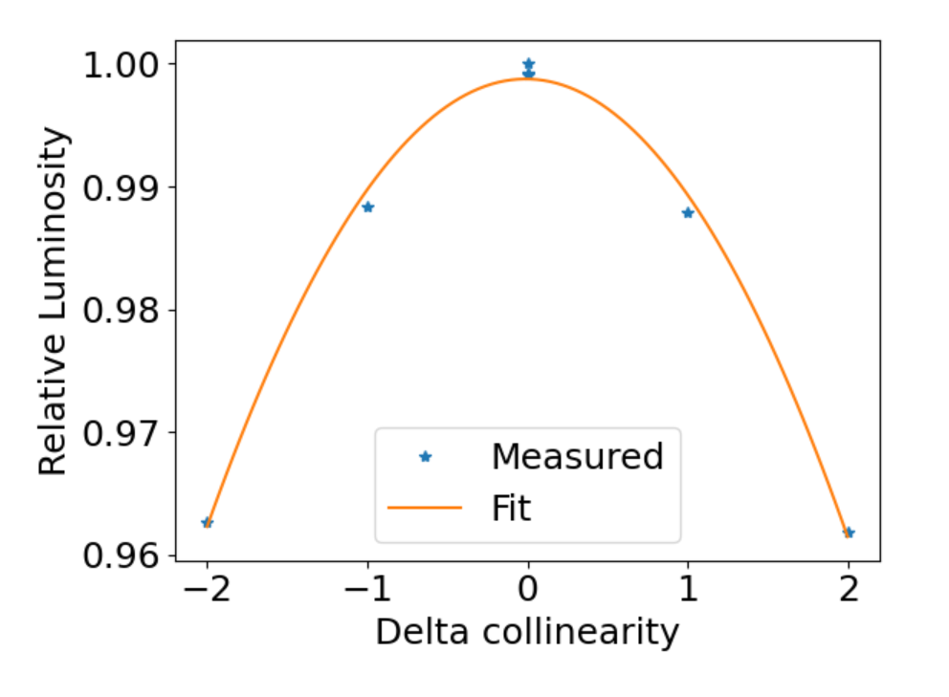
Local coupling corrected in steps
Skew-quadrupoles in IR used to minimize RDT jumps across the insertions
Response matrix of all other skew-quads used to flatten and minimize RDT globally
T.Persson
Special knobs creating closed coupling bumps over experimental IPs varied to check impact on Luminosity

Slide 24
LHC Optics Measurement and Correction (OMC)
Linear optics
Linear Coupling
Nonlinear optics

Slide 25
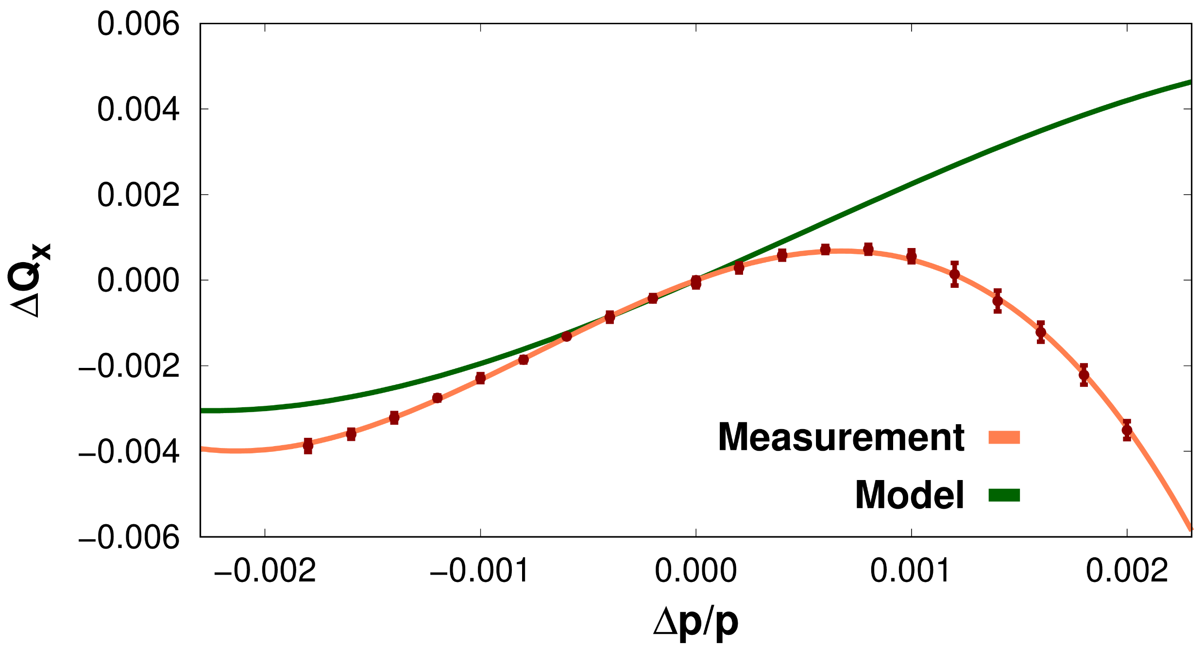
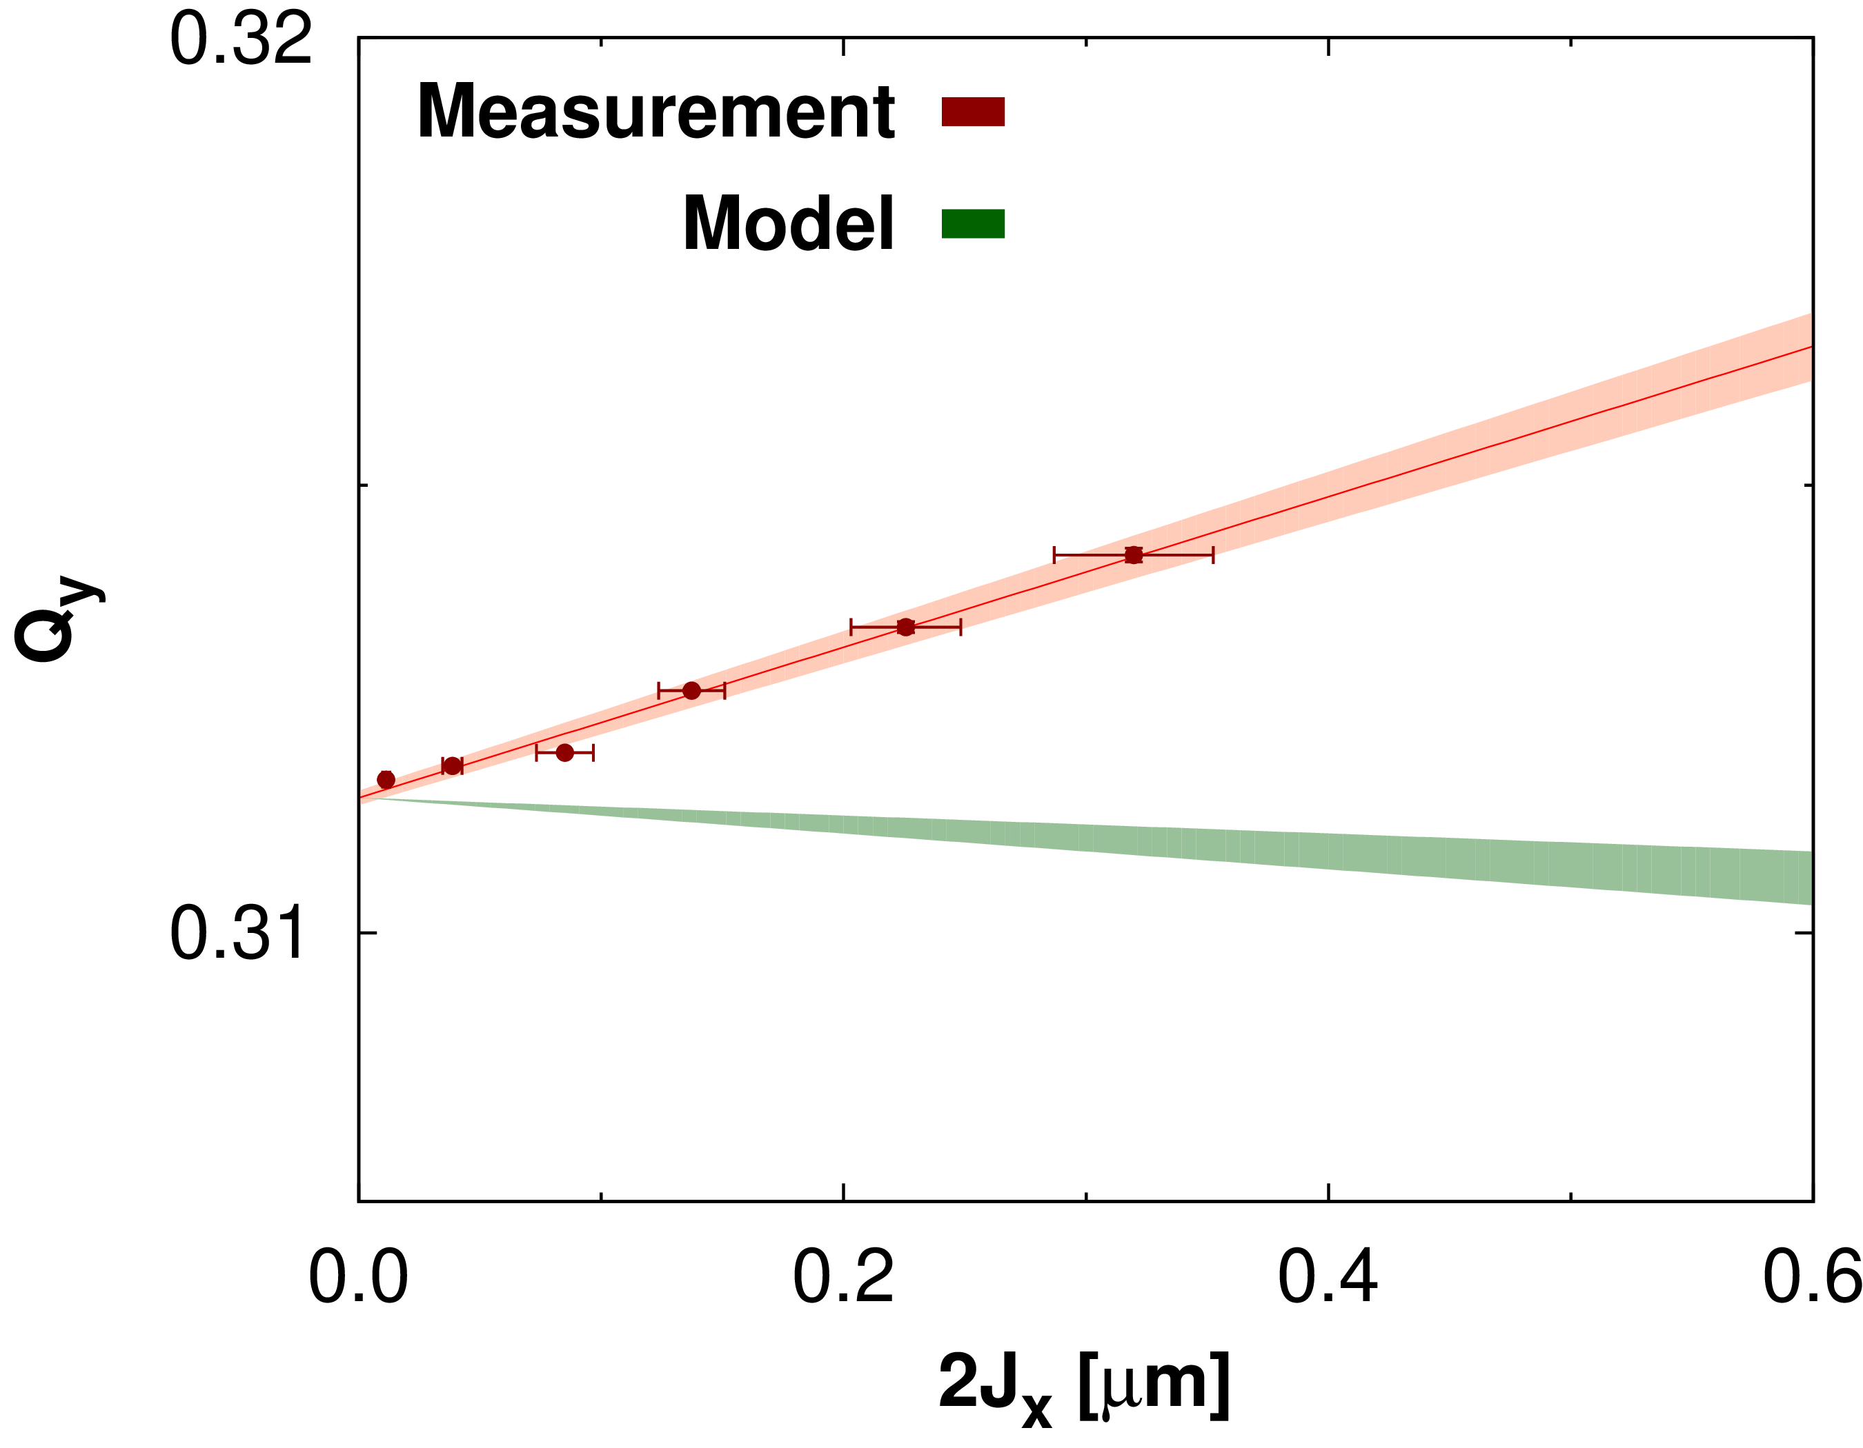
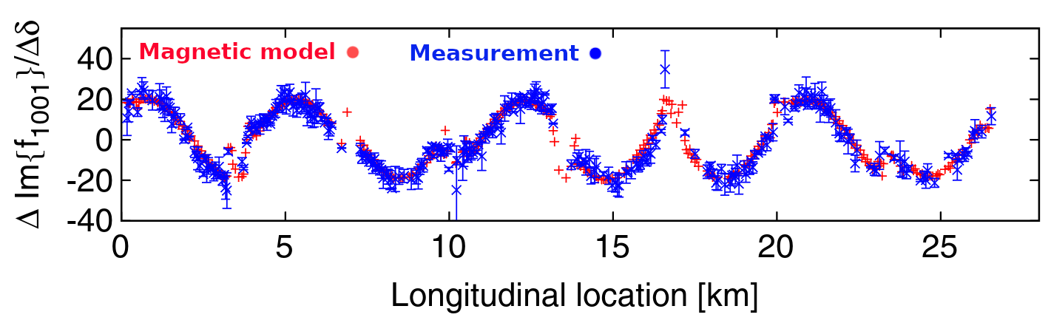
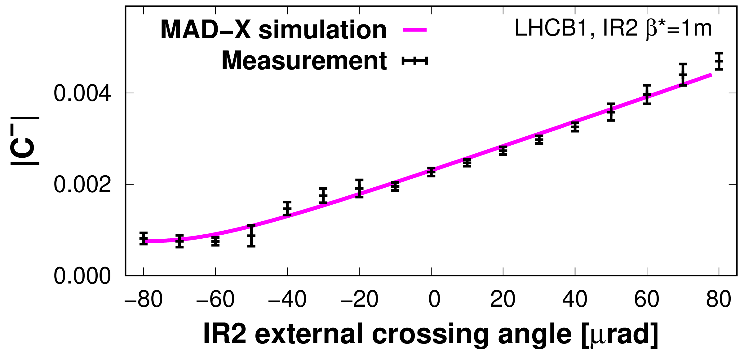
Extensive magnetic measurements of nonlinear errors performed during LHC construction
Benchmarking magnetic model with beam-based measurements ongoing activity in LHC
Large number of potential observables, with mixed results for different multipoles
At injection Q’’ and amplitude detuning showed order-of-magnitude discrepancy with magnetic model! Q’’’ and chromatic-detuning showed factor 2 discrepancy → large disparity in octupole/decapole errors
T.Persson
Excellent agreement of skew-sextupole errors via chromatic coupling measurements
Excellent agreement of normal-sextupole errors in warm separation dipoles in IR via feed-down to linear coupling

Slide 26
Extensive magnetic measurements of nonlinear errors performed during LHC construction
Benchmarking magnetic model with beam-based measurements ongoing activity in LHC
Large number of potential observables, with mixed results for different multipoles
At injection Q’’ and amplitude detuning showed order-of-magnitude discrepancy with magnetic model! Q’’’ and chromatic-detuning showed factor 2 discrepancy → large disparity in octupole/decapole errors

Slide 27

Extensive magnetic measurements of nonlinear errors performed during LHC construction
Benchmarking magnetic model with beam-based measurements ongoing activity in LHC
Large number of potential observables, with mixed results for different multipoles
Some discrepancies have been resolved
e.g originated from systematic misalignment of decapole correctors + previously neglected decapole decay
facilitated better corrections at injection
and improvement in Dynamic aperture
At injection Q’’ and amplitude detuning showed order-of-magnitude discrepancy with magnetic model! Q’’’ and chromatic-detuning showed factor 2 discrepancy → large disparity in octupole/decapole errors

Slide 28
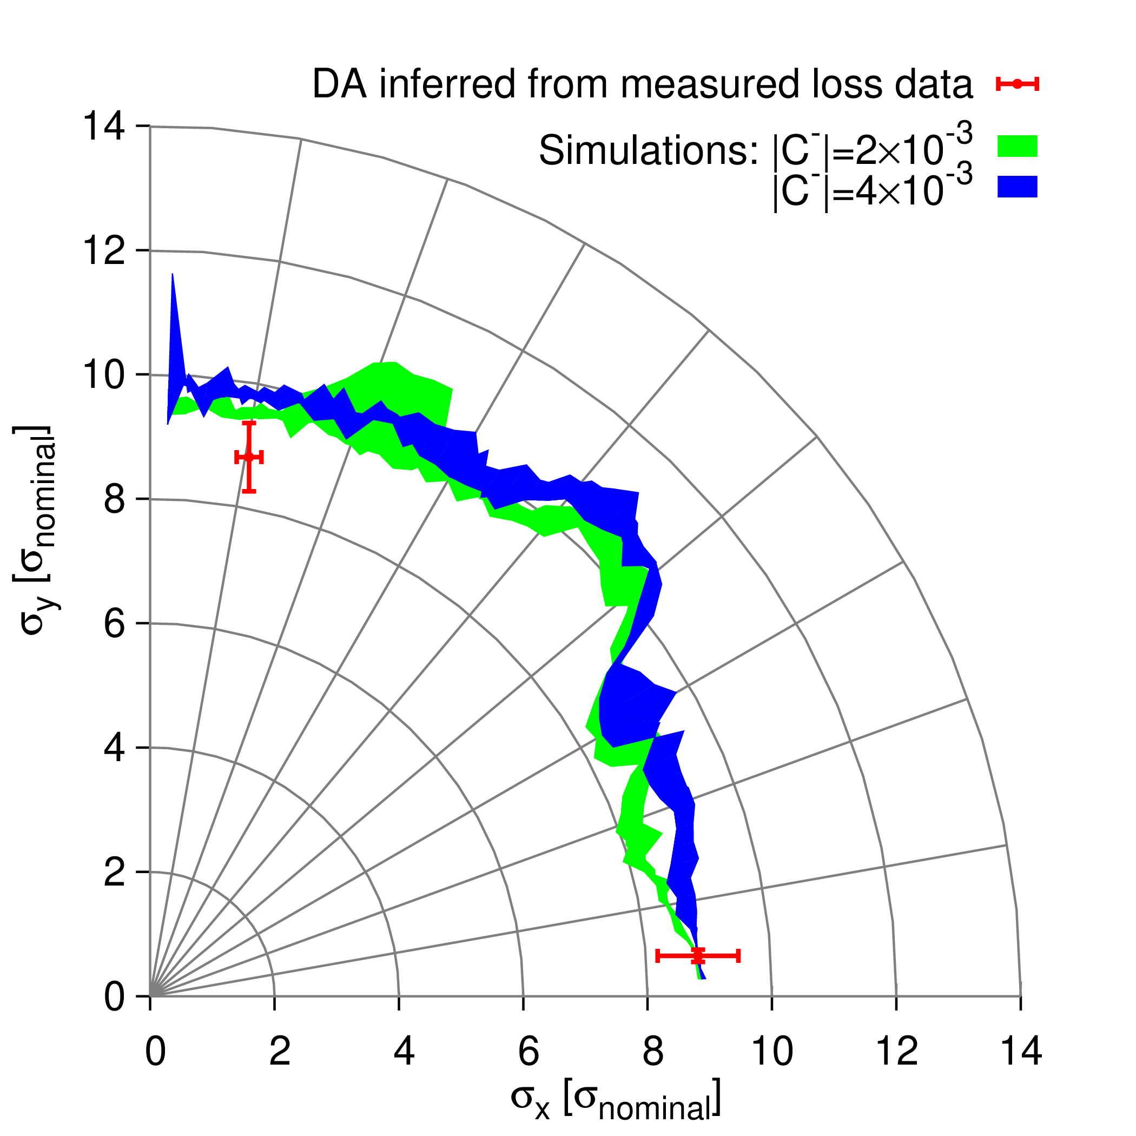
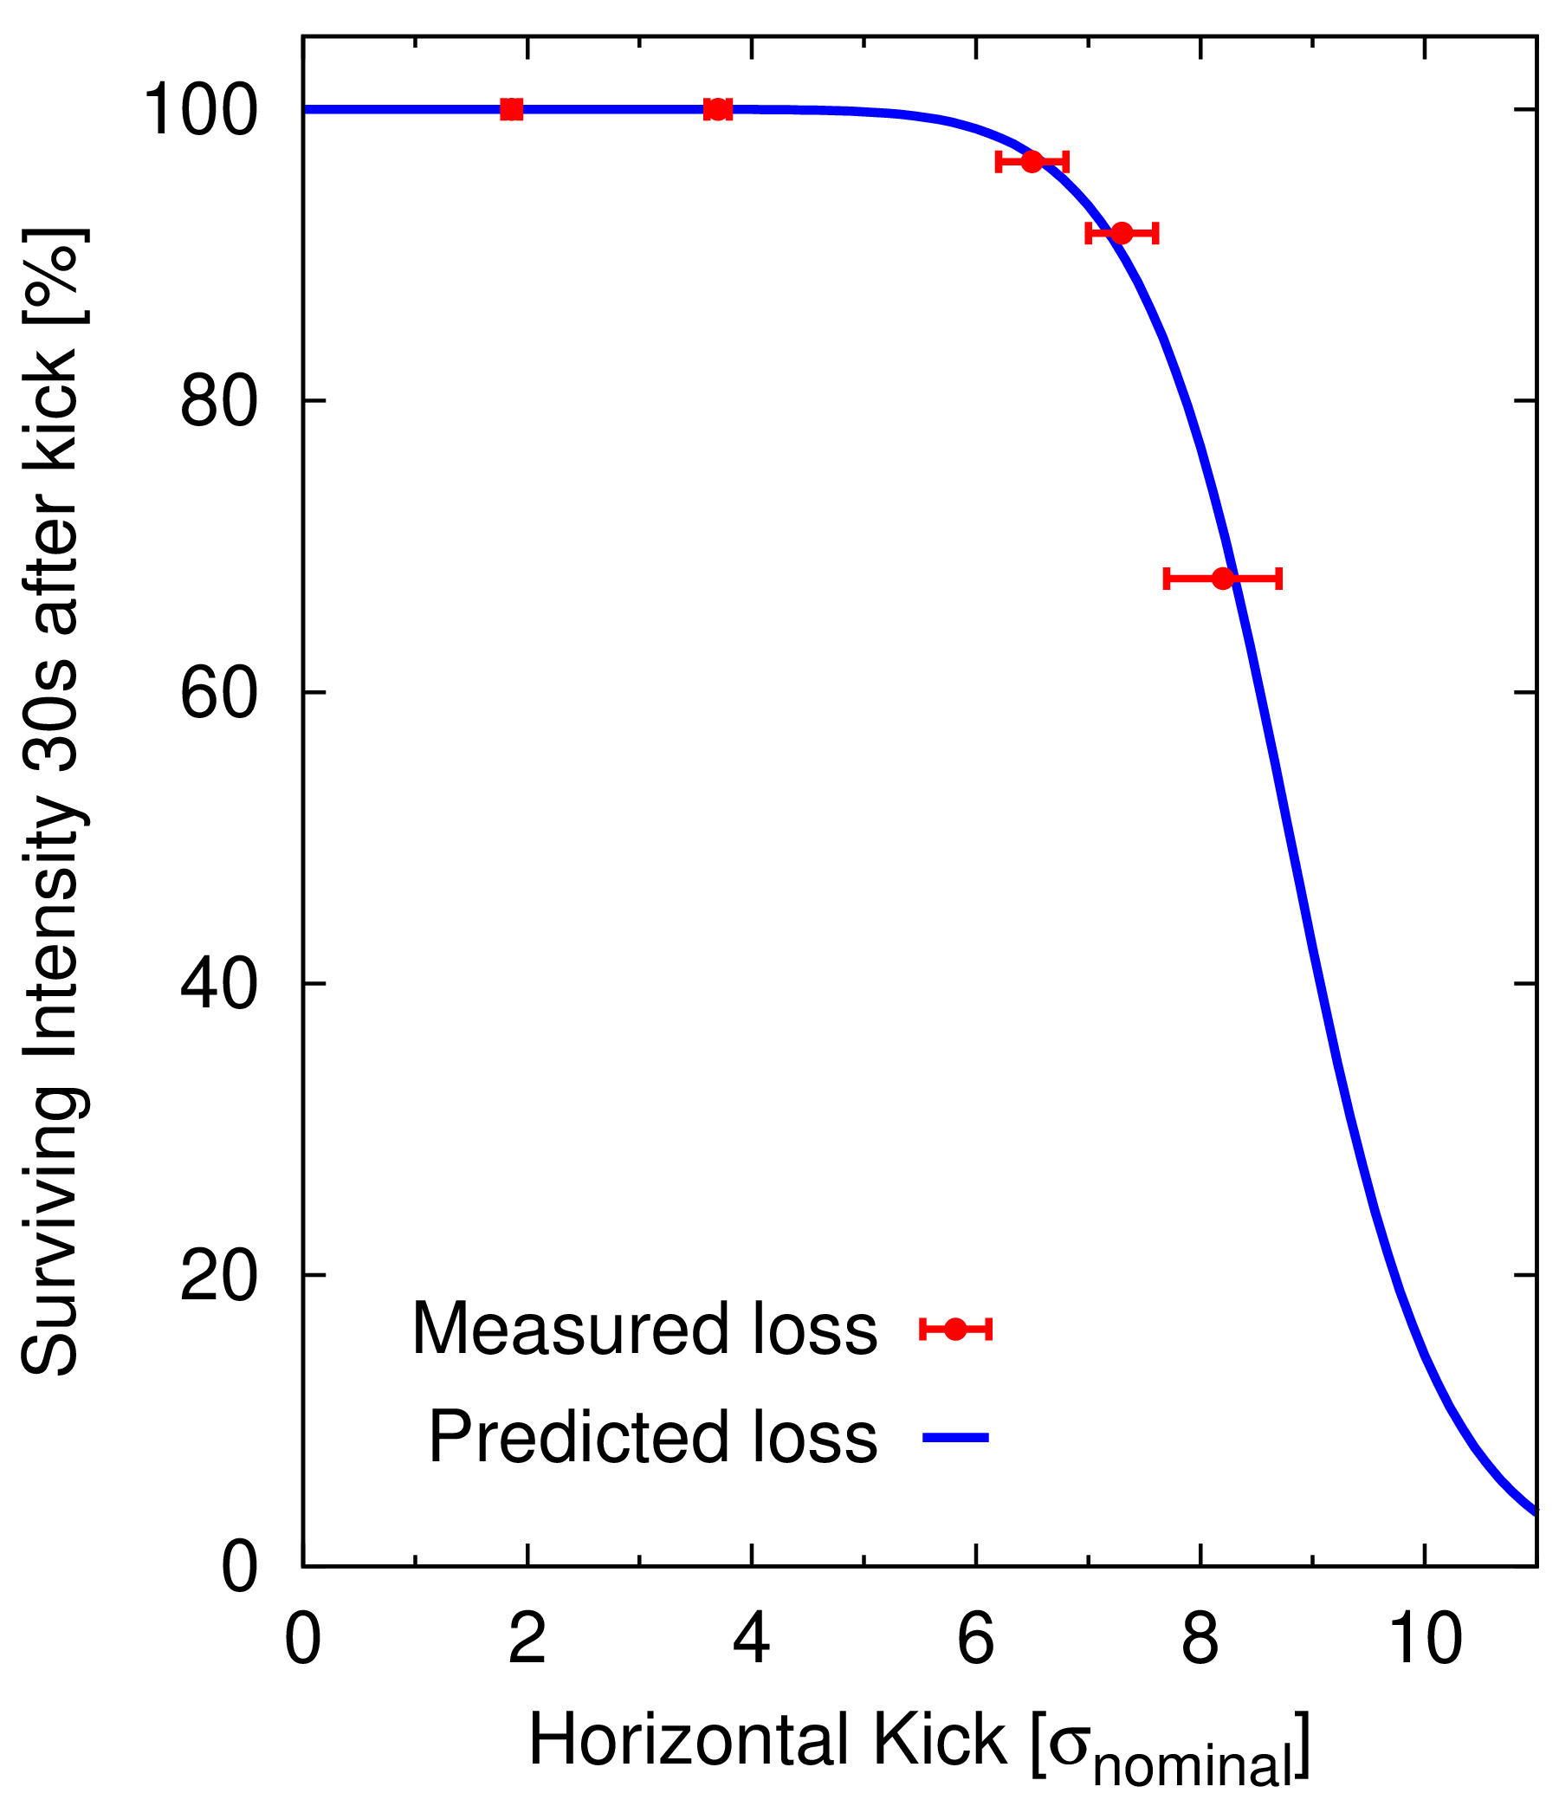
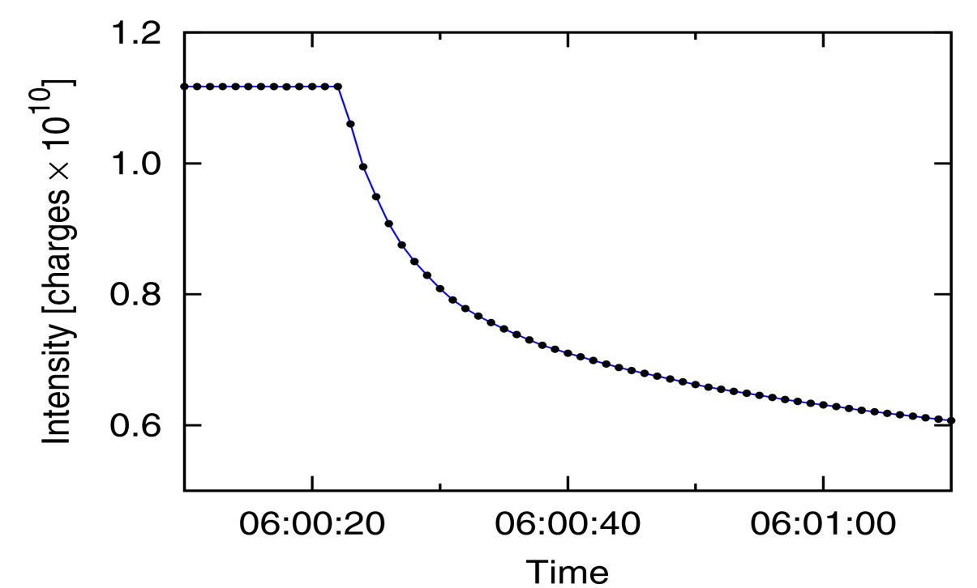
Dynamic Aperture is one of the key figures-of-merit for collider design and operation
Multiple studies to benchmark DA during the LHC’s first runs
Measurements with single-kicks (450GeV)
Kick bunch to large amplitude & infer DA from measured beam-losses

Slide 29
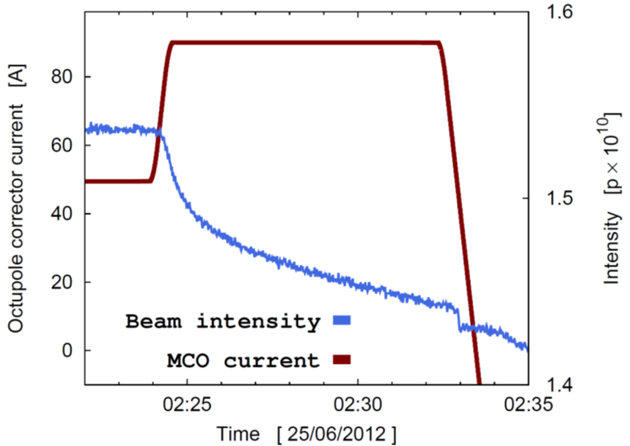
Dynamic Aperture is one of the key figures-of-merit for collider design and operation
Multiple studies to benchmark DA during the LHC’s first runs
Measurements with single-kicks (450GeV)
Measurements with large emittance bunches (450GeV & 6.8TeV)
Good agreement found for 2012 operational configuration & with residual nonlinearities
Measured DA within ≈10% of model predictions

Slide 30
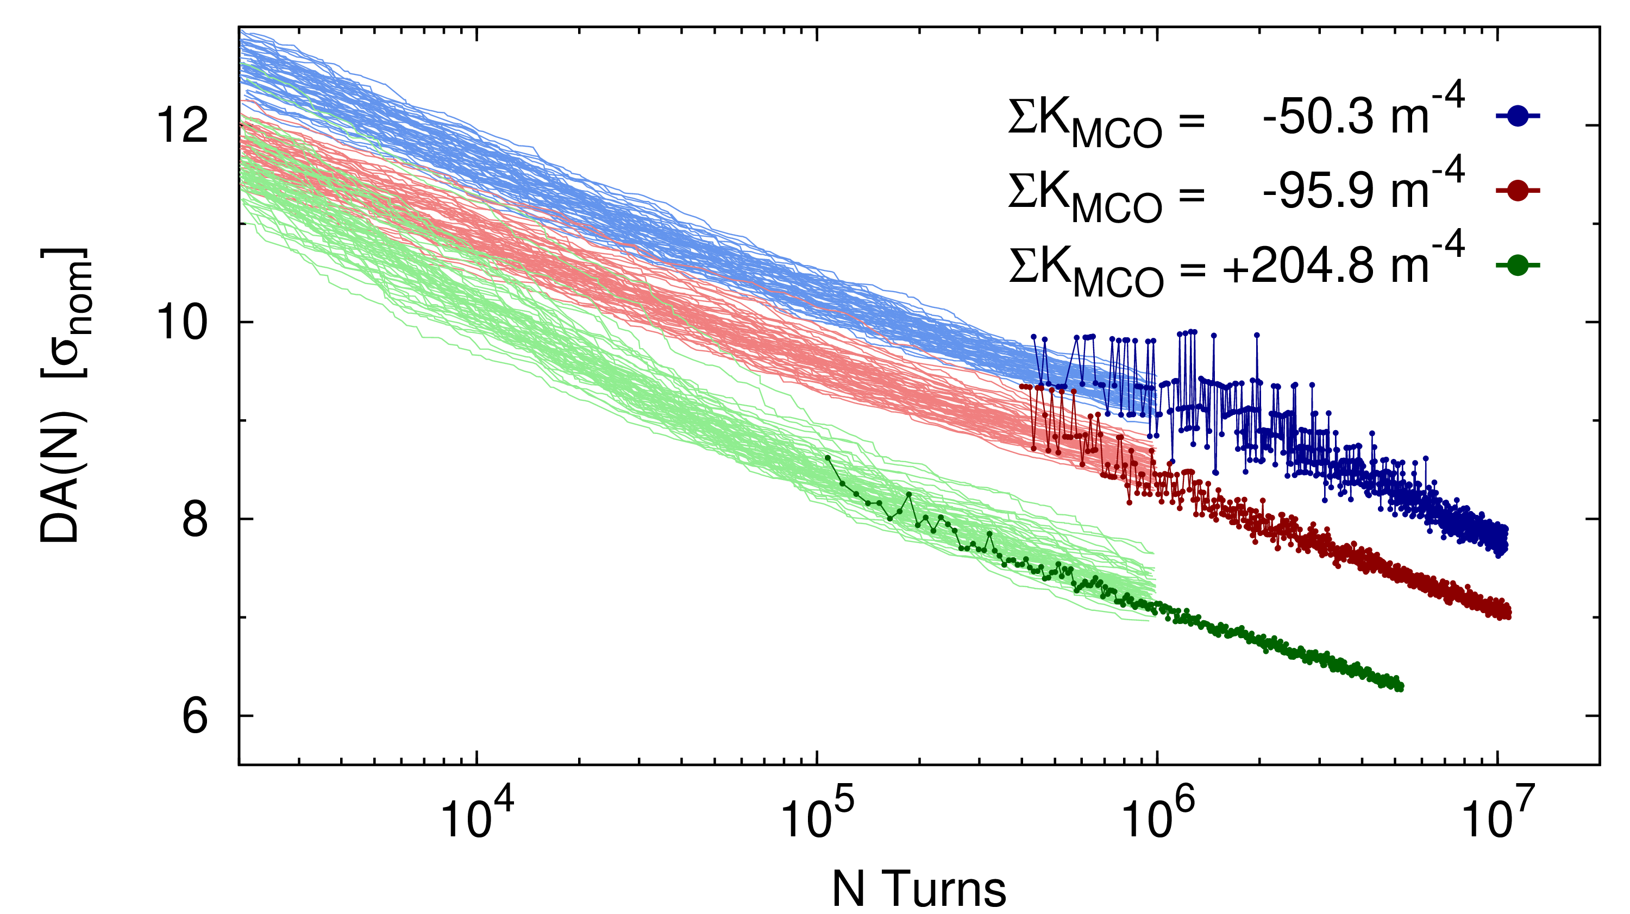
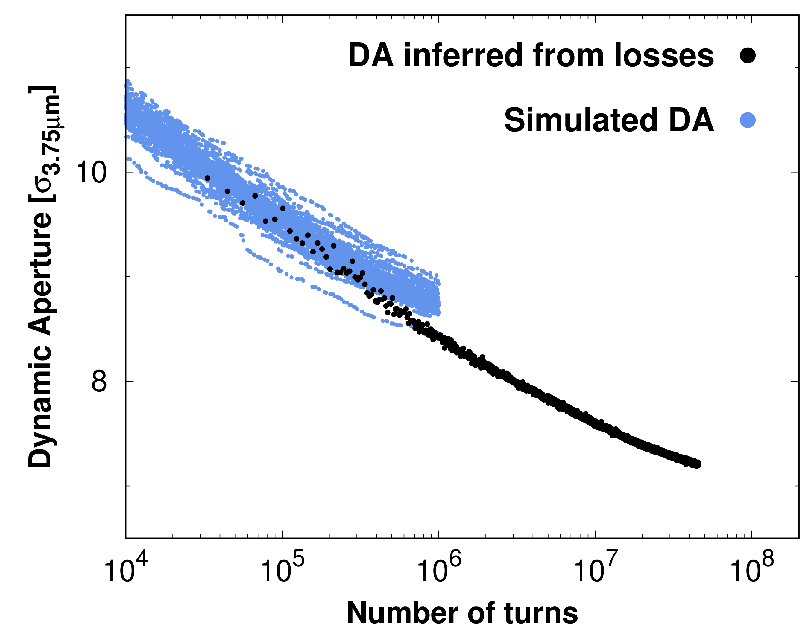
Dynamic Aperture is one of the key figures-of-merit for collider design and operation
Multiple studies to benchmark DA during the LHC’s first runs
Measurements with large emittance bunches (450GeV & 6.8TeV)
Blow up bunch with transverse damper
Infer DA from beam-losses on changes in machine configuration

Slide 31
Dynamic Aperture is one of the key figures-of-merit for collider design and operation
Multiple studies to benchmark DA during the LHC’s first runs
Measurements with large emittance bunches (450GeV & 6.8TeV)
Good agreement found for DA vs octupole current at injection
Good agreement found for DA with dodecapole current at 6.8TeV

Slide 32
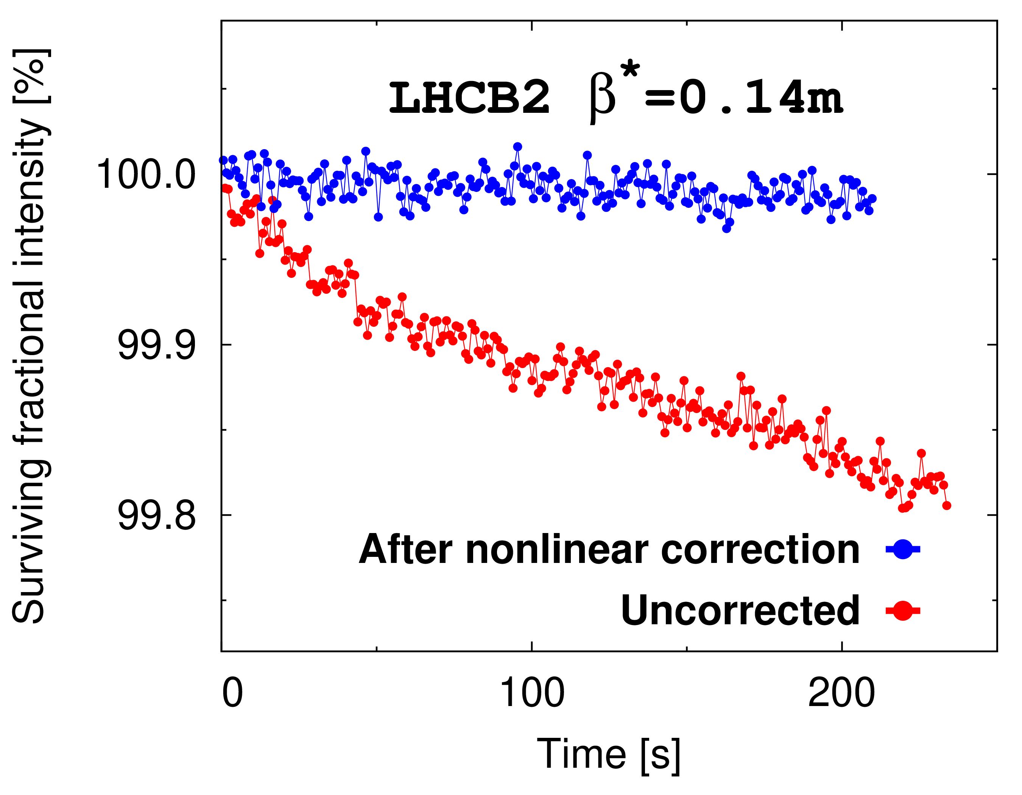
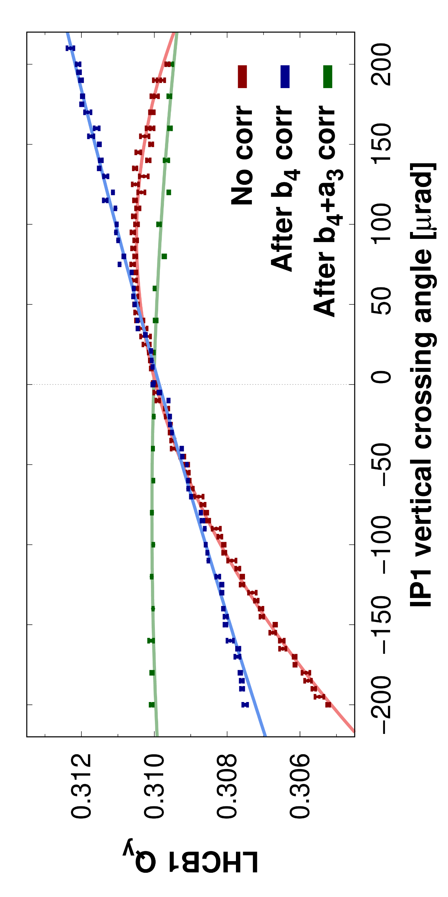
Nonlinear optics commissioning in experimental IRs now a core component of LHC start-up
→ Introduction of nonlinear optics commissioning yielded various benefits
→ IR-nonlinear corrections substantially improved
lifetime during tests squeezing to HL-LHC target $β^{∗}$
Normal octupole, normal- and skew-sextupole corrections performed regularly via minimization of detuning, and quadratic/linear feed-down

Slide 33
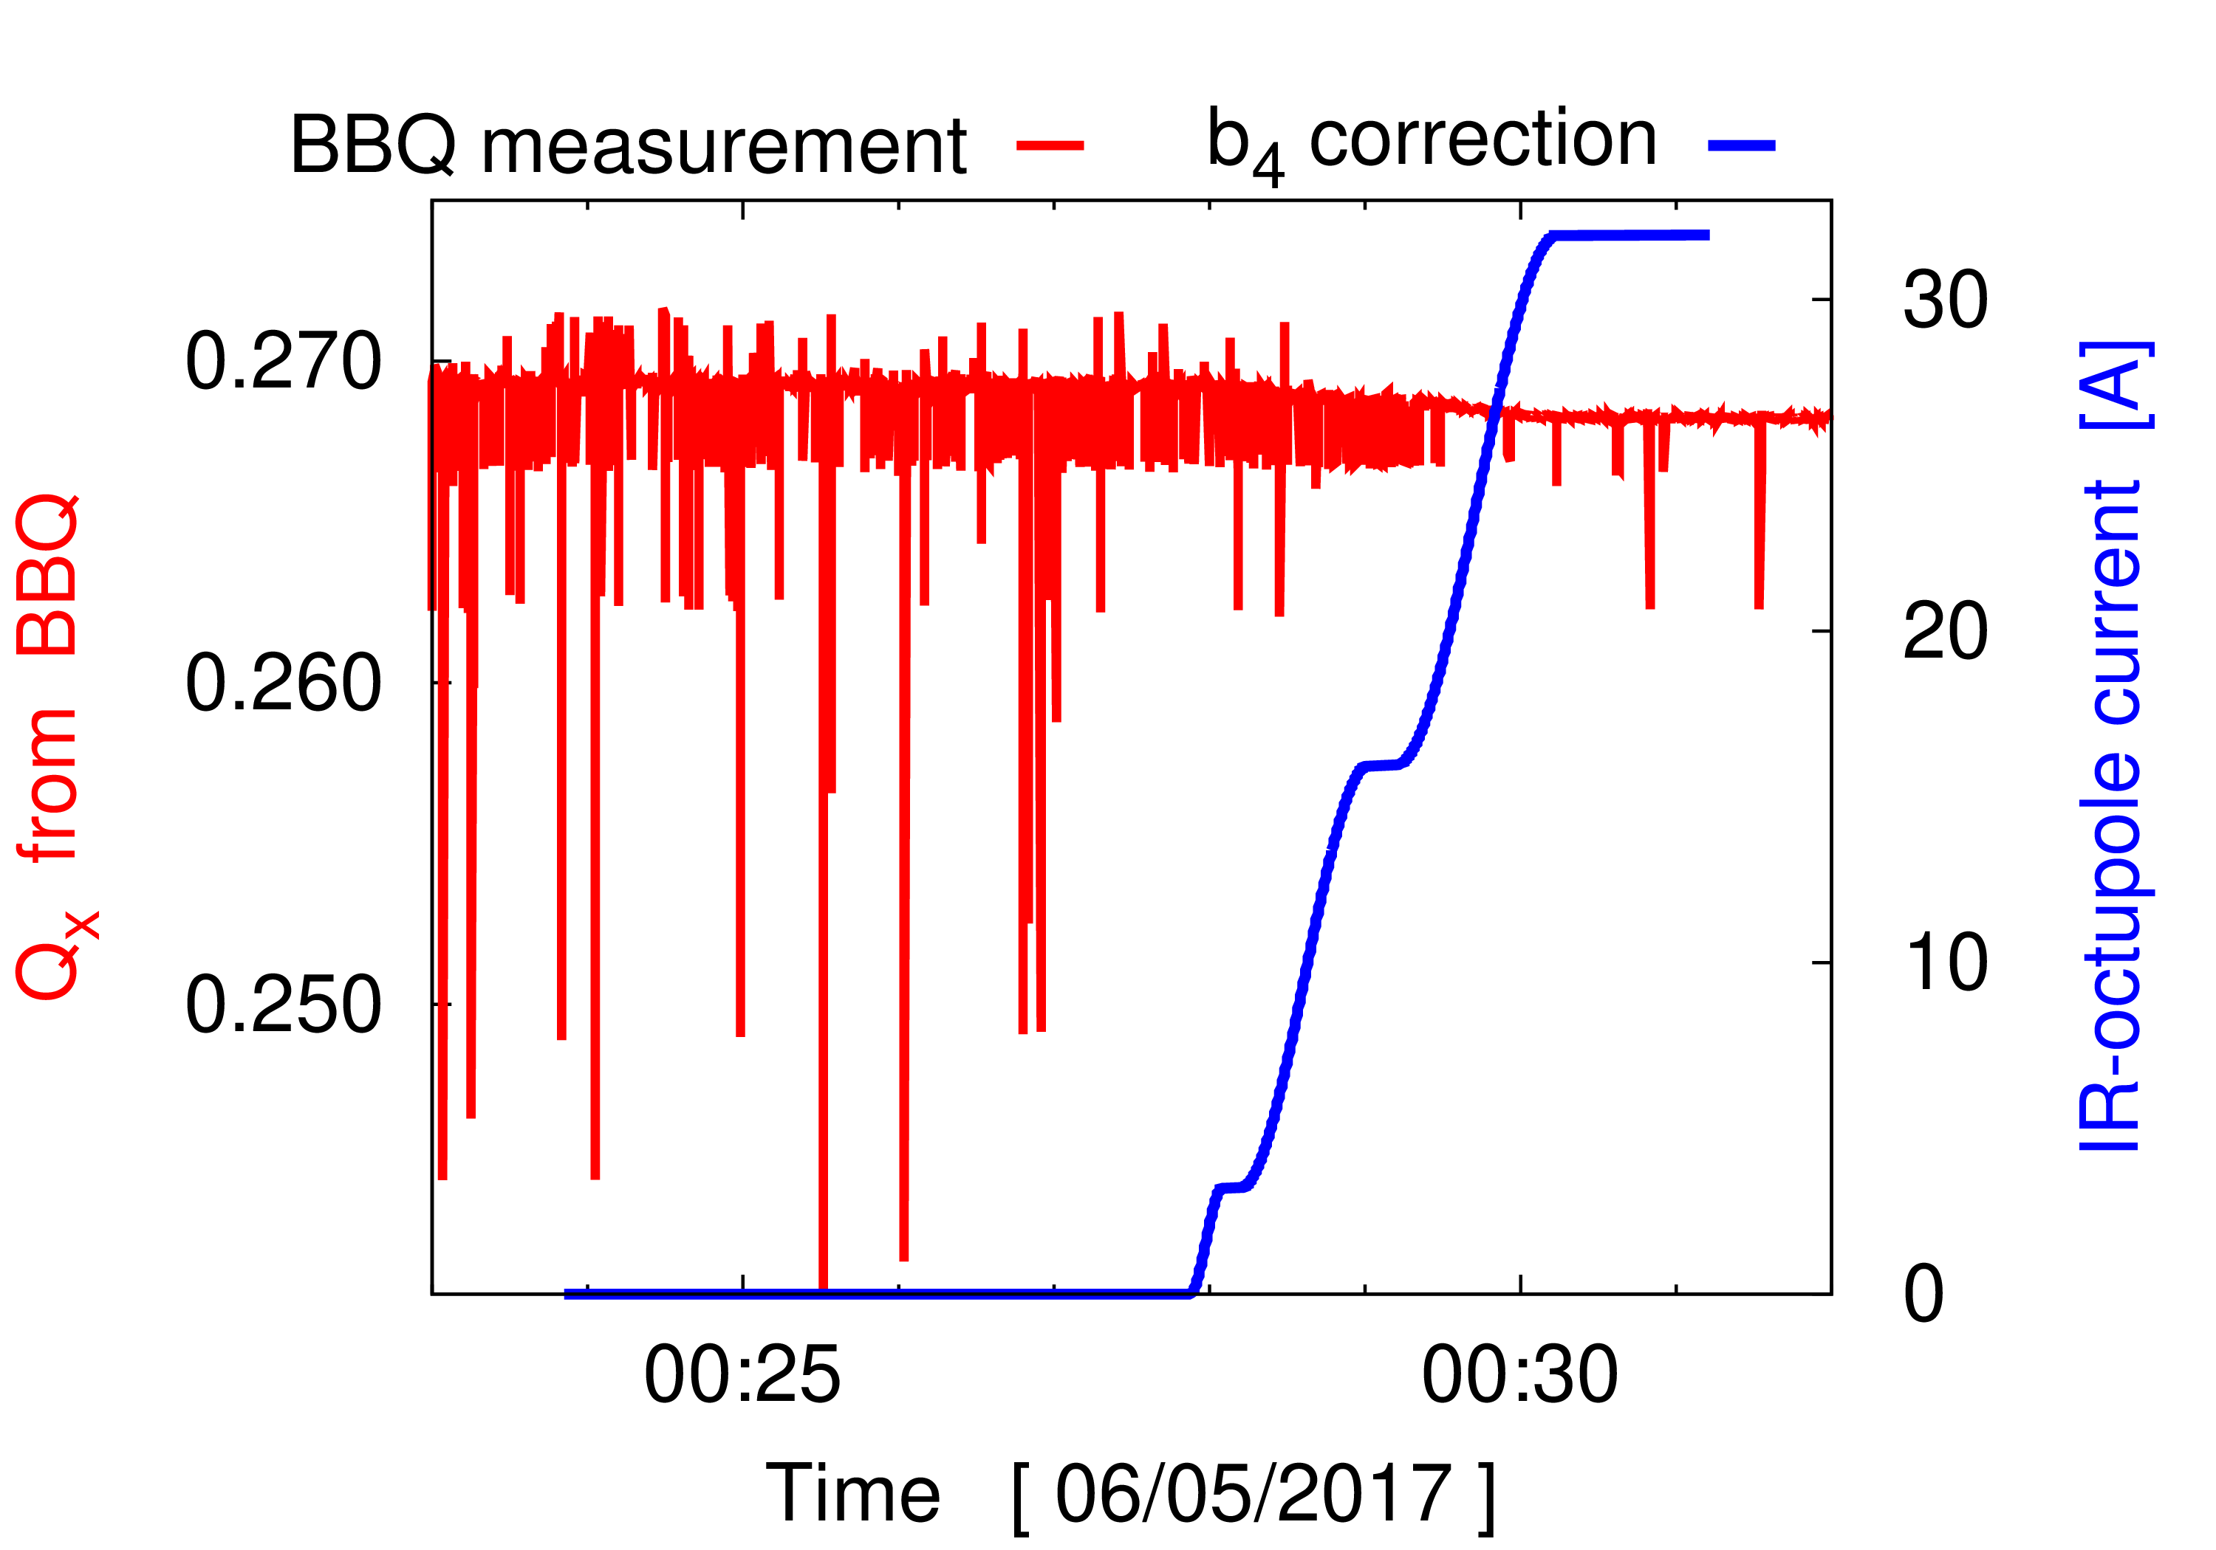

Nonlinear optics commissioning in experimental IRs now a core component of LHC start-up
→ Introduction of nonlinear optics commissioning yielded various benefits
→ IR-nonlinear corrections substantially improved
lifetime during tests squeezing to HL-LHC target $β^{∗}$

Slide 34
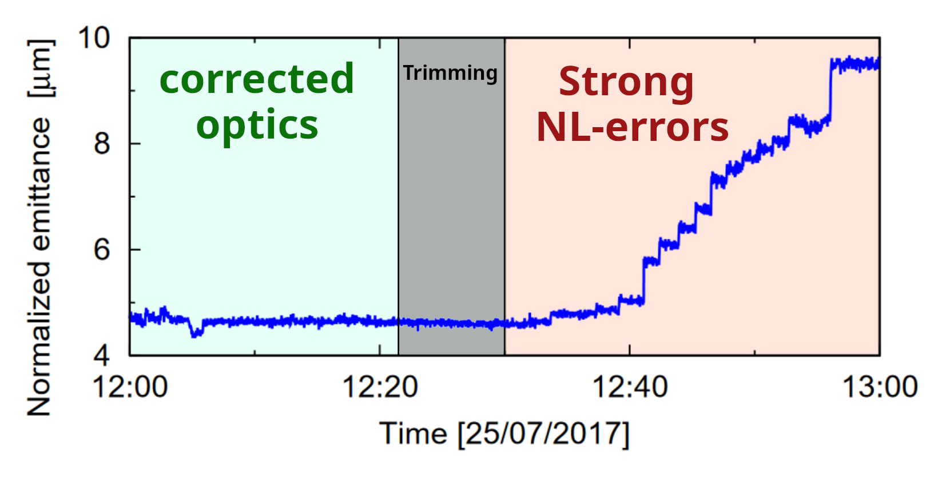
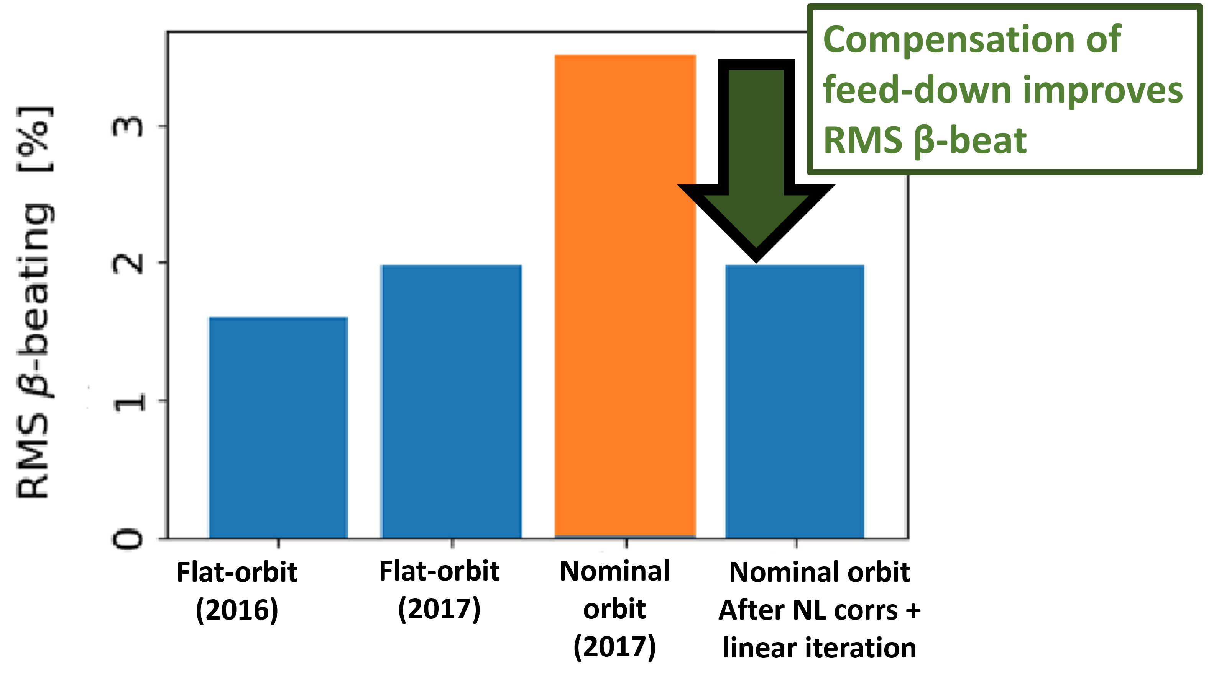


Nonlinear optics commissioning in experimental IRs now a core component of LHC start-up
→ Introduction of nonlinear optics commissioning yielded various benefits
Efficient commissioning relies on adiabaticity of the AC-dipole
→ with strong nonlinearities adiabaticity is degraded
Landau damping
RMS $β$-beat
ACD losses
& adiabaticity
$β^{∗}$ control
lifetime
At low-$β^{∗}$ success of linear commissioning depends on nonlinear optics corrections
IR-octupole corrections improve tune measurement quality → necessary to achieve target $β^{∗}$control via K-mod

Slide 35


Nonlinear optics commissioning in experimental IRs now a core component of LHC start-up
→ Introduction of nonlinear optics commissioning yielded various benefits
Landau damping
lifetime
$β^{∗}$ control
RMS $β$-beat
ACD losses
& adiabaticity

Slide 36
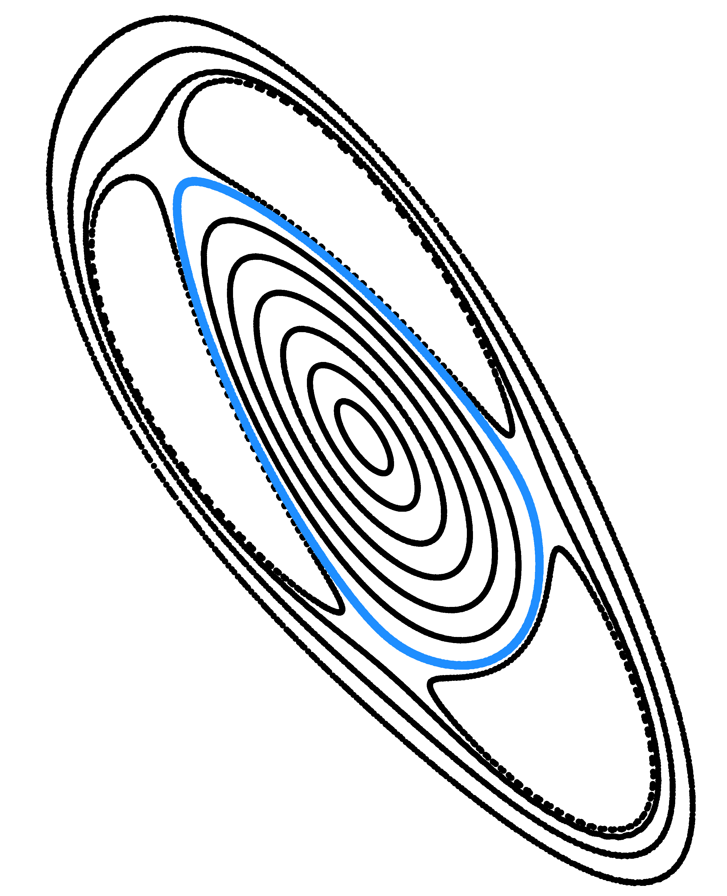
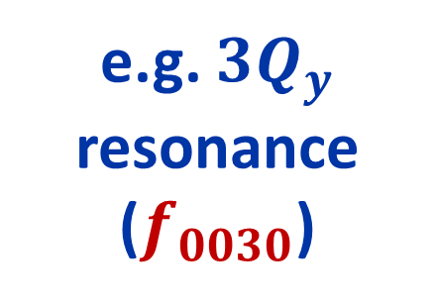
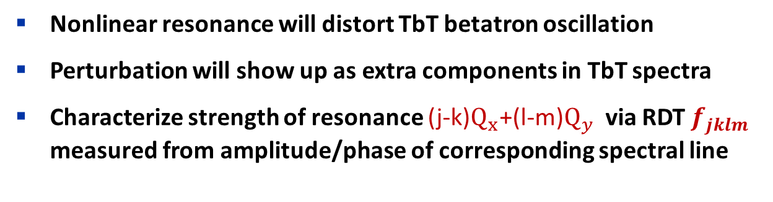
Application of nonlinear Resonance Driving Terms via AC-dipole becoming routine
Nonlinear resonance will distort TbT betatron oscillation
Perturbation will show up as extra components in TbT spectra
Characterize strength of resonance (j-k)$Q_{x}$+(l-m)$Q_{y}$ via RDT $f_{jklm}$ measured from amplitude/phase of corresponding spectral line
e.g. ${3Q}_{y}$ resonance
($f_{0030}$)

Slide 37
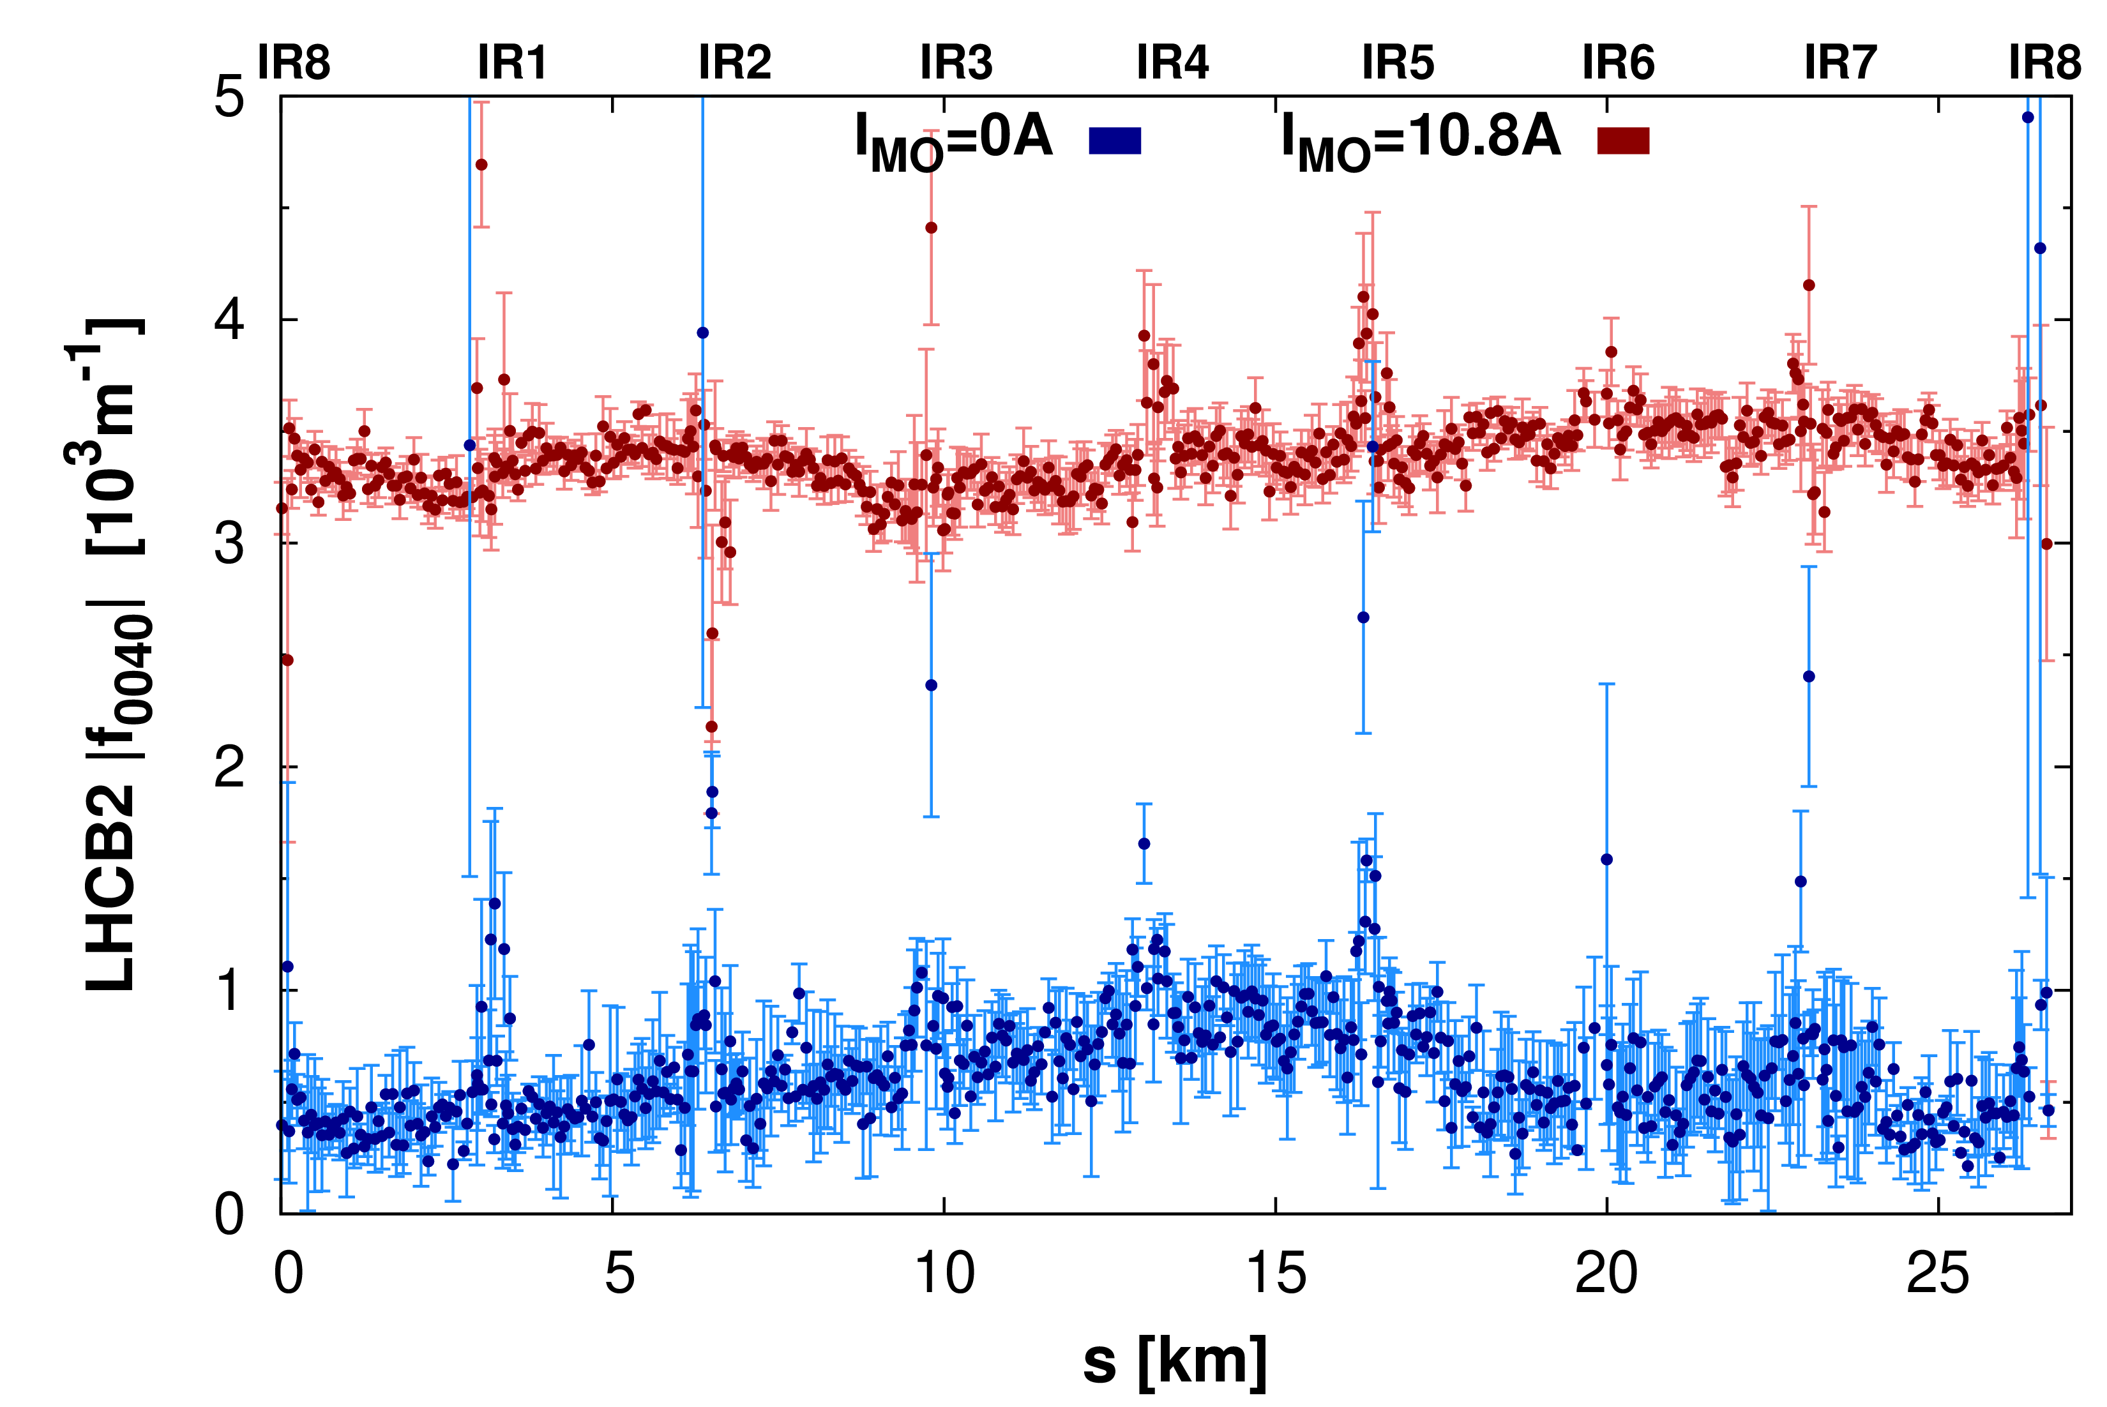
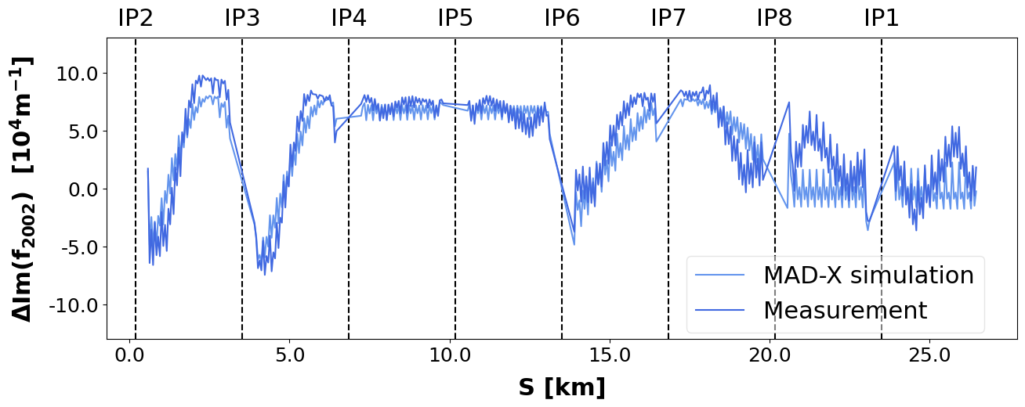
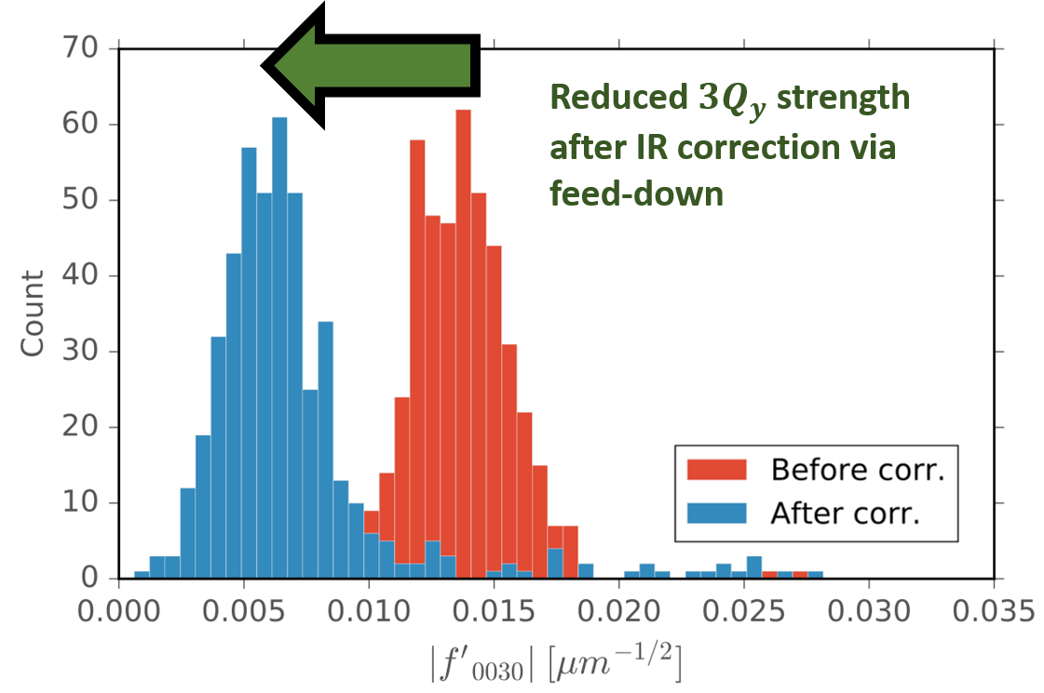
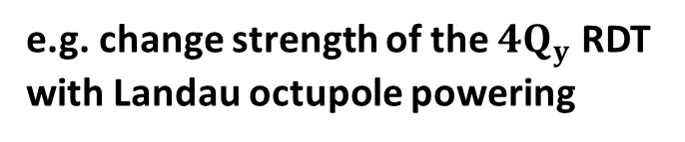
Application of nonlinear Resonance Driving Terms via AC-dipole becoming routine
Validation of nonlinear circuit responses: e.g. shift to $(2Q_{x}−2Q_{y})$ from IR octupole
→ Various applications to LHC optics studies
Validation of corrections via other observables: e.g. 3Qy before/after IR-skew-sextupole correction
→ Various applications to LHC optics studies
Benchmarking magnetic model, and testing response of nonlinear circuits
e.g. change strength of the ${4Q}_{y}$ RDT with Landau octupole powering

Slide 38
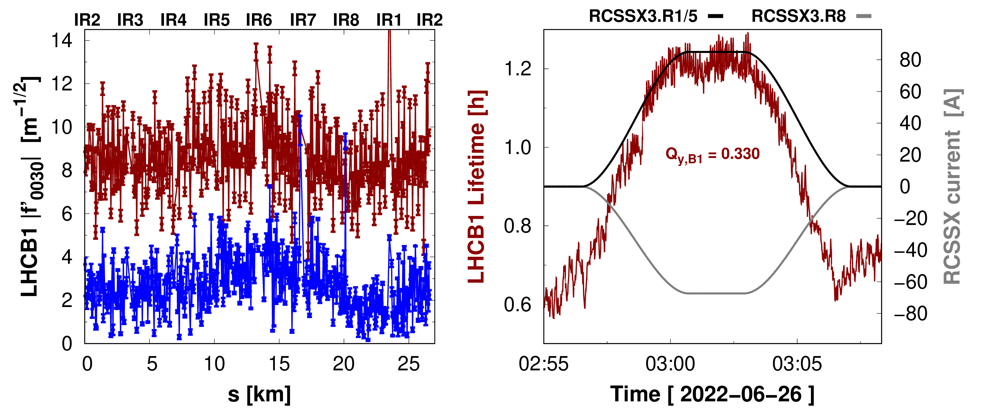
Application of nonlinear Resonance Driving Terms via AC-dipole becoming routine
→ Various applications to LHC optics studies
Benchmarking magnetic model, and testing response of nonlinear circuits
Direct RDT correction: e.g. 3Qy compensation at injection + improvement to lifetime
Validation of corrections via other observables: e.g. 3Qy before/after IR-skew-sextupole correction
F.Carlier

Slide 39
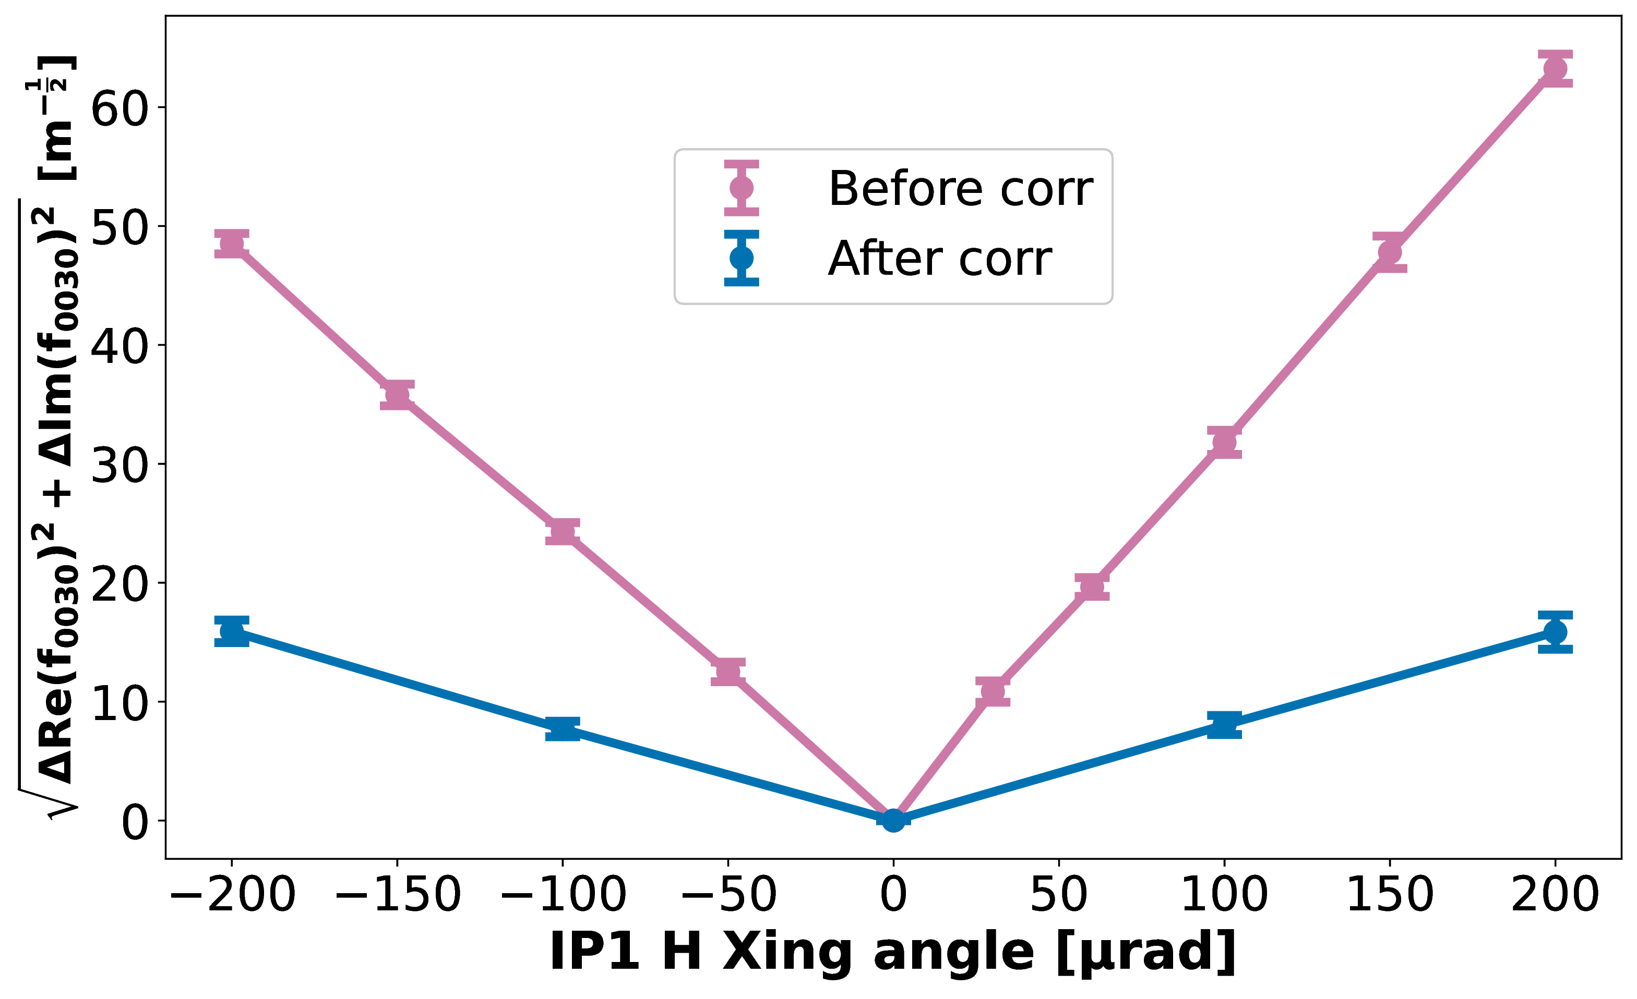
Application of nonlinear Resonance Driving Terms via AC-dipole becoming routine
→ Various applications to LHC optics studies
Benchmarking magnetic model, and testing response of nonlinear circuits
Correction of RDT feed-down: e.g. skew-octupole correction in ATLAS IR by correcting shift to 3Qy resonance vs crossing-angle
Direct RDT correction: e.g. 3Qy compensation at injection + improvement to lifetime
Validation of corrections via other observables: e.g. 3Qy before/after IR-skew-sextupole correction

Slide 40
Application of nonlinear Resonance Driving Terms via AC-dipole becoming routine
→ Various applications to LHC optics studies
Benchmarking magnetic model, and testing response of nonlinear circuits
Correction of RDT feed-down: e.g. skew-octupole correction in ATLAS IR by correcting shift to 3Qy resonance vs crossing-angle
Validation of corrections via other observables: e.g. 3Qy before/after IR-skew-sextupole correction
Direct RDT correction: e.g. 3Qy compensation at injection + improvement to lifetime
S.Horney

Slide 41
Application of nonlinear Resonance Driving Terms via AC-dipole becoming routine
Benchmarking magnetic model, and testing response of nonlinear circuits
Model Benchmarking
→ Various applications to LHC optics studies
Indirect correction via RDT feed-down
Validation of corrections via other observables: e.g. 3Qy before/after IR-skew-sextupole correction
Validating corrections from other methods
Correction of RDT feed-down: e.g. skew-octupole correction in ATLAS IR by correcting shift to 3Qy resonance vs crossing-angle
Direct RDT correction
Direct RDT correction: e.g. 3Qy compensation at injection + improvement to lifetime

Slide 42
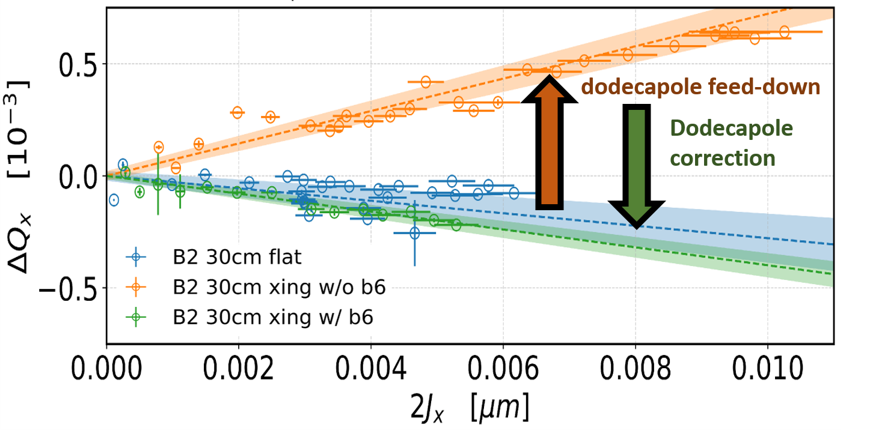

HL-LHC targets optics commissioning up to dodecapole
Correction of dodecapole errors in ATLAS/CMS insertions by compensating feed-down to amplitude detuning with crossing-angle
Measurement of quadratic shift to sextupole resonance strength vs crossing-angle being used to benchmark decapole errors in ATLAS/CMS IR
S.Horney

Slide 43


HL-LHC targets optics commissioning up to dodecapole
Measurement of quadratic shift to sextupole resonance strength vs crossing-angle being used to benchmark decapole errors in ATLAS/CMS IR
DA improvements at injection allowed measurement of dodecapole RDT with the AC-dipole → good agreement to magnetic model!
Correction of dodecapole errors in ATLAS/CMS insertions by compensating feed-down to amplitude detuning with crossing-angle
J.Dilly

Slide 44

HL-LHC targets optics commissioning up to dodecapole
Measurement of quadratic shift to sextupole resonance strength vs crossing-angle being used to benchmark decapole errors in ATLAS/CMS IR
Consistent measurements of fifth-order chromaticity show reasonable agreement with decatetrapole model
DA improvements at injection allowed measurement of dodecapole RDT with the AC-dipole → good agreement to magnetic model!
Correction of dodecapole errors in ATLAS/CMS insertions by compensating feed-down to amplitude detuning with crossing-angle
M.Le Garrec

Slide 45
HL-LHC targets optics commissioning up to dodecapole
Measurement of quadratic shift to sextupole resonance strength vs crossing-angle being used to benchmark decapole errors in ATLAS/CMS IR
High-order chromaticty
High-order RDTs
RDT
feed-down
Good progress demonstrating high-order nonlinear optics measurement
Detuning
feed-down
Consistent measurements of fifth-order chromaticity show reasonable agreement with decatetrapole model
Correction of dodecapole errors in ATLAS/CMS insertions by compensating feed-down to amplitude detuning with crossing-angle
DA improvements at injection allowed measurement of dodecapole RDT with the AC-dipole → good agreement to magnetic model!
M.Le Garrec

Slide 46
HL-LHC targets optics commissioning up to dodecapole
Measurement of quadratic shift to sextupole resonance strength vs crossing-angle being used to benchmark decapole errors in ATLAS/CMS IR
Good progress demonstrating high-order nonlinear optics measurement
RDT
feed-down
High-order chromaticty
Detuning
feed-down
High-order RDTs
Correction of dodecapole errors in ATLAS/CMS insertions by compensating feed-down to amplitude detuning with crossing-angle
Consistent measurements of fifth-order chromaticity show reasonable agreement with decatetrapole model
DA improvements at injection allowed measurement of dodecapole RDT with the AC-dipole → good agreement to magnetic model!

Slide 47
Conclusions
LHC has been able to consistently achieve high quality linear optics/coupling control
→ new OP regimes bring new challenges, push to smaller $β^{∗}$ requiring refinement of OMC methods
Significant progress achieved in measurement/control of LHC nonlinear optics
→ Sextupole+Octupole corrections in experimental IR now a routine component of commissioning
→ RDT measurement/correction with AC-dipole becoming a routinely applied tool
→ Good progress on high-order measurements in preparation for HL-LHC
Many of these TbT based techniques being applied in other machines
→ e.g. PSB, PS, SPS, superKEK…

Slide 48


With thanks to the LHC Optics Measurement and Correction team, past and present

Slide 49
Reserve

Slide 50


Beyond single particle
Almost all LHC optics studies have been performed on low-intensity non-colliding beams
First measurements in 2024 to measure RDT shifts from long-range-beam-beam in weak-strong regime

Slide 51



AC-dipole allows same bunches to be repeatedly excited
→ Potentially 100s of kicks per fill.

Slide 52

Typical example of N-BPM optics measurement in the LHC:
LHC tools/methods show good consistency in benchmarking vs ORM at ALBA, ESRF, superKEK
N-BPM precision sufficient to help identify BPM calibration errors

Slide 53

Good precision of LHC tools and N-BPM analysis confirmed via benchmarking to ORM methods at ALBA, ESRF, superKEK
Precision in LHC sufficient to perform beam-based BPM calibration checks
→ 3% miscalibration of arc BPM identified by optics recently confirmed by BPM specialists

Slide 54

Systematic calibration error on Arc BPMs identified via optics measurements

Slide 55


AC-dipole allows excellent control of linear coupling
Machine Protection doesn’t permit use in regular operation
Day to day optimization of coupling is important for Landau damping
Since 2017 AC-dipole-like oscillations generated by transverse damper used for coupling RDT measurements/correction in general operation → significant improvement in day-to-day coupling control

Slide 56
Improvement to beam losses on ACD kicks from better octupole and decapole corrections at injection

Slide 57
Measured BPM TbT from a single-kick to resonances

Slide 58
Measure detuning with the AC dipole

Slide 59

Chromatic detuning measurement and benchmarking at LHC injection

Slide 60
Application of nonlinear Resonance Driving Terms via AC-dipole becoming routine
→ Various applications to LHC optics studies
Validation of corrections via other observables: e.g. 3Qy before/after IR-skew-sextupole correction
Validation of nonlinear circuit responses: e.g. shift to $(2Q_{x}−2Q_{y})$ from IR octupole
S.Horney

Slide 61


RDT FD GUI

Slide 62
Reduction of beam-losses upon AC-dipole kicks after implementing IR-skew-octupole corrections

Slide 63


Island losses with decreasing MO

Slide 64

Approximately 550 dual plane BPMs per ring in the LHC
Log pre-calibrated turn-by-turn (TbT) bunch position during the 6600 turn AC-dipole flattop
Corrections for geometrical and electrical BPM nonlinearity pre-applied to TbT data by BI teams
From simulations + measured avg responses of the cards
Since 2015 geometrical nonlinearity corrected via 2D polynomial to 5th order
SVD decomposition/recombination of TbT data used to further reduce uncorrelated noise between BPMs
T.Persson et al., PRAB 17 0511004
Improved control of the betatron coupling in the LHC
R.Calaga et al., PRAB 7 042801
Statistical anlaysis of RHIC BPM performance

Slide 65








For nonlinear optics studies, we characterize how strongly a given resonance perturbs the turn-by-turn motion via Resonance Driving Terms (RDT): $f_{jklm}$
Linear motion
R. Tomas, CERN-THESIS-2003-010, Direct Measurement of Resonance Driving Terms in the Super Proton Synchrotron (SPS) of CERN using Beam Position Monitors
$$\hat{x}−i{\hat{p}}_{x}$$
Nonlinear distortion proportional to the RDT
Resonance: $\left(j−k\right)Q_{x}+(l−m)Q_{y}$
Appears in TbT Q spectra at:
$H\left[ \left(1−j+k\right)Q_{x} +\left(m−l\right)Q_{y} \right]$
$V\left[ \left(k−j\right)Q_{x }+\left(1+l−m\right)Q_{y} \right]$
Characterized by RDT $f_{jklm}$

Slide 66


Example of measured TbT spectrum from LHC AC-dipole kicks
see clear peaks corresponding to combinations of the AC-dipole tunes
We are measuring the RDTs of the forced-oscillation generated with AC-dipole (${f′}_{jklm}$)

Slide 67

Recipe for an LHC RDT measurement:
Excite with the AC-dipole and analyse tune spectrum of the 6600 turn flattop
→ measured phase advance used to reconstruct complex spectrum from BPM pairs with $∆θ\sim {90}^{°}$
Action of the driven oscillation ($A_{x,y}$) calculated from amplitude of AC-dipole tune lines (no decoherence)
→ take mean action value over arc-BPMs with choice of model or measured β-functions
BPM spectra are normalized to main AC-dipole peak to remove β-dependence or BPM-calibration errors
RDT value per BPM is determined from fit of normalized line amplitude vs AC-dipole kick action
→ assume line-amplitude = 0 at zero action
→ assume only single leading order RDT under-consideration contributes to line amplitude
→ working with RDT of forced oscillation: measured values differ from that of a free-oscillation measurement
$${AMP}_{ V}\left[\left(k−j\right),\left(1−l+m\right)\right] = 2l \left|f_{jklm}^{′}\right|{ \left(2A_{x}\right)}^{\frac{j+k}{2}} {(2A_{y})}^{\frac{l+m−1−1}{2}}$$
R. Tom´as PRAB 5 054001, Normal form of particle motion under the influence of an ac dipole
F. Carlier Ph.D. Thesis, CERN-THESIS-2020-025
R. Tom´as et al PRAB 8,024001, Measurement of global and local resonance terms

Slide 68



LHC injection – 3Qy RDT correction impact
No correction
With correction

Slide 69




LHC injection – f1020 RDT correction

Slide 70

ADT-ACD is opening up optics/coupling measurement via forced oscillations to other machines without dedicated ACD e.g. PSB, PS, SPS:
PSB ADT-ACD kick

Slide 71



PS RDT studies with ADT-ACD

Slide 72

PS RDT studies with ADT-ACD

Slide 73

e.g. segment by segment measurements for local IR corrections

Slide 74


Slide 75



Slide 76

Virgin beta-beat through the 2012 squeeze

Slide 77

Year to year reproducibility

Slide 78

Various types of off-momentum optics measurements
→ e.g. calibration independent normalized dispersion (for correction)

Slide 79

Various types of off-momentum optics measurements
→ e.g. vertical dispersion correction in 2025

Slide 80

Various types of off-momentum optics measurements
→ e.g. second order dispersion

Slide 81

Various types of off-momentum optics measurements
→ e.g. chromatic optics

