Slide 1





Status of the Baseline Design for a
10 TeV Muon Collider
D. Schulte
F. Meloni, C. Rogers, R. Taylor
On behalf of the International Muon Collider Collaboration
Funded by the European Union (EU). Views and opinions expressed are however those of the author(s) only and do not necessarily reflect those of the EU or European Research Executive Agency (REA). Neither the EU nor the REA can be held responsible for them.
IPAC, June , 2025
Notes:
Good morning.
I am not Daniel.
Not done IMCC IPAC since 2022, so this is a 3 year summary of the muon collider progress in that time.

Slide 2
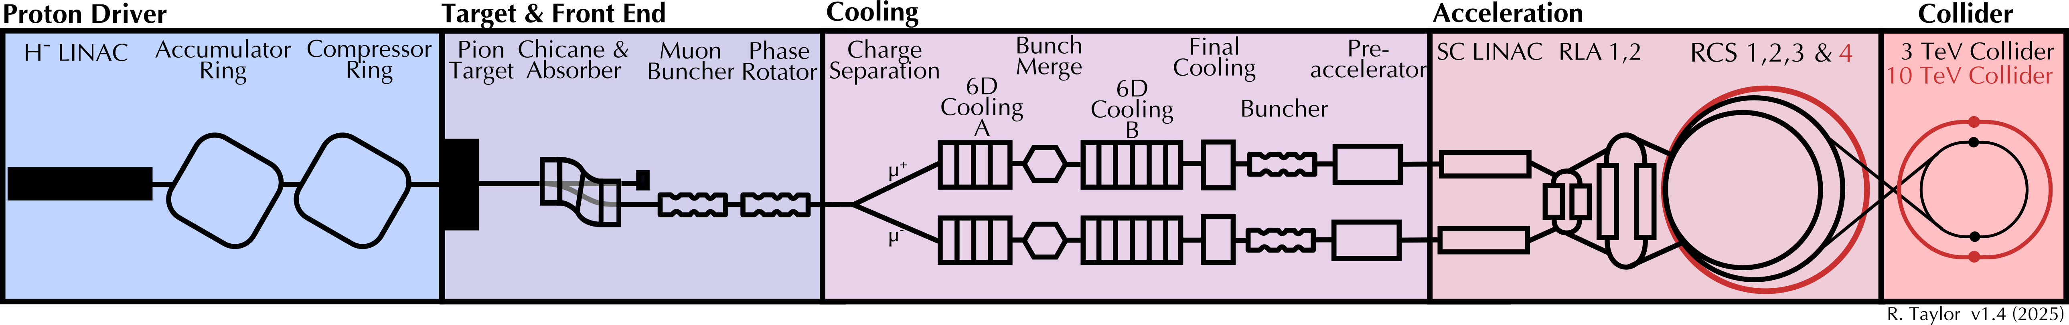
Muon Collider Concept
The main challenge is the short muon lifetime τ = γ x 2.2 μs
Protons produce pions which decay into muons which are captured
Ionisation cooling of muon in matter
Acceleration to collision energy
Short, intense proton bunch
Collision
2
Notes:
Why is the muon collider a challenge: The muon decays!
Not only that, but you have to produce the muons in the first place.
(Go through the stages)

Slide 3
IMCC
International Muon Collider Collaboration
Develop high-energy muon collider as option for particle physics:
Implement globally defined accelerator R&D roadmap (2022) to justify CDR phase
Mid-term roadmap review found 75% of goal achieved
Param. | Unit | 3 TeV | 10 TeV
L/IP | 10³⁴ cm⁻²s⁻¹ | 1.8 | 17.5
N | 10¹² | 2.2 | 1.8
f_{r} | Hz | 5 | 5
C | km | 4.5 | 11.4
B_{dipole} | T | 11 | 14
Collider techn. |  | Nb3Sn | HTS
Focus on feasibility of 10 TeV with 10 ab⁻¹ (site independent)
Explore initial stage by 2050, maybe around 3 TeV with 1 ab⁻¹ or lower luminosity 10 TeV
Explore implementation at specific sites reusing infrastructure
Provided ESPPU with
Assessment of muon collider concept, technologies and work progress
An R&D plan for the next 10 years
Implementation considerations (including site, timeline, …)
Back-up document (406p, 450 signatories)
Will inform other strategy processes
Roadmap: http://arxiv.org/abs/2201.07895
3
Notes:
So the umbrella that facilitates this work is the IMCC, the International Muon Collider Collaboration.
We were really born from the 2022 roadmap, and if you look step by step for the recommendations given to us, we have completed 75% of that initial roadmap, which is pretty incredible given that we were budgeted the minimum recommendation, and had a year less to do it in.
The MAP did a lot on 3 TeV, so we are aiming for the 10 TeV! And have a plan in place for getting to our first step by 2050. Either by having a low energy option, or a low luminosity option. Currently our theorists believe our strength is in our energy, and we can afford to be more relaxed with our luminosity.
And we accelerated our progress before ESPPU deadline by having a 400 page document, a full civil engineering siting of CERN which I will display, and an R&D plan which I will go over in detail later.

Slide 4

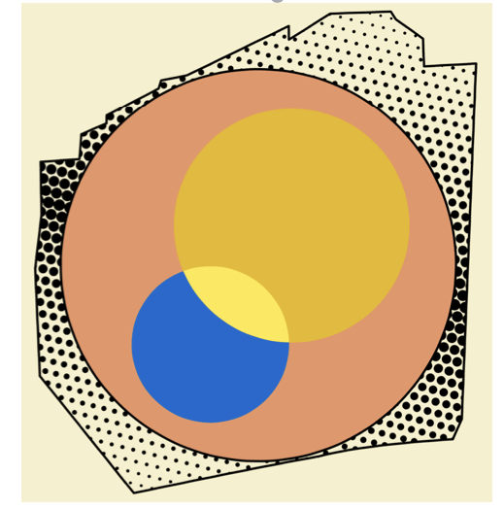

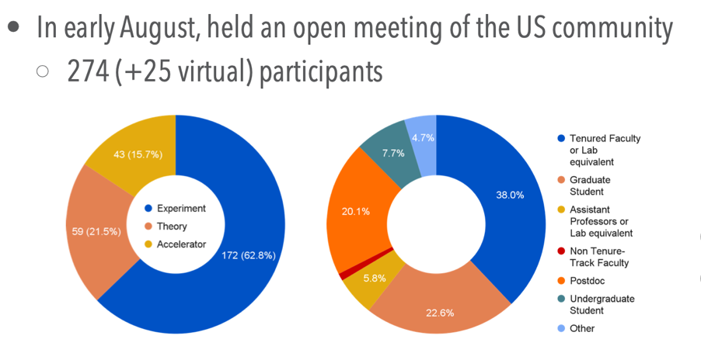
The Collaboration
Collaboration formed 2022, currently hosted by CERN
61 full partner institutes, more in process
From all regions
EU co-funded design study MuCol started 2023
Strong recommendation from P5 «This is our muon shot»
Interest in hosting at FNAL
US partners are in the process of joining
US Muon Collider Inauguration Meeting in August 2024 at Fermilab (about 300 participants)
Forming national organisation to participate
Addendum to CERN-DoE agreement in preparation
Already strong US contribution to IMCC ESPPU documents
Work at universities started
Obtained several grants also at laboratories
IMCC will carry out the R&D together and develop options to host the collider at CERN or at Fermilab and potentially also other sites
4
Notes:
Now the international muon collider collaboration is really international. We have 61 partners, more joining all the time, and we work collaboratively with our US colleagues. As we heard from both P5, and also last week input from the National Academy of Sciences.

Slide 5
IMCC Partners
IEIO | CERN
FR | CEA-IRFU
 | CNRS-LNCMI
 | Ecoles des Mines St-Etienne
DE | DESY
 | Technical University of Darmstadt
 | University of Rostock
 | KIT
UK | RAL
 | UK Research and Innovation
 | University of Lancaster
 | University of Southampton
 | University of Strathclyde
 | University of Sussex
 | Imperial College London
 | Royal Holloway
 | University of Huddersfield
 | University of Oxford
 | University of Warwick
 | University of Durham
 | University of Birmingham
 | University of Cambridge
NL | University of Twente
IT | INFN
 | INFN, Univ., Polit. Torino
 | INFN, LASA, Univ. Milano
 | INFN, Univ. Padova
 | INFN, Univ. Pavia
 | INFN, Univ. Bologna
 | INFN Trieste
 | INFN, Univ. Bari
 | INFN, Univ. Roma 1
 | ENEA
 | INFN Frascati
 | INFN, Univ. Ferrara
 | INFN, Univ. Roma 3
 | INFN Legnaro
 | INFN, Univ. Milano Bicocca
 | INFN Genova
 | INFN Laboratori del Sud
 | INFN Napoli
Mal | Univ. of Malta
EST | Tartu University
PT | LIP
SE | ESS
 | University of Uppsala
FI | Tampere University
 | HIP, University of Helsinki
LAT | Riga Technical University
CH | PSI
 | University of Geneva
 | EPFL
 | HEIA-FR
BE | Univ. Louvain
AU | HEPHY
 | TU Wien
ES | I3M
 | IFIC/CSIC
 | ICMAB
China | Sun Yat-sen University
 | IHEP
 | Peking University
 | Inst. Of Mod. Physics, CAS
 | University of CAS
KO | Kyungpook National University
 | Yonsei University
 | Seoul National University
India | CHEP
CA | Université Laval
US | Iowa State University
 | University of Iowa
 | Wisconsin-Madison
 | University of Pittsburgh
 | Old Dominion
 | Chicago University
 | Florida State University
 | RICE University
 | Tennessee University
 | MIT Plasma science center
 | Pittsburgh PAC
 | Yale
 | Princeton
 | Stony Brook
 | Stanford/SLAC
 | …
DoE labs | FNAL
 | LBNL
 | JLAB
 | BNL
Brazil | CNPEM
5
Signed MoC (61), requested MoC, contributor
Notes:
This is our list of partners who have either signed a Memoratum of Cooperation, requested one, or have otherwise contributed. Our biggest contributers beign the UK, Italy and US universites.

Slide 6
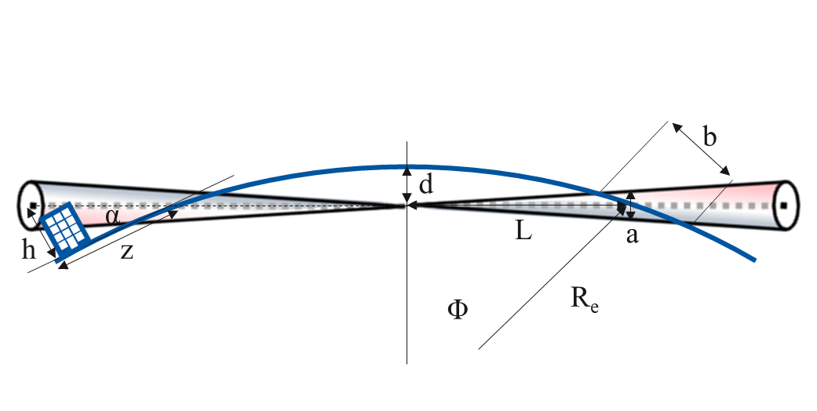
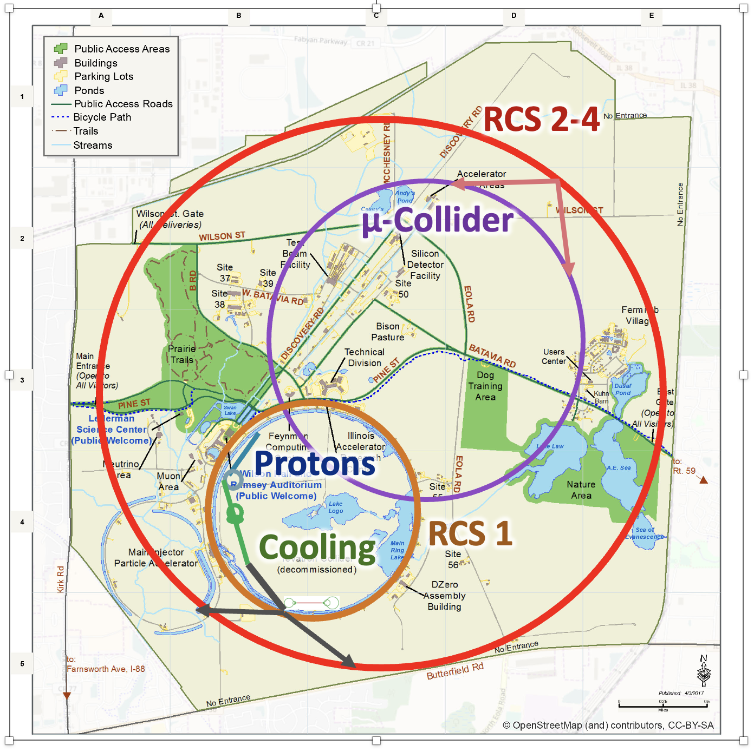
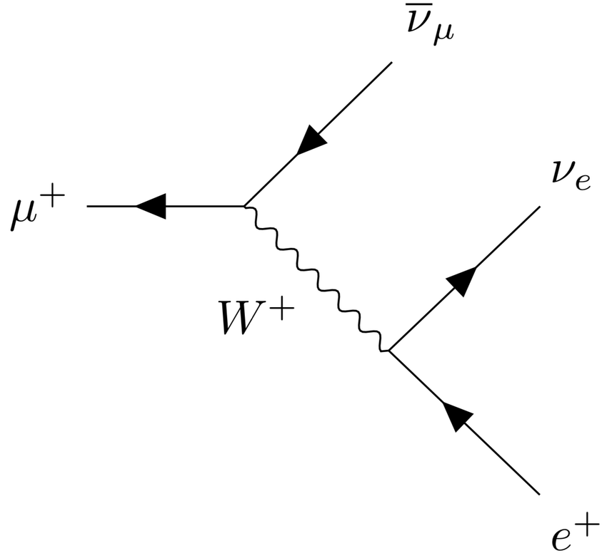
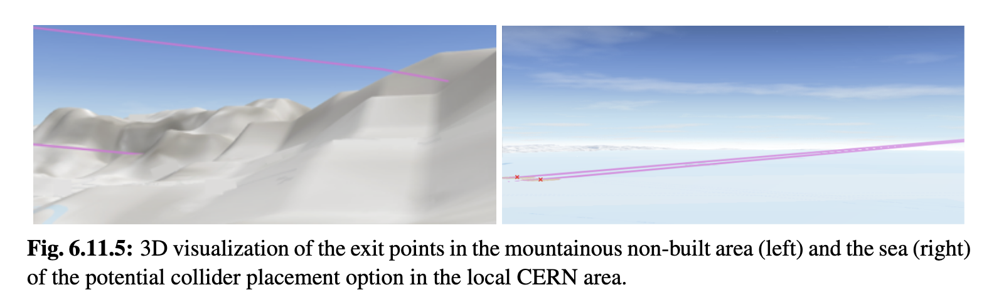
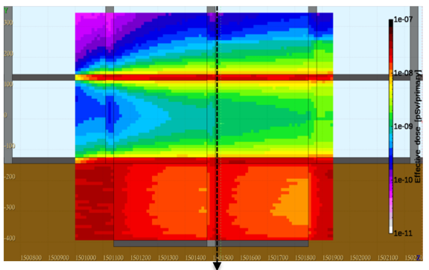
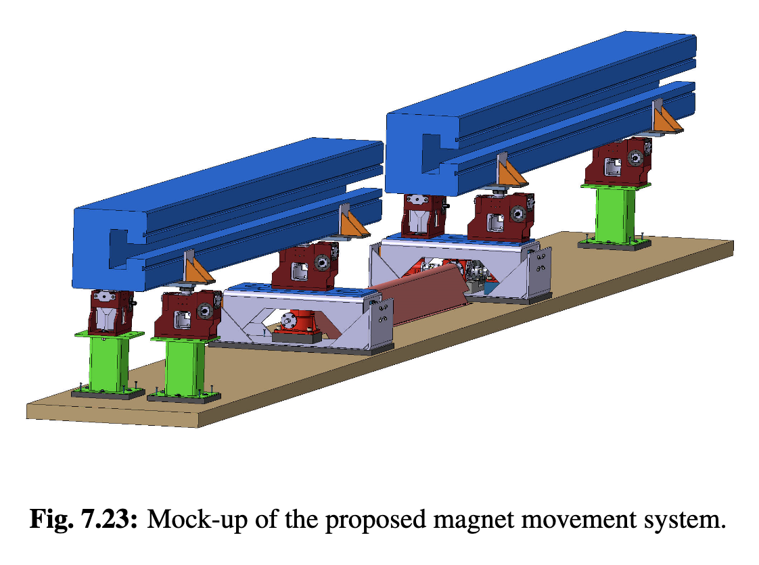
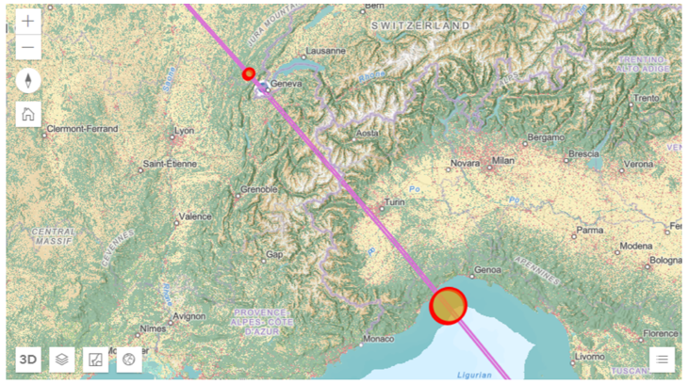
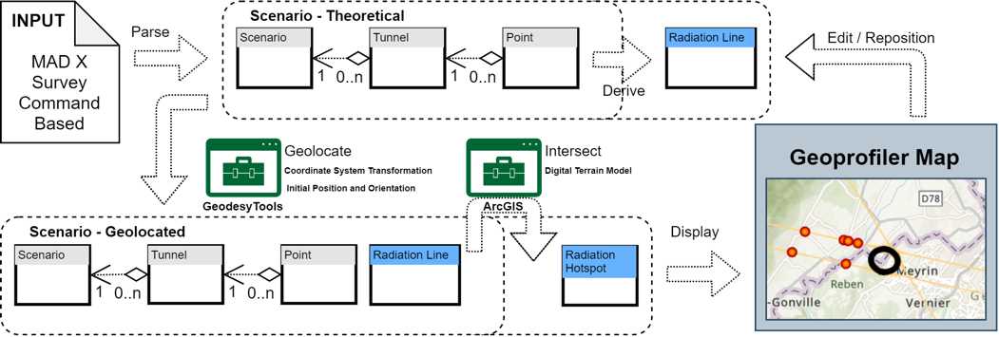
Site
Challenge:
Obtain negligible neutrino flux
Achieved:
Detailed modelling
First good orientation found
Mover system concept
Fermilab site study
t₁
t₂
Arc mitigation concept
FLUKA and RP studies
Mover system design
Key conclusions:
Are close to a solution
More work to be done
Site study at CERN for experimental insertion
TUPM076
Notes:
So starting from the end – site studies are important for all accelerators, but particularly for the muon collider, as we have directional radiation from our straight-sections, so our collider lattice has to be not only optimised for the collision, but also to reduce the straights and to orient the collider in a way that we are below the radiation emission of the LHC. The tools have been developed, and we now just iterate according to the updated lattice and updated siting.

Slide 7
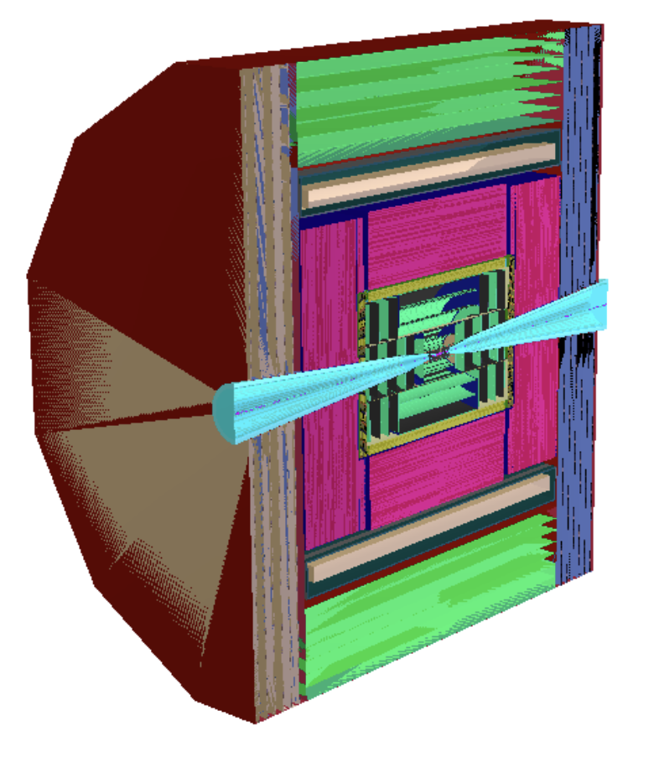
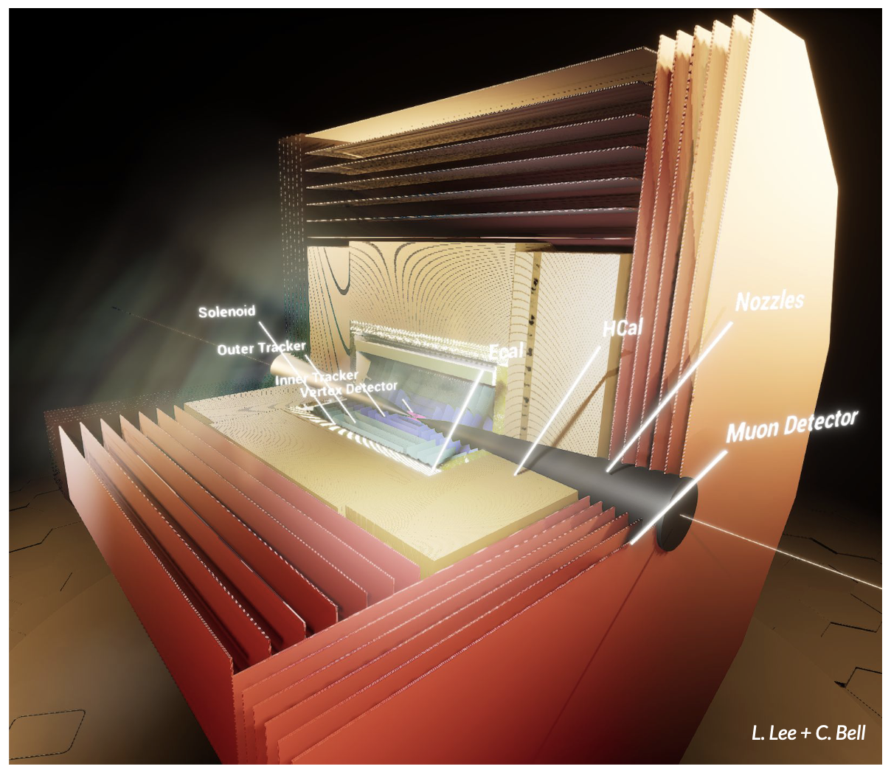
Physics and Detector Concepts
Two detector concepts are being developed
MUSIC
(MUon Smasher for Interesting Collisions)
MAIA
(Muon Accelerator Instrumented Aperatus)

Slide 8
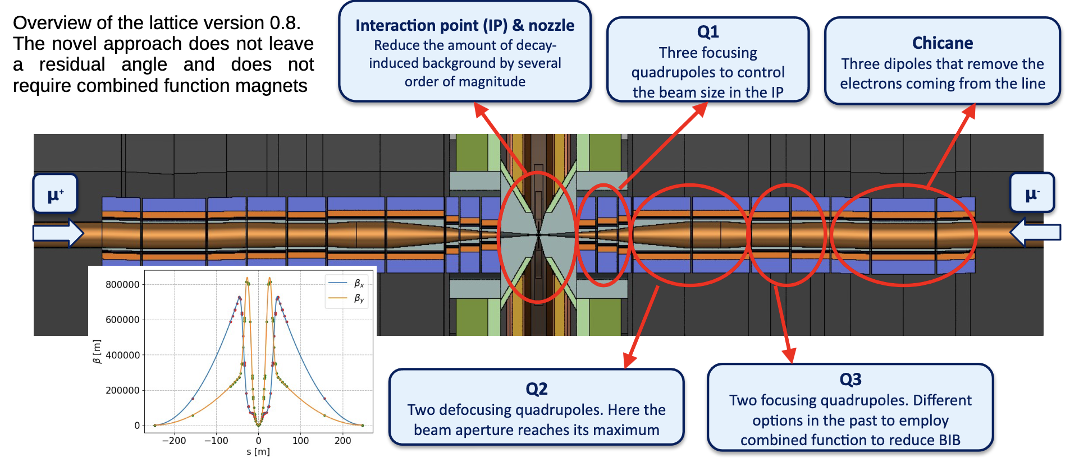
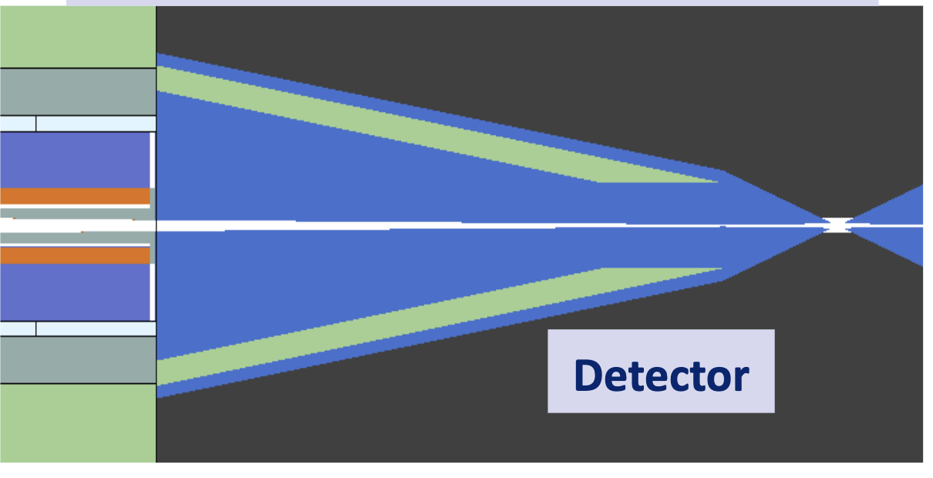
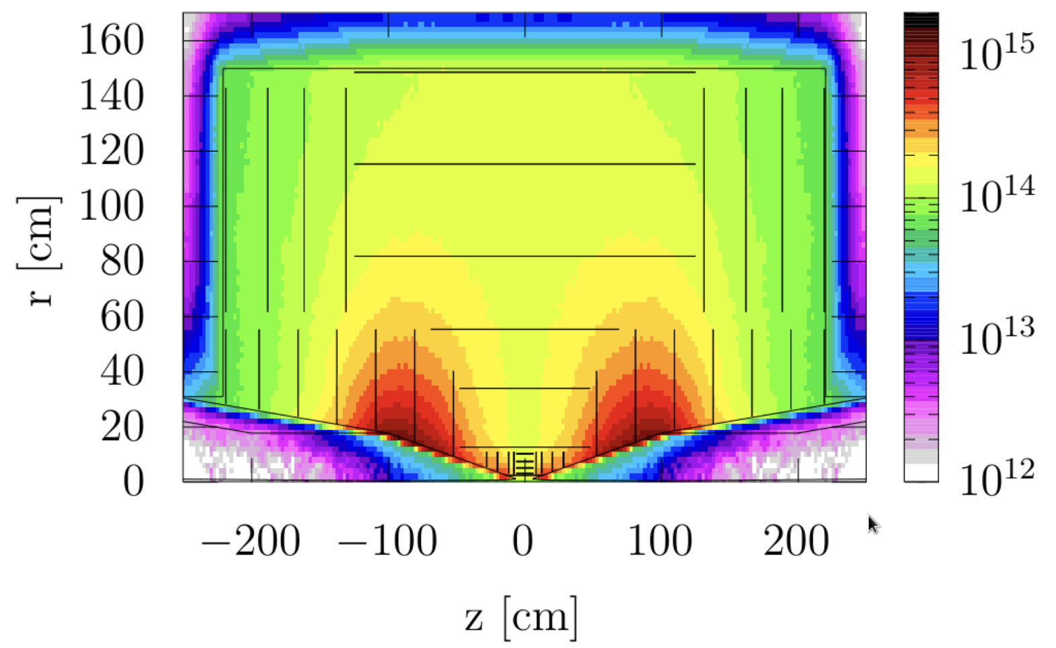
Beam-induced Background
Challenges:
Muon decay can give important background
40 000 muons/m/bunch crossing
1/3 of energy in electrons and positrons
Detailed studies with FLUKA
Achievements:
Two conceptual detector designs
Simulation studies with background also from machine
Studies of different lattices
Reconstruction algorithms
Physics studies
Conclusions:
Can do the physics
  Also thanks to HL-LHC technology
But room for improvement
Radiation level similar to HL-LHC
Notes:
Now unlike most detectors, our background is dominated by the electrons from muon decays in the IP region before the collision. It is important for us to do physics simulations with the BIB, and it ensures that we can enable background levels similar to what HL-LHC can achieve. It is lucky that the electrons are very directional, so mostly affect the end-caps, and are of a very characteristic energy.

Slide 9
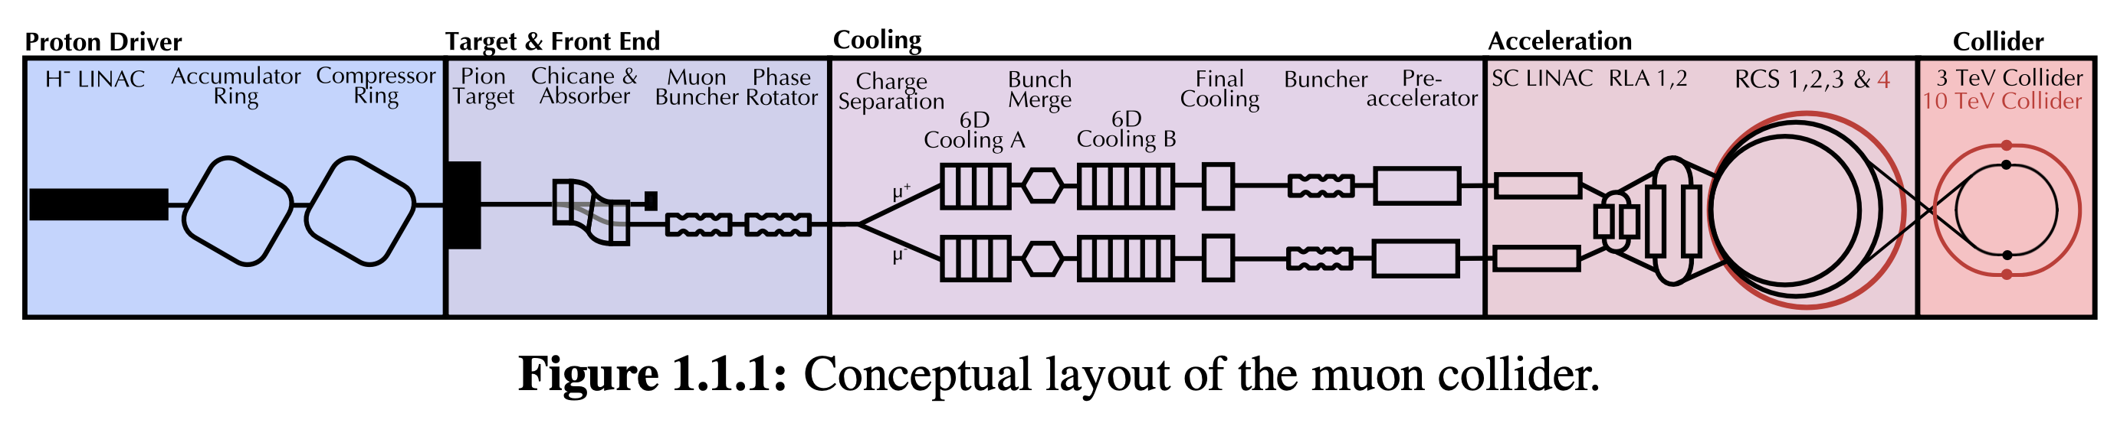
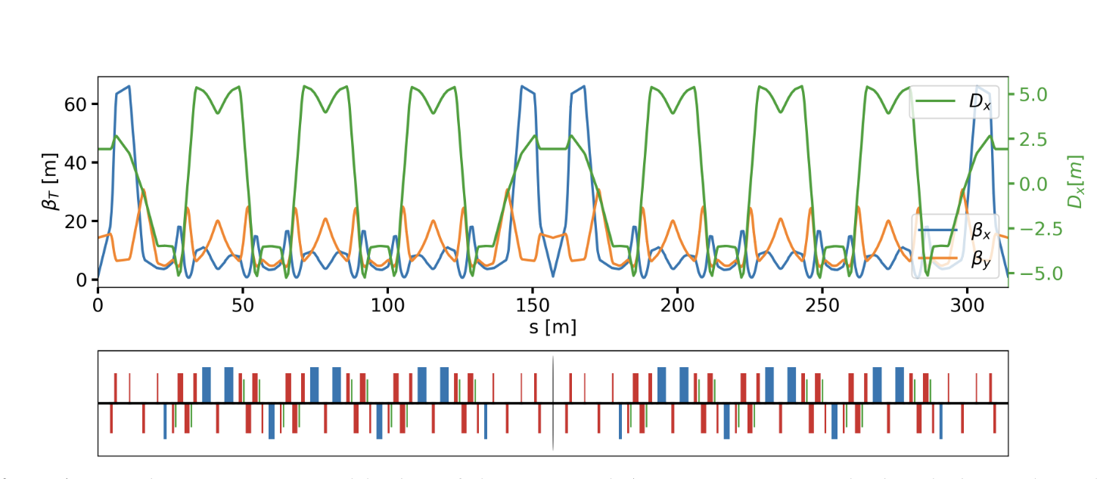
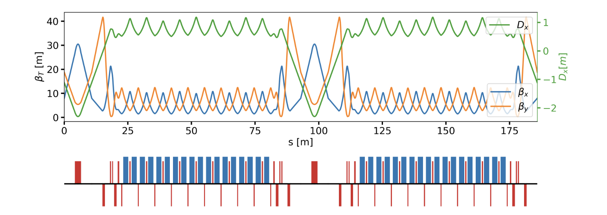
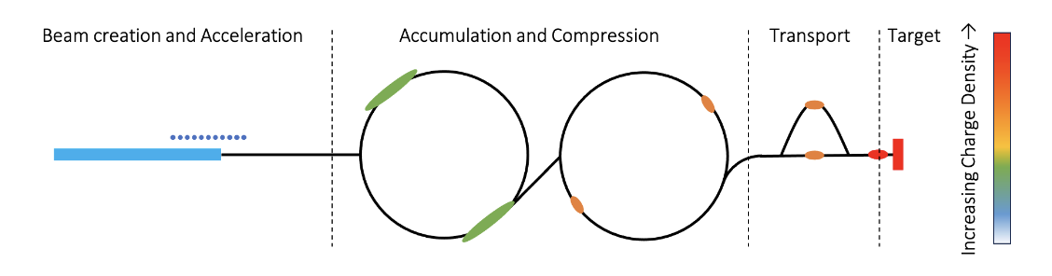
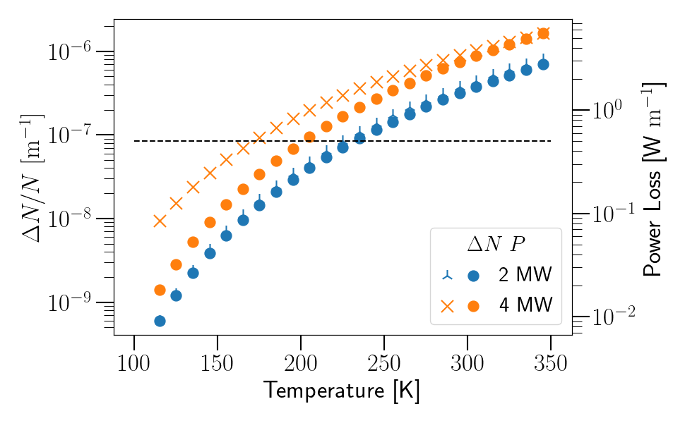
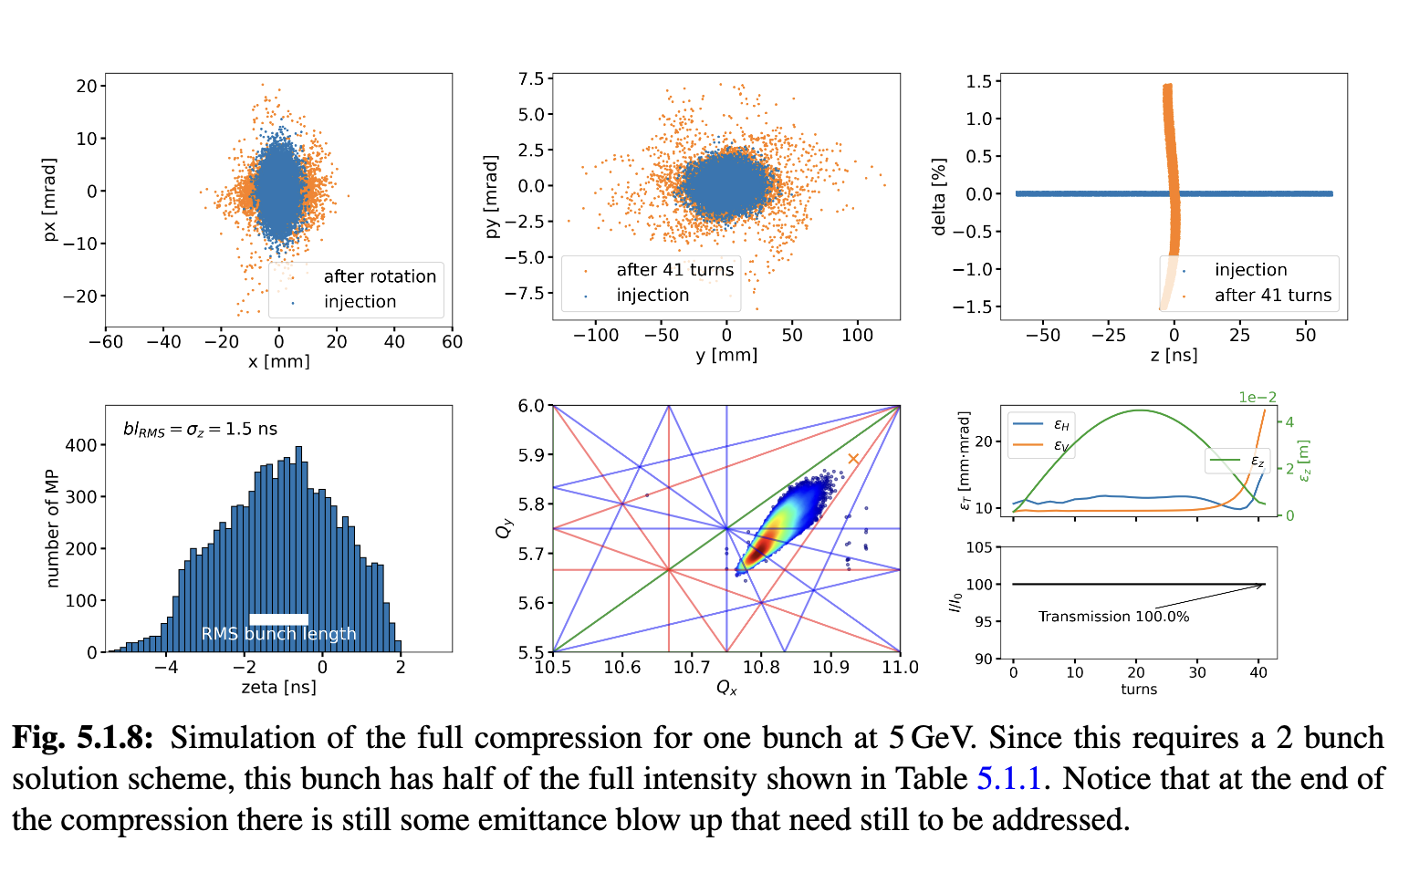
Proton Complex
Challenge:
2 MW, 5 GeV, 5 Hz,
5 x 10¹⁴ protons/pulse
Proton pulse accumulator and compressor rings
Achieved:
Accumulator and combiner ring lattices
First collective effects studies promising
One or two bunches in compressor, to be decided
Key conclusions:
Can compress 2 MW, 5 GeV proton beam to two 2 ns bunches, then merge them
  Optimisation in compressor ring for collective effects ongoing
For 4 MW need 10 GeV beam
Cool beamline to avoid ion loss from black body radiation
Notes:
Now we jump back to the start as we remember that we need to generate the muons, and we do so with protons. Our baseline is a 5 GeV beam with 2 MW of power, but should luminosity call for it, we have options for a 10 GeV beam with 4 MW beam power. The challenge is to get a short pulse. Think of the intensity and pulse of nTOF, which can currently reach ~10 ns. And we would want around a 2 ns pulse. And so to do this we have some accumulation system, think of the booster, and a compression system to get a long beam pulse and longitduinally rotate it. And of course doing with high intensity has high space-charge, so for example. 4 MW with 5 GeV would be completely unacceptable.
Most of this work was done by Sofia Johanneson, who was at BE-ABP before moving to ESS, and her current supervisor Natalia Milas.

Slide 10
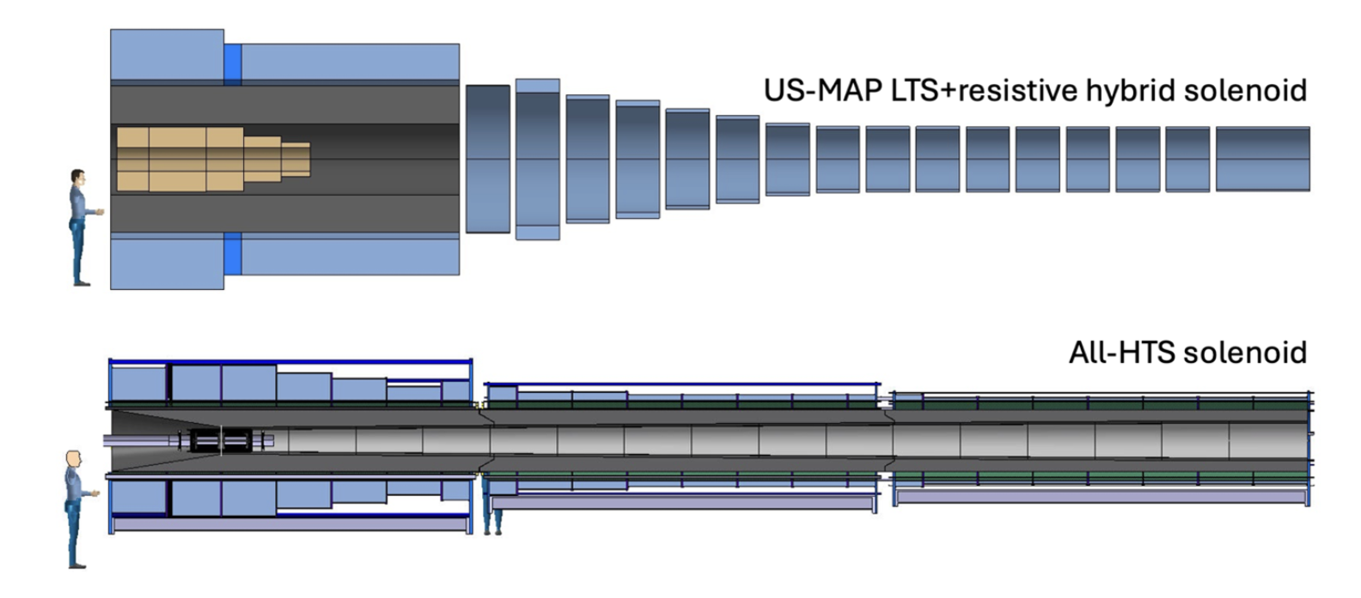
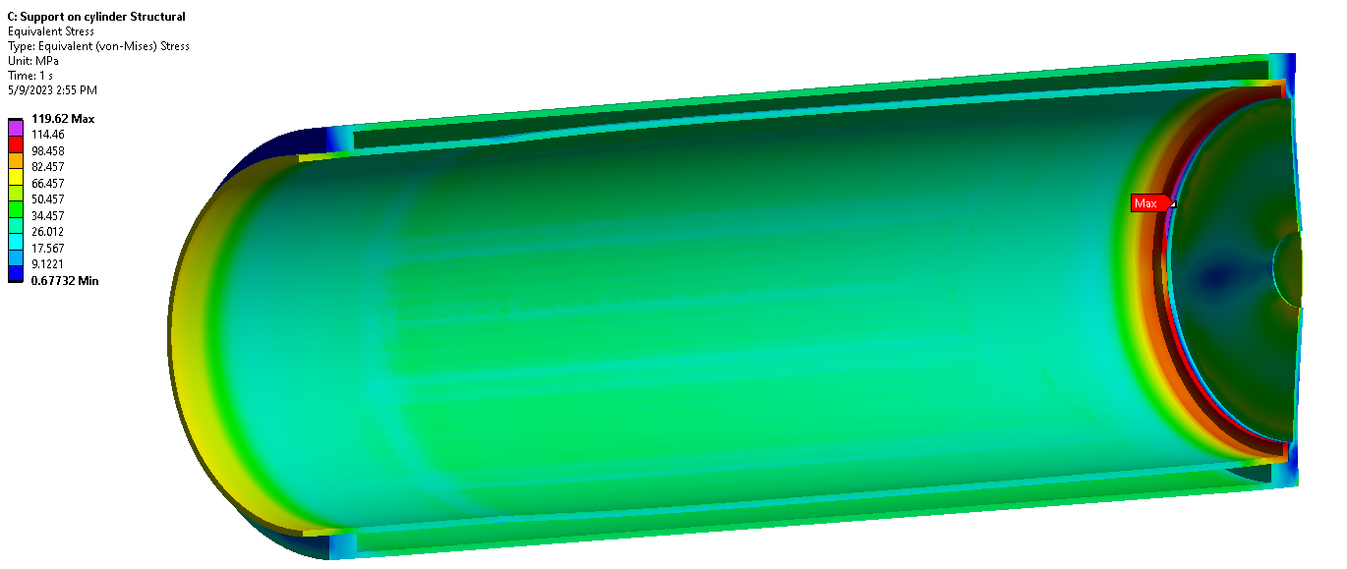
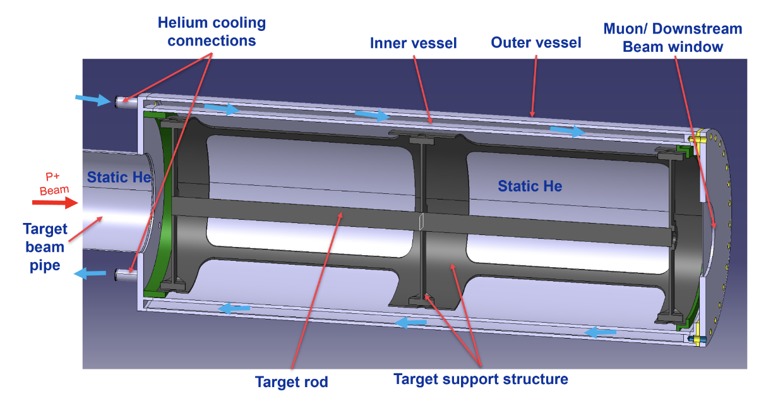
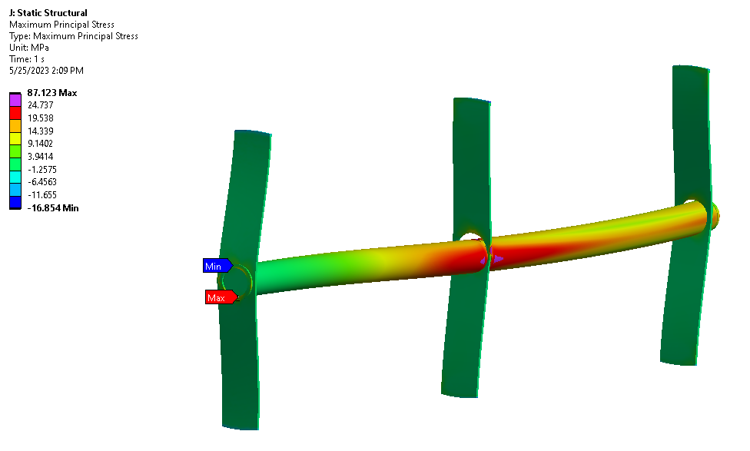
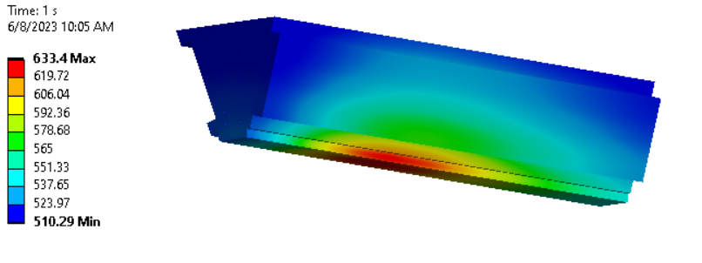
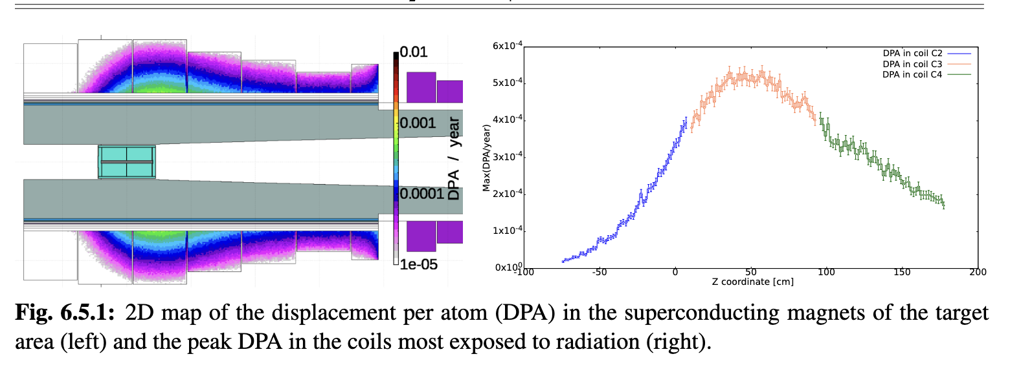
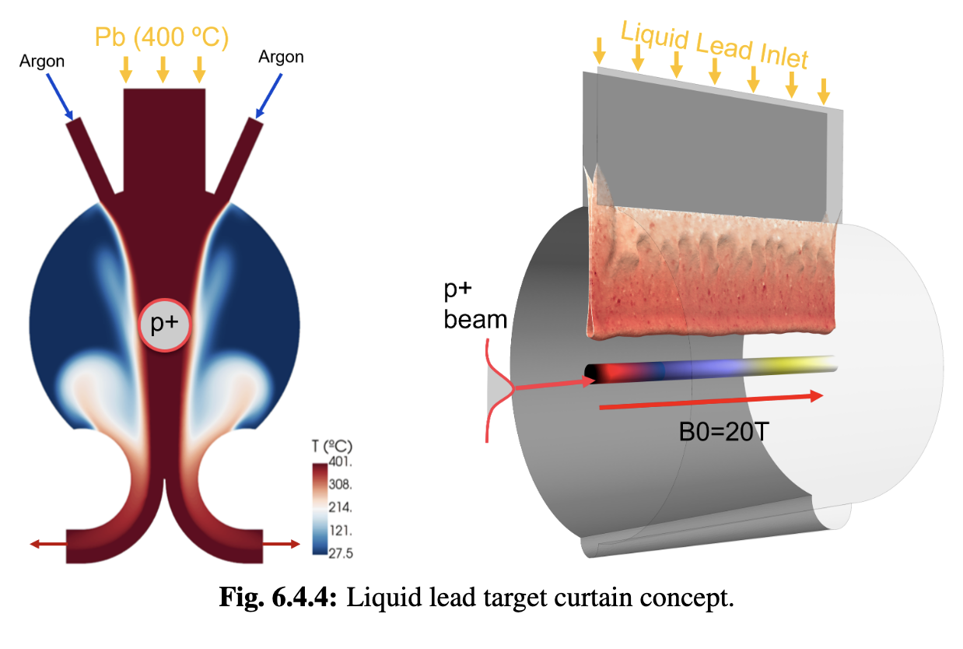
Target
Challenges:
2 MW, 5 Hz, 400 MJ/pulse target
Can we replace mercury with graphite?
Achieved:
Initial 2 MW graphite target conceptual design, pion yield optimised
HTS solenoid and shielding concept developed
Study of proton removal ongoing
Key conclusions:
Yield, magnet shielding, target stress, cooling, radiation are OK
Components survive 2 MW beam
Higher power alternatives to study:
  Graphite
  Liquid metal
TUPM077
THPB017
Notes:
Our 2 ns beam pulse hits our target, and produces pions which decay only to muons. Around 2007 at MIT there was MERIT, which was a free-flowing liquid mercury target, and since then we have verified a solution for graphite. The current challenge is to have the high-bore superconducting solenoids around the target in a high radiation environment (synergy with fusion), and then to safely extract the protons that don't produce pions. And if we had the 10 GeV, 4 MW option, we are considering what target technology we would use for that.
A lot of this work was done by the STI group, in particular Rui, Anton, Jerzy, Silvio and Daniele

Slide 11
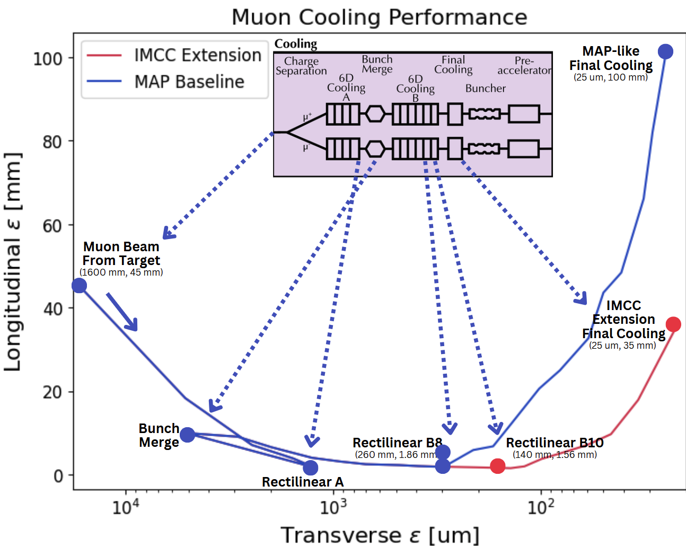
Muon Cooling Lattice Design
Challenge:
Novel, complex lattice with cavities and absorbers in solenoids
Achieved:
Much improved lattice design
Improved simulation tools: BDSIM and RFtrack
Key conclusions:
Can in principle reach or exceed performance target
Much improved longitudinal, may be useful for collider ring
Study of collective effects important
SUPM017/MOPS024
(WEPS039, WEPS042)
Notes:
The beam from the target is roughly a basketball-like shape, and we aim to reduce the 6-dimensional emittance of the beam. That's the positions (x, y, z) and the momentum of the beam (px, py, pz). In doing so we make it short for our RF cavities and a small enough aperture for the magnet apertures downstream. Simulating cooling was hard, as you have overlapping elements of solenoids and RF cavities, and beam-scattering with hydrogen. And now we have RF Track, BDSIM and have benchmarked with ICOOL and G4Beamline. And we have a lattice for the 6D Cooling which has improbed roughly by a factor of two. This is beneficial for the final cooling which cools only in x and y, but increases z.
This work was done by Chris Rogers and Ruihu at Rutherford Lab, and Bernd and myself in BE-ABP.

Slide 12
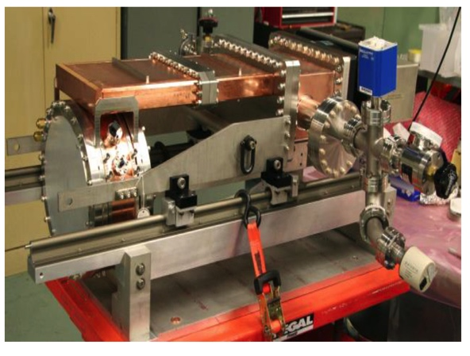
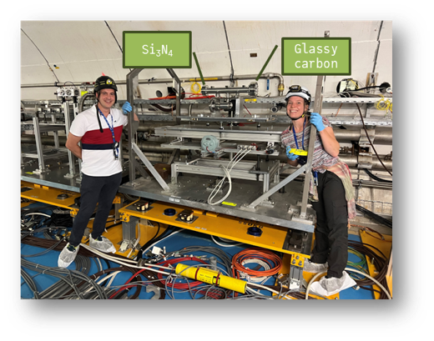
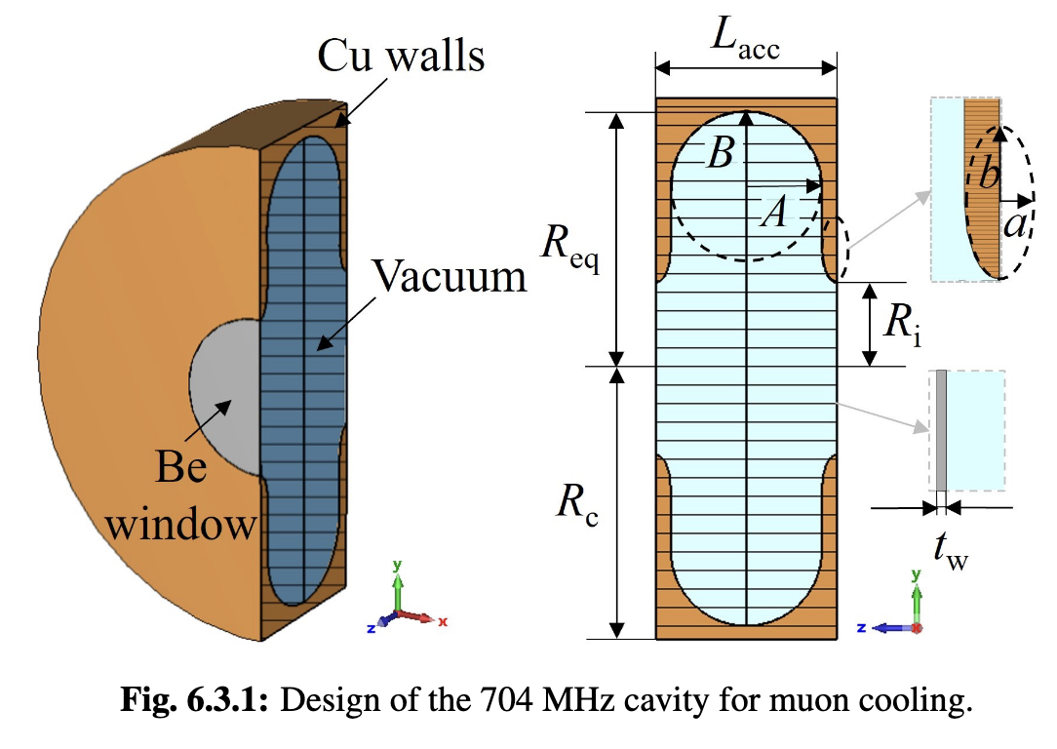
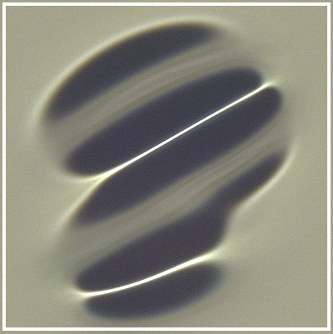
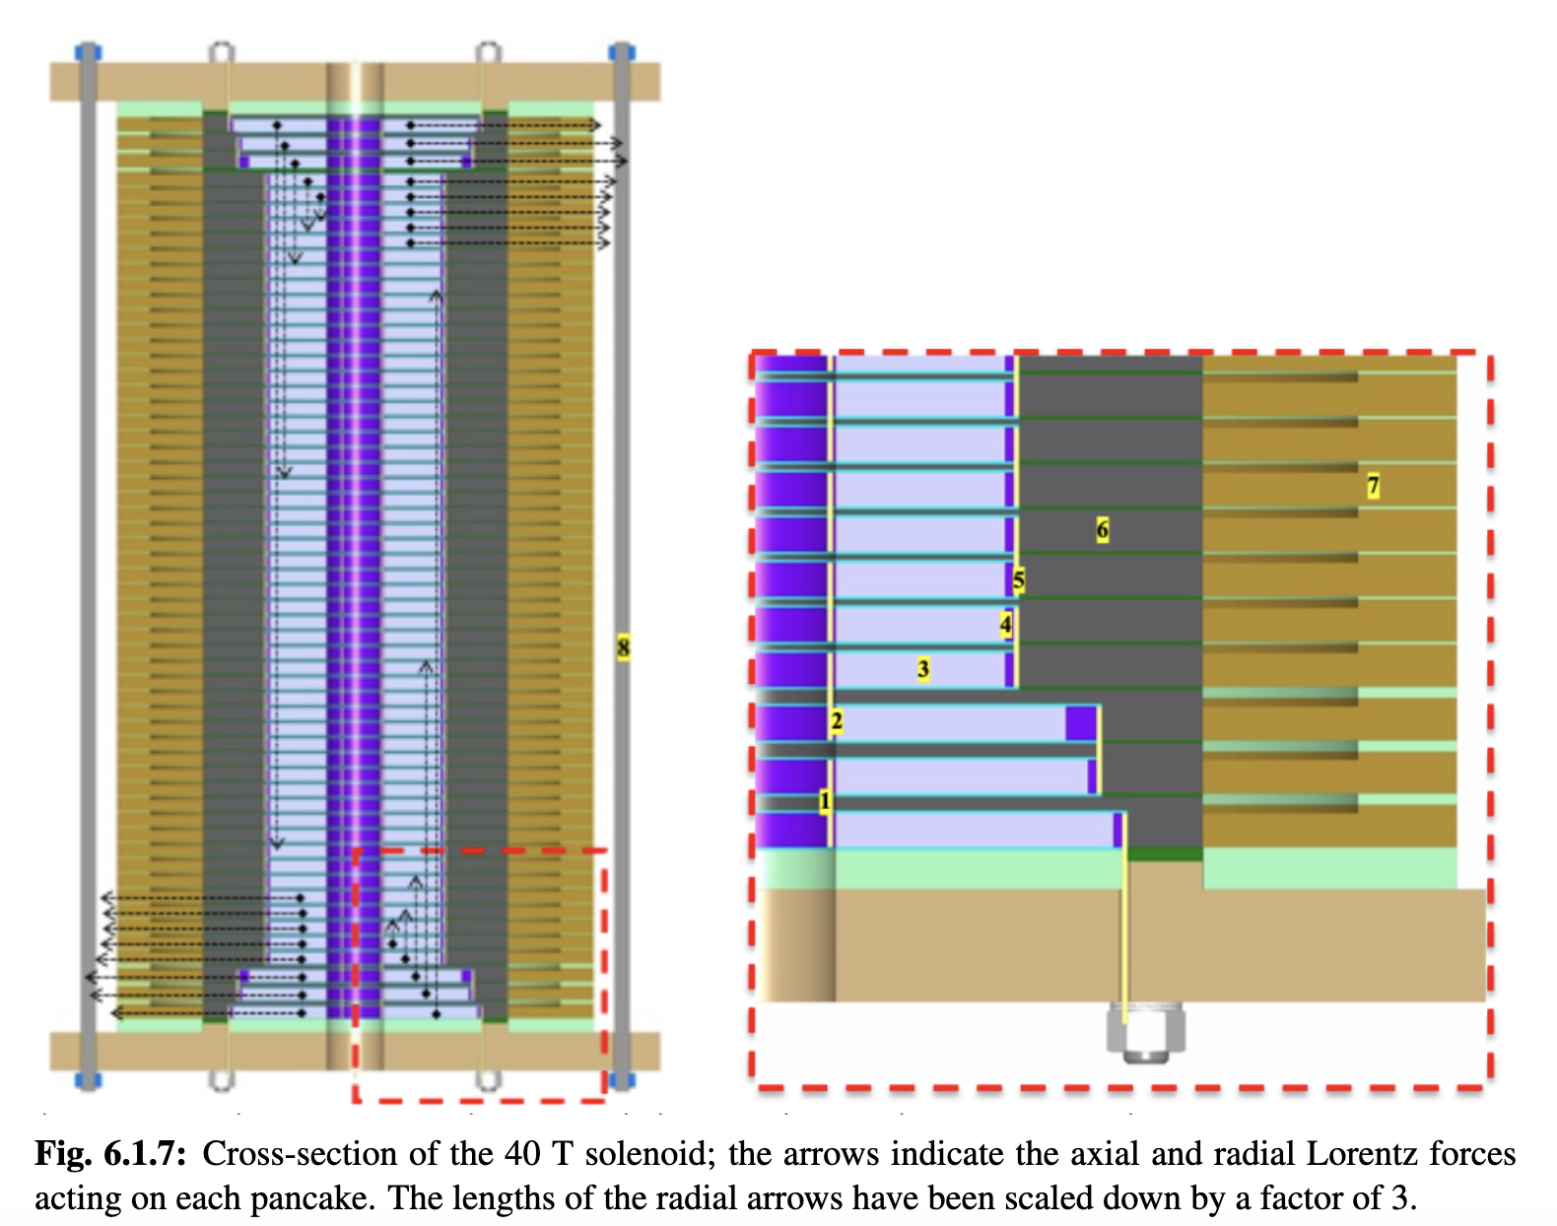
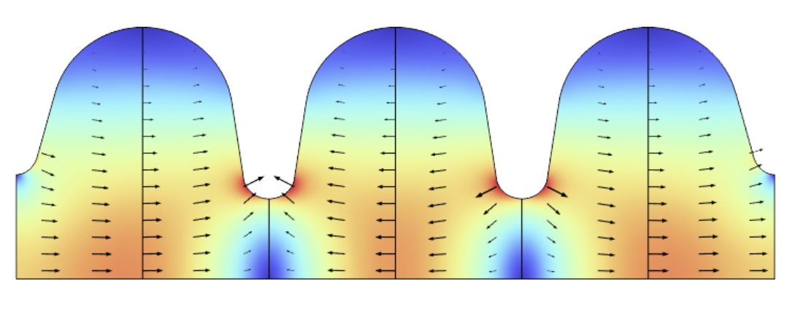
Muon Cooling Technology
Challenges:
NC RF cavities in magnetic field (30 MV/m)
HTS magnets (up to 40 T in final cooling)
Bright beam hard on absorbers and windows
  Can evaporise liquid hydrogen
MuCool demonstrated >50 MV/m in 5 T
H2-filled copper
Be end caps
MAP proved gradient
Initial RF designs
More RF design ongoing
First window tests performed with protons
Use of H2 gas where required
40 T final cooling solenoid conceptual designs exist
55 T might be possible
MOPM090
WEPB033
Key conclusions:
Ready to ramp-up effort, in particular prototyping and experimental work, also beam dynamics
Notes:
Now cooling works, and has been experimentally verified by MuScat, MICE and G-2. But cooling as an integrated technology is very hard, due to the aforementioned solenoid and RF together. And designing it in such a way that your hydrogen doesn't boil off.
So MuCool has achieved more than 50 MV/m in a 5 T field, whereas we aim for 20 MV/m in a 4 T field. We are adapting our RF designs to consider the beam-loading due to the high intensity.
We have quite a few windows and absorber tests.
And we have a very large and active magnet group, with many people doing feasibility studies on the famous 40 T magnets, where the largest issue is the forces on the magnet with itself, so there are strong clamping systems to contain the forces. These have strong synergies with the high-field magnets of MRI machines.
We have all these designs, and we can't really move forward until we can start building some of these coils, so prototyping is really the essential next step.
Most of the magnet team is from magnets, lead by Luca Bottura in ATS-DO, and from INFN

Slide 13
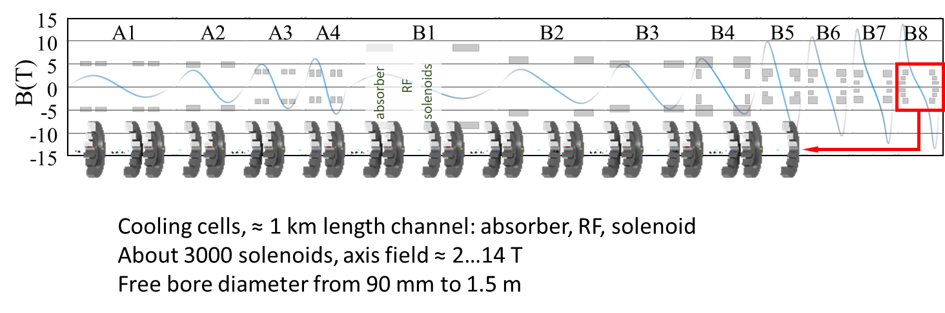
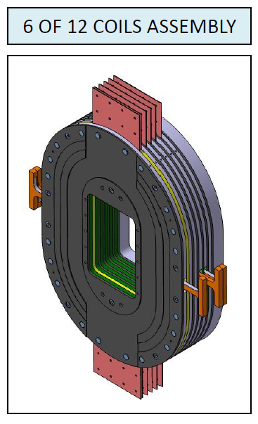
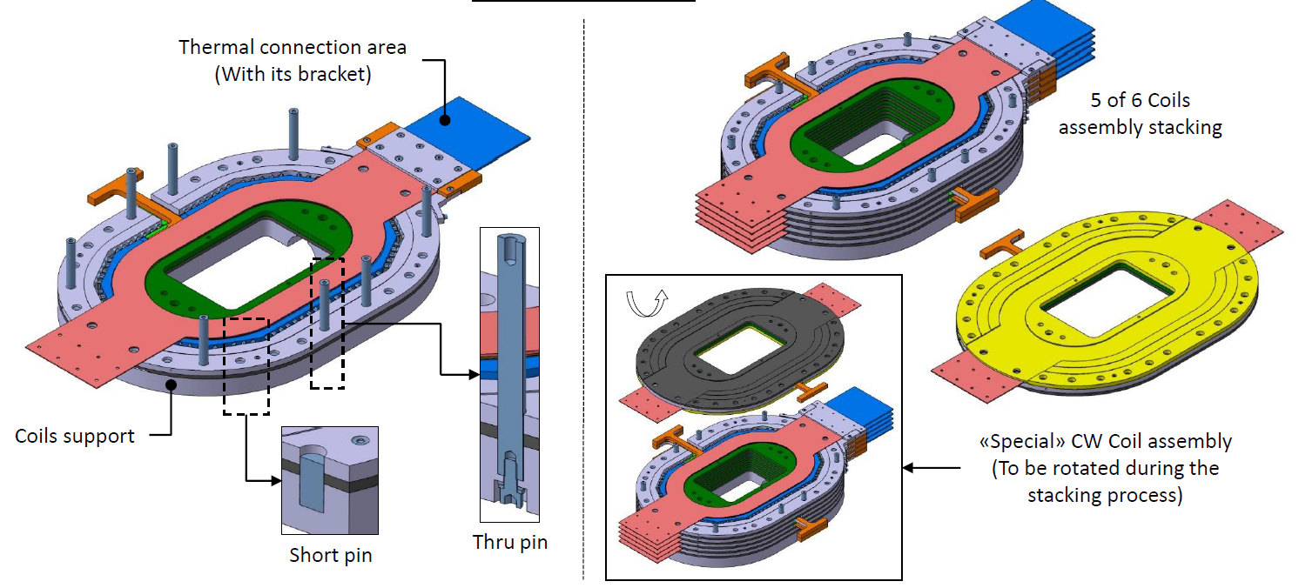
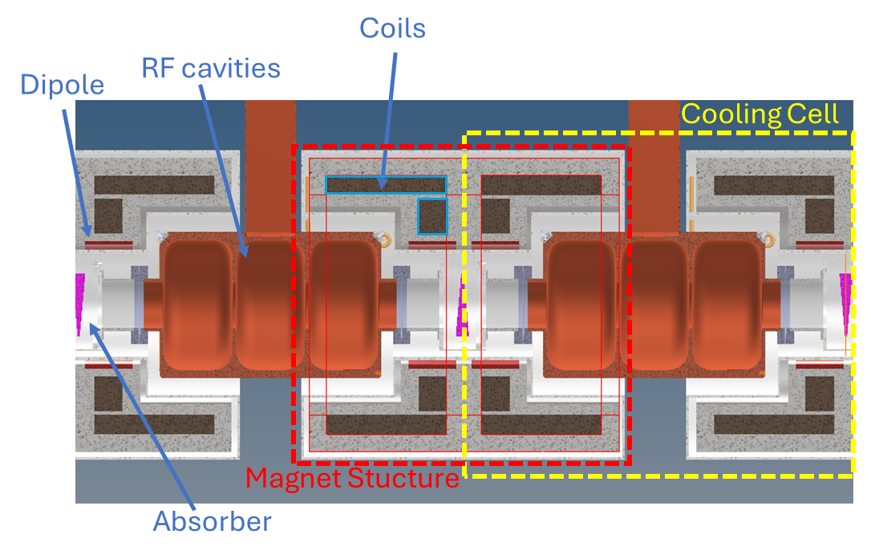
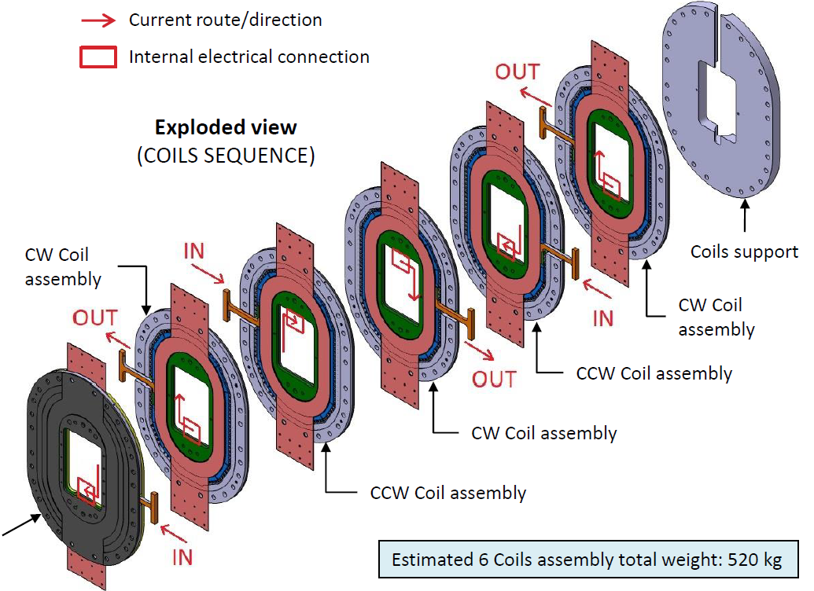
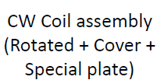
Muon 6D Cooling Cell
Challenge:
Integrated 6D cooling cell
HTS solenoid designs
Achieved:
Cooling cell engineering design almost ready
Solenoid models for use in beam dynamics optimisation
STEP 6: Connect 6x Coils with pins (half Cold Mass)
Key conclusions:
Key challenge is force from magnetic field
Concept to connect flanges developed
Iterations to improve overall and components design also considering beam dynamics is required/ongoing
Conceptual design ready in a few months
Notes:
As mentioned, The cooling cell is an integration challenge. And so we have some excellent researchers at INFN who have made a full step-by-step process to connect the solenoid coils around the RF cavities and consider the waveguide space. This is great because now we know that we had to flip our arrangements to balance the solenoid coils. And we question how to handle our flange connections. But throughout the cooling, the beam itself is changing both in aperture and in longitudinal size, and so our magnets spacing and our RF frequencies actually has to change throughout the system. So we will need integrated prototypes for each stage (currently we picked B5), and see if we can get the B9 and B10 stages that give us the increase in 2x performance.
This work is pioneered by Lucio Rossi at INFN.

Slide 14
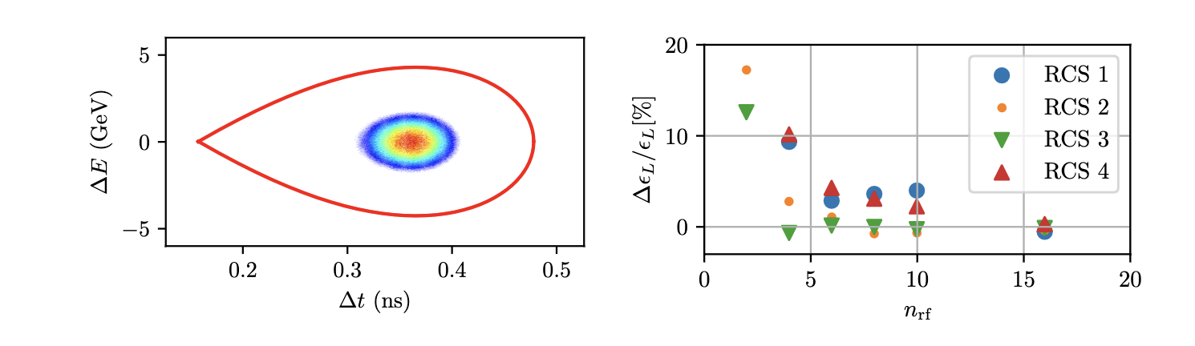
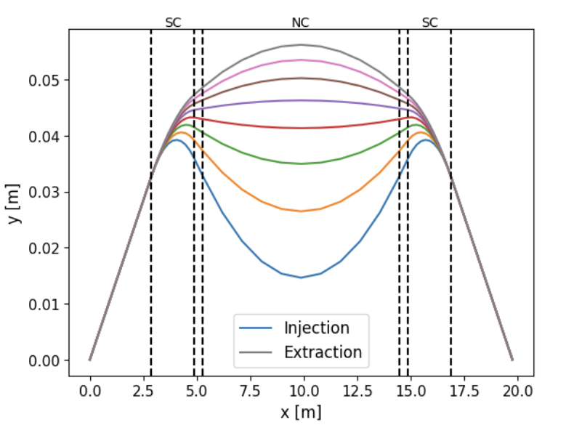
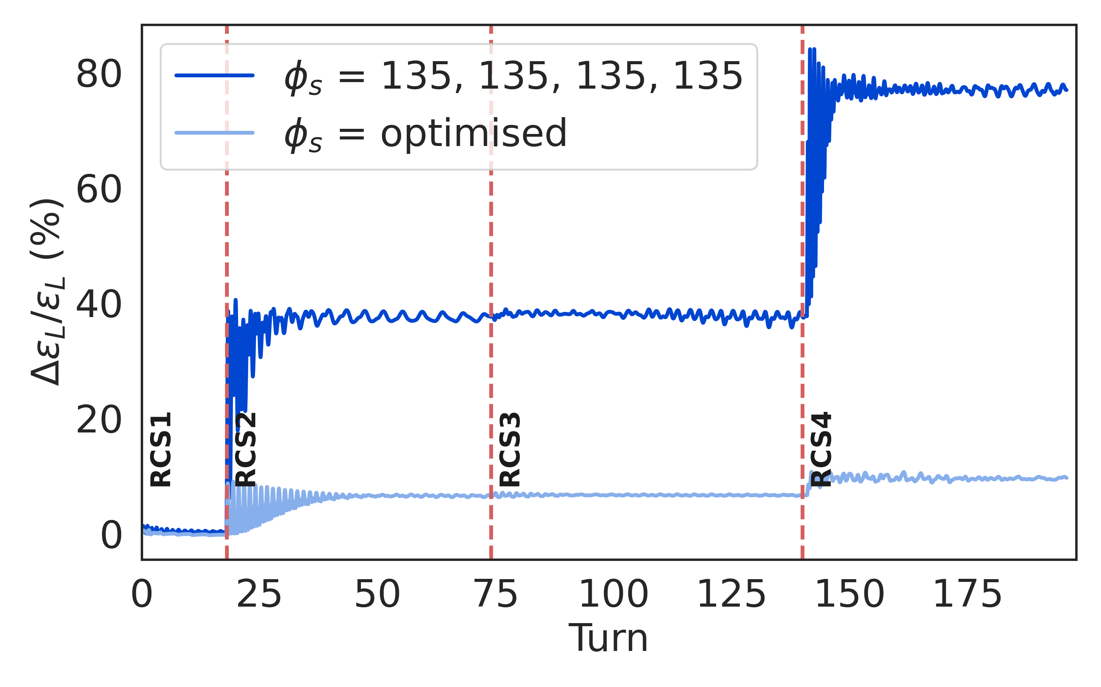
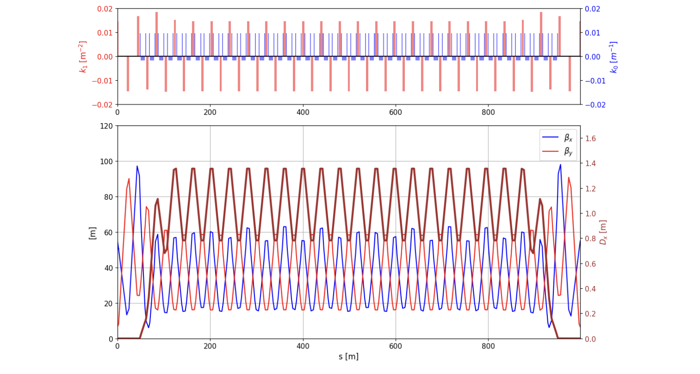
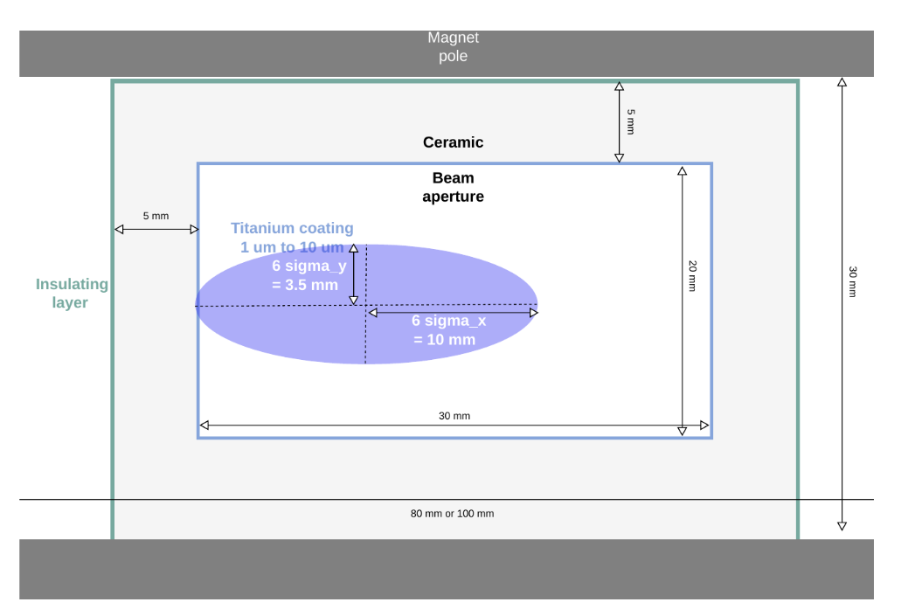
RCS Designs
Rapid-Cycling Synchrotron
Challenge:
Uses fast-pulsed normal magnets
5 Hz pulses of O(1-10ms)
6-35 km circumference
Cost and power efficient acceleration
High bunch charge
Maintain beam quality
Achieved:
Lattices for all site independent RCSs
  Strong synchrotron motion
  Including hardware specifications
Beam propagation through complex works
SUPM017
SUPM014
MOPS046
MOPS116
Key conclusions:
1.3 GHz TESLA-type cavities work
Emittance transport is OK
Need to connect to initial linacs
Notes:
Great, so we've cooled the magnet back to normal sizes, so lets start to accelerate it.
We have a couple of linacs, recirculating linacs, and then we go into our rapid cycling synchrotron. Now these have extremely fast ramp rates, around kilo-tesla per second. They are also large magnets, because we use a hybrid FODO, and sandwich normal and superconducting together. Where the normal is ramping and the superconducting is static, resulting in large orbit excursions.
And there is a challenge with the RF because there are multiple RF stations all throughout the ring. Also we have RCS designs for greenfield, CERN and for Fermilab, because it is the main component that is different between sites.
This work is mostly from SY-RF, including Fabien, Eleanor Lamb, Leonard Thiele, and from colleagues at CEA in France.

Slide 15
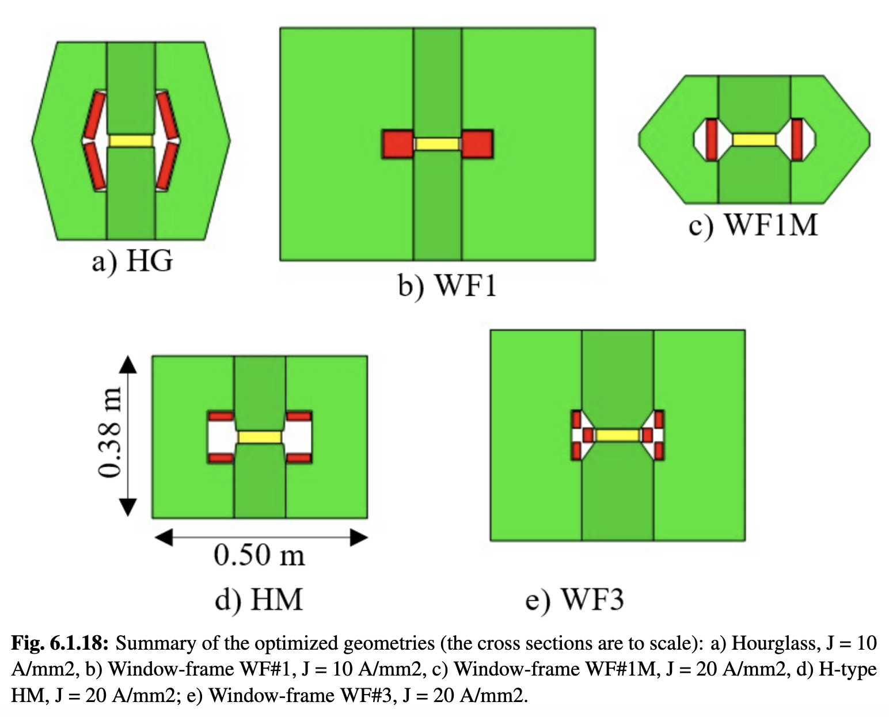
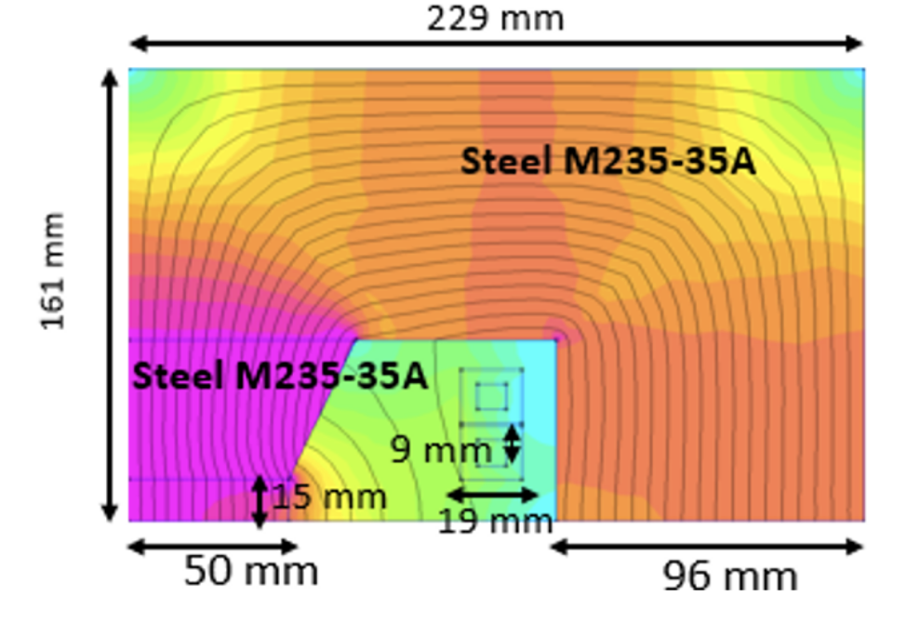
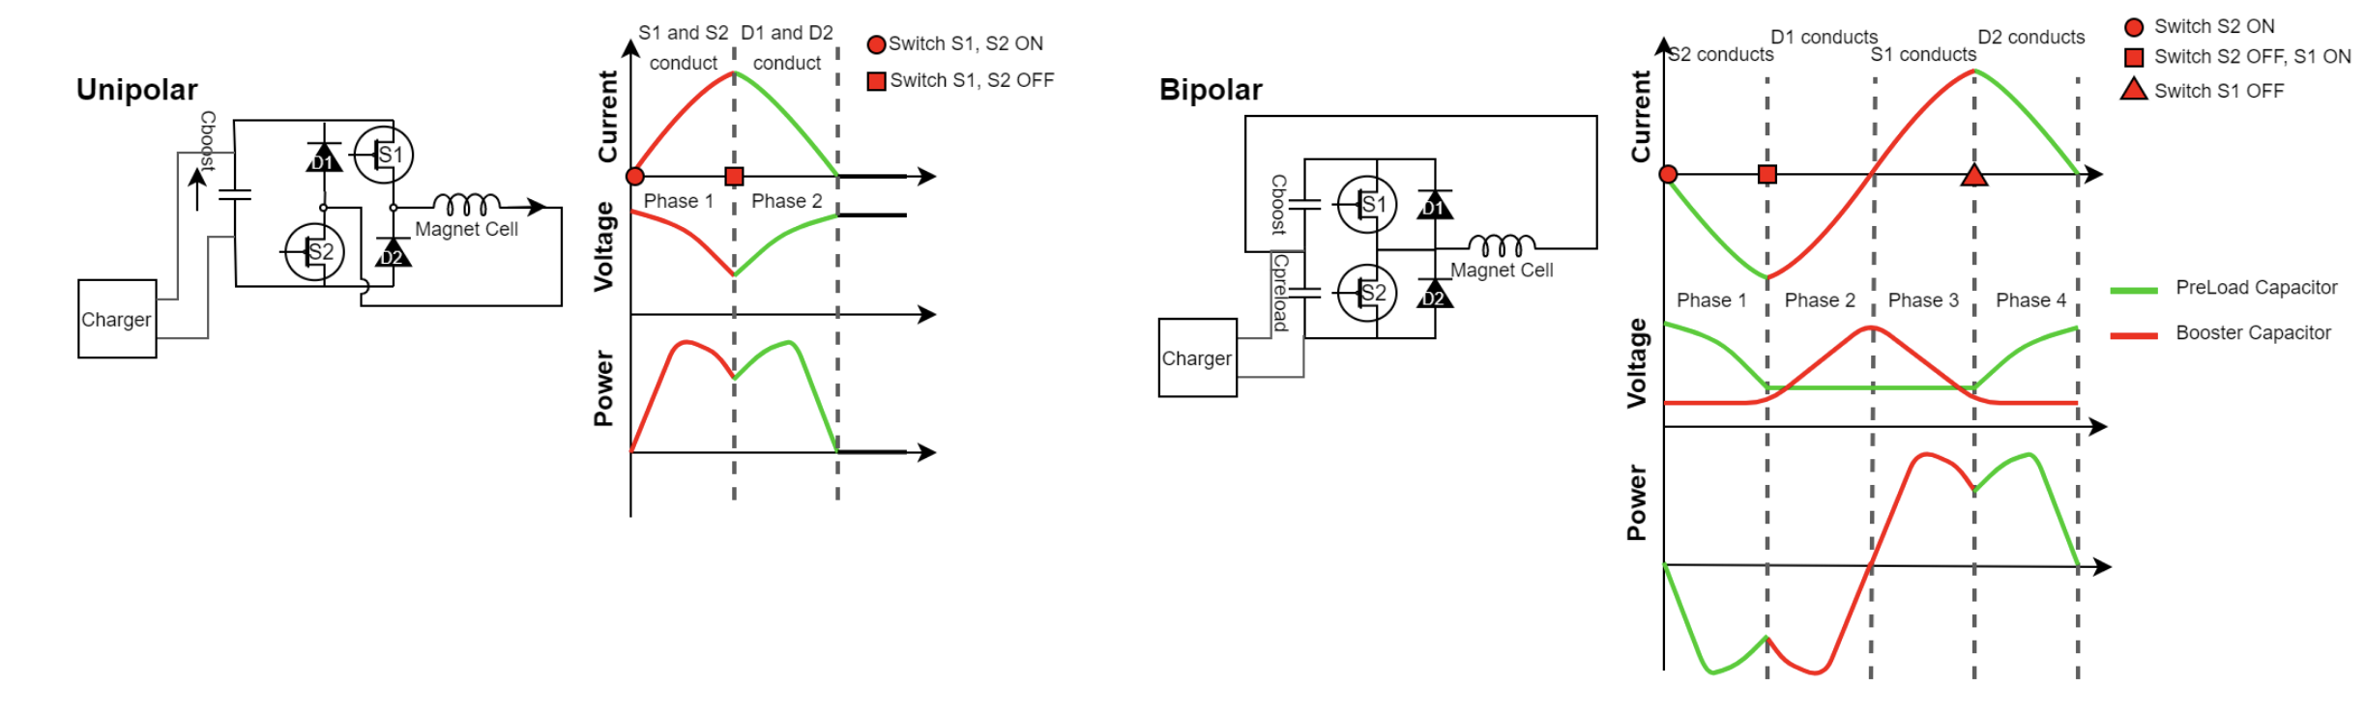
Fast-ramping RCD Dipoles
Challenge:
Fast ramping normal magnets (1-10 ms) with efficient energy recovery in power converter (200 MJ stored in magnets)
SUPS074
WEPB029
Achieved:
Conceptual design of magnets and power converters
Optimised design together with RF
Power converters can switch sign of magnets without changing direction of voltage on capacitors
RCS | E [J/m] | E_{iron} [J/m] | E_{copper} [J/m] | Loss [%] | P [MW]
SPS 1 | 5447 | 10 | 52 | 1.1 | 1.9
LHC 1 | 5678 | 9.2 | 80.6 | 1.6 | 12.8
LHC 2 | 5752 | 63.4 | 298 | 6.3/2 | 26.6
Key conclusions:
High recovery efficiency for RCSs (98-99%)
Ready for experimental optimization/models/protoypes
Energy in magnets, losses per cycle and total power at 5 Hz including cooling
Notes:
One of the challenges in the rapid ramp rate of the magnets is actually in the power converters and how to recover that energy. Below are some energy numbers for the CERN-based RCS design. This is a topic with strong synergies with the energy industry due to rapid energy fluctuations in the grid.
This work is done with SY-EPC, such as Fulvio Boatinni

Slide 16






Collider Ring
Challenges:
500 W/m loss, magnet strength, lattice design with beta 1.5-5 mm, 0.1% beam energy spread
Shielding (30-40 mm)
Achieved:
Magnet shielding design
Magnet conceptual designs
Cryogenics concept
Lattice reaches target beta-functions but not yet full target energy acceptance
First studies of mover system impact on beam
Cryogenic loads at different temperatures
Key conclusions:
Should improve energy acceptance should somewhat
OK with energy spread predicted in muon cooling
Mover system does not compromise beam in regular arcs
MOPM029
Notes:
Finally we arrive at the collider itself. The challenge here is our small beta, resulting in interaction regions needing strong chromatic correction sections for the provided energy spread. So we are iterating with a less-demanding beta-star so that we can move into dealing with energy acceptance and alignment and mover optics studies. Impedance and cryogenic studies have been performed.
This work was done by Christian Carli, Marion Vanwelde and Kyriakos in BE-ABP.

Slide 17




Collider Ring Magnets
Challenge:
High-field collider ring magnets with large aperture
Achieved:
New method developed to identify field limit, depending on technology, temperature, cost, aperture, considering current, stress and protection (quadrupoles, dipoles, combined function magnets)
Different conceptual dipole designs (block coil, cos-theta)
Combined function design ongoing
Key conclusions:
Dipoles appear feasible:
  NbTi at 4 K, 4.8 T, 16 cm aperture
  Nb3Sn at 4 K, 11 T, 16 cm aperture
  HTS at 20 K, 14 T, 14 cm aperture
Quad in dipole best combined solution
Experimental programme is now essential
Notes:
The 10 TeV collider magnets are the ones that would require the most development time. In fact the low-luminosity option of the 10 TeV collider is with reduced dipole fields.
This is where improvements in cooling would have a big effect, because it would allow for lower apertures therefore higher fields.
And this isn't just for the dipoles, but also the interaction point quadrupoles would require dedicated studies as well. So this is really as far as we can go for the collider magnet studies without any prototyping, as it is a purely hardware limitation.

Slide 18






Collective Effects
Goal:
Identify collective effects intensity bottlenecks
Achieved:
Initial studies for proton complex
Assessed impedances (beam screen and RF cavities) in RCSs and collider ring
  Studying counter-rotating beam impedance
Studies started on muon cooling
WEPM095
Key conclusions:
Impedances in RCSs and collider ring can be taken care of by design
Beam-beam can be handled by 20 turn feedback
Resistive wall in muon cooling is OK
Further key detailed studies: beam loading, longitudinal and transverse space charge in 6D cooling, impedance of cooling absorbers
Notes:
We have a healthy collective effects community in Be-ABP-CEI with Elias Metral and David Amorim, who have been very productive in assessing the proton driver space-charge and the accelerator RCS and the collider impedances. Most of the conclusions have been positive and have adjusted the beampipe designs. However collective effects in cooling is a whole new can of worms, particularly considering the high intensity and the reducing emittance at low energies.
So beam loading may indeed be the limiting intensity factor of the facility. The space-charge will affect the performance of the existing lattice designs, which needs to be quantified, and most importantly is collective effects and impedance within absorbers. So now we have a strong team which will grow by two members in October.

Slide 19

Site Specific Designs
Started studies for concrete site at CERN and Fermilab, looks very promising
CERN:
One RCS in SPS and two in LHC
Construct facility on CERN land
Adjusted parameters (3.2 and 7.6 TeV, 10 TeV maybe possible)
Fermilab:
One RCS in Tevatron tunnel,
three RCS in one site-filler tunnel
Notes:
This is the bit I am excited to show! With CERN Civil Engineers SCE-SAM (John Osbourne and Edward MacTavish), we would start with the existing LINAC4, add the Superconducting Proton LINAC to 5 GeV, transport to the Prevessin site, then add the accumulator and compressor ring right before the target which would be semi-underground. Cooling goes up for a kilometer, and we use the RLAs to naturally head back down towards the SPS again where we have our first RCS, normal conducting. Then either one or two RCS stacked in the LHC ring to get to either 3.2 or 7.6 TeV, and then inject into a new 10 km collider ring, where the experimental caverns are on existing CERN-owned land.
This means we would not need to buy any more land.
Note on the 7.6 TeV, there is nothing magical about 10 TeV, but that energy should be ‘as high as possible’ – would need to check no significant physics reduction.

Slide 20



Cost and Power Scale
Design of many collider areas/components has progressed
but uncertainties remain
No overall optimisation
HTS cost model
Power estimate based on conceptual designs and scaling from know components, e.g.
Simulations of fast-ramping magnets and power converter
Detailed scaling for RCS cavities
Notes:
This is a political slide, so I feel like I can't say too much about this.
We have collected the aforementioned design into a preliminary costing range, however without the R&D available, it is hard to know how much many of these systems cost. But order of magnitude, 12 BCHF for the 3 TeV and 16 B CHF for the 7.6 TeV at CERN, which is cheaper than the Greenfield design of 19 BCHF.
The power values we have a bit more clearer estimate of.

Slide 21

Timeline and R&D Programme Proposal
Decision on demonstrator
Initial final demonstrator
Timeline is driven by R&D
Most ambitious example to define R&D programme priorities
Muon collider next flagship after HL-LHC
Other options
In Europe after a higgs factory
In the US to become leader at the energy frontier
R&D timeline drivers
Superconducting magnets
  Collider ring with no HTS dipoles for first stage
Muon cooling demonstration
  RF cavities, solenoids, absorbers, integration, demonstration with beam
Notes:
So! Our ESPPU input highlights our 10 year R&D plan, initiating from the end of the ESPPU process. We would need another year or so to conclude the remaining 25% of our 2022 roadmap, and then we begin the technology R&D and begin the demonstration programme, should we get the green-light from 2028
This is a technically-limited timeline, meaning limited only by technology, primarily the superconducting magnets and the muon cooling demonstrator. We forsee that a successful demonstration would result in a further five years for finalising and optimising designs given the information from the prototypes, where we begin digging from 2040, and producing and installing the required beamline for 10 years, until a beginning run from 2050. If so this could be aligned with HL-LHC so that the muon collider is the next CERN flagship.
We haven’t factored other projects, such as an alternative precision-Higgs factory.

Slide 22


R&D Plan Deliverables and Resources
Notes:
This is a summary for the R&D plan. Of the main technologies, there are eight magnet technologies, four RF technologies, four muon cooling technologies and four miscellaneous, including a start-to-end facility simulation. In total this comes up to around 300 MCHF and 1800 FTEy for the accelerator. Plus 20 MCHF material, 900 FTEy for the Detector.
The numbers represent the year after the greenlight of the R&D plan.

Slide 23



Muon Cooling Demonstrator
Challenge:
Demonstrate muon cooling technology in stages
Critical for timeline
Achieved:
Defined the scope and concept, made initial cost estimate, investigated three promising locations at CERN
Staged timeline to implement demonstrator
SLAC is moving forward building a 3/1.3 GHz test stand
MOPS115
MOPS023
MOPS143
Key conclusions:
Installation of demonstrator at CERN appears possible with limited cost
Fermilab has approved a study
RF test stands are critical and urgent
Consistent with implementation timeline
R&D plan
Project
preparation
Construction
Notes:
Now what of the demonstrator itself? It is critical that we start by establishing we can produce the RF cavities, and can build a one-cell prototype. Now the best way to integrate the cell is within a cryomodule, and due to the forces between solenoids, it is easiest to produce five-cells to make a full within a module. We then want to test this five-cell module in beam-conditions. After a few years of study at CERN from Roberto, Javier in BE-EA, and Paul at ICL, it is clear there are several candidates, one being the TT7 line from the proton synchrotron, and the other being the CTF3 facility (ensuring continued operation from CLEAR).
The demonstrator would run with an nTOF like beam, which the PS can already provide, and there is already a tunnel from the PS to CTF3, which was used during the LEP injection days. So the only thing to do is include a kicker magnet, where the long-shutdown is consistent with our implementation timeline.

Slide 24










Magnets
Achieved:
Systematic dipole/solenoid performance prediction (LTS and HTS)
  Aperture, field, cost, stress, loadline, protection, …
HTS solenoid designs (6D cooling, final cooling, target)
Normal-conducting fast-pulsed dipoles (HTS as alternative)
Technically limited R&D timeline developed
MuCol HTS conductor
Operating current: 61 kA
Did adjust collider ring field
HTS final cooling solenoid mechanical design
REBCO, 20 K
First HTS winding tests
Target HTS solenoid
Key conclusions:
Design work is basically done
Opportunity to ramp up effort (engineering designs, building models, …)
With sufficient resources HTS solenoids and Nb₃Sn dipoles could be ready for decision in 10-15 years, consistent with implementation timeline
HTS dipoles likely take longer
HTS pancakes 4 mm tape
Normal-conducting RCS pulsed magnets
24
Notes:
And our magnet R&D! We would like to predict the performance for both LTS and HTS for solenoids and dipoles, to feed into the system simulations.

Slide 25








Way Forward
Continue to execute the Design Study
Defined R&D plan, with deliverables and resources estimates for the next 10 years
Identify resources, sharing of work between partners
Synergy with other particle physics and accelerators
Muons, neutrinos, …
Strong synergy with societal applications exist
HTS magnets for fusion reactors, wind power generators, motors, material science, health applications
Power converter
RF in magnetic field can be relevant for fusion
…
Design of 10 MW HTS wind generator
Examples:
Collaboration on target solenoid/fusion with F4P, ERUOFusion, GaussFusion, ENI
Common EU request with Infineon for power converter
Early career experts are very motivated by the required and possible innovations
Notes:
Regardless of anything, we will continue our path from the 2022 roadmap, as there is still plenty of work to be done. We have defined our plan for the next 10 years, and hopefully we can spread the resources with other collaborations and groups. In particular we would like to increase our industry synergies, including with Infineon for the RCS power converters, and with fusion technology companies for our solenoid technologies.

Slide 26
Conclusion
Muon collider has a compelling physics case
R&D progress is increasing confidence that the collider is a unique, sustainable path to the future
Much improved design, no showstopper identified, but more work to be done
Need to ramp up the momentum globally
Full start to end modelling
Actual hardware development
HTS solenoid and other magnet development
Preparation of the muon cooling demonstrator
Strong synergies with other fields ranging from particle physics to societal application exist
Fusion reactors
High-field solenoids
Power converter
…
Many thanks to the collaboration for all the work
Our web page: http://muoncollider.web.cern.ch
If you want to join: muon.collider.secretariat@cern.ch
Notes:
The more we look into a muon collider, the more compelling the physics case looks, especially at 10 TeV.
And the more we look into the accelerator design, the more confident we are that, whilst it is unique, it is a feasible concept, and almost seems to be the inevitable path to the future of the high-energy regime.
And the amount of progress we have made with the resources available has yielded very high efficiency. But it is still just a dream unless we complete the full modelling of the complex, unless we start to develop the hardware to continue to find showstoppers, and to verify the cooling technologies.
Not only that but the path to the muon collider is so innovative that it is already showing societal benefits from what little hardware we are beginning to consider.
It’s fun work, and we are a very proactive community, so if you want to get involved, or if you have the capacity to contribute students, fellow or yourself, then let’s chat, you can contact our secretariat and I can inform you of our regular meetings.

Slide 27
Reserve

Slide 28
R&D Plan Deliverables and Resources
Totals:
Duration 10 years
Accelerator: 300 MCHF material, 1800 FTEy
Detector: 20 MCHF material, 900 FTEy

Slide 29

Magnet R&D Impact
L. Bottura

Slide 30
Practical Examples
Fusion for Energy (ITER EU Domestic Agency)
  Framework agreement and first addendum in final negotiation
  Contribution to the design of the HTS target solenoid, relevant to the central solenoid of DTT
EUROFusion (next step European fusion reactor)
  Framework agreement signed in 2023, first addendum signed in 2024
  Contribution to the design of the HTS target solenoid, relevant to the magnets of a Volumetric Neutron Source proposed as next step in the European fusion strategy
Gauss Fusion (one of the leading EU fusion start-ups)
  Consultancy agreement signed in 2023
  CERN contribution to the design of the LTS/HTS GIGA stellarator magnets, based on advances in the HTS target solenoid
ENI (oil and gas energy giant)
  Framework agreement and first addendum signed in 2024
  Collaboration on the conceptual design and project proposal for the CERN construction of a large bore HTS solenoid (20@20 model coil) relevant to the muon collider and fusion
IFAST-2 proposal to INFRA-2025-TECH-01-02 (CERN, INFINEON, PSI)
  Proposal of fast pulsed power cell + magnet system sent to IFAST-2 coordination for ranking at TIARA
  Industrial interest in rapidly pulsed and large energy/power supplies
L. Bottura

Slide 31
European Accelerator R&D Roadmap
Reviews in Europe and the US found muon collider promising
Requires important innovation
European Strategy for Particle Physics Update (ESPPU) supported muon collider R&D in 2020
CERN Council charged Laboratory Directors Group (LDG) to develop Accelerator R&D Roadmap
Directors of institutes, e.g. INFN Frascati, PSI, DESY, RAL, CERN, …
LDG formed five panels, one on Muon Collider
Muon Collider panel developed an R&D Roadmap with the help of the global community until end of 2021
31
http://arxiv.org/abs/2201.07895

Slide 32
Muon Collider Roadmap CT
Protons produce pions which decay into muons which are captured
Short, intense proton bunch
Ionisation cooling of muon in matter
Acceleration to collision energy
Collision
- Proton driver
bunch compression
- Graphite target
- Target solenoid
- Muon cooling design
- 6D cooling solenoids
- 6D cooling RF cavities
- Final cooling solenoids
- Pulsed magnets and
power converters
- RCS RF system
Identified and prioritized with community
Other areas need now also to be addressed
(some work started)
- Collider ring dipoles
- Final focus quadrupoles
- Machine-detector interface
32

Slide 33
MuCol Timeline
LDG anticipated input to next ESPPU by 2026
The ESPPU has been advanced to early 2025
2023
2024
2025
2026
2027
ESPPU submission
ESPPU recommendation

Slide 34
Muon Cooling Challenges
High field solenoids minimise beta-function and impact of multiple scattering
Energy loss = cooling
Multiple scattering = heating
34

Slide 35
ESPPU Submission March 2025
Collaboration produced ESPPU input:
Short, ten-page report (10p)
Addendum to answers specific questions from ESPPU (18p)
Back-up document (406p, 450 signatories)
  Assessment of collider status based on progress of R&D
  R&D Plan
  Final polishing is ongoing, you Urgently sign up to support

Slide 36


