Slide 1
MQXFB10 Coils: Coil fabrication, manufacturing data and NC
N. Lusa, S. Izquierdo Bermudez, L. Baudin, A. Vieitez Suarez, P. M. Quassolo, L. Grand-Clement, R. Berthet
On behalf of MQXFB Coil Fabrication and QA team
https://indico.cern.ch/event/1549016/
21/05/2025

Slide 2
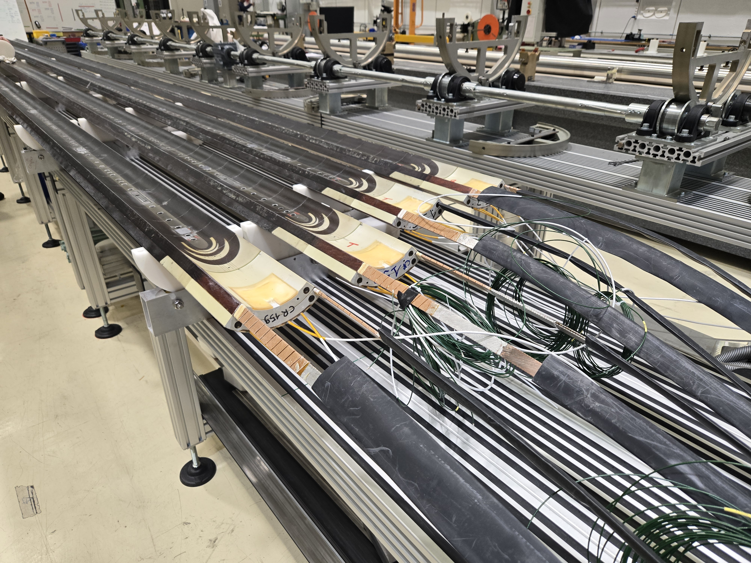
Coils for MQXFB10
Virgin coils available at the time of assembling MQXFB10
Coil 109: Spare coil of MQXFBP1 (no b₆ correction)
Coil 114: Quarantined, due to the electrical insulation issue QH to coil
Coil 116: Quarantined, due to conductor damage during handling
Coil 122: Conform previous generation coil
Coils 156-157-158-159: proposal for MQXFB10

Slide 3
Outline
Manufacturing data
Non-conformities
Conclusion/Proposal

Slide 4
Outline
Manufacturing data
Analysis of MQXFBP2 coils and comparison improvements with respect to MQXFBP1 available here
Analysis of MQXFBP3 coils and comparison improvements with respect to MQXFBP2 available here
Analysis of MQXFB02 coils and comparison improvements with respect to MQXFBP3 available here
Analysis of MQXFB03 coils and comparison improvements with respect to MQXFB02 available here
Coil fabrication data and non-conformities of MQXFB04 coils available here
Coil fabrication data and non-conformities of MQXFB05 coils available here
Coil fabrication data and non-conformities of MQXFB06 coils available here
Coil fabrication data and non-conformities of MQXFB07 coils available here
Coil fabrication data and non-conformities of MQXFB08 coils available here
Coil fabrication data and non-conformities of MQXFB09 coils available here
Non-conformities
Conclusion/Proposal

Slide 5
Cable insulation thickness
Target insulation thickness is 145 (+0 µm/-10 µm)
Fine tuning insulation thickness

Slide 6
Reaction and impregnation fixture closure
REACTION
The torque required to close the fixture is directly linked to the number of heating cycle the bolts were subjected to
Nominal torque required: 160 Nm
For B10 coils nominal torque was required (no need to further increase the torque)
IMPREGNATION
Very reproducible from coil to coil
OL impregnation closure: 60 Nm
IL impregnation closure: 120 Nm (never needed more)

Slide 7
Coil elongation during reaction fixture opening
Coil elongation during reaction fixture opening
Magnet | Coil # | CS [mm] | NCS [mm] | Total [mm] | Total/L_{m} | Fab. Line
B03 | CR128, 129, 130, 131 | 2.6 - 4.2 | 3.1 - 4.8 | 5.7 - 8.7 | 0.8 - 1.2 ‰ | CERN
B04 | CR132, 133, 134, 135 | 2.1 - 4.3 | 2.9 - 3.8 | 5.1 - 8.0 | 0.7 - 1.1 ‰
B05 | CR136, 137, 139, 140 | 2.0 - 3.4 | 2.1 - 3.6 | 4.1 - 7.0 | 0.6 - 1.0 ‰
B06 | CR141, 142, 143, 144 | 2.9 - 3.4 | 2.8 - 3.7 | 5.8 - 6.6 | 0.8 - 0.9 ‰
B07 | CR138, 145, 146, 147 | 2.0 - 3.4 | 2.6 - 3.5 | 4.6 - 6.9 | 0.6 - 1.0 ‰
B08 | CR148, 149, 150, 151 | 1.6 - 2.8 | 2.0 - 2.9 | 3.6 - 5.6 | 0.5 - 0.8 ‰
B09 | CR152, 153, 154, 155 | 2.3 - 2.9 | 2.3 - 3.3 | 4.6 - 6.2 | 0.6 - 0.9 ‰
B10 (proposal) | CR156 | 2.4 | 2.9 | 5.3 | 0.7 ‰
 | CR157 | 2.3 | 2.2 | 4.5 | 0.6 ‰
 | CR158 | 2.7 | 3.5 | 6.2 | 0.9 ‰
 | CR159 | 2 | 2.7 | 4.7 | 0.6 ‰
 | AUP 146 -147 | 2.9 - 3.6 | 0.6 - 0.4 | 3.6 - 4 | 0.8 ‰ - 0.9 ‰ | FNAL
 | AUP 237 -238 | 1.6 - 2.1 | 1.6 - 2.1 | 3.1 - 4.1 | 0.7 ‰ - 1 ‰ | BNL

Slide 8
Pole gaps
In new generation MQXFB coils pole gaps in the middle of the coil are not closed after reaction, as it is the case for AUP coils
RE
LE
Pole gap
1.5 mm
Pole gap
1.1 mm
Pole gap
1.2 mm

Slide 9
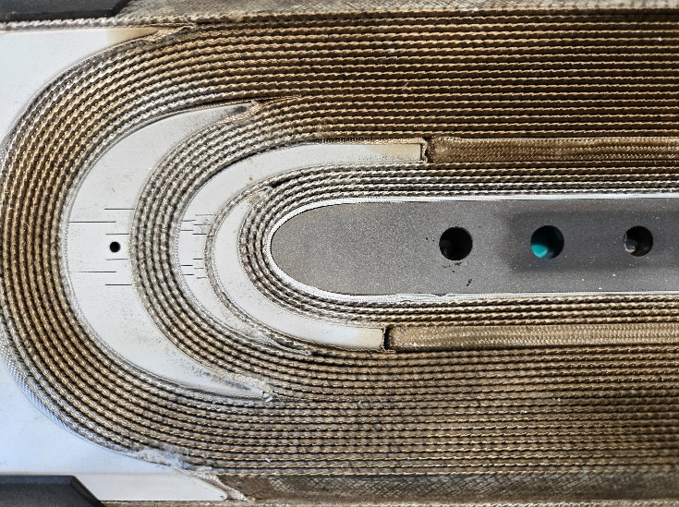
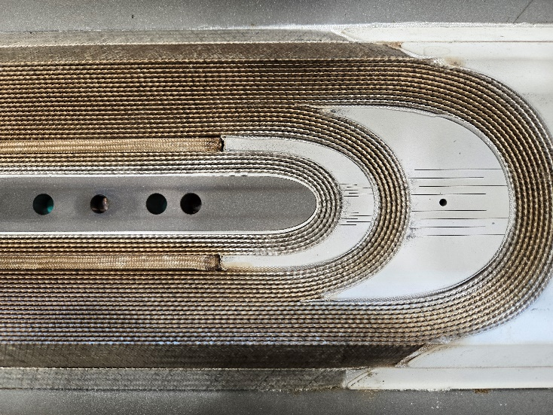
End spacers-copper wedges gaps
Starting from coil CR152, a new measurement is performed prior to prepare the IL of the reacted coil for impregnation: the gap between the copper wedges and the end spacers
The measurement is performed using a digital caliper and the result is the average of 3 measurements
LE OLJ
RE OLJ
LE LJ
RE LJ

Slide 10
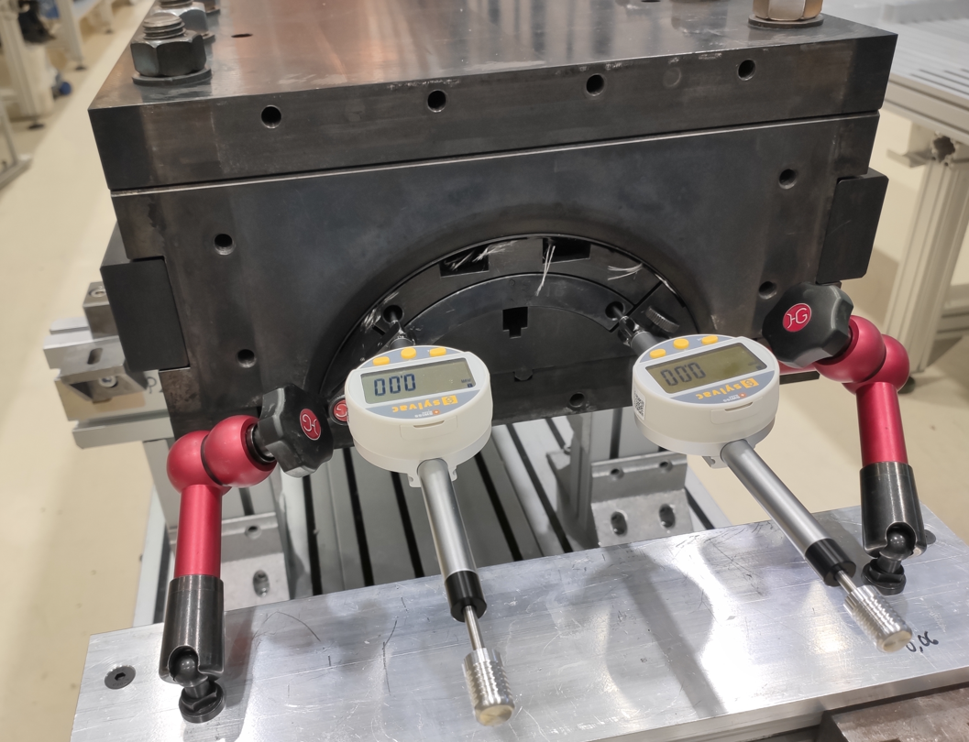
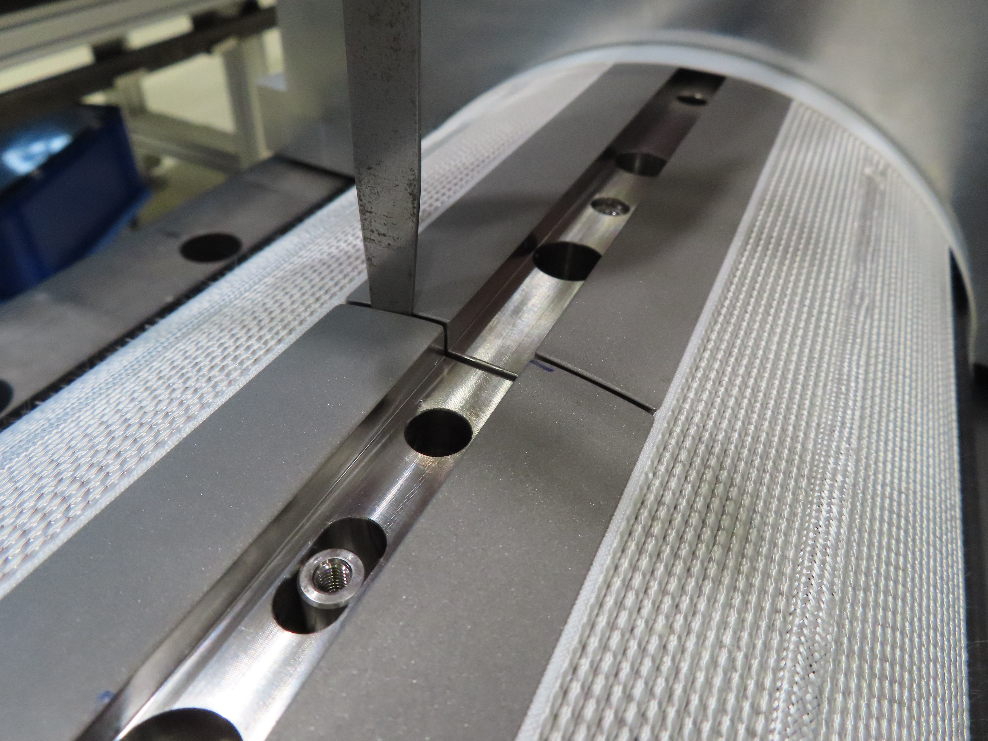
Pole gaps vs Coil elongation
The reacted coil gradually elongates on both ends during the mold opening and pole gap increases (indico 1220226)
From coil CR150 pole increased: 2.46 mm/m → 2.69 mm/m
Coil # | Total /L_{m} [‰] | Manufacturing line
CR127 | 1.50 | CERN w/ binder
CR128 – CR159 | 0.80 | CERN new gen. coils
AUP 146 – 147 | 0.89 | FNAL
AUP 237 – 238 | 0.88 | BNL

Slide 11
Coil hump after reaction

Slide 12
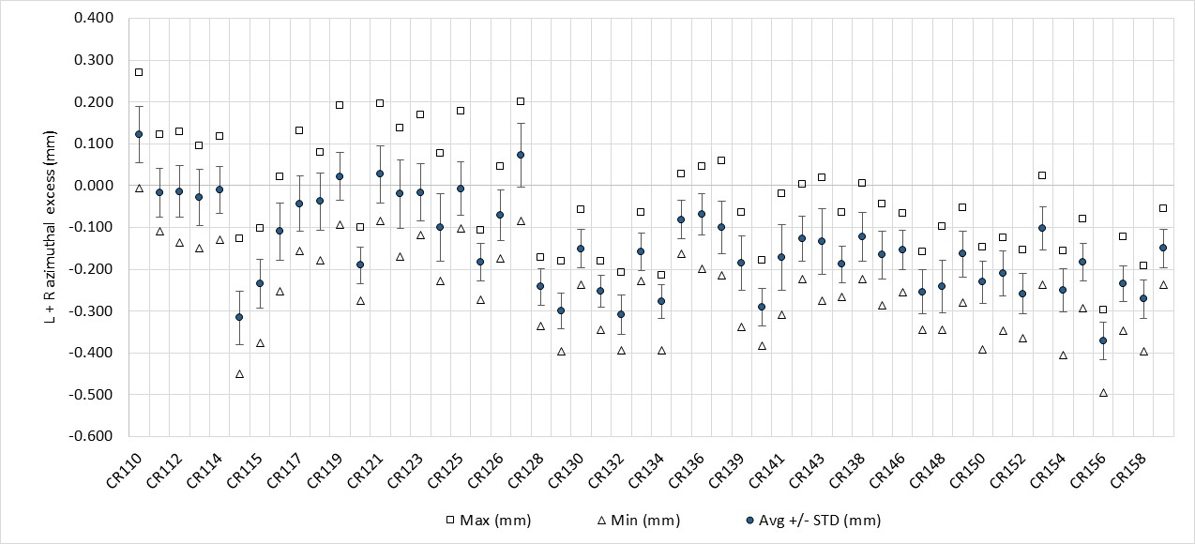
Impregnated coil geometry (Faro arm) - L+R

Slide 13
Impregnated coil geometry (Faro arm) - L+R
The coils do not have ‘belly’

Slide 14
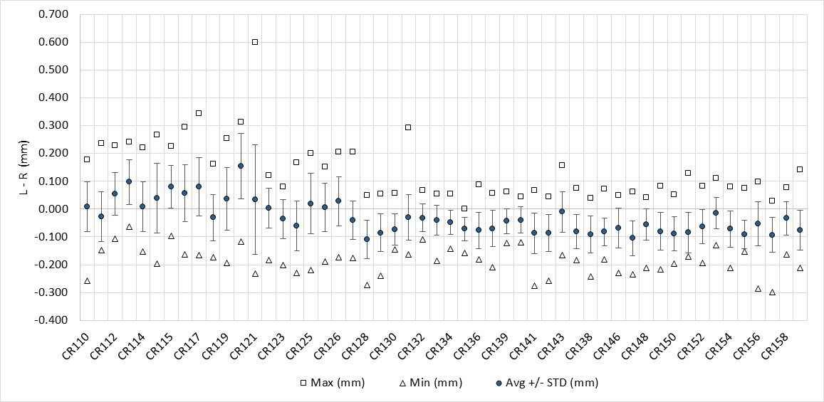
Impregnated coil geometry (Faro arm) – L-R
In terms of asymmetry, within specification (<0.3 mm) → no need of pole key machining

Slide 15
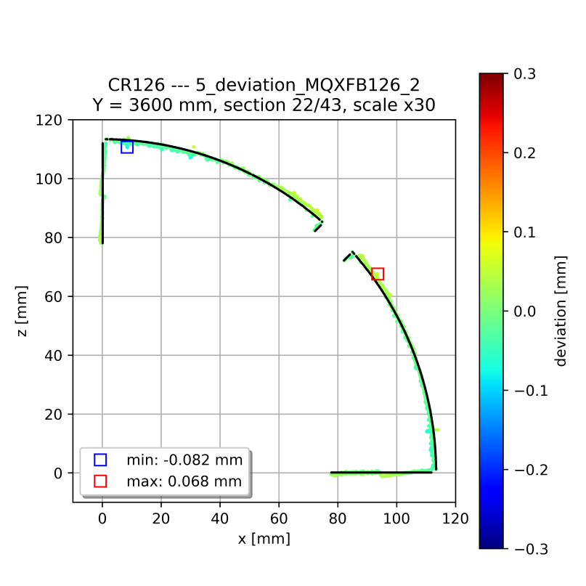
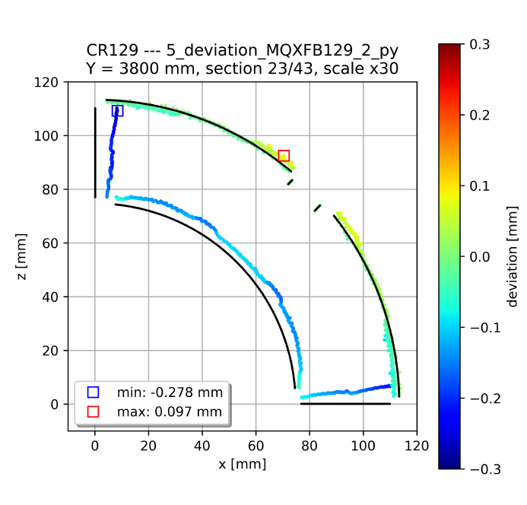
Impregnated coil geometry (Faro arm)
Systematic behavior in terms of coil shape to previous coils without binder: mid-plane has a little ‘wedge’ (the coil covers 89.6 degrees instead of 90 degrees)
Based on FEM we expect ≈ 15 MPa increase in the mid-plane stress (inner edge) under conservative assumptions, confirmed with a mock-up test, see https://indico.cern.ch/event/1260584/
Typical cross-section standard coil
Typical cross-section coil without binder in the OL

Slide 16
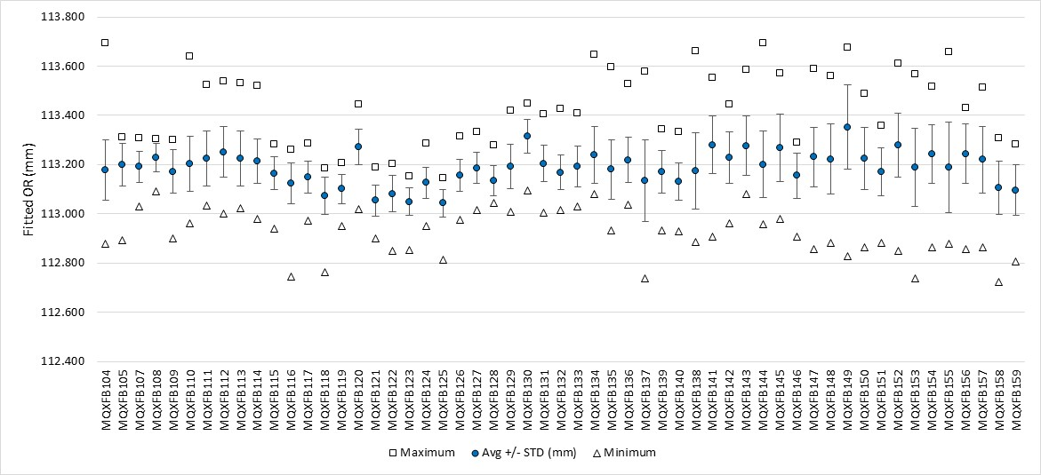
Impregnated coil geometry (Faro arm) - OR

Slide 17
Final coil length
B03
Pole gap change: 1.5 mm → 1.1 mm
Pole gap change:
1.1 mm → 1.2 mm
B04
B09
B05
B07
B08
B06
B10 proposal

Slide 18
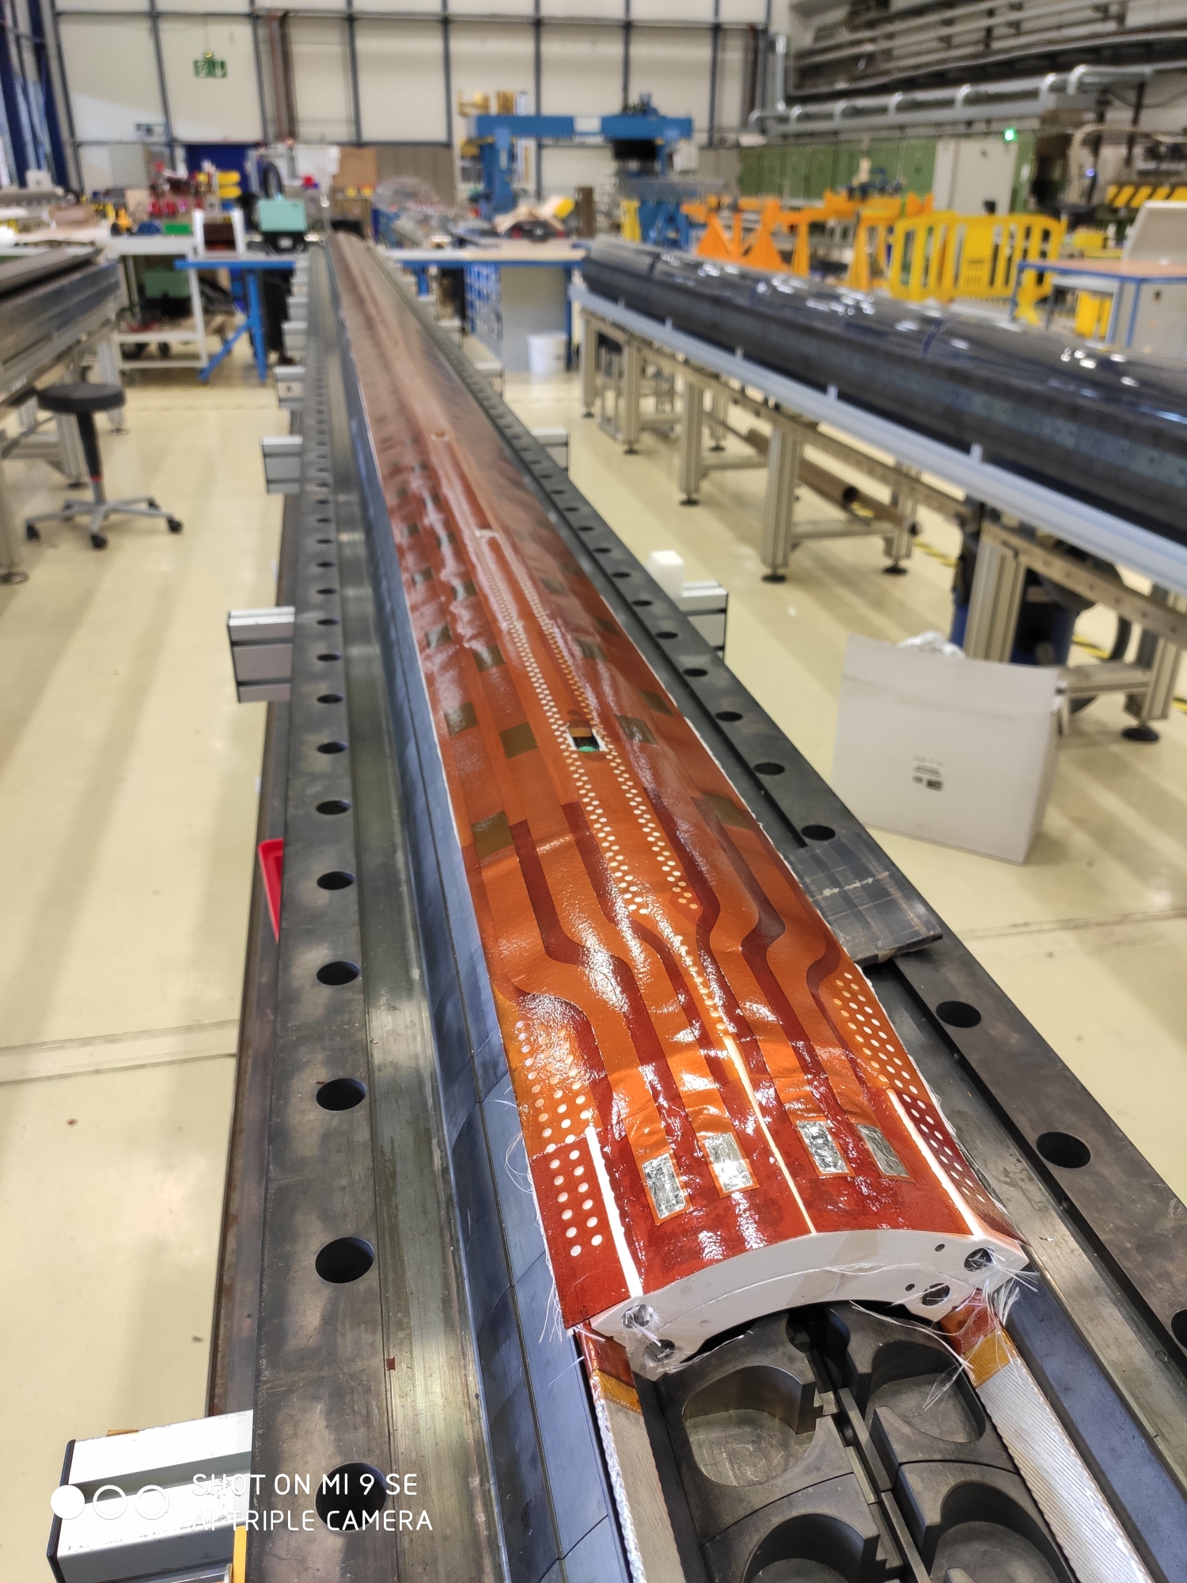
Dielectric strength
Coil to pole
Since coil 114, coil to pole insulation always above the minimum desired thanks to the reduction of ceramic binder and the use of heat cleaned fiber glass around the pole
QH to coil
From coil 126, ‘mini-swap’ quench heaters with improved fabrication process and higher qualification test voltages (see EDMS 2646046)
From production performance monitoring plots EDMS 2374351

Slide 19
Dielectric strength

Slide 20
Outline
Manufacturing data
Non-conformities
Conclusion/Proposal

Slide 21
Analysis of non-conformities
CR156 | 3224080 | Popped strands during outer layer winding | Non-critical level 2
 | 2884016 | Dwell3 homogeneity out of range | Non-critical level 1
 | 3263439 | Impregnation defect repairs | Non-critical level 2
CR157 | 3225796 | Popped strands during cable insulation inspection | Non-critical level 2
 | 3232027 | Popped strands during outer layer winding | Non-critical level 2
 | 3244118 | Chiller error during cool-down | Non-critical level 2
 | 2884016 | Dwell3 homogeneity out of range | Non-critical level 1
CR159 | 3225796 | Popped strands during cable insulation inspection | Non-critical level 2
 | 2884016 | Dwell3 homogeneity out of range | Non-critical level 1
 | 3297673 | Impregnation defect repairs | Non-critical level 2
Very minor, not described in further detail in the slides
Described in detail in the next slides
Series of minor nonconformities in heat treatment, see next slides

Slide 22
RHT NCR – dwell1
The duration of dwell1 is within specification for the 4 coils (52 h max. allowed):
CR156: 50.8 h
CR157: 50.8 h
CR158: 51.4 h
CR159: 52 h
Temperature homogeneity within specification as well
Dwell1 duration reduced

Slide 23
RHT NCR – dwell2
The duration of dwell2 is within specification for the 4 coils (52 h max. allowed):
CR156: 51.76 h
CR157: 51.96 h
CR158: 50.22 h
CR159: 50.28 h
Temperature homogeneity within specification as well
Dwell2 duration reduced

Slide 24
RHT NCR – dwell3
The duration of dwell3 is within specification for the 4 coils (52 h max. allowed)
Temperature homogeneity within specification for 1 out of 4 coils:
CR156: 3.4°C
CR157: 3.3°C
CR158: 2.9°C
CR159: 3.4°C
Spec. 3°C
Dwell3 duration reduced

Slide 25
CR156 (NCR 3224080) → Popped strand during OL winding
During the winding of the OL, a popped strand was detected on RE side turn 2 and put back in place
Coming back to RE side doing turn 3, we found out that the previous strand popped again
Popped strand partially set back in place without damaging the S2 insulation
A complete repair would have been risky without a certainty of not having this issue again
Remove the cable tension
Undo turn 3
Repair the popped strand with a deeper intervention
Based on that, it was decided to resume the winding with the partial repair

Slide 26
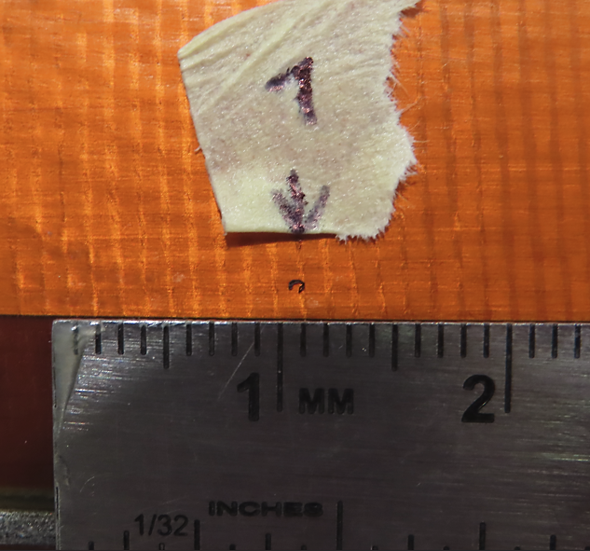
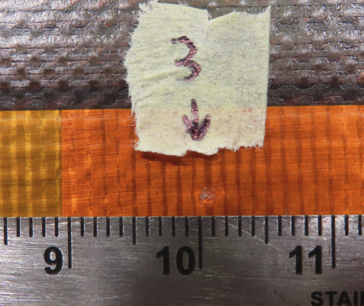
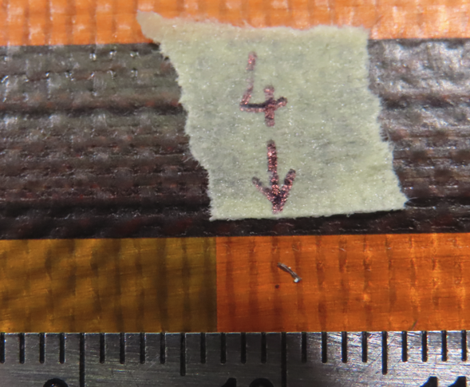
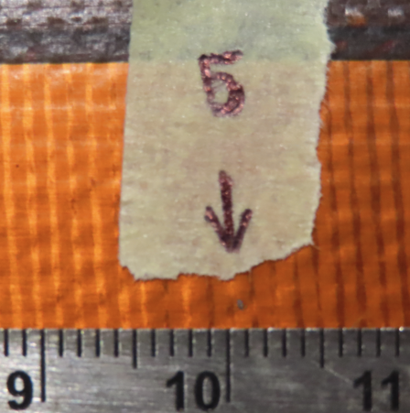
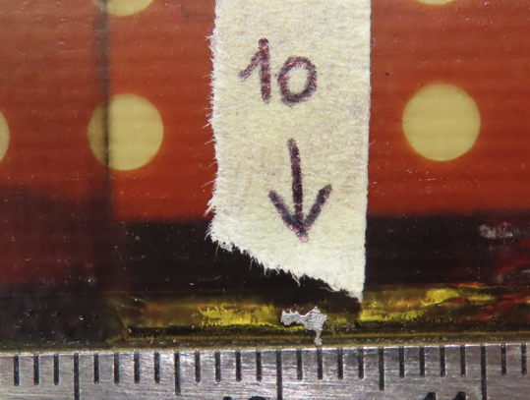
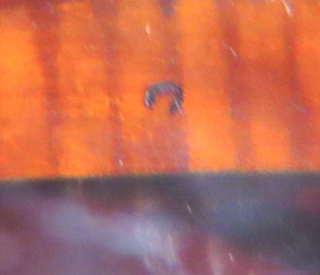
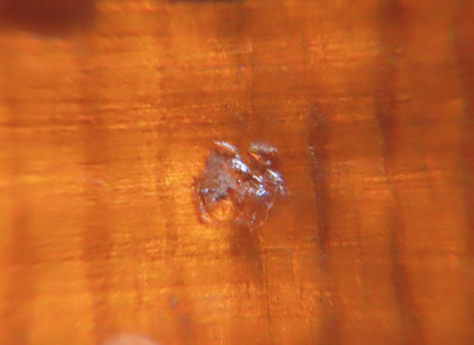
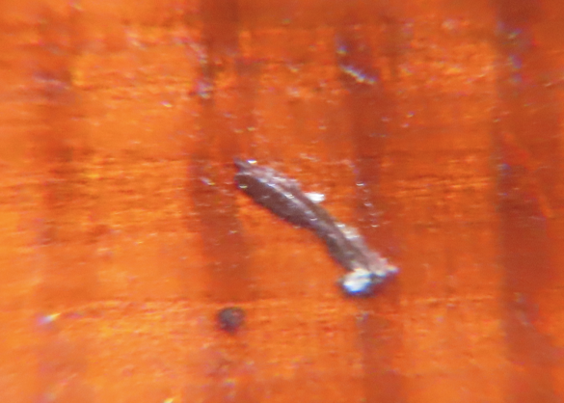
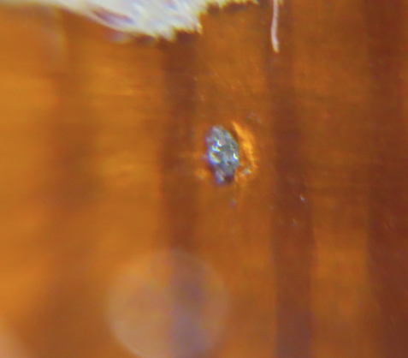
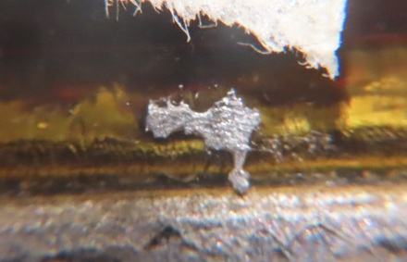
CR156 (NCR 3263439) → Impregnation defect repairs
The QA visual inspection of the OD of the coil after impregnation revealed several external particle trapped
Defetcs #1, 3, 4, 5 are very superficial and comes from the PFA coating of the radial filler
Defect #10 appears to be a drop of SnAg from the splice region

Slide 27
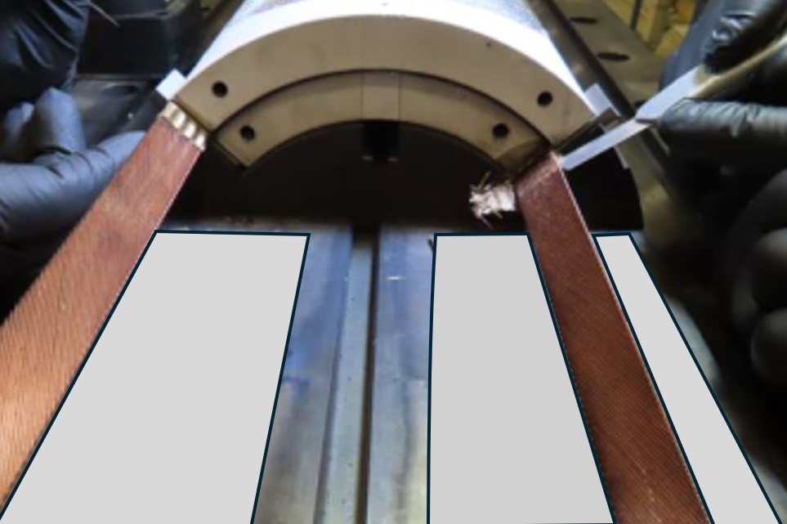
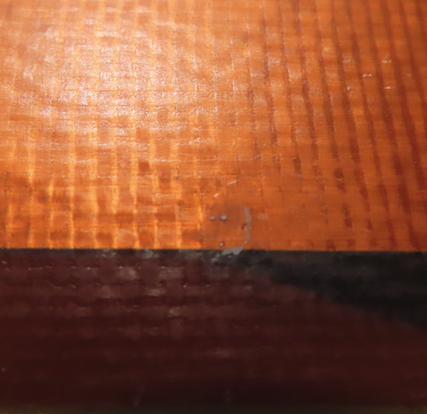
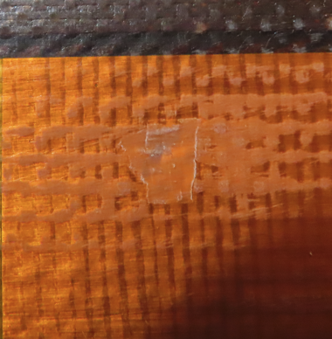
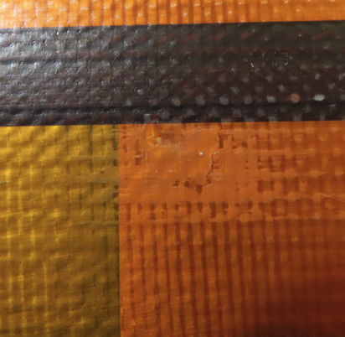
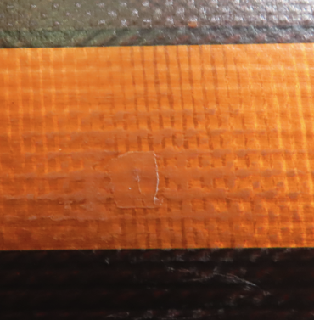
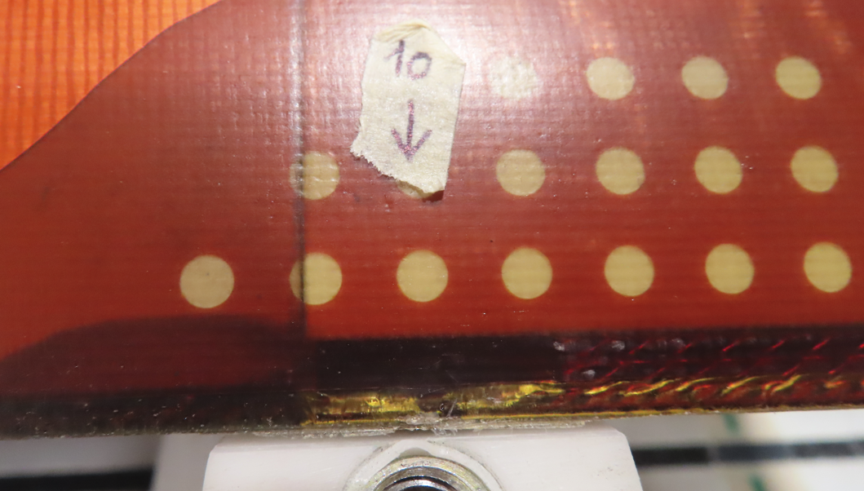
CR156 (NCR 3297673) → Impregnation defect repairs
Action plan:
Manual scrap the surface in correspondence of the defects to remove them
Restore the surface by locally applying epoxy
Validate the repairs via local Hi-pot tests
Improve the cleaniless of the splice area during splicing operation
Update the splicing procedure
Defect #1
Before installing the tools used to stabilize the leads, cover the threaded holes of the reaction baseplate with a Teflon tape
Defect #3
Defect #4
Defect #5
Defect #10

Slide 28
CR157 and CR159 (NCR 3225796) → Popped strands during cable insulation inspection
During the inspection before respooling several popped strands were detecetd by the team
From 0 to 100m, 45 popped strands detected (a major one at 14m)
From 100m to the end,17 popped strands
From 0 to 100m, 5 popped strands detected (a major one at 8m)
From 100m to 200m, about 60 popped strands
From 200m to the end, 3 popped strands
All the popped strands were set back in place using dedicated pliers, apart from the major one which is calculated to be in the winding leftover
Cause still under investigation but some weaknesses in the insulation and monitoring process have been identified (like the missing of a reliable and direct measuring device of the cable thickness before and after the braiding head)
CR157
CR159

Slide 29
CR157 (NCR 3232027) → Popped strand during OL winding
During the winding of the OL, 2 popped strands were detected and set back in place (turn 1 RE side and turn 19 LE side)
Another popped strand was detected in turn 13 once the following turn was almost completed
Popped strand partially set back in place without damaging the S2 insulation
A complete repair would have been risky without a certainty of not having this issue again
Remove the cable tension
Undo turn 3
Repair the popped strand with a deeper intervention
Based on that, it was decided to resume the winding with the partial repair

Slide 30
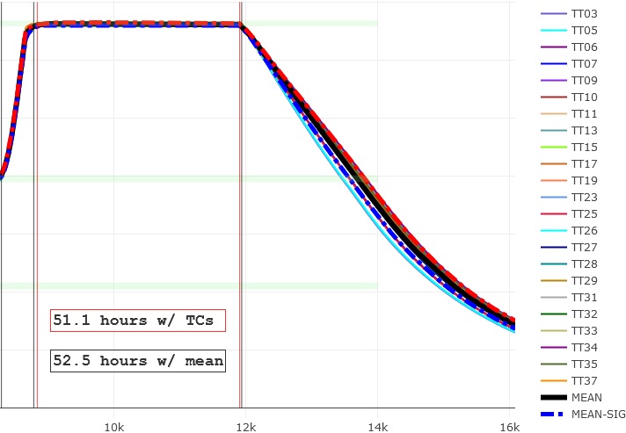
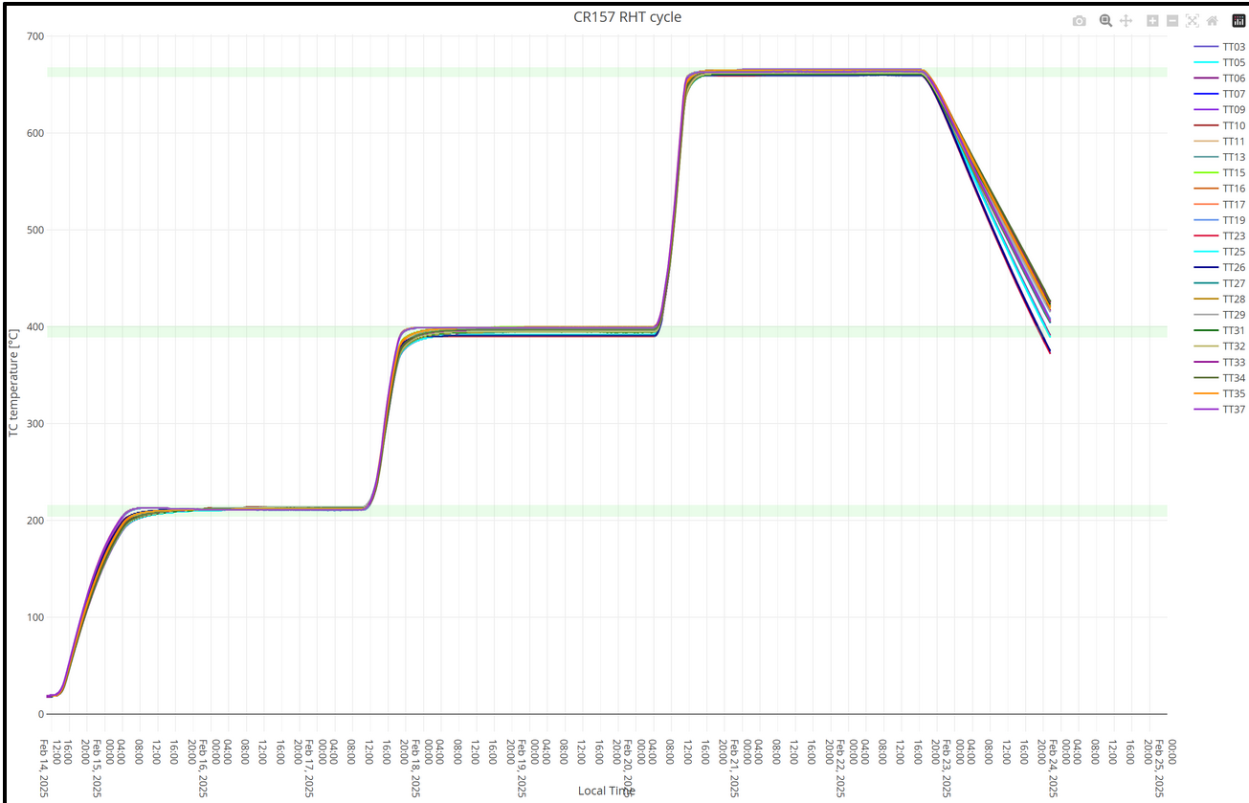
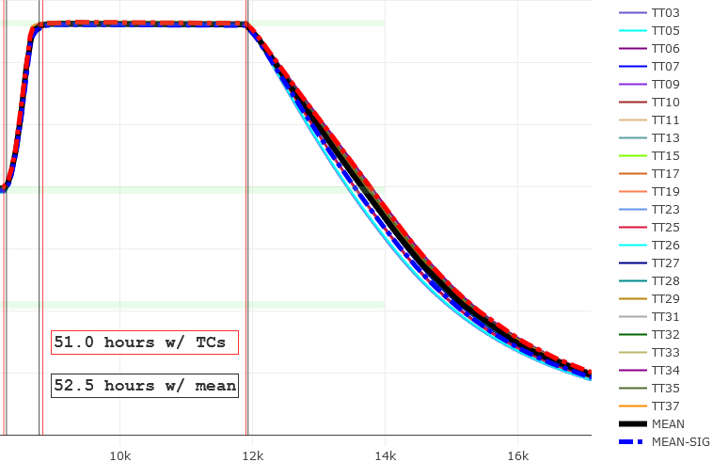
CR157 (NCR 3244118) → Chiller error during cool-down
During the cool-down at the end of the 3rd plateau, an error at the level of the chiller triggered the furnace in «flushing mode», meaning freewheel cool-down flushing Argon
The chiller stopped due to «low water level» and it required an on-site intervention to be refill
No impact at the level of the coil heat treatment nor on witness sample results
Cool-down on coil CR157
Cool-down on coil CR156

Slide 31
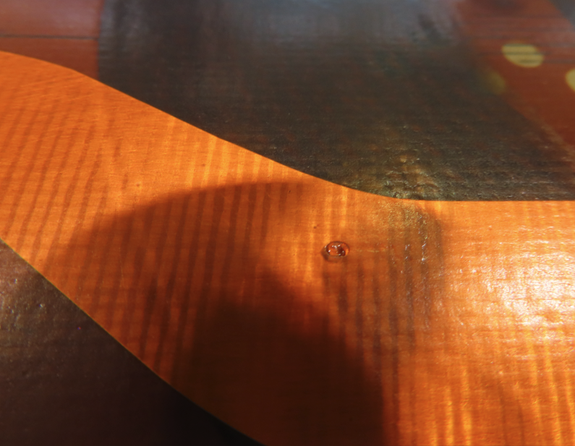
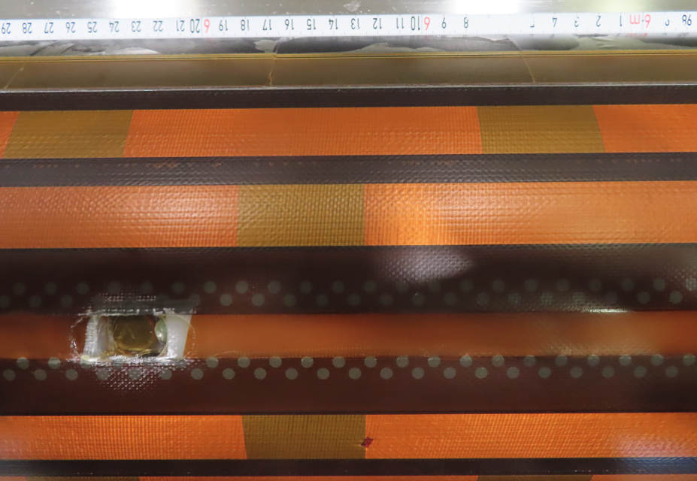
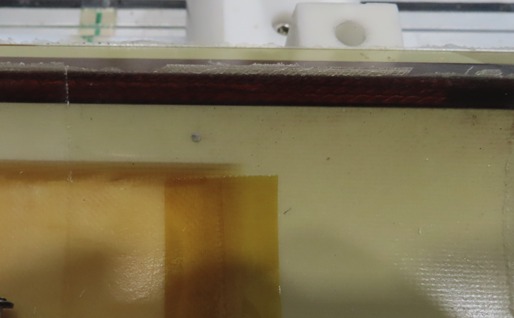
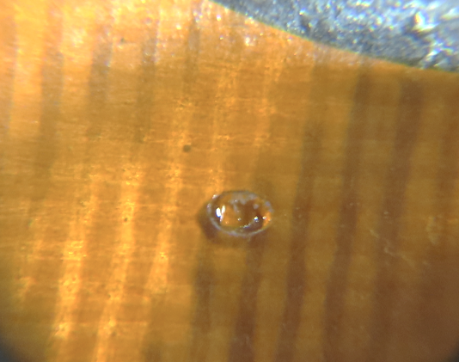
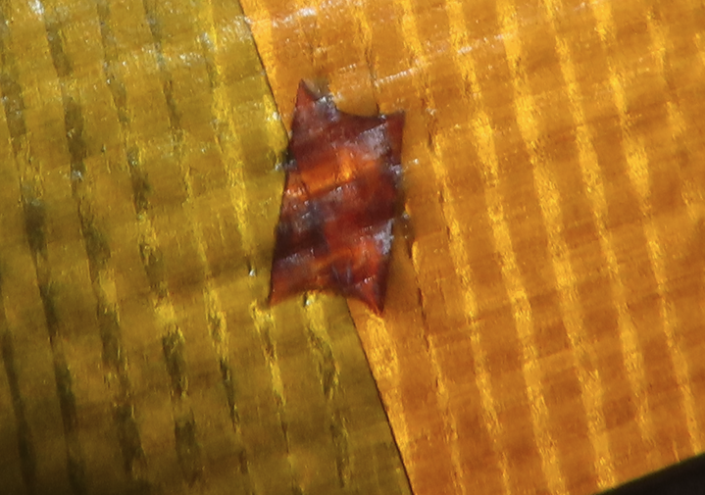
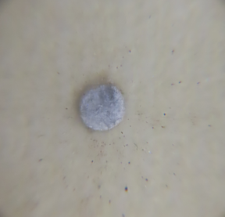
CR159 (NCR 3263439) → Impregnation defect repairs
The QA visual inspection of the OD of the coil after impregnation revealed few defect on both inner and outer layers
Defect #1
Defect #2
Defect #3

Slide 32
CR159 (NCR 3297673) → Impregnation defect repairs
Action plan:
Manual scrap the surface in correspondence of the defects to remove them
Restore the surface by locally applying epoxy
Validate the repairs via local Hi-pot tests
Improve the cleaniless of the threaded holes in the reaction baseplate
Update the preparation for reaction procedure

Slide 33
Outline
Manufacturing data
Non-conformities
Conclusion/Proposal

Slide 34
Conclusion/Proposal
Use CR156 - CR157 - CR158 - CR159 for MQXFB10 assembly
The coil instrumentation will begin tomorrow, and the magnet loading is planned for the last week of June

Slide 35
Thank you!

