Slide 1
CERN Fitness Club AGM – 28/05/2025
Agenda
Vote carried out by raised hand in person or in zoom (vote)
Elect “President du Séance” & minute taker (vote)
Quorum, 10% of current members = 54 people
  Total number members 2025 = 539
  The CERN Fitness Club has a data privacy notice which you all agree to when you register for our activities, which does not specify sharing personal data between members. In addition, we sought advice from the CERN specialists in this area (office for data protection:
  1. the publication (worldwide or internally among the members) of the Fitness Club members' personal data such as name and surname in order to verify the quorum of 10% of attendance doesn't seem proportionate or necessary. And attendance shall be verified by the President/secretariat of the session, that should have access to the list of members).
Approval minutes from 2024 AGM - (vote)
Proposed modification to statutes
President’s Annual Report
Treasurer’s Annual Report
Election Committee Members
Account auditor 2025
Equipment and Space
Questions/AOB?

Slide 2
CERN Fitness Club AGM – 28/05/2025
  Proxy votes submitted by Wed 28 May 12 midday CET:
Proxy given to | Count of Proxy given to
María Pérez Ornedo | 11
Misha Borodin | 1
Rachel Bray | 45
Sully Billingsley | 14
Grand Total | 71

Slide 3
Proposed modification to statutes
Article 4.2:
To be valid, the Assembly must be attended by at least 10% of the Annual members or represented by proxy.
Challenge to achieve quorum
  Short-term subscriptions (1 month)
  High-turn over of members
  Proposed update to the Statutes
  "The General Assembly may validly deliberate and make decisions regardless of the number of members present. Decisions shall be taken by a two-thirds (2/3) majority of the votes of members present."
  VOTE, approval of proposed update of statutes

Slide 4
President’s Report for year 2024
Fit-Boxing: (2023: 26) 2024: 6 (no activity)
General Fitness (Afro Caribbean, Bootcamp, Functional/Circuit Training, HIIT, PowHerLifting Zumba,): (2023: 168) 2024: 162
Pilates: (2o23: 47) 2024: 52
Powerlifting: (2023: 372) 2024: 377
Total number of members: (2023: 613) 2024: 597

Slide 5
President’s Report for year 2024
New Instructors
  Mel (PowHerLifing, circuits),
Powerlifting meet-ups
New GF equipment ordered (Oct 2024) May delivery
In memory of Andrey Loginov 670 $ donation to charity (Orphanage in Laos) transferred 2024
VOTE, approval of President’s Report for year 2024

Slide 6
Treasurer’s report 2024 – CHF Account
CHF
Opening balance CHF | 01.01.2024 | 60,787.27
Closing balance | 31.12.2024 | 101,640.73
debit | Debit | Credit
Withdrawal for cash instructor reimbursements | -27,000.00
Instructor Reimbursement | -25,000.00
Equipment | -8,848.23
Mini Atomiade Subsidy via SA | -2,595.00
Sundries | -2,334.10
Reimbursement L Rasmussen (mistaken payment) | -900.00
Thank-you dinner instructors & volunteers | -800.00
Orphanage LAOS | -670.00
Bu-jutsu reimbursement (mistaken payment) | -100.00
bank fees | -71.19
ATOMIADE SUBSIDY from SA |  | 2,595.00
Bujitsu subscription (error) |  | 100.00
Fit-Boxing |  | 400.26
General Fitness |  | 41,059.00
L Rasmussen mistaken payment |  | 900.00
loris reimbursement returned |  | 1,400.00
Pilates |  | 18,493.00
Powerlifting |  | 44,214.72
 | -68,318.52 | 109,161.98

Slide 7
Treasurer’s report 2024 – CHF Cash
Compensation teachers 100 chf/class (except R Bray who gives the classes for free & S Rog (CERN) who receive 50chf/class
Classes are indicated on indico: https://indico.cern.ch/category/8777/
Cash box
CHF | Opening balance CHF | 01.01.2024 | 6,100.00
 | Closing balance | 31.12.2024 | 2,301.20
 | Debit | Credit
Balance in petty cash 01.01.2024 |  | 6,100.00
Cash deposit instructors |  | 27,000.00
Reimbursement Instructor Cindy | -1,900.00
Reimbursement Instructor Jorge | -2,300.00
Reimbursement Instructor Loris | -10,000.00
Reimbursement Instructor Sebastian | -2,450.00
Reimbursement Instructor Yoyo | -13,900.00
Christmas chocolates instructors | -238.80
Reimbursement membership fee (paid twice S Coppens) | -10.00
 | -30,798.80 | 33,100.00

Slide 8
Treasurer’s report 2023 – EUR Account
Opening balance | 01.01.2024 | 483.66
Closing balance | 31.12.2024 | 23.19
Description | Debit | Credit
Bank fees | -39.44
CHF to convert to Eurs for dinner |  | 842.99
Mini Atomiade 2024 - balance |  | 1,638.41
Mini Atomiade 2024 - pre reg |  | 1,106.87
Mini Atomiade 2024 CERN tream pre-reg | -1,150.00
Mini Atomiade final payment | -1,800.00
Thank-you Fitness Instructors | -1,059.30
 | -4,048.74 | 3,588.27
Treasurer’s report 2023 – EUR Petty cash
In petty cash 31.12.2024 |  | 476.37
Balance petty cash 01.01.2024 |  | 508.34
Cash Euros | Debit | Credit
Pilates equipment | 17.97
Yellow/black tape | 13.80
 | 31.77

Slide 9
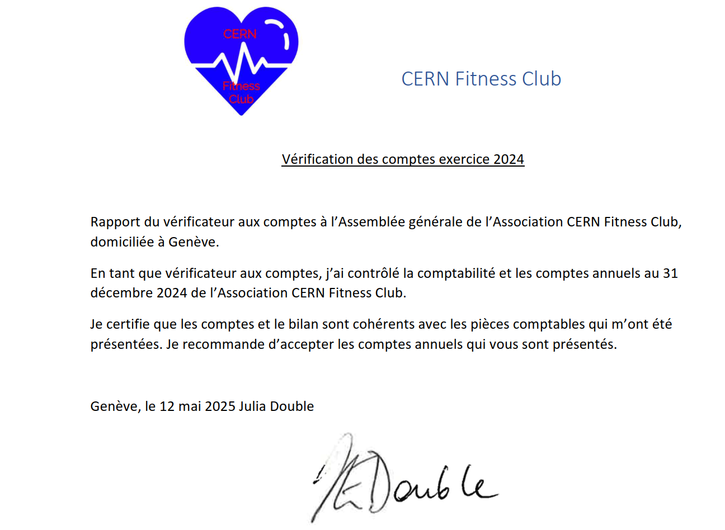
Vote:

Slide 10
CERN Fitness Club AGM
Committee Members 2024
Mariane Dissing: President
María Pérez Ornedo: Secretary
Rachel Bray: Treasurer
Helen Dixon-Altaber: Communication
Misha Borodin/Matthew Dodelson /Sully Billingsley: Powerlifting section
Account Auditor 2024: Julia Double
Volunteer: Cristina Duran Gutierrez
Many thanks to all committee members & account auditor

Slide 11
CERN Fitness Club AGM
Proposal Committee Members 2025
President: Mariane Dissing
Treasurer: Rachel Bray
Secretary: María Pérez Ornedo
Communication: Cristina Duran Gutierrez & Alexandra Bartkowska
Powerlifting responsible: Misha Borodin and Sully Billingsley
Registrations: Helen Dixon-Altaber
Web/IT: Andreas Wagner
Vote
Account auditor 2025(non-committee member): Geraldine Ballet

Slide 12
CERN Fitness Club AGM
Instructors 2024/5 & equipment
General Fitness section
  Cindy (Zumba back-up)
  Hamza (Fit-boxing from 2025)
  Jorge (Afro-Caribbean)
Pilates section
  Yoyo
Many thanks to all instructors.
General Fitness section
  Loris (HIIT/Strength training)
  Mel (Circuits & poweHerlifting)
  Rachel (Zumba)
  Sebastian (Bootcamp)
Powerlifting section
  Misha, Matthew, Sully & Jose
New storage solutions for the 'large' cupboard in 216 underway + investigating extension with SCE
New Powerlifting equipment
New General Fitness equipment
Equipment give-away - donation

Slide 13
CERN Fitness Club AGM
Club Rules Reminder
These Rules and Regulations partially exist to execute the CERN Fitness Club Statutes and must be read in conjunction with the Statutes.
Club Vision
A friendly, fun environment that provides and promotes fitness activities for people working at CERN, their family members and friends. The CERN Fitness Club is a non-political, non-profit association regulated by Swiss law. The Club is run by an Executive Committee elected annually by the members. The Executive Committee organises and provides oversight of the Club’s finances, activities and strategic direction.
Membership
The CERN Fitness Club is run by and for its members and membership is considered compulsory for frequent attendees. Once individuals have attended one free trial class per activity and if they want to keep attending club activities, they are expected to sign up as members.
Membership is applied for by completing the Club’s registration form (online), paying the corresponding fees, signing and returning the disclaimer and club rules form to fitness.club@cern.ch.
People register for a specific period of time. Recovery of missed classes is allowed within the subscription period. By general rule, extension of subscription is not permitted (unless due to illness). Members must unsubscribe for classes or inform fitness.club@cern.ch if unable to take class. Powerlifters must reserve their slots in the booking system and cancel if they are unable to attend.

Slide 14
CERN Fitness Club AGM
Club Rules Reminder
General rules
Official communication channel for CERN Fitness Club is email (messaging apps such as WhatsApp are not permitted at CERN).
The 216 and 566 are to be used for fitness activities only.
Strictly no equipment can be removed from the 216/566.
No food or alcoholic drinks in the 216/566.
Badge access to the pump room is strictly reserved for instructors and members of the powerlifting section.
All equipment must be stored correctly after use.
Powerlifters are permitted to work out in the powerlifting corner of the 216 main hall during classes, but must not encroach into the floor space of the main hall. Classes indicated in booking system.
Members must reserve their slot through the dedicated booking system. Use of the Fitness Club/Powerlifting facilities will not be permitted otherwise. People who have not booked their slot will be asked to leave.
All participants must sign and date the Fitness Club disclaimer and upload it to the Fitness Club CERNbox
All participants must accept the CERN Fitness Club data privacy notice
Equipment purchases can be proposed by instructors and members, the Committee is responsible for taking the final decision.
In case of any abuse in the use of CERN Fitness Club facilities, the CERN Fitness Club committee may, at its sole discretion, end your right to access CERN Fitness Club facilities and activities at any time, with immediate effect. The Committee is responsible for taking the final decision
Membership Renewal
Members will be informed of their membership end date by email. For each renewal, confirmation of registration and payment must be communicated to fitness.club@cern.ch by the member. The signed disclaimer, club rules and proof of payment must be uploaded to dedicated CERNbox.

Slide 15
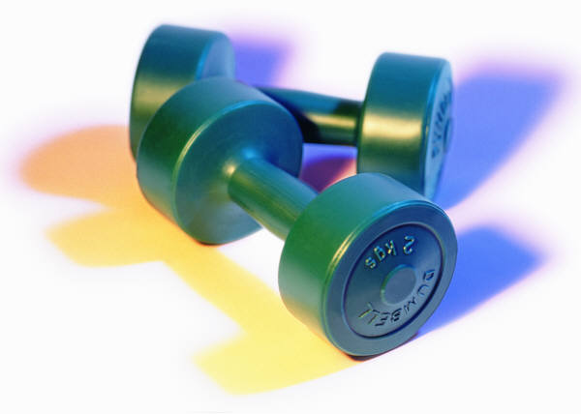
CERN Fitness Club AGM
Thank you for your support Any questions?

