Slide 1
FCC-EE Booster magnets
FCC week 2025
21st May 2025
H. Deveci, L. von Freeden (CERN)
with thanks to J. Bauche, C. Eriksson, A. Milanese, M. Pentella, C. Petrone, D. Schoerling, MSC laboratories (CERN) S. Bradley (WMG)

Slide 2
Outline
FCC-ee booster magnets — FCC week 2025
H. Deveci and L. von Freeden
Summary of FSR magnet requirements
FSR dipole design
Short dipole prototype magnetic measurement
FSR quadrupole and sextupole design
Cost analysis
Key tasks and activities for the magnet WP in the pre-TDR
Design directions

Slide 3
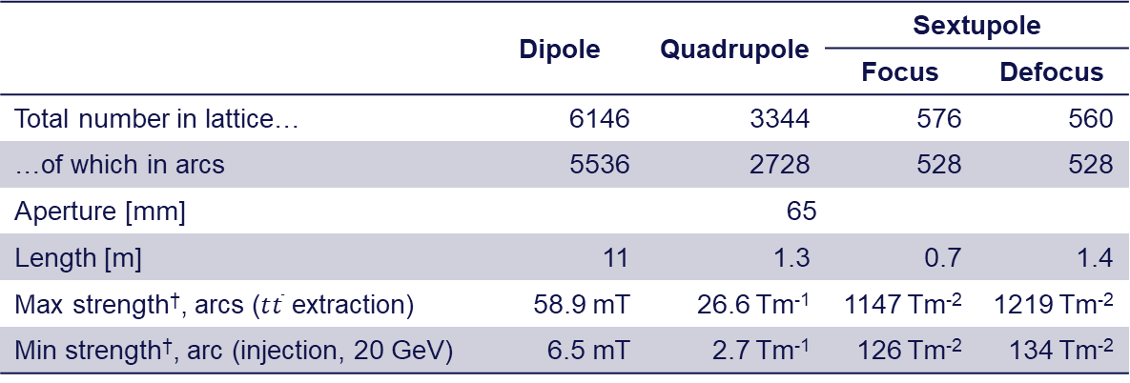
Magnet requirements, FODO version 24
FCC-ee booster magnets — FCC week 2025
H. Deveci and L. von Freeden
 | Dipole | Quadrupole | Sextupole
 |  |  | Focus | Defocus
Total number in lattice… | 6146 | 3344 | 576 | 560
…of which in arcs | 5536 | 2728 | 528 | 528
Aperture [mm] | 65
Length [m] | 11 | 1.3 | 0.7 | 1.4
Max strength†, arcs ($t\overline{t}$ extraction) | 58.9 mT | 26.6 Tm⁻¹ | 1147 Tm⁻² | 1219 Tm⁻²
Min strength†, arc (injection, 20 GeV) | 6.5 mT | 2.7 Tm⁻¹ | 126 Tm⁻² | 134 Tm⁻²
* The ratio of min:max quadrupole strength does not match the beam rigidity as there are multiple families.
† Sextupole strength given as B’’, B’’ = 2S

Slide 4
Outline
FCC-ee booster magnets — FCC week 2025
H. Deveci and L. von Freeden
Summary of FSR magnet requirements
FSR dipole design
Short dipole prototype magnetic measurement
FSR quadrupole and sextupole design
Cost analysis
Key tasks and activities for the magnet WP in the pre-TDR
Design directions

Slide 5
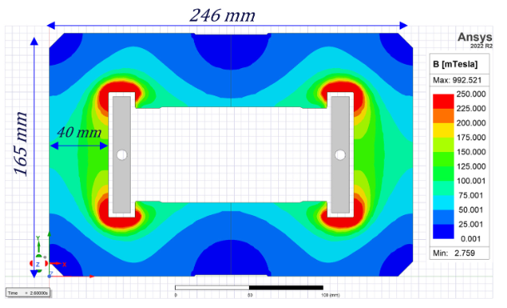
Main bending dipole
FCC-ee booster magnets — FCC week 2025
H. Deveci and L. von Freeden
Closed topology (O or H) for shielding of background fields
Poles pieces (H) to optimize field quality
Low, 1.35 Amm⁻², RMS current density with Al busbars to optimize cost and allow end to end connection
Wide, 40 mm, back leg to reduce yoke magnetization and improve S.R. shielding
Topology | Shielding factor
 | Horizontal | Vertical
O and H | 400 | 65
C | 10 | 30

Slide 6
FSR main bending dipole
FCC-ee booster magnets — FCC week 2025
H. Deveci and L. von Freeden
Parameter | Unit | Value
Strength, 20 to 182.5 GeV | mT | 6.5 to 58.9
Aperture (H × V) | mm² | 130 × 65
Magnetic length | m | 11
Outer envelope (H × V) | mm² | 246 × 165
Peak current | A | 3065
Magnet resistance | mΩ | 0.70
Magnet inductance | µH | 44
Magnet peak voltage | V | 2.2
Conductor (Aluminium) | mm² | 12 × 79, Ø7
Turns |  | 1
RMS current density, tt bar | Amm⁻² | 1.4
Magnet active mass | kg | 2452
Busbar active mass (Al) | kg | 54
Yoke active mass | kg | 2398
 | Z | W | ZH | tt bar
Duty cycle | 0.11 | 0.14 | 0.23 | 0.40
Loss per dipole [kW] | 0.08 | 0.14 | 0.34 | 1.07
Loss in arc dipoles [kW] | 460 | 750 | 1900 | 5900

Slide 7
Outline
FCC-ee booster magnets — FCC week 2025
H. Deveci and L. von Freeden
Summary of FSR magnet requirements
FSR dipole design
Short dipole prototype magnetic measurement
FSR quadrupole and sextupole design
Cost analysis
Key tasks and activities for the magnet WP in the pre-TDR
Design directions

Slide 8
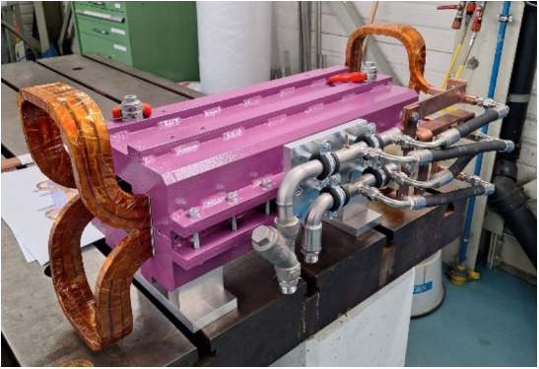
Low field and hysteresis
FCC-ee booster magnets — FCC week 2025
H. Deveci and L. von Freeden
Hysteresis effects pose a unique challenge in low field cycled dipoles
Field repeatability at injection magnet-to-magnet and cycle-to-cycle is strongly affected by material properties. Currently, 1 × 10⁻³ magnet-to-magnet relative field error is required.
Field quality across the cycle can also be impacted. Optics studies ongoing into field errors, no firm requirement
FCC-ee ttbar booster dipole cycle is more challenging than previously proposed low field cycled dipoles
Build and test short prototype magnet to test the proposed magnetic circuit using M270-50A (Hc = 66 A/m @ 1.5 T peak, 15 A/m @ 0.14 T peak)
Machine | Minimum field [mT] | Field ratio peak/min
FCC-ee booster | 6.5 | 9.0
CEPC booster | 9.5 | 6.0
LEP | 21.5 | 6.3
LHeC ring-ring | 12.7 | 6.0

Slide 9
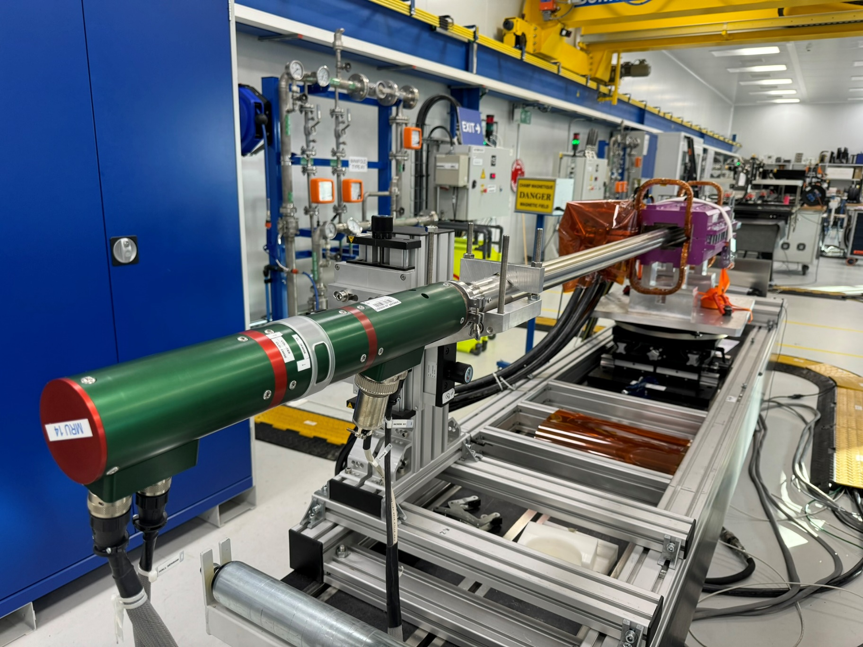
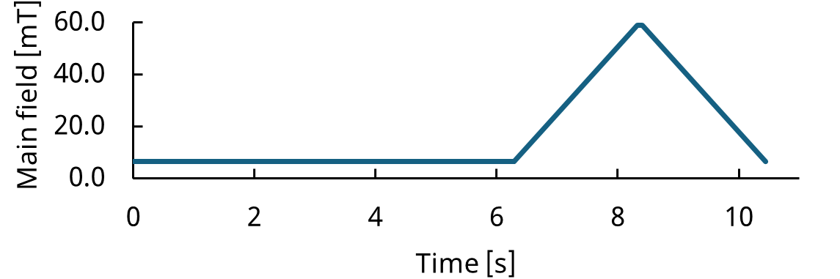
Magnetic measurement results
FCC-ee booster magnets — FCC week 2025
H. Deveci and L. von Freeden
w/ thanks to Mariano Pentella and Carlo Petrone
Magnet degaussed
Pre-cycled injection to extraction field between zero and three times
Stepped through ttbar cycle with quasi-static measurements

Slide 10
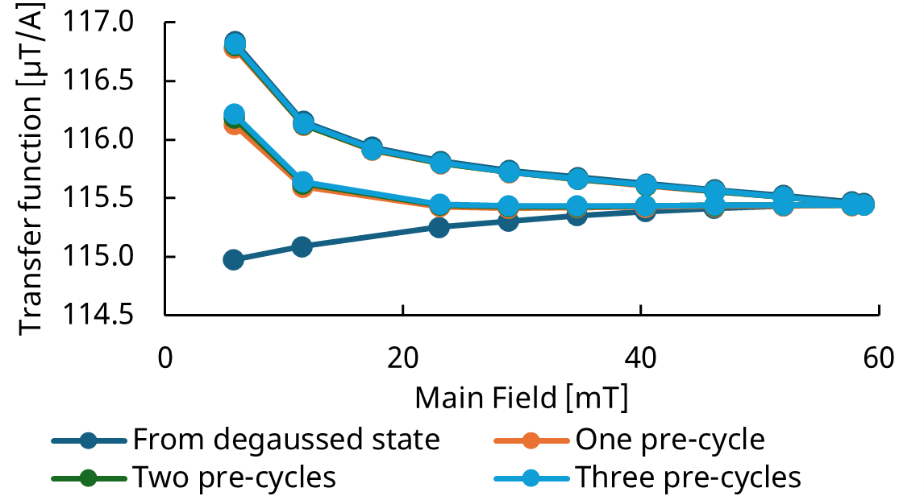
Magnetic measurement results
FCC-ee booster magnets — FCC week 2025
H. Deveci and L. von Freeden
w/ thanks to Mariano Pentella and Carlo Petrone
Transfer function stabilizes after two pre-cycles
3 × 10⁻⁴ relative change in transfer function between two pre-cycle and three pre-cycle measurement.
Remanent magnetization contributes 60 µT (1%) of main field.
To achieve 1 × 10⁻³ dipole-to-dipole relative field error currently required, implying magnetization must be controlled better than ±10%
Simulations predicted transfer function within 99% to facilitate future design studies.

Slide 11
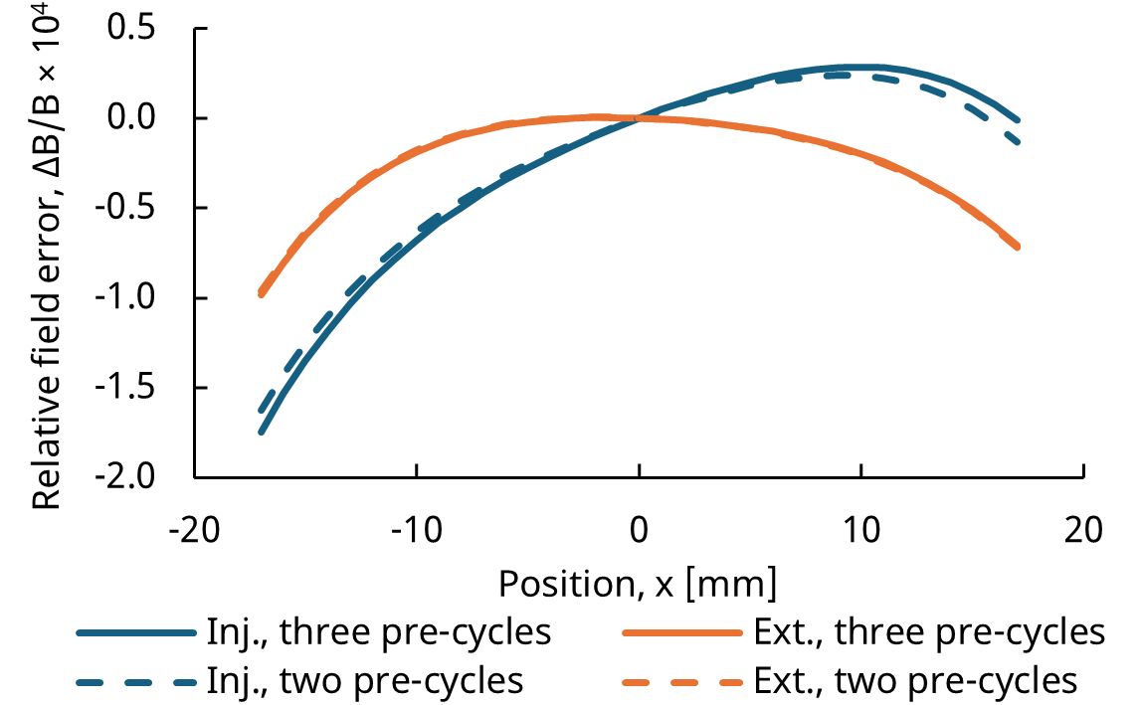
Magnetic measurement results
FCC-ee booster magnets — FCC week 2025
H. Deveci and L. von Freeden
w/ thanks to Mariano Pentella and Carlo Petrone
In ±10 mm good field region
less than ±1 × 10⁻⁴ relative field error in all cases
less than 1 × 10⁻⁵ change in relative field error between cycles (dash vs. solid)
Sextupolar component* between -0.15 × 10⁻⁴ at injection and -0.12 × 10⁻⁴ at extraction.
Quadrupolar component† 0.5 × 10⁻⁴ at injection, decays at extraction.
asymetric magnetization in the yoke
* b3 = B3/B1 at R = 10 mm
† b2 = B2/B1 at R = 10 mm

Slide 12
Outline
FCC-ee booster magnets — FCC week 2025
H. Deveci and L. von Freeden
Summary of FSR magnet requirements
FSR dipole design
Short dipole prototype magnetic measurement
FSR quadrupole and sextupole design
Cost analysis
Key tasks and activities for the magnet WP in the pre-TDR
Design directions

Slide 13
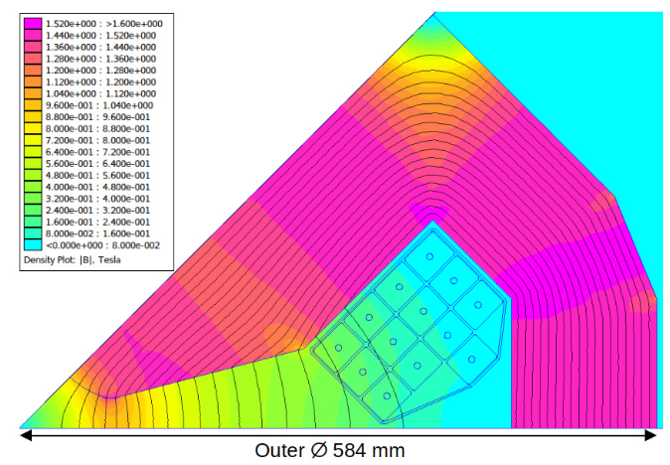
FSR main arc quadrupole
FCC-ee booster magnets — FCC week 2025
H. Deveci and L. von Freeden
Parameter | Unit | Value
Max. strength, main arc ttbar ext. | Tm⁻¹ | 26.6
Ult. strength, disp. sup. ttbar ext. | Tm⁻¹ | 28.7
Aperture diameter | mm | 65
Magnetic length | m | 1.3
Outer envelope | mm | Ø584
Peak current | A | 939
Additional MMF for disp. sup. | A·t | 1350
Magnet resistance | mΩ | 11.4
Magnet inductance | mH | 13.3
Magnet peak voltage | V | 15.5
Conductor (Copper) | mm² | 14.3 × 18.25, Ø2.8
Turns |  | 13
RMS current density, tt bar | Amm⁻² | 1.5
Magnet active mass | kg | 2070
Coil active mass (Cu) | kg | 368
Yoke active mass | kg | 1702
 | Z | W | ZH | tt bar
Duty cycle | 0.11 | 0.14 | 0.23 | 0.40
Loss per quad [kW] | 0.13 | 0.21 | 0.52 | 1.63
Loss in arc quads [kW] | 350 | 560 | 1400 | 4400

Slide 14
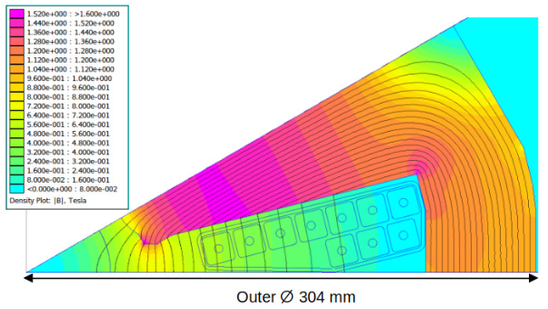
FSR main arc sextupole
FCC-ee booster magnets — FCC week 2025
H. Deveci and L. von Freeden
Parameter | Unit | Value
 |  | Defocus | Focus
Max. strength, B’’ | Tm⁻² | 1219 | 1147
Aperture diameter | mm | Ø65
Magnetic length | m | 1.4 | 0.7
Outer envelope | mm | Ø305
Peak current | A | 595 | 556
Magnet resistance | mΩ | 51 | 27
Magnet inductance | mH | 9.3 | 4.7
Magnet peak voltage | V | 32 | 16
Conductor (Copper) | mm² | 8.4 × 8.4, Ø2.5
Turns |  | 10
RMS current density, tt bar | Amm⁻² | 3.7 | 3.5
Magnet active mass | kg | 614 | 312
Coil active mass (Cu) | kg | 105 | 57
Yoke active mass | kg | 509 | 255
 | Z | W | ZH | tt bar
Duty cycle | 0.11 | 0.14 | 0.23 | 0.40
Loss per sext. F [kW] | 0.11 | 0.17 | 0.42 | 1.34
Loss per sext. D [kW] | 0.23 | 0.37 | 0.92 | 2.90
Loss arc sexts. [kW] | 120 | 200 | 490 | 1600

Slide 15
Outline
FCC-ee booster magnets — FCC week 2025
H. Deveci and L. von Freeden
Summary of FSR magnet requirements
FSR dipole design
Short dipole prototype magnetic measurement
FSR quadrupole and sextupole design
Cost analysis
Key tasks and activities for the magnet WP in the pre-TDR
Design directions

Slide 16
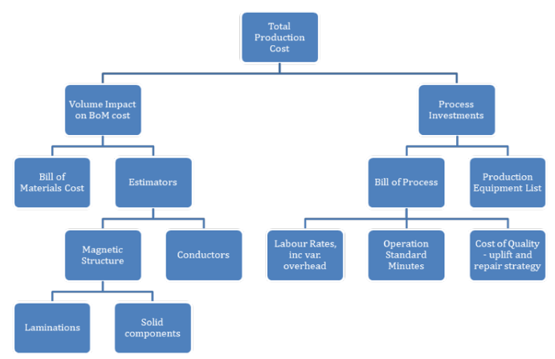
Should-cost-modelling of baseline designs
FCC-ee booster magnets — FCC week 2025
H. Deveci and L. von Freeden
Warwick manufacturing group experienced in manufacture of electromechanical devices (eMachines). Thanks to S. Bradley and D. Simkin.
Compared cost estimates using 3 approaches:
WMG should cost model (bottom-up using estimators and volume considerations)
Cost per unit mass using coefficients from experience
Fitting of 65 previous magnet contracts corrected for exchange rate and Producer Price Index
Benchmarked with a length scaling from LEP data
Improved cost estimation accuracy
Highlighted key cost drivers (BOM and BOP) to target for cost optimization in pre-TDR phase

Slide 17
Outline
FCC-ee booster magnets — FCC week 2025
H. Deveci and L. von Freeden
Summary of FSR magnet requirements
FSR dipole design
Short dipole prototype magnetic measurement
FSR quadrupole and sextupole design
Cost analysis
Key tasks and activities for the magnet WP in the pre-TDR
Design directions

Slide 18
pre-TDR Magnet WP key tasks
FCC-ee booster magnets — FCC week 2025
H. Deveci and L. von Freeden
w/ thanks to D. Schoerling
Task 1: Functional design and specification
Technical feed-back to optics to inform updated booster design (to follow collider update)
Corrector design
Task 2: Models and prototypes
Dipole: updated measurement device for transient study. Change materials.
Quadrupole and sextupole: optimise design for manufacture and assembly, manufacturing demonstrators.
Task 3: Industrialisation strategy
Task 4: Cost estimate

Slide 19
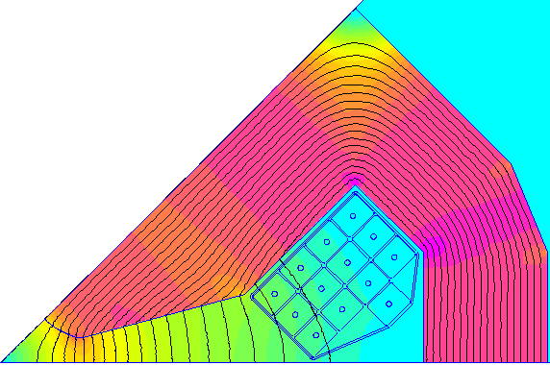
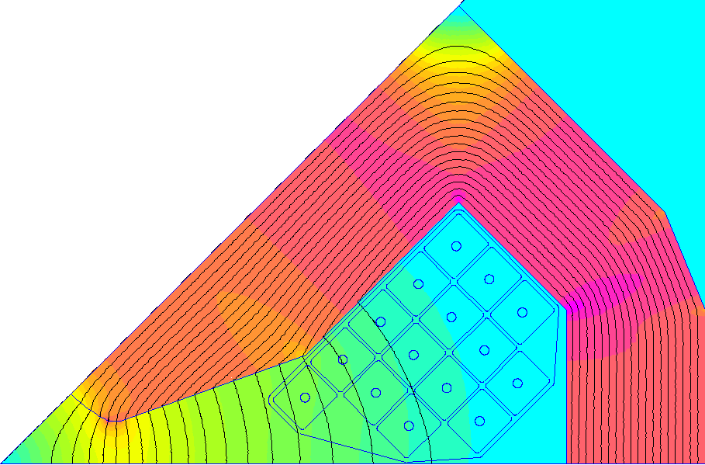
pre-TDR option: longer quadrupole
FCC-ee booster magnets — FCC week 2025
H. Deveci and L. von Freeden
Increasing the length of the quadrupole, for the same integrated strength:
~30% lighter yoke
120 mm narrower cross section
Re-global optimisation recommends low current density:
Heavier coil and lower power loss.
J lower than typical due to the consideration of technical services.
Integration and stability not included; detailed holistic design refinement ongoing.
Parameter | Unit | Value
 |  | FSR (v24) | Option (v24.1)
Max. strength, main arc ttbar ext. | Tm⁻¹ | 26.6 | 23.2
Magnetic length | m | 1.3 | 1.5
Peak current | A | 939 | 690
Magnet peak voltage | V | 15.5 | 16.3
Joule loss at ttbar | W | 1634 | 1278
Outer envelope | mm | Ø584 | Ø464
Magnet active mass | kg | 2070 | 1575
Coil active mass | kg | 368 | 431
Yoke active mass | kg | 1702 | 1144
RMS current density, tt bar | Amm⁻² | 1.5 | 1.22

Slide 20
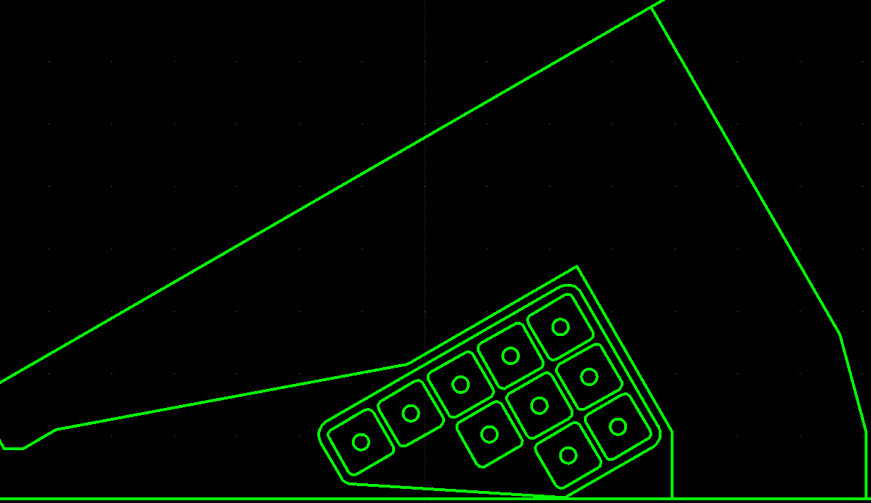
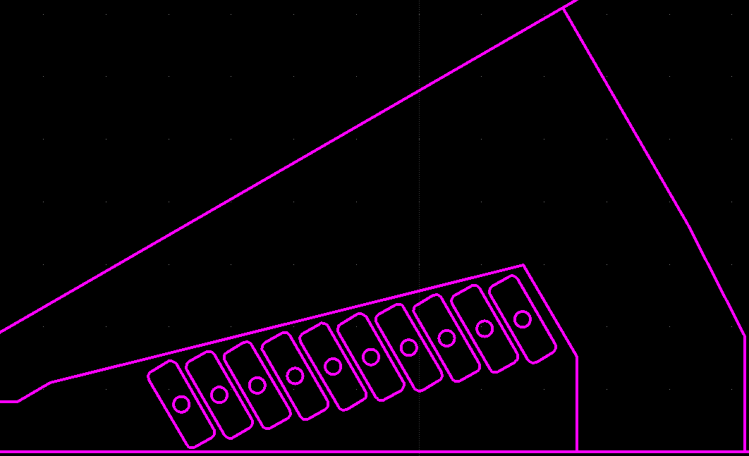
pre-TDR option: updated (sextupole) coil
FCC-ee booster magnets — FCC week 2025
H. Deveci and L. von Freeden
Simplified racetrack coils adapted to bobbin winding
Edge wound flat conductor adapted to automation with hairpin/busbar winding machines

Slide 21
Conclusion
FCC-ee booster magnets — FCC week 2025
H. Deveci and L. von Freeden
FSR main magnet designs meet key requirements
Demonstration of the feasibility of low-field cycled dipole, active development to further refine design
Detailed cost analysis tool has been created to inform pre-TDR developments
Pre-TDR phase will be focussed on specifying baseline, building prototypes, industrialisation and cost optimisation/analysis
Initial directions already under study

Slide 22
Thank you for your attention.
22

