Slide 1
FCC-ee transfer lines magnets design status

Slide 2
Outline
FCC-ee transfer lines magnet specifications
Magnets based on permanent magnet technology
  Magnets design description
  2D modelling results
  Cost estimate
Conventional electromagnets
  Magnets design description
  2D modelling results
  Cost estimate
Comparison and Conclusion

Slide 3
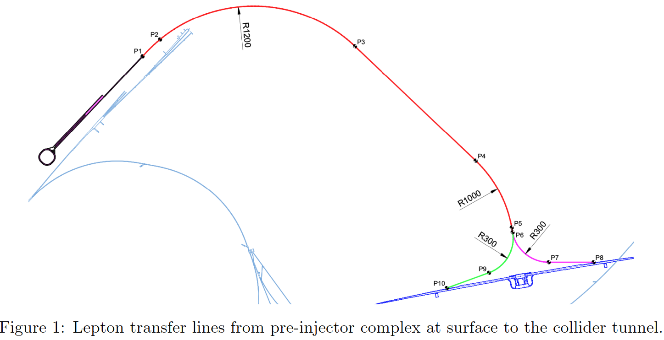
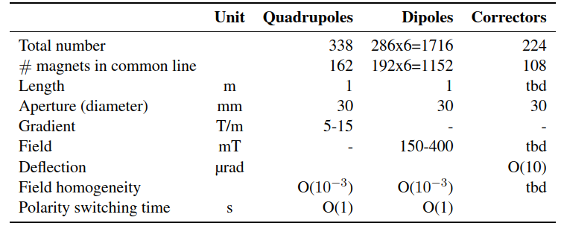
3
Requirements
Reference: Future Circular Collider Feasibility Study Report, March 2025
Common line (P1-P6) – 4.0 km
Total TL – 5.56 km
Magnet type | Position & Quantity | Strength | Unit
Dipole Type A | P1-P6 ,192 units × 6 m | 0.15 | T
Dipole Type B | P6-P8/P10, 47 units × 2 lines × 6 m | 0.4 | T
Quadrupole Type A | P1-P6 ,162 units × 1 m | 5 | T/m
Quadrupole Type B | P6-P8/P10, 88 units × 2 lines × 1 m | 15 | T/m

Slide 4
Magnets based on permanent magnet technology

Slide 5
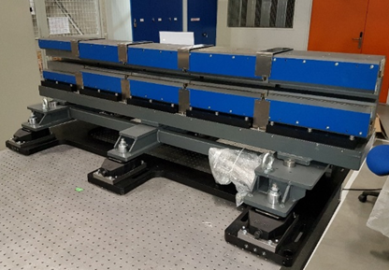
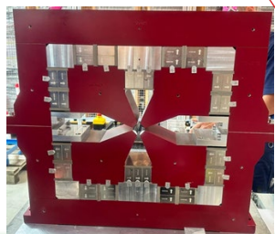
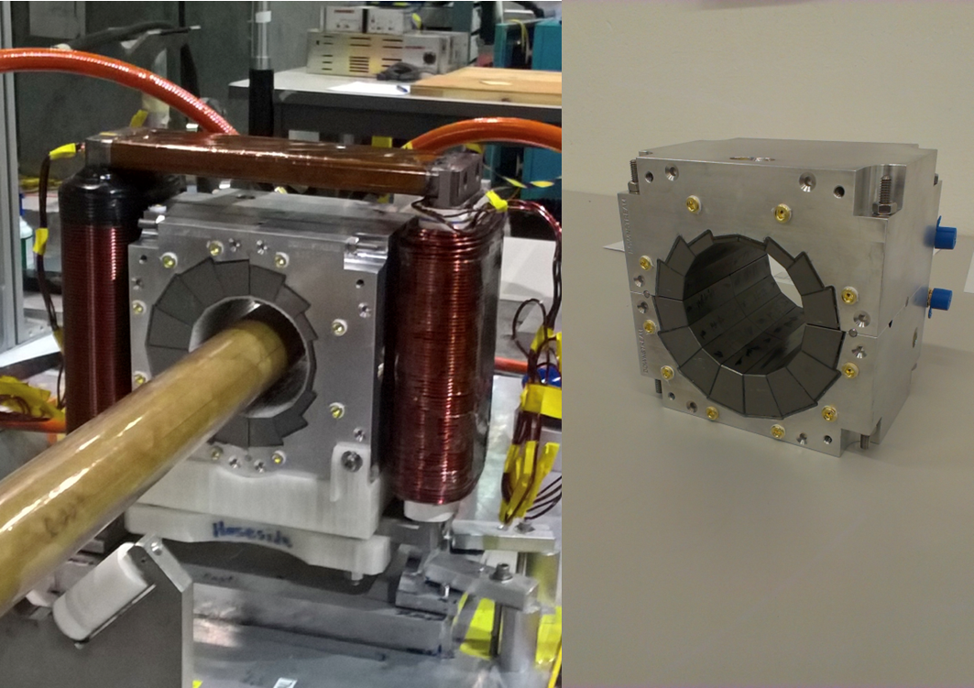
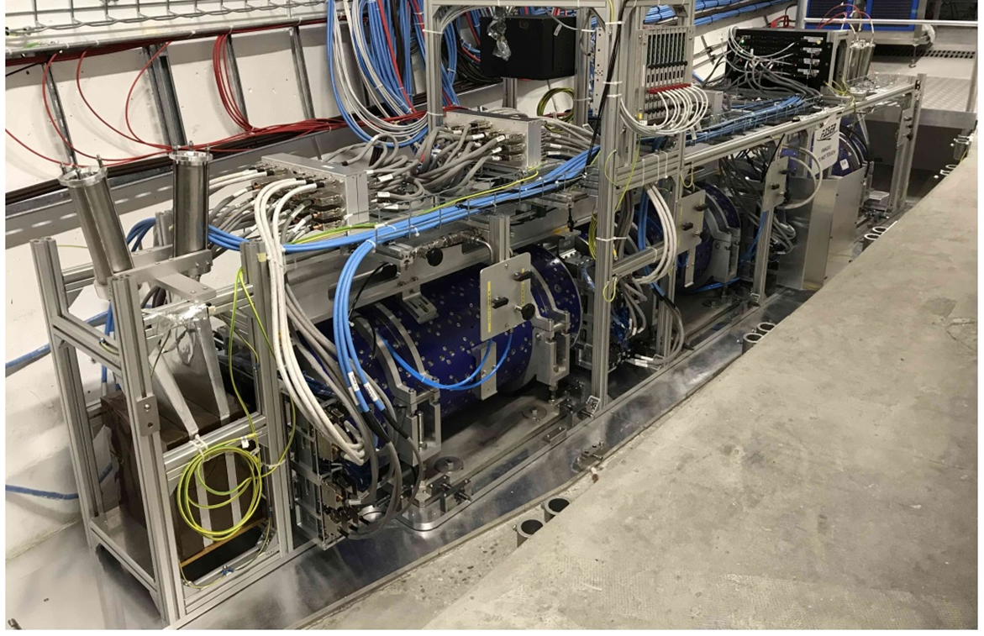
Use of permanent magnets in accelerators
Permanent magnets are largely used in accelerators, especially in storage rings, transfer lines, linacs, experimental areas or undulators, as for example:
Dipoles for the EBS (ESRF)
Dipoles and quadrupoles for the Swiss light source (PSI)
Combined function magnets for CBETA (Cornell-BNL)
Dipoles and quadrupoles for the Recycler ring (Fermilab)
Quadrupoles for the Linac 4 (CERN)
Dipoles for FASER (CERN)

Slide 6
Motivations for permanent magnets
Advantages of permanent magnet over electromagnet designs
Cost efficient solution
  No additional infrastructure required such as power convertors, cabling, water networks
  No running cost
  For low field magnets the required quantity of permanent magnet material stays low
Fast process to assemble the magnets
No additional heat load to evacuate from the transfer line tunnel
Compact devices
Reliability, interesting for large number of magnets (no hydraulic or electric failures)
Limitations
Need 2 independent beam lines between points 1 and 6
Fixed field (no flexibility for injection energy)

Slide 7
Design baseline
Iron dominated designs (in opposition to Halbach designs)
  Simplify the permanent magnet blocks shape
  Lower the incidence of permanent magnet irregularities on field quality
  Optimize magnet assembly and tunning process
Maximum of 1-m long sections for both dipoles and quadrupoles
  Stay within reasonable and largely available machining capabilities
  Simplify permanent magnet blocks insertion
Compensation for temperature dependence
Cost effective design
Series production
Tuning possibility
  Adjustment of field/gradient integral at magnetic measurement stage
  Hybrid designs, with permanent magnets and some mechanism to provide remote tunability (coils or movable parts) are not considered, mainly due to cost and complexity increase

Slide 8
Design baseline
Choice of the permanent magnet material: Samarium Cobalt Sm₂Co₁₇
Neodymium (NdFeB) magnets have higher magnetic characteristics and are normally cheaper than Samarium Cobalt (SmCo) but for accelerator magnets SmCo presents some advantages:
Grades with high remanent field (Br≥1.1 T) and coercivity Hcb ≥820 kA/m (however lower than NdFeB)
Large range of energy product (from 5 to 34 MGOe)
=> Interesting for FCC-ee TL as for some of the magnets the field/gradient is relatively low
Good radiation resistance
Can work at high temperature
Acceptable corrosion stability even without protective coating
High intrinsic coercivity Hcj ≥1990 kA/m to prevent from any risk of demagnetization
=> Interesting for FCC-ee TL as magnet blocks are thin
Small temperature coefficient: -0.035%/°C
=> Interesting for FCC-ee TL for field stability

Slide 9
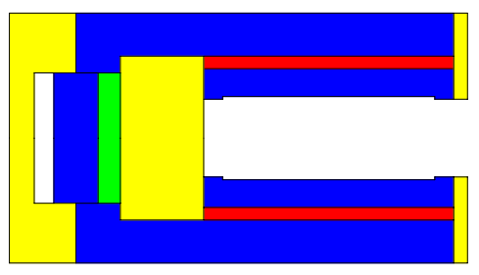
Dipole type A
The field is adjusted in the aperture by moving away a shim to locally reduce the section of the yoke and bring it close to saturation.
B₀=0.15 T (P1-P6)
165
Yoke (low carbon steel)
Permanent magnet (grade TC16 MGOe,
temperature compensated Sm₂Co₁₇)
90
30
90
Pole (low carbon steel)
Parameter | Value | Unit
Number of dipoles | 2304 | -
Aperture height | 30 | mm
Mechanical length | 1 | m
Central field | 0.15 | T
Good Field Region H x V | ±20 × ±10 | mm²
Permanent magnet mass | 7 | kg
Dipole mass | 72 | kg
Spacer (aluminum)
Adjustable spacer (aluminum)
Movable shim (low carbon steel)
Outer frame (aluminum)

Slide 10
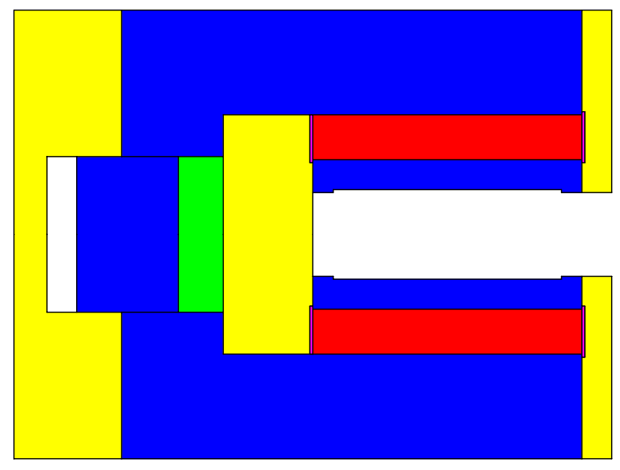
Dipole type B
PM block
Yoke
Pole
B₀=0.4 T (P6-P8/P10)
200
Fe-Ni shunt with 30 % Ni
(with Curie temperature
slightly above room temperature)
Yoke (low carbon steel)
Permanent magnet
(grade 30 MGOe, Sm₂Co₁₇)
150
30
90
Pole (low carbon steel)
Parameter | Value | Unit
Number of dipoles | 564 | -
Aperture height | 30 | mm
Mechanical length | 1 | m
Central field | 0.4 | T
Good Field Region H x V | ±20 × ±10 | mm²
Permanent magnet mass | 22 | kg
Dipole mass | 165 | kg
Passive thermal compensation (Fe-Ni)
Spacer (aluminum)
Adjustable spacer (aluminum)
Movable shim (low carbon steel)
Outer frame (aluminum)

Slide 11
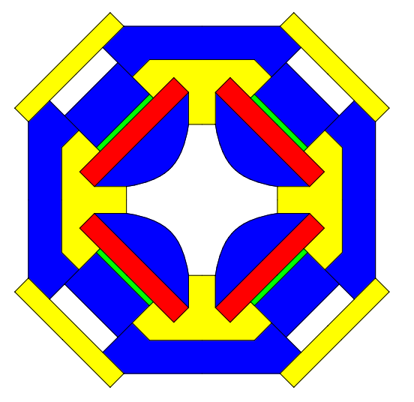
Quadrupole types A and B
The gradient is adjusted by moving away some shims to change the reluctance of the magnetic circuit.
Same cross section, different length, G₀=15 T/m
125
Return yoke (low carbon steel)
Movable shim (low carbon steel)
Permanent magnet (grade TC16 MGOe, temperature compensated Sm₂Co₁₇)
125
30
Frame (aluminum)
Parameter | Type A (P1-P6) | Type B (P6-P8/P10) | Unit
Number of quadrupoles | 324 | 176 | -
Aperture diameter | 30 | 30 | mm
Mechanical length | 0.333 | 1 | m
Gradient | 15 | 15 | T/m
Good Field Region Ø | 20 | 20 | mm
Permanent magnet mass | 3.5 | 10.5 | kg
Quadrupole mass | 23 | 69 | kg
Pole (low carbon steel)
Adjustable spacer (aluminum)

Slide 12
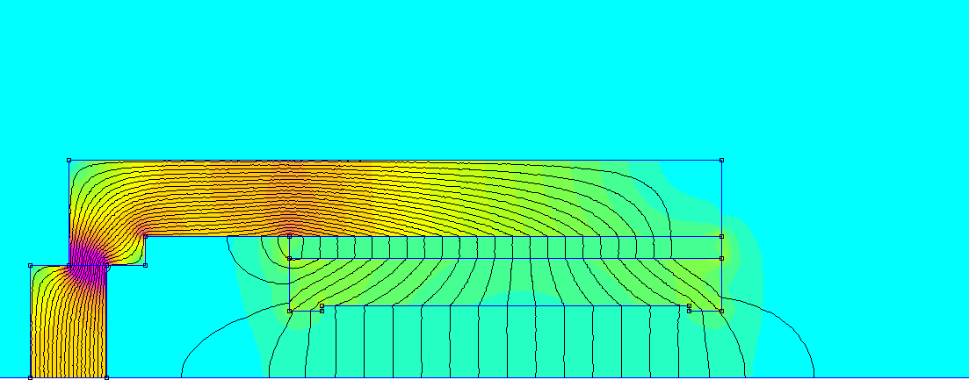
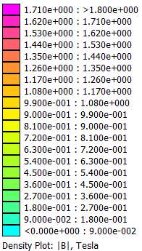
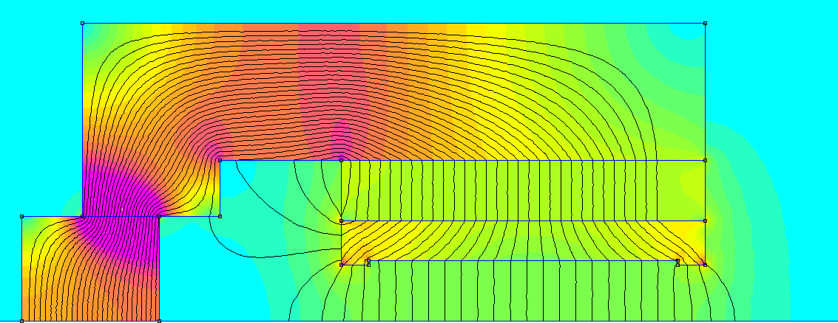
2 D modelling: dipoles
Dipole type A
Parameter | Type A | Type B | Unit
Field | 0.15 | 0.4 | T
Field homogeneity in GFR | ± 5 | ± 5 | 10⁻⁴
Tuning range | +6 / -30 | ± 6 / -15 | %
Expected field stability / temperature | ~0.004 | ~0.004 | % /°C
Dipole type B

Slide 13
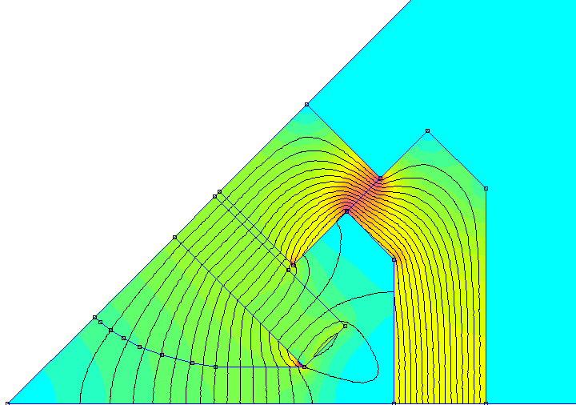
2 D modelling: quadrupole
Quadrupole types A and B
Parameter | Value | Unit
Gradient | 15 | T/m
Gradient homogeneity in GFR | ± 5 | 10⁻⁴
Tuning range | +6 / -30 | %
Expected gradient stability / temperature | ~0.004 | % /°C

Slide 14
Permanent magnet cost breakdown
 | Category | Dipole type A | Dipole type B | Quadrupole type A | Quadrupole type B | Unit
Material | Low carbon steel | 10 | 13 | 3 | 7 | %
 | Aluminium | 4 | 5 | 2 | 3 | %
 | Permanent magnet blocks | 18 | 33 | 8 | 15 | %
 | Ancillaries | 2 | 2 | 2 | 2 | %
Labour | Machining | 37 | 27 | 54 | 48 | %
 | Surface treatment | 1 | 1 | 1 | 1 | %
 | Assembly | 14 | 10 | 16 | 14 | %
 | Magnetic measurements and tuning | 14 | 9 | 14 | 10 | %
TOTAL |  | 100 | 100 | 100 | 100 | %
The budget is largely driven by labour due to the relatively small size of the dipoles and quadrupoles.
The permanent magnet material cost would represent ~20% of the overall budget.
The required quantity of Sm₂Co₁₇ permanent magnet material would be ~ 30 tons for the whole transfer line, which stays within production capabilities of several known companies.

Slide 15
Conventional electromagnets

Slide 16
Motivations for conventional electromagnets
Electromagnets provide adjustable field strength and polarity
  ±100 % tuning range
  common (electron–positron) beam line between P1 and P6
Field strength is not sensitive to possible temperature variation in the tunnel
Well known manufacturing technology, price & availability of raw materials (steel & copper) are less sensitive to the market “perturbations” as compared to the permanent magnets
Design considerations
Conventional EM with as simple as possible coil and magnet core cross-sections
Current density in the “cost effective” range 3.5 – 5.0 A / mm² for Cu-conductor, (Al – e.g. 1 turn, high current busbar → large dissipated power(heat) of the cabling in the tunnel)
Cooling water temperature rise < 10°C
2D FE modeling for all magnets, including pole shimming study to ensure that the required field quality is provided
Optimized cross-section & engineering parameters as an input for the cost estimate

Slide 17
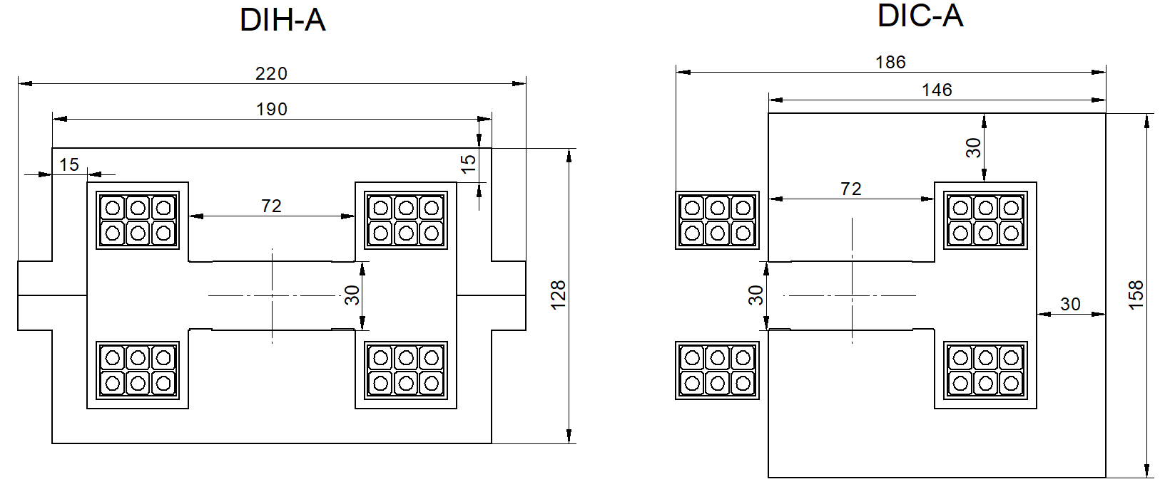
Dipole type A
Bo=0.15 T (P1-P6)
Parameter | H-type | C-type | C-type | Unit
Excitation current / Current density | 307.7 / 4.3 | 1846 , 307.7, 4.3 | 307.7 / 4.3 | A, A, A/mm2
Conductor dimensions, No turns per pole | 10×10 Ø6, nw=6 | 10×10 Ø6, 6 turns /coil | 10×10 Ø6, nw=6 | mm
Magnet inductance / resistance@20°C | 3.8 / 35.9 | 3.8 / 35.9 | 3.8 / 35.9 | mH / mΩ
Voltage L∙dI/dt, for t=1s (-Imax → Imax) | 2.3 |  | 2.3 | V
Voltage DC(warm) @Imax | 11.4 | 11.4 | 11.4 | V
Power consumption DC @ Imax | 3.5 | 3.5 | 3.5 | kW
Cooling circuits per mag / Trise @ImaxDC | 2 / 3.0 | 2 / 3.0 | 2 / 3.0 | / °C
Good Field Region H x V | ±20 with Sagitta × ±10 |  |  | mm²
Magnet length / mass | 6 / 776 | 6 / 878 |  | m / kg

Slide 18
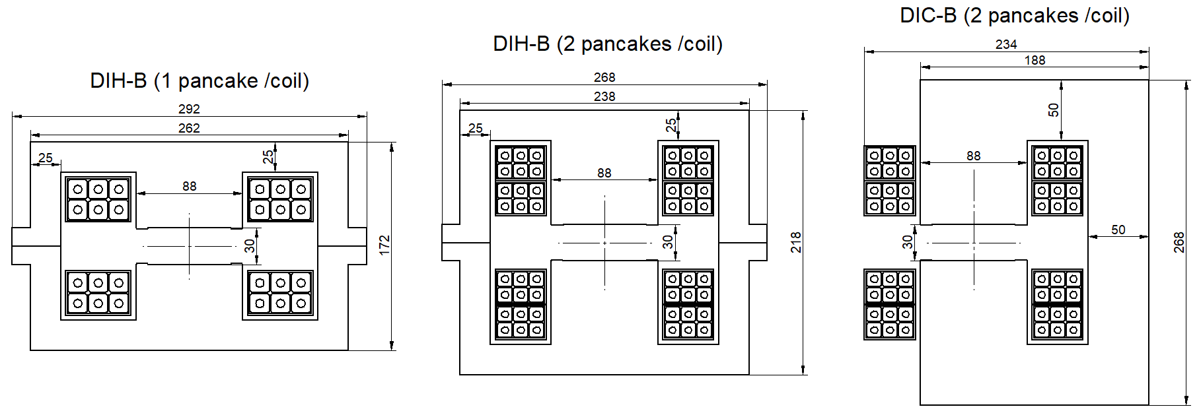
Dipole type B
Bo=0.40 T (P6-P8/P10)
Parameter | H-type, 1 pancake / coil | H-type, 2 pancakes / coil | C-type, 2 pancakes / coil | Unit
Excitation current / Current density | 820.3, 3.81 | 410.2, 3.57 | 410.2, 3.57 | A, A/mm²
Conductor dimensions, No turns per pole | 16×16 Ø7 , nw=6 | 12×12 Ø6, nw=12 | 12×12 Ø6, nw=12 | mm
Magnet inductance / resistance@20°C | 4.4 / 11.8 | 18.4 / 44.3 | 18.2 / 4.3 | mH / mΩ
Voltage L∙dI/dt, for t=1s (-Imax → Imax) | 7.3 | 15.1 | 15 | V
Voltage DC(warm) @Imax | 10.3 | 19 | 19 | V
Power consumption DC @Imax | 8.4 | 7.8 | 7.8 | kW
Cooling circuits per mag / Trise @Imax | 2 / 10 | 4 / 7.0 | 4 / 7 | / °C
Good Field Region H x V | ±28(with Sagitta) × ±10 |  |  | mm²
Magnet length / mass | 6 / 1617 | 6 / 1879 | 6 / 2162 | kg

Slide 19
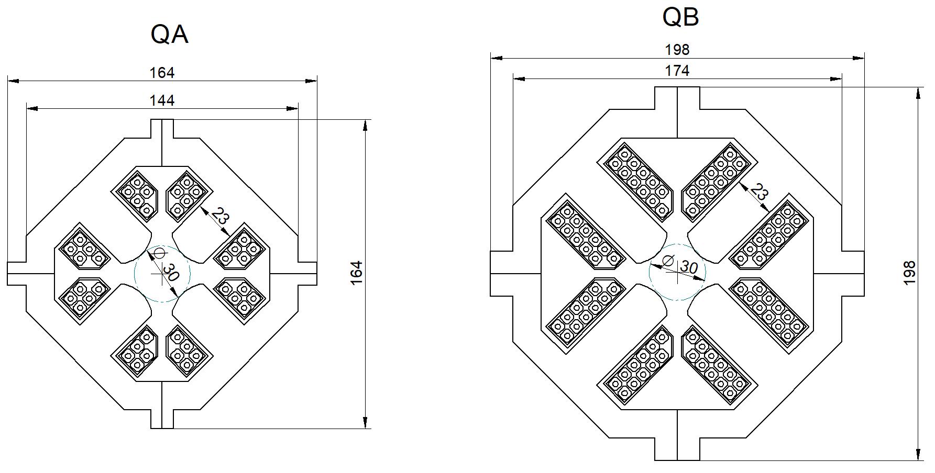
Quadrupole type A and B
Go=5 & 15 T/m
Parameter | Type A(P1-P6) | Type B(P6-P8/P10) | Unit
Excitation current / Current density | 91.4 / 3.26 | 124.5 / 3.81 | A, A/mm²
Conductor dimensions, No turns per pole | 6×6 Ø3, nw=5 | 6×6 Ø3, nw=11 | mm
Magnet inductance / resistance@20°C | 0.9 / 28.2 | 4.9 / 62.1 | mH / mΩ
Voltage L∙dI/dt, for t=1s (-Imax → Imax) | 0.2 | 1.2 | V
Voltage DC(warm) @Imax | 2.7 | 8.0 | V
Power consumption DC @Imax | 0.2 | 1.0 | kW
Cooling circuits per mag / Trise @Imax | 2 / 2.0 | 4 / 5 | / °C
Good Field Region Ø | 20 | 20 | mm
Magnet length / mass | 1 / 68 | 1 / 137 | m / kg

Slide 20
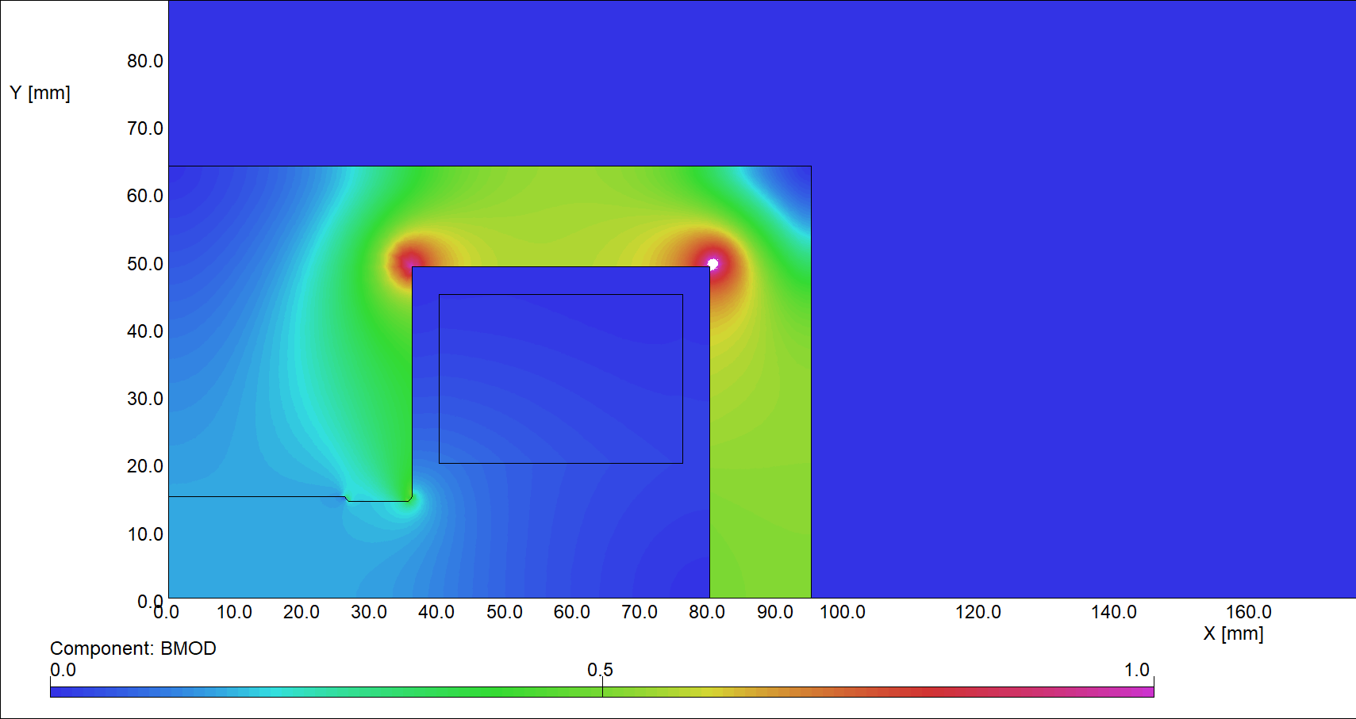
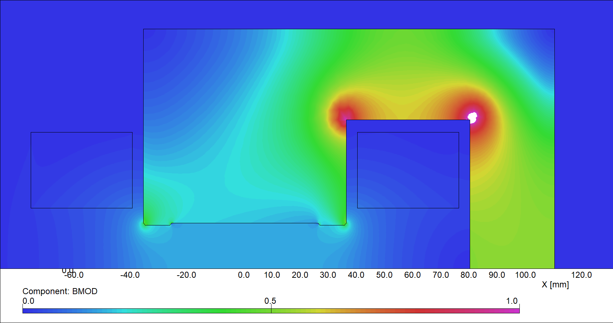
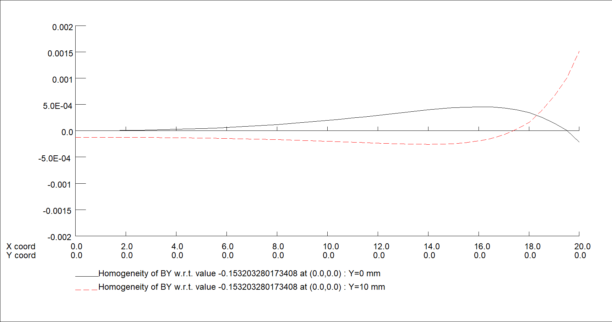
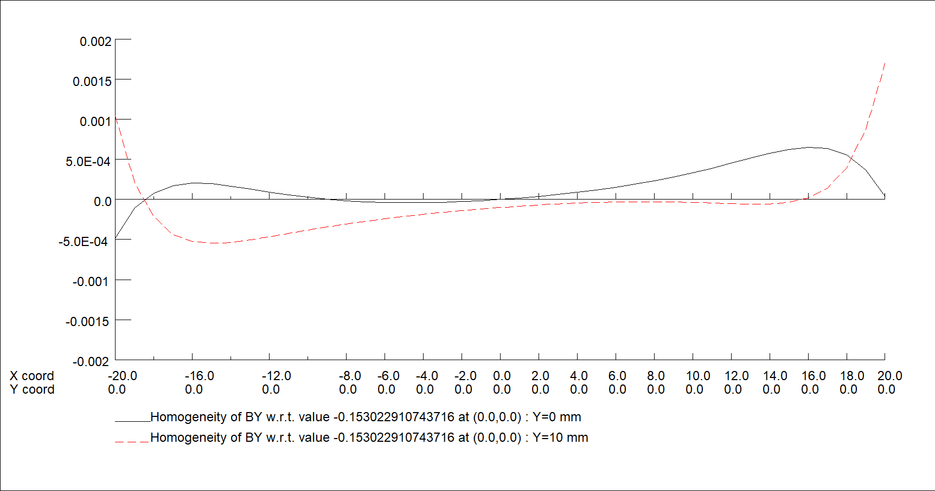
Dipole type A
2D modelling
DIH-A
DIC-A
Field homogeneity @ GFR = ±20 (Hor.) × ±10 (Vert.)

Slide 21
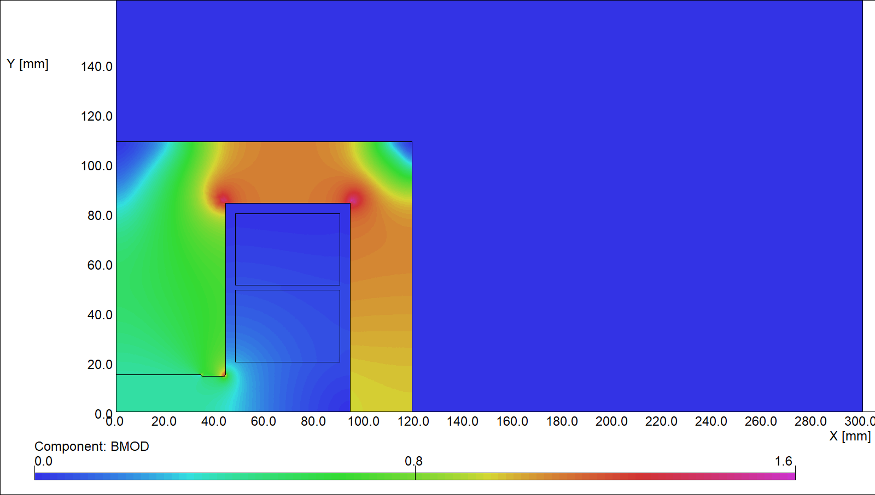
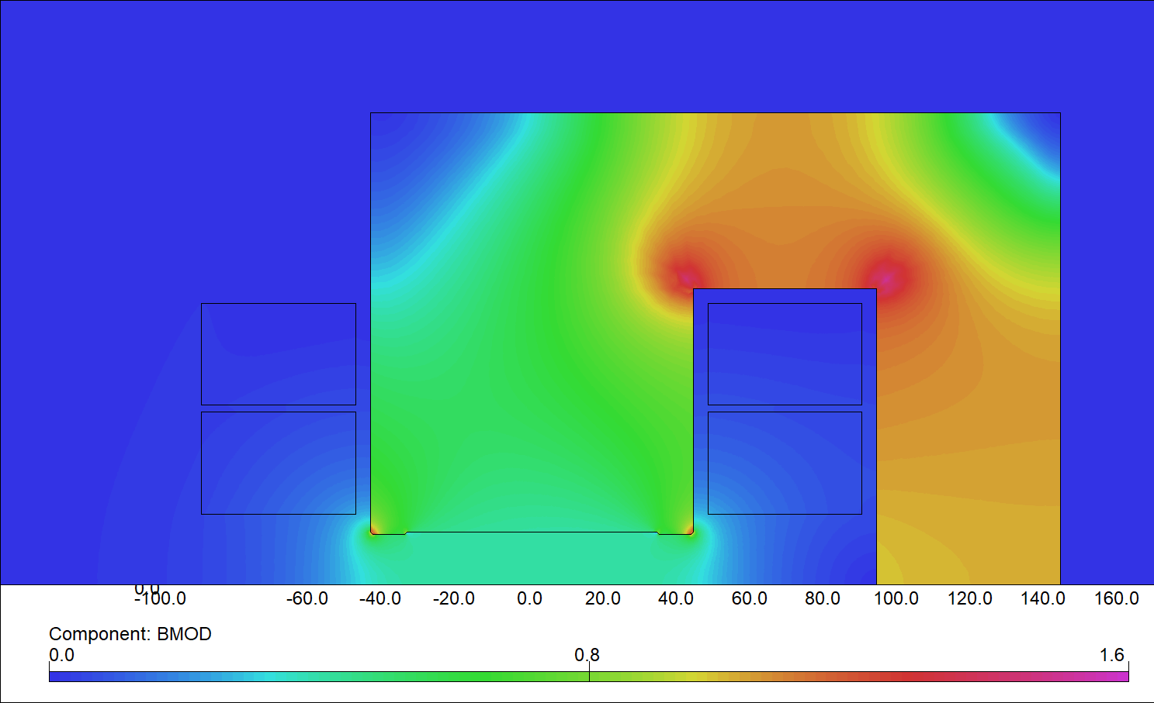
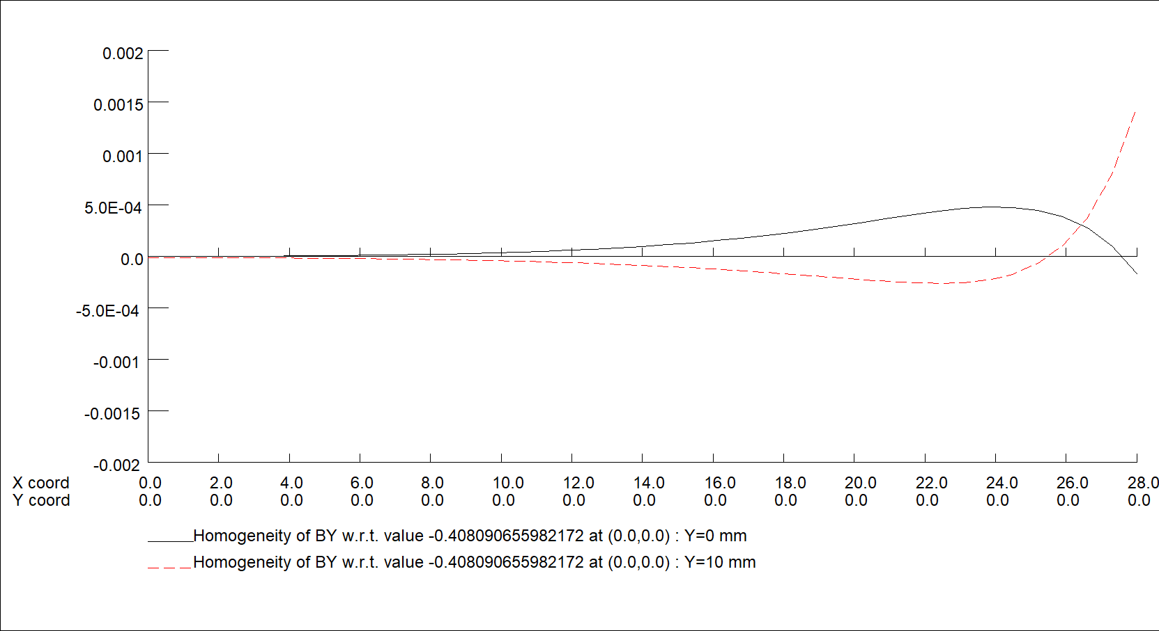
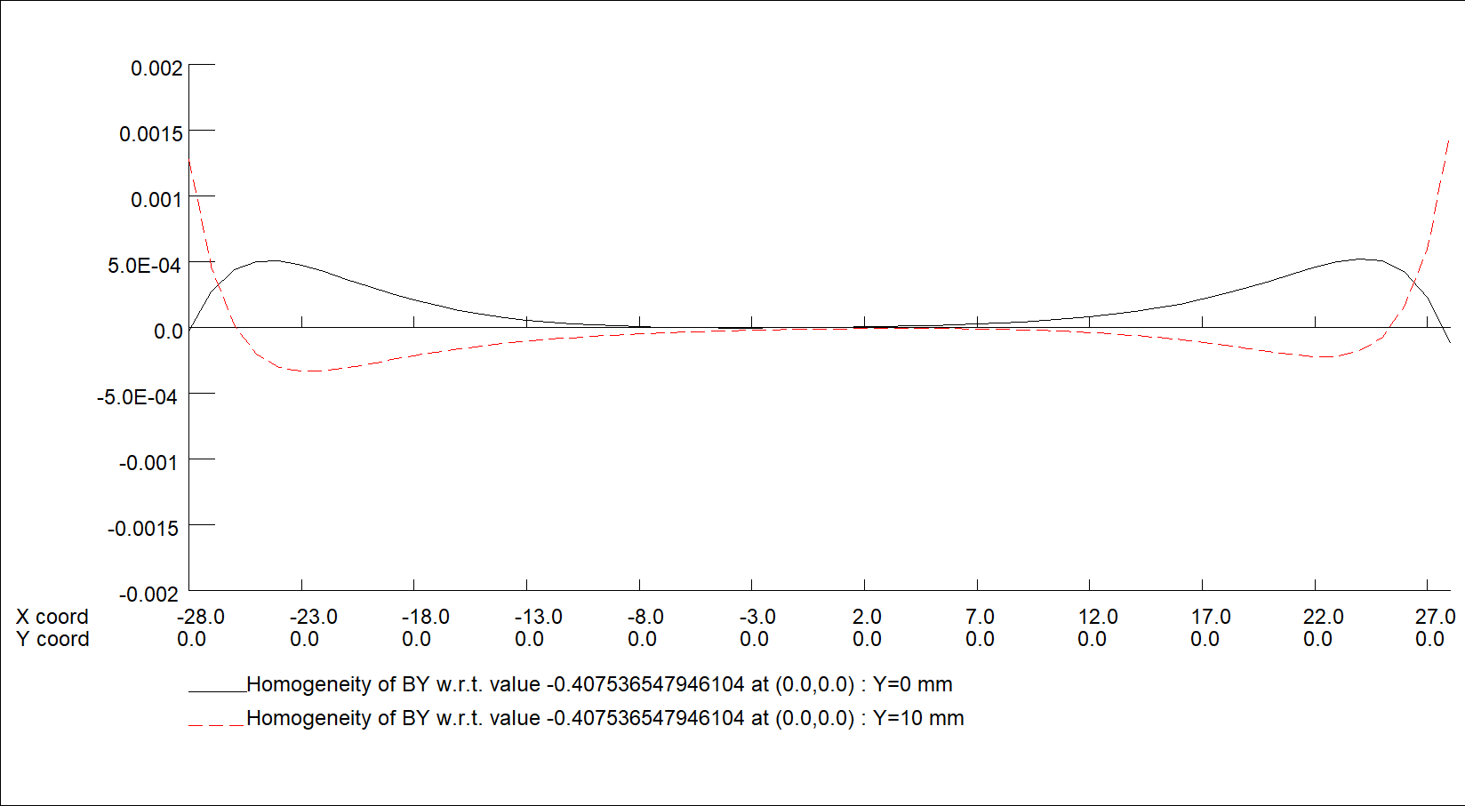
21
Dipole type B
2D modelling
DIH-B
DIC-B
Field homogeneity @ GFR = ±28 (Hor.) × ±10 (Vert.)

Slide 22
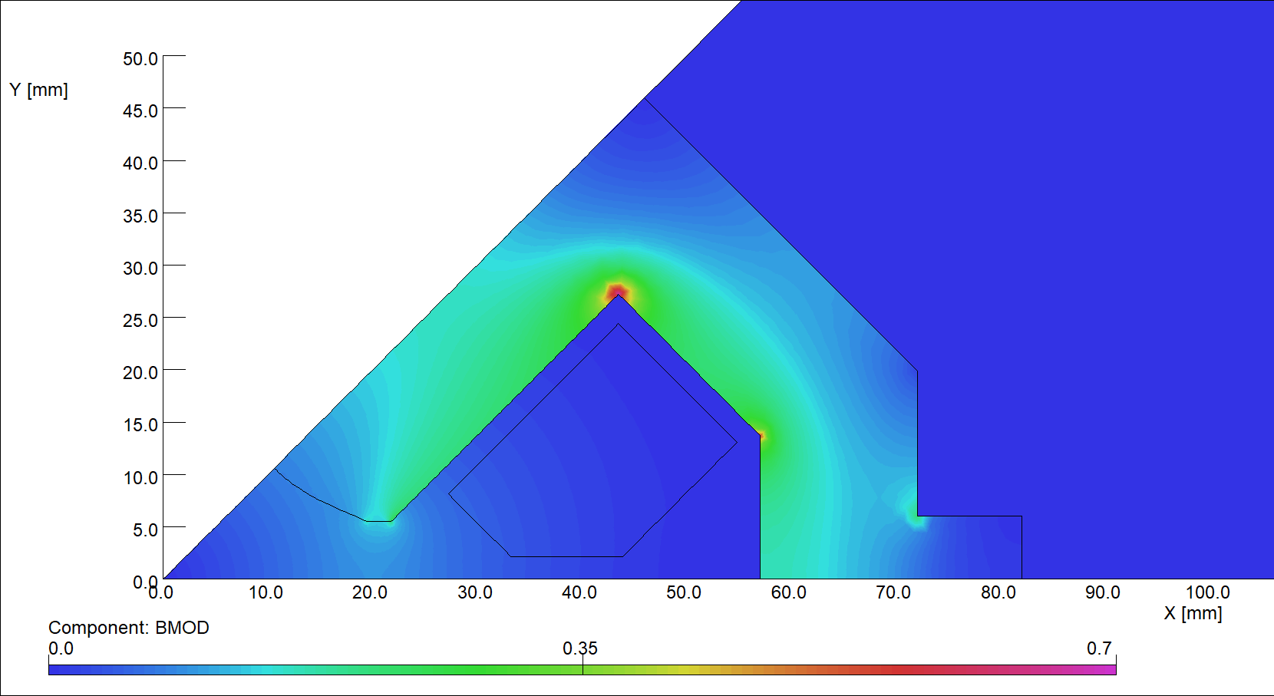
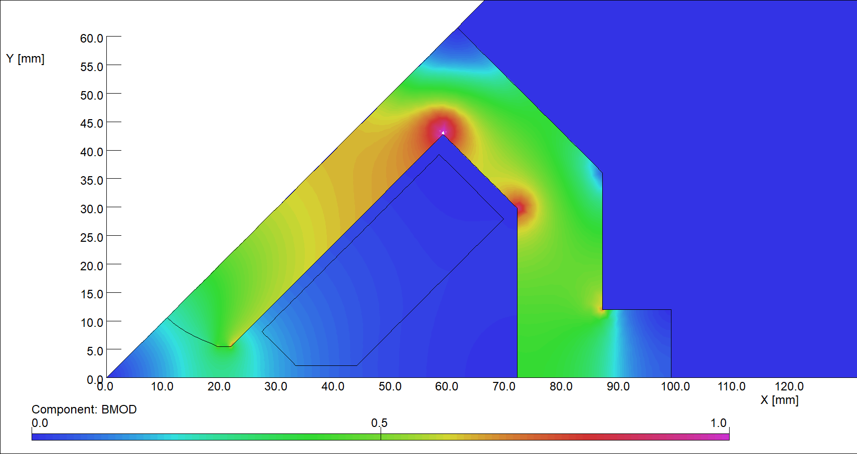
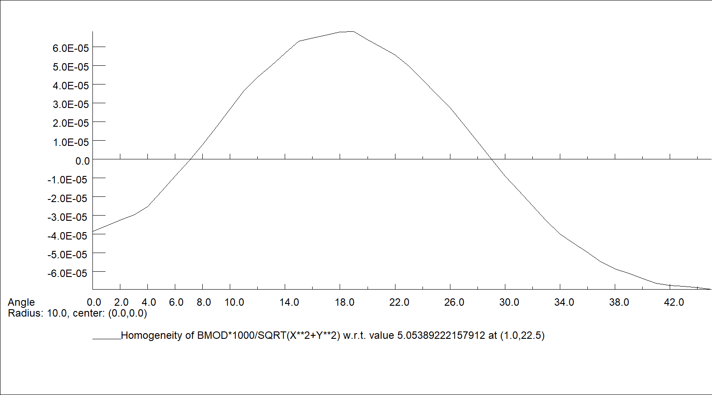
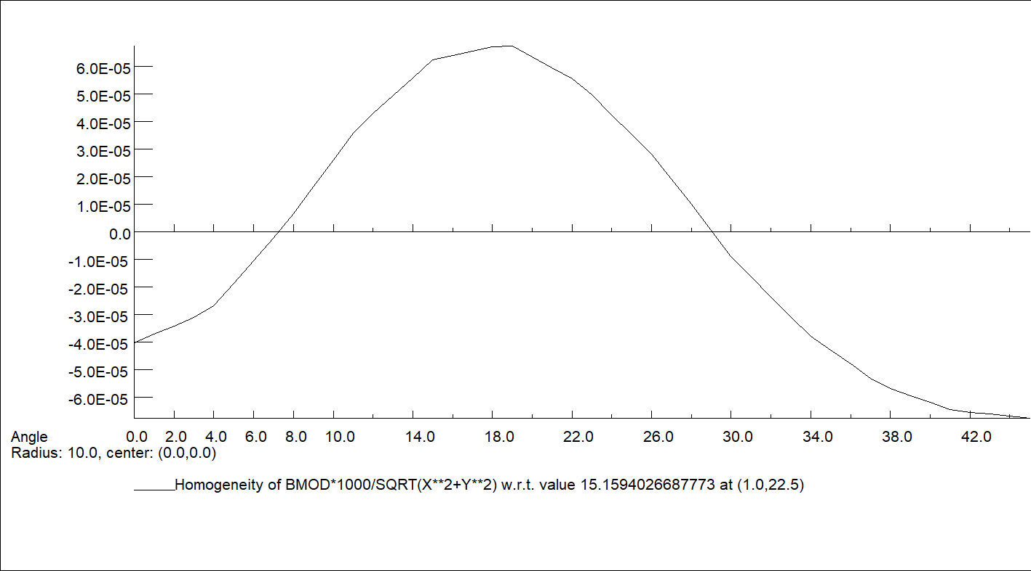
22
Quadrupole QA and QB
2D modelling
QA, 5 T/m
QB, 15 T/m
Field homogeneity @r=10 mm (good field region=2/3 aperture)

Slide 23
23
Cost estimate
only capital costs
 | DIPOLE TYPE A |  | DIPOLE TYPE B |  |  | QUADRUPOLES
 | H-yoke | C-yoke | H-yoke (1 pancake) | H-yoke (2 pancakes) | C-yoke | type A | type B | unit
Steel | 5.7 | 4.6 | 5.5 | 5.0 | 4.3 | 1.1 | 1.6 | %
Copper OF | 2.8 | 3.1 | 5.0 | 4.4 | 4.6 | 0.6 | 1.0 | %
Yoke manufacturing | 31.5 | 26.0 | 25.8 | 23.2 | 18.9 | 17.5 | 21.8 | %
Coil manufacturing | 46.2 | 50.4 | 52.7 | 57.6 | 61.1 | 72.4 | 66.8 | %
Magnet assembly | 11.3 | 13.1 | 9.6 | 8.5 | 9.6 | 4.7 | 5.7 | %
TESTs + Measurements | 2.7 | 2.9 | 1.6 | 1.3 | 1.4 | 3.7 | 3.3 | %
Total | 100.0 | 100.0 | 100.0 | 100.0 | 100.0 | 100.0 | 100.0 | %
Total cost dipole Normalised to C-yoke | 1.1 | 1.0 | 0.9 | 1.1 | 1.0 |  |  | %
Learning curve, rate=98% | Dipole Type A |  | Dipole Type B |  |  | Quadrupoles |  | unit
 | H-yoke | C-yoke | H-yoke (1 pancake) | H-yoke (2 pancakes) | C-yoke | type A | type B
Manufacturing cost 1st magnet | 100.0 | 100.0 | 100.0 | 100.0 | 100.0 | 100.0 | 100.0 | %
Manufacturing cost last magnet | 85.8 | 85.8 | 87.6 | 87.6 | 87.6 | 86.2 | 87.8 | %
Manufacturing cost AVERAGE | 88.3 | 88.3 | 90.1 | 90.1 | 90.1 | 88.7 | 90.3 | %
TOTAL /1 MAGNET | 0.92 | 0.92 | 0.93 | 0.92 | 0.92 | 0.93 | 0.94 | %

Slide 24
PM vs EM comparison
Feasibility: Both technologies Permanent Magnets (PM) and Electromagnets (EM) are technically feasible
Capital costs: in total the EM option is by factor ~1.5 more expensive than the PM
  Main contributions to the price increase are from: (magnets, power and signal cables, power converters and cooling)
  PM more expensive for the Vacuum system: two transfer lines in parallel required for the initial 4 km
Running costs:
  The PM would require about a factor 10 less power (only for corrector magnets and ventilation)
  However, the EM power consumption is also low 2.0 MW (100% duty cycle): <10% to overall injector complex (In fact even less duty cycle 5-75%)
Tunability:
  PM: from 20 to 35% by mechanical shunt, only possible with pre-characterized field values (shim position), would take several weeks to adjust shunts for all magnets
  EM: ±100% by power converter

Slide 25
Conclusion on baseline choice
Feasibility Study Report - 2025
Operational flexibility is the main aspect to consider when choosing between magnet technologies:
If the are beam stability issues in the booster, a transfer energy increase can be beneficial.
If the booster could accept a lower energy beam at injection, reducing the transfer energy reduces the power consumption of the whole injector complex which is driven by the HE-linac.
Another argument for operational flexibility is the duty cycle of the injector complex, which varies between 5 and 75% depending on the operation mode. In particular, in the low-duty modes, the injector beam can be used for experiments beyond FCC physics and shot-to-shot variability of beam parameters, including the transfer energy, open the door to a very diverse physics program.
Conclusion & next steps:
At this stage, electromagnets have been chosen as the baseline technology due to the higher operational flexibility for the FCC and any science programme beyond the FCC.
EM design of the corrector magnets
Design optimization considering the manufacturing cost

Slide 26
Thank you for your attention.
26

