Slide 1



Progress towards HTS HFM
Magnet and Conductor Strategy
Amalia Ballarino, CERN
22/05/2025
Hofburg, Vienna

Slide 2
CERN: A. Ballarino, C. Barth, A. Baskys, D. Perini
CEA: T. Lecrevisse
PSI: B. Auchmann
KIT: B. Holzapfel, N. Bagrets
SPIN: A. Malagoli
INFN: L. Rossi, M. Statera
Univ. of Southampton: Y. Yang
Univ. of Vienna: M. Eisterer

Slide 3
HTS HFM Strategy
LDG Roadmap: “demonstrate the suitability of High-temperature superconductor (HTS) for accelerator magnet applications, providing a proof-of-principle of HTS magnet technology beyond the range of Nb₃Sn, with a target in excess of 20 T”
HTS Conductor
  Iron Based Superconductor (Ba-122)
  REBCO
HTS Magnets
  REBCO Coils

Slide 4
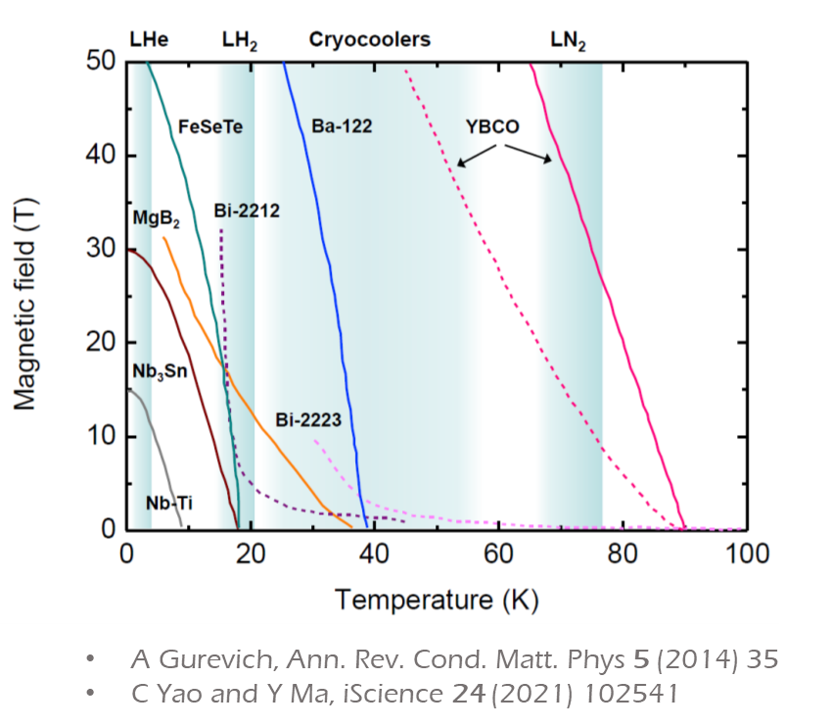
Iron Based Superconductors – Why ?
SppC in China: IBS Ba-122 baseline for 20 T – 24 T magnets (125 – 150 TeV) – with Nb₃Sn + REBCO as option
Bc2 ∼70 T @ 20 K
Tc ∼ 38 K
Low Anisotropy
Improved grain connectivity
Powder In Tube (PIT) technology for tapes and wires (used for Nb₃Sn, MgB₂, BSCCO 2212 and BSCCO 2223)
Potentially low cost
Better than Nb₃Sn
Better than HTS - REBCO

Slide 5
Ba-122 Iron Based Superconductor

Slide 6
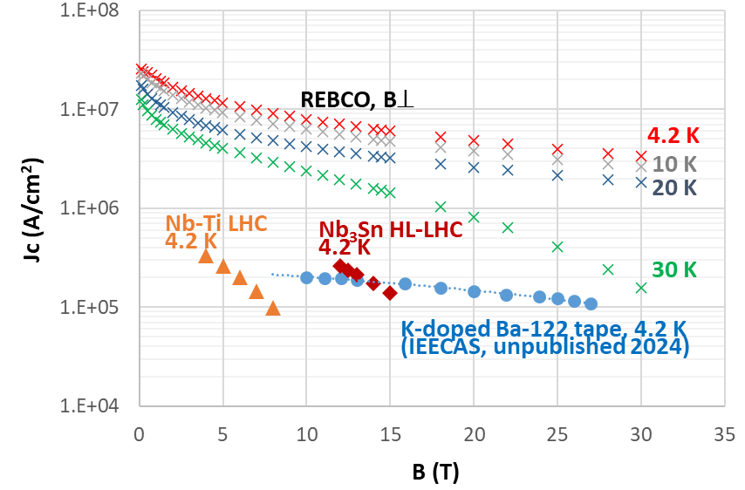
REBCO – Why ?
REBCO Performance refers to conductor recently procured by CERN in unit lengths > 200 m
Cost (E/m) reduced by a factor ∼ 3 in the last two years

Slide 7
SST - Shanghai Superconductor Technology
Courtesy of Bai Song

Slide 8

REBCO Production plan
Much more aggressive growth scenarios are possible, depending on market situation
Courtesy of Alexander Molodyk

Slide 9


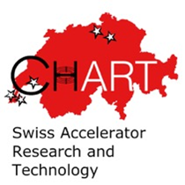








HFM HTS – A European Effort
9 Contributors
Magnets
Superconductors
Measurement of Superconductors/Studies

Slide 10
Topics on Accelerator Magnets Being Addressed
SPIN: a laboratory on iron-based superconductors
KIT: a laboratory on REBCO tape
TU Wien: pinning (irradiation) and quench protection studies
University of Southampton: AC losses and small coils (solenoid)
University of Twente: BSCCO 2212 cable qualification (and AC losses)
CEA: Metal Insulated Coils
PSI/Chart: Modelling of AC losses and electrically insulated coils
CERN: Electrically Insulated Coils and REBCO cables (other than stacks)
INFN: REBCO coils

Slide 11
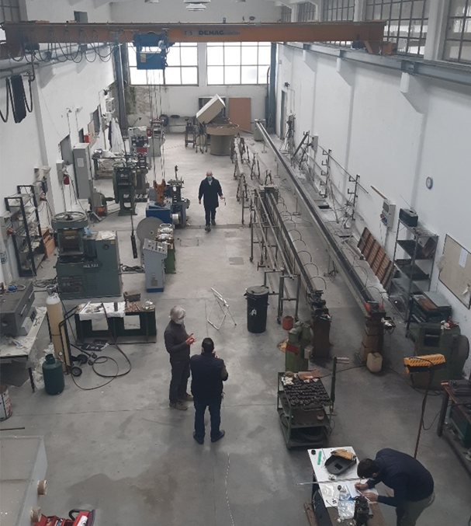
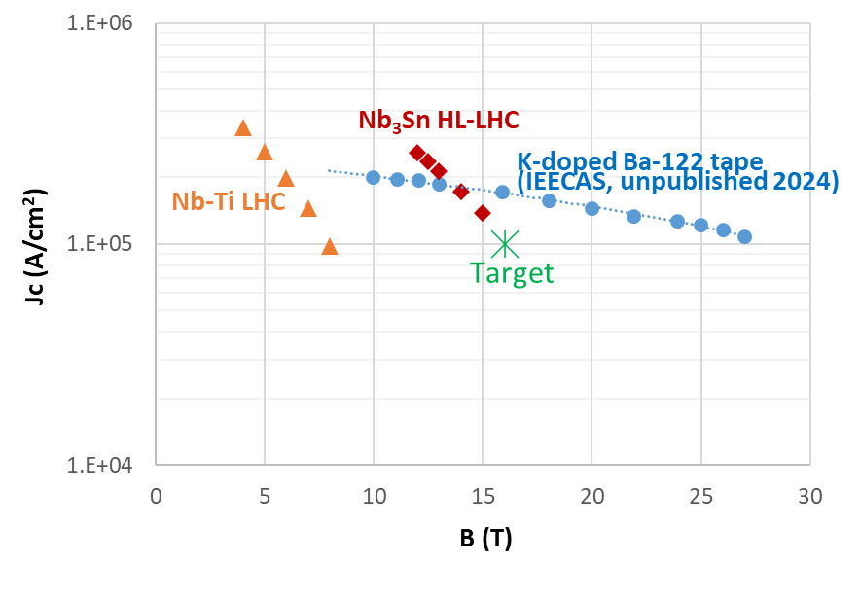
Iron Based Superconductors – SPIN (1/3)
IBS Laboratory at SPIN, Genova, to investigate potentials of IBS for high field magnets (A. Malagoli et al)
Ba-122
  Multi-filamentary Powder In Tube (PIT) Ba-122 round wire
  Investigation of wire layouts enabling React & Wind technology
  Target Jc: 10⁵ A/cm² @ 4.5 K and 16 T, 10⁴ A/cm² @ 20 K and 10 T
  Development of powder, development of optimized wire layouts and composition, production and qualification of multi-filamentary tape and wire (with unit lengths ≥ 100 m)
  Challenge: Jc across grain boundaries (inter-grain connectivity)

Slide 12
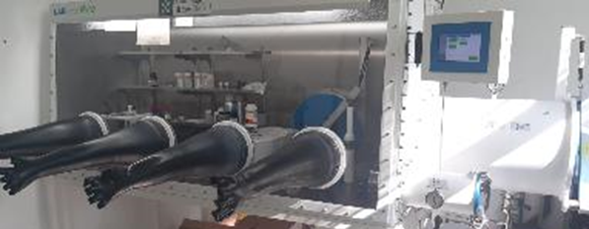
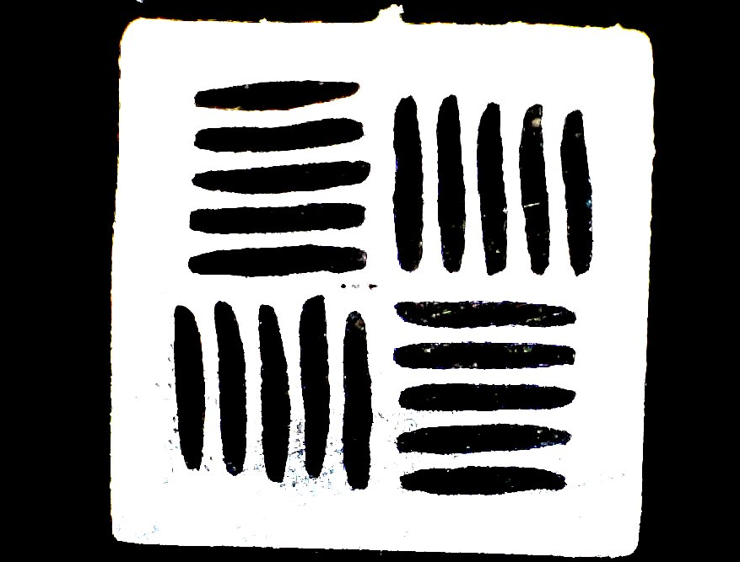
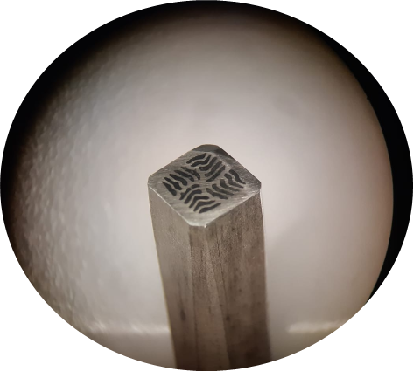
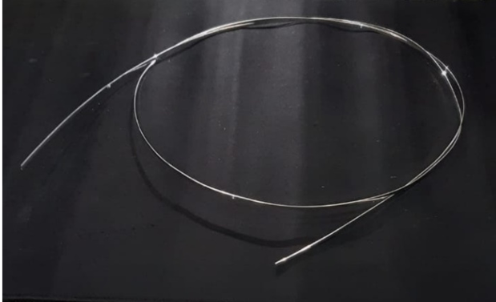
Iron Based Superconductors – SPIN (2/3)
Powder developed (see poster of E. Bellingeri “Impact of powder granulometry”, today). Required both quality and quantity (today ∼ 50 g/week). K doping (K-Ba 122) and study of effect of excess of K doping on grain size
First multi-filamentary tapes and wires produced. Study of different sheath architectures, with Ag and Nb identified as good options as chemical barriers
  Working on multi-filamentary wire architecture on-going. New architectures being studied for better grain alignment and reduction of grain boundary misorientation - to improve intergrain connectivity
Innovative multi-filamentary architecture
10 m multi-filamentary

Slide 13
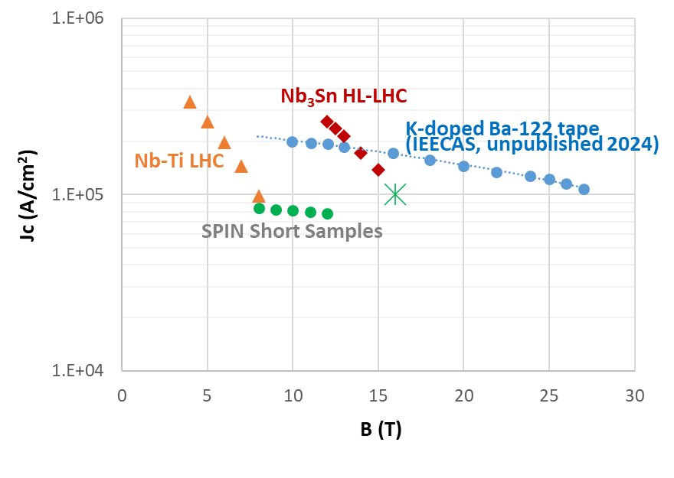
Ba-122 multi-filamentary wire/tape at SPIN (3/3)
Target
Mono-filamentary

Slide 14

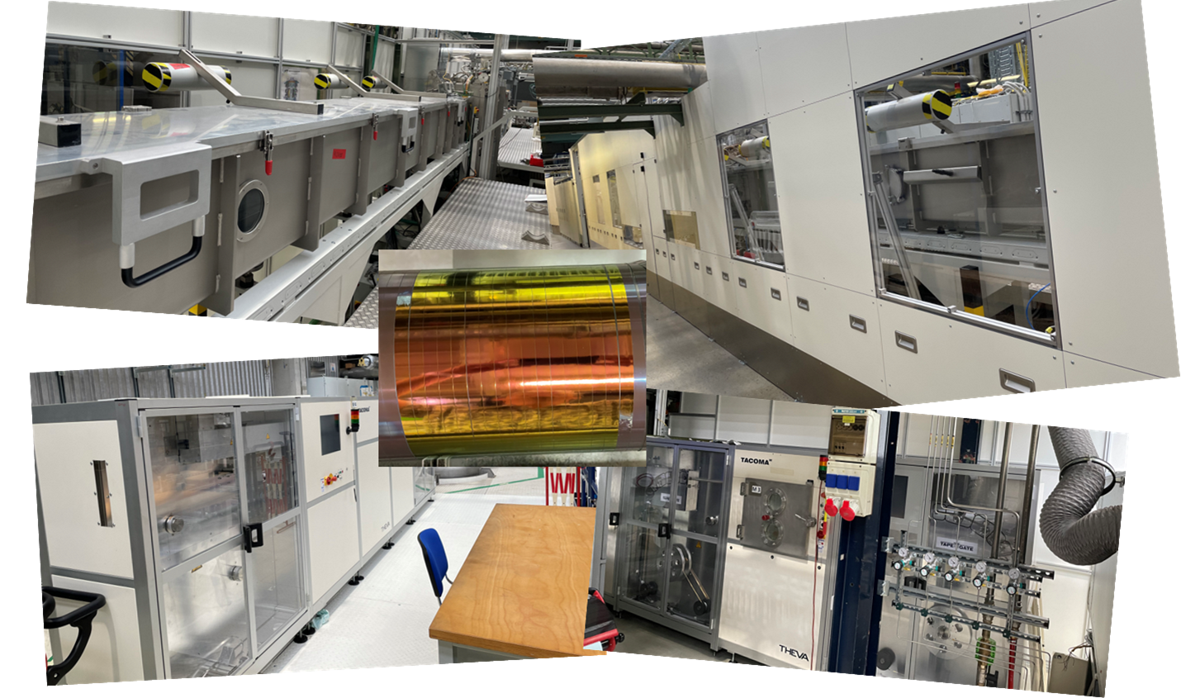
REBCO Tape – KIT (1/2)
KIT-CERN Collaboration on Coated Conductors
Laboratory bridging the gap between basic materials research and large-scale production in industry (B. Holzapfel, N. Bagrets, et al)
Transfer to KIT of BRUKER HTS R&D-line. Operational at KIT since March 2024
IBAD/PLD CC. IBAD MgO tapes procured. At KC⁴: PLD buffer and REBCO deposition, Ag coating, O₂ loading, Cu plating
Tailored developments. Present focus:
  Understanding and improving internal resistance in between layers of a tape;
  Implementing REBCO on both sides of the tapes;
  Implementing filamentization in REBCO layer

Slide 15

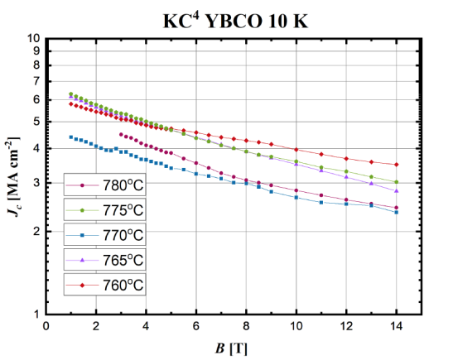
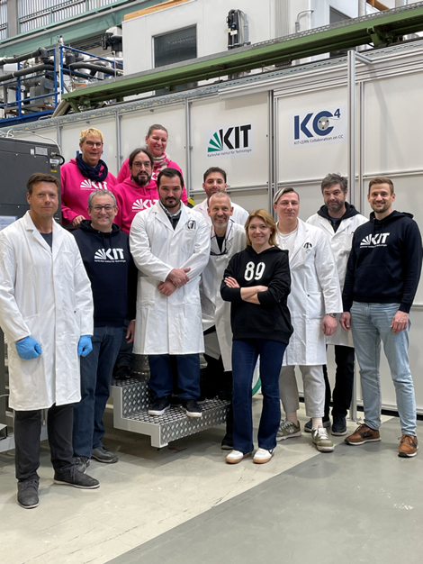
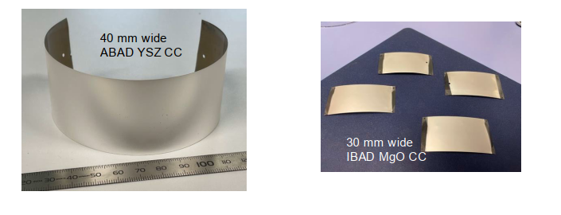
REBCO Tape – KIT (2/2)
KIT-CERN Collaboration on Coated Conductors
More than 50 m of tape delivered
to CERN for qualification
Wide (30 mm - 40 mm) tape development. Activity for HIGHEST-I.FAST
(High-Gradient RF Applications, S. Calatroni)

Slide 16
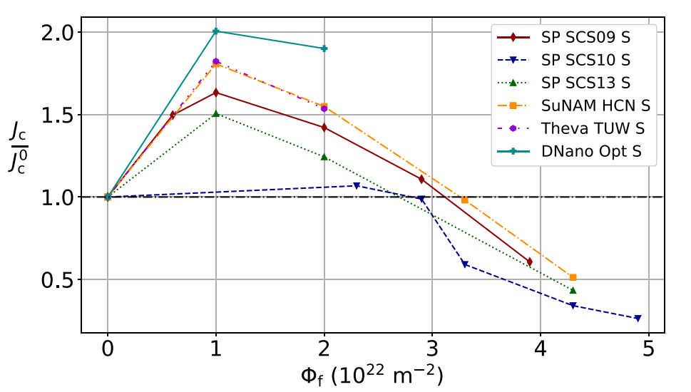
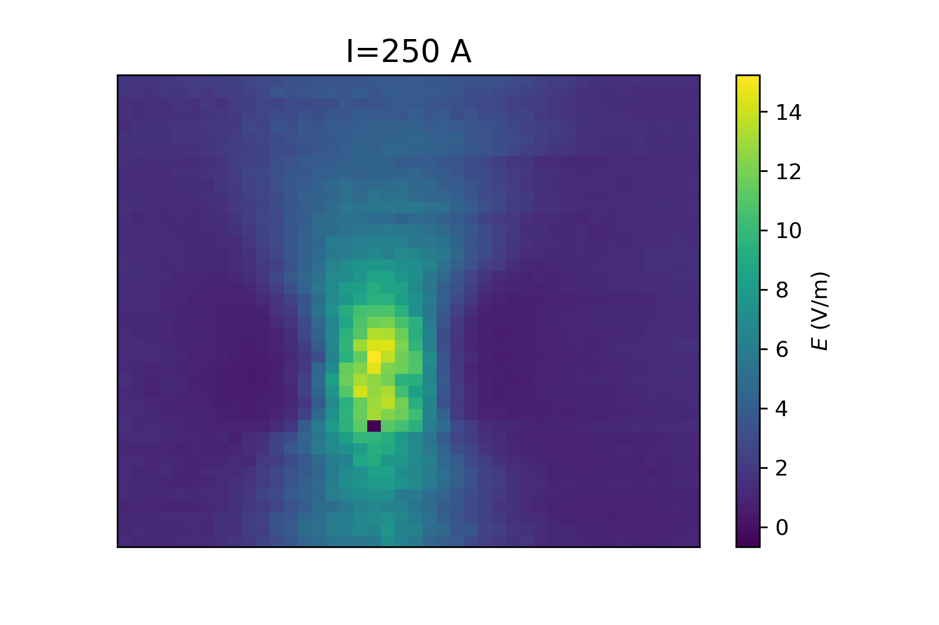
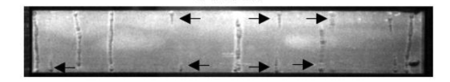
TU Wien – Pinning and hot-spot formation
Change of critical current between 4.2 K and 30 K: balance between cooling costs and conductor performance.
Full angle dependence: I_{c}(B, T, θ).
Benchmarking with fast neutron irradiation experiments. I_{c} not optimized in state-of-the-art conductors?
Better understanding of hot-spot formation at over-currents:
  Local measurement of electric field
  Local measurement of current density
  Local dissipation
Spatial resolution: 100 µm
Increase by 50-100% due to irradiation
Local electric field around defect
Bubble formation in liquid nitrogen
(Previous work at Grenoble)

Slide 17

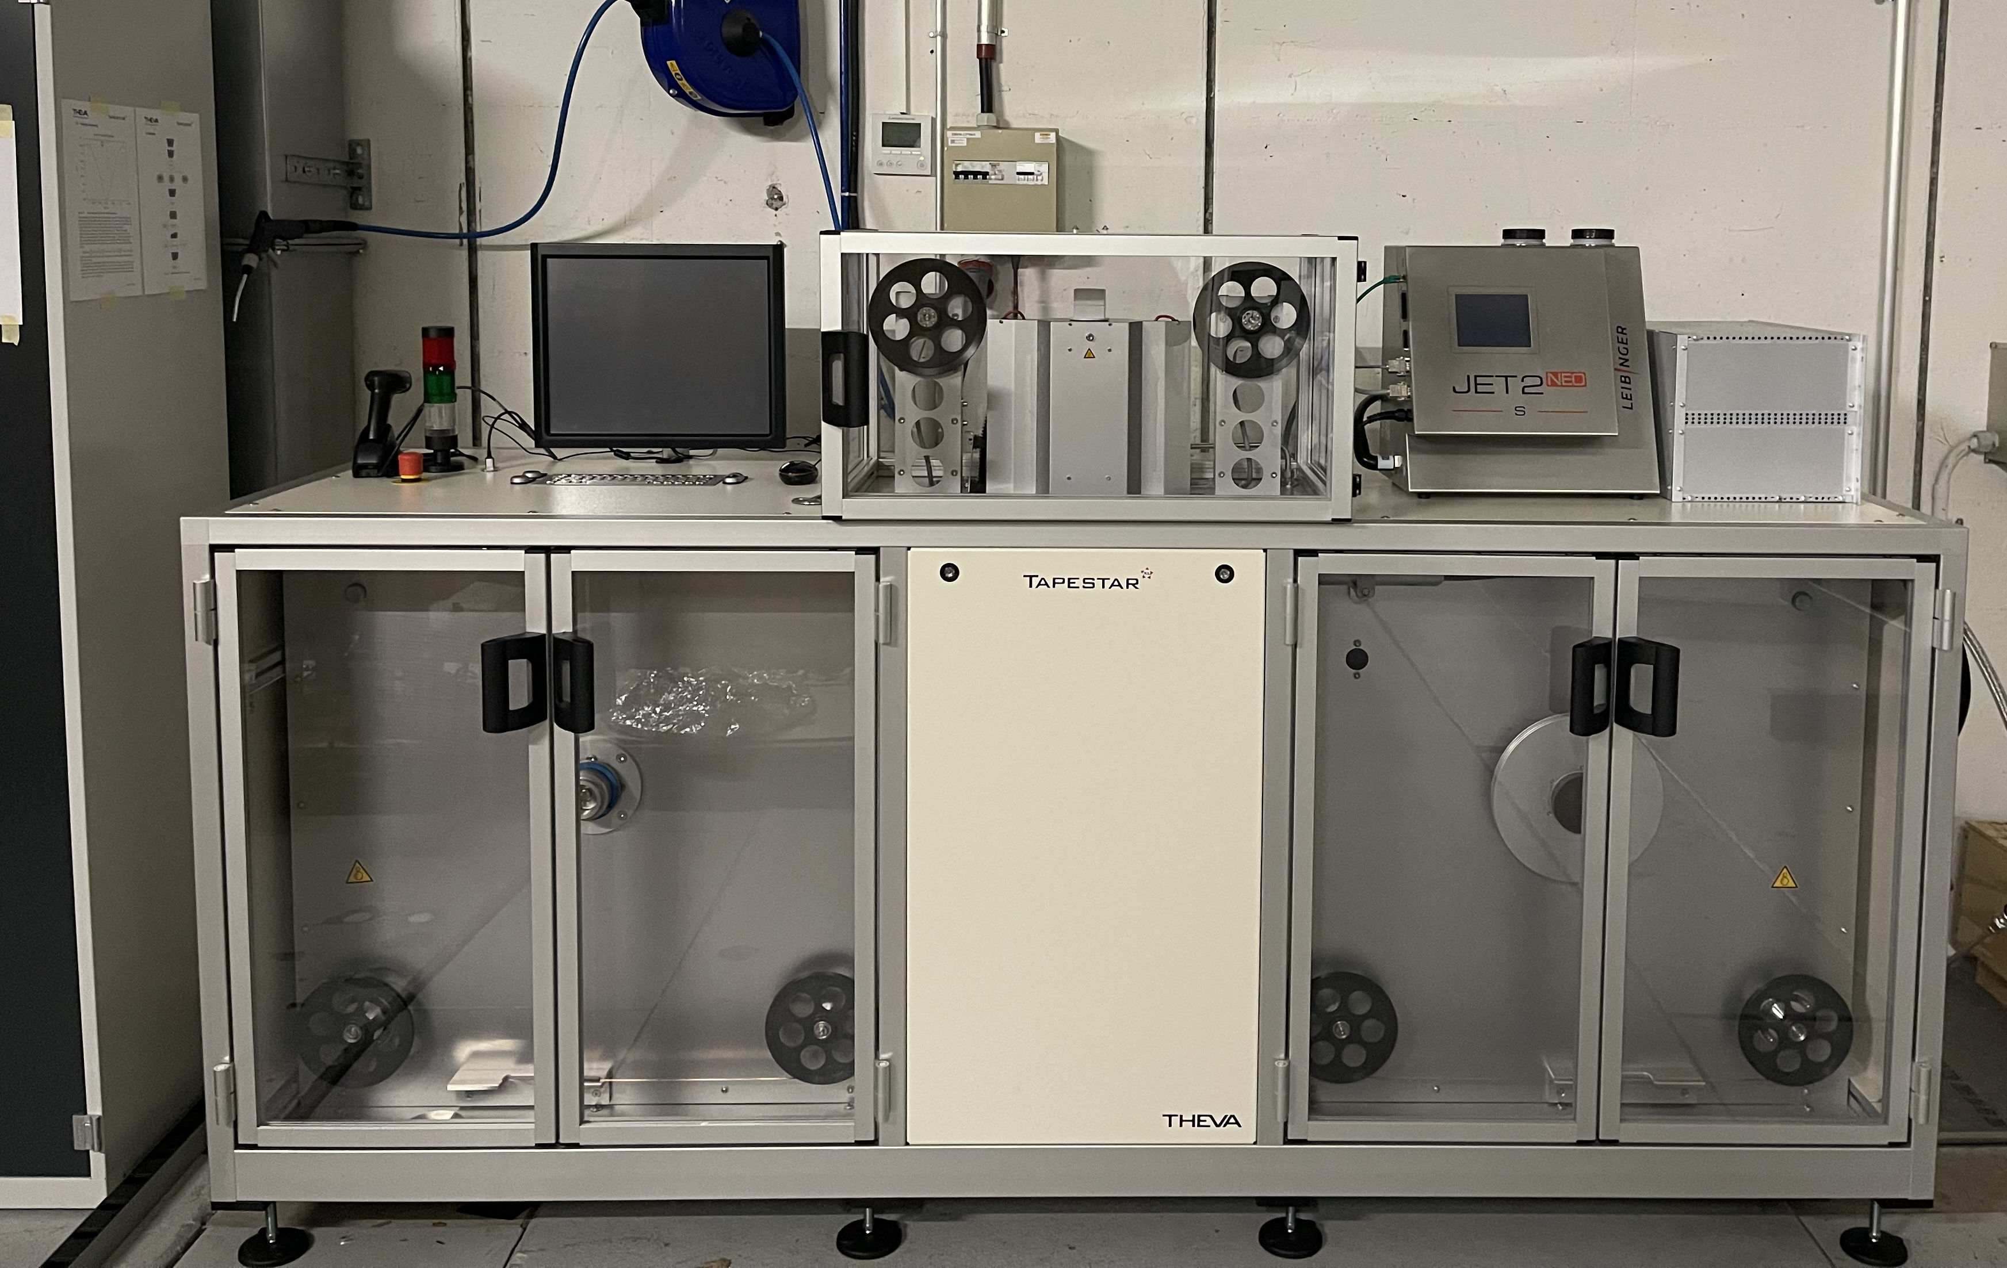
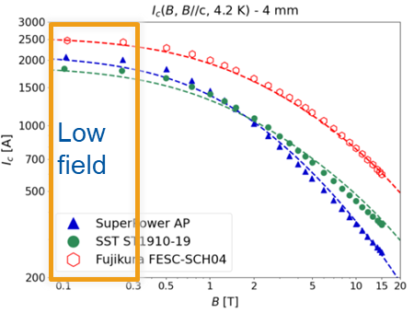
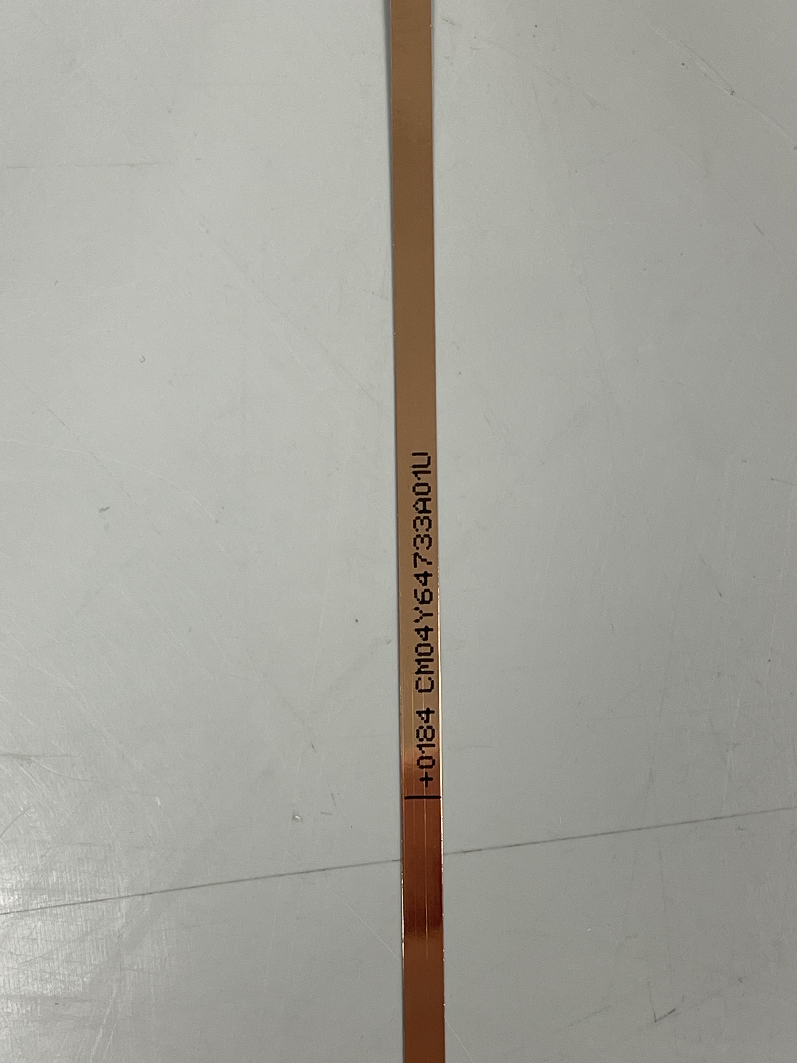
REBCO Tape – CERN (1/2)
Procured 33 km of tape from different manufacturers (2, 4 and12 mm width)
Unit lengths of up to 850 m (for a 4 mm wide tape)
Defining and performing QC measurements
TAPESTAR™ (reel-to reel critical current measurement)
Tape marking and width/thickness measurement

Slide 18
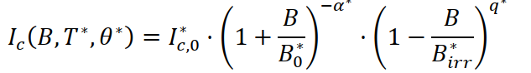
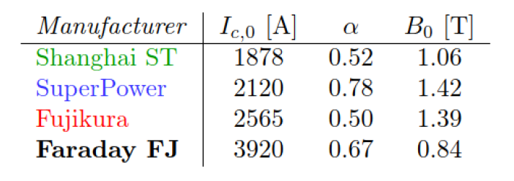
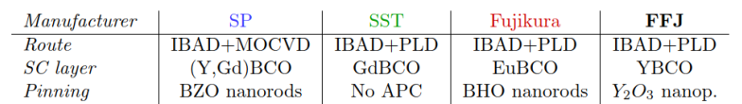
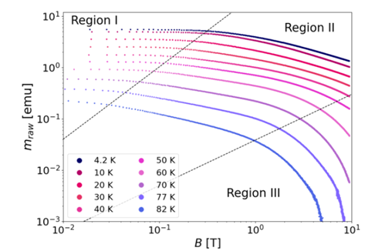
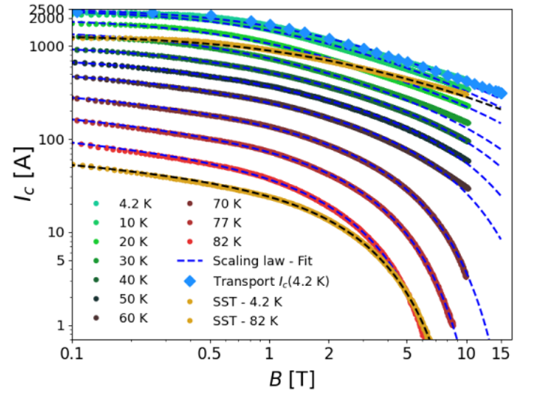
REBCO Tape – CERN (2/2)
Scaling law – covering also the low field region
G. Succi, PhD thesis, SOTON and CERN
Pinning in REBCO
Temperature dependence

Slide 19
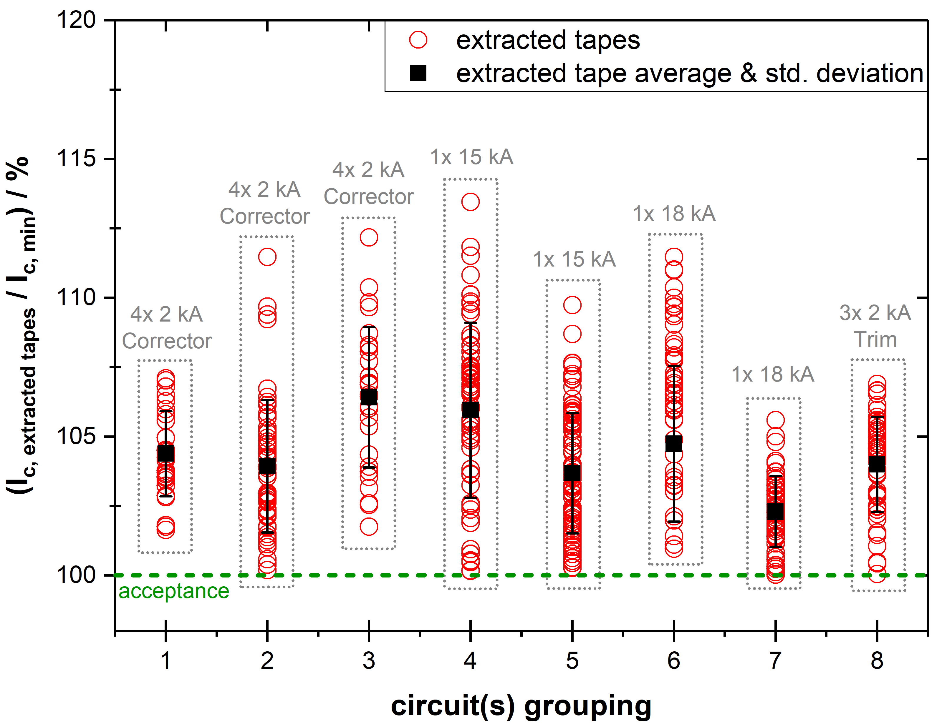
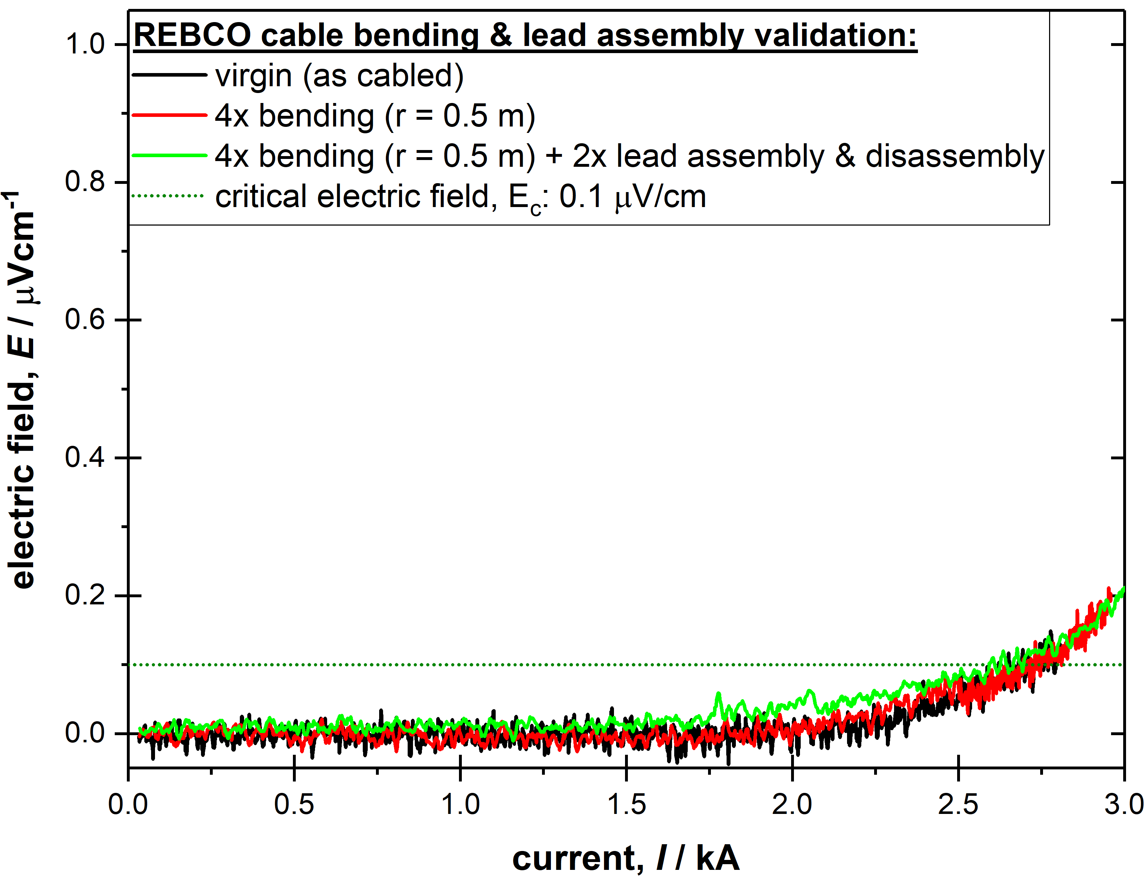
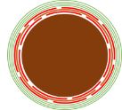
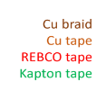
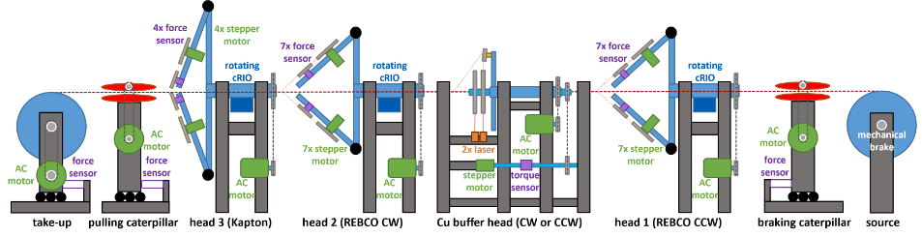
REBCO Cables – CERN
REBCO in HL-LHC
No cabling degradation
No bending degradation
CERN Cabling Machine

Slide 20
CERN – From Racetracks to Common Coil
Single-layer and double-layer racetracks
- Multi-racetrack and Common Coil
- Common Coil
Phase 1
Phase 2
Phase 3
Qualification also at T > 4.2 K (10 K – 20 K)
Stack cable. Program used also for validating other cable geometries
Φ_{BORE}
20 mm
Φ_{BORE}
50 mm
Double aperture
Double aperture

Slide 21
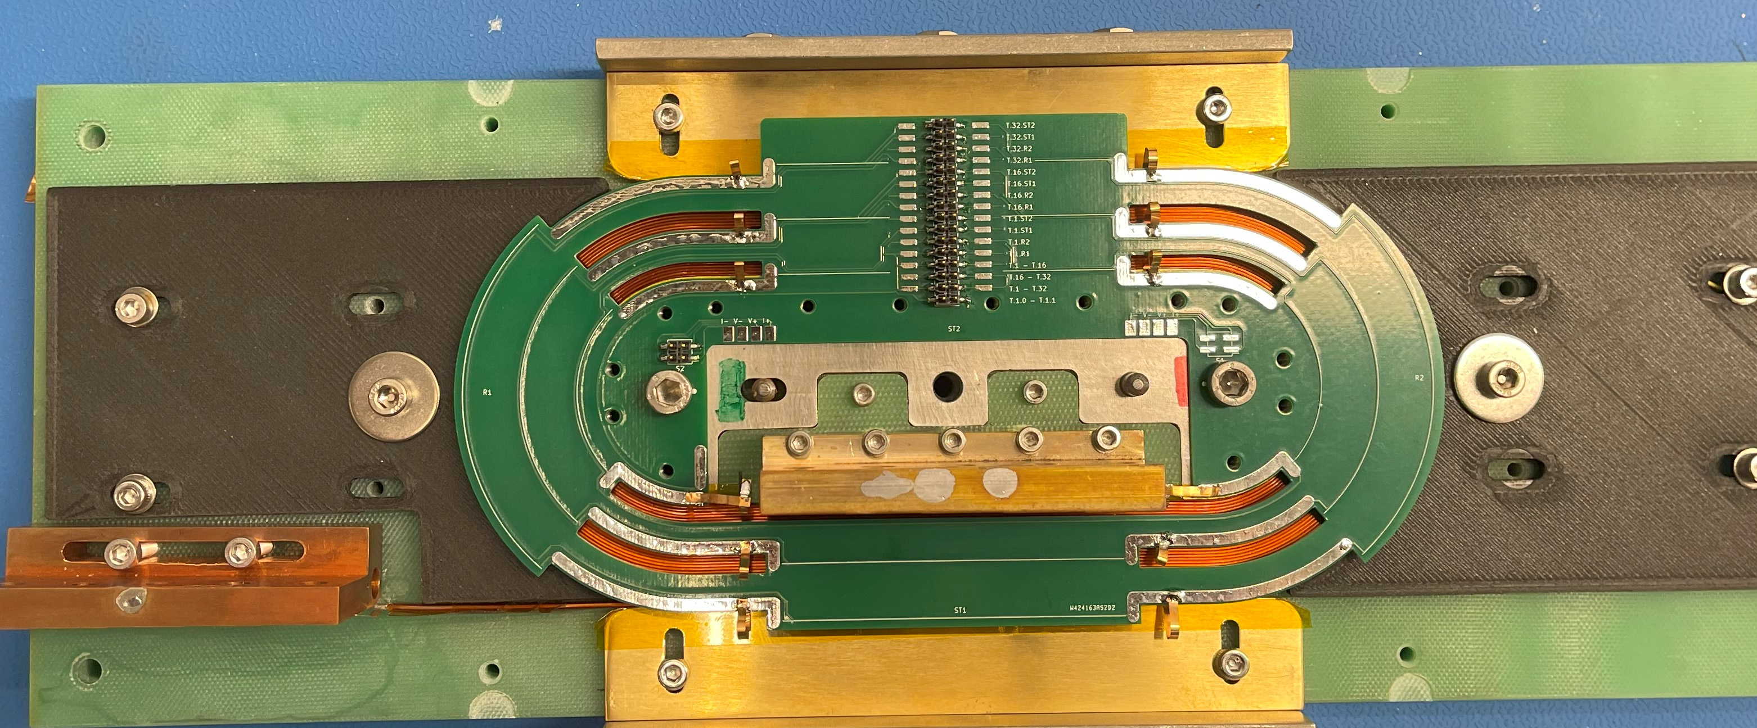
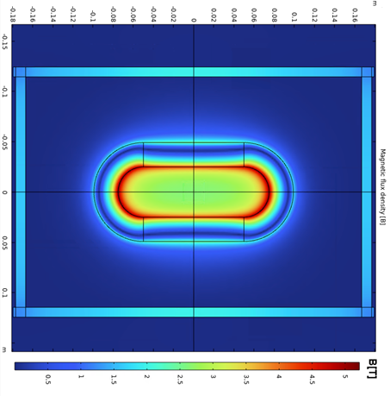
CERN Coils – Recent Achievements
Phase 1
Single racetrack
Produced several single-layer and double-layer racetracks and qualified them in liquid nitrogen and one in liquid helium. In-house made winding machine
The cable is a stack of tapes electrically insulated: 4 REBCO tapes, 2 copper tapes, Kapton® electrical insulation
Measured double racetrack at 4.2 K . Reached the design field: 2.72 T in the central hole (5.2 T peak field in the conductor)
Double racetrack
A. Baskys
A. Baskys
380 mm
2.72 T @ 2 kA
4.2 K
1 Thermal cycle
No training quenches

Slide 22
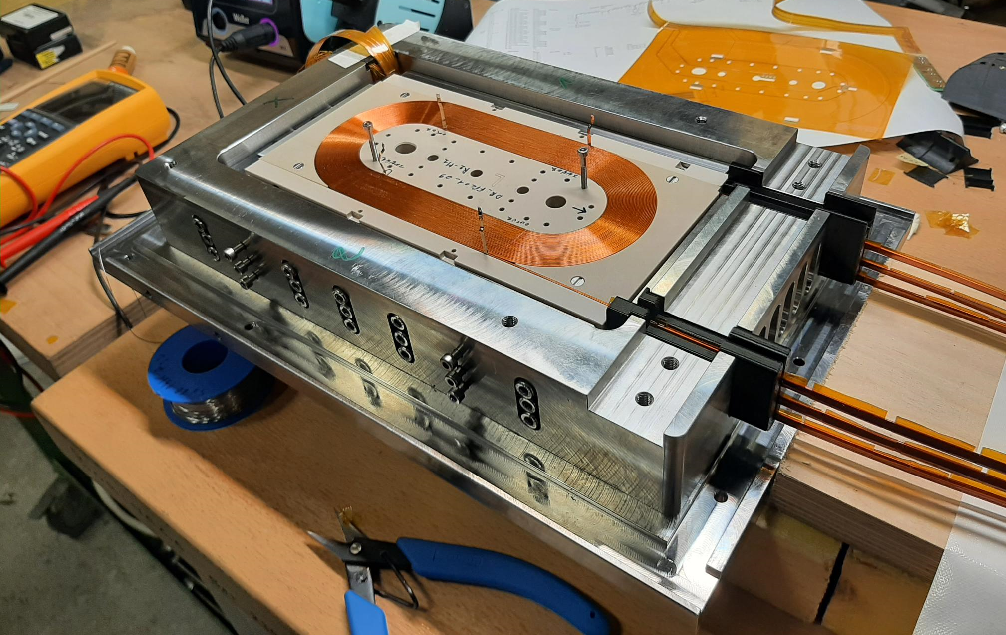
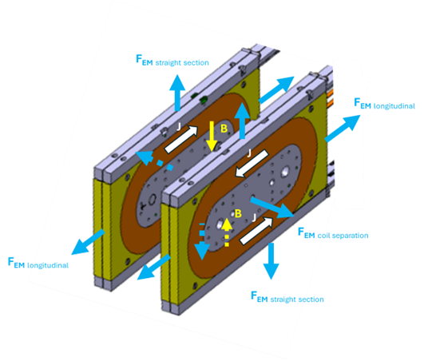
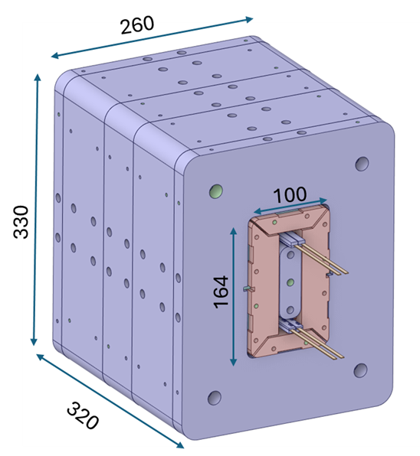
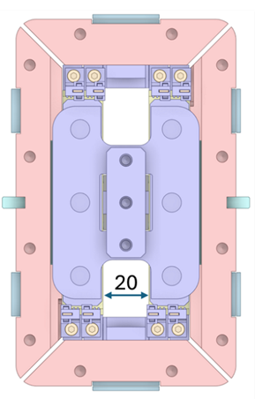
CERN Coils – Recent Achievements
Phase 2
Three double racetracks
Assembled three double racetracks in a mechanical structure. Design field: 5.4 T at 4.2 K in the central hole (8.8 T peak field in the conductor). Measured in liquid nitrogen: 1.12 T in the central hole. Measurements in liquid helium in the following weeks
Common coil dipole, 20 mm bore, by end 2025
2+2 Double racetracks
4 mm wide tape
∼ 5 T @ 4.2 K in the center of each bore (Φ = 20 mm)
∼ 9 T @ 4.2 K in the center if six double racetracks in series

Slide 23
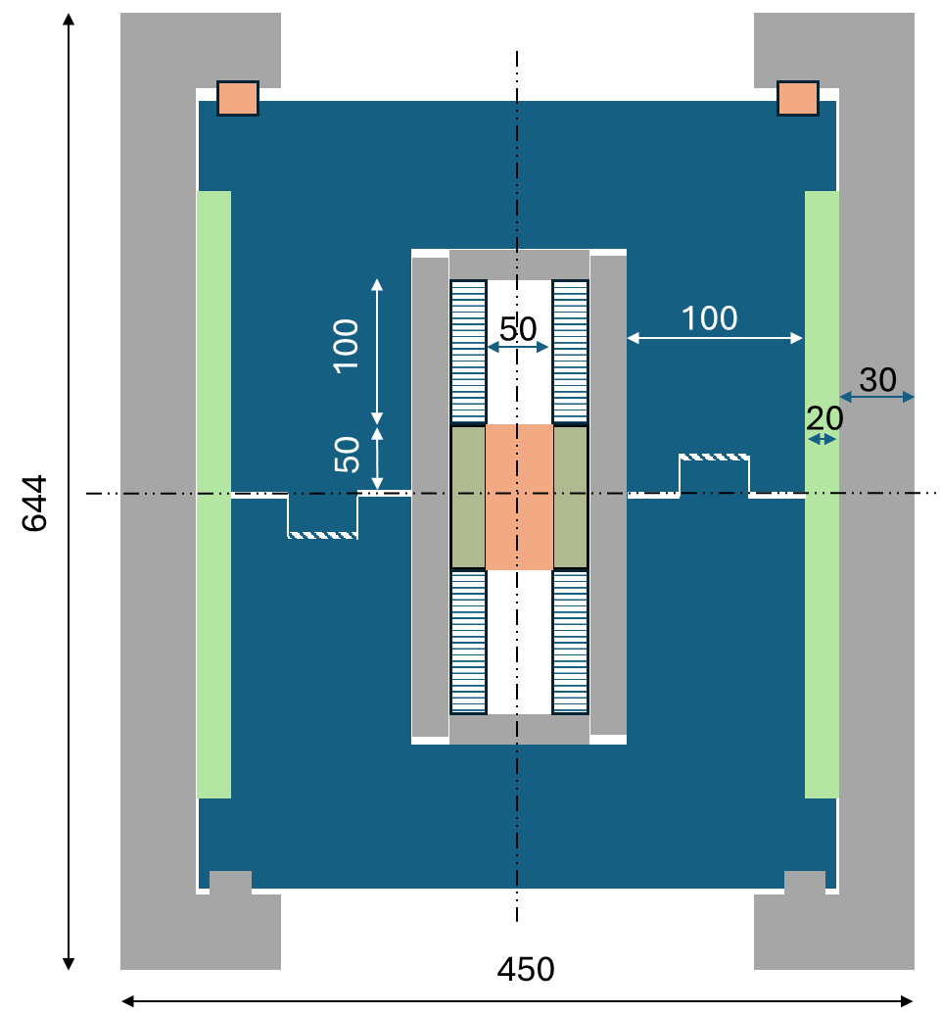
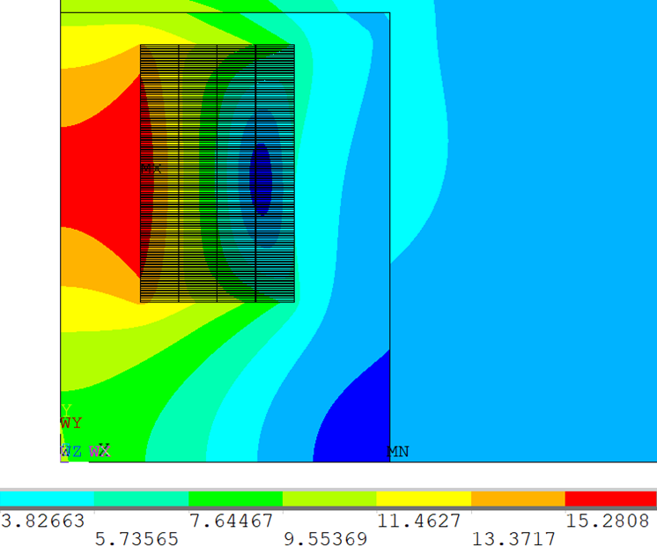
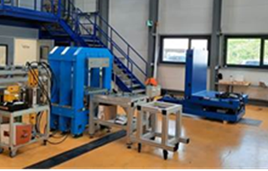
CERN – Larger aperture, higher fields
Phase 3
14 T – 50 mm bore
2+2 Double racetracks
12 mm wide tape
∼ 14 T @ 4.2 K in the center of each bore (Φ = 50 mm)
Magnet assembly line
under commissioning
D. Perini

Slide 24
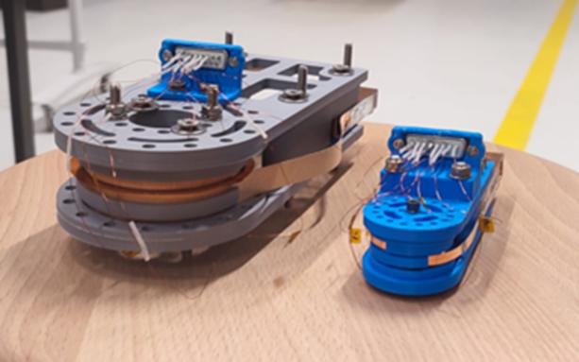
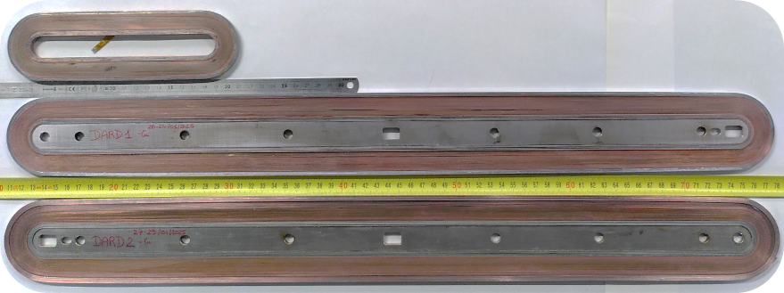
HFM HTS Activities
CEA
PSI
Single and double racetracks wound with single REBCO tape (4 mm width). Tape procured by CERN. Racetrack length: 140 mm and 600 mm
Metal Insulation to ease protection: co-winding of REBCO tape with 30 µm thick Durnomag® tape
Iop = 670 A @ 4.2 K (∼ 1600 A/mm²)
B_{center}= 3.6 T, B_{peak}=8.2 T @ 4.2 K
Modelling (with LittleBeast) and measurement (at University of Twente) of AC losses of REBCO coils
  Electrically insulated stacks of two soldered REBCO tape. Soldering during winding to ease quench protection
  Study of REBCO Block Coil dipole - scaling with temperature (5 K – 30 K)
140 mm
600 mm
See this afternoon presentations by E. Rochepault (CEA), B. Auchmann (PSI), A. Pampaloni (INFN)

Slide 25
Conclusions
In Europe work on HTS high field accelerator magnets is on REBCO. There is development of IBS Ba-122 wire and interesting results have already been achieved
REBCO is an enabling material (B > ∼ 15 T and/or T > ∼ 5 K). However, focused R&D and innovation efforts are required to establish the technology and fill the gap between HTS and LTS. Accelerator technology has specific and challenging requirements that ask for dedicated R&D
Ongoing activities address identified challenges via a coordinated effort between laboratories and academia
Small 5 T -10 T REBCO coils are the present focus. This is a required intermediate step toward higher fields and accelerator quality magnets

