Slide 1
Optimizing Magnet Production Plan: Insights from Simulations
22/05/2025 FCC Week 2025
Miłosz Artur Zieliński
Milosz Artur Zielinski 22/05/2025
Many thanks to the members of the Normal Conducting Magnets section, Damien Lafarge (CERN), Benedikt Müller (Fraunhofer IML), and Felix Blum (Simplan)

Slide 2
Agenda
Equipment to be produced
Details of the production process
Simulation tool used
Production Model in Plant Simulation
Estimating number of processing stations and buffer size
Study outcomes
Next steps and further developments

Slide 3
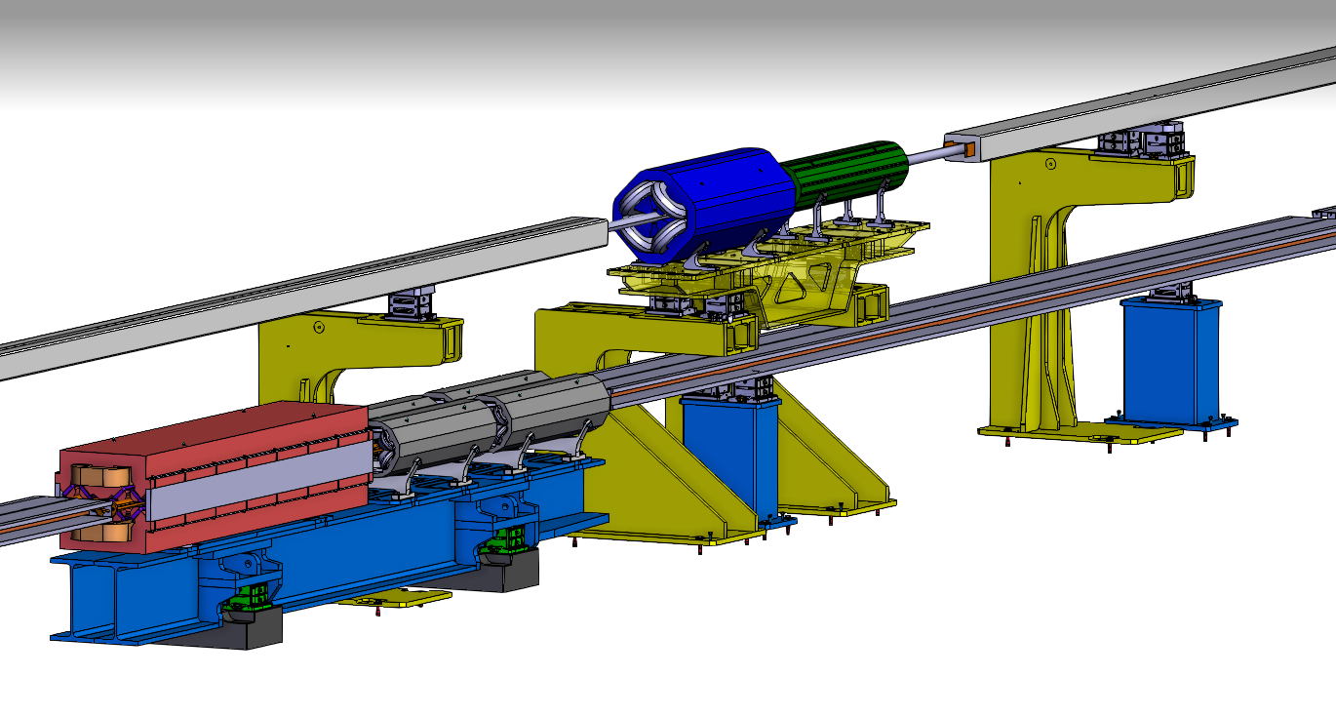
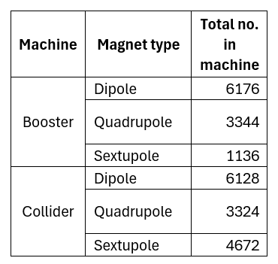
Equipment to be produced
Courtesy of Emeric Bernard

Slide 4
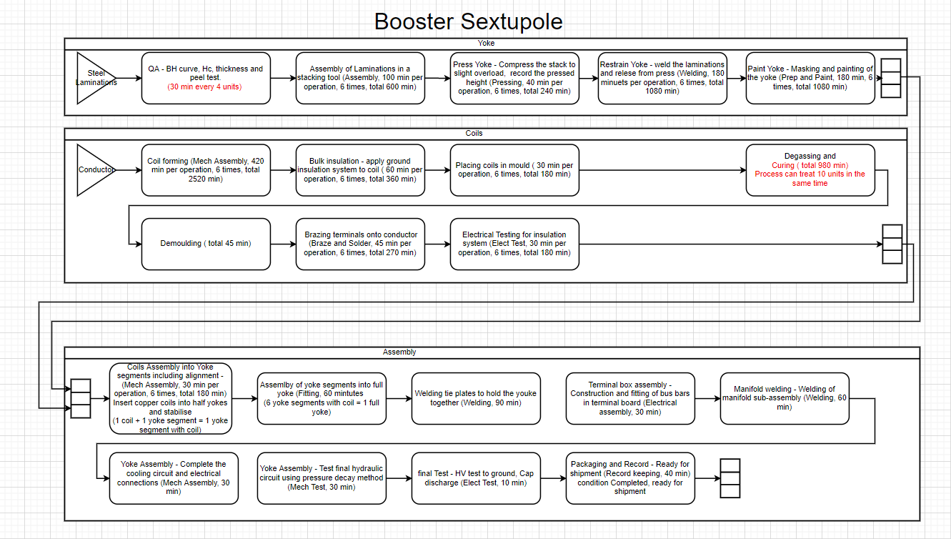
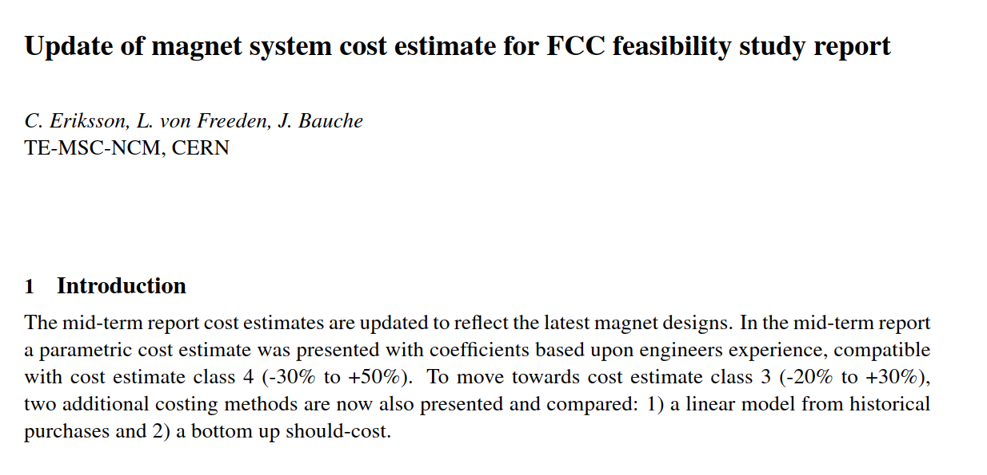
Production process details

Slide 5
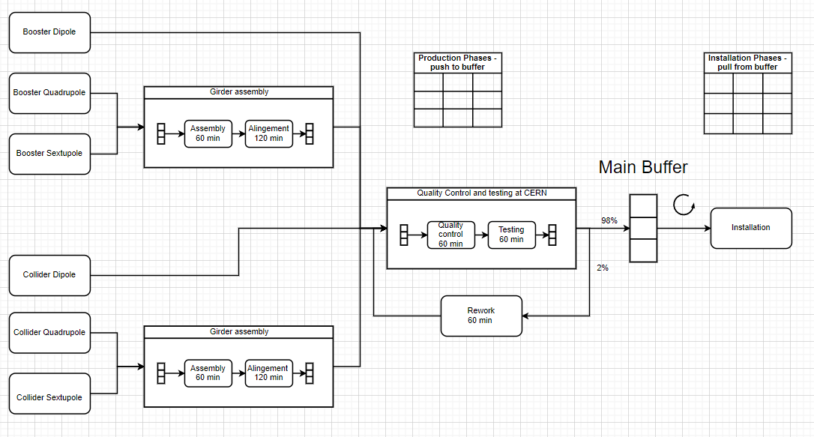
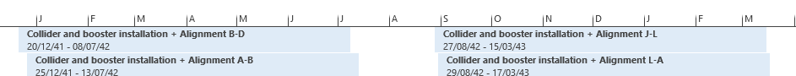
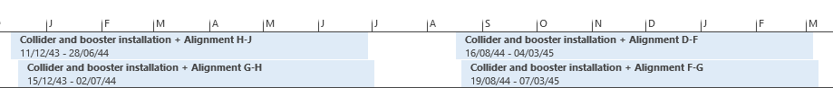
Production process details
Courtesy of Sarah Fleury

Slide 6
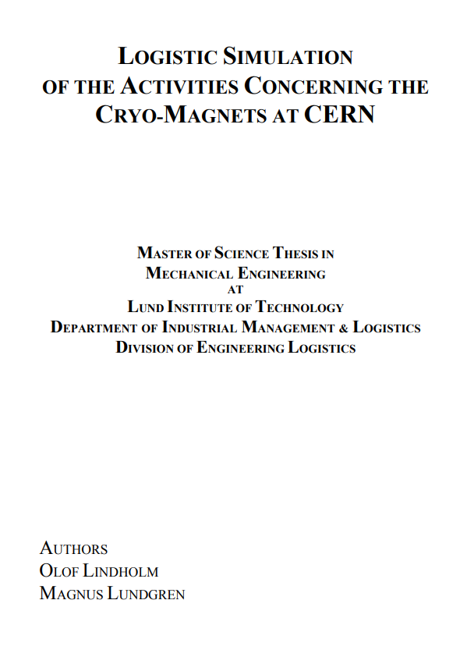
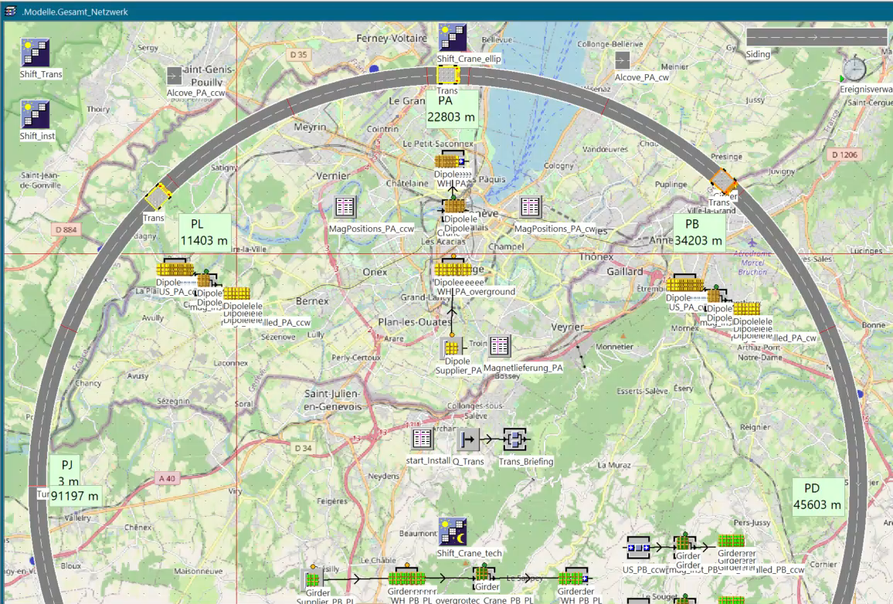
Simulation tool
Notes:
Optimizes production processes and logistics
Plans material movement, workforce, and equipment
Identifies bottlenecks and evaluates scenarios
3D visualization for facility layouts and component transport
Integrates real-time data for adjustments

Slide 7
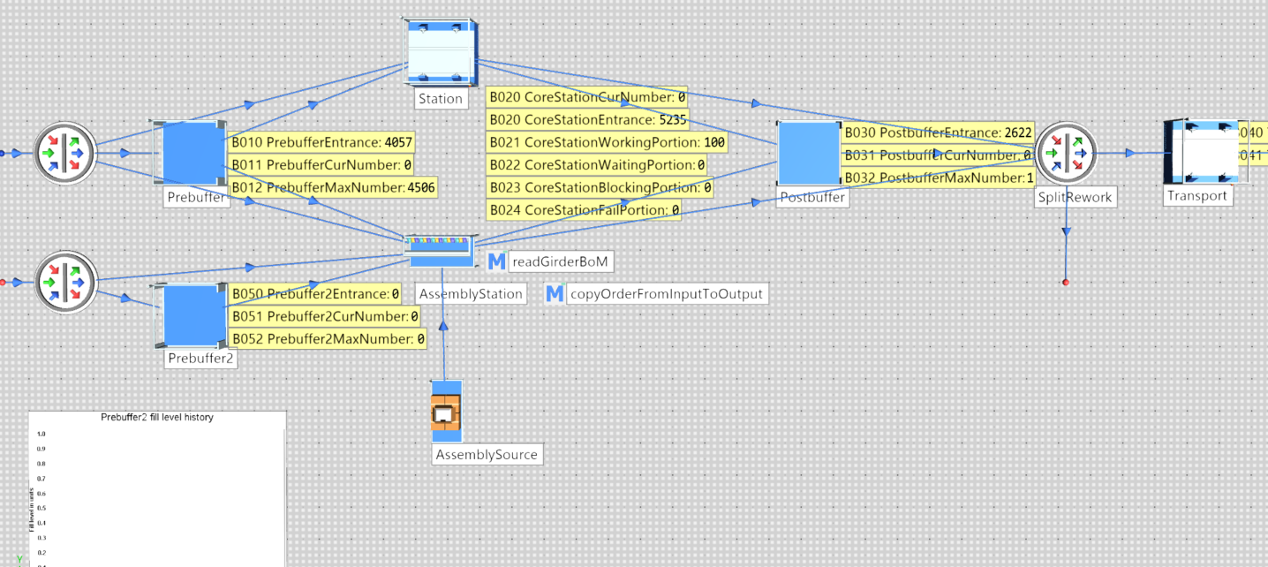
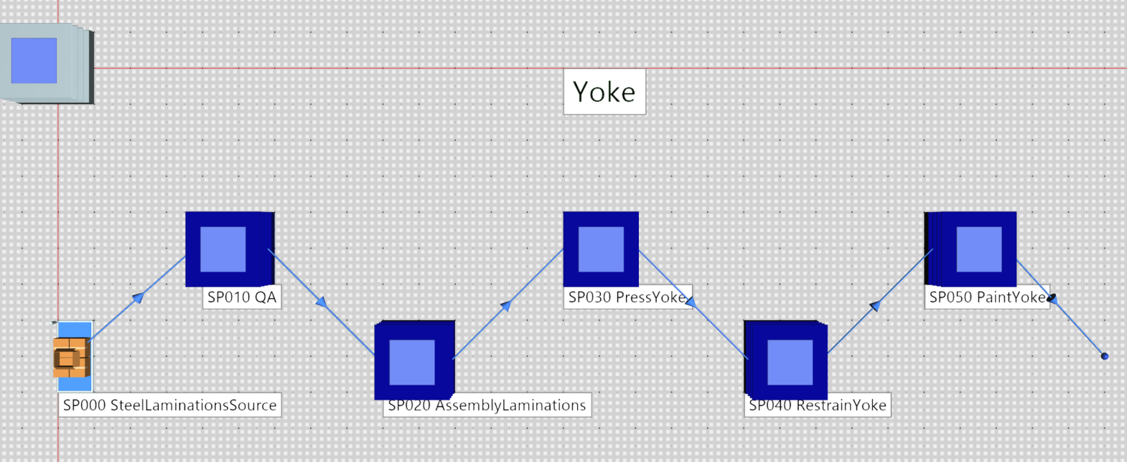
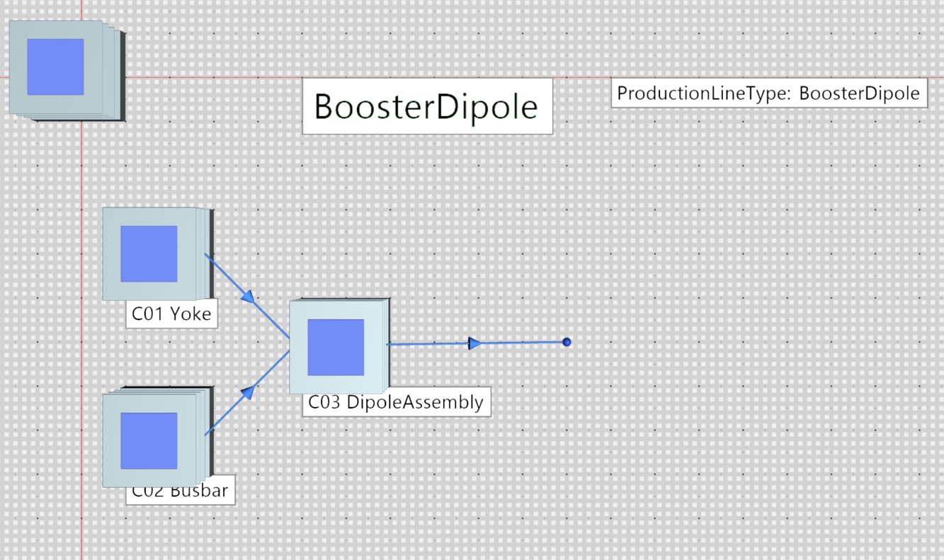
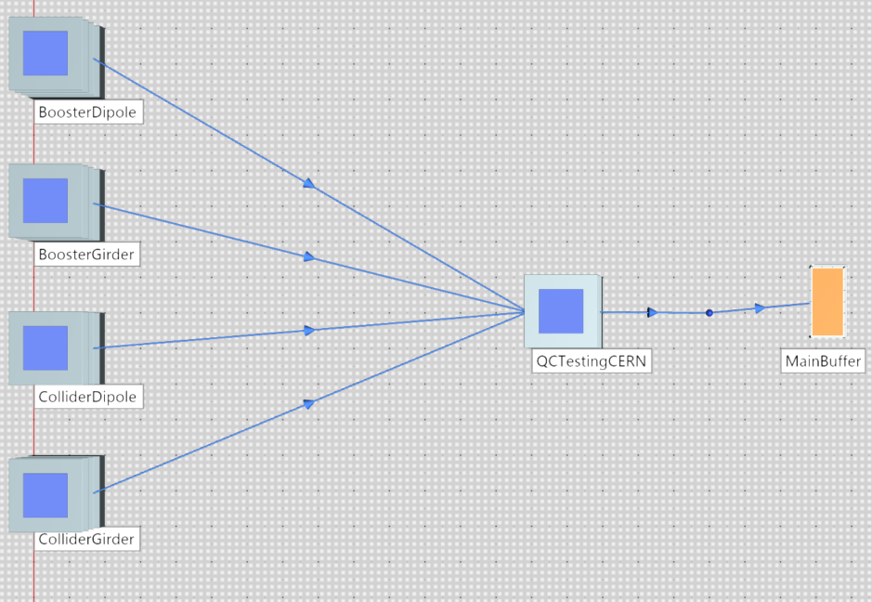
Production Model in Plant Simulation

Slide 8
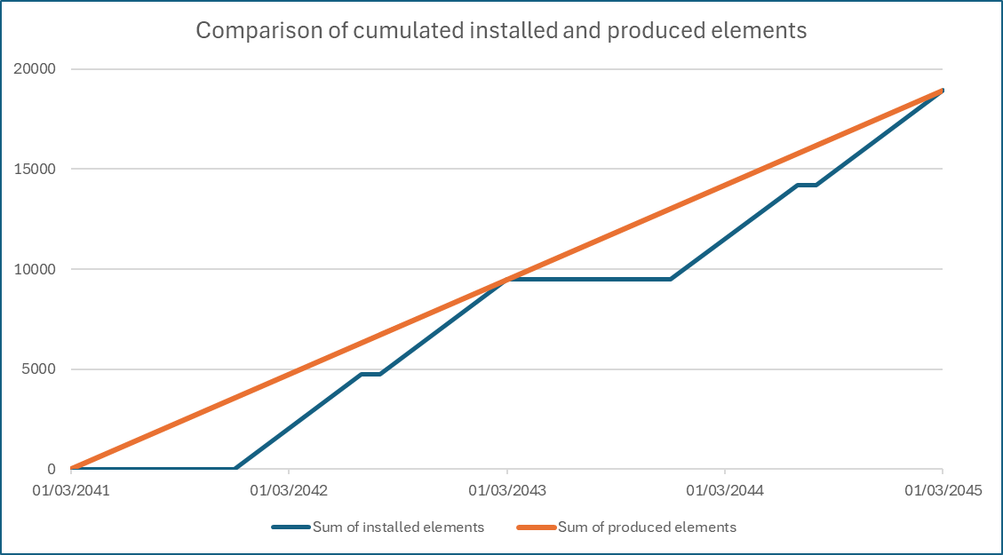
Production duration (baseline scenario): 1441 days

Slide 9


Determining number of processing stations
$$Takt time=\frac{Total avalible production time}{Total demand}$$
$$\frac{1441 (days)}{6176 (booster dipoles)}=336 minutes$$

Slide 10
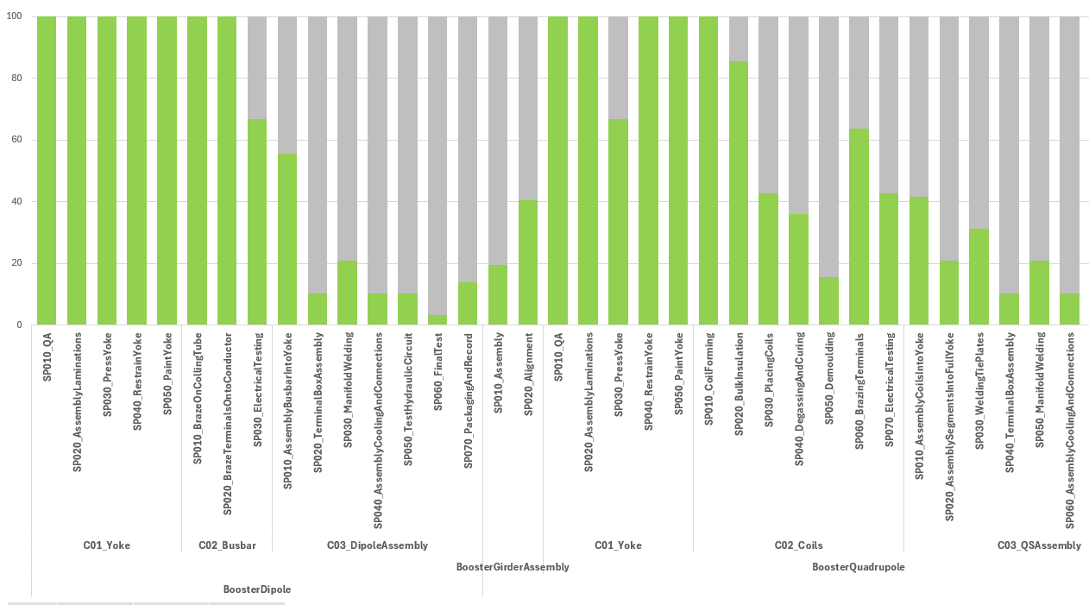
Utilization of processing stations

Slide 11
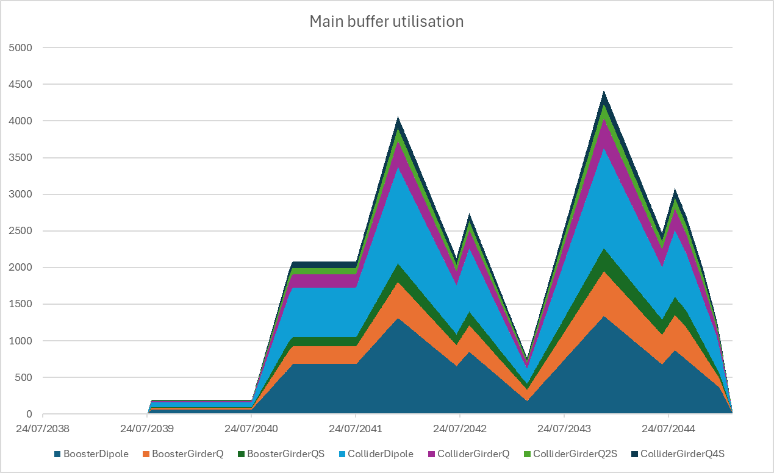
3rd install.
phase
1st install.
phase
4th install.
phase
2nd install.
phase
Pre-series
Small series
Mass production
First Article Inspections

Slide 12
Outcomes
Validated simulation model for magnet production and logistics
Tool at CERN to handle complex operations
First production strategy defined
Storage requirement analysis: estimated cost ~10 million CHF
Demonstrated impact of installation schedule on storage cost

Slide 13
Further works
Integrate production and installation models
Update transport durations based on contracting strategy
Include contingency parameters and perform risk analysis
Integration of auxiliary magnet equipment in the production process
Model sourcing lead times and supplier availability for raw materials
Add facility usage costs to existing cost model
Identify optimal balance between production throughput and storage costs

Slide 14
Thank you for your attention
22/05/2025 FCC Week 2025
Miłosz Artur Zieliński
Optimizing Magnet Production Plan: Insights from Simulations
Milosz Artur Zielinski 22/05/2025
Many thanks to the members of the Normal Conducting Magnets section, Damien Lafarge (CERN), Benedikt Müller (Fraunhofer IML), and Felix Blum (Simplan)

Slide 15
Further topics
Requiring Just-in-time delivery
Balancing contracts between countries
Division of contracts to reduce risks and encourage continuous improvement

