Slide 1
AI Assistants in Terminal
Shuwei Ye
HSF Seminar
June 4, 2025

Slide 2




Contents
Aider
Ollama
Warp Terminal
GitHub Copilot CLI

Slide 3
What is Aider?
Aider is AI pair programming in your terminal:
Powerful AI Coding
Chat questions
File editing
Git Integration
Linting & Testing
More …
Aider is also available in VSCode, JetBrains, NVim, etc
Visit https://aider.chat/ for more details

Slide 4
Comparison: aider vs ChatGPT
Why aider in terminal?
Workflow Efficiency: No need to copy/paste code b/w terminal and browser; edits are applied directly to files
Command Execution: Can capture stdout/stderr directly and run suggested commands in the terminal env
Integration with Codebase: Seamlessly works with local Git repos and files; maps entire codebase for context
Other useful features in aider, option --watch-files
https://aider.chat/docs/usage/watch.html

Slide 5
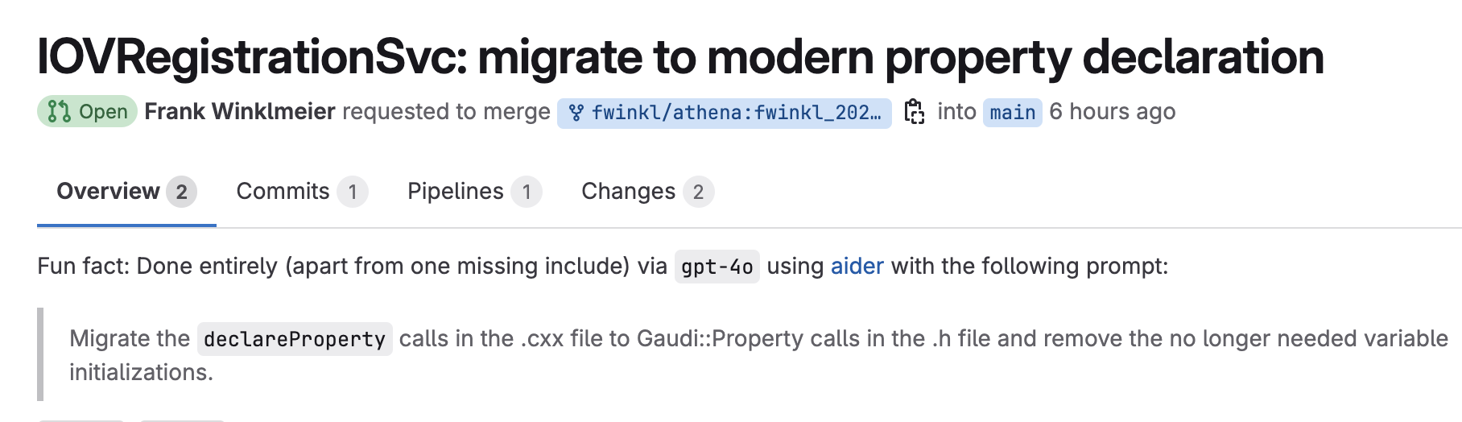
User Feedback
Frank shared via email:
Hi Shuwei,
thanks for the Aider talk today. Super useful. I tried it for the first time this morning and already made good use of it for some Gaudi migrations, e.g.:
https://gitlab.cern.ch/atlas/athena/-/merge_requests/80492
Definitely saved me lots of typing.
-Frank

Slide 6
Aider Installation
If uv is available, just run:
uv tool install --force --python python3.12 aider-chat
Otherwise, use pip to install:
pip install aider-install && aider-install

Slide 7
Aider Setup
API keys are defined via env variables,
or through configuration file: ~/.aider.conf.yml
Free API Keys
Gemini models: https://aistudio.google.com/
Check rate limits: https://ai.google.dev/gemini-api/docs/rate-limits
OpenRouter: https://openrouter.ai/
Local LLM Models
$ cat ~/.aider.conf.yml
# Specify the default model to use
model: gemini/gemini-2.5-flash-preview-05-20
# Chat API key, without enclosing quotation mark
api-key:
- gemini=…
- openrouter=…

Slide 8
Aider Demo
How to use aider on command line (focus on shell commands, not on AI coding)

Slide 9
Examples of Aider Runs
Examples on command line
aider --help
aider --no-git --list-models=gemini/
aider --no-git --list-models=openrouter/ | grep -i free
aider --model=gemini-2.5
aider --commit
# Commit all pending changes with a suitable commit message
aider
aider --no-git
aider file

Slide 10
Examples of Aider Commands
Commands inside aider
/ask #Ask question with editing files
/clear #Clear the chat history
/chat-mode ask #Switch to ask chat mode
/copy #Copy the last assistant message to the clipboard
/run #Run a shell cmd & add the output to the chat
/test #Run a shell cmd & add the output to the chat on non-zero exit code
/exit #Exit the application
Run /help for more commands.

Slide 11
Aider Chat History
The Aider chat history can be found in CWD
$ ls -1 .aider.*history*
.aider.chat.history.md
.aider.input.history

Slide 12
Using Local ollama Models
Aider can also use local LLM models
To use local models through ollama:
$ ollama list
$ aider --openai-api-base http://localhost:11434/v1 \
--openai-api-key any --model ollama/gemma3:4b

Slide 13
Ollama: Local AI Models
Local AI models can run via ollama
Download from
https://ollama.com/
Search/full the models from:
https://ollama.com/library

Slide 14

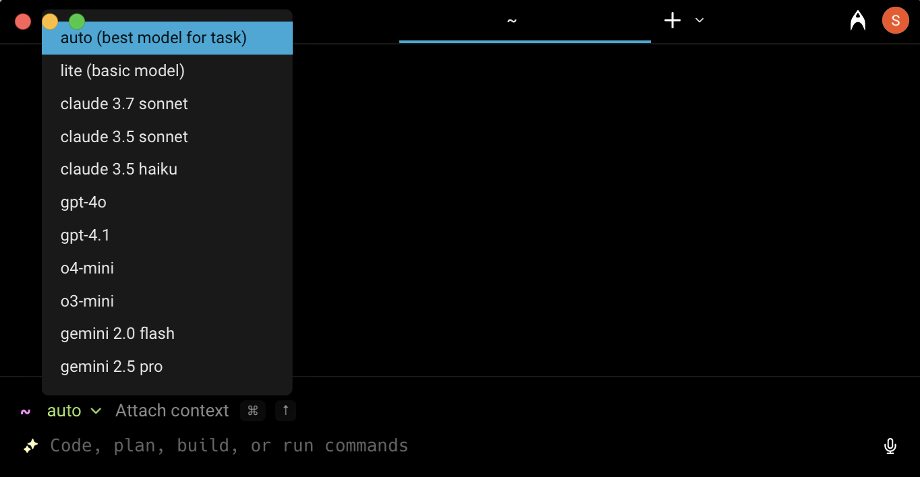
Warp: Intelligent Terminal
Warp: AI-Powered Terminal
https://www.warp.dev/
Available for Windows, Mac, and Linux
The built-in AI is also available on remote ssh machines
Free plan: Up to 150 requests / month

Slide 15
GitHub Copilot in Terminal
GitHub Copilot CLI can be installed
Mac:
Linux:
Then run:
Usage examples:
For usage help, run “gh copilot --help”
brew install gh
$ sudo dnf config-manager \
--add-repo https://cli.github.com/packages/rpm/gh-cli.repo
$ sudo dnf install -y gh
$ gh auth login
$ gh extension install github/gh-copilot
$ gh copilot suggest "Install git"
$ gh copilot explain "traceroute github.com"

