Slide 1
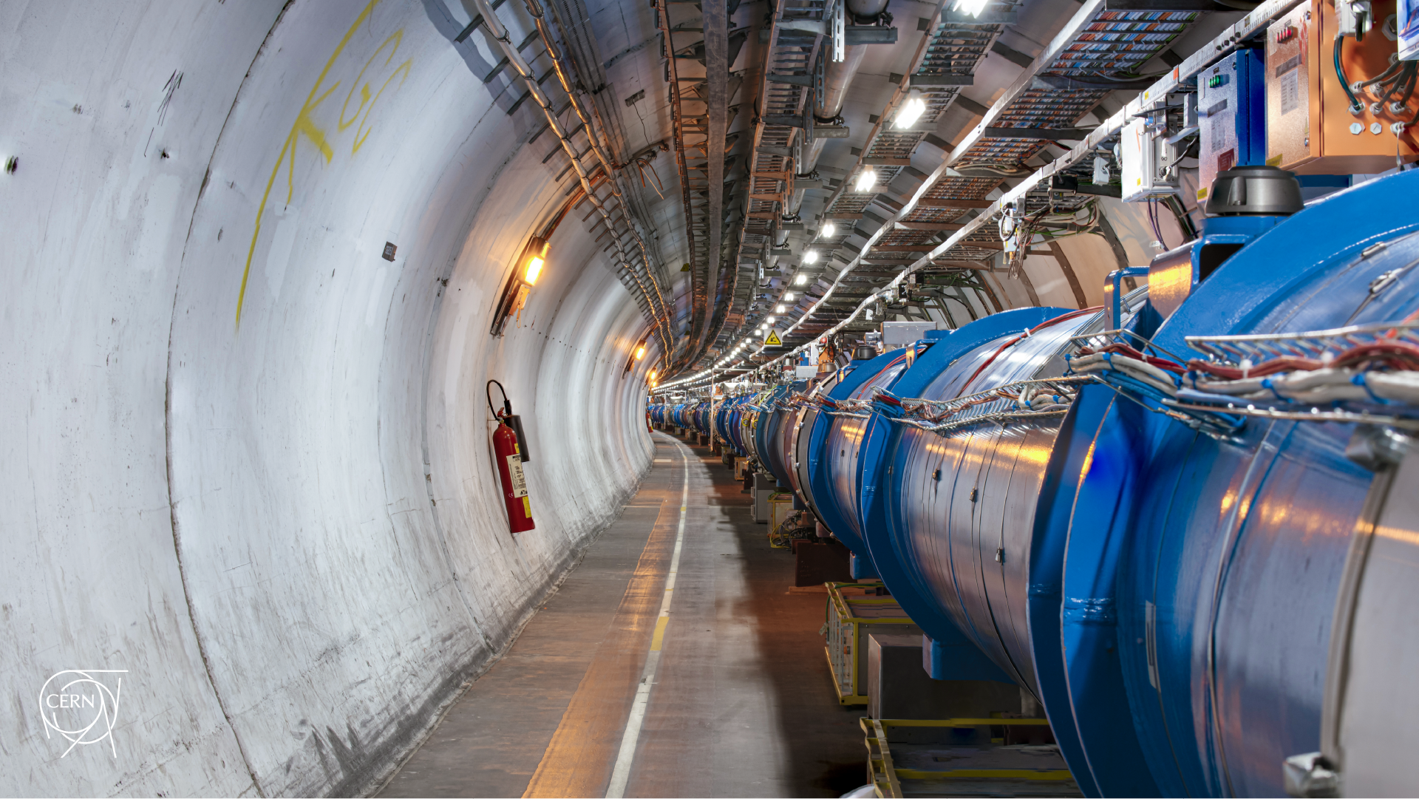
MD 15209: IR3 operational losses limit
D. Mirarchi, A. Butterworth, R. Bruce, P. Hermes, B. Karlsen, A. Lechner, S. Morales, S. Redaelli, B. Salvachua, M. Solfaroli, K. Taylor, H. Timko, J. Wenninger
rMPP meeting on MD1 approval

Slide 2
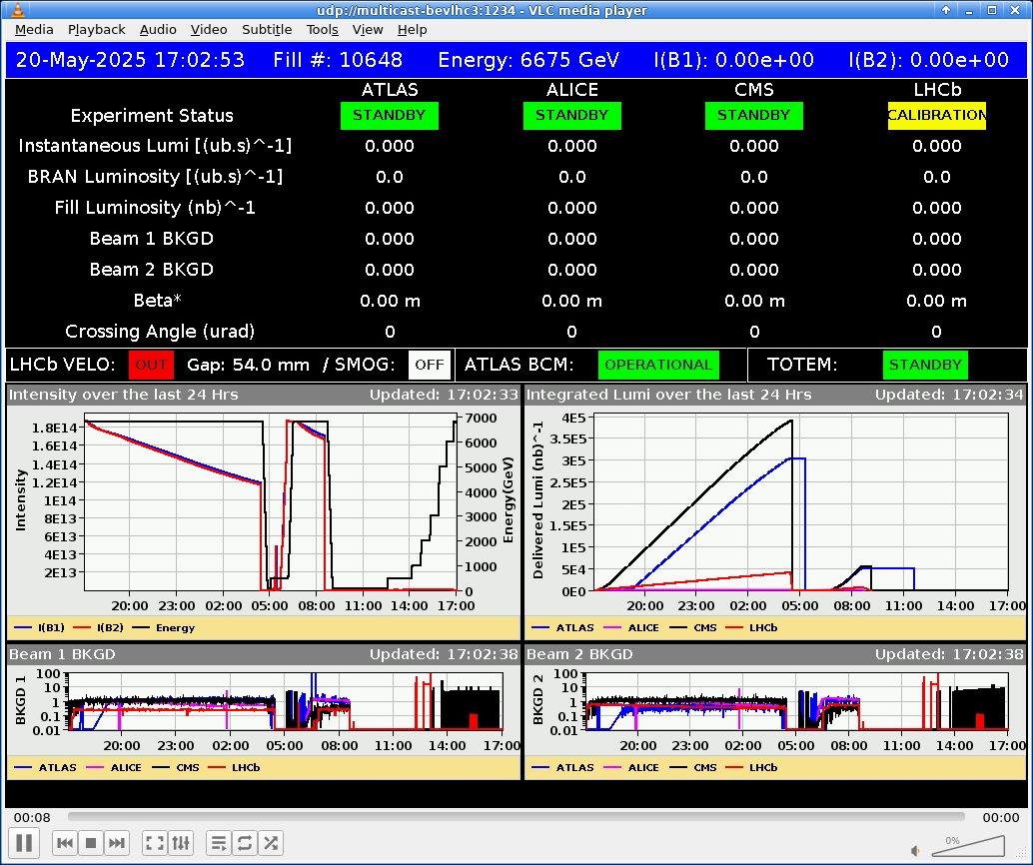
Open points from last LSWG
BPM interlock: full scraping will be avoided
Test of PPLP ramp with first 1.5 GeV stretched:
Successfully tested with pilot and nominal coll. !
Planned to play until 1 TeV it with INDIVs < 3e11
Any other open point to be followed up?
Given on-going investigations on B1 hierarchy at start of ramp,
we’d request to have a slot in MD2

