Slide 1


MD15146: Rematched IR7 optics for improved cleaning and performance – high intensity part
B. Lindström, L. Bertolozzi, R. Bruce, X. Buffat, R. de Maria,
D. Mirarchi, N. Mounet, S. Redaelli
Acknowledgements: OP, LNO, CEI, RF, BI, MPE, STI
28th May 2025 – rMPP meeting on MD block 1

Slide 2
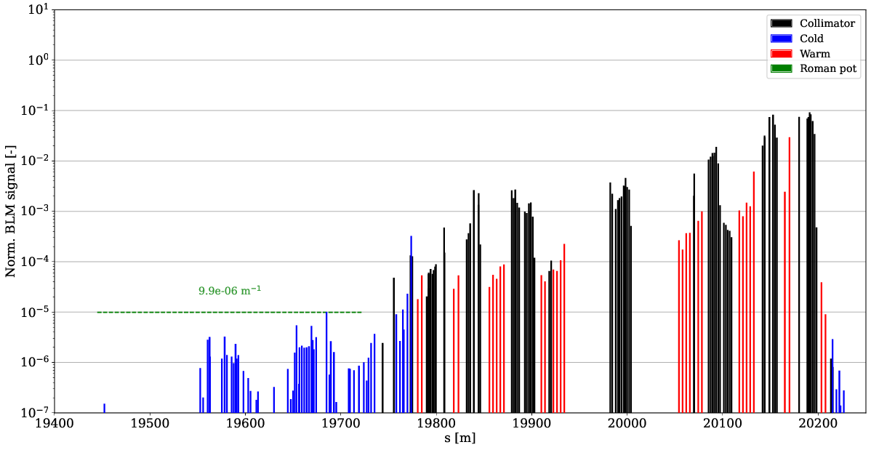
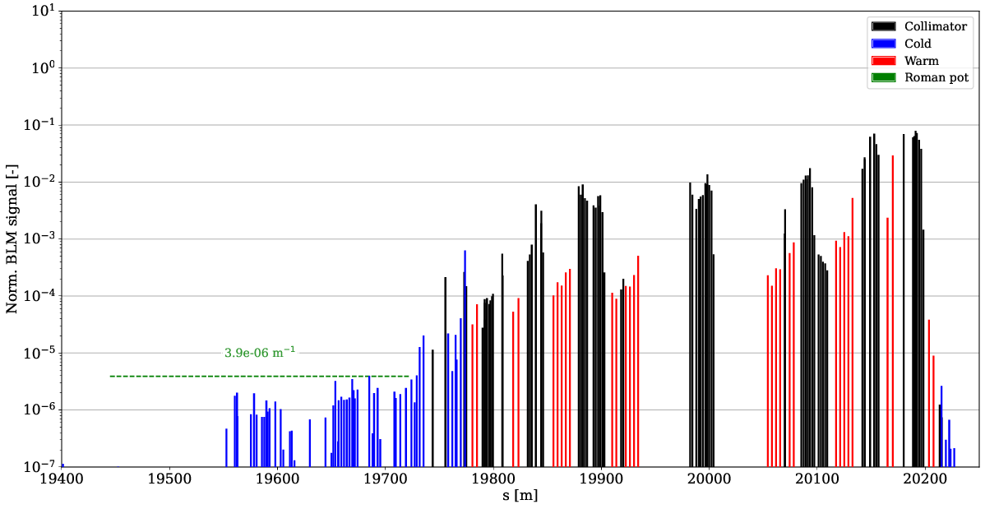
Introduction
HL-LHC beam intensity and brightness:
  Beam losses in IR7 DS could cause quenches
  Impedance can cause instabilities
Very successful MD last year:
  Up to 61 % reduction of DS losses
  Up to 33 % reduction of impedance
Optics require combined ramp and desqueeze
  Must test with high-intensity beams to ensure
  no issues with beam lifetime or loss spikes in IR7
New ramp compared to last year compatible with 2025 physics cycle
nominal meas.
HL MD meas.
Ideally MD1 due to contract of participant
contact person: B. Lindström

Slide 3
20h for 7 fills
MD block 1:
  1 (4h): 3 pilots, optics measurement throughout ramp and at FT
  -- coarse collimator settings for optics measurements, stay at FT
  2 (2h): 3 pilots to validate corrections (if needed)
  3 (3h): Collimator alignment check and loss maps
  -- two nominal (1.3e11, 0.8e11) and ~8 pilots per beam
  -- impedance measurement
  -- Betatron (H/V), off-momentum (dp+/dp-) and ASD
  Standard collimator setup interlock masks
Preparations for next MD block:
  Orbit feed-forward correction
  Cross-check BLM thresholds in IR7
MD block 2:
  4 (2h): repetition of fill 3, nominal collimator ramp functions, no collimator alignment
  5 (2h): 12 nominal bunches, nominal collimator ramp functions, dump directly at FT
  6 (2h): 75 nominal bunches, nominal collimator ramp functions, dump directly at FT
  MP checklist before proceeding (next slide)
  7 (2h): 400 nominal bunches, nominal collimator ramp functions, dump directly at FT
  In fills with trains, add a few pilots for lossmaps

Slide 4
MP checklist
First check after loss maps before proceeding with > 3e11 protons
Second check after 75b, before proceeding with 400b
  Steady state losses
  Losses during ramp
  Collimator ramp functions
  Beam orbit
  Heating of collimators

