Slide 1
Target Station Integration 16/5/25
Beatriz Martinez Sutil

Slide 2
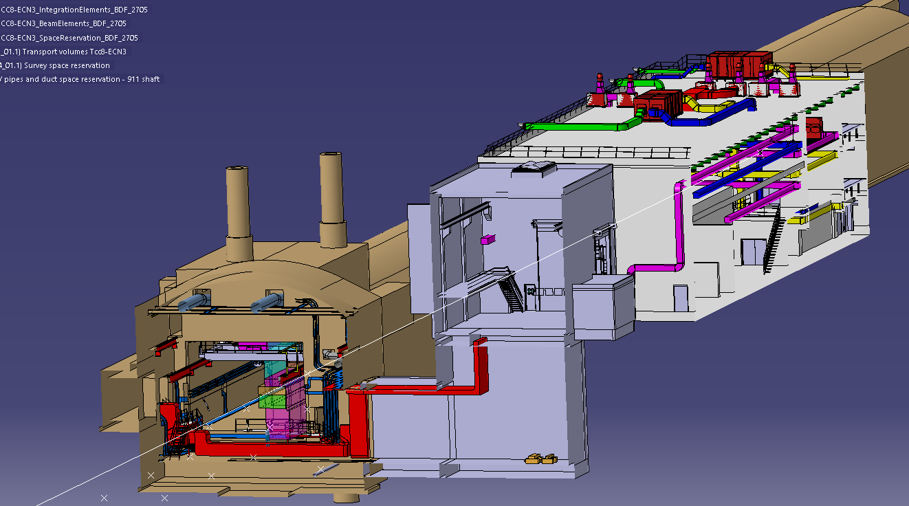
CV space reservation
How to continue? - Space reservation CV towards target station building

Slide 3
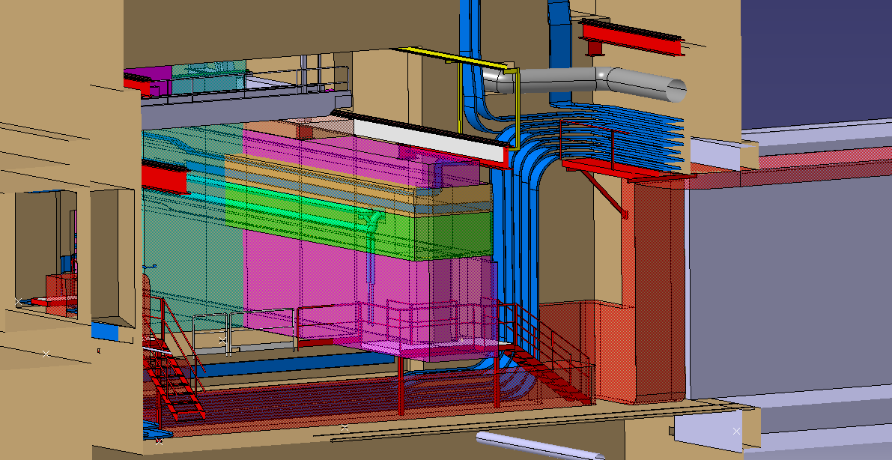

CV space reservation
Inside this red volume are pipes and ducts. The ducts will be rerouted towards the yellow separation (as shown in white)

Slide 4
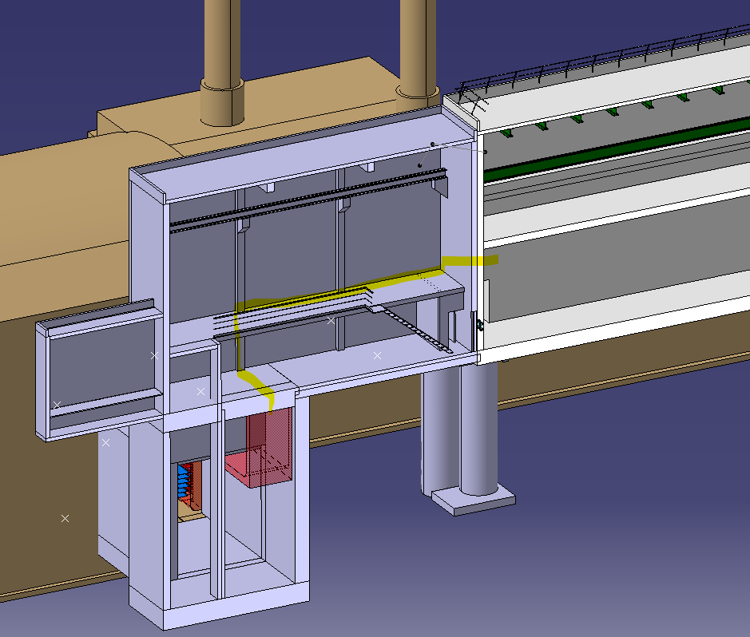
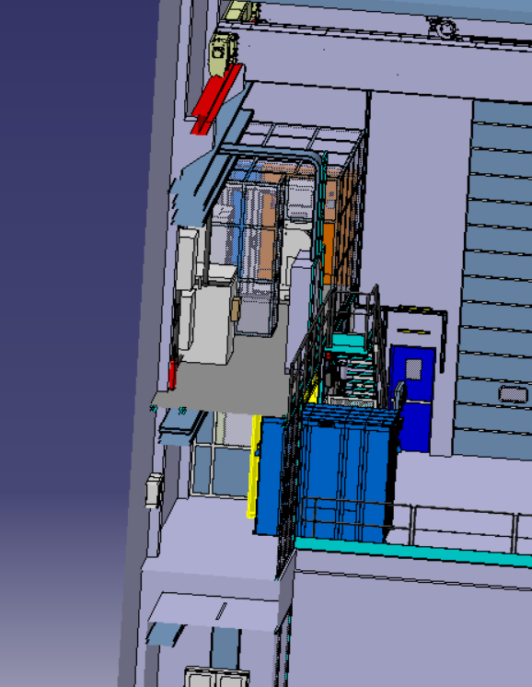
CV space reservation
Add this in the integration model (mezzanine) to understand the routing of the services until the target station building
Continue the reroute of the CV space reservation to the target station building as highlighted

Slide 5
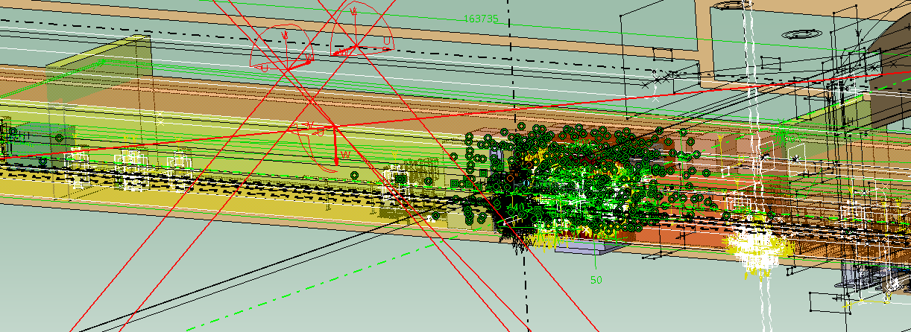
Space reservation
Unhide the ventilation walls – Their position is still known

Slide 6
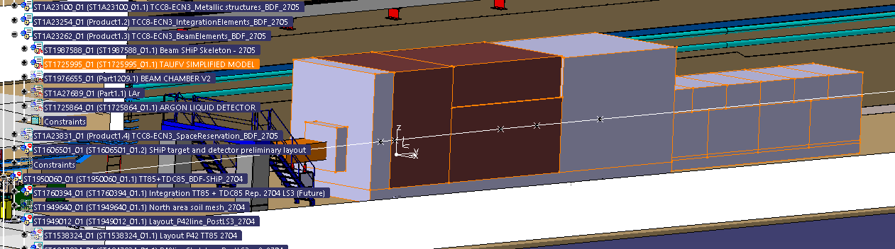
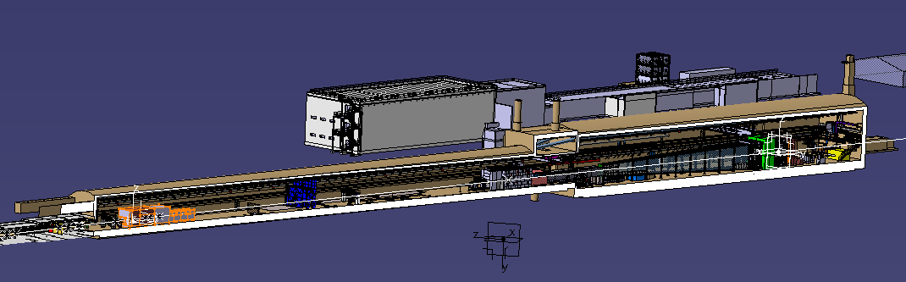
Cleaning the model of TCC8 and ECN3
TAUFV is a possible future experiment (like another target station).
It is not the baseline.
Hide it and put it in space reservation.

Slide 7
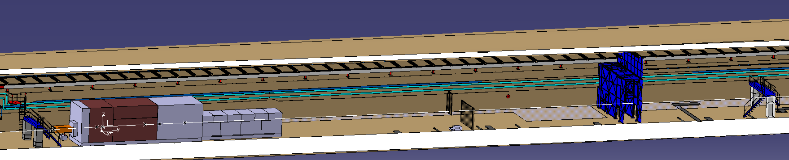
Cleaning the model of TCC8 and ECN3
Hide the doors (grilled door and blue door), as well as the bridges.
Leave just the yellow door downstream and upstream the target station.
Action: Add the footprint of the cartridge and heat exchanger slide 6 18mx1mx1.6 that Nikola provided in the last WP4.

Slide 8
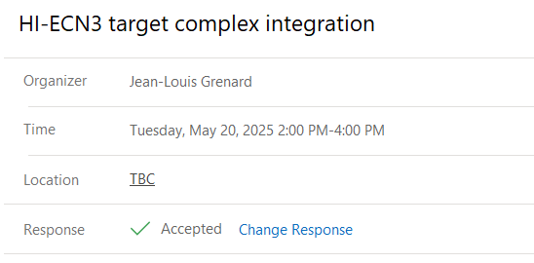
Target complex integration – Next tuesday
Topics to be treated?
CV space reservation
Inclination of the C.Engineering
- EN-EL model

Slide 9
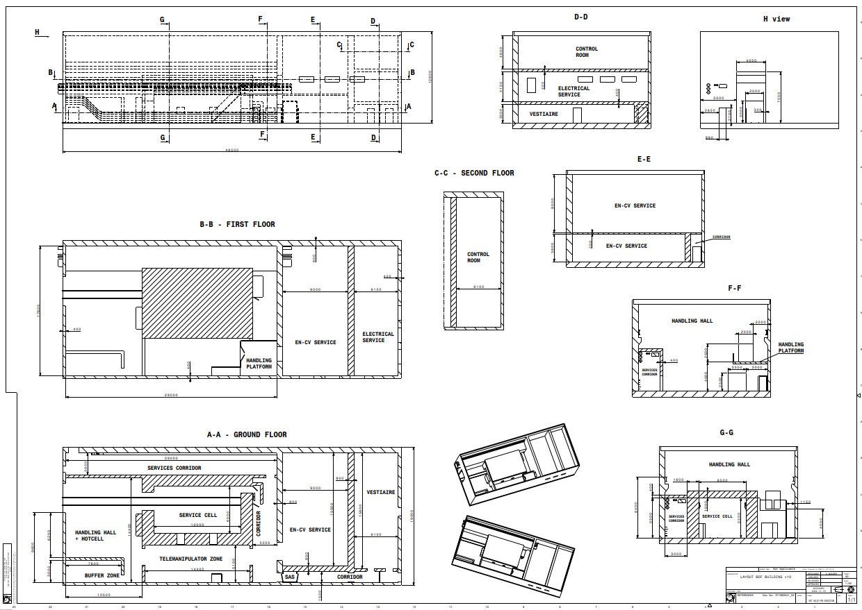
Target service building
This is the latest drawing.
The latest version of the C.Engineering is the CAD provided by CE (ST1942728_01) that does not correspond to the drawing.
That CAD has the 2m corridor wider as requested by CV.
5300mm in CAD

Slide 10
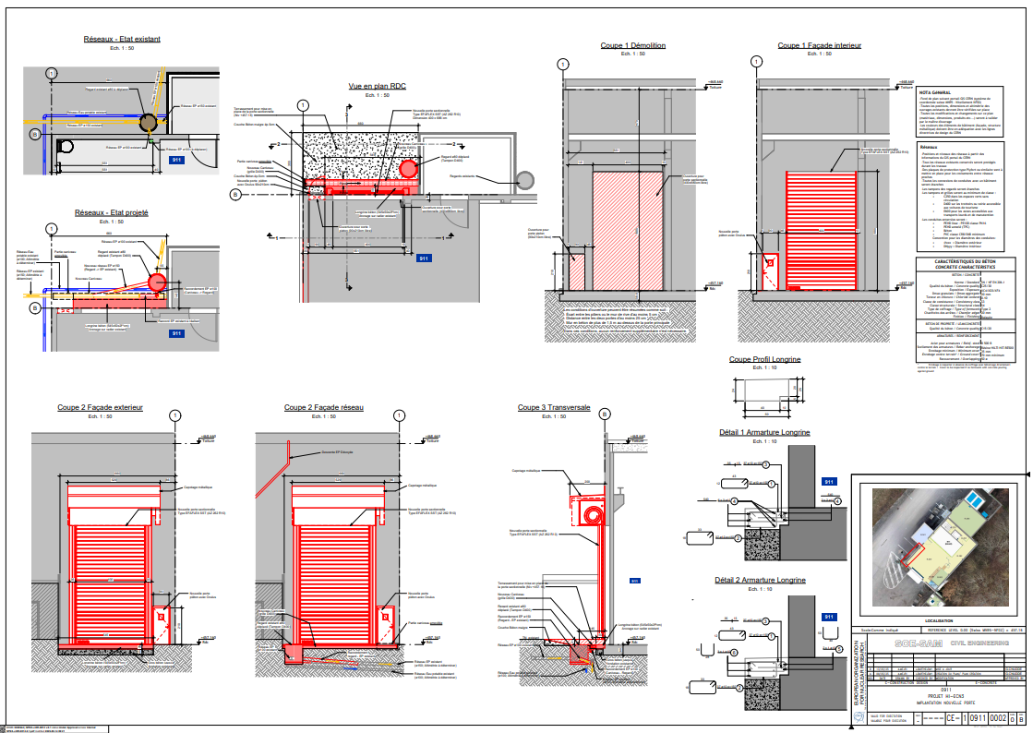
Drawing C.Engineering – B.911
No fully the same measures respect to the integration model and on-site. Level of critic case as follow:
CE model > On-site > Integration
Need to be extremely careful with the operation. No too much space between personnel door and lorry door. (Action: add this in a comment in EDMS)

Slide 11
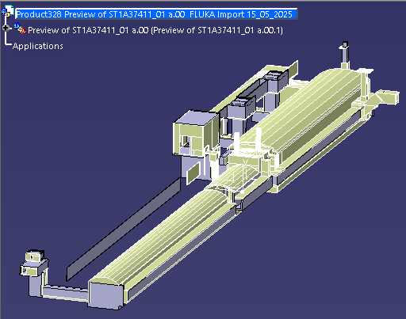
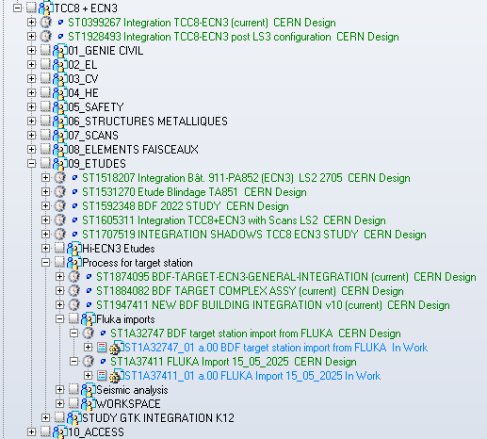
Fluka model
Create a study model superposing the fluka model and the integration model, situating the fluka model in its place
Notes:
Speak with Michael to create another e-group for integration HI-ECN3.
Users – Pablo, Gemma, Jean-Louis, Christophe, Bea

