Slide 1
DUNE CRU Cold Test Nitrogen Delivery System
Brandon Bozeat, Russell Feder, Pratik Patel, Roberto Than
May 20th, 2025

Slide 2
Outline
N2 Delivery System Overview
LN2 Usage Estimates
Budgetary Estimates
Pending Topics

Slide 3
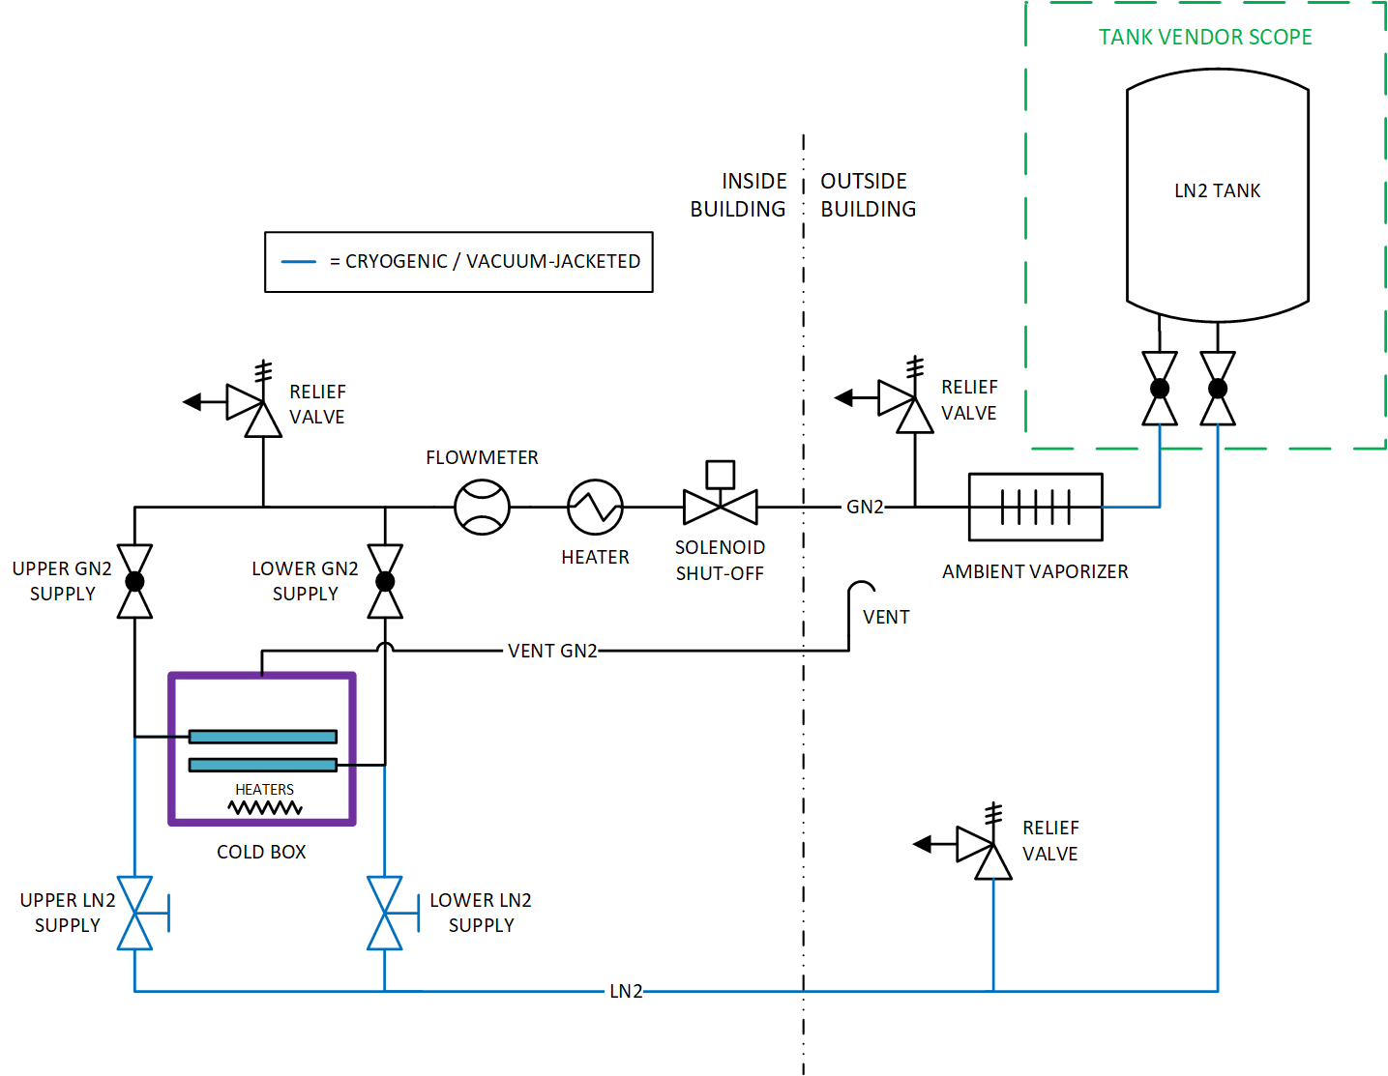
System Overview
Nitrogen Delivery System provides liquid and gas nitrogen to the CRU cold box
  Liquid is supplied through vacuum-jacketed piping and valves
  Gas nitrogen is provided using an ambient vaporizer and heater to bring the gas temperature above the dew point
A vent path is always open to prevent pressurizing the cold box
Pressure relief valves are implemented where trapped volumes may occur

Slide 4
System Overview continued
LN2 tank to provide ~7,000 Liters per week (estimates in later slides)
Supply valves provide operator control over liquid and gas supplies to the cold box
Solenoid valve can be used for automatic shutoff if warm-up left unattended
Flowmeter allows operator to set correct warm-up rate
Flanged, threaded, bayonet connections will be utilized for ease of assembly

Slide 5
LN2 Estimates
LN2 consumption is estimated for each step of the CRU test process:
Purge: A small flow of GN2 overnight removes water vapor from cold box.
Cool Down: LN2 is supplied to cool the stainless steel tank, while the vapor generated pre-cools the CRU mass. Then, the liquid supply completes cool down of CRU mass.
Fill-up: Continue supplying LN2 to submerge both units.
Cold Test: Level is maintained for 4 hours with minimal losses due to heat loads.
Boil-off: After testing, heaters are powered up to remove liquid from the cold box.
Warm-up: Once liquid is fully vaporized, heaters are turned off and warm GN2 is used to warm the cold box and test mass to room temperature.

Slide 6
LN2 Estimates continued
Test Phase | Time [hours] | LN2 Use [liters] | Notes & Assumptions
Purge | 12.0 | 161 | 3 g/s (~5 SCFM) for 12 hours
Cool Down | 1.0 | 632 | 1-hour minimum cooling time. CRU test assembly reaches ~140K once tank is cold and takes on liquid
Fill-up | 2.9 | 5008 | Assume ~0.5 L/s (7.5 gpm); fill to 59% depth
Cold Test | 4.0 | 151 | Assume ~1.3 kW heat load (static + electronics)
Boil-off | 14.9 | 0 | 15kW heater power applied
Warm-up | 5.6 | 1239 | Flow 50 g/s (~90 SCFM) 295K gas
Total | 40.4 | 7192 | (1900 gallons)
Notes:
Does not include time for setup, warm testing, removal, etc.
Does not include losses for cooling down transfer lines.

Slide 7
Cost Estimates
Item | Unit Cost ($) | UOM | Qty | Total Cost ($) | Note
LN2 Bulk Storage Tank (monthly rental) | 1,985.00 | month | 60 | 119,100.00 | 5-year contract
LN2 Deliveries | 0.21 | liter | 360000 | 75,600.00 | Estimated 30kL/mo, 12mo
LN2 sub-total |  |  |  | 194,700.00
Ambient Vaporizer | 3,600.00 | each | 1 | 3,600.00 | Price from recent BNL project (8500 SCFH)
Relief Valves | 150.00 | each | 3 | 450.00 | REGO 19434 PRV or similar
Solenoid Valve | 200.00 | each | 1 | 200.00 | McMaster 3/4" solenoid
Inline Heater | 1,000.00 | each | 1 | 1,000.00 | based on McMaster 1/2" NPT 2.5kW
Flowmeter | 1,000.00 | each | 1 | 1,000.00 | IFM inline thermal flowmeter
Warm valves | 150.00 | each | 2 | 300.00 | ~Average for globe valves 1/2"-1" NPT, McMaster-Carr
Vacuum-jacketed valves | 3,700.00 | each | 2 | 7,400.00 | Quote from PHPK 3/4" x 2" VJ globe valve
Vacuum-jacketed piping | 400.00 | ft | 75 | 30,000.00 | Budgetary estimate from Technifab
Small warm piping (<=1") for purge line | 20.00 | ft | 75 | 1,500.00 | 3/4" 304 SST sch 40
Large warm pipig (~2-3") for vent line | 60.00 | ft | 50 | 3,000.00 | 2-1/2" 304 SST sch 40
Small pipe fittings | 20.00 | each | 10 | 200.00 | elbows, tees, etc.
Large pipe fittings | 100.00 | each | 3 | 300.00 | elbows
Heater (per 5kW) with integrated RTD | 9,300.00 | each | 3 | 28,000.00 | Budgetary quote from Kelvin. Note: Chromalox alternate
Heater controller, circuit breaker, etc. | 15,000.00 | group | 1 | 15,000.00 | Estimate from BNL project experience
Misc. pipe supports & fittings | 300.00 | group | 6 | 1,800.00 | pipe clamps, strut, etc.
Parts sub-total |  |  |  | 93,650.00
Total |  |  |  | 288,350.00
Notes: ROM cost of materials and nitrogen only, no labor. For dual CRU cold box. Cost is per test site. Excludes cost of cold box itself.

Slide 8
Pending Topics
ODH analysis and monitoring system requirements, design, cost
Facility-specific layouts of piping systems
Interface plan between delivery system and cold box proper
Level, temperature, and other instrumentation plans

Slide 9
Backup

Slide 10
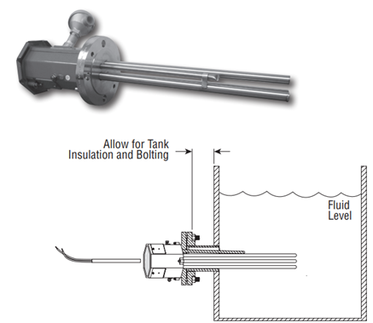
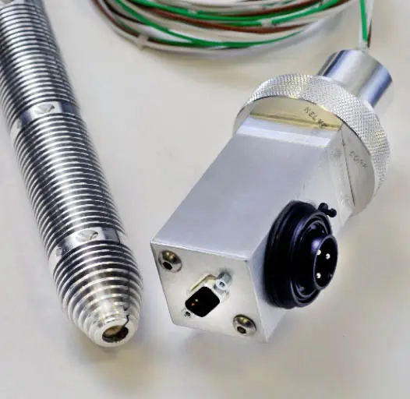
Heaters
Kelvin style
Elements lay at bottom of tank
Cables connect to junction box
480 VAC
0.50 Watts/cm²
Chromalox style
Flanged connection
208V 3 Phase 3 Wire (Delta)
25.0 W/in²

Slide 11
Alternative Concepts
Alternative setups were considered, including:
Two single cold boxes with a pump
  Single shared pump recycles LN2 between cold boxes
Two single cold boxes with heaters
Notes: Cost per test site. Excludes cost to build cold box(es).
Other considerations: pacing of testing and assembly, space constraints, …
Setup | LN2/month (kL) | Total Cost ($) | Notes
Dual cold box, with heaters | 28.8 | 288,350.00 | Baseline (see prev. slide)
Two single cold boxes, with heaters | 24.4 | 290,730.00 | 10kW heaters per box; slightly more piping; slightly less LN2 consumed
Two single cold boxes, with pump | 15.7 | 290,470.00 | Lower LN2 consumption; increased cost for pump, motor, instrumentation; added VJ piping/valving

Slide 12
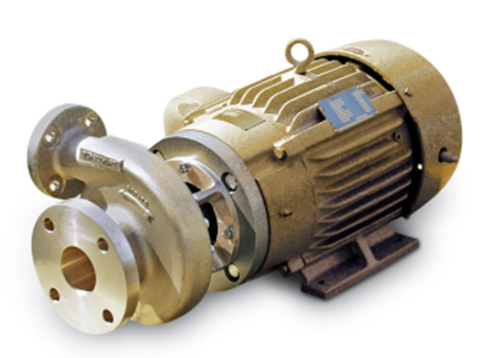
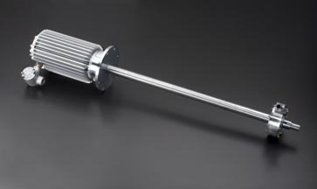
LN2 Pumps
Pumps may reduce LN2 consumption by recycling
Cost to implement is ≥ heaters
Nikkiso-ACD ~$20k - $45k excluding controls
Barber Nichols ~$50k excluding controls
Technical barriers: cold box setup requires low flow and has very low NPSH available
Available pumps require higher inlet pressures than available at bottom of cold box
Most pumps minimum speed is too fast for the controlled cool down required

