Slide 1
May 27 Super Locked-In Status Report
Dongha Simon Lim

Slide 2
Last time…
Working on:
f fbar
V V (including H)
W production below sqrt(s) = 2 m_W
t production below sqrt(s) = 2 m_t
H production below 240 GeV with VBF
VVV
4 jets and 4 nu
VBF e+e- X and e+e- XX
Plus an updated table, graph of up to 3TeV with e+e-, 3-10 TeV for mu+mu-

Slide 3
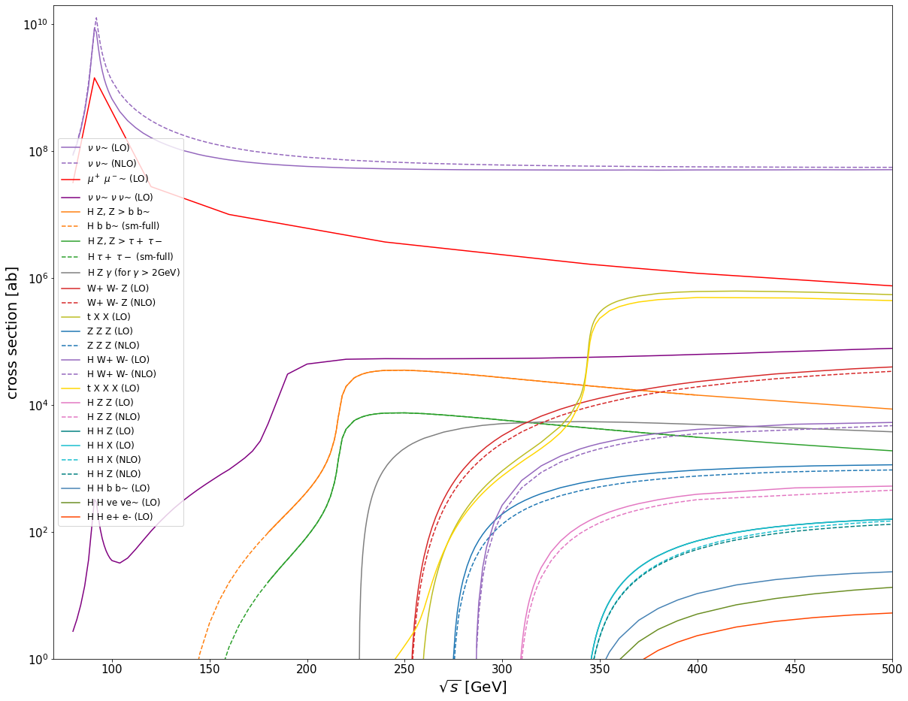
Example Plot from the past

Slide 4
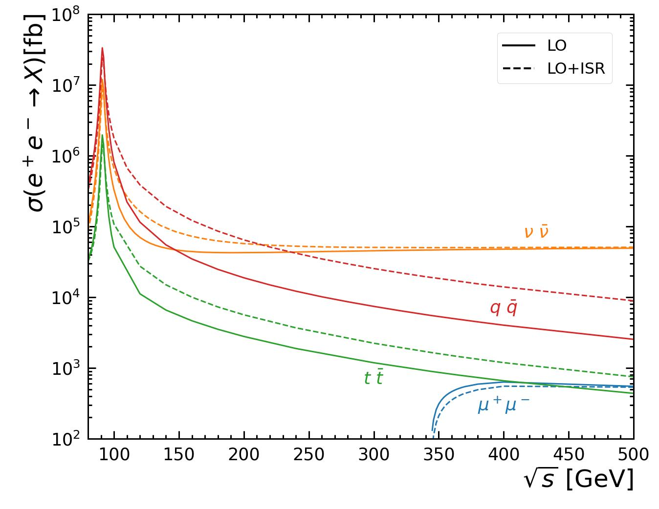
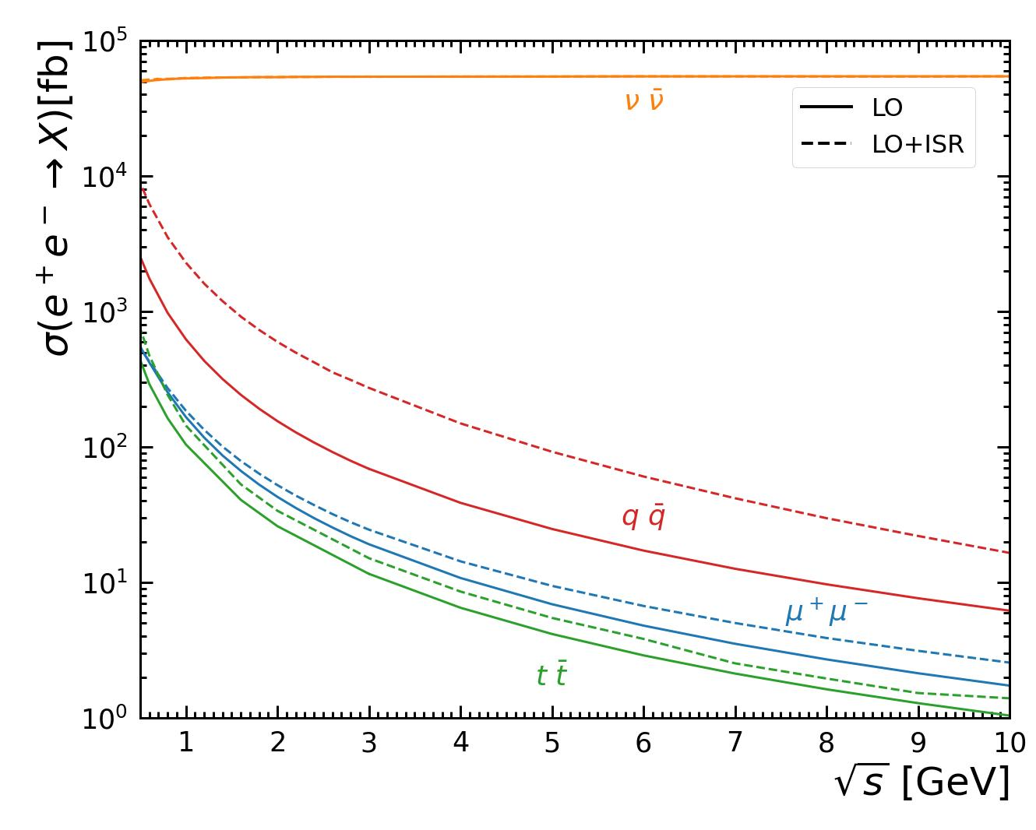
1. f fbar

Slide 5
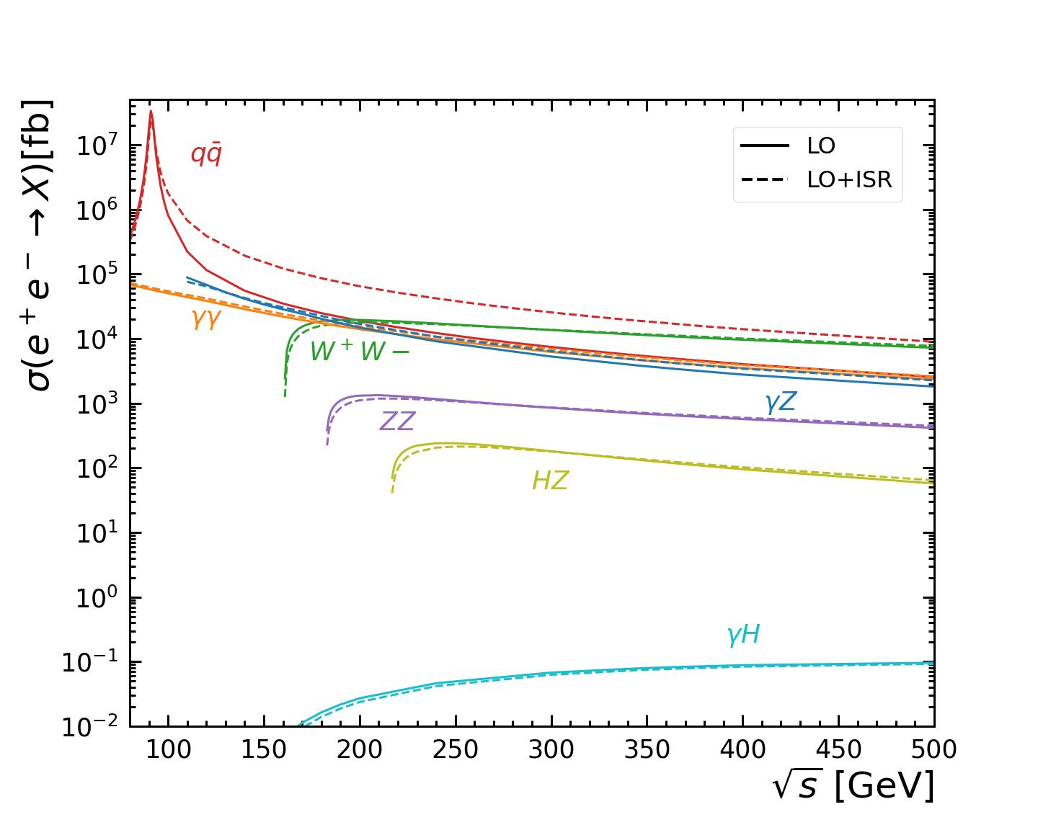
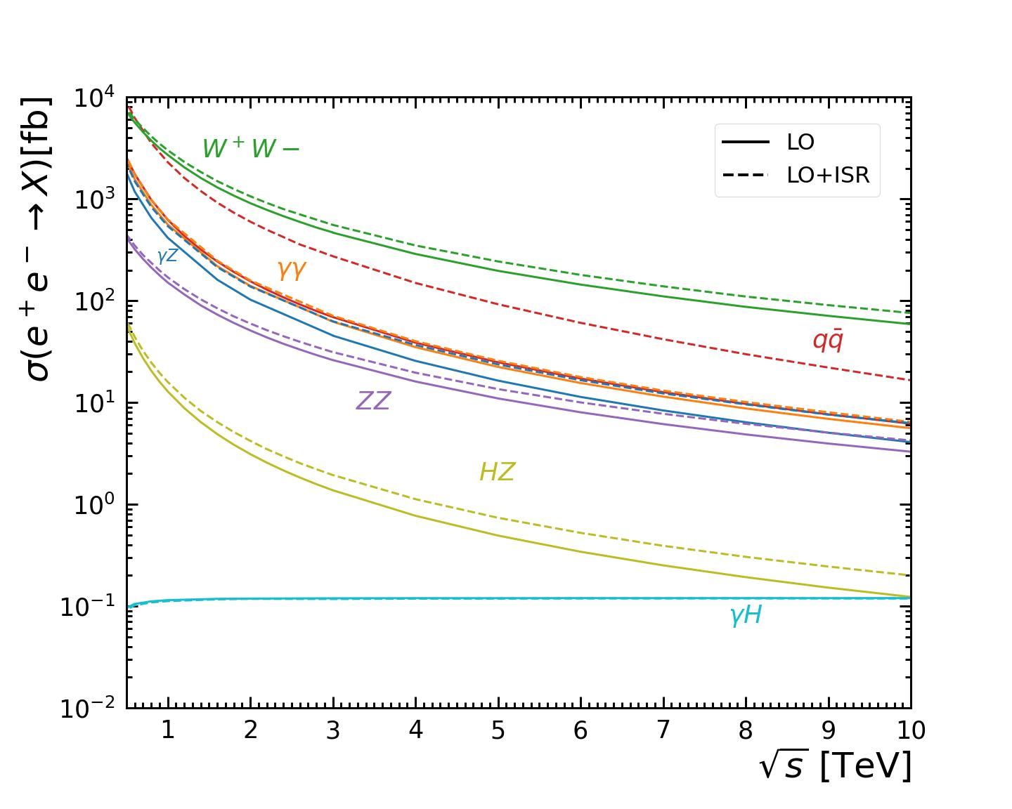
2. V V (including H)

Slide 6
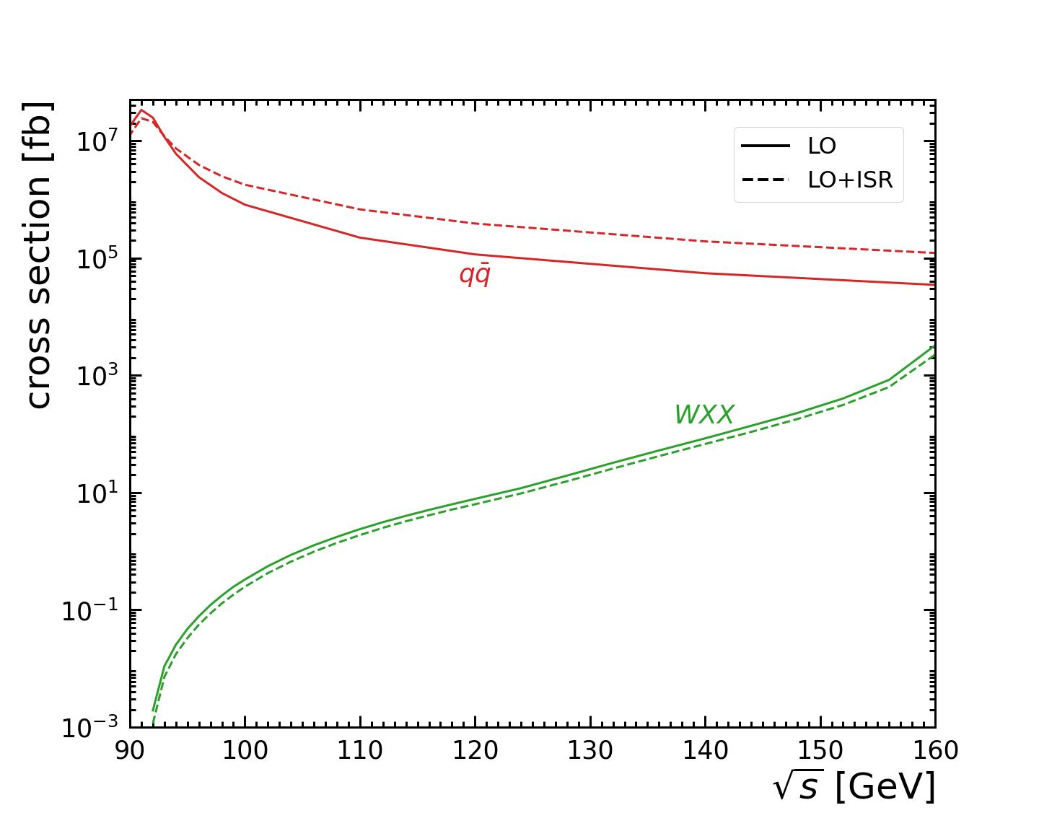
3. W production below sqrt(s) = 2 m_W

Slide 7
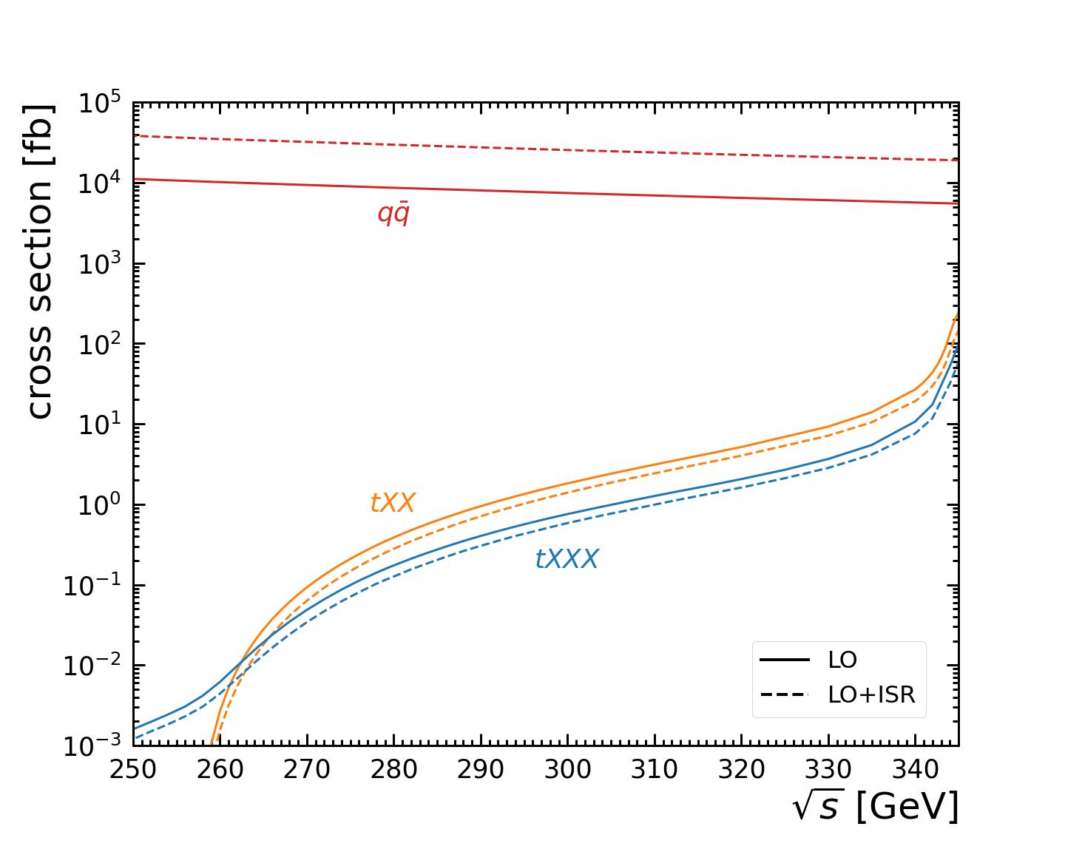
4. t production below sqrt(s) = 2 m_t

Slide 8
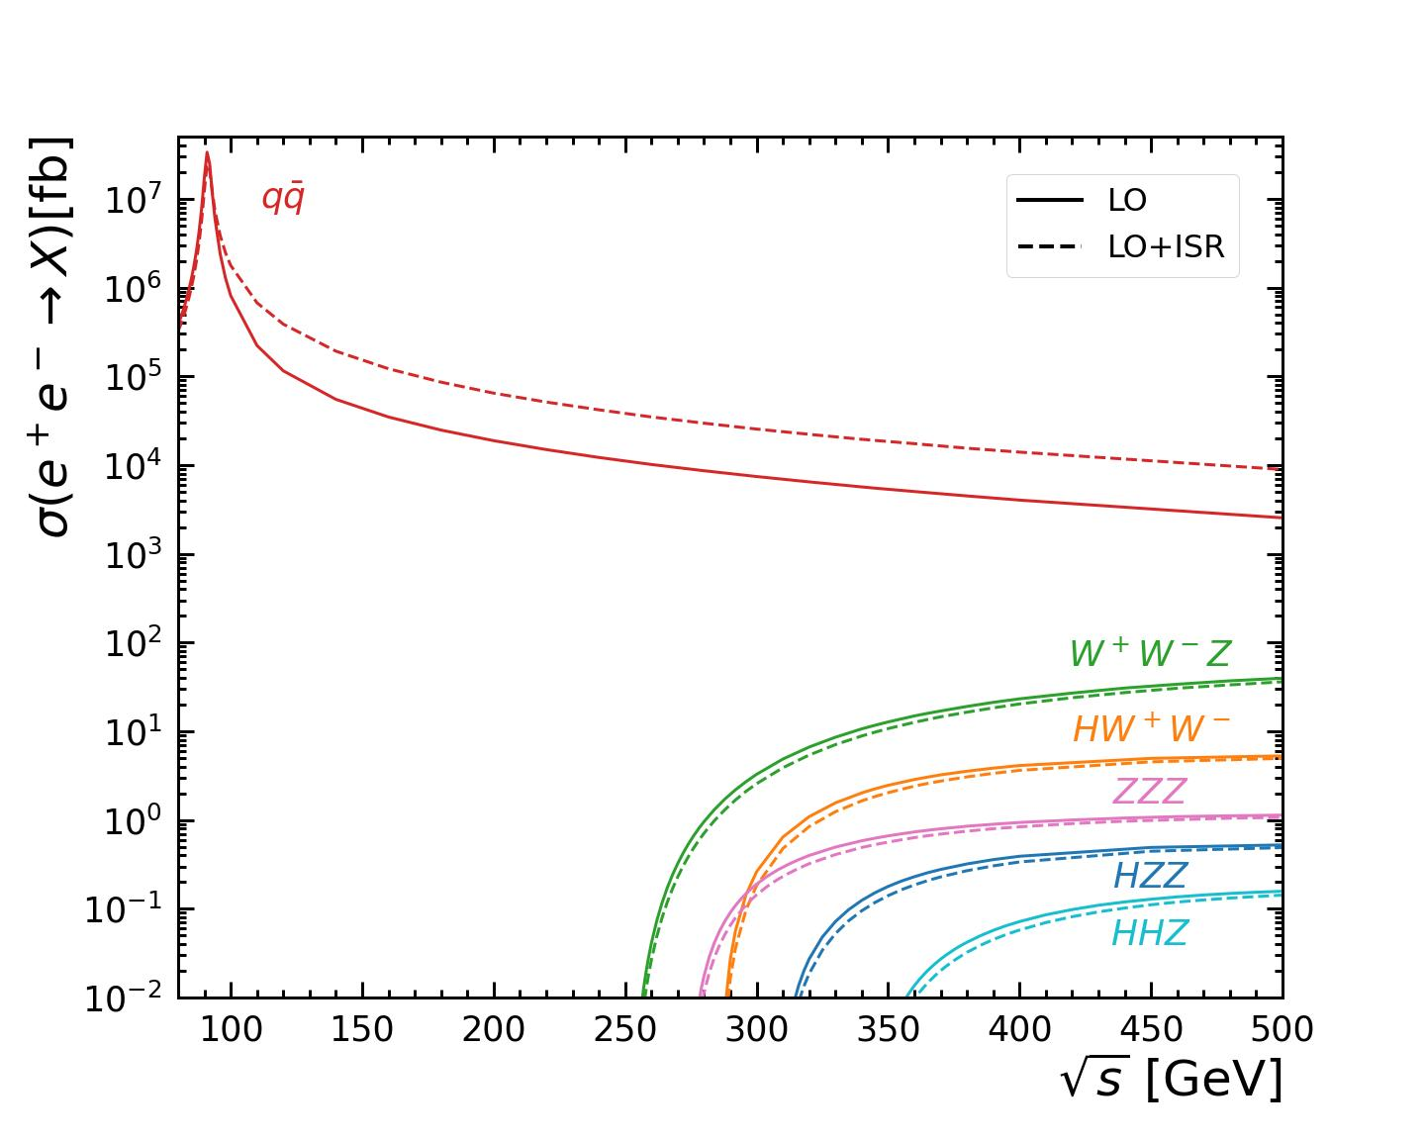
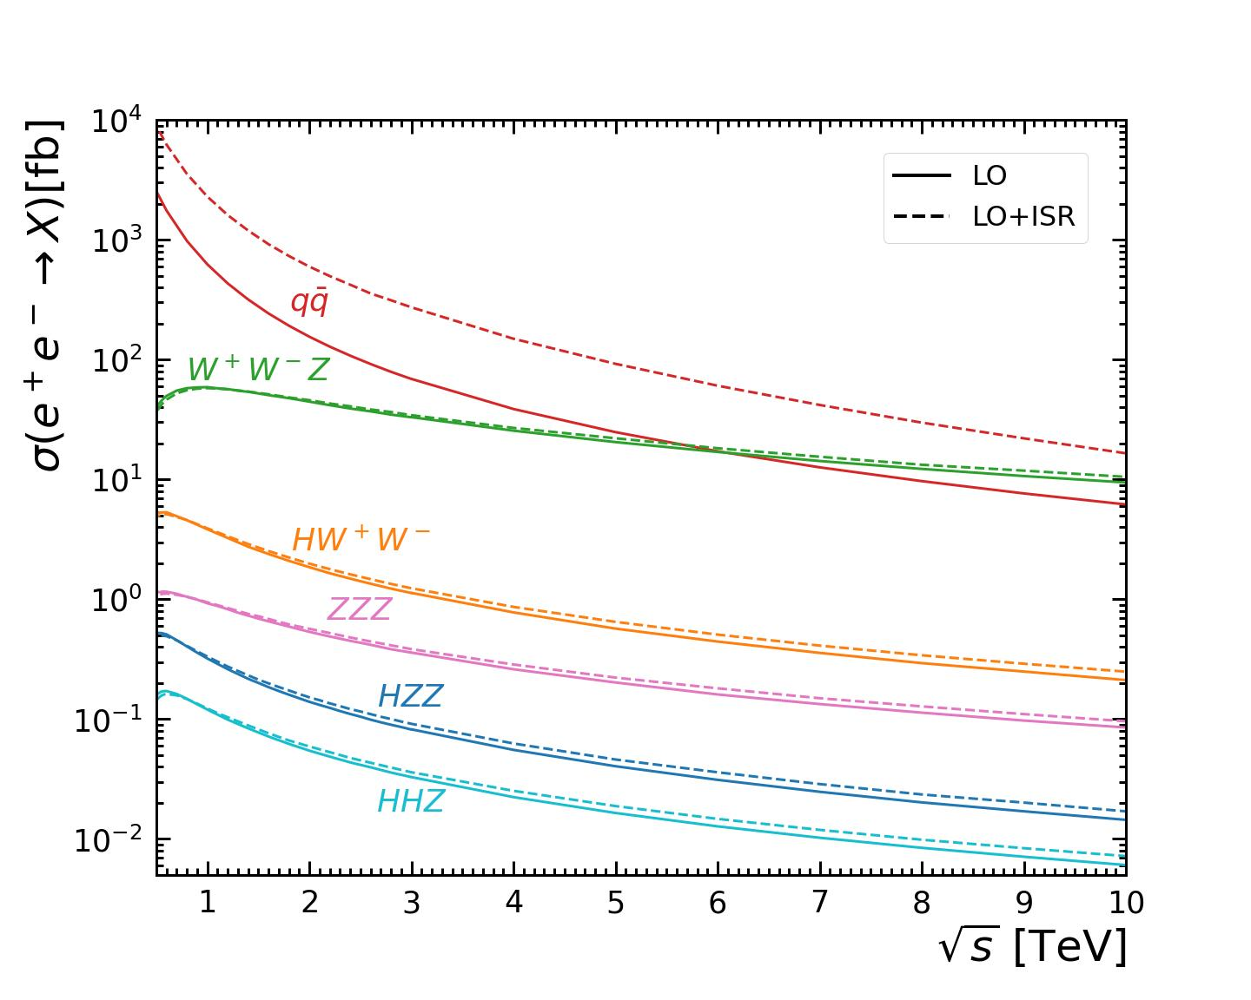
6. VVV

Slide 9
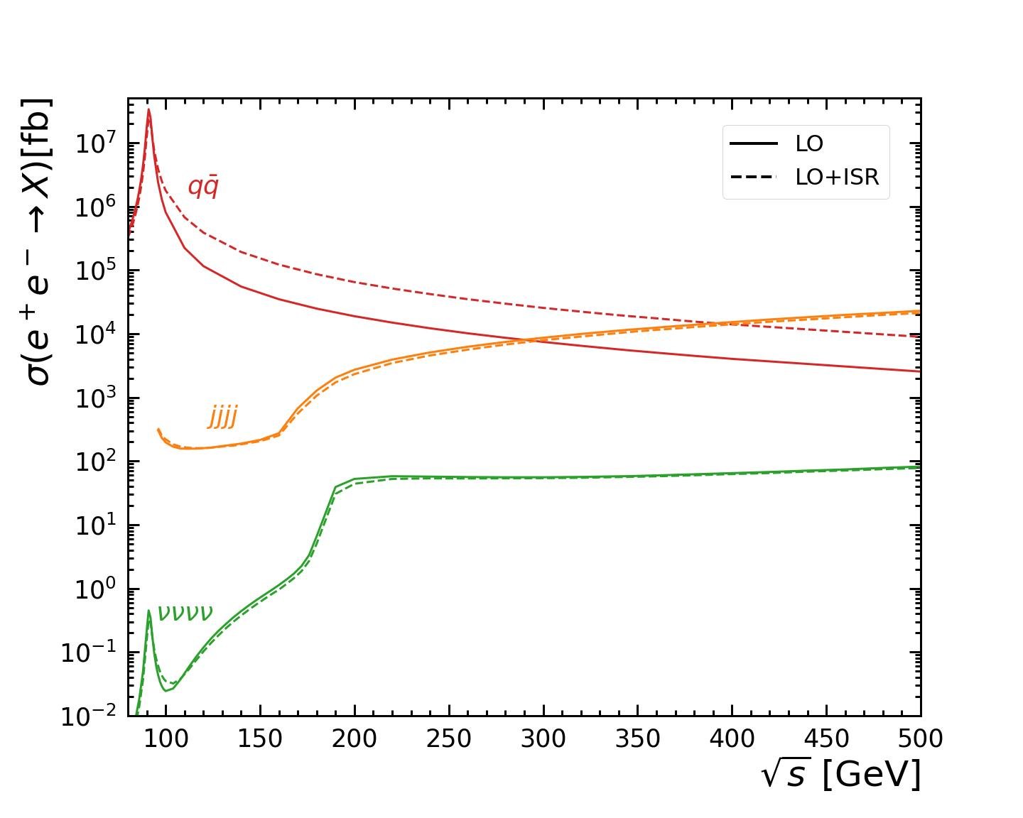
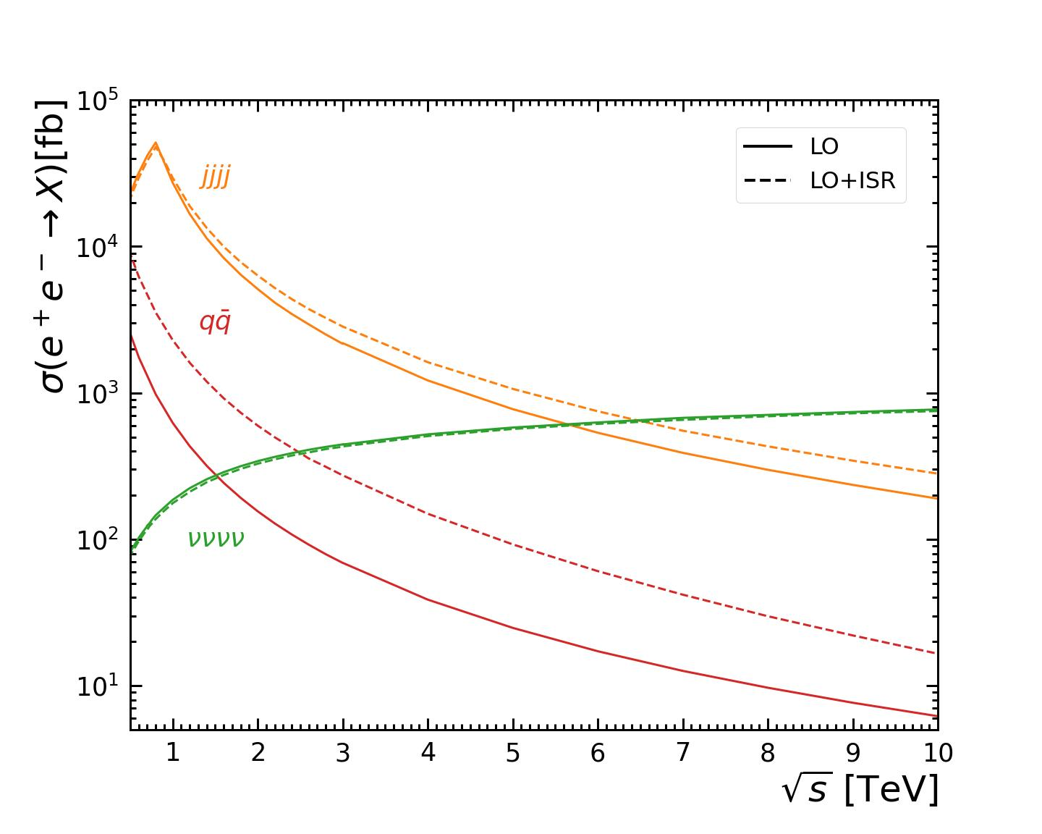
7. 4j and 4 nu

Slide 10
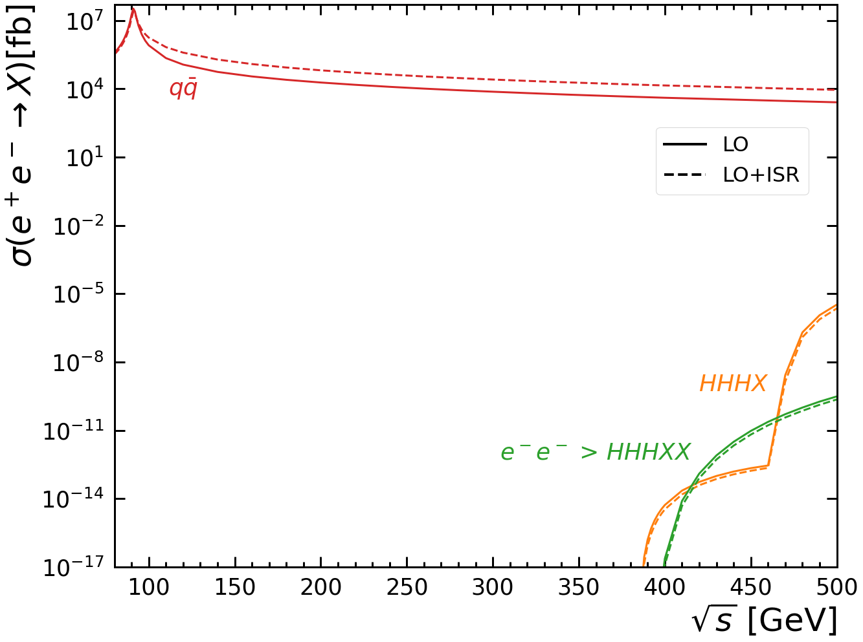
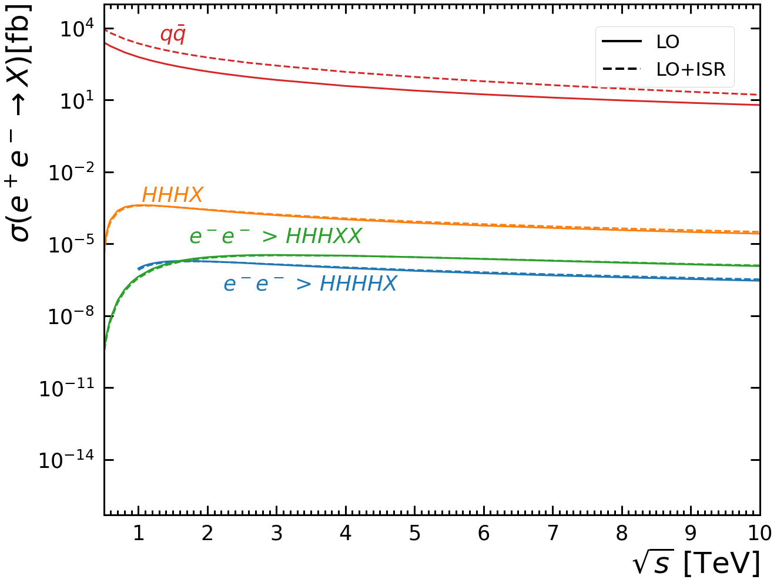
9. HHH(H) X(X)

Slide 11
Things to do
8. With VBF’s
5. From another source
Make tables

