Slide 1


Progress Update
27/5/2025
Owen M. Van Horn

Slide 2
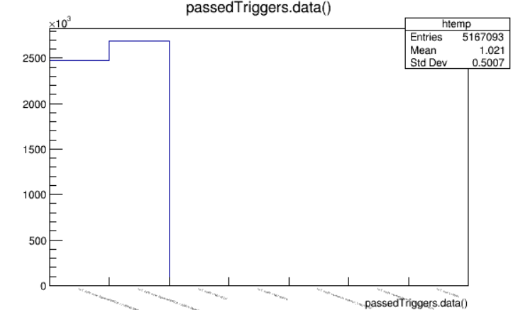
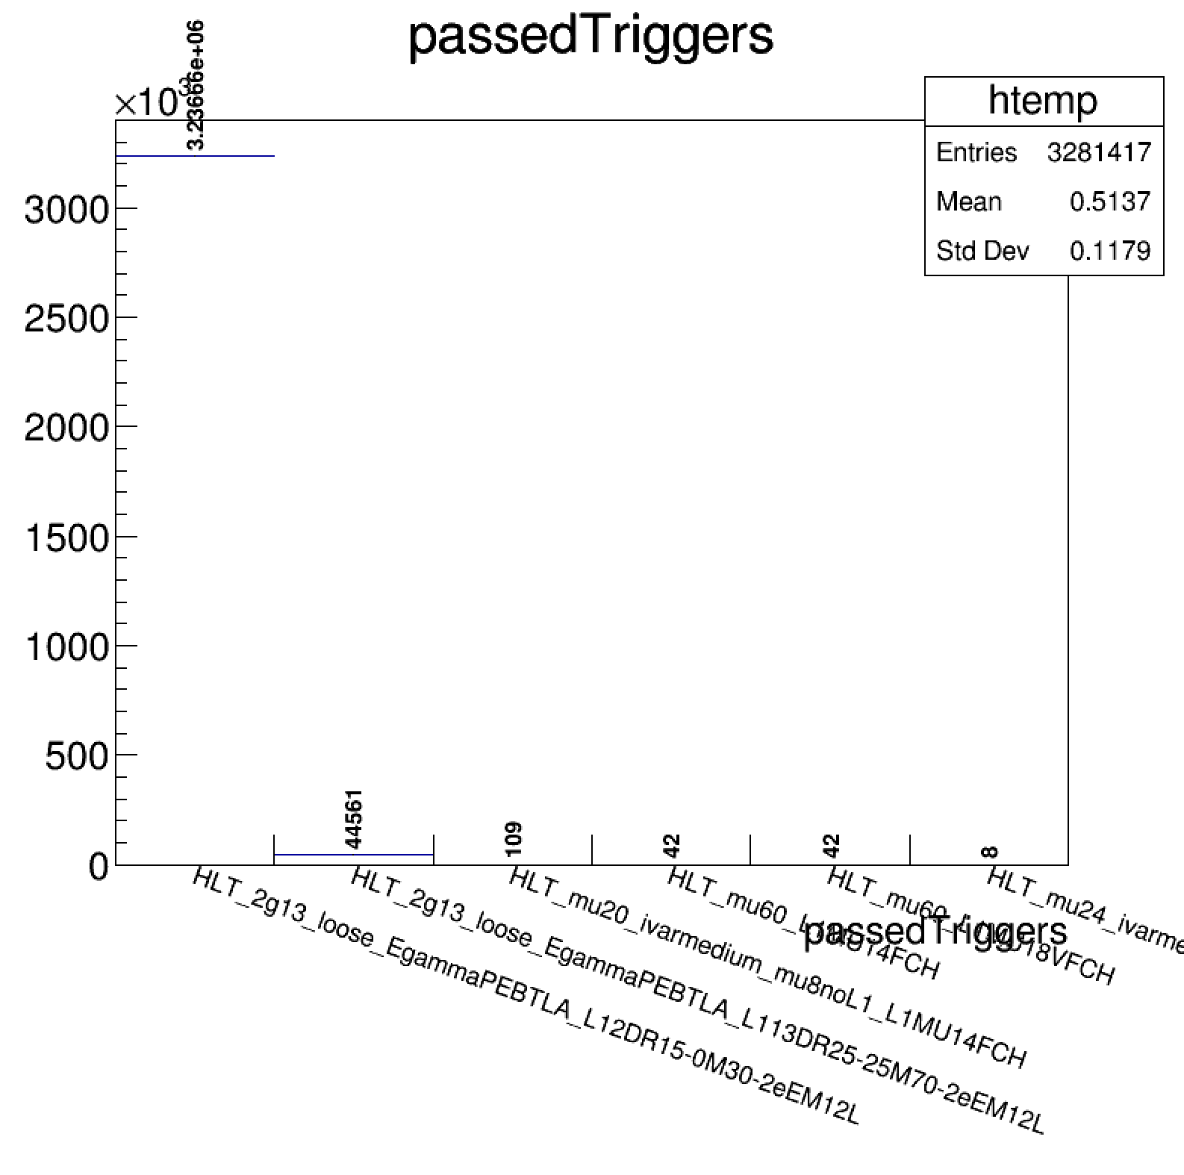

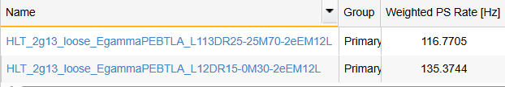

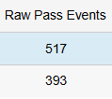
Header Problems Resolved
Our analysis software was built for use with Athena 24, but the files were generated with Athena 25
  This did not break any essential parts of the software that allowed it to run, but it did cause some weird interactions in the header file
Now, the triggers are more evenly distributed, which is what we were expecting

Slide 3
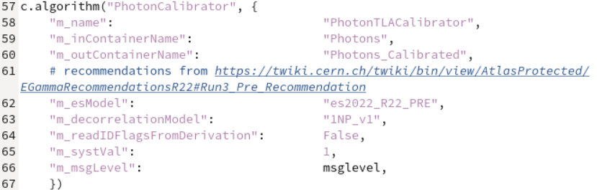
Photon Calibration
Our analysis software did not store data on the strength of photon identification, but this could be a good way to remove the low energy bumps from misidentified photons
To add this variable into the final dataset, it is a simple modification to one of the config files that will allow us to look at loose, medium, and tight photon identification

Slide 4

Running on the Grid
We have too many events to run the entire analysis software locally on lxplus, so instead I am submitting these runs to PanDA (the ATLAS Production and Distributed Analysis System)
Requires files to be available within Rucio, so we needed to wait for the runs to be restored from tape
PanDA gives you a report after you finish running to give you an idea of your energy consumption and success during the run

Slide 5
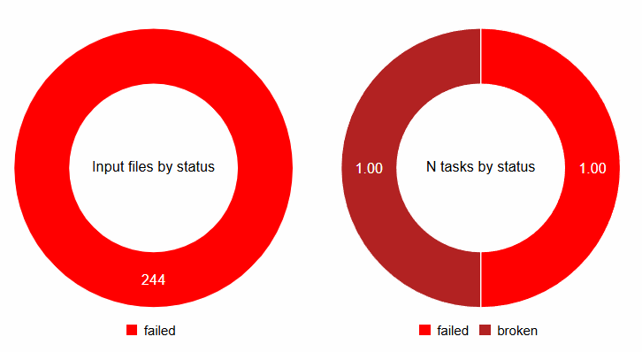
My First Grid Run
Cost: 2.38 gCO2

Slide 6
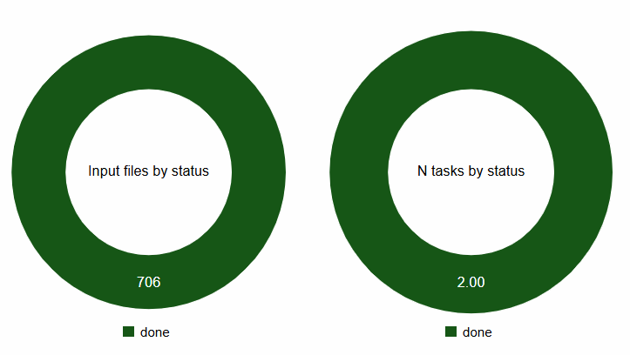
I Fixed the Problems
Cost: 19 gCO2
Total Cost: 21 gCO2

Slide 7
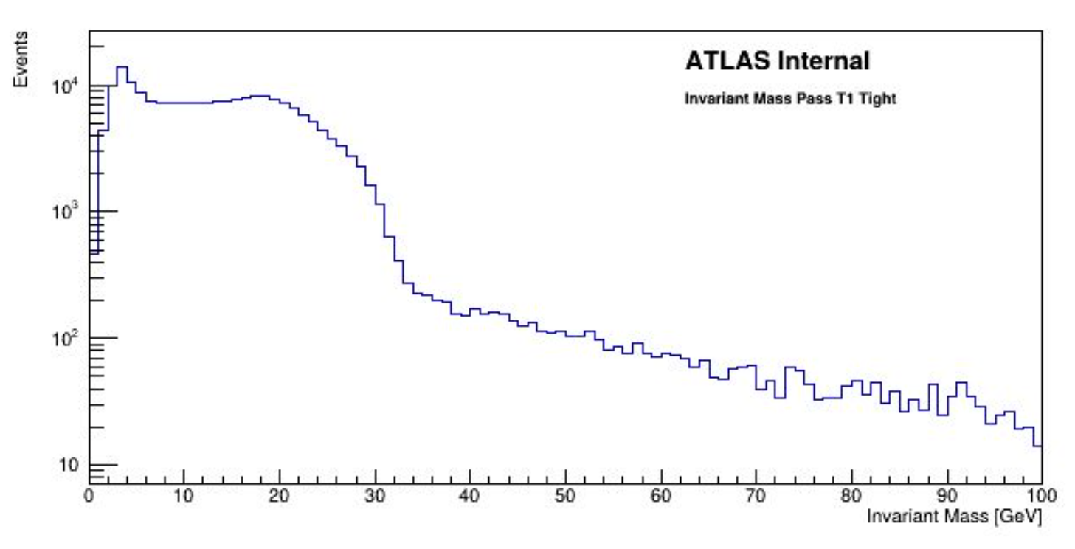
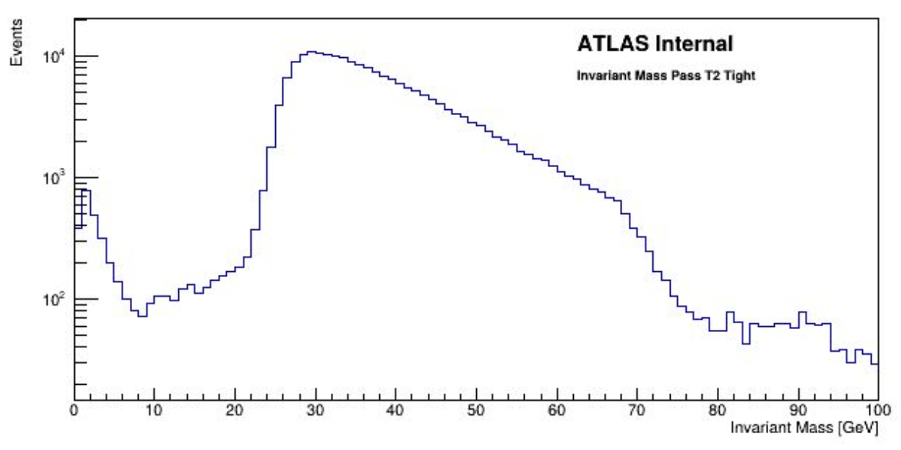
Promising Final Products
HLT_2g13_loose_EgammaPEBTLA_
L113DR25-25M70-2eEM12L
HLT_2g13_loose_EgammaPEBTLA_
L12DR15-0M30-2eEM12L

Slide 8
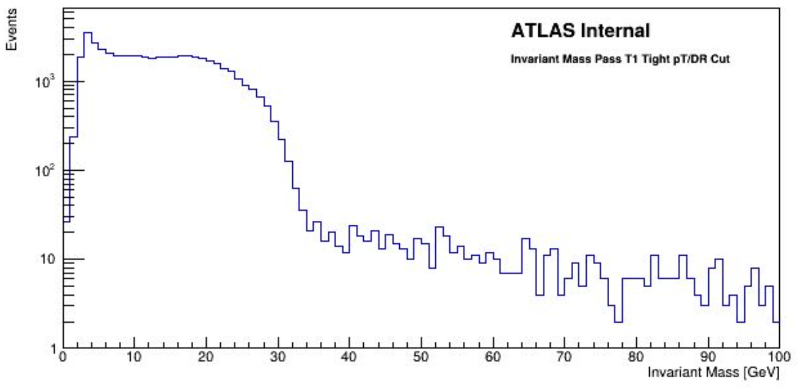
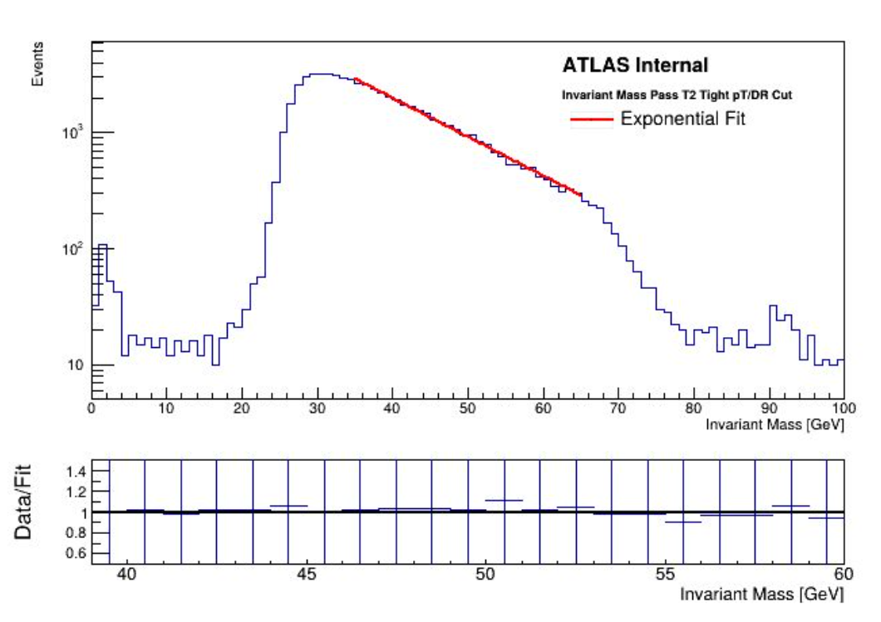
Refining Cuts
HLT_2g13_loose_EgammaPEBTLA_
L113DR25-25M70-2eEM12L
nph > 1 : pass=4820720 all=5069470 -- eff=95.09 % cumulative eff=95.09 %
ph0 is tight: pass=1399238 all=4820720 -- eff=29.03 % cumulative eff=27.60 %
ph1 is tight: pass=403272 all=1399238 -- eff=28.82 % cumulative eff=7.95 %
Pass T2 : pass=206583 all=403272 -- eff=51.23 % cumulative eff=4.08 %
ph0_pt > 13: pass=205953 all=206583 -- eff=99.70 % cumulative eff=4.06 %
ph1_pt > 13: pass=183167 all=205953 -- eff=88.94 % cumulative eff=3.61 %
Delta R > 1.3: pass=164236 all=183167 -- eff=89.66 % cumulative eff=3.24 %
Delta R < 2.5: pass=64157 all=164236 -- eff=39.06 % cumulative eff=1.27 %
HLT_2g13_loose_EgammaPEBTLA_
L12DR15-0M30-2eEM12L
nph > 1 : pass=4820720 all=5069470 -- eff=95.09 % cumulative eff=95.09 %
ph0 is tight: pass=1399238 all=4820720 -- eff=29.03 % cumulative eff=27.60 %
ph1 is tight: pass=403272 all=1399238 -- eff=28.82 % cumulative eff=7.95 %
Pass T1 : pass=204384 all=403272 -- eff=50.68 % cumulative eff=4.03 %
ph0_pt > 13: pass=202449 all=204384 -- eff=99.05 % cumulative eff=3.99 %
ph1_pt > 13: pass=169176 all=202449 -- eff=83.56 % cumulative eff=3.34 %
Delta R > 0.2: pass=167438 all=169176 -- eff=98.97 % cumulative eff=3.30 %
Delta R < 1.5: pass=48535 all=167438 -- eff=28.99 % cumulative eff=0.96 %

Slide 9
Q&A

