Slide 1






EXO-24-030: WH SUEP
Reinterpretation
05/27/2025
Zeynep Demiragli, Carlos Erice Cid, Gianfranco de Castro, Ryleigh Resendiz

Slide 2

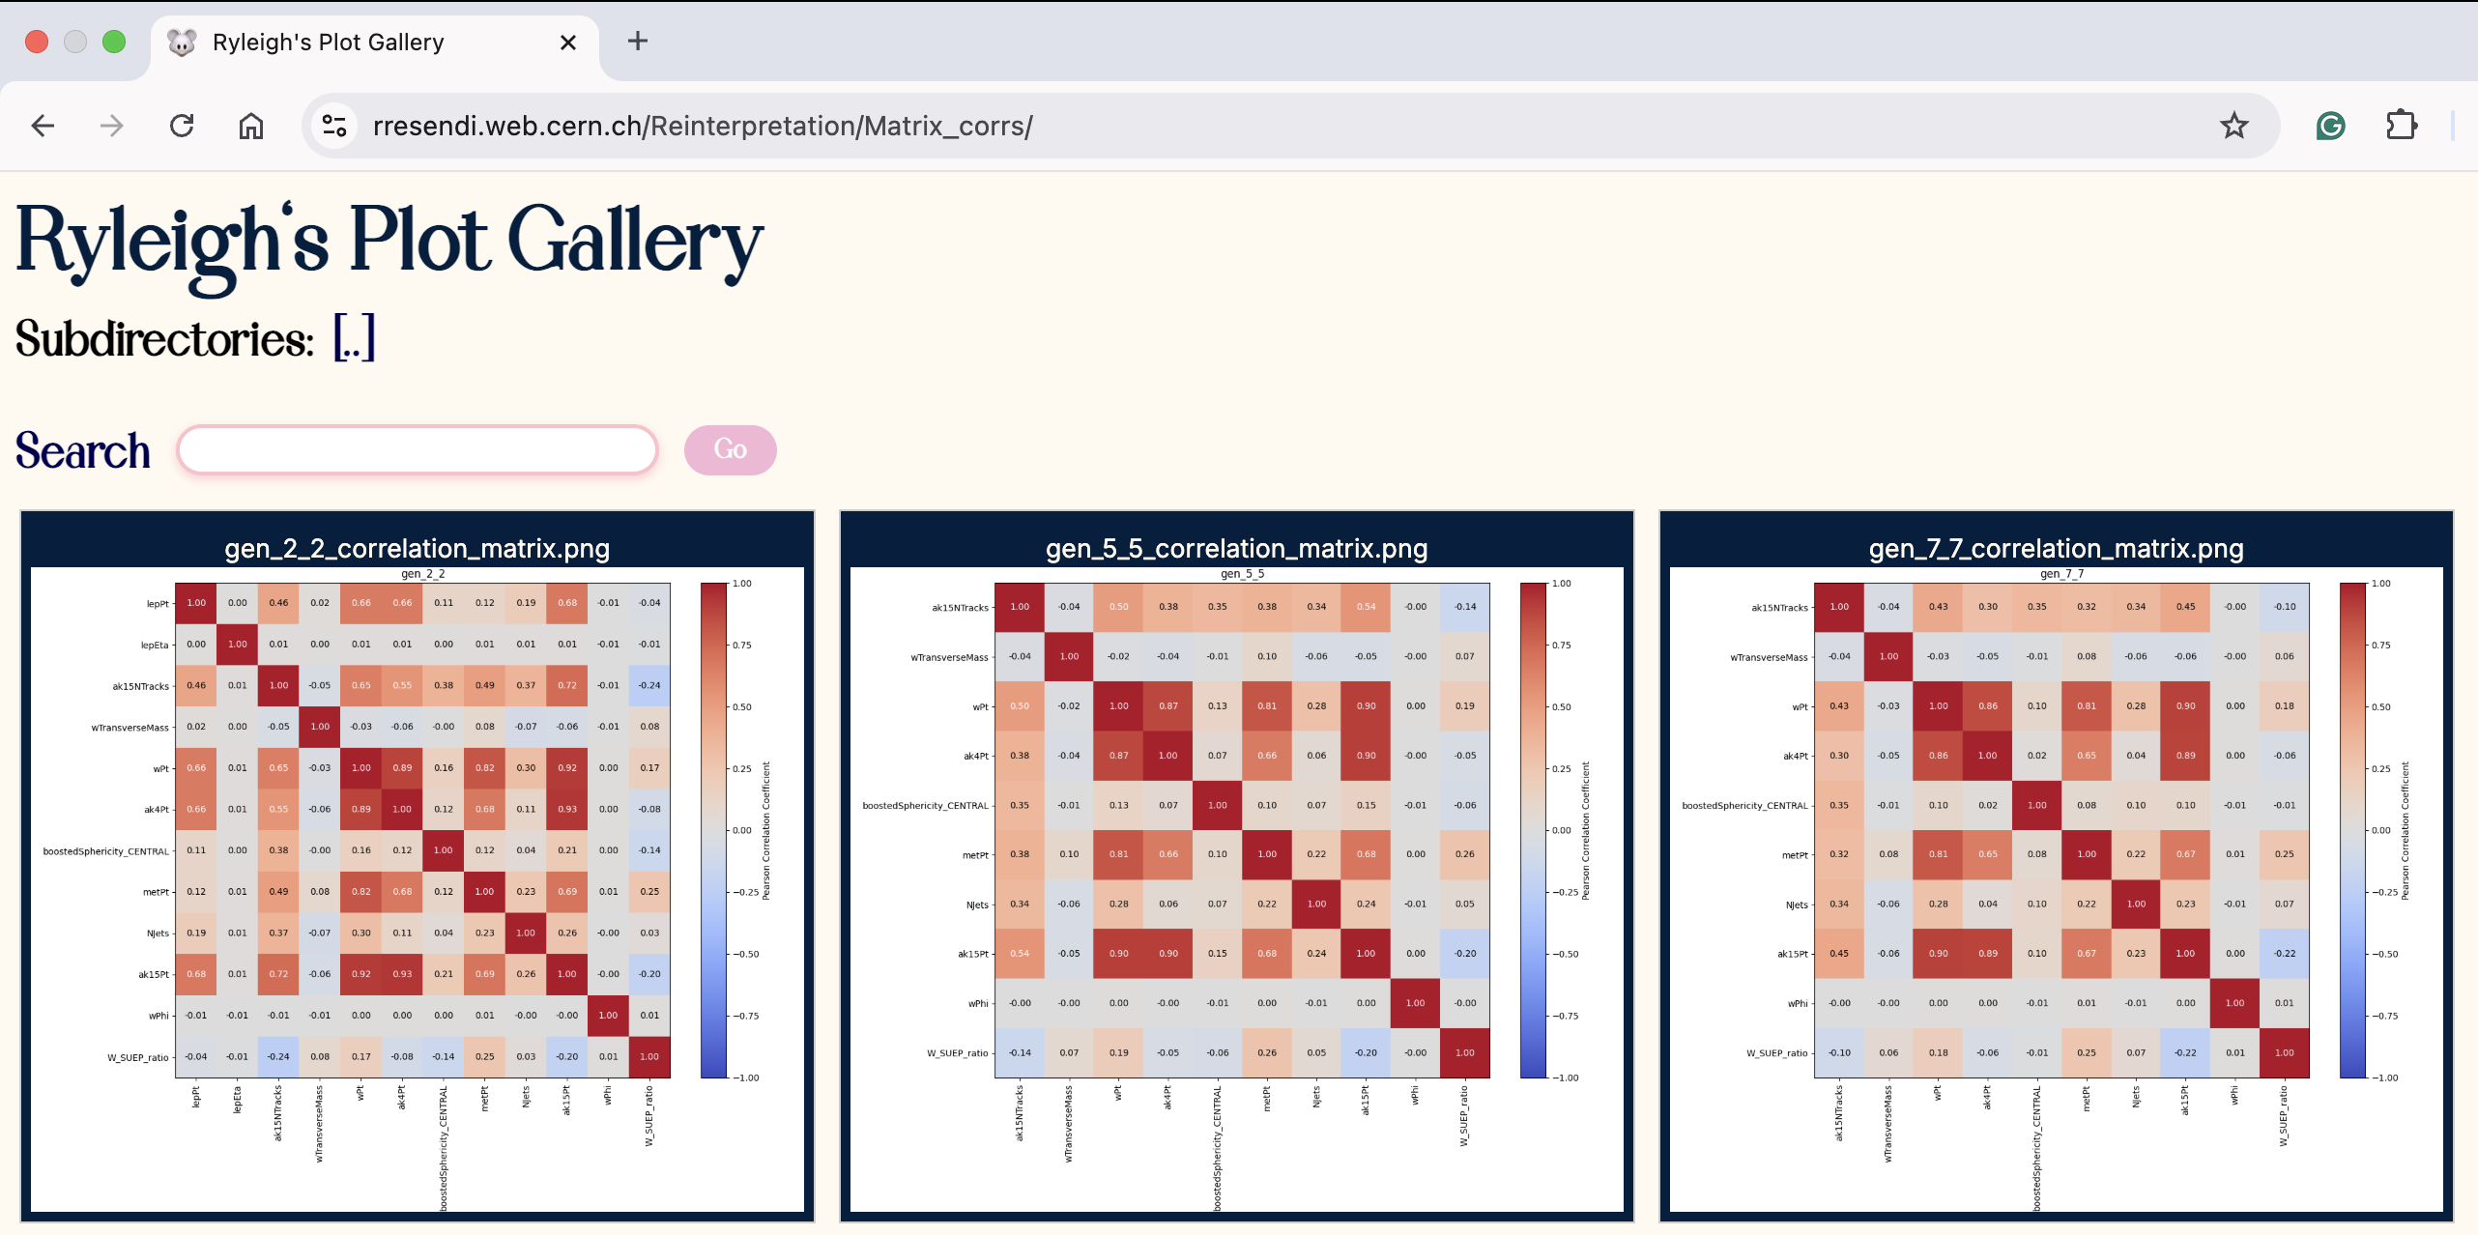
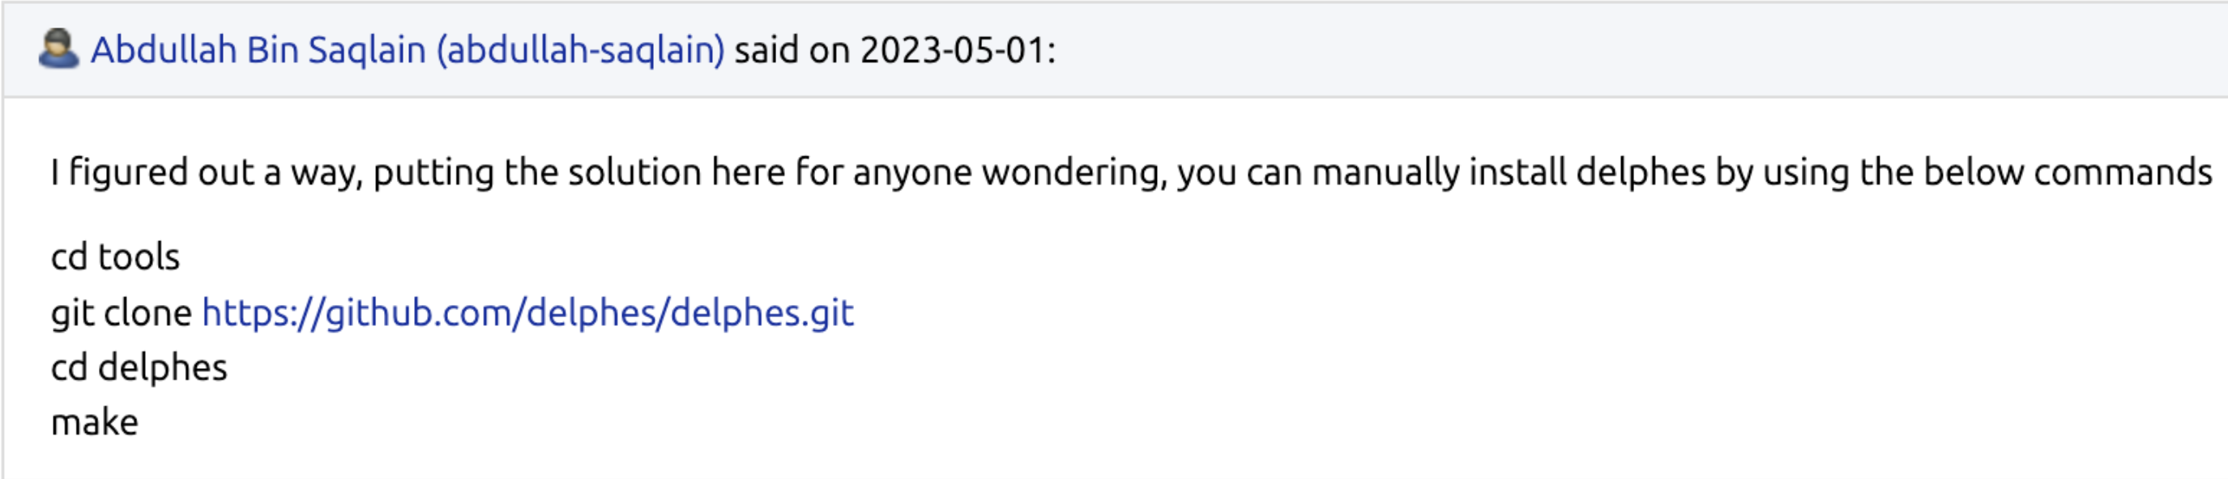

Miscellaneous Updates
CMS Week EXO General talk approved!!!!!!!!!!!!!!!!!!!!!!!!!
  Gianfranco will be giving a plenary talk as well
  Draft slides and practice talks
  High visibility for our analyses before we publish ☺
Thought we were done tuning WH and ZH in Delphes…
  Request to stop tuning was denied
  More to come in later slides
CAT meeting went well!
  Met my summer advisor
  Request for formal documentation → CAT or LHC WG Yellow paper
    direction TBD
  Suggested we make our own docker image for software installation
Still patching ZH datacard instructions
  Found a solution to the install delphes issue
Summer project
  Tuning Delphes for Run 2
  Porting Combine into MadAnalysis5 (helping with anything in my wheelhouse)
Set up my website

Slide 3
Cleaning things up
Background and system systematics?
  Tracking efficiency
ZH uses what we call a ‘choppiness’ algorithm to make their fit more robust to statistical fluctuations
  Expect drastic differences in UL agreement at low-stat points
  WH does not do this, which is why we are hypersensitive to points with low stats (ev. 0-5)
We added a 10% lnN bin-decorrelation systematic to improve agreement
  Instead of guestimating this value we will be doing something a bit more methodical

Slide 4
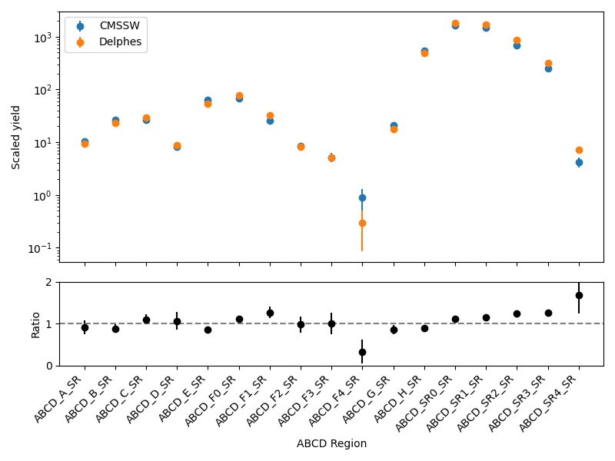
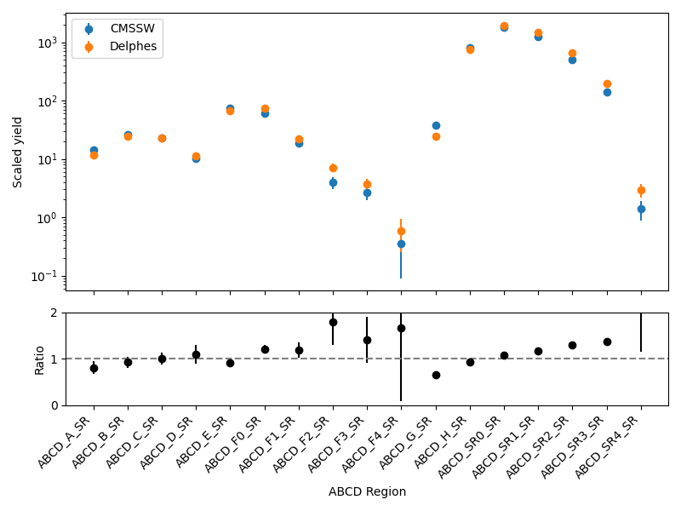
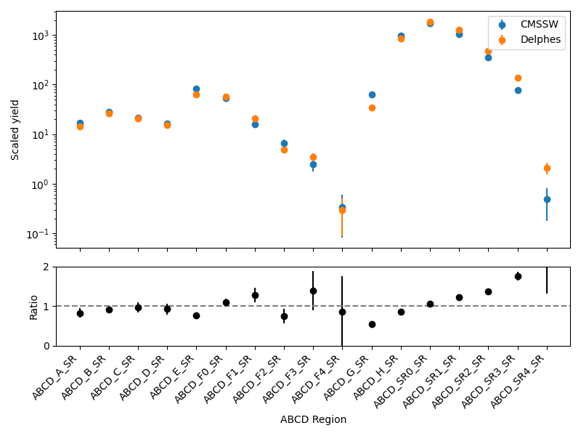
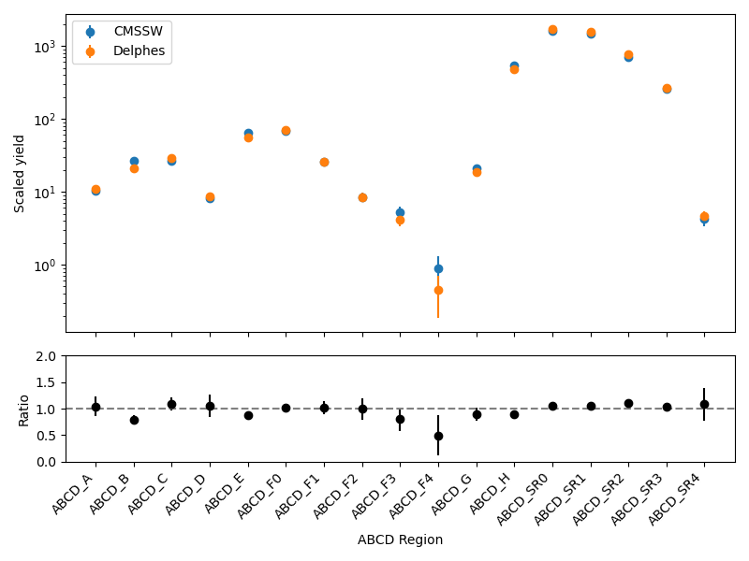
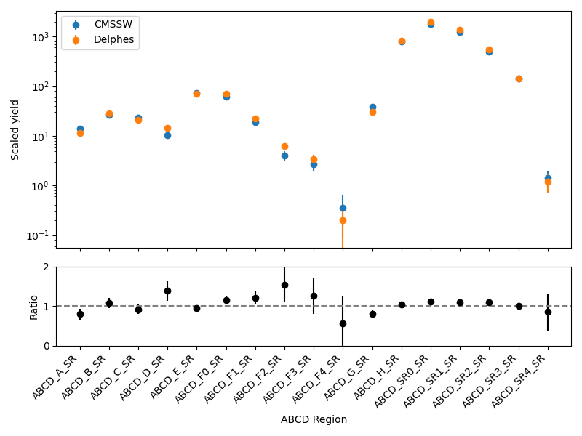
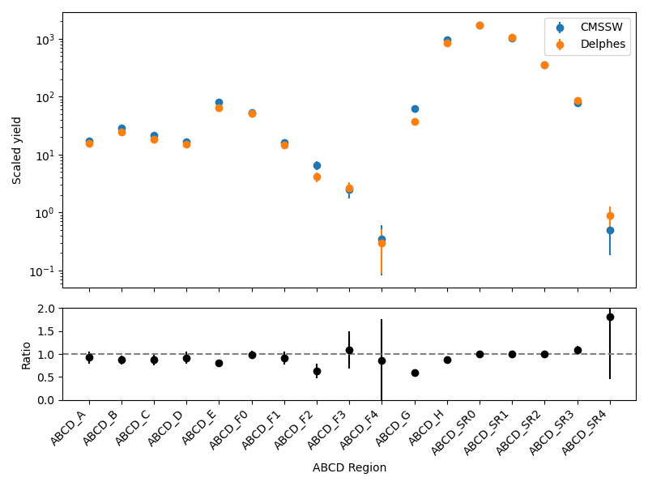
Fit Bias in high n-tracks
Generic mD = T = 2 GeV
Hadronic mD = T = 2 GeV
Leptonic mD = T = 2 GeV

Slide 5
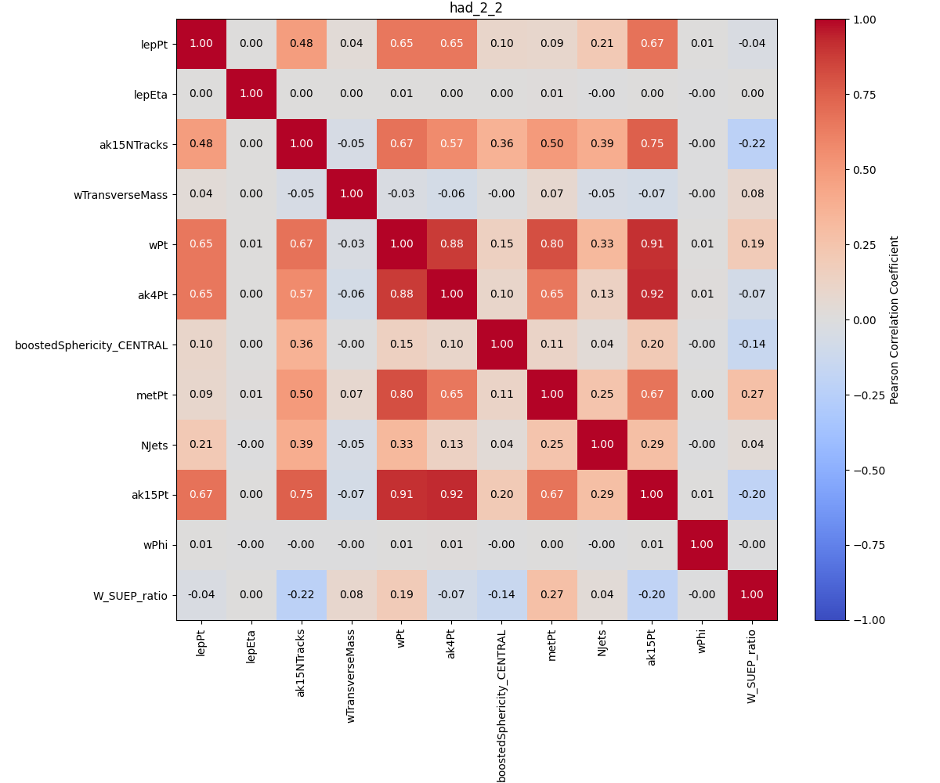
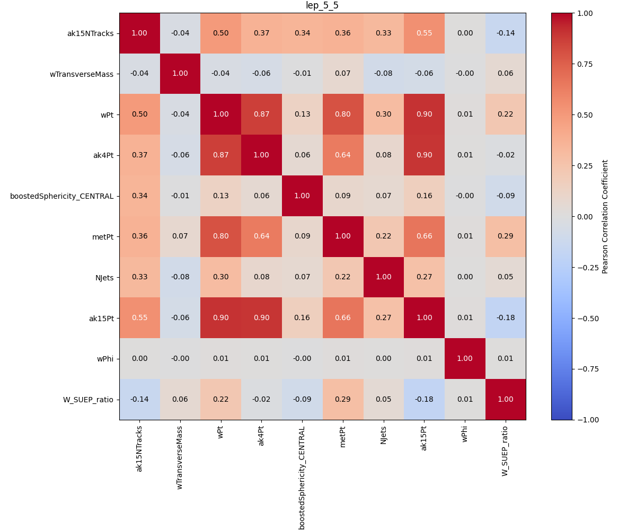
Variable correlations
Sanity checks:
  ak4pt and ak15pt have a strong corr. (0.67)
  boosted sphericity is highly decorrelated
  Strong correlation between jet pT kins
wPt and ak15pT
  corr. decreases by temp
  high corr. because the W decay produces the suep
No alarming giveaway to the bias in high ntracks

Slide 6
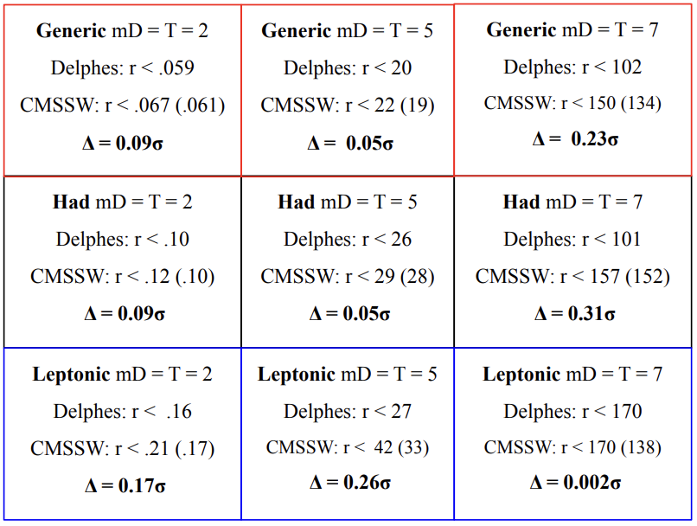
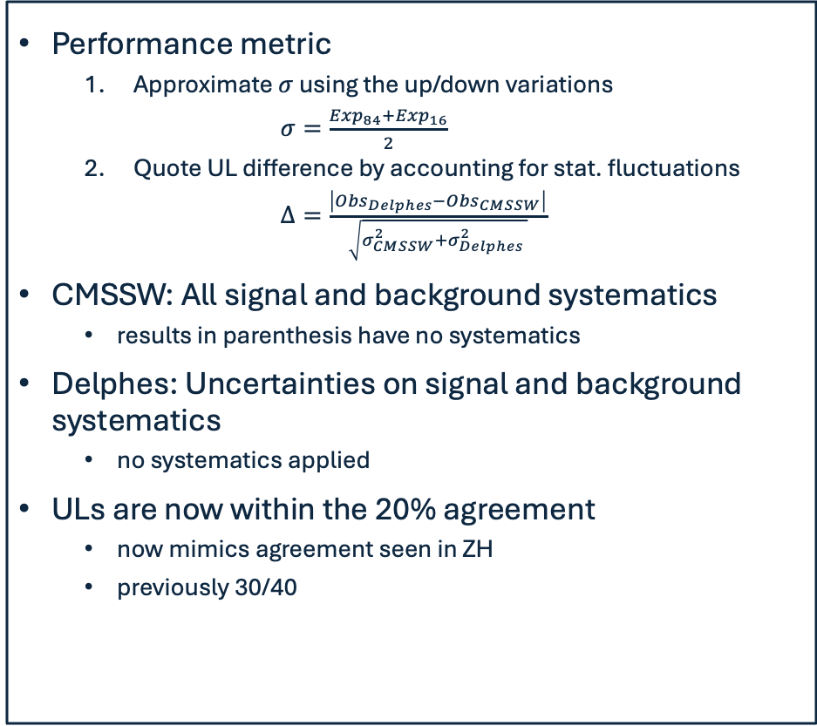
Upper Limits
Performance metric
  Approximate $σ$ using the up/down variations
    $σ=\frac{{Exp}_{84}+{Exp}_{16}}{2}$
  Quote UL difference by accounting for stat. fluctuations
  $Δ=\frac{\left|{Obs}_{Delphes}−{Obs}_{CMSSW}\right|}{\sqrt{σ_{CMSSW}^{2}+σ_{Delphes}^{2} }}$
CMSSW: All signal and background systematics
  results in parenthesis have no systematics
Delphes: Uncertainties on signal and background systematics
  no systematics applied
ULs are now within the 20% agreement
  now mimics agreement seen in ZH
  previously 30/40

Slide 7
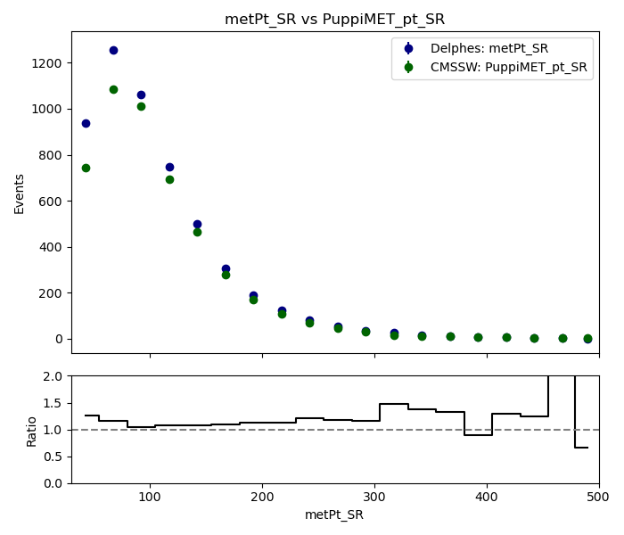
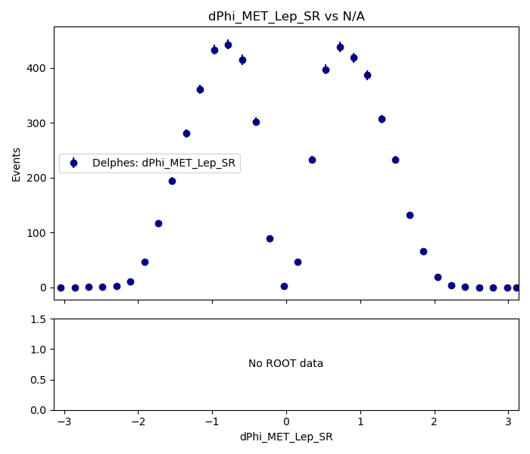
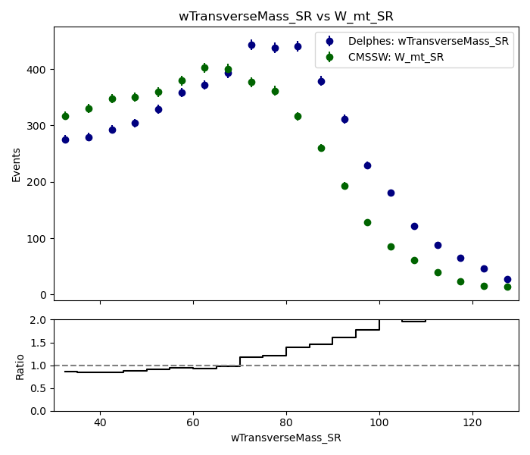

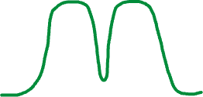
Further Investigations
Is MET mismodeling really the issue??
$m_{T}^{W}=\sqrt{2p_{T}^{l}p_{T}^{MET}(1−\cos{(Δφ))}}$
will hopefully tune $Δφ$(MET, lep) instead

Slide 8

Looking forward
Lingering? Play time?
VH combination reinterpretation efforts have begun
Writing a reinterpretation-specific AN

