Slide 1
Open Science at CERN
27/05/2025
Merten Dahlkemper
Open Science Community Engagement Manager

Slide 2




CERN
Organisation and
Statistics
24 Member States
2 Pre-stage Membership States
8 Associate Member States
4 Observers
1 400 000 000 CHF Budget
2,600 Personnel
2,000 Contractors
13,000+ Scientists and Researchers
110 Nationalities

Slide 3
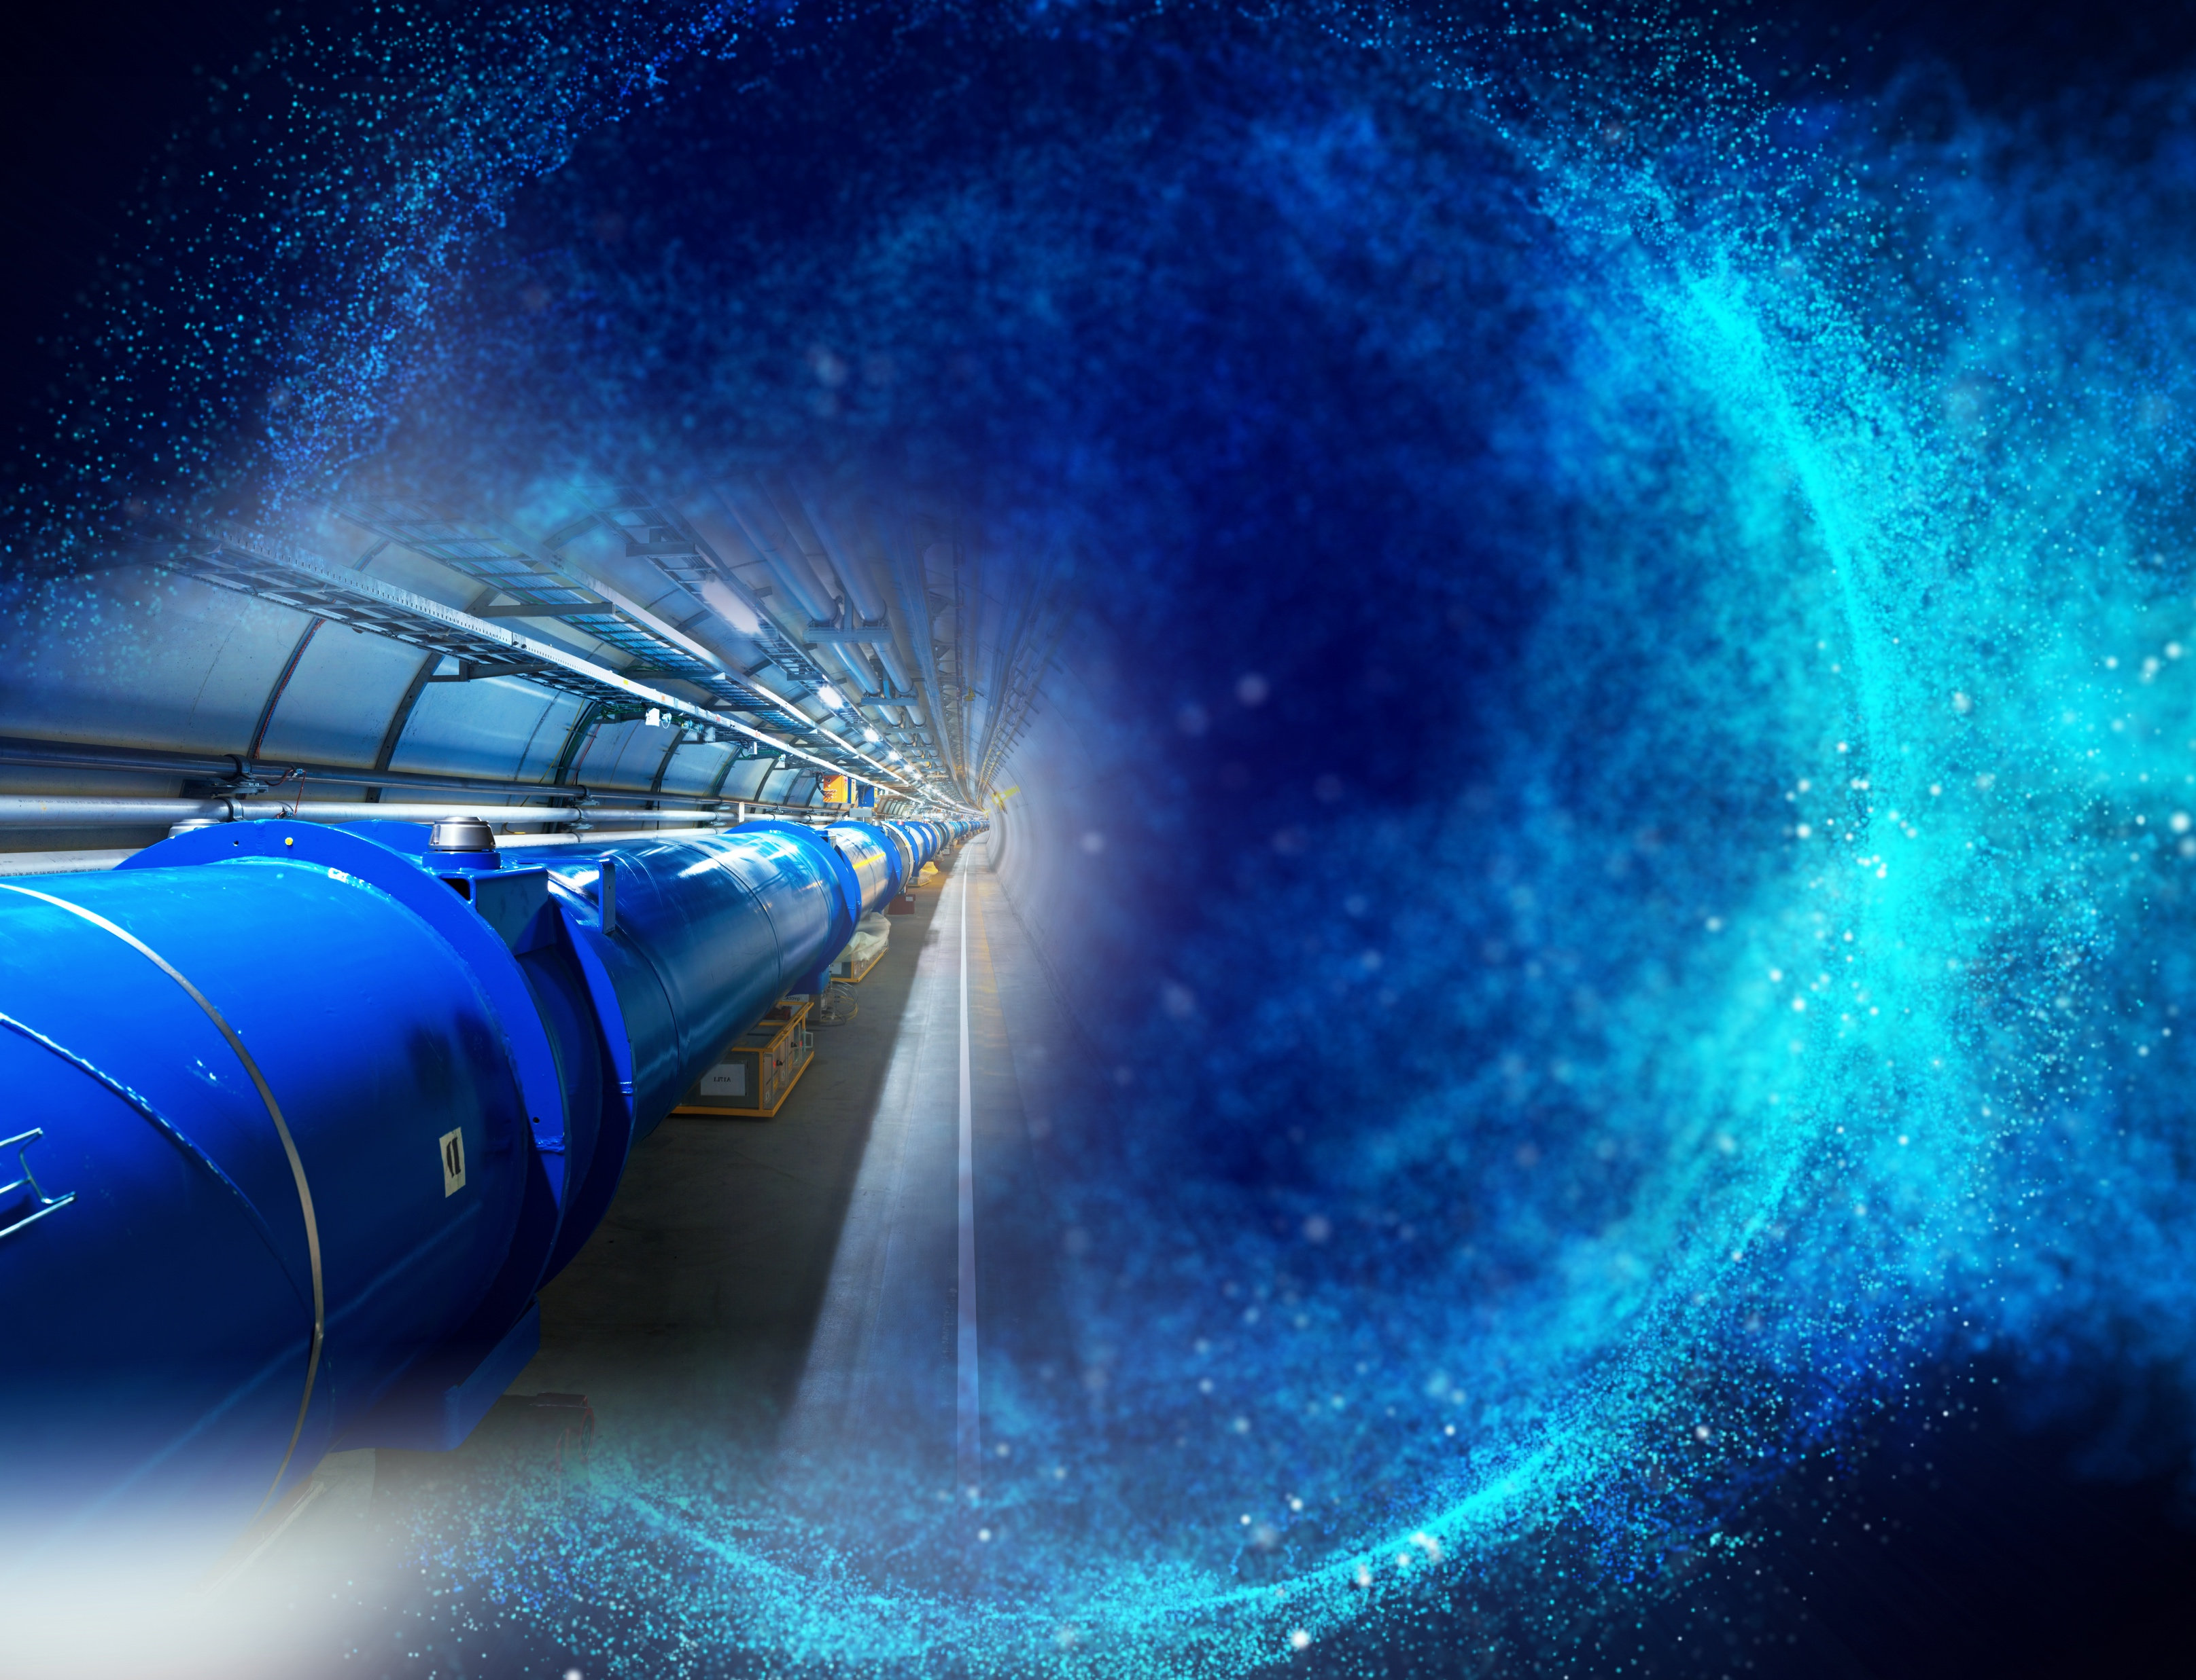
CERN Mission
Perform world-class research in fundamental physics;
Provide particle accelerator facilities in an environmentally responsible and sustainable way;
Unite people from all over the world to push the frontiers of science and technology;
Train new generations of physicists, engineers and technicians;
Engage all citizens in research and in the values of science.

Slide 4

“… and the results of its experimental and theoretical work shall be published or otherwise made generally available.”
CERN CONVENTION, 1954

Slide 5
Open Science
Policy captures current best practices and states vision across multiple domains
Policy
WORKING ACROSS DOMAINS
Open Access to publications
Open Research Data
Open Software
Open Hardware
Research Integrity, Reuse and Reproducibility
Infrastructure for Open Science
Research Assessment and Evaluation
Education, Training and Outreach
Citizen Science
Full policy text available at https://openscience.cern

Slide 6

Open Access
Mechanisms
SCOAP³
COLLECTIVE MODELS
Sponsoring consortium for Open Access publishing in Particle Physics.
CERN supports other OA Model transparent for the author (S2O, sponsorship).
OA AGREEMENTS
INDIVIDUAL APC
CERN has negotiated Open Access agreements with 10+ publishers for 4000+ journals.
For other articles fees can
be centrally covered under certain conditions.

Slide 7
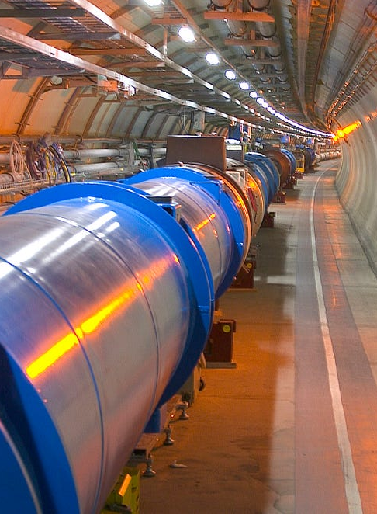
The Large Hadron Collider
CERN’s flagship
100m underground
27km circumference
Coldest known place in the universe (-271°C)
Hottest place in the solar system (100000x the sun)
1 billion particle collisions per second
Detectors collect 1PB per second of data
Will soon be updated to the “High-Luminosity LHC” (starting 2029) producing 10x more collisions = 10x more data

Slide 8

Open Data
LHC & High-Lumi
Data production
LHC: 50-60PB/Year
High-Lumi: 600PB/Year

Slide 9

Open Data
Akopov et al., Status report of the DPHEP Study Group: Towards a global effort for sustainable data preservation in high energy physics. arXiv preprint arXiv:1205.4667 (2012).
1
Additional documentation
for published results.
Data Levels
2
Simplified data formats for analysis in outreach and training exercises.
3
Reconstructed data & simulations
for scientific analysis.
4
Basic raw level data and their associated software which
allows access to full potential of experimental data.

Slide 10
Open Source
at CERN
PRODUCER
CONTRIBUTOR
CERN regularly creates or updates numerous open-source products, such as
- analysis or experiment software (e.g. root),
- general software projects (e.g. Indico),
- hardware design (e.g. 3D-printed face mask).
CERN extensively contributes to a wide range of worldwide open-source initiatives.
CONSUMER
GOVERNANCE DRIVER
More than 70% of open-source software used at CERN is based on external projects; most CERN services rely on components such as Python, Kubernetes and the Linux Kernel.
CERN has been a driver of several open source infrastructure governing attempts, e.g. by creating the CERN Open Hardware licenses.
https://opensource.cern/

Slide 11

Open
Infrastructure
CERN
Open Data
Portal
CERN
Analysis
Preservation
REANA
(Reproducible Analysis)
Open
Hardware
Repository
Services & Activities
CERN
Document
Server
Inspire
Zenodo
Indico

Slide 12
CERN
Infrastructure
Goals
Enable Open Science
Accessibility and Reusability
Facilitate Long-Term Preservation

Slide 13
Research Integrity
DISTRIBUTED EFFORTS
Infrastructure for analysis preservation: REANA, CAP
Trainings offered through HEP Software Foundation
Some model projects of publishing and re-using analyses
Policies differ widely throughout experiments
Answering the question
How did Data become knowledge?
POTENTIAL FOR DEVELOPMENT
Coordination of different stakeholders
Centralisation of training efforts
Engagement of researchers
Automation using AI

Slide 14
14
Research
Assessment
Recognize the diversity of contributions to, and careers in, research in accordance with the needs and nature of the research.
Base research assessment primarily on qualitative evaluation for which peer review is central, supported
by responsible use of quantitative indicators.
Abandon inappropriate uses in research assessment of journal and publication-based metrics, in particular inappropriate uses of Journal Impact Factor (JIF)
and h-index.
Avoid the use of rankings of research organizations
in research assessment.”
CoARA

Slide 15
Research
Assessment
The CoARA principles are well aligned with CERN Values and established particles physics practices.
To further enhance this alignment, the following actions will be taken in the next 5 years:
CoARA at CERN
Acknowledge diverse career trajectories within
the institution.
Value promoting open science, facilitating outreach activities.
Acknowledge the societal impact of research taking
place at CERN.

Slide 16
Public Engagement with Science
Democratizing science
Making science accessible to everyone
Foster bi-directional science communication
Enhancing research
Including diverse perspectives
Expand our idea of what are scientific contributions
Building support for science
Increasing scientific literacy
Create science advocates

Slide 17
Public Engagement
Co-creating Physics Experiments:
Beamline 4 Schools, ELISA
Levels of Engagement
Co-creation through
Hackathons:
CERN Webfest, THE Port
Using CERN Open Data:
Masterclasses, Open Data Portal
Learning about CERN:
Guided Tours, Science Shows, Workshops,
Hands-on Exhibitions

Slide 18
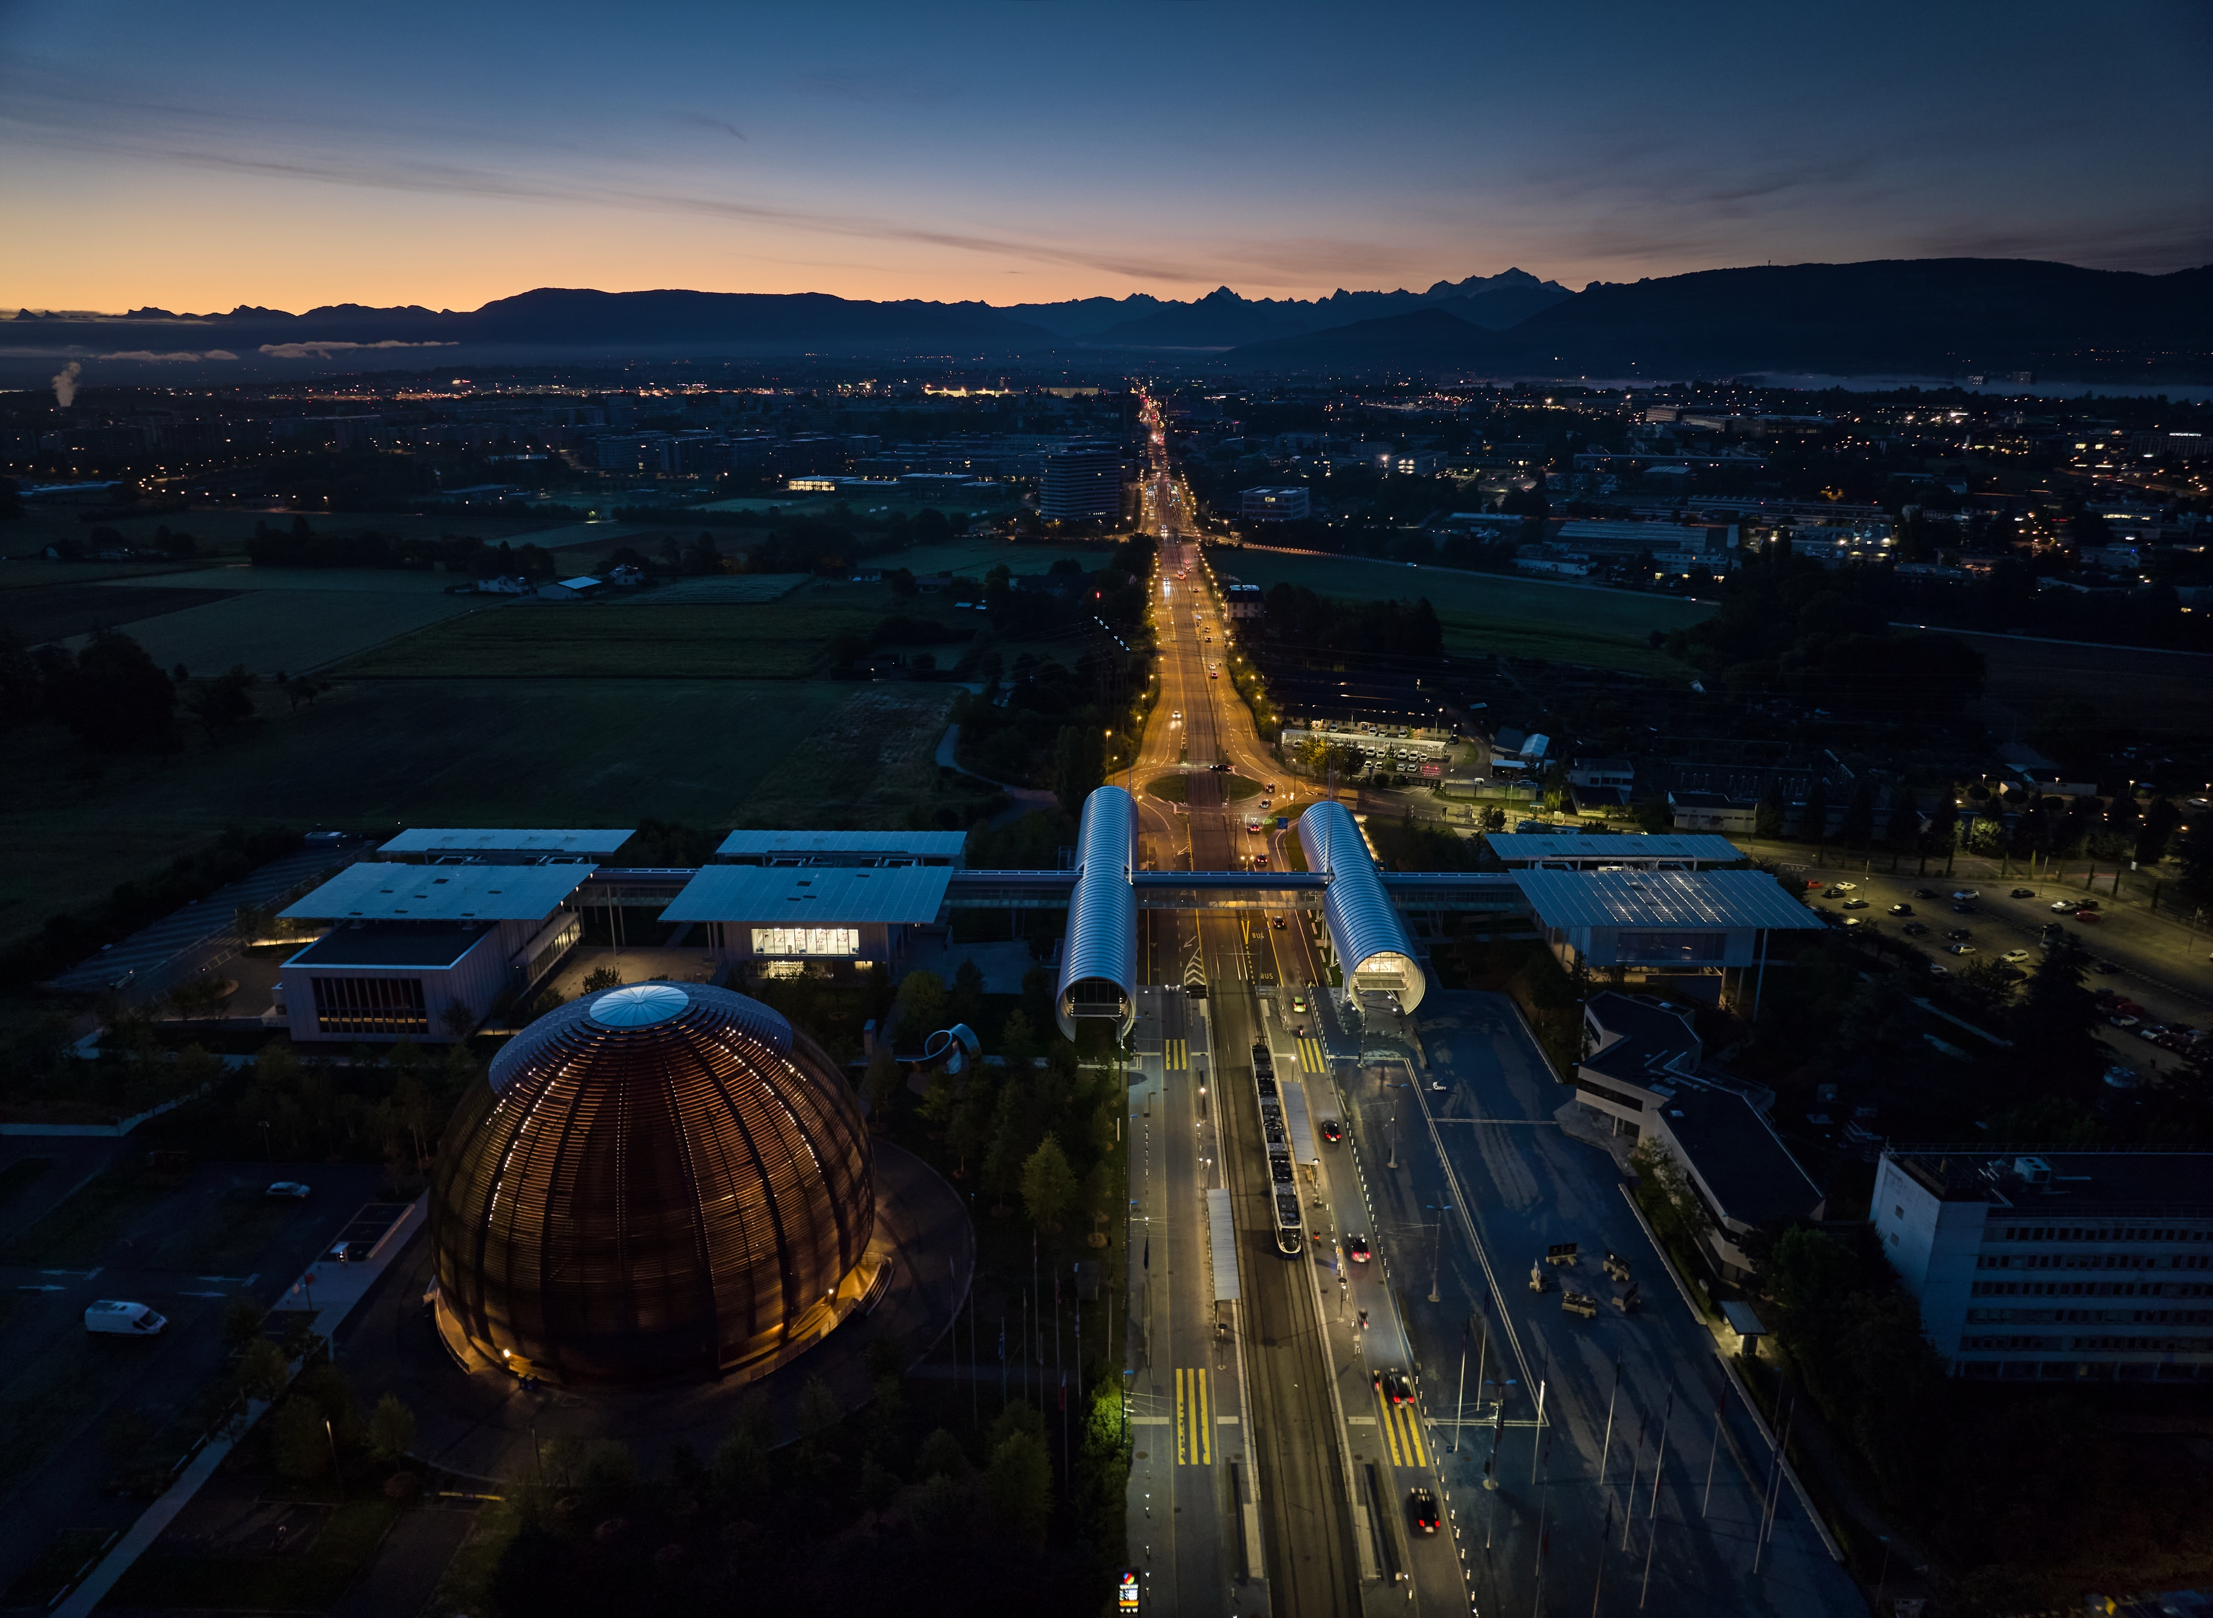
Education & Outreach
25 000 + workshop participants
1 000 + teachers trained
180 000 visitors guided to CERN facilities by CERN volunteers
Open educational resources: https://educational-resources.web.cern.ch/

Slide 19
Open Science
Policy captures current best practices and states vision across multiple domains
Policy
WORKING ACROSS DOMAINS
Open Access to publications
Open Research Data
Open Software
Open Hardware
Research Integrity, Reuse and Reproducibility
Infrastructure for Open Science
Research Assessment and Evaluation
Education, Training and Outreach
Citizen Science
GOVERNANCE AND IMPLEMENTATION
Community Governance
Community-led Implementation
Following CERN’s spirit of collaboration
Full policy text available at https://openscience.cern

Slide 20

The Road towards Community Engagement
Assessing Needs for Training and Communication
Developing and coordinating trainings
Assessing available resources
Focus interviews
with Stakeholders
Monitoring community health
Organising
community events
Community Survey

Slide 21

Get Involved
Explore CERN’s Open Data
Share your work on Zenodo
Join the Open Science Fair
(15th – 17th September @ CERN Science Gateway)
Discover CERN through the Science Gateway

Slide 22
Merten Dahlkemper (OS Community Engagement)
merten.dahlkemper@cern.ch
Anne Gentil-Beccot (Open Access)
anne.gentil-beccot@cern.ch
Kamran Naim (Head of Open Science)
kamran.naim@cern.ch
Open Science Office
open-science@cern.ch
openscience.cern | opensciencefair.eu

Slide 23
BACKUP

Slide 24
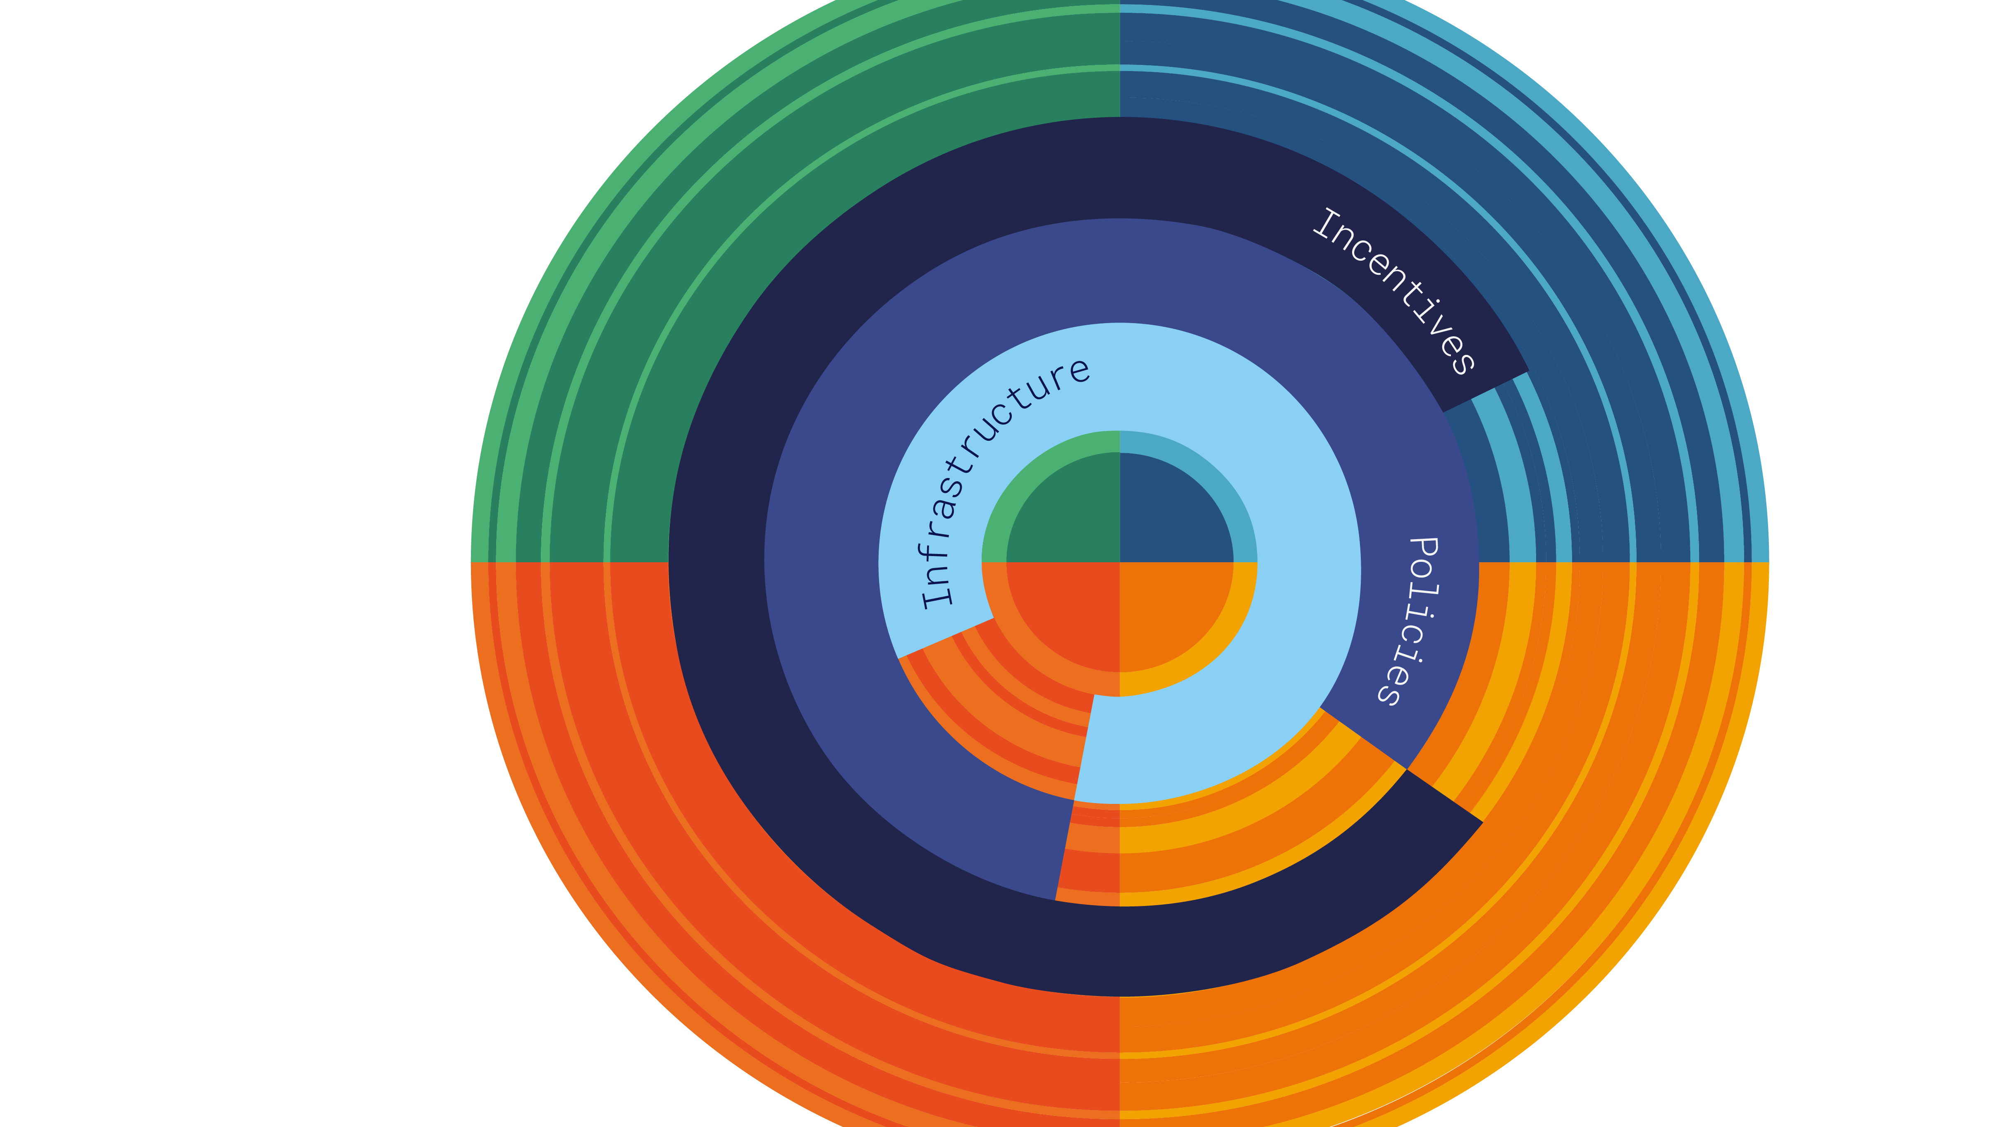
Open Science
Structures & Process
DATA
PUBLICATIONS
SOFTWARE
HARDWARE

Slide 25

Open Science
Creating efficient and effective coordination of CERN´s Open Science efforts.
Director of Research
and Computing
Governance
Framework
Open Science
Steering Board
OS Practitioners Forum
OS Office
Open Data WG
CoARA Implementation WG
Interest Groups
SIPB
OSPO

Slide 26

Open Data:
Experimental Programme
LHC Major Experiments
LHCb
ATLAS
CMS
ALICE

Slide 27
Open Data
cds.cern.ch/record/2745133
Published in 2020
All experiments engage into opening datasets to the world
Four levels of data defined – policy commitment is for levels 1, 2, 3 only, level 4 too complex and resource-intense
Efforts coordinated jointly by CERN Open Data Working Group, RCS-SIS, CERN IT
Policy for LHC Experiments

Slide 28
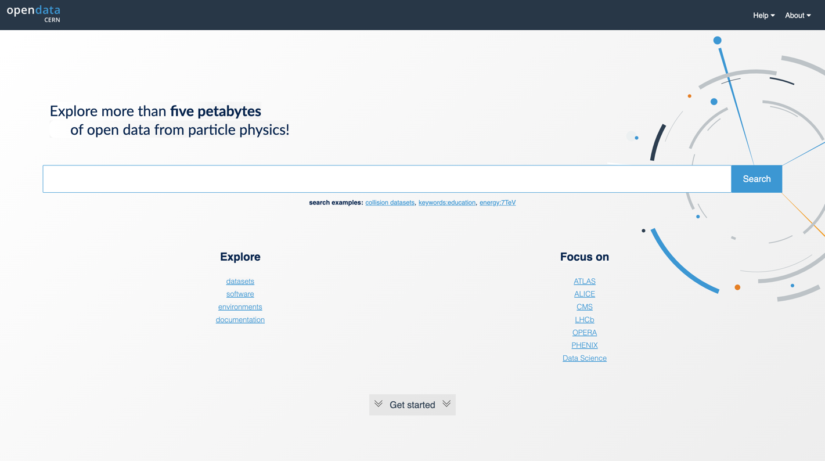
https://opendata.cern.ch/

Slide 29
Open Data
Portal to Access data form the LHC Experiments
and beyond.
Portal
BUILD WITH THE EXPERIMENTS FOR THE PHYSICS WORLD
Digital repository for event-level particle physics
open data.
Rich content:
  Collision and simulated datasets for research.
  Derived datasets for education.
  Virtual machines and container images.
  Software tools and analysis examples.
Launched in November 2014, publishing about 30TB.
Total size in June 2024: about 5000TB.
USES CASES
Education-oriented.
Research-oriented.

Slide 30

Research Integrity
Data Management Plans
WHEN: Schedule for data sharing
and long-term preservation, embargo periods.
WHERE: Repositories most suitable to store the archived data.
WHAT: Data types, volume formats, metadata, documentation,
new vs re-use.
HOW: Quality control measures, backups, data security, protection of sensitive data.
WHO: Data steward responsible for data management and ensuring data is FAIR.

Slide 31

Highlights
1989-2023
2014
2018
Open Access Policy
Open Data Portal
90% OA Reuse & Reproducibility Framework
1991
2023
arXiv.org
OSPO
1989
World Wide Web
2020
2011
Open Data Policy
Open Hardware License V1.0
2022
Open
Science
Policy

Slide 32

Open Access
1991-2024
2024
SCOAP³ Introduces Open Science Elements
2014
CERN Open Access Policy
1991
arXiv.org
2014
Launch of SCOAP³
2018
APS joins SCOAP³, 90% of OA in HEP

Slide 33

Open Data
2012-2024
2020
LHC Open Data Policy
2012
CMS Open Data Policy
2012
2024
HEPdata connected with INSPIRE
2014
More than 5000TB of data in CERN Open Data Portal
CERN Open Data Portal

Slide 34
Open Software
1993-2023
1993
WWW released into public domain
2002
Indico, Invenio
1995
ROOT
2023
CERN Open Science Program Office (OSPO) launched

Slide 35

Open Hardware
2008-2024
2020
2011
CERN OHL V2
2023
CERN Open Hardware License V1
CERN OSPO
2008
White Rabbit
2024
White Rabbit Collaboration established
2011
2023
CERN joins KiCad development
KiCad supported through commercial company
2009
Open Hardware Repository

Slide 36

Incentives
2022-2024
2024
Preliminary CoARA Action Plan prepared
2022
CERN Signs CoARA Agreement

Slide 37

Policies
2023
2014-2025
OS Governance Framework
implement of OS Policy
align with CERN strategy
2021
2014
CERN Open Science Strategy Working group to devise organisational
OS policy
CERN Open Access Policy Published
2025
CERN to publish first OS report
2020
LHC Open Data Policy Published
2021
CERN contributes to development of UNESCO Open Science recommendation
2023
CERN publishes OS implementation plan
2020
ESSP Update states:
“The particle physics community should work with the relevant authorities to help, shape the emerging consensus on Open Science to be adopted for publicly-funded research, and should then implement a policy of Open Science field.”
2022
CERN publishes its first organizational OS Policy

Slide 38

Infrastructure
1969-2017
1991
arXiv.org
2012
2019
2002
INSPIRE
InvenioRDM
Invenio Framework
2014
CERN Open Data Portal
2013
ZENODO
2009
2014
2017
Open Hardware repository
CERN ANALYSIS PRESERVATION
REANA
1969
SPIRES

Slide 39
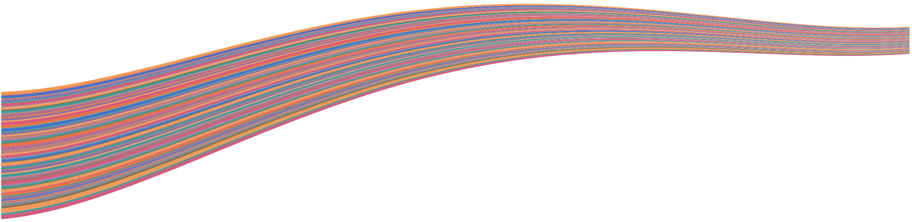
CoARA at CERN
Timeline
YEAR 3
Device recommendations in line with the CoARA principles.
YEAR 5
Test and revise implemented changes.
YEAR 1
Overview of individual research practices.
YEAR 4
Implement recommendations.
YEAR 2
Review of official documentation on assessment.
YEAR 1
Overview of Project proposal assessment practices.

Slide 40
Open Science
Creating efficient and effective coordination
of CERN´s Open Science efforts.
Governance Framework
OPEN SCIENCE STEERING BOARD
To oversee OS efforts at the strategic level.
Reports to DRC.
Inter-departmental body (currently 15 members).
OPEN SCIENCE PRACTITIONERS FORUM
De-facto continuation of the OSWG
CERN-wide Exchange amongst different OS expert groups.
OSPF elects a member to represent it at the OSSB.

Slide 41
Open Science
Creating efficient and effective coordination
of CERN´s Open Science efforts.
Governance Framework
OPEN SCIENCE OFFICE
Organisationally set up in RCS-SIS-OS
Support of different expert groups, OSPF and OSSB, coordinates communication efforts and creation of OS Report.
Provides additional concrete services to CERN community (e.g. advice on creating Data Management Plans)

Slide 42

Open Access
Process for Authors
Write your article…
Is your data available?
Make the preprint available.
Find a journal with an OA option.
Select your license.
ZENODO
HEPDATA
ARXIV
CDS CERN
CERN Author guide
to choose journal
CC-BY License required for CERN

Slide 43
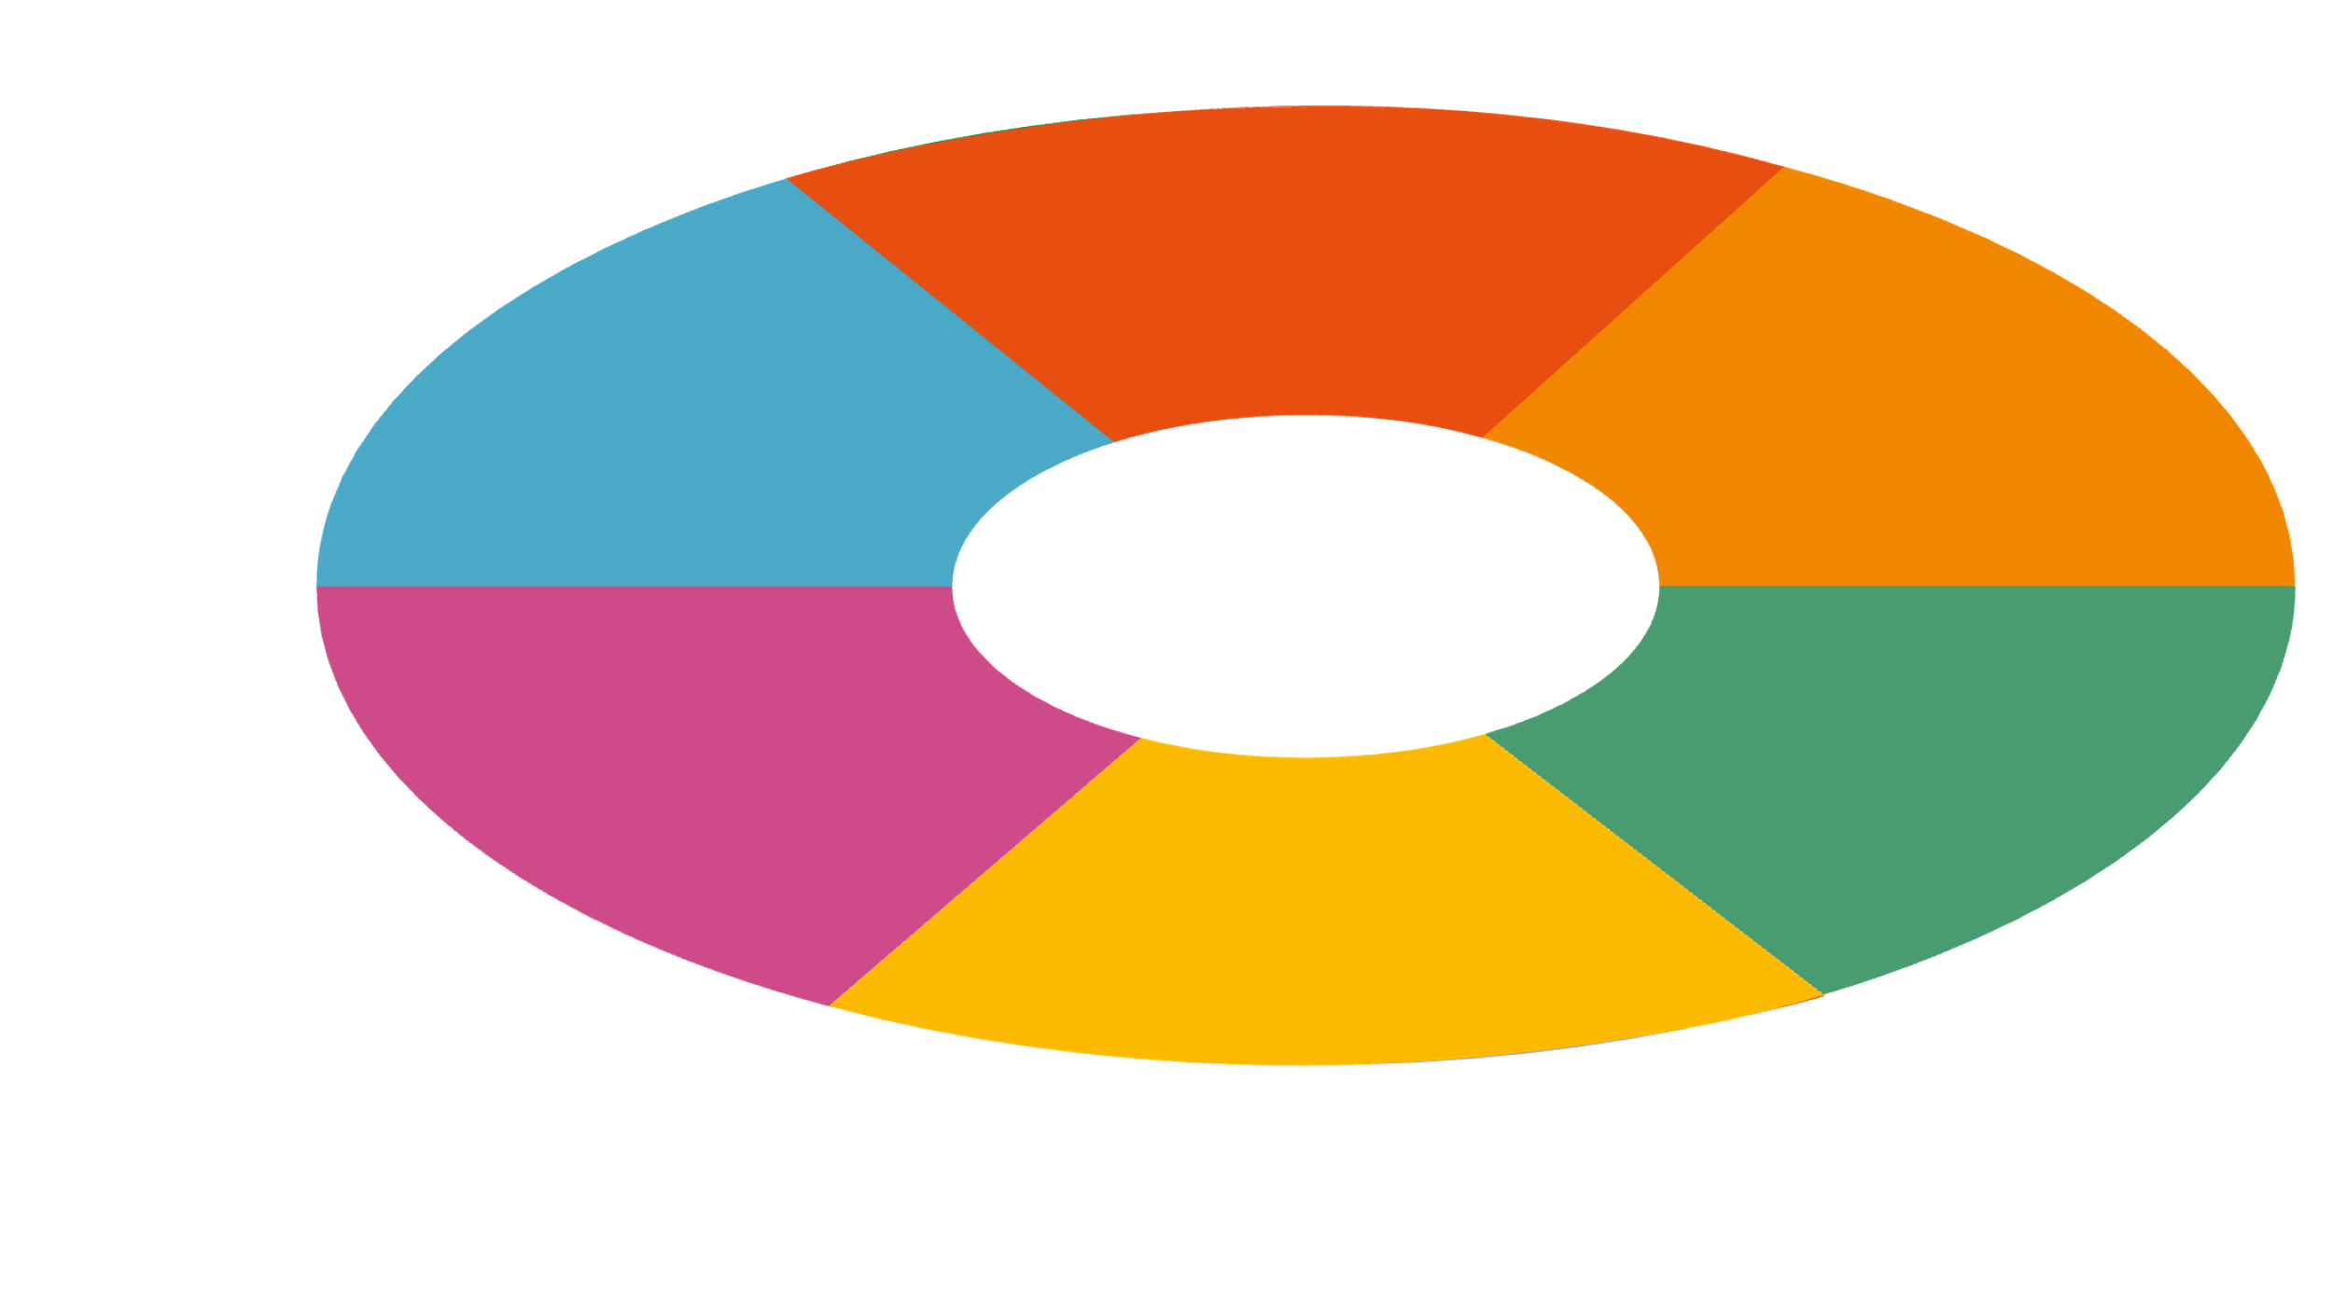
Persistent
Identifiers
Data & Software
DataCite
Publications
Funders
CrossRef, DataCite
CrossRef
Research & Contributors
Grants & Projects
ORCiD
CrossRef
Organisations
ROR

Slide 44

OSPO
Involvement process
Executed by KT
Understand Software/Development team ambitions.
HARDWARE
DISCLOSURE
SOFTWARE
DISCLOSURE
Identify contributions, contributors, ownership.
OSPO
TASK EXECUTED BY OSPO
KT GROUP
BE,EP,HSE,IR,IT,KT,
SIS,SY,TE,TH
With representation of technical departments and KT experts.
Map potential use for
knowledge transfer.
Assessment of legal reputational, Safety risk.
Advice on recommended
licencing scheme.
OSL
Y
Y
OSPO
Catalogue
OHL
Potential for CERN to demonstrate knowledge transfer and societal impact, and are used for KT.
N
Proprietary
Catalogue
N

Slide 45
Open Source
Program Office
INTERNAL MANDATE
Mandate
Consult, advice, train on Open source best practices,
tools licenses, etc.
Advices on open-sourcing CERN software and hardware.
Identify dependencies and compatibility for critical services.
Advices CERN on Open Source matters.
EXTERNAL MANDATE
Showcase CERN contributions to e.g. member states’
Open Source ecosystem.
Facilitate partnerships with external entities,
e.g. companies.
Promote CERN as an Open Source lab.
Contact: Open.Source@cern.ch
opensource.cern
cds.cern.ch/record/2B79995
Mandate:

Slide 46

CERN Open Source
Program Office
STRATEGIC
OS Policy
OSPO Mandate
OSPO Outreach
OS Partnership
INTERNAL
EXTERNAL
Licensing
Tips & Tools
OSPO Catalogue
CLA Management
OPERATIONAL

Slide 47
Open Source
SOFTWARE
Reach beyond High-Energy Physics
Conference management (Indico).
Document management (InvenioRDM).
Storage (CTA, CERNbox, CernVM-FS).
Data analysis/computing (ROOT, BioDynaMo, EMP2,
REANA, SWAN, Rucio).
HARDWARE
High-precision timing (White Rabbit).
EDA tools (kiCAD).

