Slide 1



The Open Quantum Institute

Slide 2
Who We Are
OQI: The collaborative platform developing quantum computing for the benefit of all

Slide 3


The OQI Journey
Disruptive technologies can develop faster than legal frameworks and acceptance from societies
Current Disruptive Technology
Future Disruptive Technology

Slide 4
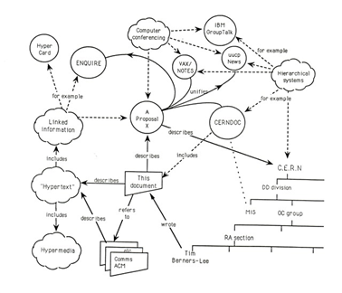
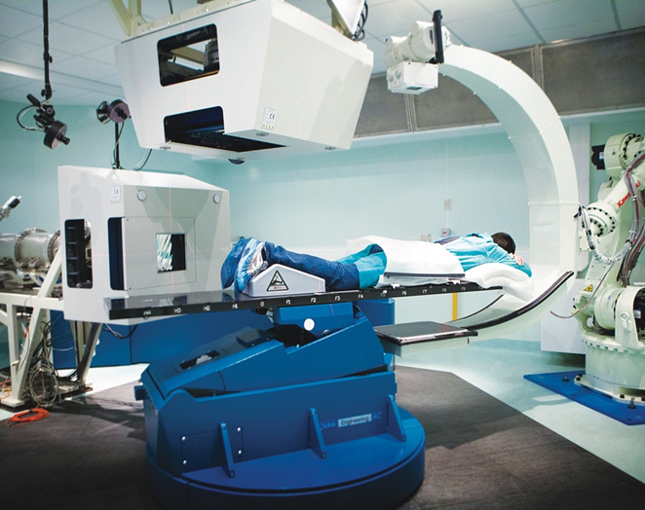
Why CERN?
70 years of exemplary track record in sharing technology with Society
Non-profit, inclusive, open science in action
Collaboration is at our core: more than 700 partner universities worldwide and over 13,000 users

Slide 5



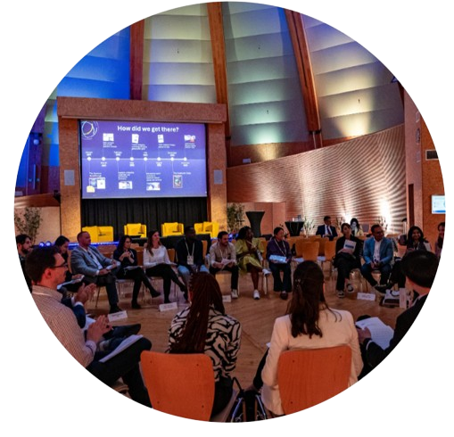
What Makes us Different?
Partnership with industry providers to target underserved geographies in quantum computing (e.g. IBM, Pasqal, qBraid)
Bringing together quantum scientists, subject matter experts, and UN organisations and large NGOs to explore the potential of quantum computing for all (e.g. WHO, ICRC)
Developing educational tools to be used around the world for everyone to benefit from quantum computing technology (e.g. ETH, EPFL),

Slide 6
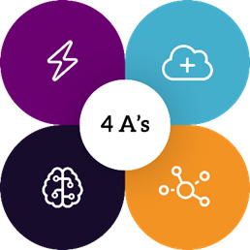




Main objectives
A1 - Accelerating applications for humanity (quantum computing use case ideas)
Realising the full potential of quantum computing by accelerating the use cases geared towards achieving the SDGs, thanks to the combined forces of researchers and developers, entrepreneurs, the United Nations, and large NGOs.
A2 - Access for all (collaborating with industry)
Providing global, inclusive and equitable access to a pool of public and private quantum computers and simulators available via the cloud, addressing underserved geographies and mitigating the digital divide.
A3 - Advancing capacity building (education)
Developing educational tools to enable everyone around the world to contribute to the development of quantum computing and make the most of the technology.
A4 - Activating multilateral governance for the SDGs (diplomacy)
Providing a neutral forum to help shape multilateral governance of quantum computing for the SDGs and engaging with the science diplomacy community to support the development of use cases for the SDGs.

Slide 7
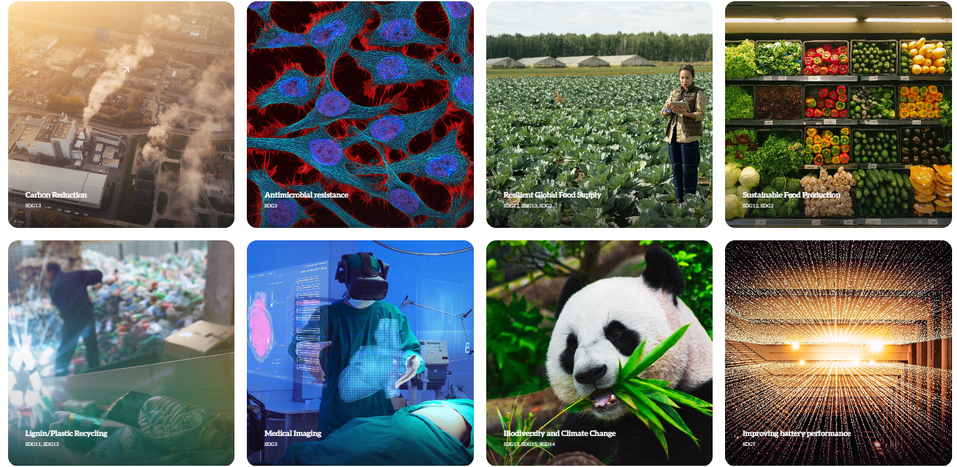


A1 - Accelerating applications for humanity
An OQI use case highlights a problem with a societal impact that has potential to be tackled using quantum computing in a real-world context.

Slide 8
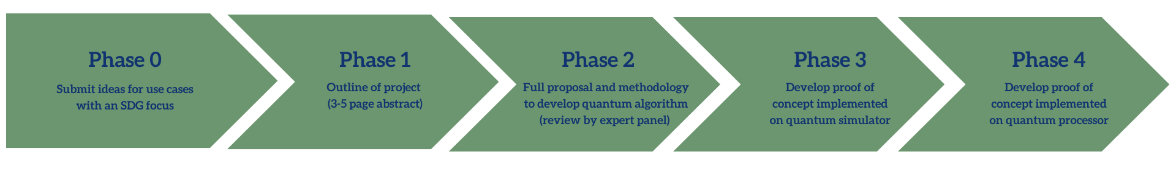
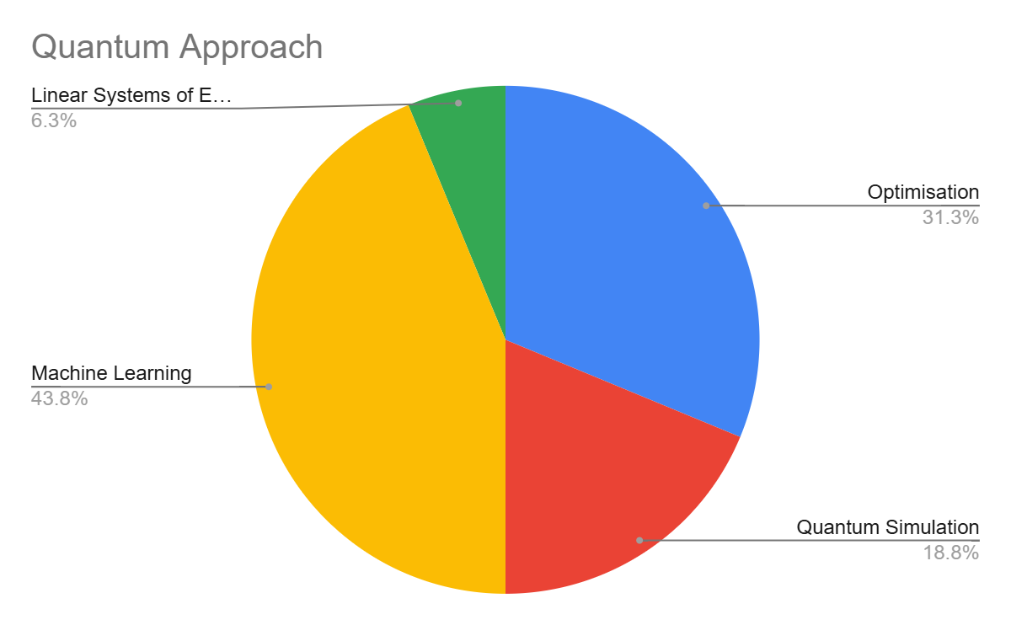




Use Case Development
Use case examples:
Sustainable food production
Antimicrobial resistance
Carbon reduction
Water quality
More info at oqi.cern
Quantum Approach:
Linear System of Equations
6.3 %
Optimisation
31.3 %
Machine Learning
43.8 %
Quantum Simulation
18.8 %

Slide 9






































Project Teams
Our incubation partners helped us grow OQI from a concept to reality, with many in the process of formalising their engagement to become partners during our pilot phase.
Nonprofits
Academia
Industry
IGOs/NGOs

Slide 10





001 - Water Leak Detection
Use Case Team:
Manny countries affected by water scarcity with numbers set to increase with climate change and growing populations.
From water resources that are collected and treated, often more than 50% of water unaccounted for.
Quantum computing to determine optimal positions for sensors in large pipe networks, allowing for identification of locations of water losses.
UN Agency:
Quantum Approach:
Status:
Optimisation
Phase 3
Optimal Placement of Sensors in Pipe Network
Improved Identification of Damaged Pipes
Improved Ability to Fix/Replace Leaking Pipes
Decrease in Unaccounted for Water

Slide 11






101 - Accelerating Novel Antimicrobial Discovery
Use Case Team:
Antimicrobial resistance is considered to be one of the largest threats to global public health by the WHO.
Due to a lack or profitability, promising antibiotics failing to reach market due to lack of investment from pharmaceutical companies.
Quantum computing to explore a larger number of chemical interactions more effectively, improving ability to produce affordable antibiotics.
UN Agency:
Quantum Approach:
Status:
Machine Learning and Quantum Simulation
Phase 2
More Efficient Drug Discovery Process
More Profitable Industry
Investment form Pharmaceutical Companies
More Available + Effective Antibiotics

Slide 12
Main objectives
A1 - Accelerating applications for humanity (quantum computing use case ideas)
Realising the full potential of quantum computing by accelerating the use cases geared towards achieving the SDGs, thanks to the combined forces of researchers and developers, entrepreneurs, the United Nations, and large NGOs.
A2 - Access for all (collaborating with industry)
Providing global, inclusive and equitable access to a pool of public and private quantum computers and simulators available via the cloud, addressing underserved geographies and mitigating the digital divide.
A3 - Advancing capacity building (education)
Developing educational tools to enable everyone around the world to contribute to the development of quantum computing and make the most of the technology.
A4 - Activating multilateral governance for the SDGs (diplomacy)
Providing a neutral forum to help shape multilateral governance of quantum computing for the SDGs and engaging with the science diplomacy community to support the development of use cases for the SDGs.

Slide 13
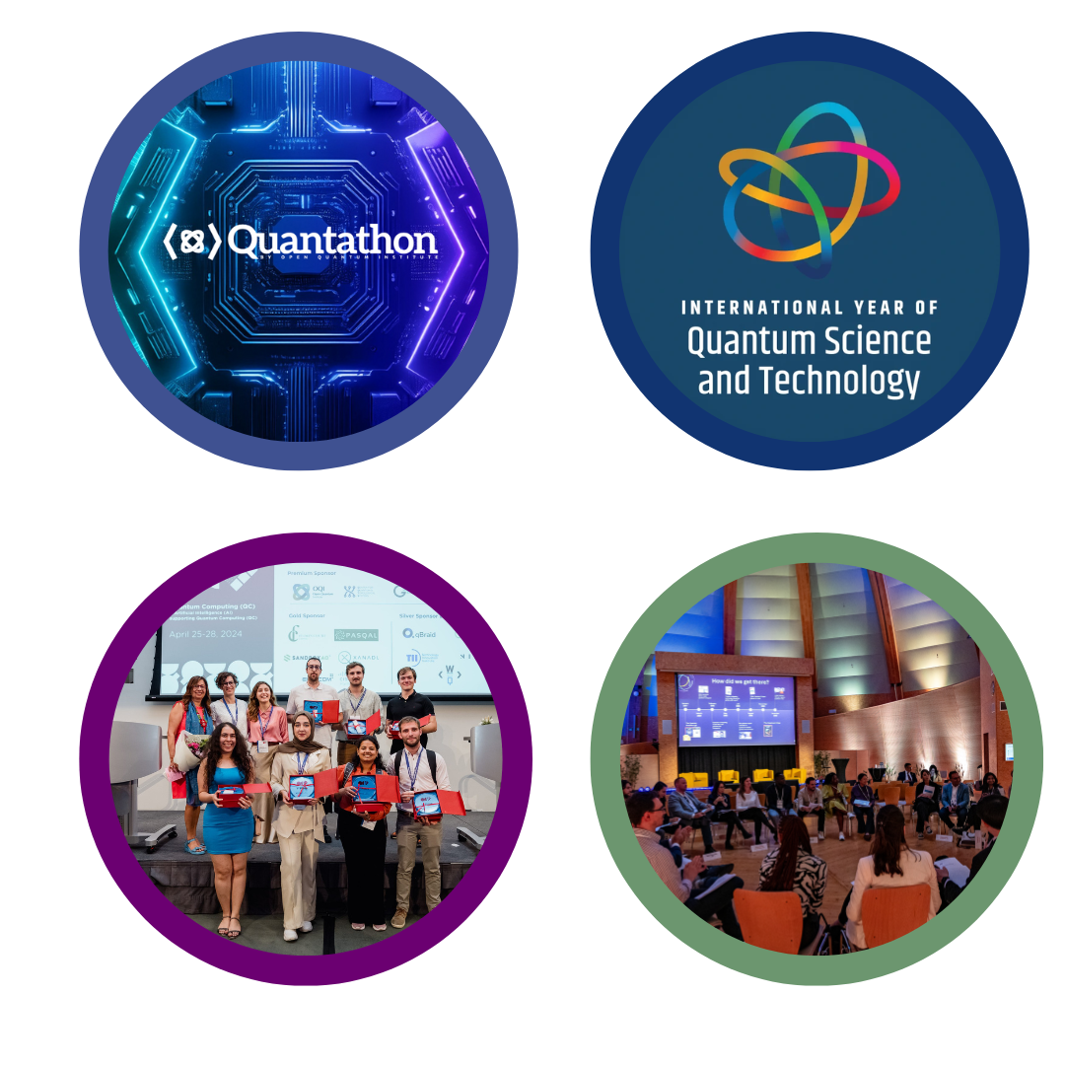
Educational efforts
Quantum Diplomacy Game
International Year of Quantum Technology and Science (IYQ)
OQI educational consortium
Hackathons
Share experience and best practices and co-develop tools
Participation from 25+ academic and industrial members from all continents
NYUAD Hackathon for Social Good - 2023, 2024
Hackathon in a Box
Post Hackathon Internship Program
Role play on the geopolitical implications of quantum computing as an emerging technology
Deployed in multiple countries
OQI representation on the IYQ Steering Committee
Contribution to the IYQ global events calendar

Slide 14
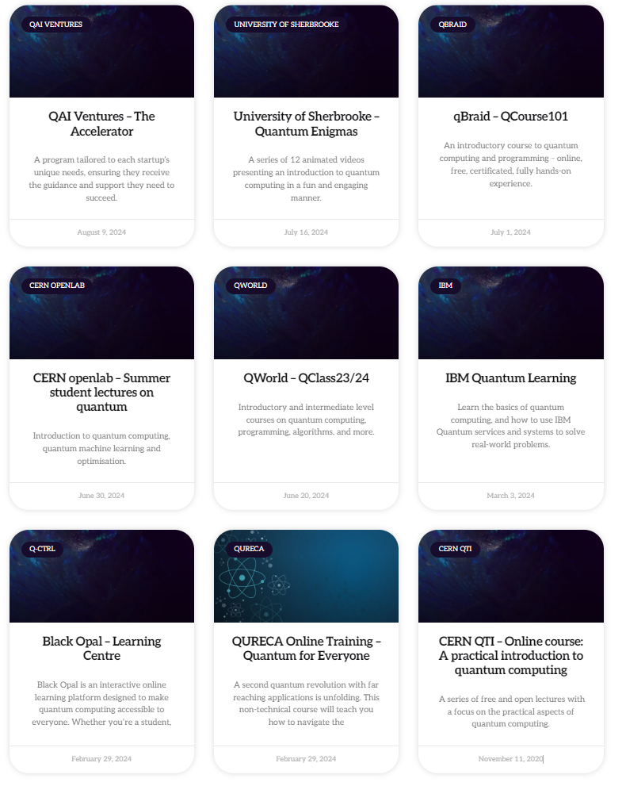
Educational tools
OQI’s educational tools aim to allow everyone around the world to contribute to the development of quantum computing and make the most of the technology
OQI invites institutions to submit their educational resources to the educational repository of vetted resources
These educational tools are stepping stones towards developing an established curriculum created by OQI

Slide 15
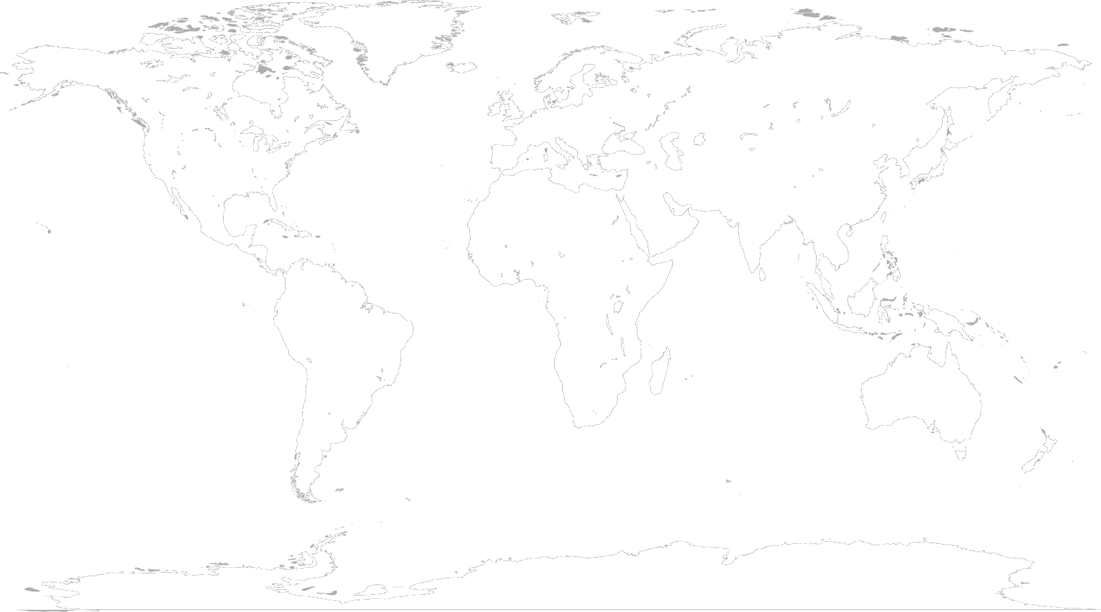

Map of Global OQI Educational Activities in 2025
Germany
Switzerland
USA
Greece
Lebanon
Egypt
UAE
Thailand
Costa Rica
Ghana
Philippines
Malaysia
Quantum Diplomacy Game
OQI Inspired Hackathon
Uruguay
OQI Quantathon
Notes:
Marianne Schoerling:
Marianne:
Raise outstanding action: Quantum Africa Series: support from OQI offered. Clarification on the modalities needed by Quantum Africa

Slide 16
Main objectives
A1 - Accelerating applications for humanity (quantum computing use case ideas)
Realising the full potential of quantum computing by accelerating the use cases geared towards achieving the SDGs, thanks to the combined forces of researchers and developers, entrepreneurs, the United Nations, and large NGOs.
A2 - Access for all (collaborating with industry)
Providing global, inclusive and equitable access to a pool of public and private quantum computers and simulators available via the cloud, addressing underserved geographies and mitigating the digital divide.
A3 - Advancing capacity building (education)
Developing educational tools to enable everyone around the world to contribute to the development of quantum computing and make the most of the technology.
A4 - Activating multilateral governance for the SDGs (diplomacy)
Providing a neutral forum to help shape multilateral governance of quantum computing for the SDGs and engaging with the science diplomacy community to support the development of use cases for the SDGs.

Slide 17

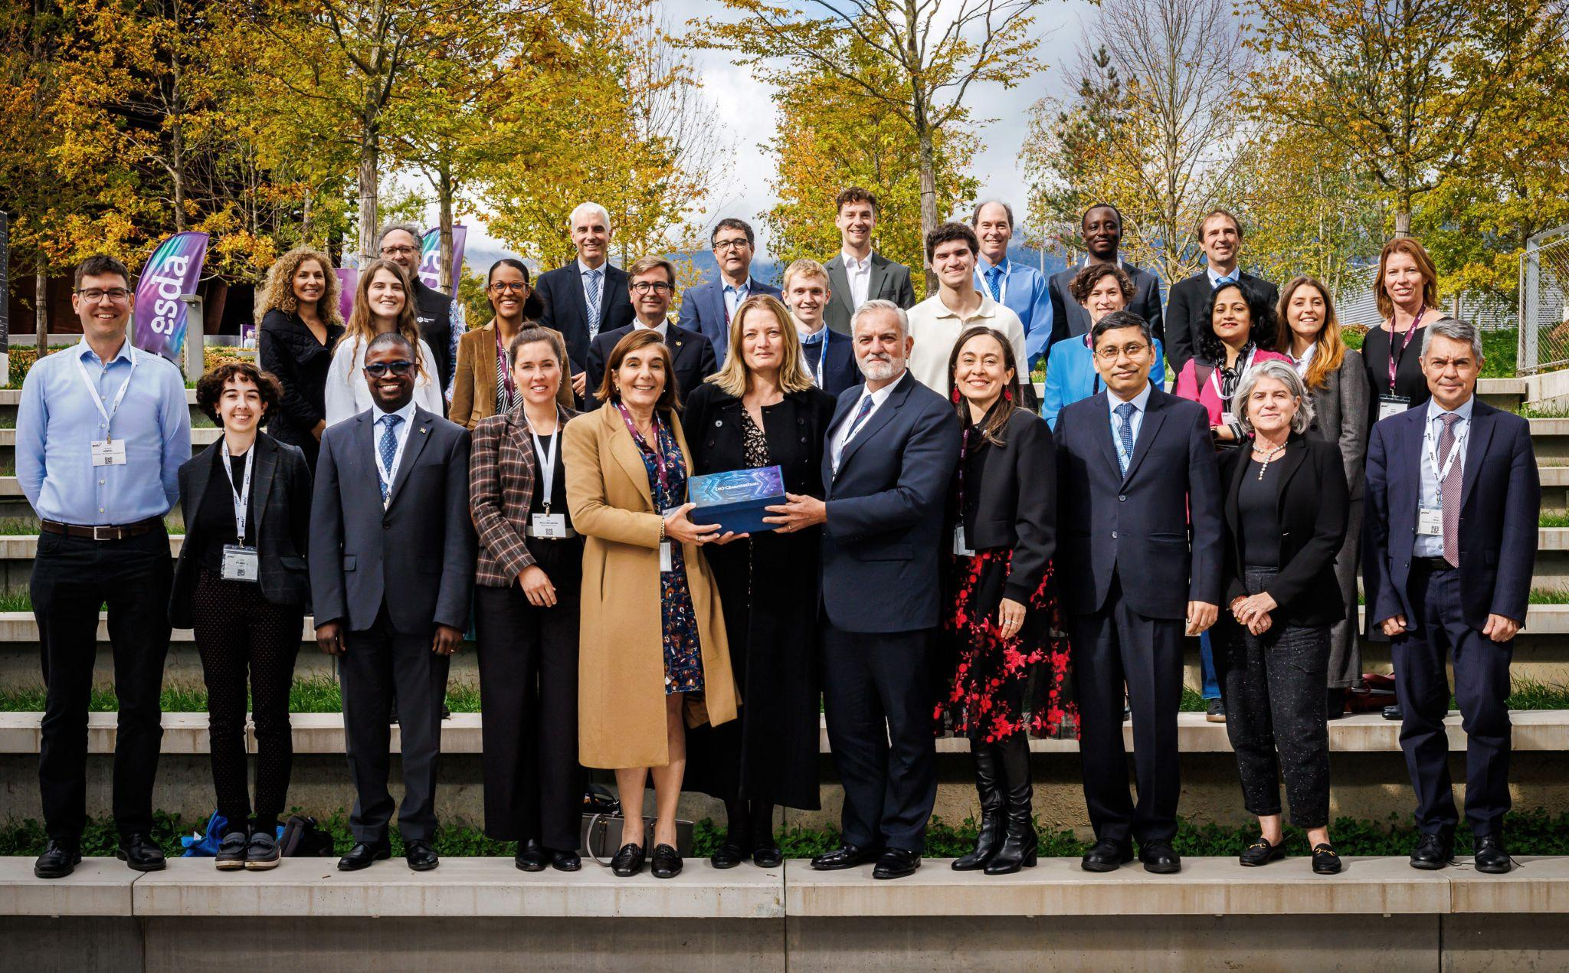
Governance: OQI Advisory Committee
Formed of 34 members from industry, academia, diplomacy and education, working together to provide strategic input to the OQI team to achieve the goals of OQI
OQI’s advisory committee includes diplomats from: Austria, the Netherlands, Chile, Mexico, Morocco, Italy, India, Kenya, Pakistan and Brazil
Other members are from organisations such as IBM, ETH Zurich, XPRIZE, and other collaborating organisations

Slide 18
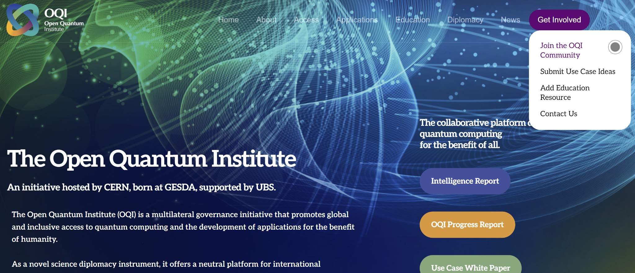
Join the OQI Community

