Slide 1
Coherent Effects and Impedances section (CEI) – general information
BE-ABP-CEI
Coherent Effects and Impedance
Giovanni RUMOLO
David AMORIM
Chiara ANTUONO
Miltiadis BOZATZIS
Xavier BUFFAT
Elena DE LA FUENTE GARCIA
Dora GIBELLIERI
Fredrik GRØNVOLD
Evangelos KATRALIS
Peter KICSINY
Jintao LI
Elena MACCHIA
Lotta METHER
Elias MÉTRAL
Nicolas MOUNET
Luca SABATO
Daniel SCHULTE
Leonardo SITO
Roxana SOOS
R TAYLOR
Carlo ZANNINI
Giovanni Rumolo
CEI Section Meeting, 12/06/2025
Scientific secretary: Elena Macchia
https://indico.cern.ch/event/1550276/

Slide 2
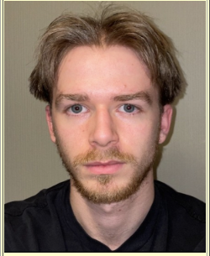
New arrivals
We welcome a new summer student
Egil Gustaf Bjarne Edvardsson
who will work with Xavier and Roxana until
8 August on symmetry breaking configurations
for FCC-ee to mitigate coherent instabilities
He will use the CMM and possibly validate
with more detailed tracking simulations.

Slide 3
Arising matters
We need to provide a list of participants for the HL-LHC collaboration meeting to be held at CERN from 29th September to 2nd October (Science Gateway)
  Proposed CEI participants: Nicolas, Chiara, Xavier, Lotta, Vangelis – anyone else interested?
  Need to propose to ABP group by 20 June
ATS sector grads and students have been invited to a networking event that will take place on Friday 27 June (10:00-11:30)
  There will be a presentation from Knowledge Transfer on healthcare applications followed by an informal coffee meeting to allow students and grads to network and make connections with others from the sector
  The event will take place in bldg. 30, with plans to hopefully hold a similar event in Prévessin in the autumn

Slide 4
Arising matters
For your information, please note that the position Accelerator Physicist (BE-ABP-CEI-2025-113-LD) has been published on the CERN career website and posted on relevant internet job portals.
  Publication date: 26.05.2025
  Publication deadline: 23.06.2025
  Focus is on impedance and electron cloud effects for FCC-ee – web interviews and final board expected in late August or even September
Introductory CAS in Santa Susanna (21st September – 4th October) – indico site
  Only one participant from CEI (and actually from ABP): Vangelis – please go ahead to put arrangements in place asap

Slide 5
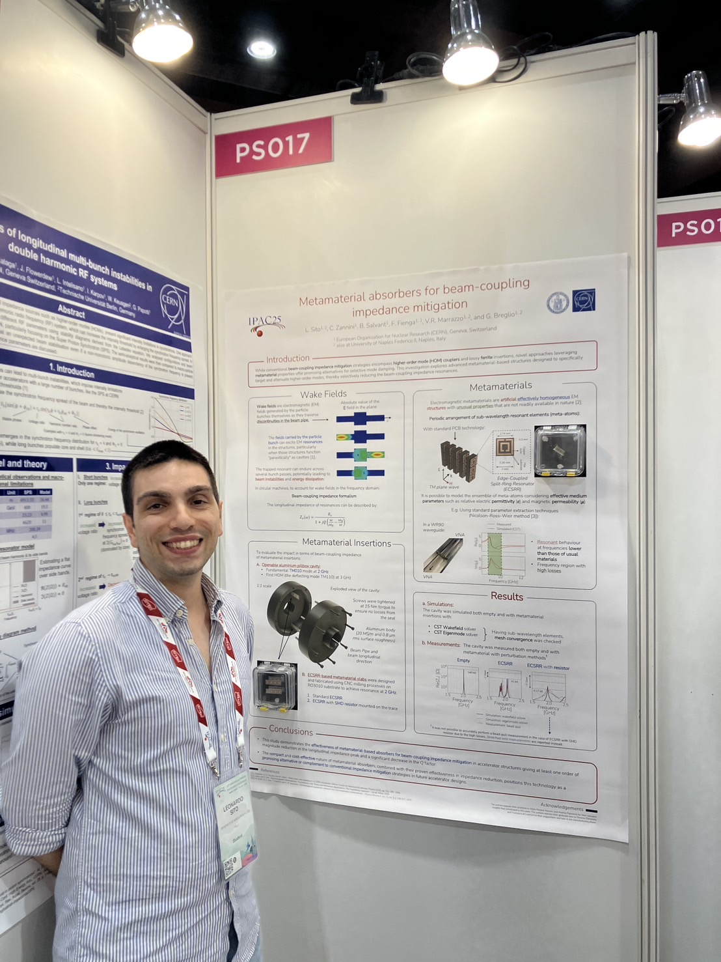
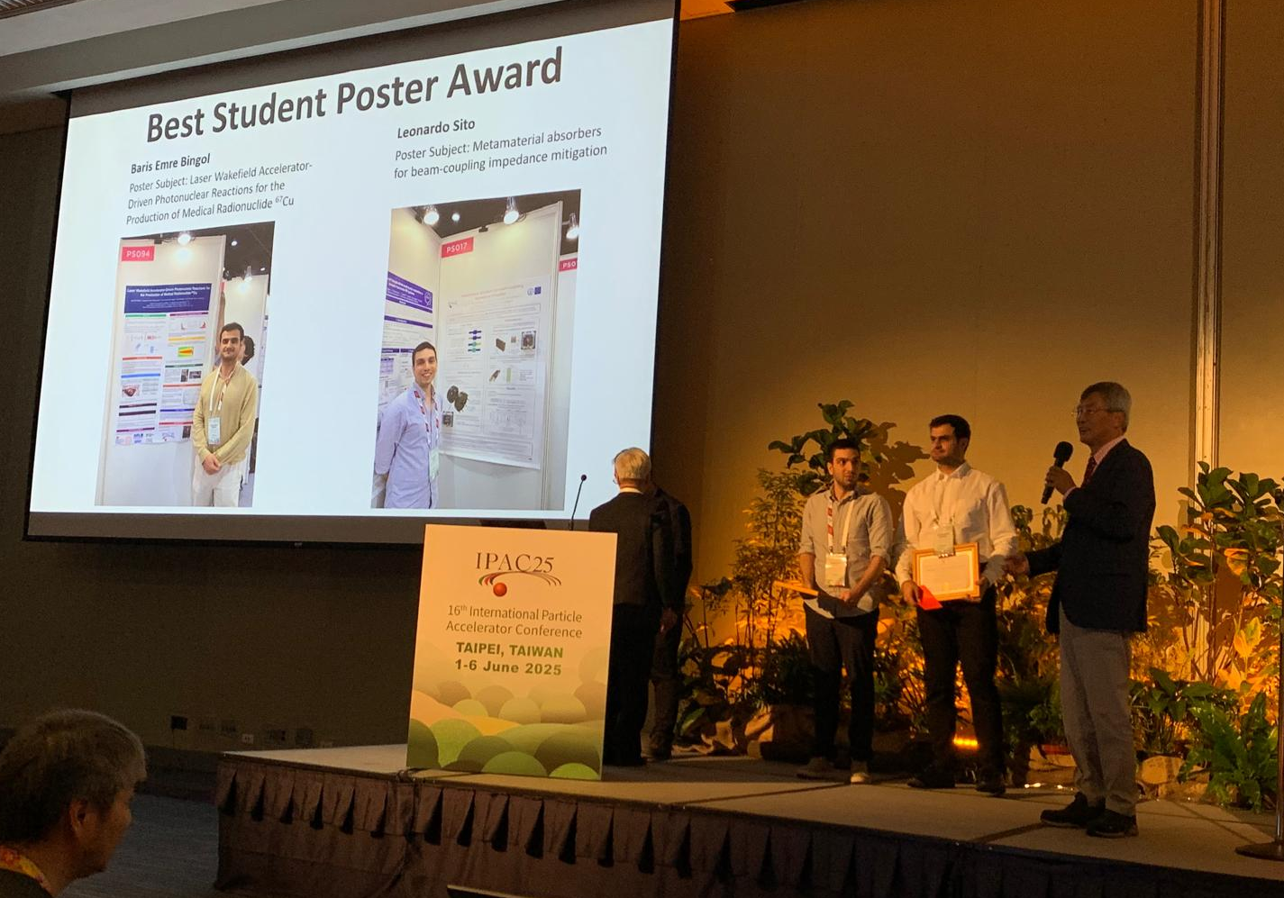
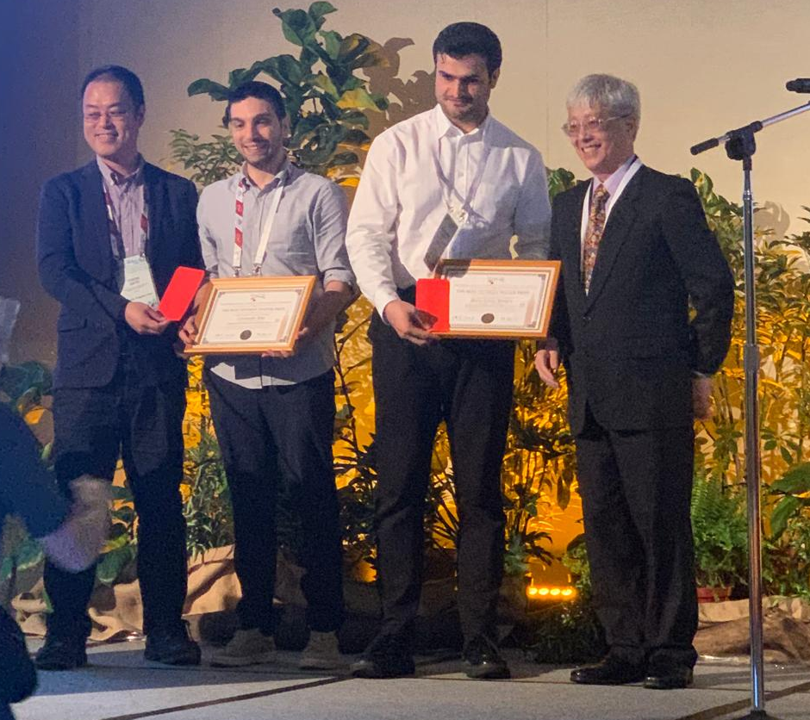
IPAC poster prize
Leonardo’s poster “Metamaterial absorbers for
beam-coupling impedance mitigation” was
awarded the best student poster prize of IPAC25!
Congratulations to Leo!
Courtesy: E. Métral for the ceremony pictures ☺

Slide 6
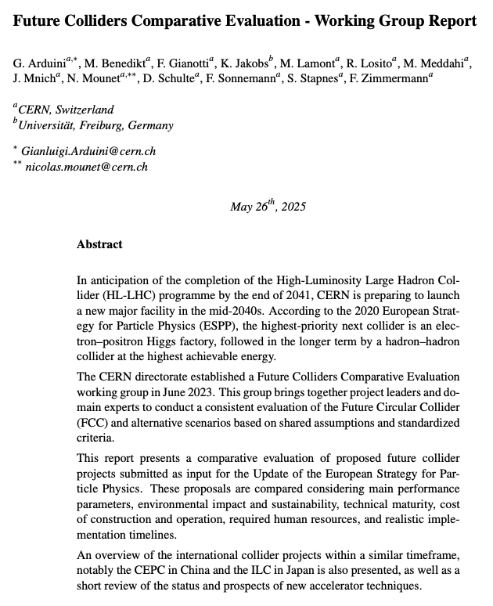
Report from the Future Colliders Comparative Evaluation WG
The report from the Future Colliders
Comparative Evaluation working group is
out, thanks Nicolas for serving as
scientific secretary on this years-long effort
Here several options for future flagship CERN
project have been analysed and compared,
namely FCC, CLIC, Muon collider, projects re-
using LHC tunnel (LEP3, LHeC, HE-LHC), novel
acceleration techniques have been evaluated,
projects outside CERN have been considered
Hopefully, an invaluable input to steer CERN’s
future direction!

Slide 7
LHC schedule
In the middle of physics production
Very good performance in spite of long downtimes due to different issues
  Last week >50% in stable beams though availability was only below 70%
  Main cause for downtime was loss of cryo in P8

Slide 8
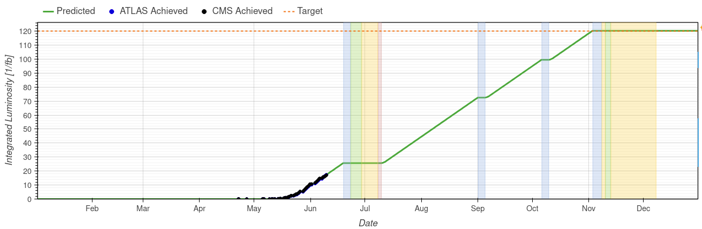
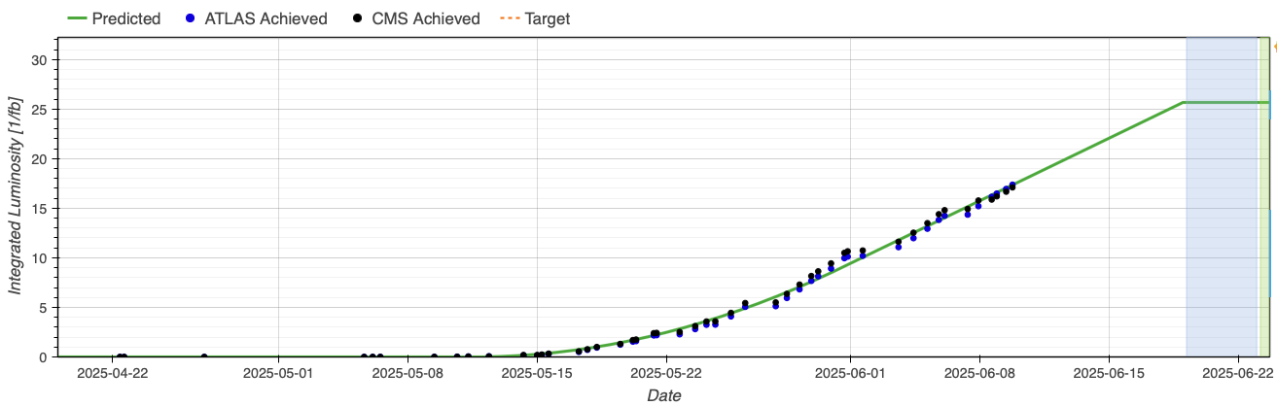
LHC integrated luminosity so far
Right on predicted curve

Slide 9
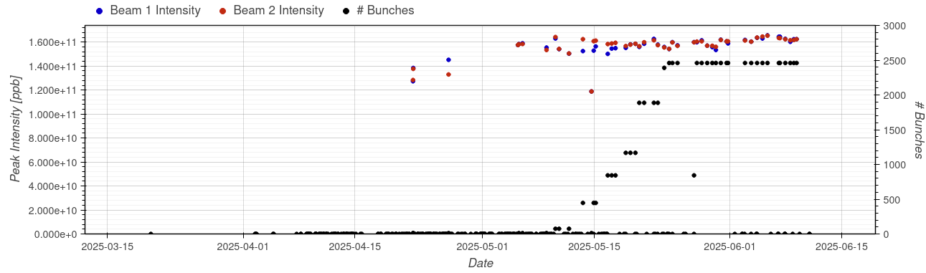
LHC integrated luminosity so far
Right on predicted curve
  Intensity at stable beams 1.6-1.64e11 p/b

Slide 10
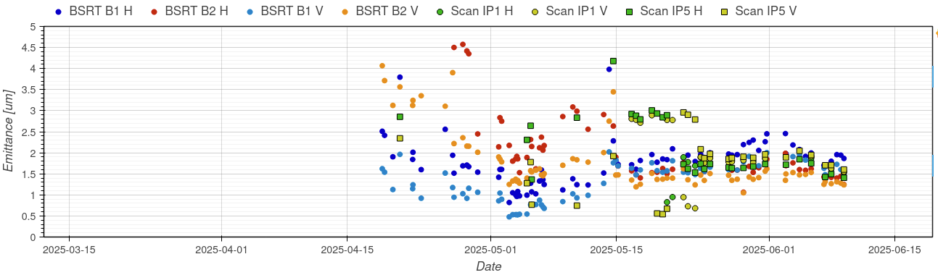
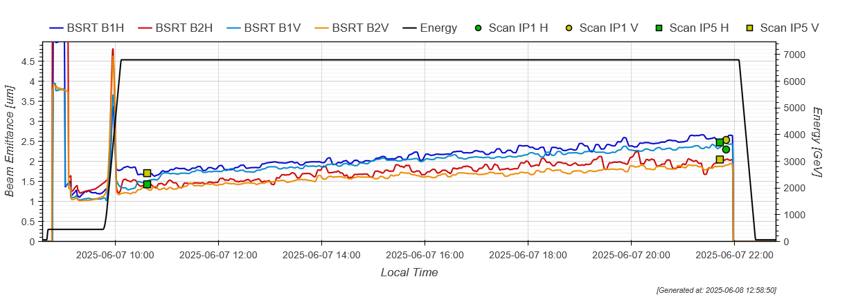
LHC integrated luminosity so far
Right on predicted curve
  Intensity at stable beams 1.6-1.64e11 p/b
  Emittances greatly improved since last Friday, when SPS optimized the WP, and now 1-1.3 um at injection with 1.5 um at collisions → Needed to increase octupoles at injection

Slide 11
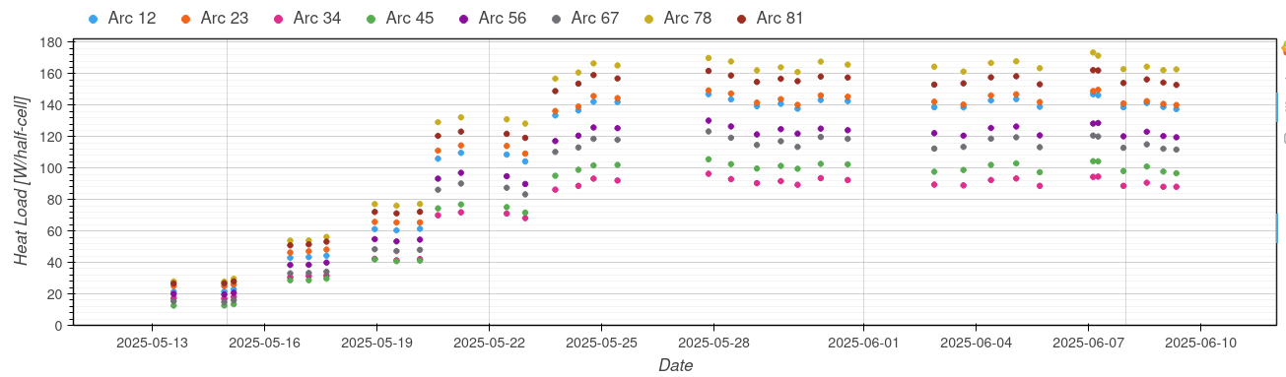
LHC heat load
Heat load around 170 W/hc, as predicted by Lotta with current filling scheme using 4x 36b per injection
  Even went close to 180 W/hc in fills with higher intensity
  Will need to change filling scheme when/if moving to 1.8e11 p/b (3x 36b per inj)?

Slide 12
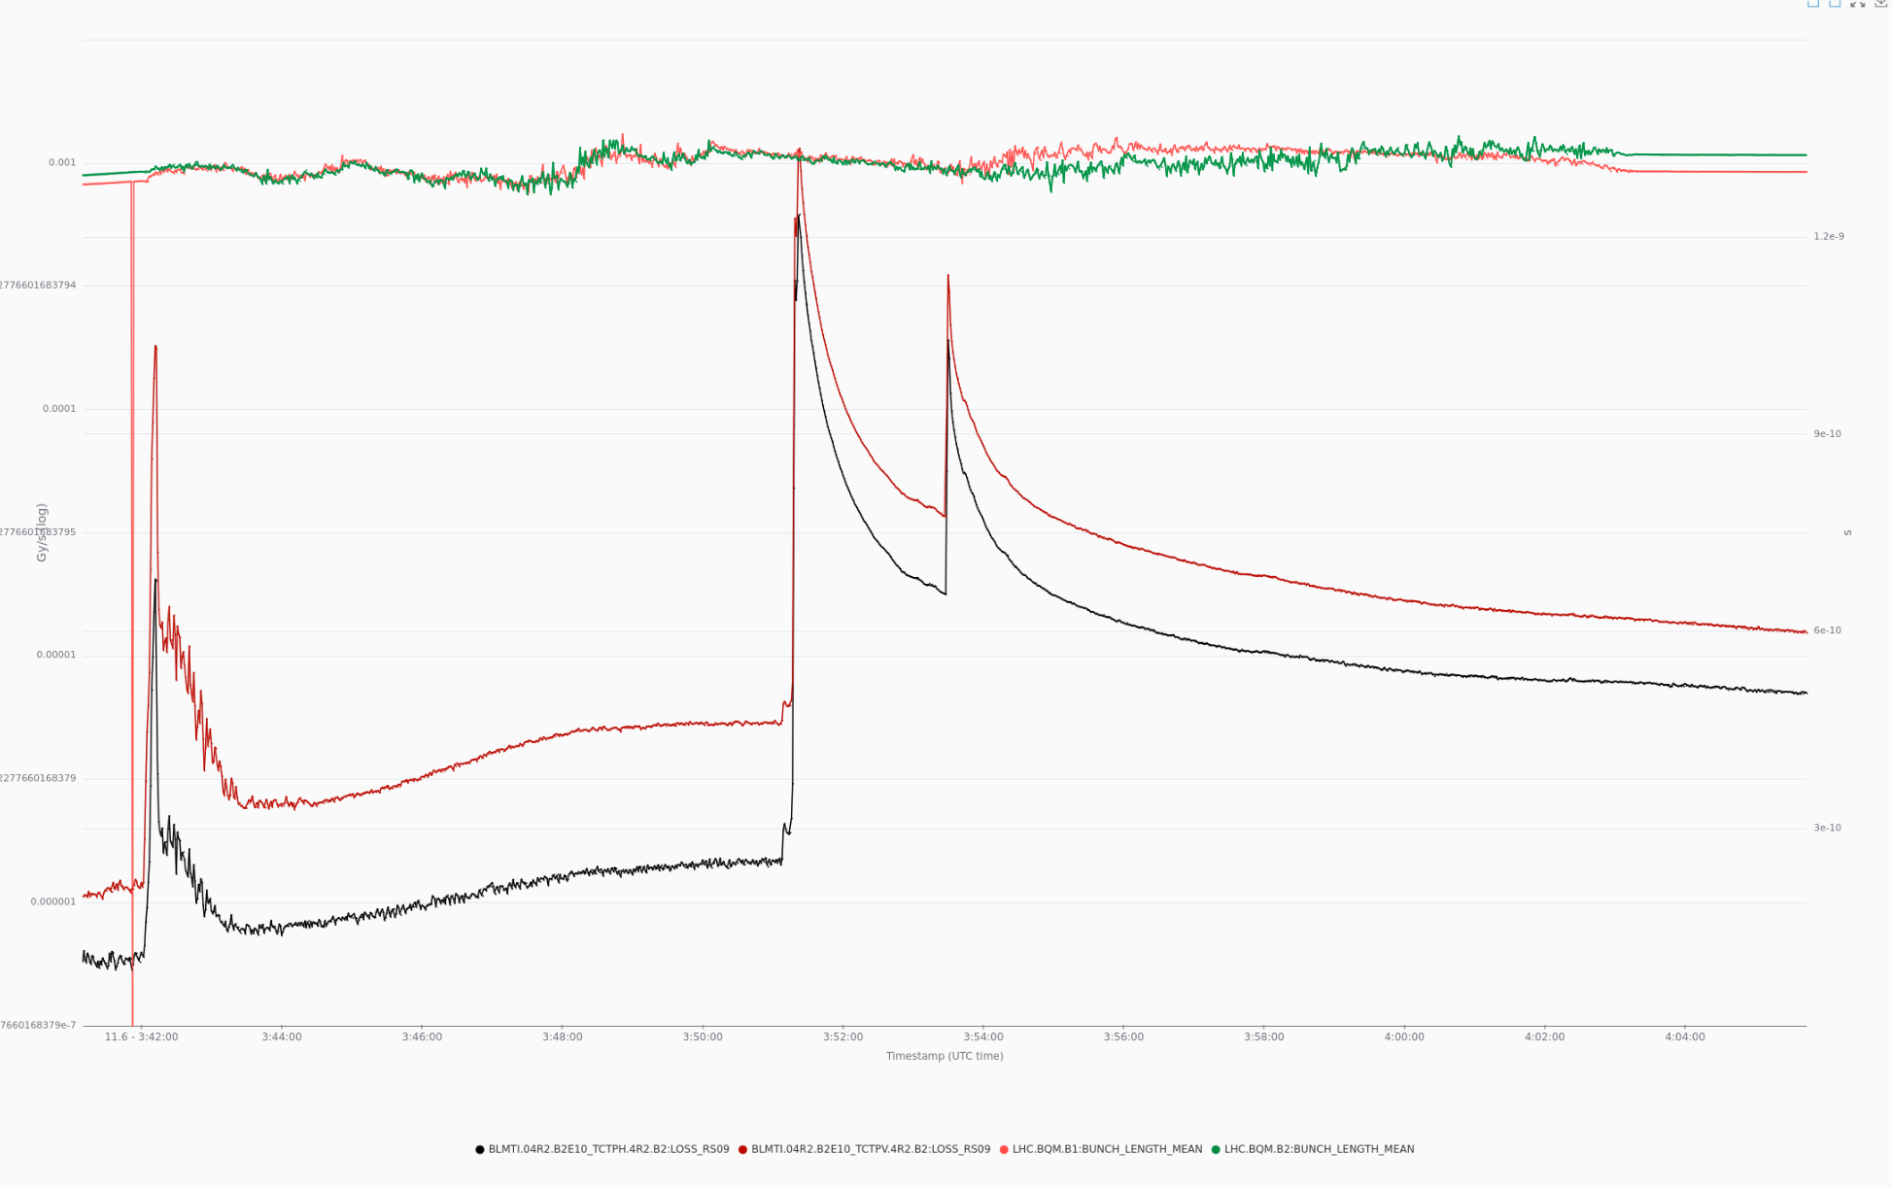
ALICE pressure spikes
During last fill losses were reported by ALICE along the ramp
They were found to be correlated with important pressure spikes in the 800 cm vacuum chamber right of IP2 (present in previous fills, but tiny) – 5R2

Slide 13
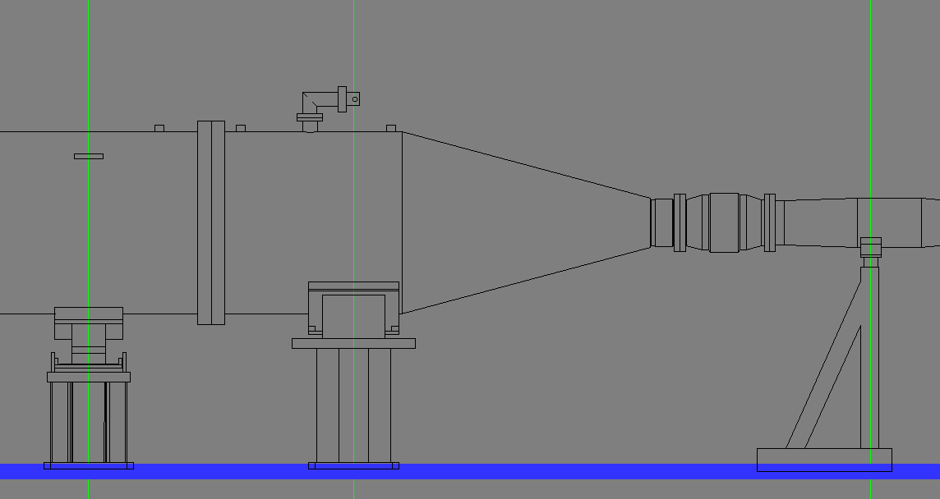
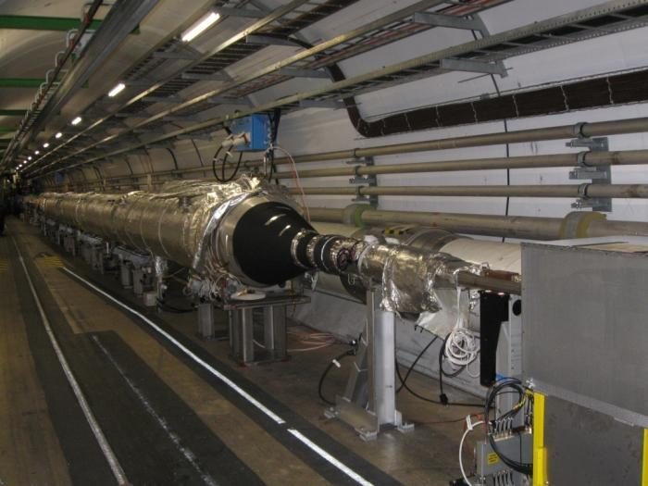
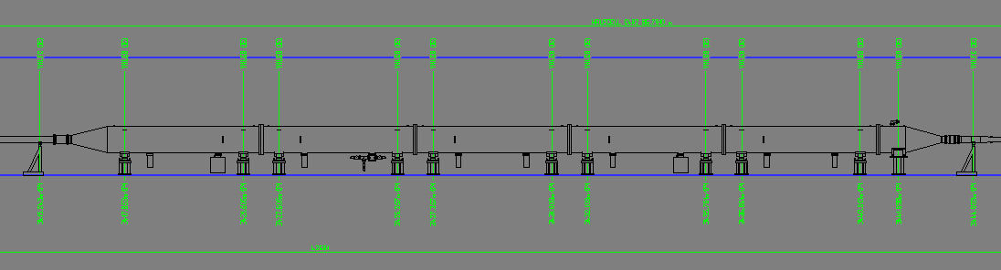
ALICE pressure spikes
Any of the warm transition modules (DRF) showing signs of failing?
Ø 80cm
Ø 20cm
27m

Slide 14
Injectors schedule
Yesterday another magnet exchange in the SPS (2nd of the year) caused 24h downtime, beam only back this morning

Slide 15
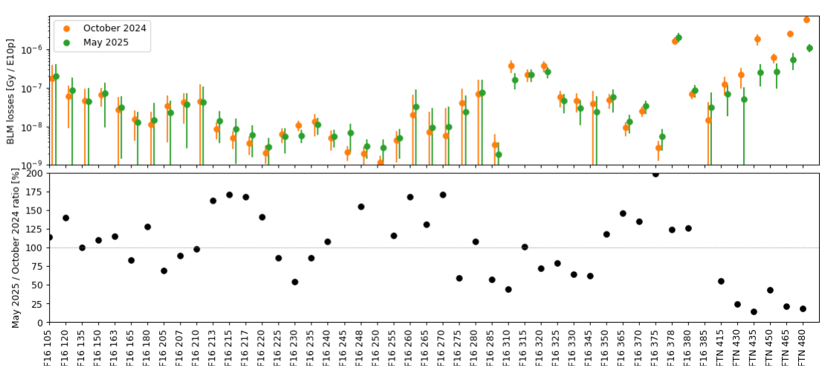
Injectors Performance Panel meeting yesterday
IPP meeting exceptionally held on a Wednesday, featuring mainly updates on nTOF beam in the PS
A. Huschauer showed the follow-up on nTOF operational conditions in 2025
  Parasitic TOF intensity stably running at 600e10 poT – transparent to EAST operation
  Dedicated TOF running close to 850e12 poT
  Bunch length 28-30 ns (or lower for lower intensity) ensures much reduces losses in last part of FTN – more info on general activation and dose on magnet coils after iTS end of June

Slide 16
Injectors Performance Panel meeting yesterday
IPP meeting exceptionally held on a Wednesday, featuring mainly updates on nTOF beam in the PS
A. Huschauer showed the follow-up on nTOF operational conditions in 2025
  Parasitic TOF intensity stably running at 600e10 poT – transparent to EAST operation
  Dedicated TOF running close to 850e12 poT
  Bunch length 28-30 ns (or lower for lower intensity) ensures much reduces losses in last part of FTN – more info on general activation and dose on magnet coils after iTS end of June
  Studies on FTN magnet activation, transport and replacement/spare policy followed up and largely promising

Slide 17
Injectors Performance Panel meeting yesterday
IPP meeting exceptionally held on a Wednesday, featuring mainly updates on nTOF beam in the PS
A. Huschauer showed the follow-up on nTOF operational conditions in 2025
Excellent presentation by Miltos on study of aperture limitations and losses at transition crossing in the PS
  Great modeling of PS transition crossing with Xsuite – very detailed study of the effect of gamma-jump quad position on losses
  Need to include space charge and impedance effect to complete the picture
  No more spoiling, Miltos will also discuss this in one of the next CEI section meetings ☺

Slide 18
News from projects?
HL-LHC
Muon collider
FCC

