Slide 1
LHC scrubbing run and e-cloud observables
L. Mether, C. Antuono, E. Katralis
B. Bradu, G. Bregliozzi, X. Buffat, A. Calia, J. Esteban Muller, G. Favia, C. Hernalsteens, M. Hostettler, D. Mirarchi, M. Pojer, B. Salvant, M. Solfaroli, G. Trad, J. Wanczyk,
J. Wenninger, C. Wiesner, Cryo OP, Injectors OP

Slide 2
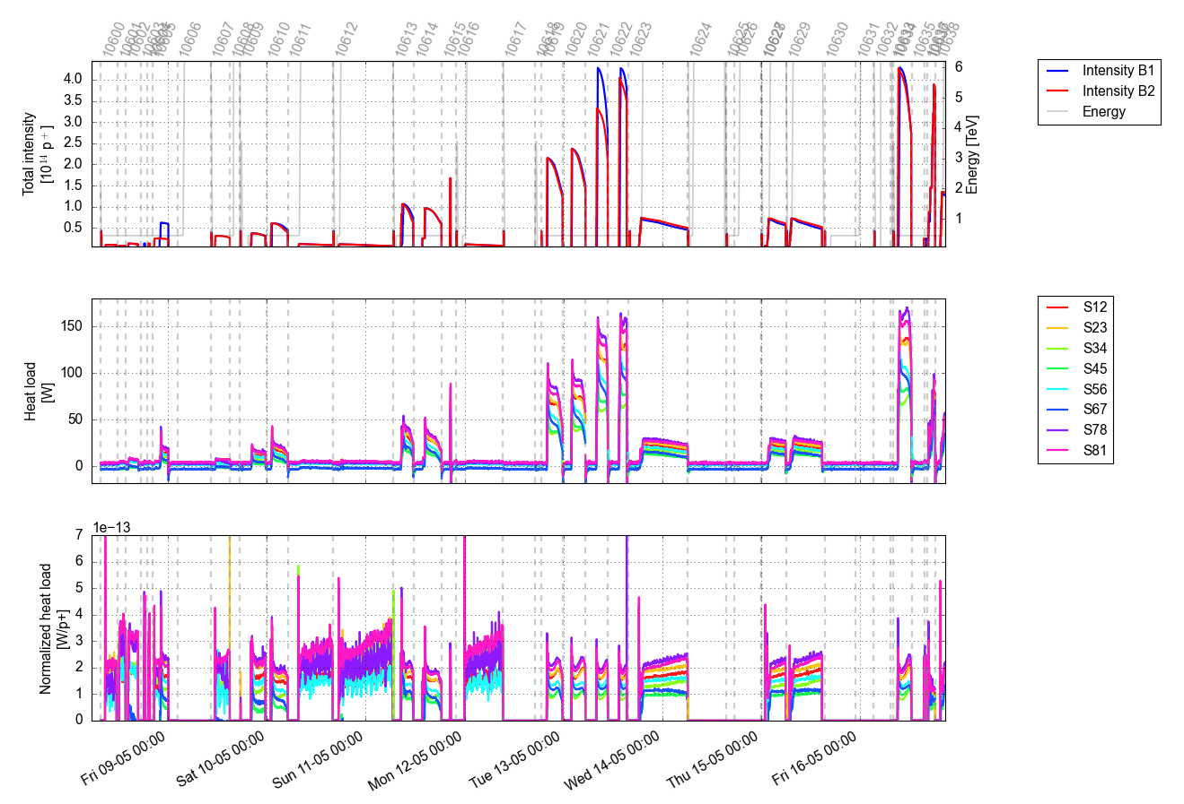
Overview
LHC scrubbing took place during an 8-day period, interleaved with commissioning and the intensity ramp-up
The newly installed injection kickers (MKIs) were the main bottleneck, setting the pace and duration of the scrubbing
Scrubbing
Scrubbing
Scrubbing
Scrubbing
Scrubbing

Slide 3
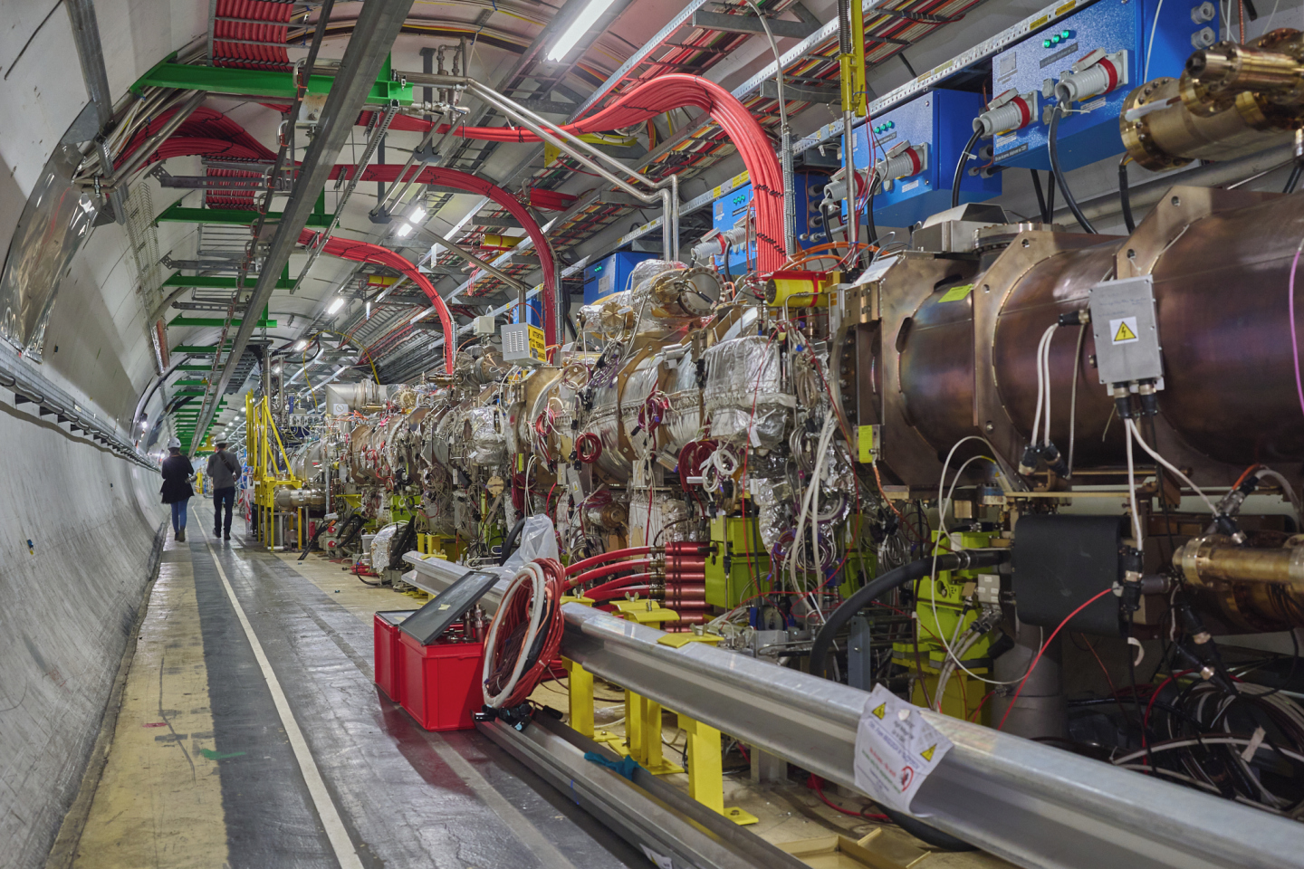
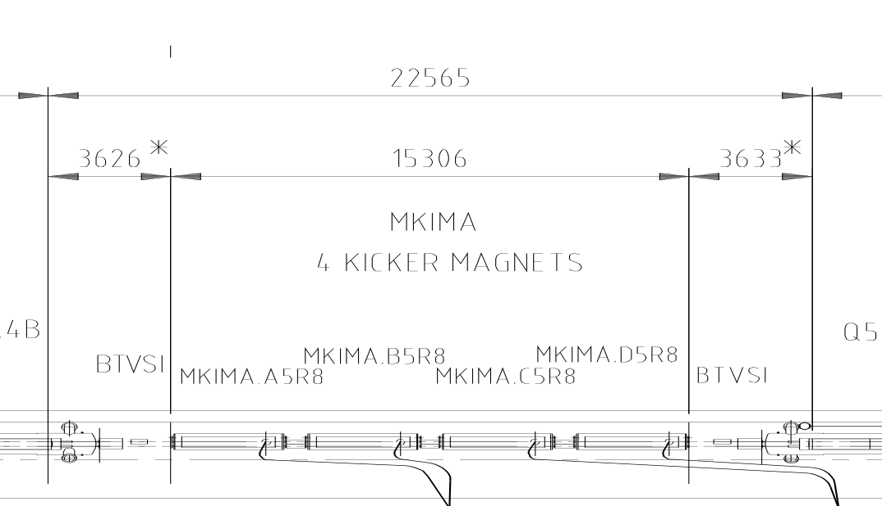
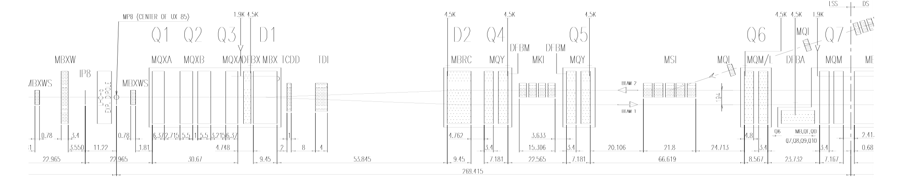
The MKIs
The injected LHC beam is deflected by four pulsed HV MKI magnets (MKI2D-A for B1, MKI8D-A for B2)

Slide 4
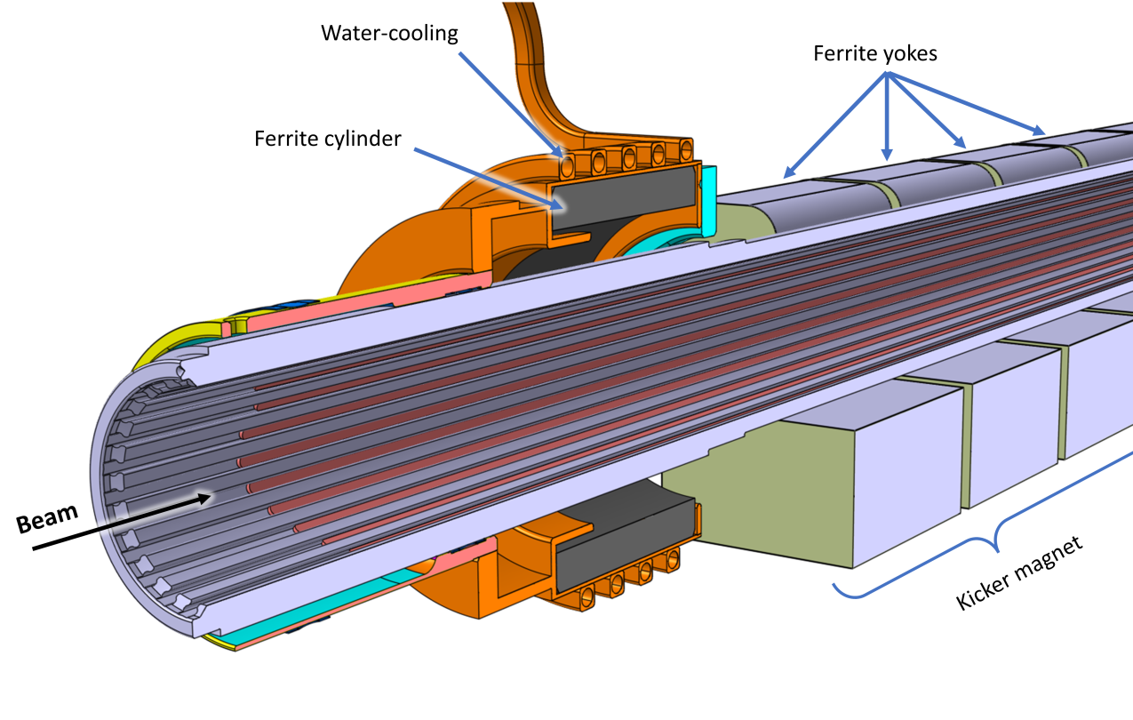
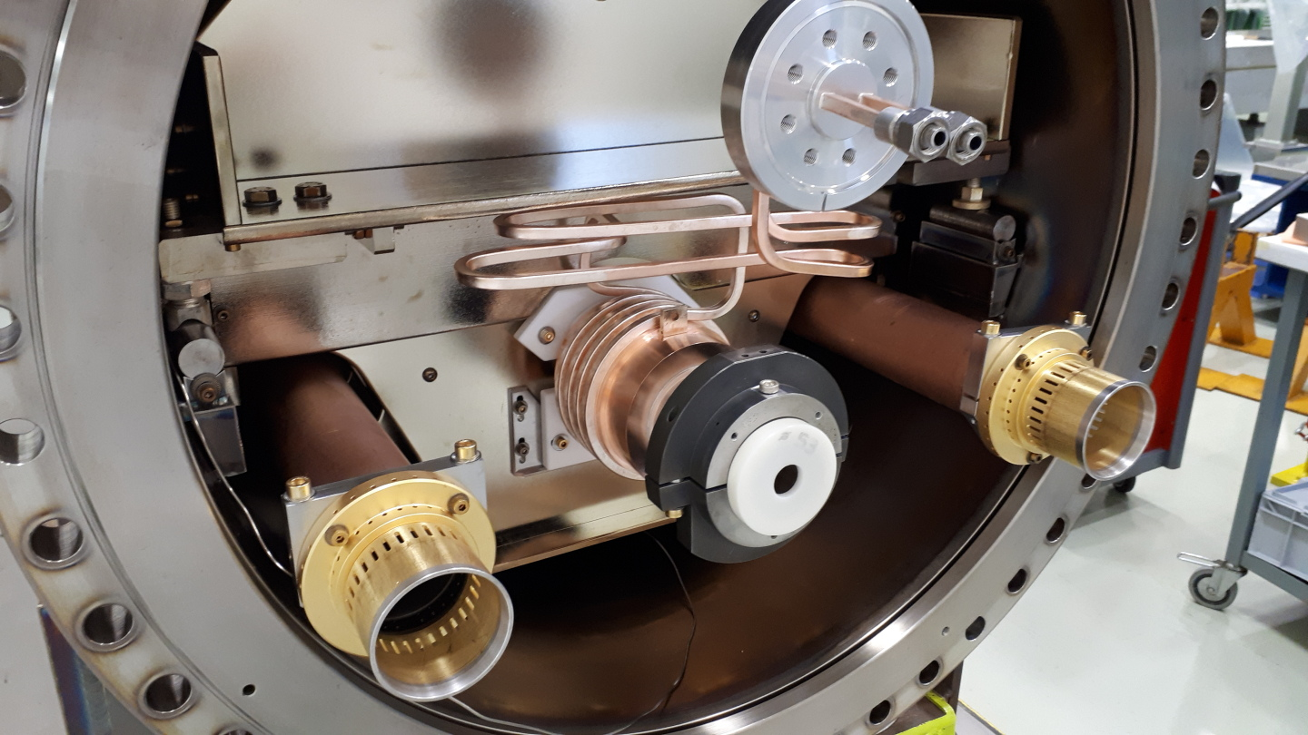
The MKIs
The MKIs are being upgraded to “MKI-Cools” for HL-LHC
  Water-cooled ferrite “damper” outside high-field region, to reduce beam-induced heating of ferrite yokes

Slide 5
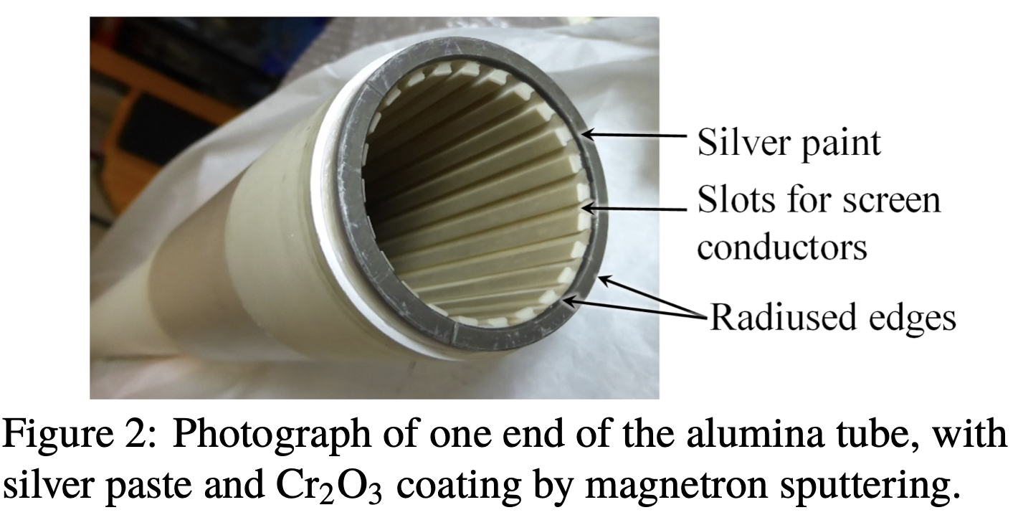
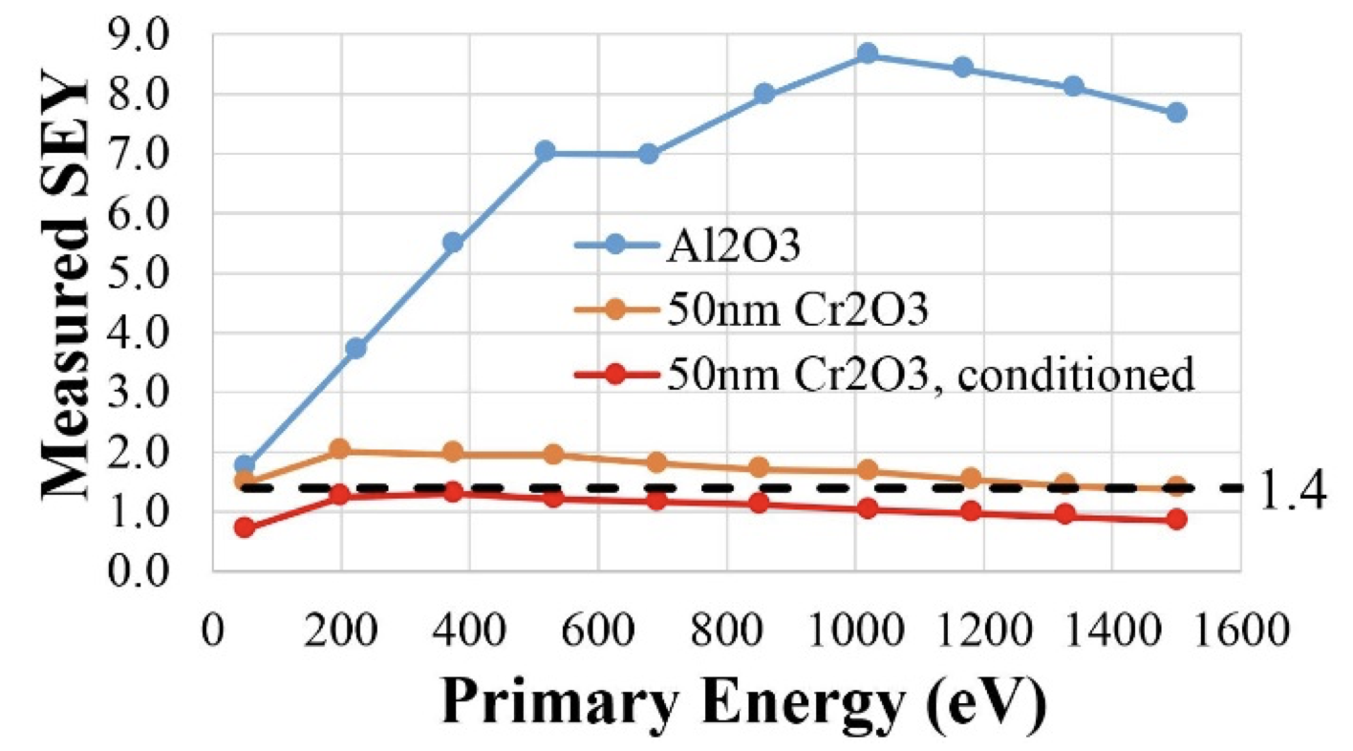
The MKIs
The MKIs are being upgraded to “MKI-Cools” for HL-LHC
  Water-cooled ferrite “damper” outside high-field region, to reduce beam-induced heating of ferrite yokes
  Cr₂O₃ coating applied to alumina beam screens to reduce the secondary emission yield (SEY)
[M. Barnes et al,
IPAC’17, IPAC’18]

Slide 6
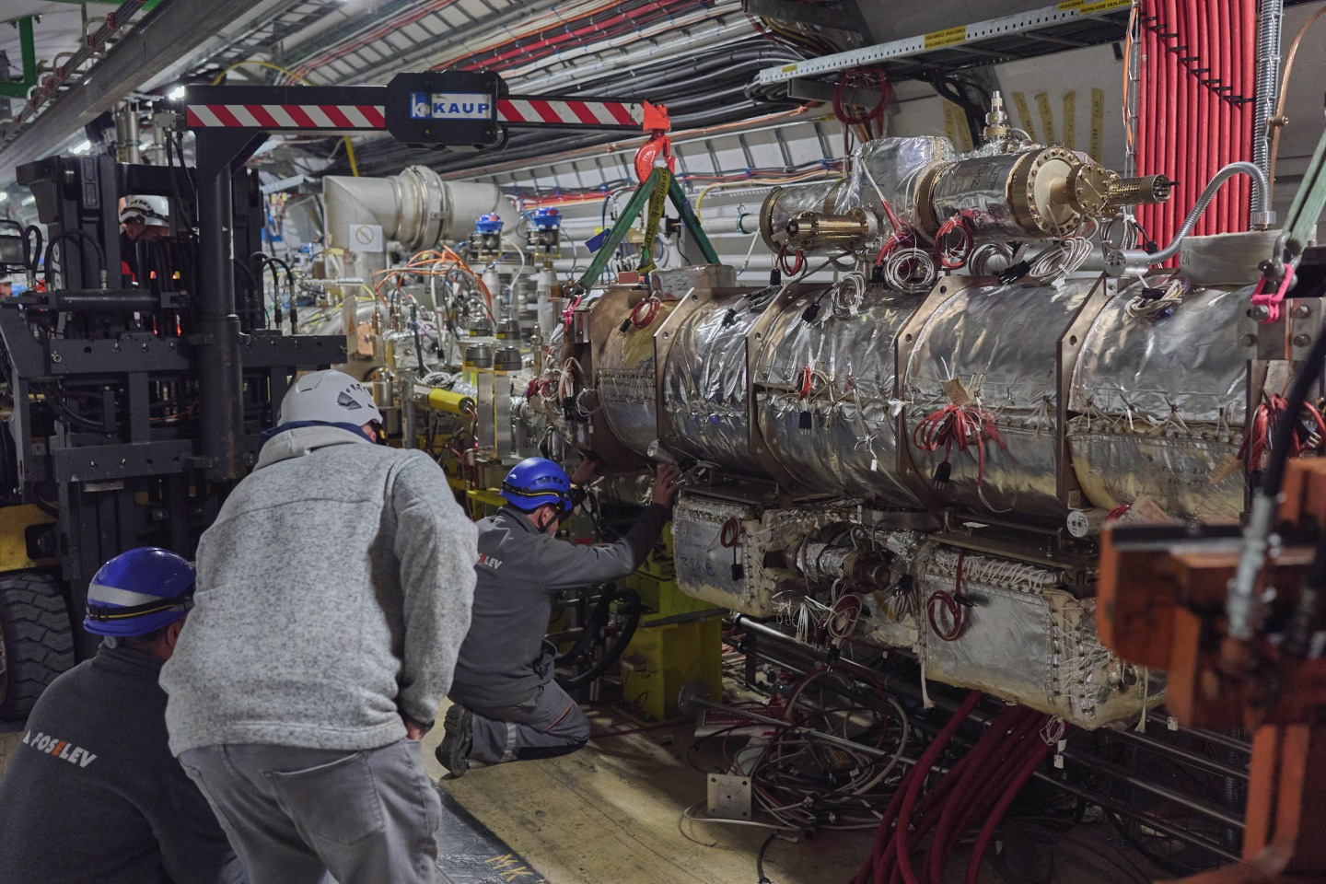
The MKIs
After the YETS 24-25, the MKI system in Point 8 (B2 injection) is fully cool
  MKI8D was replaced with the first MKI-Cool in the YETS 22-23
  MKI8C was exchanged with an MKI-Cool in the YETS 23-24
  MKI8B and MKI8A were exchanged with MKI-Cools in the YETS 24-25
2025
2024
2023

Slide 7
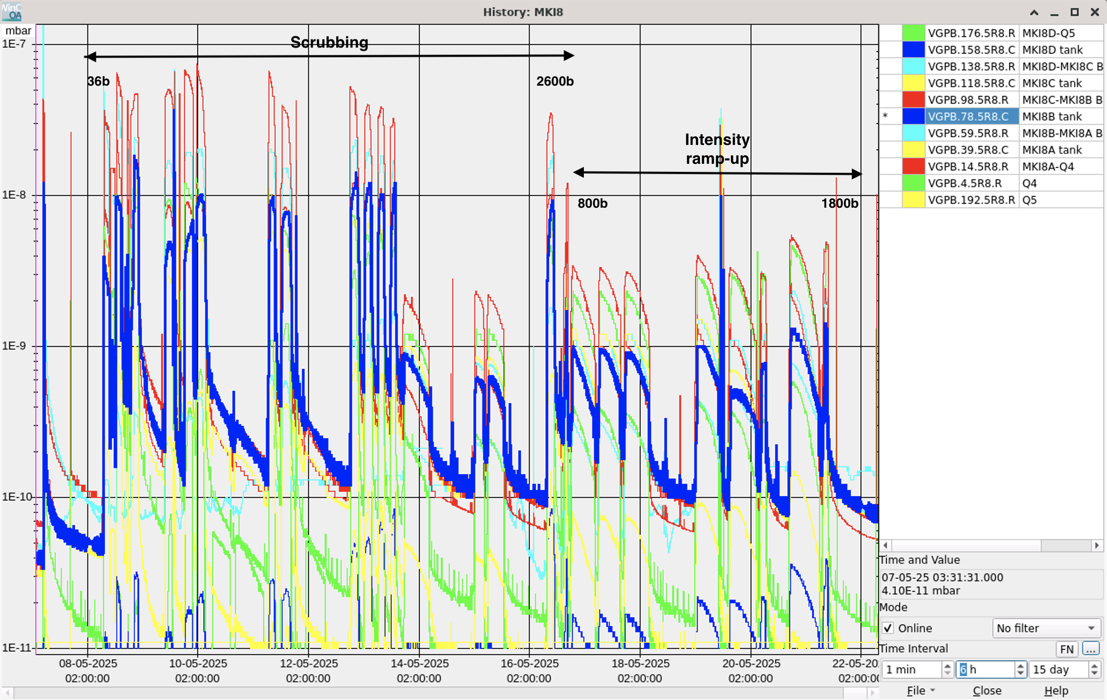
MKI8 conditioning
The scrubbing pace was determined by the MKI pressure evolution
  Initially limited by MKI8A-Q4 interconnect, later MKI8B tank

Slide 8
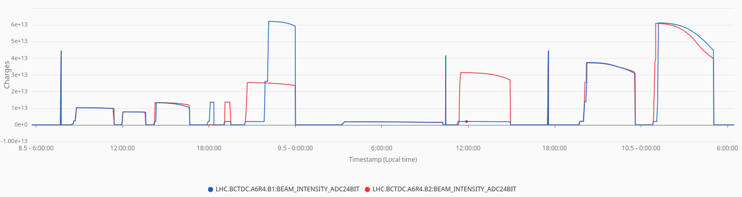
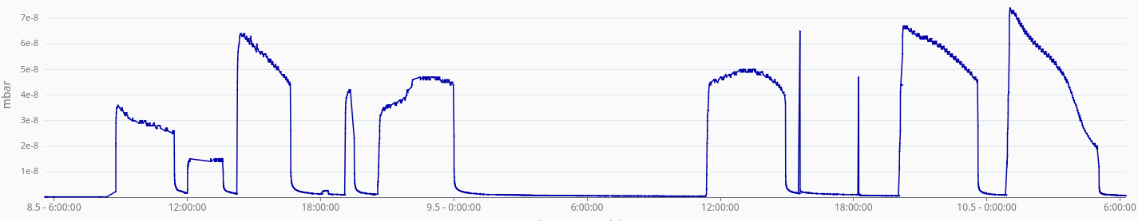
MKI8 conditioning
The MKI8 (tank/interconnect) vacuum interlock thresholds were gradually increased in coordination with the equipment experts to allow for more injections:
  If interlock crossed during fill → increase threshold by one step after fill
  Later, could make one step also during fill, if this would allow to inject an additional train
Intensity B1
Intensity B2
372b
192b
228b
156b
48b
84b
MKI8A-Q4 interconnect pressure
Interlock threshold

Slide 9
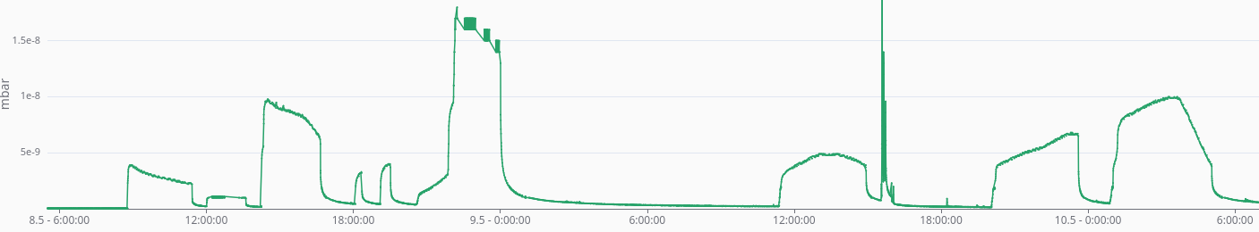
MKI8 conditioning
The MKI8 (tank/interconnect) vacuum interlock thresholds were gradually increased in coordination with the equipment experts to allow for more injections:
  If interlock crossed during fill → increase threshold by one step after fill
  Later, could make one step also during fill, if this would allow to inject an additional train
Intensity B1
Intensity B2
372b
192b
228b
156b
48b
84b
MKI8B tank pressure
Interlock threshold

Slide 10
MKI8 conditioning
The pressure in the tank, shared by both beams, increases also with injections of the other beam
  Inject all bunches in Beam 2 first to maximize amount of beam before hitting interlock threshold
The pressure continues to increase for a long time after finishing injection
  Inject Beam 2 as fast as possible (no SPS NA) to maximize amount of beam before hitting interlock threshold
Intensity B1
Intensity B2
372b
192b
228b
156b
48b
84b
MKI8B tank pressure
Interlock threshold
1.
2.

Slide 11
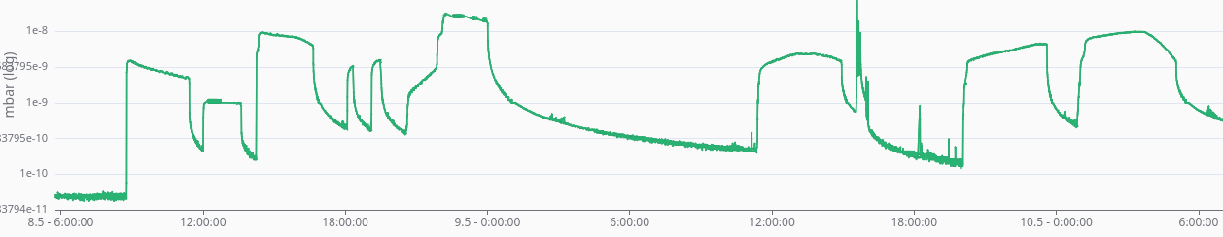
MKI8 conditioning
After every scrubbing fill, the kickers need to be conditioned with the “SoftStart”: a program that pulses the kicker without beam with a gradually increasing voltage
  Expert request to run the SoftStart only when the pressure in the tank is below ~8e-9 mbar
    Up to 2.5 h waiting after each fill (never an issue before, as far as I remember)
Intensity B1
Intensity B2
372b
192b
228b
156b
48b
84b
MKI8B tank pressure
SoftStart threshold
Sublimation of MKI8A and B
to reset pressure integral;
already at > 50%

Slide 12
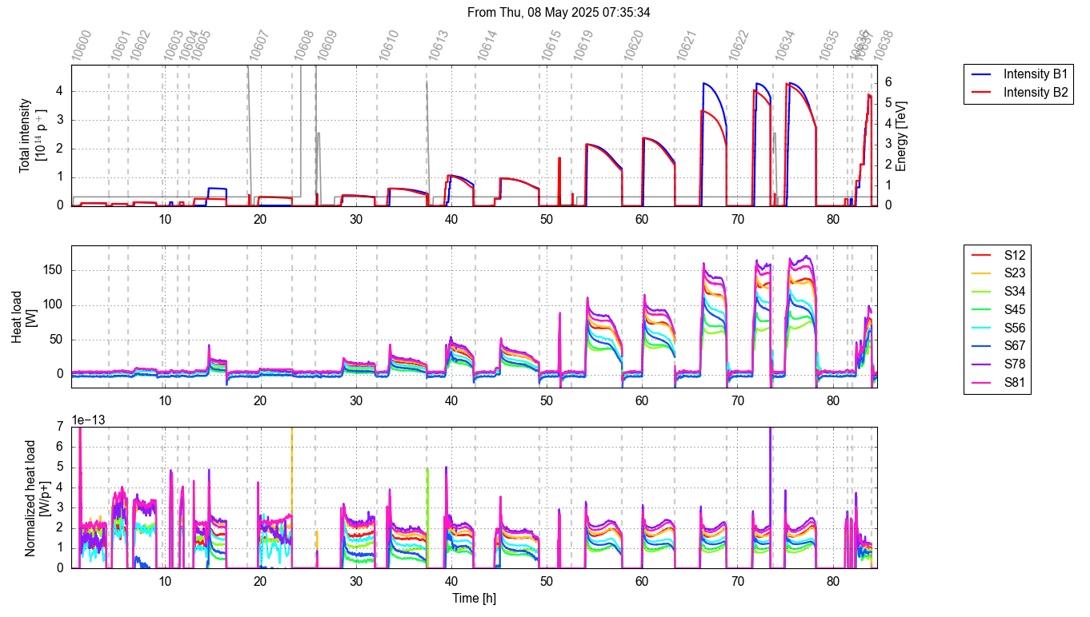
MKI8 conditioning
In total, around 80h, or 3.5 days, were needed to scrub the newly installed kickers
2025
Max thresholds reached
→ Nx72b
2028b
2460b
2604b
MPP checklist
1308b
1456b
Qualification
1020b
156b
192b
228b
372b
660b
588b
48b
84b

Slide 13
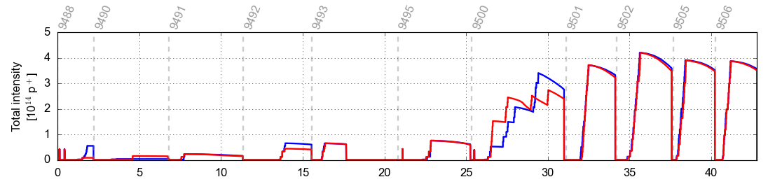

MKI8 conditioning
Scrubbing took about twice as long as last year: two (neighbouring) MKIs exchanged instead of one
  In Run 4, we will need to condition 4 adjacent MKIs in B1, but also the rest of the machine will need scrubbing
2025
Max thresholds reached
→ Nx72b
2028b
2460b
2604b
MPP checklist
1308b
1456b
Qualification
1020b
156b
192b
228b
372b
660b
588b
48b
84b
2024
“Pre-scrubbing” (to 500b)
2676b
Qualification
MPP checklist
108b
300b
444b
516b
60b
156b

Slide 14
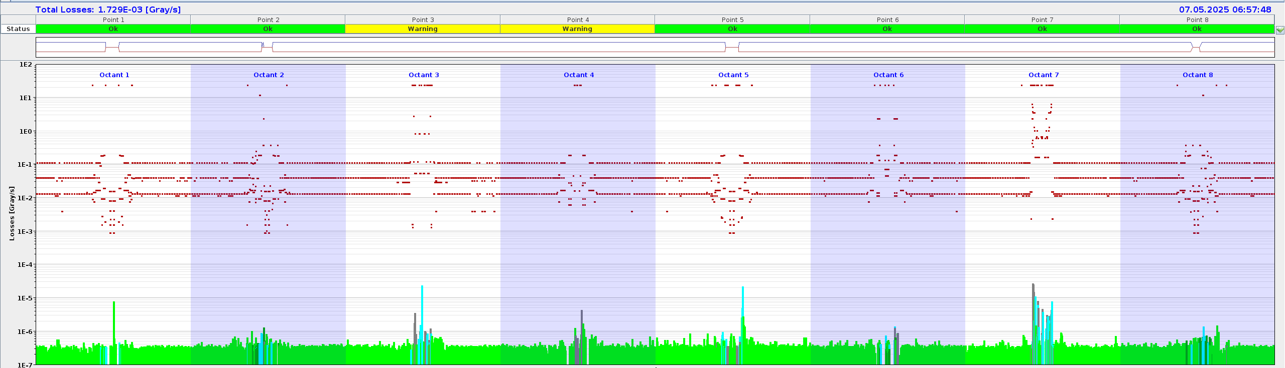
Loss observations
High losses were observed from before the scrubbing run throughout the intensity ramp-up in a few vented locations
TWOCRYST experiment
CMS XRPs

Slide 15
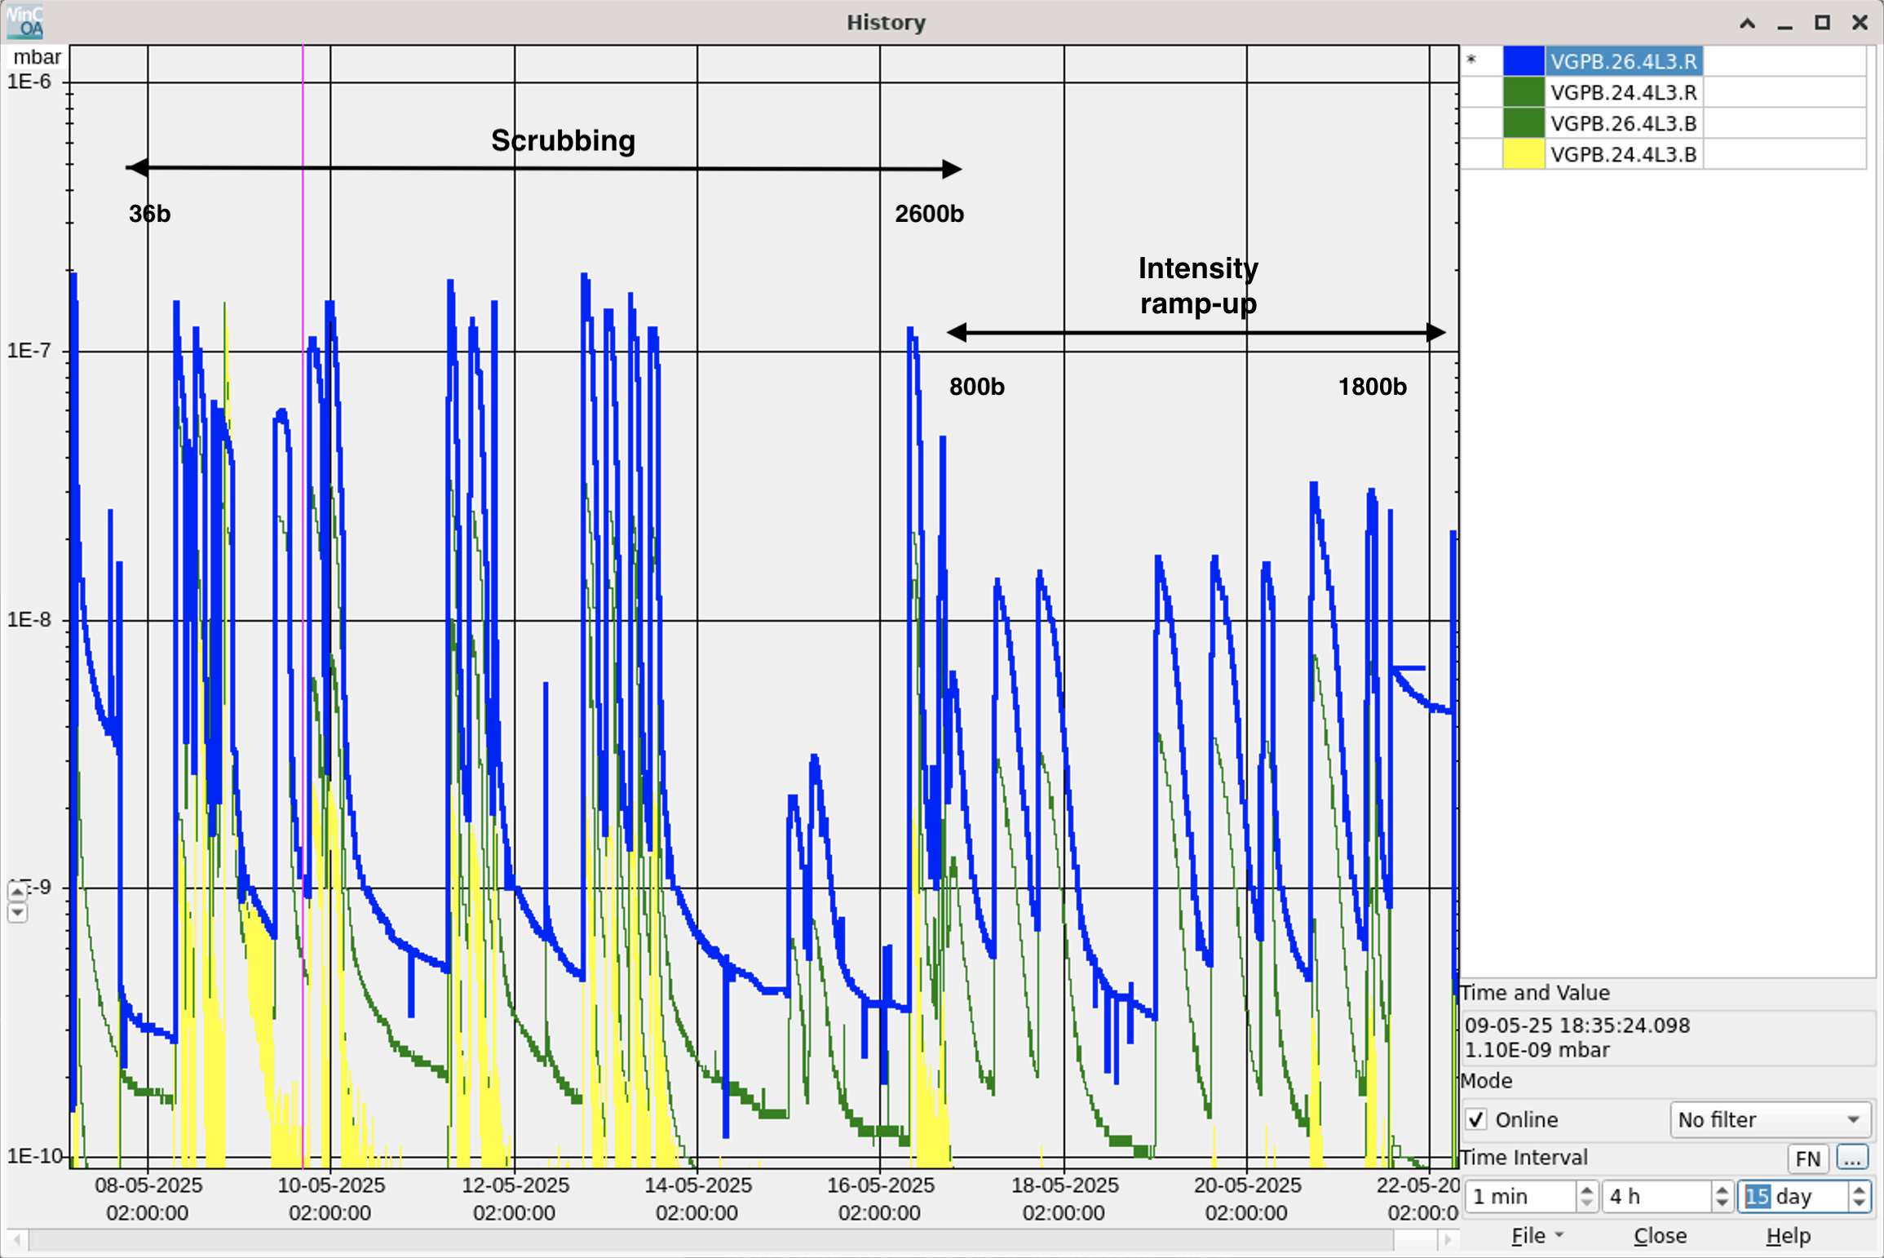
Loss observations
High losses were observed from before the scrubbing run throughout the intensity ramp-up in a few vented locations
Correlated with strong pressure rise, scrubbing as expected in the shadow of the MKIs
TWOCRYST experiment
CMS XRPs

Slide 16
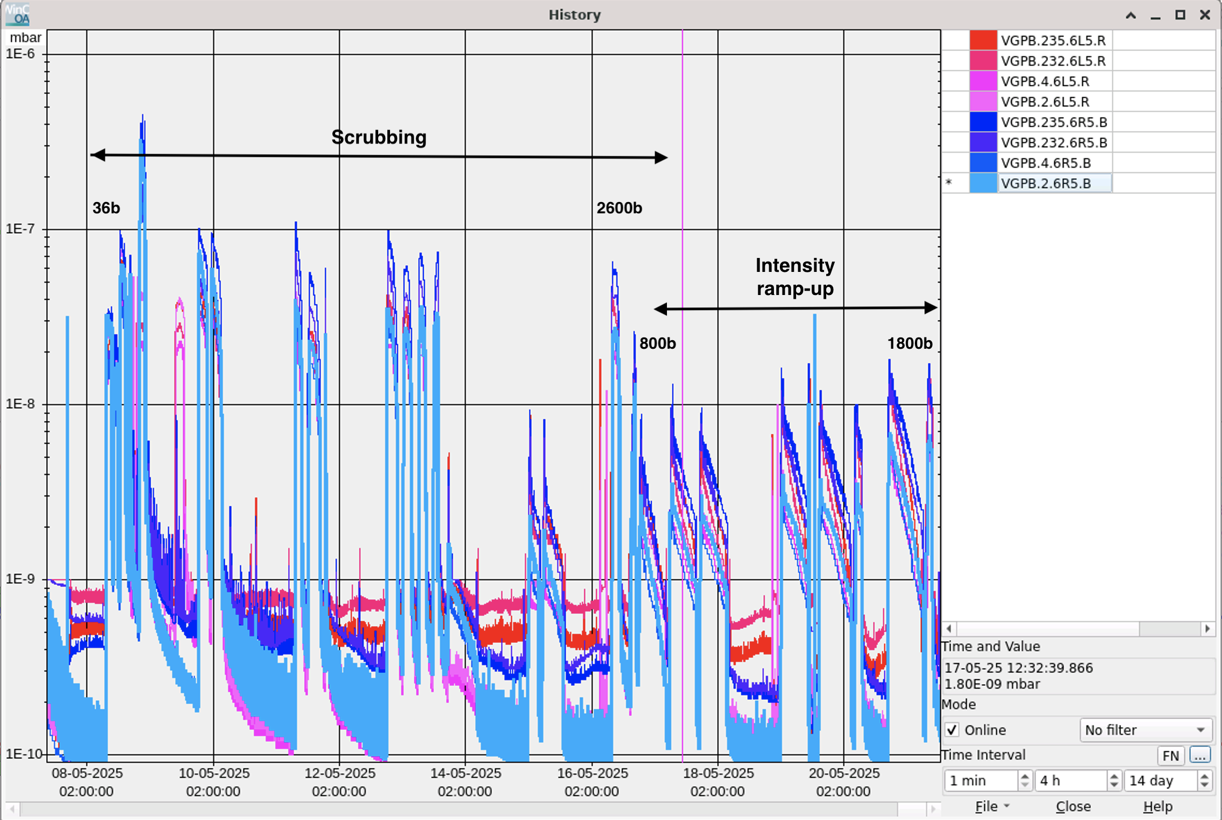
Loss observations
High losses were observed from before the scrubbing run throughout the intensity ramp-up in a few vented locations
Correlated with strong pressure rise, scrubbing as expected in the shadow of the MKIs
CMS XRPs
TWOCRYST experiment
+ Losses in P8
+ TDISs exchanged: pressure rise, but no issues

Slide 17
Heat load at injection
Although not limiting at injection, large heat loads ~160 W/hc were measured with 2600b in trains 2x72b
Larger difference between trains of 72b and trains of 36b than expected (similar observation last year for 48b)
  Expected ~20% between 2x72b and 4x36b, measured ~30%
  Expected ~10% between 2x72b and 3x48b, measured ~20%
Impacts heat load estimates for high-intensity run with 4x72b (TBC)

Slide 18
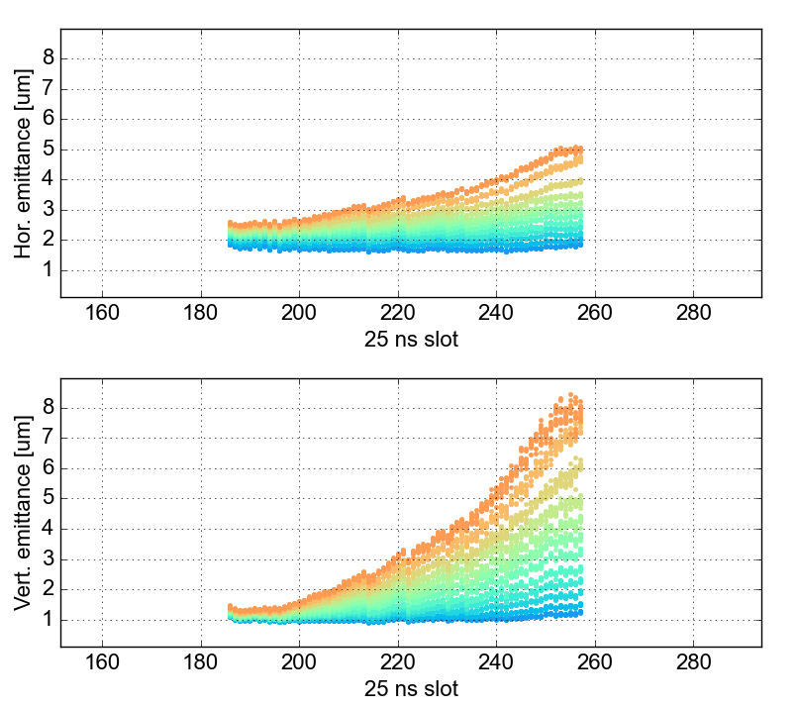
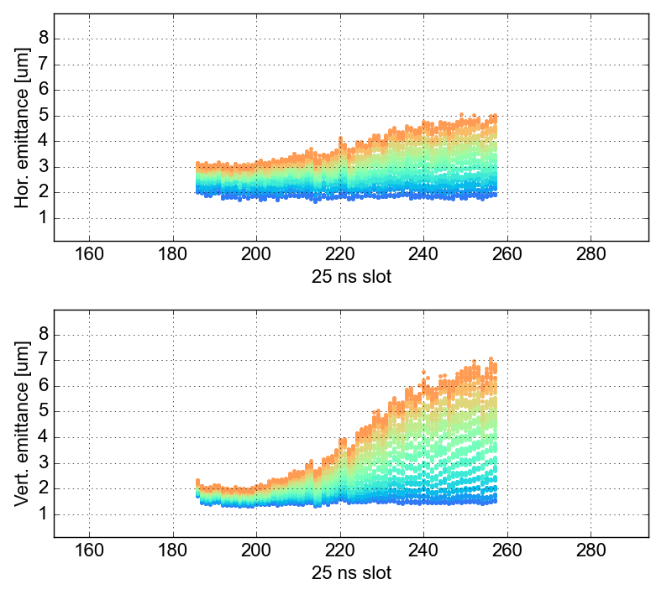
Beam quality
From the beginning, the beam quality seemed worse than in the past years
Started scrubbing with negative
octupole polarity (positive knob)
  Tunes set to working point
  identified in MD last year
Very strong incoherent emittance
growth with e-cloud signature
2028b
2460b
2604b
Qx/Qy = .295/.313
MO = 2
Q’ = 20
1308b
1456b
Qualification
1020b
156b
192b
228b
372b
660b
588b
48b
84b
B1
B2
2.5h
2.5h

Slide 19
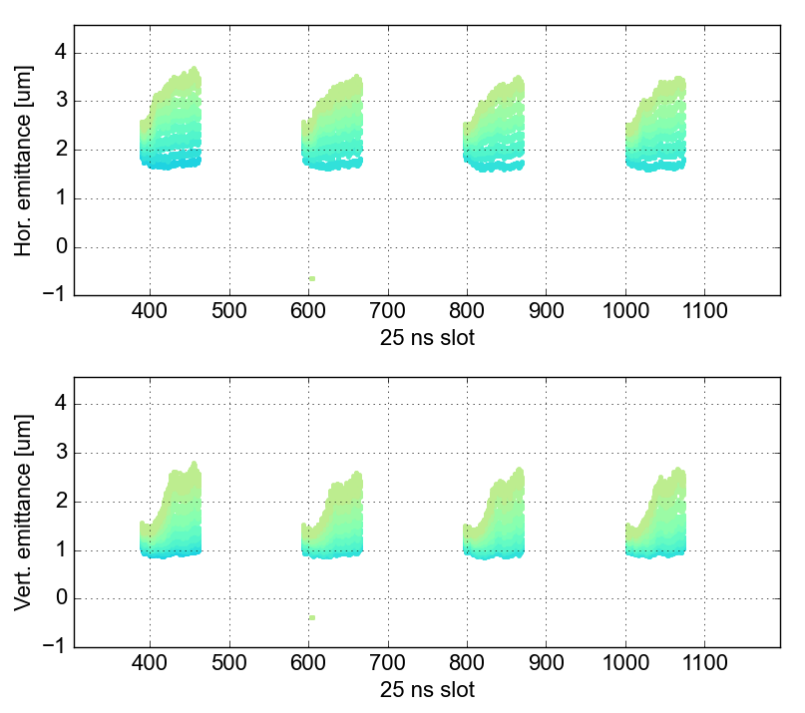
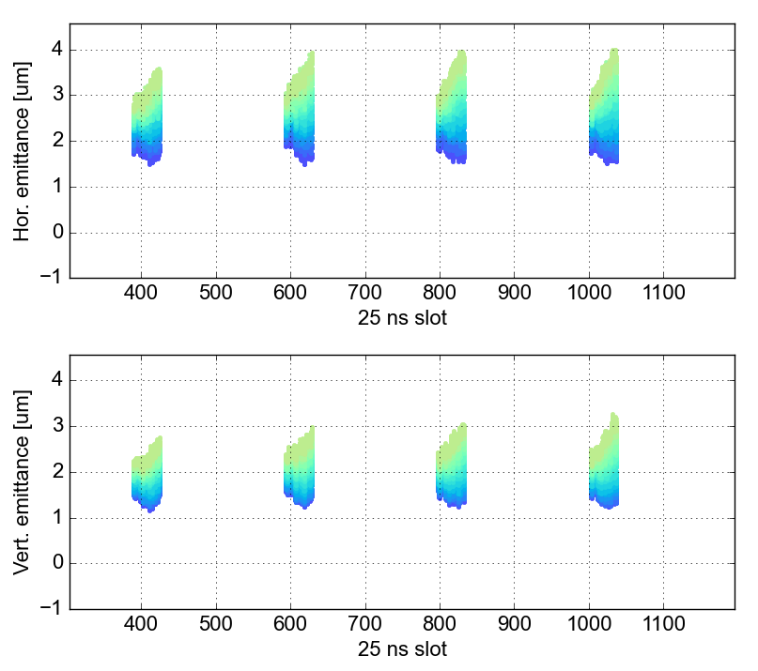
Beam quality
Situation seemed improved with new
working point after (parasitic) scan
(NB: 36b trains)
2028b
2460b
2604b
Qx/Qy = .291/.309
MO = 2
Q’ = 20
1308b
1456b
Qualification
1020b
156b
192b
228b
372b
660b
588b
48b
84b
B1
B2
2h
3.5h

Slide 20
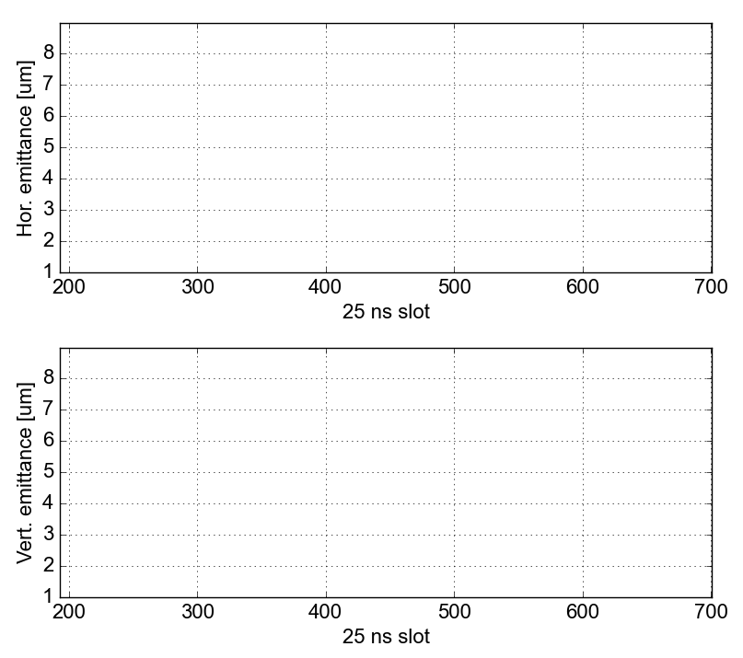
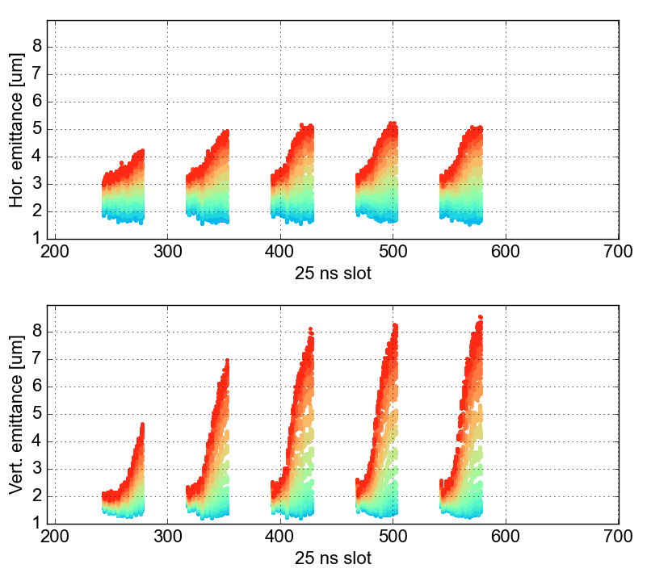
Beam quality
Situation seemed improved with new
working point after (parasitic) scan
(NB: 36b trains)
But worse again as of the following
fill with the same settings
(NB: trains more closely spaced)
2028b
2460b
2604b
Qx/Qy = .291/.309
MO = 2
Q’ = 20
1308b
1456b
Qualification
1020b
156b
192b
228b
372b
660b
588b
48b
84b
B1
B2
3.5h

Slide 21
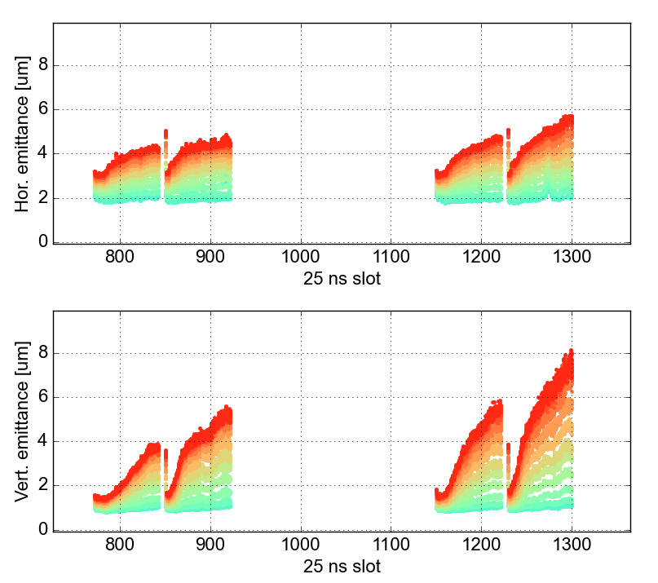
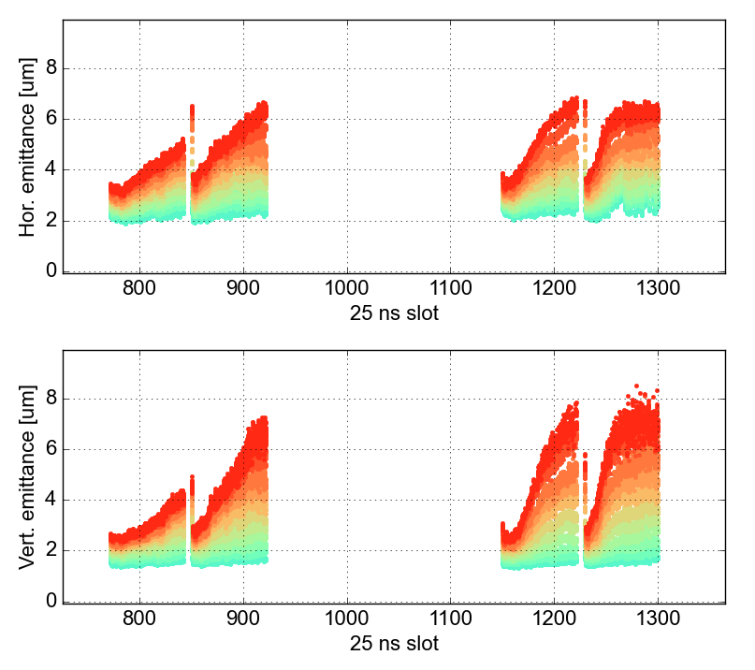
Beam quality
Fall-back to 2024-MD working point
after second tune scan (144b/beam),
but not very significant reduction in emittance growth
Qx/Qy = .295/.313
MO = 2
Q’ = 20
2028b
2460b
2604b
1308b
1456b
Qualification
1020b
156b
192b
228b
372b
660b
588b
48b
84b
B1
B2
4h
4h

Slide 22
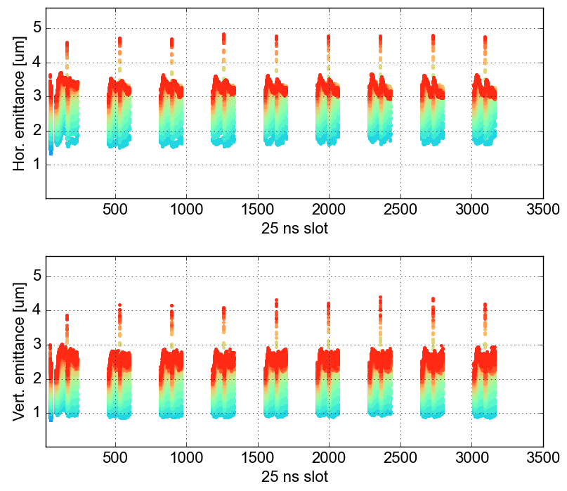
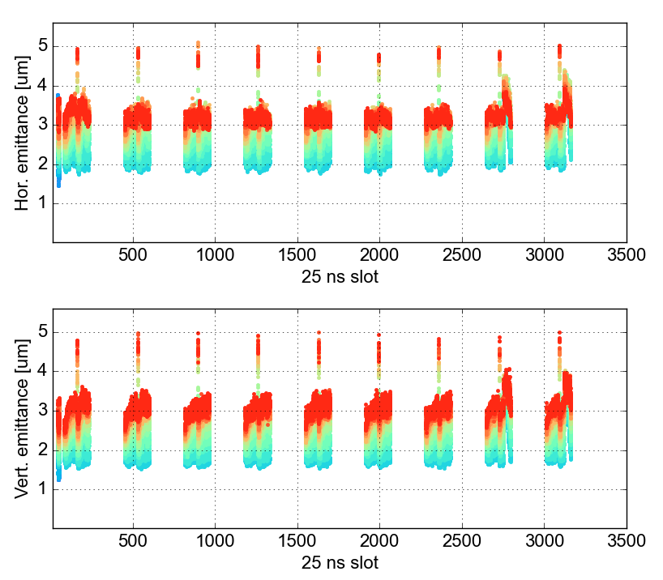
Beam quality
Going to positive octupole polarity
gave a clear improvement in emittance growth
  Better for scrubbing, although lifetime improvement quite moderate
Some instabilities, despite high Q’ and MO
Qx/Qy = .275/.293
MO = -3 → -3.5
Q’ = 20 → 25
2028b
2460b
2604b
1308b
1456b
Qualification
1020b
156b
192b
228b
372b
660b
588b
48b
84b
B1
B2
4h
4h

Slide 23
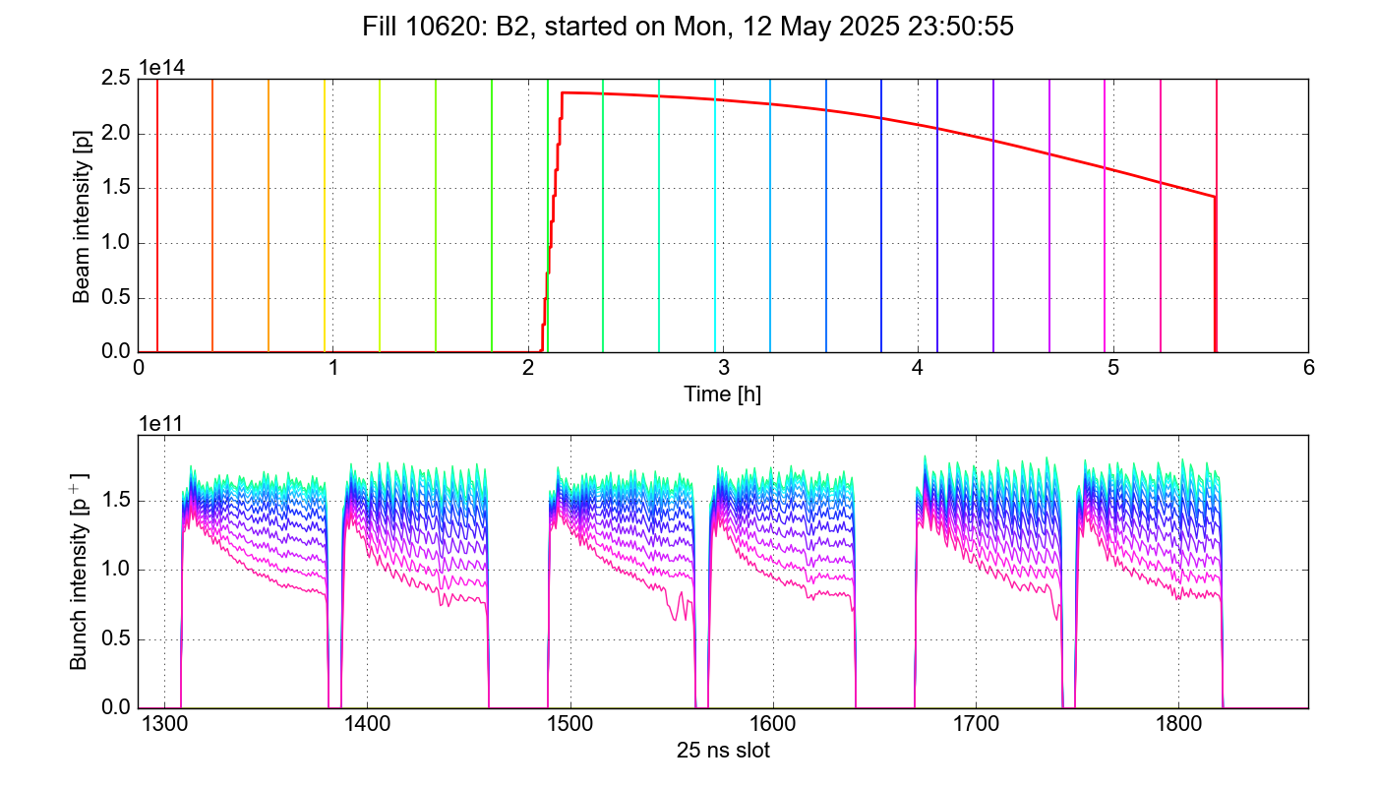
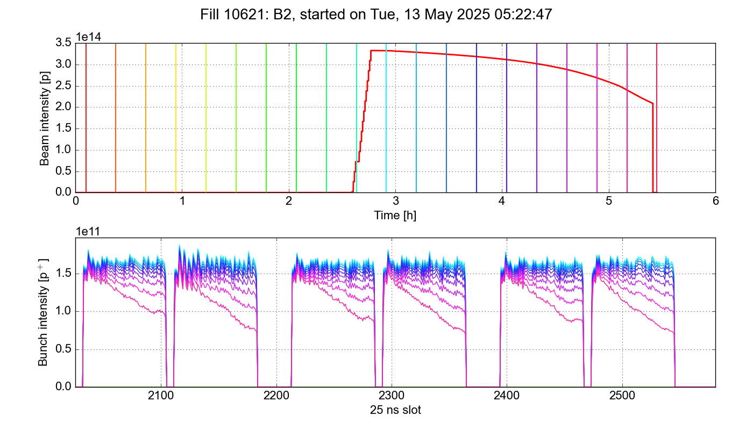
Beam quality
Some difference also in loss pattern between fills with positive and negative octupole (for the chosen settings)
Qx/Qy = .275/.293
MO = -3.5
Q’ = 20 → 22
Qx/Qy = .295/.313
MO = 2 → 2.5
Q’ = 20

Slide 24
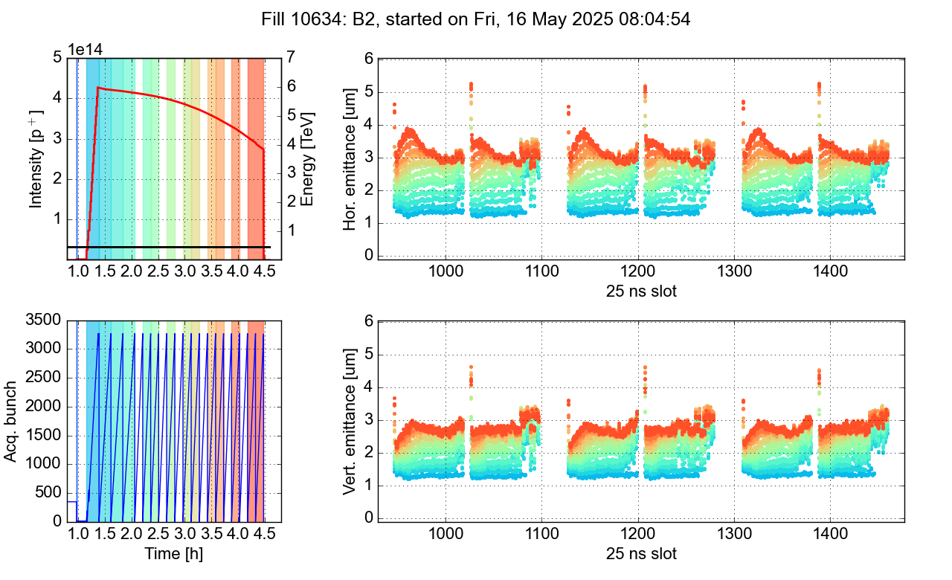
Beam stability
With increasing number of bunches in the machine, the beam stability got worse, especially for B2
  The mild instabilities were not limiting for scrubbing, but were puzzling
Stability worse than past years, but no
real reason to expect worse e-cloud
stability, since most of the machine
stayed under vacuum
Initially suspected relation to positive
octupoles (expect better lifetime, but
worse stability), but instabilities
eventually appeared for both
polarities
Sometimes correlated with smaller
injected emittances, but not
systematically

Slide 25
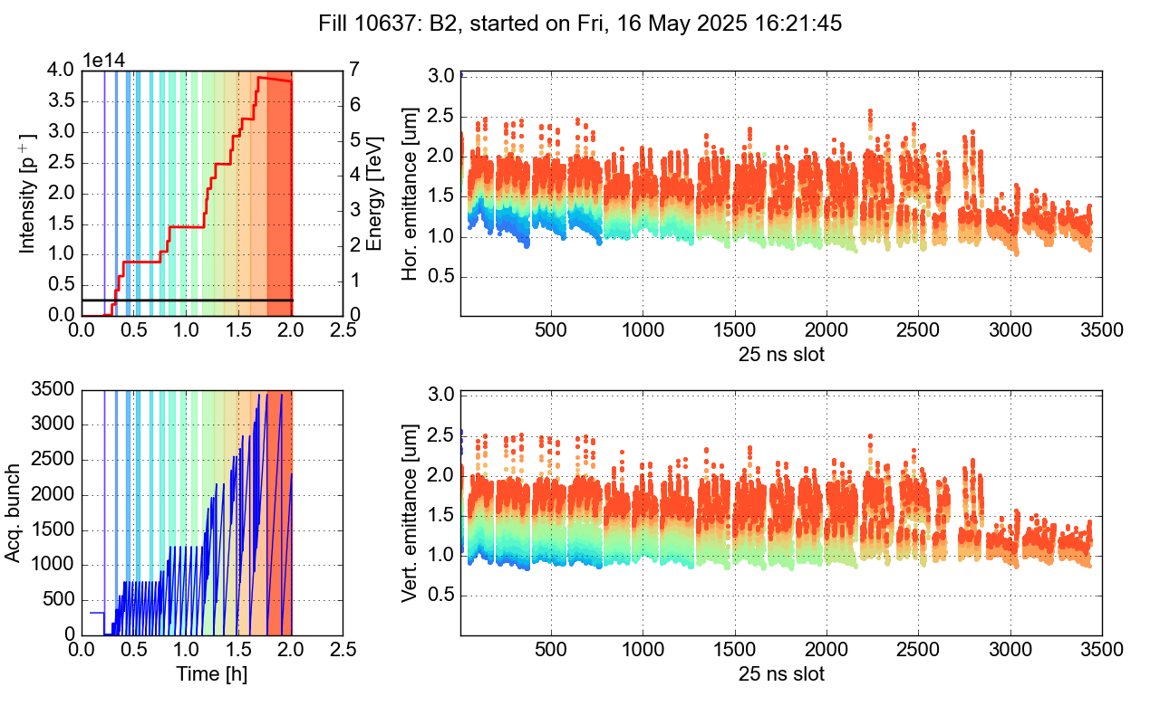
Scrubbing qualification
The qualification fill, to confirm that the filling scheme for physics operation can be injected without issues, was not very successful
  The injection process lasted much longer than usual, due to issues in the SPS, and was therefore not representative of a standard injection
The beam suffered both from emittance growth and instabilities, but it was difficult to disentangle the effect of the prolonged injection
The MKI pressures stayed close to the operational
thresholds, so at least it allowed to conclude that the
kickers were likely sufficiently scrubbed for operation

Slide 26
Scrubbing qualification
Overall, the experience from the scrubbing suggested that the machine was not optimally set up
The tunes were not well controlled
  Unclear BBQ signals
  Large tune drift during filling/fills
  Inconsistent measurements during working point scans
  Strong emittance growth indicating a suboptimal working point?
The beam was more unstable than expected
  No reason for stronger e-cloud instabilities
  Octupoles and chromaticity did not seem fully effective
Repeated ADT module H1B2 trips – any impact?

Slide 27
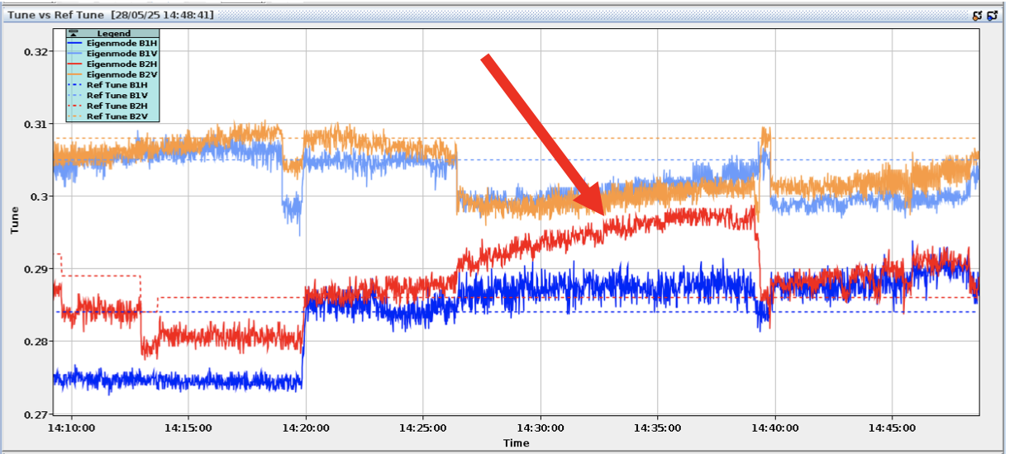
Follow-up during operation
The issues encountered during scrubbing continued in the intensity ramp-up and were gradually addressed in the weeks following the scrubbing run
Poor tune control
  Switching BBQ from gated on-demand to gated continuous
  Comparing to ADT tune measurements (1e-2 difference in B1H)
  → adjusted target accordingly
  Working point optimization
Tune drifts & instabilities
  Very large tune drifts observed, especially in B2 tunes approach each other → coupling
  Stability improved with better tune control
  Regularly switch tune feedback on during injection (disable Abort Gap cleaning)
Hierarchy-breaking losses in B1 observed at start of ramp with high octupole currents
X. Buffat

Slide 28
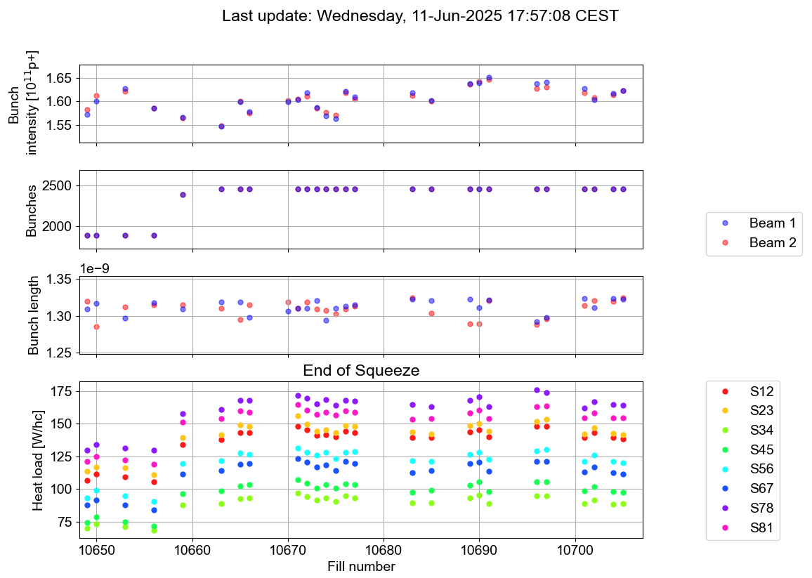
Heat load at flat top
When making the step from 2000 to the full filling scheme, cryo asked to lower the intensity for the first fills
to control the heat load
No issues encountered and the
intensity has now been increased
beyond 1.6e11 p/b
The heat load at flat top is very
close to the predicted value

Slide 29
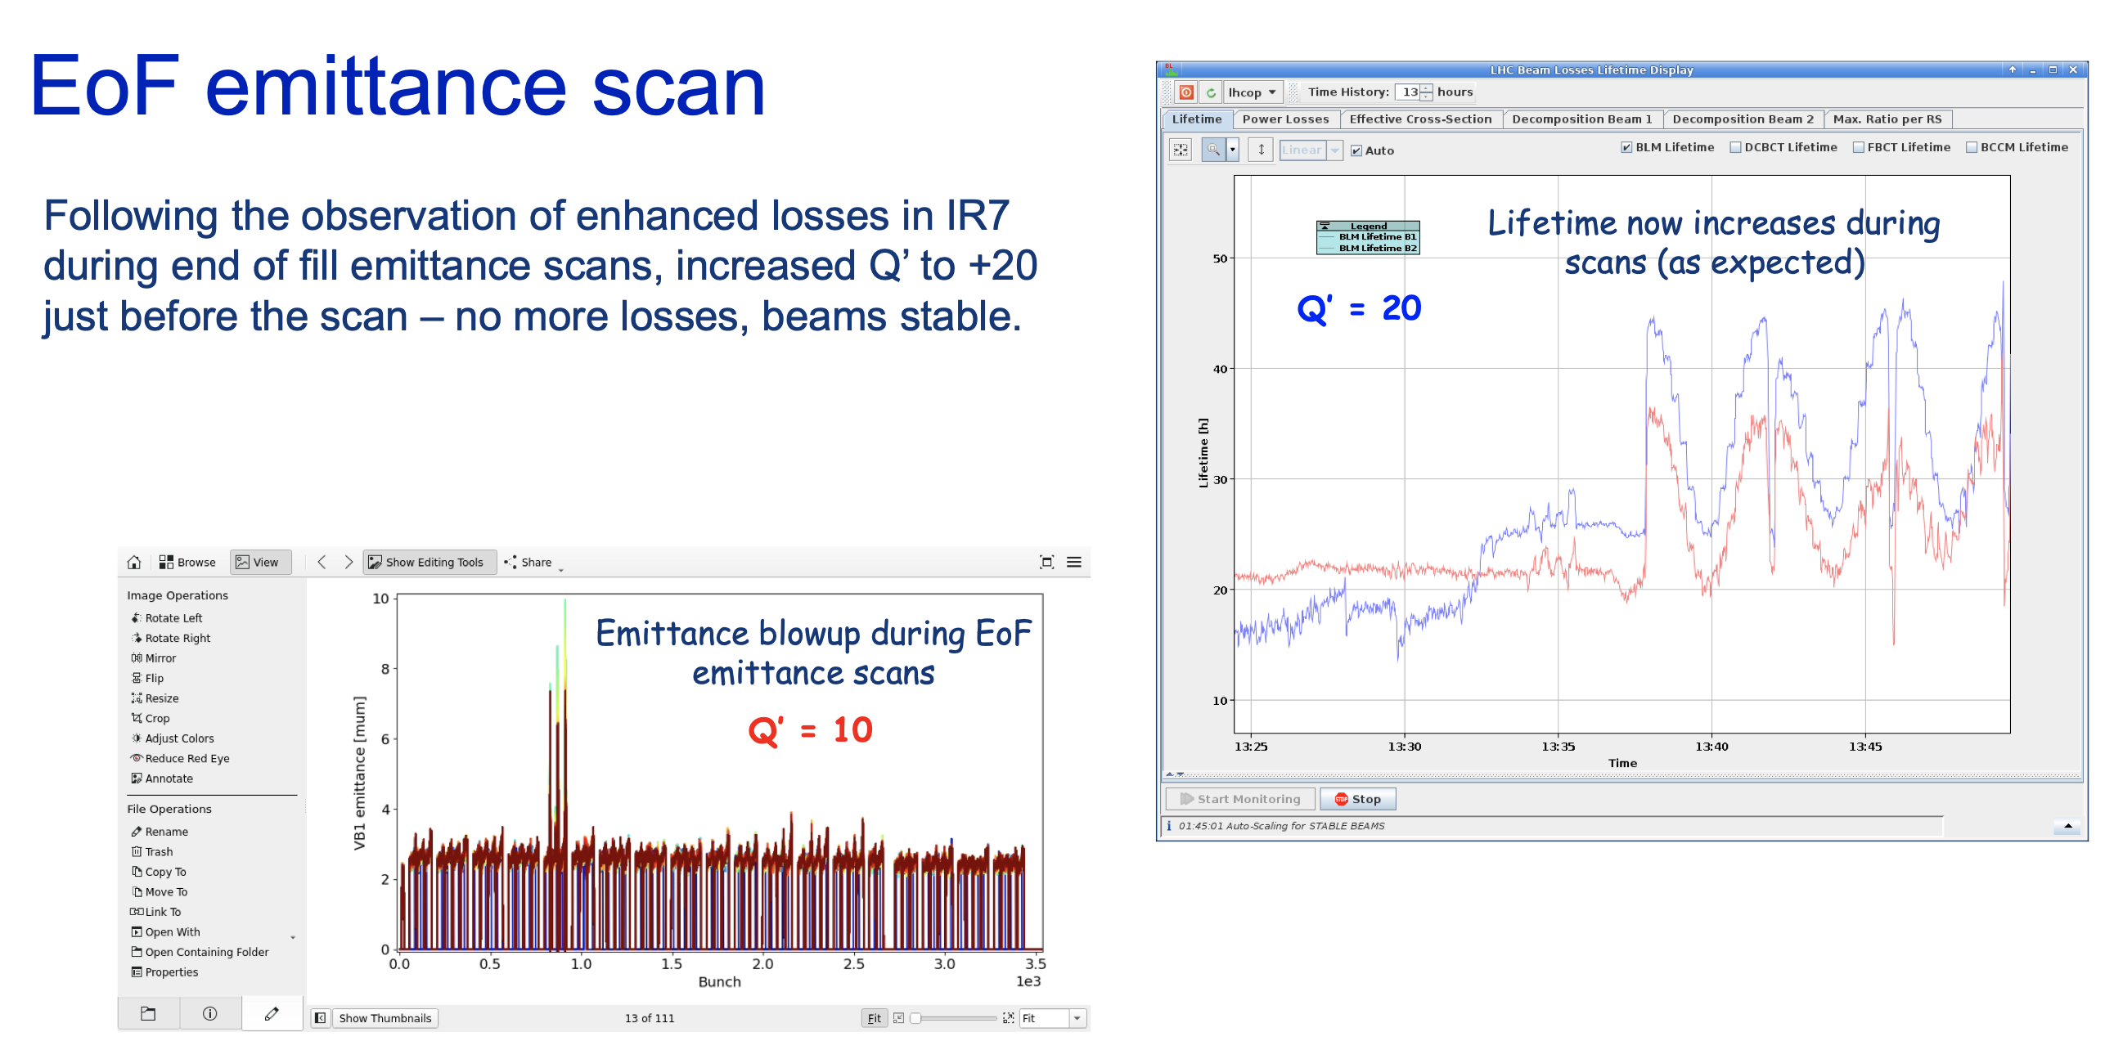
Instabilities at flat top
Chromaticity increased from Q’=10 → 20 during end-of-fill emittance scans to ensure stability
J. Wenninger

