Slide 1


PH GENERATOR MEETING
Jet Substructure Tuning Studies​
Eda Erdoğan, Bora Işıldak, Salim Çerçi, Deniz Sunar Çerçi
19/05/2025

Slide 2
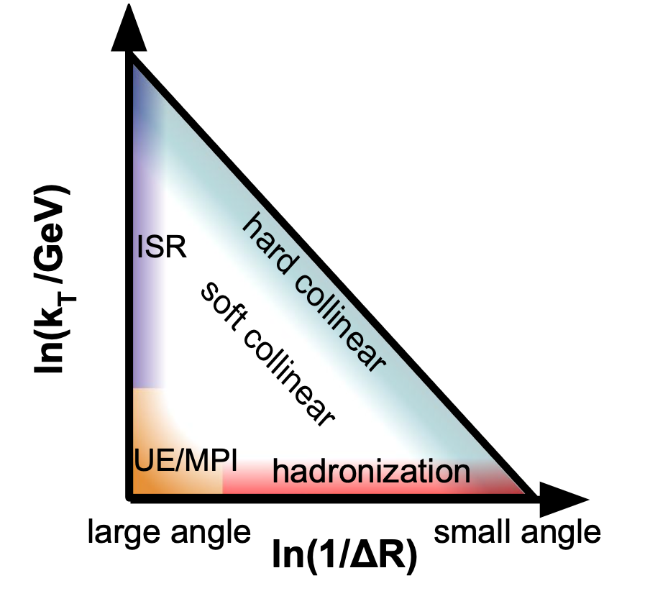
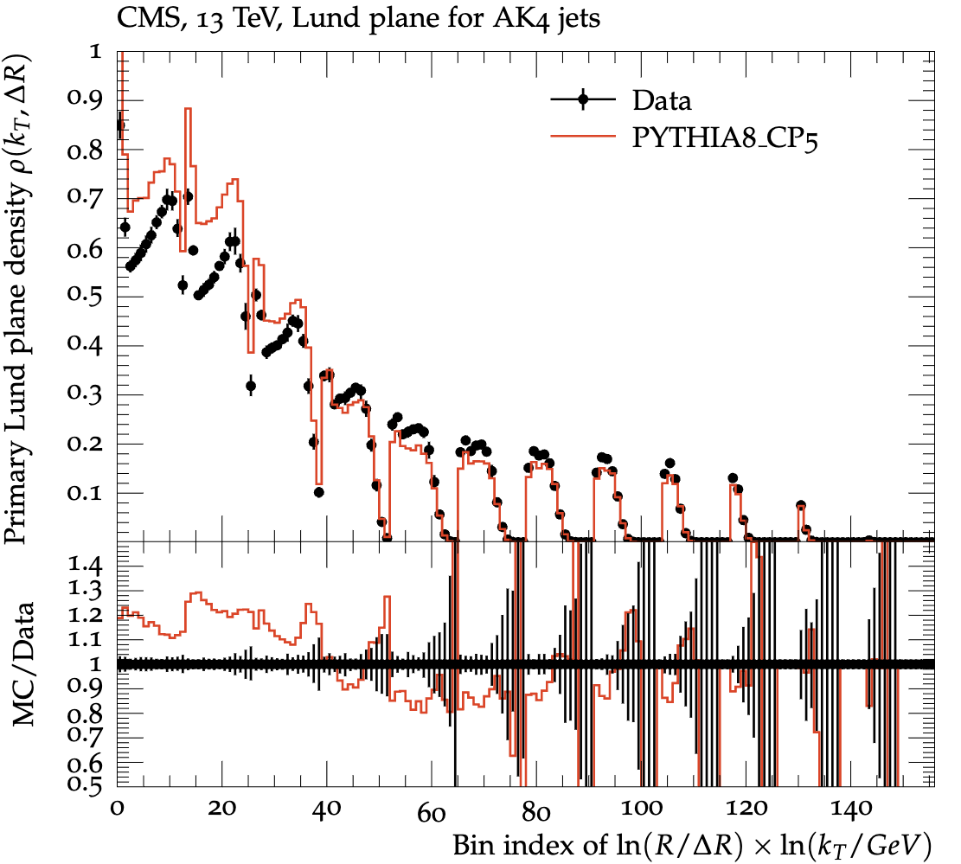
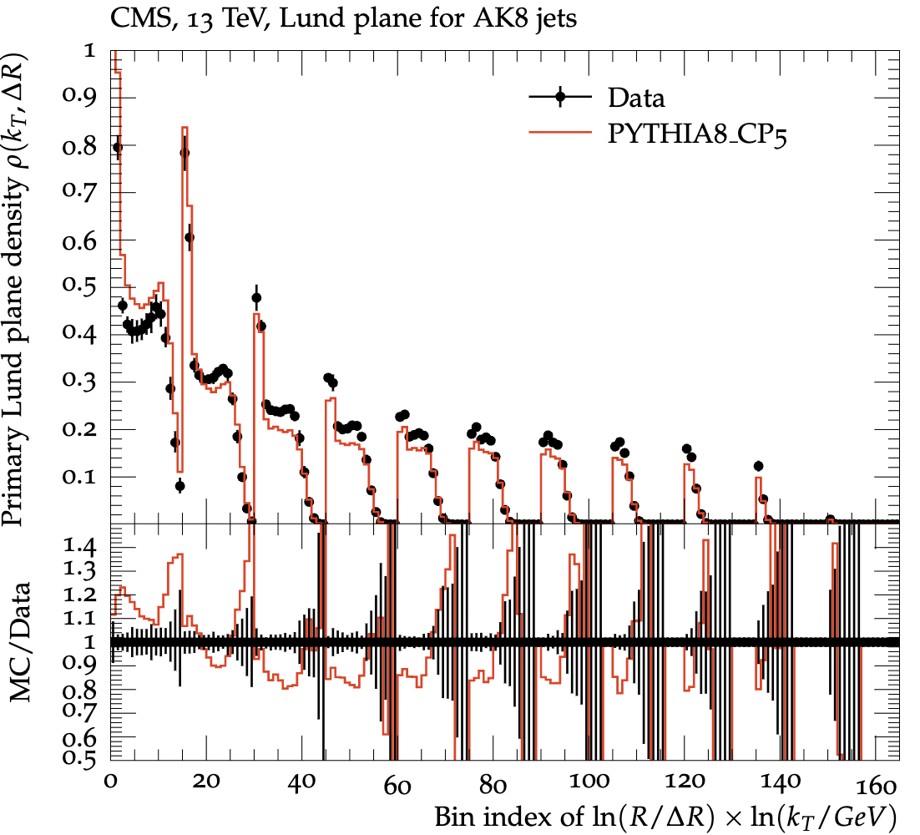

Overview for LJP tuning with CP5
SMP-22-007
Sensitivity checks for α_{s}​(m_{Z}​) limits (meaningful ones)
Sensitivity checks with pT = 1 GeV threshold
Colour Reconnection tunes
The CP5 tune underestimates the emission density in the perturbative region (kT > 5 GeV) by about 15% due to its low value of α_{s}​ for FSR at the Z mass.
Also the PYTHIA8 predictions overestimate the LJP density by about 15–20% for kT at the GeV scale for a wide range of ∆R values (~nonperturbative region).

Slide 3
Sensitivity Checks

Slide 4
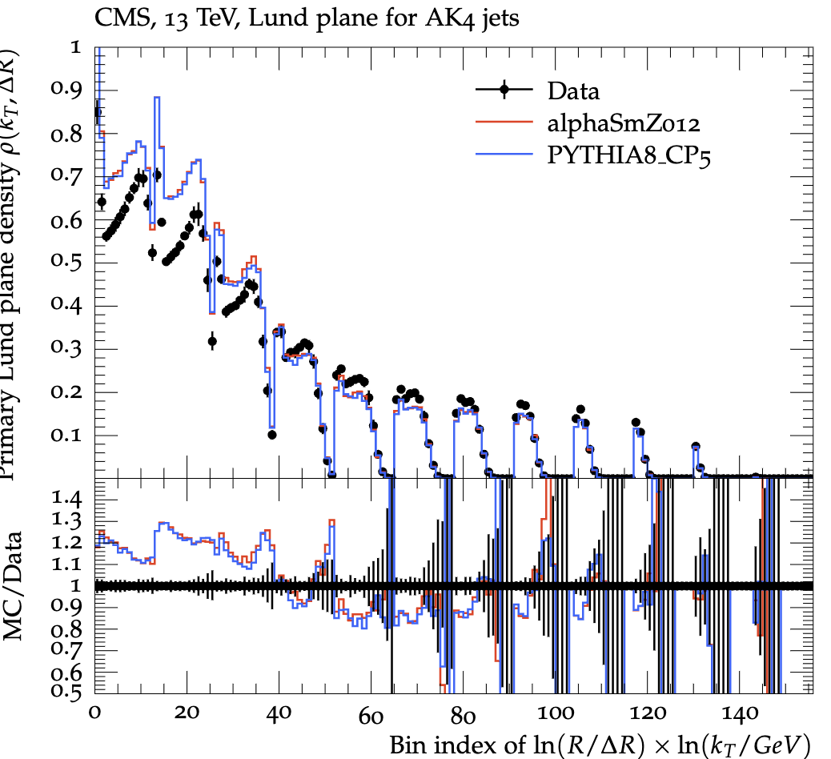
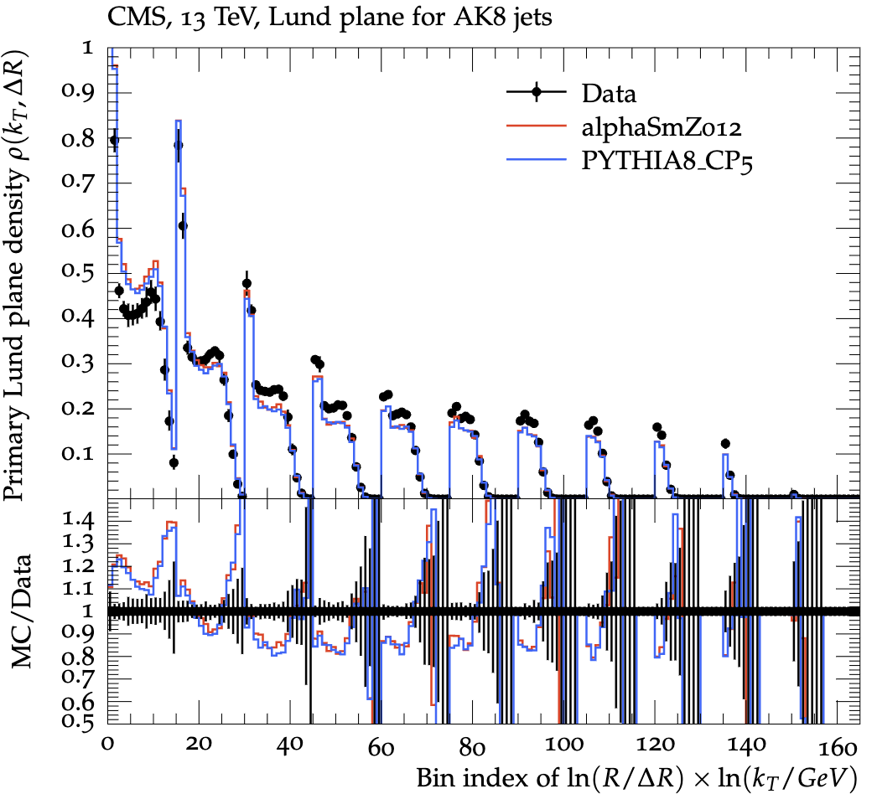
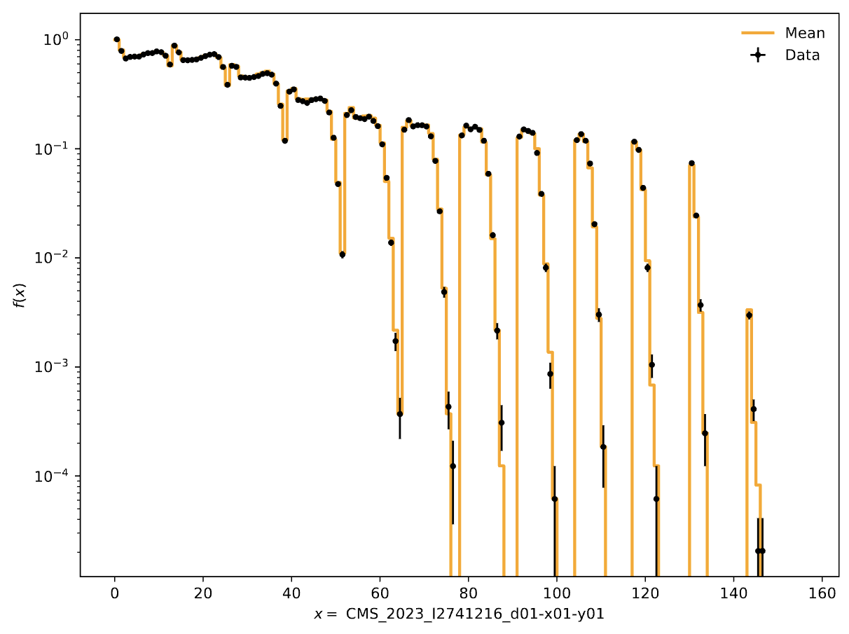
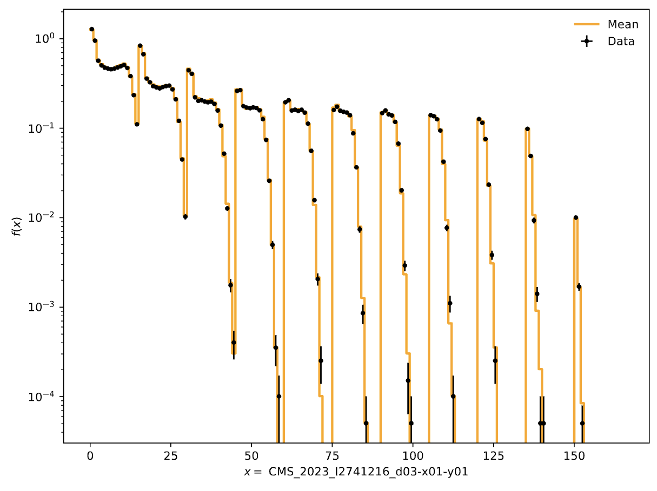
α_{s} ^{FSR}​(m_{Z}​)= 0.12
Still close to the CP5 as expected.
Ak4 jets
Ak8 jets
Good coverage still?

Slide 5
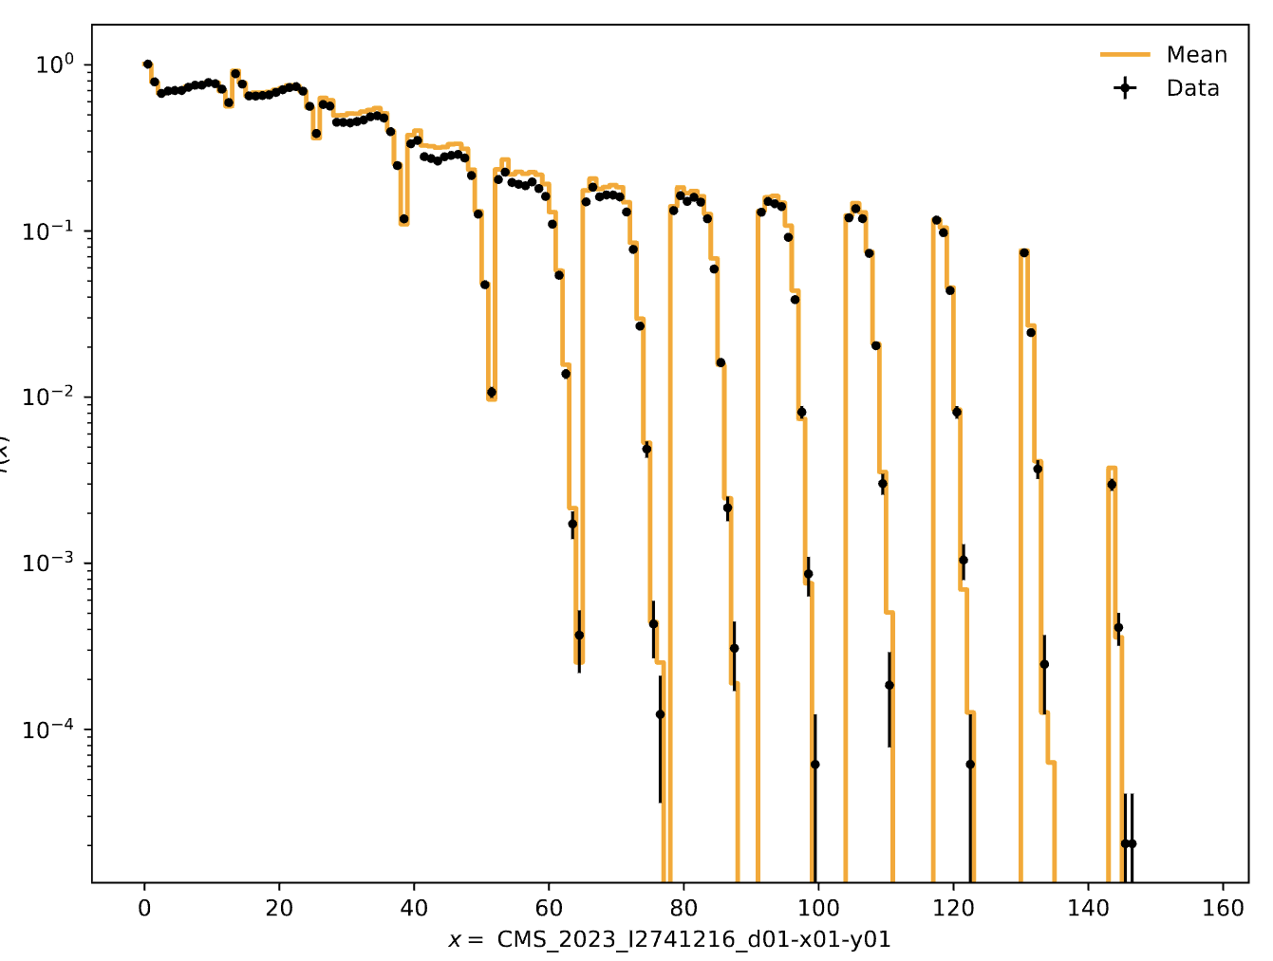
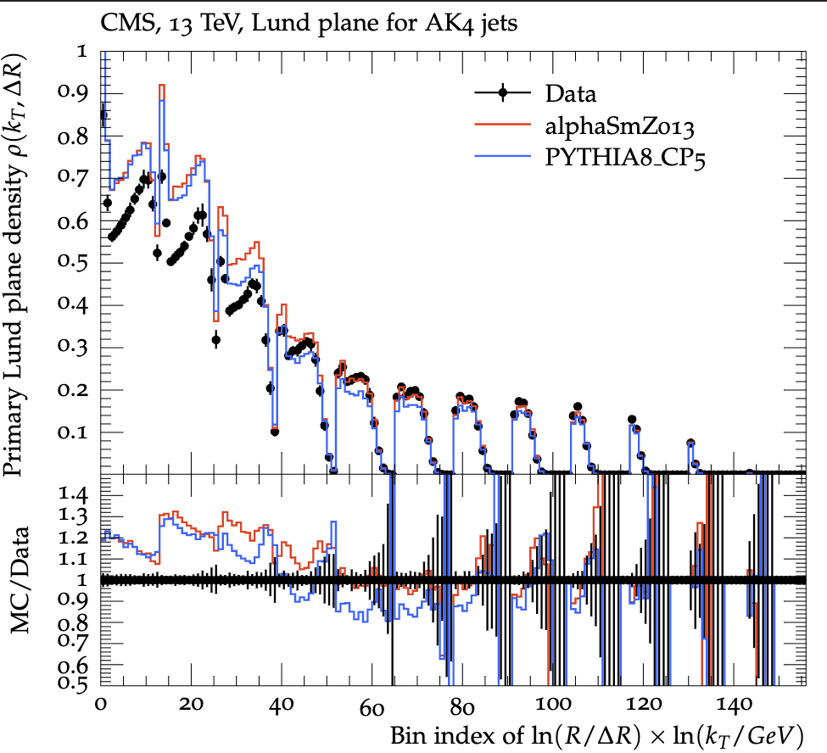
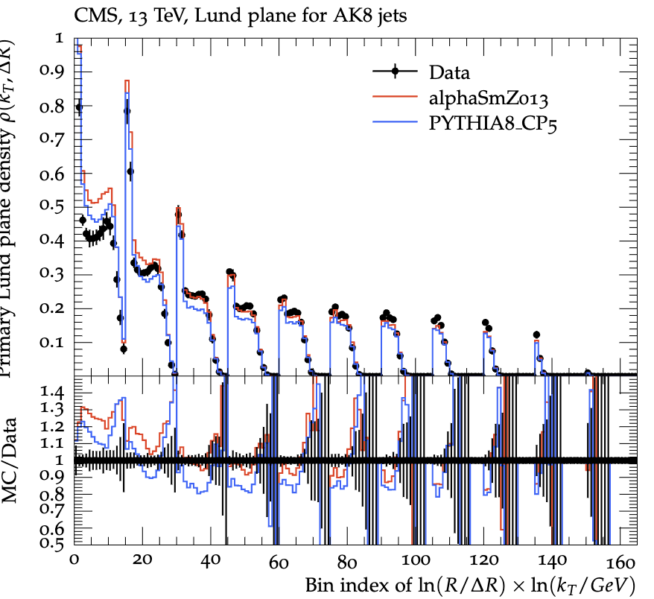
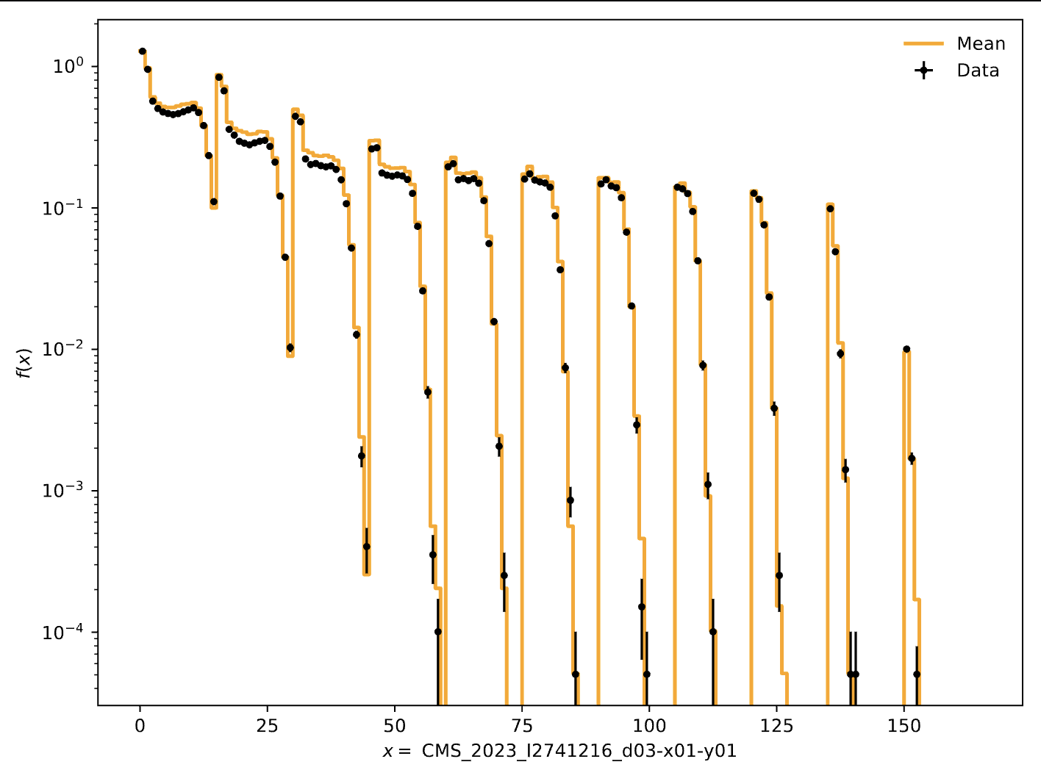
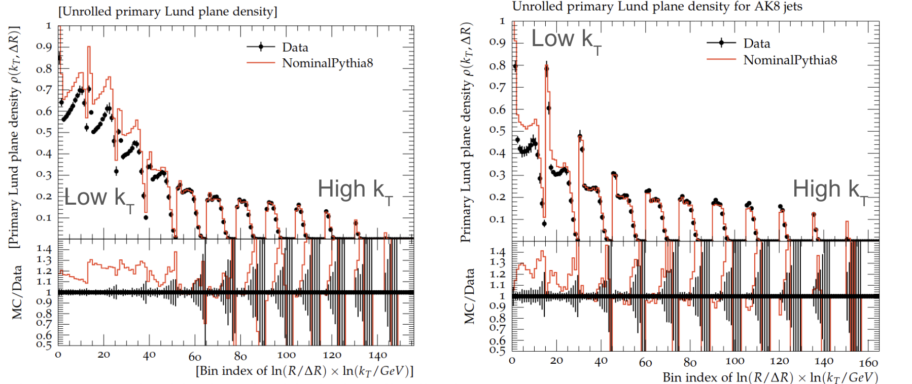
α_{s} ^{FSR}​(m_{Z}​)= 0.13
Ak4 jets
Ak8 jets
Almost identical to Nominal
Pythia8 plots, as expected

Slide 6
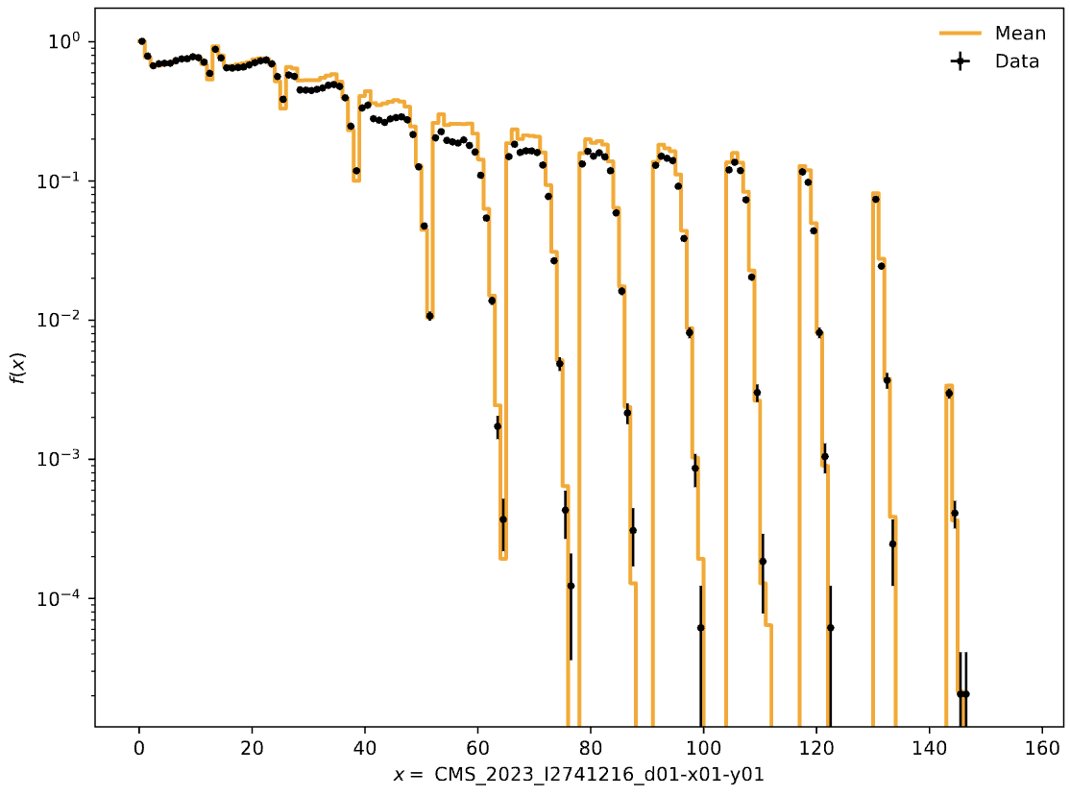
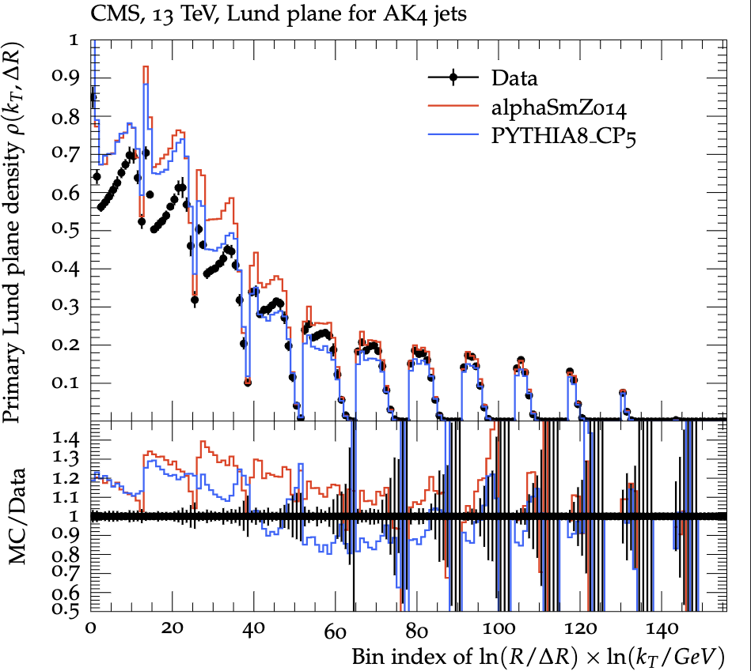
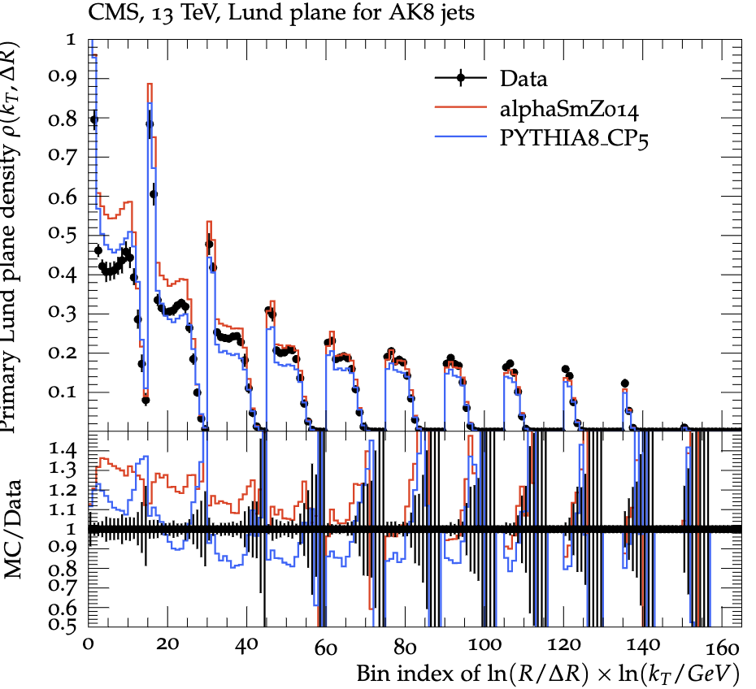
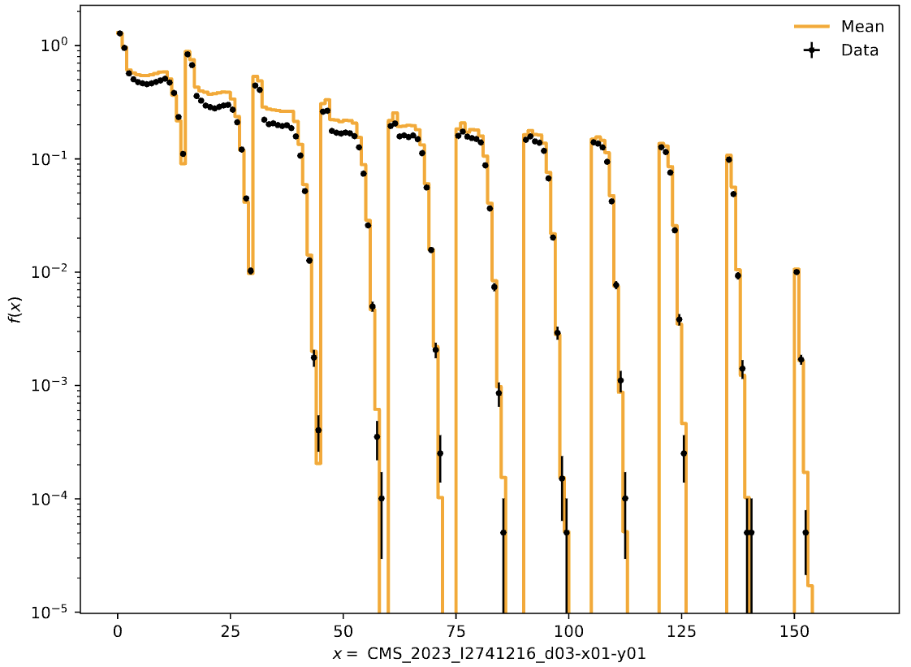
α_{s} ^{FSR}​(m_{Z}​)= 0.14
Ak4 jets
Bad coverage especially in the AK8 jets
Ak8 jets

Slide 7
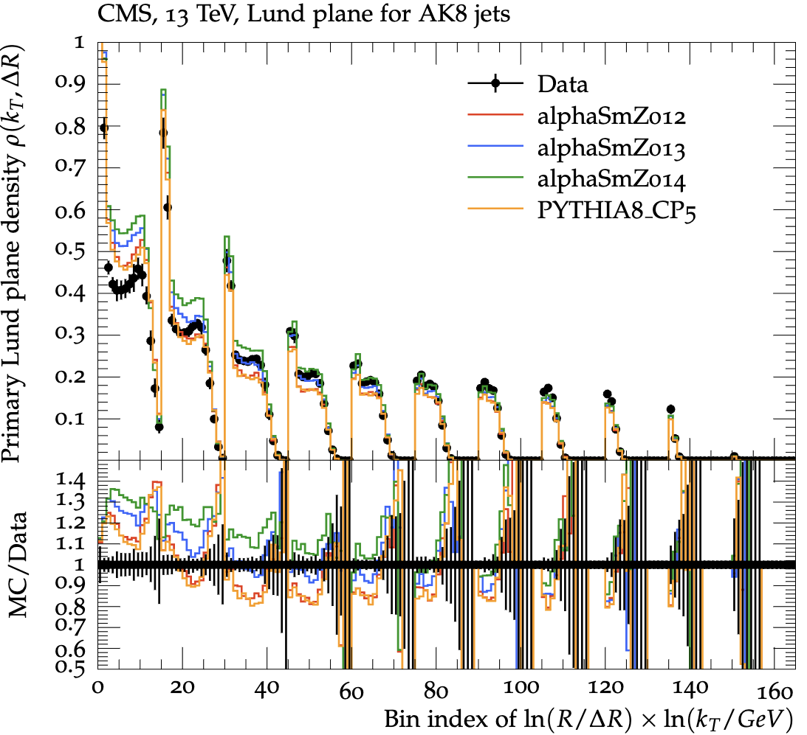
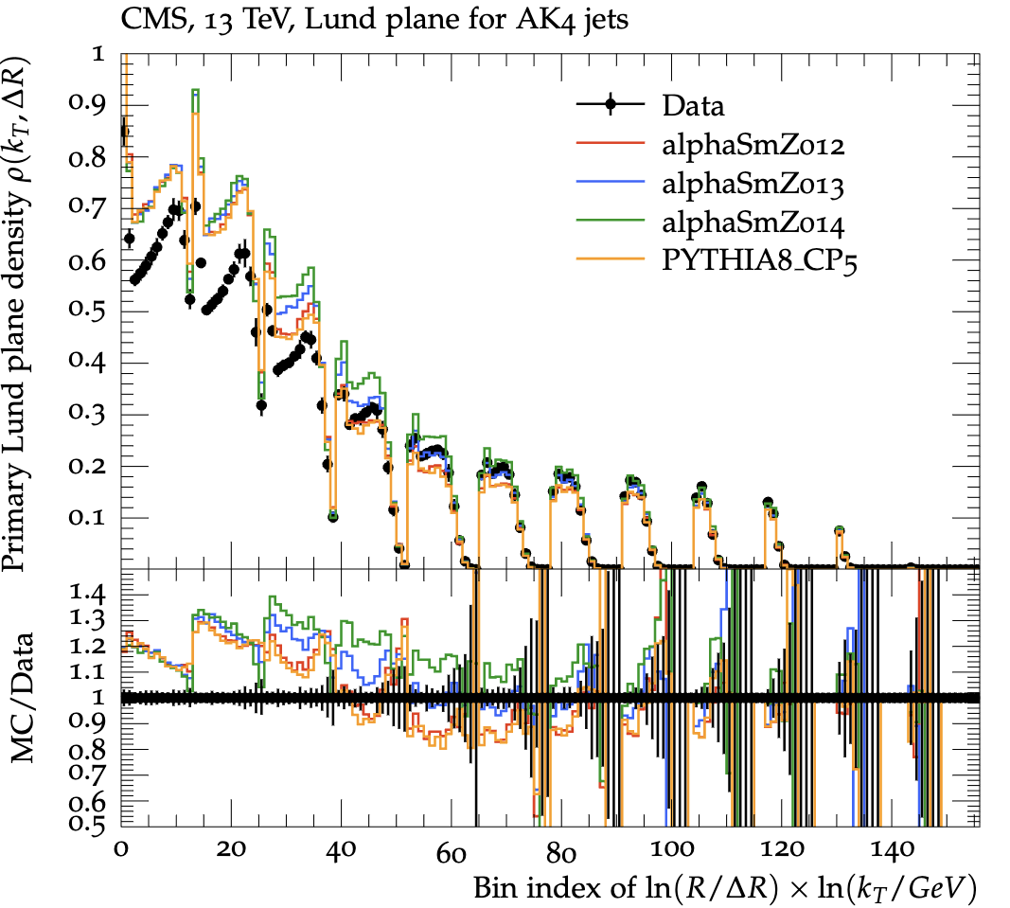
Merged Result

Slide 8
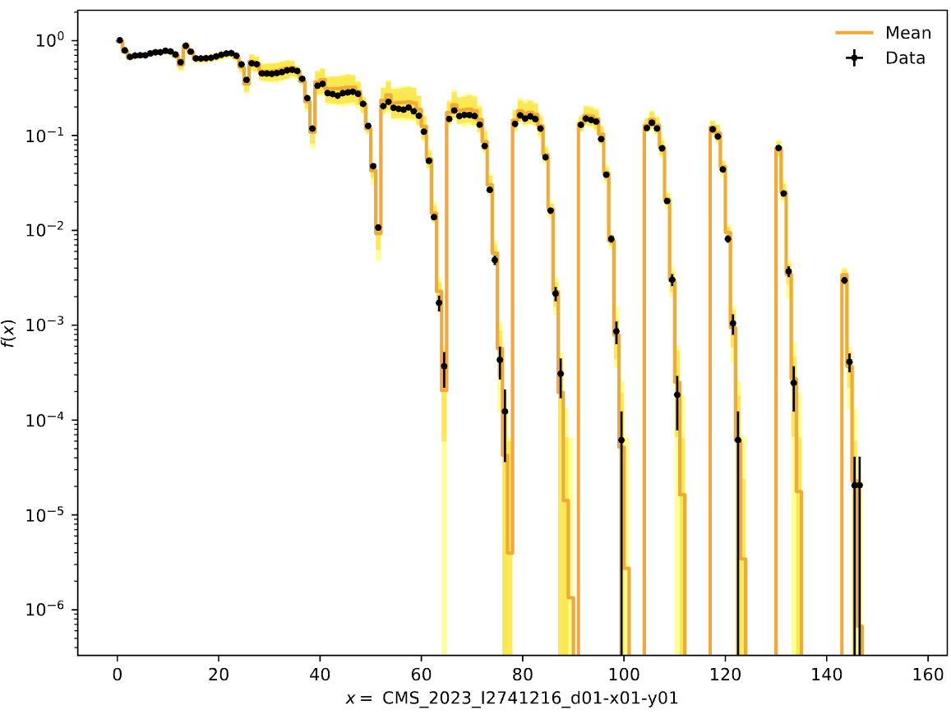
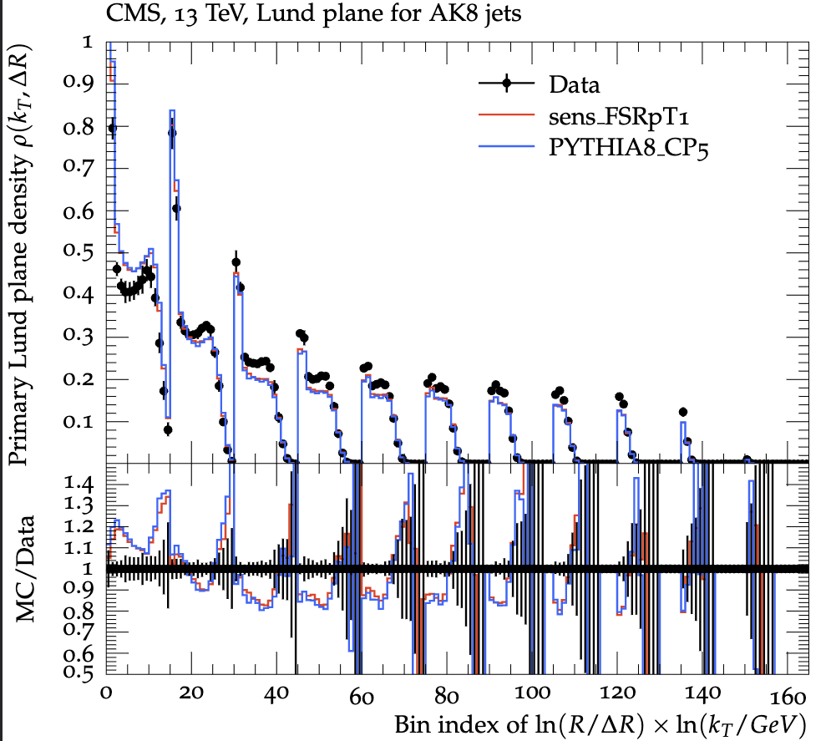
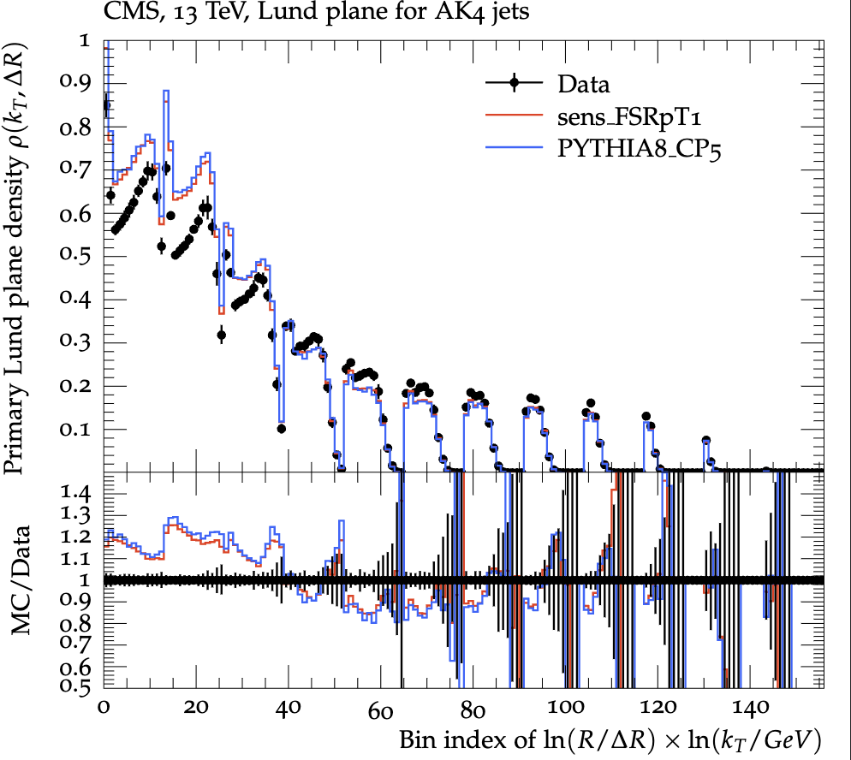
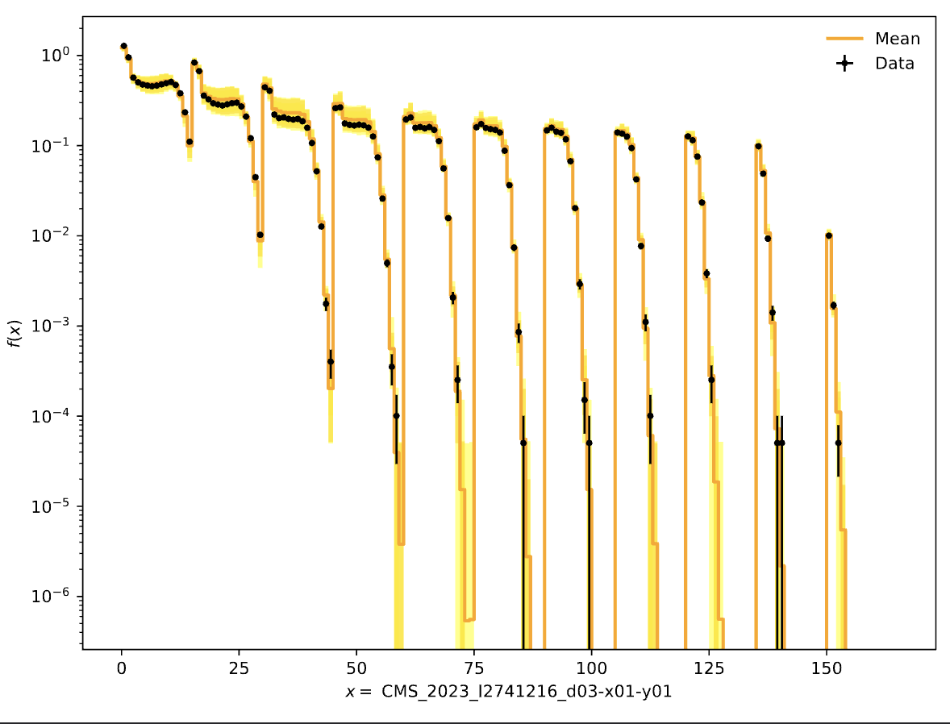
Parton Shower pT Checks for CP5 only
Ak4 jets
Ak8 jets

Slide 9
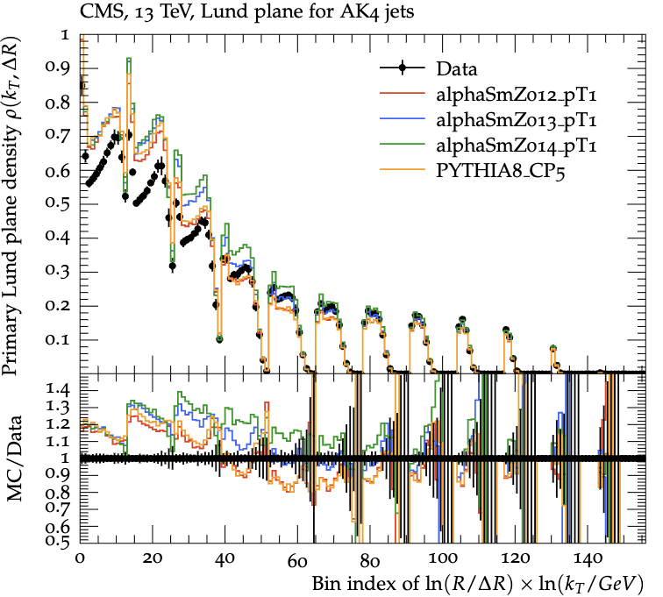
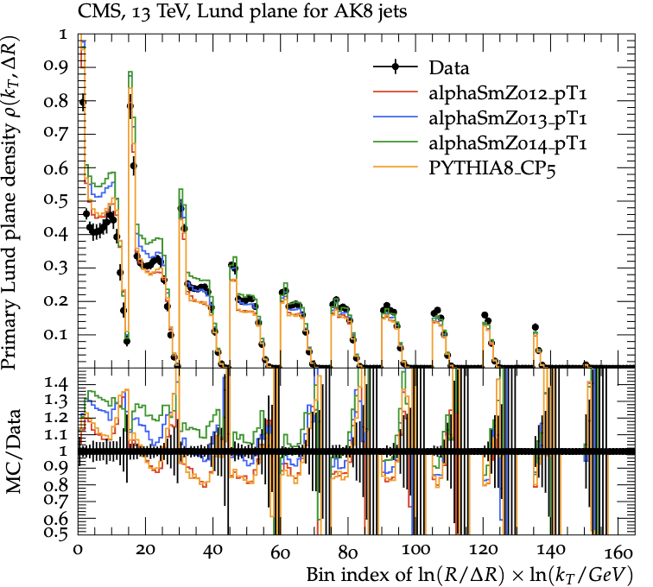
Comparisons of FSR pT Cutoff with α_{s} ^{FSR}​(m_{Z}​) Variations

Slide 10
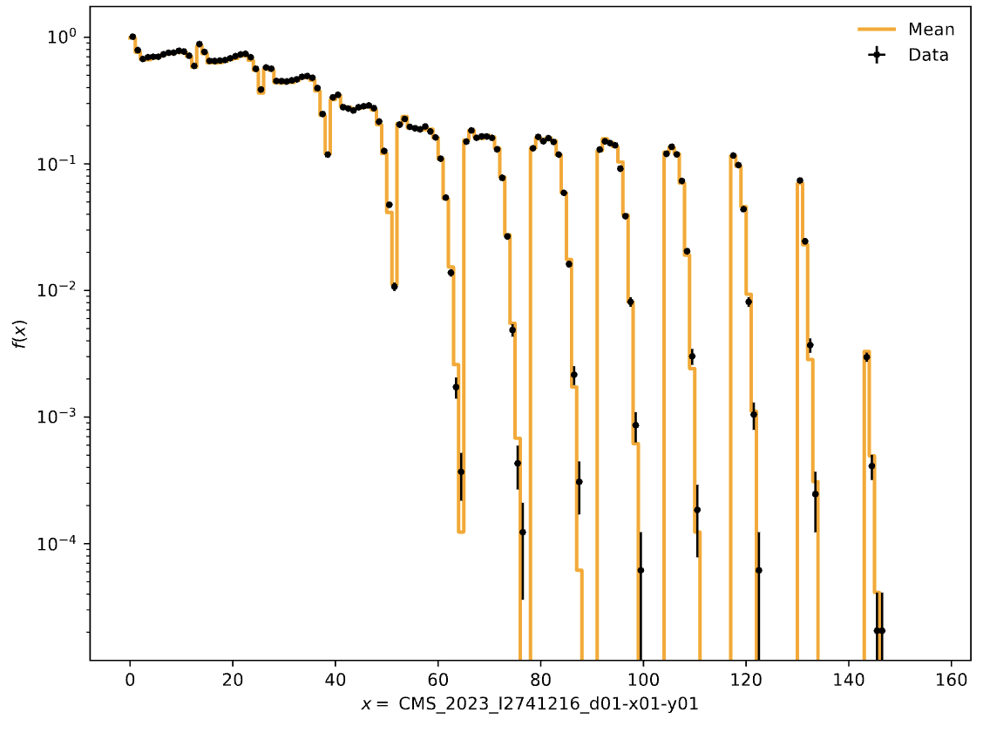
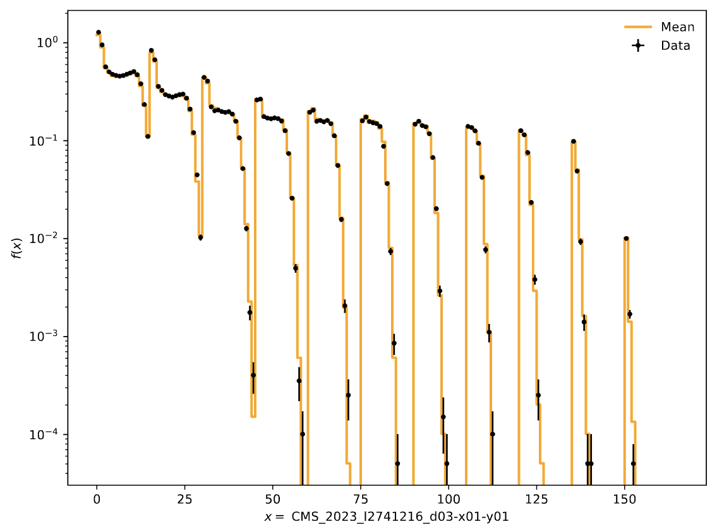
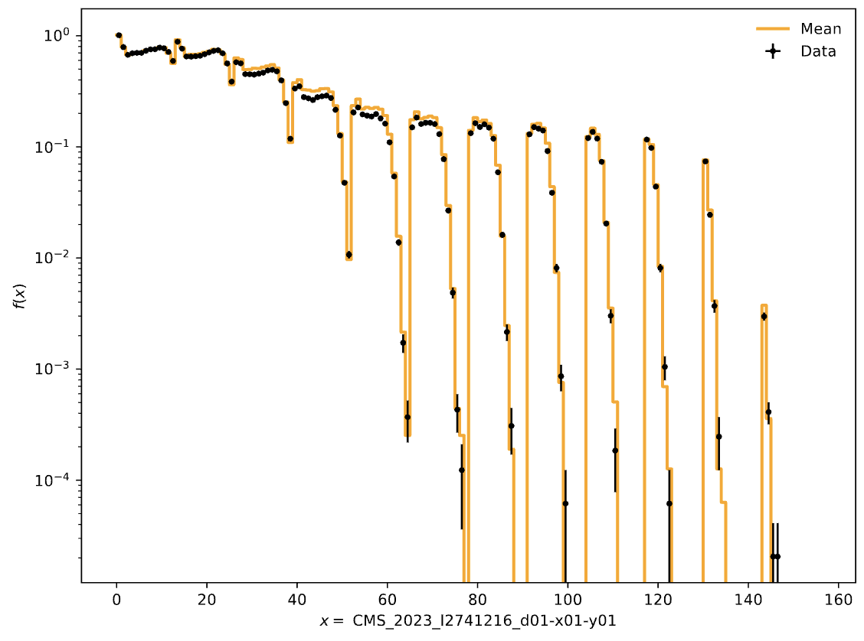
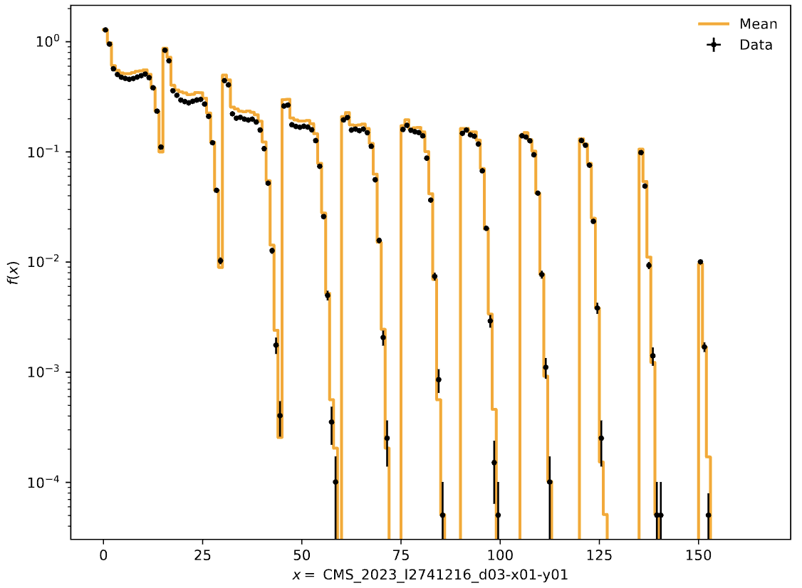
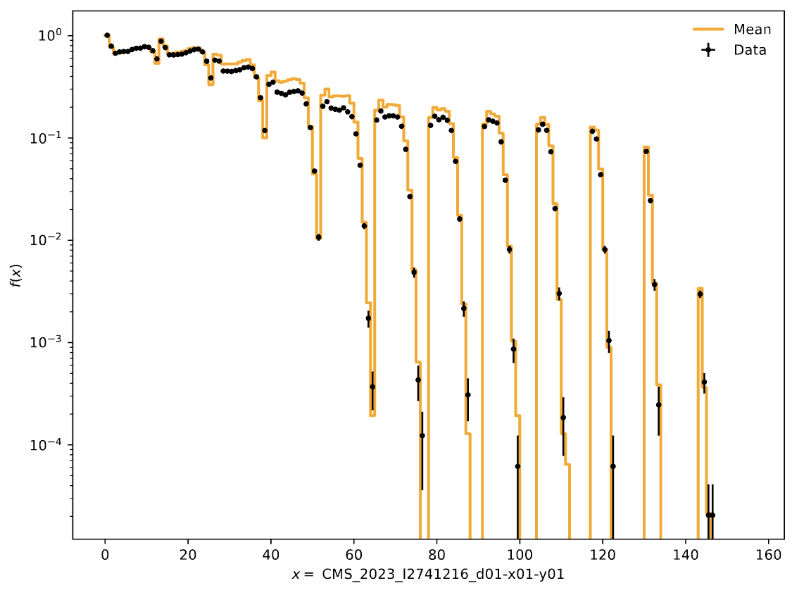
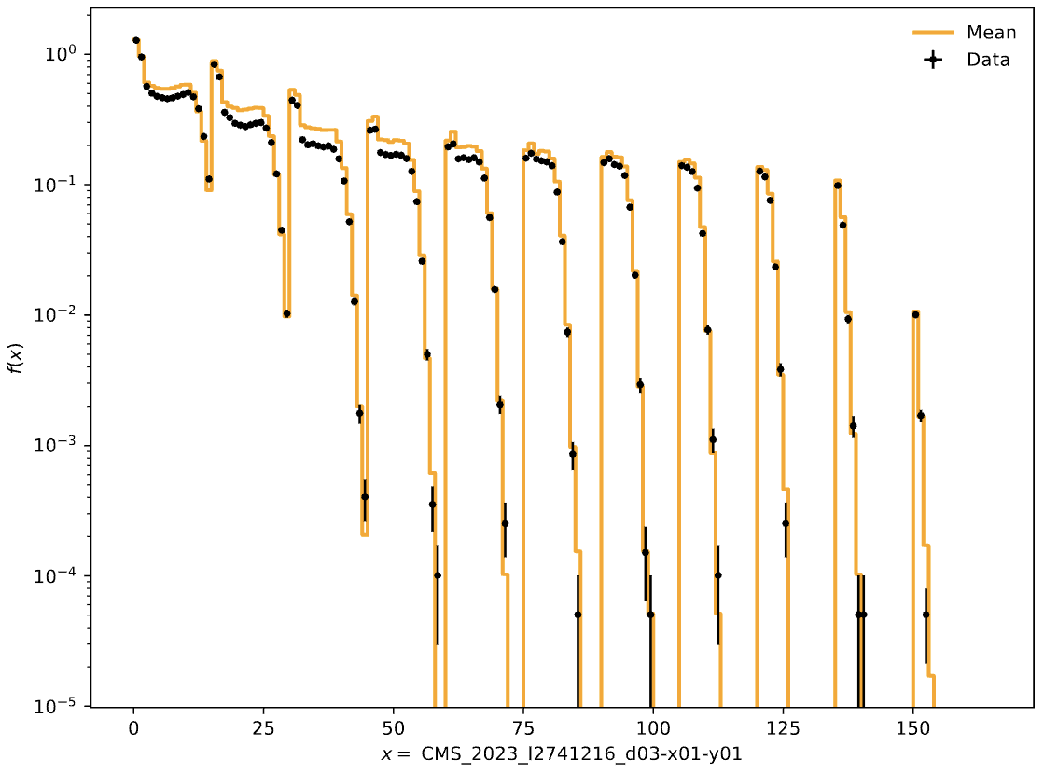
Envelopes for pT Cutoffs (Ak4 and Ak8 jets in that in order)
α_{s} ^{FSR}​(m_{Z}​) =0.12
α_{s} ^{FSR}​(m_{Z}​) = 0.13
α_{s} ^{FSR}​(m_{Z}​) = 0.14
Coverage gets worse
somehow!

Slide 11
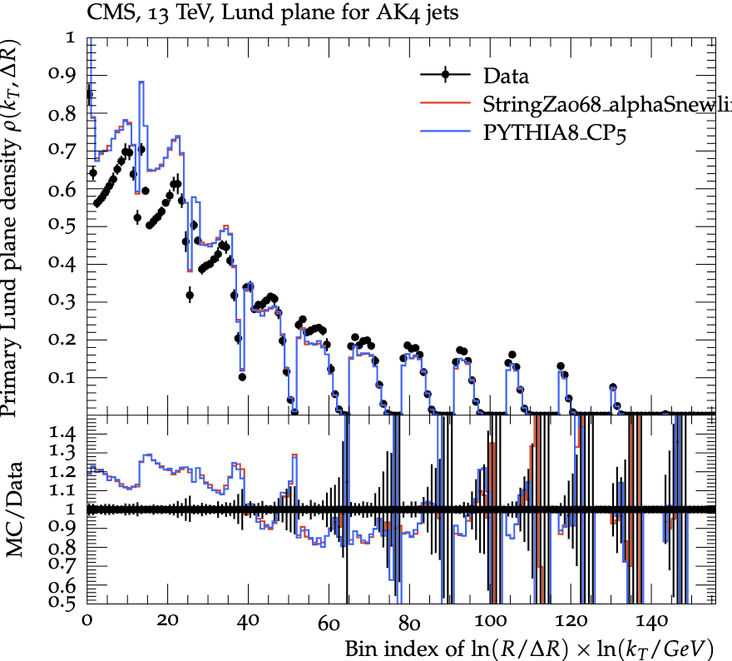
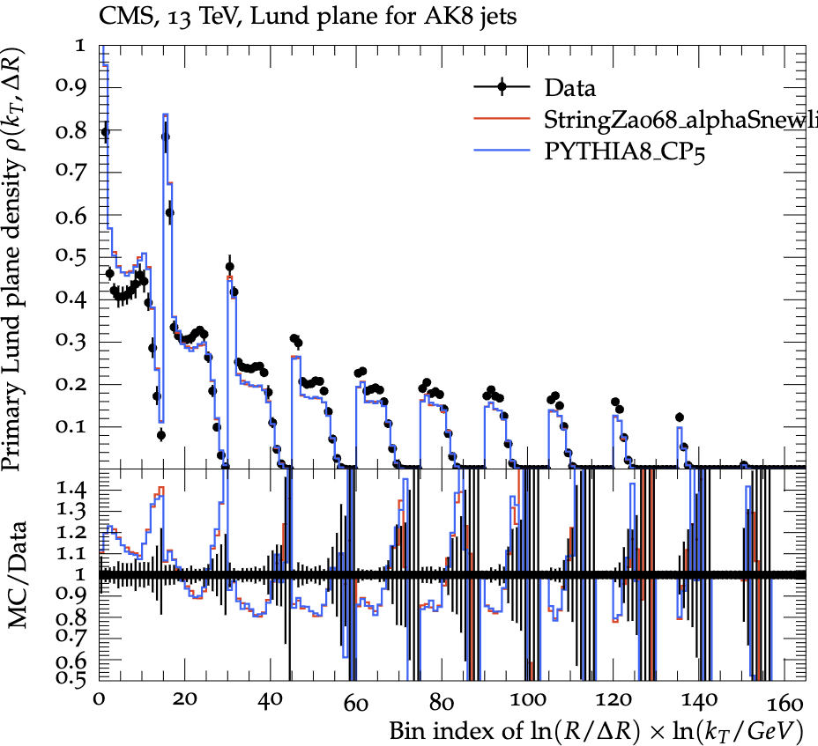
About Hadronization Parameter Tunes
When we tune the α_{s} ^{FSR}​(m_{Z}​) with the hadronization parameters (e.g StringZ:aLund) we get an “optimum” value of each tuned parameter, which may not be the ideal case!

Slide 12
Colour Reconnection Tunes

Slide 13
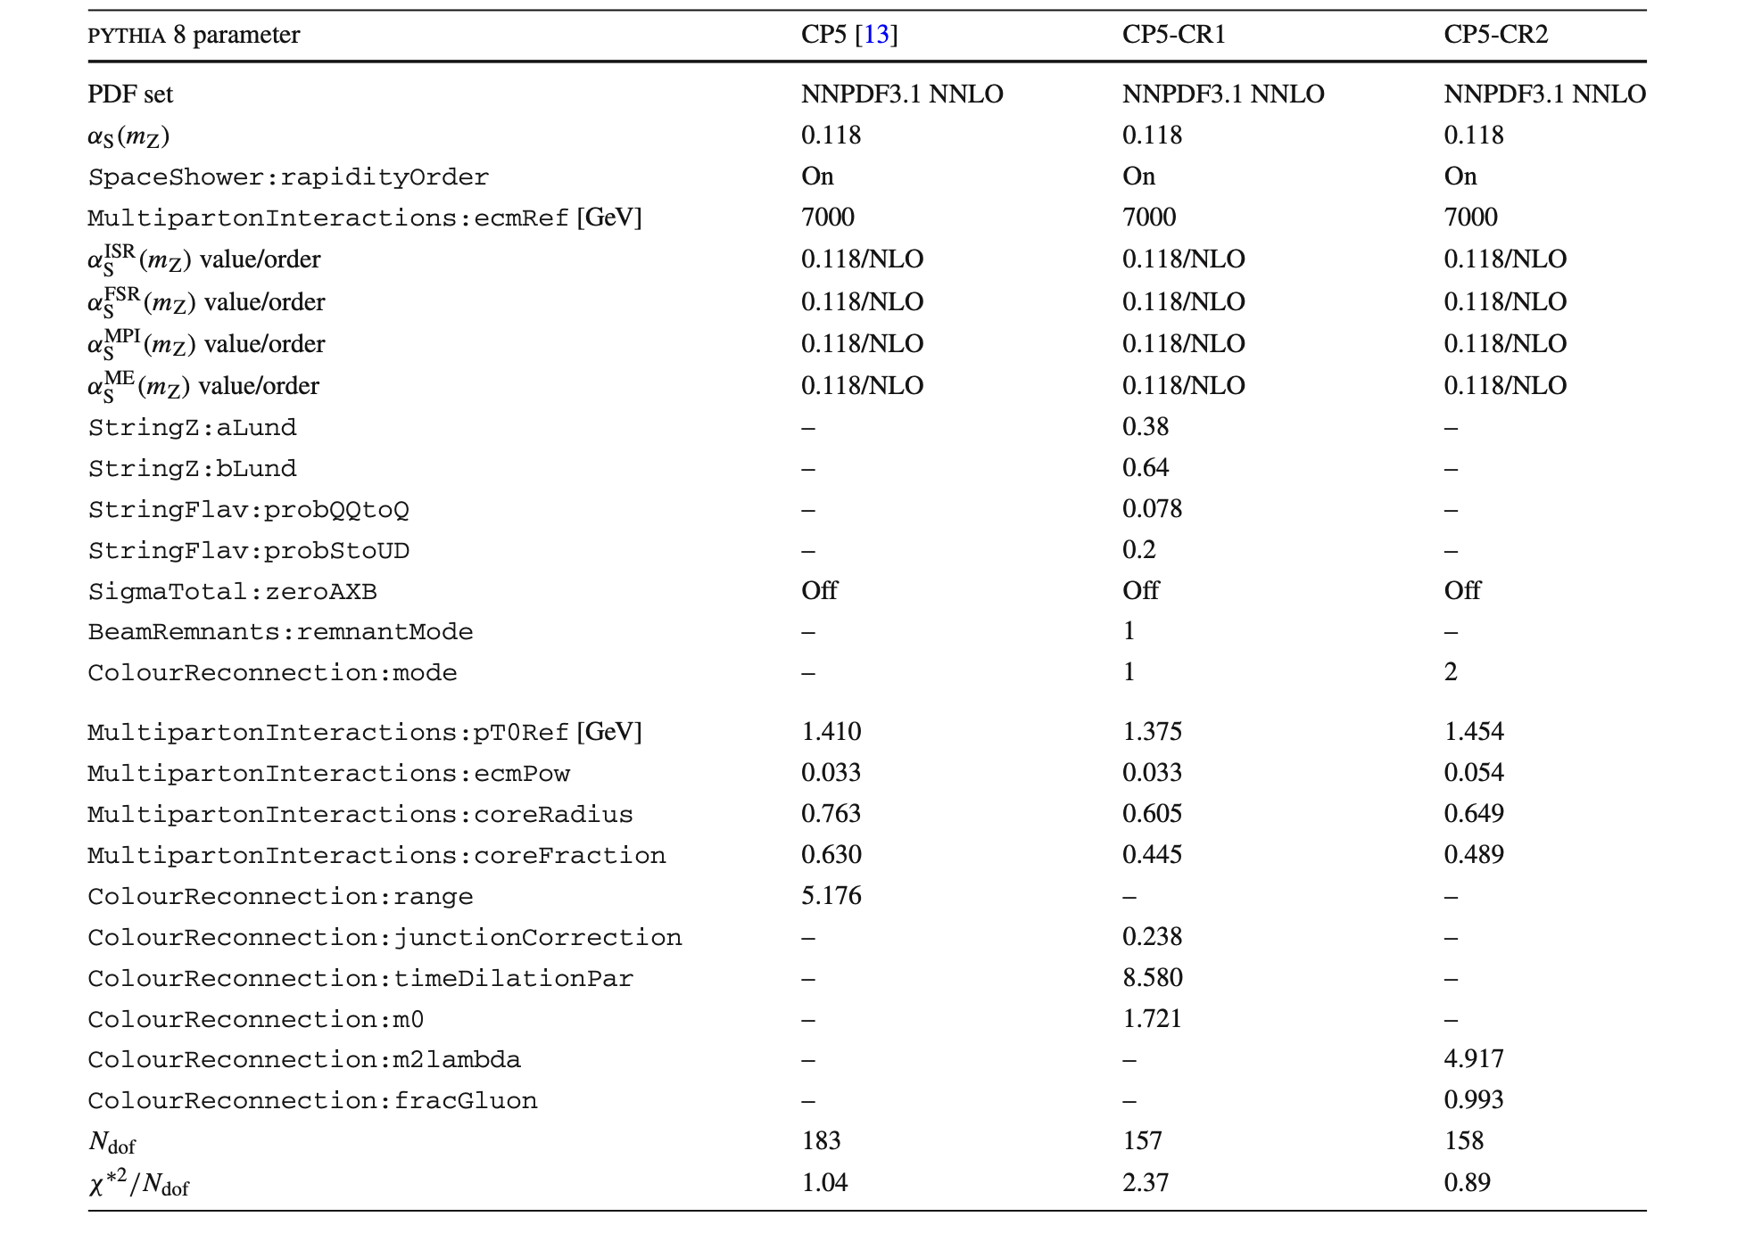

Colour Reconnection Tune Parameters
CR tunes

Slide 14
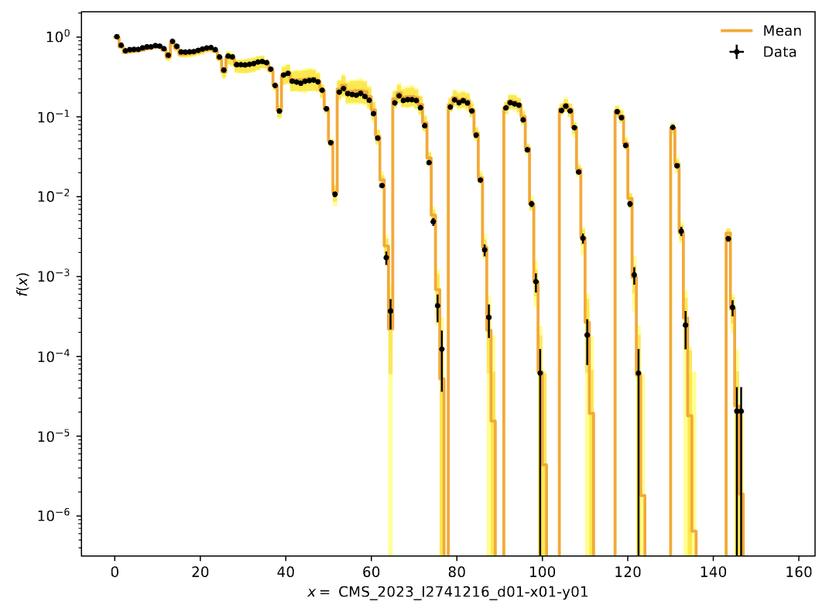
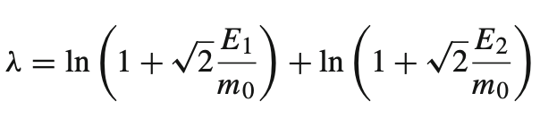
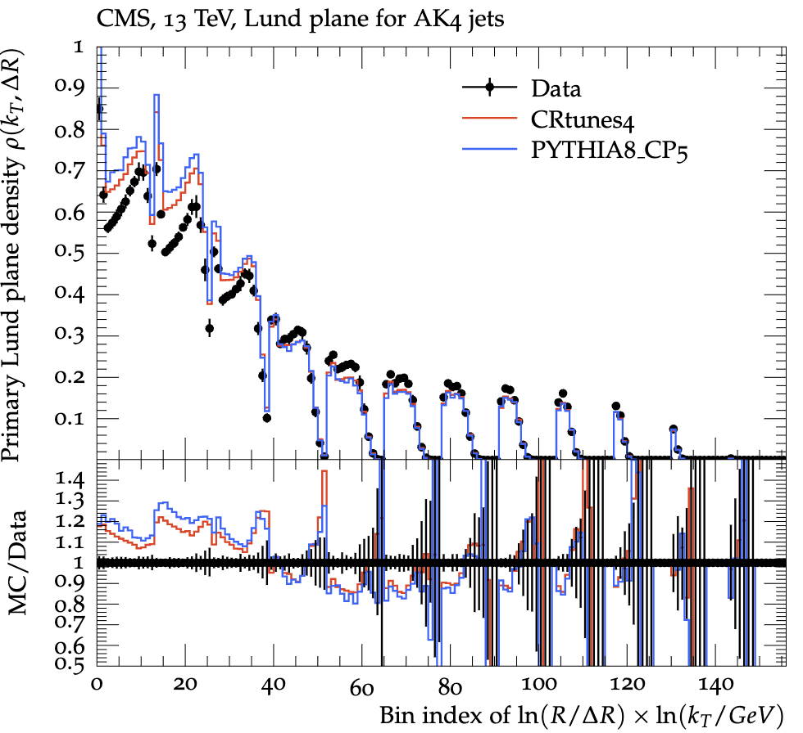
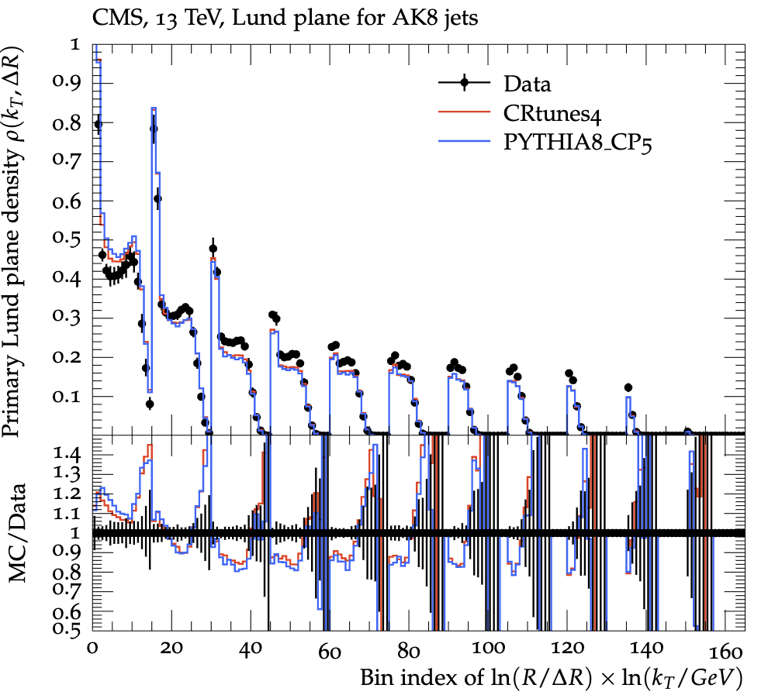
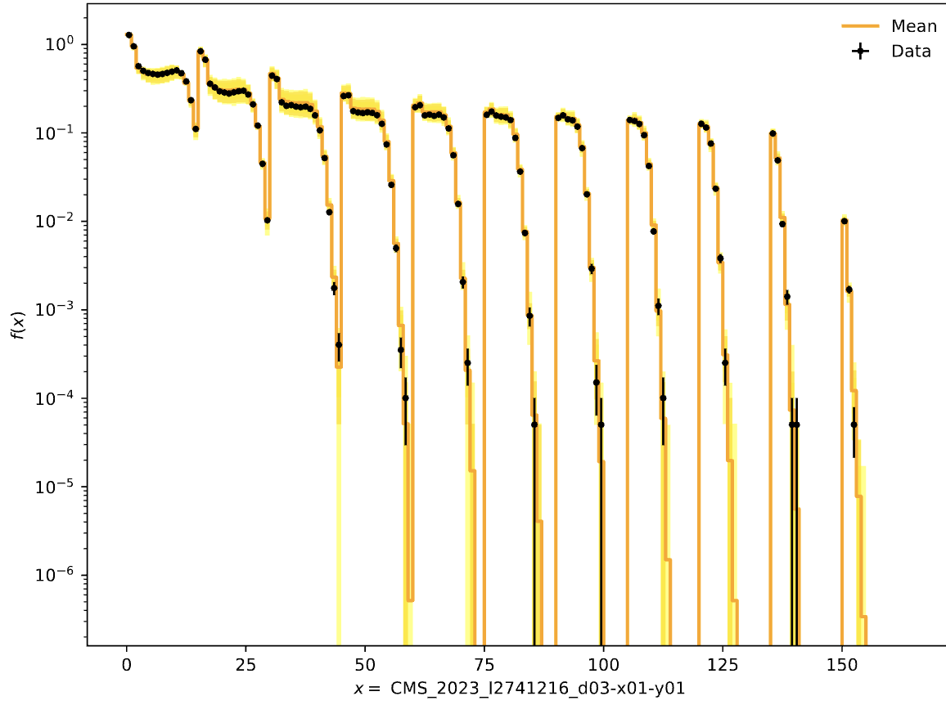
Colour Reconnection Tunes– CR1 QCD Inspired Model
Ak4 jets
Minimize total string length (also in CR2).
Better modeling of baryon production, influences how many particles, especially baryons are produced in each event.
α_{s} ^{FSR}​(m_{Z}​) range 0.1-0.165
α_{s} ^{FSR}​(m_{Z}​) = 0.121
Ak8 jets

Slide 15
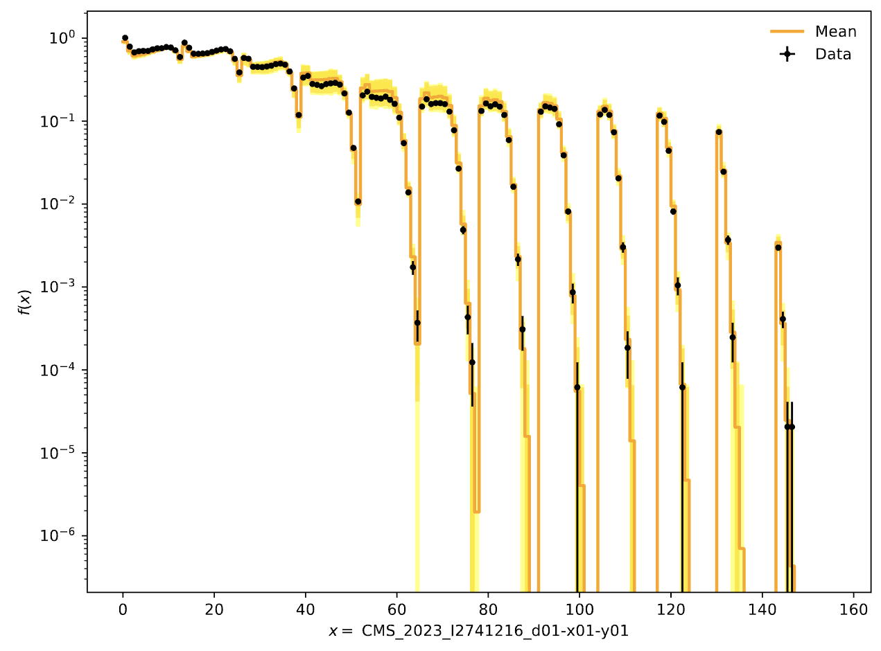
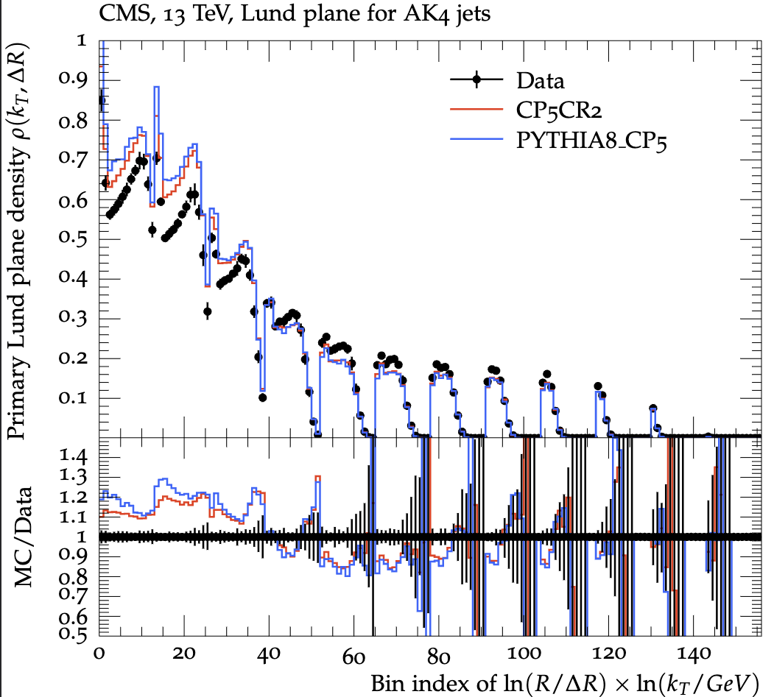

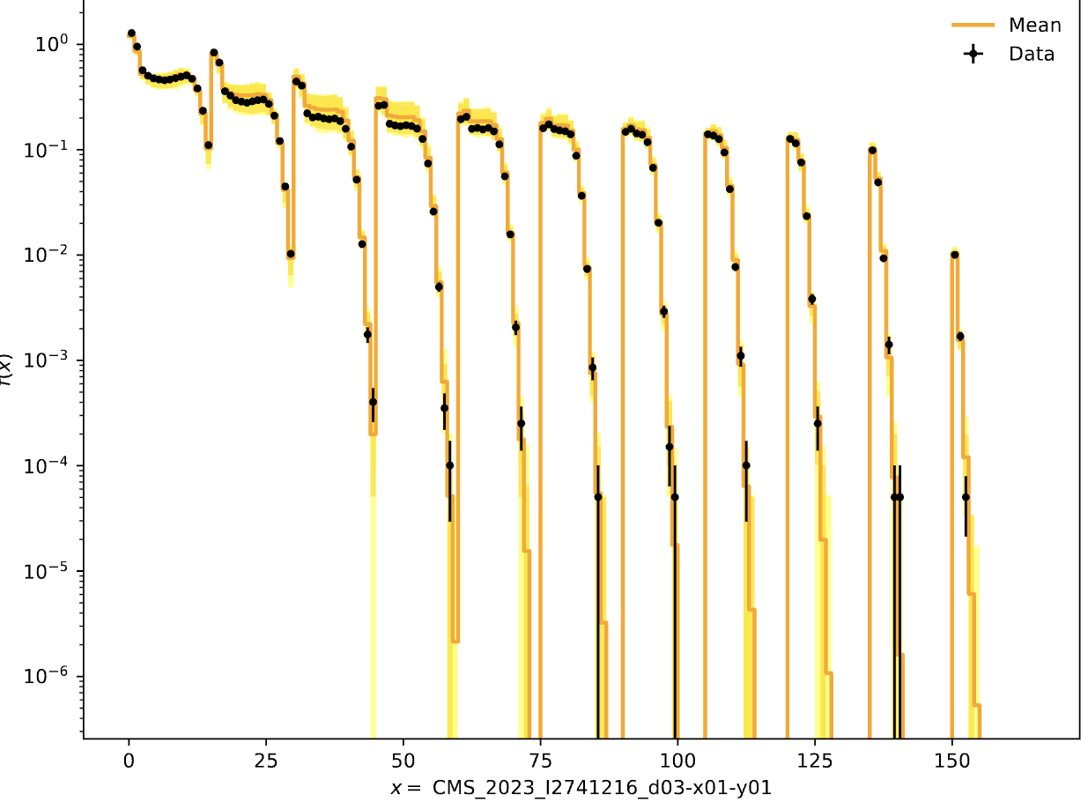
Colour Reconnection Tunes– CR2 Gluon move model
Ak4 jets
This model identifies gluons sitting between two partons.
It tries moving these gluons to another parton pair’s string if it reduces total string length.
α_{s} ^{FSR}​(m_{Z}​) range 0.1-0.165
α_{s} ^{FSR}​(m_{Z}​) = 0.120
Ak8 jets

Slide 16
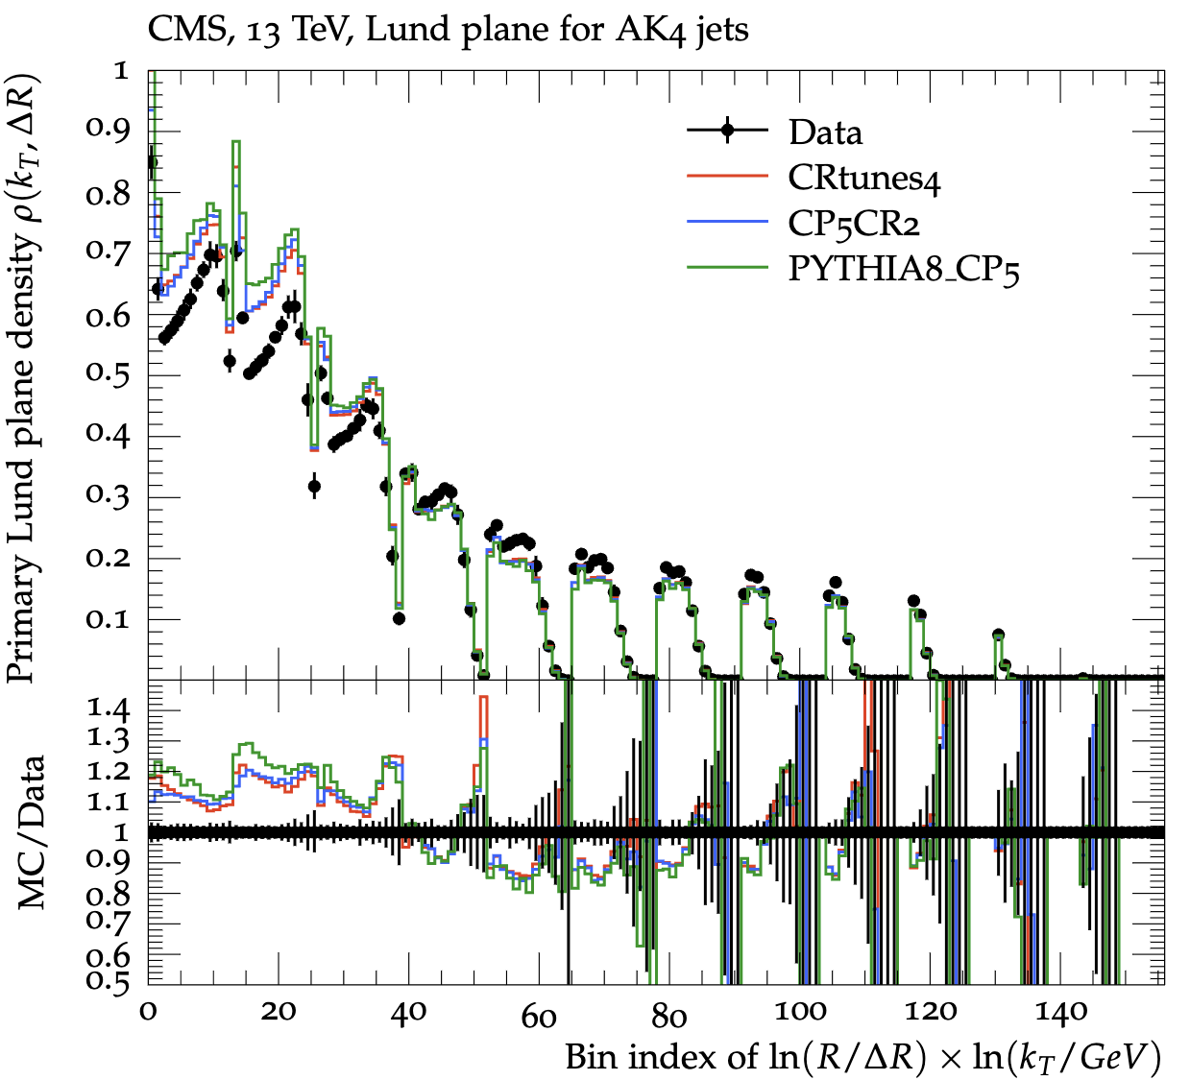
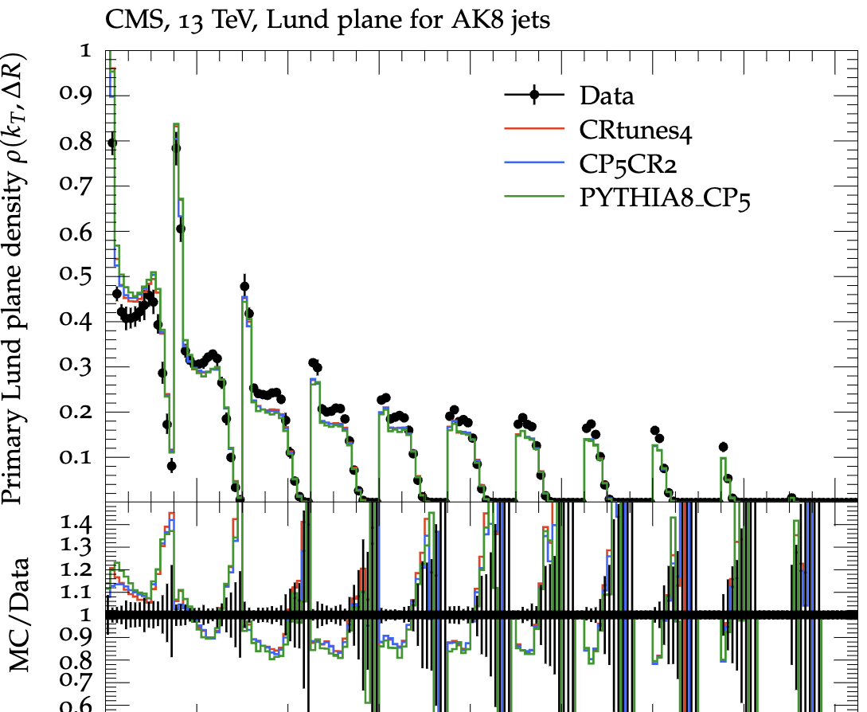
CR Tunes Comparison

Slide 17
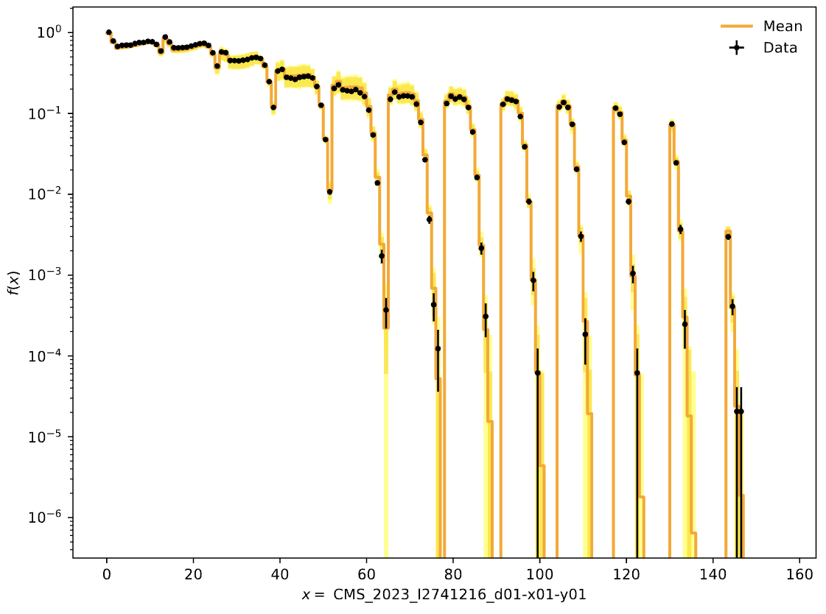
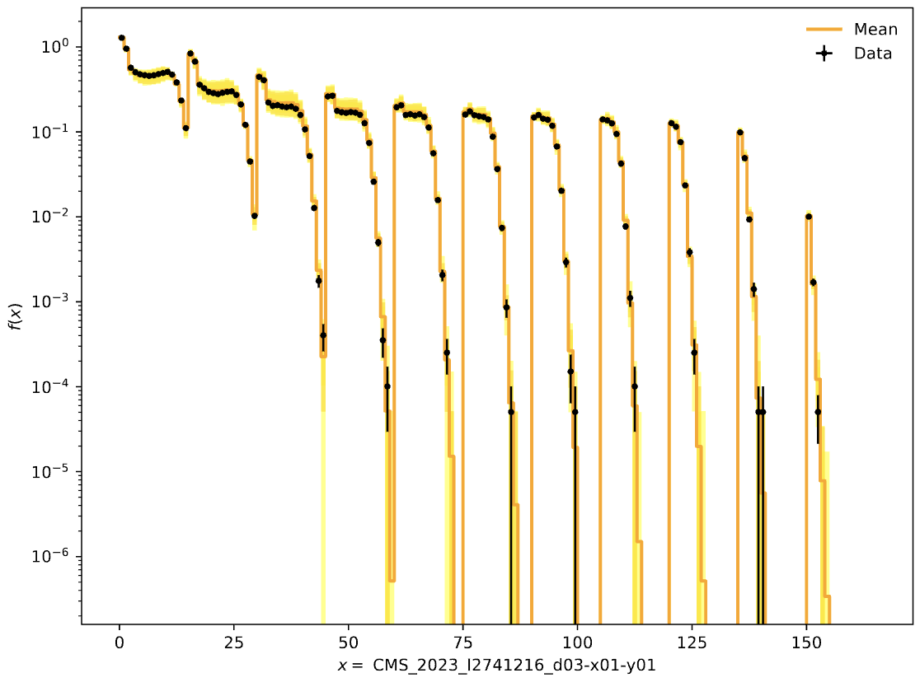
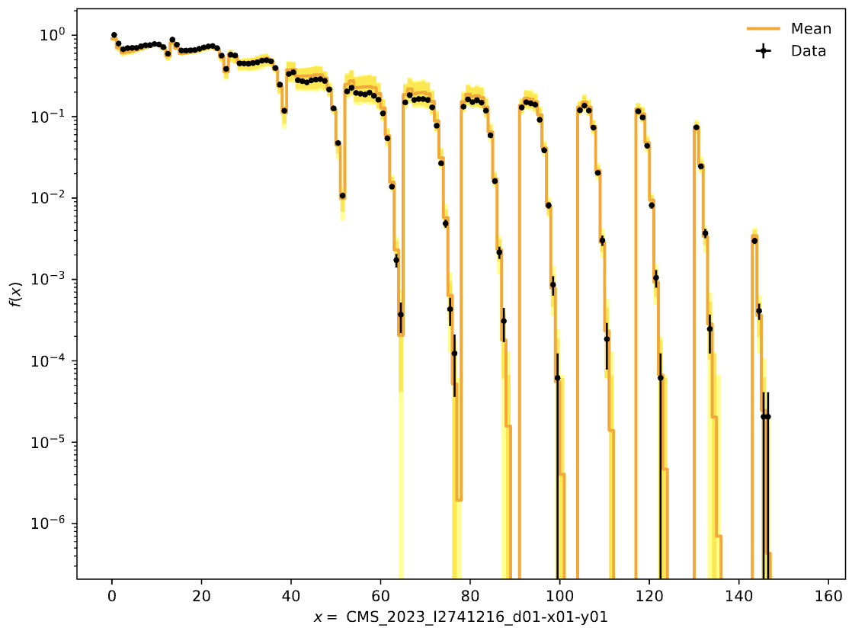
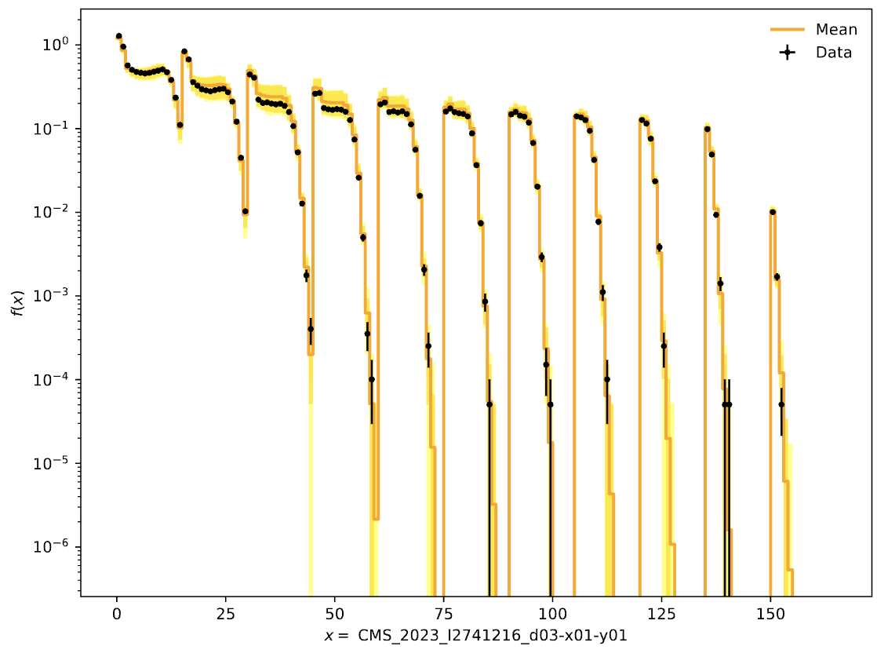
Envelopes
Ak4 jets for CR1
Ak8 jets for CR1
Ak4 jets for CR2
Ak8 jets for CR2

Slide 18
Ongoing Problems
For now, can’t go beyond α_{s}​(m_{Z}​)= 0.16, which is a problem if must “tune” this parameter with prof2
How to separate 1 measurement (Primary LP Density) into 2 observables (into separate jets)?
Can a custom Rivet analysis (.cc) be reliably used within CMSSW, or is standalone usage preferred?

