Slide 1
BSRH SW – now and in the future
Jan Pucek

Slide 2
Quick recap - BSRH
A device from the BSR family with higher complexity
  Two apertures (total 5 motors), three motorized mirrors (total 10 motors), glass plate with occulters (2 motors), several targets (one motorized, other on pneumatics), one camera coupled to an intensifier, four target cameras
Currently sharing the same light source as the BSRT (b2)
Designed for FT energy operation

Slide 3
Coronagraph – principle
1. Telescope – two lenses
2. Telescope with occulter
Occulter to block the ”core”
Aperture – creates diffraction
Aperture
3. Coronagraph
Telescope provides an image of an object
In case of measuring low intensity tails, the occulter is not sufficient – diffraction created at the aperture will disturb the image
Coronagraph is an “enhanced” telescope that uses “field” lens to image the aperture on the Lyot’s stop – blocking the diffraction of the aperture
Lyot’s stop
Field lens to image the aperture onto the “eyepiece” lens

Slide 4
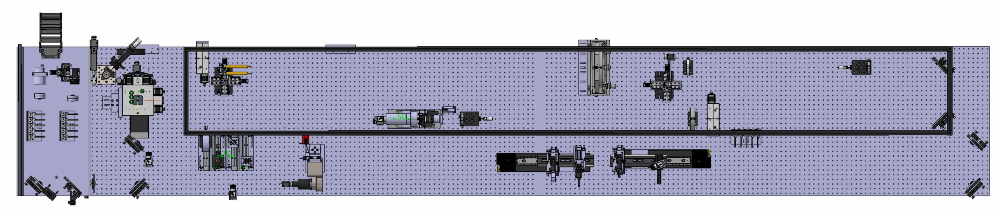
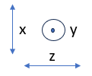
Current layout – Beam 2
Occulter (masks)
Readout camera
Lyot’s stop
Light in
Splitter
Possible configurations:
Regular telescope – imaging the SR
Telescope with occulter – masking the core enables longer exposure time/gain
Coronagraph – diffraction from the beam mirror can be mitigated

Slide 5
Current operation
After reaching FT, verify alignment, close apertures accordingly
Take reference data
Insert occulter
Start measurement
When beam charge ∆ ≈ 10% then retake reference data

Slide 6
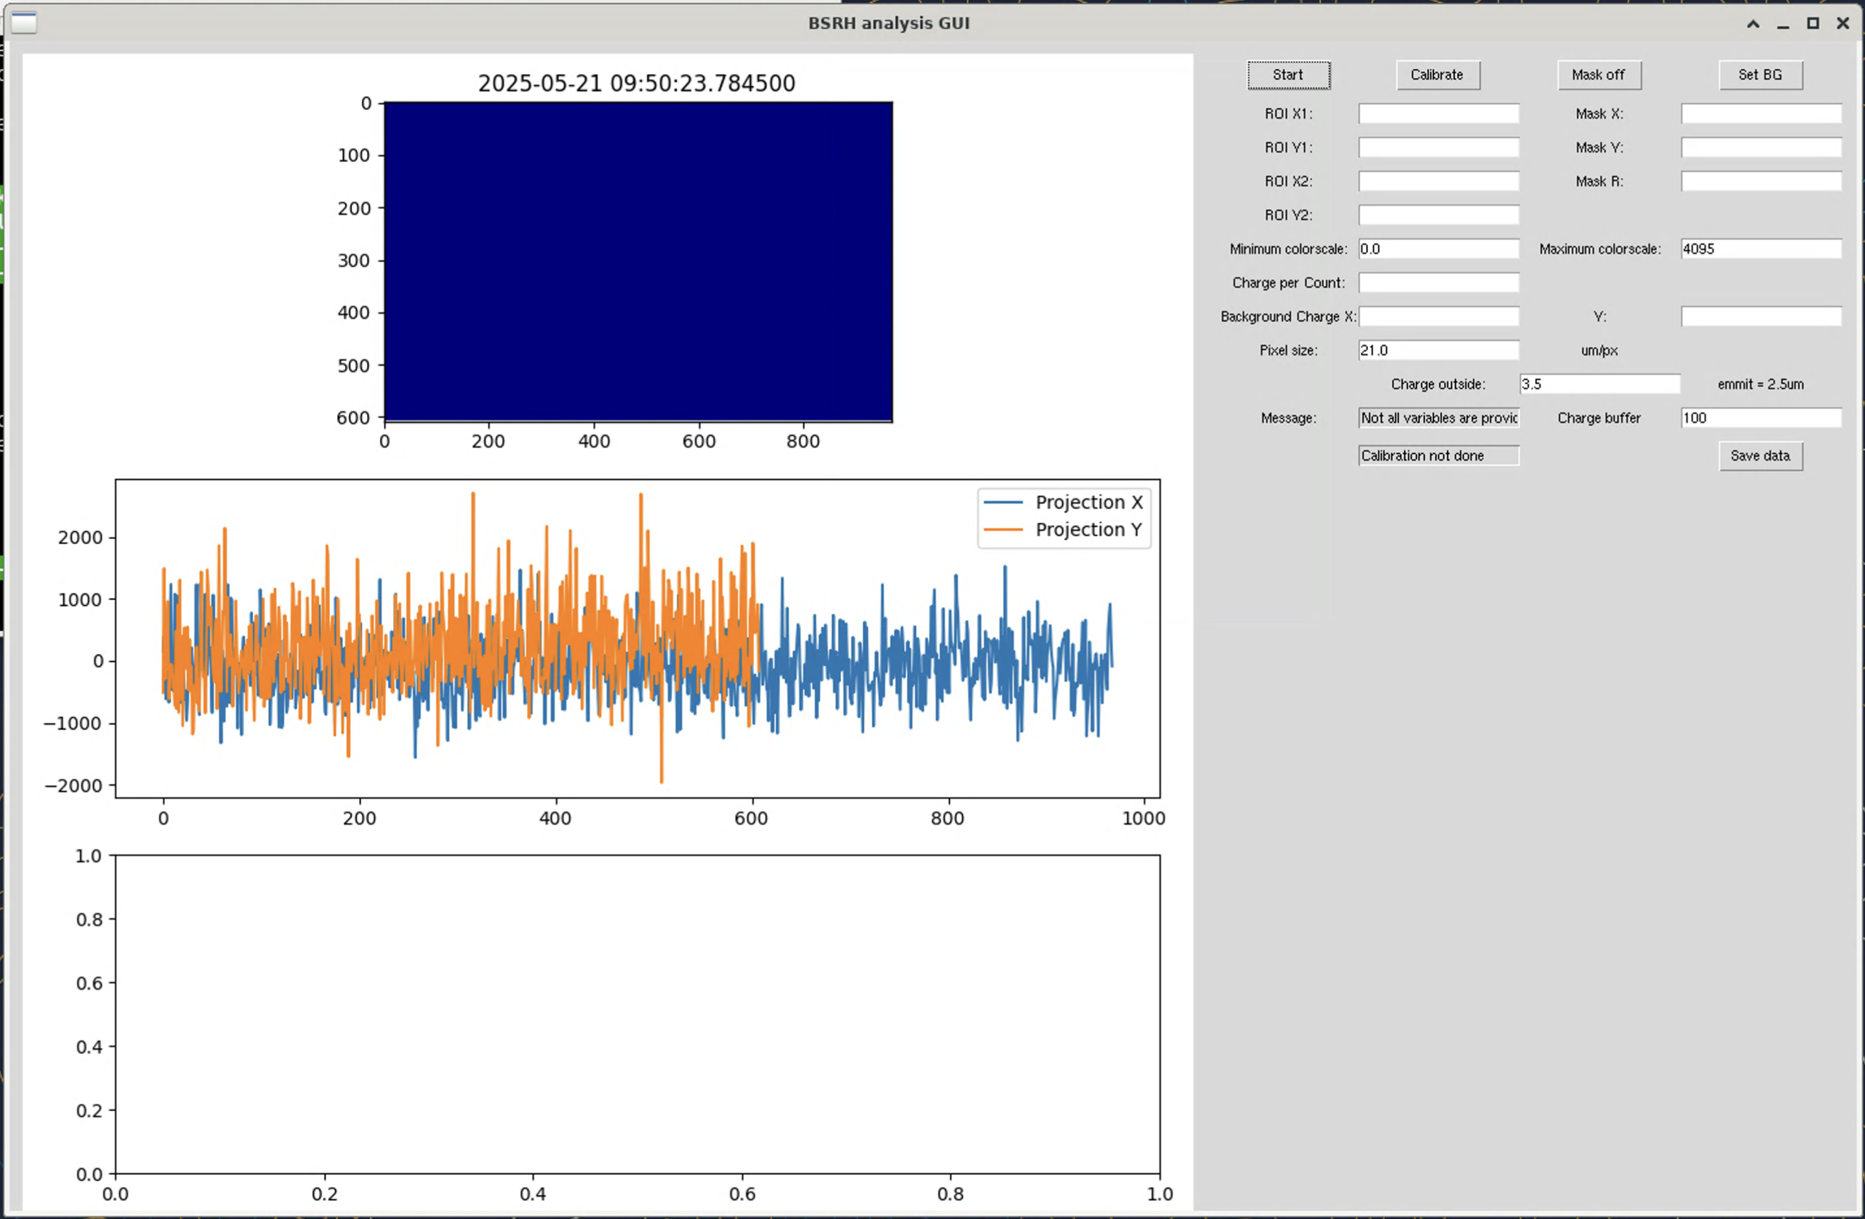
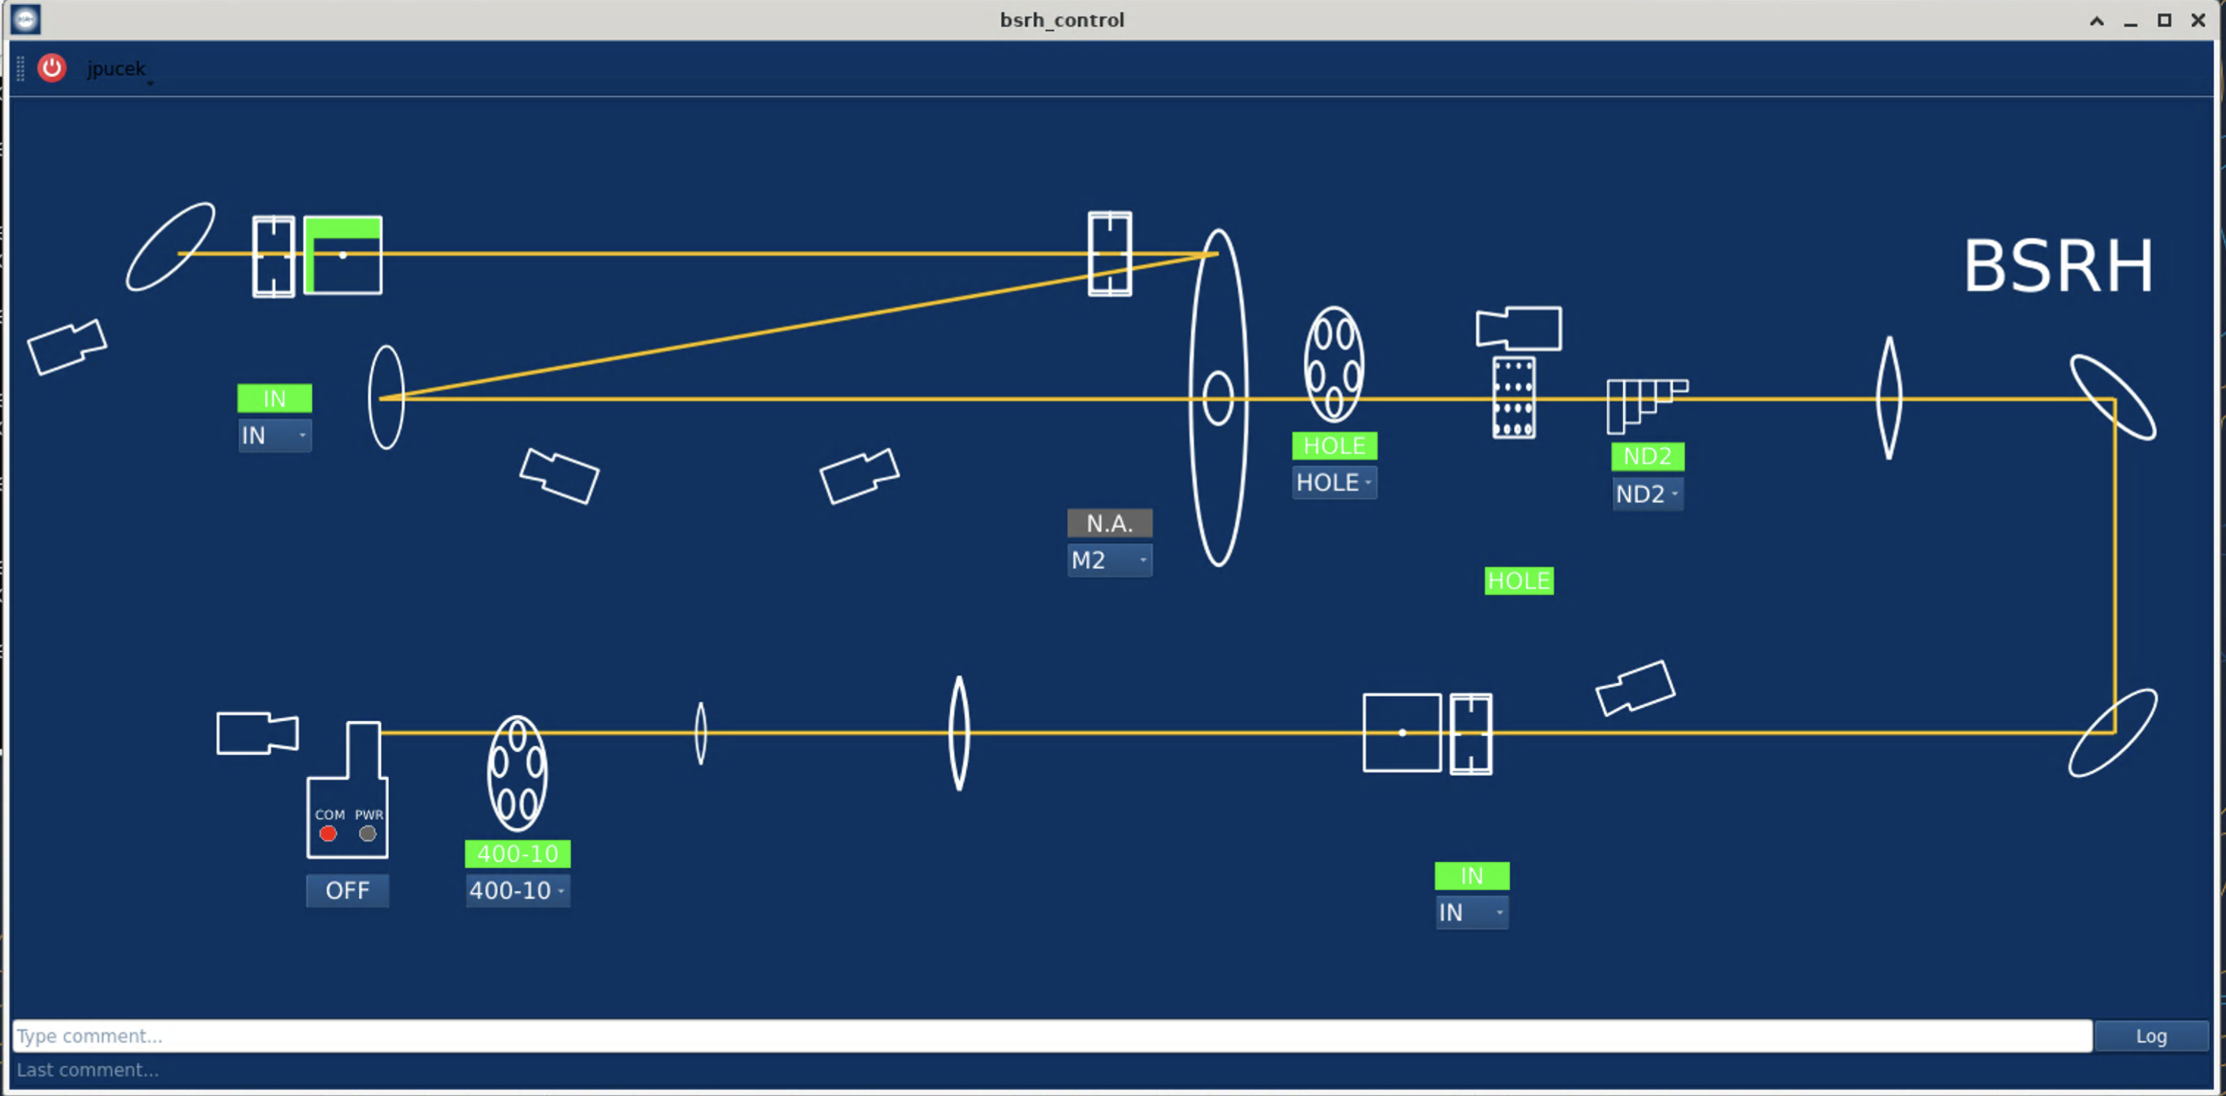
Current operation tools
GUI – overview of the whole instrument, online analysis tool
Scripts – alignment (to be finished), acquisition/data saving
BTVDC runs the main camera, basler_rda_server runs all others

Slide 7
Current needs
*the system might change, the following is necessary no matter the design
Acquisition system – running at 10Hz, 550kB/image -> 5.5MB/sec for 8 hours (MD duration) or profiles during operation
  Currently save on nfs (80GB per MD)…
  Lot of the data could be omitted (no change in motor position etc.)
    Currently using JAPC getParam instead of subscriptions
Hardware control – camera + intensifier (for bunch scan), analysis interface (offload to UCAP?)
Done

Slide 8
Future needs
Complete interface with the instrument – stepper motor control, calibration procedure, data taking procedure
  FESA?

