Slide 1
HL-LHC DE-CABLING PREPARATION
Status and Next Steps
23/05/2025
Georgi GEORGIEV, Javier PARA EN-EL
Indico

Slide 2
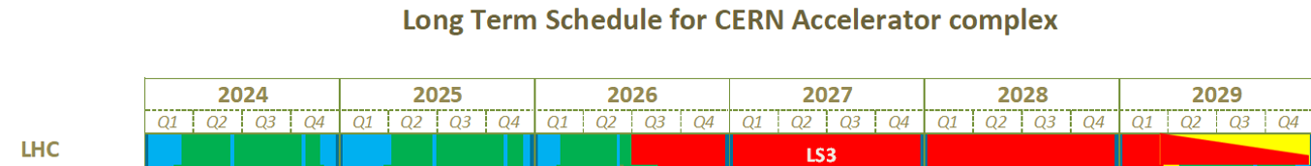

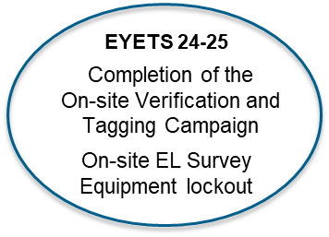
Timeline
We are here
Beginning of the de-cabling
Progressive Equipment Lockout by the Groups
Progressive Disconnection and labeling by the Groups
See slide 3, 4 and 5
See slide 6 and 7
EDMS approval of
Equipment to be locked out by the Groups
Final Cable lists for LS3
1778 equipment identified
During the survey
HL-LHC: 5,3k cables , 594,2 km
Forward Physics: 1043 cables, 188 km
Total: 6343 cables, 782.2 km
On-site confirmation of
Equipment to be locked out
by the Groups
See slide 3, 4 and 5
Completed
Office verification of
Equipment to be locked out
by the Groups
Works to be carried out by the Groups ahead
DECs to be updated on EDMS:
SY-BI P1 EDMS 2806307 and P5 EDMS 2909129
EN-EL EPM P5 EDMS 2806334
Action EN-EL, HL-LHC. To be signed by SY-BI and EN-EL

Slide 3
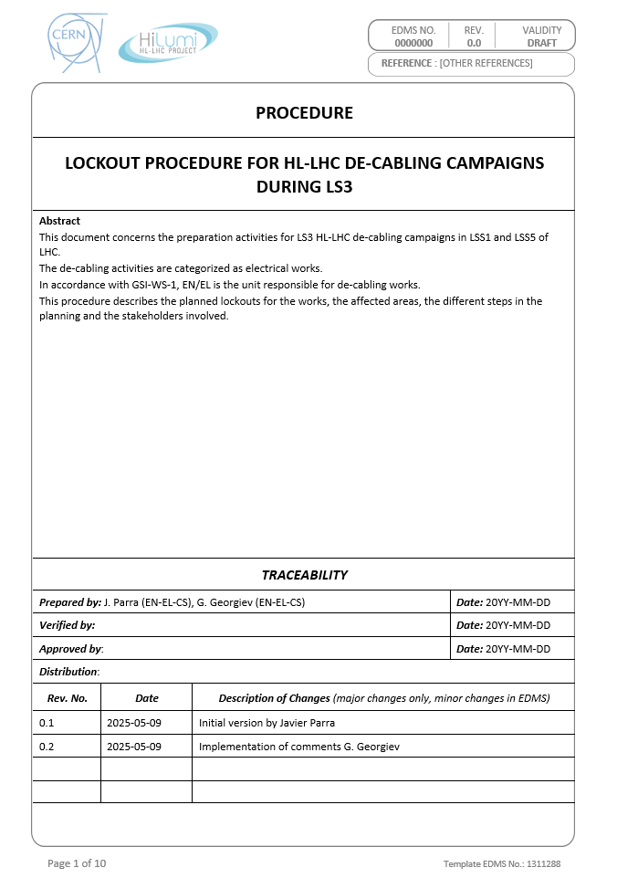
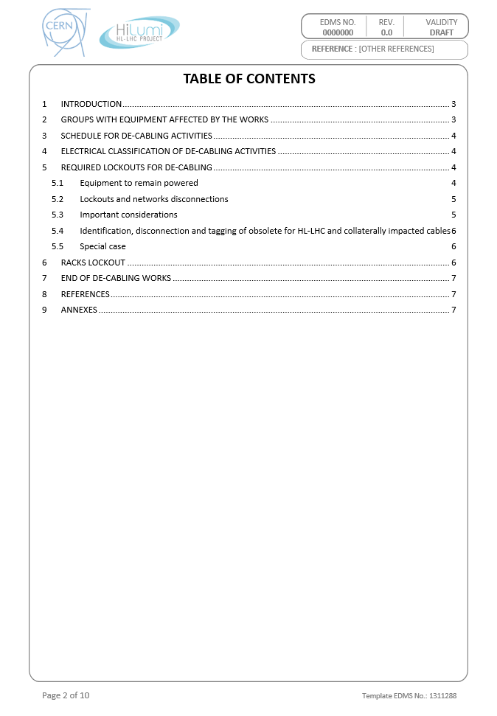
LOCKOUT PROCEDURE FOR HL-LHC DE-CABLING 1/3
"Standard" LHC Machine lockout + additional specific lockouts for de-cabling
Inventory of 1778 equipment for both points by EN-EL
EDMS 3302715

Slide 4
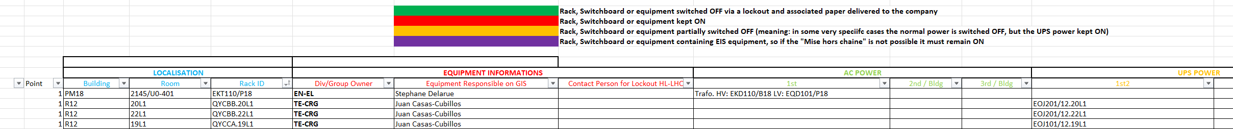
LOCKOUT PROCEDURE FOR HL-LHC DE-CABLING 2/3
Office verification of Equipment to be locked out
by the Groups to complete before YETS25-26:
Validation of the equipment ownership
Validation of the power supply
Identification of the Equipment which must remain powered during de-cabling
EDMS 3302715
On-site confirmation of Equipment to be locked out
by the Groups to complete during YETS25-26:
Validation of the information from the ‘Office verification’
Clear doubts
Formal EDMS approval of the Equipment list to be locked out by the Groups - April 2026.

Slide 5
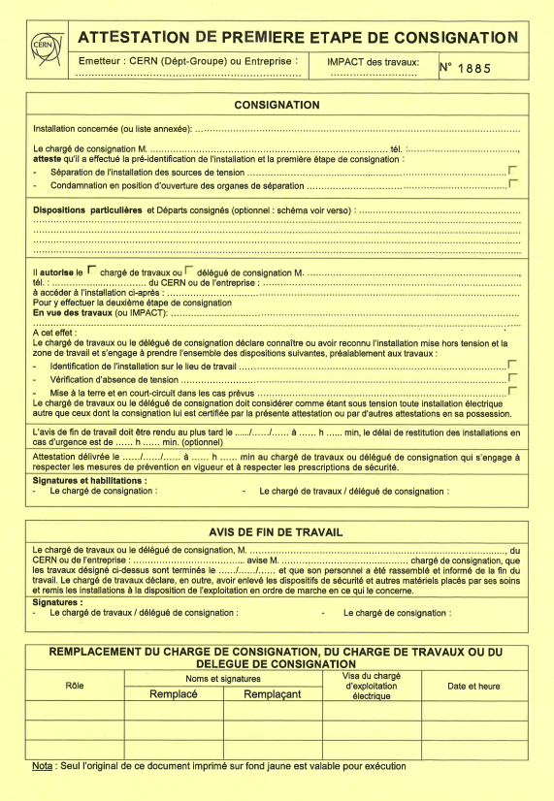
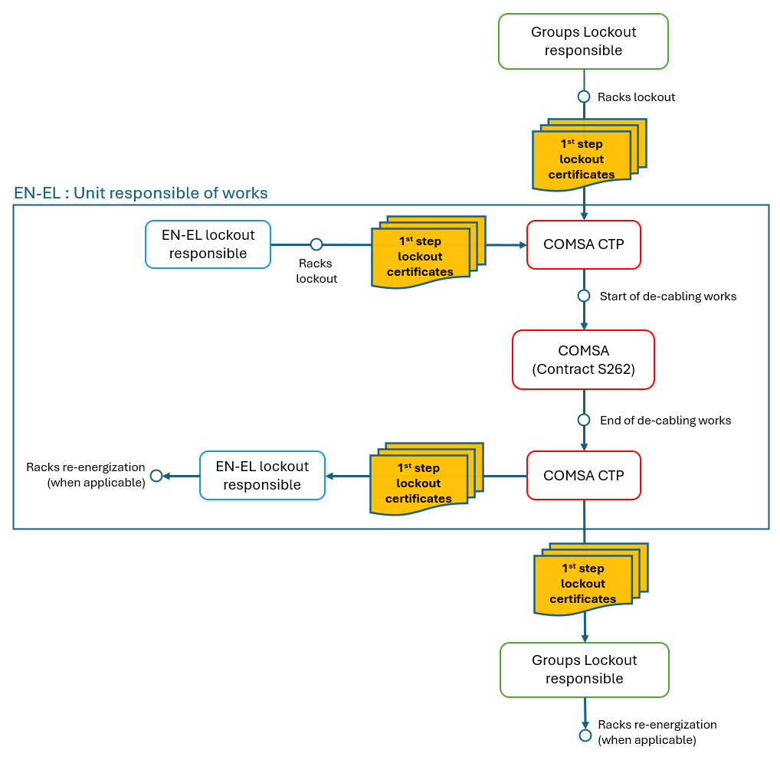
LOCKOUT PROCEDURE FOR HL-LHC DE-CABLING 3/3
EDMS 3302714
Exchange of lockout certificates workflow
Certificates to be delivered from the EL Lockout responsible to CTP/ EL Contractor
Higher level than Groups equipment
When possible
Certificates to be delivered from the Lockout responsible to CTP/ EL Contractor
Not required
As 1778 equipment to be locked out
physically impossible in a single day
To be planned progressively before the start of de-cabling
Synergy with cables disconnection and tagging (See slide 6)
Certificates returned to the Lockout responsible
Certificates returned to the EL Lockout responsible

Slide 6
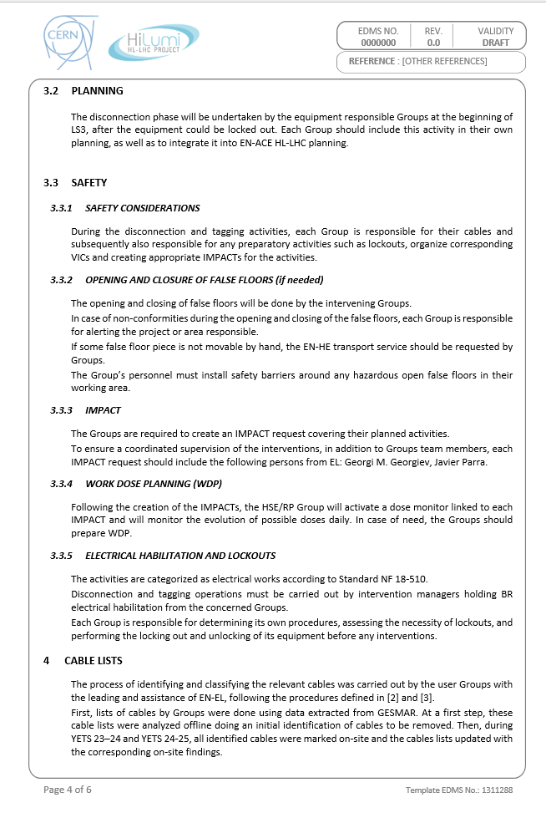
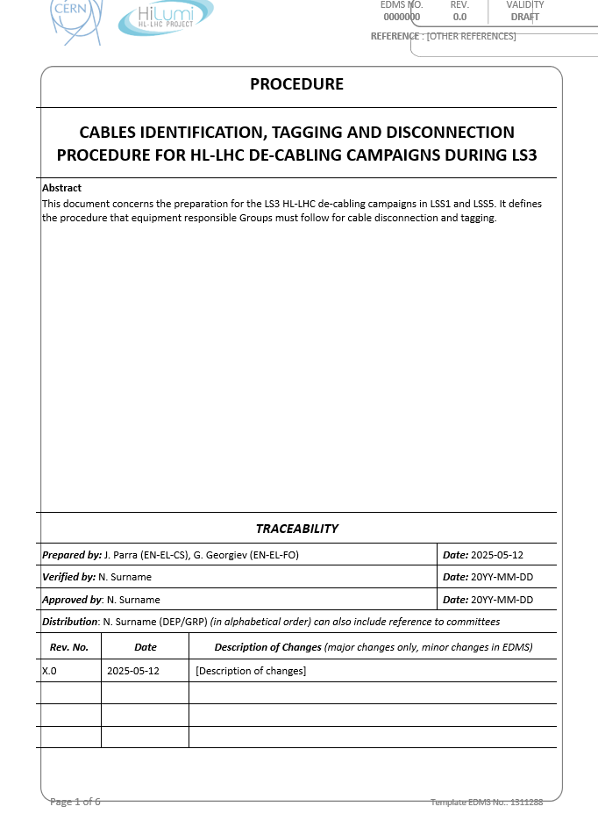
Labelling and disconnection procedure HL-LHC 1/2
EDMS 3302714
Groups are responsible for their own safety:
  Planning
  Lockout for disconnection and tagging
  Electrical accreditation of the collaborators
  IMPACT
  VIC
  WDP
  False floor
IMPORTANT!!!

Slide 7
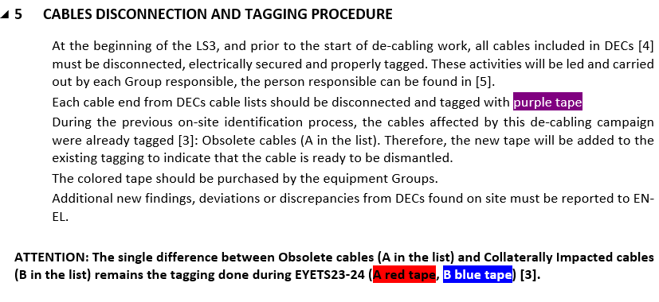
Labelling and disconnection procedure HL-LHC 2/2
EDMS 3302714
  Cables must be disconnected in the both ends
  Cables must be marked with PURPLE tape in both ends
  Power cables must be secured (MALTCC)
  The cable list must be updated and communicated regularly to EN-EL (Javier PARRA) for final approval before the start of the de-cabling
  To be done progressively by the groups before the start of de-cabling
!
  The PURPLE tape marking is in addition to the RED and BLUE tagging done during EYETS23-24.
  If you find an error on this tagging, please correct it and communicate the change to EN-EL (Javier PARRA)

Slide 8
take-home message
HL-LHC need the strong commitment of the lock-out responsible of the Groups for:
  Office verification of Equipment to be locked out
  On-site confirmation of Equipment to be locked out
  Planning for Equipment lockout and Disconnection and labeling
  EDMS approval of Equipment to be locked out
  The Lockout, Disconnection and labeling must be completed before the beginning of the de-cabling

Slide 9
Thank you for your attention!

