Slide 1
Revision of the LHC Helium WG Recommendations for post LS3 period
Summary for TCC, with remaining slides as complements
S. Claudet, as Chair for this exercise
14-May-2025, ATS General Safety Meeting
https://indico.cern.ch/category/9599/
EDMS#3503566

Slide 2
CONTENT
Mandate, meetings, documentation repository
Brief recall HL-LHC context, ODH-spill key elements, documentation and procedures in place, REX
Cases identified and studied by the wg:
- Cool-down
- Powering
- Intervention for HL triplets
Other cases (Wup, Cmg, CrabCav...)
Summary of recommendations
+ list of documents/text/drawings to be updated
Complements: ODH detectors in UR galleries, sector door at P5, possible interface with LHC Ventilation wg, possible link of workframe authorisations with IMPACT tool

Slide 3
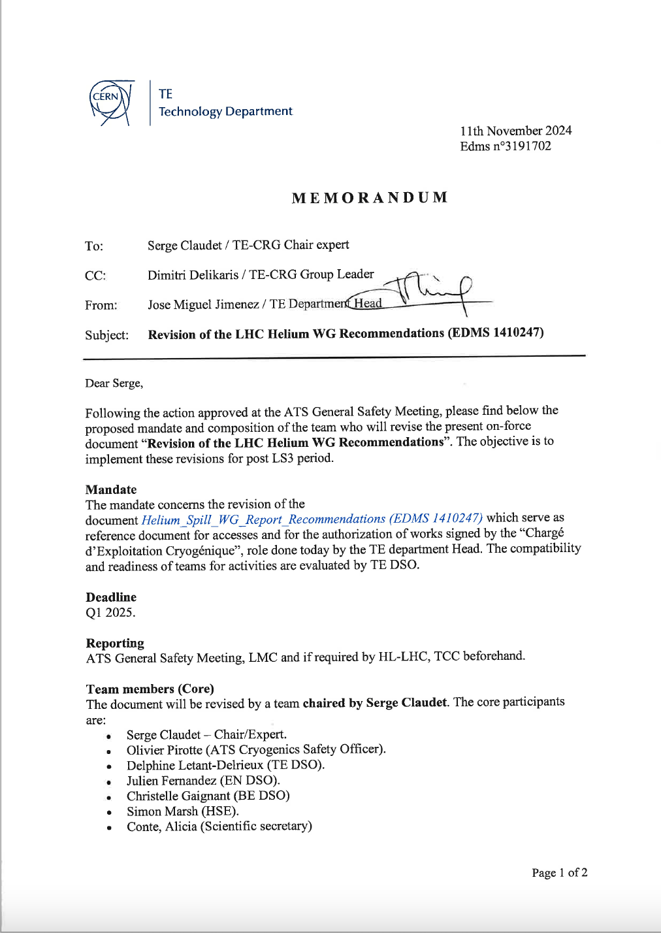
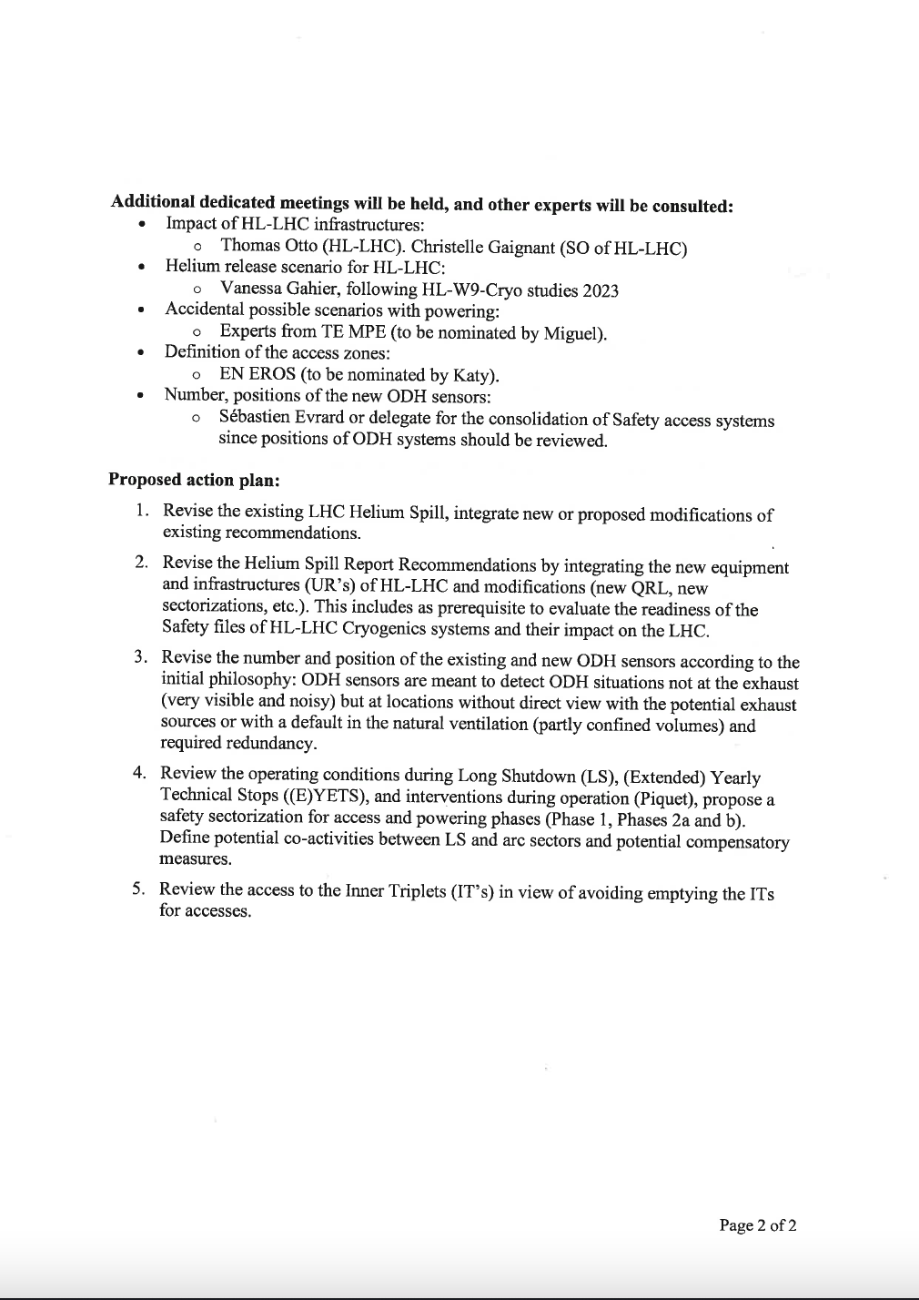
Mandate
EDMS#3191702
Thanks to all for very active
and knowledgeable contributions!

Slide 4
Some element of context & some references
Some element of context:
- LHC event in sector 34 (2008)
- WG on suppression or mitigation of the Helium spill (2014)
- Activities in sensitive areas for He spill in LHC below 80K (2016)
- He spill WG recommendations (2018)
=> HL-LHC infrastructure to be installed during LS3
Some Key Reference Documents:
EDMS 1410247 : Helium Spill Working Group Recommendations
EDMS 1406764 : Activities in Sensitive Areas for Helium spill in Accelerators below 80 K (+ Annex)
EDMS 2843277 : Access to HL-LHC LSS or LHC Arc during during Cool-down, Warm-up and Powering Phases
Recall of all valid documents (reference, access constraints) by:
- CSOC
- TE-DSO

Slide 5
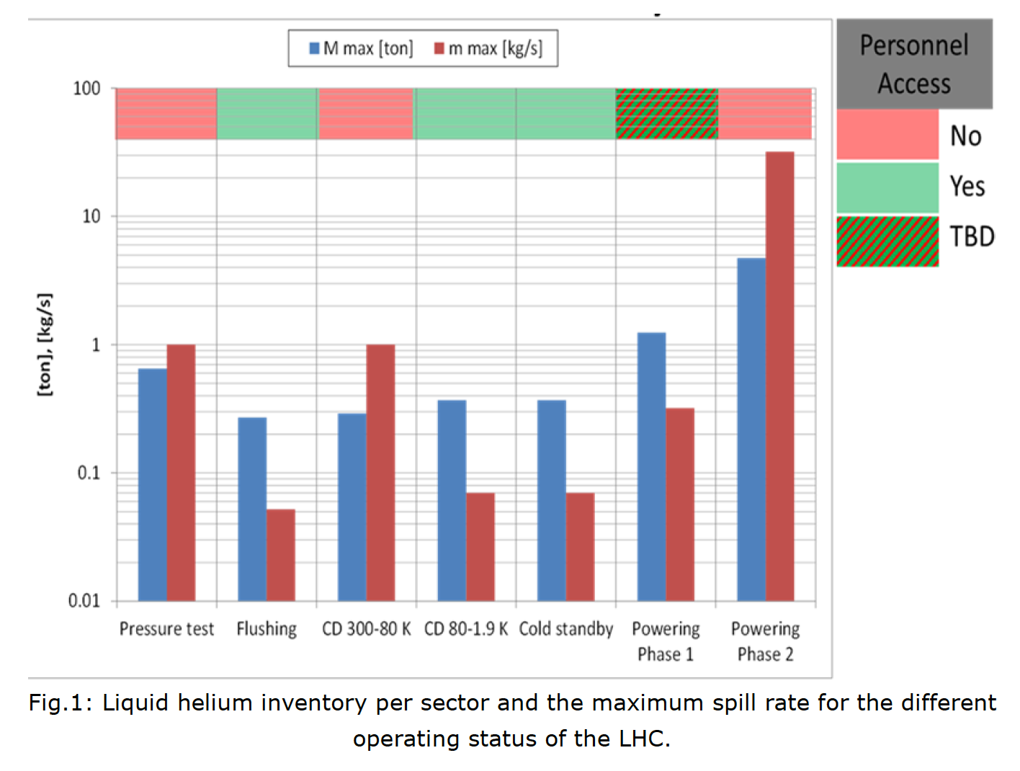
He spill WG, Rates & Inventory, EDMS#1410247
Helium spill tests performed to benchmark simulations, at various rates defined according to operating modes, with He spill WG recommendations to ATSMB for approval
Operation at cold: considered low probability
access allowed
< 100 g/s: Rupture of an instrumentation tube
"Only a human mistake can provoke such a spill"
< 320 g/s: Hole due to 30kJ arc
corresponding to "Powering Ph1a"
<1 kg/s: Rupture of a pipe or 100kJ arc (1kA)
could happen during P_test, Cool-down 300-80K, Powering Ph1b (Ph2 arc at 12kA <=> 30kg/s)
cf extract:
Rmk: safe access to LHC when granted, with slow ODH propagation compatible with normal/walking evacuation

Slide 6
He spill WG, Rates & Inventory, EDMS#1410247
Helium spill tests performed to benchmark simulations, at various rates defined according to operating modes, with He spill WG recommendations to ATSMB for approval
2.2.2 Helium Spill @ 100 g/s | 2.2.3 Helium Spill @ 320 g/s | 2.2.1 Helium Spill @ 1 kg/s
The oxygen content in the tunnel is nowhere lower than 19% except for the area directly next to the spill point (11%). At a distance of 10 meter from the spill point the oxygen content at 50 cm from floor level is already more than 19%, while this value is also reached at the 1.75 meter from floor level at a distance of 20 meter from the spill point. The given values are valid for the direction downstream of the spill point (with reference to the ventilation flow), while the oxygen content in the upstream direction stays on values above 19% at already a distance of 10 meter from the spill point. | The results of these tests under nominal tunnel conditions scale in a first approximation with the Spilling rate (extrapolation from Helium Spill Tests at 100 and 250 g/s). The volume close to the floor remains safe if at more than a 100 m from the Helium Spill location. | Oxygen deficiency propagates on entire tunnel cross-section, both in the horizontal and vertical planes. All oxygen deficiency detectors triggered, including farthest one at 200 meters and 0.3 m height.
2.3.3 No risk at 100 g/s and below | 2.3.2 Moderate risk at 320 g/s | 2.3.1 Significant risk with 1 kg/s and higher
Below 100 g/s, the measurements have shown that the oxygen concentration always remains higher than 19% and that the temperature variations remain acceptable for a short period of time, the maximum variation measured was of 10 K. The measurements upstream regarding the ventilation show no impact of the helium spill. | In the presence of a helium spill of 320 g/s or below, the risk of oxygen deficiency does not expand far from the spilling point. The oxygen concentration close to the floor is higher than 18%. The presence of a “safe” volume close to the floor is therefore granted. The measurements upstream of the release point regarding the ventilation show no impact of the helium spill. | In presence of a helium spill of 1 kg/s or higher, the risk of oxygen deficiency is high, expands over more than 200 m and could in some locations cover the entire cross section of the tunnel. The presence of a “safe” volume close to the floor is no longer granted. The measurements upstream of the ventilation show a fast attenuation of the impact of the helium spill.
Controlled (training) | Restricted (specialists, close to exit) | Forbidden (no access)
Rmk: safe access to LHC when granted, and very beneficial situation upstream of the ventilation flow

Slide 7
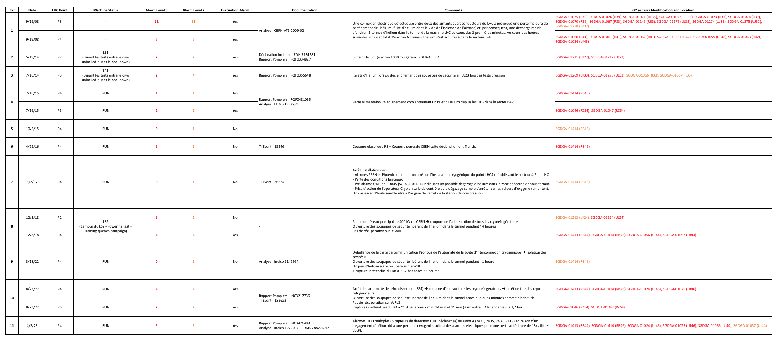
ODH events recorded in LHC Machine (2008-2025)
Takeway messages from LHC-Machine-ODH-Tracking file [EN-AA]
ODH cases registered:
  11 events with L3 and/or L2 alarms
  9/11 with P4 (incl. 34-MCI-2008 and 45-Cryo-stops)
  7 during RUN (CRYO due to Elec-Cryo-SF4)
  3 during LS (SV tuning or P_test, 400kV)
  1 special case (MCI-Sept'2008)
Proposed analysis:
  4/11: L2 or 1L3, no evacuation required
  1/11: 2L3, local event (P tuning in a DFB)
  5/11: 3 to 6 L3/L2: propagation via ventilation
  1/11: 19L3 due to MCI-Sept'2008
Origin of helium release:
  10/11: SV or RD with origin due to process, not due to a breach or degraded equipment
  1/11: multiple discharges (MCI-Sept'2008)
List being checked
and completed for references of events
Rather low statistics (< 1 per year in average) highly dominated by P4 (specificity with RF as low pressure & high heat load equipment)
Since MCI-Sept'2008, no surprise or unforeseen case observed
=> Could be seen as a confirmation of diagnostics and procedures in place

Slide 8
Specific cases already asked/envisaged
Chronological order
Warm-up before LS3:
- Possible work in LSS on room-temperature equipment by specific teams (VSC,...) ?
Tests at cold during LS3:
- QXL_Ph2 commissioning while there is no fixed ODH system in place?
Cool-down & Powering tests at the end of LS3:
- Possible cool-down of arc with work in HL-LSS: New ODH at arc extremity, barriers?
- Powering Ph1b threshold increased to keep access in adjacent zones/sectors ?
Operation after LS3:
- General: any reason to revise more globally the rules to be applied?
- Degraded ventilation conditions: how would this impact LHC, specific case of HL-LHC?
- Specific for HL-triplets:
- inspections: less than 10 min without work on magnets nor QXL: OK with LHe today
- work for RP, VSC, Survey: OK with LHe ?

Slide 9
CONTENT
Mandate, meetings, documentation repository
Brief recall HL-LHC context, ODH-spill key elements, documentation and procedures in place, REX
Cases identified and studied by the wg:
- Cool-down
- Powering
- Intervention for HL triplets
Other cases (Wup, Cmg, CrabCav...)
Summary of recommendations
+ list of documents/text/drawings to be updated
Complements: ODH detectors in UR galleries, sector door at P5, possible interface with LHC Ventilation wg, possible link of workframe authorisations with IMPACT tool

Slide 10
HL / LHC , Cool-down
(for tunnel)
(the same applies for warm-up)

Slide 11
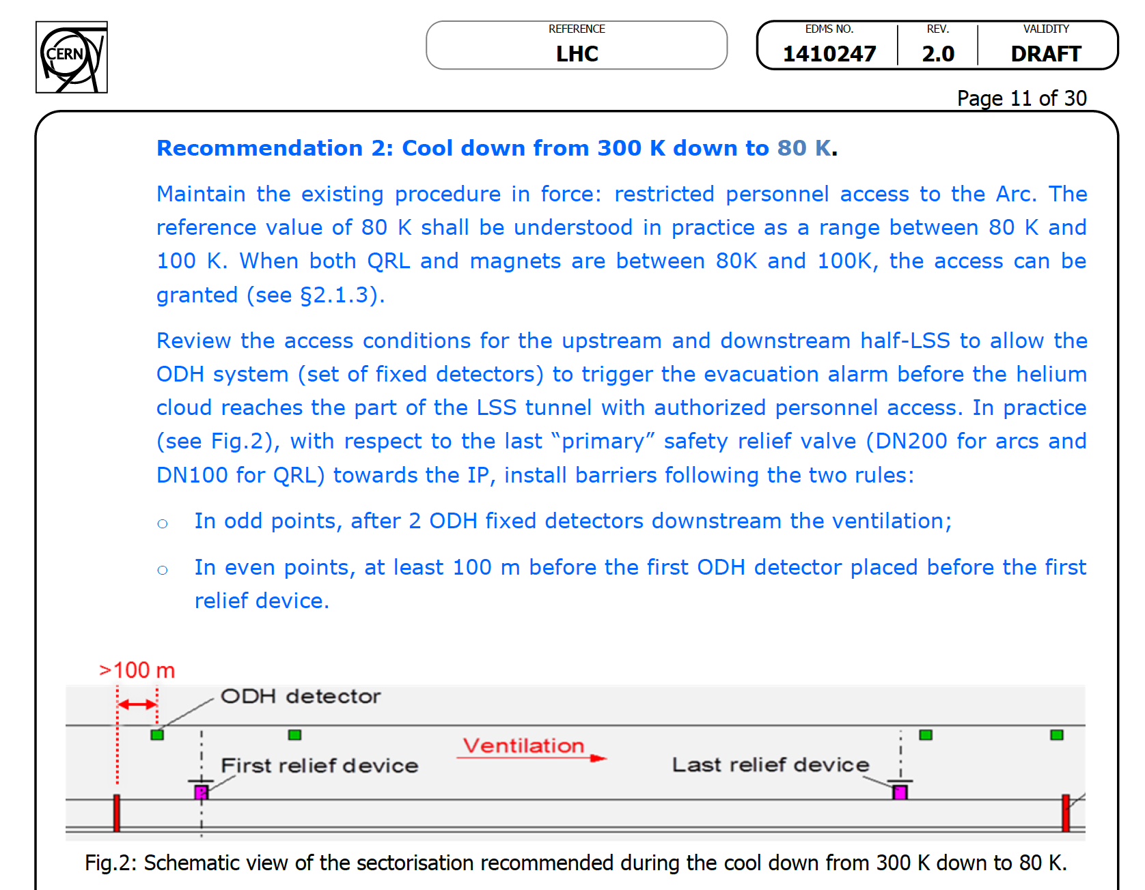
Complements, extracted from He Spill WG, EDMS#1410247
? Could this be a way in order to allow access to LHC ARC during cool-down 300-80K of HL-LSS or vice-versa (access HL-LSS during cool-down 300-80K of the arc) ?
? What about Powering Ph1 ?
Rmk: Barriers + signs are standard practice for securing zones

Slide 12
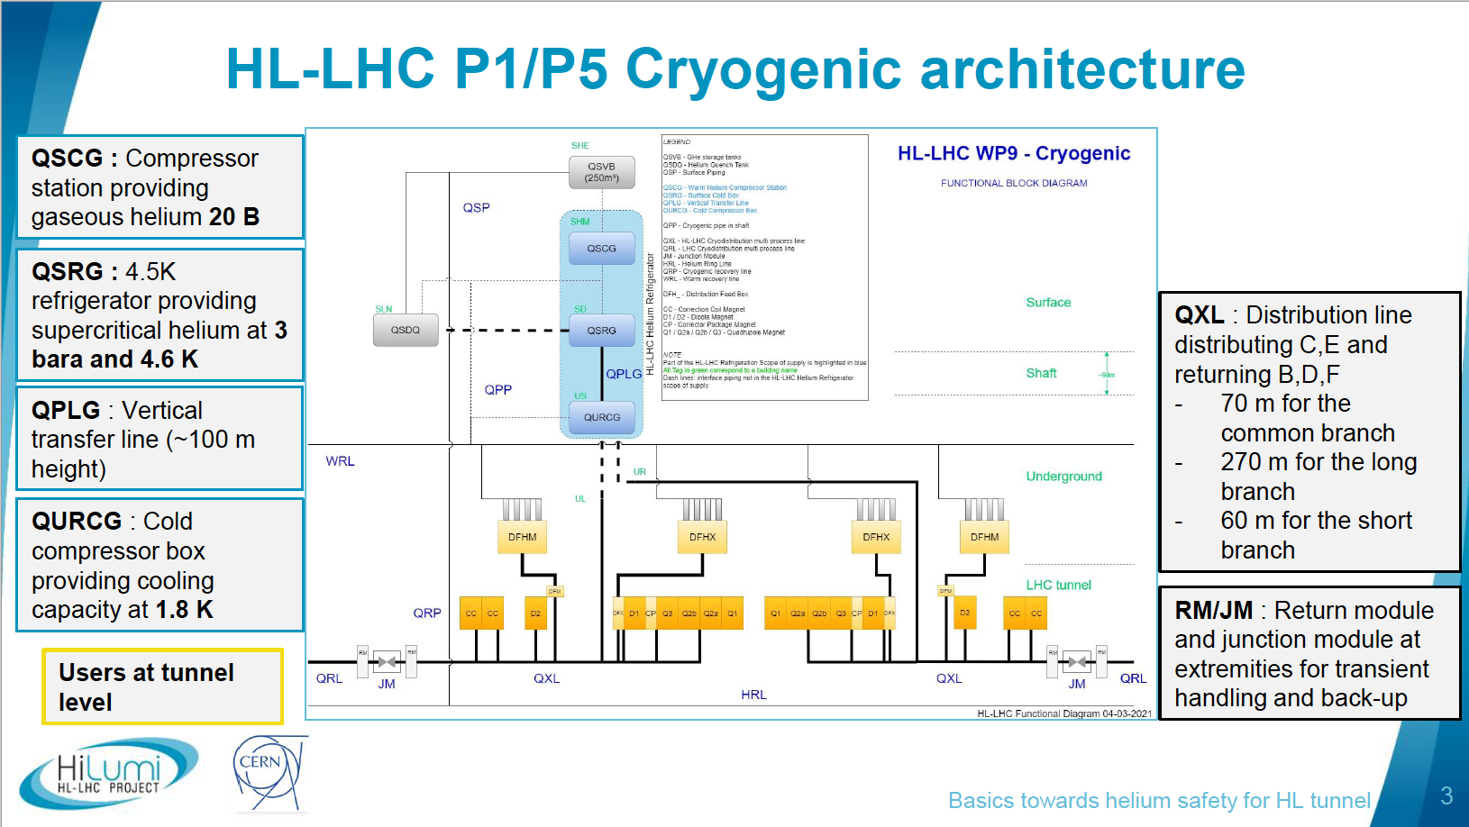
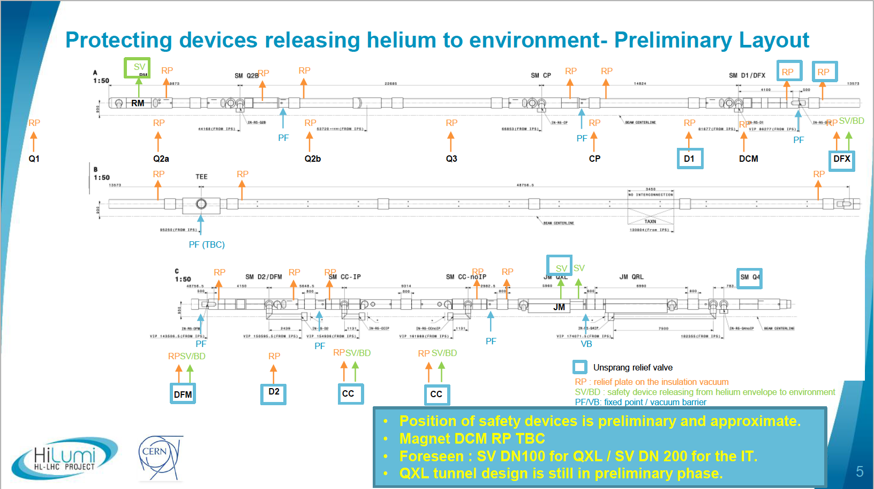
Relevant information from HL-WP9-Cryogenics
Extracted from a specific study & presentation made by V. Gahier
A. Helium circuit overpressure
B. Helium pipe breach to insulation vacuum
C. MCI for any case due to powering energy
Compulsory SV between 2 valves, but one is failure-open to header_B (VLP)
=> Not foreseen to blow!
No stay area 1
(D1 to DFX)
Junction Modules to decouple Helium flows between QRL/ARC+SAM from QXL/HL-LSS
No stay area 2
(DFM-D2, CC's, JM, Q4)
closed: for HL beams,
open: for fallback (YETS, maintenance) up to low lumi (<10e34)

Slide 13
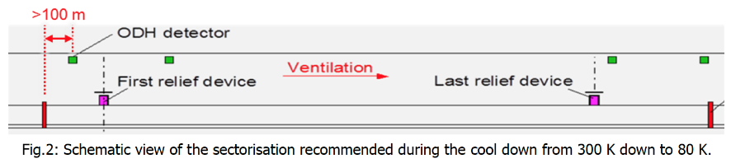
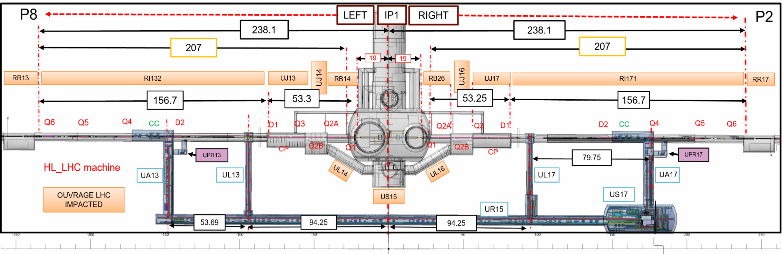
CD-WUP HL-LSS, access in LHC-ARC
(1/4)
UPR: Always right of UA Galleries, valid escape route for ARC in case of fire/problem
(real risk in LHC-ARC Vs potential risk in HL-LSS)
IP1 ZONE
Cases to be evaluated: Cool-down 300K-80K (Warm-up)
- HL-LSS CD/WUP, work in ARC-Q7+RR: Fully compatible, with LHC SAM's as buffer zone upstream of ventilation flow
Rmk: Very similar to HL-LHC safety report by Th. Otto (EDMS#2843277), with two complementary ODH sensors in LHC-SAM's

Slide 14
CD-WUP LHC-ARC, access in HL-IT ? (Not D2-CC)
(2/4)
UL14 & UL16: valid escape route in case of ODH problem in LHC-ARC
IP1 ZONE
Cases to be evaluated: Cool-down 300K-80K (Warm-up)
- ARC CD/WUP (and Q6-Q5-Q4), work in (part of) HL-LSS: Looks compatible, with CC-D2 to QXL core as buffer, but with risk of 1kg/s to be considered (no 2nd chance!) and ODH (helium cloud) propagation at the speed of ventilation (~1 m/s), would provide about 1min to evacuate.
=> Could be considered for derogations based on risk analysis, with limited number of people and duration for valuable tasks

Slide 15
HL / LHC, Cool-down, Summary
Considerations
Thanks to QRL-QXL Junction Modules, it will be possible to decouple (under some conditions) the circulation of helium in ARCS and in HL_LSS (while not possible for LHC)
New equipments required
Complementary ODH systems in LSS, barriers + signs
Recommendations
=> Validate new equipment and principle proposed (ODH, barriers, signs) to decouple the two zones LHC ARC & HL-LSS for cool-down & warm-up operations, allowing:
- For HL-LSS cool-down & warm-up: access possible to adjacent arc up to RR (included)
- For LHC ARC cool-down & warm-up: no general access to HL_triplets. Possibility to consider derogations based on risk analysis, with limited number of people and duration for valuable tasks that could be duly justified and with access conditions clarified (similar to present LHC Powering Ph1a restrictions)
Rmk: this would keep the present spirit of inherently safe access to LHC tunnel when granted

Slide 16
HL / LHC , Powering_Ph1
(for tunnel)

Slide 17
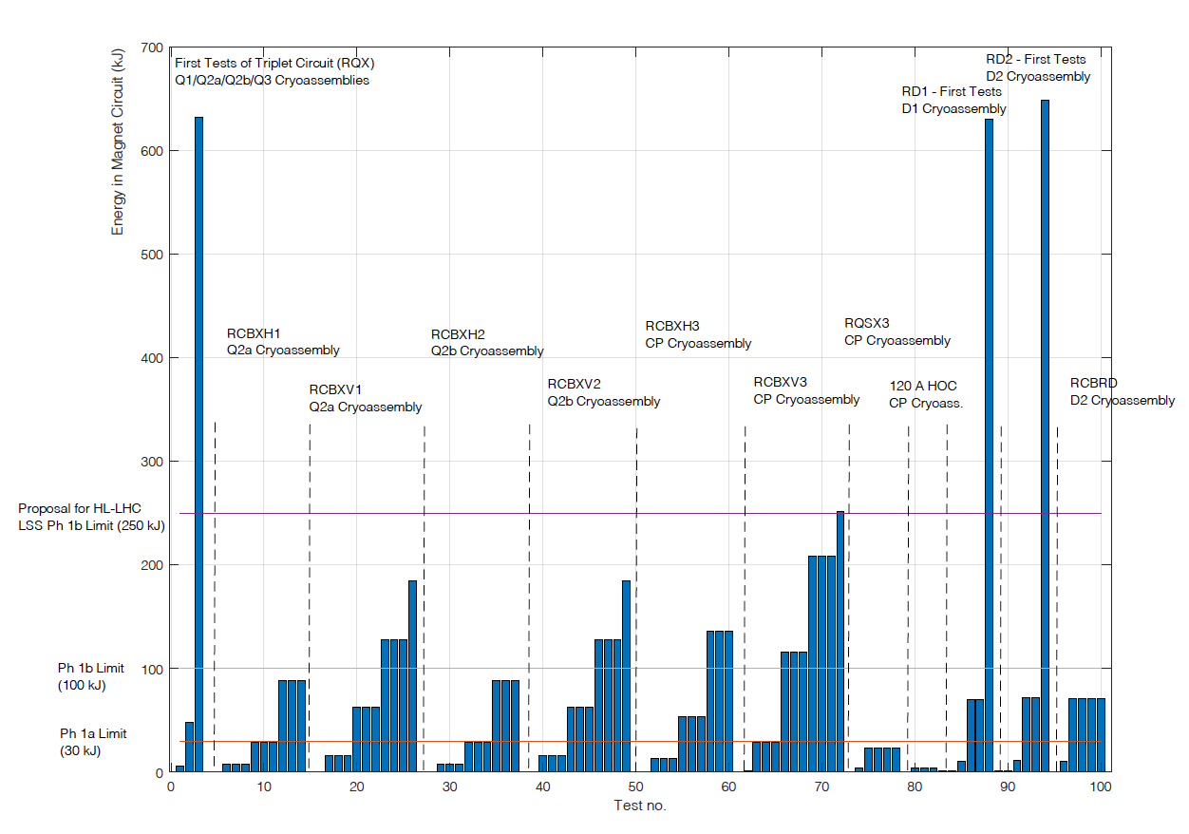
HL_LHC, proposal for powering Ph1-Ph2
Present rules for LHC:
Graph from HL-LHC and Magnet Circuit Forum (S. Yammine)
Ph2, >1kg/s (Significant risk)
Patrol required, no access possible,
+ restrictions on adjacent sectors
?!?
Ph1b, <100kJ, <1kg/s (Moderate risk)
Patrol required, no access possible in sector
Ph1a, <30kJ, <320g/s,
Access restricted, possible for powering experts

Slide 18
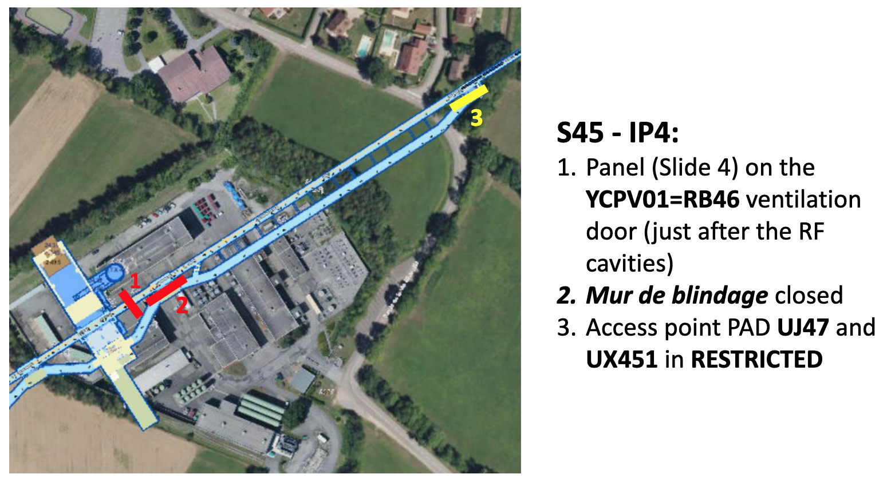
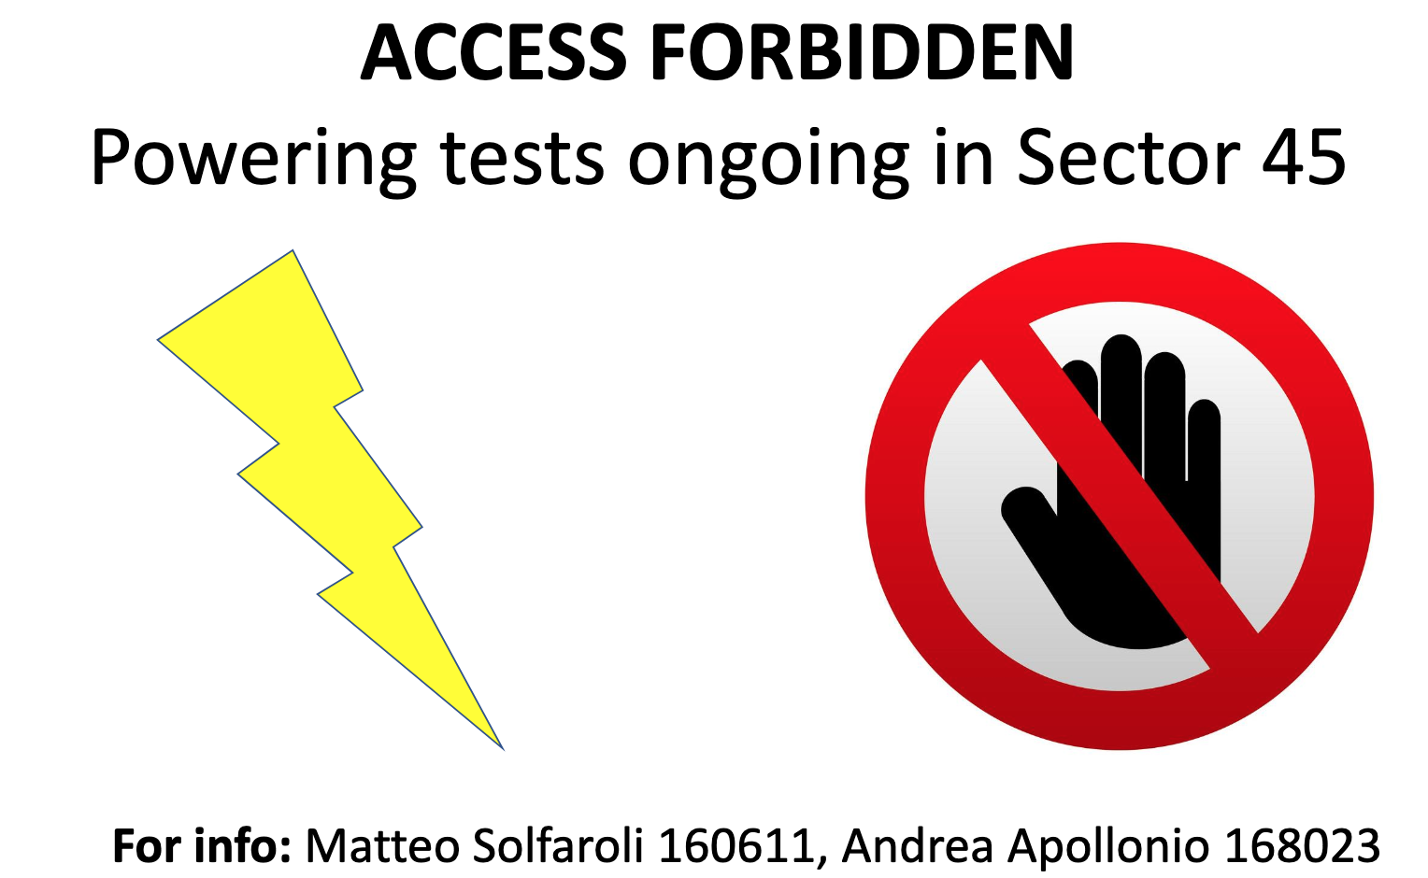
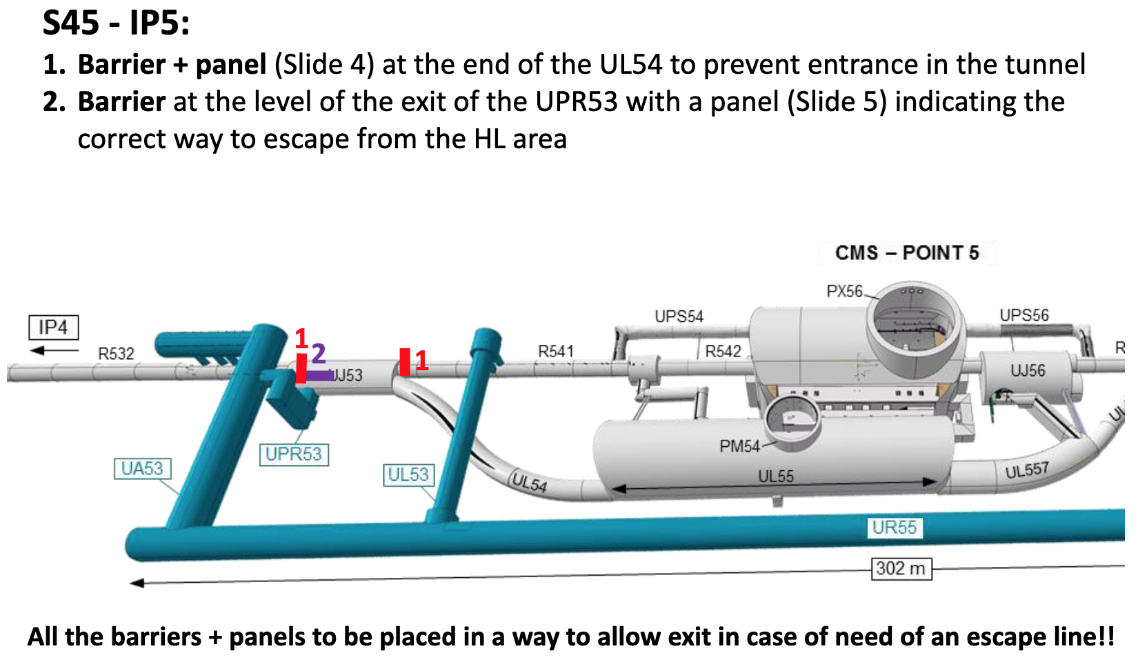
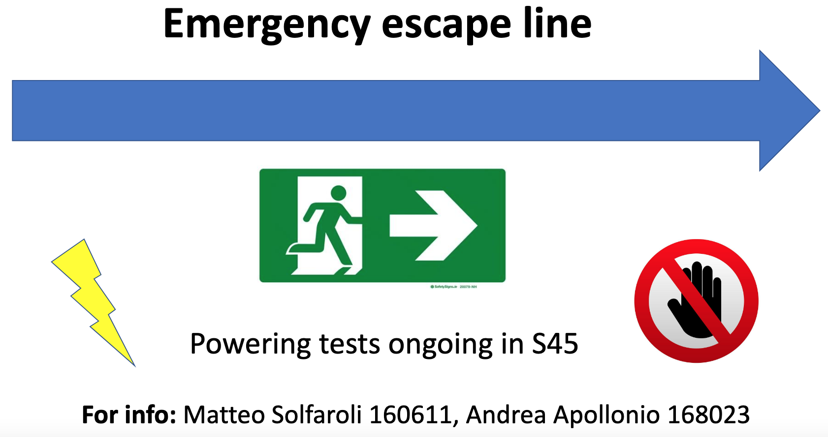
HL_LHC, proposal for powering Ph1-Ph2
Post-LS2 specific powering Ph1 protocol for 34-45-78 (M. Solfaroli)
For ex. S45: EDMS#2460151
Similar approach would be proposed for barriers between HL and LHC for (Cool-Down or) Powering Ph1

Slide 19
HL_LHC, proposal for powering Ph1-Ph2
Proposal for HL-LHC:
Graph from HL-LHC and Magnet Circuit Forum (S. Yammine)
Ph2, >250kJ, >1-2kg/s (Significant risk)
Patrol required, no access possible,
+ restrictions on adjacent sectors
Ph1c, <250kJ, <1-2kg/s (Moderate risk)
Barriers+signs, no access possible in LSS (HL+LHC)
Ph1b, <100kJ, <1kg/s (Moderate risk)
Patrol required, no access possible in sector
Ph1a, <30kJ, <320g/s,
Access restricted, possible for powering experts

Slide 20
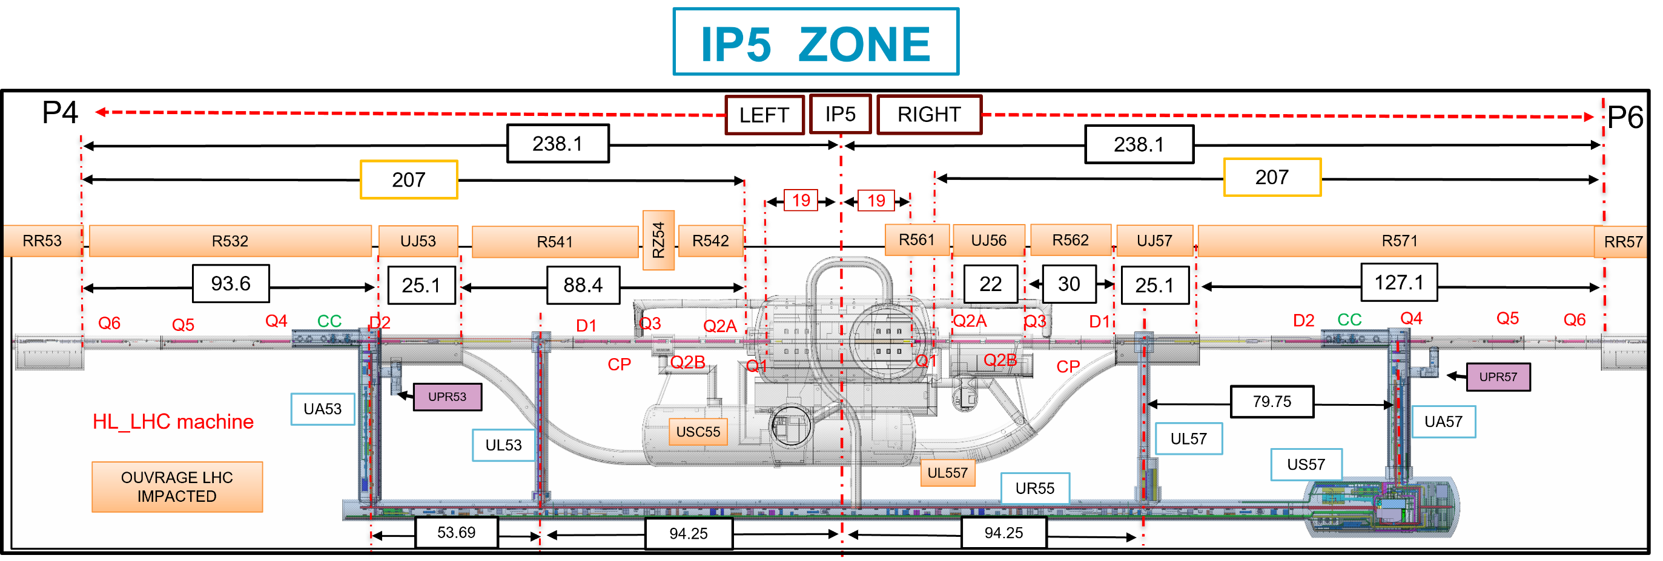
Powering Ph1 in HL-LSS, access in LHC-ARC
(3/4)
UPR: Always right of UA Galleries, valid escape route for ARC in case of fire/problem
(real risk in LHC-ARC Vs potential risk in HL-LSS)
Cases to be evaluated: Powering Ph1
- Powering Ph1c in HL-LSS, work in ARC-Q7+RR: Fully compatible, with LHC SAM's as buffer zone upstream of ventilation flow

Slide 21
Powering Ph1 in LHC (ARC), access in HL-LSS
(4/4)
UPR53, UP53 & UP566: valid escape route in case of ODH problem in LHC-ARC
Cases to be evaluated: Powering Ph1
- Powering Ph1 in LHC-ARC, work in HL-LSS: Fully compatible, with LHC SAM's as buffer zone with the possibility to keep CS/CM OFF for Q4-Q5-Q6.
Rmk: Q4-Q5-Q6 will be tested when no access will be allowed in HL-LSS (probably minor timing impact)

Slide 22
HL / LHC, Powering, Summary
Considerations
Powering is considered per circuit (independant for HL-LSS, LHC-SAM, LHC-ARC), more flexible than for cool-down allowing to consider Ph1c for HL-LSS in complement to Ph1b for LHC-ARC
New equipments required
As for cool-down, complementary ODH systems in LSS, barriers + signs
Recommendations
=> Validate new equipment and principle proposed (ODH, barriers, signs) to decouple the two zones LHC ARC & HL-LSS for Powering_Ph1, allowing:
- For HL-LSS Powering_Ph1: access possible to adjacent arc up to RR (included)
- For LHC ARC Powering_Ph1: access possible to HL_triplets.
Rmk: Q4-Q5-Q6 will be tested when no access will be allowed in HL-LSS (probably minor timing impact)

Slide 23
HL TRIPLETS
(Possibility to access triplets when LHe@1.9K)
=> change of paradigm for inner triplets 1st discharge device

Slide 24
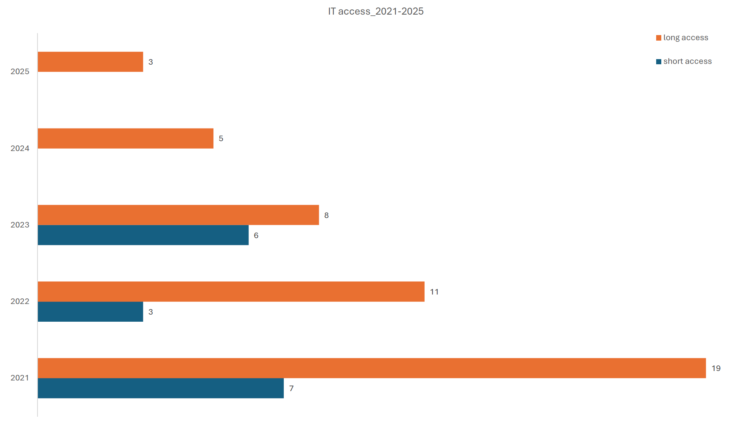
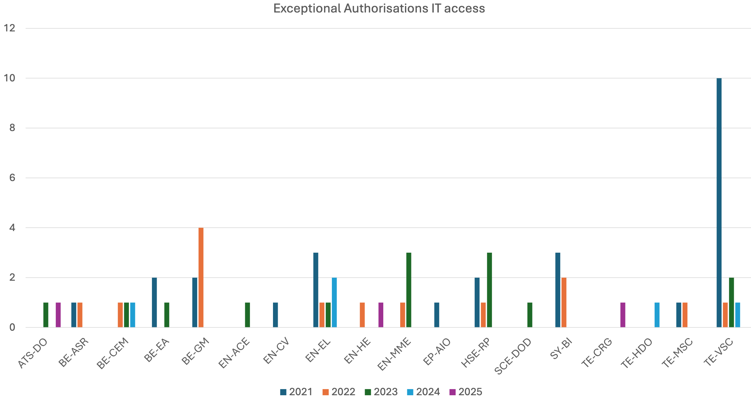
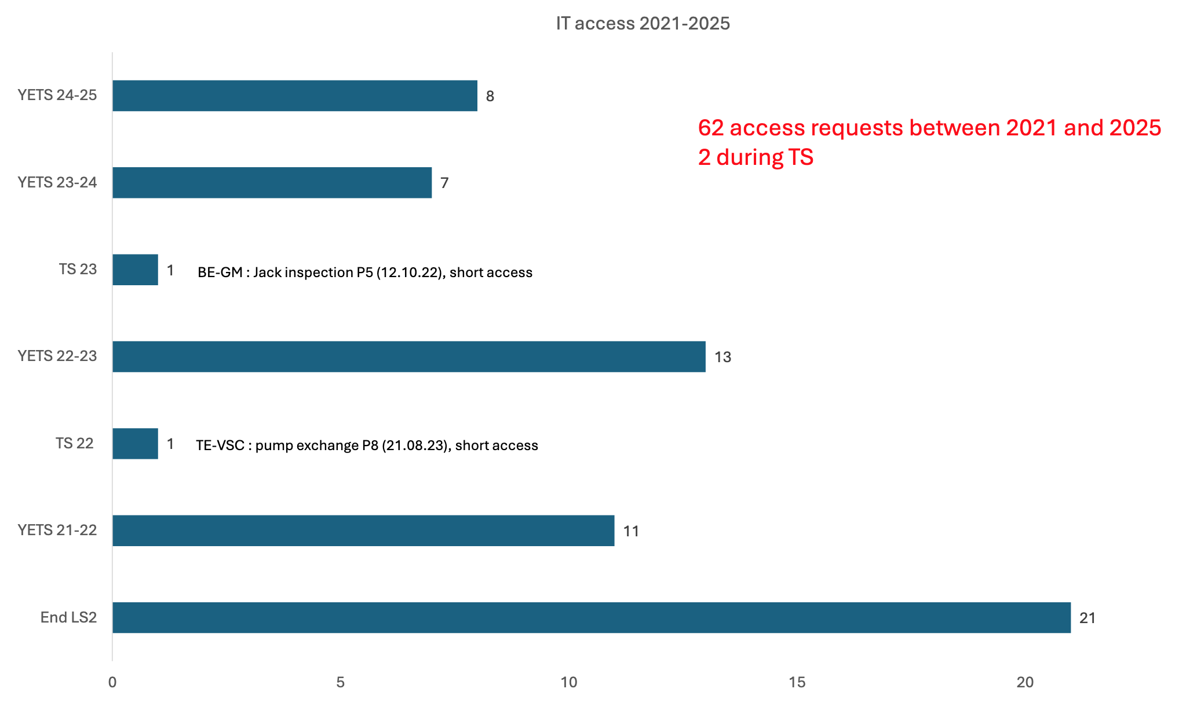
LHC inner triplets, REX special access
Takeway messages from TE-DSO compiled data
LHC IT access requests:
  18 groups concerned
  16/62 short access (26%)
  46/62 long access (74%)
Machine mode considered:
  2 during TS, short access (LHe possible)
  60 during YETS or end of LS2
  (GHe in general, But LHe at some point)
Workframe cases:
  8 so far, for 4 groups, mostly inspections or simple maintenance interventions (trained teams)
Recall of rules:
- no access to LHC IT when <80K
- exceptions possible #1406764
- Template for exceptional requests
Post LS2
Post LS2
Exceptional Authorisations IT access

Slide 25
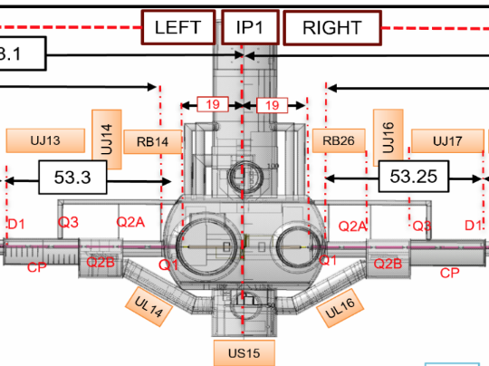
Alternative escape routes for HL_triplets ?
Point 1:
UL14 and UL16 identified as possible escape route
(rather well known and applied)
Rmk: UL's in front of Q2b

Slide 26
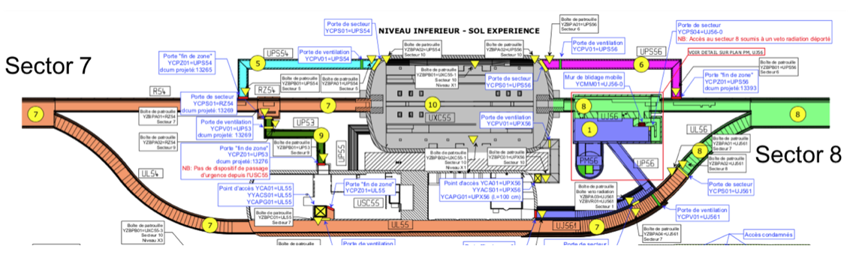
Alternative escape routes for HL_triplets ?
Point 5:
UP53 and UJ56 identified as possible escape route
(UPS54-56 considered not realistic as behind magnets+QXL)
Rmk: UP53 & UJ56 in front of Q2b

Slide 27
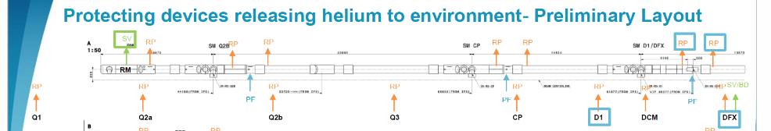
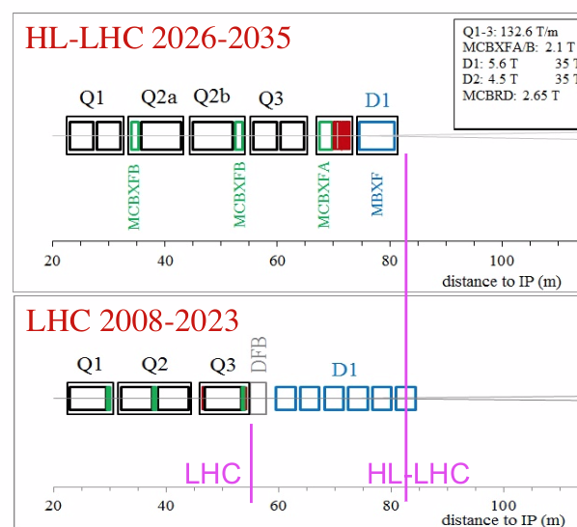
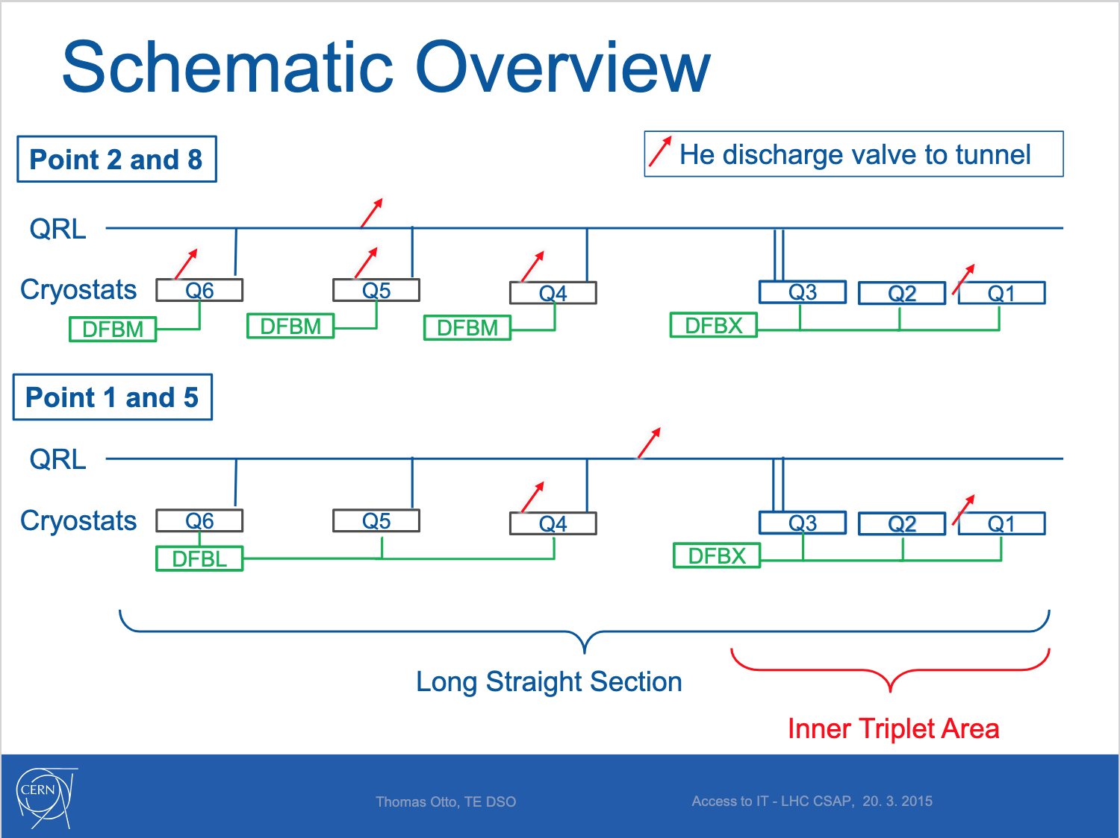
First He discharge to tunnel, change of approach
First discharge valve: From Q1 @LHC to D1@HL
=> escape from IT zone possible for HL-LHC
D1
P1
P5
Possible escape route at short distance without crossing a eventual helium release

Slide 28
HL_Triplets, Summary
Considerations
For HL-LHC, change of position of the first Safety device to open (Helium release close to D1), and identification of escape routes, ensuring short evacuation distances without crossing possible helium release zones
New equipments required
Remove existing fixed barriers + signs at P1 & P5
Recommendations
  => Keep exceptional authorisation for intervention next to cryogenic sensitive equipment as for any other zone
  => Long access now possible with LHe, except for intervention on FRAS/JACKS limiters, with risk of cm-range movements of cold masses
Rmk: existing procedure to access Inner Triplets at P2 & P8 is unchanged

Slide 29
Specific cases already asked/envisaged
Chronological order
Warm-up before LS3:
- Possible work in LSS on room-temperature equipment by specific teams (VSC,...) ?
=> Looks OK for some specialised teams to perform manual work on room temperature equipment
=> NotOK for this wg to validate heavy work and handling near sensitive cryogenic equipment
Tests at cold during LS3:
- QXL_Ph2 commissioning while there is no fixed ODH system in place:
=> temporary ODH systems to be considered in LHC-SAM buffer zone (see details in complements)
Cool-down & Powering tests at the end of LS3:
=> Treated in previous slides
Operation after LS3:
- General: extension of present recommendations for LHC, specific conditions & procedures
- Degraded ventilation conditions: No impact of degraded ventilation identified for HL-LHC proper
- Specific for HL-triplets:
=> Treated in previous slides

Slide 30
CONTENT
Mandate, meetings, documentation repository
Brief recall HL-LHC context, ODH-spill key elements, documentation and procedures in place, REX
Cases identified and studied by the wg:
- Cool-down
- Powering
- Intervention for HL triplets
Other cases (Wup, Cmg, CrabCav...)
Summary of recommendations
+ list of documents/text/drawings to be updated
Complements: ODH detectors in UR galleries, sector door at P5, possible interface with LHC Ventilation wg, possible link of workframe authorisations with IMPACT tool

Slide 31
Summary of recommendations
Thanks to QRL-QXL junction module, it will be possible to decouple (under some conditions) the circulation of helium in arcs and in HL-LSS.
Besides, a new configuration and approach will be applied for HL triplets.
This will allow for concerned sectors to:
- Decouple cool-down of HL-LSS from LHC ARC+SAM (not the other way around!)
- Fully decouple powering Ph1 of LHC ARC and HL-LSS (with limits on LHC SAM)
- Allow access to HL triplets in presence of LHe
+ Some specific activities will be possible during LS3 with compensatory measures
(temporary and removable ODH systems)
All other rules and procedures apply in matter of safety w.r.t presence of helium & ODH risk

Slide 32
Summary of recommendations, HL-LSS versus LHC-ARC
Considering complementary ODH sensors (x2/LSS) and barriers+signs as proposed
Status / Activity in HL-LSS | Access conditions to adjacent ARC
Cryogenic at room Temp. (300K) | Permitted
Pressure Test | Forbidden
Cool-Down or Warm-up (330K-80K) | Permitted
Operation at cold (below 80K) | Permitted
Powering Ph1 | Permitted (SAM as buffer zone)
Powering Ph2 | Forbidden
Status / Activity in LHC-ARC | Access conditions to adjacent HL-LSS
Cryogenic at room Temp. (300K) | Permitted
Pressure Test | Forbidden
Cool-Down or Warm-up (330K-80K) | Forbidden
Operation at cold (below 80K) | Permitted
Powering Ph1 | Permitted (SAM as buffer zone)
Powering Ph2 | Forbidden

Slide 33
Further actions and documents to be updated, once recommendations endorsed
document/text: update of Helium spill wg recommendations for post LS3 configuration
drawings with "green" zones authorised, "red" not accessible
definition of sensitive areas, no stay areas and position of barriers
activities in sensitive areas, annex 11 applicable only for triplets at P2 & P8

Slide 34
Complementary slides

Slide 35
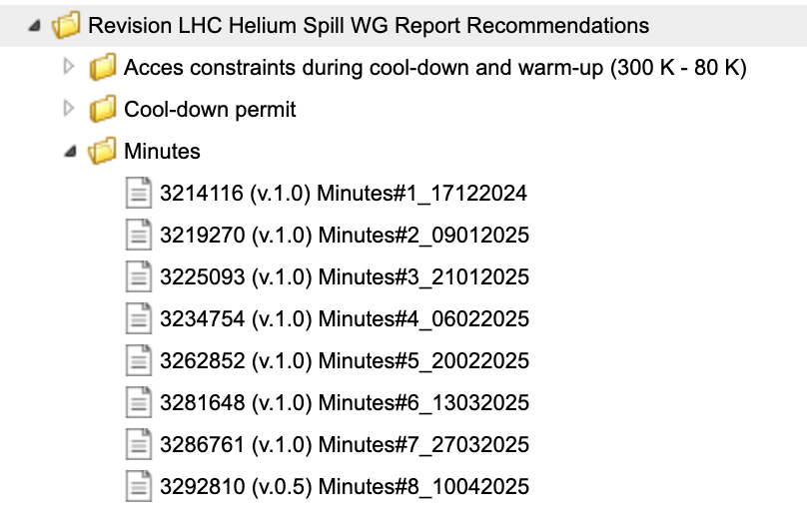
Complementary information foreseen, meetings
Specific meetings with specialists held in complement to plenary meetings of the wg
EDMS# TE_Department - Safety
Impact of HL-LHC infrastructures:
  Thomas Otto (HL-LHC), Christelle Gaignant (PSO HL-LHC)
Helium release scenarii for HL-LHC:
  Vanessa Gahier, following HL-W9-Cryo studies 2023
Accidental possible scenarios with powering:
  Experts from TE MPE (or HL Magnet Circuit Forum)
Definition of the access zones:
  EN EROS (or DSO's & schedule/access coordination)
Number, positions of the new ODH sensors:
  Sébastien Evrard or delegate for the consolidation of Safety access systems since positions of ODH systems should be reviewed (entire EN-AA team for PSSCONS)
Thanks to all contributors for fruitful exchanges and maturation of solutions!

Slide 36
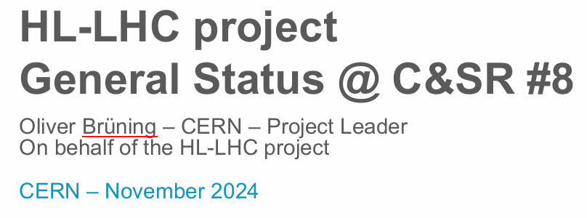
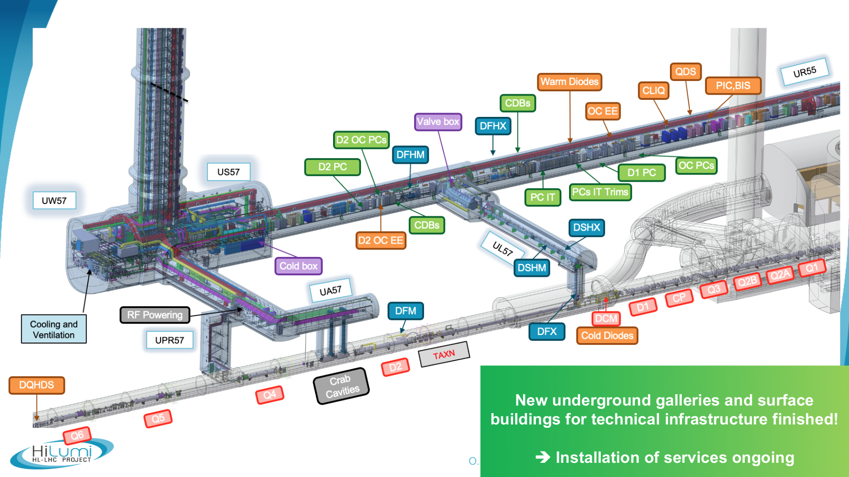
HL-LHC infrastructure in brief
Main changes for HL-LHC:
- QRL-QXL Junction module
- UPR to connect LHC tunnel with UA/UR galleries
QRL-QXL
Junction Module

Slide 37
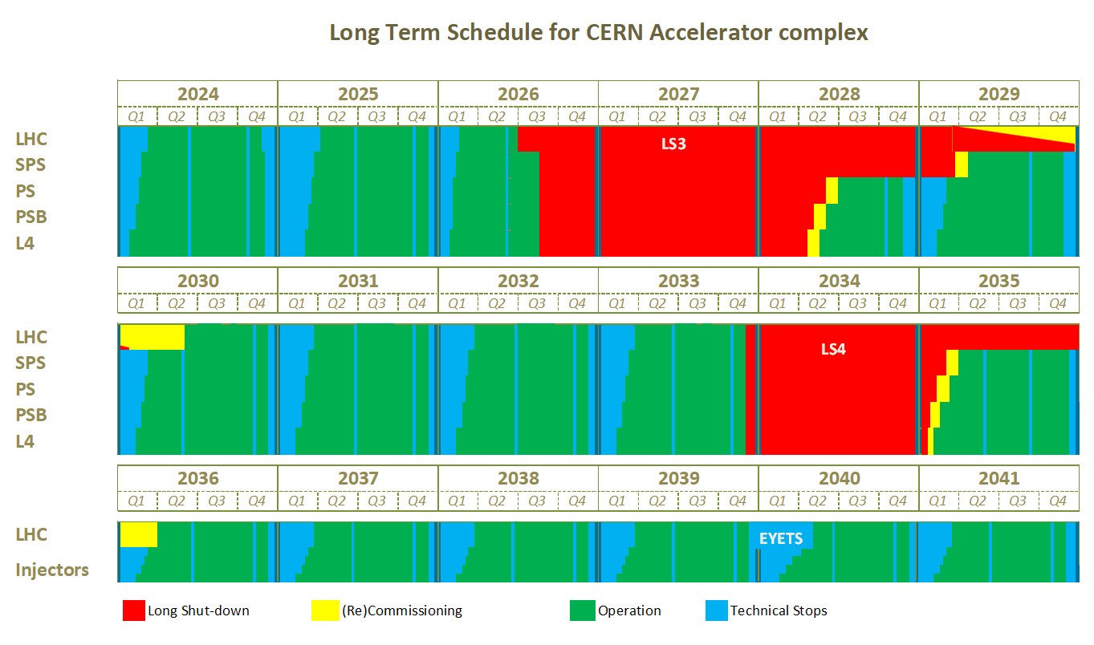
CERN, long term schedule (Rev. Nov'24)
EDMS#2311633 v.4.1
ACC-PM-MS-0004 v.4.1

Slide 38
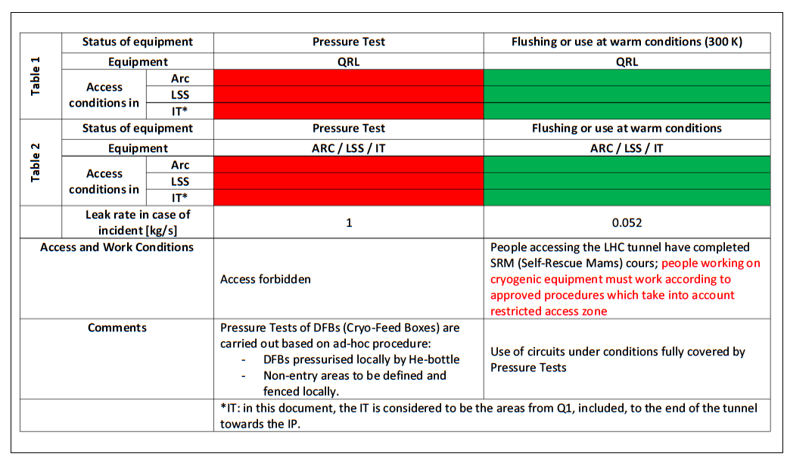
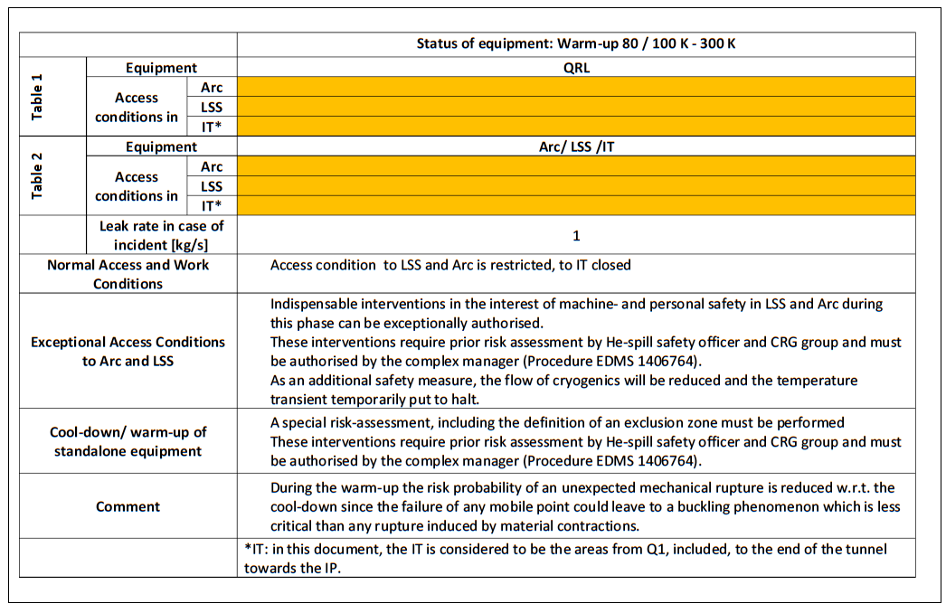
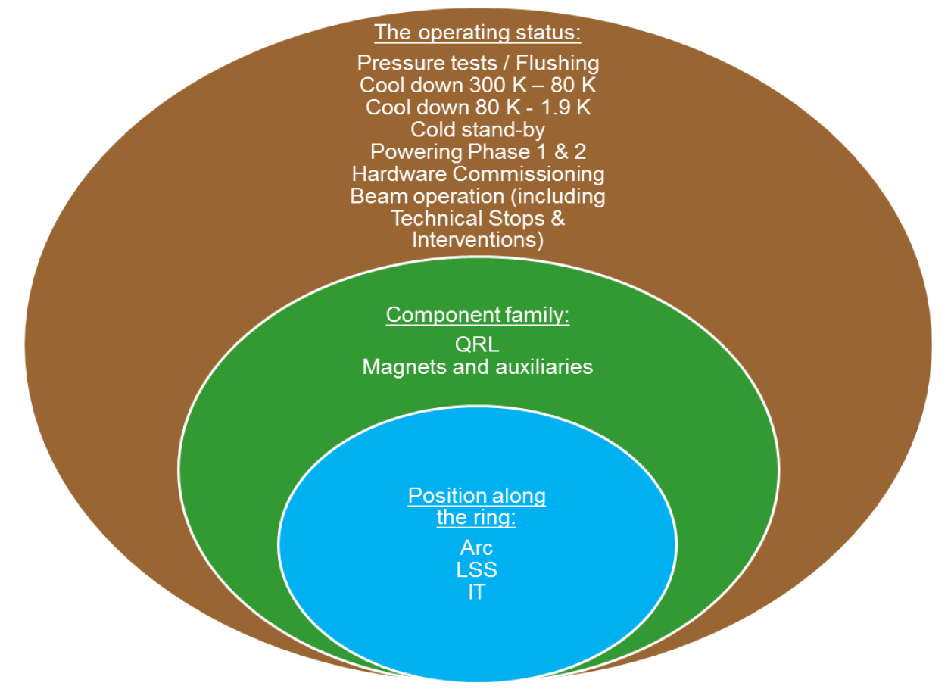
He spill wg recommendations (Aut'17), EDMS#1410247
Formal recommendations following clear risk assessment (various He flow categories), safety impacts (operation modes) or configurations (zones) with definition of an access matrix (modes-components-position) and work conditions
For "below 80K conditions", exceptional derogations possible for work around sensitive equipment, with procedure and mitigation measures
Rmk: Restricted access during warm-up defined in 2.6.8, even if not recalled in access matrix.
reduced risk w.r.t cool-down, due to less damage with buckling compared to rupture,
(but observed cases like with QRL bellows with NC degrading after thermal cycles)
Forbidden
Restricted
Controlled

Slide 39
Activities in sensitive areas (Aut'20), EDMS#1406764
300K
Below 80K: for sensitive areas (fragile cryogenic instrumentation)
- work frame for regular activities (TS, YETS)
- exceptions on case-by-case
=> Complete list & DCUM in annex (QRL, DFB's, SAM's, RF)
Specific areas and exceptions for well justified cases:
- Inner Triplet Areas (short Vs long access)
- RF at P4 (specific case at 4.5K)
- Forward experimental areas in UJ12-UJ18
- Side tunnels like TD62-TD68, injection tunnels TI2-TI8
=> No additional authorisation for last two lines
Forbidden
Restricted
under conditions
80K
Controlled
20K
=> Sensitive areas
=> Specific areas

Slide 40
Safety Request Form (Aut'23), EDMS#2975840
? LHC ODH system End-of-Life in LS3, Need for consolidation?
237 sensors in LHC machine:
- every ~300m in arcs (visibility 284m),
with flashing lights every 150m
- between 150m & 300m in service areas (LSS)
pre-alarm L2 19%_O2 (technical alarm)
alarm L3 18%_O2: 1 sensor: flash +/- 300m from sensor
2nd sensor: Evacuation alarm
Trigger time in minutes (3min to 50min)
walking speed ~1m/s similar to air speed (ventilation towards odd points)
=> 1 to 1 replacement, REX few years before any change 2 to 1 for L3 alarm evacuation
He spill scenarii for access [Ref.6]:
< 100 g/s: only for trained personnel,
no powering and specific conditions for special zones
< 320 g/s: Powering Ph1a: only in LSS with short escape route (restricted to powering experts)
< 1 kg/s: Powering Ph1b+2: NO ACCESS
Rmk: safe access to LHC when granted, with slow ODH propagation compatible with normal/walking evacuation

Slide 41
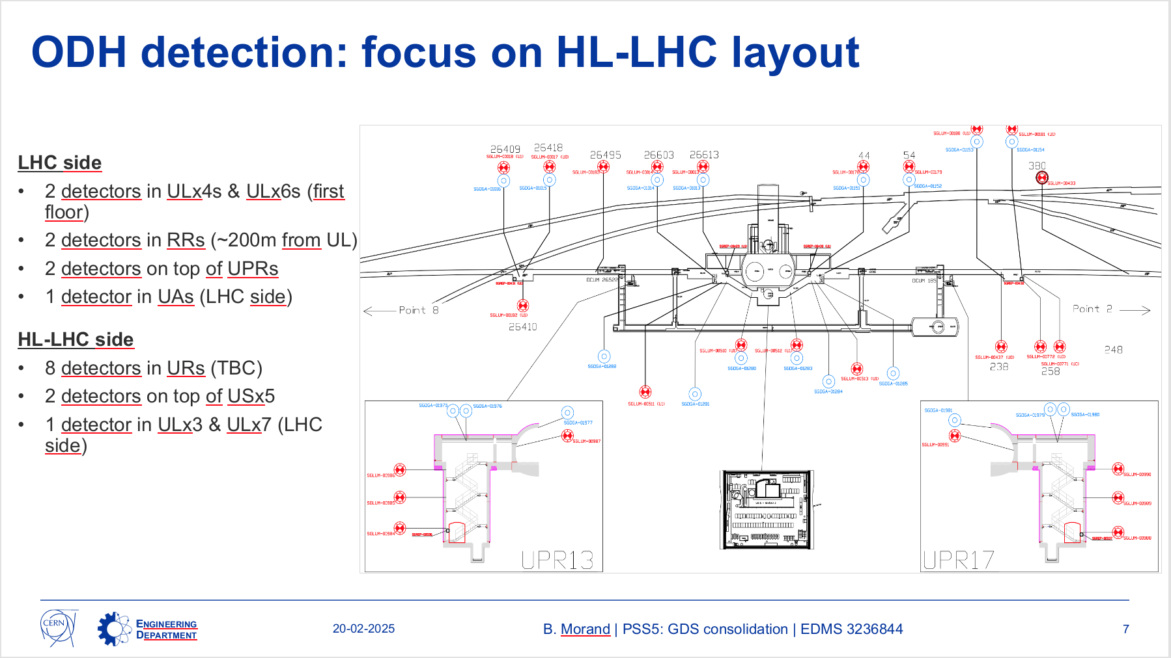
PSSCONS plans for ODH, example for P1

Slide 42
CD-WUP HL-LSS, access in LHC-ARC
(3/4)
UPR: Always right of UA Galleries, valid escape route for ARC in case of fire/problem
(real risk in LHC-ARC Vs potential risk in HL-LSS)
Cases to be evaluated: Cool-down 300K-80K (Warm-up)
- HL-LSS CD/WUP, work in ARC-Q7+RR: Fully compatible, with LHC SAM's as buffer zone upstream of ventilation flow
Rmk: Very similar to HL-LHC safety report by Th. Otto (EDMS#2843277), with two complementary ODH sensors in LHC-SAM's

Slide 43
CD-WUP LHC-ARC, access in HL-IT ? (Not D2-CC)
(4/4)
UP53 & UP56: valid escape route in case of ODH problem in LHC-ARC
Cases to be evaluated: Cool-down 300K-80K (Warm-up)
- ARC CD/WUP (and Q6-Q5-Q4), work in (part of) HL-LSS: Looks compatible?, with CC-D2 to QXL core as buffer, but with risk of 1kg/s to be considered (no 2nd chance!) and ODH (helium cloud) propagation at the speed of ventilation (~1 m/s), would provide less than a 1min to evacuate...
=> Could be considered for derogations based on risk analysis, with limited number of people and duration for valuable tasks

Slide 44
Powering Ph1 in HL-LSS, access in LHC-ARC
(1/4)
UPR: Always right of UA Galleries, valid escape route for ARC in case of fire/problem
(real risk in LHC-ARC Vs potential risk in HL-LSS)
IP1 ZONE
Cases to be evaluated: Powering Ph1
- Powering Ph1c in HL-LSS, work in ARC-Q7+RR: Fully compatible, with LHC SAM's as buffer zone upstream of ventilation flow

Slide 45
Powering Ph1 in LHC (ARC), access in HL-LSS
(2/4)
UPR13, UL14 & UL16: valid escape route in case of ODH problem in LHC-ARC
IP1 ZONE
Cases to be evaluated: Powering Ph1
- Powering Ph1 in LHC-ARC, work in HL-LSS: Fully compatible, with LHC SAM's as buffer zone with the possibility to keep CS/CM OFF for Q4-Q5-Q6.
Rmk: Q4-Q5-Q6 will be tested when no access will be allowed in HL-LSS (probably minor timing impact)

Slide 46
Complements
ODH in (new) HL-UR galleries: checked, with adjustments proposed (x2 in US moved in B2)
New fixed and new removable ODH systems for compensatory measures
New sector door at P5 for RF-CC tests, ECR launched
DSO action to propose a link impact-workframe/derogation, at a later stage once endorsed
No impact of degraded ventilation on this series of recommendation (see dedicated wg)

Slide 47
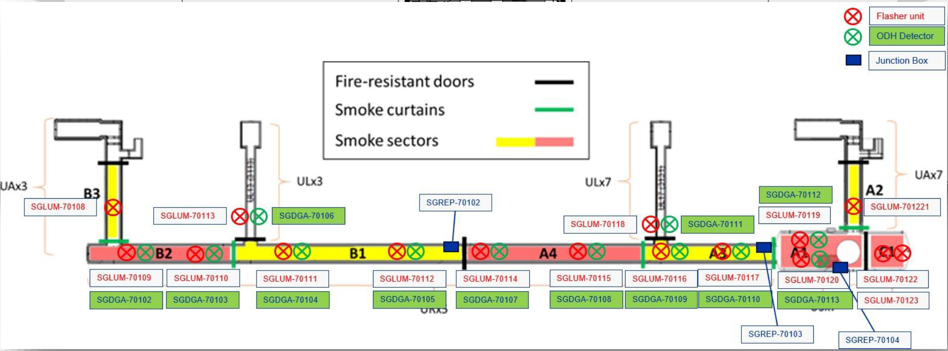
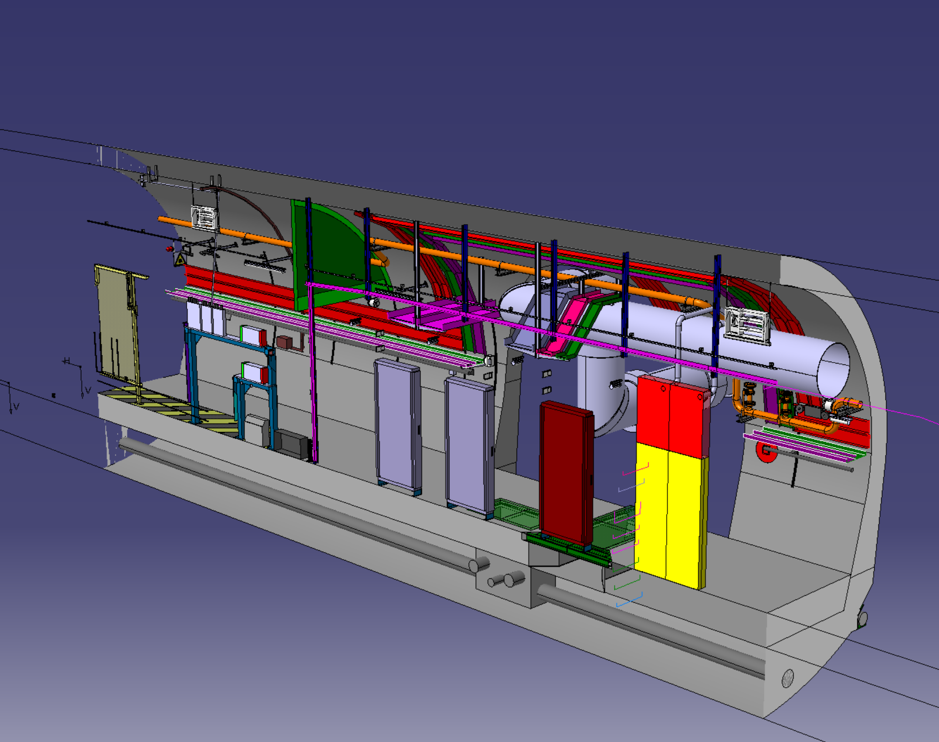
ODH sensors for HL technical galleries and zones
Extracted from original Engineering Specification for ODH sensors in LHC EDMS#398629
General concept for definition of needs for ODH sensors:
- in LHC tunnel: every 300m in arcs (distance for visibility, flash lights every 150m)
- in high points (ceiling): two ODH sensors as collective protection for "low" but permanent helium leaks
smoke curtain
Application to HL technical galleries and zones:
- Smoke curtains (down to h~2.5m) somehow creates local high points => Needed in B2, B1, A4, A3
- With PM starting at top of US cavern (no local high point) => Needed/foreseen in SD, NOT needed in US

Slide 48
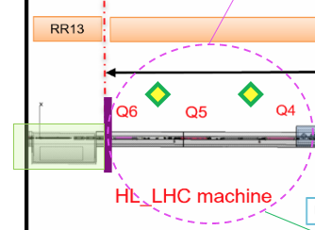
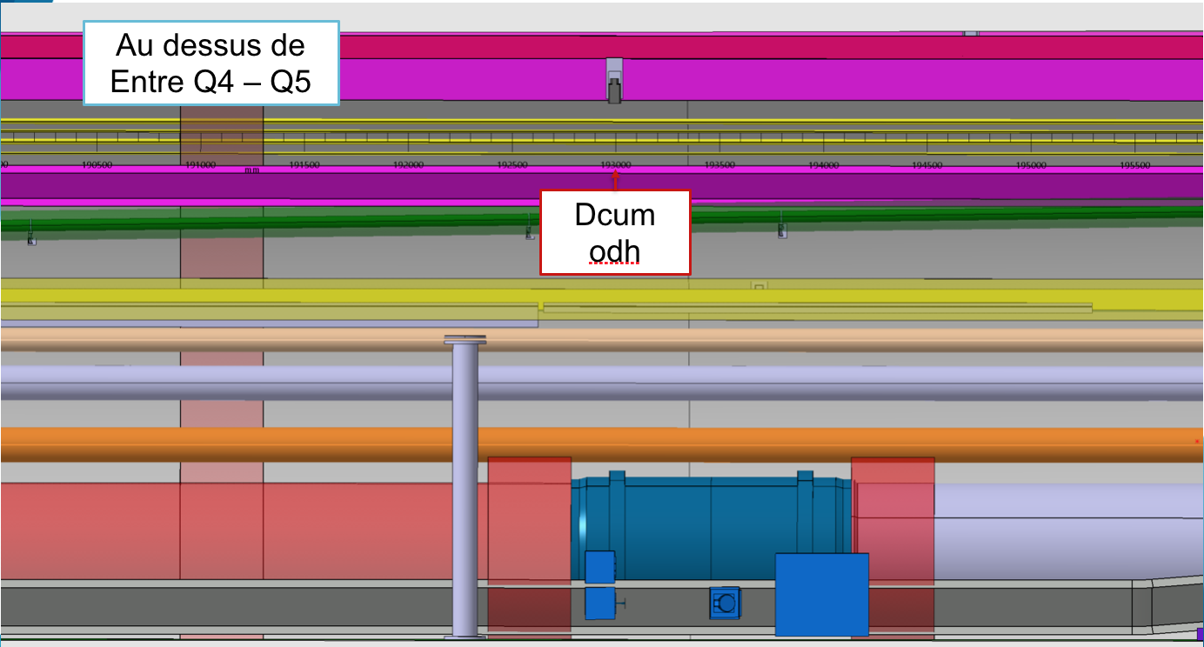
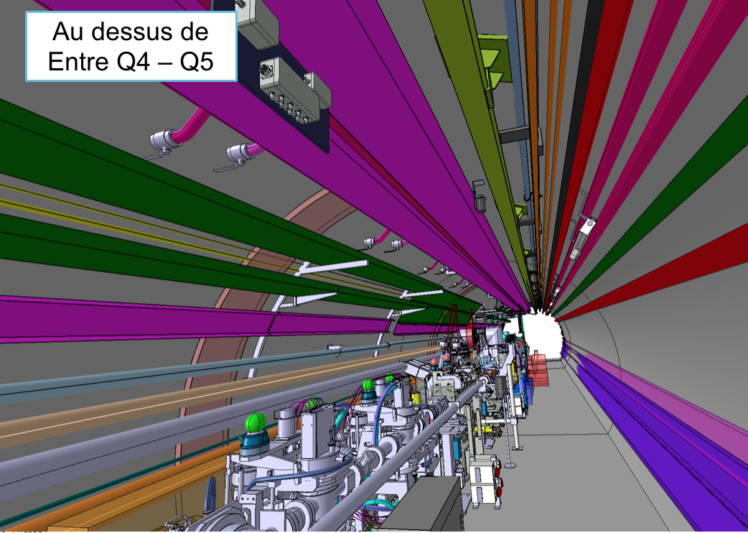
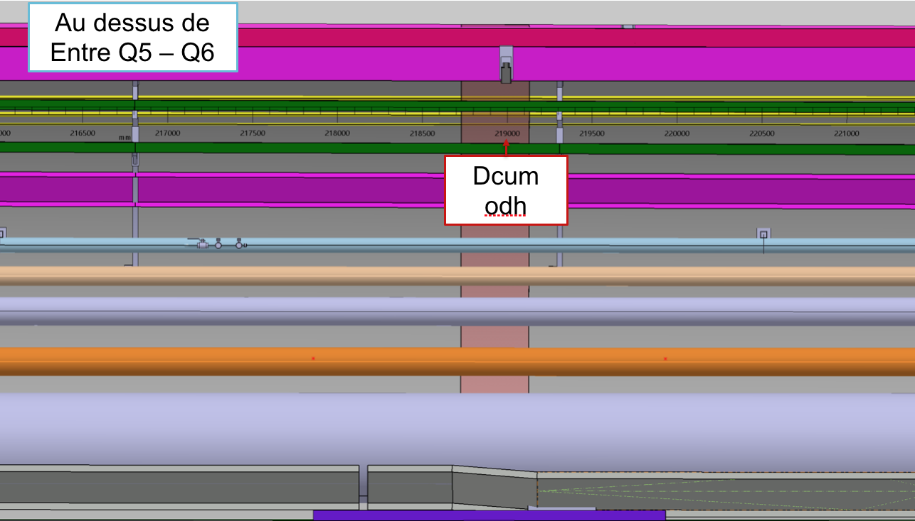
New fixed and new temporary ODH systems for compensatory measures
New fixed in LHC tunnel & LSS (LHC SAM area):
+2 (like between Q4-Q5 and between Q5-Q6),
proposal to trigger on 1 sensor (back to 2 during run)
Temporary and removable ODH systems for specific needs/tests during LS3, like QXL_Ph2:
- Same requirements to keep access in ARC
(+2 ODH in LHC SAM area, barrier + sign at RR interface)
- During cool-down 300-80K, no access in UR nor HL-LSS
- For stable operation with cold GHe (possibly with LHe), access possible in HL-LSS tunnel with compensatory measures:
=> temporary ODH + flash lights + signal_to_Cryo and personnal ODH sensors for people
=> no heavy handing or cable pulling campaign near QXL sensitive equipment
=> access in HL UR galleries without specific measures (no safety devices blowing helium in the zone)
Preliminary integration (DCUM) by S. Maridor & P. Fessia
Rmk: system to be studied & quoted by EN-AA (support + sensor + flash + sound + battery + signal_to_Cryo)

Slide 49
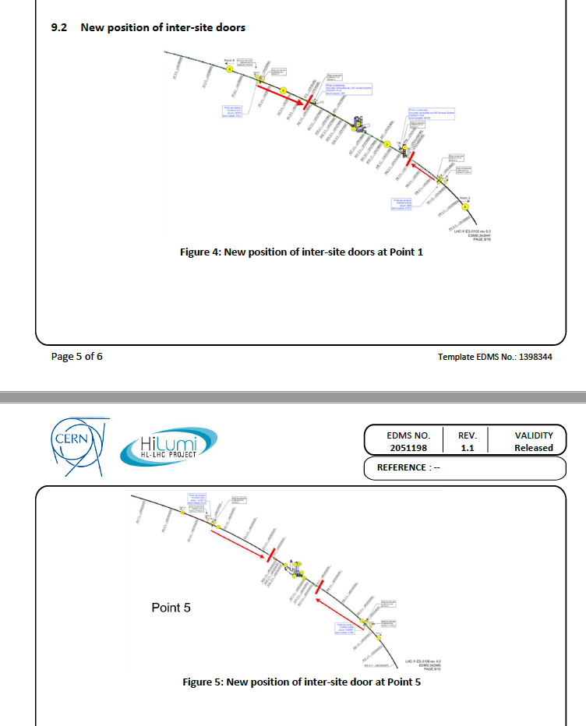
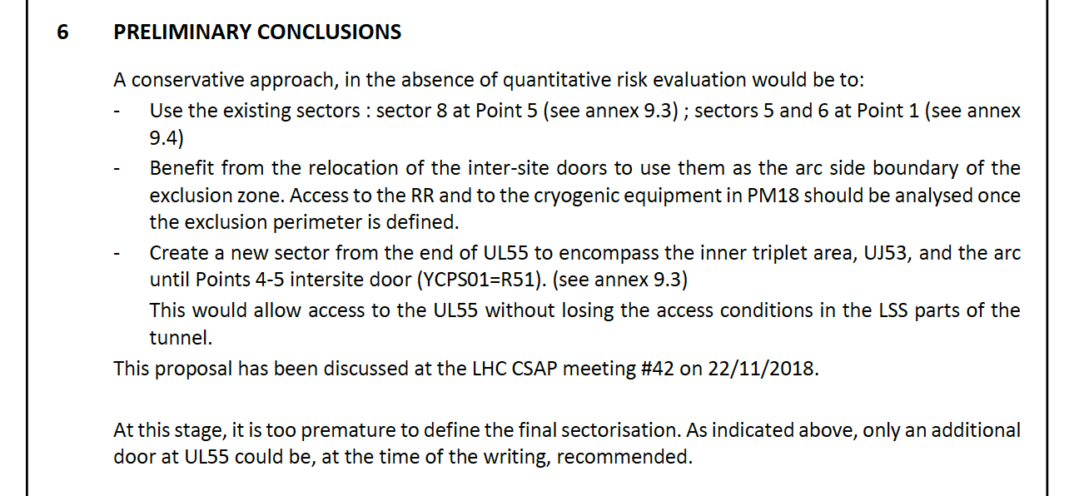
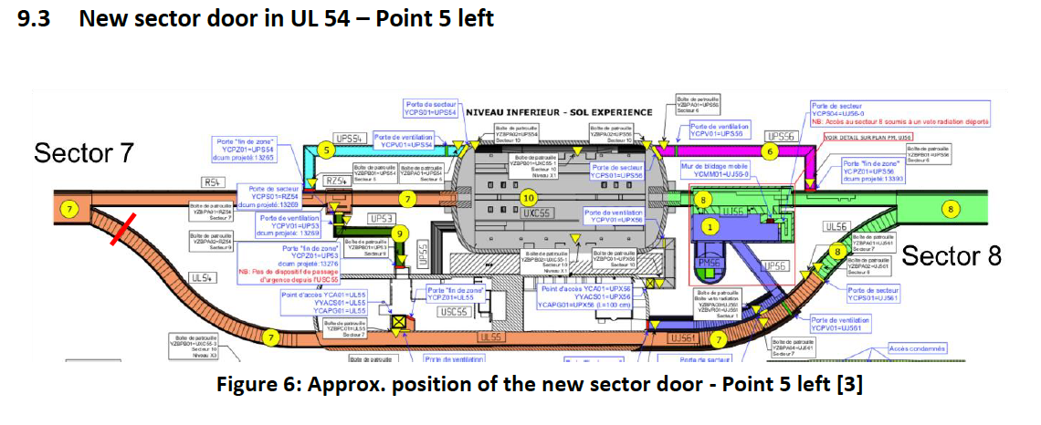
HL-LHC Crab Cavities conditionning, EDMS#2051198
ECR under approval,
LHC-J-EC-0007
EDMS#3236401
Modification of inter-site doors position
=> not considered at this stage
Supported for added flexibility, and will be formalised by an ECR (standard practice for such cases)

Slide 50
Proposal to link IMPACT with workframe or derogations
Link workframe authorisation or special derogations with IMPACT, so as to manage efficiently and coherently accesses
=> Action proposed by TE-EN-BE DSO's, at a later stage once recommendations of this wg will be endorsed

Slide 51
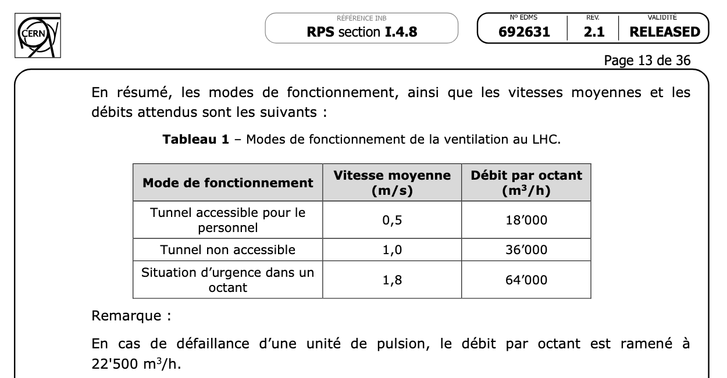
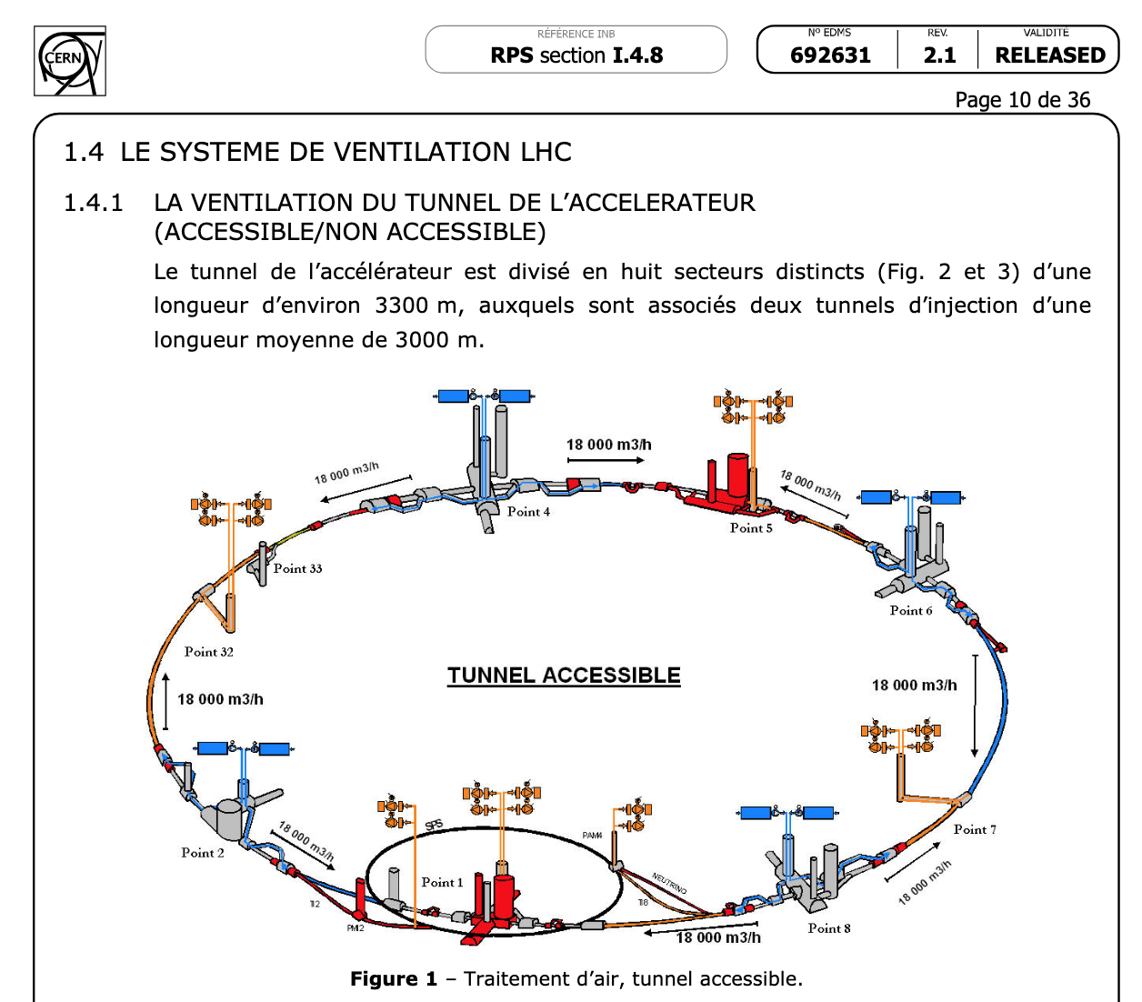
Ventilation, basic principles, EDMS#692631
? What is foreseen in case of "NO ventilation" in a sector ?
? is it a possible case ?
=> No impact of degraded ventilation identified on this series of recommendation
=> (see dedicated ventilation wg for more details)

Slide 52
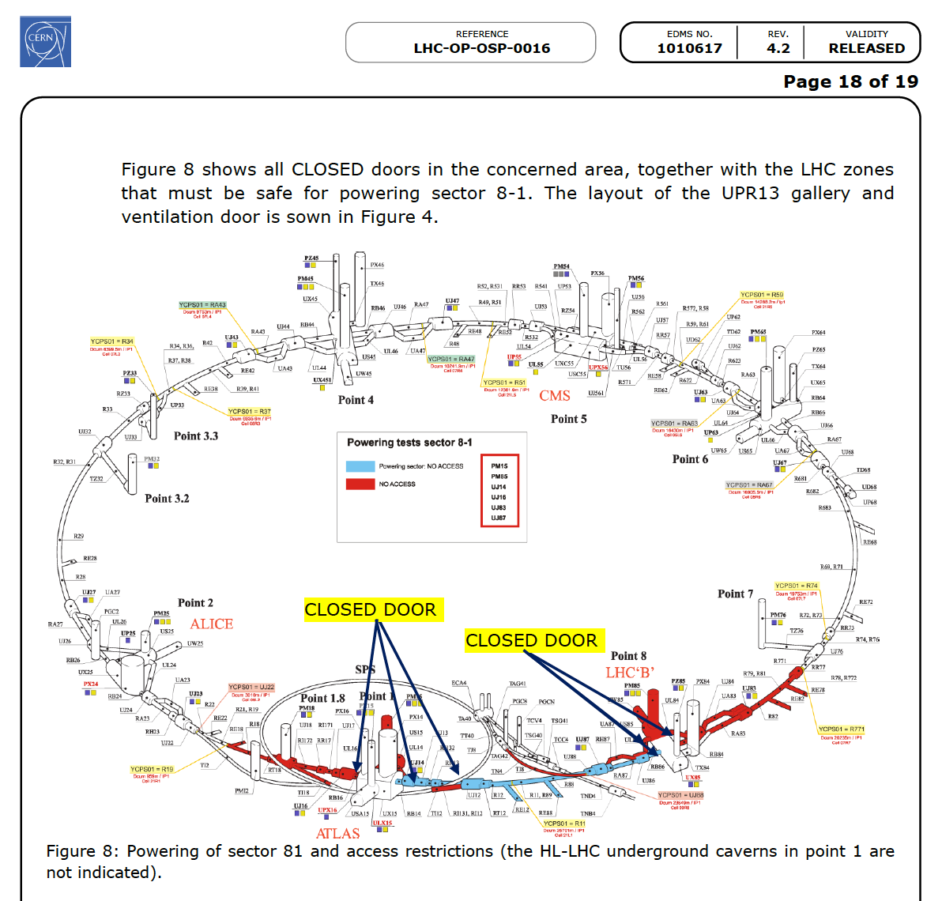
Powering Ph2, ventilation and access, EDMS#1010617
For a sector with limited impact, next LHC tunnel yellow door:
- upstream air injection (even point)
- downstream evacuation shaft (odd point)

Slide 53
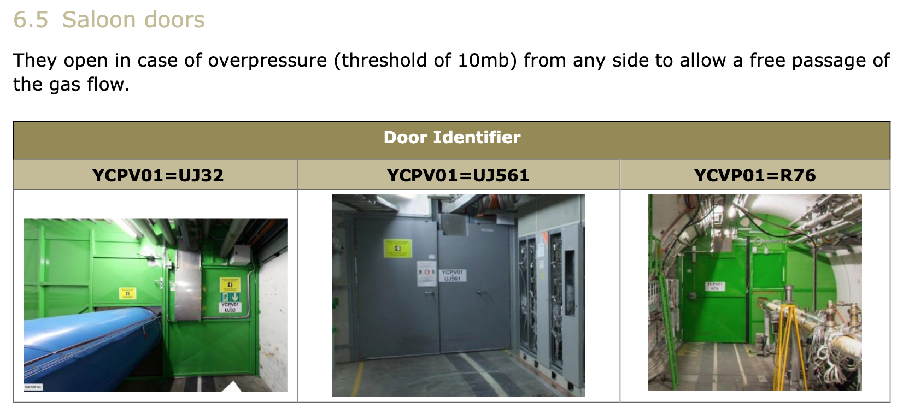
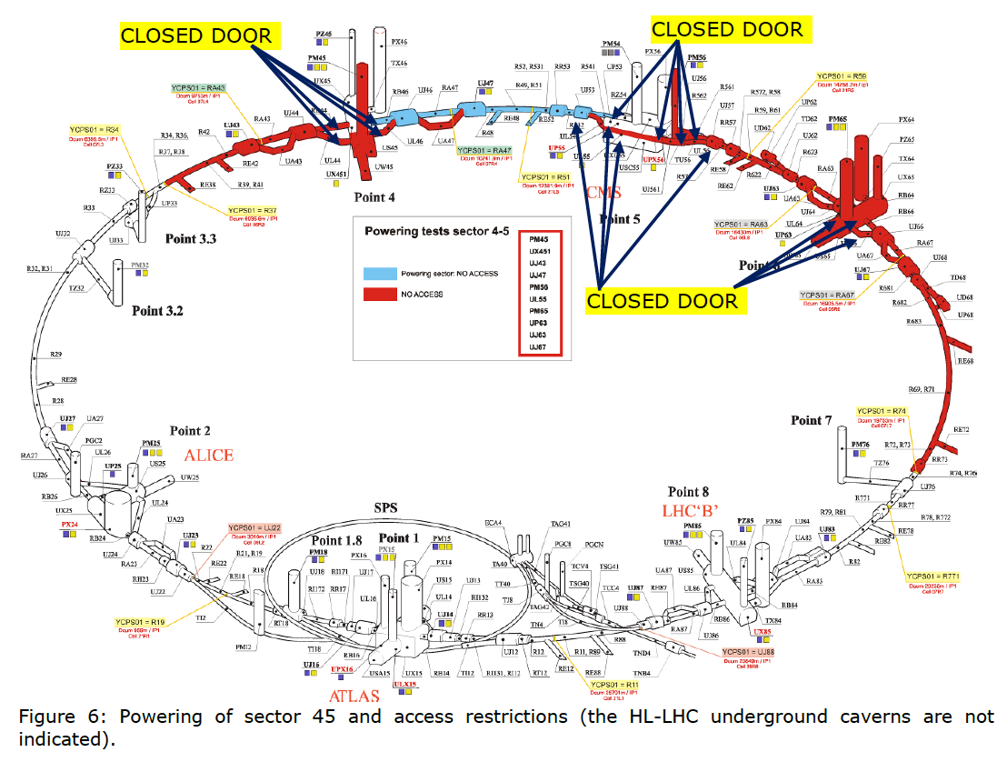
Powering Ph2, ventilation and access, EDMS#1010617
For a sector with limited impact, next LHC tunnel yellow door:
- upstream air injection (even point)
- downstream evacuation shaft (odd point)
Special cases:
Plus a sector as buffer due to
"Saloon doors" at:
P3 (UJ32), P5 (UL55), P7 (UJ76)
Rmk: Possible need for update depending on evolutions of inter-site doors for crabs

