Slide 1
GT837
Florent LEGAY

Slide 2
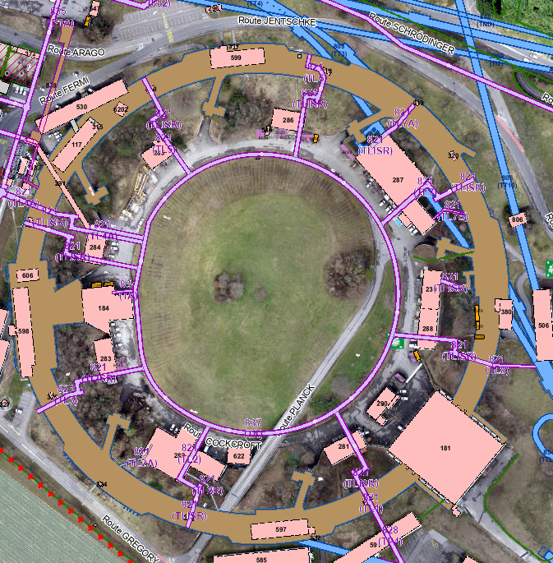
Situation
ISR Gallerie – 837
Year of construction: 1967 – 1969
Infrastructure:
  High voltage electrical network
  Low voltage electrical network
  Low current network
  Optical fiber
  Chilled Water / Superheated water
  Potable water
  Sanitation
  etc…
TG Cons – Civil Engineering – GT837

Slide 3
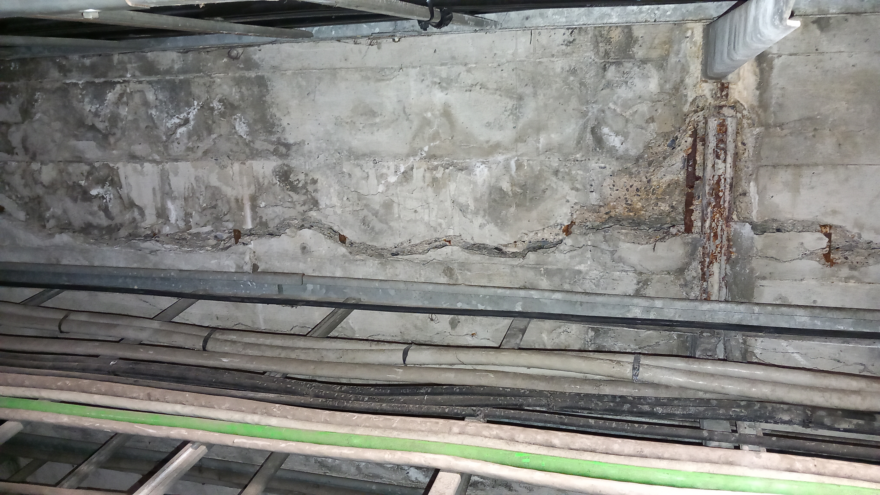
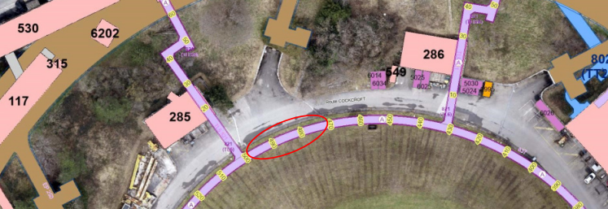
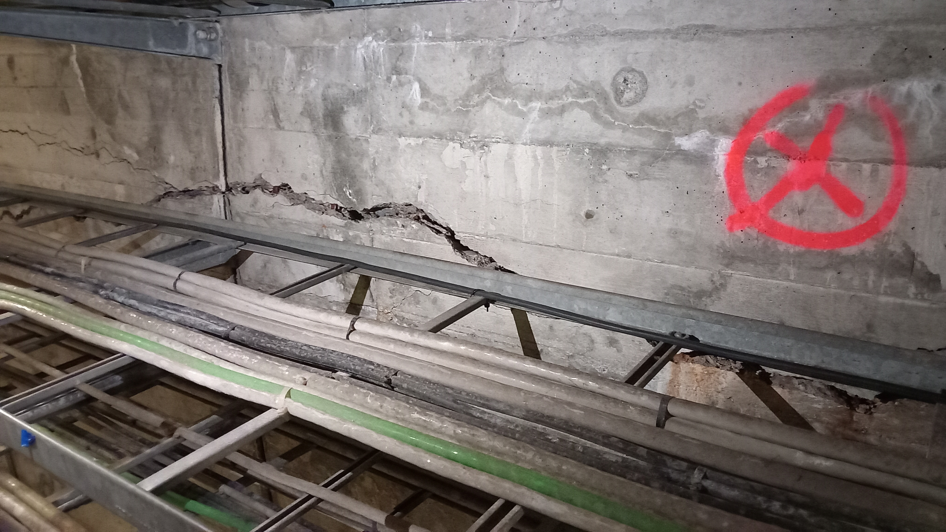
Structural disorder
Important structural disorder has been found in the gallery GT837 between TL5 and TL6:
  Cracks more than 5cm width
  Severed steel reinforcement
  Severed halfen rails
TG Cons – Civil Engineering – GT837

Slide 4
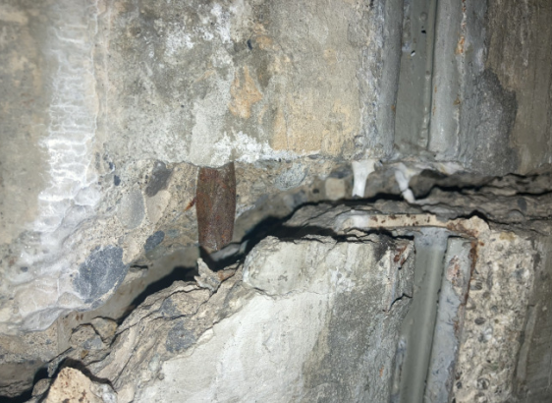
Structural disorder
Important structural disorder has been found in the gallery GT837 between TL5 and TL6:
  Cracks more than 5cm width
  Severed steel reinforcement
  Severed halfen rail
TG Cons – Civil Engineering – GT837

Slide 5
Risks in case of gallery failure
EN/CV – Cooling and Ventilation
    Loss of the demineralised water-cooling circuits would lead to the shutdown of the PS and nTOF machines.
    Disruption of Essential Technical Services
    Interruption of drinking water, firefighting network, and compressed air supply.
    No possibility possible to feed the area without these pipes, and no rerouting options are available at the moment.
EN/EL – Electrical Systems
HV/LV Networks
    Failure of the gallery would lead in a power cut to B287.
    Low Voltage (LV) and AUG cables form part of the ISR general services loop
    Their loss would impact nTOF and TT2A as well as all ISR buildings
Fiber Optic Networks
    Failure of Communication - IT-CS: GPN, TN, GSM, TETRA
    Failure of Safety systems - EN-AA: Access control, CSAM, fire detection, etc.
SCE/SAM – Heating system
    Loss of Heating System in all the building of ISR area
Should the gallery collapse, the beam could be severed for a prolonged period while the utility systems are reinstated. This would also lead to a suspension of operations in a significant number of buildings.
TG Cons – Civil Engineering – GT837

Slide 6
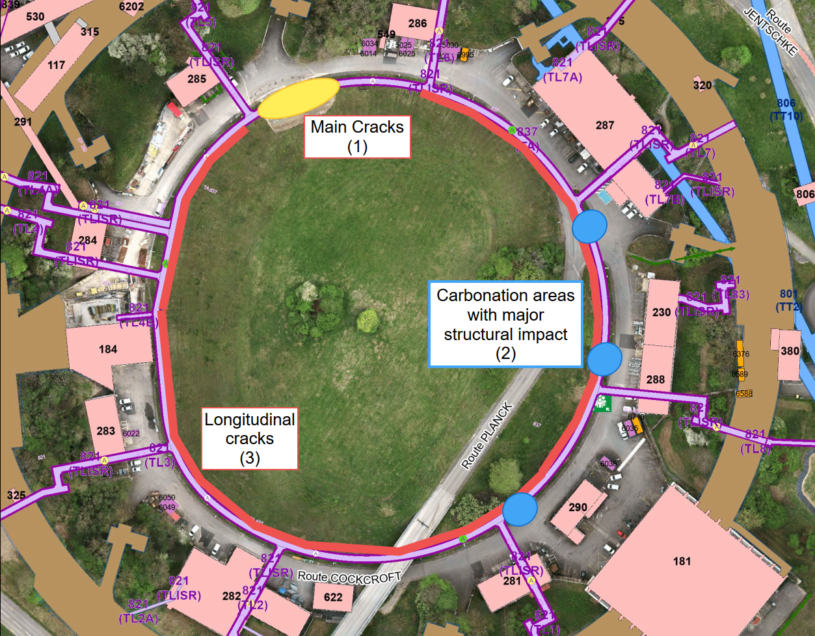
Reminder - Project Board meeting #4 – 30.05.2024
Main Cracks (1)
Important disorder due to carbonation (2)
Cracks along the ring (3)
Probable cause of failure for the main cracks:
Red molasse swelling upon contact with water, exerting extreme loads that weaken the gallery structure
TG Cons – Civil Engineering – GT837

Slide 7
Reminder - Project Board meeting #4 – 30.05.2024
Before launching any large-scale work inside the gallery, the following roadmap could be followed:
▪ Launch surveys of the gallery to check the current state of the concrete, the rebars, and the drainage.
▪ Carry on with the execution design for remedial works for point (1).
▪ Determine repair solutions for points (2) and (3)
▪ Evaluate the costs and impacts of remedial works for the overall ring
▪ Depending on the outcome, find extra funding to execute remedial works during LS3
▪ Launch an IT and coordinate with other work package
TG Cons – Civil Engineering – GT837

Slide 8
Surveys and studies
May 2024
Geotechnical survey - GADZ
July 2024
Structural report - Synapse
February 2025
Materials survey report - CRL Survey
Geotechnical Survey:
  Gave us the maximum load brought by the molasse: 125kPA
Structural Report:
  Confirm that the molasse is probable reason of the structure failure.
  Reports currently being cross-checked
Material survey:
  Medium cracks along the ring crosses the wall – structural disorder
  Small cracks along the ring follow rebars pattern – due to concrete shrinkage after casting
  Cracks are old
  The concrete and rebars are in correct state
  Except in carbonated areas needs to be treated before worsening of the situation
Cracks Monitoring
No evolution of cracks during the last year
Drainage
Video inspection impossible
Piezometer indicates that the water level stay below the lower slab
TG Cons – Civil Engineering – GT837

Slide 9
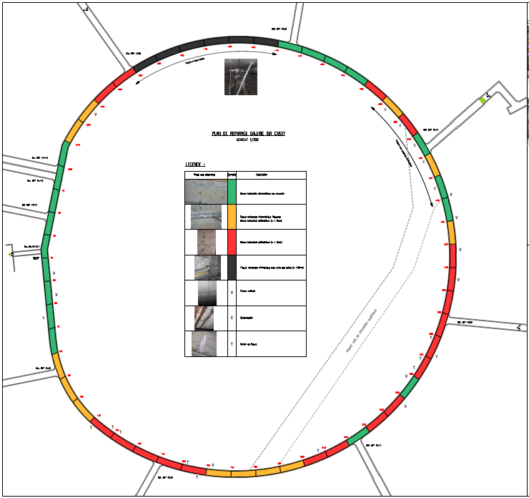
Structural disorder mapping
Horizontal cracks
  Longitudinal cracks larger than 2 mm on 190ml of the gallery (red)
  Important cracks larger than 1cm between B285 (TL5) et B286 (TL6) causing rebars break (black)
  Thinner cracks following rebars pattern
Vertical Cracks
  Ponctual and non-critical
  Works as expansion joint
Carbonation
  6 area of high carbocation
TG Cons – Civil Engineering

Slide 10
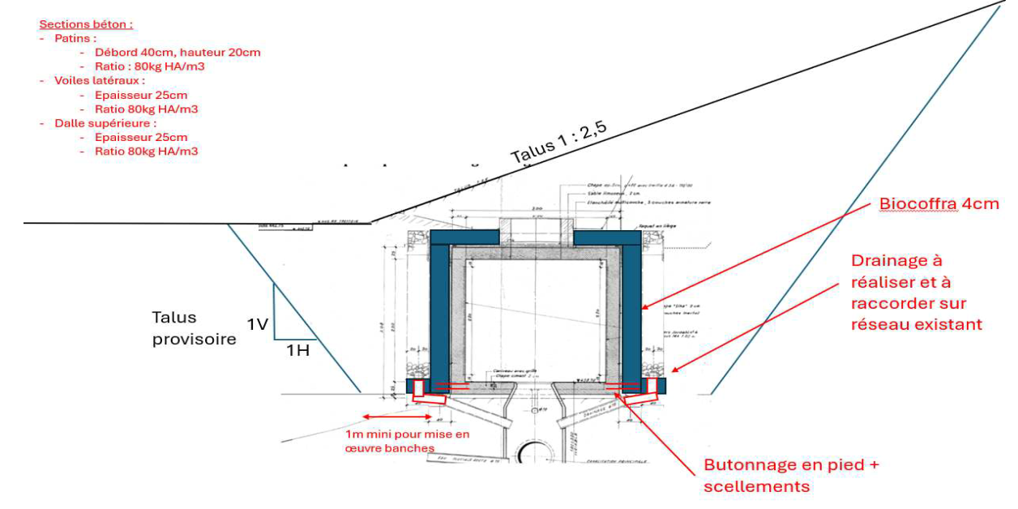
Remedial works solution for the Main Cracks
TG Cons – Civil Engineering

Slide 11
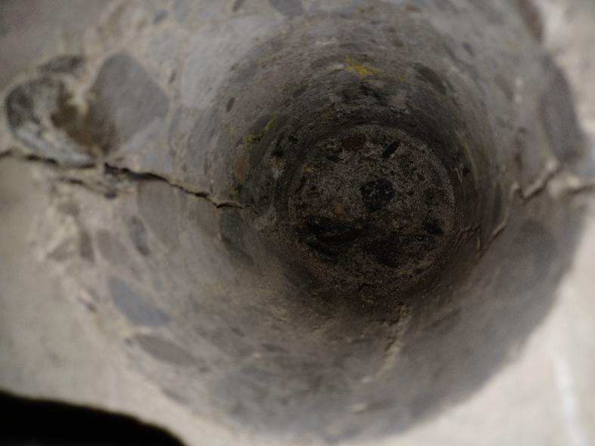
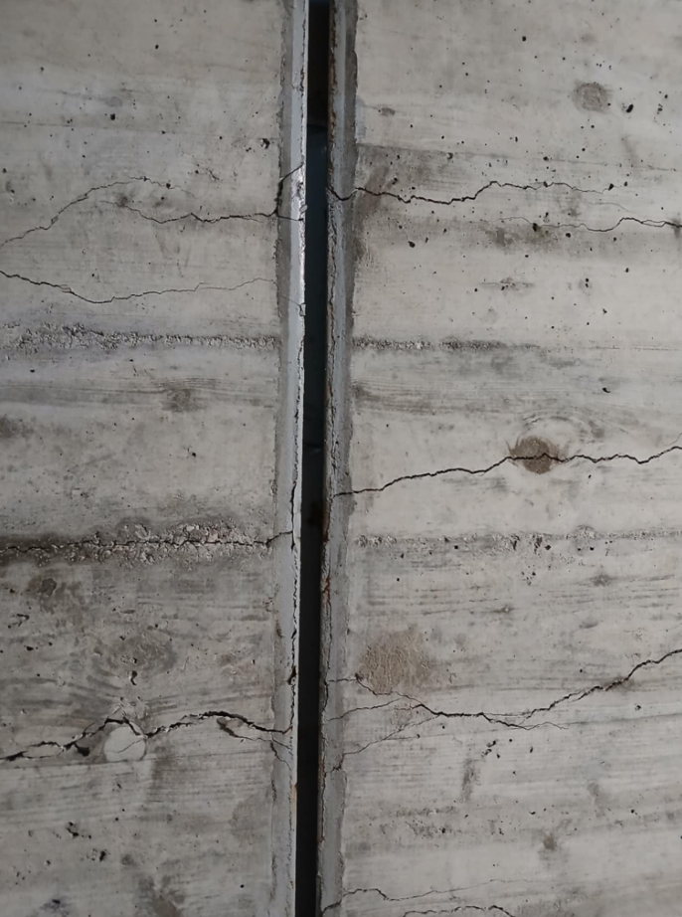
Remedial works solution for the horizontal Cracks
  The gallery is currently monitored, and we know that :
    No movement occured during the last year
    The cracks are old – indicating no recent activity
  What we don’t know:
    How the current structure of the gallery is working
    Define the structure’s remaining lifespan without information movement identify
  Repair plan:
    Monitor the cracks
    In case of movement, the repair solution would need to be defined depending of the evolution
TG Cons – Civil Engineering

Slide 12
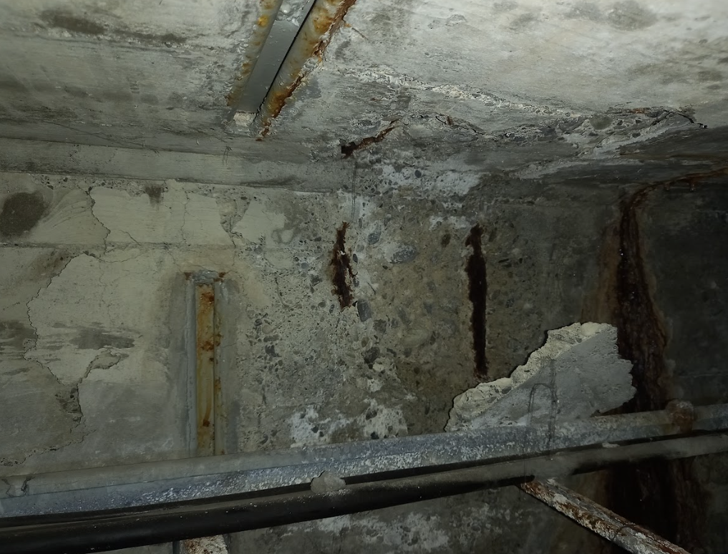
Remedial works solution for carbonation
  The material survey shows that:
    The carbonation is not deeper than 20 mm
    The corrosion rebars has started
  Repair plan
    Removal of carbonated concrete
    Treatment of exposed rebars
    Removal of corroded halfen-rails
    Application of a cementitious coating
TG Cons – Civil Engineering

Slide 13
Remedial works – Cost and planning
 |  | LS3 |  |  |  |  |  |  |  | LS4
 | 2025 | 2026 | 2027 | 2028 | 2029 | 2030 | 2031 | 2032 | 2033 | 2034 | 2035 | 2036
Black area | Studies | Repair
Carbonation | Studies | Repair
Red Area | Movement monitoring |  |  |  |  |  |  |  |  | Repair if need
Orange Area | Movement monitoring
Green Area | Monitoring
Cost (CHF) ±30% | 20,000 | 550,000 |  |  | 0 | 0 | 0 | 0 | 0 | From 0 up to 2,400,000**
* Highly depend on the amount of molasse to be removed
** The 2,400,000 CHF figure corresponds to the worst-case scenario, in which the 190 m of gallery exhibiting cracks wider than 2 mm would require the construction of a full sarcophagus.
TG Cons – Civil Engineering

Slide 14
Alternative Solution – Creation a new technical trench, rerouting all the networks in the technical trench, backfilling of gallery
Cost
  5 Millions (±20%) 25% Structure – 75% Networks
Planning
  Critical services during LS3
Group involved
  SCE/SAM – EN/CV – EN/EL – EN/AA
Risk
  The risk of collapse is fully resolved by the
  proposed intervention.
  Risk related to gallery instability is fully resolved once completed
  Overload of contractors during shutdown periods
  Unavailability of resources for integration studies
  Create Major disturbance for HSE/RP during LS3
OPTION 2 |  | LS3 |  |  |  |  |  |  |  | LS4
 | 2025 | 2026 | 2027 | 2028 | 2029 | 2030 | 2031 | 2032 | 2033 | 2034 | 2035 | 2036
All ISR ring | Studies | Construction
Cost (CHF) ±20% | 200,000 | 4,800,000 |  |  | 0 | 0 | 0 | 0 | 0 | 0 | 0 | 0
Based on current knowledge, this seems out of proportion
TG Cons – Civil Engineering

Slide 15
Road Map - 2025-2026
Launch surveys of the gallery to check the current state of the concrete, the rebars, and the drainage.
Carry on with the execution design for remedial works for point (1).
Determine repair solutions for points (2) and (3)
Evaluate the costs and impacts of remedial works for the overall ring
Define funding to execute remedial works during LS3
Appointing a consultant for the tender design
Launch of an IT for the remedial works for Main cracks repair
Carbonation Treatment can be done by frame contractor
TG Cons – Civil Engineering – GT837

Slide 17
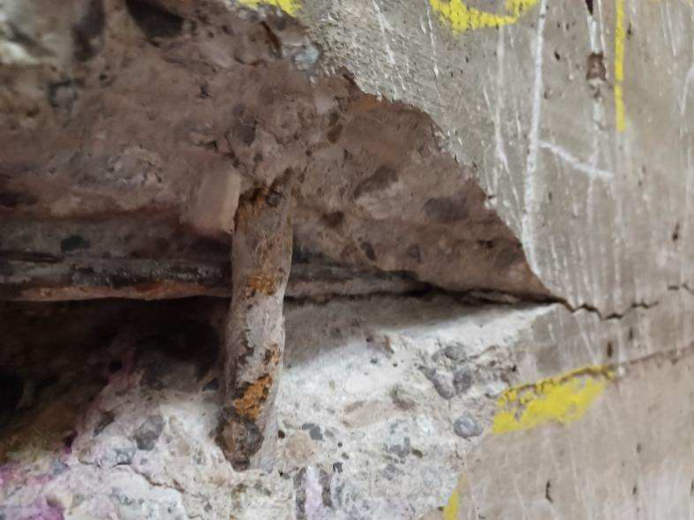
Back up - Material survey Report – CRL Survey
Horizontal Cracking
Cause: Likely due to hydraulic pressure, compaction, or swelling exceeding design strength.
Inspection: No corrosion found in reinforcement.
Carbonation
Depth: Most areas unaffected, but carbonation reached within 5mm in some cracks.
Cracks: Suggest long-term presence of cracks.
Chloride
Risk: Chloride-induced corrosion risk is "Negligible" to "Moderate".
Sulphate
Attack: No evidence found.
Alkali Metals
Content: High levels, no alkali reactivity observed.
Petrographical Analysis
Condition: Low deterioration with high strength aggregates.
Corrosion
Carbonated Areas: Active corrosion.
Uncarbonated Areas: Clean reinforcement.
Cracks developed along the rebars shortly after casting, but did not extend beyond them. (Often thinner than 2mm)
Cracks which are not align with rebars pattern are wider and are going through all the wall (Often the one wider than 2mm)
TG Cons – Civil Engineering – GT837

Slide 18
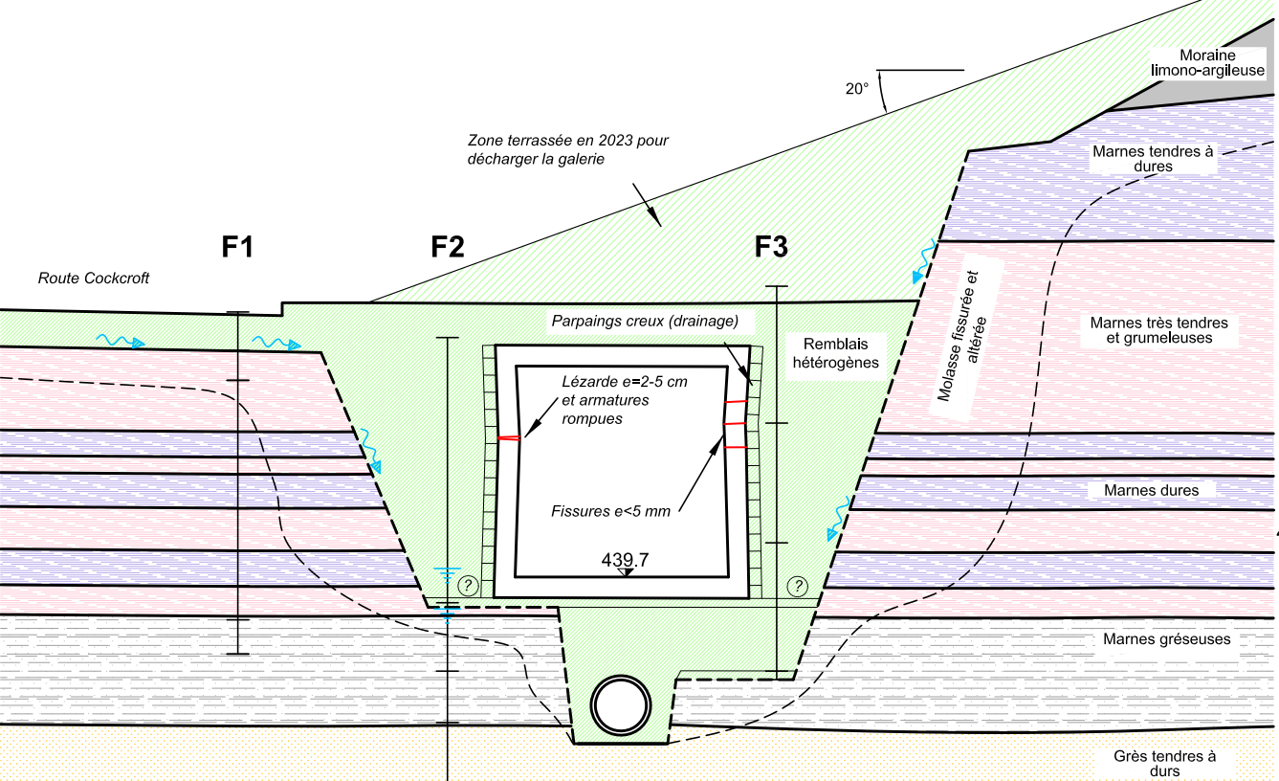
Back up – Geotechnical Section
TG Cons – Civil Engineering – GT837

