Slide 2
Technical Galleries Consolidation Program
Project Board meeting#5 - 6th June
Budget allocation 2025-2028 / Works 2025-2028 & LS3 Impact
E. Amarilla EN-CV-WMC

Slide 3
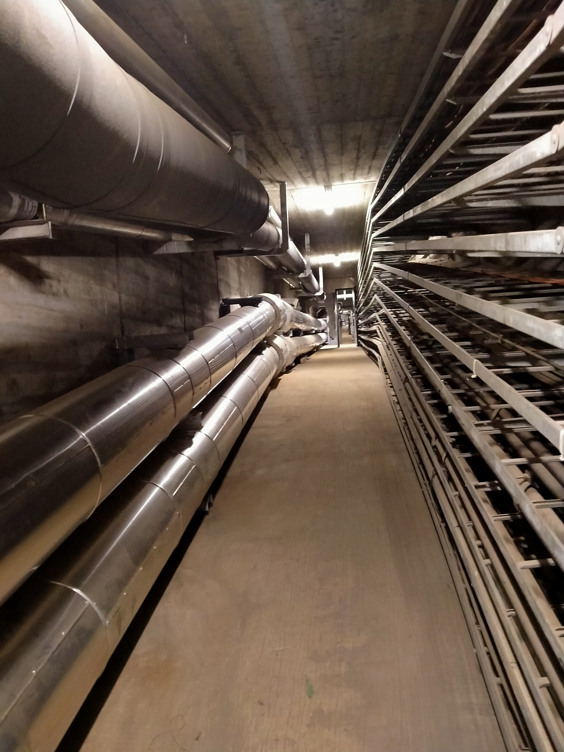
EN-CV CONSOLIDATION STATUS: MEYRIN

Slide 4
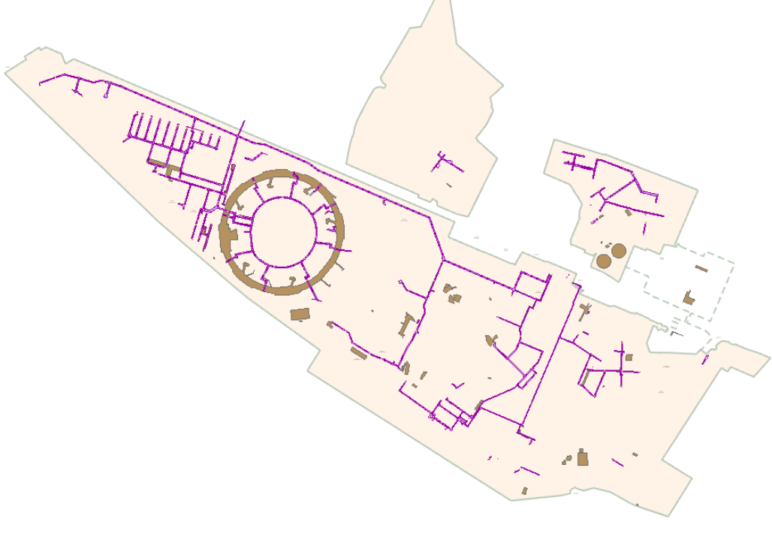
EN-CV Consolidation works: Initial planning
WEST AREA
2022-2024
CENTRAL AREA
2025-2029
EAST AREA
2030-xxxx

Slide 5
EN-CV Consolidation works: Status
WEST AREA
COMPLETED
2022- April 2025
ON GOING
CENTRAL AREA
Nov 2024-2030
EAST AREA
INVENTORY IN PROGRESS
From 2031

Slide 6

BUDGET ALLOCATION 2025-2028

Slide 7
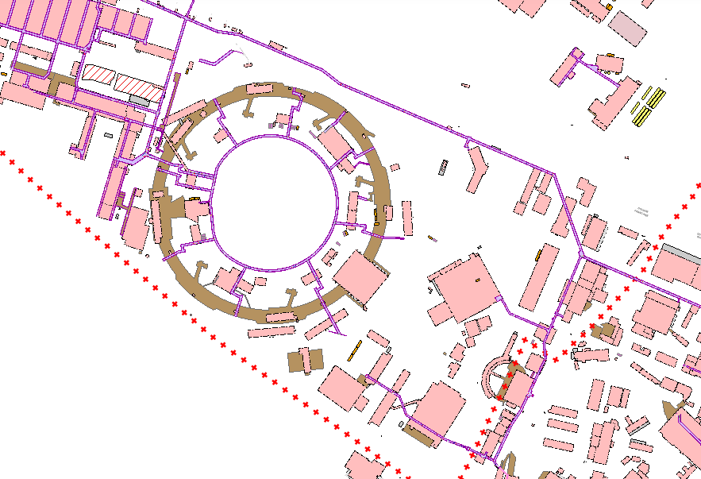
Budget & Works planning: Constraints
The compressed air feeding to West area by the buried pipe has to be completed in 2025 to allow works in GT825 from 2026
GT825 long gallery: not enough 2026 to finish GT835-bdg.54
Constraints LS3:
Experimental areas Isolde-AD-Booster-Linac need to be consolidated during an LS period:
B193 connection to GT833 has to be completed during LS3
Connection between b.361 and b.359 has to be done during LS3, drinking water used for POPS CT. This area has to be done in collaboration with SCE to renew the whole passage: AC, EP and EC
Time constraint: 14 months to install more than 1500m (EN-CV&SCE)
2026
-2027
GT825
2028
GT837/GT821
2029-2030
2025
Water tower
2027
GT833
Buried pipes
2025
833
AC
2025-2026
EP

Slide 8
Budget & Works planning
2026
-2027
Very ambitious target. The current allocation does not match with works schedule
Major works in 2025 to prepare LS3
2026 and 2027: Important period for works advancement in the experimental areas (Booster/Linac)
After 2028 we could foresee smaller works for ISR area during 2/3 years
From 2031 we could start the East area of Meyrin with higher budget.
GT825
2028
GT837/GT821
2029-2030
2025
Water tower
2027
GT833
Buried pipes
2025
833
AC
2025-2026
EP

Slide 9
Budget Forecast EN-CV
 | 2025 | 2026 | 2027 | 2028
CET | 250k CHF
South feeding pipes | 675kCHF
GT825 (835-b54) |  | 375kCHF | 300kCHF
GT833 (b28-Linac4) |  | 300kCHF
GT833 (Isolde-Linac4) |  |  | 550kCHF | 100kCHF
GT825 (b54-Isolde) |  |  |  | 300kCHF
Current (2.4MCHF) | 590kCHF | 600kCHF | 600kCHF | 600kCHF
New Proposal (2.925MCHF) | 1000kCHF | 675kCHF | 850kCHF | 400kCHF
OK for works in 2025

Slide 10
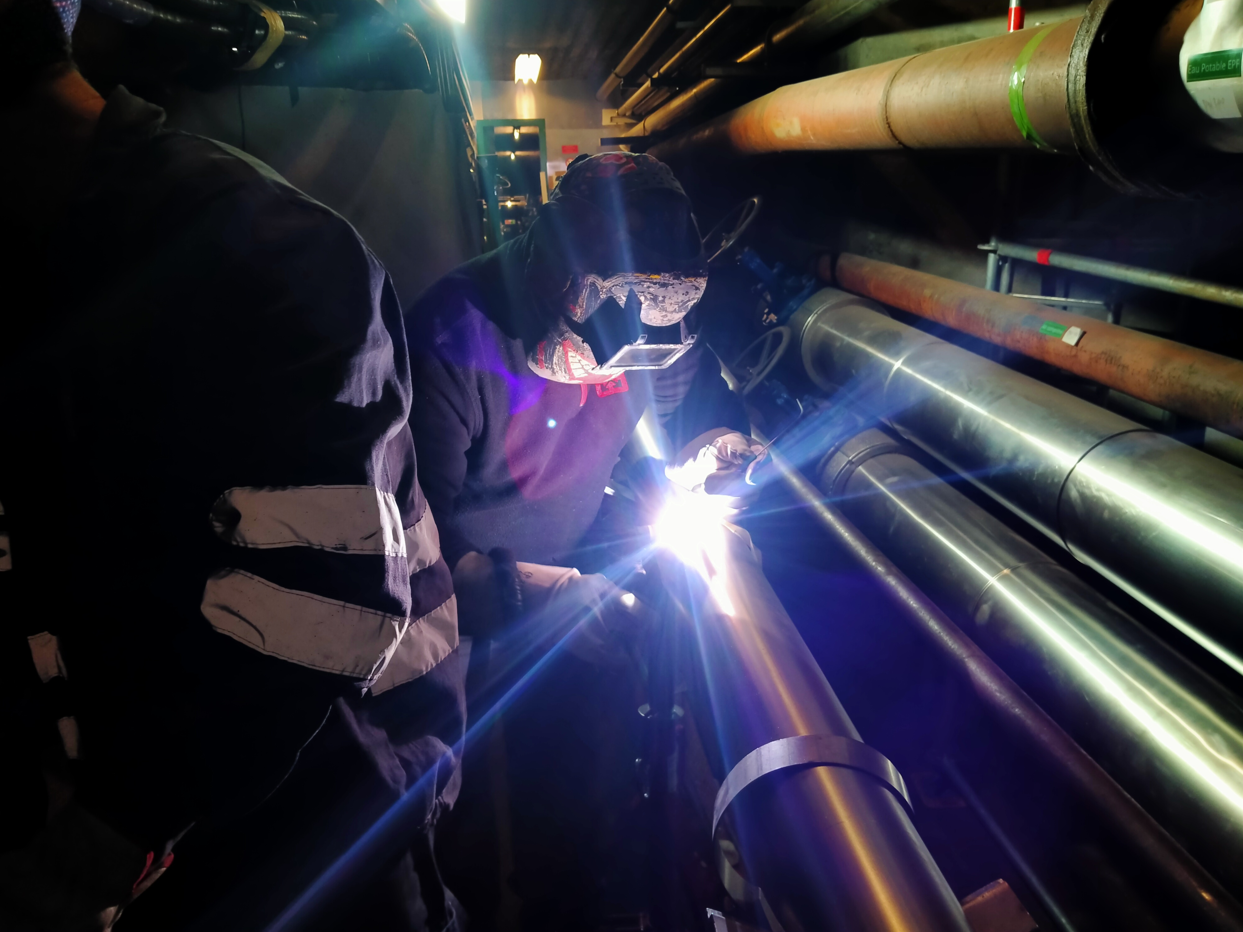
EN-CV WORKS 2025-2028 & LS3 IMPACT

Slide 11
EN-CV future works planning
2026
-2027
GT825
2028
GT837/GT821
2029-2030
2025
Water tower
2027
East Meyrin
From 2031
GT833
South feeding pipes
2025
833
2025-2026
833

Slide 12
GT825 works
Works impact during LS3

Slide 13
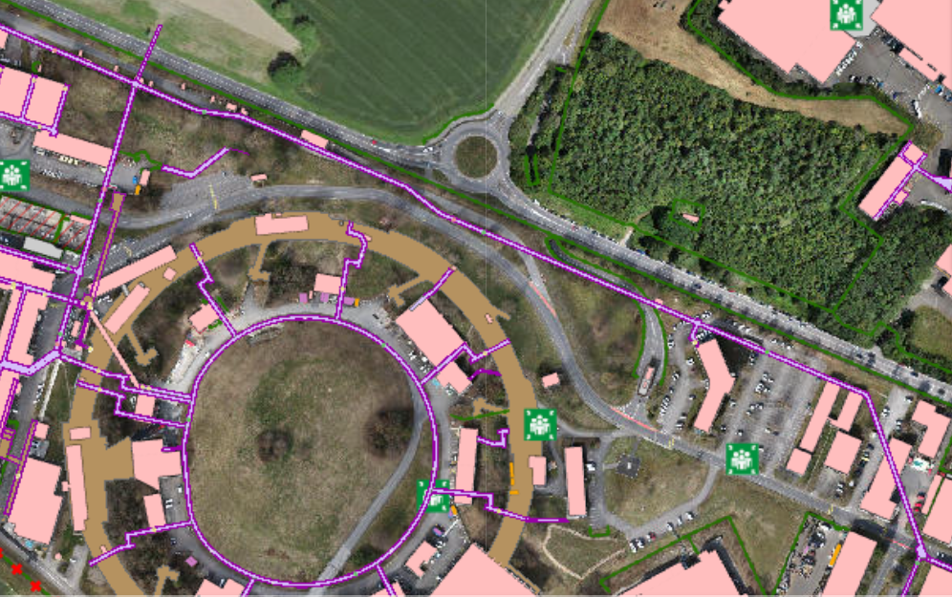
TG CONS LS3 Impact: GT825
Preliminary Planning (GT835-bdg.54): Nov 2025 – May 2027
Piping layout: Cross sections studies almost finished. Validation ongoing. (415m)
In GT825 we need to dismantle to allow new piping installation: Firefighting, compressed air and drinking water pipes
Drinking water network: No double feeding to CDE will be in service during works
Only bdg.54 could be impacted by a short service disruption
2025/2027
2028

Slide 14
TG CONS LS3 Impact: GT825
Works in GT825 are feasible only if we have the south line feeding compressed air to the West area (GT833-311)
Compressed air line will be out of service from bdg.54

Slide 15
GT833 works
Firefighting network disruption during LS3

Slide 16
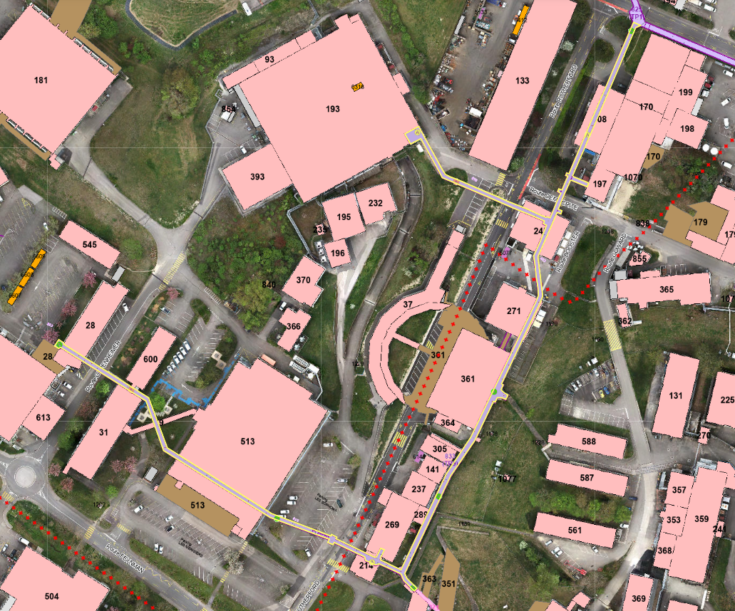
TG CONS LS3 Impact: Firefighting network
The disruption of firefighting network for several
months has to be validated with the Fire Brigade
Meeting 6th June
EN-CV works in GT833:
Service disruption of several networks to allow works:
Compressed air
Drinking water
Firefighting water
Demineralised water
Chilled water
Different disruptions on areas and duration will be foreseen to minimize the impact of the works as much as possible.
Buildings/areas involved:
Compressed air: At least these buildings are involved. Need of service disruption in other buildings to be defined
b.275, b.65, b.508, Isolde, PSBooster tunnel and surface (37, 361,271), b.365, AD, PS ring surface (b.353, 357, 359, 367, 561, 587, 588, 270), b.269, data center area (b.28, 31, 186, 513), Linac 4, Linac3
Drinking water: At least these buildings are involved. Need of service disruption in other buildings to be defined
b.133,b.508, Isolde buildings, Medicis, POPSB, b.365, AD (b.193, 393, 232, 195), PSBooster surface buildings, PS ring surface (b.353, 357, 359, 367, 561, 573, 587, 588, 270), b.269, data center area (b.28, 31, 545, 186, 613, 513), Linac 3, Linac 4, b.504 (R2)
2027
2025-2026
2026

Slide 17
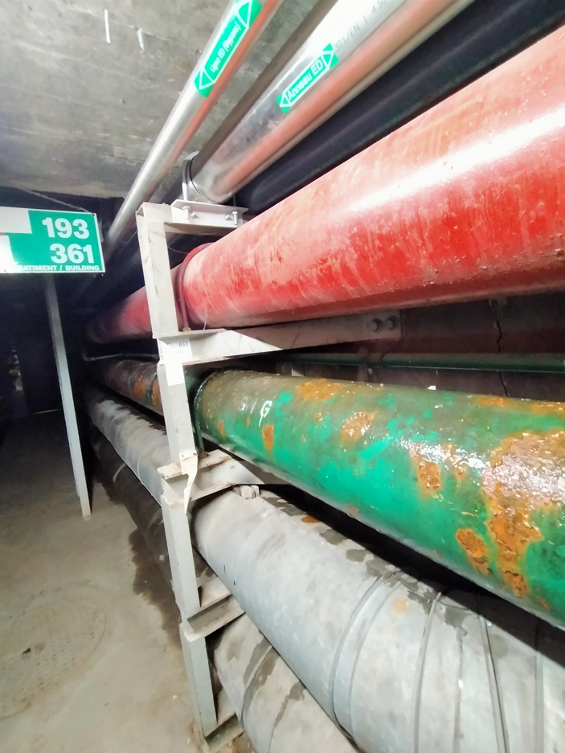
TG CONS LS3 Impact: Firefighting network
Works on GT833 (513 area and Booster area) networks are foreseen from June 2025 till June 2028
The firefighting pipeline feeding several hydrants and a few buildings (RIAs) will be out of service to allow the needed room for new pipes
Firefighting water disruptions foreseen from November 2025
New strategy for firefighting during LS3 period is needed in the Booster area and PS center ring surface, following works advancement
Today first discussion with the Fire Brigade: Positive feedback to EN-CV request
Eau incendie

Slide 18
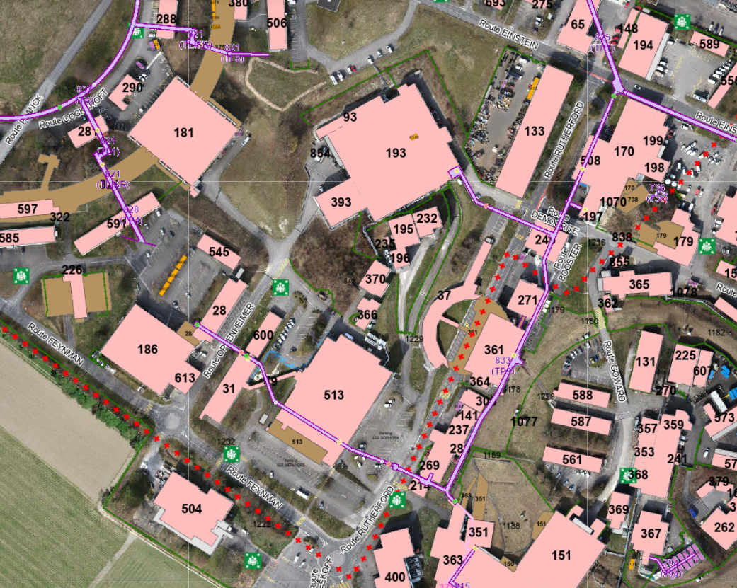
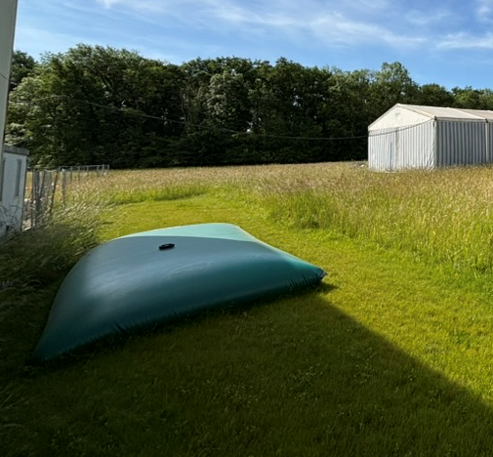
SERVICE DISRUPTION OF CURRENT HYDRANTS
Two critical areas: the fire brigade will evaluate risks and strategy
Mitigation measures: N.2 locations with water containers of 10m³ and hoses branched to some hydrants ready to be used
Cost about 15kCHF (BC TG CONS)
HS Set 2026
13 months
HS Set 2026
Coupure zone complete
1 wk Avril 2026
13 months
HS definitive Avril 2026
HS Nov2025
10 months
HS Set 2026
10 months

Slide 19
SERVICE RESTORED
Service: Oct 2027
Service: Oct 2027
Service: Avril 2027
Service: Aout 2026
Service: Juillet 2027

Slide 20
GT833 works
Works impact during LS3

Slide 21
TG CONS LS3 Impact: GT833
Sequencial planning defined for GT833 works in LS3
WORKS DESCRIPTION | NETWORK | AREA | NOTE DE COUPURE / CONSTRAINTS | Planning
Connexion, basculement et test ligne bouclage zone West au C.T.5 b.28-31-186-513-613(Note de coupure) | AC | ZONE 1 | b.28-31-186-513-613 | Aout 2025 (max 1 day)
Connexion Booster (Vérifier bouclage par le Tunnel) PAS DE COUPURE | AC | ZONE 3 | Booster impliqué | YETS25 (max 1 day)
Connexion b.359 pas possible pour l'instant. Attendre LS3 (Note de coupure 1 journée AC: b588-587-561-357-353-359-367-270 ) | AC | ZONE 3 | b588-587-561-357-353-359-367-270 | Nov 26 (max 1 day)
EIF (Garantir alimentation vers 513 avec l'EP) 1 journée | EP | ZONE 1 | b. 513 | Oct-25
Connexion EP cross linac et vers lignes enterrés (C.T.5 et C. T.7) (Note de coupure 1 JOURNÉE) | EP | ZONE 2 | b.28-31-186-513-613-366/370 | Fin juillet 26 (max 1 day)
Connexion piquages EP nouvelle b.28-31-186-513-613-366/370 (Note de coupure) | EP | ZONE 1 | b.28-31-186-513-613-366/370 | Fin juillet 26 (max 1 day)
Connexion piquages Booster et Linac/Leir (Note de coupure, b.361,b.289, 141, 237, 6141, 359) | EP | ZONE 3 | b.361,b.289, 141, 237, 6141, 588-587-561-357-353-359-573-262-367 | Nov 26 (max 1 day)
Connexion, basculement sur ligne nouvelle (Notes de coupure AC: / b. 65-194-275 / sans coupure si bouclage Booster OK: 197-170-Isolde tunnel-Medicis / B.508 / B.365 / Attendre Nov2026 pour AD B.193 ) | AC | ZONE 5 | b. 65-194-275 | Juin2026 (max 1 day)
Connexion, basculement sur ligne nouvelle (Notes de coupure AC: sans coupure si bouclage Booster OK: 197-170-Isolde tunnel-Medicis | AC | ZONE 5 | 197-170-Isolde -Medicis | Set2026 (max 1 day)
Connexion, basculement sur ligne nouvelle (Notes de coupure AC: B.508 / B.365 | AC | ZONE 5 | B.508 / B.365 | Set2026 (max 1 day)
Connexion, basculement sur ligne nouvelle (Notes de coupure AC: Attendre Nov2026 pour AD B.193 ) | AC | ZONE 4 | b.193-195-393-232-853(AD RING et AD TARGET)-Vannes source ELENA | Nov 26 (max 1 day)
Connexion tous les piquages AD/b245 Note de coupure EP: b.193-393-232-93-245 1 journée | EP | ZONE 4 | b.193-393-232-93-245 | Avril27 (max 1 day)
Connexion tous les piquages /hydrant-365-133/ 197-Isolde / b508 / b.133 (Notes de coupure d'une journée) | EP | ZONE 5 | 365-133/ 197-Isolde / b508 / b.133 | Set2027
Basculement connexions AD pour l'AC (Note de coupure) Coupure AC: b.193-195-393-232-853(AD RING et AD TARGET)-Vannes source ELENA | AC | ZONE 6 | b.193-195-393-232-853(AD RING et AD TARGET)-Vannes source ELENA | Fev 27 (max 1 day)
Mise HS EP (2 lignes) Coupure EP: b.193-393-232-93 | EP | ZONE 6 | b.193-393-232-93 | Avril 27 (max 1 day)
Connexion Nouvelle ligne EP vers b.193 connecté sur nouveaux réseau. Coupure EP: b.193-393-232-93 | EP | ZONE 4 | b.193-393-232-93 | Oct 27 (max 1 day)
Alimentation ligne EIF depuis l'EPF au b.588 - Connexion DN50 (2 journées) et bride ligne EIF. Mise HS la premiere partie de la ligne cross Booster-b.588 | EP | ZONE 7 | b588-587-561-357-353-359-367-270 | Mars 2027 (2 days)
Mise HS EIF au 588 et EPF dans le cross Booster Coupure b588-587-561-357-353-359-367-270 | EP | ZONE 7 | b588-587-561-357-353-359-367-270 | June2027-July2027 (8 weeks)
Connexion AC sur la ligne nouvelle (1 semaine) | AC | ZONE 7 | b588-587-561-357-353-359-367-270 | Juin 27 (1 semaine)
ZONE 5
Works sequence
defined with 19 service
disruption periods linked
to the execution
ZONE 6
ZONE 4
ZONE 1
ZONE 7
ZONE 3
ZONE 2

Slide 22
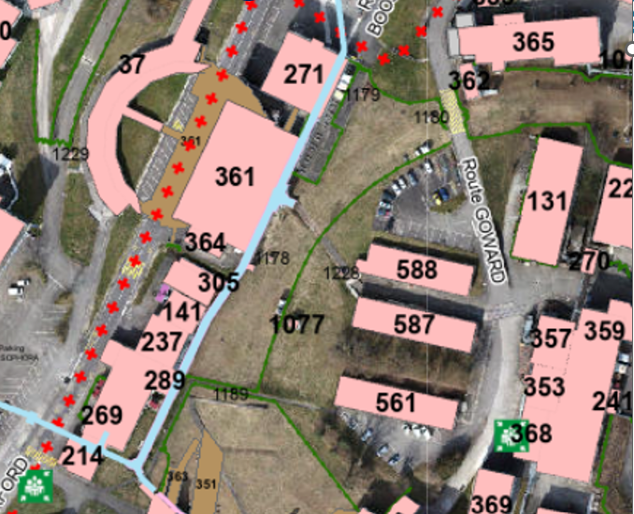
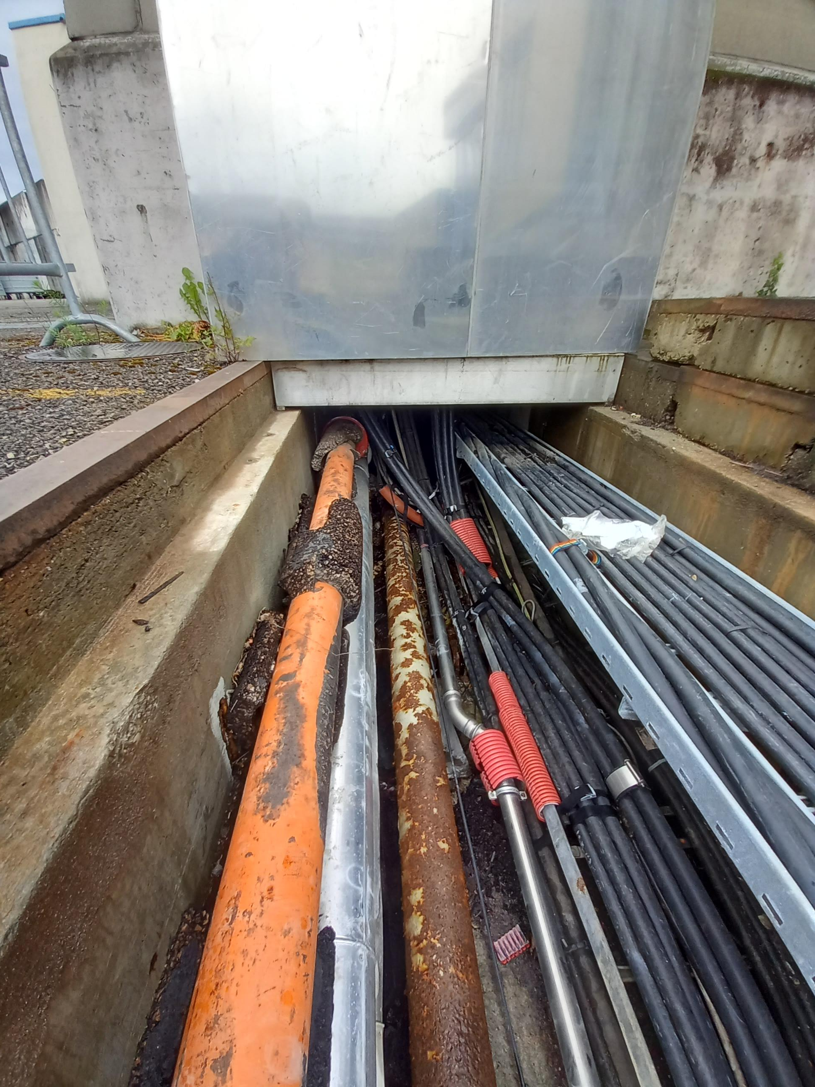
TG CONS LS3 Impact: PS center ring surface
Main distribution line (115m) for drinking water, compressed air, hot water and cables from GT833 to bdg.359
SCE and EN-CV will intervene simultaneously
The hot water lines need to be repaired but there is no access to the pipes: EN-CV pipes are on the top. During works hot water pipes will be partially replaced
Compressed air line will be in service during works. Only small modifications and short disruptions (1 week) are foreseen
Drinking water completely replaced. Service disruption for drinking water of about 2 months (June/July). Priority!
A new hydrant will be installed close to bdg.359
Some decabling works will be done by EN-EL
Eau incendie
Eau potable
Eau chaude

Slide 23
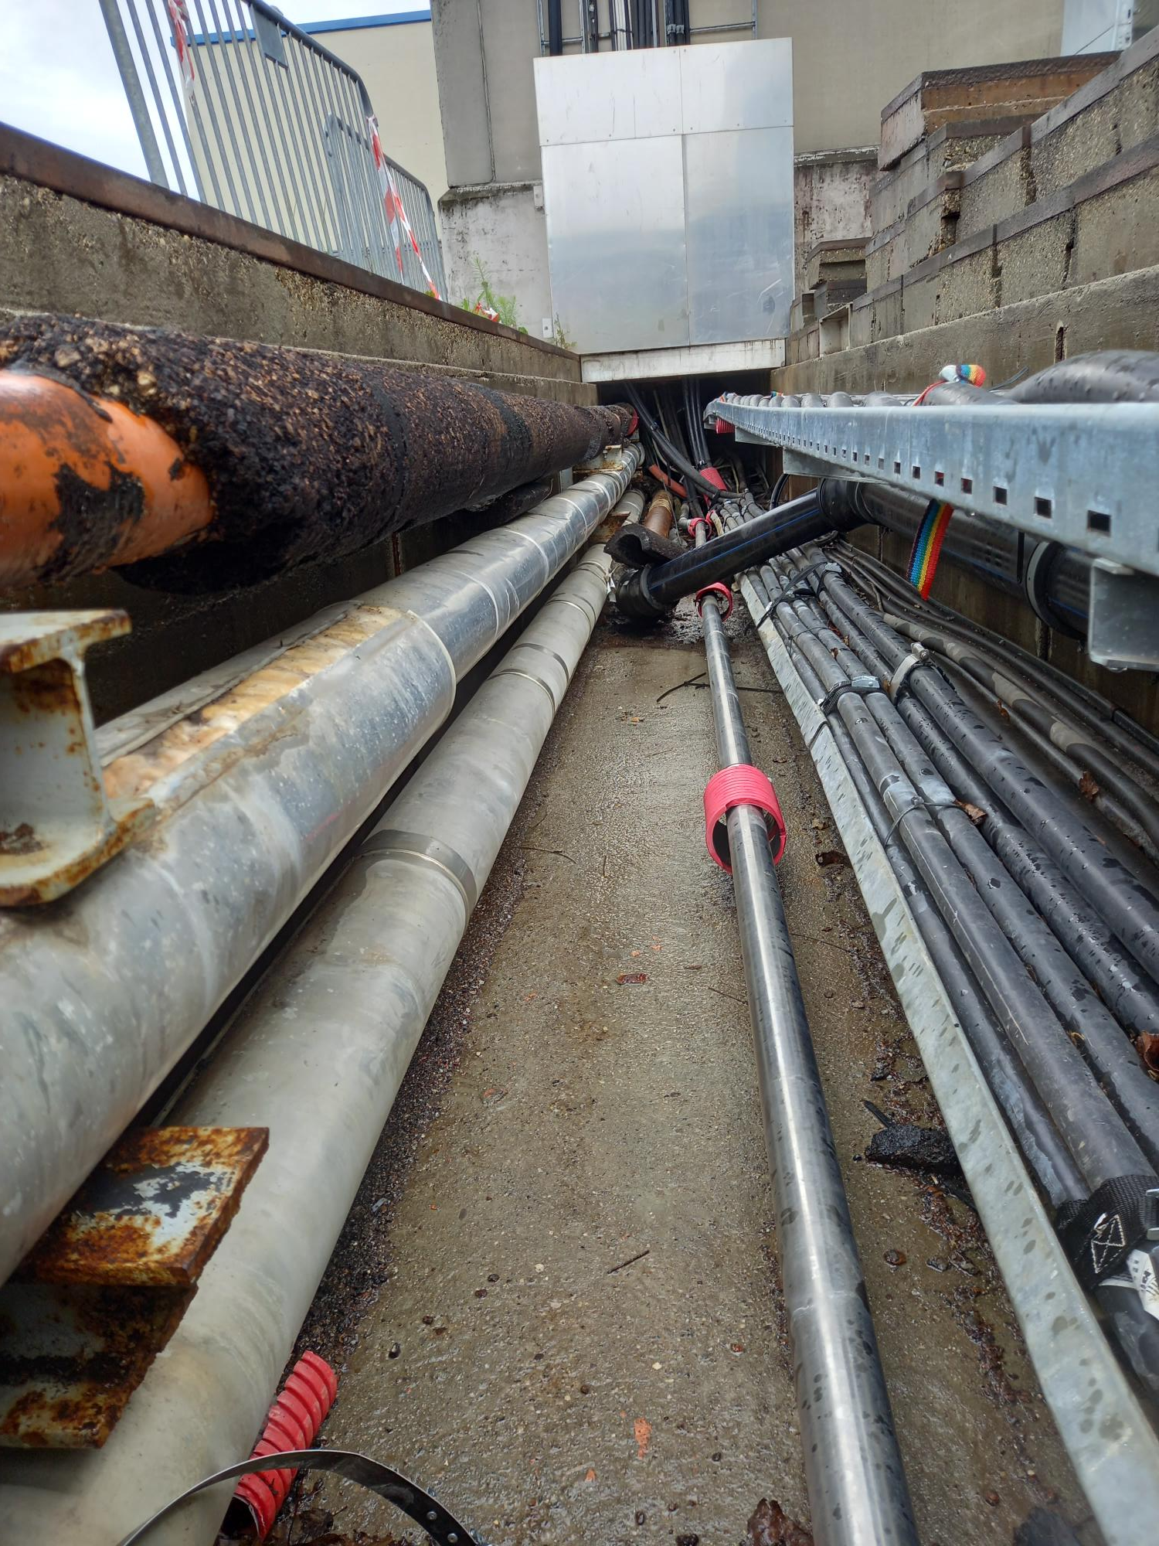
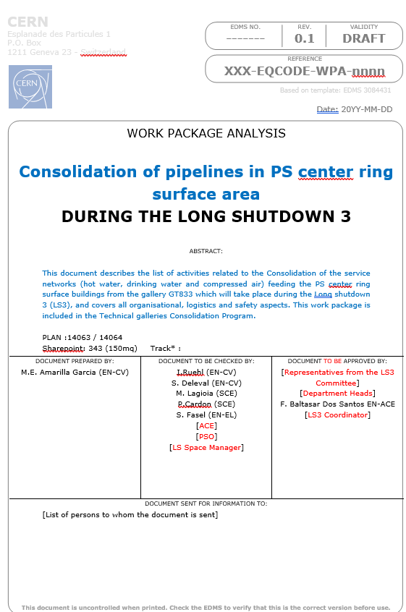
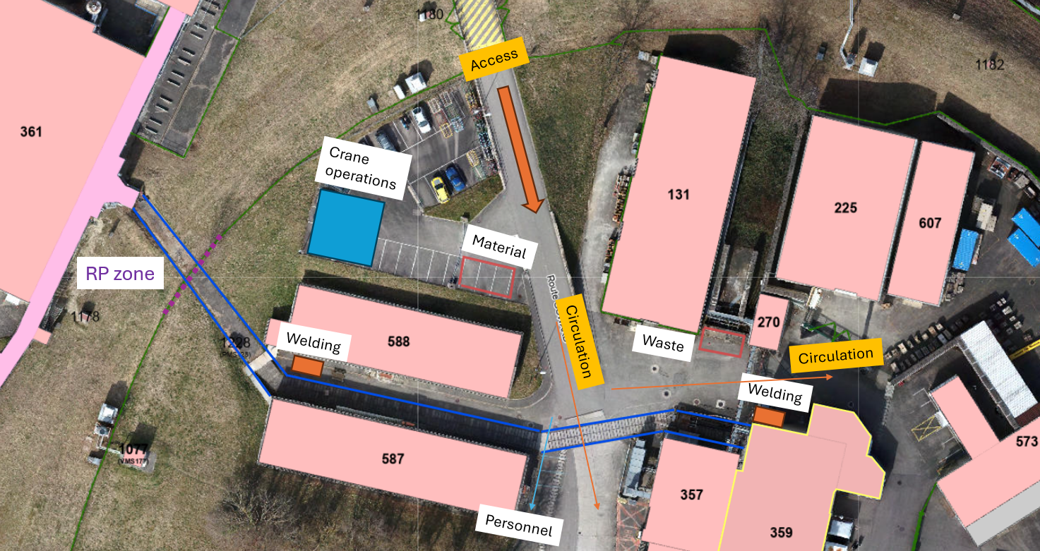
TG CONS LS3 Impact: PS center ring surface
Preliminary Planning: March 2027-Oct 2027
These works have to be included in the Coordination plan for LS3 to check the constraints. WPA done for these works.

Slide 24
GT833 works
Material access

Slide 25
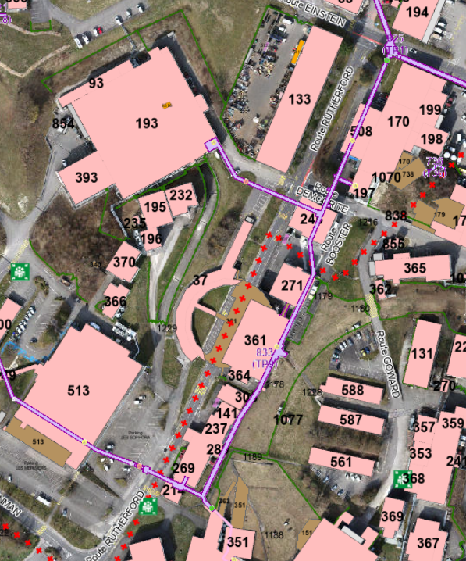
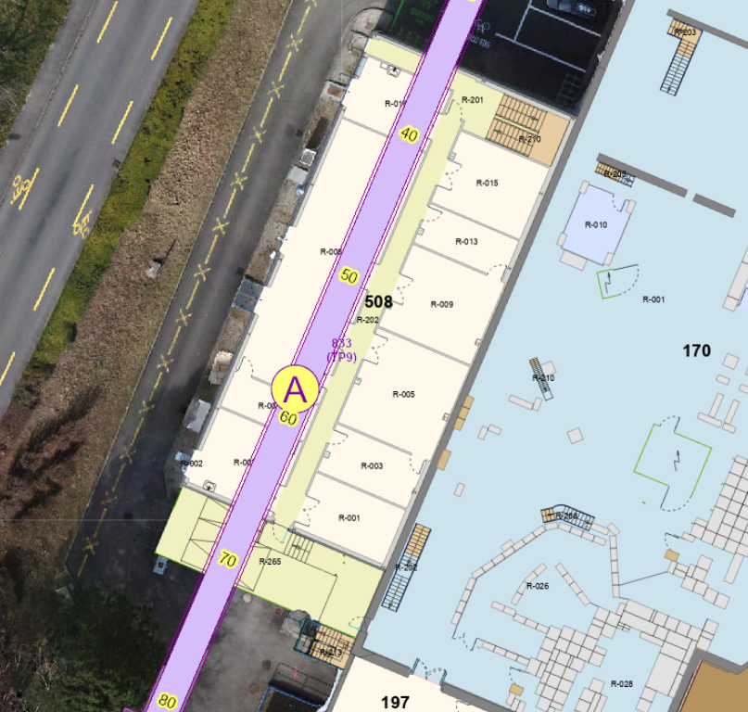
URGENT REQUEST: Material Access traps
NO MATERIAL ACCESS IN GT833
GT833 is 300m long with some complicated areas: narrow passage close to Isolde and stairs close to Booster. Crosses would not allow big pipes to turn
No possible to use traps in 193 or 513 to arrive to GT833
About 1300m of piping to install in this gallery in 12/14 months for EN-CV. Almost impossible if there is no access available
6m pipes for big diameters (DN200-DN350) could not be entered into the gallery:
High cost for cutting and welding pipes
Time consuming activity
In the past there was an access that has been closed
due to the building 508 construction and the new labs

Slide 26
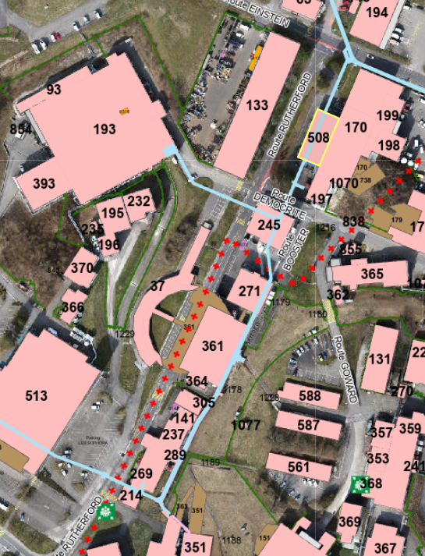
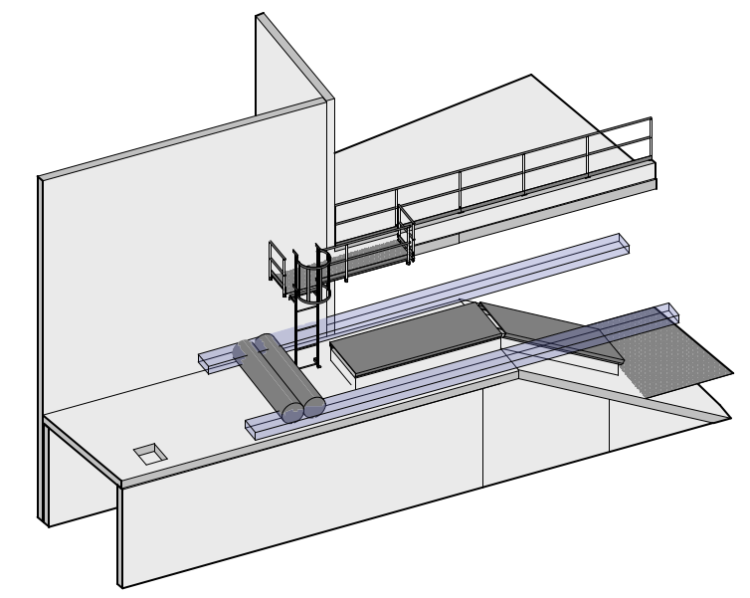
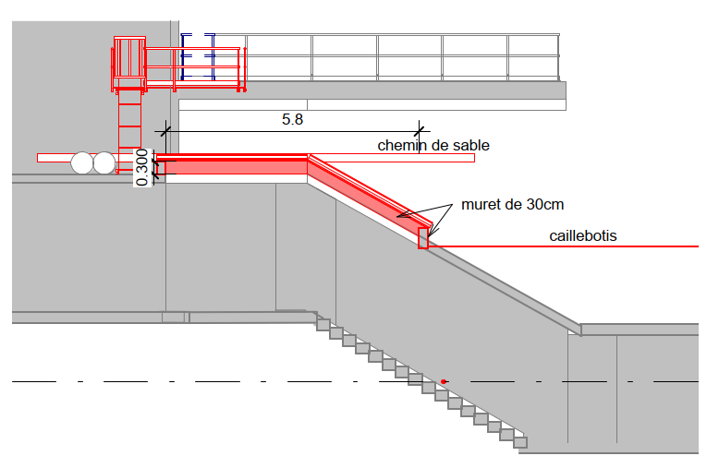
URGENT REQUEST: Material Access traps
An urgent request to the TG CONS program and to SCE has been done to open n.2 traps in the GT833 (min. 5m long): close to Isolde current trap and close to Booster cross.
SCE-SAM has already a 3D model for the trap close to Booster
According to EN-CV preliminary planning for GT833 the traps should be ready in March 2026

Slide 27
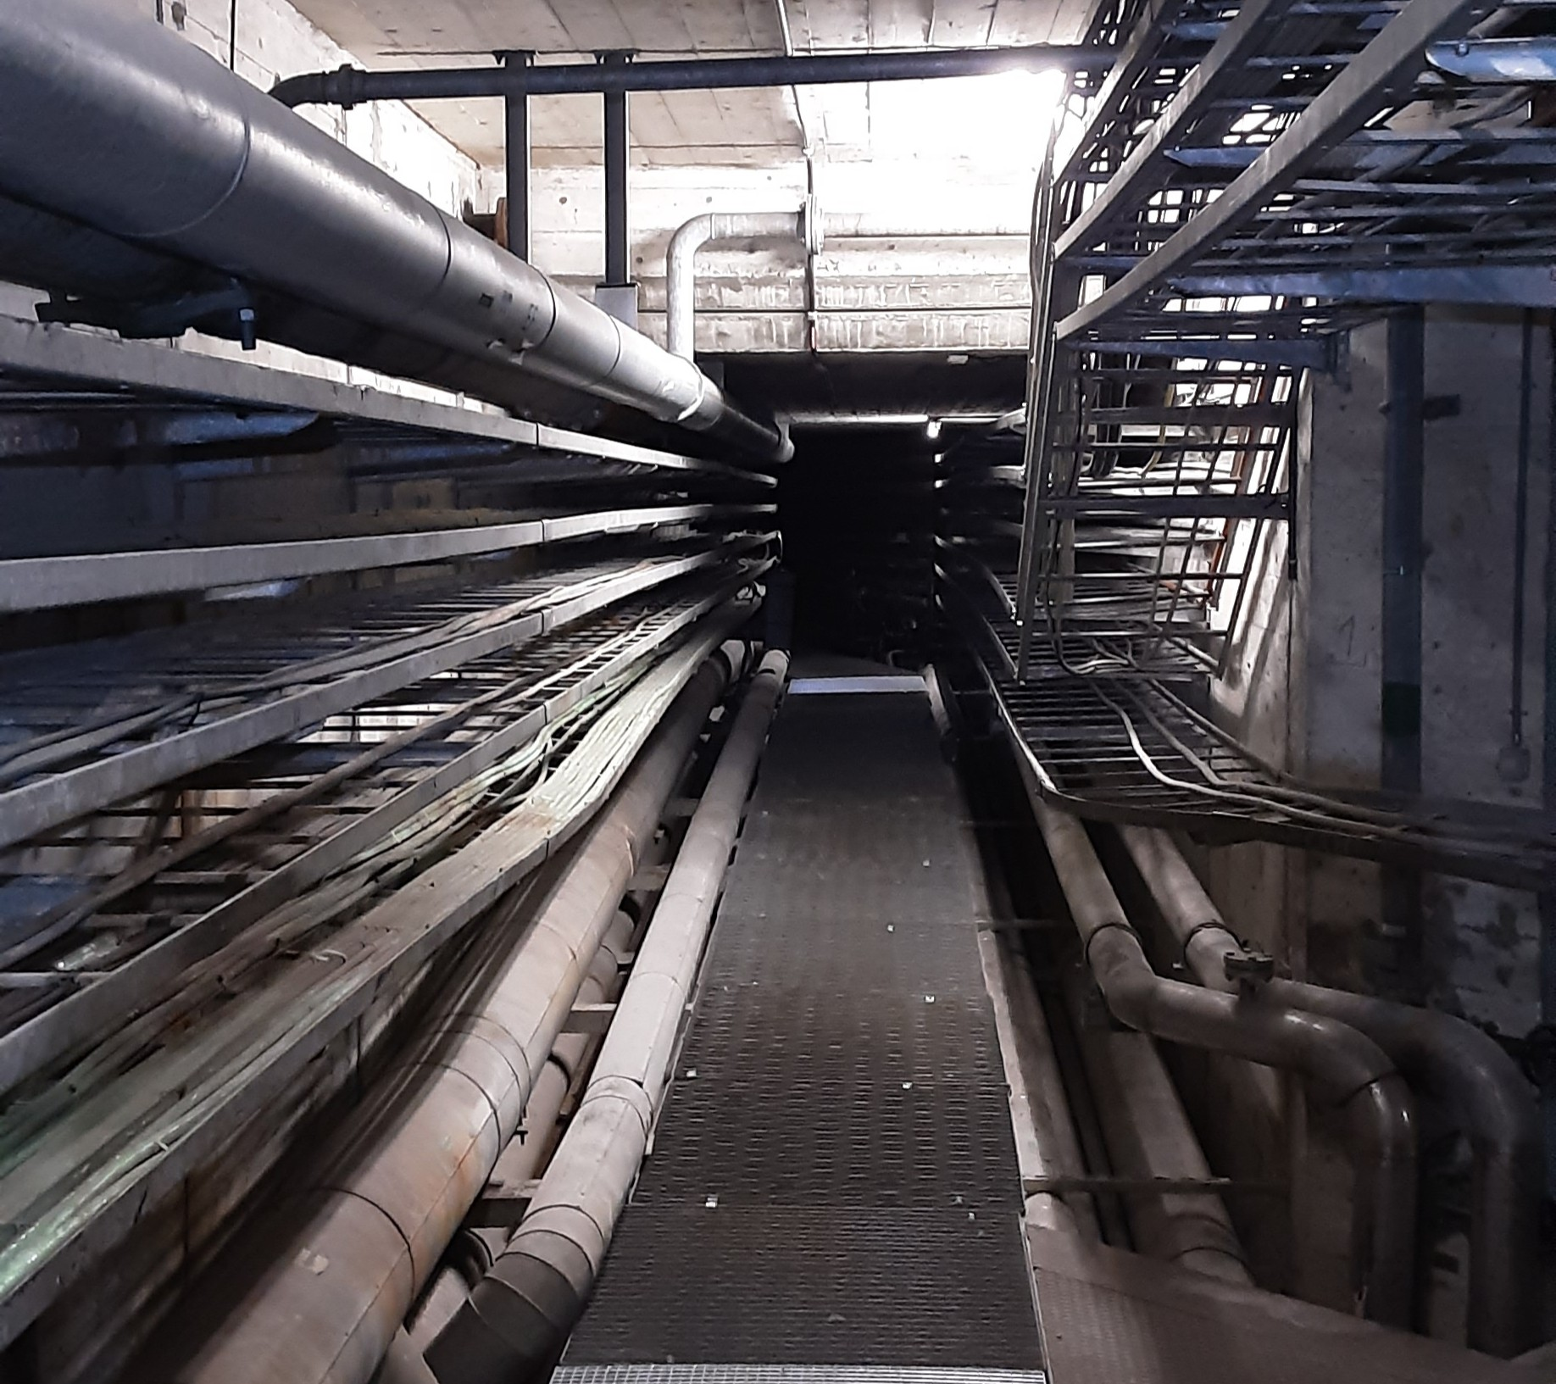
MAJOR EVENT IN ISR GALLERY

Slide 28
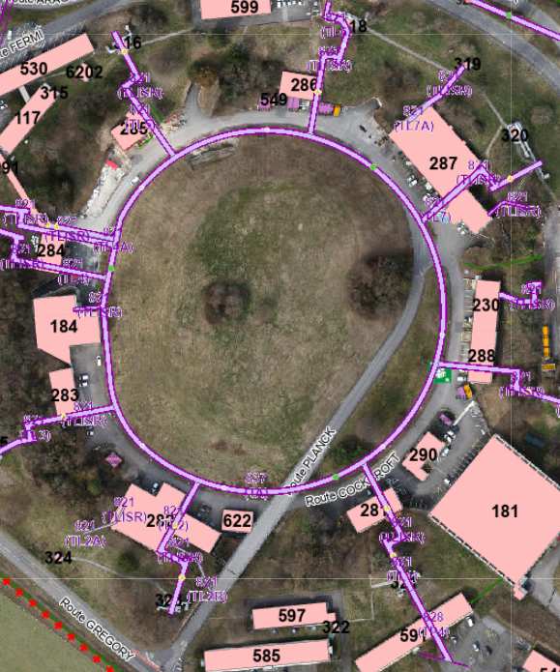
Major event in ISR technical gallery GT837
EVENT: COLLAPSE, SEVERE LEAK, OTHER MAJOR EVENT?
DAMAGED AREA: TL5-TL6

Slide 29
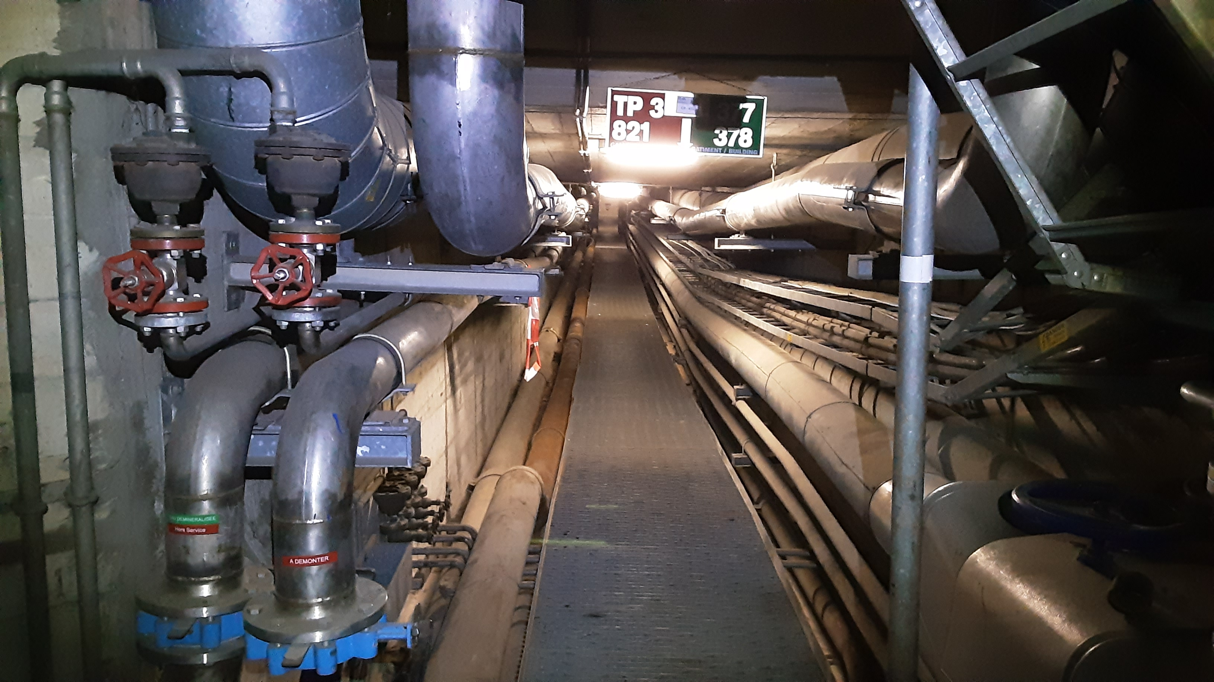
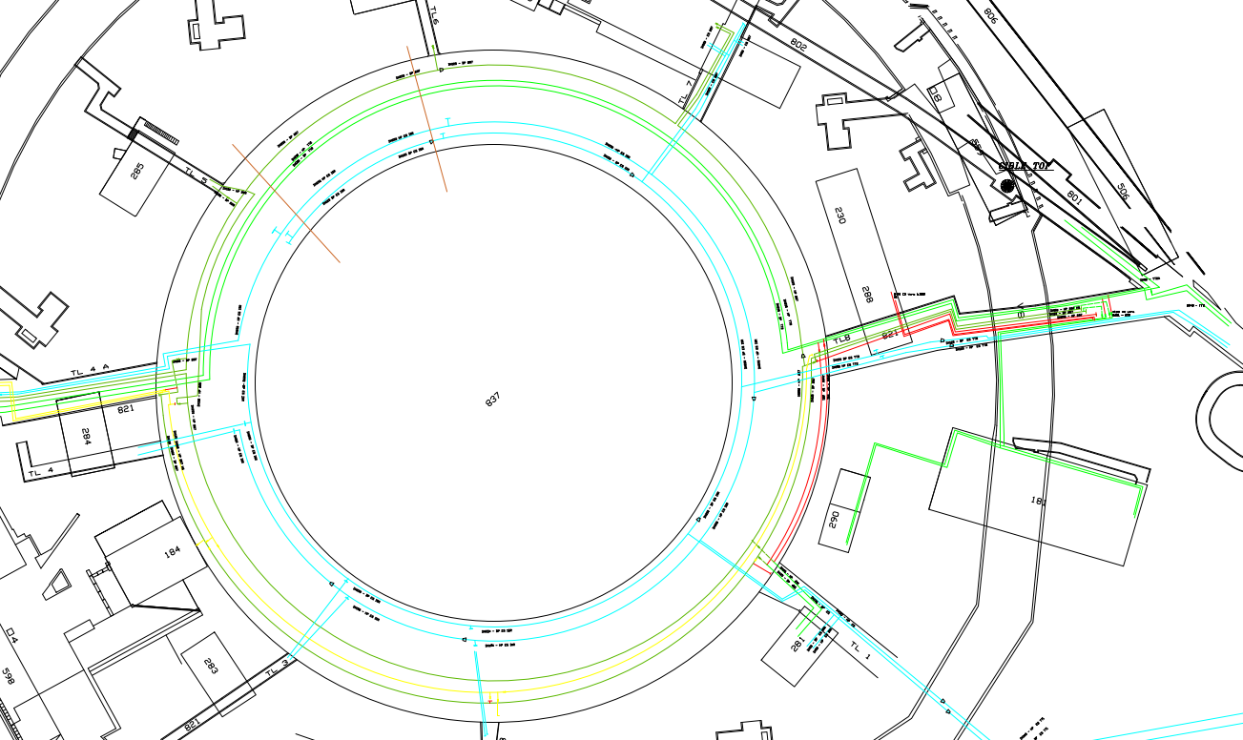
Major event in ISR technical gallery GT837
Cooling circuits in the area:
  HP and BP lines of demi water circuit cooling nTOF magnets (TT2 beam dump impacted)
  BP line of demi water circuit cooling ISR zone test (return line from bdg.287)
  HP and BP lines of chilled water circuit cooling ventilation units in TT2, bdg.287 and 281
Impact:
  nTOF magnets circuit out of service: It could be branched to zone test circuit. Works needed.
  Bdg.287, 281 and 285 out of service
  Chilled water out of service for ventilation units
To take into account:
  LS3: Zone test ISR more impacted than tunnels
  RUN: nTOF and Tunnels more impacted than surface bdgs.
  Piping not accessible for repairing or modification all along the gallery
287
285
nTOF,TT2
beam dump
281

Slide 30
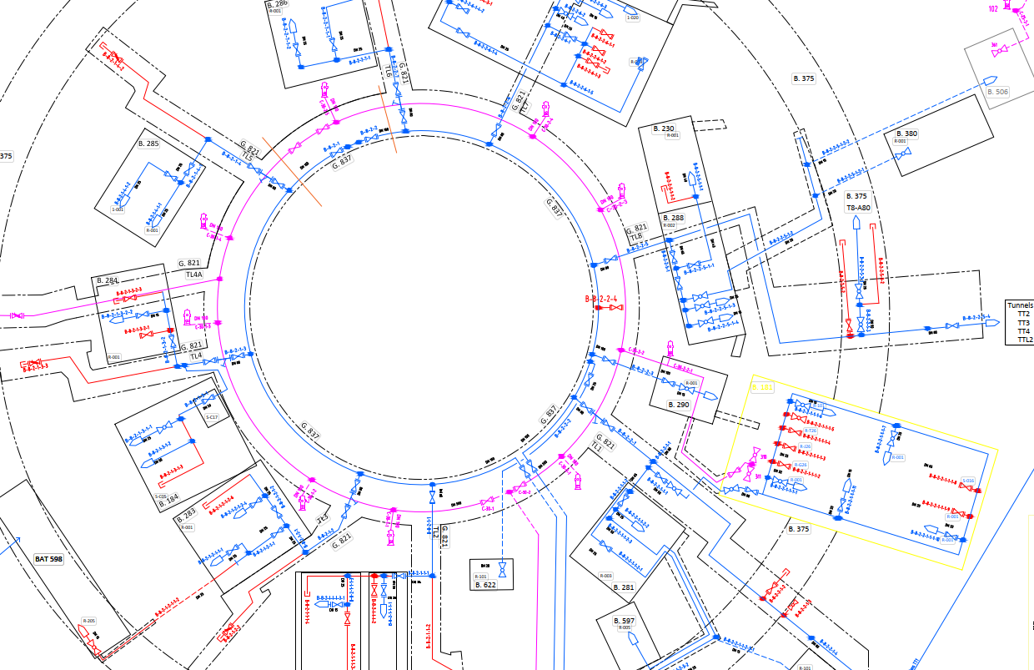
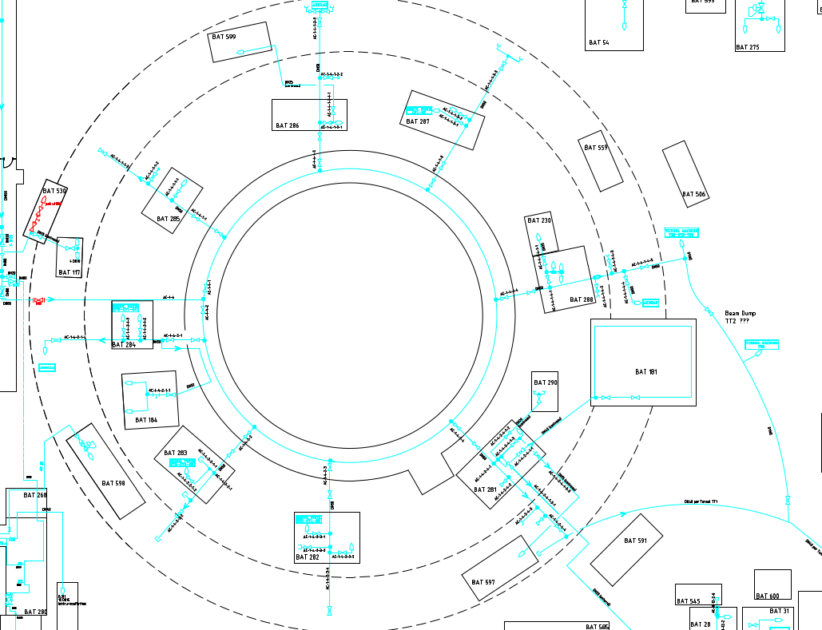
Major event in ISR technical gallery
Water networks
Service networks in the area:
  Drinking water ring fed only by main line in Route Gregory
  Firefighting water ring fed by GT835 line and main line in Route Gregory
  Compressed air ring fed by GT835 line. Small connections from TT1 and TT2
Impact:
  Isolation of the circuits feasible: valves located far from the area
  All buildings impacted or only one part of the ring
  Hydrants out of service
  Solutions to be studied depending on the nature of the event and severity
Compressed air

Slide 31
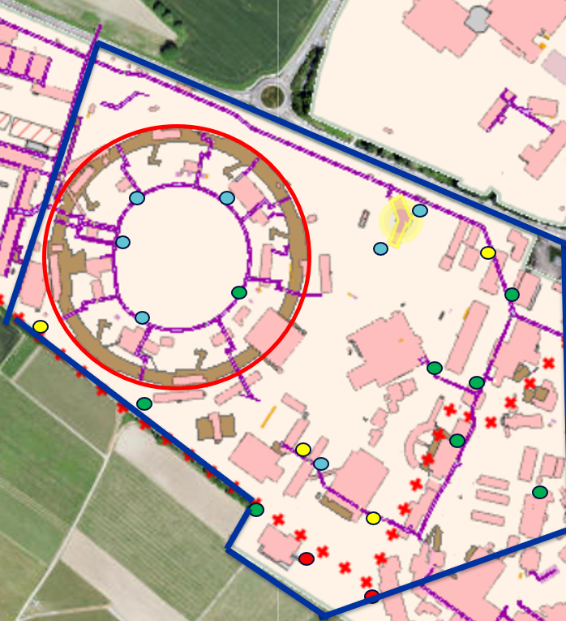
Constraints for EN-CV due to ISR conditions
Pipework to be done passing along the more damaged area: From 2029, installation and dismantling of service networks in ISR gallery GT837
Hydrants to be connected and relocated in the area. Wall drillings will be necessary to pass the new piping connections
Future hydrants Layout Central Area Meyrin

Slide 32
CONCLUSION
Foreseen works during 2025 are key to proceed with the galleries GT825 and GT833
Budget forecast follows the works planning: 2025-2027 are key for Central area consolidation
LS3 period is the only possibility to carry out the consolidation of Isolde-Booster-AD-Linac-PS center ring area
Material access in GT833 is a major improvement that will make works feasible
Works sequence needs to be respected to guarantee the planning
Service disruptions are compulsory to renew the network and make new connections. They are linked to the works sequence. TSOs and Coordination team will be involved
Firefighting water service disruptions to be validated by the Fire brigade. Mitigation measures will be put in place

Slide 33
THANKS

Slide 35
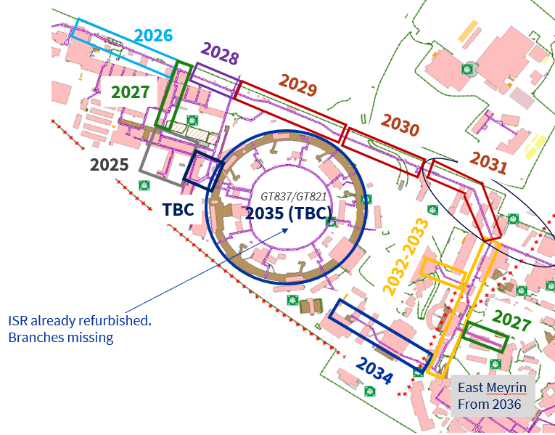
SCE Consolidation works
To keep in mind:
SCE &EN-CV in 2031 in the same area
From Booster to bdg.359:
All pipes to be done together during LS3
SCE&EN-CV

Slide 36
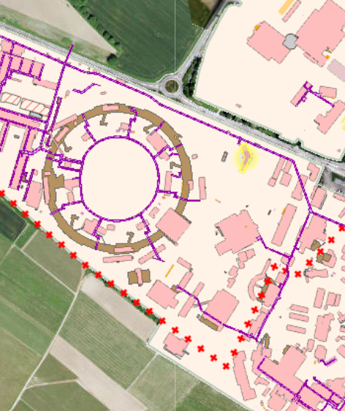
Current hydrants Layout Zone Centrale Meyrin
Total amount: n. 21
Zone ISR: n.9 hydrants
Zone Route Einstein: n.3 hydrants
Zone Booster-AD: n.3 hydrants
Zone 513: n.1 hydrants
Zone 504: n.2 hydrants
Zone Route Gregory: n.1 hydrant
Zone centre anneau PS: n.2 hydrants
Current position

Slide 37
FINAL VALIDATION WITH CFRS 21/05/2025
Future hydrants Layout Central Area Meyrin
Total amount: n. 20
Zone ISR: 570 m n.5 hydrants
Zone Route Einstein: n.4 hydrants
Zone Booster-AD: n.3 hydrants
Zone 513: n.3 hydrants
Zone 504: n.2 hydrants
Zone Route Gregory: n.2 hydrant
Zone centre anneau PS: n.1 hydrants
Kept same position OK
Different position
New hydrant/emplacement

Slide 38
