Slide 1
Technical Galleries Consolidation Program
Program Board #5
Other Work Packages
S. Evrard – EN – Program Leader on behalf of the Program Team
06 June 2025

Slide 2

Agenda
Cabling /decabling activities
Secure Means of Communication
Scans and Integration
Civil engineering works
Safety
Project Dashboard

Slide 3
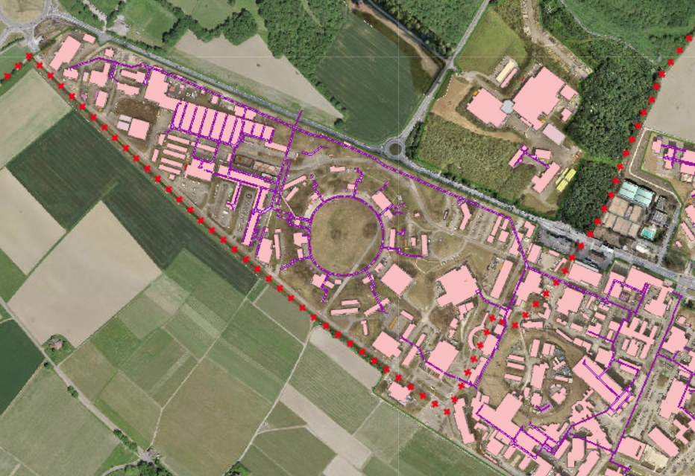
TGCONS – Past and Future works EN-EL
Decabling completed in b.180 & b.183
Cabling: emergency call system West Area
  82 cables, 9km
  Scheduling TBD, Q3-Q4 2025
Decabling: telecom and HV cables in gallery 825
  5 cables, 1km
  Scheduling TBD, Q2-Q3 2025
[TBC] Decabling: cables in b.291
  300 cables, 25km
  Execution TBC
[TBC] Decabling: of gallery 833
  150 cables, 25km
  Execution TBC
Cabling West area
Decabling gallery 825
[TBC] Decabling b.291
[TBC] Decabling gallery 833
Courtesy S. Fasel – EN-EL

Slide 4
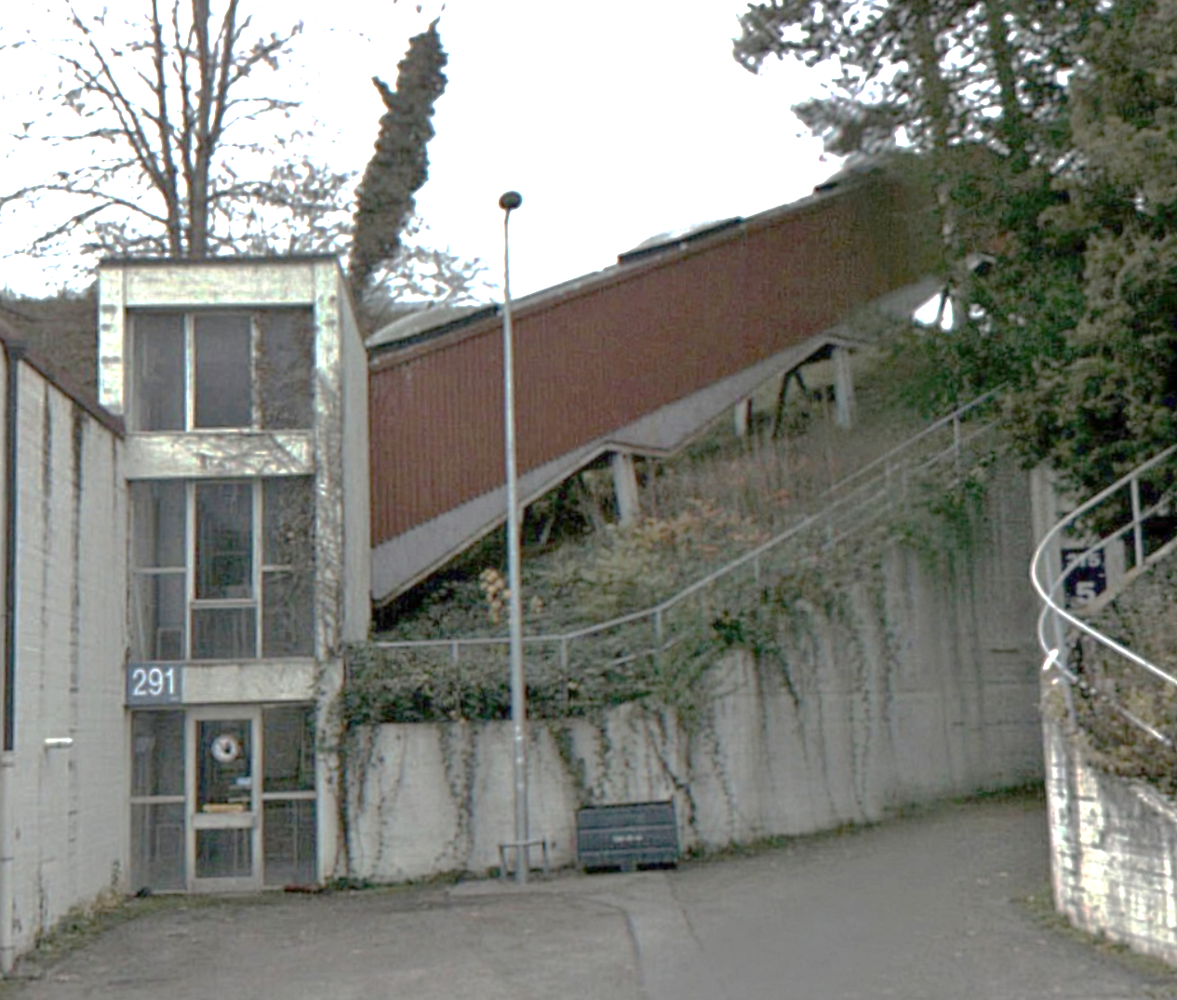
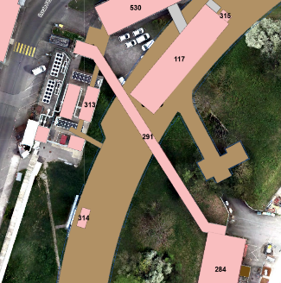
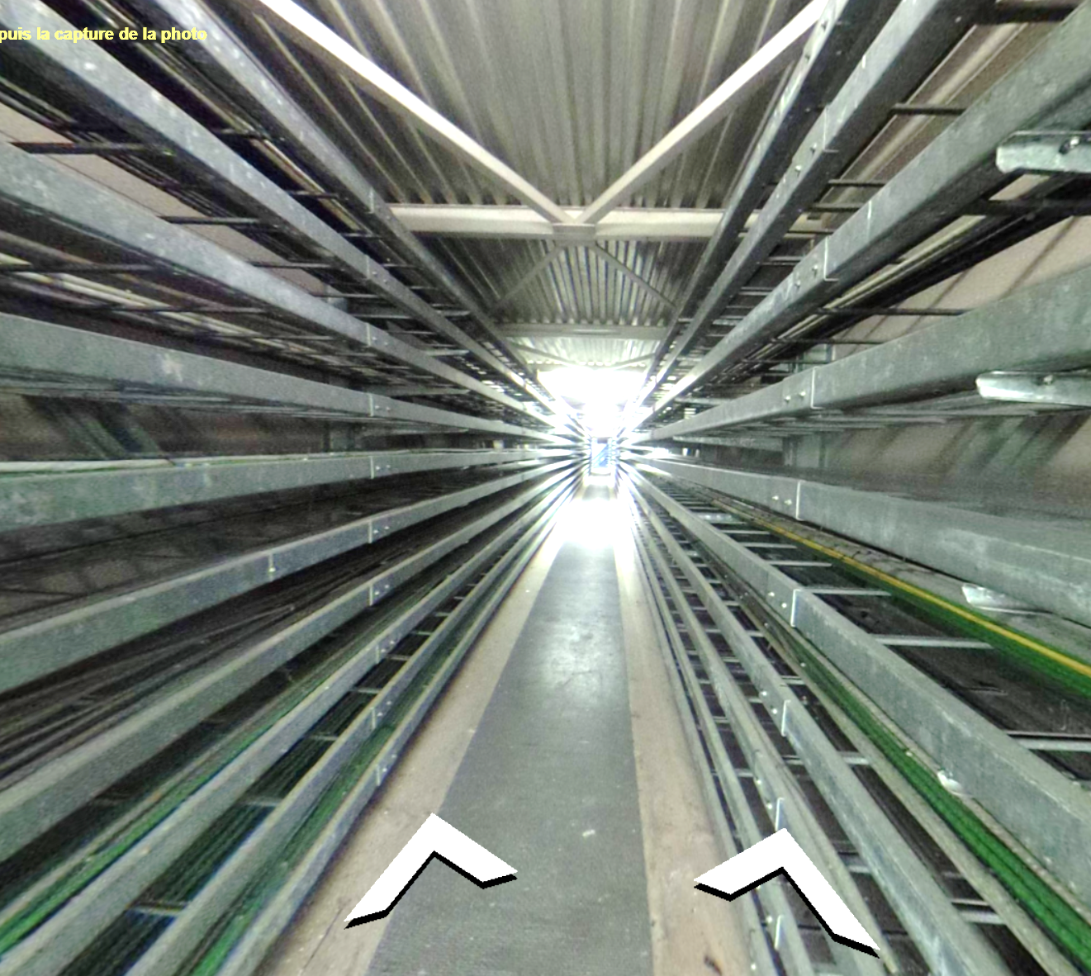
Decabling proposal for gallery 291
Survey done, Estimation done, work preparation left is minimal
«simple» execution, cables cut on either side or simply passing through the gallery
Decabling would allow the removal of >7t of cables from this structure
Possible removal of unused cable trays to make room for other services? (piping etc.)
Not considered a gallery, possible funding by SCE?
Courtesy S. Fasel – EN-EL

Slide 5
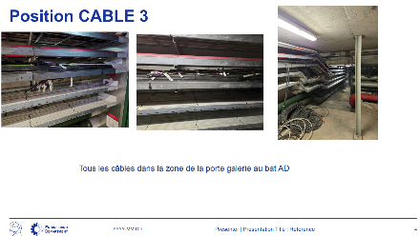
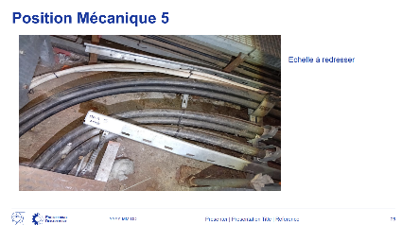
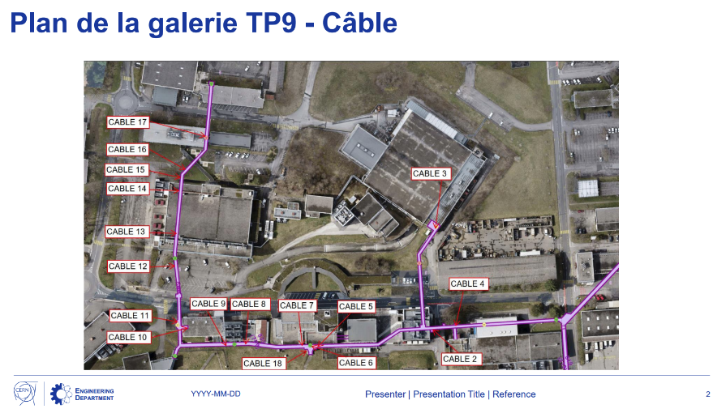
Decabling proposal for 833 during RUN3-2025
Survey of cables and mechanical renovation works done Q2 2024 (see EDMS 3151425)
Decabling initially foreseen to be done during a YETS due to sensitive links passing through this gallery
Manpower requirements during YETS make it hard to dedicate a team for this work, execution during YETS is not realistic
Decabling team that would perform this work successfully decabled PS during the end of RUN3-2024
EN-EL-CS decabling responsible ready to present methodology and risk mitigation measures to TIOC, coordinations etc.
Courtesy S. Fasel – EN-EL

Slide 6
Secure Means of Communications (SMC)
Exigences Fonctionnelles et HSE
Exigences fonctionnelles(EDMS 2588546):
Un système d'alerte doit être présent tous les 200 m dans les tunnels des accélérateurs du CERN.
Il doit être adapté aux conditions environnementales variées présentes sur les sites du CERN (souterrains, zones radioactives, etc.) + galeries techniques, hôtels de surface, chambres froides, PMR, crèches…
Le système doit déclencher une alarme de niveau 3 (conformément à la norme IS37).
Il doit être capable d'assurer des communications bidirectionnelles fiables.
Il doit pouvoir fonctionner en cas de panne de courant pendant une durée donnée, compatible avec le concept d'urgence du site.
Il doit fournir une géolocalisation sans ambiguïté.
Alert Systems – Exigences HSE:
En réponse aux questions d’EN-AA (EDMS 2894058, Mai 2023), réponse d’HSE EDMS 3021609 (Mars 2024) - SRF sur l'intégrité des circuits des systèmes d'appel d'urgence dans les galeries techniques
Courtesy J. Ramos – EN-AA

Slide 7
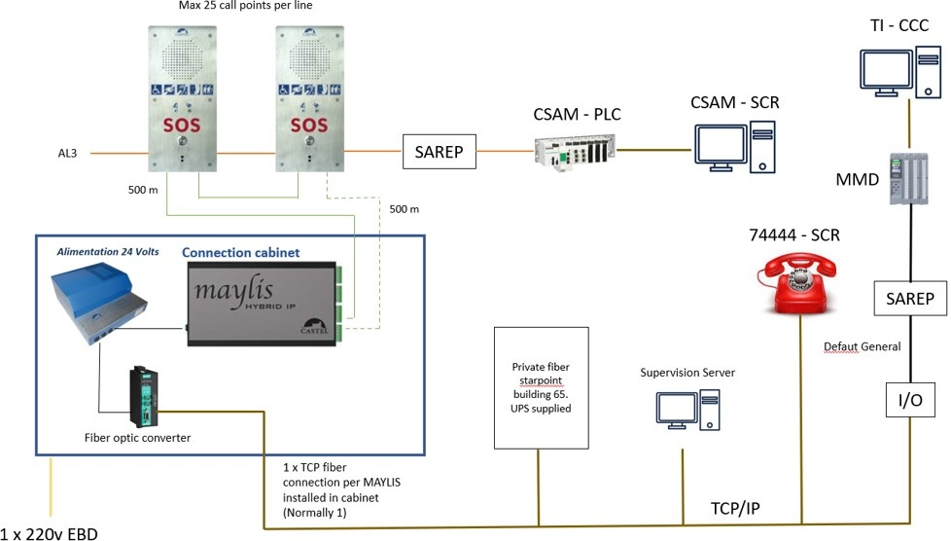
SMC - Architecture réseau
Courtesy J. Ramos – EN-AA

Slide 8
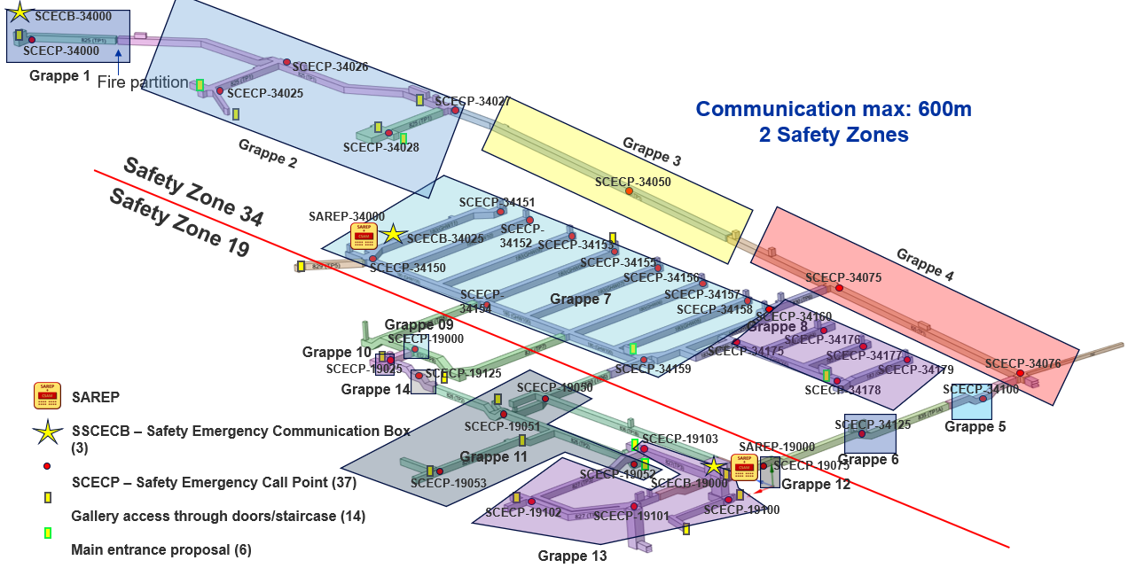
SMC - Architecture réseau West Area
Courtesy J. Ramos – EN-AA

Slide 9
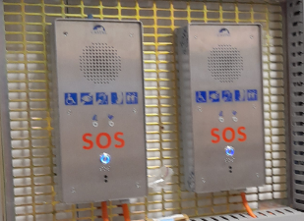
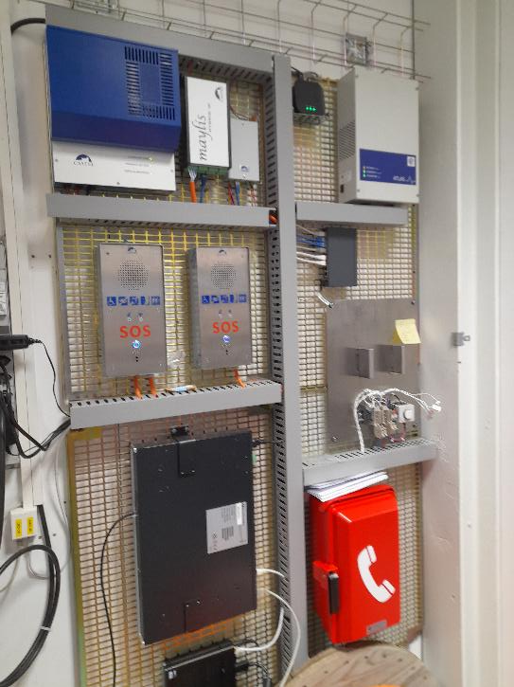
SMS Status Report – West Area
Banc d’essai installé et prêt à configurer:
  Prévue pour le mois de Mai 2025:
    Collaboration avec IT-CS et CASTEL (fournisseur).
Commande des équipements et système de communication en attente de validation de câble par EN-EL:
  Demande de standardisation de câble effectuée:
    RQF3024171 - CR1-C1 - Multipair telephone cable - RQF3024171
Demande d’installation des câbles en attente:
  Aussi de validation de cable par EN-EL.
  Une pré-DIC a été effectuée.
  Une fois validée, commande de cable et lancement de DIC.
SMC deployment in West Area still in 2025
Courtesy J. Ramos – EN-AA

Slide 10
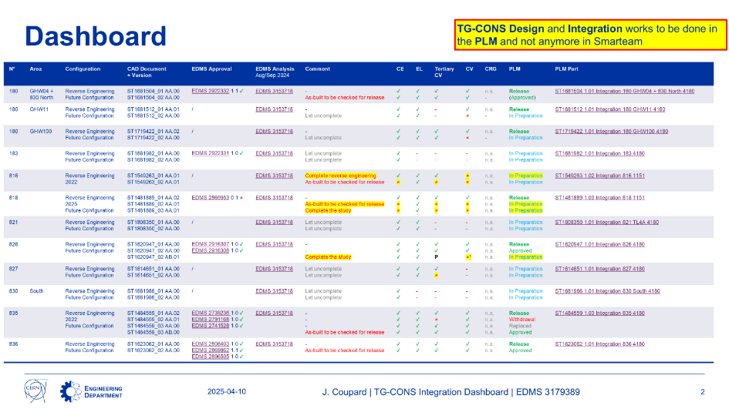
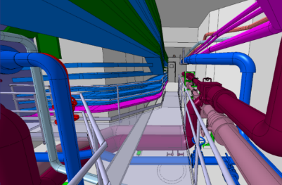
Scans and Integration
Integration
Monthly meeting: https://indico.cern.ch/event/1537603/
Switched over to the new PLM. This means that designers now have to edit their models for technical galleries on the PLM, and no longer on Smarteam.
Integration GT80 – 847 will be achieved by BE-EA design office due to NA-CONS urgent needs for TDC2/TCC2 full renovation in LS3
Scans
Gallery 833 scan completed during EYETS
Meshing and 3D modelling in progress
Courtesy J. Coupard – EN-ACE

Slide 11
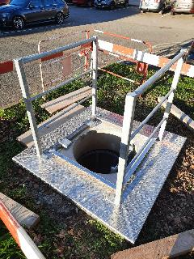
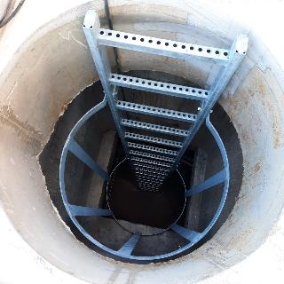
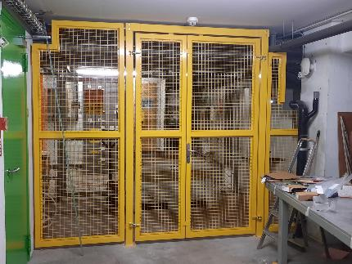
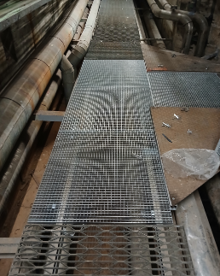
Civil engineering (other) works
Fire partitions under buildings 864, 865, 866 in Prevessin: done, waiting for electronic key installation
Installation of 3 fire doors in NA complex (Synergy NA-CONS)
The civil works for external accesses of GT796 in Prevessin: done
Gallery 837 Gratings: done
Replacement of the interior access in the local 112/R-C30: done
Courtesy of F. Legay

Slide 12
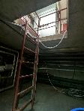
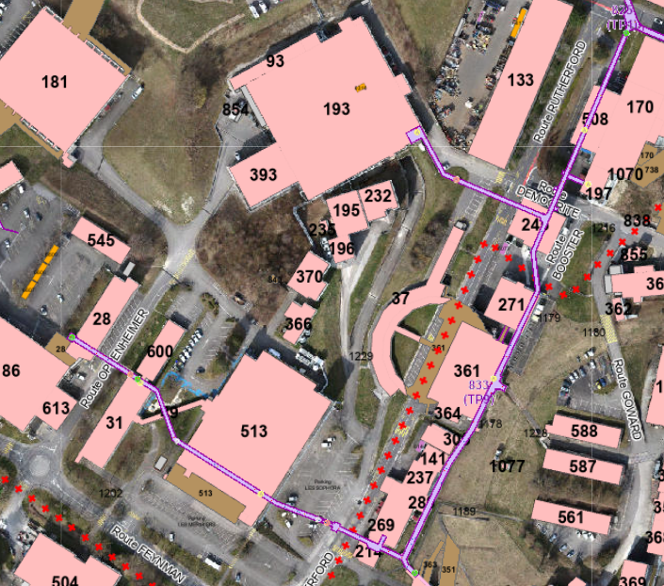
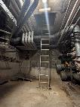
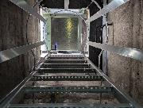

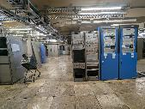
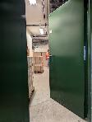
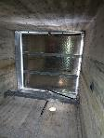
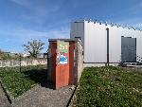
Gallery 833 survey
Ladder, inside hatch
EDMS: 3136100
General comments:
Drain pipes should be unblocked
Legend:
Yellow A – access from the building (GIS)
Green A – access from the outside (GIS)
Recommended personnel/material access
Ladder, external hatch
Material access, consolidated
Ladder, external hatch, consolidated, temporary water valve in the middle of access
Ladder (bad shape), external hatch (is it needed if exit via building right next to it?)
Door from b.361, PSB access needed
Door from b.31
Material access, consolidated, square opening (shorter than normally)
Staircase from the outside
Courtesy I. Krautsztrung – EN-PAS

Slide 13
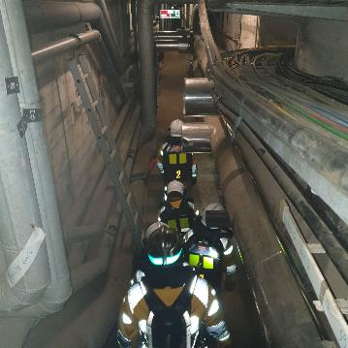
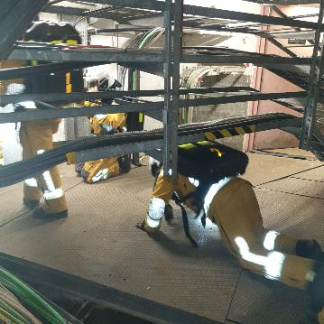
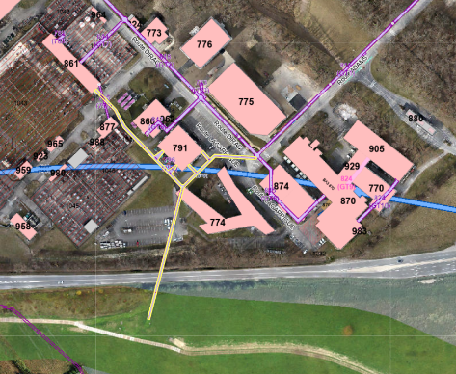
Safety
Joint CERN FRS / SIS Geneva annual exercise
Gallery 796 safety improvements
  ECR: 3017542 – launched
    Visit on-site on March 18 with CERN FRS and Site Security
    Recent inputs
    Newly identified actions
    Special safety measures to enter
Courtesy I. Krautsztrung – EN-PAS

Slide 14
Program Status - DASHBOARD
Gallery | Drinking water | Firefighting network | Compressed air | Heating pipes | Decabling | Doors, metal frames, roofs, ladders, false floors | Asbestos , led diagnostics | Drain check | Scans | 3D model Integration / cross-section
835 north | Done | Done | Done | Done | Done | Done | Done | Done | Done | Done
835 south | Done | Done | Done | Done | Done | Done | Done | Done | Done | Done
825 part 4.1 | Done | Done | Done | Done | Done | Partially | Done | Done | Done | Done
825 part 4.2 | Done | Done | Done | Done | Done | Partially | Done | Done | Done | Done
825 part 3 | Done | Done | Done | 2026 - 2028 | Done | Partially | Partially, 2025 + 2026 | TBC | Done | Done
825 part 2 | 2026 | 2026 | 2026 | 2029/30 | Done | TBC | 2025 - 2028 | TBC | Done | Ongoing
825 part 1 | 2028 | 2028 | 2028 | 2031 | Done | TBC | 2026 + 2029 | TBC | Done | Ongoing
833 | 2025-27 | 2025-27 | 2025-27 | 2027, 2032-34 | 2025 | TBC | 2026/27 | TBC | Done | Ongoing
826 | Done | N/A | Done | Ongoing | Done | TBC | Done | Done | Done | Done
827 | Done | N/A | Done | TBC | Done | TBC | Partially | Done | Done | Done
830 | Done | N/A | Done | TBC | Partially, 2024 | TBC | Partially | Done | Done | Partially
836 | Done | N/A | Done | Done | Done | TBC | Done | Done | Done | Done
180 | Done | Done | Done | TBC | Done | TBC | TBC | Done | Done | Partially
183 | Done | Done | Done | N/A | Done | TBC | TBC | Done | Done | Partially
829 | Done | Done | Done | TBC | TBC | TBC | Partially | Done | Done | TBC
831 + 832 | TBC | TBC | TBC | N/A | Done | TBC | TBC | Done | Done | TBC
837 | 2029/30 | 2029/30 | 2029/30 | Done | Done | Partially | TBC | TBC | Done | TBC
821 | 2029/30 | 2029/30 | 2029/30 | 2035 | Done | Partially | 2027/28 | TBC | Done | TBC
No specific critical path
EDMS: 2917540
Notes:
Done/Partially (Green bold font) – final state of consolidation achieved
N/A – equipment is not present in the gallery
TBC – consolidation needed, no specific date/technical solution foreseen yet
YEAR – consolidation foreseen in the specified year
Partially (blue font) – some consolidation works were already done, more to come

Slide 15
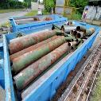
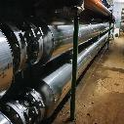
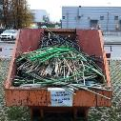
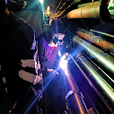
Works in numbers
342.1 tonnes of old piping and material removed
6.13 km of old piping dismantled and replaced by 4.70 km of new piping
397 km of cables removed, 510 m³ of waste
2700 welds and 270 non-destructive tests so far have been performed
Notes:
15.05.2025:
342.1 tonnes of old piping and material removed (271t CV & 71.1 t SCE) // SCE old piping and supports = amount from invoice for new + 20% margin
6.13 km of old piping dismantled and replaced by 4.70 km of new piping (dismantling: 4.685 km CV & 1.45 km SCE, installation: 3.25 km CV & 1.45 km SCE)
397 km of cables removed, 510 m3 of waste (cables & scrap metal elements)
2700 welds and 267 non-destructive tests so far have been performed (total of CV & SCE)

Slide 16
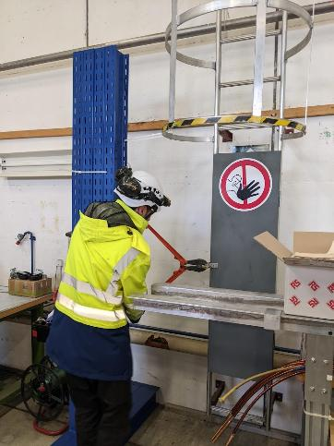
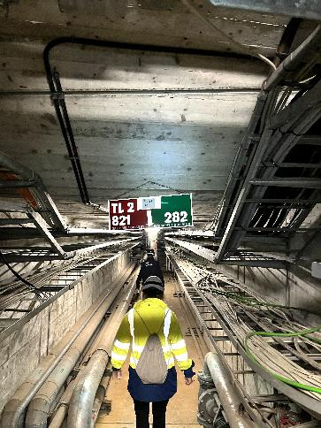
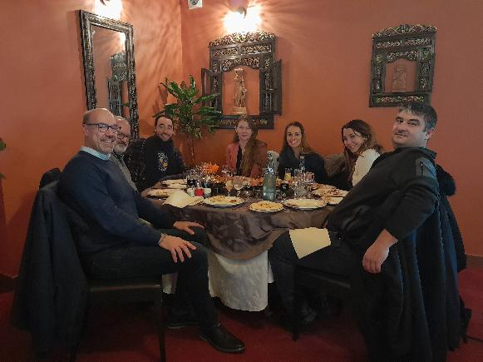
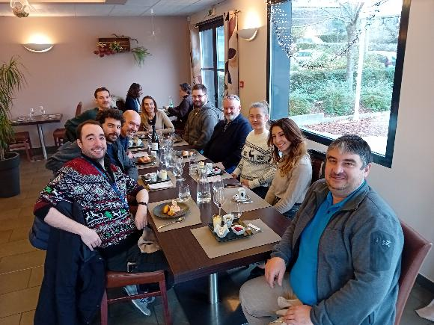
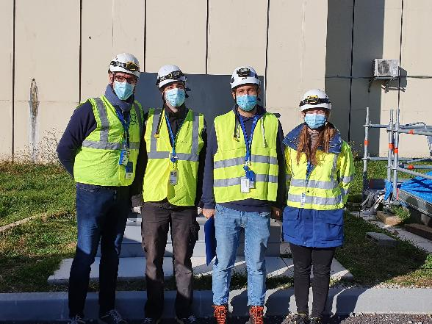
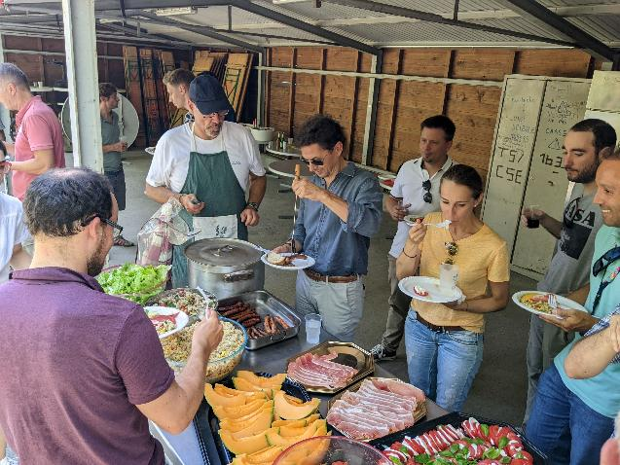
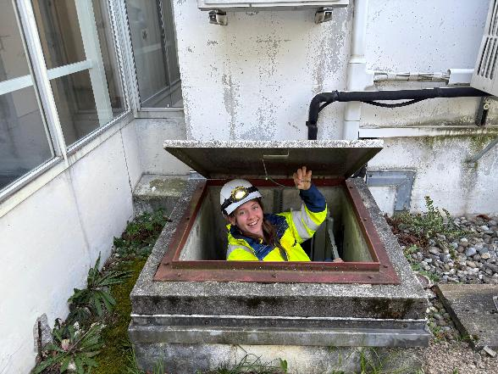
Thank you!!!

