Slide 1
Technical Galleries Consolidation Program
Program Board #5
Introduction & Discussion
S. Evrard – EN – Program Leader on behalf of the Program Team
06 June 2025

Slide 2

Goals of the meeting
Project status report
  Technical and budgetary aspects
Review proposed strategy for the future
  Inner lining of an existing pipe
Discuss critical situation in ISR gallery
  Civil Engineering Assessment
  Worst case scenario
    Risk for the operation of the accelerator complex
    Mitigation measures to be prepared
  Repair options
    Missing budget required

Slide 3
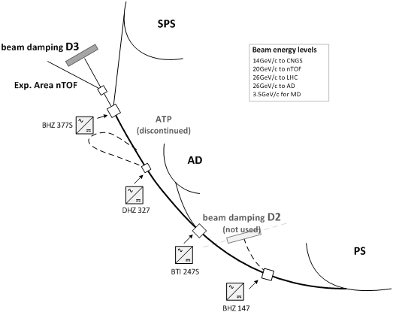
TT2 beamline
The Beam Transfer Line TT2 is special in that it delivers particles from the Proton Synchrotron to the following Accelerator (SPS) as well as to a number of Physics experiments directly (Neutrons time of Fly -NToF, Antiproton decelerator – AD). Consequently, it is required to handle beams of different energies.

