Slide 1
HL-LHC WP3 – CMI Activities Review
General considerations from CMI
F. Savary
10 June 2025 – Room 112/4-019 – Indico event 1550621

Slide 2
Scope of the review
Review on production done so far, with details in durations with respect to targets.
Dependencies
  Components
    List of components that are still not in-house.
    Remind on what was critical in the past and what can be still critical, bellows need particular attention, are followed carefully
  Services
    Show all the people that need to intervene along the construction process (MME/VSC/Busbars/Electrical Technicians/X-Rays...).
Work organization and potential bottlenecks: how work is organized, how different teams are called to intervene and where things can be improved. Is there potential to advance some preparation activities with less experience personnel? If yes, what would be useful?
Include an assessment of what would be needed if Q1/Q3 needs to be cryostated at CERN, and what is the difference in terms of workload for a full cryostating of a Q1/Q3 unit vs a change from transport to test configuration.
QA/QC, procedures and tracking… workload likely too much for only one person, even more critical if we have to do Q1/Q3
Budget and Resources (Staff, grads, M4P, MAT).
Space.

Slide 3
HL-LHC WP3 activities within the context of CMI
CMI Organizational Chart
WP6a
WP3
  SC magnet cryostating
  DCM & DQM
Anti-cryostats for cold tests (completed)
SM18 upgrade (completed)
WP16 (completed)
LHC (MB & SSS)
2025-20XX

Slide 4
TE-MSC-CMI
CRYOSTATS & MACHINE INTEGRATION
SL: F. Savary
DSL: D. Ramos
Quality Correspondent
M. Struik
FSU7 (QA/QC Officer) – 100% WP3 Cécile
TEMP (Renfort QA/QC Officer) - Till end 2025 tbc
X
X
Cryostats for
Superconducting Magnets
D. Ramos
DCM
LDQM
LHC MB – SSS
R. Diaz Vez
Cryostats for
Special Devices
Y. Leclercq
Test Stands Upgrade
(Anti-) Cryostats for
Magnet Test Stands
F. Savary
Cryo-magnets & Cryostats
Assembly Facility
R. Diaz Vez
WP3
LHC - WP3
WP6a
SM18
SMI2
PROD
V. Sanchis Ortola
F. Pasdeloup
D. Garcia Robles
S. Spathopoulos
Shuffling module “C2”
H. Prin*
T. Bampton*
S. Straarup*
J. Mouleyre (WP3 – Cryo-magnets)
S. McIntyre (WP3 – DCM)
J.B. Deschamps (WP6a)
Ch. Pryce (Cryo-magnets)
N. Messina (WP3 Cryo-magnets)
Jeremy Mouleyre
FSU3 90% Nabil
FSU5 100% Missing
FSU6 50% William
FSU8 100% Marc
FSU11 100% Guillaume
FSU1 40% (S2) Momo
1 additional FSU to hire
1 welder to hire (joining in Sept.25)
Sean McIntyre
Chad Pryce
FSU1 50% (operation S2) Momo
FSU2 100% Xavier (LHC MB & SSS)
FSU4 100% Stéphane (paid by operation for S2, was by WP3 for S1)
FSU14 100% Gregory
Jean-Baptiste Deschamps
FSU9 100% Olivier
TEMP 100% Romain
FSU3 10% Nabil
FSU2 100% Xavier (paid by WP6a for S2, was by operation for S1)
FSU1 10% (S2) Momo
Chad Pryce
FSU1 25% Momo
FSU3 25% Nabil
FSU4 (Mechanics – 3D Printing) – WP3 DCM [Stéphane]
FSU1 (Mechanics) – OP/SM/WP3 [Momo]
FSU2 (Mechanics) – SM [Xavier]
FSU3 (Welder) – WP3 [Nabil]
FSU5 (Mechanics) – WP3 [Missing]
FSU6 (Logistician) – WP3/OP [William]
FSU8 (Mechanics) – WP3 [Marc]
FSU9 (Electromechanics) – WP6a [Olivier]
FSU10 (Electromechanics) SM [Left, not replaced]
FSU11 (Mechanics) – WP3 [Guillaume]
FSU14 (Mechanics) – WP3 DCM [Gregory]
1 additional FSU to hire – WP3
1 additional FSU to be replaced by a welder – WP3
9 FSUs
1 TEMP full-time
1 TEMP renfort
Italic means shared resource
Staff
Fellow/GRAD-QUEST
TTE/ORIGIN
PJAS
FSU
TEMP
Student

Slide 5
Some of us, staff, are working/called on other tasks
Jean-Baptiste Deschamps - Support to refurbishment of HIE-ISOLDE Cryo-module 1.
- During LS3, at the beginning of LS3, which for Isolde, start
in end 2025.
- Although a 3-month duration is announced, we are expecting
that more time and more resources will be needed.
Yann Leclercq - Same as Jean-Baptiste for HIE-ISOLDE
Delio Ramos - Contribution to EESD & SHiP

Slide 6
QA/QC
My personal feeling is that 1 FTE·y is not sufficient to cover all the work of WP3 cryo-assemblies + WP3 DCM/LDQM + Q4/Q10 (for Q5, most of the work will be done by VSC) + LHC (MB, SSS)
I would consider reinforcing the QA/QC team with an additional FTE, assuming that the need should be reassessed on a yearly basis.

Slide 7
Resources management
Internal to the section
  There are 3 main activities in the section (see organisational chart), i.e. 3 teams, and this is OK
  Sharing resources is beneficial. However, this is occasional. It does happen, but not as easily as I would expect. There are hiccups!
With external contributors
  My understanding is that the organisation of X-Ray examination is difficult. The response of the service is not at the level we would like/need.
  Otherwise, it is so far allright, e.g., welding with EN-MME, survey with BE-GM, 4030 leak and pressure tests with TE-VSC, pressure tests with HSE, bb and electrical tests with LMF.
  Of course, all these contributors have own priorities.

Slide 8
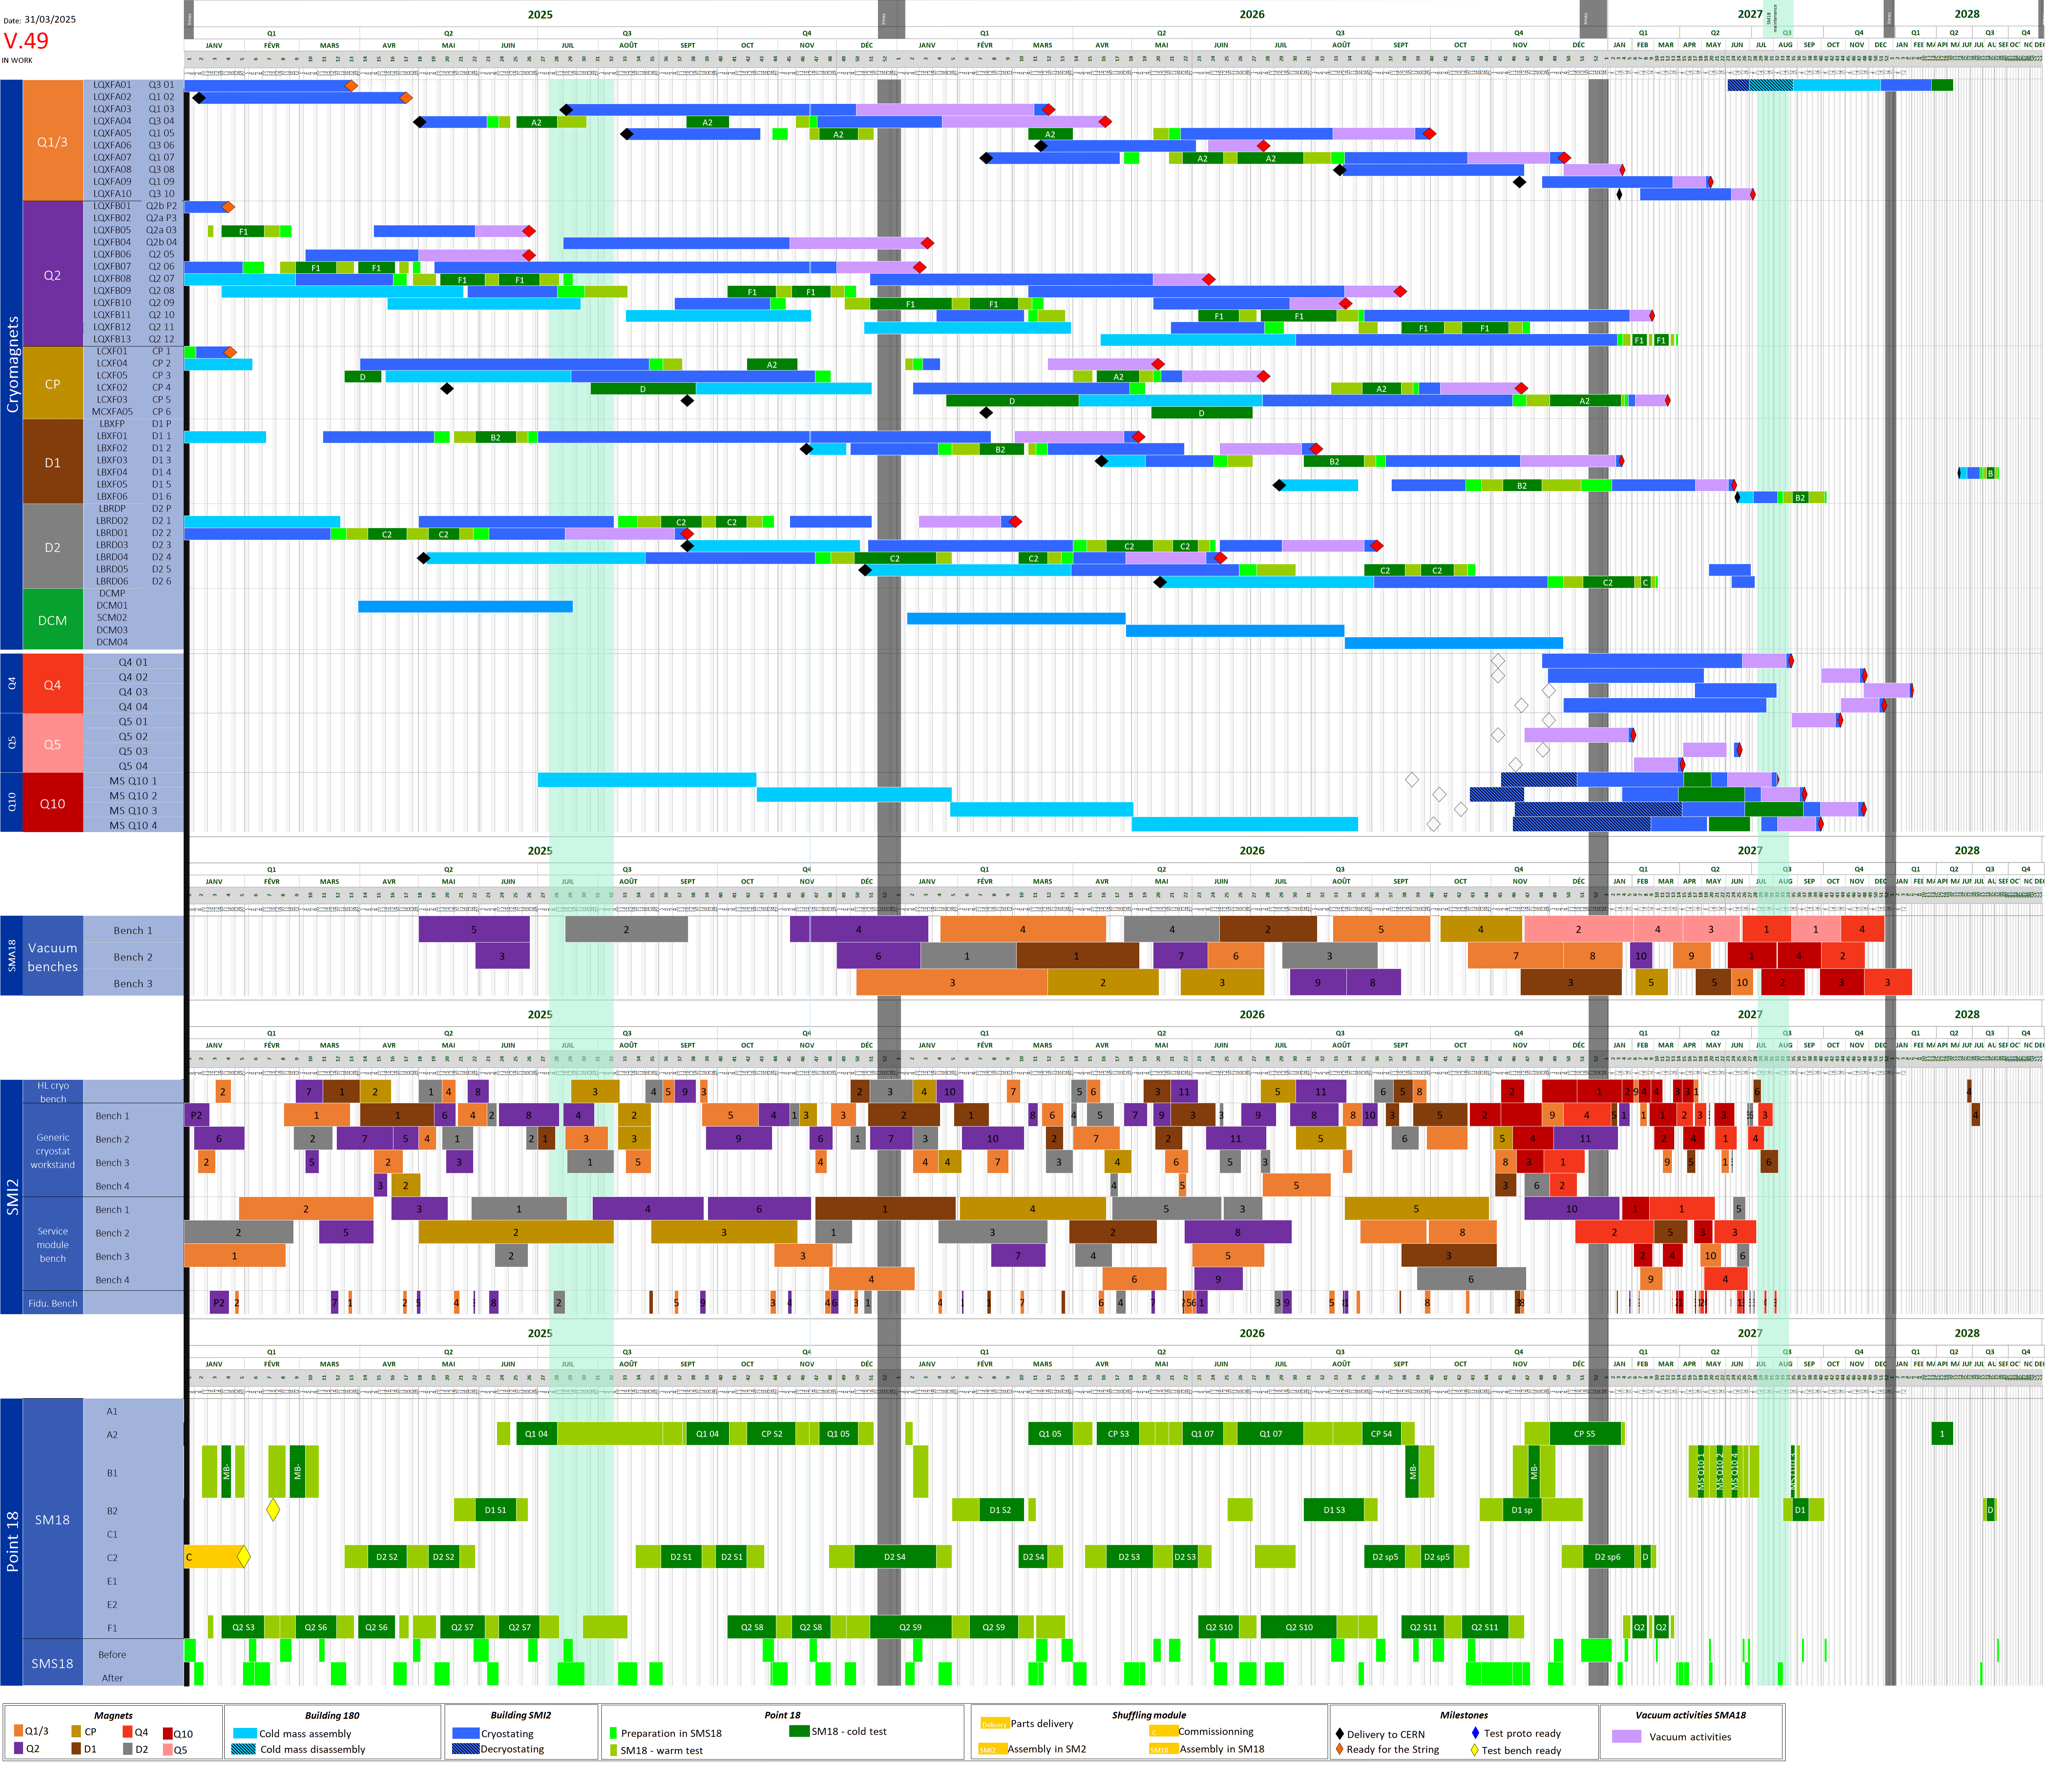
From November 2023 to March 2025 …
Nov.2023
2025
2026
2027
Mar.2025
Compaction factor increase over time

Slide 9
WP3 – Project Integrated Schedule
Courtesy S. Fleury – Mar.25
2025

Slide 10
WP3 – Project Integrated Schedule
Courtesy S. Fleury – Nov.23
2024

Slide 11
Thank you for your attention

