Slide 1
SiteView
Current status and plans
Julia Andreeva, CERN IT-ES
GDB 08.02.2012

Slide 2
motivation
Every experiment does evaluation of the site status and experiment activities at the site
As a rule the state of the site is exposed through experiment-specific monitoring systems
Too many information sources, different entry points, different implementation
The information published by the VO-specific monitoring systems should be integrated in a high level site-centric tool which offers a generic view of the computing activities of the LHC experiments at the site.

Slide 3
history
SiteView development started in 2009
First prototype ready by spring 2009
It suffered from the instability of the collectors and lack of the LHC VO topology descriptors
In the end of summer 2009 it was completely redesigned. Common implementation with Site Status Board

Slide 4
Information sources
Over last years progress in decreasing of number of various information sources
VO | Topology | Status | Job processing | Transfer
ALICE | VO feed | MonAlisa | MonAlisa | MonAlisa
ATLAS | VO feed | SSB | Job monitoring Dashboard | DDM Dashboard (Soon WLCG Transfer Dashboard)
CMS | VO feed | SSB | Job monitoring Dashboard | Phedex (Soon WLCG Transfer Dashboard)
LHCb | VO feed | SUM (Soon new Dirac site monitoring) | Dirac | Dirac (Soon WLCG Transfer Dashboard)

Slide 5
Siteview current Status
SiteView collects: global site status, job monitoring information and transfer monitoring information
From the implementation point of view SSB and SiteView is the same system (DB schema, collectors , UI)
Recently many improvements done in SiteView :
-Collectors became stable, alarms are raised in case any of collectors is stuck
- Thanks to appearing of VO-feeds in most cases the problems with inconsistent site names (GOCDB-experiment site name mapping) are solved
- ATLAS and CMS share many underlying monitoring systems : SSB, Dashboard job monitoring applications
- The underlying monitoring systems like ATLAS DDM Dashboard, Phedex
had improved over last two years (Phedex data service)
- When new FTS version is deployed to all T1 sites there would be a common monitoring system for data transfers shared by CMS, ATLAS and LHCb which could be used as a source for SiteView
So far is used mainly for dissemination purposes
(runs behind WLCG GoogleEarth ).
Not actively used for operations

Slide 6
Current metrics (1)
Overall status
CMS and ATLAS: as defined in the SSB shifter view (realistic but not necessary all metrics are under site responsibility and not all of them are comprehensive to the sites)
ALICE: based on the status of the critical services as published in MonAlisa
LHCb: based on critical SAM tests ( does not provide complete picture, all tests are OK, but the site is banned, why?)
LHCb is validating new site monitoring system which will define two statuses for the site, one takes into account only things which are under site responsibility, another one defines overall usability of the site from the LHCb perspective
Should this strategy be applied for all experiments in order to disentangle site-related problems from the problems of other nature?

Slide 7
Current metrics (2)
Job monitoring (where possible split by activity analysis, production, tests, etc…):
- # of running jobs, average per hour
- success rate (1,4,24 hours) as ratio of successful jobs to all accomplished jobs
- CPU and wall clock consumption
Data transfer (in and out)
- average transfer rate over last hour
- success rate as ratio of successfully transferred files to all transfer attempts over last 4 hours

Slide 8
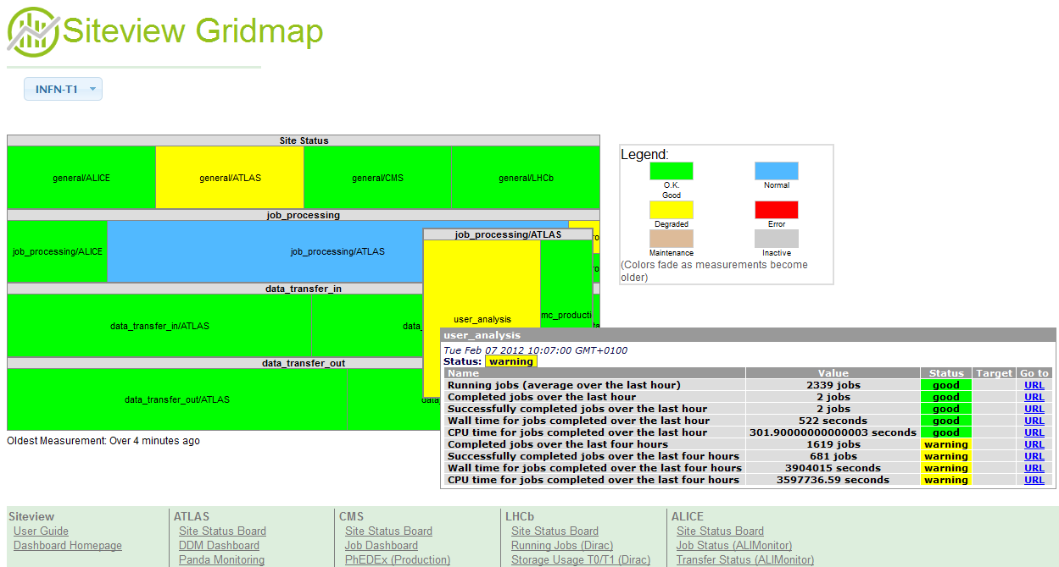
Visualization (1)
Treemap visualization
Per-site snapshot view

Slide 9
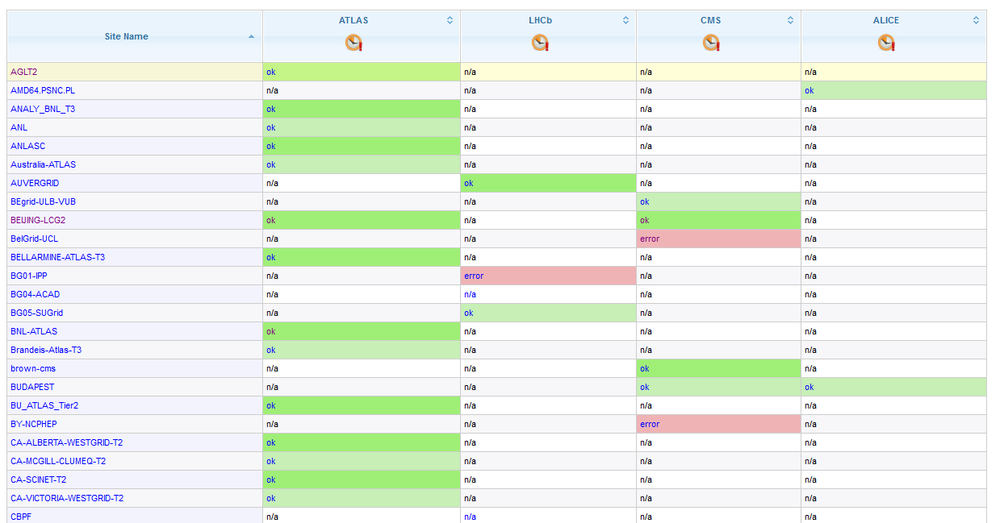
Visualization (2)
Click on a given site to see 24 hours history
SiteView SSB-like
all sites snapshot page

Slide 10
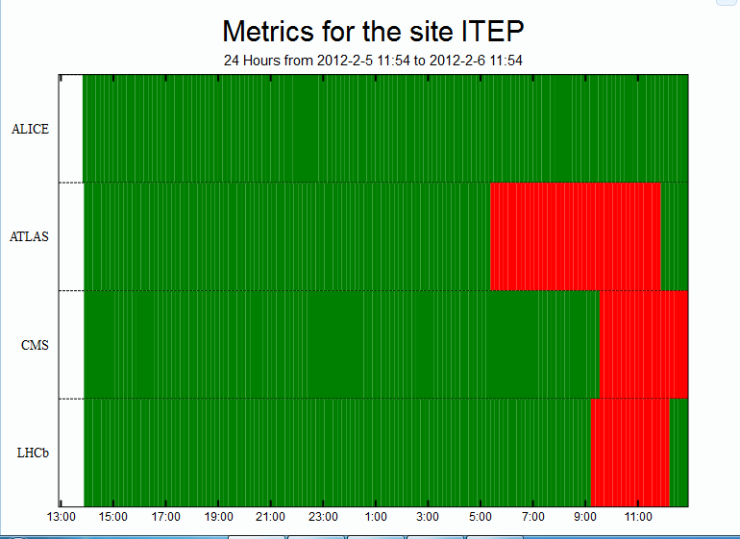
Visualization (3)
SiteView SSB-like per-site history page
Click to be redirected to the underlying data source

Slide 11
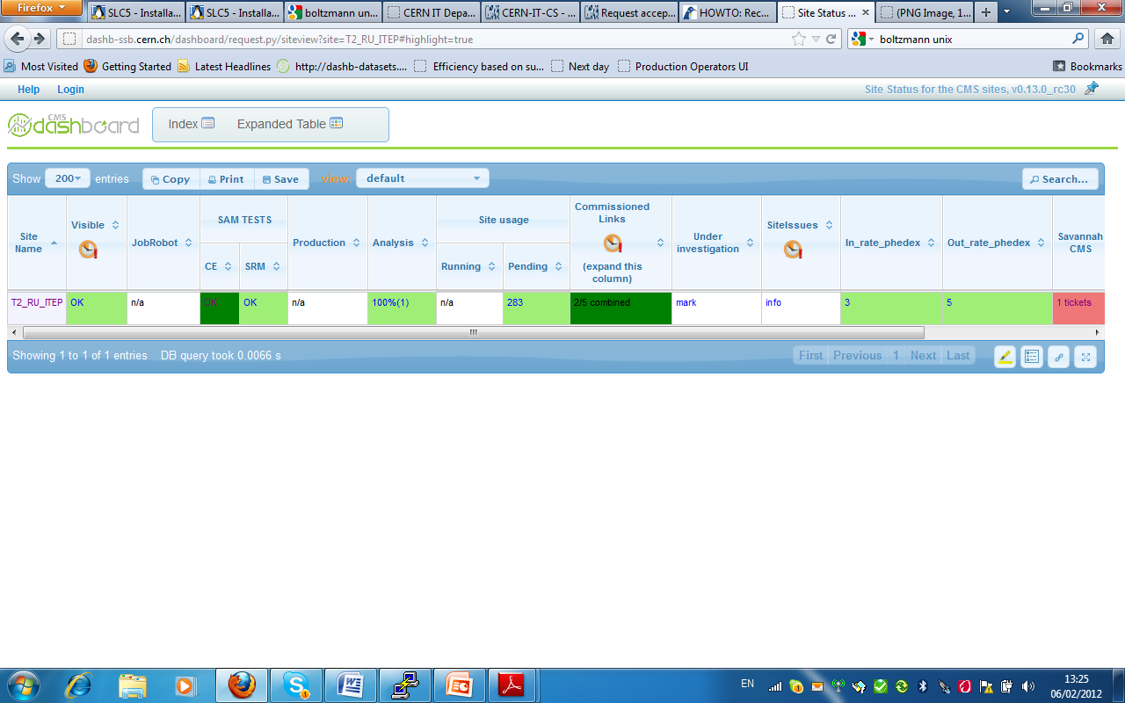
Navigation to the information sources (1)
CMS SSB
Snapshot view
Click to get history

Slide 12
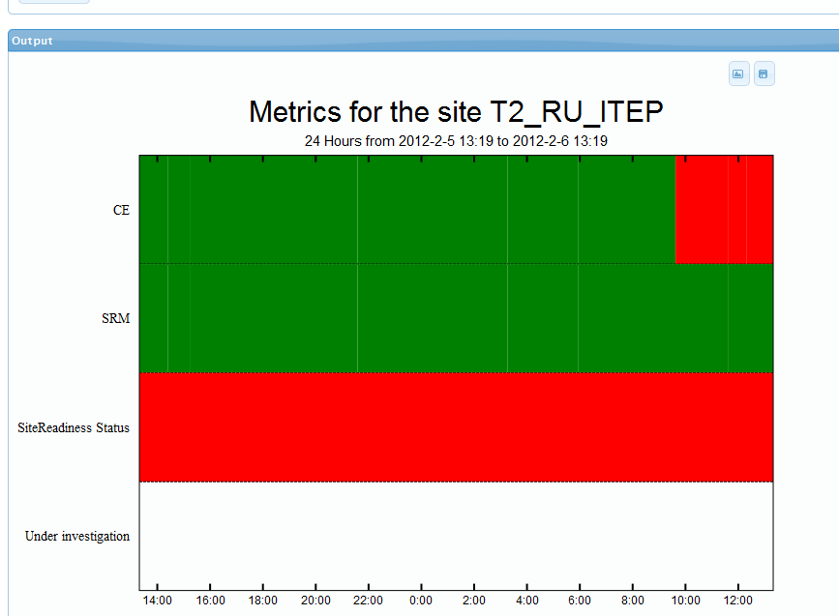
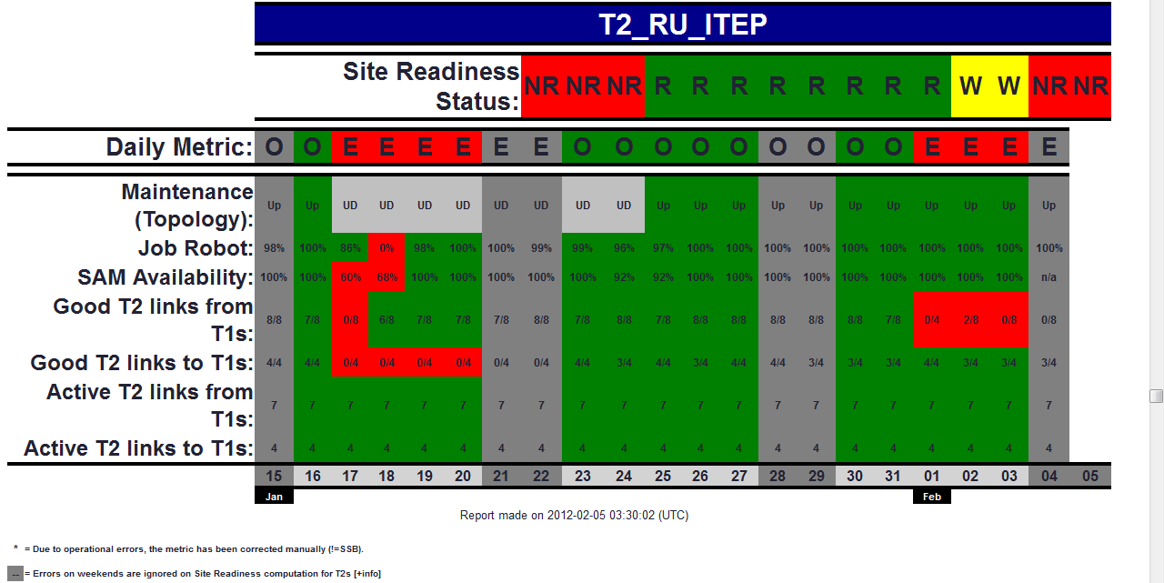
Navigation to the information sources (2)
CMS SSB
history
Click to
See Site Readiness

Slide 13
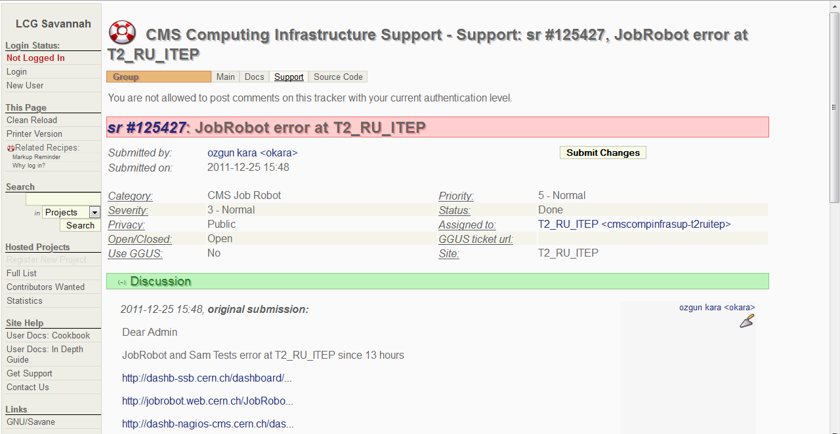
Navigation to the information sources (3)
CMS SSB
Click to
See Savannah
tickets

Slide 14
ISSUES
In order to make the system useful for operations serious commitment from the sites and experiments is required
Question to the sites:
-Is information which is provided by SiteView is what you need?
Is it comprehensive? Is it consistent with local site monitoring?
Questions to the experiments:
- Is it possible to define realistic status of the site usability based on set of metrics which are under site responsibility and are comprehensive to the site? In case when the cause of the problem is not under site control, how to communicate what is wrong in a clear way?
These questions have to be addressed following the outcome of the Operations TEG. Set of current metrics and status definitions to be reviewed. When the new set of metrics and status definitions is agreed , validation of the SiteView data has to be performed both by sites and experiments.

Slide 15
SUMMARY
The SiteView application is in place for few years
It has common implementation with Site Status Board.
Number of various information sources used by SiteView is gradually decreasing, though it is not realistic to hope that we can always enforce use of common solutions
In order to make it useful for operations, commitment of the potential users (sites) and information owners (VOs) is required. Metrics and status definitions have to be reviewed. After changes exposed data needs validation
In the process of defining new metrics the most complicated task is to disentangle site problems from the problems related to VOs, users, applications, external GRID services…
This work will be followed up in the scope of Operations TEG
GridMap UI
http://dashb-siteview.cern.ch
SSB-like UI
http://dashb-siteview/dashboard/request.py/siteview

