Slide 1
BOND
Engineering design
N. Peray
20/05/2025

Slide 2
Boat/coil assembly fitting
How to guaranty a good fit between the boat and the coil to insure a homogenous stress in the coil?
The coil might be longer than nominal due to Nb3Sn behavior and impregnation process.
As tight are the tolerance we will ask on the boat, it might not fit the coil straight forward

Slide 3
Adaptative boat
Measurement of the overlength of the coil, after reaction
- How to measure the overlength?
2) Tuning of the length of the boat, and the filler piece of the impregnation mold
- Measurement of the boat and the filler after length change?
- Mounting those part on top of the coil is may be enough to figure out if the fit is good.
Impregnation of the coil
Coil pack assembly
  - Measurement after impregnation?

Slide 4
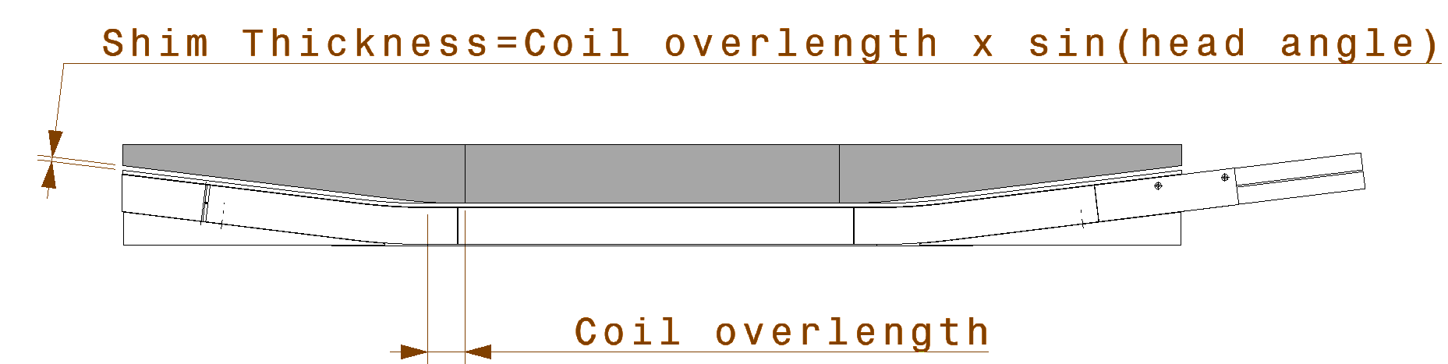
Fixed boat
Measurement of the overlength to estimate the amount of fiber to add
    - Shape measurement or gape measurement with the filler/boat mount on top of the coil
Impregnation
  - Extra layers of fiber glass might be difficult to handle
  - Contraction of the resin
  - Does the impregnation guaranty a good fit?
Coil pack assembly
    - Measurement after impregnation? Fit test?

Slide 5
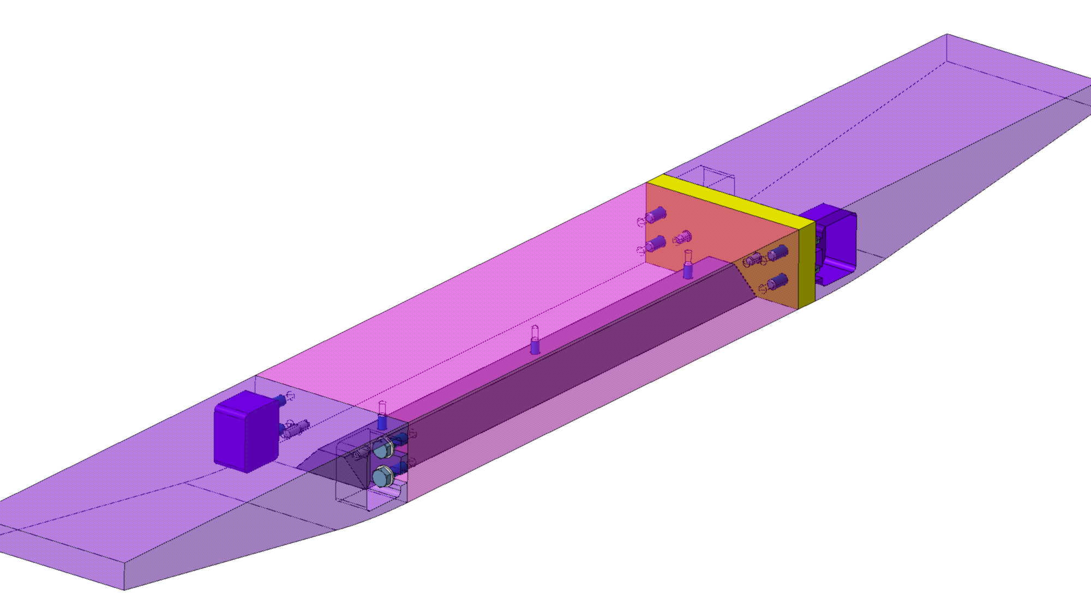
Boat construction
Adaptative boat
Impregnated overlength
Pros :
  No extra fiber glass layer during impregnation
Cons :
  Overlength seems difficult to properly measure (as we measure it on low angle slope)
  The adaptative shim give the orientation of one head of the boat, so the shim needs to be very precisely machined
  One shim per coil
Pros :
  No need to change the boat
Cons :
  Extra layer of fiber glass might be difficult to handle in the mold
  Is it enough to managed a good fit?
Coil overlenght | Total shim thickness*
mm | mm
1 | 0.12
2 | 0.24
3 | 0.37
4 | 0.49
5 | 0.61
6 | 0.73
7 | 0.85
8 | 0.97
9 | 1.10
10 | 1.22
11 | 1.34
12 | 1.46
13 | 1.58
14 | 1.71
15 | 1.83
16 | 1.95
17 | 2.07
18 | 2.19
19 | 2.32
20 | 2.44
Adaptative shim
*Shim thickness to be split in two if equally spread at each end

