Slide 1
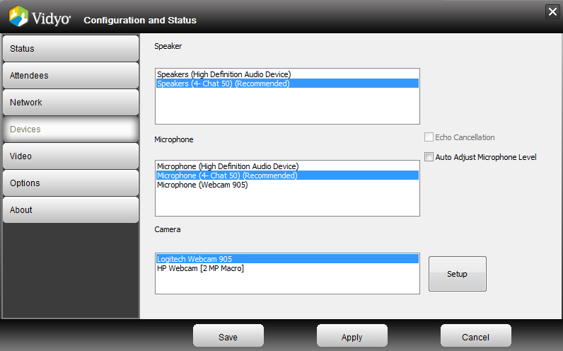

Instructions for Today’s Session
Step 1: Select your devices and click Apply
Step 2: Select Full-Screen for Best Viewing
Notes:
When you join a meeting room or call direct from your Portal home page, you might briefly see a progress bar and then the VidyoDesktop launches.
The first time you launch VidyoDesktop and after any change to your camera or audio settings, you are prompted to select the webcam, microphone and speakers you want to use in the configuration/devices window. Choose the appropriate devices and click Save to proceed to the VidyoDesktop. Changes take place during the current call.

Slide 2
Getting Started with Vidyo

Slide 3
Agenda
Getting Started
VidyoPortal™
VidyoDesktop™
Best Practices & QA

Slide 4

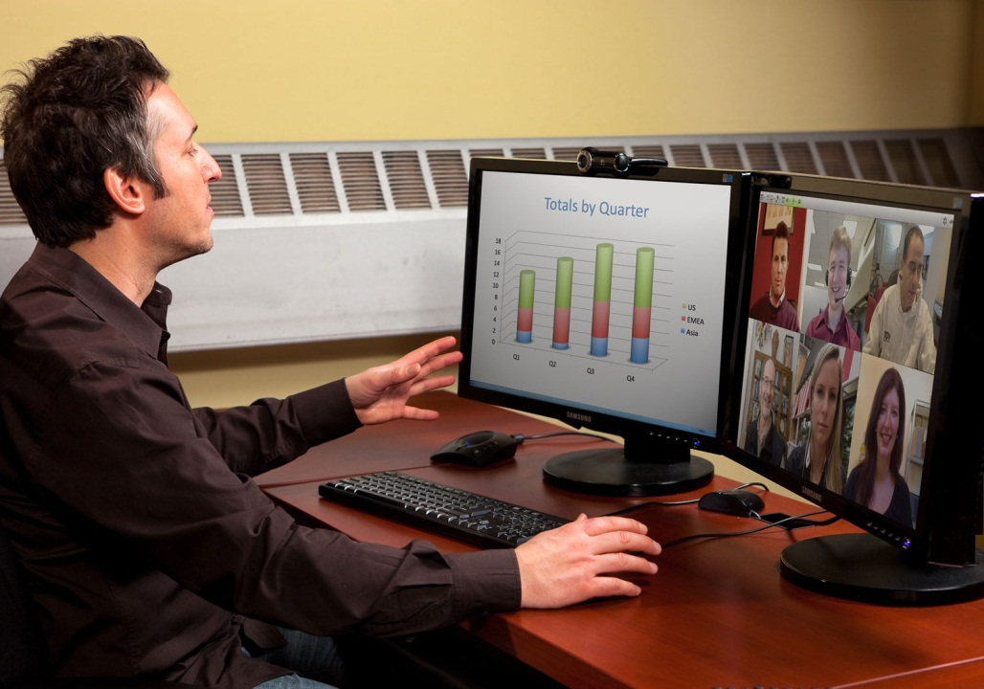
Housekeeping Items
This session will be open and interactive
Mute/unmute your microphone to limit background noise

Slide 5


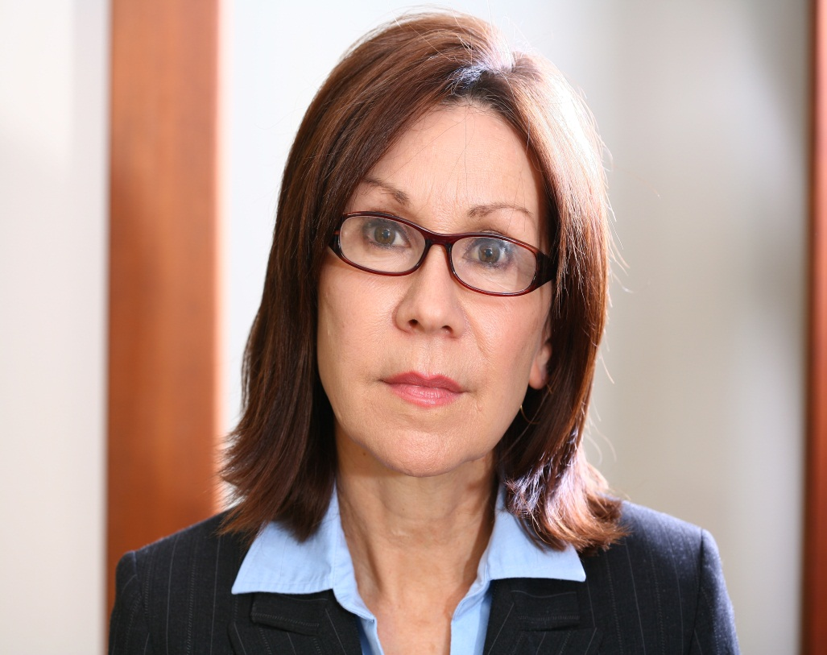

Housekeeping Items – Self-View
Notes:
Click on the Self-View button to preview your video feed for lighting, camera positioning, and adjustments

Slide 6

Getting Started
Round Table
Name
Location
How you plan to use Vidyo
What you hope to get out of today’s session

Slide 7
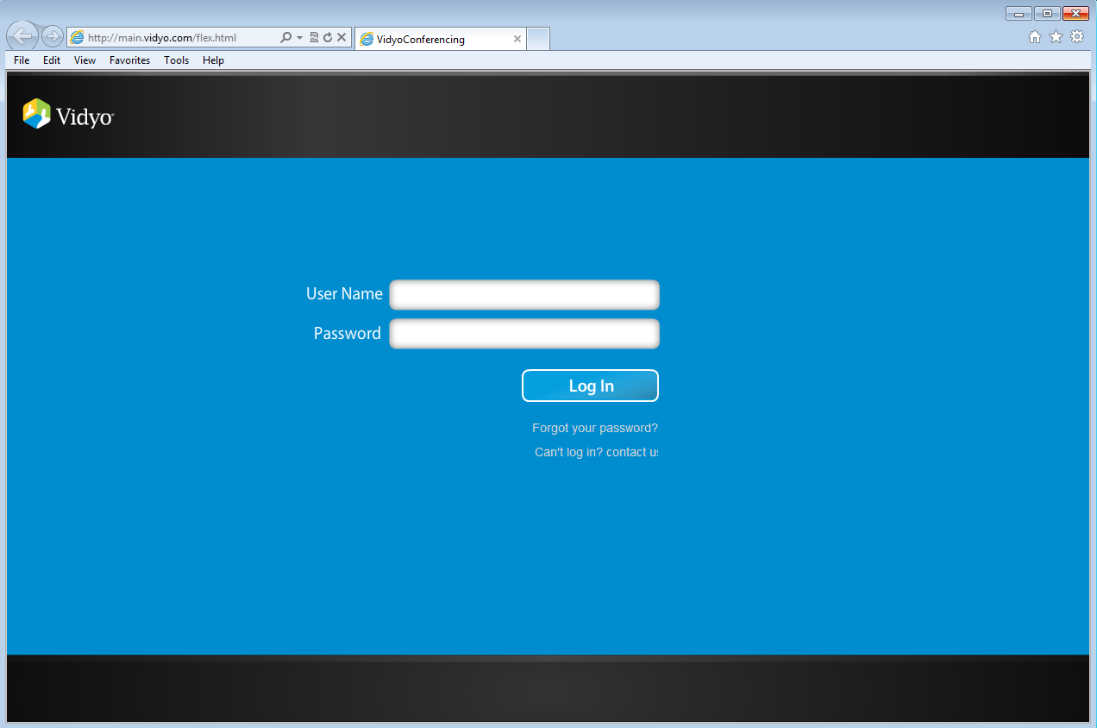
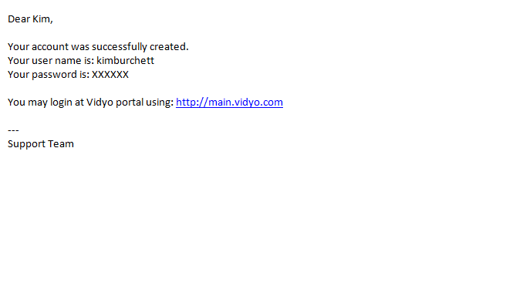
Getting Started
Welcome Email
User Name
Password
Portal URL address
Navigate to your Portal
Login

Slide 8
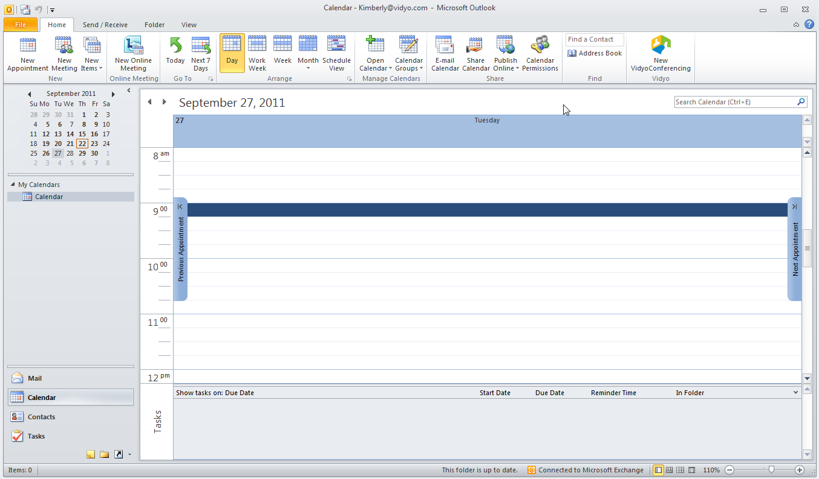
Scheduling from Outlook
http://www.vidyo.com/support/software-downloads/

Slide 9
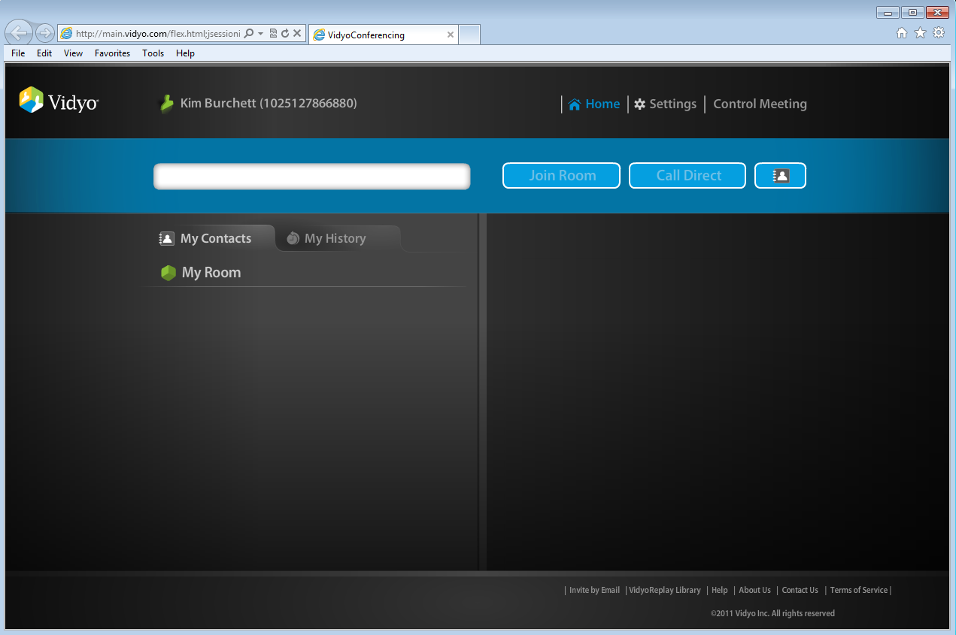
VidyoPortal Tour
Notes:
User Name/Status
Control Meeting / Utility Links -
Contact Search field – Allows you to search for a user or public meeting room
Join Room button - The Join Room button enables you to join a room to participate in a meeting. You can join your own meeting room for a meeting you host yourself, or join another user’s room. The owner of the meeting room is the host.
Call Direct button – starts a direct (point-to-point) call with another contact. A direct call involves just two users; no additional users can join.
Add/Delete Contact
My Contacts/Search Results tab
My History tab
My Room
Informational Links/Invite by Email

Slide 10
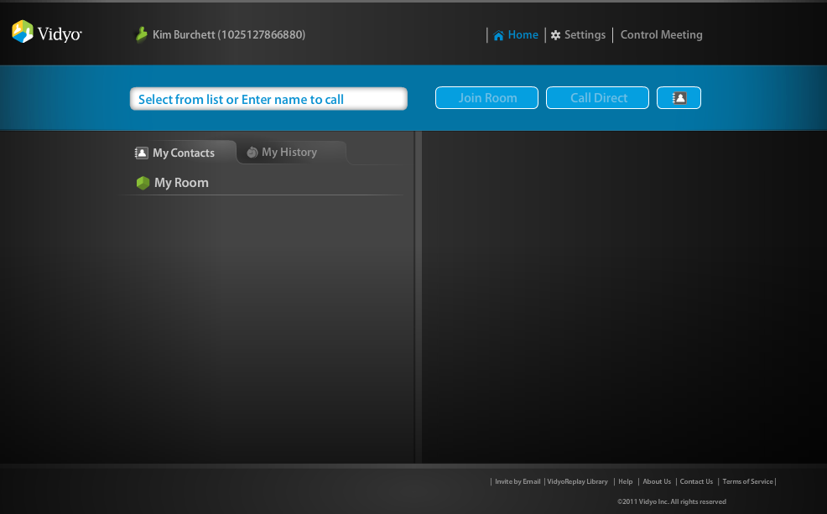
Contact Search Field
Notes:
Contact Search Field
You start by searching for a user or public meeting room in the contact search field.
You can search by name (first/last/initials) or by extension. When you find the user you are searching for, you can call them direct or join their room if they are available.
If you type a percent sign (%), a list of all registered users appears.
If you type an asterisk (*) a list of all registered users who are currently online appears.

Slide 11
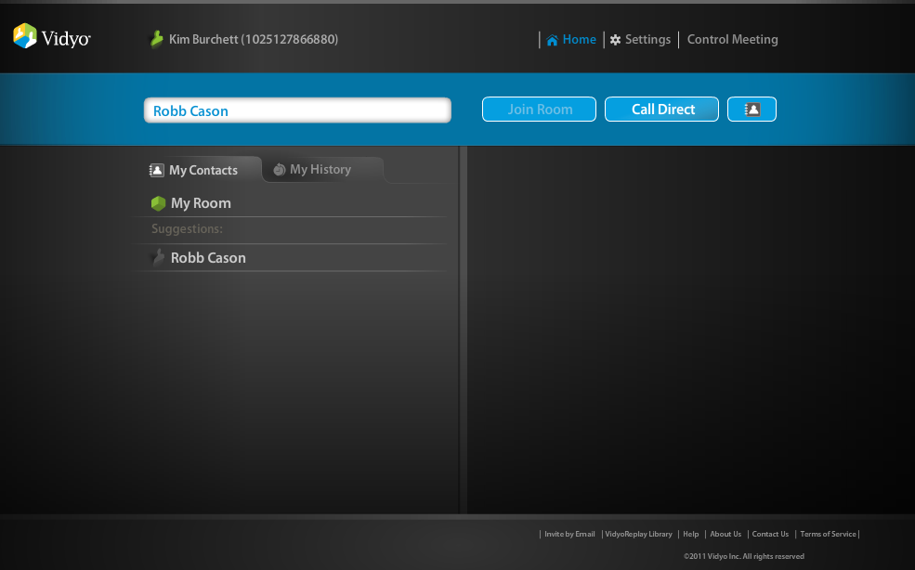
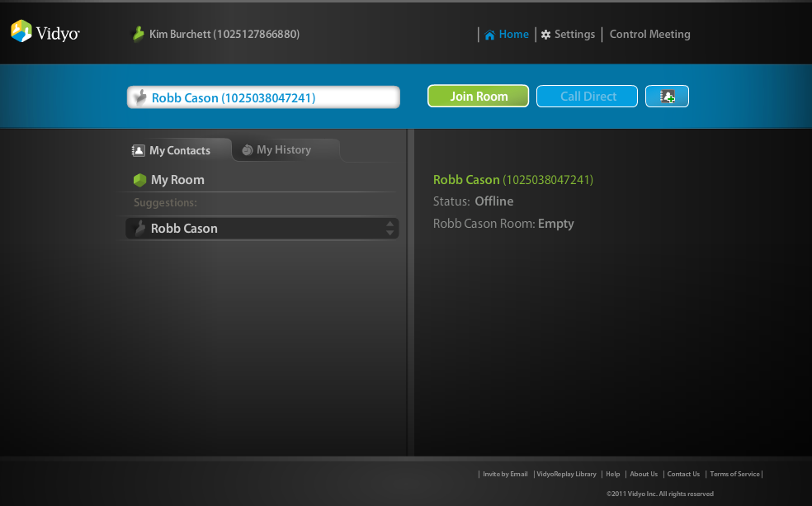
Contact Search Field
Notes:
When you find a contact or public room, click to select it.
The contact/room status details appear on the right side of the home page (user status and room status).
A meeting room must be available for you to join it and a user must be available for you to place a direct call. Room and user statuses appear on the right side of the VidyoPortal home Page for a selected user or public room. Also, when a meeting room is available, the Join Room button is active, and when a user is available, the Call Direct button is active.
User status and room status are independent of one another. You can join the room of a user who is not available (online) for a direct call. Likewise, you can direct call a user whose room is locked, full or PIN protected.

Slide 12
User Status

Slide 13
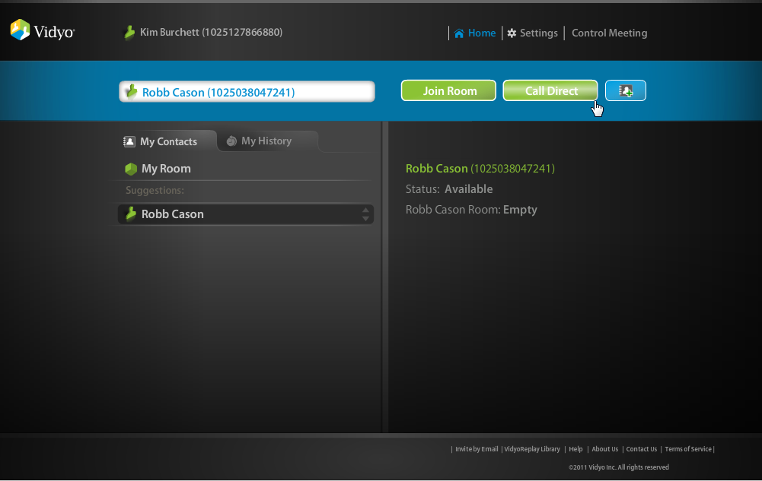
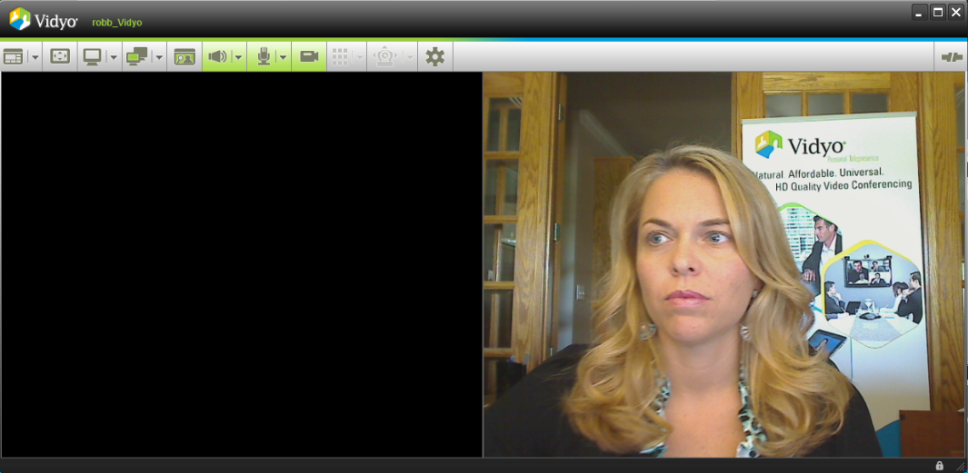
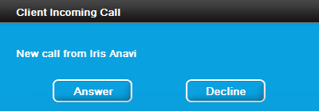
Call Direct
Notes:
Call Direct
The Call Direct button starts a direct (point-to-point) call with another contact. To call direct, search for a contact in the search field as described in Contact Search Field on page 19 (or select one from your My Contacts list if they are on your contacts list) and click the Call Direct button.
Note: The Call Direct button is active only when the selected contact is available for a direct call.
An incoming call alert launches on the persons screen that you are attempting to call. They can answer or decline. If they answer, the VidyoDesktop will launch and your VidyoConference will begin.

Slide 14
Join Room
Notes:
Join Room
The Join Room button enables you to join a room to participate in a meeting. You can join your own meeting room for a meeting you host yourself, or join another user’s room. The owner of the meeting room is the host. The Join Room button becomes active when you select your own room or any private or public room that is not full, busy or locked.
To join your own room, click My Room in the VidyoPortal home page and then click the Join Room button.
To join another contact’s room, search for a contact in the search field as described in “Contact Search Field” on page 19 (or select a user from your My Contacts list) and click the Join Room button.
NOTE: The Join Room button is active only when the selected contact’s room status allows their room to be joined, e.g., the room is neither full nor locked.
The VidyoDesktop launches and takes you to the meeting room.
When you host a meeting in your own room, you see a list of attendees on the right side of the home page under In My Room. When you video conference with users from other tenants, you also see their tenant names.

Slide 15
Add/Delete Contact

Slide 16
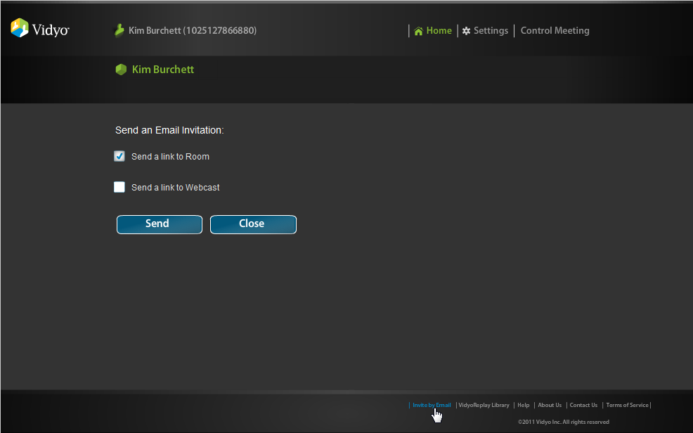
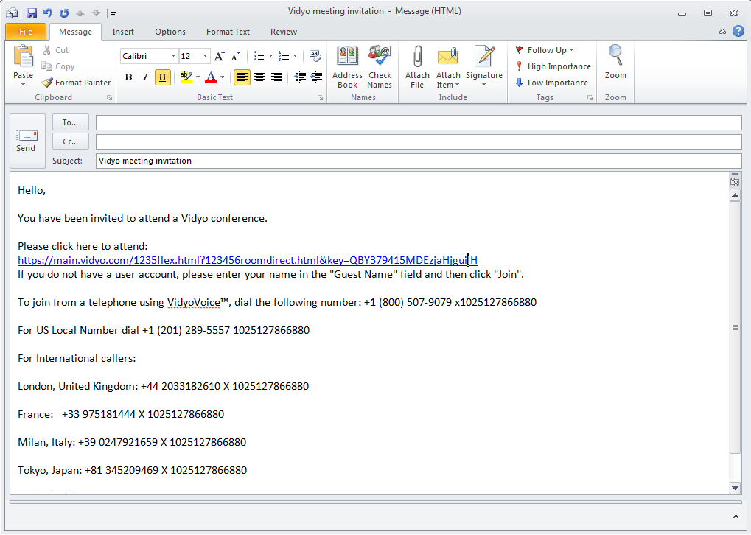
Invite by Email
Notes:
Invite by Email — A link that launches your default email program and creates a message to invite one or more users to join a meeting.
The email contains editable text and the link to your meeting room. It also contains an extension to call into a VidyoConference by phone (and the PIN to use if you have chosen to require one if voice-only participation has been enabled on your system.

Slide 17
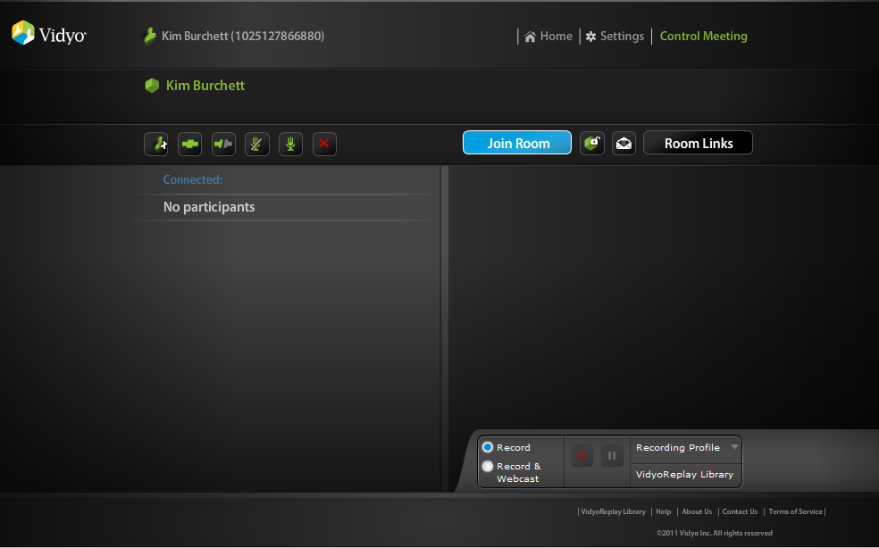
Control Meeting
Notes:
Add Participants
Connect All
Disconnect All
Mute All
Unmute All
Remove All
Join Room
Lock Room
Invite by email
Room Links – gives you access to your room link, making changes, and adding a pin (more advanced)

Slide 18
Launching the VidyoDesktop

Slide 19
Selecting Devices
Notes:
When you join a meeting room or call direct from your Portal home page, you might briefly see a progress bar and then the VidyoDesktop launches.
The first time you launch VidyoDesktop and after any change to your camera or audio settings, you are prompted to select the webcam, microphone and speakers you want to use in the configuration/devices window. Choose the appropriate devices and click Save to proceed to the VidyoDesktop. Changes take place during the current call.

Slide 20

VidyoDesktop - Layout
Notes:
A single VidyoConference can host up to 100 participants but no more than eight remote parties can be displayed at once (the eight are chosen by the last active speakers based on their voice activity).
You can control the layout you see on your own screen, choosing a lower number (overriding the default Auto mode) by clicking on the drop down menu and selecting a number in the 0-8 range (when 0 is selected, none of the participants are displayed).
Clicking on the Layout icon itself changes the screen to Preferred mode, in which the person who is speaking has the largest screen real estate. In Preferred mode, the participant shown in the largest screen area changes as the active speaker changes. Preferred mode is also automatically activated when a participant shares an application. You may also stretch and resize the VidyoDesktop window to change the size and presentation of the layout.
Note:
In a direct (point-to-point) call, the range of screens will be 0-3 since you can turn on Self-View and you can also share what an application on your computer is displaying.
In a multipoint call, the maximum number of displayed participants might be lower than 8 (even if there are more than 8 remote participants) if there isn’t enough available network bandwidth.
The number of displayed screens can total up to 10 if you are using Self-View and viewing a document share.
You can display a thumbnail image of yourself in the lower right corner of the screen by clicking the Self-View button once. Click a second time to view yourself and the other participant. Click a third time to view only the other participant.
Remember, while the default is to always start in the Picture-in-Picture style of the Self-View mode, if you’d prefer not to, just make sure you turn it off before you end a call or conference and VidyoDesktop will remember that Self-View was off and start with it off next time.

Slide 21
VidyoDesktop – Full Screen
Notes:
Clicking on the Full Screen button toggles the screen between sizing the window to utilize the entire screen real estate and restoring the window to the previous size. When in Full Screen mode, the toolbar is hidden unless you mouse over the screen. (Alternatively you can choose to have the toolbar displayed even when you’re in Full Screen mode. See Configuration Options on page 40 for more information.) Mac users will see the application maximized.

Slide 22
VidyoDesktop – Share Screen
Notes:
Participants can share applications on their computers by clicking the Share button. Clicking the button itself toggles between sharing and stopping the share. Click the drop-down arrow to select from the open applications on your local machine to share with other meeting participants.
You can also choose to share your entire desktop by selecting your display from the share list (Windows only). When you first share an application or screen, the VidyoDesktop shrinks to enable you to view the shared application. You can resize the VidyoDesktop, as desired.
You can see the screen with your shared application by clicking the Toggle button next to the Share button and choosing your name from the list. If you choose not to view your shared application, you know you are sharing because the Share icon is green.
Tip: To more easily view shared presentations and documents on-screen, set your layout to preferred mode or to 0 (zero). You’ll see only the shared application.
When another participant is sharing an application, it will show on the VidyoDesktop window. When layout is set to Preferred mode, the shared application appears largest. You may undock the shared screen (i.e., view it as a separate window) and re-dock the shared screen (i.e., snap it back into the main VidyoDesktop window) by double-clicking the contents of the application window.

Slide 23
VidyoDesktop - Toggle
Notes:
Many participants may share what’s on their computer screens (like a PowerPoint slide, a spreadsheet, a Web page and so on) but you can view only one shared screen at a time. When shared applications are available from multiple participants, the Toggle button turns green, indicating a share is available. You may toggle between multiple applications using the Toggle button. Click the button to cycle through the available shares.
When you click the button you’ll see a list of the people who are currently sharing their screens and you can choose the person whose share you want to view. If you are sharing your screen you’ll see your own name on the list as well. Click the drop-down arrow to select a specific share from all available shared applications, including yours. The first option in the drop-down is always None. Selecting None means that you will not see any shared applications in the VidyoDesktop window.

Slide 24
VidyoDesktop – Self-View
Notes:
You can view your own video feed in “Picture-in-Picture” mode by clicking the Self-View button. Your feed appears as a thumbnail image in the lower right corner of the screen.
Click the Self-View button a second time to see your image the same size as others on the screen layout. For example, if you’re in a direct call the screen will split in half and you’ll see the person you’re talking to on the left hand side and yourself on the right. Click the Self-View button a third time to remove yourself from the layout and view only the other meeting participant.

Slide 25
VidyoDesktop – Volume
Notes:
Click on the Volume button to mute/unmute the sound you’re hearing. The button turns red when mute is on. Or use the drop-down arrow to change the volume level. You’ll see a slider and a green line whose vertical movement reflects the energy (volume) level your speakers or headphones are outputting.

Slide 26
VidyoDesktop – Microphone
Notes:
Click on the Microphone button to mute/unmute the sound you’re broadcasting. Or use the drop-down arrow to change the volume level. You’ll see a slider and a green line whose vertical movement reflects the energy (volume) level your mic is outputting.
The button turns red when you mute yourself and a small red circle with a line through it appears under the microphone icon.
When the room owner mutes you, the Microphone button turns red and a red line appears over the microphone icon.
When you mute yourself and the room owner also mutes you, the Microphone button turns red, you see a red line over the microphone icon and a small red circle with a line through it under the microphone icon

Slide 27
VidyoDesktop – Privacy
Notes:
Click on the Privacy button to stop the video you’re sending (i.e., privacy mode). You stay on the call but other participants will not be able to see you. If you are showing a document, it will continue to be visible.
The Privacy button turns red when you put yourself in privacy mode and a small red circle with a line through it appears under the camera icon.
When the room owner or admin puts you in privacy mode, the Privacy button turns red and a red line appears over the camera icon.
When you put yourself in privacy and the room owner or admin also puts you in privacy mode, the Privacy button turns red; you see a red line over the camera icon and a small red circle with a line through it under the camera icon.

Slide 28
VidyoDesktop – Configuration
Notes:
The Configuration button turns red when there is an alarm, indicating that your settings need attention. Click the configuration button to configure your VidyoDesktop, including Status, Attendees, Network, Devices, Video, Options and About. The following settings are accessible when your status is Not in Conference as well. You may access the configuration settings

Slide 29
VidyoDesktop – Disconnect
Notes:
Clicking the Disconnect button immediately disconnects you from any meeting or conference you’re in.

Slide 30
Best Practices
Use a wired network connection when possible and disable wireless
Use recommended audio/video devices to prevent echo and other audio/video issues
Plug each device (camera, microphone etc.) directly into one of your computer’s USB ports whenever possible rather than a USB hub (whether it’s one you added to your computer, is built into your flat panel monitor or is built into your laptop’s docking station)
If you’re using a laptop avoid running on battery—it reduces performance and video quality
If your computer has a Power Plan (All Windows and Mac laptops do) choose “High Performance”
Make sure you have the latest drivers (like your DirectX video driver if you’re a Windows user) for the devices you use during VidyoConferencing (camera, microphone etc.)
Notes:
How to Get The Best VidyoConferencing Experience
The VidyoConferencing system is designed to work through all sorts of network and endpoint (e.g., your computer) deficiencies and still deliver quality audio and video. However, we’ve discovered a few things you can do to help ensure you get the best possible experience. Here are some tips we think you’ll find helpful:

Slide 31
Questions??

