Slide 1
Updating the CERN Computer Centre Infrastructure
Ian Bird, CERN
GDB, 21st March 2012

Slide 2
Outline
Rationale
Agile Infrastructure project @ CERN
  Configuration management
  Virtualisation/Openstack/etc.
  Monitoring & Analysis
Cloud initiatives
  Helix Nebula initiative and project
Remote extension of the Tier 0
  Status & timescales

Slide 3
Rationale
When CERN developed existing tools, etc there were no other large-scale solutions
  Now there are …
Why is CERN different?
  Usually it is not
  When it is, its often a self-imposed difference
Long term: we need to reduce effort in developing and maintaining home-grown tools
  Where there are proven solutions used in the wider world
HEP is no longer large scale in terms of computer centres
Continually ask why we need to do it that way (any longer)

Slide 4
Some other reasons
Today: very hard to add services – time & effort
  Time to provision a machine, define & set up a service
  VOBox a.k.a. PaaS a viable alternative for many services today
More automation is essential; limited today by some of the tools
Exploitation of remote Tier 0
Business continuity
Optimise resource allocation; live migration (if possible)
Reduce hardware variations (as far as possible)
Large community developing tools & enhancements & recipes
Skills likely to be found in new hires; valuable for departing staff
  Training and documentation available everywhere

Slide 5
?aaS
We need to be able to provision at all levels
  Facility: CERN CC; safehost; remote Tier 0
  Infrastructure: {lxcloud, CVI}
  Platform: CERN Web services, “VOBox”
  Software: Indico
Need to be more dynamic than now in order to support this
 |  |  | Applications
 |  | Platform
 | Infrastructure
Facilities

Slide 6
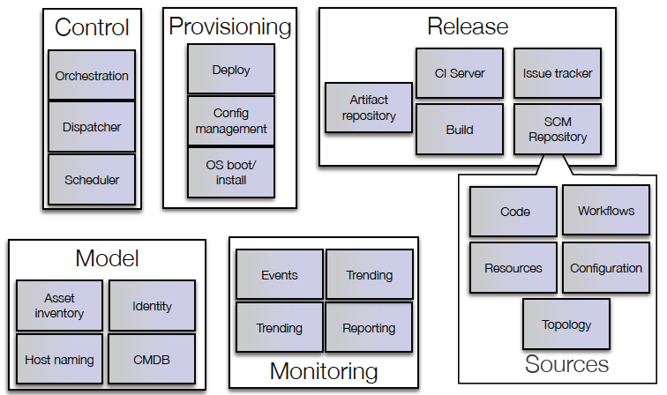
Use standard tools

Slide 7
Agile Infrastructure project
Integrates all the activities in IT that are reworking all aspects of running and managing the CC (and the remote extensions)
Started with 2 aspects: configuration management (full machine lifecycle); and virtualisation/internal cloud deployment
In parallel we re-assessed the monitoring infrastructure IT-wide
  To remove duplicities; Most important: to be able to data mine and analyse monitoring information (automation, trends, etc.)
Integrated all 3 aspects together into one overall umbrella project
  Coordinated by Bernd Panzer; with effort drawn from across most IT groups

Slide 8
Aspects of the Agile Infrastructure
Areas that deal with:
  Overall architecture
  Installation
  Configuration management
  Monitoring & accounting (billing?)
  Orchestration/Scheduling and task/job placement
  Storage infrastructure
  Network infrastructure
  Private and hybrid cloud infrastructure

Slide 9
Configuration management

Slide 10
Project scope
The project is reviewing the entire CERN computer-centre management toolset
  What happens from the bare metal up
  Asset management, inventory
  Sysadmin tools and maintenance workflows
  Service management and configuration tools
  Dynamic configuration for ‘virtual’ hosts
  Operations monitoring
  Workflow automation and continuous deployment

Slide 11
Scaling challenges: nodes
Current production system built around the Quattor toolset is successfully managing 10k servers
  (CERN) Quattor + many CERN components
Currently we have O(10k) physical nodes
IaaS approach:
  Moving to virtual machines
  More (smaller, load-balanced) service nodes
  VMs for raw compute (batch or pilot jobs)
  Homogeneous: compute + storage on the same node
Add another computer centre, 24/48 SMT cores per node, you get 100k – 300k virtual nodes to be managed
  99.6%⁽¹⁾ node update success-rate means 1200 manual interventions to “fix it”
  ⁽¹⁾ in a recent intervention on lxbatch

Slide 12
Scaling challenges: people
Many, diverse applications (“clusters”) managed by different teams
..and 700+ other “unmanaged” Linux nodes in VMs that could benefit from a simple configuration system

Slide 13
Current tool snapshot (liable to change)
Puppet
Foreman
mcollective, yum
Jenkins
AIMS/PXE
Foreman
JIRA
Openstack Nova
git, SVN
Koji, Mock
Yum repo
Pulp
Hardware database
Lemon
Puppet stored config DB

Slide 14
VM management

Slide 15
Today
LXCloud pilot:
  Based on OpenNebula, providing EC2 services for physics
CVI (CERN Virtual Infrastructure) “kiosk”:
  Uses Hyper-V providing long-lived server-like workloads (VOBoxes, etc)
Neither is ideal for long-term support or scale
  Different teams with different initial goals

Slide 16
Some goals
Support CERN needs and use-cases
  Existing use cases of LXCloud and CVI
  PaaS, bursting to commercial or academic clouds
  Dynamic provisioning of services for users
More efficient use of hardware
  Reduce impact of failure
  Can we reduce the amount of “specialized” hardware types?
Improve usage accounting and monitoring
  Understand usage and provisioning better
Management & provisioning of remote data centre
  Need a more dynamic way to provision services (how dynamic tbd!)
  Will have no local admins
Exploit work done in industry & elsewhere
  Load balancing, schedulers, etc., etc.

Slide 17
Openstack
Open source software components to help run a cloud infrastructure
  Is “Amazon-like” (i.e. EC2 and S3)
Large community –
  Significant industry support: 149 companies
  Several large research organisations
Active community:
  Design summits, conferences, user groups
Openstack Foundation:
  Independent of a company (and thus associated risks)

Slide 18
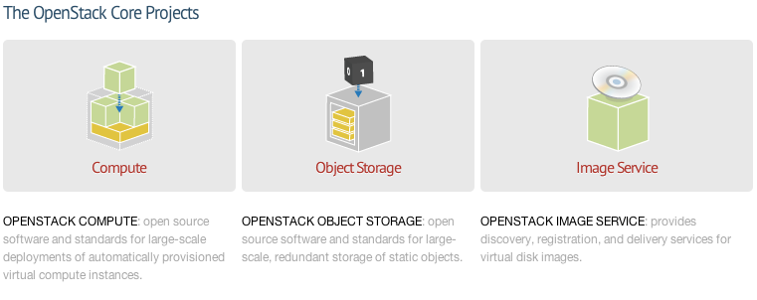
Openstack projects:
“Incubated” projects becoming part of the core now:
  Keystone (AA across openstack projects and integration with existing authN systems)
  Horizon (dashboard: portal for admins and users)
Large number of community projects:
  Network, load balancing, gateways, installation/maint., etc.

Slide 19
Monitoring

Slide 20
Motives
We have lots of monitoring – and a successful framework
  Lemon and SLS widely used
No coherent monitoring architecture
Lots of teams starting to want additional facilities, including log mining and analysis
  Potential for huge duplication of effort
Recognise a need to be able to do across the board analysis
  Trends, correlations, etc
  Need to be able to automate responses to complex situations
  Need to be able to react to changing usage patterns
Had internal workshop, and working group to agree a common architecture and approach

Slide 21
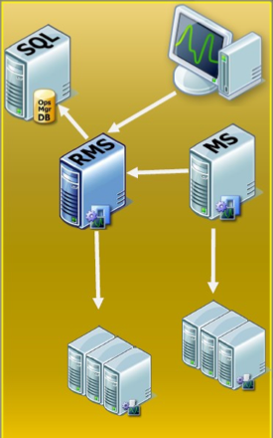
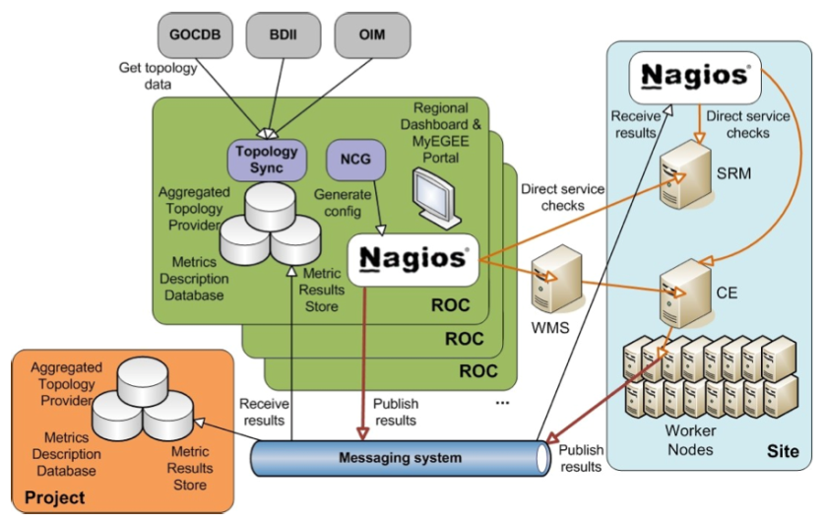
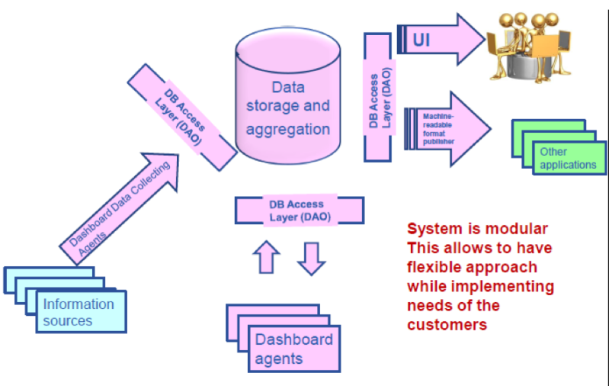
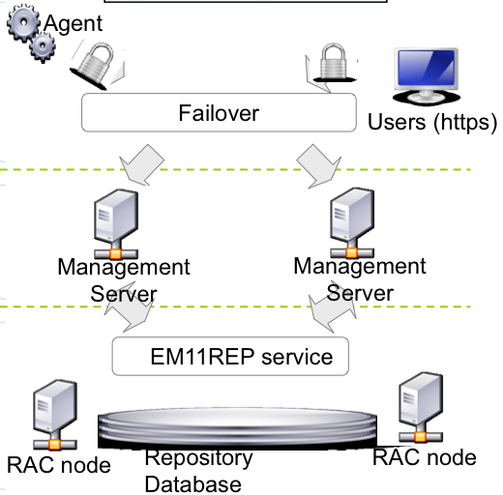
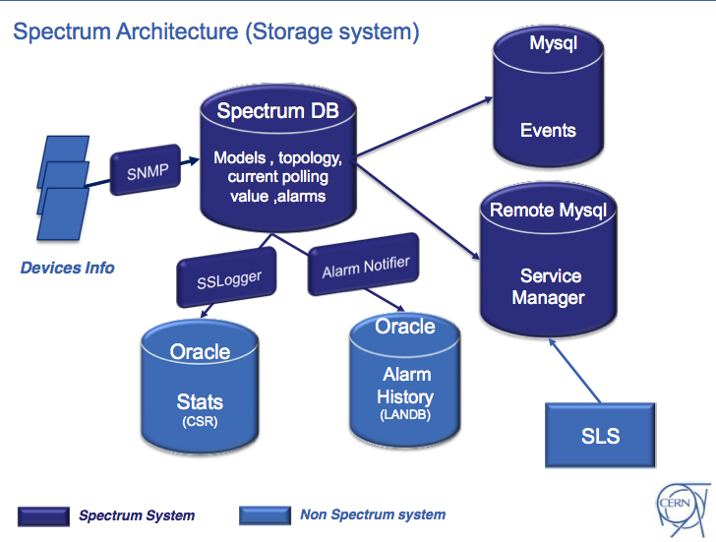
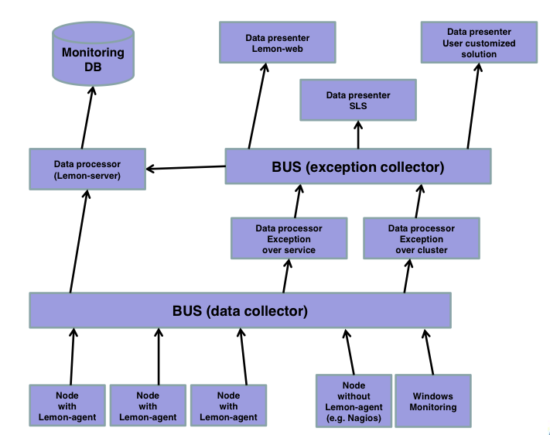
Monitoring Applications

Slide 22
Monitoring Data
Producers
  40538
Input Volume
  283 GB per day
Input Rate
  697 M entries per min
  2,4 M entries per min without (batch) process accounting
Query Rate
  52 M queries per day
  3,3 M entries per day without process accounting

Slide 23
Analysis
Monitoring in IT covers a wide range of resources
  Hardware, OS, applications, files, jobs, etc
Many application-specific monitoring solutions
  Some are commercial solutions
  Based on different technologies
Limited sharing of monitoring data
  Maybe no sharing, simply duplication of monitoring data
All monitoring applications have similar needs
  Publish metric results, aggregate results, alarms, etc

Slide 24
Constraints (Technology)
Focus on providing well established solutions for each layer of the monitoring architecture
  Transport, storage, analysis
Flexible architecture where a particular technology can be easily replaced by a better one
Adopt whenever possible existing tools and avoid home grown solutions
Follow a tool chain approach
Allow a phased transition where existing applications are gradually integrated

Slide 25
User Stories
User stories were collected from all IT groups and commonalities between them were identified
To guarantee that different types of user stories were provided three categories were established:
  Fast and Furious (FF)
    Get metrics values for hardware and selected services
    Raise alarms according to appropriate thresholds
  Digging Deep (DD)
    Curation of hardware and network historical data
    Analysis and statistics on batch job and network data
  Correlate and Combine (CC)
    Correlation between usage, hardware, and services
    Correlation between job status and grid status

Slide 26
Architecture Overview
Splunk
Portal
Report
Alarm
Portal
Hadoop
Oracle
Analysis
Storage
Application
Specific
Storage Feed
Alarm Feed
Custom Feed
Apollo
Aggregation
Lemon
Publisher
Sensor
Publisher
Sensor

Slide 27
Central Storage and Analysis
Hadoop is a good candidate to start with
  Prior positive experience in IT and the experiments
  Map-reduce paradigm is a good match for the use cases
  Has been used successfully at scale
  Many different NoSQL solutions use Hadoop as backend
  Many tools provide export and import interfaces
  Several related modules available (Hive, HBase)
Document based store also considered
  CouchDB/MongoDB are good candidates
For some use cases a parallel relational database solution (based on Oracle) could be considered

Slide 28
Integrating Closed Solutions
External (commercial) monitoring
  Windows SCOM, Oracle EM Grid Control, Spectrum CA
These data sources must be integrated
  Injecting final results into the messaging layer
  Exporting relevant data at an intermediate stage
Visualization/Reports
Analysis
Messaging
Storage
Transport
Sensor
Export Interface
Integrated Product

Slide 29
Milestones
Monitoring.v1 Q1 2012
AI nodes monitored with Lemon (dependency on Quattor)
Monitoring.v2 Q2 2012
AI nodes monitored with Lemon (no dependency on Quattor)
Lemon data starts to be published via messaging
Monitoring.v3 Q4 2012
Several clients exploiting the messaging infrastructure
Initial data store/analysis for select use cases
Monitoring.v4 Q4 2013
Deployment of Messaging Broker and Hadoop cluster
Testing of other technologies (Splunk)
Monitoring data published to the messaging infrastructure
Large scale data store/analysis on Hadoop cluster
Messaging consumers for real time alarms and notifications

Slide 30
Monitoring: note
This architecture is (surprise!) essentially that of the WLCG monitoring infrastructure
  Although scope and scales are different
  Anticipate significant re-use of experience & tools – in both directions
    E.g. we start to prototype an analysis service based on Hadoop and …

Slide 31
Agile Infrastructure project: summary
Year | What | Actions
2011 |  | Agree overall principles
2012 |  | Prepare formal project plan Establish IaaS in CERN CC Production Agile Infrastructure Monitoring Implementation as per WG Migrate lxcloud Early adopters to Agile Infrastructure
2013 | LS 1 New Data Centre | Extend IaaS to remote CC Business Continuity Support Experiment App re-work Migrate CVI General migration to Agile with SLC6 and Windows 8
2014 | LS 1 (to November) | Phase out Quattor/CDB/…

Slide 32
Clouds & virtualisation
Several prongs:
Use of virtualisation in the CERN CC:
  Lxcloud pilot + CVI ➔ dynamic virtualised infrastructure (which may include “bare-metal” provisioning)
  No change to any grid or service interfaces (but new possibilities)
  Likely based on Openstack – see above
  Other WLCG sites also virtualising their infrastructures
Use of commercial clouds – “bursting”
  Additional resources;
  potential of outsourcing some services?
  Helix Nebula project – see next slides
Not discussed here:
  Can cloud technologies supplement/replace some of the grid services? On what timescale?
  Was hoping TEGs would comment here…

Slide 33
Helix Nebula project

Slide 34
Origin of the initiative
Conceived by ESA as a prospective for providing cloud services to space sector in Europe
Presented to the IT working group of the EIROforum where other members (CERN, EMBL) joined
Two workshops held during 2011
  June: hosted by ESA in Frascati
  October: hosted by EMBL in Heidelberg
EIROforum: CERN, EFDA-JET, EMBL, ESA, ESO, ESRF, European XFEL, ILL

Slide 35
Timeline
Set-up
(2011)
Pilot phase
(2012-2014)
Full-scale cloud service market
(2014 … )
Select flagships use cases,
identify service providers,
define governance model
Deploy flagships,
Analysis of functionality,
performance & financial
model
More applications,
More services,
More users,
More service providers

Slide 36
Role of Helix Nebula: The Science Cloud
Vision of a unified cloud‐based infrastructure for the ERA based on Public/Private Partnership, 4 goals building on the collective experience of all involved.
Goal One : Establish HELIX NEBULA – the Science Cloud – as a cloud computing infrastructure addressing the needs of the ERA and capable of serving as a platform for innovation and evolution of the overall e‐infrastructure.
Goal Two: Identify and adopt suitable policies for trust, security and privacy on a European‐level
Goal Three: Create a light‐weight governance structure that involves all the stakeholders ‐ and which can evolve over time as the infrastructure, services and user‐base grows.
Goal Four: Define a funding scheme involving all the stake‐holder groups (service suppliers, users, EC and national funding agencies) for PPP to implement a Cloud Computing Infrastructure that delivers a sustainable and profitable business environment adhering to European‐ level policies.

Slide 37
Specific outcomes
Develop strategies for extremely large or highly distributed and heterogeneous scientific data (including service architectures, applications and standardisation) in order to manage the upcoming data deluge
Analyse and promote trust building towards open scientific data e‐Infrastructures covering organisational, operational, legal and technological aspects, including authentication, authorisation and accounting (AAA)
Develop strategies and establish structures aiming at co‐ordination between e‐infrastructure operators
Create frameworks, including business models for supporting Open Science and cloud infrastructures based on PPP, useful for procurement of computing services suitable for e‐ Science

Slide 38
Scientific Flagships
CERN LHC (ATLAS):
  High Throughput Computing and large scale data movement
EMBL:
  Novel de novo genomic assembly techniques
ESA:
  Integrated access to data held in existing Earth Observation “Super Sites”
Each flagship brings out very different features and requirements and exercises different aspects of a cloud offering

Slide 39
ATLAS use case
Simulations (~no input) with stage out to:
  Traditional grid storage vs
  Long term cloud storage
Data processing (== “Tier 1”)
  This implies large scale data import and export to/from the cloud resource
Distributed analysis (== “Tier 2”)
  Data accessed remotely (located at grid sites), or
  Data located at the cloud resource (or another?)
Bursting for urgent tasks
  Centrally managed: urgent processing
  Regionally managed: urgent local analysis needs
All experiences immediately transferable to other LHC (& HEP) experiments

Slide 40
Immediate and longer term goals
Determine costs of commercial cloud resources from various sources
  Compute resources
  Network transfers into and out of cloud
  Short and long term data storage in the cloud
Develop understanding of appropriate SLA’s
  How can they be broadly applicable to LHC or HEP
Understand policy and legal constraints; e.g. in moving scientific data to commercial resources
Performance and reliability – compared to WLCG baseline
Use of standards (interfaces, etc.) & interoperability between providers
Can CERN transparently offload work to a cloud resource
  Which type of work makes sense?
Long term: Can we use commercial services as a significant fraction of overall resources available to CERN experiments?
  At which point is it economic/practical to rely on 3rd party providers?

Slide 41
Service Procurement
Assuming pilot phase proves successful, the provision of commercial Cloud services would need to be integrated into the ICT procurement process of the demand-side organisations
For the initial flagships this implies:
  Inter-governmental organisations
    Jurisdiction (governing laws & arbitration), tax-free status, etc.
    Return on Investment: preference for procurement from each organisation’s member-states
  Pool of commercial service providers that can respond to calls for tender
  Cannot integrate procurement processes of all demand-side organisations but can converge:
    Technical specifications & standards
    Terms and conditions
EC published Guide for the procurement of standards based ICT Elements of Good Practice (21 Dec 2011)

Slide 42
Summary
The objective of this initiative is to establish a sustainable cloud computing infrastructure for the European Research Area based on commercially provided services
It is a collaborative initiative bringing together all the stakeholders to establish a public-private partnership
Interoperability with existing e-infrastructures is a goal of the initiative
It has commitments from the IT industry and user organisations – flagship deployment started Jan 2012
3 initial flagship use cases identified
Framework collaboration EC project to start summer 2012

Slide 43
Summary
“Agile Infrastructure” Project: CERN IT is re-working the tools used to manage & monitor the CC (and extensions!)
  To become more industry-standard
  To address issues of scalability and management effort
  To be able to more flexibly and dynamically provide services
  To be able to better monitor and analyse the use of resources
  Increase automation
Cloud investigations:
  Internally as part of the above
  Use of commercial clouds: issues of policy, overall feasibility, data management, cloud models, cost
    Helix Nebula project is one step in this direction
    Will consider other direct investigations with other providers
  CERN openlab:
    New partner Huawei: prototype cloud storage appliance (S3, and others as services)

Slide 44
Extension of the Tier 0
In 2006 we first recognised the need for an extension of the Tier 0
Eventually it was decided that this should not be at CERN
Several years of investigations and proposals
Last year – call for proposals
  Followed by detailed technical follow ups
  Led to call for tender
Results adjudicated last week in the Finance Committee (of Council)
Winner is Budapest, Hungary (Wigner Inst.)

Slide 45
Remote Tier 0
Timescales
  Prototyping in 2012 hopefully
  Testing in 2013
  Production in 2014
This will be a “hands-off” facility for CERN
  They manage the infrastructure and hands-on work
  We do everything else remotely
Need to be reasonably dynamic in our usage
  Will pay power bill
Various possible models of usage – sure to evolve
  The less specific the hardware installed there, the easier to change function
This facility is another reason for modernising the tools and the way we deliver services
  (More) Automation is essential to be able to use this effectively

Slide 46
Summary
CERN is re-working how we manage the CC infrastructure
  Address sustainability of solutions
  Better ways to deliver services
  More dynamic response to changing environment
  Need to be able to integrate the remote Tier 0
Agile Infrastructure project has 3 aspects
  Management tool chain
  Use of virtualisation
  Monitoring
Also investigate feasibility of using cloud providers

Slide 47
Milestones
July 2012
  10% resources in CC managed by IaaS system (1000 nodes) including installation, configuration, etc.
January 2013
  50 % resources managed (over 3 sites)
July 2013
  95% resources managed
Initial focus on service/server consolidation use cases

Slide 48
Technical details
IT Technical Forum (Internal IT Dept. seminars):
  Configuration management: http://indico.cern.ch/conferenceDisplay.py?confId=172002
  Openstack: http://indico.cern.ch/conferenceDisplay.py?confId=175809
  Monitoring: http://indico.cern.ch/conferenceDisplay.py?confId=175813
Will be presentations at HEPiX, CHEP, …

