Slide 1

IAEA activities related to accelerators applications to healthcare
Valeriia Starovoitova, Aruna Korde, Celina Horak
International Atomic Energy Agency
Notes:
logo

Slide 2
Overview of the IAEA

Slide 3
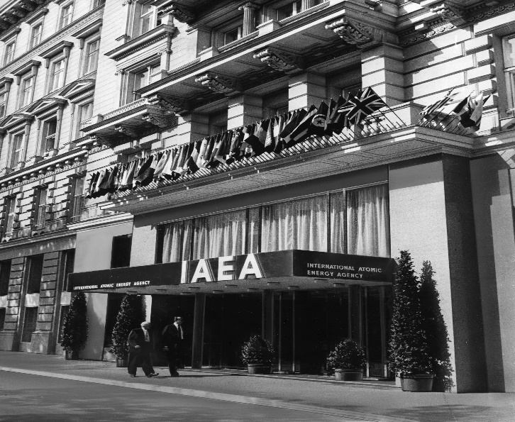
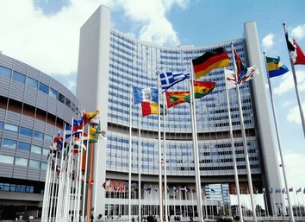
IAEA
Set up in 1957 to promote safe, secure and peaceful nuclear technologies
Currently includes 178 Member States
Over 2500 professional and support staff
Headquarters in Vienna
Two scientific laboratories and research centres
Liaison offices in New York and Geneva

Slide 4

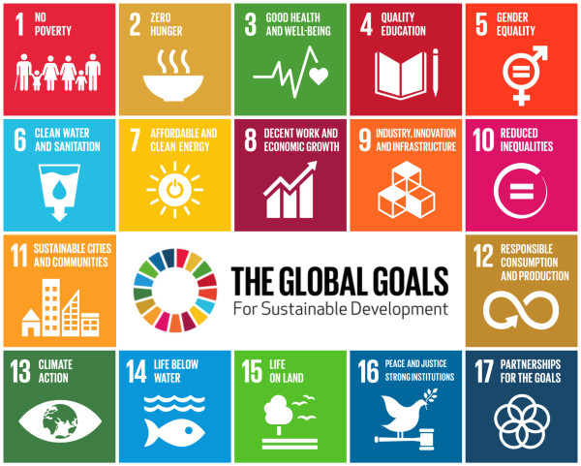

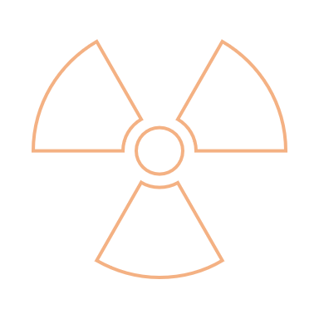

IAEA and SDGs
The “Three Pillars” of the IAEA
Safeguards
&
Verification
Safety
&
Security
Science
&
Technology
Notes:
Better picture of SDGs

Slide 5
Organizational Chart
Office of the Director General
Department of Management
Department of Nuclear Energy
Department of Nuclear Science and Applications
Department of Technical Cooperation
Department of Nuclear Safety and Security
Department of Safeguards
Division of Physical and Chemical Sciences
Division of Human Health
Radiochemistry and Radiation Technology Section
Dosimetry and Medical Radiation Physics Section

Slide 6
What do we do?
Research and development
Production of radioisotopes and radiopharmaceuticals
Radiation technologies for healthcare, industry, environment and cultural heritage
Non-destructive testing and other uses of sealed sources
Education and training
Implementation of technologies

Slide 7



How do we do it?
Publications
Coordinated Research Projects (R&D)
Technical Cooperation Projects (implementation)
Regular program activities
Technical Meetings, Consultancy Meetings & Conferences
General Conference side-events and Scientific Forum
Expert Missions
Collaborating Centres
https://www.iaea.org/services/coordinated-research-activities/how-to-participate

Slide 8
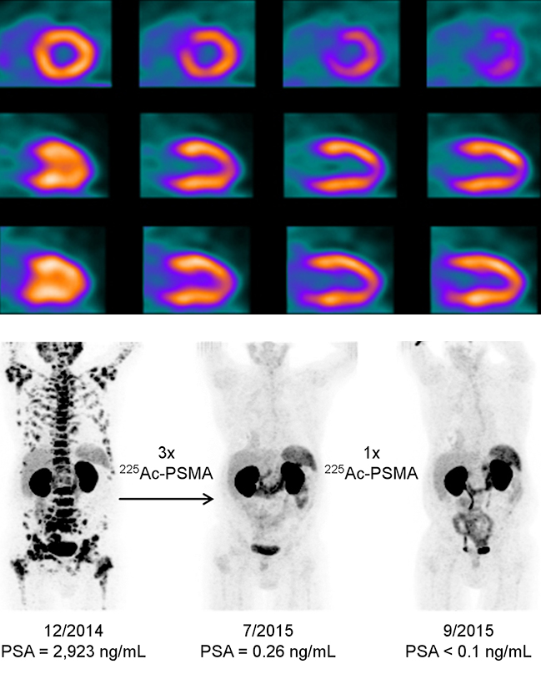
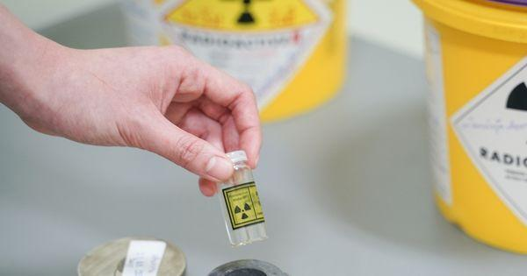
Projects for Health Applications
Development of new Tc-99m radiopharmaceuticals for disease diagnosis
Production of Zr-89 and Development of Zr-89 Radiopharmaceuticals
Production of Cyclotron-based Gallium-68 and related Radiopharmaceuticals
Production and Quality Control of Actinium-225 Radiopharmaceuticals

Slide 9
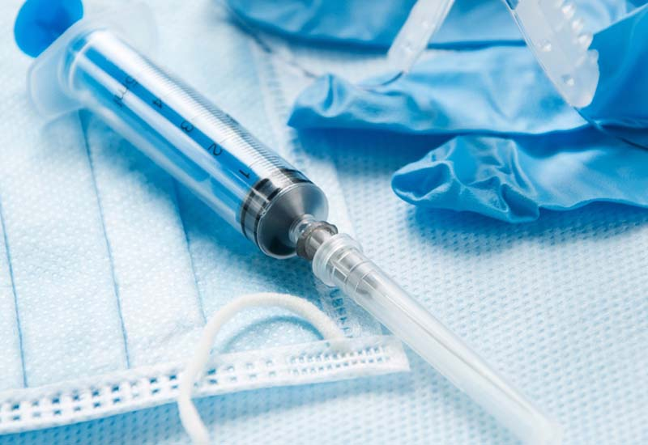
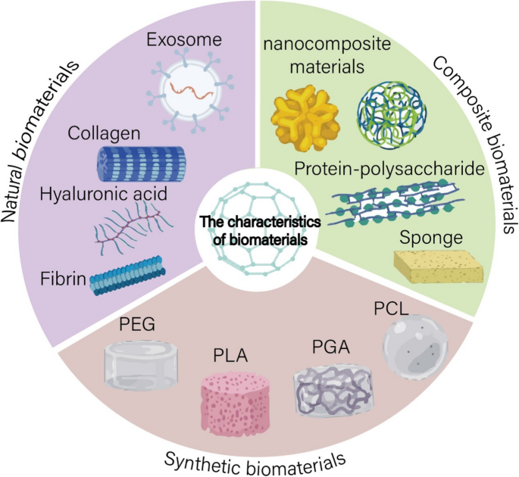
Projects for Health Applications
Enhancing the Beneficial Effects of Radiation Processing in Nanotechnology
Radiation Effects on Polymer Materials Commonly Used in Medical Devices
Biomaterials for sustainable health care
Radiation Sterilization of Biomedical Materials and Biological Tissues

Slide 10
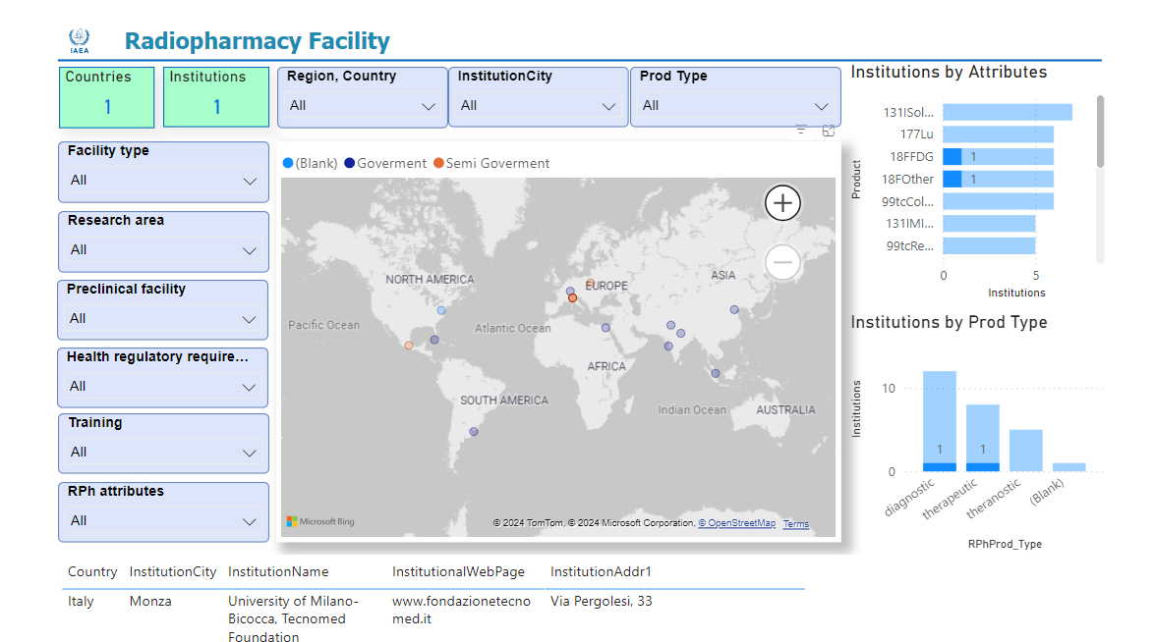
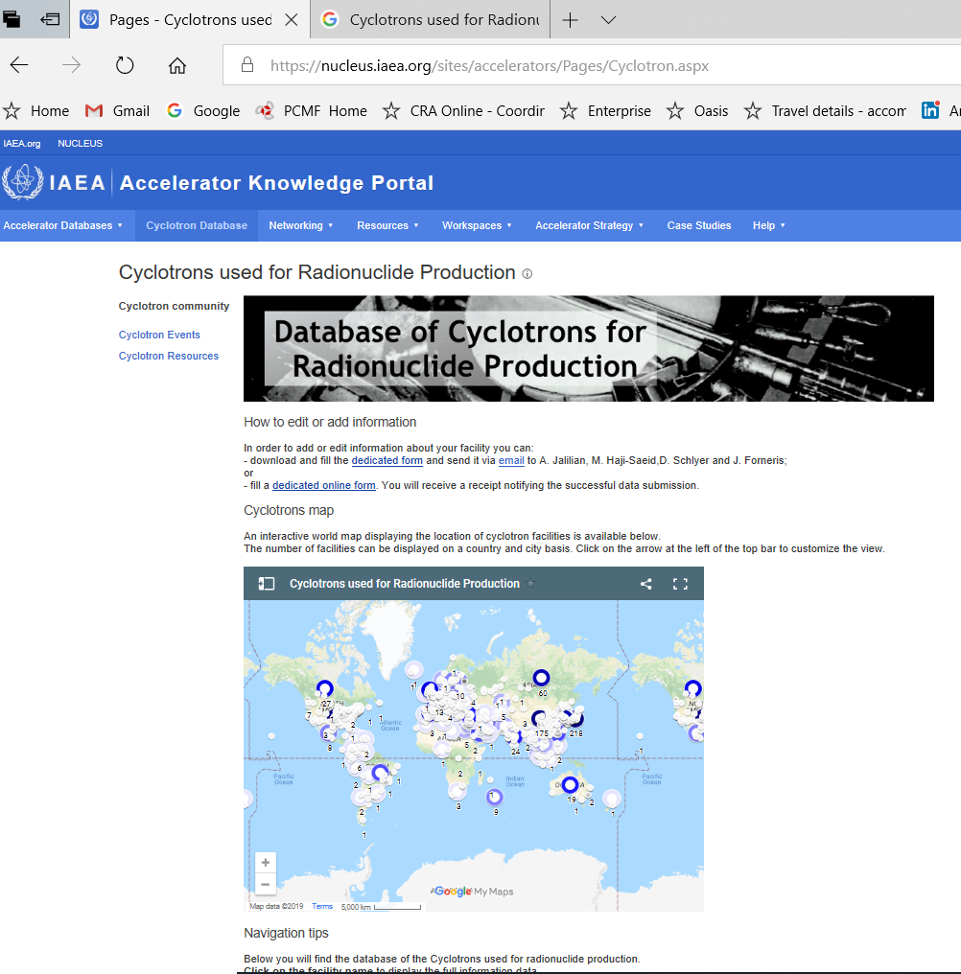
Databases
Cyclotrons used for Radionuclide Production Database:
https://nucleus.iaea.org/sites/accelerators/Pages/Cyclotron.aspx
IAEA Radiopharmacy Database:
https://nucleus.iaea.org/sites/NAPCRadiopharmacyDB

Slide 11
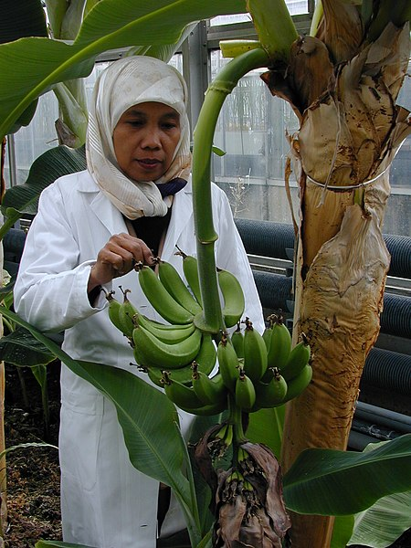
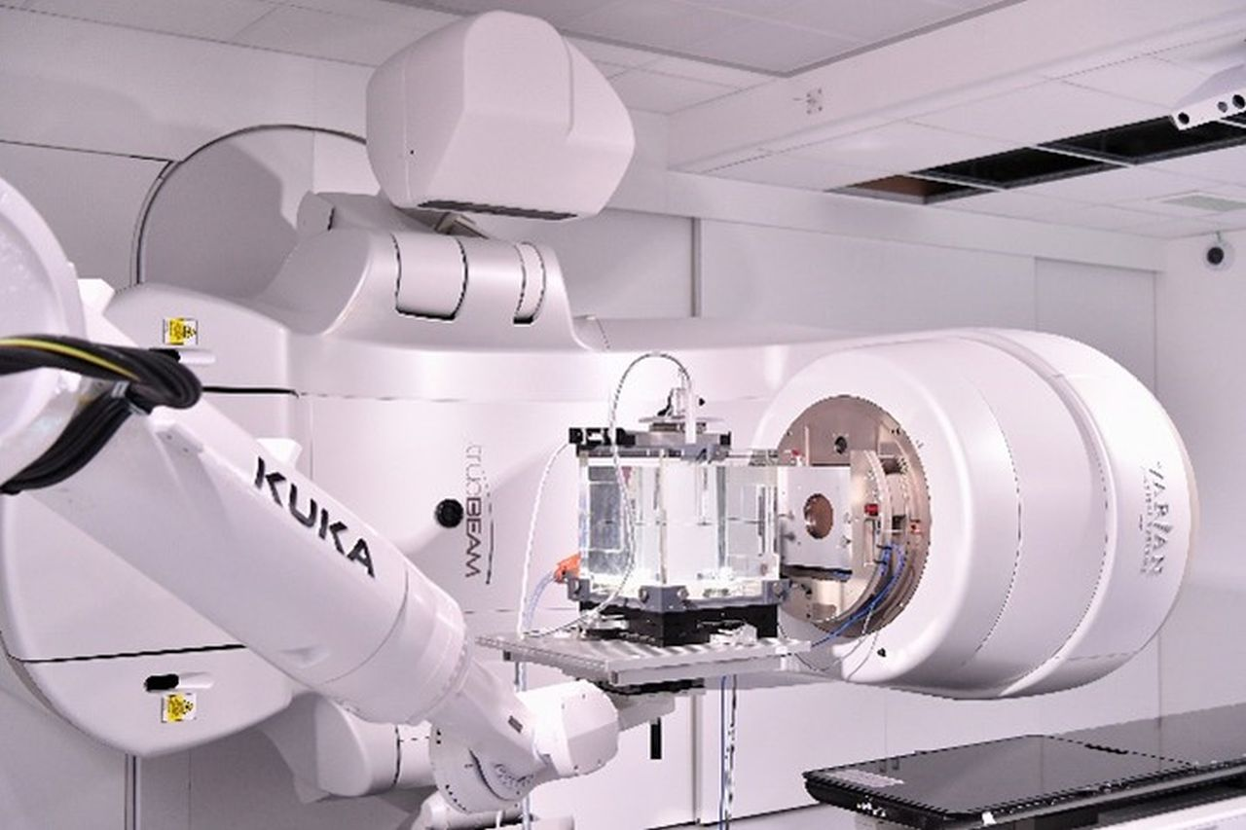
Seibersdorf Laboratories
Already existing facilities:
  dosimetry
  spectroscopy
  gamma facility
  plant breeding facility
Mobile Electron Beam

Slide 12
Accelerator-based production of medical radioisotopes and radiopharmaceuticals

Slide 13
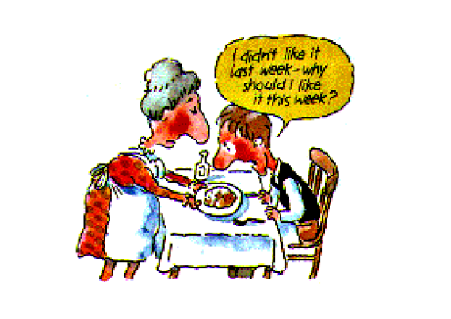
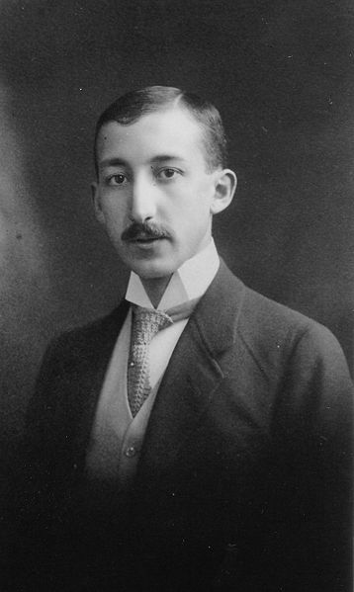
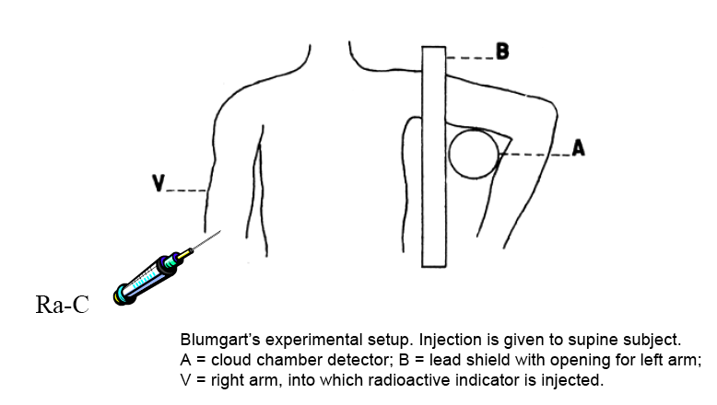
Beginning of nuclear medicine
George de Hevesy (1885 -1966)
Notes:
George de Hevesy (1885 -1966) was a Hungarian radiochemist and Nobel laureate, recognized in 1943 for his key role in the development of radioactive tracers

Slide 14
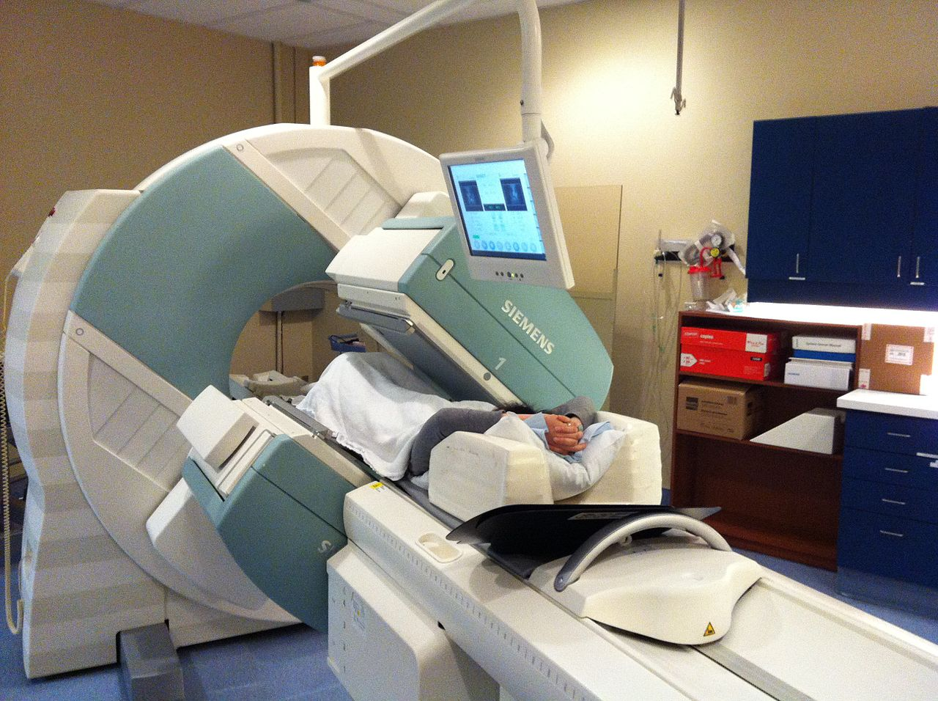
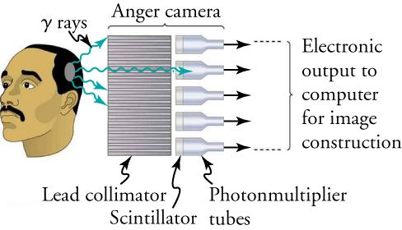
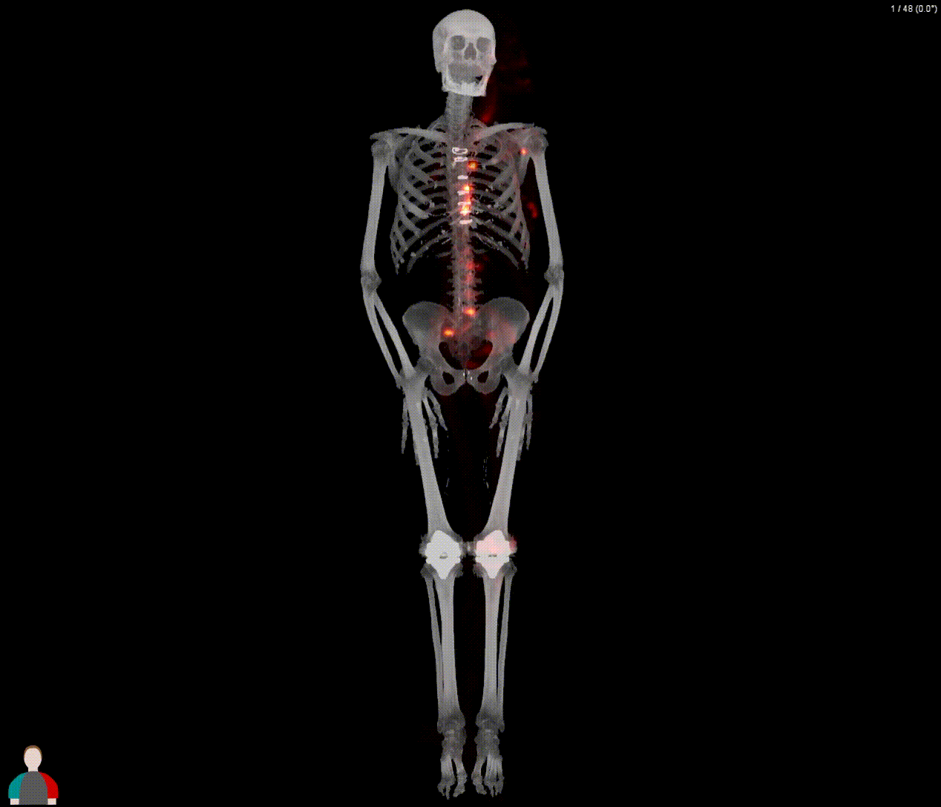


Uses of RI in medicine: SPECT
Short-lived (hours) gamma emitters: mostly Mo-99, mostly produced in reactors

Slide 15
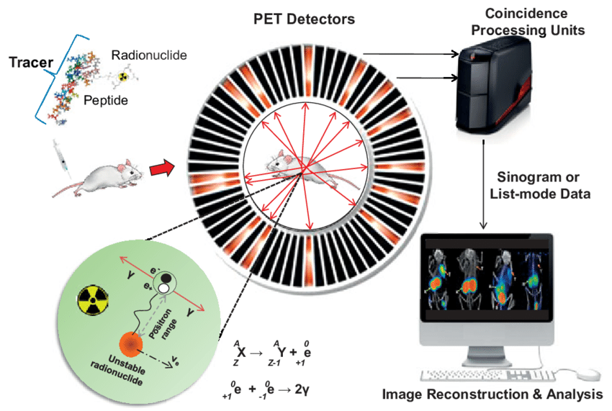
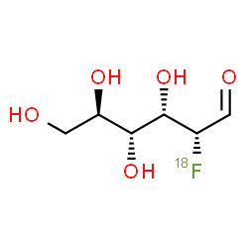
Uses of RI in medicine: PET
Short-lived (minutes to hours) positron emitters: F-18, O-15, Ga-68,etc, commonly produced in accelerators on-site

Slide 16
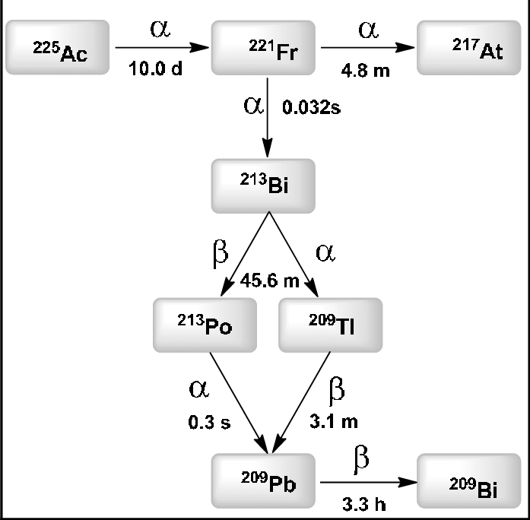
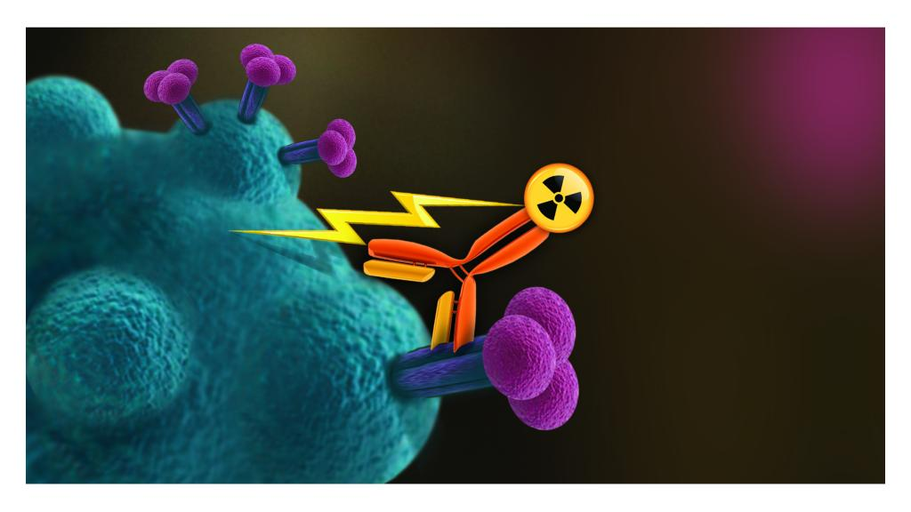
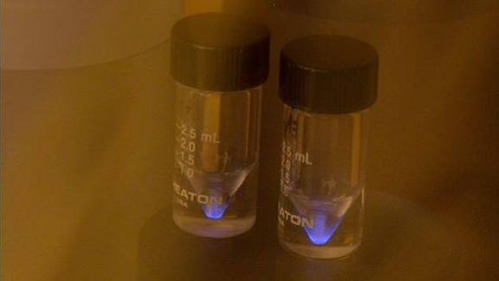
Uses of RI in medicine: targeted therapy
Alpha and beta emitters: for example Ac-225

Slide 17
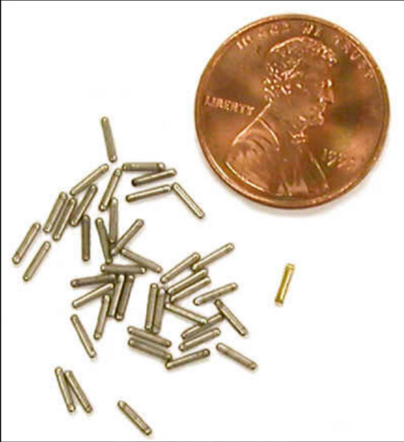
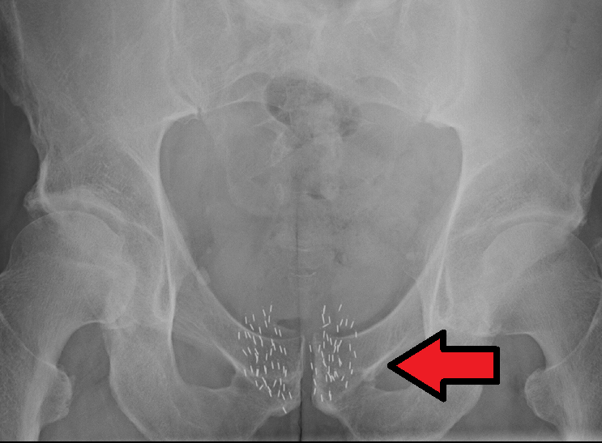
Uses of RI in medicine: brachytherapy
Brachytherapy – solution for localized cancers (breast, prostate, eye, etc)
Seeds (iodine-125, iridium-192, etc) are implanted in the tumor

Slide 18
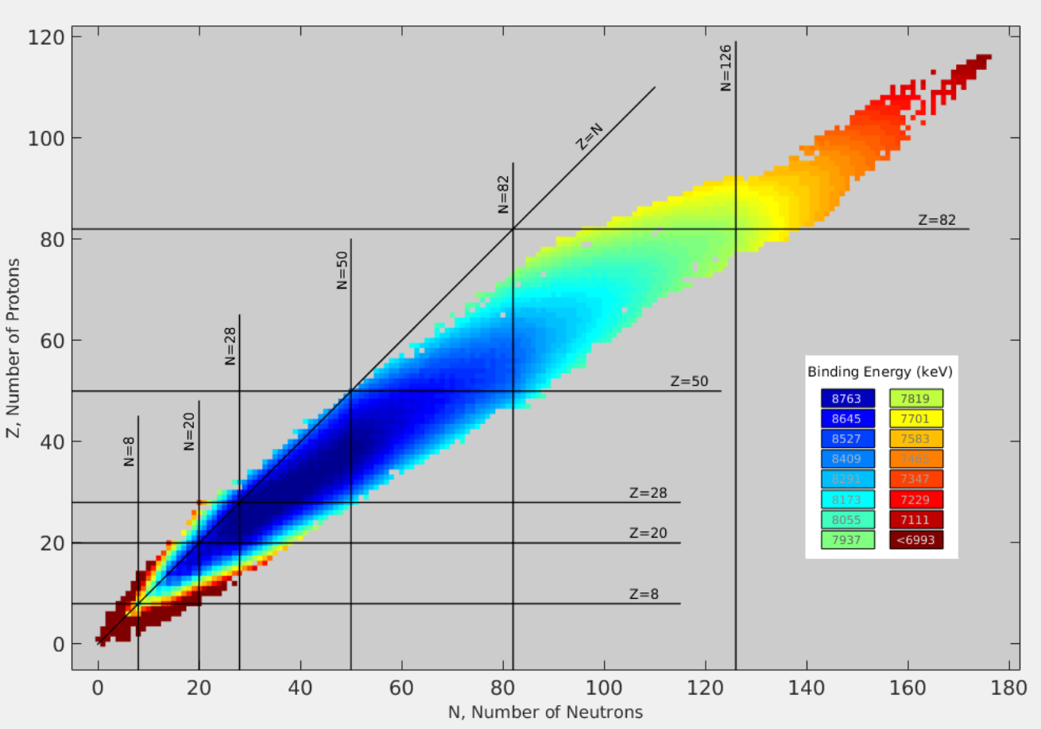
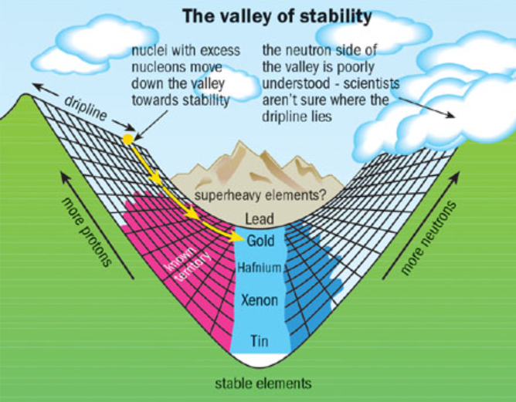
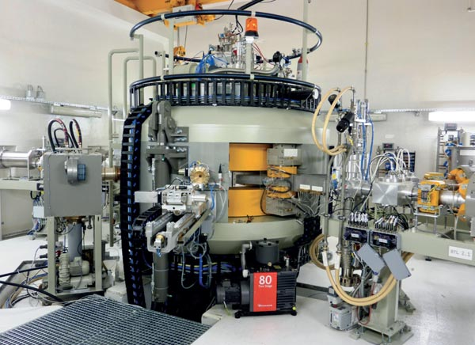
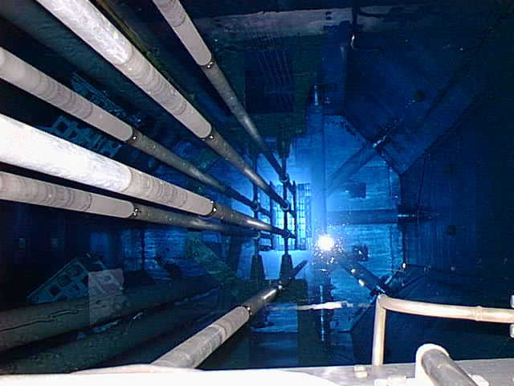
Valley of Stability
Proton-rich isotopes typically:
Undergo β⁺ decay or electron capture
Produced by accelerators
Neutron-rich isotopes typically:
Undergo β⁻ decay
Produced in reactors

Slide 19
“Start the ball rolling…”
1927: Lord Rutherford requested a “copious supply” of projectiles more energetic than natural alpha and beta particles:
“What we require is an apparatus to give us a potential of the order of 10 million volts which can be safely accommodated in a reasonably sized room and operated by a few kilowatts of power. We require too an exhausted tube capable of withstanding this voltage… I see no reason why such a requirement cannot be made practical.”

Slide 20
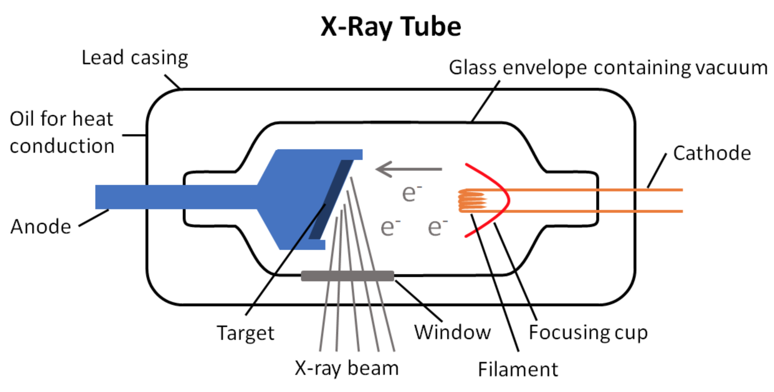
Electrostatic accelerators - X-Ray tube
Old, simple, and reliable technology
Energy and current limit due to anode heating

Slide 21
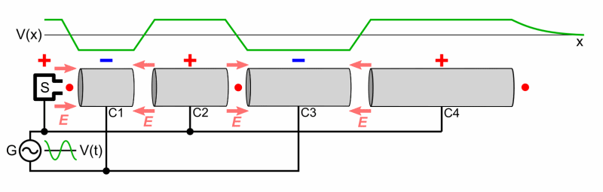
RF Linacs
RF linac: the particles are accelerated multiple times, so the particle energy is not limited by the accelerating voltage.
Notes:
The beampipe is divided into sections, with a gap between each: an alternating voltage is applied to the plates. The applied voltage is at its maximum when the particles reach the gap between these drift tube sections and is zero when the particles are right in the center of a drift tube.

Slide 22
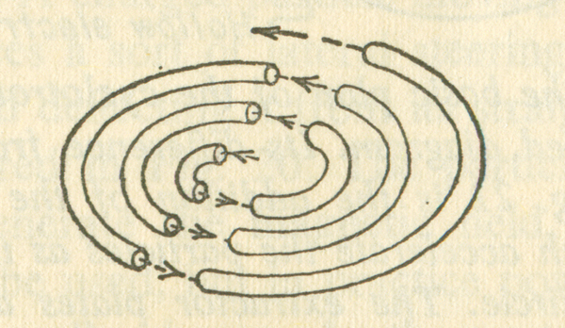
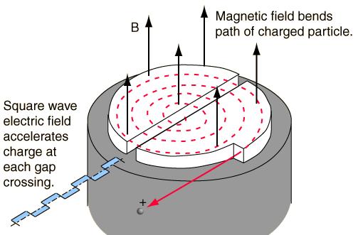
Cyclotrons
In 1929 Ernest Lawrence proposed a modification to a linac: bend the tubes and apply a magnetic field to bend the ion’s path

Slide 23
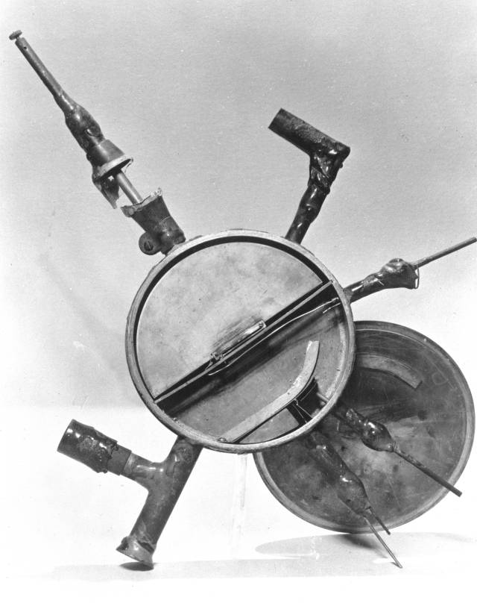
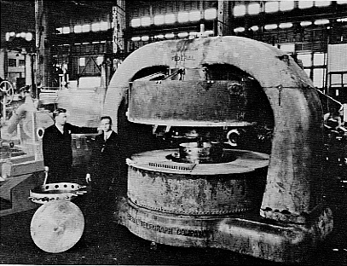
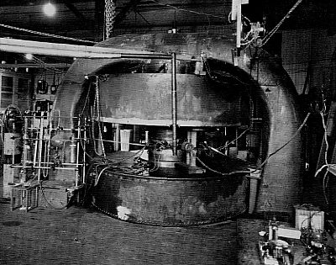
Size does matter!
11-inch → 27-inch → 60-inch (16 MeV) → 100 MeV?!
Relativistic limits!
Notes:
Theoretician Hans Bethe disagreed… Bethe calculated the upper limit of the cyclotron was 20 MeV for protons. Protons traveling any faster would become noticeably relativistic, thus gaining in mass. The increase in mass would cause the particle to fall out of sync with the magnetic resonance condition.

Slide 24
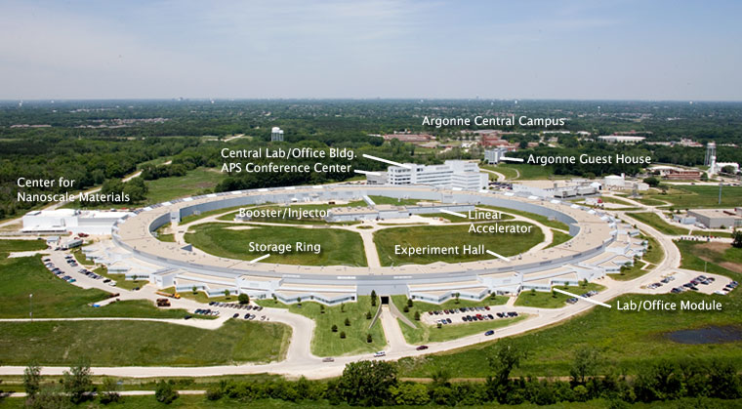
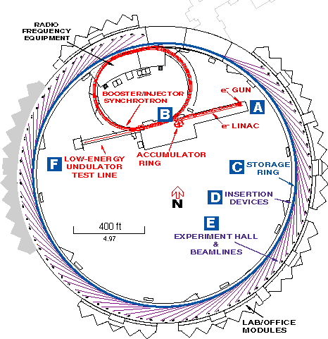
Synchrotrons
The Synchrotron maintains a fixed orbital radius while adjusting the magnetic field to contain the accelerated beam.
Pre-acceleration is necessary, usually with a linac
Notes:
Variations in the magnetic field compensate for the increasing relativistic mass of particles during acceleration.

Slide 25
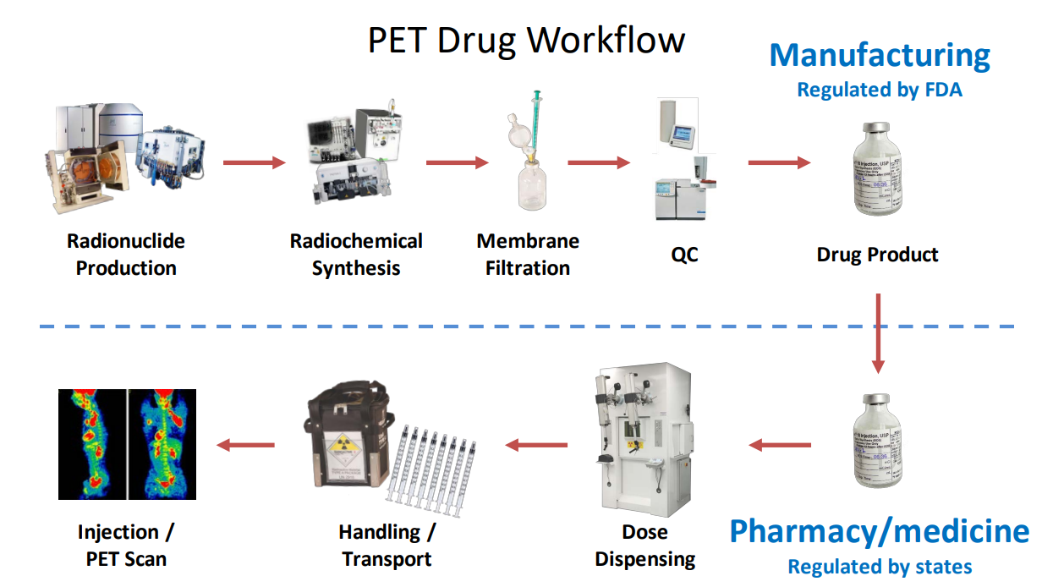
Fluorine-18
Short half-life means the typical shelf life is minutes to hours
High energy radiation (511 keV) necessitates heavy shielding
Each batch provides only a handful of patient doses
Closed system - pre-sterilized components

Slide 26
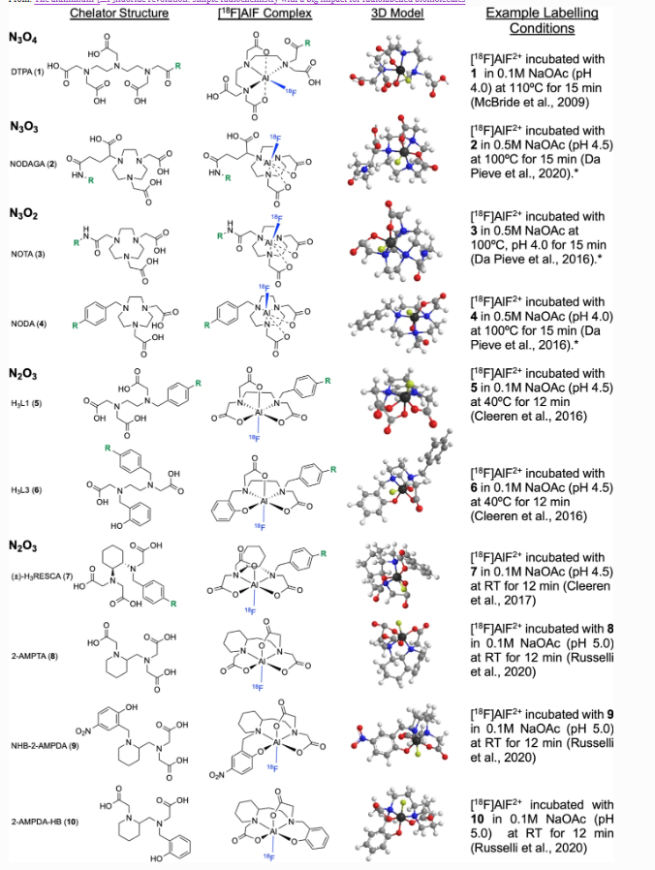
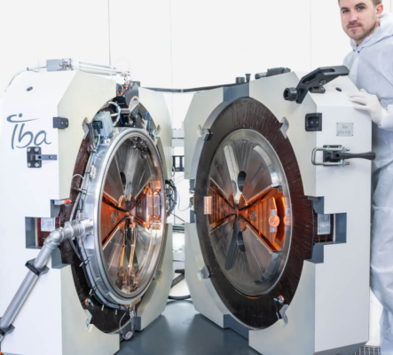
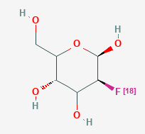
¹⁸O(p,n) ¹⁸F
- Hundreds of cyclotrons worldwide (10-18 MeV)
- Liquid H₂¹⁸O → liquid solution of¹⁸F-fluoride ion
- Gas ¹⁸O₂ gas → ¹⁸F–F₂ gas

Slide 27
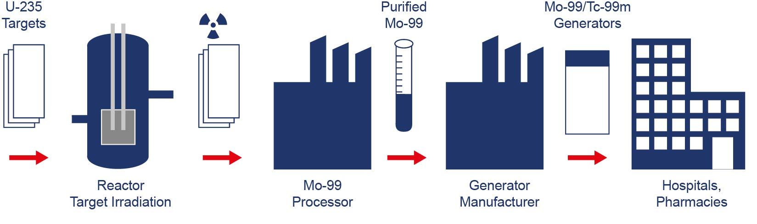
Molybdenum-99/Technicium-99m
- SPECT imaging
- Tc-99m is the most commonly used medical isotope!
- Mo-99 (T_{1/2} = 6 days) → Tc-99m (T_{1/2} = 6 hours)

Slide 28
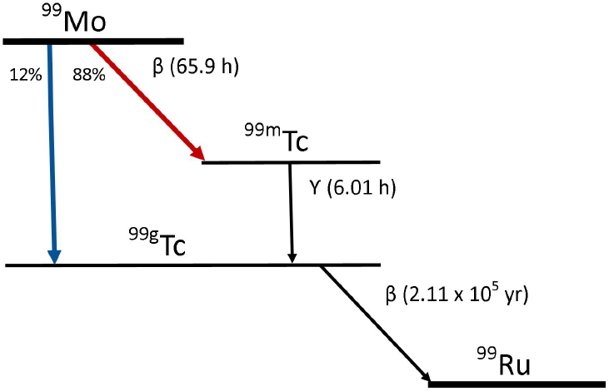
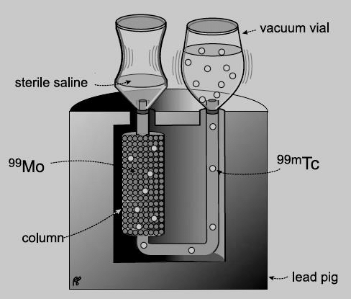
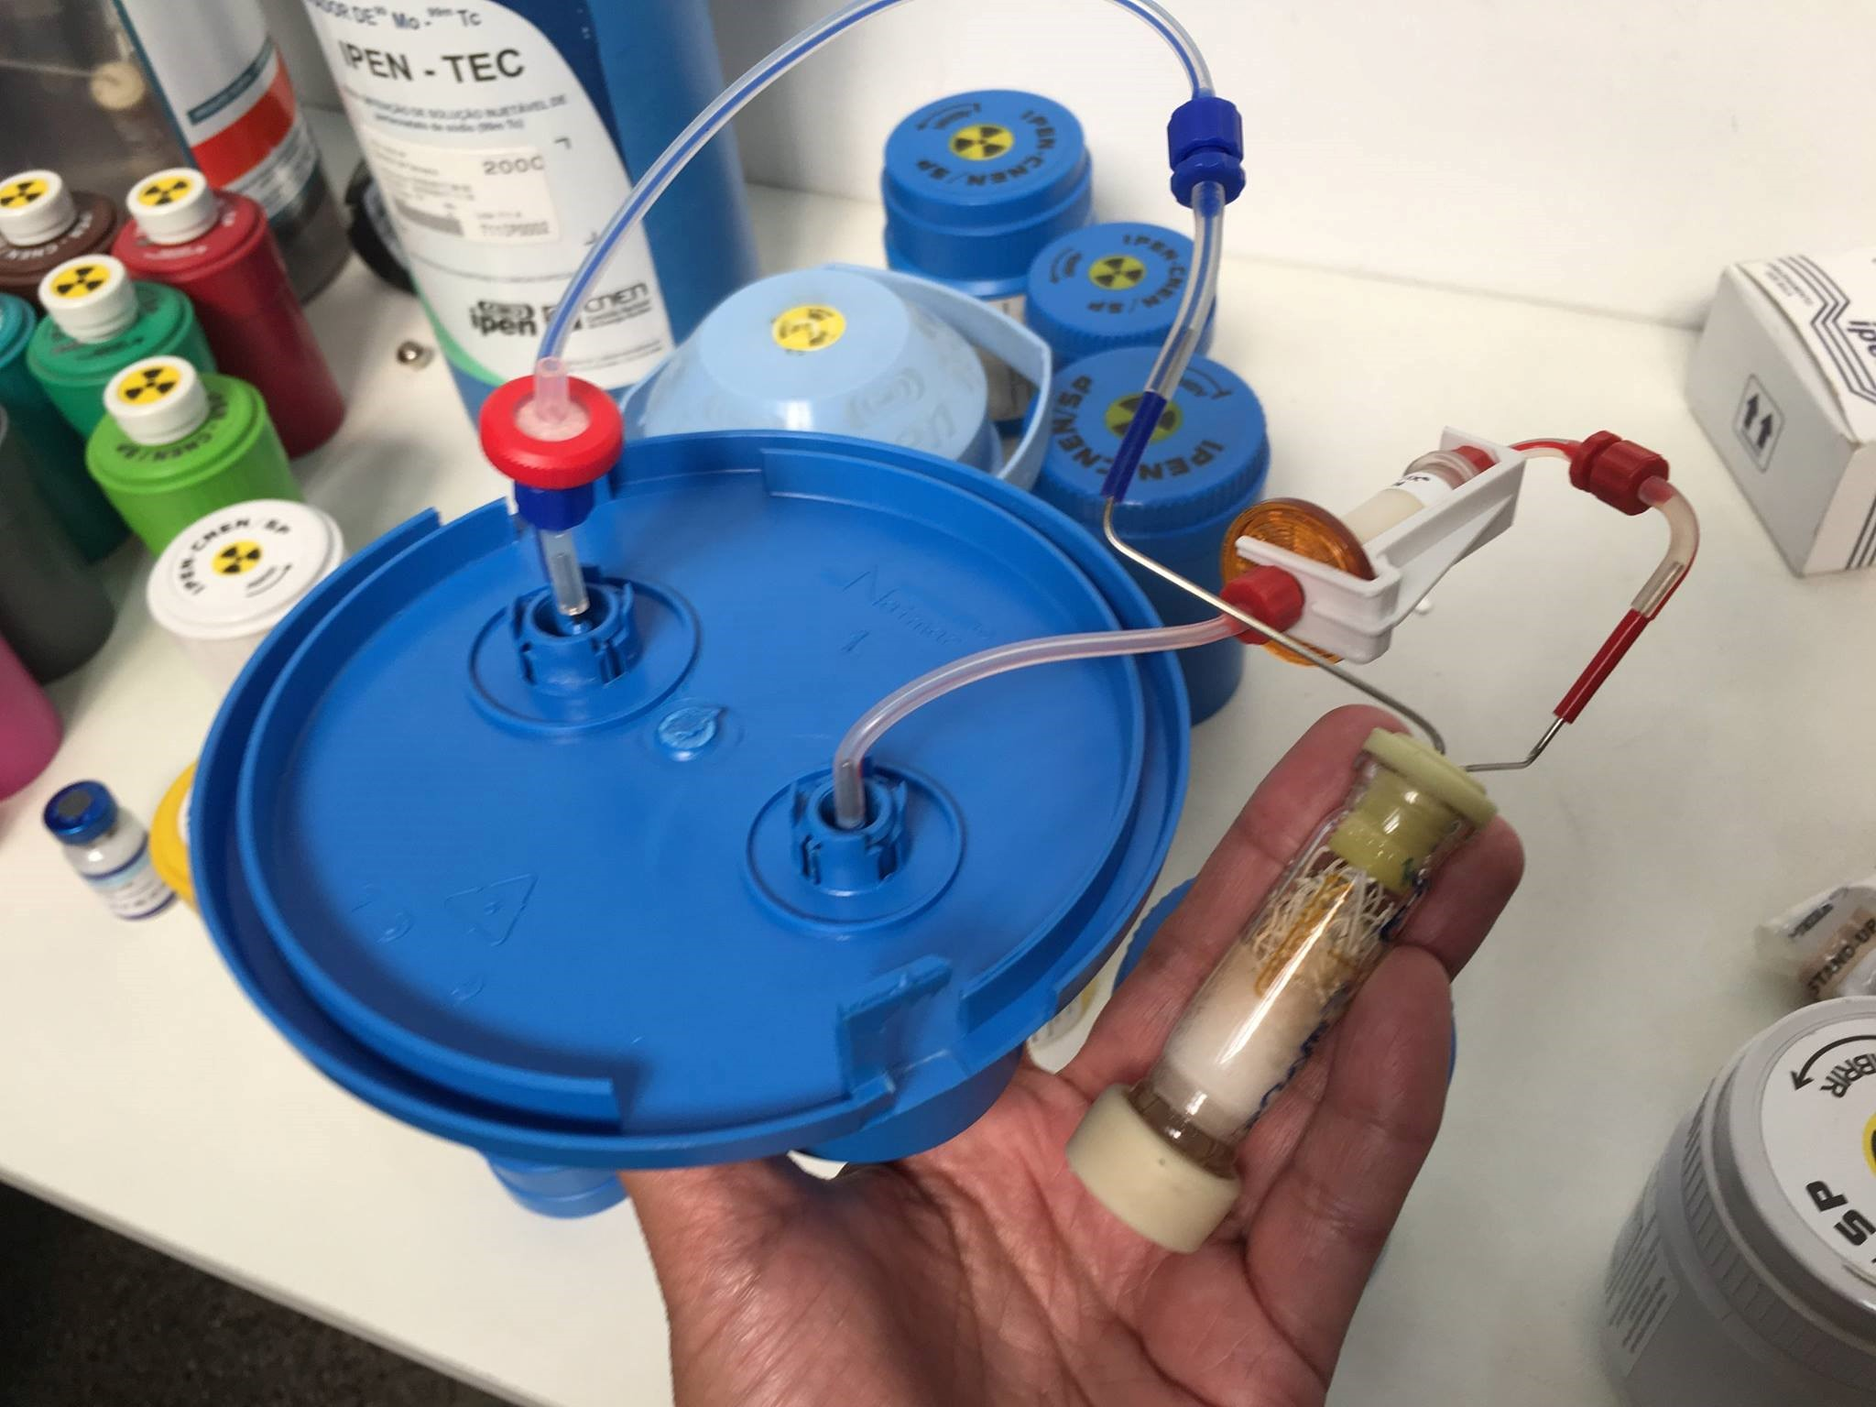
Moly cow
Mo-99 (T_{1/2} = 6 days) → Tc-99m (T_{1/2} = 6 hours)

Slide 29
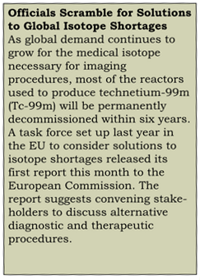
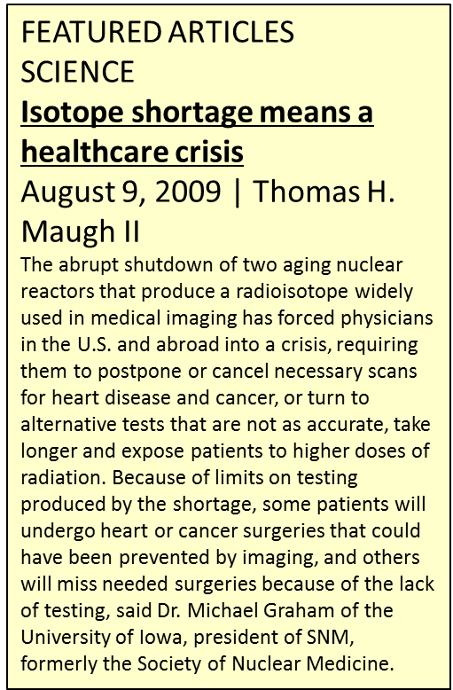
Tc-99m crisis in 2009

Slide 30
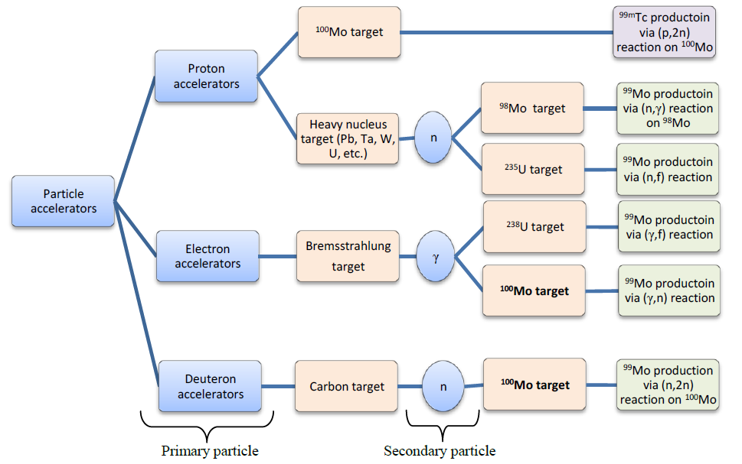
Mo-99 production with accelerators

Slide 31
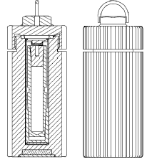



Actinium-225: milking Th-229
~140 mCi of Th-229 at the ORNL for the provision of Ac-225
DOE produces 700-900 mCi/year
Similar amounts in Europe (JRC Karlsruhe) and Russia (JSC IPP)
Additional Th-229 by irradiation Ra-226 in the HFIR ( potentially hundreds of mCi/year)
²³³U (T1/2 = 1.6×10⁵ a) → ²²⁹Th (T1/2 = 7.9×10³ a) → ²²⁵Ra (T1/2 = 15 d) → ²²⁵Ac
Notes:
The United States Department of Energy (DOE) recovered approximately 140 mCi of thorium-229 (Th229) from legacy uranium-233 processing solutions in the 1990s and stores the Th-229 in four fractions (cows) in a hot cell at the Oak Ridge National Laboratory (ORNL) for the provision of actinium-225 (Ac-225).

Slide 32

Actinium-225: spallation
Natural thorium targets are bombarded with 100’s MeV protons
Several facilities worldwide are capable
Ac-227 impurities!

Slide 33



²²⁵Ac: Production with protons or electrons
Handling of Rn-222 gas (alpha decay from Ra-226)
Separation of Ac from Ra target

Slide 34
Summary
First thought: treatment and diagnosis
  X-ray units and medical linacs
  Production of radioisotopes and radiopharmaceuticals
However, other applications:
  Sterilization of drugs, vaccines, tissues, medical devices, etc
  Development of biomaterials
  Drug development
  ???

Slide 35


AccConf 2026
Accelerators for Research and Sustainable Development: first in series took place in May 2022, next in June 2026!
https://www.iaea.org/events/accconf2026

Slide 36


ISTR 2027
Next one is in April 2027!

Slide 37

Thank you! v.starovoitova@iaea.org

