Slide 1
Update on XSEC Calibration Factors
Dani Metin, Aurélie Goldblatt, Michel Duraffourg, Federico Roncarolo
02 May 2025

Slide 2
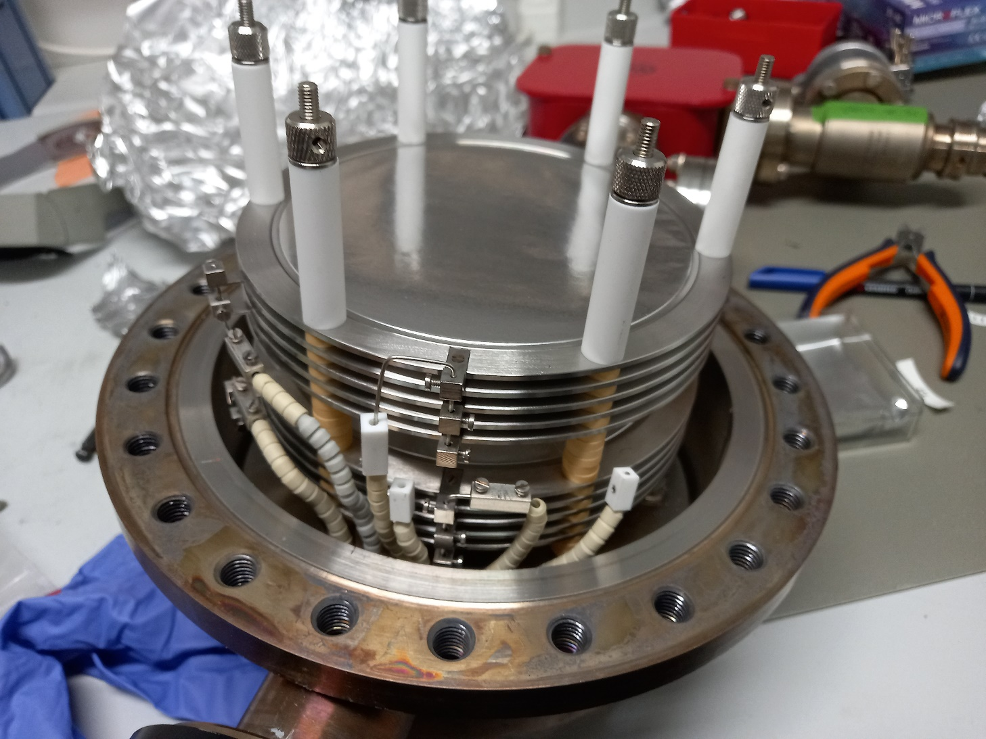
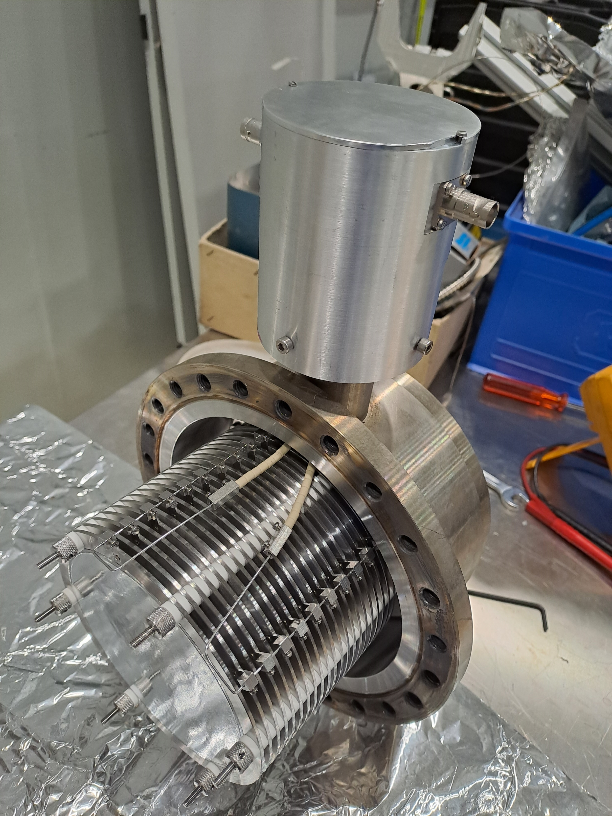
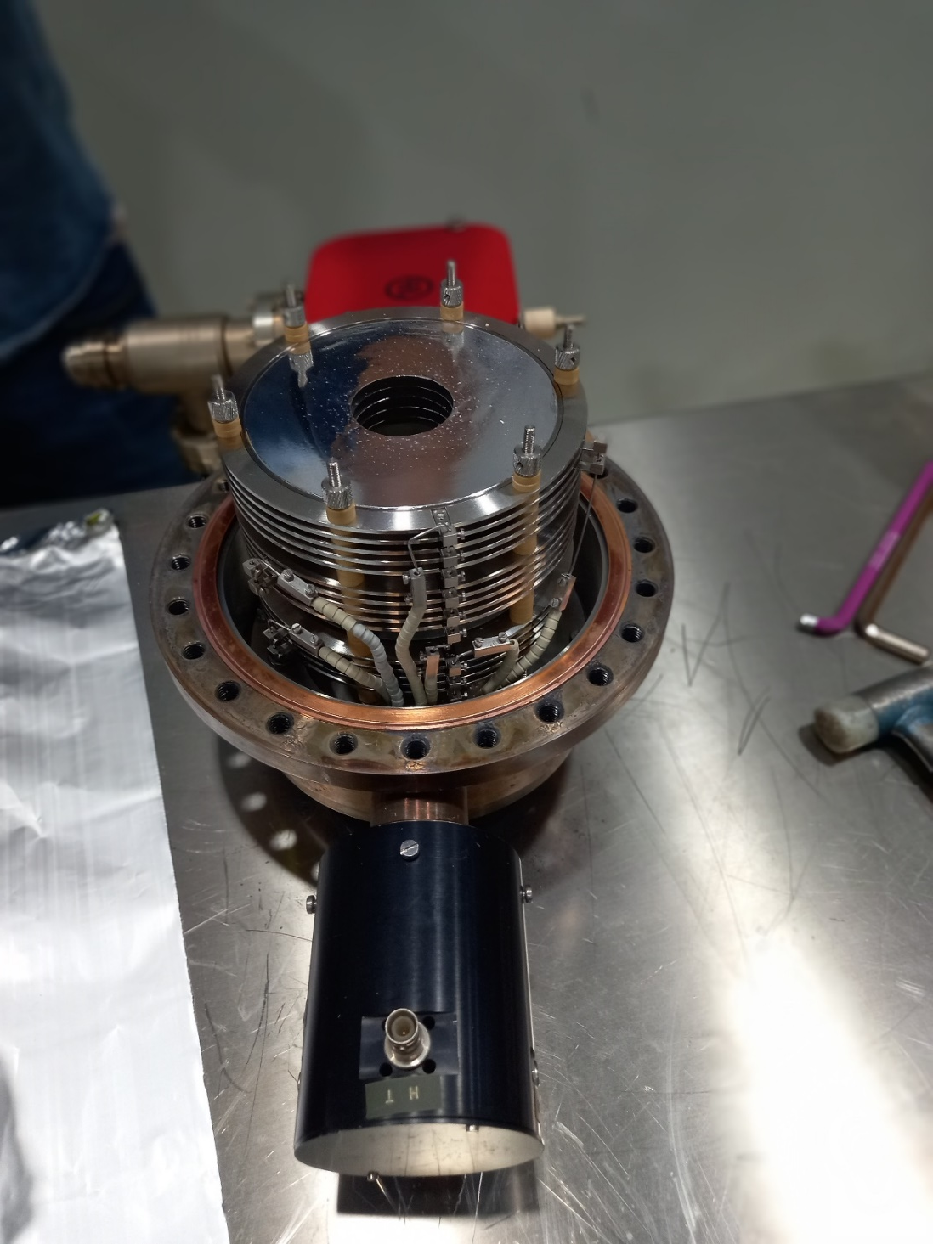
Secondary Electron Emission Chamber (XSEC)
Signal proportional to number of foils¹
¹ Ravotti, F., Ollacarizqueta, A.G. and Ruffieux, R.B., 2022. Calibration of the T08. XSEC devices by means of Al-foil activation and BCTF measurements (No. EP-Tech-Note-2022-001).

Slide 3
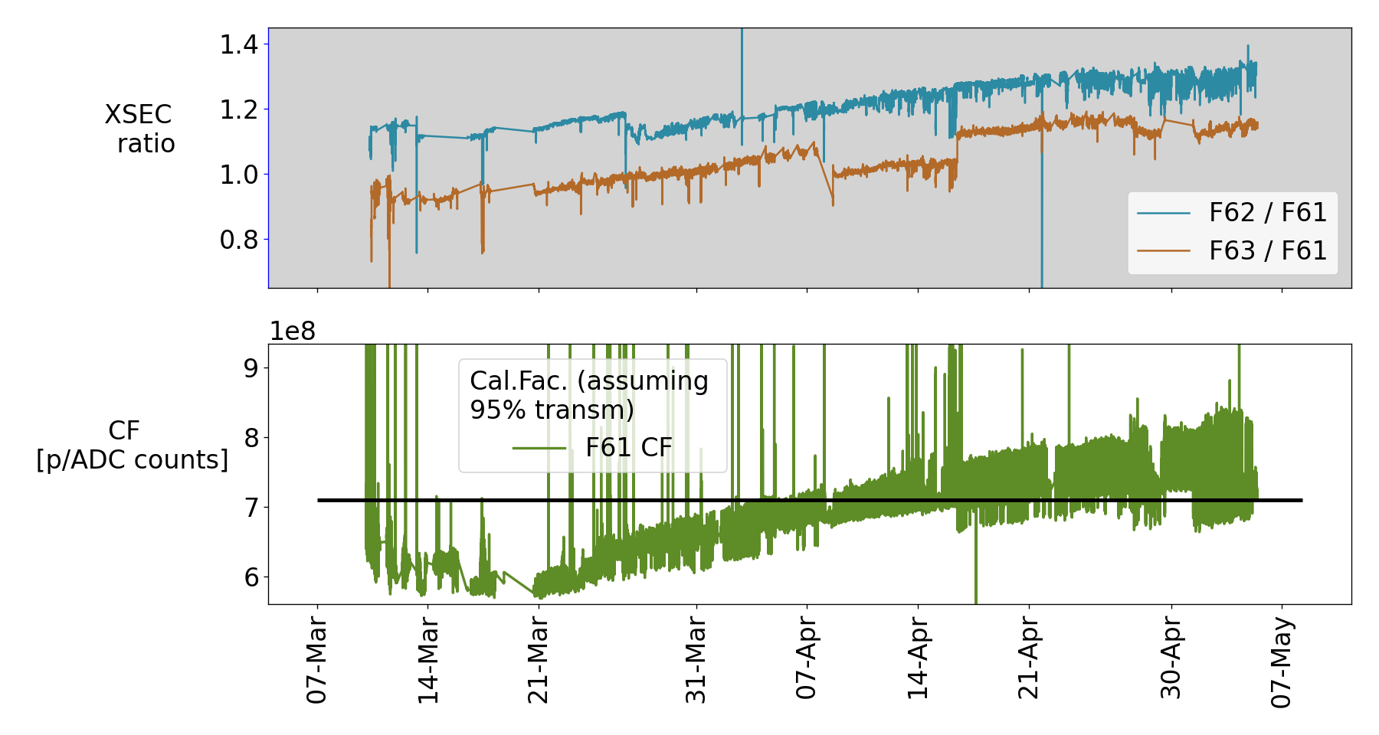
XSEC relative signal and Calibration Factor for F61
March to beginning of May

Slide 4
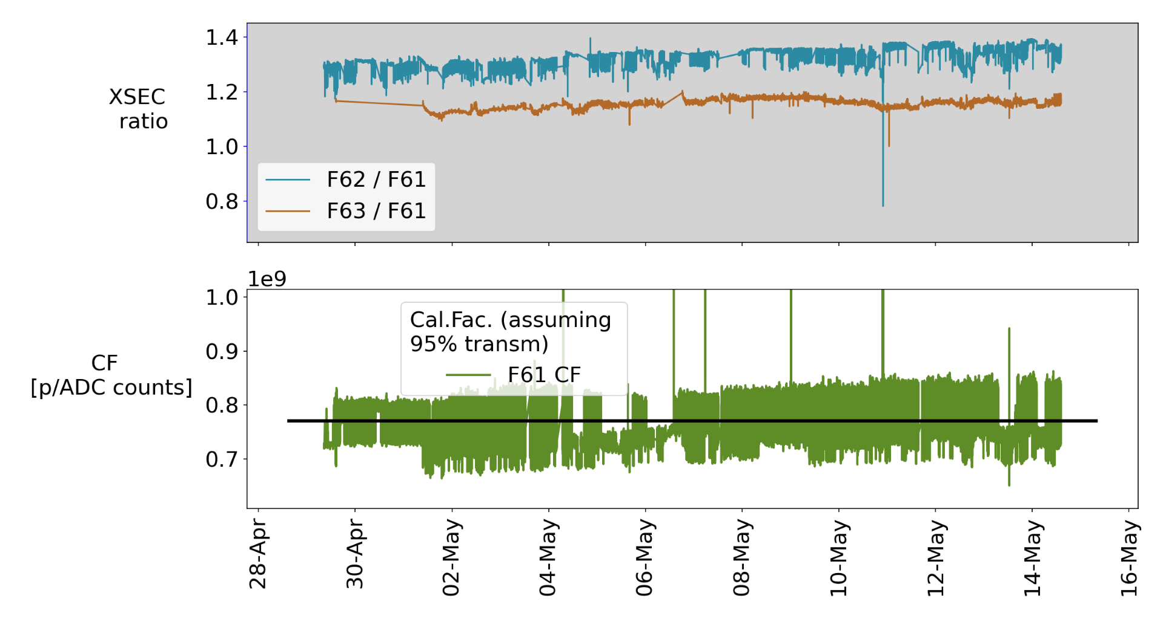
XSEC relative signal and Calibration Factor for F61
Late April and May

Slide 5
New Calibration Factors
Past calibration factors indicated unphysical transmission, update is necessary
Changed on 15th May 2025
Name​ | 2024 Calibration factor​s | 2025 calibration factors | Notes on calibration factors | ​ XSEC details
F61.XSEC023-I1​ | 1.15e+08​ | 7.52e8 | To give avg ~95% transmission from PS | 2 x signal foil + 3 x bias foil​
F62.XSEC022-I​ | 5.08e+08​ | 1.11e8 | To give avg ~95% transmission from F61 | 10 x signal foil + 11 x bias foil​
F63.XSEC008-I​ | 5.08e+08​ | 6.25e8 | To give avg ~95% transmission from F61 | 2 x signal foil + 3 x bias foil​

Slide 6
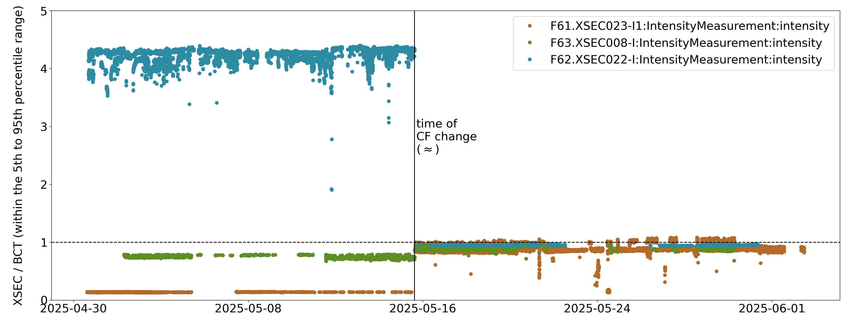
New Calibration Factors

Slide 7
Conclusions
At the start of year, observed XSEC signal drift (19th BIFT)
New calibration factors suitable for monitoring the evolution of XSEC transmission
In the future, we aim to look further into the dynamics between XSEC and vacuum conditions

