Slide 1
BSPI.045 769
Foil Destruction: a controlled experiment
boisseaux
Dani Metin, Philippe Boisseux-Bourgeois, Damien Jacquier, Aurélie Goldblatt, Michel Duraffourg, Morad Hamani, Christophe Vuitton, Miguel Lino Diogo Dos Santos, Maarten Van Dijk, Johannes Bernhard, Federico Roncarolo
20 May 2025

Slide 2
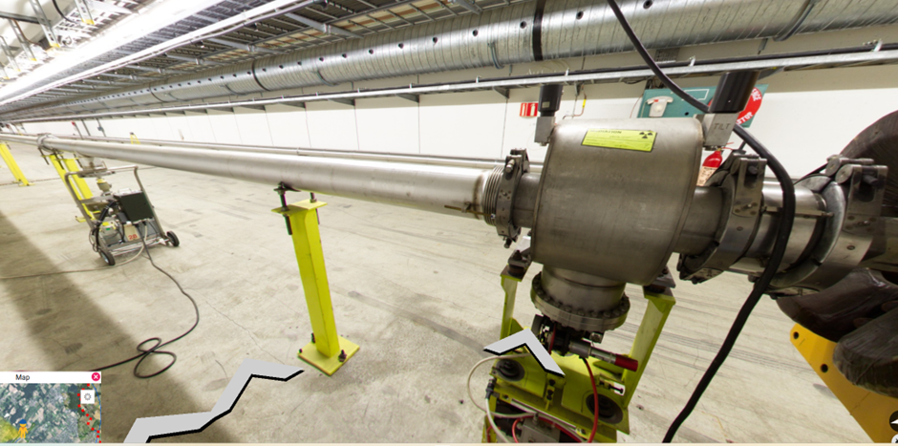
BSPI.045 769 is a SEM detector on the P42 line
Within a tank, contains split foils as well as single foils
Always in “IN” position (in the past)

Slide 3
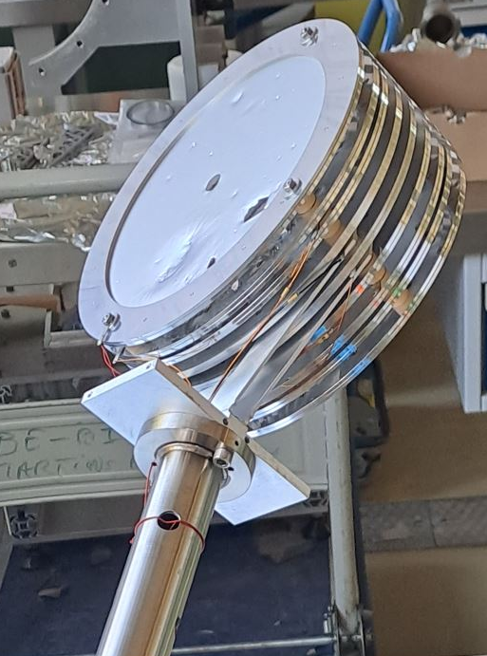
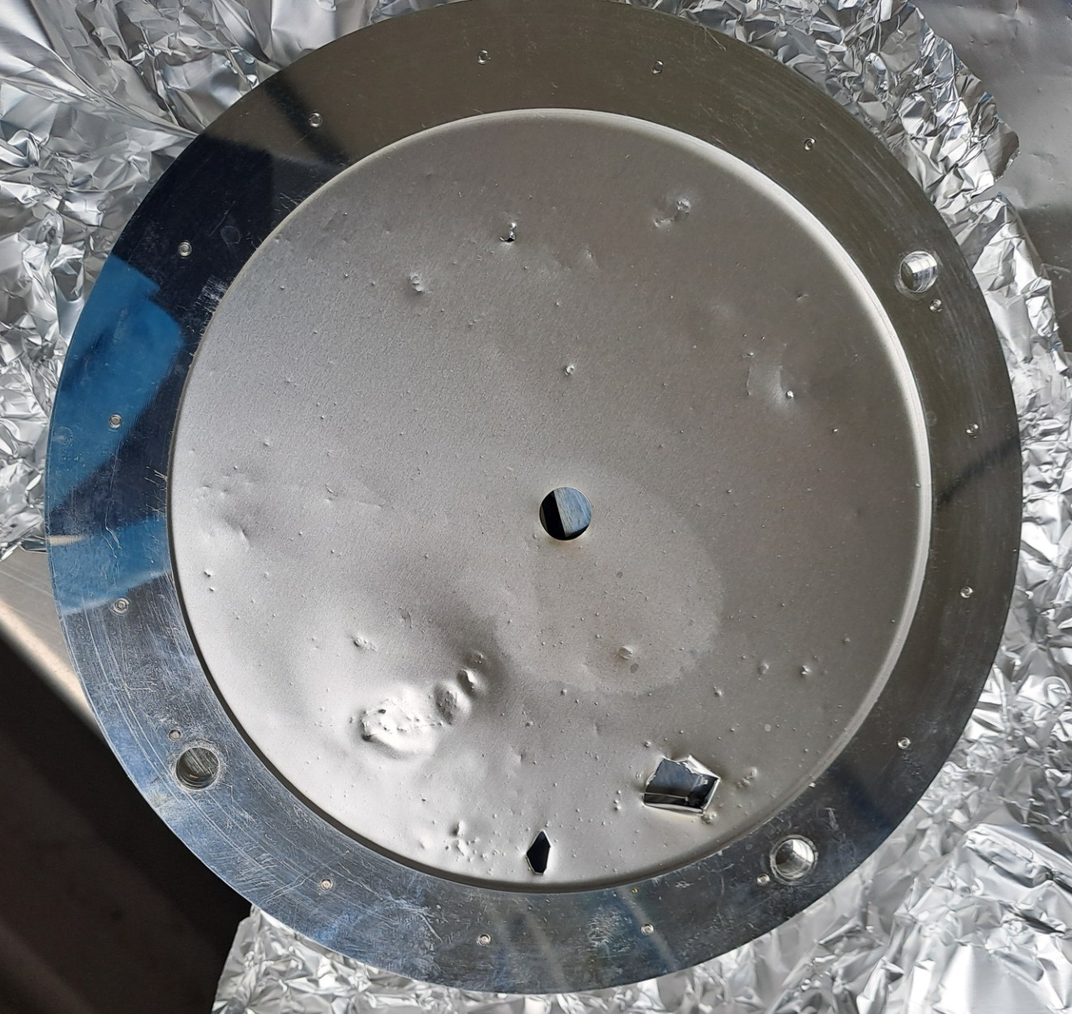
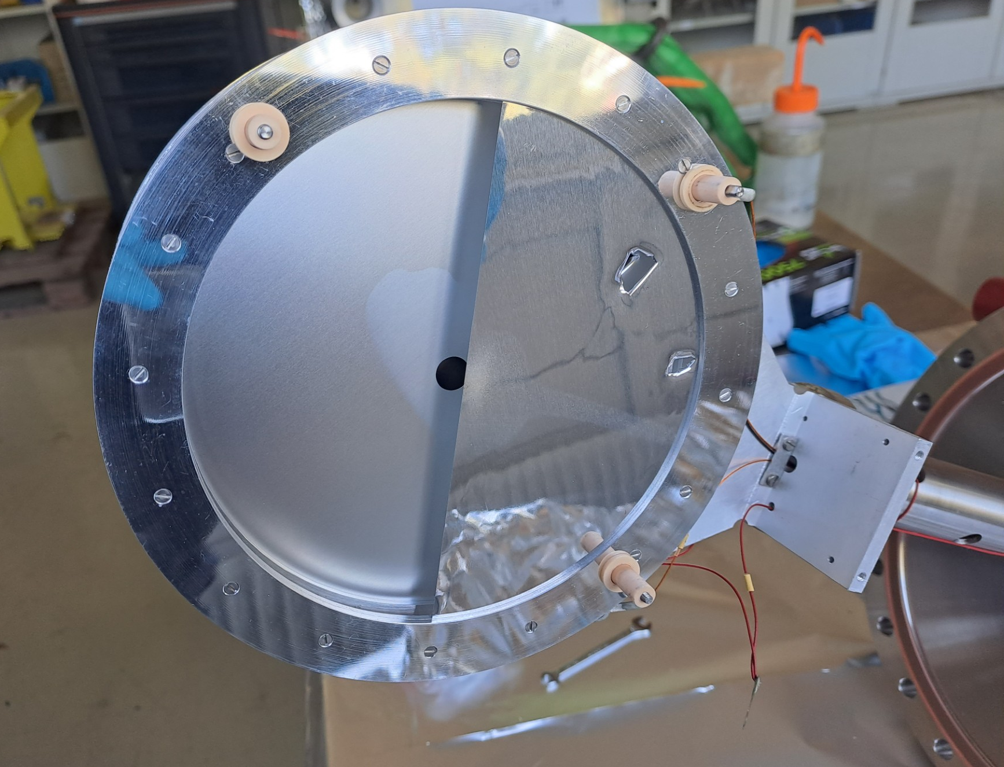
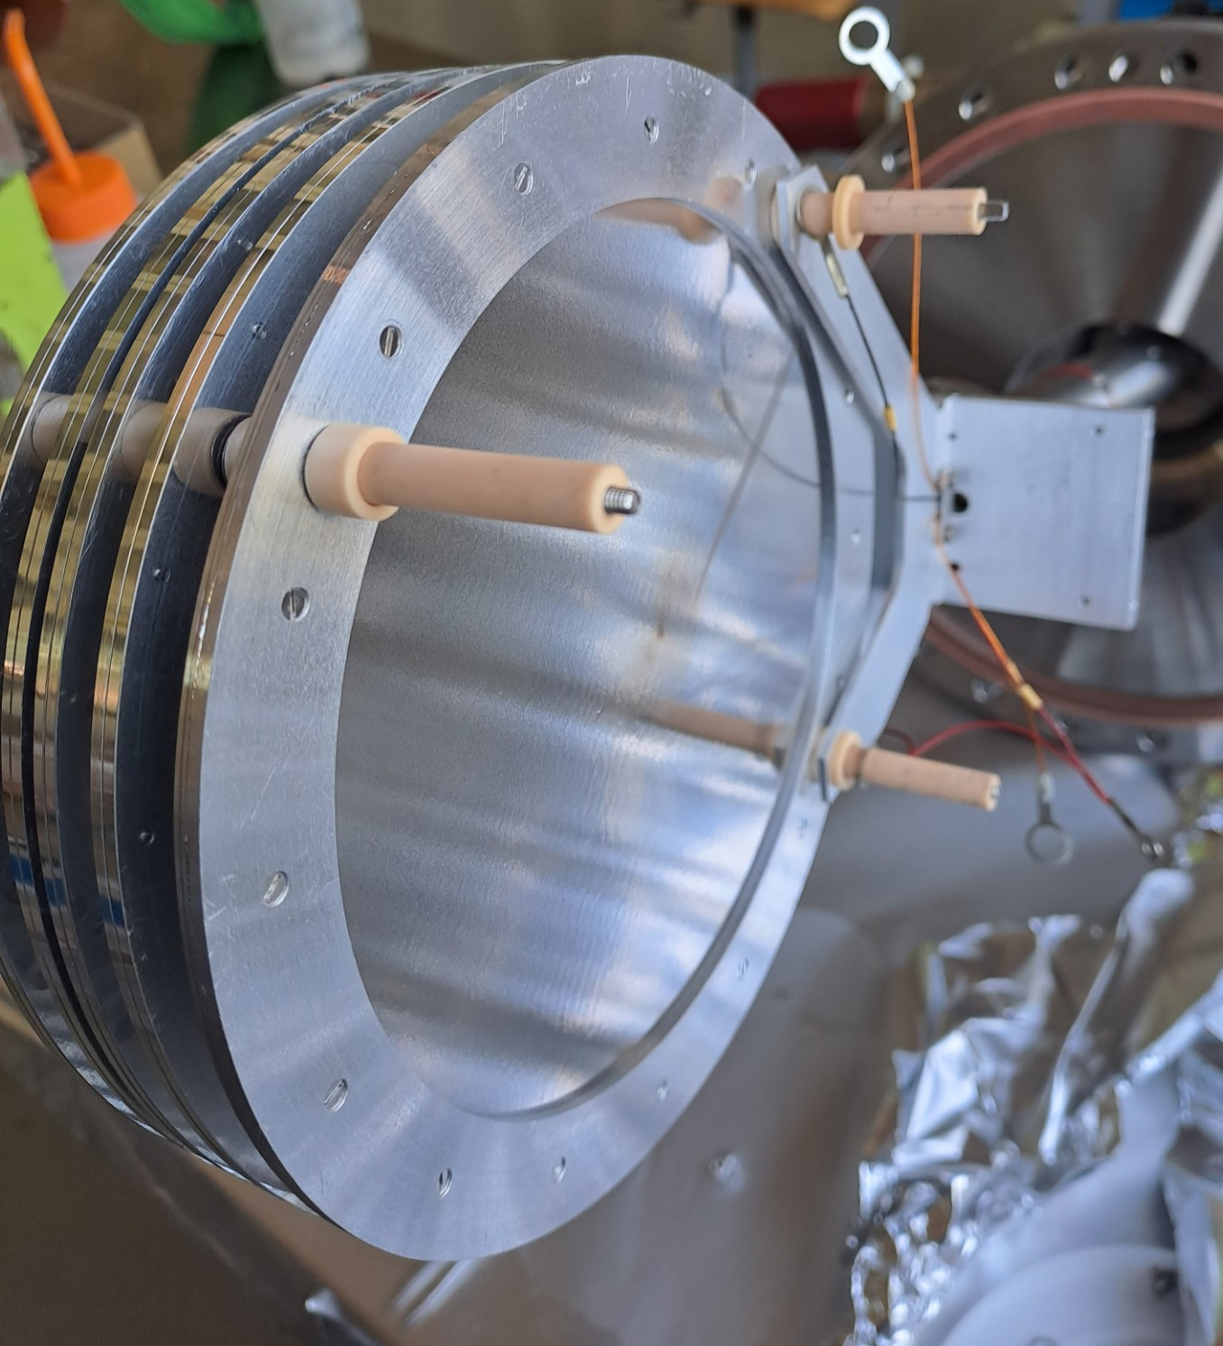
Damage in 2016
BSPI was removed due to severe damage to foils

Slide 4
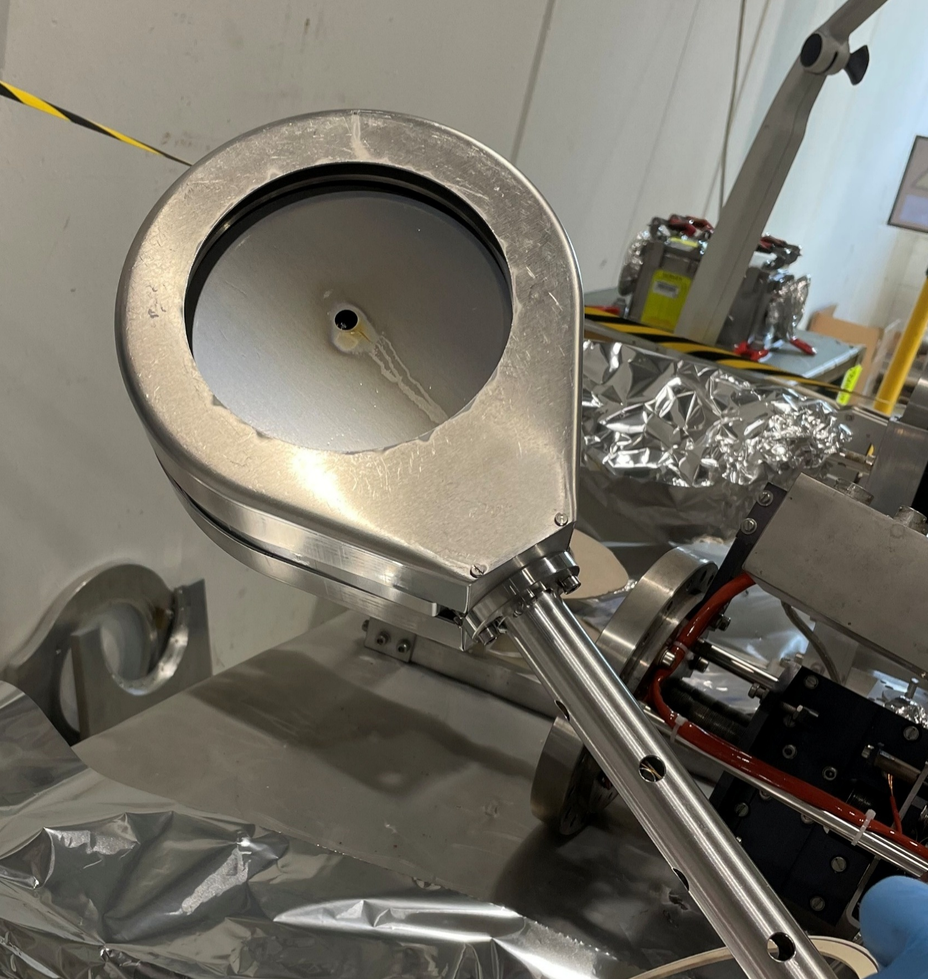
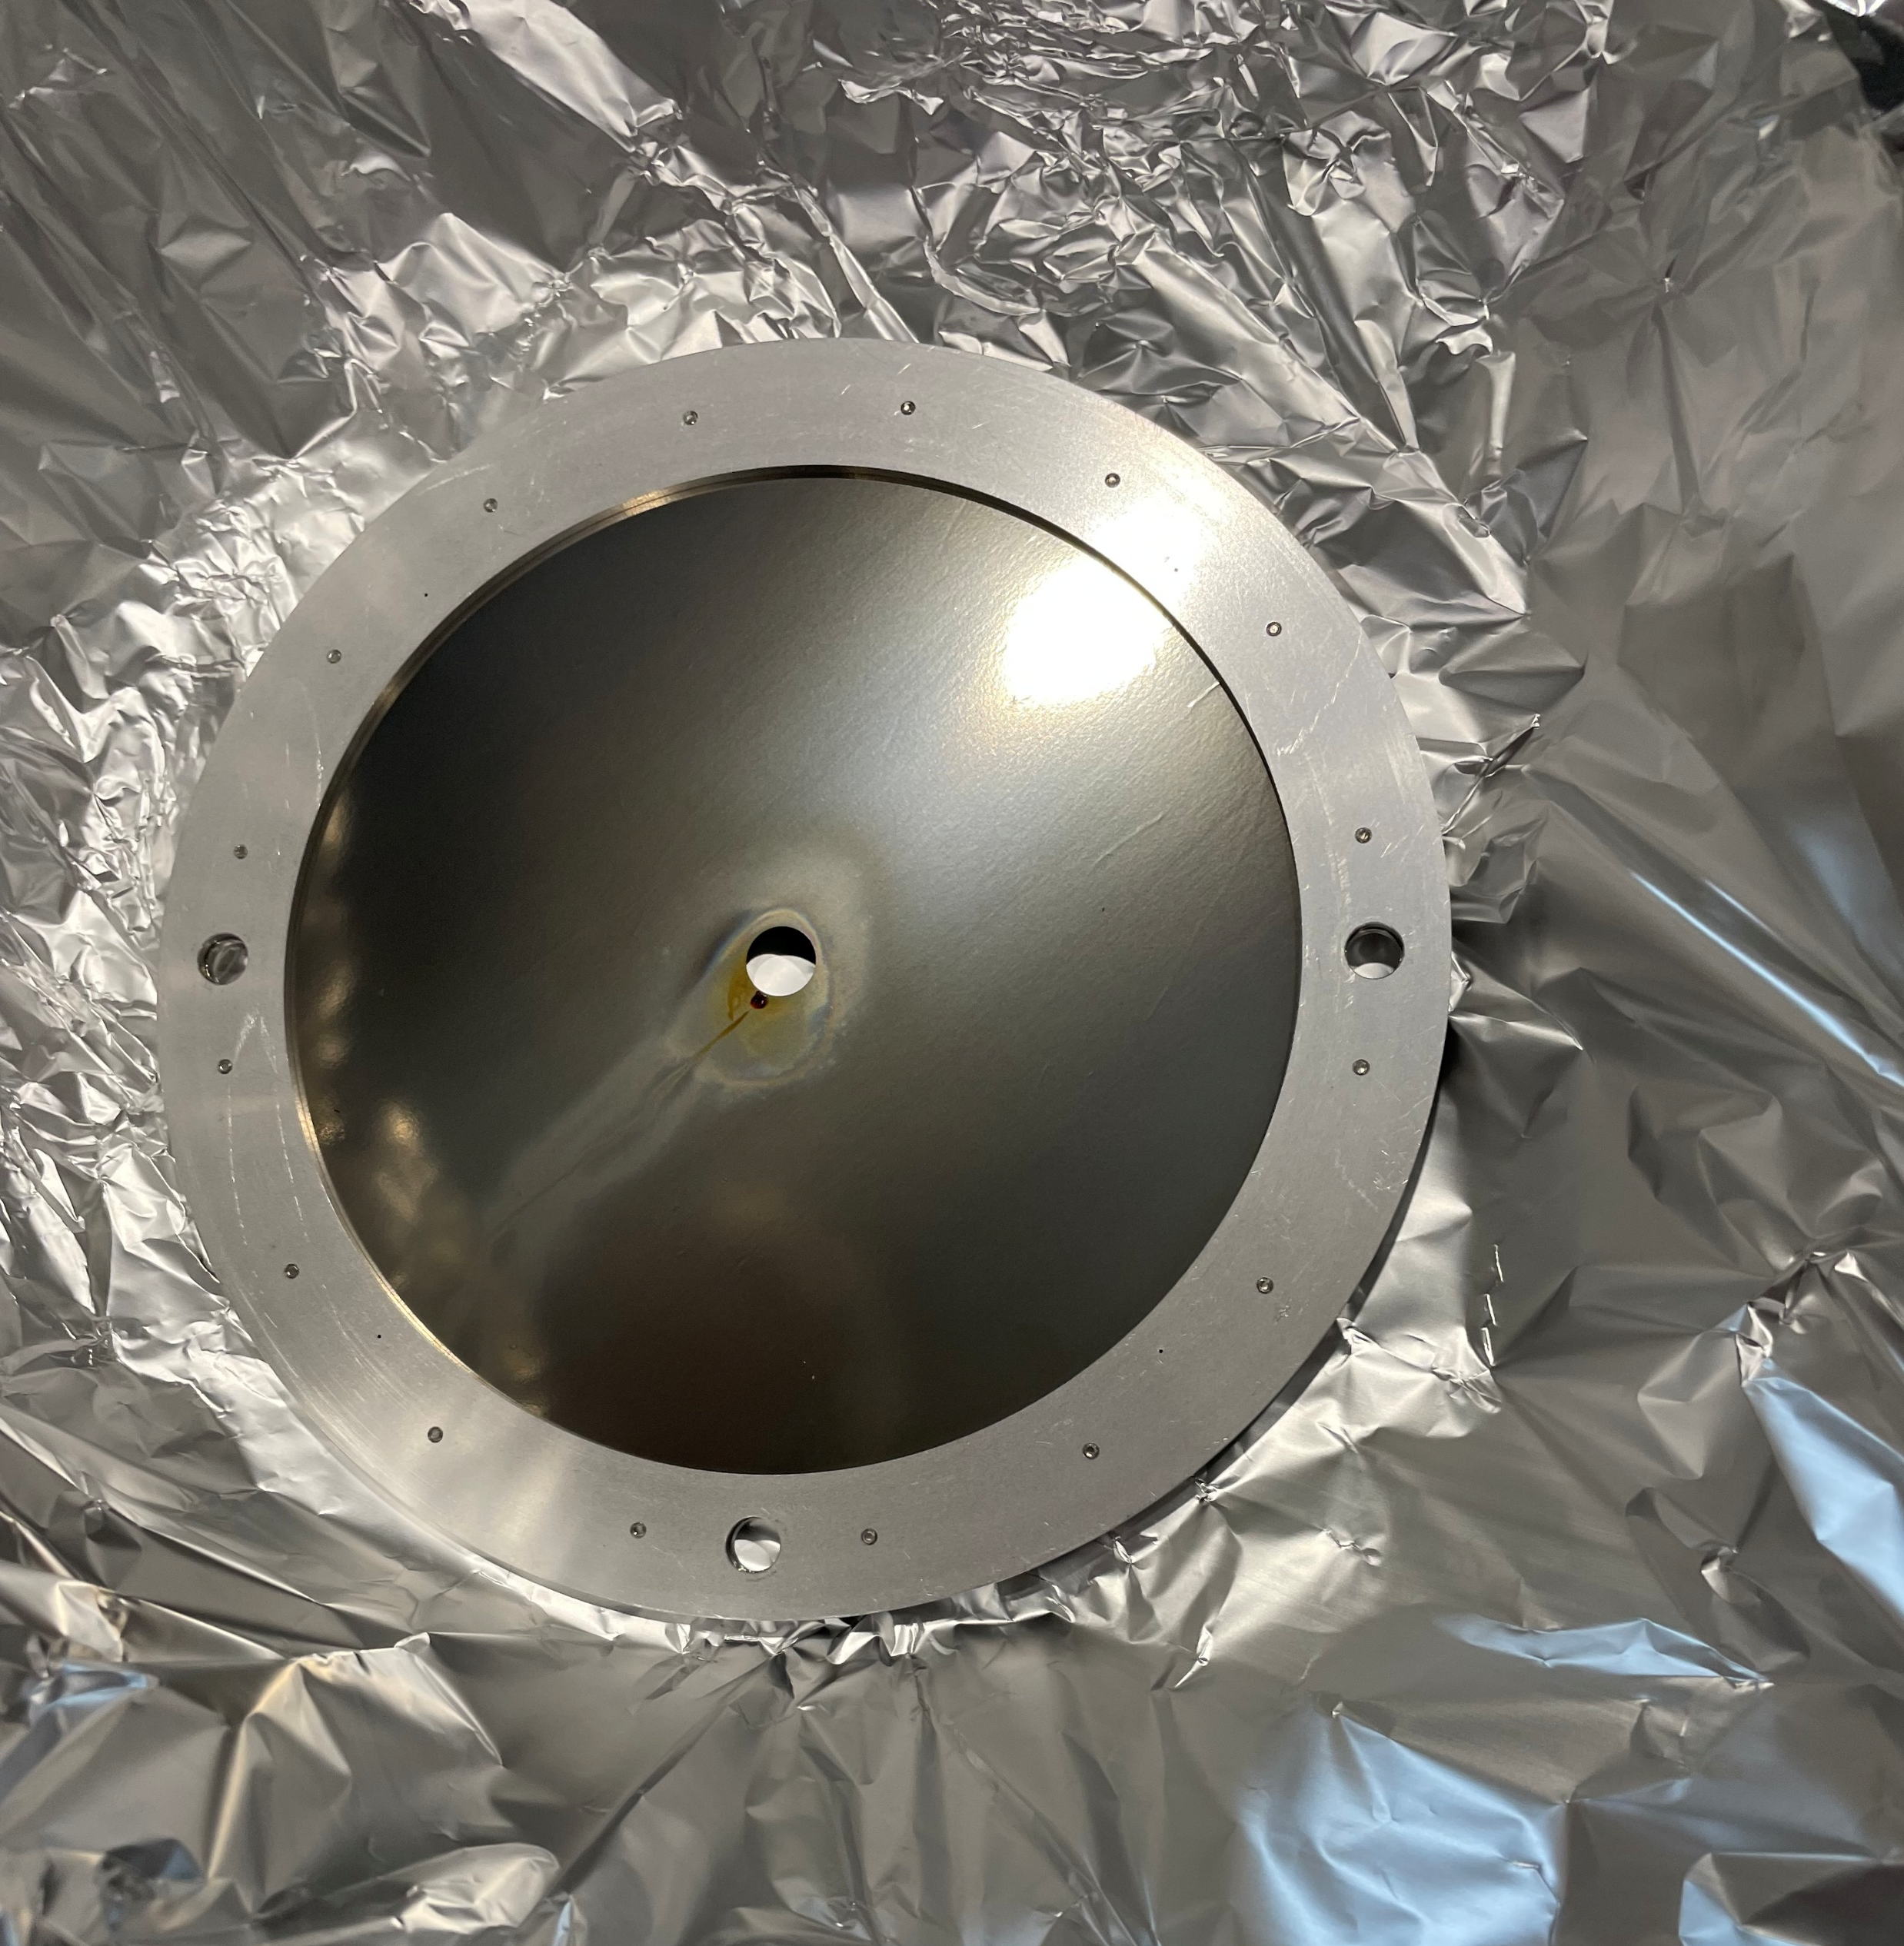
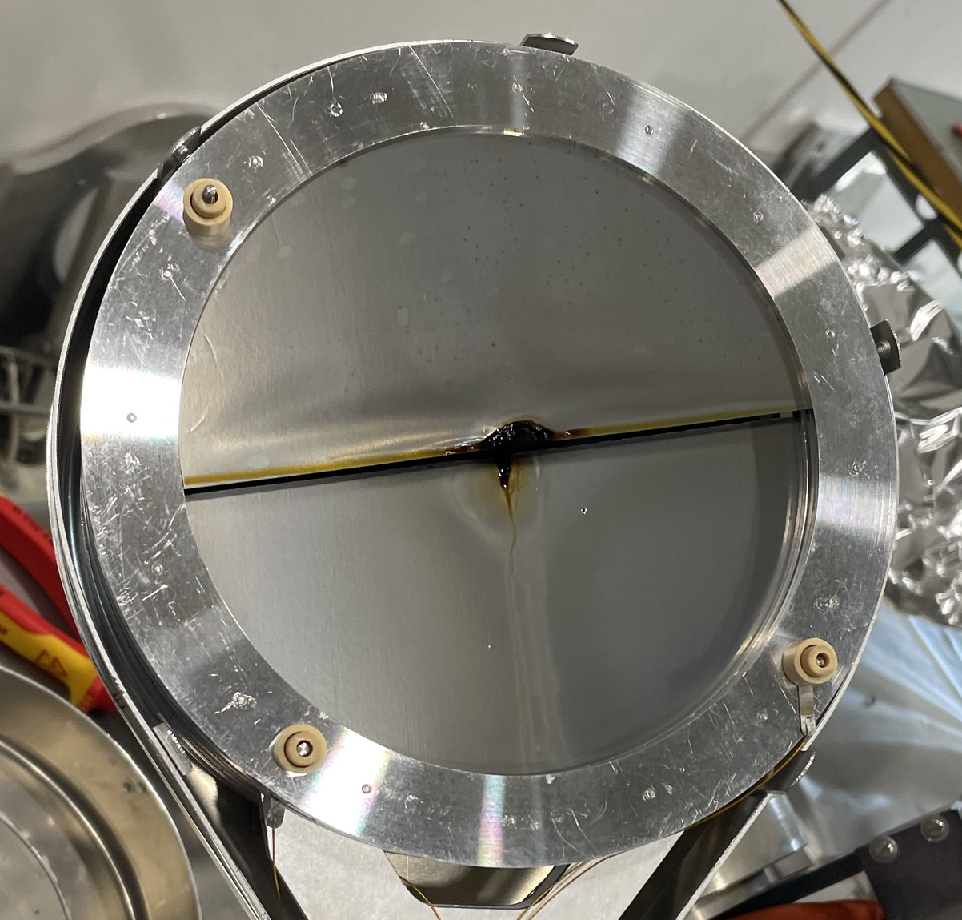
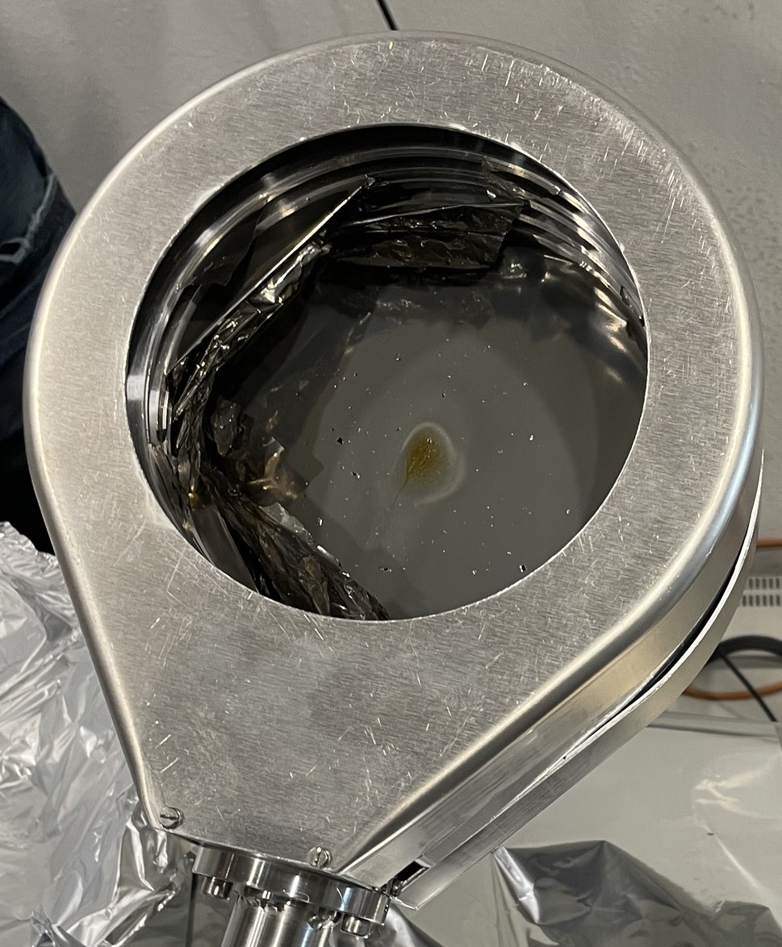
Damage in 2024
This was the second time that we have this issue of holes in foils (right)
We did not observe it in other BSIs, and suspected it could be vacuum-related

Slide 5
Vacuum Test

Slide 6
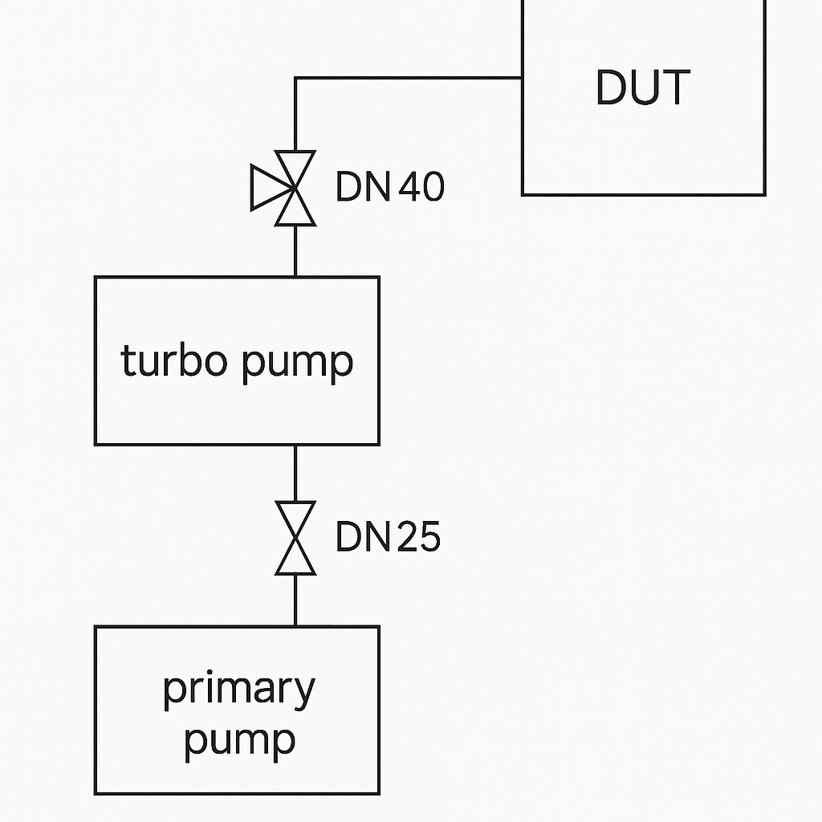
Vacuum Test in Building 867
Setup to see if foil damage occurs

Slide 7
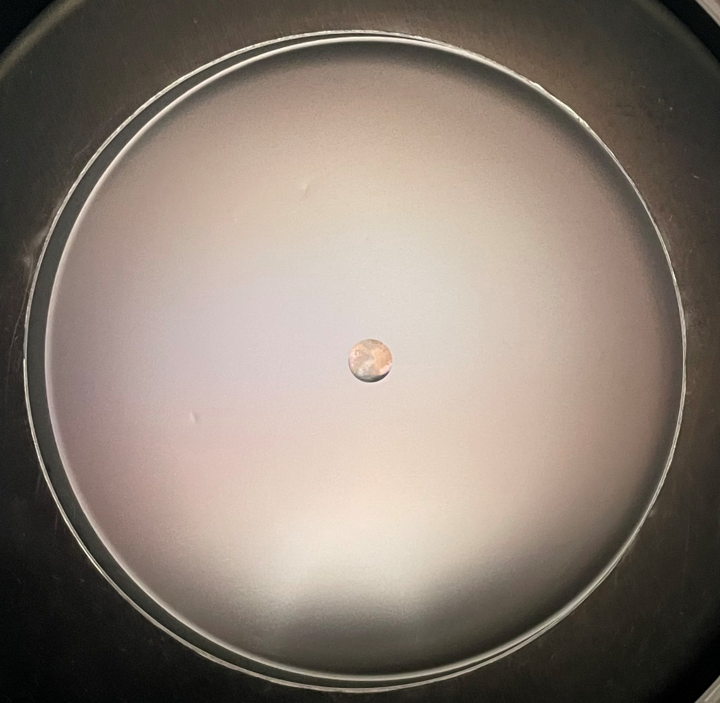
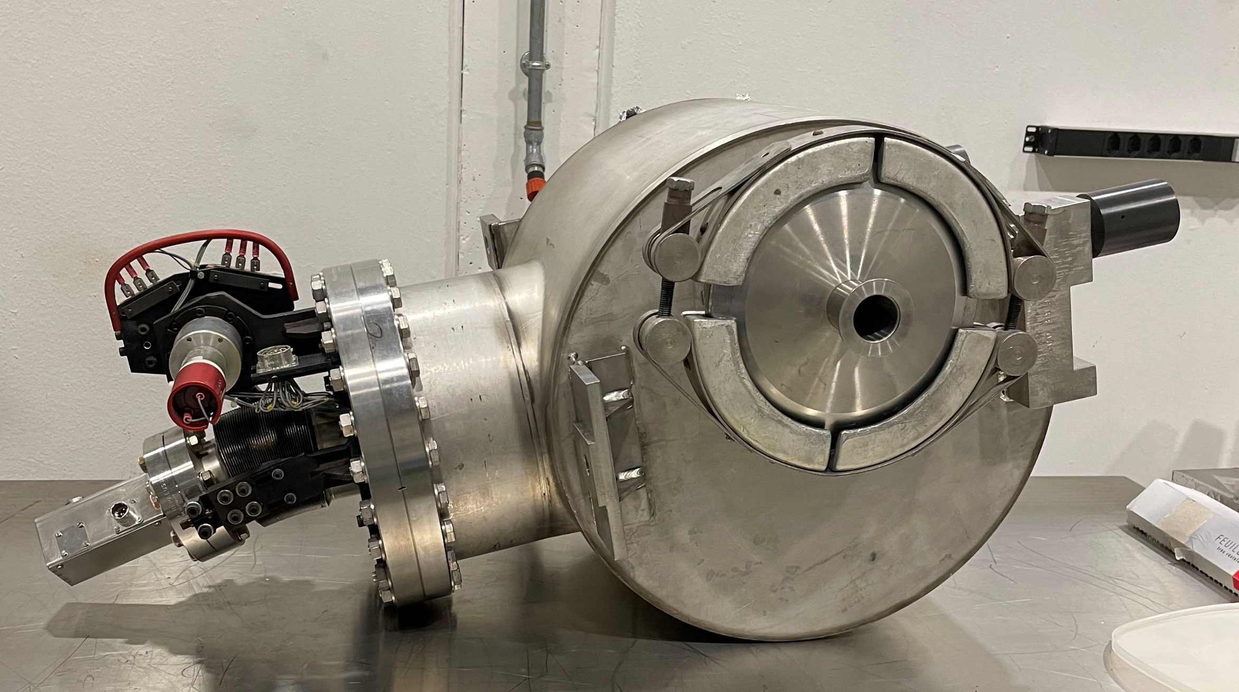
BSPI.045 769 model (spare parts)
Aluminium foil at front of stack (main part of experiment, 20μm thickness, 145mm radius)
Also have titanium foil in stack behind
(12.5μm thickness, 145mm radius)
Foils in “good” condition to begin with
Contained in a tank
Pumping port DN40 on the upstream flange

Slide 8
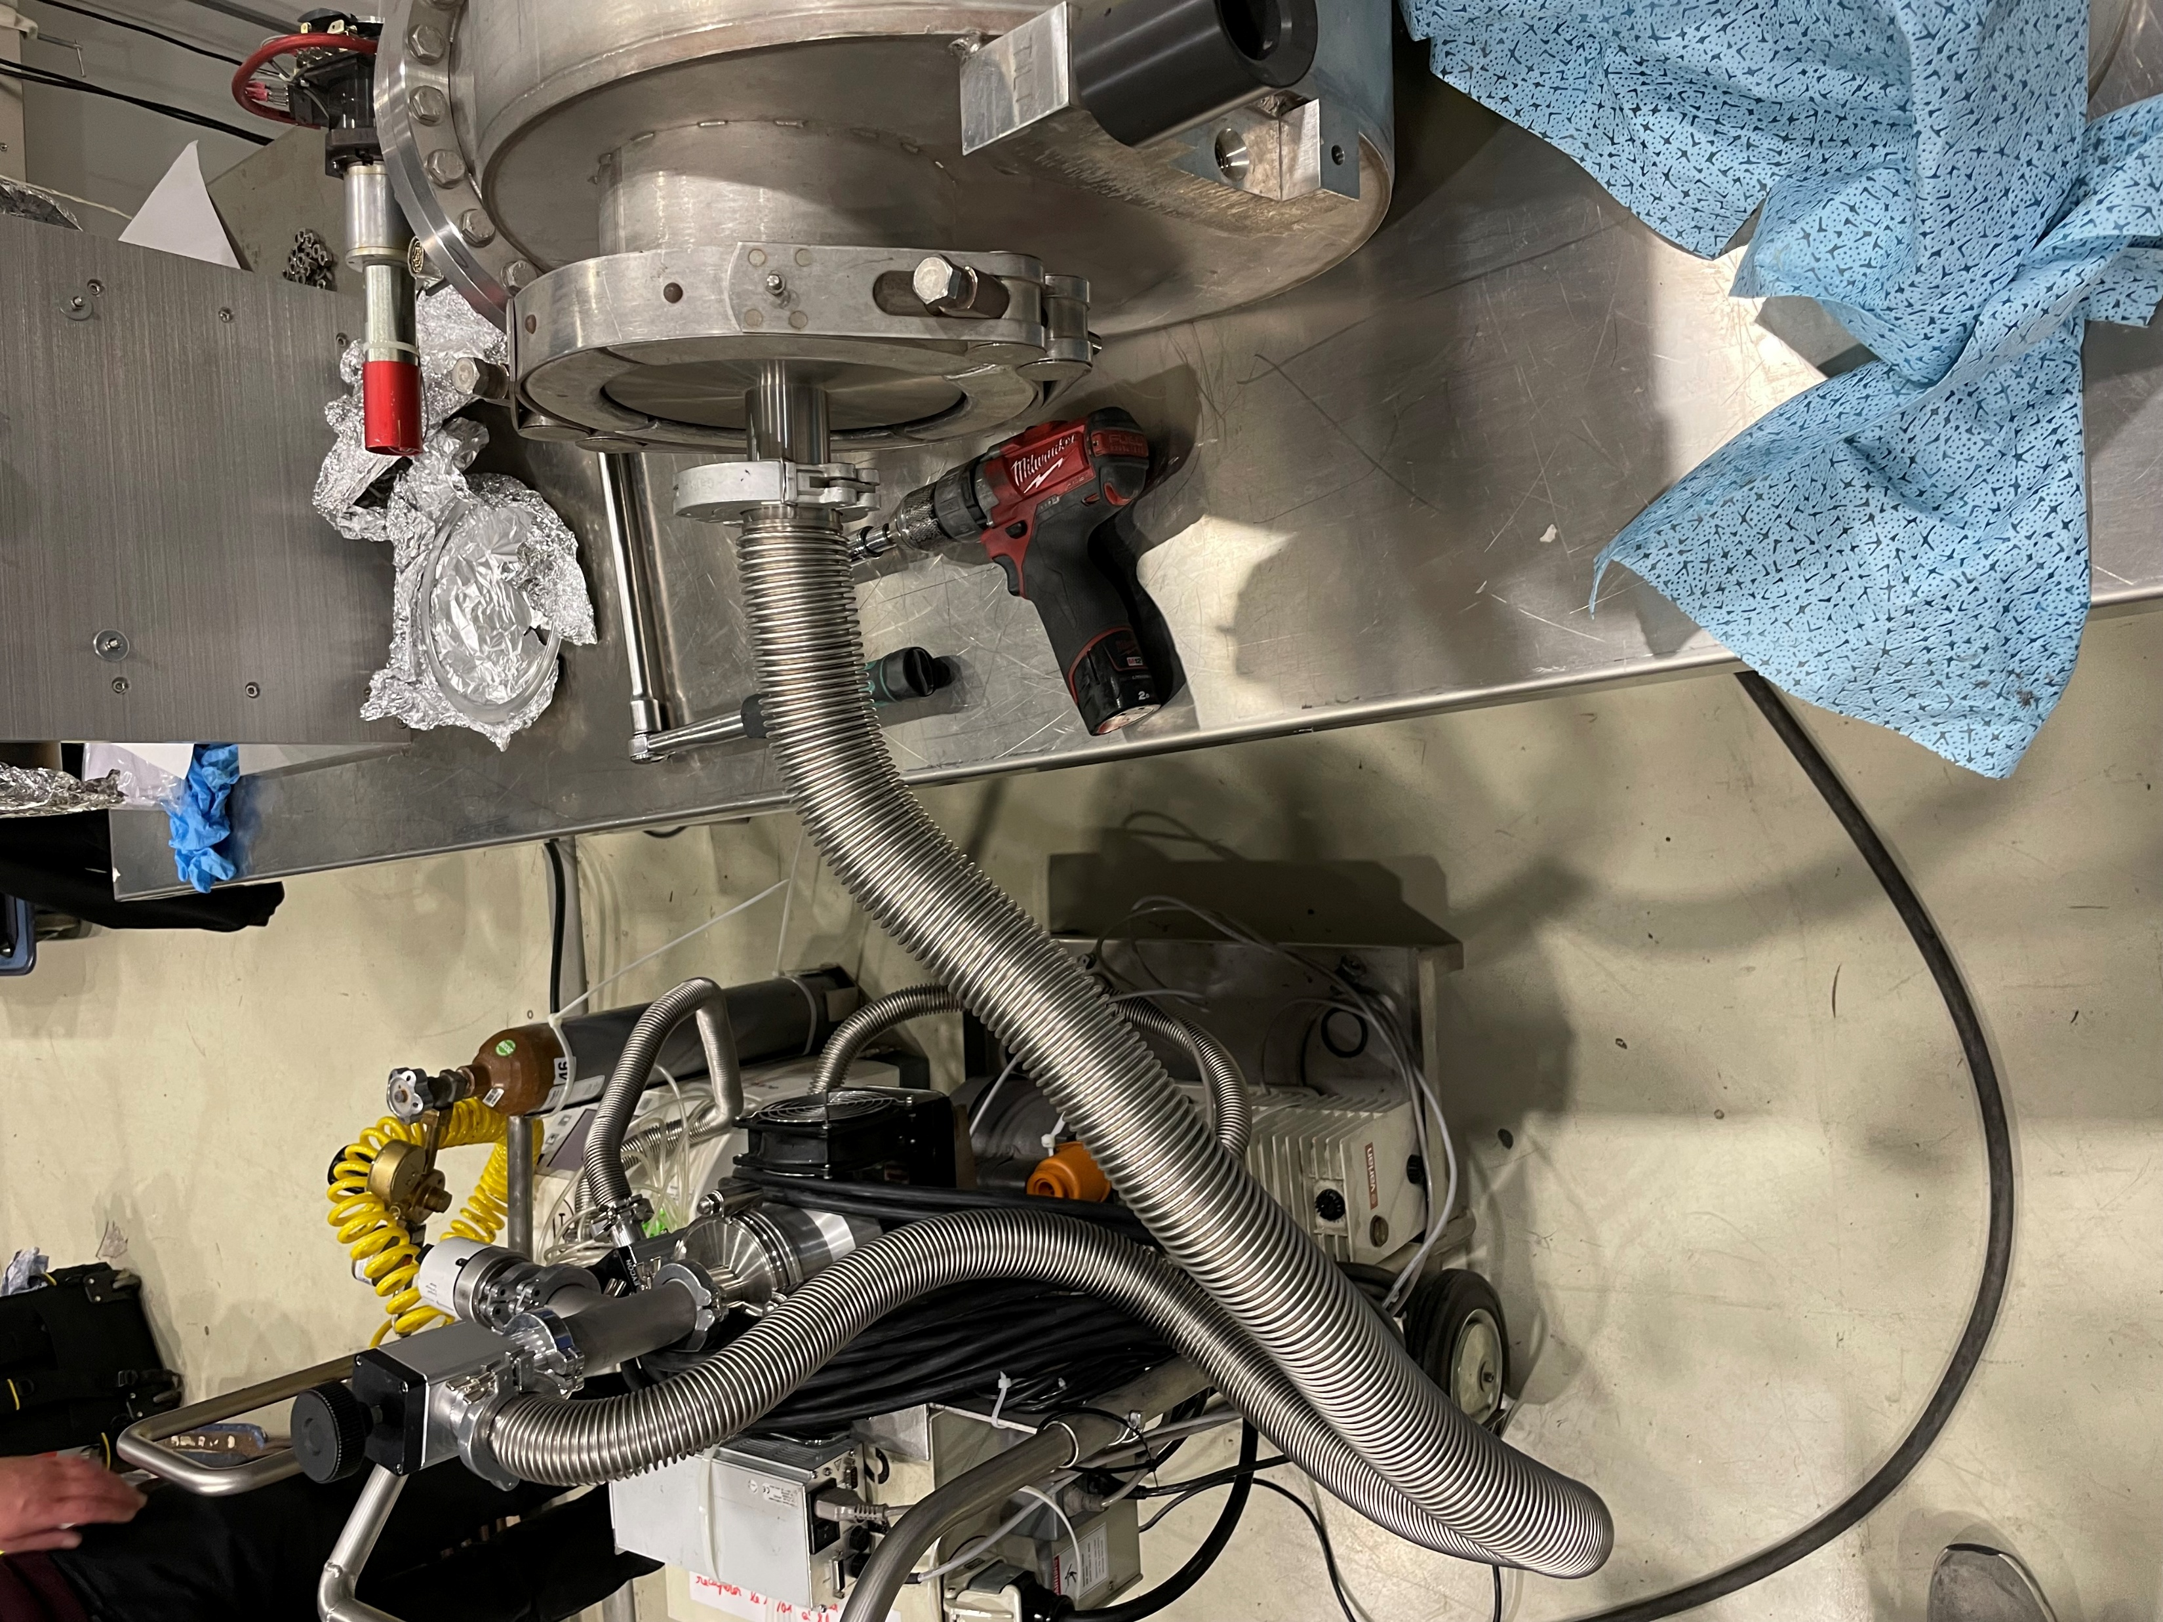
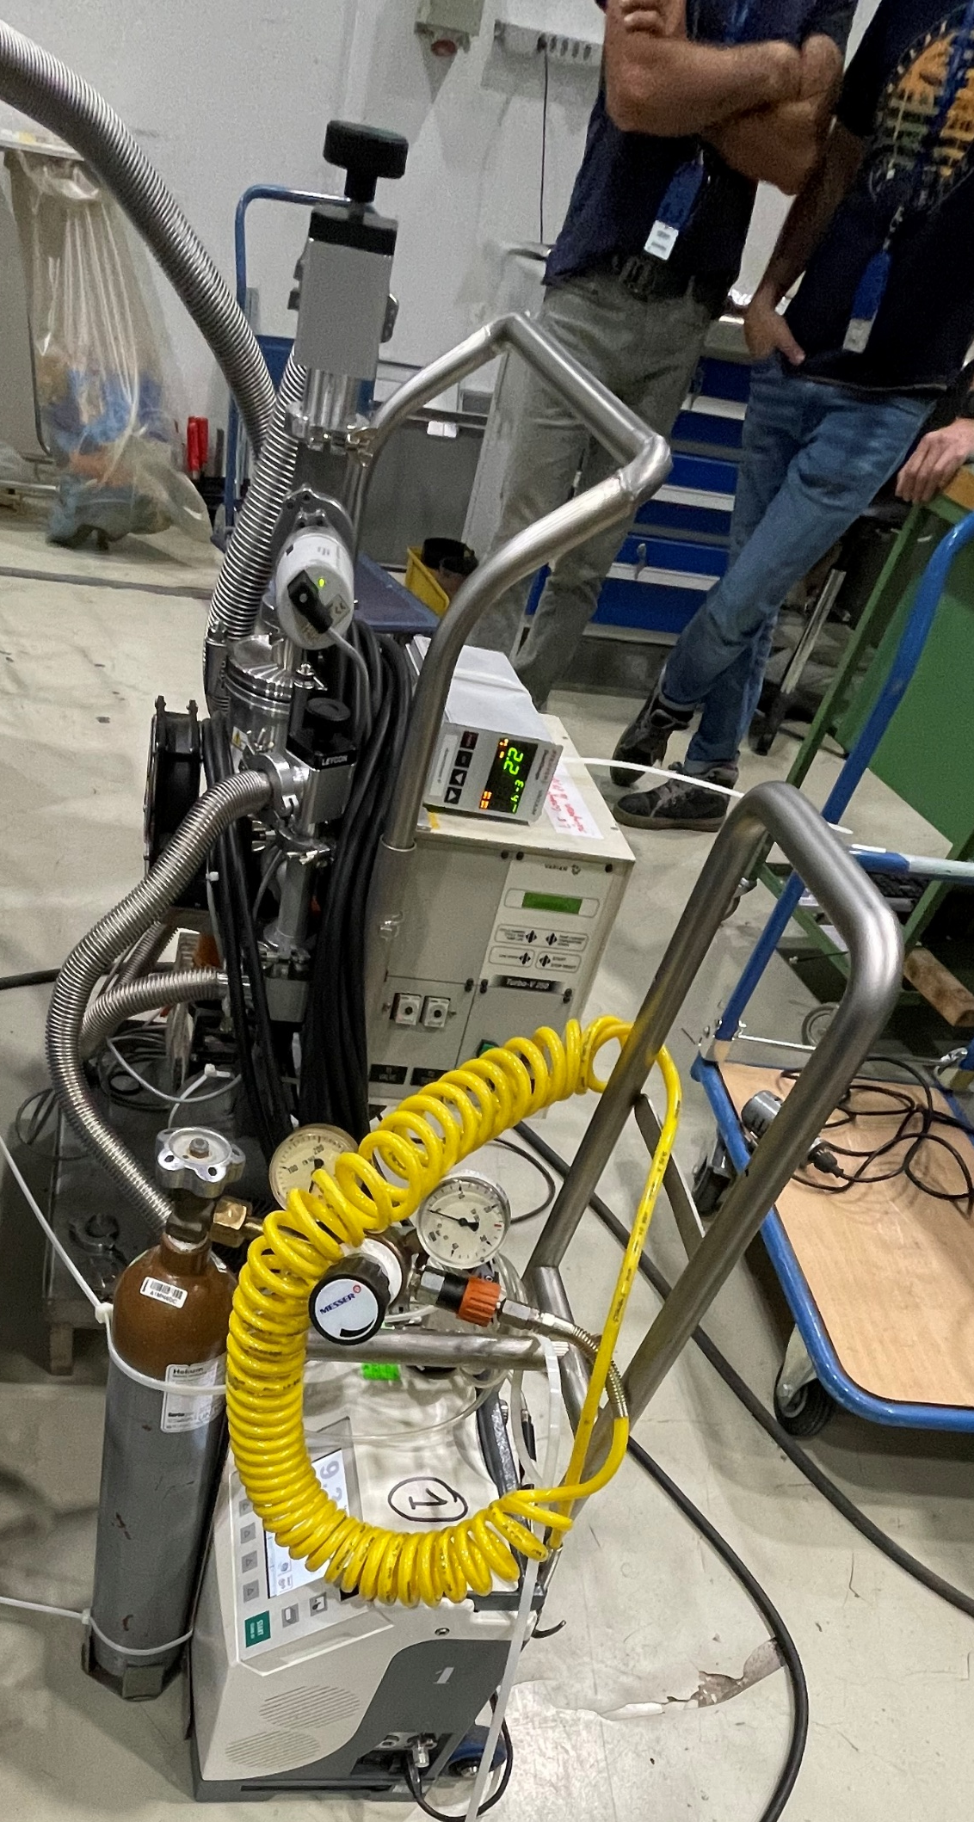
Foils investigated in 3 locations
Small manual valve DN25
opened gently in one test, then more aggressively in another
Valve DN40, tank side
manually opening
Pumping port DN40 fast manual opening (done twice in a row)

Slide 9
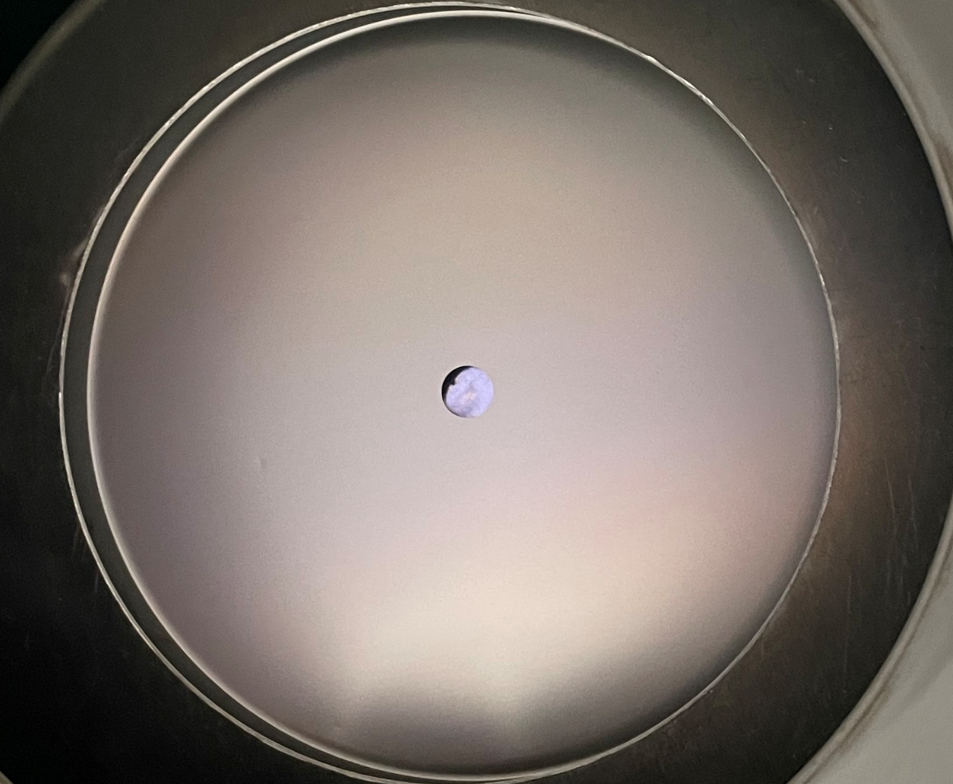
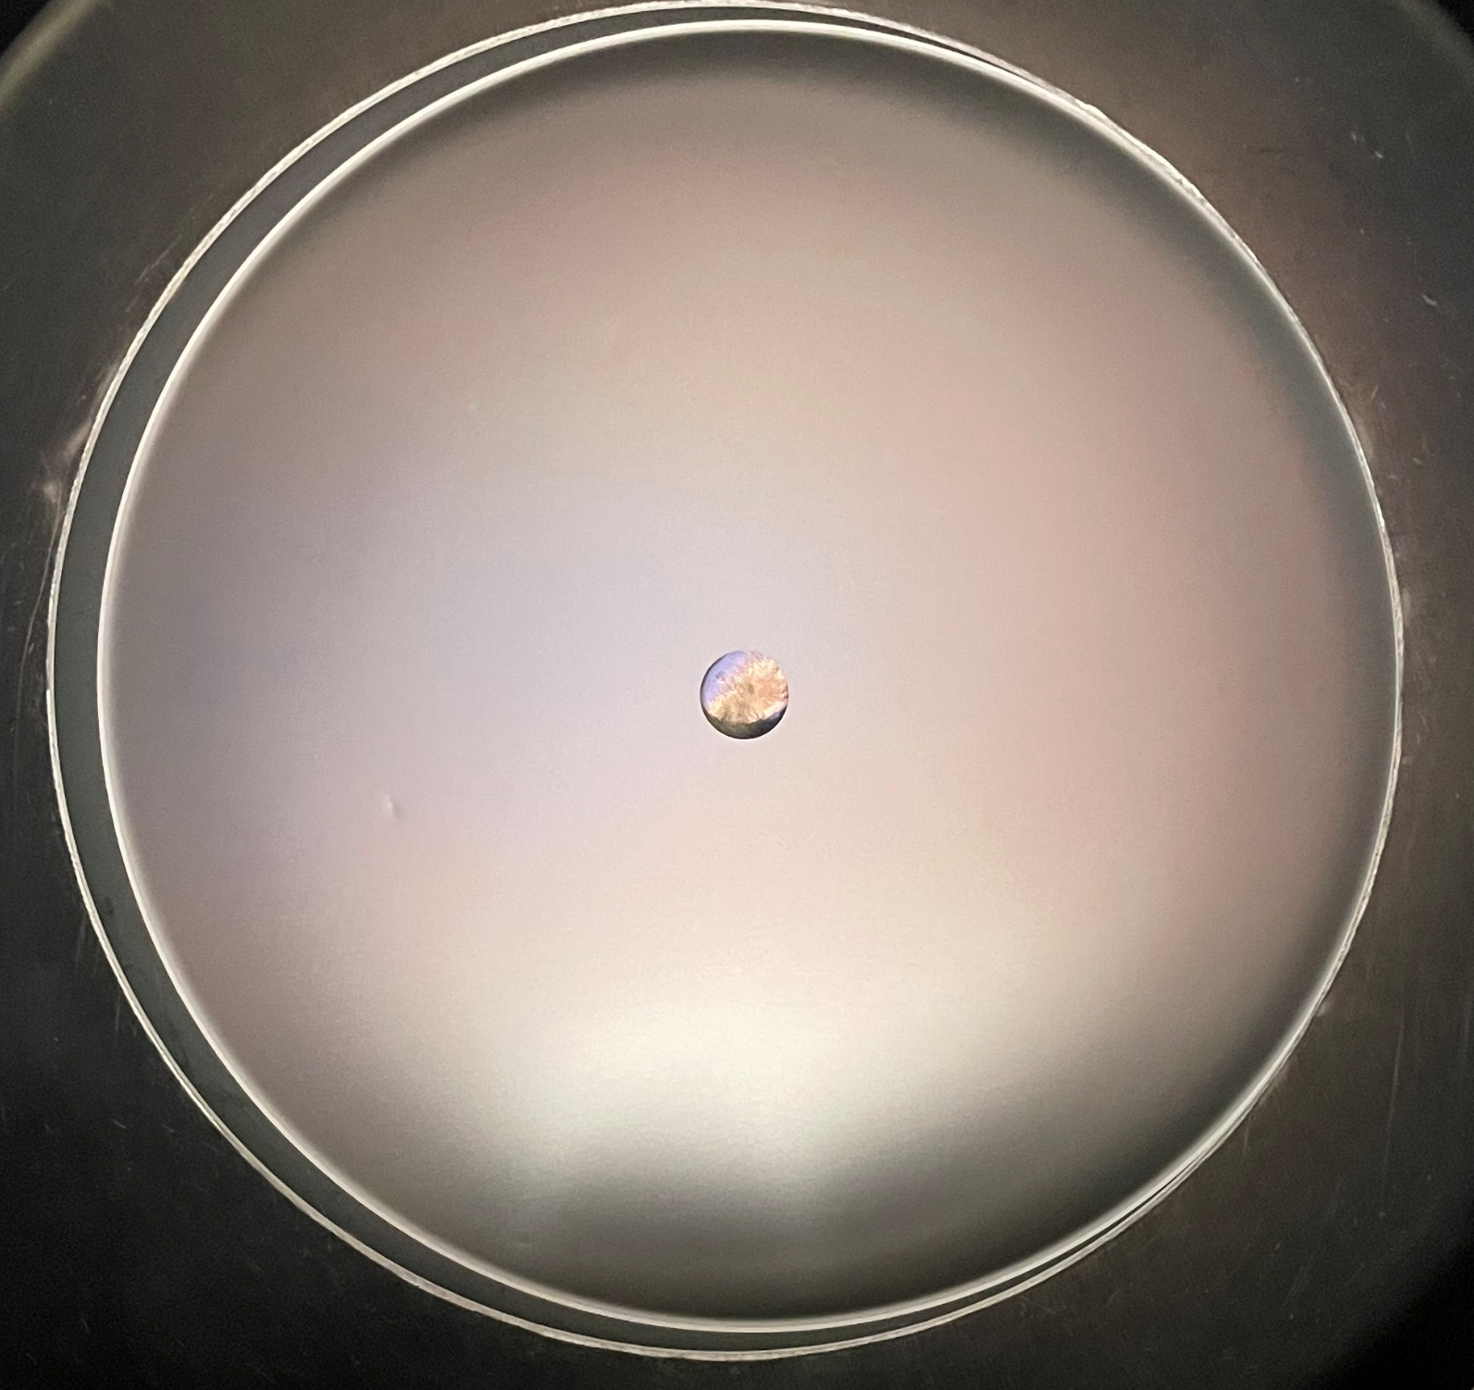
DN25 (tested with gentle and aggressive opening)
No new damage immediately visible to the eye

Slide 10
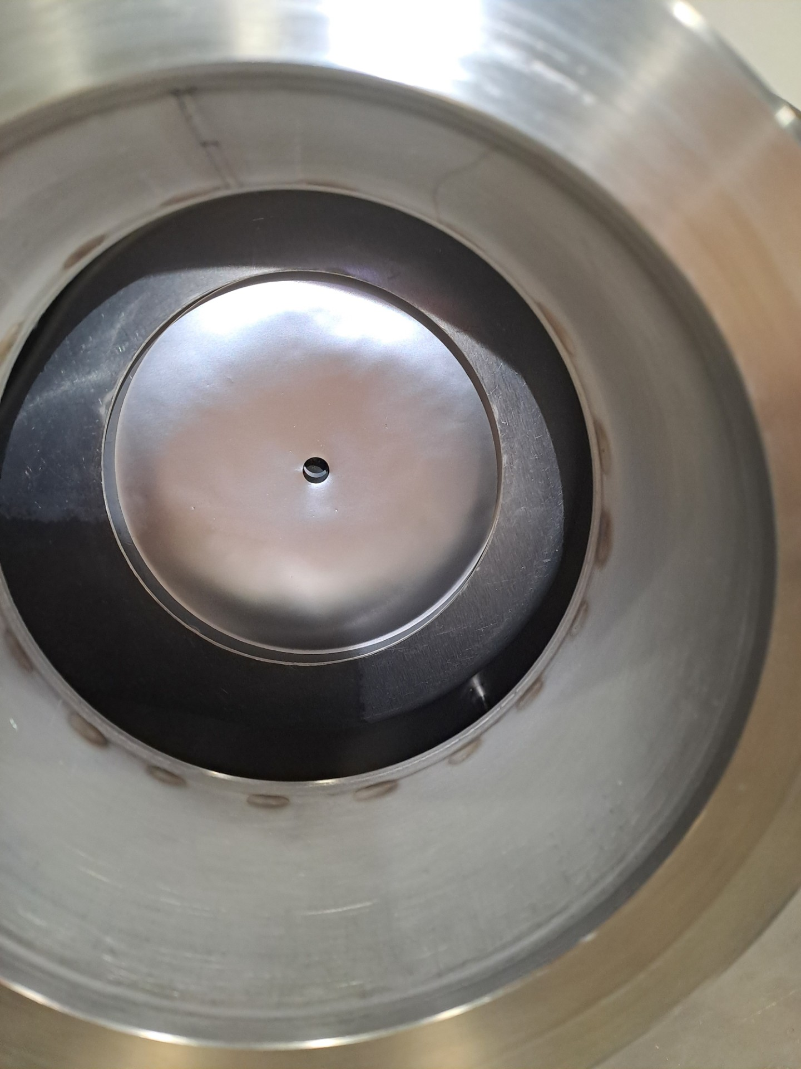
DN40
New damage (abrasions, warping) of aluminium foil
Foil is visibly deformed

Slide 11
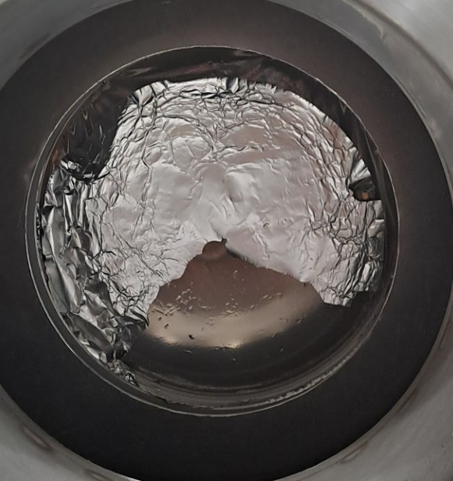
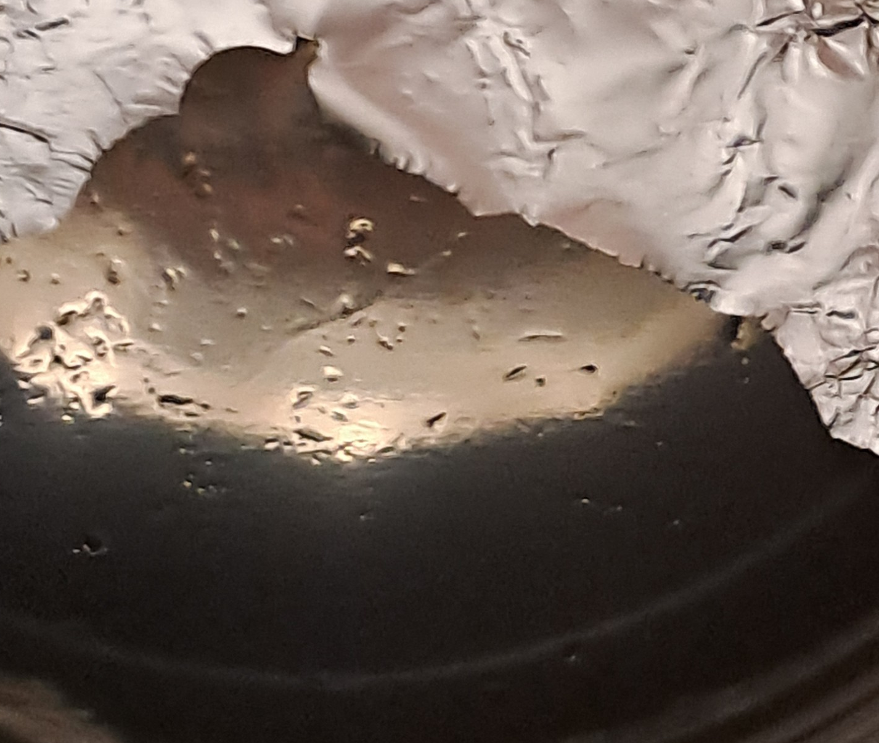
DN40 (close range)
Complete destruction
Even visible on titanium foil shown behind

Slide 12
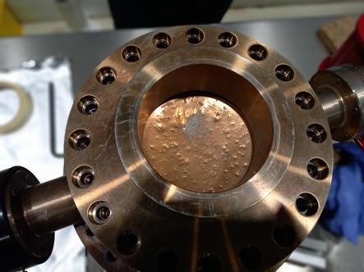
Conclusions
Results show significant potential for the BSPI.045 769 to be damaged by pump events
We have an explanation for previous years of damage of BSPI.045 769
XSEC had similar destruction (pump issue?) more reason to be careful in the future
Attention should be paid to venting method in the future

Slide 13
Supplementary Slides

Slide 14
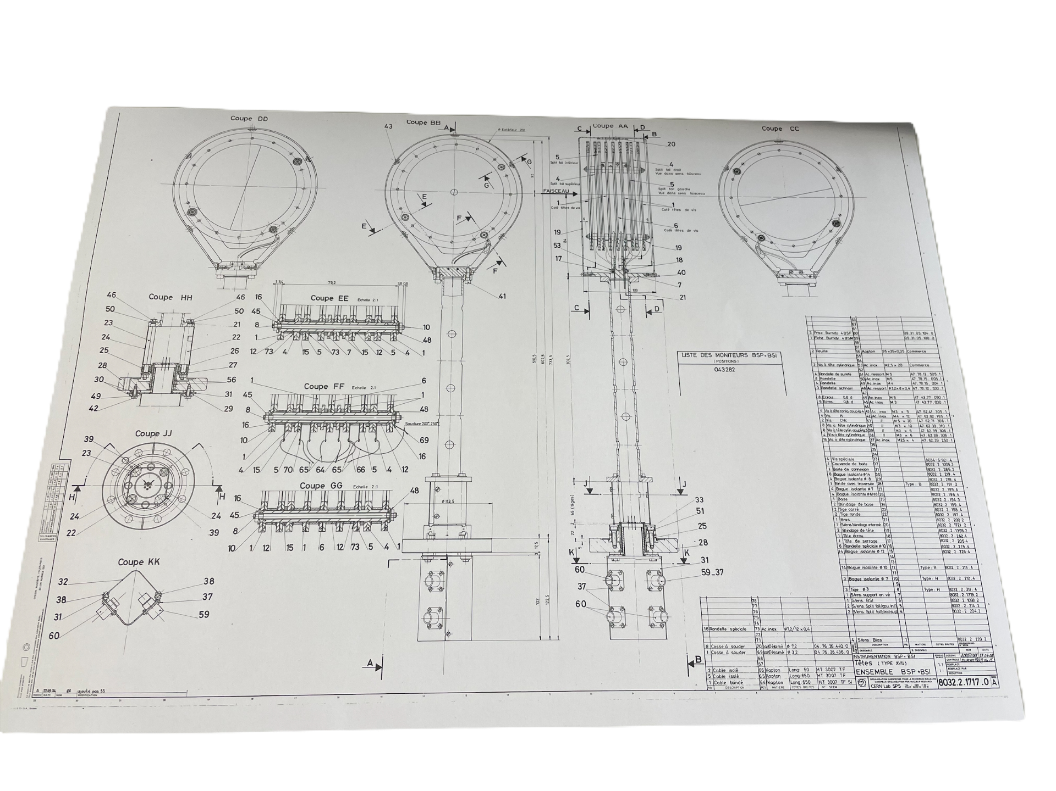
BSPI.045 769 Assembly
* Diagram for BSPI 043 282, but also applies to the assembly of BSPI 045 769

Slide 15
BSPI.045 769
BSPI often in “IN” position – this is how it differs from undamaged BSPIs
Note proximity of pump to the BSPI

Slide 16
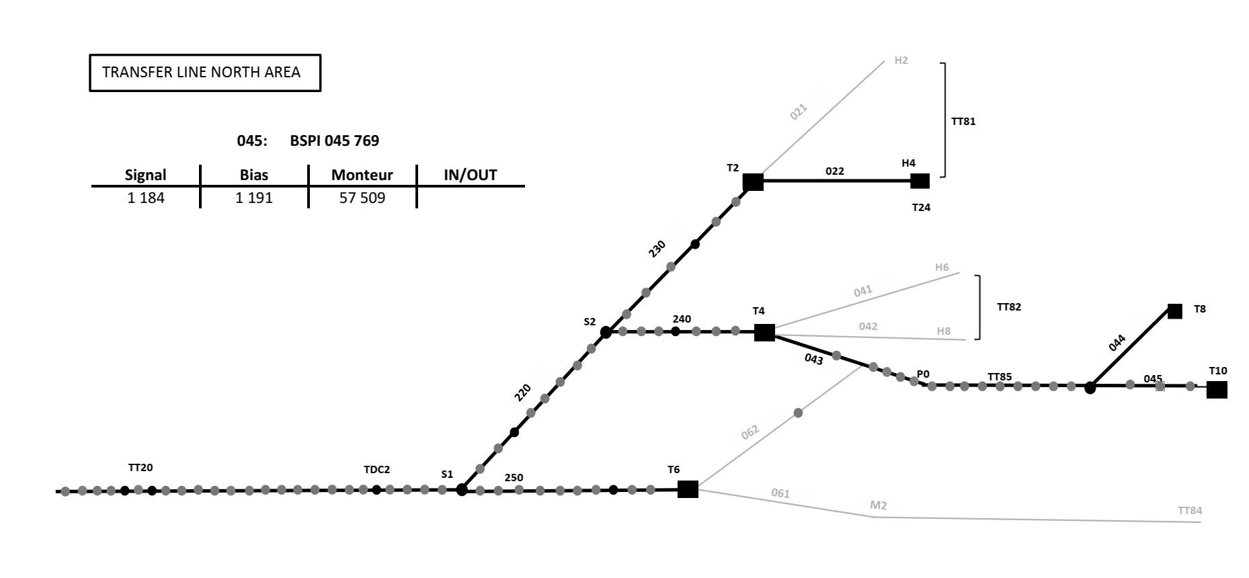
BSPI location in red

Slide 17
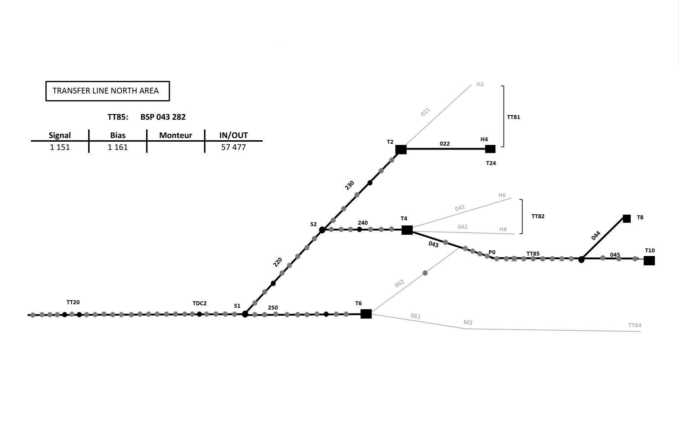
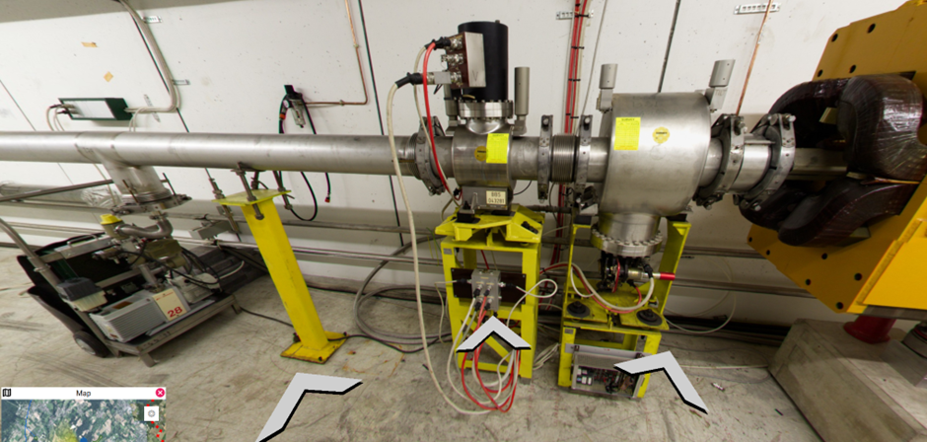
Undamaged Comparison (BSPI.043 282)
Has BBS, we have not had problems with BSPI here
Pump is closer than for 045769, but BSPI is often in “out” setting

Slide 18
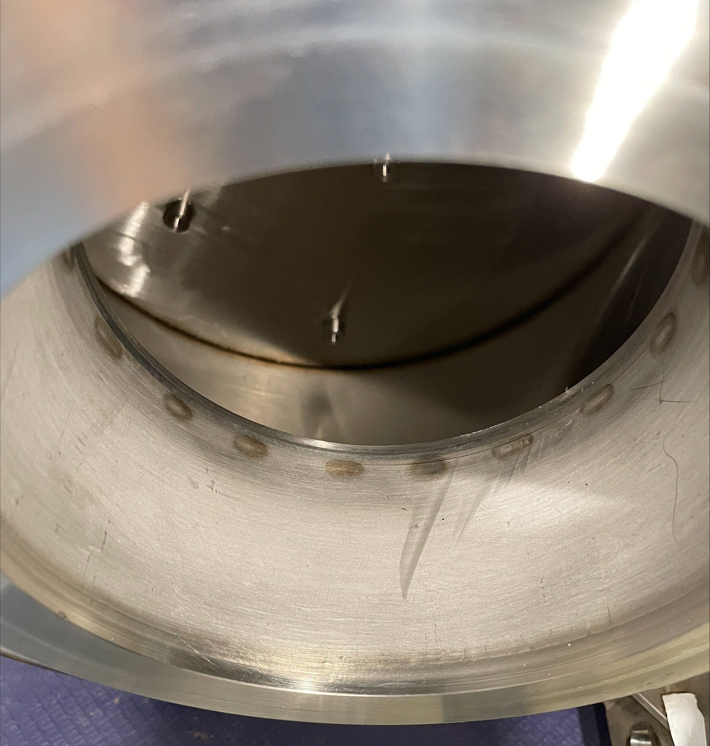
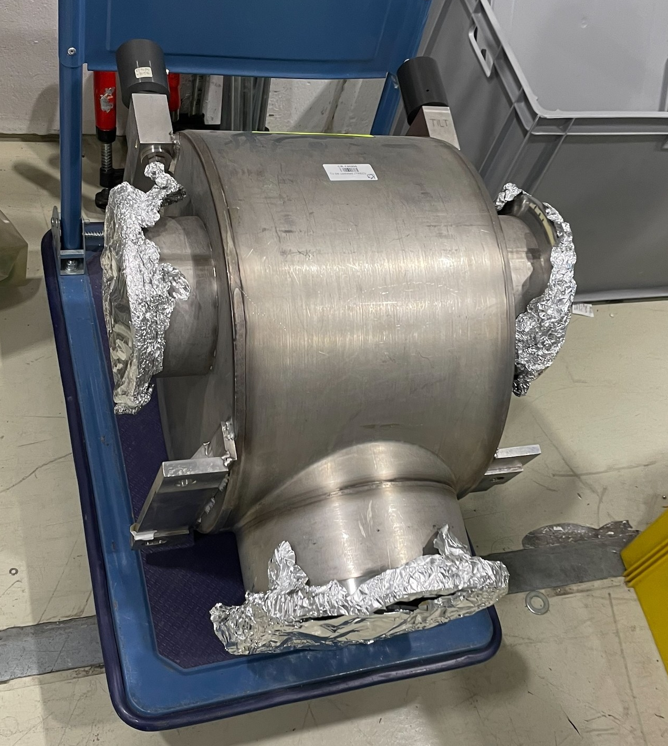
Did visual check for dust for BSPI.045 769 tank before to conduct tests (early 2025)
Could not see any dust from looking inside tank

