Slide 1

Doing Business with CERN
MS-5097/HSE – Occupational Medicine
Eva Vordogianni
05/06/2025

Slide 2

AGENDA
Introduction
Procurement @ CERN - the rules
Documents to be submitted

Slide 3

Introduction

Slide 4

CERN - the world’s biggest laboratory for particle physics.
International Organization
established on 1 July 1953 -
“Science for Peace”.
Immunity of jurisdiction
and execution.
Notes:
This slide addresses two questions:
“Where are we?”
Use the map to indicate the location of CERN, headquartered in Geneva, straddling the Franco-Swiss border
“What is CERN?”
CERN is one of the world’s leading laboratories for particle physics
CERN’s vision (long-term goal) is to understand the fundamental particles and laws of the Universe (This is the Vision statement that features in CERN’s communication strategy)
Thus, CERN is first and foremost a research laboratory

Slide 5

CERN is entitled to establish its own internal rules necessary for its proper functioning, including:
Procurement Rules
Safety Rules
Staff Regulation of its own personnel

Slide 6

In 1954 CERN had 12 Member States
Today CERN has 24 Member States
24 Member States
2 Associate Member States in the pre-stage to membership
9 Associate Member States
4 Observers
Geographical & cultural diversity
110 nationalities,
from 77 countries
~ 2,676 Staff members
~ 2,000 contractors’ employees
~ 13,000 physicists /users
Yearly budget ~ 1300 MCHF
Notes:
The speaker can highlight CERN’s second mission as stated when it was established: to foster peaceful collaborations between nations that had recently been at war.
This slide will have information on the country of the visiting delegation:
Location on the world map
Date of accession (if Member State or Associate Member State)
For information:
Member States – Austria, Belgium, Bulgaria, Czech Republic, Denmark, Estonia, Finland, France, Germany, Greece, Hungary, Israel, Italy, Netherlands, Norway, Poland, Portugal, Romania, Serbia, Slovak Republic, Spain, Sweden, Switzerland, United Kingdom
Associate Member States in the pre-stage to membership – Cyprus, Slovenia
Associate Member States – Croatia, India, Latvia, Lithuania, Pakistan, Turkey, Ukraine, Brazil, Ireland
Observers – USA, Russia (SUSPENDED), Japan, (EU, JINR, UNESCO)

Slide 7


Procurement @CERN - Rules

Slide 8
Principles of the Procurement Rules (1/3)
1
Transparency and Impartiality
2
Tenders open to Member States only
3
Objectivity and equal treatment: tendering packages are objective and impartial

Slide 9
Principles of the Procurement Rules (2/3)
Selective tendering procedures: CERN’s tendering procedures are not open to any interested firms
Confidentiality: Opening and evaluation of bids as well as negotiations are not public

Slide 10
Principles of the Procurement Rules (3/3)
Award on Best Value For Money basis
Most commonly used for industrial service contracts
2
No alignment rule

Slide 11

Enquiries exceeding 400’000 CHF (1/2)
“Market Survey” (MS)
Prior announcement on CERN’s procurement website, see
“Business Opportunities”
  At this stage, interested firms are encouraged to contact CERN in
  order to have a clear understanding of the requirement, allowing
  them to begin their organization ahead of the tendering process.
Market surveys consist of:
  “Technical Description” and;
  “Qualification Questionnaire” (financial and technical).
Submission deadline: 4 weeks, or more if the MS is still online.

Slide 12

Enquiries exceeding 400’000 CHF (2/2)
“Invitation to tender” (IT)
Sent to qualified and selected firms only;
Submission deadline: 4 weeks from date of dispatch (with a longer period for more complex requirements);
Firms shall ask all necessary questions in writing to understand all requirements and prepare a bid that best matches CERN’s needs;
All invitations to tender are sent to the Industrial Liaison Officers (ILOs) for information;
Bids shall be submitted via CERN’s e-tendering application.
Notes:
Invitations to tender consist of:
Technical specification and annexes;
Tender form (and a technical annex - optional);
General Conditions of CERN (contracts, invitations to tender, Safety, etc.)

Slide 13
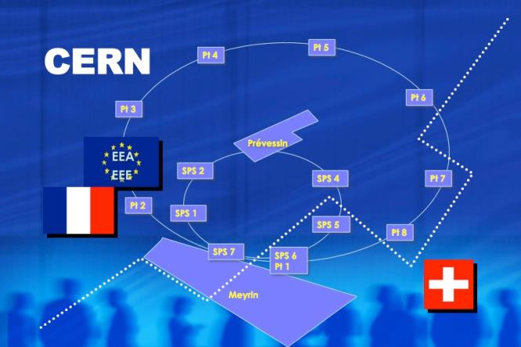
Law applicable to Contractor’s personnel

Slide 14

Reminder
According to its status CERN has the right to establish its own rules (i.e. SRR, safety rules, CPR) which are applicable to all
HOWEVER: Contractors shall comply with common law as well as CERN rules

Slide 15
















According to the principle of territoriality established under the Swiss-French agreement of 1965, contractors must comply with the law of their country of origin as well as with a number of provisions concerning the working conditions of their staff applicable in the country where services are executed
2 territories where services are executed
=
2 applicable laws in addition to the one in their country of origin
+
+

Slide 16
The application of the principle of territoriality creates practical and legal problems for contractors and their staff. The two host countries, with CERN, have therefore defined a new system:
2 territories where services are executed
=
only 1 applicable law in addition to the one in their country of origin
or
+

Slide 17






Areas concerned
rest time & leave
the minimum wage
hygiene, safety and health at work
protection for young workers and pregnant women or have just given birth
equal treatment
temporary work
The other areas such as hiring, contract termination and personnel representation are not concerned by this new regime

Slide 18
4P for IT-5097 – Preliminary information - to be confirmed in IT
The applicable law is determined on the basis of the Part Prépondérante Prévisible de la Prestation = 4P
The 4P for this contract is likely to be located on the Swiss part of the CERN domain. The applicable law may thus be Swiss law
This rule, when confirmed in the IT, will apply to the entire contract, including subcontractors unless subcontracting concerns only one territory

Slide 19


MS documents

Slide 20
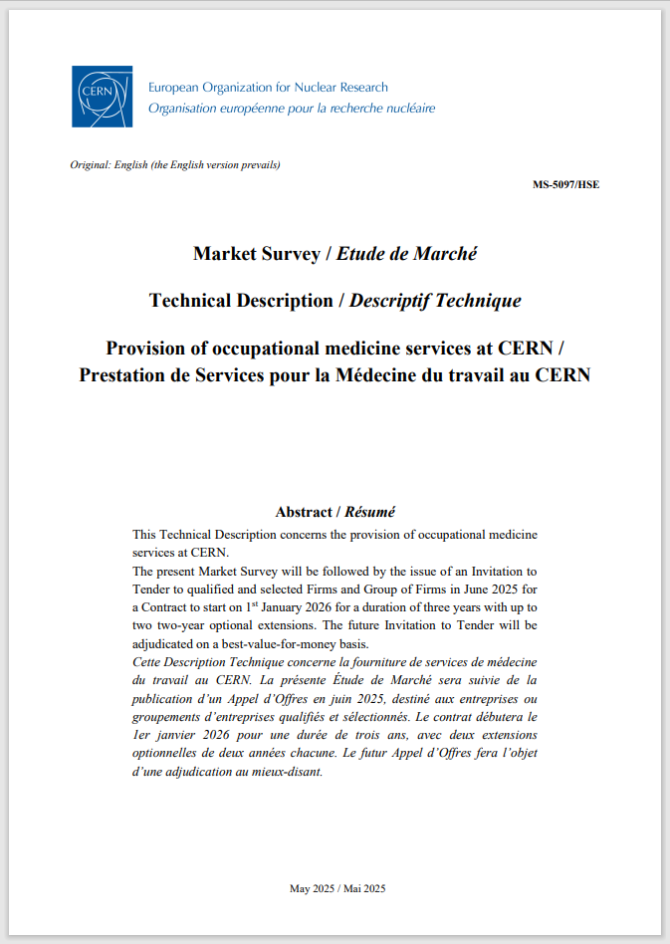

Technical description
Describes the services and gives information about the future contract:
- Contract start date
- Contract duration
- Optional extensions
- Adjudication basis

Slide 21
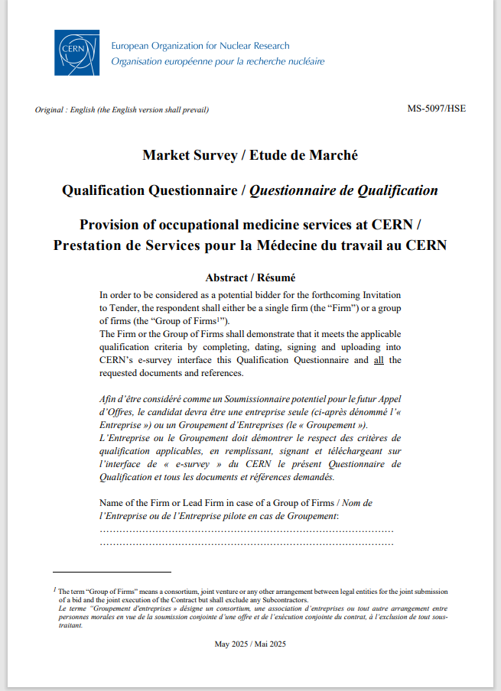
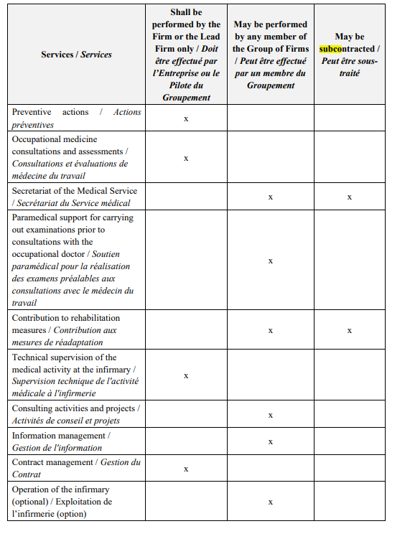
Qualification questionnaire (QQ)
aims to help assess the bidder’s suitability for the Invitation to Tender
provides for the distribution of the contract performance, e.g.:
Submit your duly filled-in and signed QQ, according to the instructions received by CERN

Slide 22

Final arrangements

Slide 23
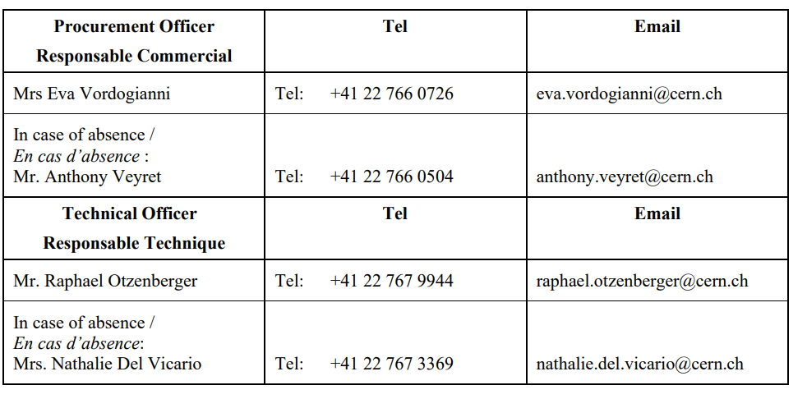
After this webinar
Presentation and video of this webinar will be uploaded on CDS platform here: Provision of occupational medicine services at CERN / Prestation de Services pour la Médecine du travail au CERN - CERN Document Server
Contact persons:

Slide 24

Follow us on LinkedIn

Slide 25

Thank you
Thank you

