Slide 1
Multi-core support in IS
Maria Alandes Pradillo, CERN
CERN IT Department, Grid Technology Group
GDB 12th September 2012

Slide 2
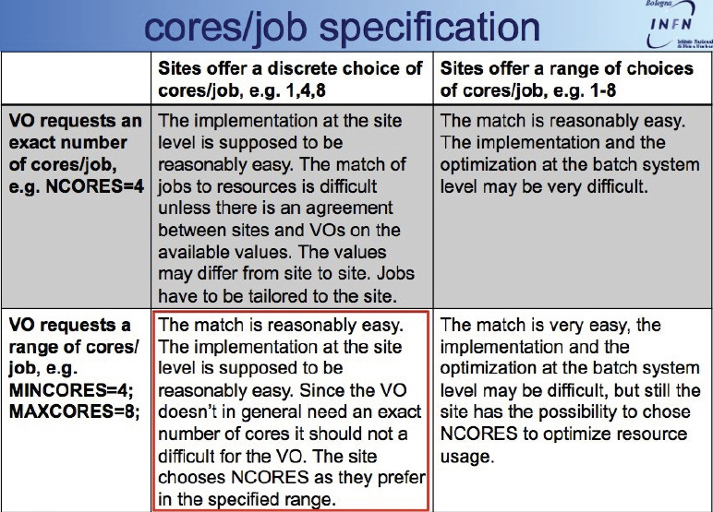
CE extensions pre-GDB July
Multicore use cases to be addressed

Slide 3
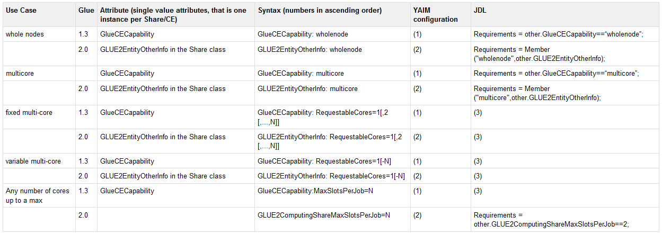
IS proposal
IS proposal to address the use cases
All details can be found in:
https://tomtools.cern.ch/confluence/display/IS/GLUE2UseCaseMultiCoreJobs

Slide 4
Open issues (I)
Syntax issues
  One attribute per value. i.e.:
    Allows for an easy JDL ☺
    Increases the volume of published information ☹
      Need to assess impact. i.e. How many attributes are published in practice.
  One single attribute. i.e.:
    More complex JDL due to the lack of proper classads primitives ☹
    Simple and compact published information☺
GLUE2EntityOtherInfo: RequestableCores=4
GLUE2EntityOtherInfo: RequestableCores=8
GLUE2EntityOtherInfo: RequestableCores=16
GLUE2EntityOtherInfo: RequestableCores=4,8,16

Slide 5
Open issues (II)
Realistic use cases for multicore support?
  Is this really needed?
  Isn’t it enough something like…
    With the mechanism in place in the WN which tells the job how many cores it is allowed to use
      Is this mechanism available?
  What about…
    would allow requests for 4,8,12,16 cores to be fulfilled.
GLUE2EntityOtherInfo: RequestableCores=4-32
GLUE2EntityOtherInfo: RequestableCores=2,4,8
GLUE2EntityOtherInfo: multicore
GLUE2ComputingShareMaxSlotsPerJob=16
GLUE2EntityOtherInfo: multicore_granularity=4

Slide 6
Open Issues (III)
Do we really need to publish wholenodes or multicore at all?
  It seems we need to publish wholenodes since this is not provided by all CEs
  For multicore it would be enough to know the maximum number of cores
    If a CE can do 8 and 16 cores, why not 12?
      Maybe scheduling is not optimal for certain combination of cores/job?
      Feedback from sysadmins needed!

Slide 7
Conclusions:
IS can publish any reasonable configuration (complex parsing to be taken into account)
We don’t have enough understanding of the use cases we need to satisfy
  What batch systems can actually do?

