Slide 1
Migration from unsupported middleware to UMD/EMI
SHA-2
Status and plans
Peter Solagna – EGI.eu

Slide 2
Summary
Unsupported MW decommission
  Timeline and current status
  Next actions
  Future plans for EMI-1
SHA-2 and RFC proxies
  Current status and future plans

Slide 3
Unsupported middleware
Unsupported gLite products:
  ARGUS, BDII, CREAM, LB, dCache, lcg-CE, VOMS, WMS
gLite products supported until 30/11/2012
  WN, UI, FTS, GLEXEC, LFC, DPM
Products supported until 30/04/2013
  gLite VOBOX, all EMI-1 components

Slide 4
Timeline
Policy decisions
  March 2012, OMB agreed to decommission gLite 3.1 components by the end of September
  July 2012, OMB agreed to decommission unsupported gLite 3.2 middleware by the end of October
    August 2012, >1000 services to be decommissioned
  August 2012, EGI PMB enacted a policy to decommission unsupported software within one month after the end of security support, if a replacement is available
August 2012, EGI CSIRT circulated a security advisory to all sites asking to upgrade unsupported middleware by the end of October 2012
  NGIs and sites have been warned many times in the following two months
October 2012, sites are being actively monitored and followed up by EGI (COD and CSIRT)

Slide 5
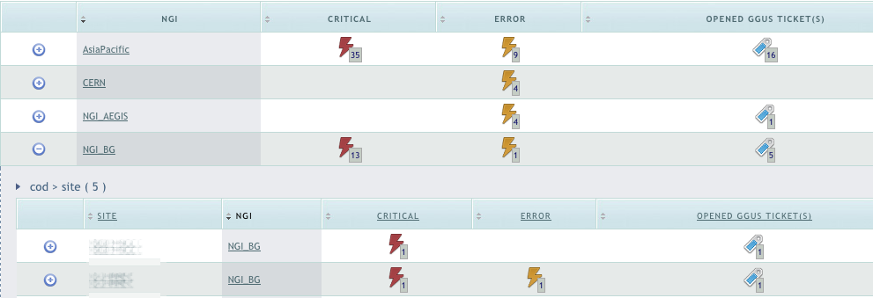
The monitoring process
EGI security dashboard has been extended to raise alarms for unsupported middleware
  Tool used by EGI CSIRT and COD
  NGIs have access, to check the status of their sites
GGUS tickets are opened by COD
  Sites must acknowledge the ticket and provide a timeline for the upgrade or decommission of the services
  Total of 261 tickets opened
Every site has max one ticket opened from the security dashboard
  Tickets are kept open until there are no more alarms for the site

Slide 6
Issues
Not all the components publish (correctly) the gLite version
  Custom probes for CREAM and dCache
  Manually opened ticket for VOMS
Quattor based sites need templates for the EMI version of the product
  Templates should be already available or will be in few days
  To be checked the availability of the DPM templates

Slide 7
Current status
~120 sites deploying unsupported middleware
  ~210 services involved
~90: Sites planning to upgrade or decommission before the end of November
8: Sites with late plans
  Proposing an upgrade timeline beyond middle December
  They will be asked to open a downtime for the affected services on Dec 1st
19: Sites who did not provide a schedule for the upgrade
  These sites are risking suspension in one week time
  Asia Pacific: 6
  ROC_Russia: 4
  NGI_France: 2
  NGI_BG: 2
  NGI_IT: 1
  NGI_DE: 1
  ROC_LA: 1
  NGI_IL: 1
  NGI_RO: 1

Slide 8
Sites suspension process
Nov 8, NGIs and VO Managers were warned about unresponsive sites risking suspension
Nov 13, NGIs were asked to open a downtime for the sites risking suspension
After Nov 19 sites with no answer will be suspended by EGI CSIRT
  Suspension will be validated site by site by EGI CSIRT and COO
  To successfully be re-certified sites will need to decommission unsupported services

Slide 9
Remaining gLite services
DPM, LFC and WN will be unsupported starting from Dec 1st
  No extension of the support expected
DPM
  Raise alarms for DPM starting from Dec 1st
  Deadline for upgrading DPM: Jan 31, 2013
  Site managers must put unsupported DPM in downtime by Feb 1st, 2013
LFC timeline can be aligned with DPM
WN timeline to be defined in the coming few days
  WN 2.0.1-1 is planned to be released Next Monday in UMD

Slide 10
Action plan for EMI-1
EMI-1 products will end security support at the end of April 2013
  Specific probes to be ready before the end of 2012
January 2013, EMI-1 middleware triggers warning alarms on the Operations dashboard
March 2013, EMI-1 triggers critical alarms
NGIs ROD teams will handle these alarms
  Opening tickets, following up with sites
  Normal operations escalation procedures
EGI COD and CSIRT will follow up only with problematic sites
  More scalable workflow
  Non responsive NGIs and sites will escalate to COD and EGI

Slide 11
SHA-2: current status
EUGridPMA agreed in September 2012 the following timeline:
  IGTF CAs shall enforce use of SHA-2 *not* before August 1st 2013
    After the end of support of EMI-1
EGI asked EMI and IGE to assess for all their components:
  Available support for SHA-2 certificates and RFC proxies
    Not supporting SHA-2
      EMI: StoRM (➔EMI-3), VOMS (➔Nov 2012), CREAM (➔EMI-3), dCache (evaluating CANL),
      IGE: GSI-SSHTerm (➔Q2 2013), jGlobus1.x
    Not answered, yet: DPM, LB (but it should be ok)
  Copy of the documents available in the EGI document DB: Link
    Product teams provided the version of the product where the SHA2 and RFC support was available first

Slide 12
SHA-2: future plans
UMD verification will check user authN with SHA-2 certificates and RFC proxies starting from one of the next UMD releases
  Products that fail to handle SHA-2 (and RFC) certificates will trigger a warning sent to the developers
EGI is planning to set up Nagios probes to monitor that deployed middleware accepts SHA-2 certificates and RFC proxies
  During the first months of 2013

Slide 13
Conclusions
Most of the sites have plans to upgrade to EMI/UMD within the end of the month
Unsupported services in downtime to mark them as ‘at risk’
Currently there are 19 site eligible for suspension
  Hopefully the number will decrease by Monday!
DPM and WN are the next steps
EMI-1 decommission and monitor of SHA-2 support
  First half of 2013

Slide 14
Questions?
Acknowledgements
  EGI COD team
  EGI CSIRT team
  Operations portal team
  Emir, Paschalis for the security Nagios

