Slide 1
Information System
Status and Evolution
Maria Alandes Pradillo, CERN
CERN IT Department, Grid Technology Group
GDB 14th November 2012

Slide 2
Overview
Current status
  Development
  Quality of Service and Data
  Requirements from experiments
  Statistics on current use
Evolution
  Service Discovery
Conclusions

Slide 3
Current status of the Information System

Slide 4
Development

Slide 5
BDII development status
No major incidents
No releases since August
EMI 1, EMI 2 and EMI 3 releases are all aligned
  Note that EMI 1 Standard updates are over
  Direct upgrade path from EMI 1 to EMI 2 for the BDII
Details on EMI releases:
  http://malandes.web.cern.ch/malandes/infosys/bdii_emi.html

Slide 6

BDII development status
Next release in December:
  EPEL compliance
  EMIR integration
  ARC integration
  glue-validator improvements
  Service information provider bug fixes
Continuous improvement of the Documentation
    https://tomtools.cern.ch/confluence/download/attachments/983044/EMI_BDII_sysadmin.pdf
  Latest changes:
    glite-info-update-endpoints configuration
    Site BDII configuration aligned with EGI guidelines
  Upcoming changes:
    Nagios probes documentation
    EMIR publisher configuration

Slide 7
Quality of Service

Slide 8

Top level BDIIs and failover
Initial proposal to configure failover
  https://tomtools.cern.ch/confluence/display/IS/WLCG_Support_Proposal
EGI recommends sites to use the NGI top level BDII: https://wiki.egi.eu/wiki/Top-BDII_list_for_NGI
EGI monitors Reliability&Availability of top level BDIIs: https://documents.egi.eu/public/ShowDocument?docid=1429
Follow up actions by EGI
Underperforming top level BDIIs in small NGIs are asked to be decommissioned
Catch all top level BDII provided by EGI or good performing neighbour NGI top level BDII used instead
NGIs contacted monthly to explain reasons for underperformance.

Slide 9
Top level BDIIs and failover
Configuration of LCG_GFAL_INFOSYS variable hasn’t changed since June 2012
  Most sites still configure one BDII only
  Good news is that the most configured BDIIs have 100% availability
Next steps:
  Work together with EGI:
  No clear policy on LCG_GFAL_INFOSYS configuration
  Good quality of service of NGI top level BDIIs
  To be monitored together with EGI and together with them discuss further actions
(*) The NA in the graph is due to a bug in SAM already fixed.

Slide 10
Data Quality

Slide 11
Glue 2.0
More on Stephen Burke’s presentation
  EGI Glue 2.0 profile
  Deployment of Glue 2.0
From the Information System point of view
  Improve glue-validator to check compliance
  Collaborate with EGI to check and monitor Glue 2.0 deployment
      To be discussed with next presentation…

Slide 12
Requirements from experiments

Slide 13
Multicore support
Is there anything else needed from IS?
  Attempt to restart discussion in WM TEG ML in August
    No more reactions
  As reported in the last September GDB
    https://indico.cern.ch/getFile.py/access?contribId=7&sessionId=1&resId=1&materialId=slides&confId=155072
    Information System is ready
    We can address any requirements

Slide 14
Requirements from experiments
Who? | Requirements | Addressed by
ALICE | Reliable information published by the resource BDII in the CREAM CE | Follow up on information provider issues
ATLAS | Reliable service discovery (GOCDB, OIM and BDII in sync) Better SE space utilization information and in sync with Storage Accounting Reliable client tools | Cached top BDII
CMS |  | Cached top BDII Understand Storage Accounting and what would be needed from the IS ginfo
LHCb | Reliable service discovery of CEs | Cached top BDII
Service Discovery is the most important use case for experiments

Slide 15
Statistics on current use

Slide 16

Top BDII query statistics
Analyzed LDAP logs from production top BDIIs
  Using the ldap-stats.pl script
  http://prefetch.net/code/ldap-stats.pl.html
Thanks to:
  CERN – Ulrich Schwickerath
  TRIUMF - Di Qing
  PIC - Arnau Bria, Carles Costa

Slide 17
Top BDII query statistics
Site | Queries in one week
CERN | 3223758
TRIUMF | 397701
PIC | 36007
Most queried attributes
No attribute explicitly requested
GLUEService (version, type, endpoint)
GLUESE (port, status)
GLUESA (root, accesscontrolbaserule)
GLUECE (name, status, uniqueID)

Slide 18
Top BDII query statistics
Difficult to extract conclusions
  No common pattern
  Analysis from only one week!
    This would require a longer time window -> Log file increases fast (>15 GB in one week)
It was an interesting exercise though
  BDII heavily used
    Stability, performance and robustness very important
  Which attributes are most queried

Slide 19
Evolution of the Information System

Slide 20
Service Discovery
Focus on Service Discovery
Cached top level BDII has improved the perceived stability
How can we make it even better?
  Monitor quality of the published information
    As part of the overall GLUE 2.0 effort
  Provide a reliable client tool to query the IS
    For both EGI and OSG resources
      OSG is not publishing in GLUE 2.0 though!
  Study other possible implementations: EMIR

Slide 21
ginfo
Simple comand line tool
  Queries BDII GLUE 2.0 Service Endpoints
Available in EPEL for SL5 and SL6
  http://fedoraproject.org/wiki/EPEL
  yum install ginfo
Ready to be used!
  Feedback is very much welcome!
    project-grid-info-support@cern.ch
  Already some feedback from CMS and ATLAS
    Missing other GLUE objects currently available in lcg-info
    Query OSG resources?
GLUE 2 attribute filters
EndpointCapability
ServiceAdminDomainForeignKey
EndpointID
ServiceID
EndpointImplementationName
EndpointImplementationVersion
EndpointInterfaceName
EndpointInterfaceVersion
EndpointQualityLevel
EndpointTechnology
ServiceType
EndpointURL
PolicyRule

Slide 22

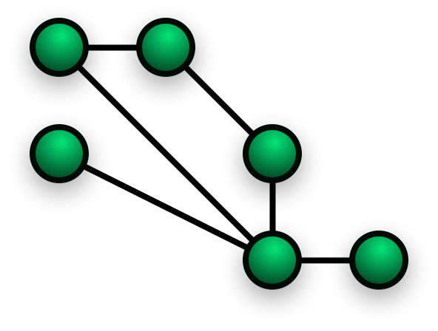
EMIR
EMI Service Registry
Provides References to Services
  Endpoints
  Associated Metadata
    Service Type, Supported VO, Capability
Automated Information Management
  Services are the authoritative source
Components
  Service Publisher
  Domain Service Registry
  Global Service Registry
A domain could be a site, a country, a region…
  It’s a collection of services
EMIR pilot testing is ongoing
  Some robustness issues detected but overall feedback is positive
  Not ready for production deployment yet

Slide 23
Conclusions
Current status
  BDII performing well in production
  On going development:
    EPEL compliance
    EMIR integration
    ARC integration
    glue-validator improvements
    Service information provider bug fixes
Future work
  Focus on Service Discovery
  Follow up Glue 2.0 deployment and evaluate published information
  Follow up EMIR pilot and ginfo

