Slide 1
GGUS Report Generator
G. Grein, C. Rogge, H. Dres, T. Antoni

Slide 2
Purpose
Provide a tool for
  Easy reporting on most common key performance indicators
  Offering reports in self-service
  Exporting report data in a generic format for further processing
  Reports requested by EGI-Inspire
  Reports requested by techonology providers, e.g. EMI
Replace reports currently done by GGUS team manually
  Replace previous Report Generator

Slide 3
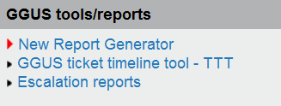
Access
Report Generator linked from GGUS home
Access restricted
  Request access permissions by GGUS ticket or a GGUS contact mail.
  The SLA report requires additional permissions and is for technology providers’ use only

Slide 4
Reports
Available reports are:
  Tickets submitted
  Tickets closed; focused on ticket life time
  Response time; time frame from ticket assignment to 1st status change
  Solution time; time frame from ticket assignment to status “solved/unsolved”
  Violated SLA; only for technology providers like EMI, IGE etc.

Slide 5
Time prerequisites
Office hours
  Assuming office hours from 09:00 to 17:00
  Excluding week-ends
  Not considering national holidays!
Time zones
  For SUs covering several time zones a default time zone is used, e.g. for OSG UTC -5 hours
Not considering summer time!

Slide 6
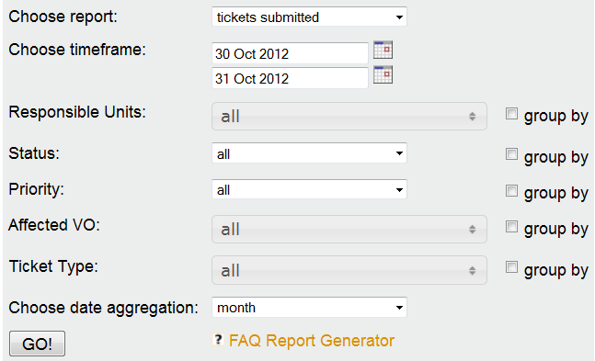
Tickets submitted

Slide 7
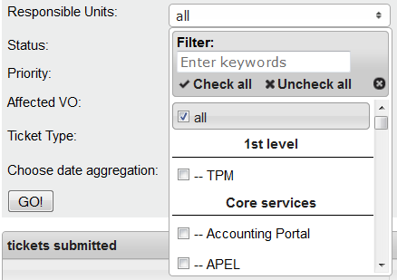
Responsible units

Slide 8
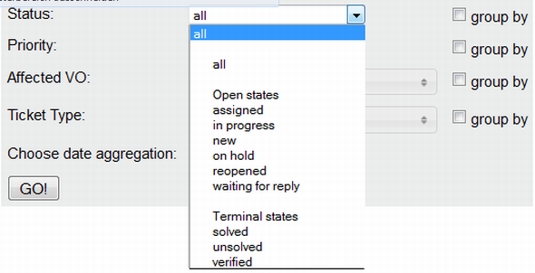
Status

Slide 9
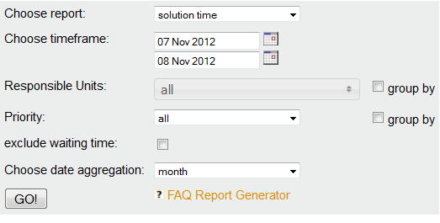
Solution time

Slide 10
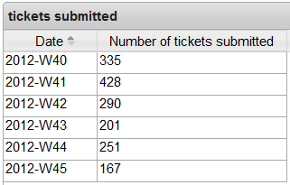
Date aggregation
Date aggregation is possible over
  Day
  Week (calendar week counting from Sunday to Saturday)
  Month
  Quarter (calendar quarter)
  Year
Default: Month
Week aggregation

Slide 11
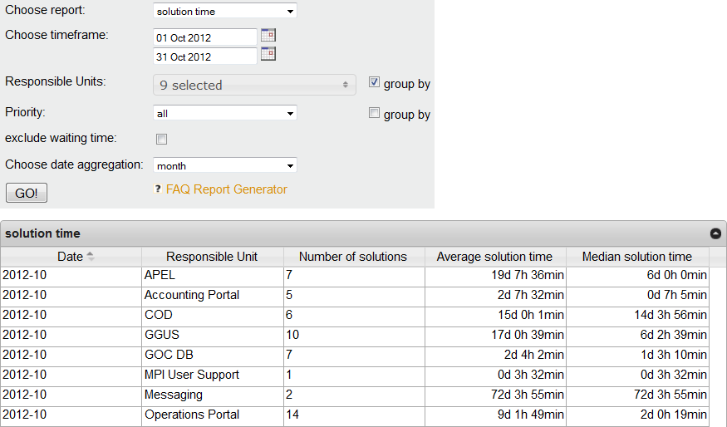
Result list

Slide 12
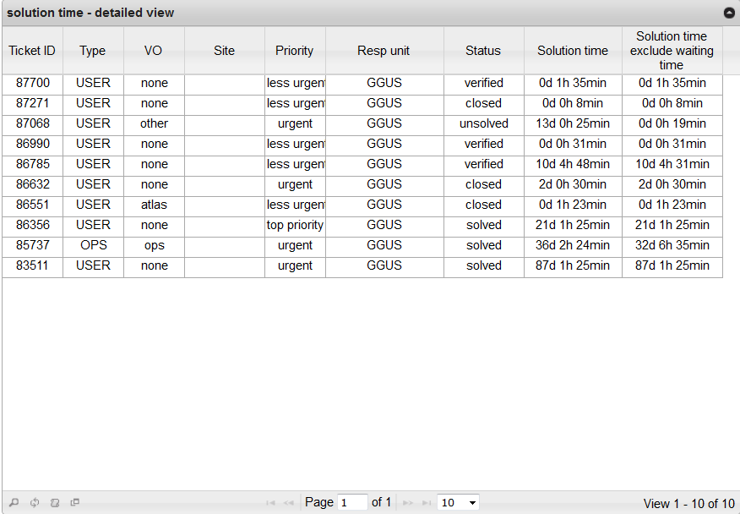
Result list details

Slide 13

Result list features
Search
Refresh
Export
  Exporting result list data without column labels
  Export format .csv
Export what you see
  Exporting result list data including column labels

Slide 14
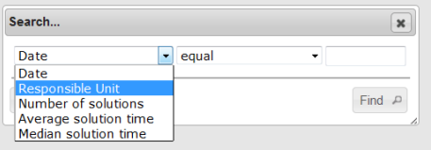
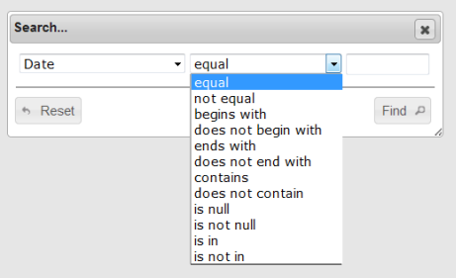
Result list search
Searching result lists
  Search parameters are the column labels of the result list

Slide 15
Thank you for your attention!

