Slide 1
FALCOND-C (WP3.1) follow up meeting
Update on mechanical LMK1 mock up
Schedule
SMT meeting, 20/05/2025
MSC-SMT-Arnaud Foussat, CERN

Slide 2
Cos-ϴ dipole development plan
CERN-MSC SMT and INFN-Ge, LASA collaboration towards a twin-aperture 12 T, 1.5 m long Nb₃Sn dipole design by 2028.
Date | Description | Length | Scope | Goals | Institute
Q2-2025 Q3 2026 | 1 mechanical Mock-up 1-in-1 demonstrator Magnet | < 0.5 m 1.5 m | INFN B&K magnet model | Novel dipole b&k 45deg quadrant structure design validation | INFN WP3.2
Q3-Q4 2025 | Mechanical mock ups LMK1/2 | < 0.5 m | CERN B&K & collars coils section mock up assembly ( use 11T coils) | Benchmarked concepts of mechanical cross section structures at RT and cold. Measurement of residual stress | CERN WP3.1
Q3- 2026 Q4 - 2027 | Two 1-in-1 demonstrator magnets M1, M2 | 1.5 m | CERN B&K magnet models | M1: Novel dipole b&k structure design validation M2 Optimization of b&k structure design. ESC coil protection test Reproducibility Structure pro’s & con’s assessment | CERN WP3.1
Q2-2028 | 2-in-1 demonstrator magnet M3 | 1.5 m | CERN B&K 2-in-1 magnet assembly | New 2-in-1 structure, Field optimization, fabrication process, scale-up design inputs for 14T design | CERN WP3.1
Notes:
Series of mock up both at CERN and INFN during 2025 to validate concepts of structure

Slide 3

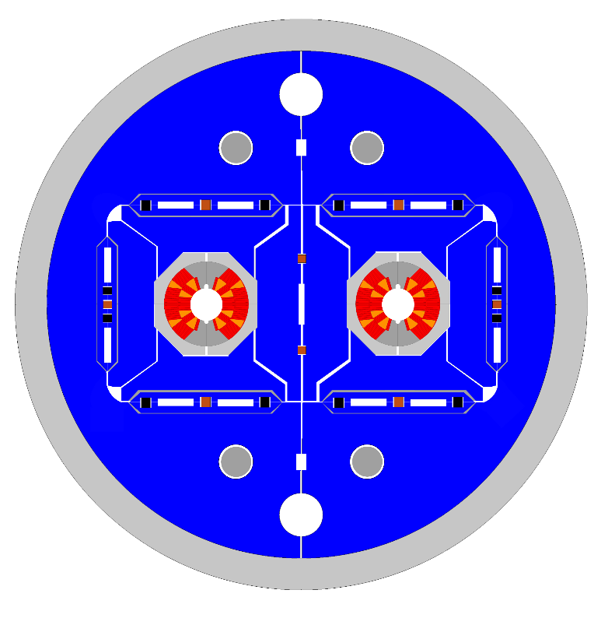
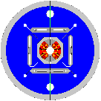
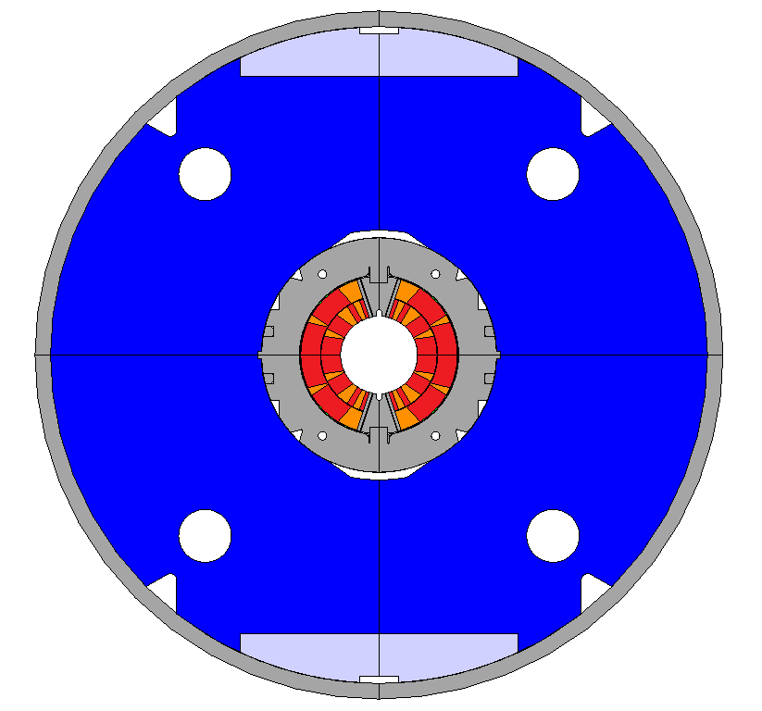
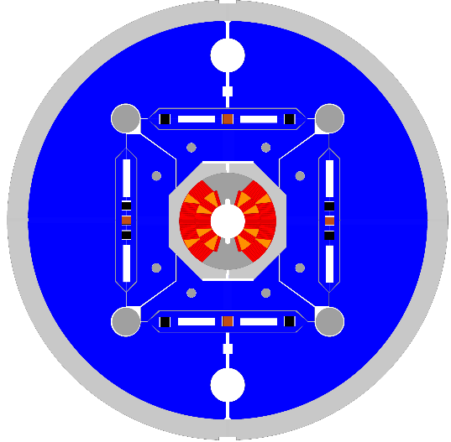
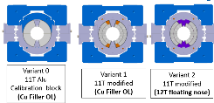
WP3.1 FalconD 12T dipole roadmap
Structure dipole with novel b&k structure and Alu ring (per QXF, US-AUP experience)
Mechanical mock ups measurement platform ( structure, cable stacks)
1-in-1 magnet models design and construction towards 2-in-1 dipole.
Long mechanical mock ups
Single Aperture
B&K magnet models
Double aperture B&K 12T cos theta dipole magnet
LMK1,2
M3
2025
2026
2027-2028
SMKs
Short mechanical mock up
M1,2

Slide 4
Objectives of LMK1
LMK1 is a mechanical Falcon D-C mock up, 626 mm long, tested at 4K, does not have all magnet alignment features.
Main objective is to test the b&k loading system principle and assumptions, loading sequence on a dipole coil geometry, anticipate pending features for magnet M1 model.
  Based on existing Nb3Sn Cos theta coils, i.e HL-11T coil sections ()
Use of instrumentation to benchmark the FE model :
  Coil stress, pole stress, shell stress: to validate shimming plan, load transfer function (coil stress vs shell one)
FE model analysis presented in SMT last 11st March 25, (event/1521630/), EDMS technical report 3293115/1
Nominal loading is checked at 12T e.m load and enhanced ( by 30%) for testing reason with larger stress dynamic range.

Slide 5
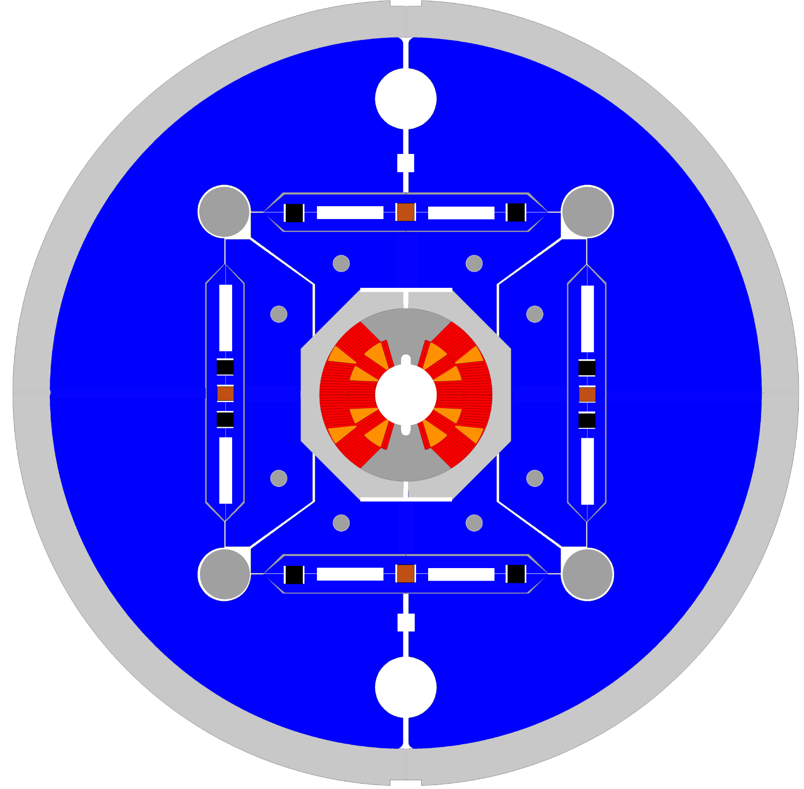

FalconD Cos theta LMK1
Top vertical interference keys in masters
Top loading pad at 45° and vertical gap.
Al-6082 collar pad
Midplane lateral interference keys
Al-7075 Alu structural ring, OD630mm
Iron yoke tailored stiffness
MSC-SMT N.Sala, A.Foussat

Slide 6
Main design features
Keys positions optimized for load transfer ratio between vertical pole and horizontal mid plane (1:3) wrt coil stress
Alu spacer collars across the 2 coils mid plane – Capability of shimming 0.3 mm radially to compensate coil deviation
Two yoke halves for dipole, give mechanical assembly reference geometry .
Asymmetric design of load pads, gap management not to overload coil poles.
Sequential loading of H and V loading with different openings: keys interference up to V: 0.15 mm, Lateral H 0.45 mm. At the end of sequence, early structural relax on lateral keys to reduce overshoot.
Use of master (Armco) and bladder/keys preassembly, centering of coil to pads in mid plane, auto centering in vertical plane. Gap management to half yoke.
Limit hyperstaticity in first mechanical assembly. to study main geometrical coil compensation features;
  to align and center only masters to coil,
  centering wrt to yoke only through components tolerancing ( gaps design in vertical split)

Slide 7
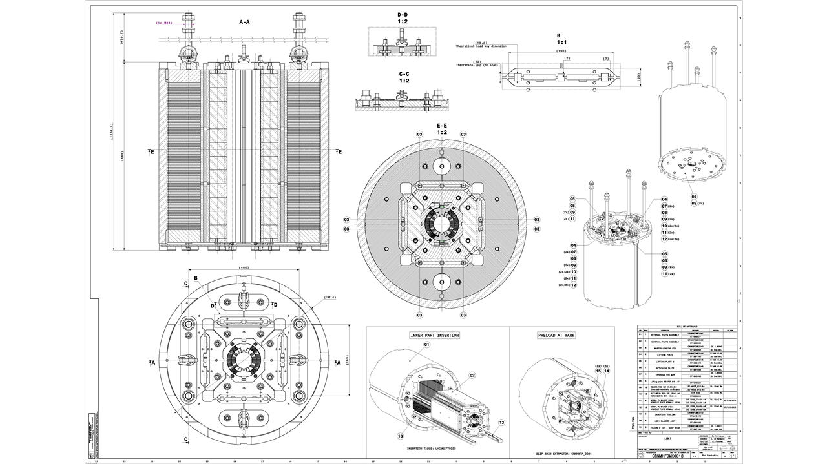
LMK1 assembly PLM CAD model
CRNMHFDMK0013

Slide 8
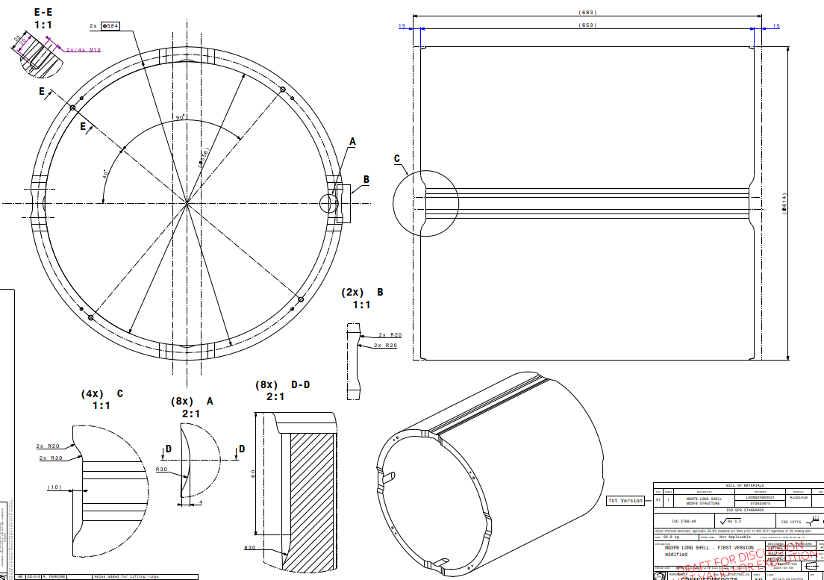
Al-7075 long shell (old QXF design mod.)

Slide 9
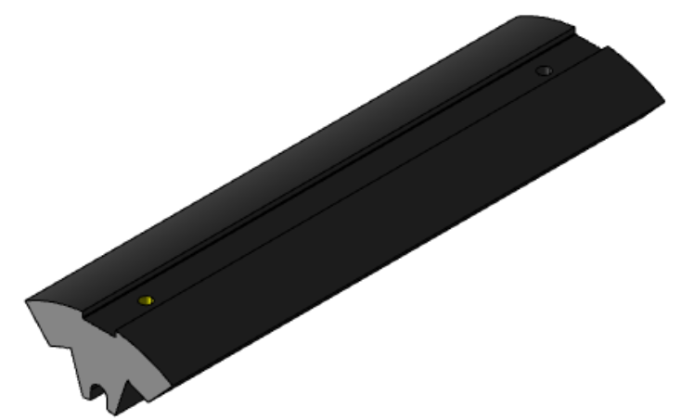
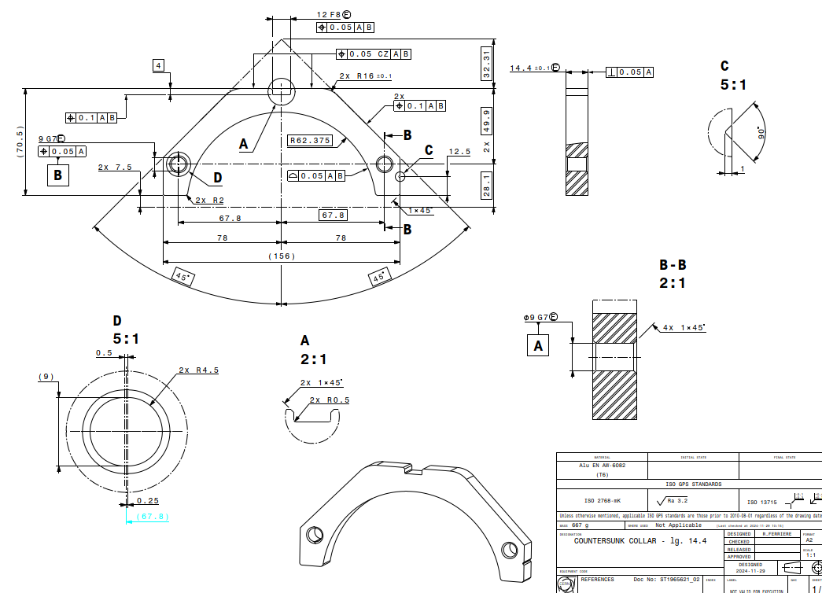
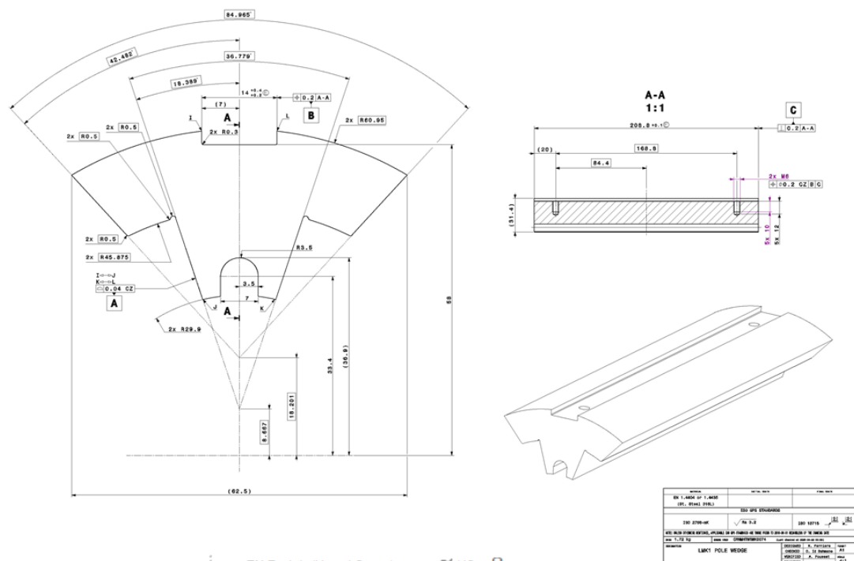
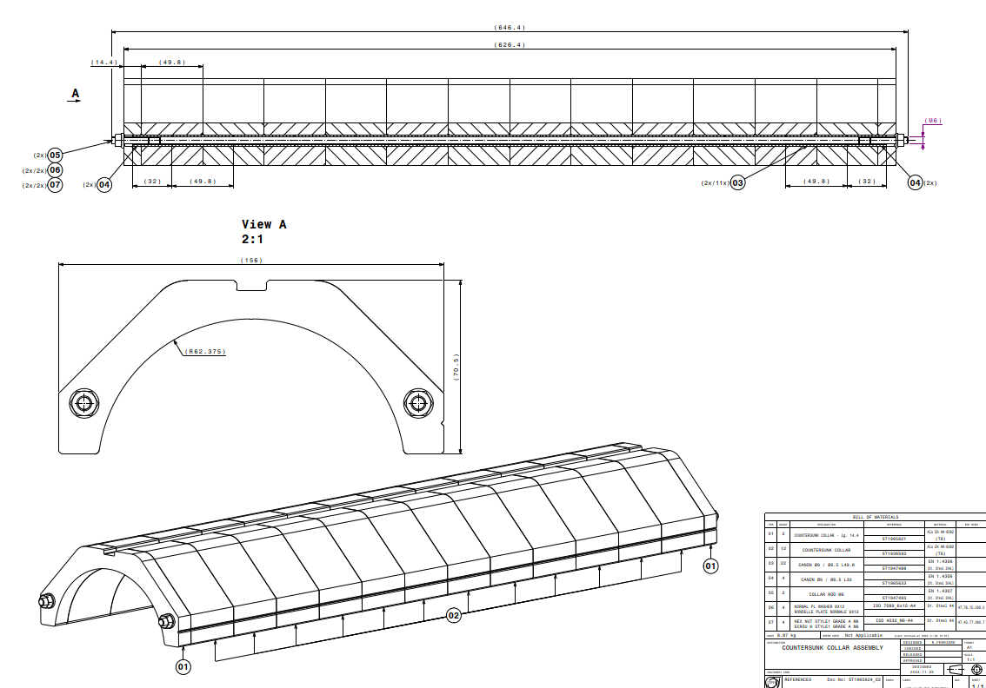
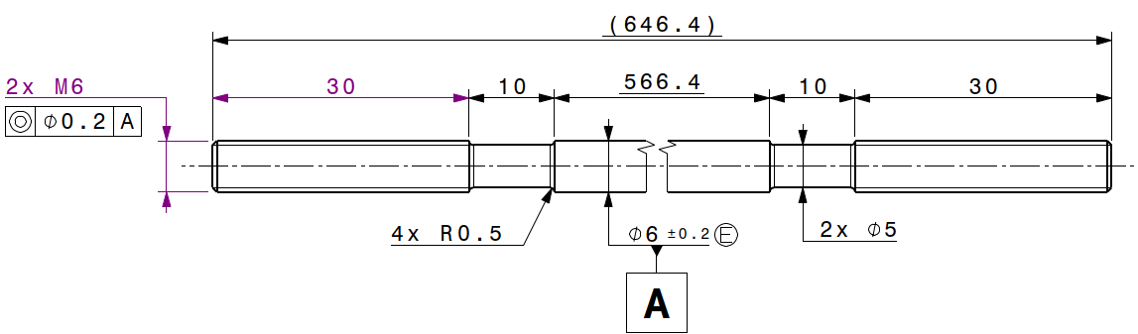
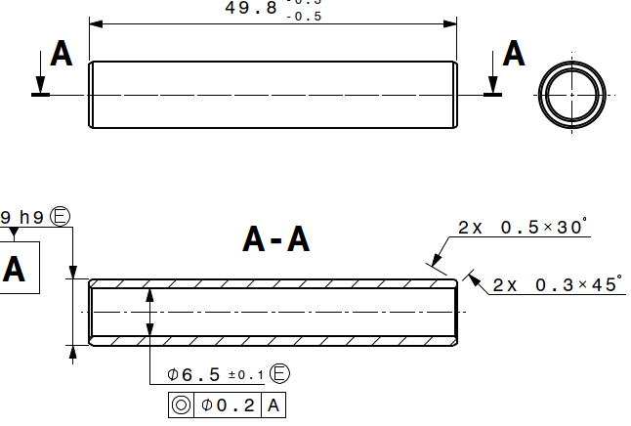
Alu collar pads, central SS poles

Slide 10
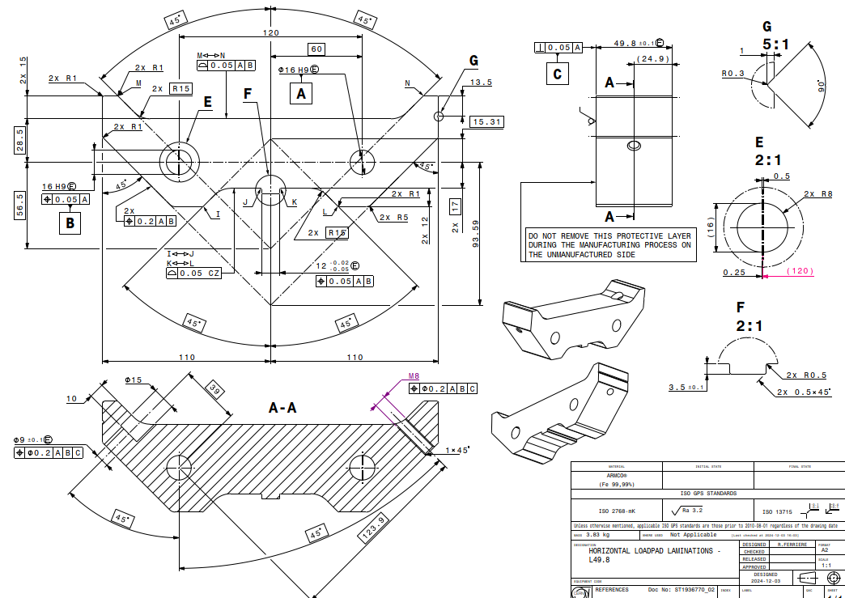
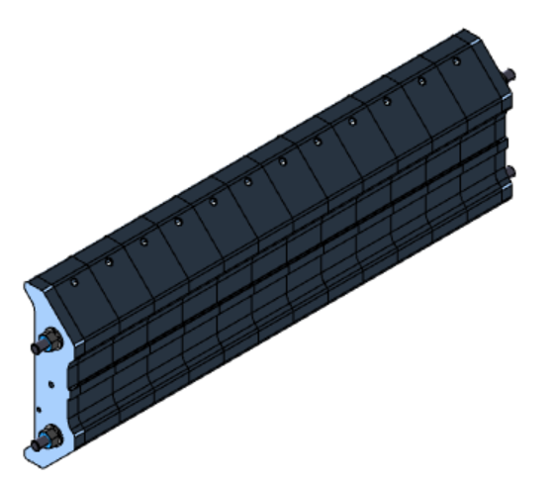
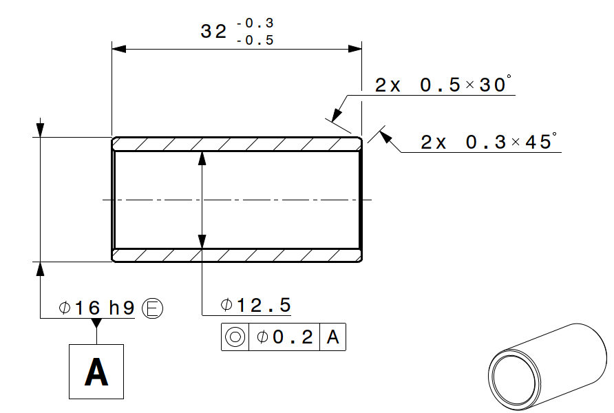
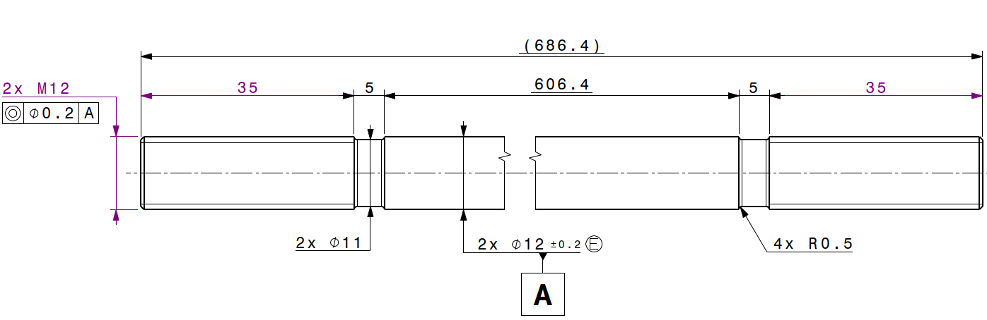
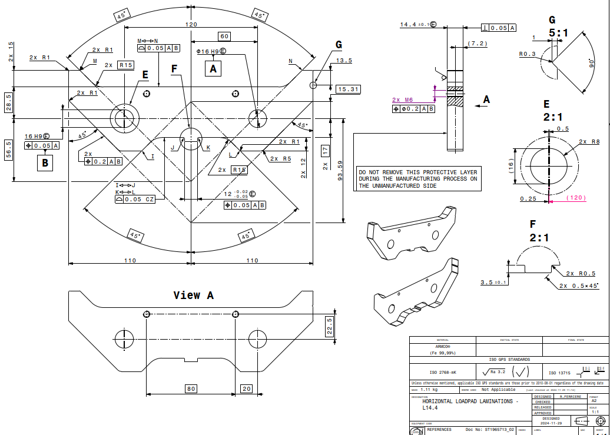
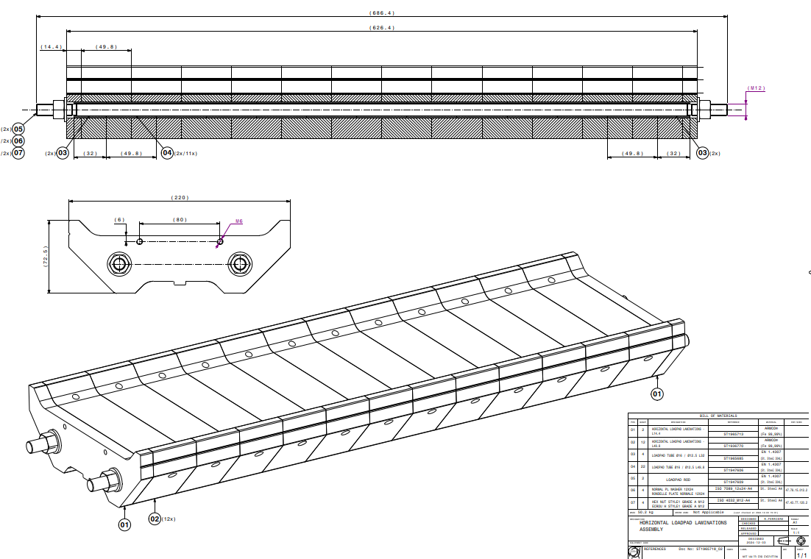
Horizontal load pads

Slide 11
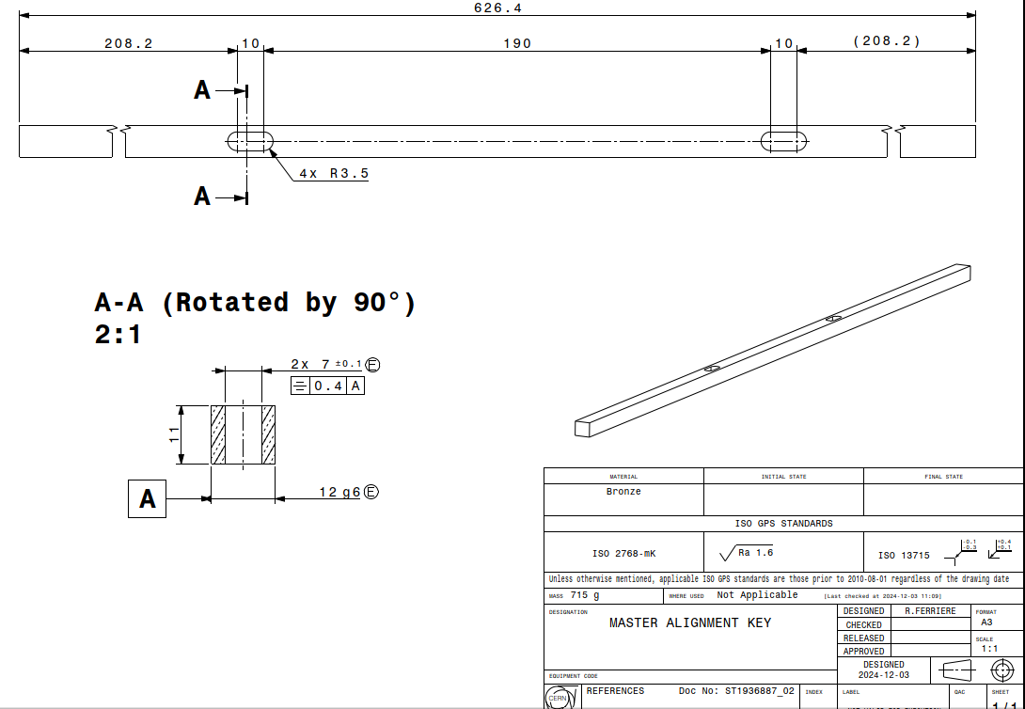
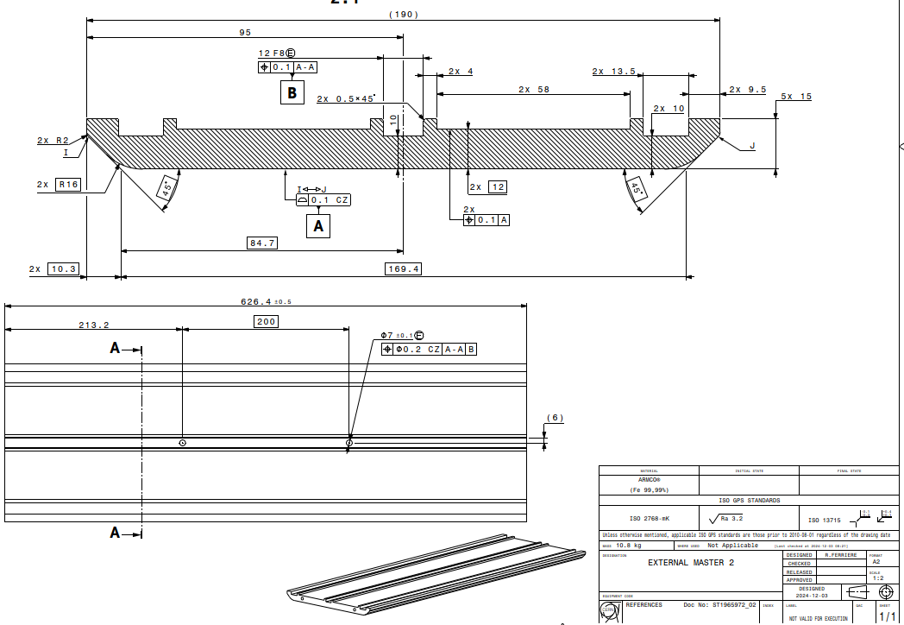
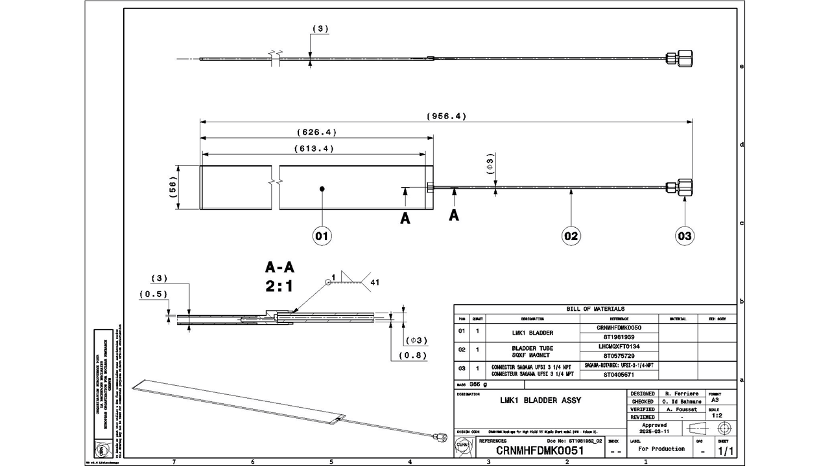
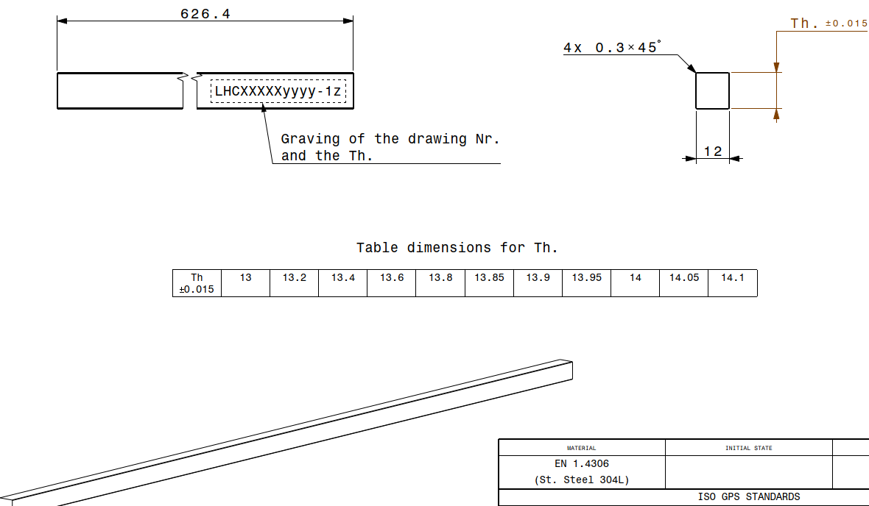
Masters, bladders, alignment keys

Slide 12
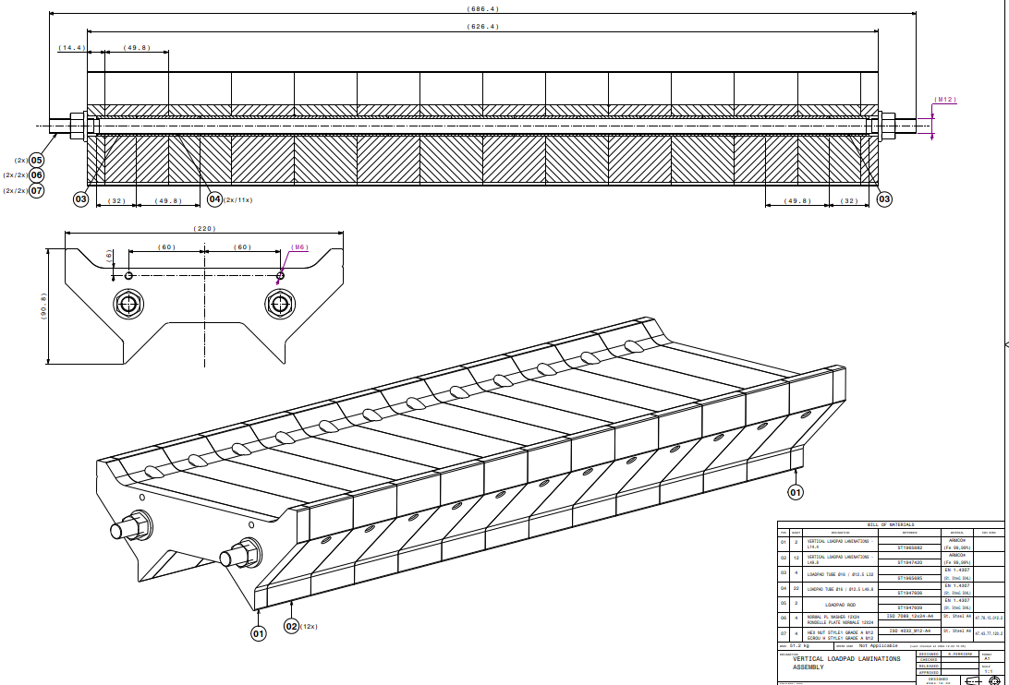
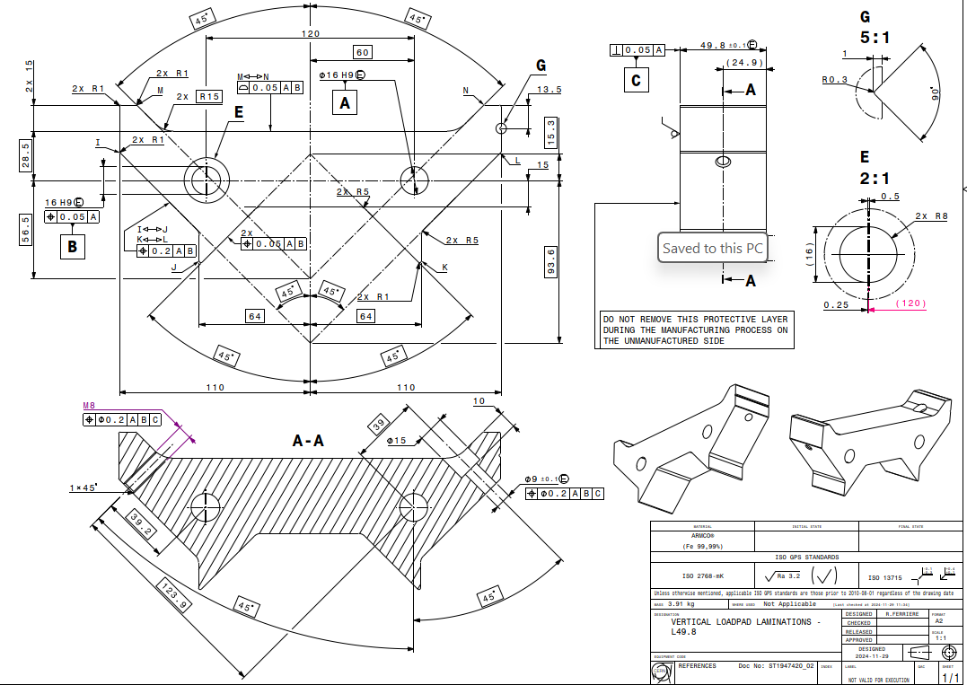
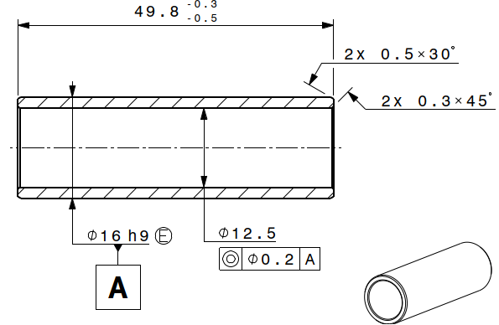
Vertical load pads

Slide 13
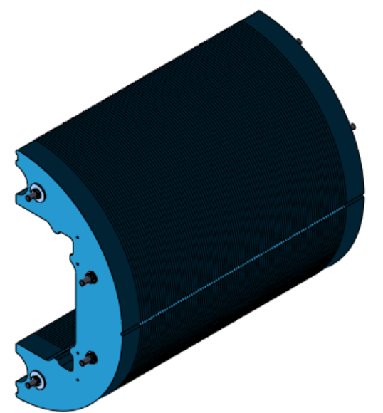
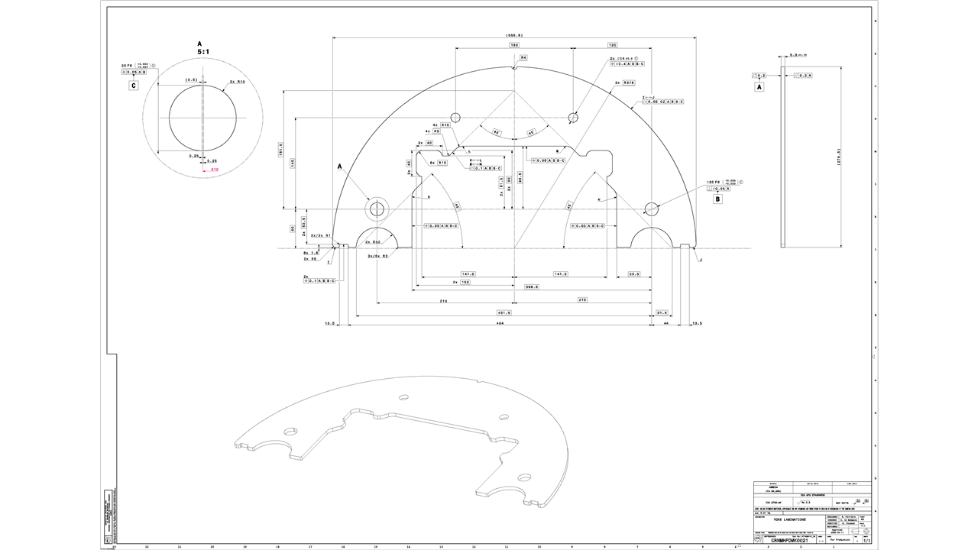
Yoke halves
2 halves yoke dipole assembly, lamination 5.8 mm thick

Slide 14
Procurement status
LMK1 components under procurement: April-Sept 25
  Alu shell QXF ( old design ) modified to remove sharp angles, checked fracture FAD load margin
  11T coils section cut, CMM done, shimming plan in progress
  GI + shims layers for production (927)
  Load pads H, V under procurement ( CERN main workshop),
  Rods, pins, alignment & interference keys in progress bladders done ( CERN main workshop)
  Insertion rails in procurement, alignment and V-support in completion

Slide 15
Pending procedure, items design
Global sequence kinematic document
Ancillary support, insertion indexing alignment
First assembly Fuji paper trial, shimming plan
Detail structure preloading, assembly procedure
Next
M1 structure FE design – 2D model update, X section, 3D axial ends preload
FQ impact from mode of geometrical possible deformation

Slide 16
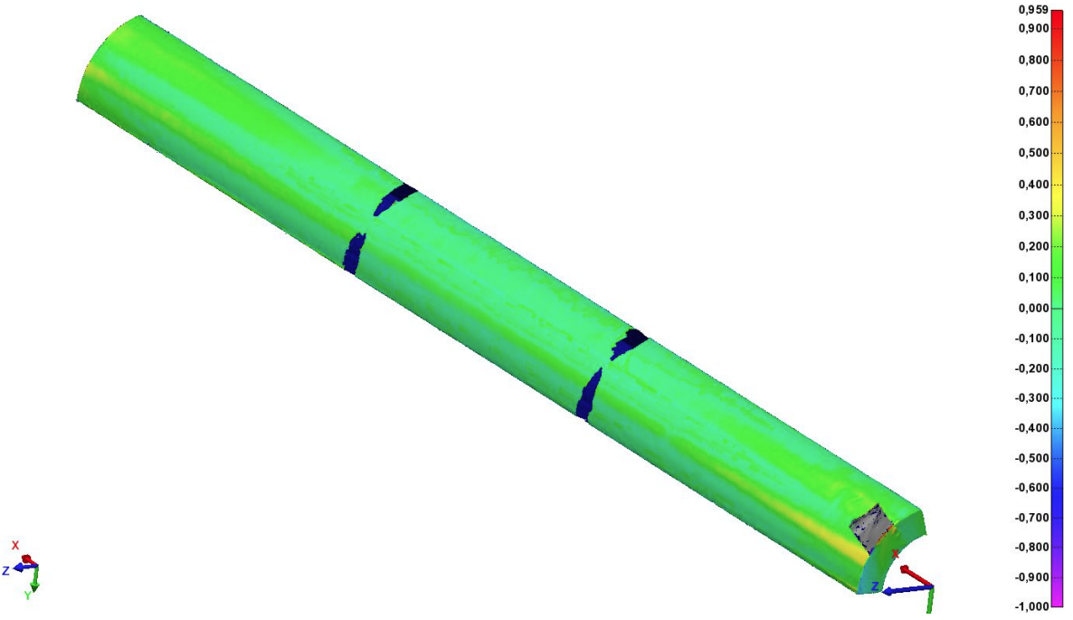
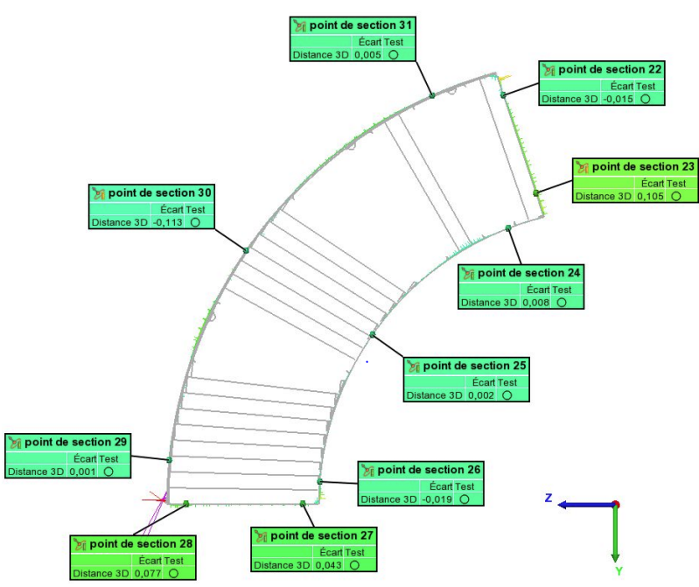
CMM of LMK1 11T coil sections: 6-1 (inner layer example)
smaller by 100
microns
larger by 100
microns
larger by 60 microns
20 May 2025

Slide 17
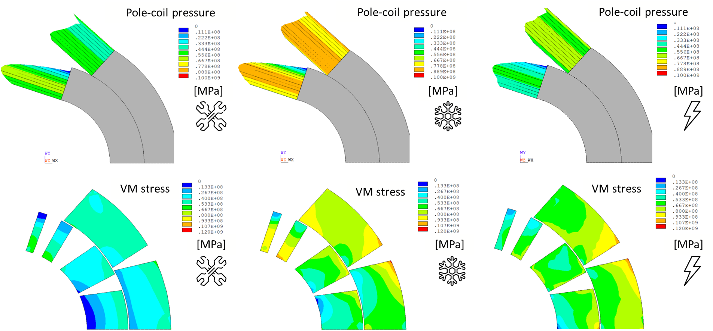
Structural analysis outcomes
Presentation at SMT by N.Sala last 11st March 25, (event/1521630/)

Slide 18
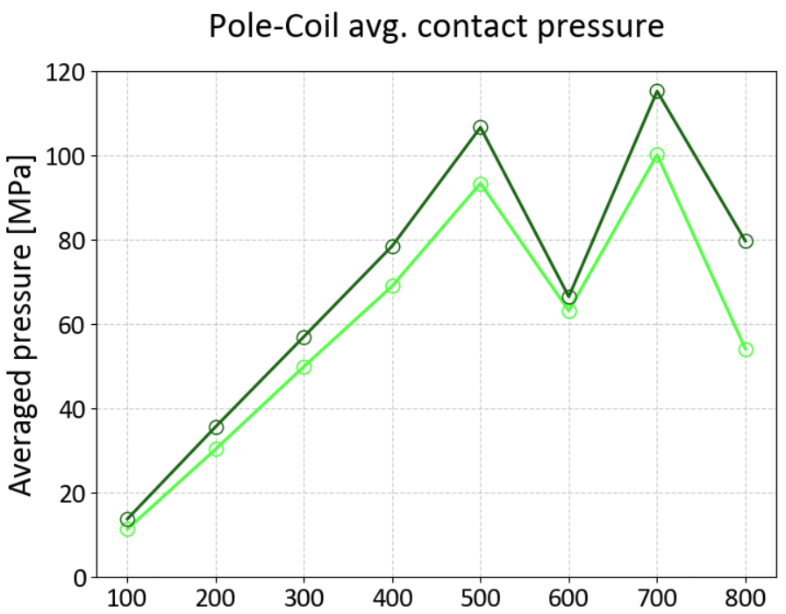
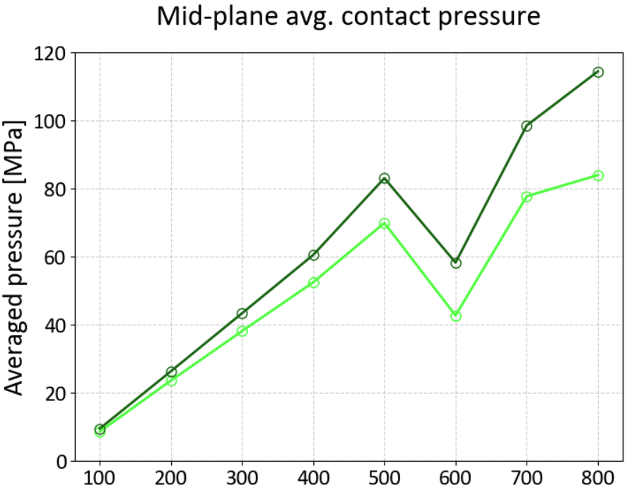
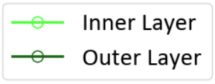






Preloading coil layers stress
Overshoot
Overshoot
Nominal
Nominal
Lateral Interference [$μm$]
Lateral Interference [$μm$]
SMT – N.Sala

Slide 19
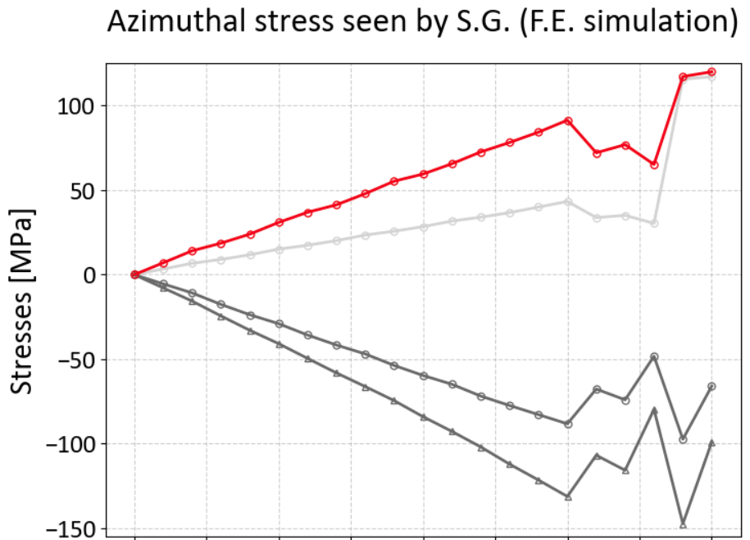
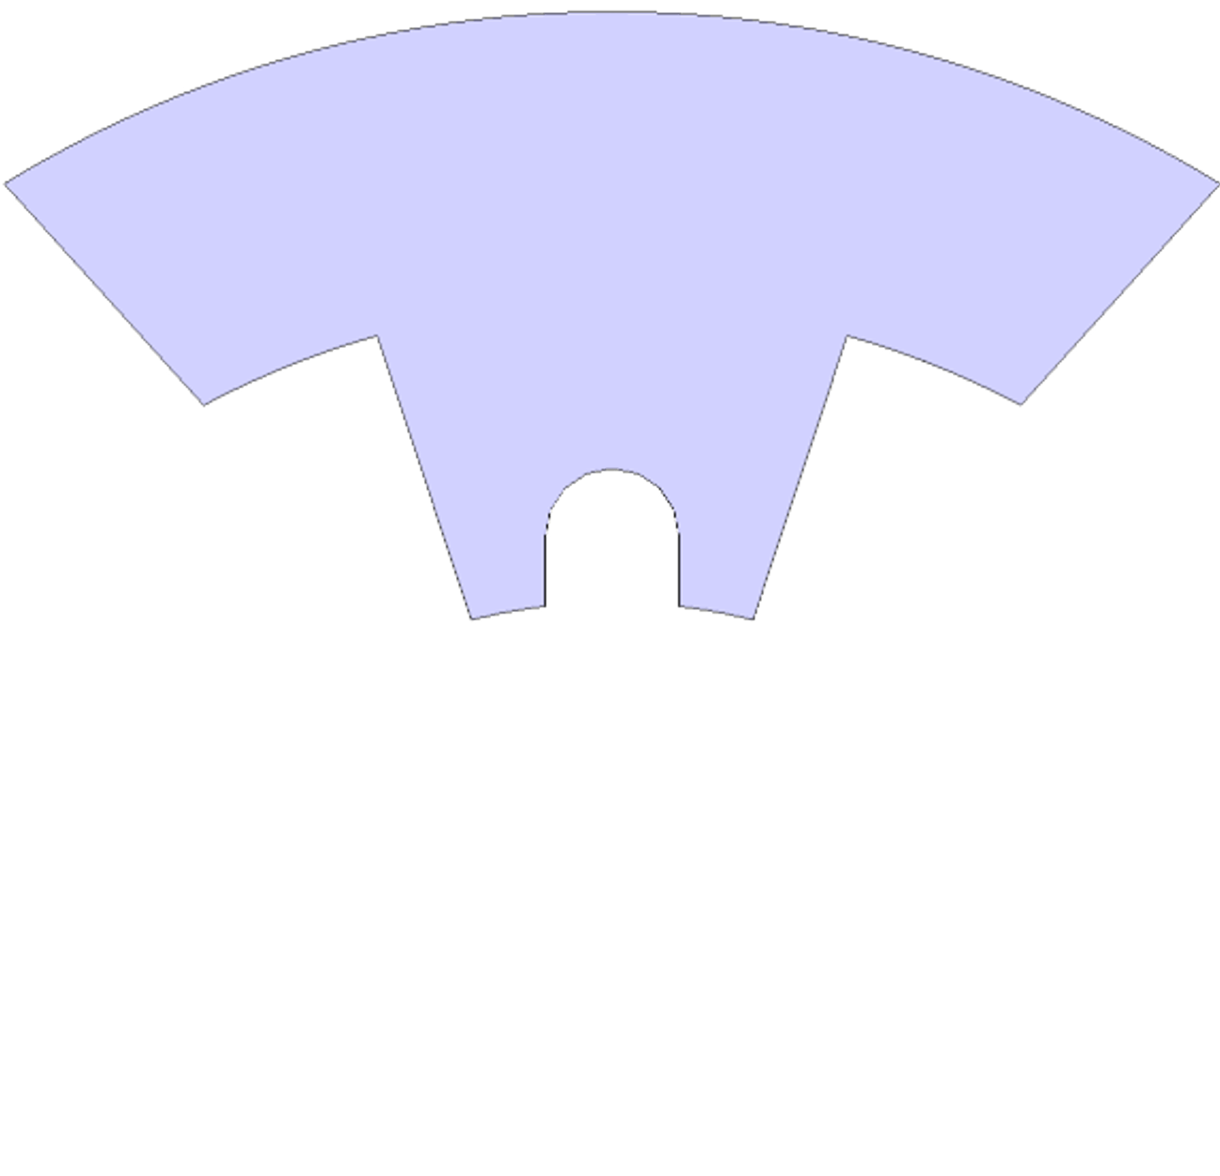
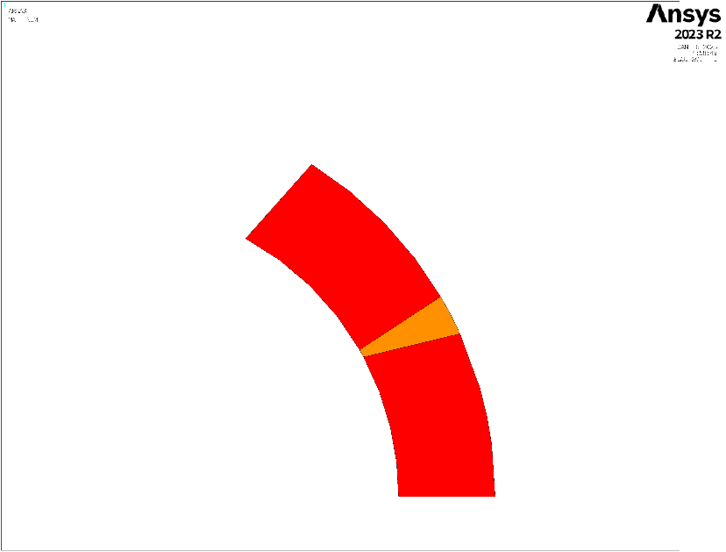
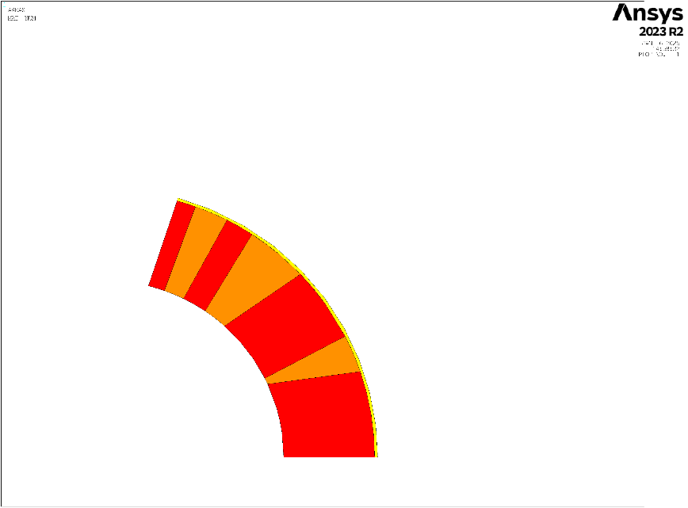
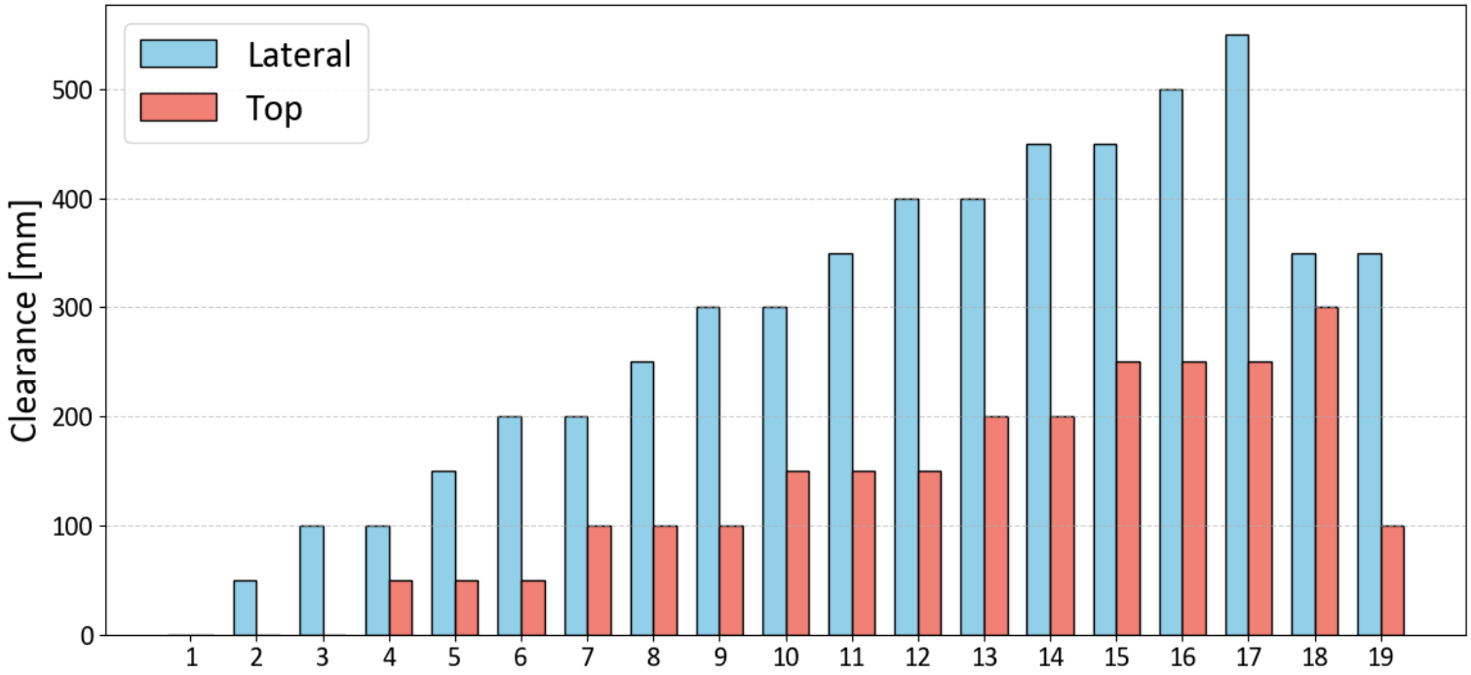

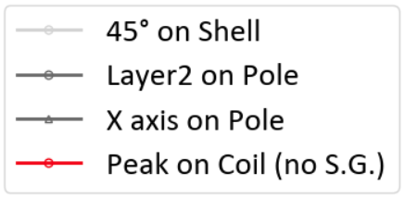
Azimuthal stress – preload steps
Structure relaxed on lateral keys

Slide 20
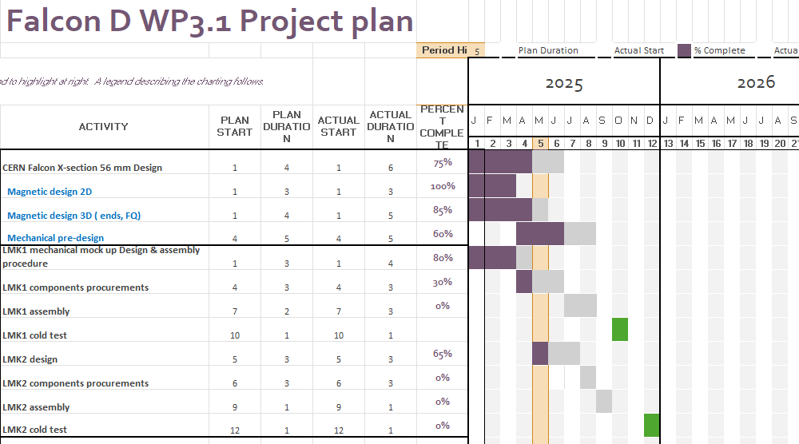
LMK1-2 Schedule

Slide 21
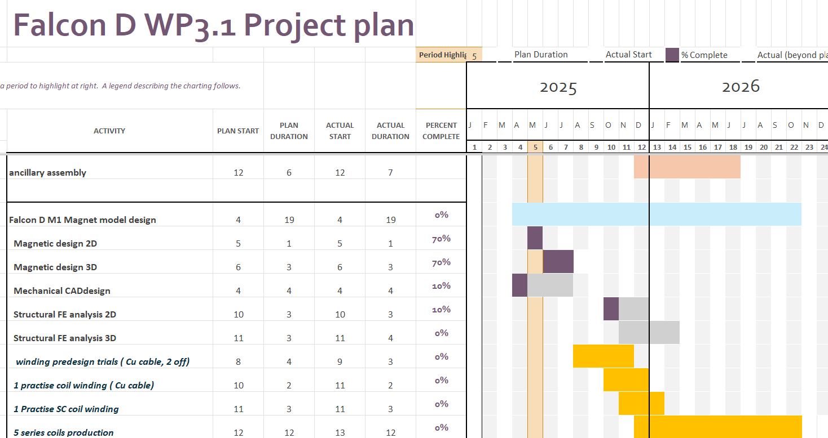
Falcon schedule
- Trial windings shifted to Aug-September 25

Slide 22
LMK1 assembly
B&K assembly of coil pack
  11T coils sections + Alu pads
Preassembly of 2 halves yoke in shell
Insertion of coil pack in yoke
Preloading bladders, insertion of keys
  2 hydraulic circuits : H&V
  Interference up to H: 0.35 mm, V: 0.2 mm

Slide 23
Procurement work LMK 1,2
LMK1:
  All in-structure components under production : Pads, keys, masters, alu pads, poles by July 25
  Coils layers sections done,
  7075 Alu shell done, bladders produced, under instrumentation
  All GI sheets, shims pending, in 927
  Interlayer to be produced in 927 by July 25
LMK2: under design,
  316LSS shell available
  Coils section done
  All GI sheets, shims pending, in 927
  Collared pack to be produced , July or september
  Structure CAD Parts in 09/25

Slide 24
LMK1 half yoke assembly
Use of inter half yoke bladders

Slide 25
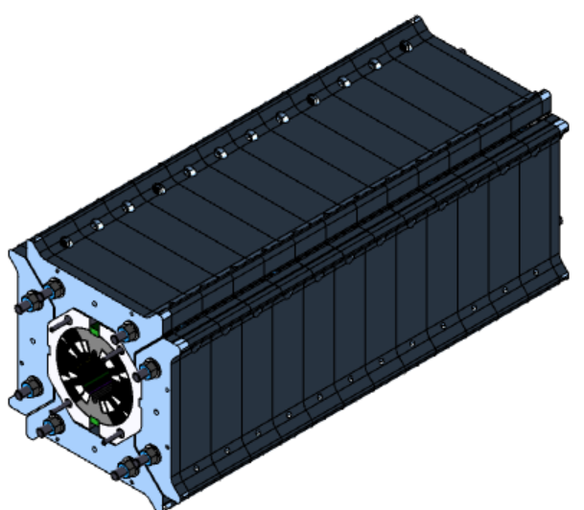
Coil pack insertion in yoke

Slide 26
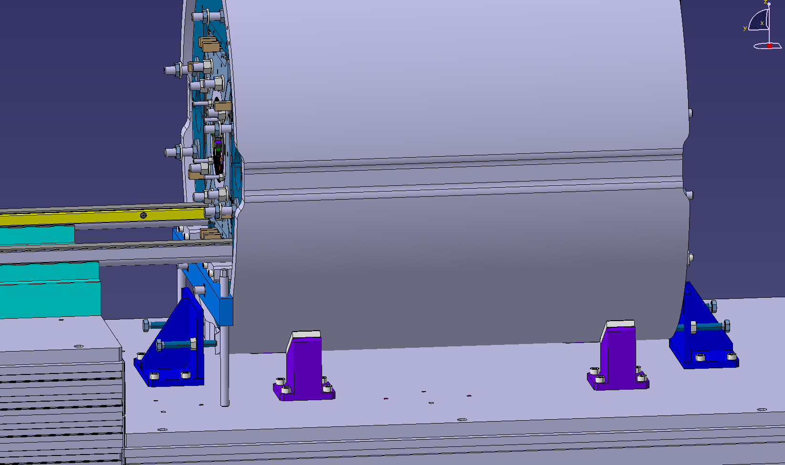
Insertion rails, table, supports
Réhausse rails
Butée longi
Réglage angulaire
Support V
Butée longi

Slide 27
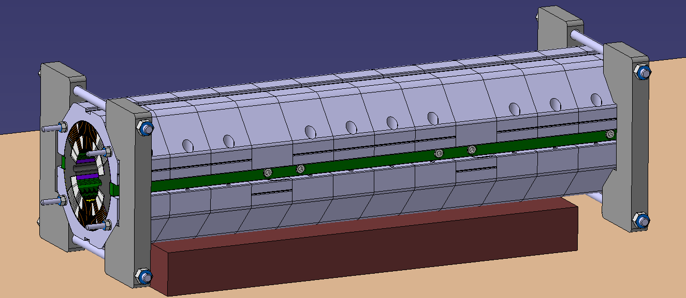
Coil pack pre-assembly
Outillage de
positionnement
Réhausse
Outillage de
positionnement

Slide 28
Table d’insertion
LHCMQXFT0320
Supports shells a definir
Ajout guidage rails sur table

Slide 29
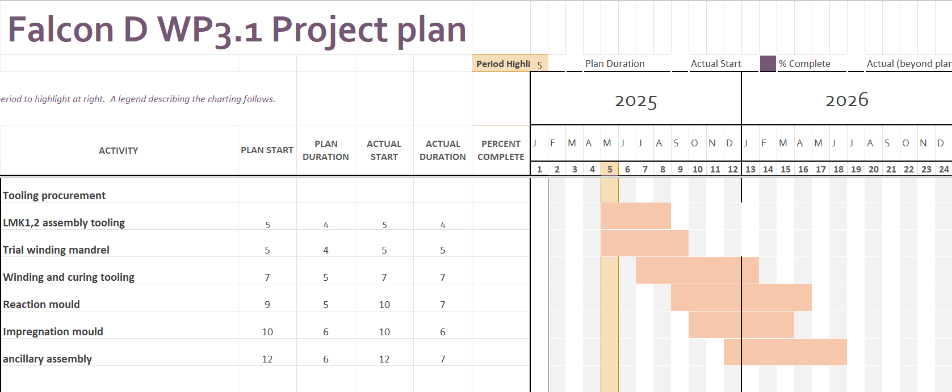
Tooling procurement plan

Slide 30
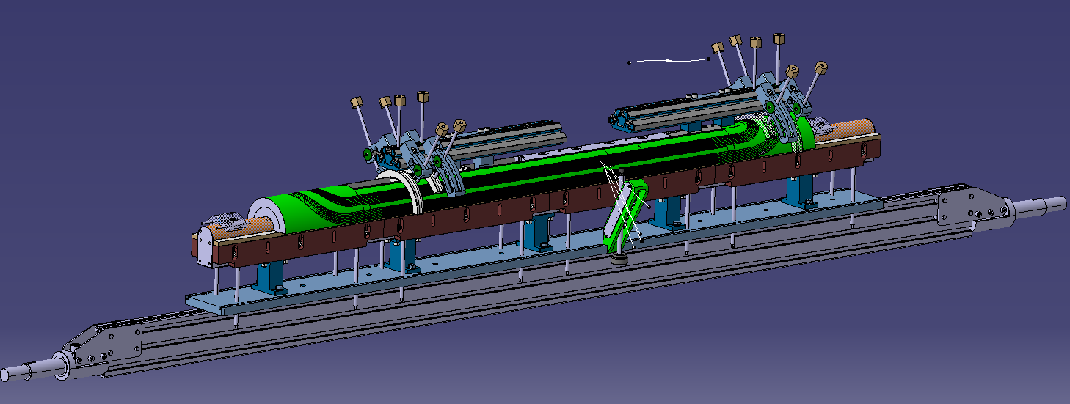
Trials winding intermediate tooling
Simple mandrel for winding trials
Final interface plate, support, clamps tooling
First batch procurement for Sept 2025

Slide 31
Curing press tooling
11T curing mould modified by machining, compatibility with electrical heating supply
Check of mold integration in curing press
Check of central mandrel heater, T-sensors integration
Machining of curing mold, internal shells Fabrication of new Falcon D mandrel - Sept-Nov 2025

Slide 32
Curing press tooling

Slide 33
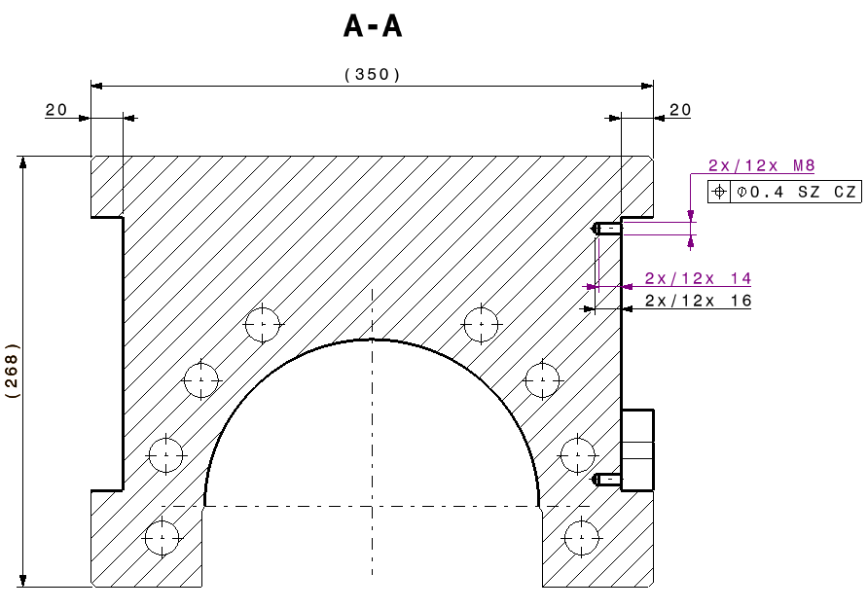
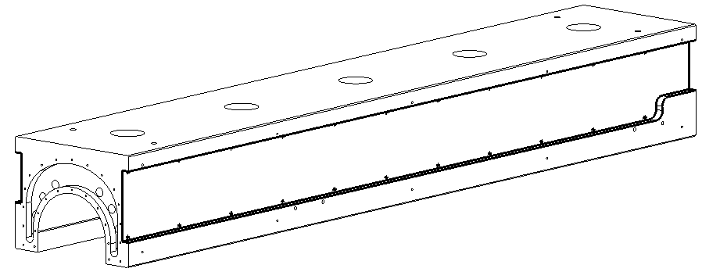

Curing press tooling
CRNMHFDTA0032

Slide 34




Curing press tooling
Chaufferettes
4 chaufferettes type R8,
Dimensions 920x140x8
Charge maxi 6.5 W/cm²
P= 4*92*14*6.5 = 33 488 W

Slide 35

56 mm aperture Falcon D-C coil section

Slide 36




Coil, M1 magnet CAD models

Slide 37
END

