Slide 1

GENERAL ASSEMBLY MEETING 02.2025
18.12.2025 | CERN- GENEVA - Switzerland

Slide 2
TABLE OF CONTENTS
01
02
03
Welcome to the New Scientific Committees
Collaborative Actions and Institutional Partnerships
Presentation of the Newly Elected Presidium & Executive Committee
05
06
04
2026 Annual Event & Open Proposals for the 2027 Symposium
Conclusion
Outlook for 2026 Activities

Slide 3
1
0
Presentation of the Newly Elected Presidium & Executive Committee

Slide 4
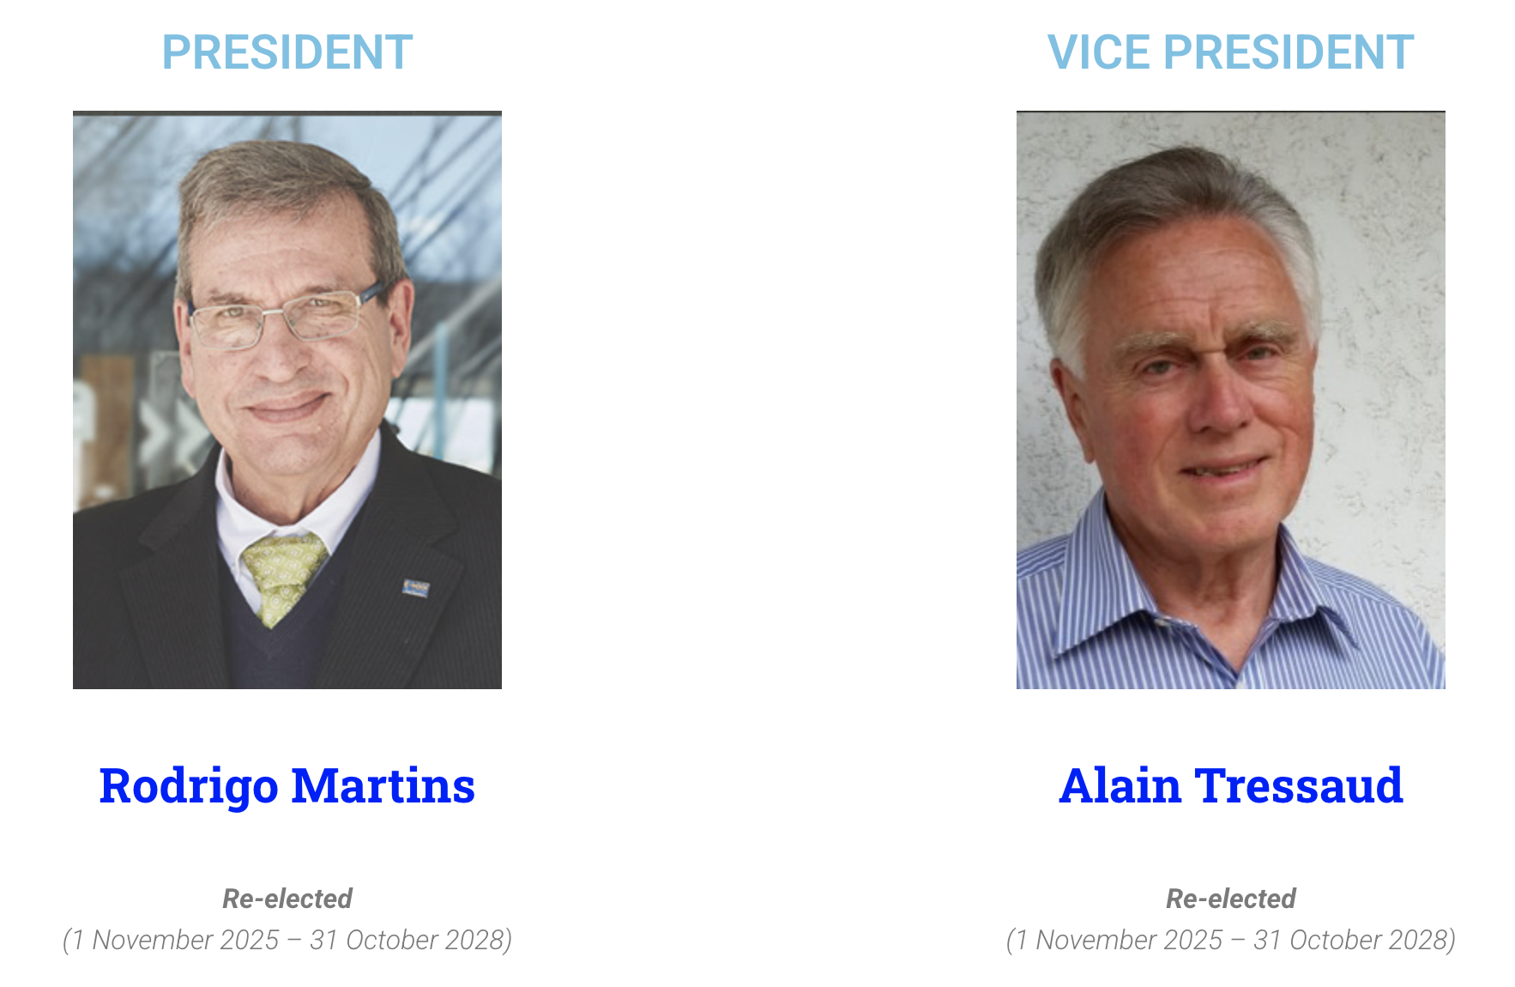
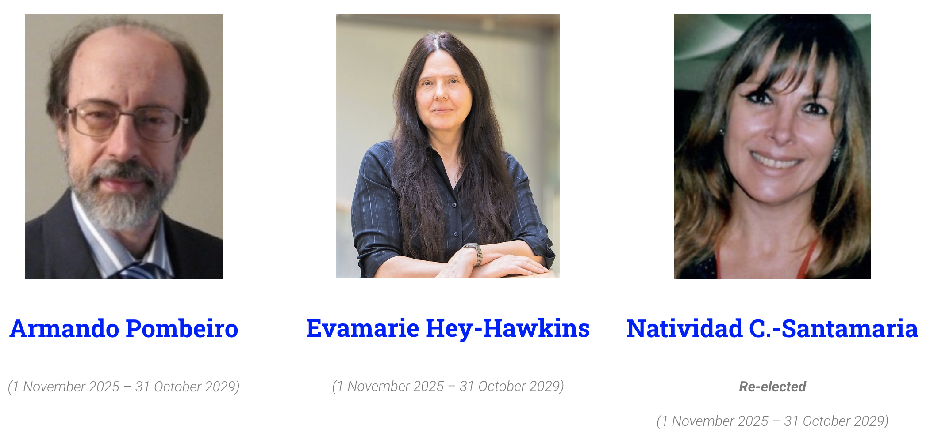
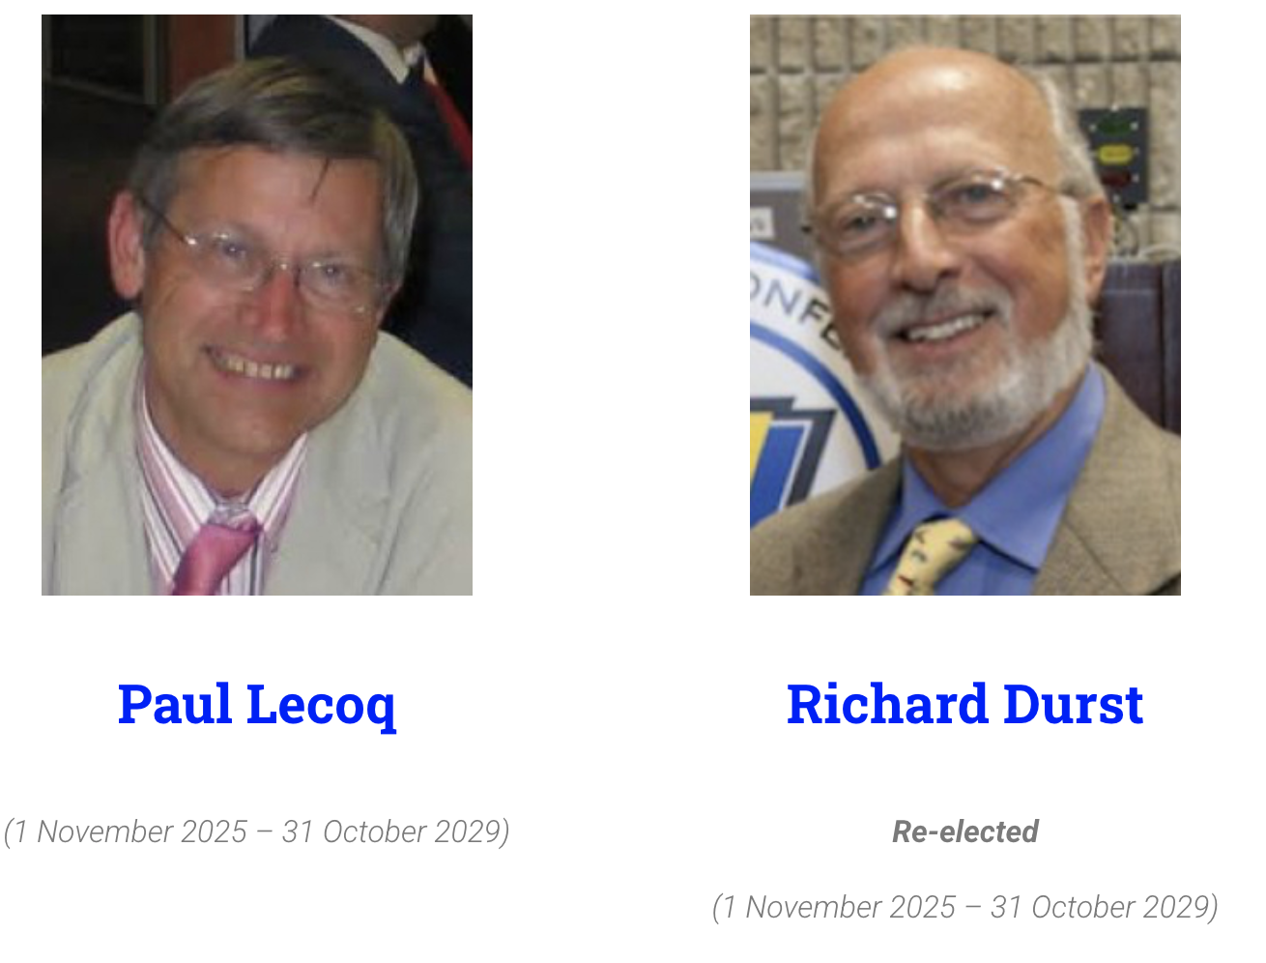
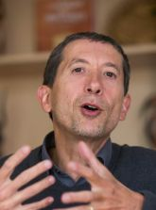

Presidium 2025 - 2029
General Secretary
Notes:
We begin by officially introducing the newly elected Presidium Members for the 2025–2029 mandate. These elections were conducted from 19 September to 8 October 2025.
The new terms officially began on 1 November 2025.
The current composition of the Presidium is:
President: Prof. Rodrigo Martins (re-elected) 2025 - 2028
Vice-President: Prof. Alain Tressaud (re-elected) 2025 - 2028
Presidium Members 2025-2029:
Prof. Armando Pombeiro
Prof. Evamarie Hey-Hawkins
Prof. Natividad Santamaría (re-elected)
Prof. Paul Lecoq
Prof. Richard Durst (re-elected)
We also reaffirm the role of Prof. François Pichault as Secretary-General of the Academy.

Slide 5
Executive Committee 2025 - 2028
General Secretary
Notes:
I’m pleased to present the composition of the new Executive Committee, as validated in the last Presidium meeting. This body ensures the continuity of governance and coordinates institutional priorities between Presidium meetings.
In addition to the President and Vice-President, Prof. François Pichault has been reconfirmed as Secretary-General, ensuring legal, institutional, and continuity oversight.
Prof. Richard Durst & Prof. Natividad Santamaría joins as a core Presidium members, ensuring scientific depth and experience.
This team will serve from 1 November 2025 until 31 October 2028, in line with our Statutes.
We count on their combined leadership to strengthen the Academy’s operations, partnerships, and global impact.

Slide 6
2
0
Welcome to the Divisions
New Scientific Committees
Notes:
We now welcome the newly elected Division Officers, who form the Scientific Committees of each Division.

Slide 7
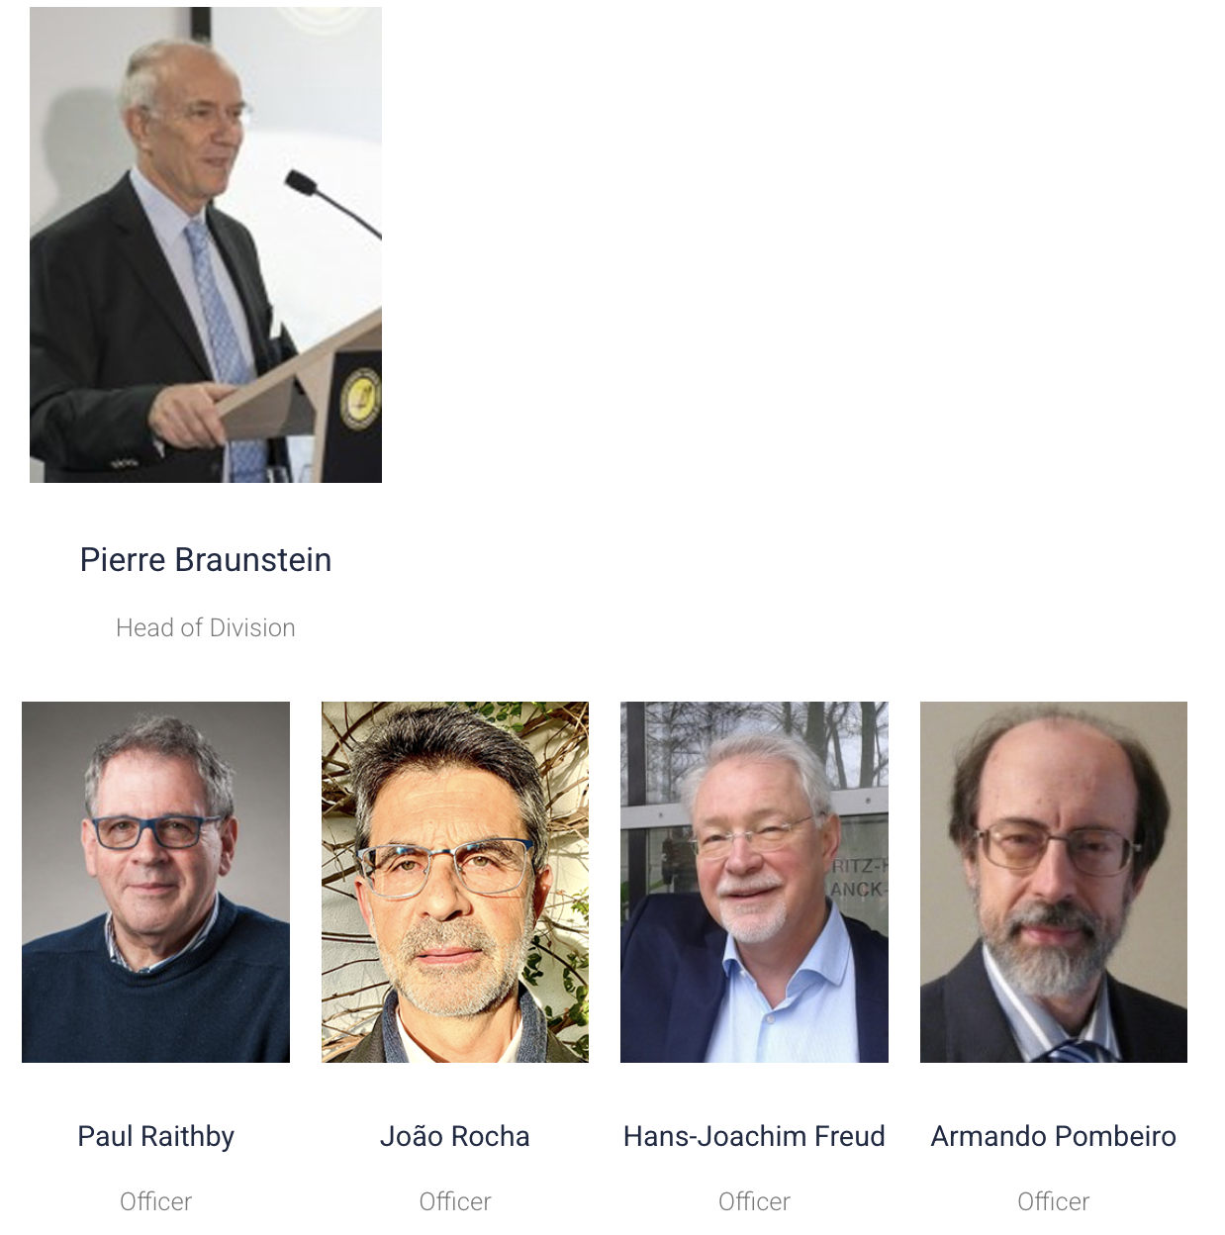
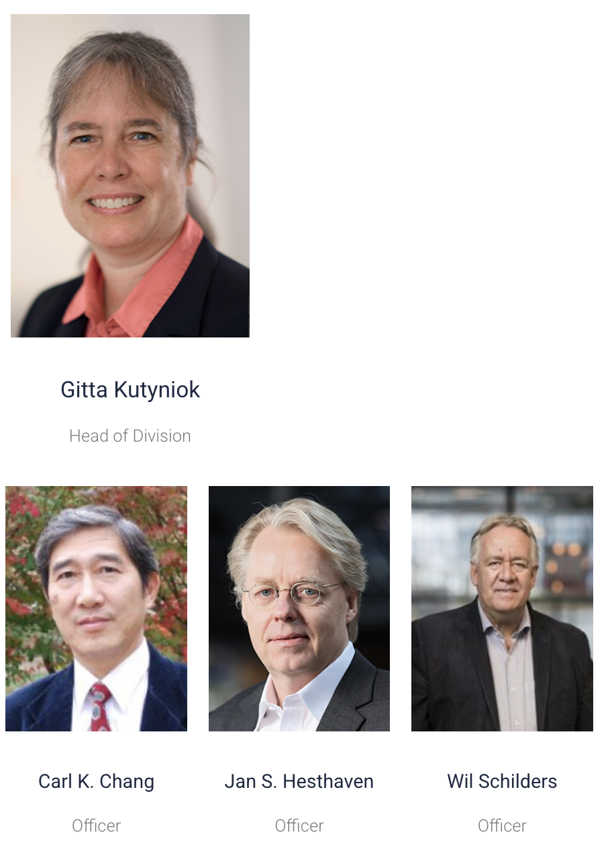
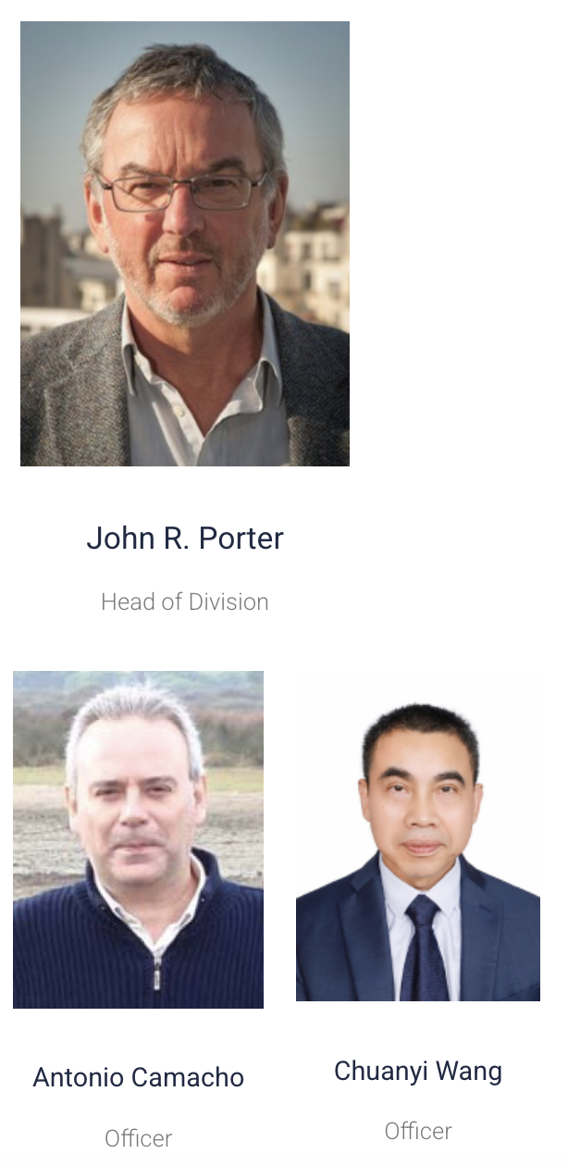
Divisions Scientific Committee
Chemistry Division
Computational & Information Sciences Division
Earth & Environmental Sciences Division
Notes:
These elections took place between April and May 2025.
8 Divisions have now a confirmed Head of Division and up to four Scientific Committee Members, all serving for a 3-year term (May 2025 – April 2028). Note that Earth & Environmental Sc. Division was not able to open elections for Head of Division and as so, in the beginning of 2026 candidatures will open again.
We thank the outgoing Officers for their service and commitment, and we warmly welcome the new teams across all scientific areas.

Slide 8
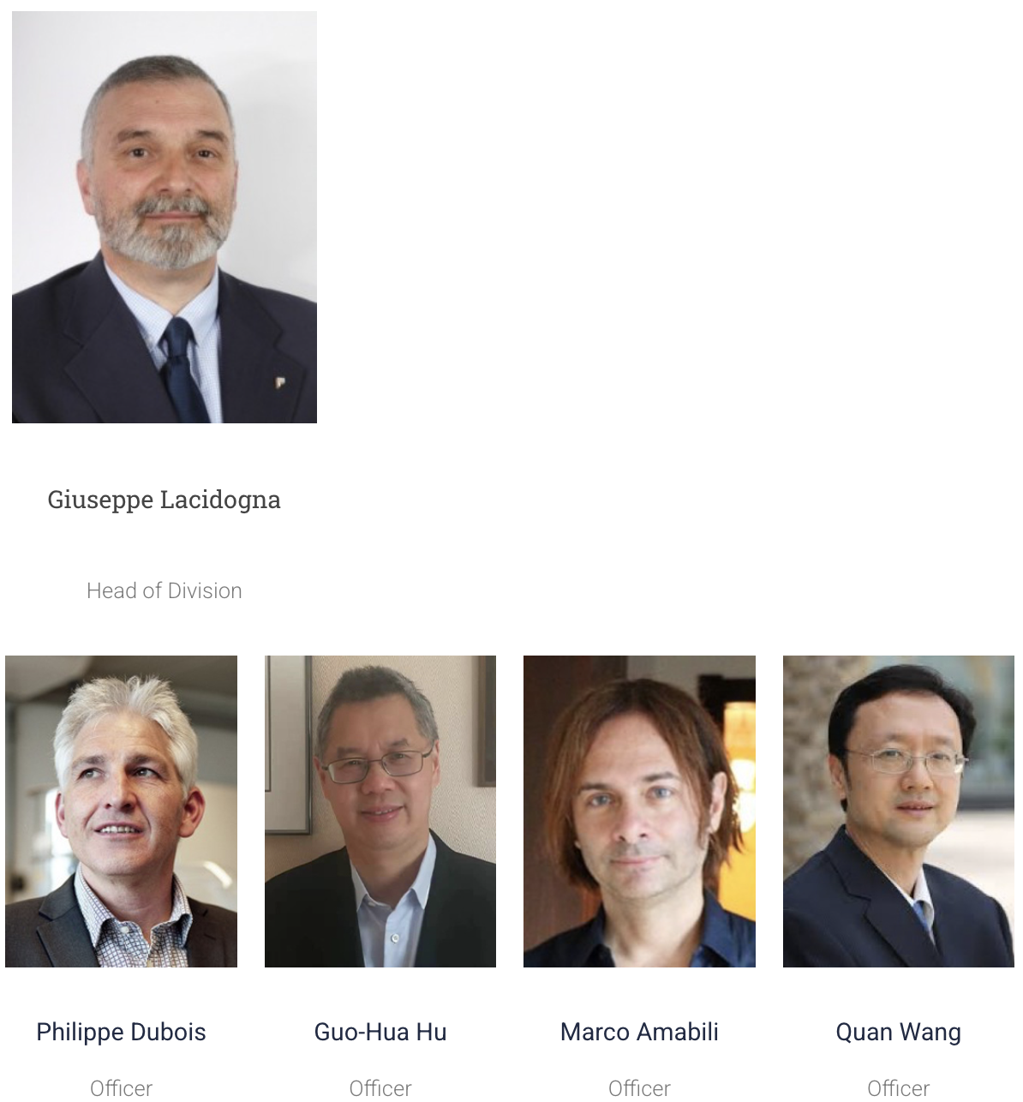
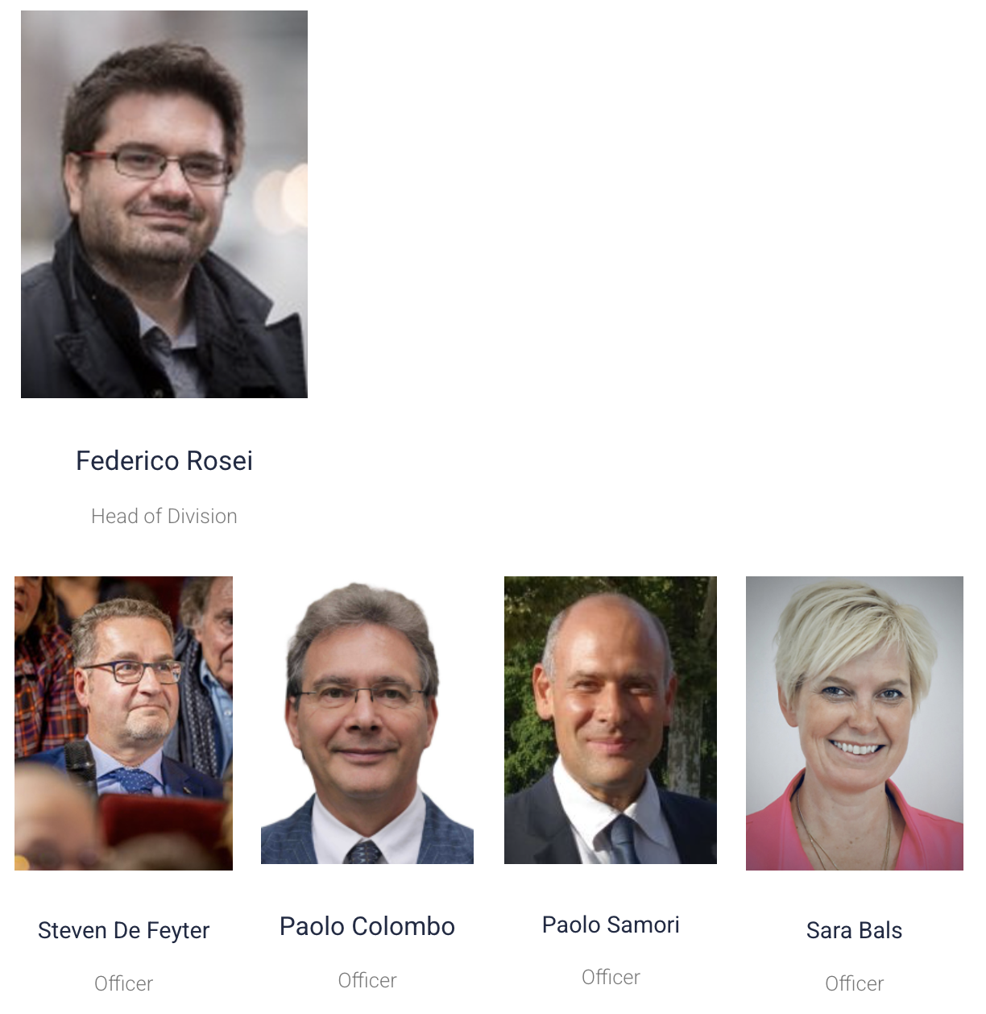
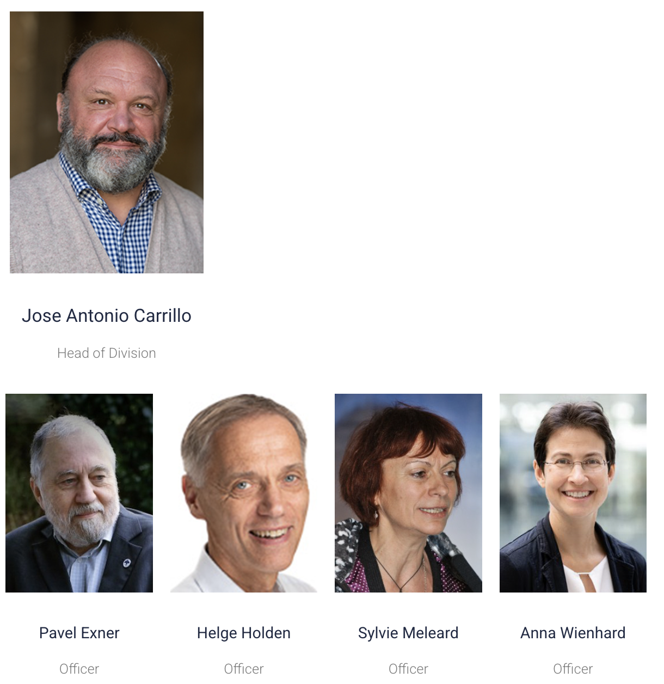
Divisions Scientific Committee
Engineering Division
Materials Sciences Division
Mathematics Division

Slide 9
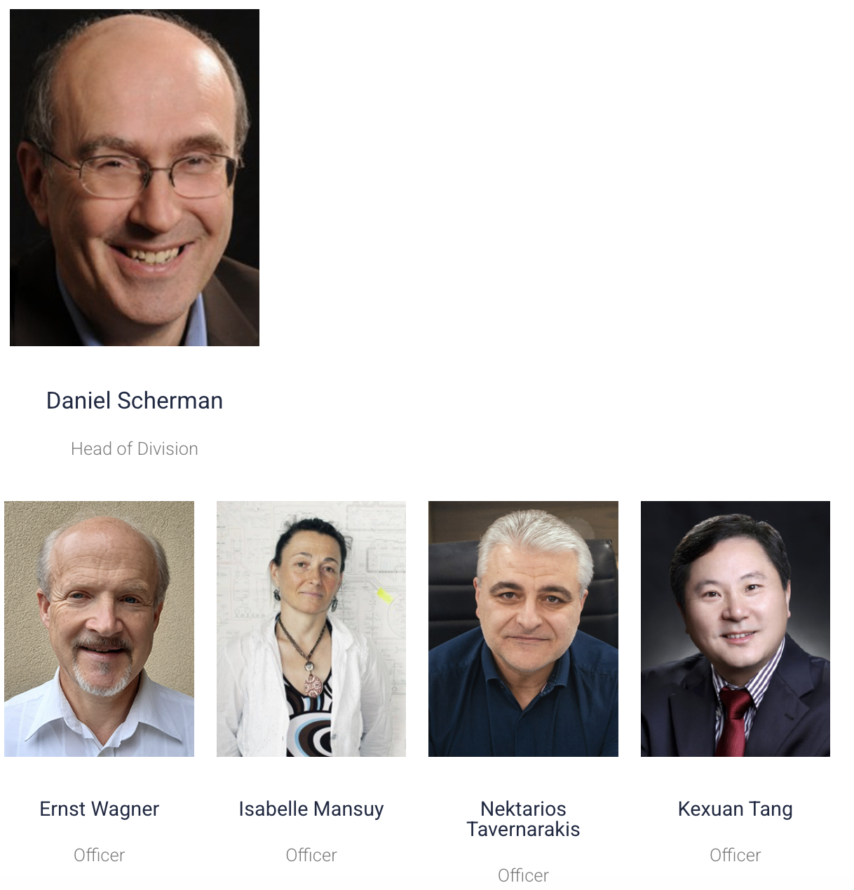
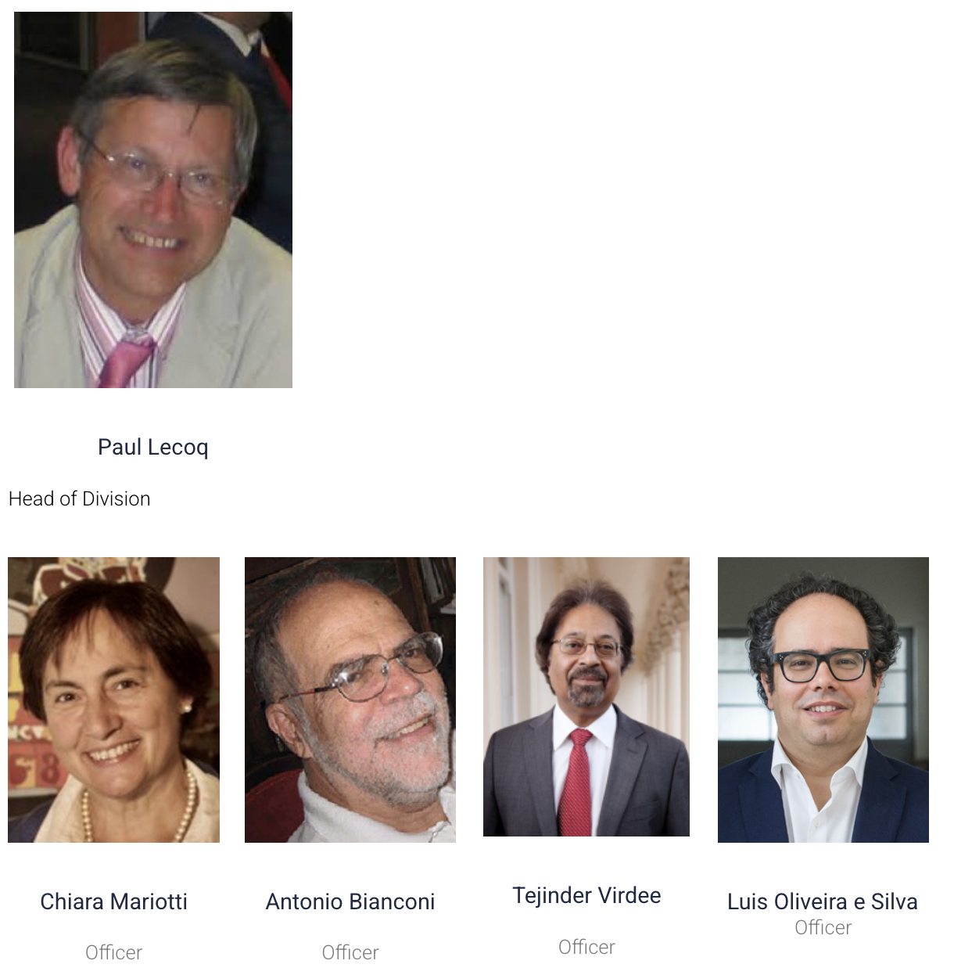
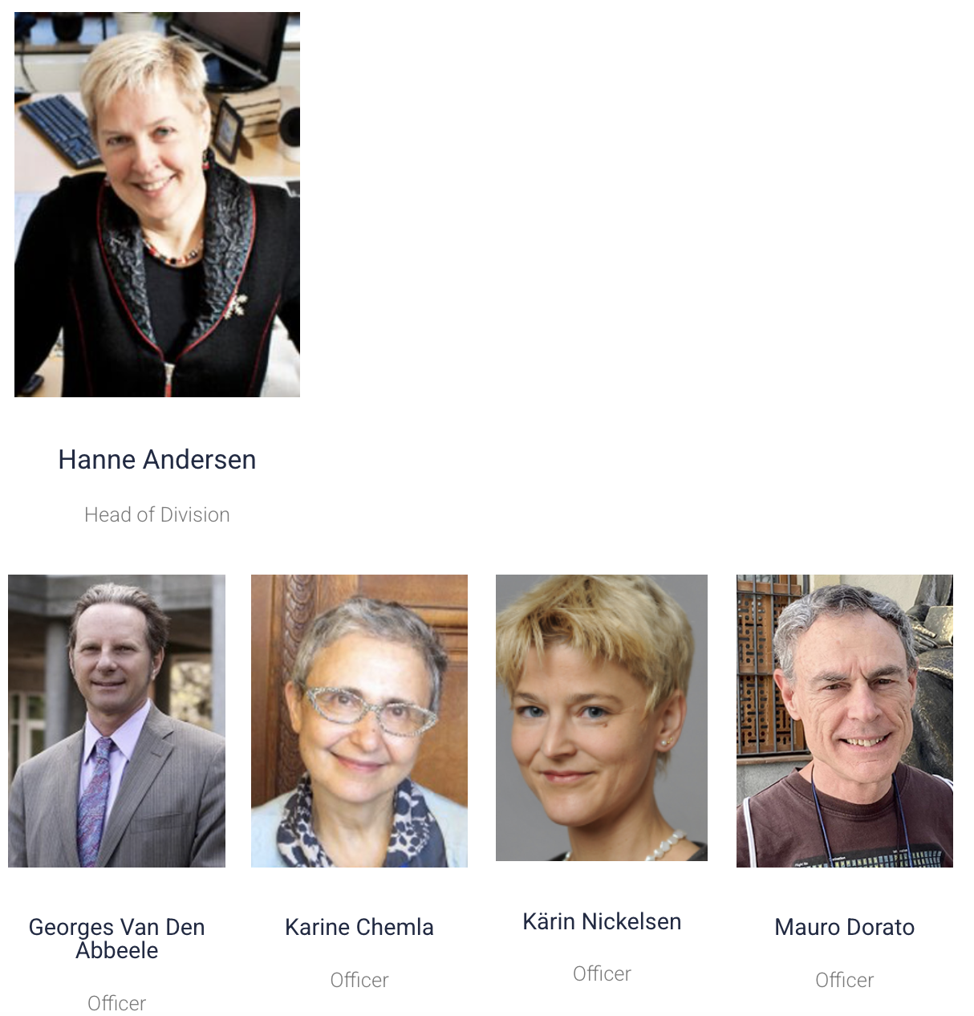
Divisions Scientific Committee
Medicine & Life Sciences Division
Physics Division
Social Sciences & Humanities Division

Slide 10
3
0
Collaborative Actions and
Institutional Partnerships

Slide 11
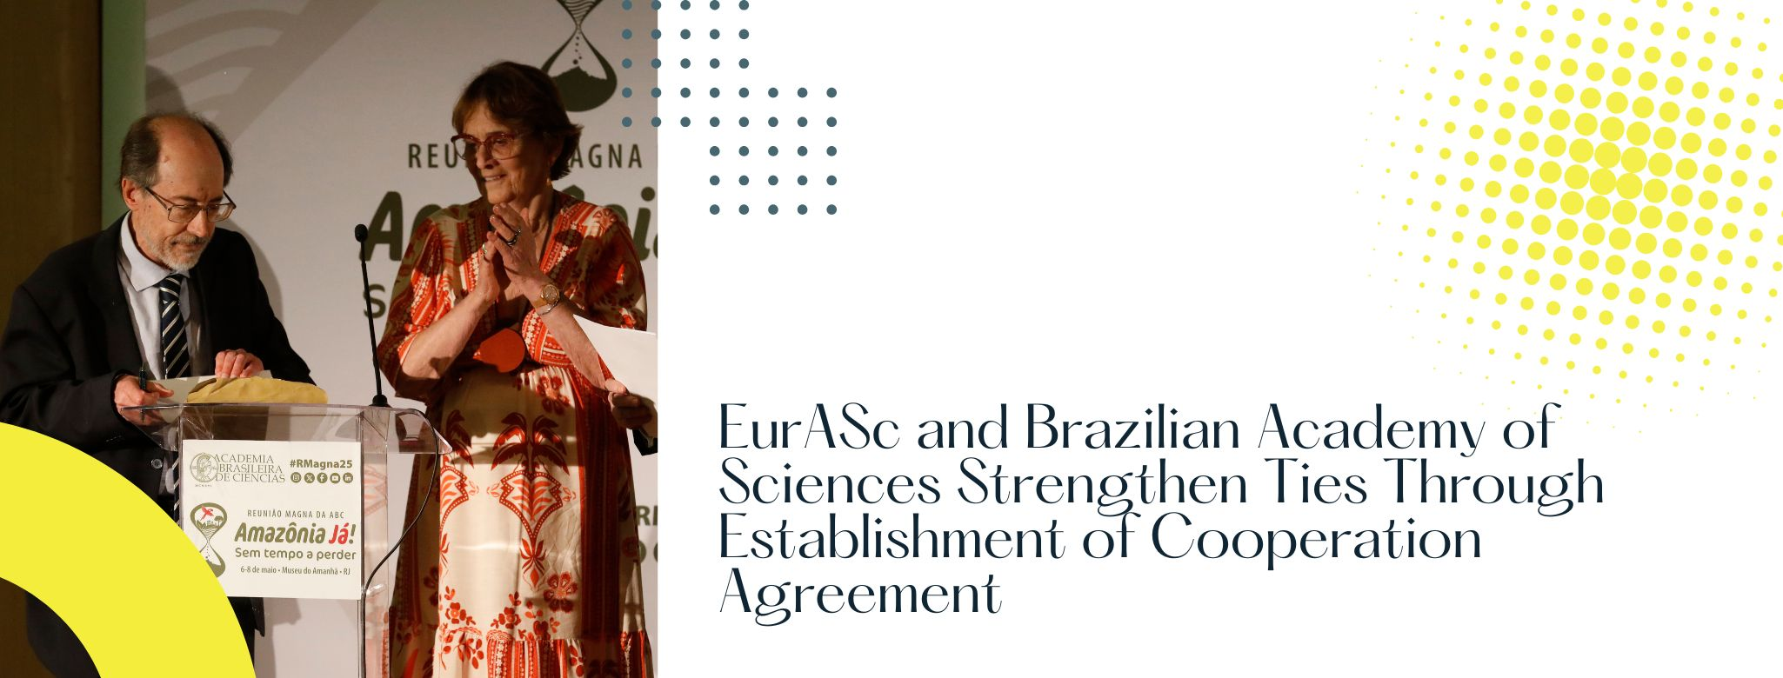
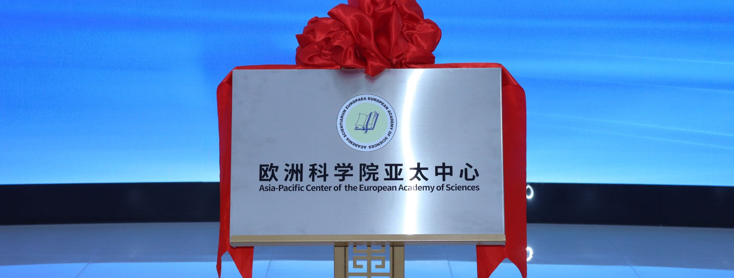




Notes:
This section highlights two priority institutional partnerships currently being developed by the Academy:
Brazilian Academy of Sciences (ABC):
Exploratory discussions are underway regarding potential joint events and scientific exchange programmes.
Hefei Institutes of Physical Science, under the Chinese Academy of Sciences (CAS):
In parallel to their expression of interest in hosting an Asia-Pacific satellite centre of EurASc, we are also collaborating on the FFPOST – Frontier Forum on Ocean Science and Technologies, co-organised every two years since 2020.
The next edition, FFPOST 4, is scheduled for Autumn 2026, to be held in Europe, and EurASc has been invited to submit a venue and thematic proposal.
In this context, Prof. Paul Tréguer has been formally mandated to continue serving as:
EurASc Lead Representative for FFPOST, and
EurASc Focal Point in the IPOS Consortium, under the UN framework for Ocean Science.
We thank him for his commitment and active representation of the Academy at the global level.
Also in 2025, following a proposal brought forward by Prof. Daniel Scherman and subsequent approval by the Presidium, EurASc formally initiated the process to join the InterAcademy Partnership (IAP) — a global network of academies of science, engineering, and medicine. This strategic step is expected to provide EurASc with access to an international community of peer academies, foster collaboration on science policy at national and global levels, support capacity building for advising governments, enable participation in IAP-led projects and leadership structures, and enhance the Academy’s visibility through shared reports, statements, and collective outputs.

Slide 12
4
0
Outlook for 2026 Activities

Slide 13

New Working Groups
Expanding strategic action within the Academy
In 2025, two new Working Groups were officially established:
🔹 Working Group on Diversity and Inclusion
Coordinator: Prof. Evamarie Hey-Hawkins
🔹 Working Group on Inter-Academic Relations
Coordinator: Prof. Armando Pombeiro
These groups reflect EurASc’s commitment to scientific equity, institutional visibility, and international cooperation.
Notes:
The Working Group on Science Communication, established in 2024 under the coordination of Prof. Mioara Mandea, Prof. Katharina Kohse-Höinghaus, and Prof. Shahzada Ahmad, laid important groundwork for strengthening EurASc’s public engagement. Among its deliverables, the EurASc Webinar Series was successfully launched in early 2025 and continues to grow in visibility and impact.
Building on this foundation, two new Working Groups were officially launched in 2025 and will be highlighted in this session. The Working Group on Diversity and Inclusion, coordinated by Prof. Evamarie Hey-Hawkins, and the Working Group on Inter-Academic Relations, coordinated by Prof. Armando Pombeiro, reflect EurASc’s strategic priorities for equity, outreach, and global positioning.
Both coordinators have been invited to share their vision and planned actions with the Assembly.

Slide 14

Project kick-off
Working Group on Diversity and Inclusion
Coordinated by:

Slide 15
Key Challenges
Diversity drives innovation and scientific excellence
Current EurASc membership shows persistent imbalances
  Gender imbalance across most divisions (17.9% women)
  Aging membership (average age ≈ 69 years)
  Geographic concentration in highly research-intensive countries (e.g. only two members from Bosnia and Herzegovina, Bulgaria, Croatia, Cyprus, Hungary, Serbia)
Women, young scientists, and some regions are underrepresented

Slide 16
Strategic Measures
Examples:
Partnerships with regional institutions in underrepresented areas
Targeted outreach to women and young scientists
  Recruitment in underrepresented groups
  Structured mentorship networks
Dedicated support schemes
  e.g. Funding support for early-career scientists
  Awards, visibility, and recognition programs
Inclusive website, social media, and webinars
…and more

Slide 17

Conclusion
Diversity strengthens scientific excellence
Inclusion ensures innovation and sustainability
EurASc can lead by example globally

Slide 18

Project kick-off
Working Group on
Inter-Academic Relations
Coordinated by:

Slide 19

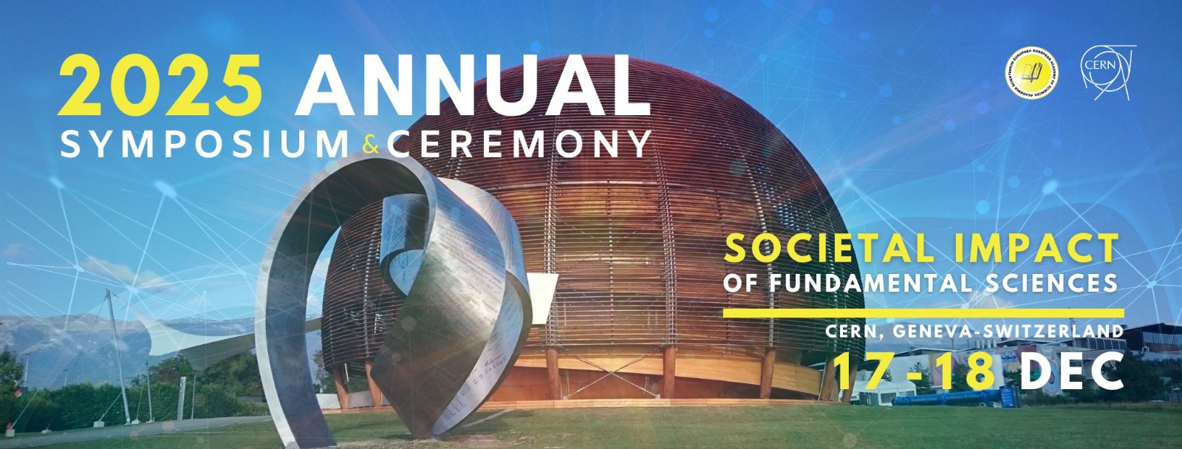
EurASc Inter-Academic Relations Group
Project kick-off: why, what, how
Coordinator: Armando Pombeiro
EurASc General Assembly, December 18th, 2025
1

Slide 20
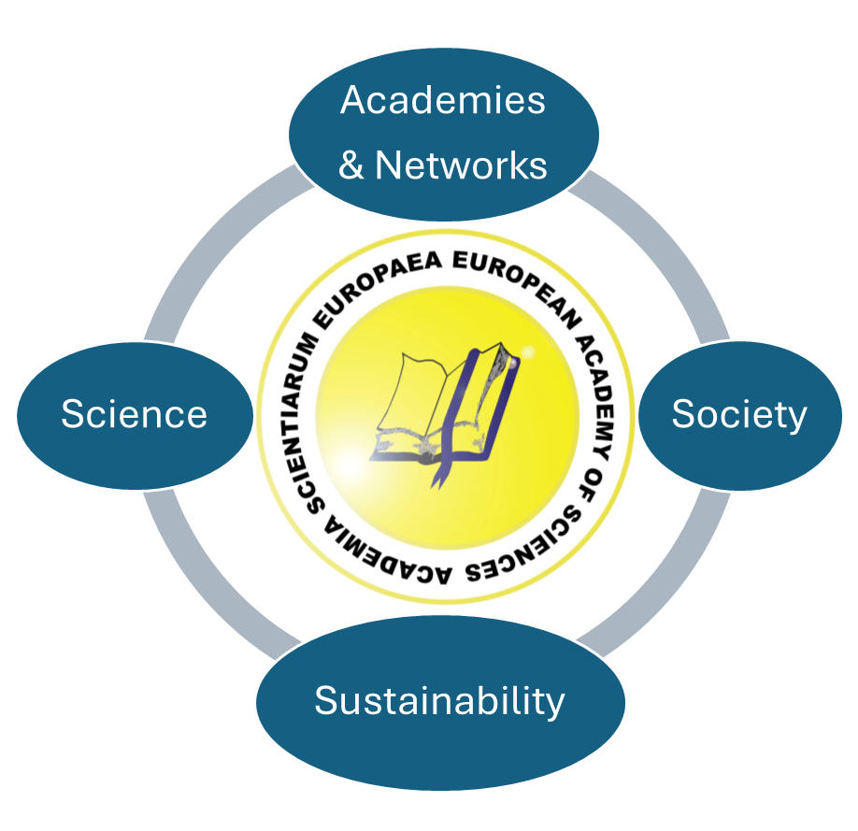
Promotion of EurASc Inter-Academic Relations
General EurASc aims: “strengthening European science and scientific cooperation and utilising expertise of its members in advising other European bodies in the betterment of European research, technological application and social development”
Inter-academic relations: fostering science towards sustainability and welfare of society
General mottos (latest EurASc Symposia) Science for Sustainability (2024) and Societal Impact of Fundamental Sciences (2025)
Cooperation agreements, joint working groups
Topics for cooperation - EurASc Divisions, EurASc working groups*
Raw Materials; Intelligent or responsive Materials; Catalysis for Sustainable Goods Production; Energy Alternatives; Artificial Intelligence; Information Technology; STEM (Science, Technology, Engineering and Mathematics) fields education; Oceans and Environment*; Inclusion & Discrimination*; Inter-Academic Relations*; etc.
2

Slide 21





EurASc Inter-Academic Relations
Summary of established and not yet established ones
Thick arrow: established
Networks
of
Academies
Other
Institutions
SAPEA, ALLEA, EASAC, Euro-CASE, FEAM, YASAS
EC Directorate (Innovation,
Prosperity & Intern. Cooperation), ISC, EASSH
3

Slide 22
EurASc Inter-Academic Relations
National Academies: European and others
Academy of Sciences of Lisbon (ASL)*
Cooperation activities: hosting by ASL of 2024 EurASc symposium.
Proposed actions for 2026: launching session of celebratory EurASc 20th anniversary book “Science for Sustainability”. Joint session of both Academies at ASL, with video broadcast.
Further proposed action: EurASc representation at ASL 250th anniversary (2029).
Cycles of conferences at ASL: Global health; Human microbiome; From human to artificial intelligence; For a culture of open scientific data; Future of oceans; Water management; Cultural diversity, development & human rights; etc
Brazilian Academy of Sciences (ABC)*
Steering Committee
EurASc: Armando Pombeiro (coordinator) + ?
ABC: Helena Nader (President of ABC), Marco Cortesão (secretariat)
Cooperation activities (expected within the agreement)
- workshops, conferences, seminars, and other scientific events
- documents on specific topics
Working groups at ABC: Health Challenges, Energy Transition, Artificial Intelligence, Bioeconomy, Science and Education, Mental Health, Plastics, Scientific Misinformation Food Safety, Open Science
* Established Cooperation Agreement
4

Slide 23
EurASc Inter-Academic Relations
National Academies
Chinese Academy of Sciences (CAS)
Cooperation activities
EurASc Ocean: EurASc in ocean science, research, policy on climate action and ocean sustainability, bridging science and policy for global ocean health. Organization of events and supporting initiatives:
China-Europe Ocean Fora: ocean research, sharing expertise on big data, digital twins and climate solutions
One Ocean Science Congress (OOSC): scientific foundation for global ocean policy discussions
Support for International Platform for Ocean Sustainability (IPOS): global ocean health and European Seas
EurASc Asia-Pacific Centre, based in Hefei (EurASc hub): Europe-Asia cooperation in advanced materials, new energy, information technologies, and related domains
5

Slide 24
EurASc Inter-Academic Relations
International Academies
Academia Europaea (AE)
Working Groups at AE: Translational Medicine; Environment, Climate and Sustainability Task Force; HERCULES (Higher Education, Research and Culture in European Society; series of international symposia, with proceedings; occasionally, with formal statement about an issue); SAPEA
European Academy of Sciences and Arts (EASA)
Mission: Spiritual unity of Europe
Projects: Tolerance project (intercultural and interreligious understanding); Global Peace Offensive (with World Academy of Science and Art); Proceedings of EASA; Danube Academies Conferences
6

Slide 25
EurASc Inter-Academic Relations
International Networks of Academies
SAPEA (Science Advice for Policy by European Academies): part of SAM (Scientific Advice Mechanism) of EC, issues independent scientific evidence for policy recommendations by the Group of Chief Scientific Advisors (highest body of SAM), upon request of College of Commissioners. Consortium of Academy Networks (including those below), funded by Horizon Europe, representing over 120 academies from more than 40 countries
ALLEA: European Federation of Academies of Sciences and Humanities, representing more than 50 academies from over 40 countries in Europe.
EASAC (European Academy Science Advisory Council): voice of independent science advice to guide EU policy for benefit of society. It gathers National Academies of Science of EU Member States, Norway, Switzerland and UK and Academia Europaea
Euro-CASE (European Council of Academies of Applied Sciences, Technologies and Engineering): gathers 23 European Academies, focusing on innovation, energy and bioeconomy policy, with expertise from business sector
FEAM (Federation of European Academies of Medicine): gathers 22 National Academies of Medicine and medical sections of National Academies of Sciences
YASAS (Young Academies Science Advice Structure): network of 22 young academies across Europe. Strengthens the voice of early- and mid-career researchers in European science policy and scientific advice ecosystem
7

Slide 26
EurASc Inter-Academic Relations
Other International Organizations
EC Directorate-General for Research and Innovation, Deputy Director-General: Innovation, Prosperity and International Cooperation
ISC (International Science Council): for science as a global public good, gathers 250 intern. scientific unions and associations, including academies, research councils, intern. federations and societies, and young academies.
World Science Day for Peace and Development, held annually on November 10th (based on UNESCO's proclamation of the day), to promote participation to highlight science's role in society, encourage public engagement, and discuss solutions for a sustainable future. In 2025: “Trust, Transformation and Tomorrow" (building trust in science and driving solutions).
EASSH (European Alliance for Social Sciences and Humanities): to the benefit, innovation and resilience of societies Gathers scientific networks, associations, disciplines and universities
8

Slide 27
EurASc Inter-Academic Relations
Relations Oriented EurASc Reorganization
EurASc Hubs: branches in European and non-European regions of strategic significance, to strengthen the visibility and impact of EurASc
EurASc Asia-Pacific Centre; others?
EurASc opening to young scientists, under defined conditions, eg, as Affiliated Members for a non-renewable period of 5 years (?)
Suggestions/Comments Requested to EurASc Members
Academies for cooperative relations and contacts
Forms of cooperation
Topics and persons (within EurASC and other Academies)
Availability (or not) to participate
Creation of EurASc hubs
Opening of EurASc to young scientists
Acknowledgments: Prof. Rodrigo Martins (EurASc President), Prof. Alain Tressaud (EurASc Vice-president) and Prof. Fatima Guedes da Silva
9

Slide 28
5
0
2026 Annual Event &
Open Proposals for the 2027 Symposium

Slide 29


Slide 30
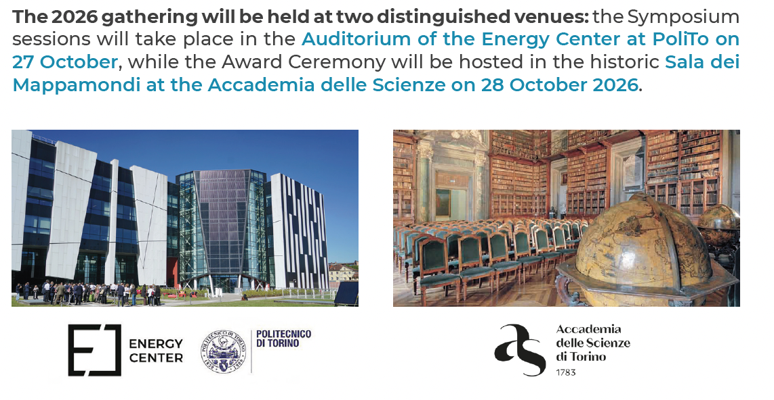
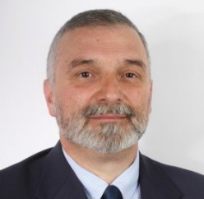
The Nexus of Science, Technology, and Philosophy in Exploring the Future of Society
Chairmen:
Giuseppe Lacidogna

Slide 31

Call open from January to June, and must be done in the correct form (find on the website and personal area).
Proposals must be submitted to the secretariat (contact@eurasc.eu) to allow for comprehensive evaluation and voting by the Presidium.
The selected hosts will be announced in July /August and disseminated within the Academy during the next event.
Notes:
We invite interested Fellows to submit proposals for hosting this prestigious event, which includes both the Symposium and Ceremony. It is essential that the proposed theme is comprehensive and of interest to all divisions within EurASc.
Candidates should consider the availability of suitable venues and demonstrate a strong commitment to engaging with potential sponsors. The successful organization of this event relies on active participation in sponsor acquisition efforts.
Proposals are accepted from January to June, and must be done in the correct form (find on the website and personal area).
Proposals must be submitted to the secretariat (contact@eurasc.eu) to allow for comprehensive evaluation and voting by the Presidium. The selected hosts will be announced in July /August and disseminated within the Academy during the next event.

Slide 32
6
0
Conclusions

Slide 33

EurASc in NUMBERS
190 members
36 members
62 members
100 members
135 members
125 members
106 members
38 members
104 members
900 Members
Notes:
TOTAL of 900 MEMBER as of today
Currently, we have 161 women and 739 men involved, and we aim to further enhance gender equality in the academy.
Gender Representation – Membership Evolution (2024–2025)
Women members increased from 157 to 161, representing a +2.5% growth
Men members increased from 728 to 739, representing a +1.5% growth
➡️ The proportional growth rate among women members is higher than among men, reflecting continued progress towards greater gender balance within the European Academy of Sciences.

Slide 34
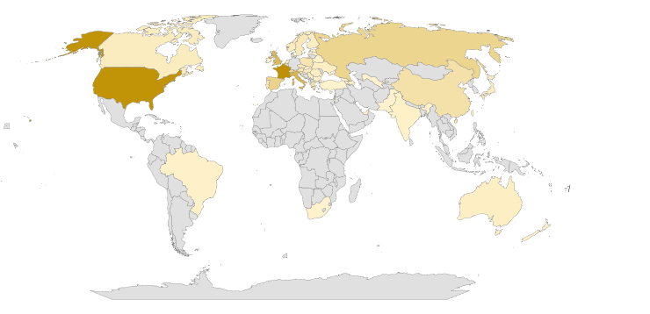
1617 members since its foundation in 2002
900 active MEMBERS to date
From 57 countries
78%
22%
European Members
Non-EU Members

Slide 35
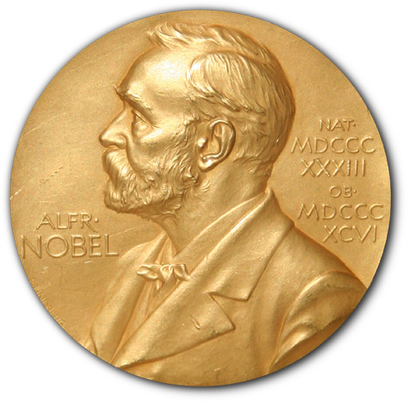
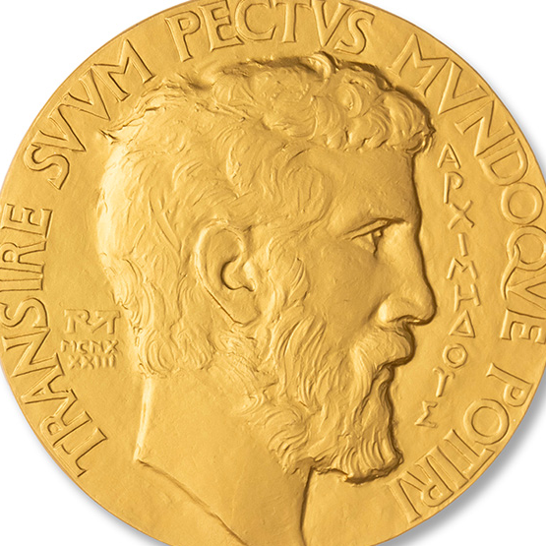

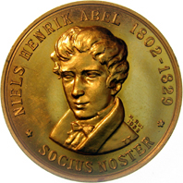
HONORARY MEMBERS
NOBEL PRIZE
FIELDS PRIZE
WOLF PRIZE
ABEL PRIZE
32
15
17
3
Notes:
57 HONORARY MEMBERS IN TOTAL… some have all the awards mentioned

Slide 36


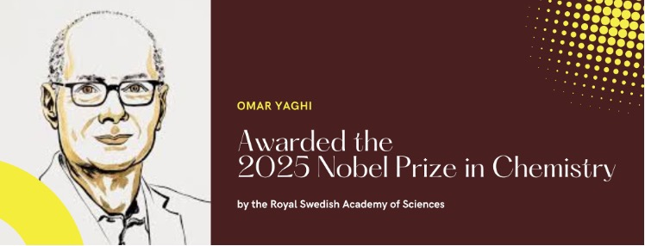
EurASc has the privilege of having among its fellows Nobel Prize laureates in the last years:

Slide 37
EurASc
AWARDS
0
The Academy rewards scientific accomplishments with its own awards

Slide 38
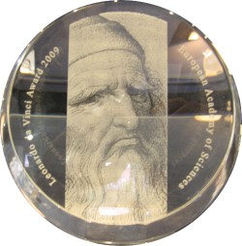
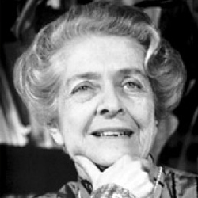
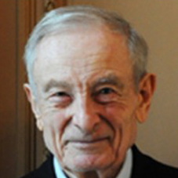
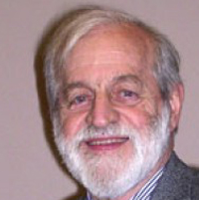
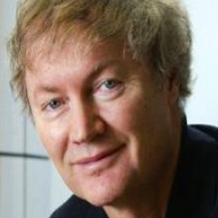
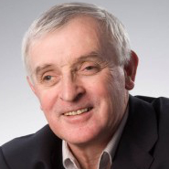
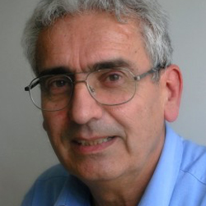
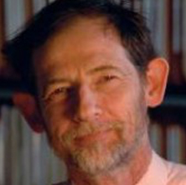
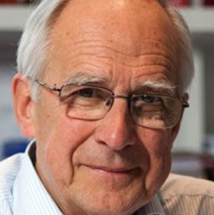
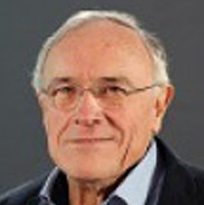
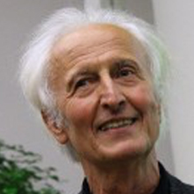
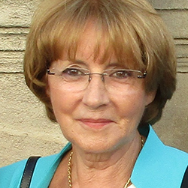
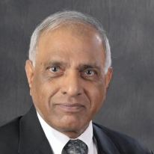
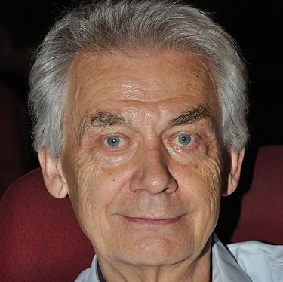
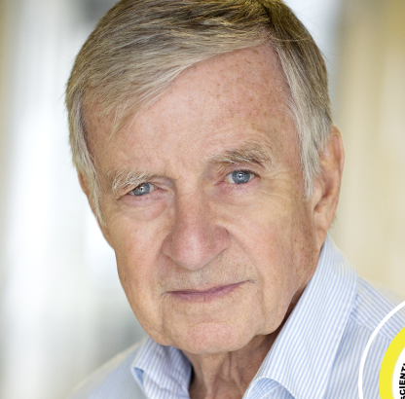
LEONARD DA VINCI AWARD
The European Academy of Sciences established the Leonardo da Vinci Award in 2009 for Outstanding Lifelong Achievement.
One Award is attributed per year.
14 Awardees to date
Rita (†) Levi-Montalcini; Jacques (†) Friedel; James D. Murray; Michael Graetzel; Jean Jouzel; Vincenzo Balzani; John Ball; Pierre Corvol; Klaus Müllen; Helmut Schwarz; Anny Cazenave; J. N. Reddy; Herbert Roesky (†); Yves Agid.
2009
2010
2011
2013
2015
2017
2018
2019
2020
2021
2022
2023
2024
2025

Slide 39
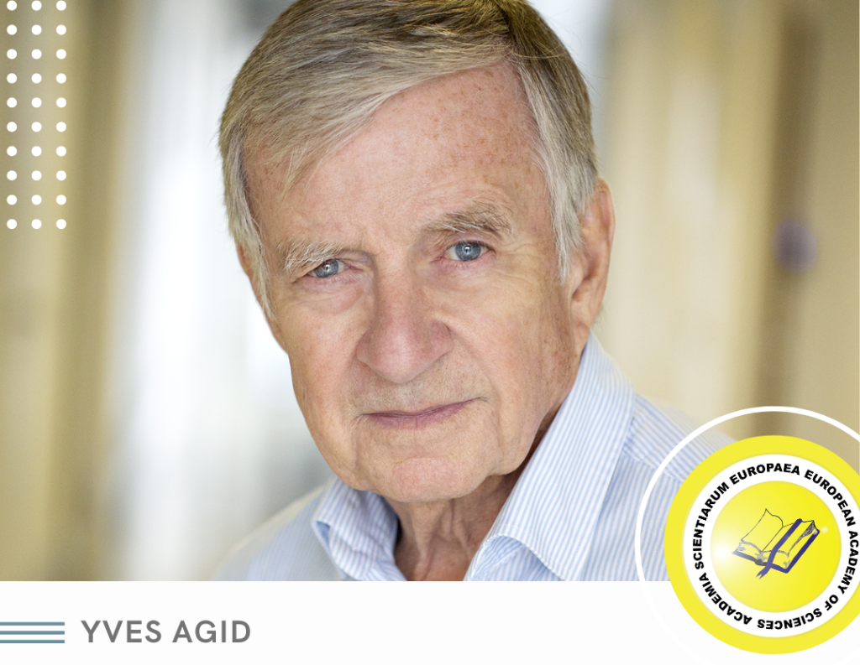
2025 LEONARDO DA VINCI AWARD

Slide 40
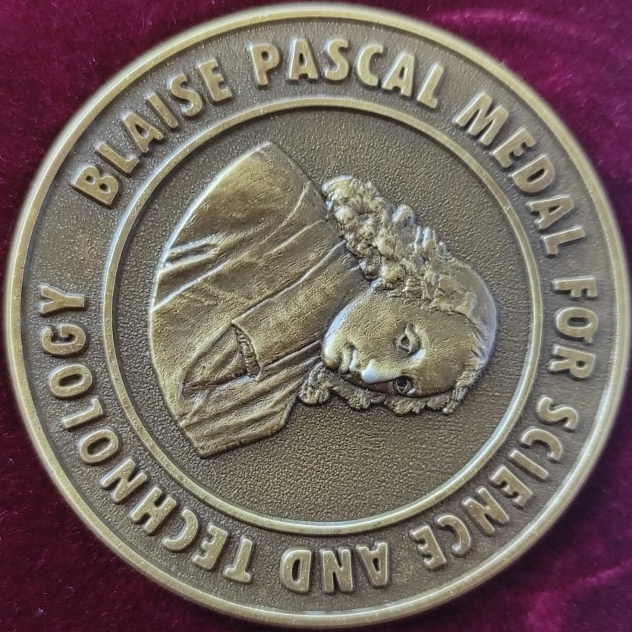
BLAISE PASCAL MEDAL
The European Academy of Sciences established the Blaise Pascal Medal in 2003 to recognise an outstanding and demonstrated personal contribution to science and technology and the promotion of excellence in research and education. Up to nine medals may be awarded in any one year.
96 Medallists to date

Slide 41
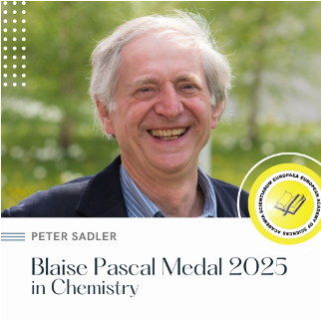
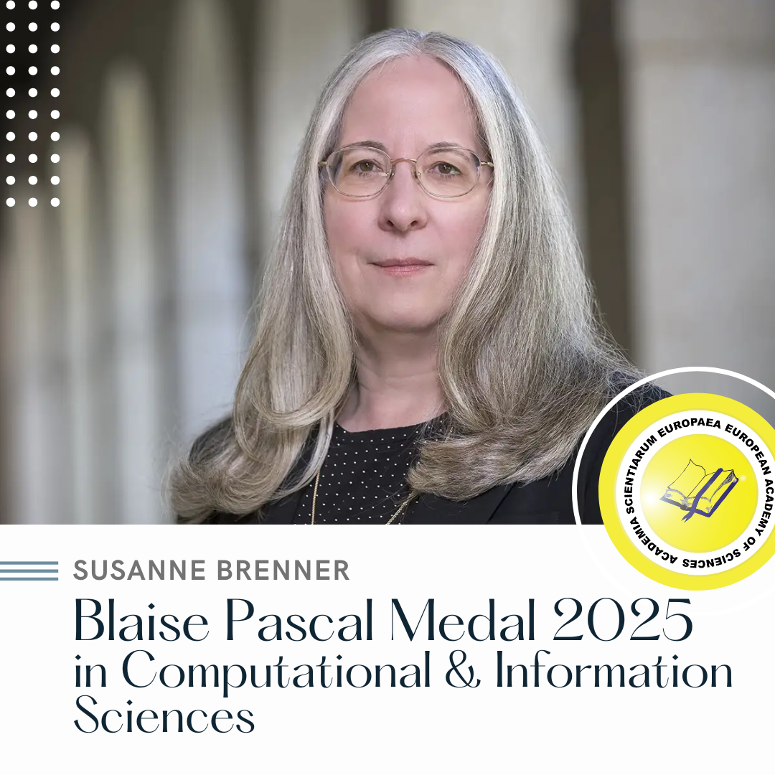
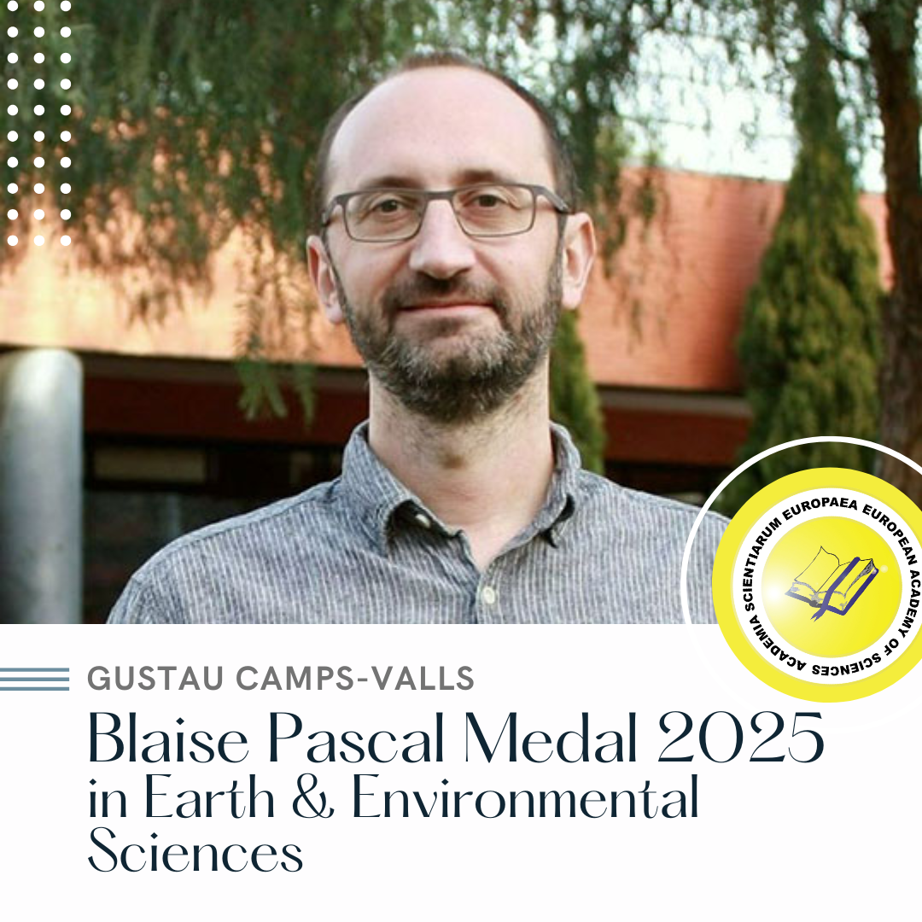
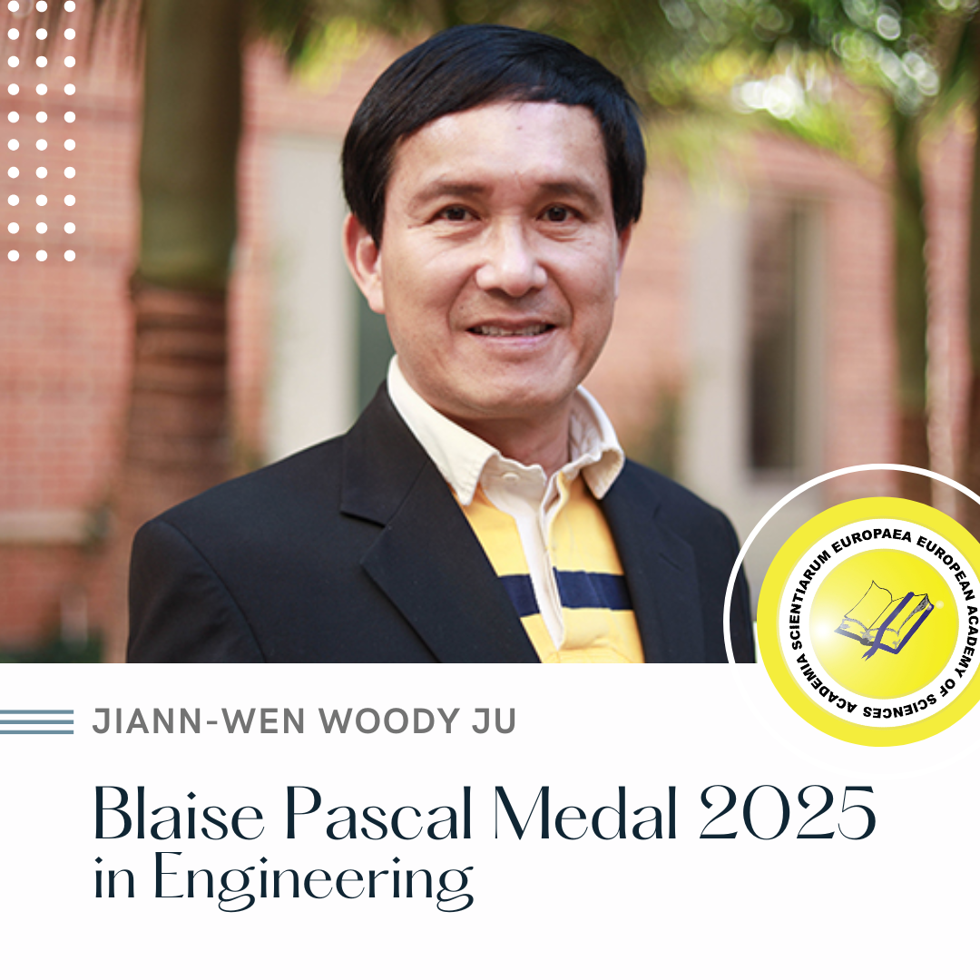
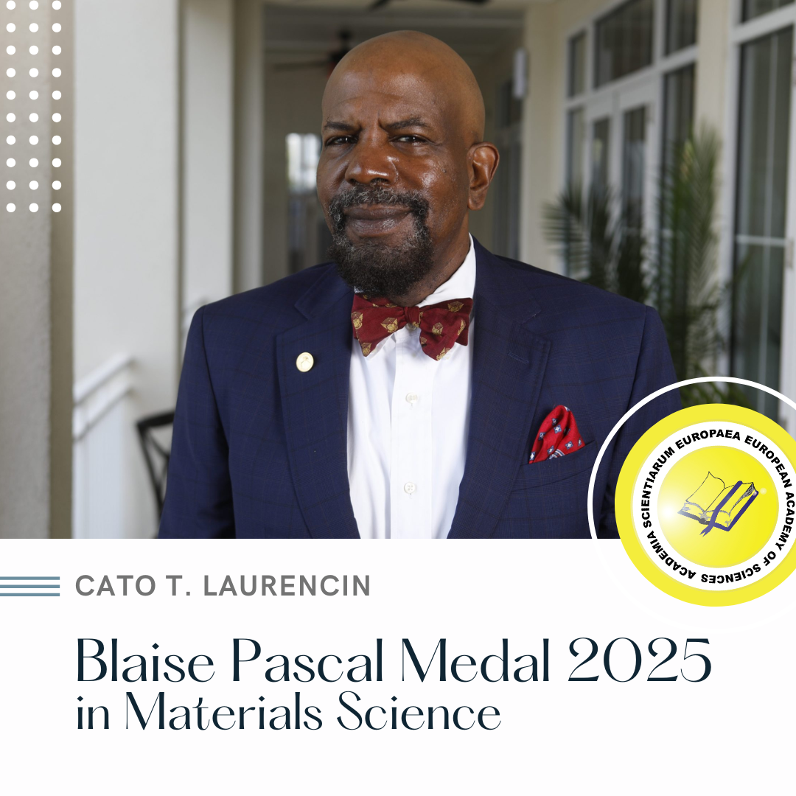

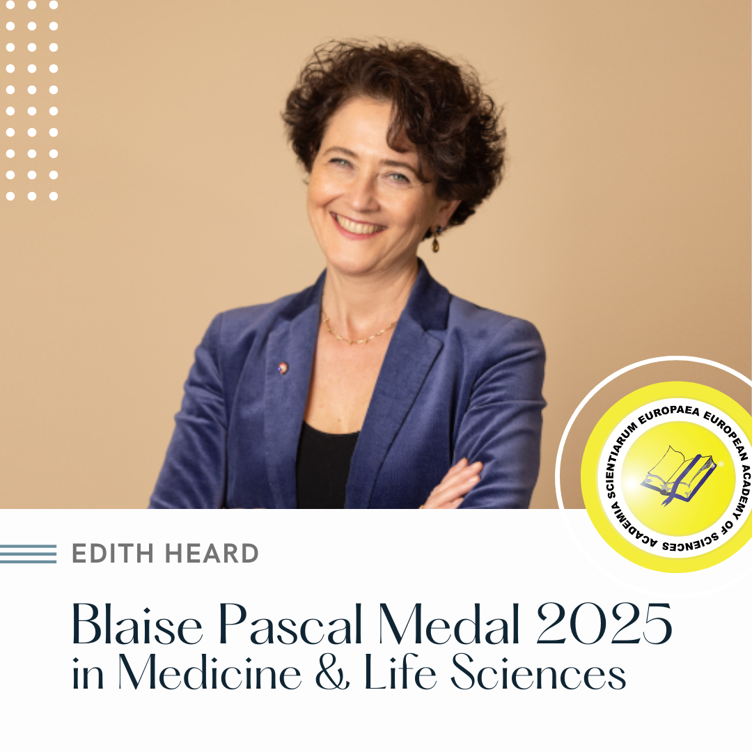
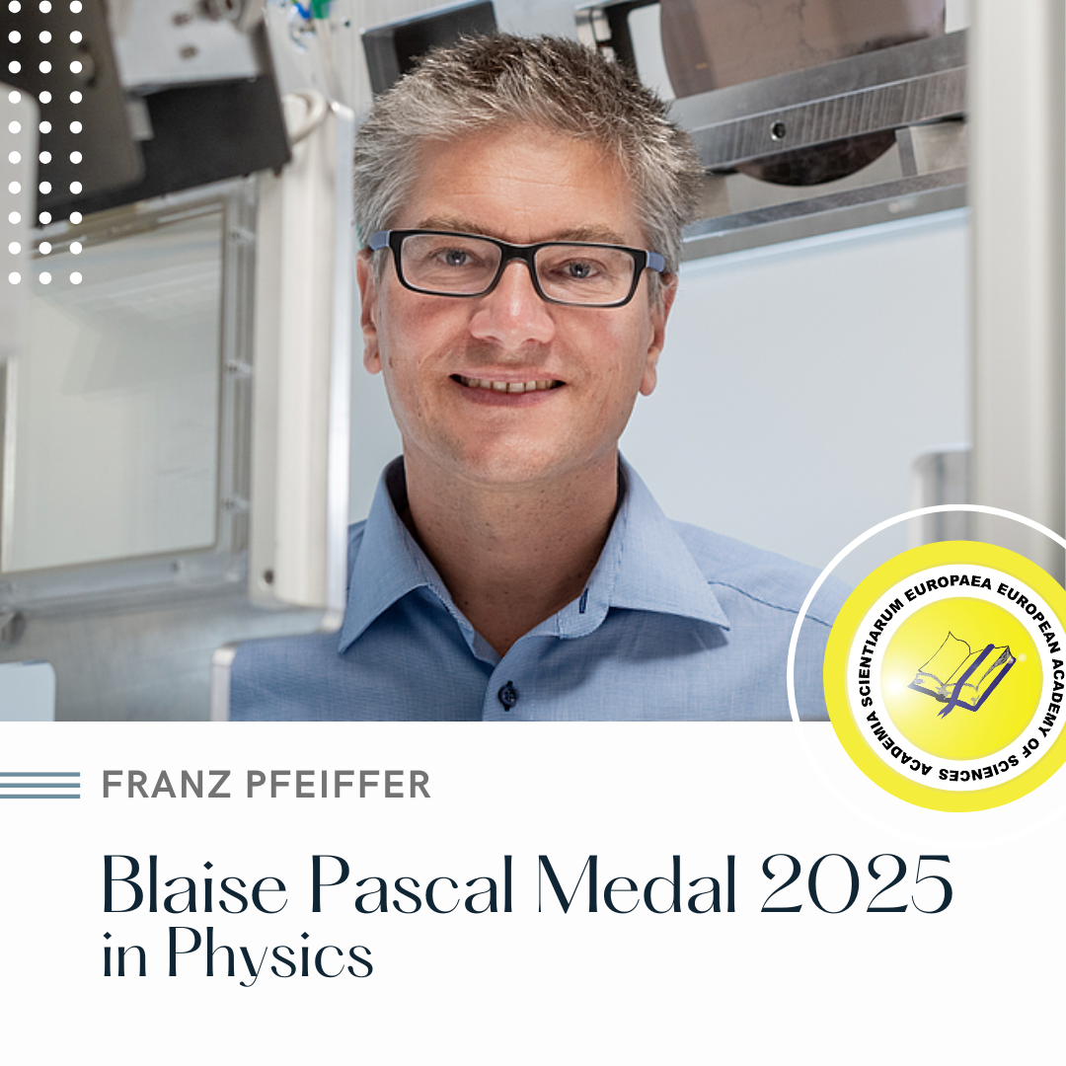
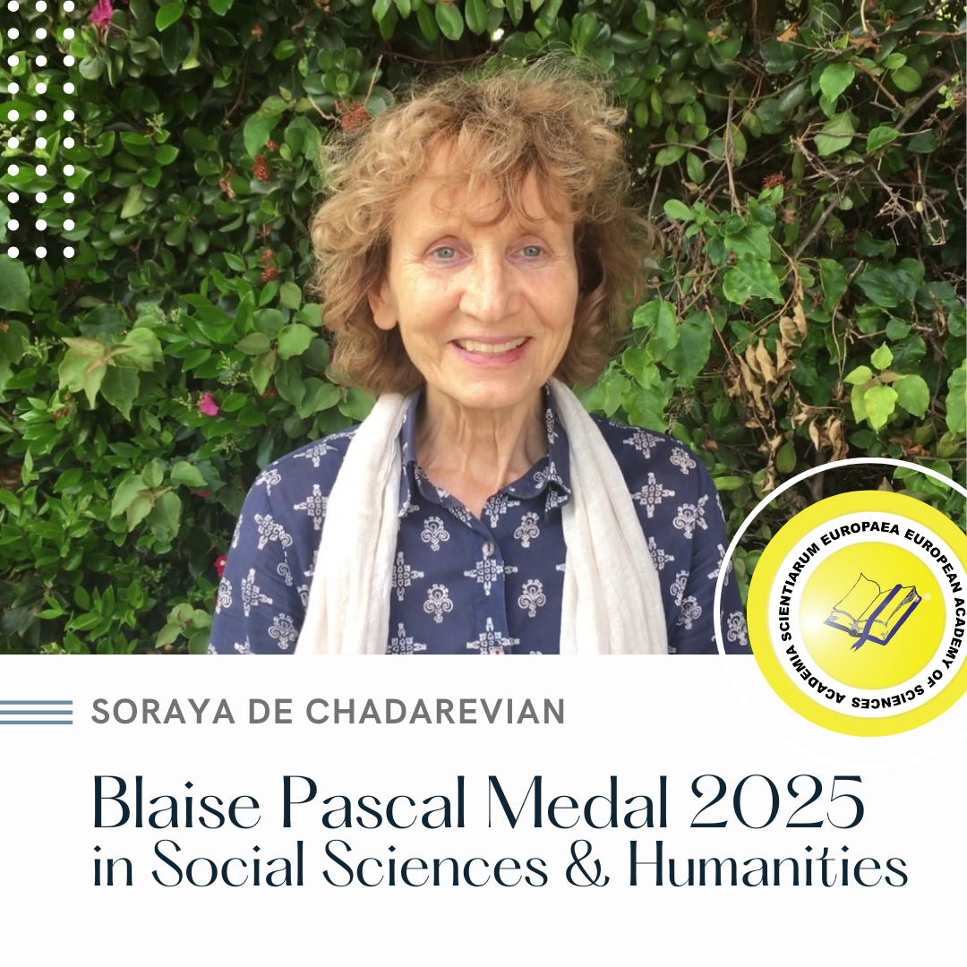
2025 BLAISE PASCAL MEDALISTS

Slide 42
EurASc
FINANTIAL OVERVIEW
0

Slide 43

Membership fees growth
34,12%
In 2025, membership-fee collections increased by 34.12% compared to 2024, and exceeded the initial forecast by 96.52%.
This result reflects both the update of the annual fee from €100 to €130—the first adjustment in nearly a decade—and the Secretariat’s consistent efforts to improve payment regularisation.
The fee will continue to follow a progressive structure, reaching €150 in 2026.
Notes:
In 2025, membership-fee collections increased by 34.12% compared with the previous year.
This performance also exceeded the original 2025 forecast by 96.52%, noting that the forecast had been prepared before the fee adjustment was anticipated. The outcome reflects both the increase in the annual membership fee from €100 to €130—the first fee increase in approximately 10 years—and the team’s sustained, rigorous efforts to improve fee collection.
As previously communicated, the fee increase will continue on a progressive basis, with the annual membership fee rising to €150 in 2026.

Slide 44
EurASc
FUTURE STEPS
0
Intranet Improvement;
Enhanced Communication;
Feedback Mechanisms;
Regular Updates;
Website Modernisation.
Notes:
Intranet Improvement: We will continue enhancing the website's intranet, focusing on implementing a restricted area for voting and proposal submissions. This will facilitate the nomination of new members, the introduction of new events, and other important initiatives.
Enhanced Communication: We will keep improving our communication strategies and increase our presence on social media platforms to engage more effectively with our members and the public.
Feedback Mechanisms: We will establish feedback mechanisms to ensure that members can voice their opinions and suggestions for further improvements.
Regular Updates: Members will continuing receive regular updates on our progress and upcoming initiatives to maintain transparency and engagement.
Website Modernisation: We also aim to implement a visual and structural update of the public-facing website to improve usability, accessibility, and alignment with EurASc’s current identity and strategic direction.

Slide 45
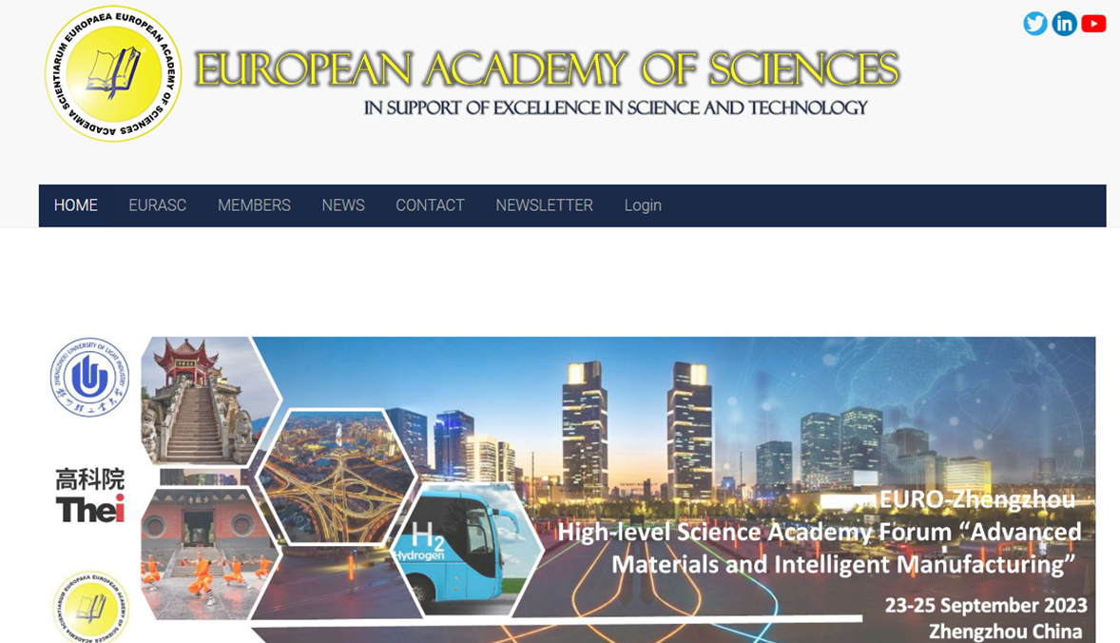



OUR WEBSITE
WWW.EURASC.EU
ALSO FIND US
Notes:
Before we open the floor for comments and discussion, I would like to take a moment to emphasise how essential your active participation is to the success and growth of our Academy.
EurASc is only as strong as its members are engaged, and your ideas, proposals, and involvement—both formal and informal—make a real difference.
I also remind you that the nominations for the 2026 Leonardo da Vinci Award are currently open, but the deadline is approaching rapidly — 15 January. We encourage all of you to submit outstanding candidates.
The Blaise Pascal Medal nominations are also open and will remain so for a slightly longer period, giving you additional time to reflect on potential nominees from your fields.
And finally, I’m pleased to announce that in 2026 we will relaunch the Kepler Award, an initiative that has the goal of steering the cooperation of highly talented young scientists in Europe interested in research crossing the borders of disciplines and states.
More information about the Kepler Prize will be shared very soon.
Thank you once again for your presence and commitment — and now, we invite your questions, proposals, and reflections.

Slide 46

THANK YOU!
contact@eurasc.eu
www.eurasc.eu

