Slide 1
Target Station Integration 21/5/25
Beatriz Martinez Sutil

Slide 2
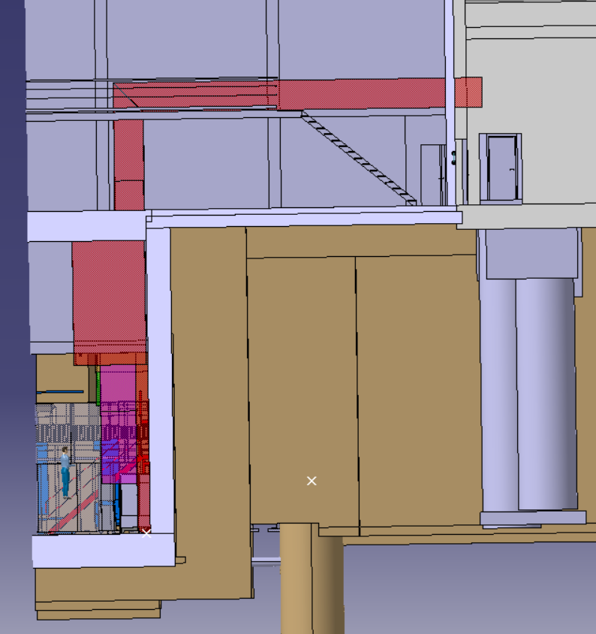
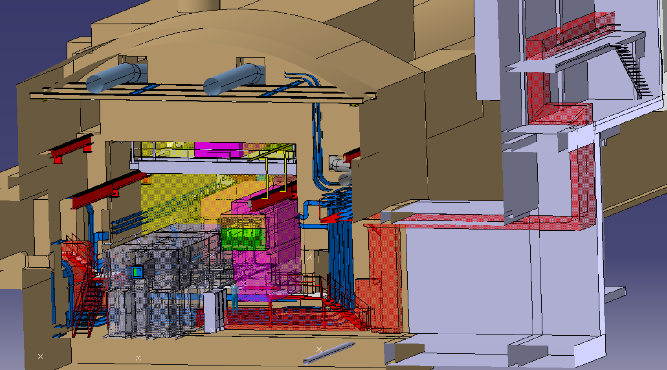
CV space reservation
Fully completed

Slide 3
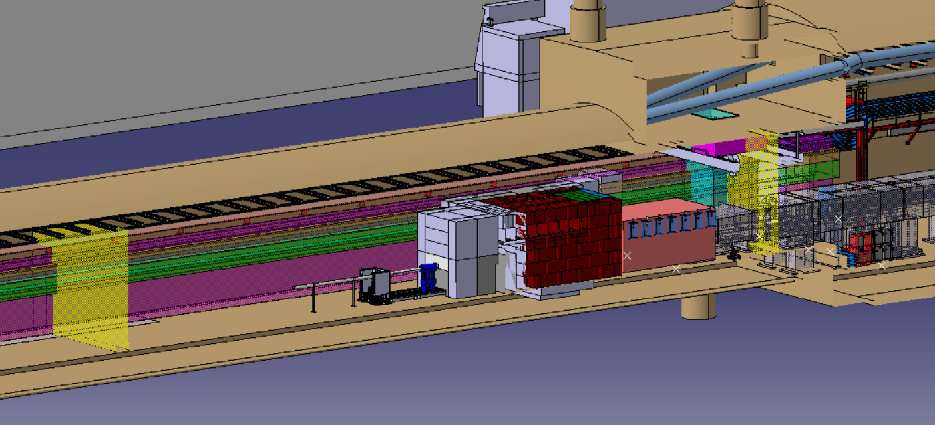
Space reservation
Estimate position:
Upstream: Should confine the 2 beam instrumentation and the target space reserved for maintenance.
Downstream: Necessary a meeting with Pablo to stablish the position

Slide 4
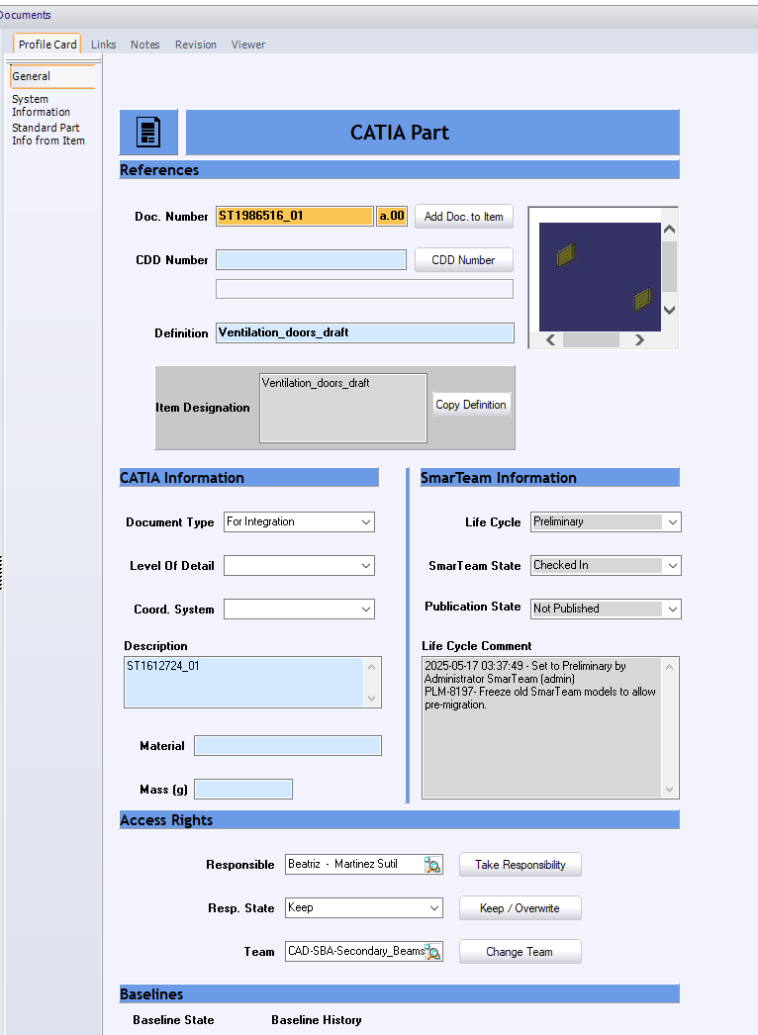
PLM
It is necessary to understand the meaning of the Life Cycle Comment.
Are the changes made after migrated as well?
After making check out, modify the document and make the check in, it is necessary set to preliminary again to Premigrate this new version. Not define how much time we have to make this.

Slide 5
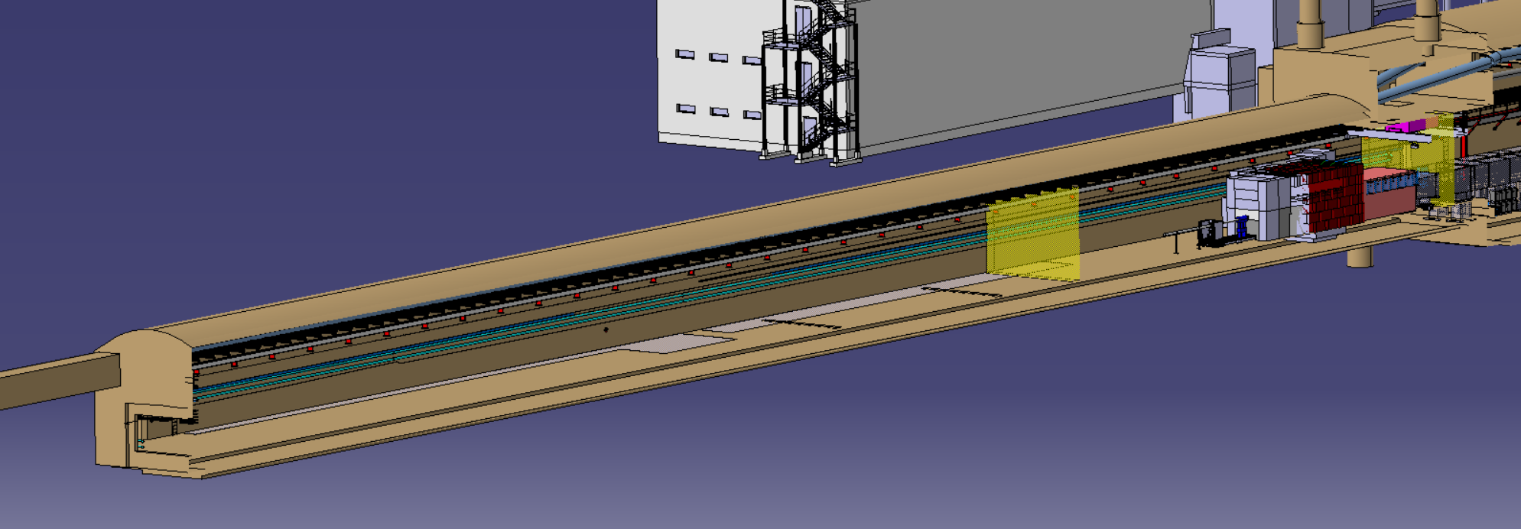
Cleaning the model of TCC8 and ECN3
Action – With the new MADX version, see how to divide the P42 line (all the modifications are in one full line currently)
TBD with Sylvain

Slide 6
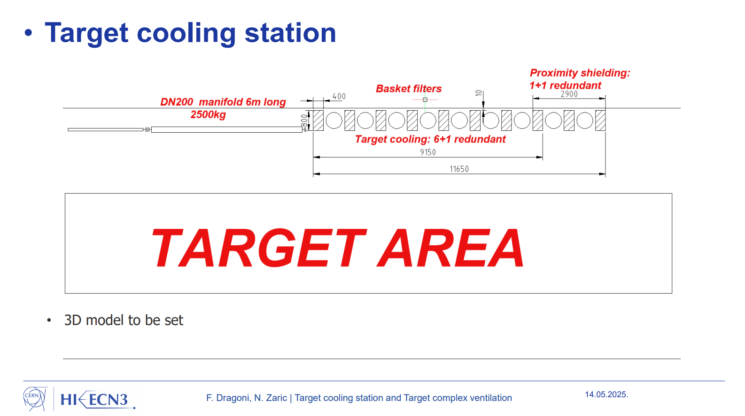
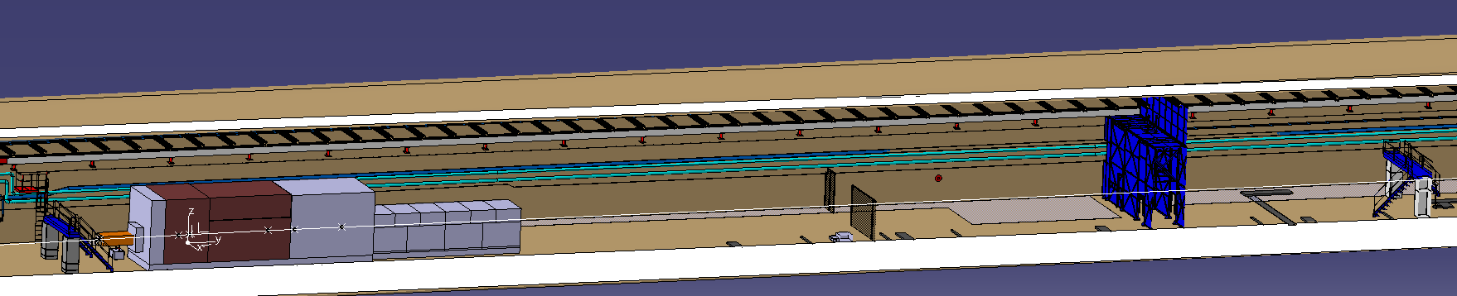
Cleaning the model of TCC8 and ECN3
Action: Add the footprint of the cartridge and heat exchanger slide 6 18mx1mx1.6 that Nikola provided in the last WP4.
TBD

Slide 7
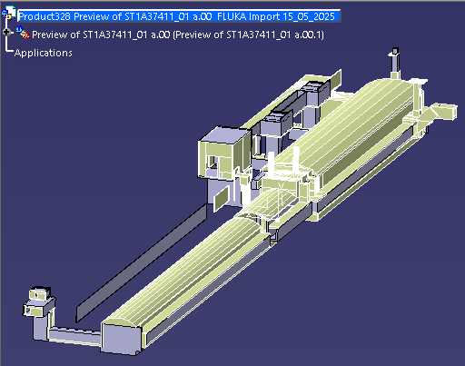
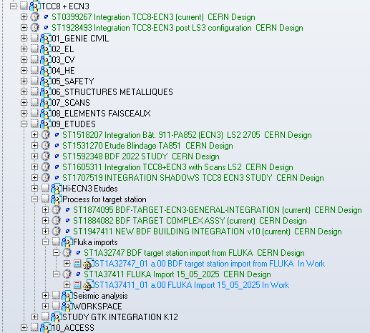
Fluka model
Create a study model superposing the fluka model and the integration model, situating the fluka model in its place
TBD
Notes:
Speak with Michael to create another e-group for integration HI-ECN3.
Users – Pablo, Gemma, Jean-Louis, Christophe, Bea

Slide 8
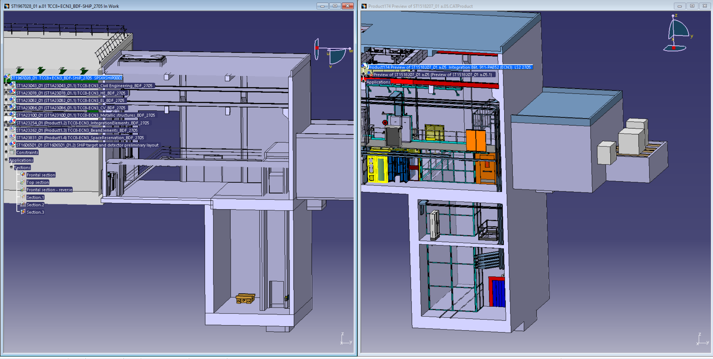
B911
Note: Need to speak with CE because in their new model there is one room missing.

