Slide 1
Physics at CERN
Standard Model and beyond
Luke McElhinney
14/12/23

Slide 2
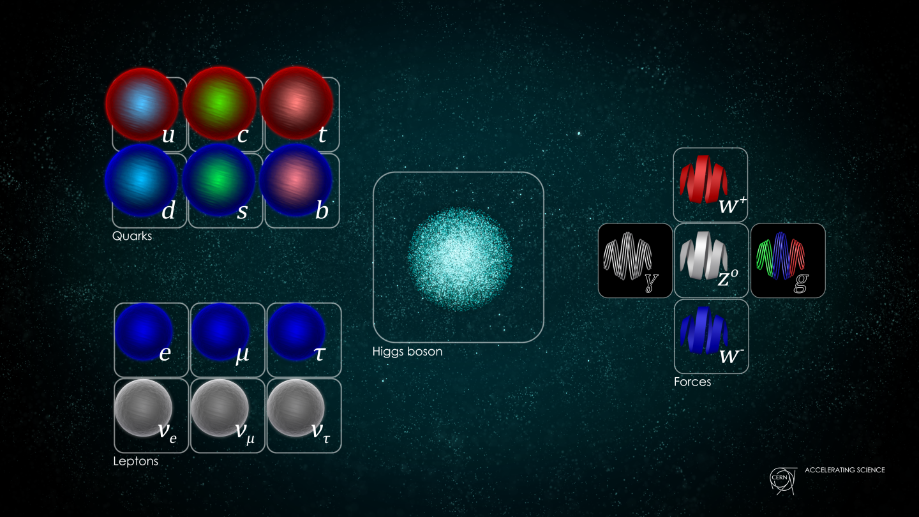
The Standard Model
Higgs boson observed by ATLAS and CMS 4th July 2012
Higgs explains how SM particles get their mass
Completes the SM picture

Slide 3
The Standard Model
SM gets vigorously tested by the LHC and accurately describes phenomena within it domain, its is still incomplete
Some unanswered questions include:
  Neutrino masses
  Matter vs antimatter
  Dark matter & Dark energy

Slide 4
Dark Matter
Dark Matter is a non-luminous matter that doesn’t interact with the electromagnetic field
How do we know Dark Matter exists when we can’t see it??
Gravity to the rescue!!
Galaxy Clusters
Galactic Rotation Curves
Gravitational Lensing

Slide 5
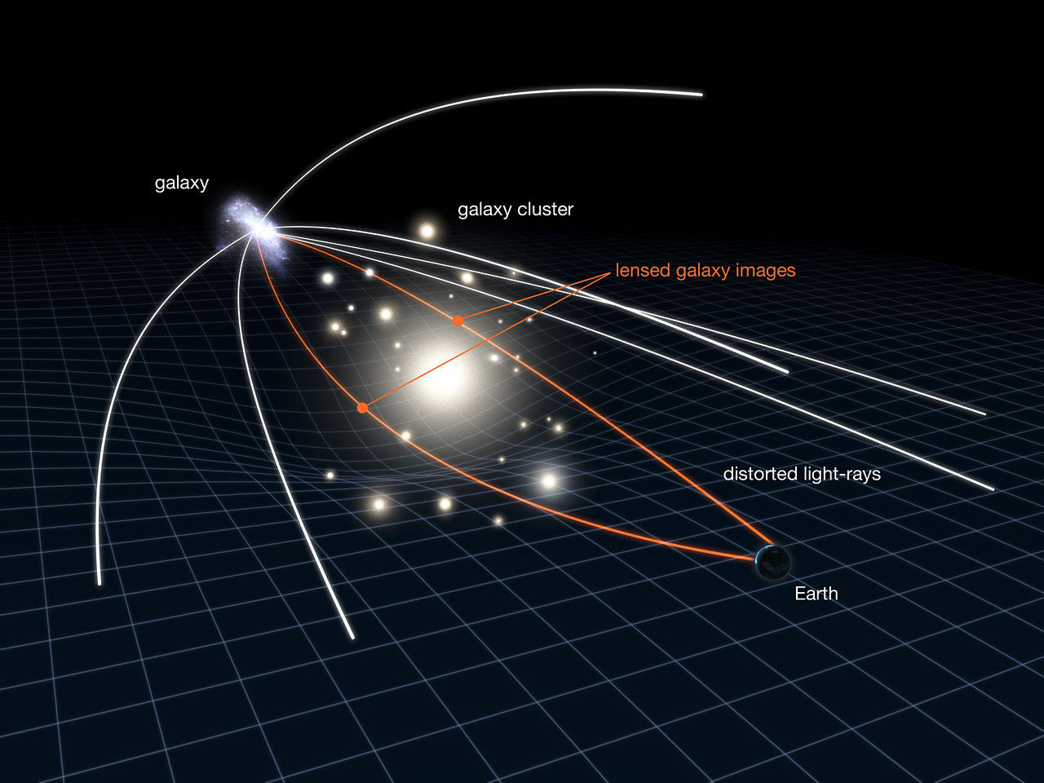
Gravitational Lensing
Gravitational Lensing was first suggested by Einstein
Was observed by imaging the small shift in position of stars near the sun during a total Solar Eclipse
The results of Gravitational Lensing suggests that there is ~5 times more Dark Matter(0.27) than Normal Matter(0.05)
DM + NM = 32%

Slide 6
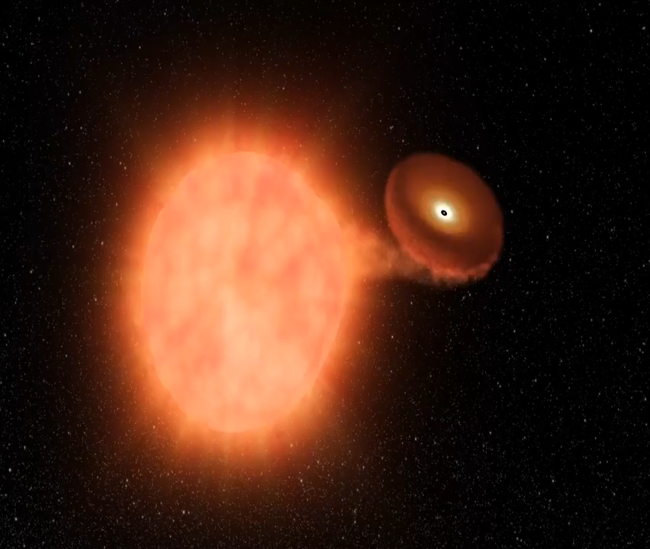
Dark Energy
Dark Energy therefore makes the rest of the universe
The most direct and “easy” method is the evolution of the universe
Best method is by using Type Ia supernovae
Type Ia is when a white dwarf somehow gathers enough mass to pass the Chandrasekhar mass
Observing the shift of light from the supernova
Plot the mass (m) against the shift (z)

Slide 7
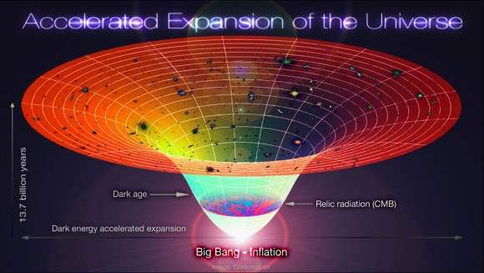
Dark Energy
What does the supernovae observations tell us?
The universe was travelling slower in the past
Implies existence of a long-range repulsive force that is able to overcome gravity
Dark Energy is therefore accelerating the expansion of the universe

Slide 8
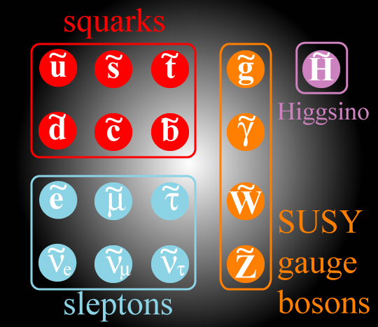
Back to CERN
Looking for dark matter at CERN
One idea is that it could contain “supersymmetric (SUSY) particles” – which goes beyond the Standard Model
A partner particle for each particle in the Standard Model
Would also solve a major problem within SM – fixing the Higgs boson mass

Slide 9
Higgs Mass Problem
Particles achieved their mass via their interaction with the Higgs field
They don’t make their own mass
The stronger this interaction the heavier the particle
Why the Higgs boson should be light?
Where does the Higgs Mass originate from?
Specific mass values suggest a meta-stable universe

Slide 10
Looking for SUSY
If theory correct SUSY particles should appear during collisions at LHC
How do we find them??
SUSY particles formed in the primary collision/vertex within the detector
SUSY particles move away from primary vertex and decay into SM particles
SM particles are detected in the detector and a secondary vertex can be reconstructed (hopefully)

Slide 11
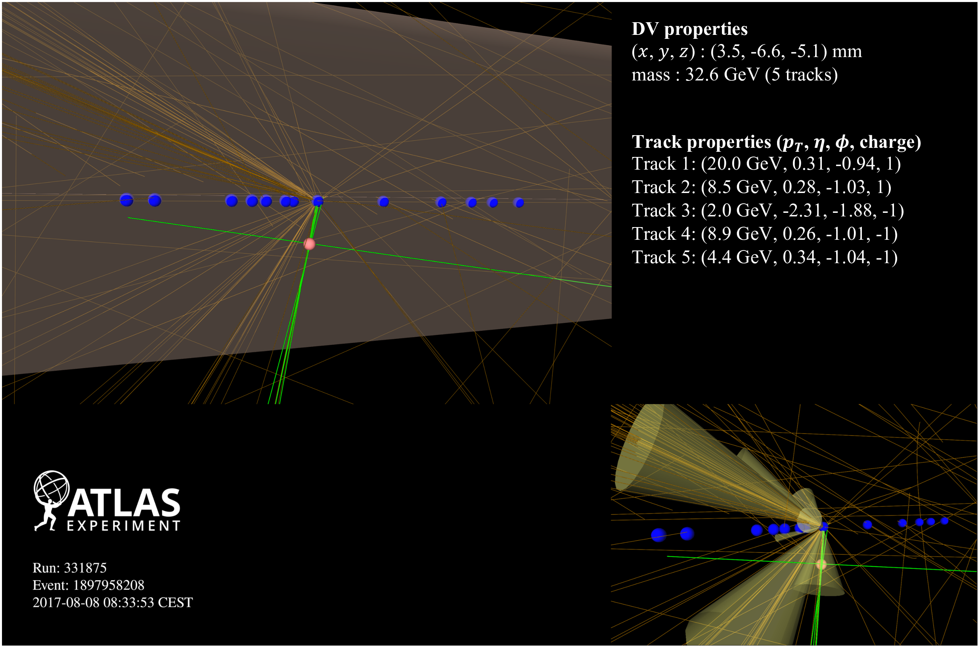
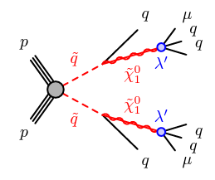
Looking for SUSY
Find a secondary vertex and investigate everything about it
Does it match what we are looking for?
Yes – Noble prize No – try again

Slide 12
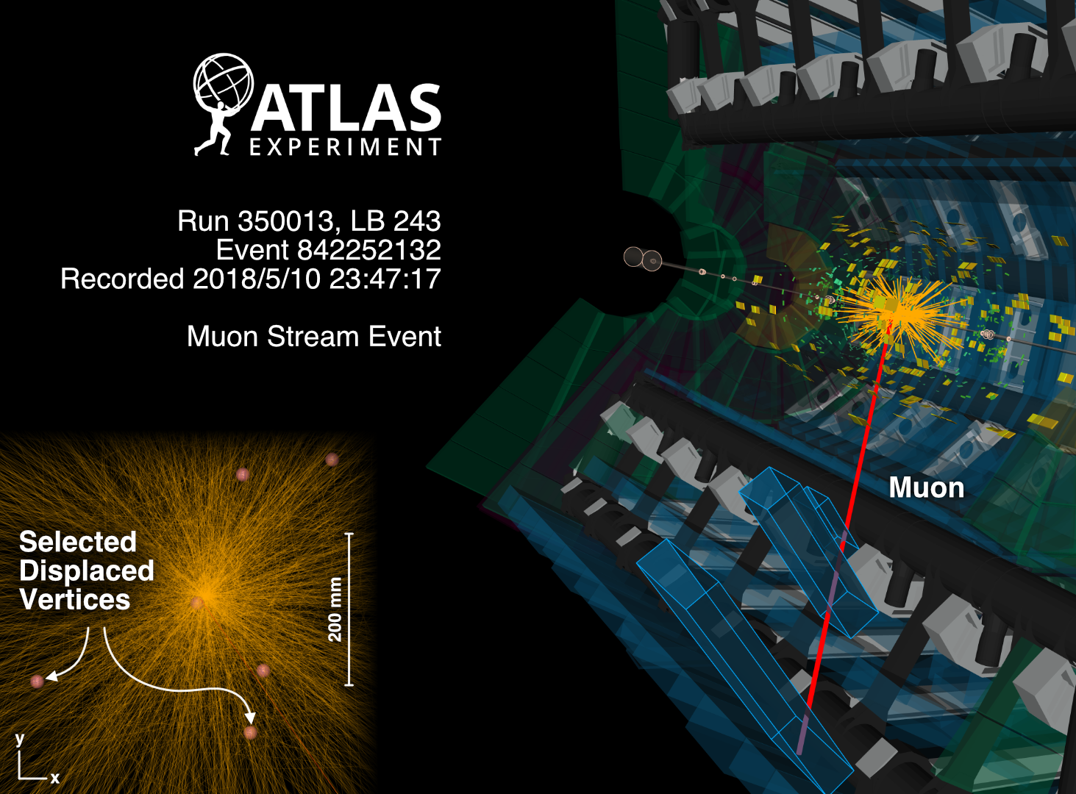
Finding a Secondary Vertex

Slide 13
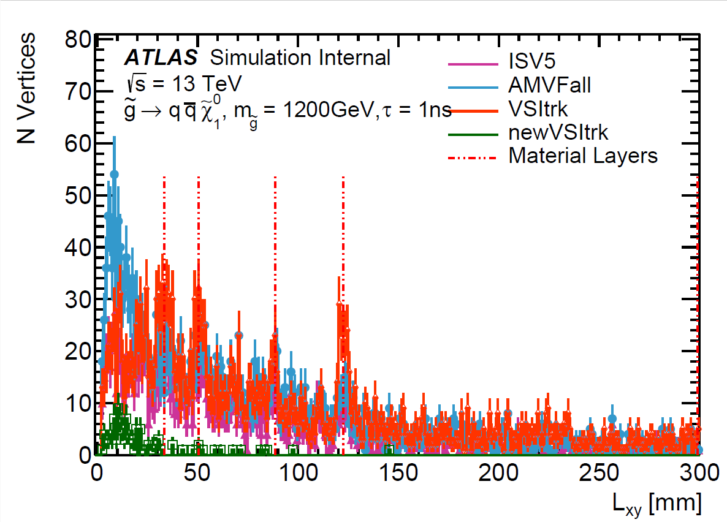
Secondary Vertices

Slide 14
Thank you
Any Questions

