Slide 1
Introducing the final I.FAST Meeting CERN, October 2025
M. Vretenar, Project Coordinator

Slide 2
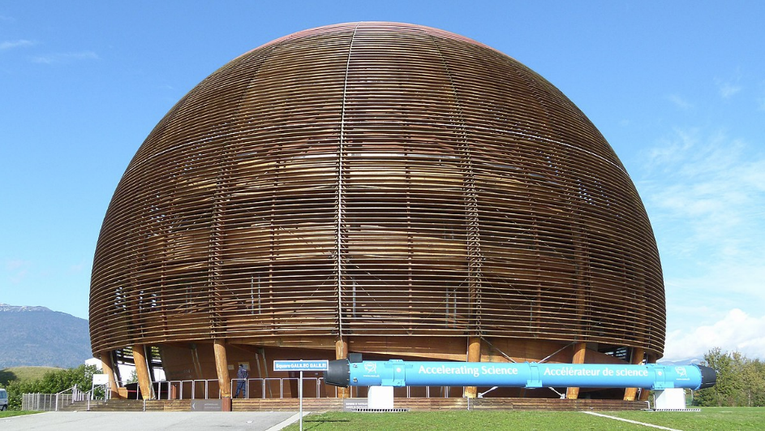
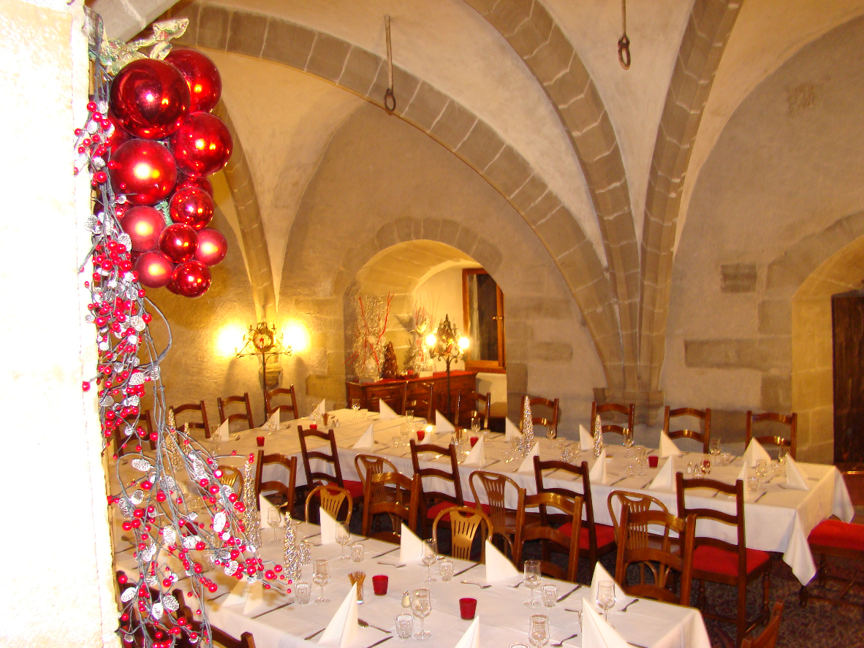
Welcome to the 5th and final I.FAST meeting
Goals:
Review results and impact in preparation for the Final Report
Agree on timing and procedure for Final Report
Celebrate the end of the project with some last social events.
A special meeting:
Shorter: Tuesday 14:00 - Wednesday 16:00
Presentations by WP and Task leaders for active Tasks only, centered on latest results and impact
No highlights, no sessions, no parallel meetings.
An outlook into the future: ESPP and CERN programmes, future EU projects.
We will as usual profit of the presence of our SAC that will help in assessing the overall impact of the project for the Final Report

Slide 3
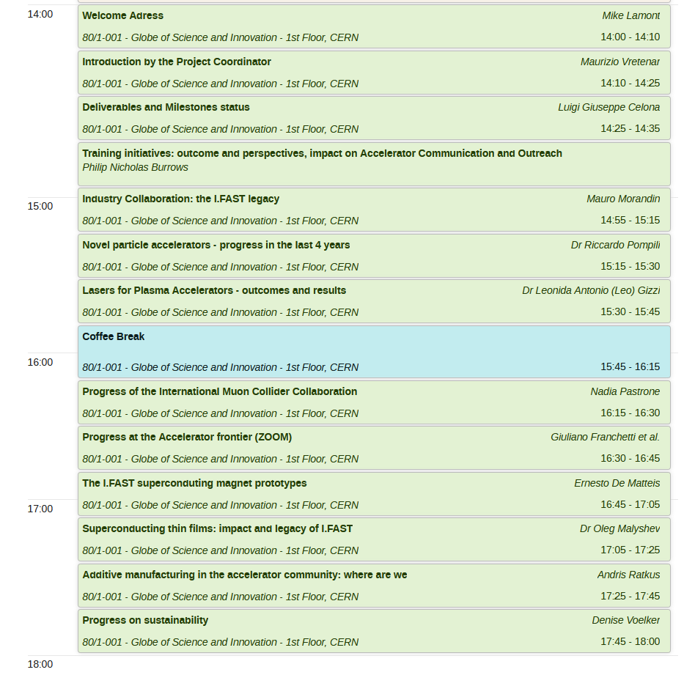
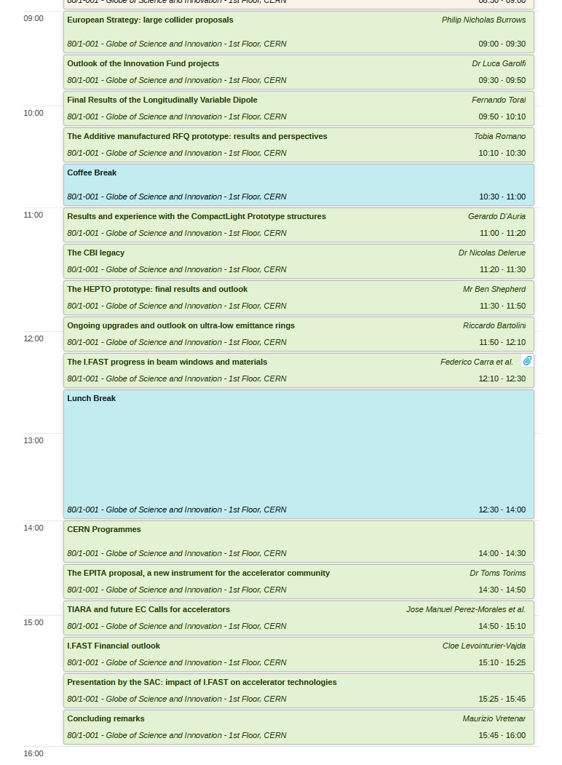
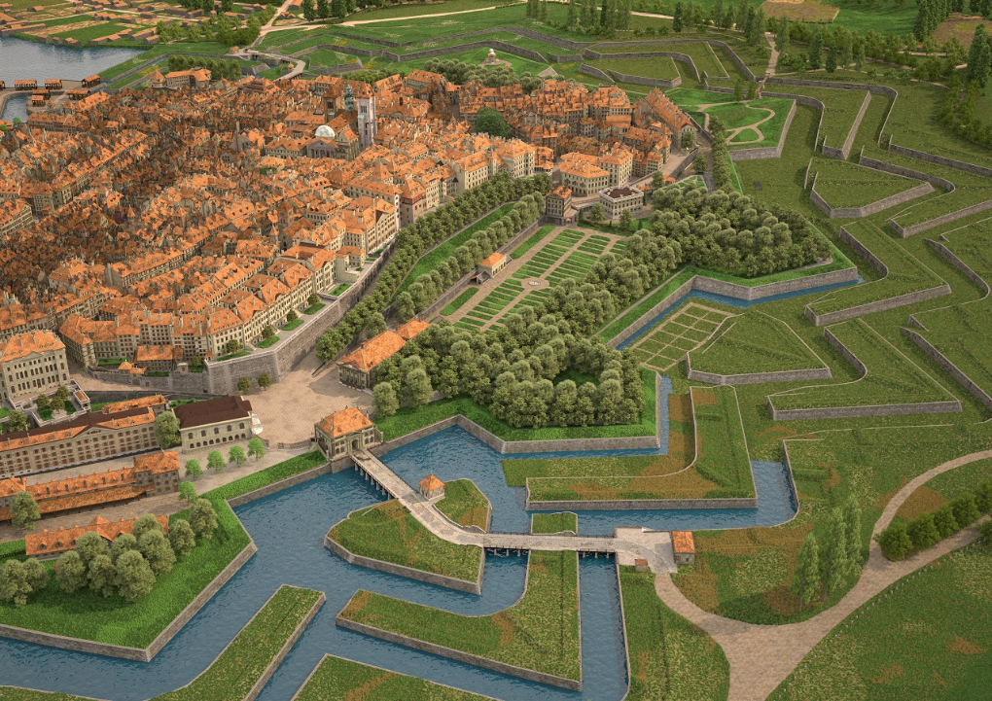
A rich programme
19:30
No-host fondue dinner at Restaurant Edelweiss, close to train station.
T. Torims will assist.
19:30
IFAST Dinner at Café Papon
Rue H. Fazy 1
Genève
Take tram 18 to Bel-Air then go up to the Old Town on Grande Rue

Slide 4
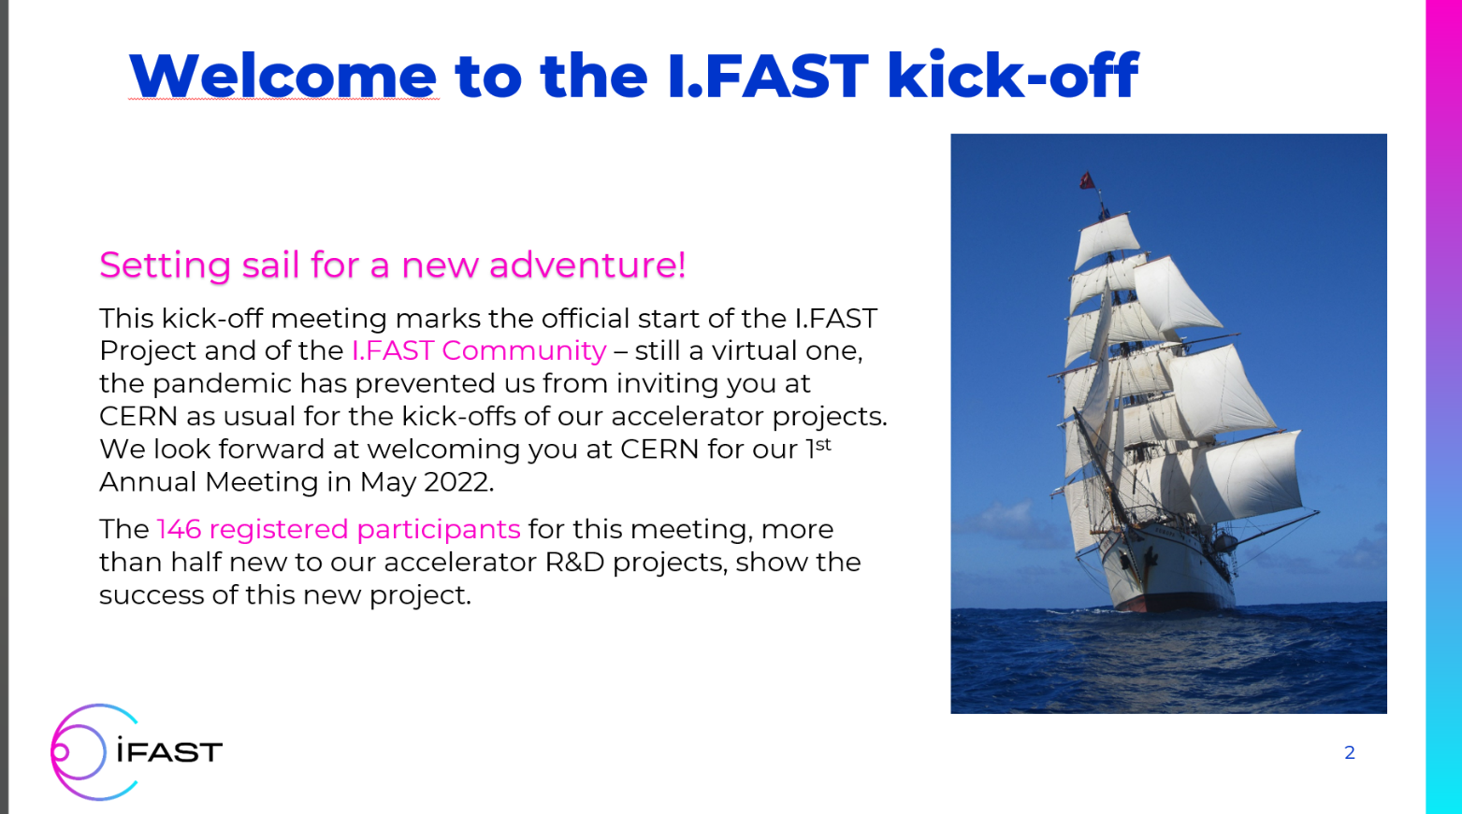
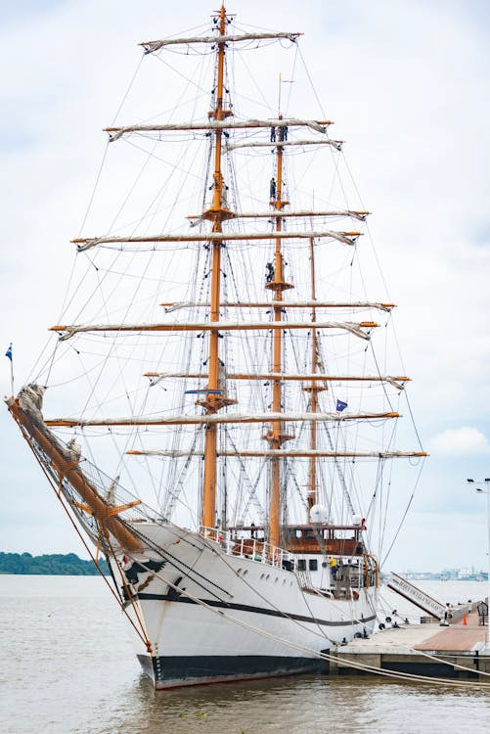
I.FAST: coming to the end of a long journey
After 4.5 years, I.FAST terminates officially on 31 October 2025. Deadline for submitting 3rd and final technical report and financial reporting is 31 December 2025.
Final Review online scheduled for 21 January 2026 (presentations by Task Leaders, with Project Officer S. Kakarantzas and Reviewer Prof. Zeyrek.
Last meeting of Governing Board in March 2026, to take note of Financial Reports and outcome of Review, and decide possible budget redistribution.
If Final Periodic Report approved (scientifically and financially) by EC, last payment could take place in late spring 2026.
From sailing (May 2021) to safe mooring (October 2025)
I.FAST kick-off, May 2021

Slide 5
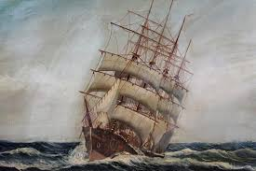
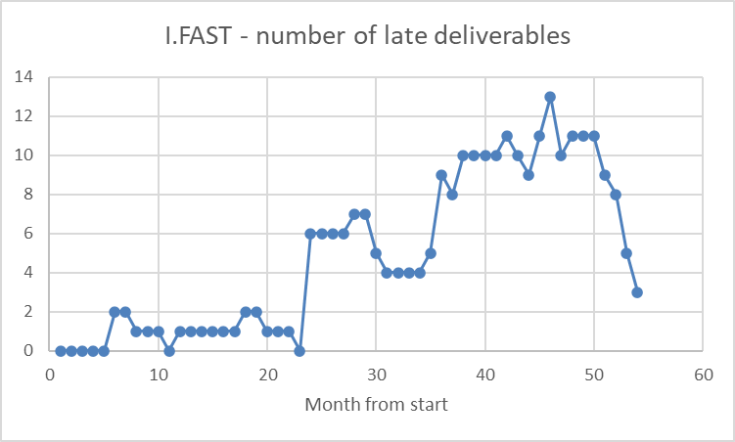
Not really a peaceful journey…
Proposal prepared at end 2019 and submitted in March-May 2020 (fully in the Covid crisis!).
Evaluation received 30.10.2020, 14/15.
Grant Agreement signed 05.03.2021, project started on 01.05.2021.
Kick-off online, Annual Meetings CERN (2022), Trieste (2023), Paris (2024), Krakow (2025).
Meetings slowed down by 2nd year of Covid.
Material and prices crisis in 2021/22, two industrial partners withdrawing from project.
War in Ukraine, stop to some collaborations (BY).
Delays and technical problems showing up, reaching a maximum of 13 late Deliverables in M46 (February 2025) – out of 53, 25%.
Extension by 6 months granted in Dec. 2024.
Luigi will report on the present status of milestones and deliverables

Slide 6
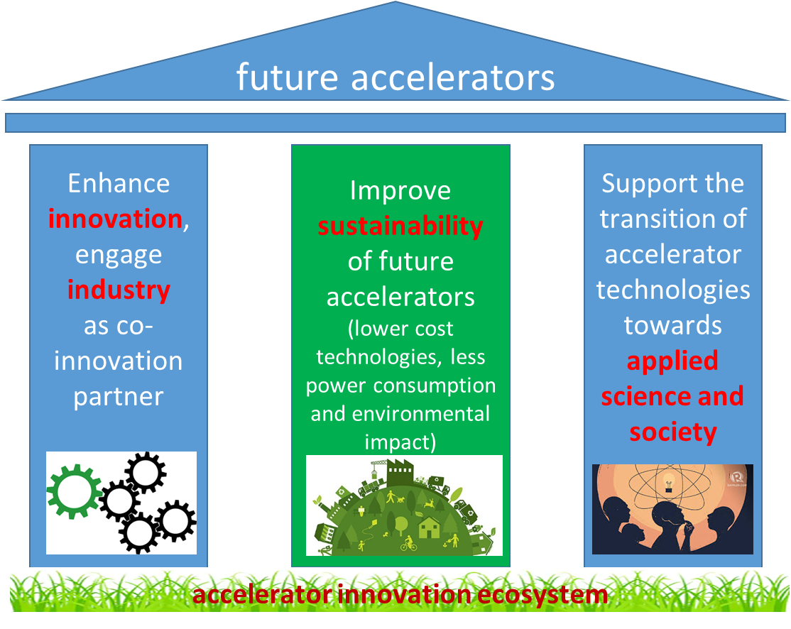
Did we achieve our objectives?
Goals of I.FAST:
As an Innovation Pilot, move to open innovation: associate industry to innovation, engage industry as co-innovation partner.
Structure and enlarge the accelerator innovation ecosystem, thanks to 17 industrial partners (35% of total) and 37% new partners w.r.t. previous projects. Integrate technology infrastructure.
Develop technologies to improve sustainability of future accelerators.
Favour transition of accelerator technologies to applied science and society.
YES !

Slide 7
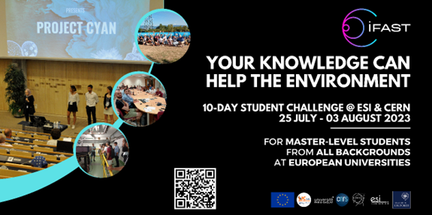
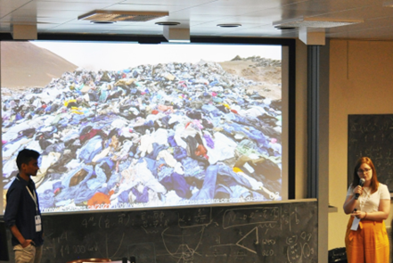
Some highlights along the main priorities
13 innovative prototypes realised with industry (some still ongoing - details in next presentation) - so far, all respecting specifications. Innovation Fund very successful.
Important industry engagement, setting up of the Accelerator Industry Permanent Forum, final success of the industry exchange programme (5 exchanges, last 2 ongoing).
Sustainability becoming key component of all our R&D activities.
Outreach via 4 successful CBI events. Impact on society with accelerators for environment.

Slide 8
The 13 I.FAST high-level prototypes
N. | WP | Prototype | Status
1 | 7 | Longitudinally variable dipole | D7.3 – missing accept.
2 | 7 | Two high-gradient C-band RF guns | D7.4 - completed
3 | 7 | CompactLight structure prototype 1 | D7.5 – missing meas.
4 | 7 | CompactLight structure prototype 2 | D7.6 – missing meas.
5 | 8 | Combined CCT magnet demonstrator | D8.4 – completed?
6 | 8 | HTS CCT magnet demonstrator | D8.5 – missing meas.
7 | 9 | Coated cavity | D9.3 – completed
8 | 9 | Multilayer coated cavities | D9.4 - completed
9 | 10 | RFQ prototype | completed
10 | 11 | Klystron prototype | D11.2 - completed
11 | 11 | Adjustable PM quadrupole | D11.3 - completed
12 | 12 | Internal RF source for cyclotrons | D12.3 – completed
13 | 13 | GaN amplifier module | D13.3 - completed

Slide 9
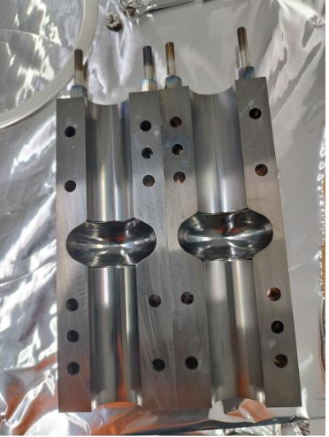
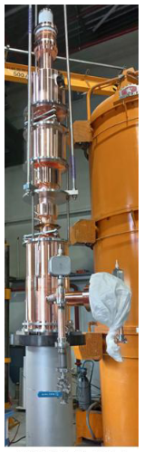
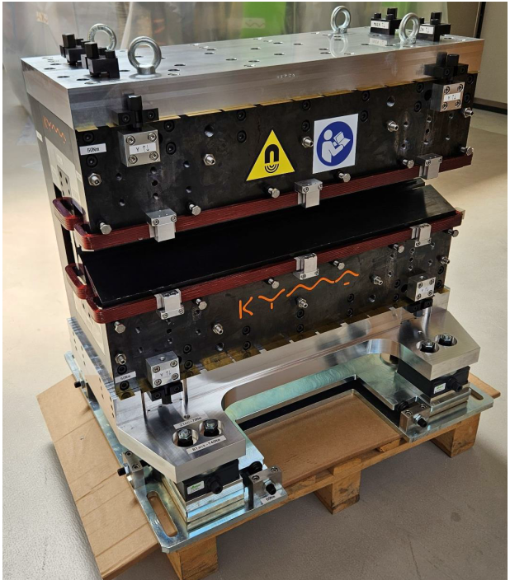
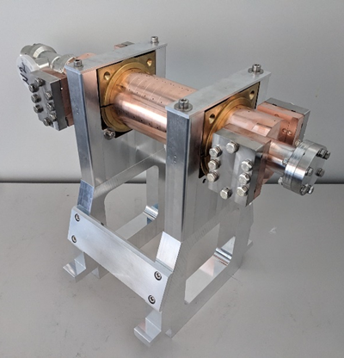
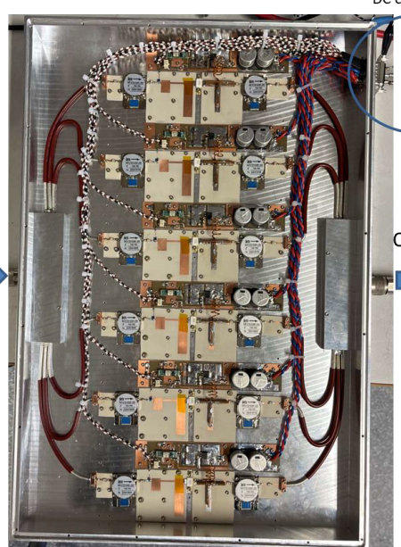
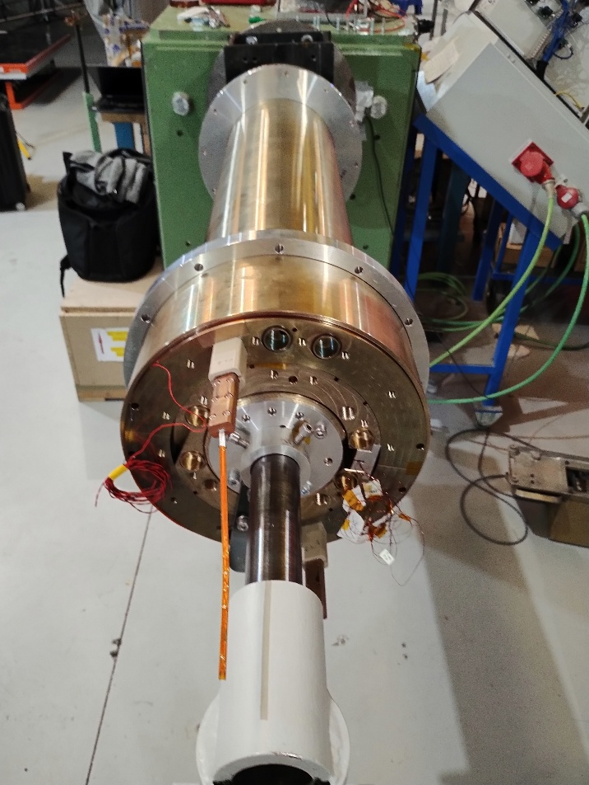
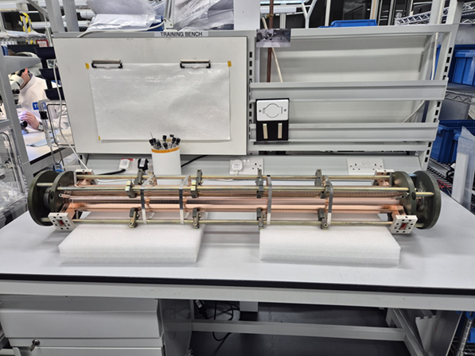

I.FAST prototypes in pictures
9

Slide 10
Last effort: Periodic Report 3
Covers the 3rd 18-month period (May 2024 – October 2025)
Must be submitted 2 months after end of period (31 December 2025)
Task Leaders for active Tasks have received at end September a template to be filled in with a description of activities (May 2024 - October 2025): summary, objectives, description of work, meetings, milestones, deliverables, publications, ~2 pages per Task.
20 October 2025 was the deadline for sending the contributions to Valérie, who assembles the WP Sections and sends them to WP Coordinators for validation at end October.
15 November 2025: deadline for WP Coordinators to send WP chapters to Valérie.
30 November: complete document sent to WP Coordinators for approval.
15 December: Report ready for submission.

Slide 11
Periodic Report 3: status of contributions
Deadline for submission was 20 October (yesterday).
Many thanks to all those who have submitted their contribution on time – we will start working on them immediately after this Meeting.
Still to be received: N. Delerue, T. Ekelof, M. Morandin (?), L. Garolfi, F. Zimmermann/G. Franchetti, L. Gizzi (?), R. Bartolini, Y. Papaphilippou, E. De Matteis/J. Munilla Lopez, G. Dauria, M. Vedani (?).
Reminder: even if your Task was not active in Period 3, if you are claiming expenditures in this period you must contribute to the Periodic Report – to show how you used the budget.
We did not ask for contributions to Tasks there were completed – but if you still had some activities, please contact us!

Slide 12
SAC Observations and recommended actions
SAC Message | Action
Expand communication output (publication quotas, communication liaisons in WPs, communication trainings for WPs). Secure CBI sustainability (alumni, spin-off funding). Broaden communication audiences. (schools, policy makers). | Lack of time and resources to implement in last 6 months of I.FAST. Message passed to EPITA that plans to hire a full-time person for communication and outreach.
Provide new concepts legacy catalogue (summary, maturity, use, next steps). | Resources were limited to Workshops, but message transferred to T5.2.
Continue in next project high-field HTS magnets, SC RF with A15 (Nb3SN and other), AM technology, advanced acceleration technologies, … | Message taken, see presentation on EPITA proposal.
Publish sustainability assessment approach as a reusable I.FAST framework, promoted across RIs. | Will be part of EPITA
For major hardware outcomes, provide TRL status update, intended use case, estimated maturity. Cross-WP “lessons learned” report on best practices. | Message passed to speakers for this meeting, lessons learned will be compiled.
At final meeting, showcase project outcomes (demos, roadmaps, partner matchmaking). | Message passed.
Consistent use of terminology and metrics. | To be implemented (via TIARA?)
Knowledge valorisation, start-up support in I.FAST2 | See EPITA presentation

Slide 13
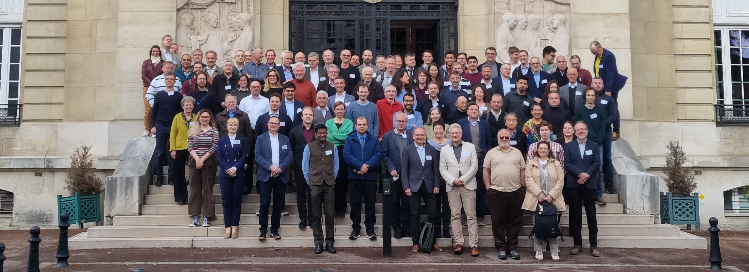

A final thank you
I.FAST has been an amazing project. It was our first one focused on innovation, and even through tough times, it really delivered. It’s going to be a great example for future accelerator projects.
And of course, none of this would’ve been possible without a fantastic team—huge thanks to all of you for your hard work, your support, and the great team spirit throughout this adventure!
Special thanks to:
Valérie
The CERN Project Team
My 2 Deputies
All WP and Task Leaders
Our Scientific Advisory Committee
All the I.FAST participants!
This project has been proud of received funding from the European Union’s Horizon 2020 Research and Innovation programme under GA No 101004730.

