Slide 1
Final Results of the Longitudinally Variable Dipole
I.FAST – 5th annual Meeting 2025 – 22/10/2025
F. Toral (CIEMAT) and Y. Papaphilippou (CERN)
for the Task 7.3 collaborators

Slide 2


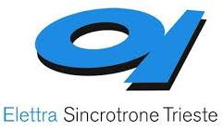

VAriable Dipole for the Elettra Ring - VADER
Task 7.3 within I.FAST WP7: High Brightness Accelerators for Light Sources
Partners and collaborators:
Y. Papaphilippou
(A. Poyet)
M. Dominguez
F. Toral
E. Karantzoulis
D. Castronovo
D. Caiazza
R. Geometrante
R. Righi
D. Topalovic

Slide 3
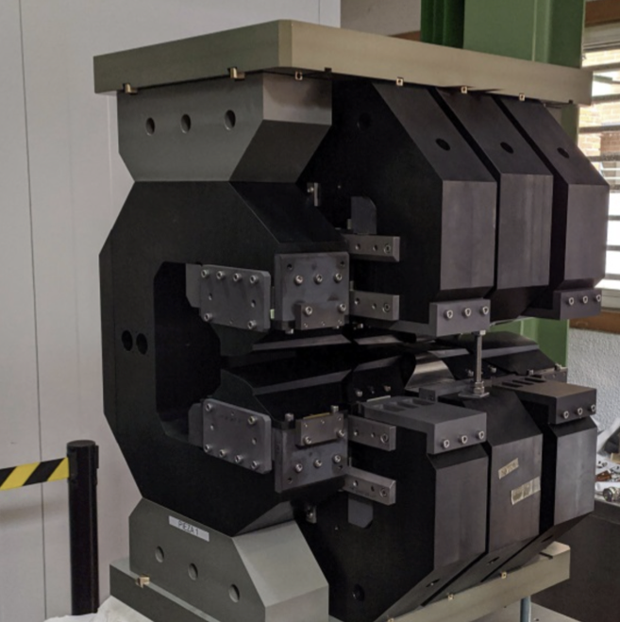
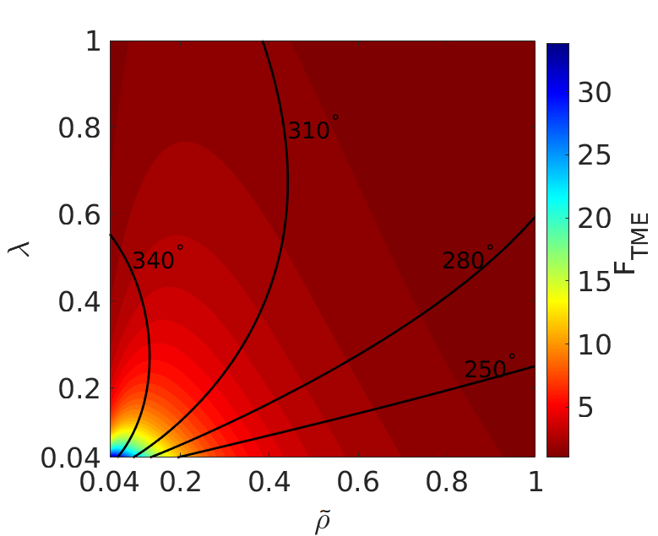
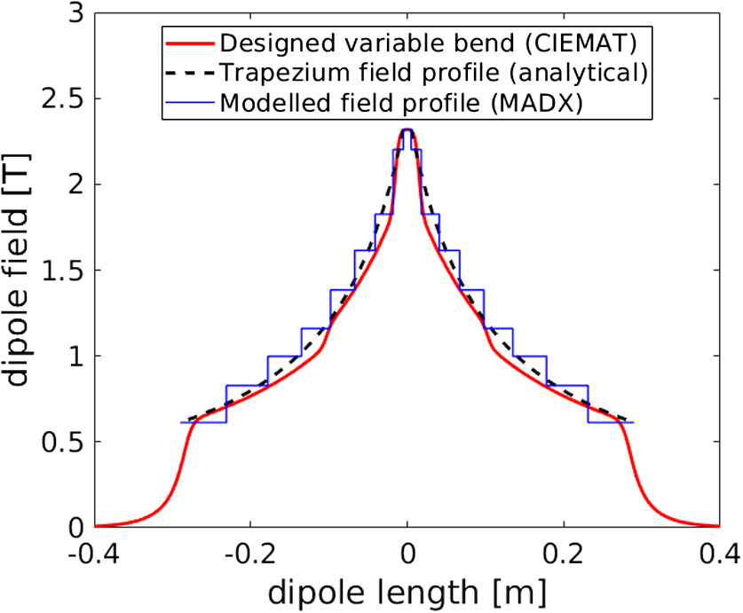
VADER objectives
Fabricate an innovative dipole magnet prototype with longitudinal varying dipole field, including a transverse gradient for the ELETTRA upgrade
Permanent magnet concept with trapezoidal bending radius, 2.3 T peak field and ~10 T/m gradient, already established (CERN/CIEMAT)
Proved the horizontal emittance reduction to ultra-low levels of i.e. ~60 pm @ 2.86 GeV, for the CLIC DR (M. A. Domínguez Martinez et al., IEEE Trans. Appl. Supercond. 28, 1, 2018; S. Papadopoulou et al, PRAB 22, 091601, 2019)
First demonstrator constructed/qualified by CIEMAT

Slide 4
VADER objectives
Keep the same S6BA-E lattice for Elettra and replace the LG dipoles by VADER ones.
Implement a trapezoidal profile in bending radius
Observe a clear emittance reduction
Some constraints:
Same geometrical layout
Same total bending angle for each dipole
Same dipole length
But also some freedoms:
We set the dipole peak field at 2.3 T (as for the CLIC magnet) instead of the current 1.8 T

Slide 5
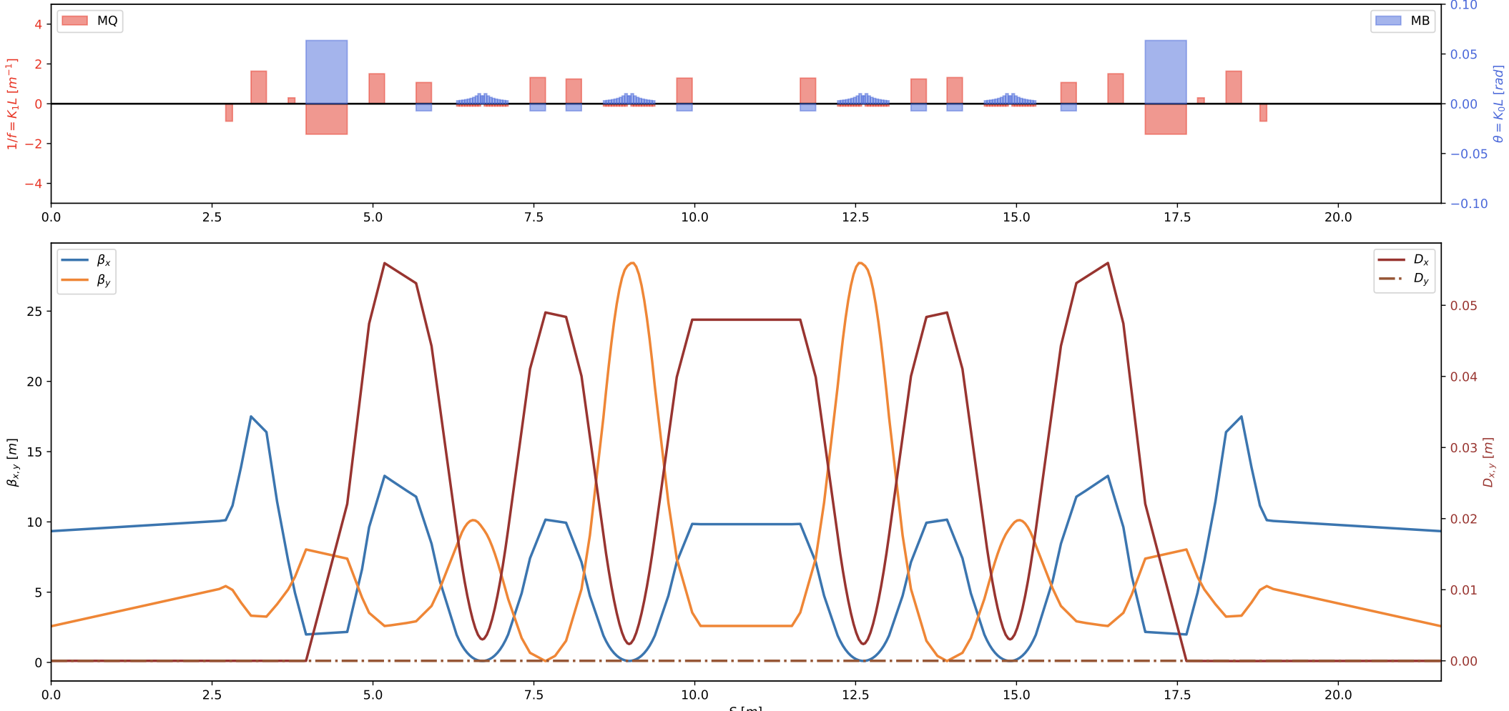
Lattice and optics design
A. Poyet
Optics constraints at the ID are matched
Horizontal emittance reduction from 212 to 100 pm (more than factor of 2!)
Tunes: 34.706 / 22.852
Chromaticities: -157/-125

Slide 6
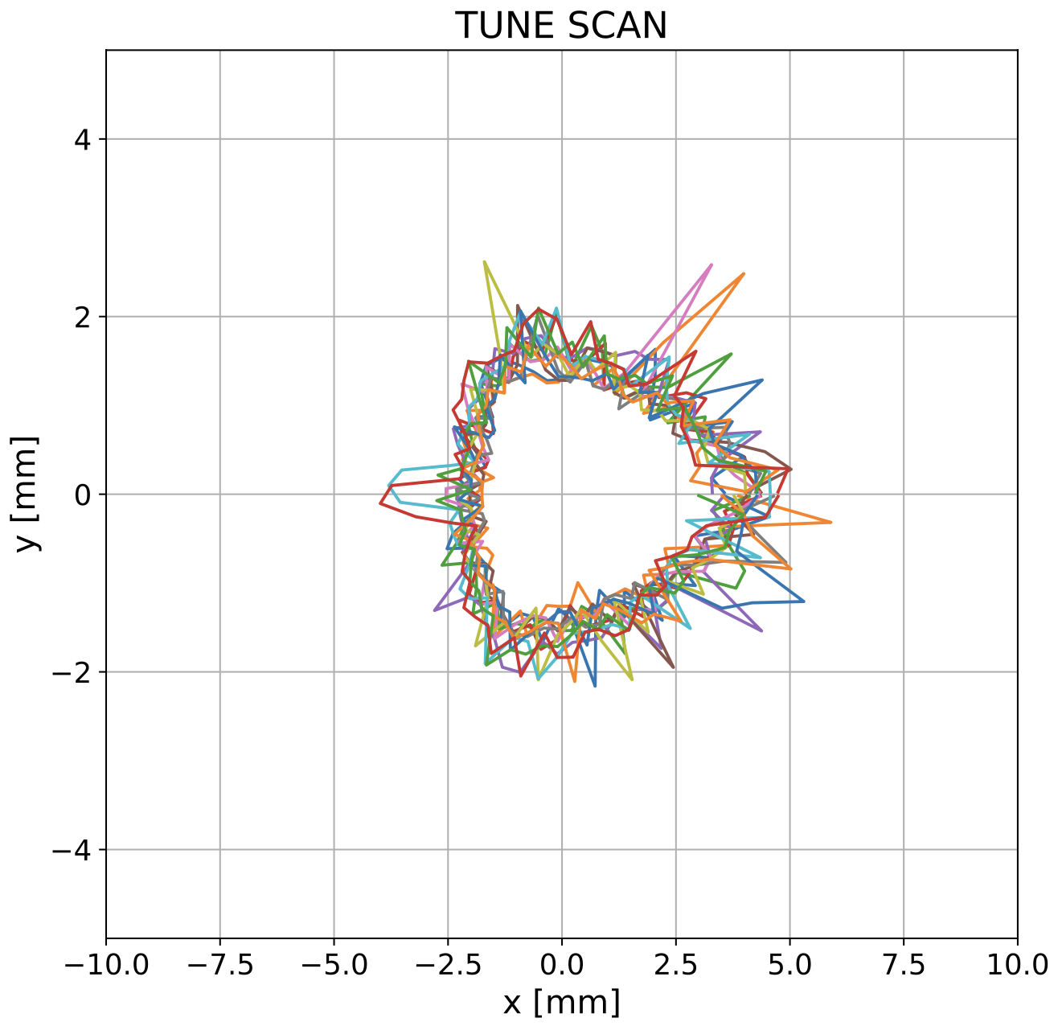
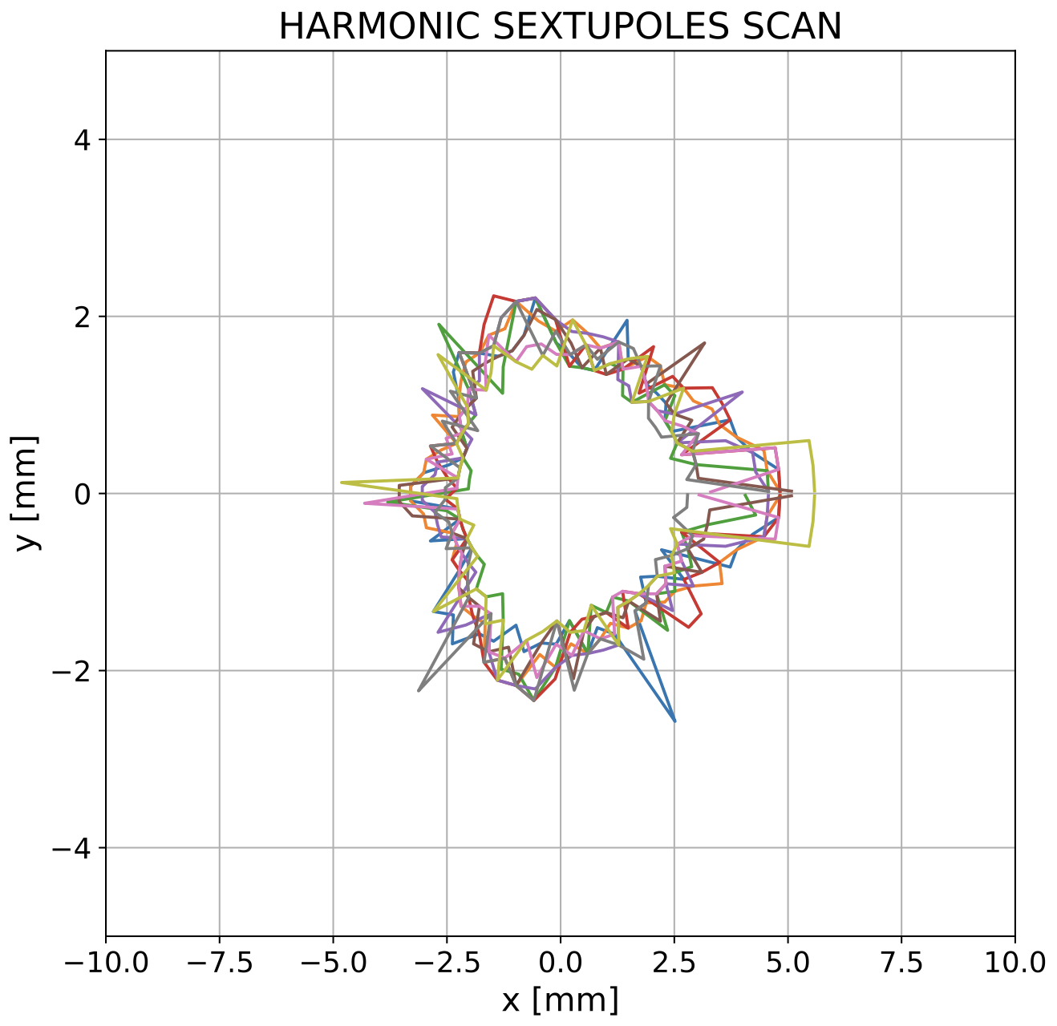
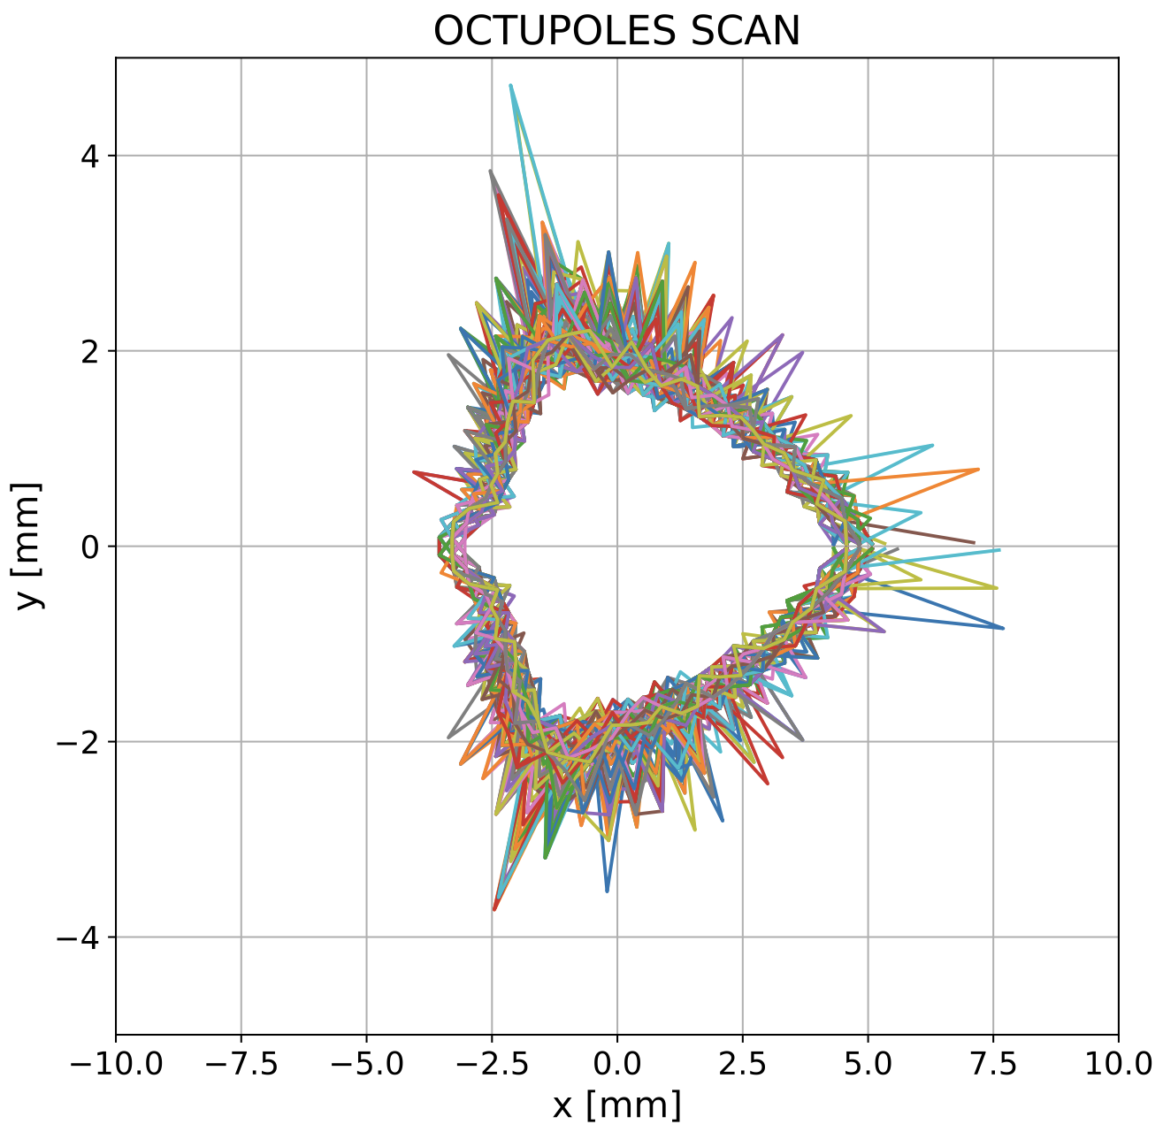
Non-linear Optimization
On-momentum, without error
→ Up to ~ 6 mm DA in the horizontal plane, ~ 3 mm in the vertical one
→ Good starting point for further iterations, including errors/corrections, tune optimisation etc.

Slide 7
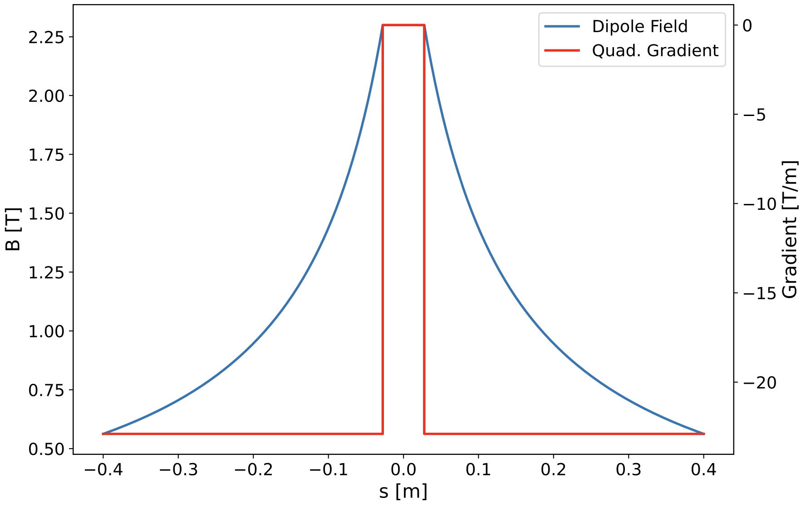
Profile Design and Magnet Specifications
Similar parameters as CLIC DR but…
Higher transverse gradient (> factor of 2)
Higher magnetic gap (~40%)
Longer magnet (~40%)
Specifications | CLIC DR | VADER
Magnet Gap (mm) | 13 | 18
Max Field (T) | 2.3 | 2.3
Transverse G (T/m) | 11 | 23
Field Quality (Units 1E-4) | ≈ 1 | ≈ 1
Magnet Length (cm) | 56 | 80

Slide 8
Magnetic design challenges
Needed to satisfy field requirements for curved trajectory.
Curved trajectory combined with higher gap and low multipole content for iron dominated magnet that works under saturation, extremely difficult objective
Sagitta much higher than expected
Impossible to perform required calculations with Opera software for curved trajectory
This forced to manually develop in-house code (CIEMAT) to analyse field quality in both Opera & Matlab

Slide 9
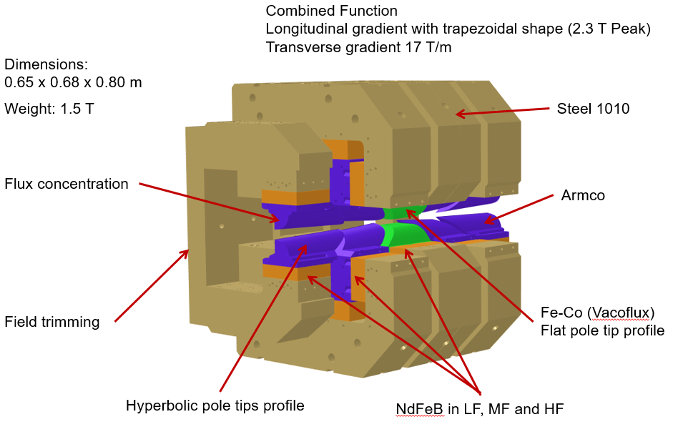
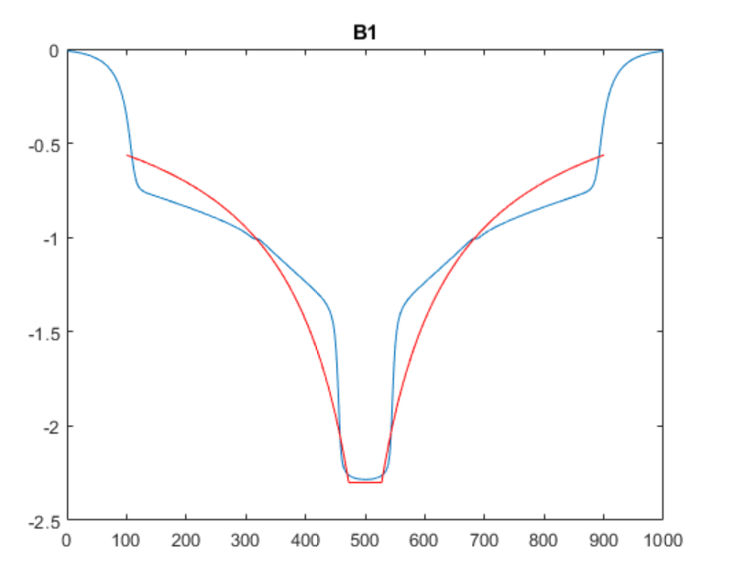
Magnetic Design @ CIEMAT
M. Dominguez,
F. Toral
Longitudinal gradient profile achieved
Integrated transverse gradient slightly below specs but ok for optics
Field quality looks reasonable
Mechanical design done
Fabrication drawings communicated to KYMA
B1 | B2 | B3 | B4 | B5 | B6 | B7 | B8 | B9 | B10
10000 | -807.79 | 4.65 | 6.74 | -1.09 | 0.21 | -0.07 | 2.55E-05 | -0.01 | -0.03

Slide 10
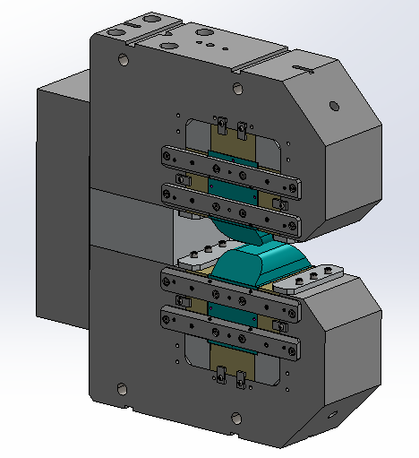
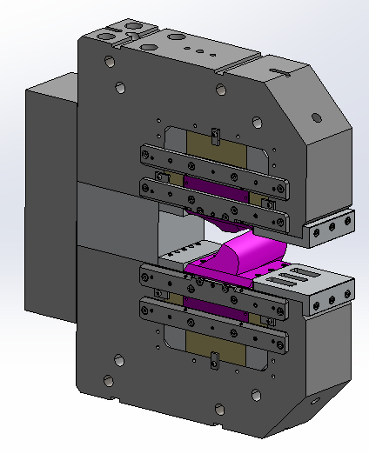
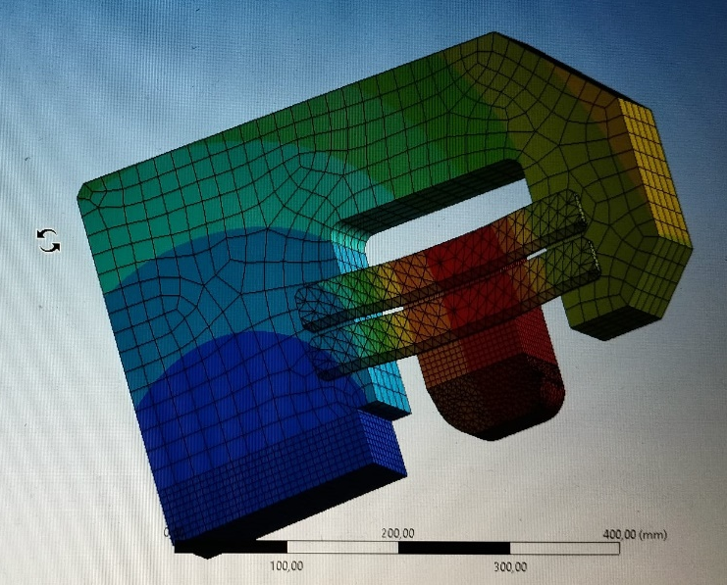
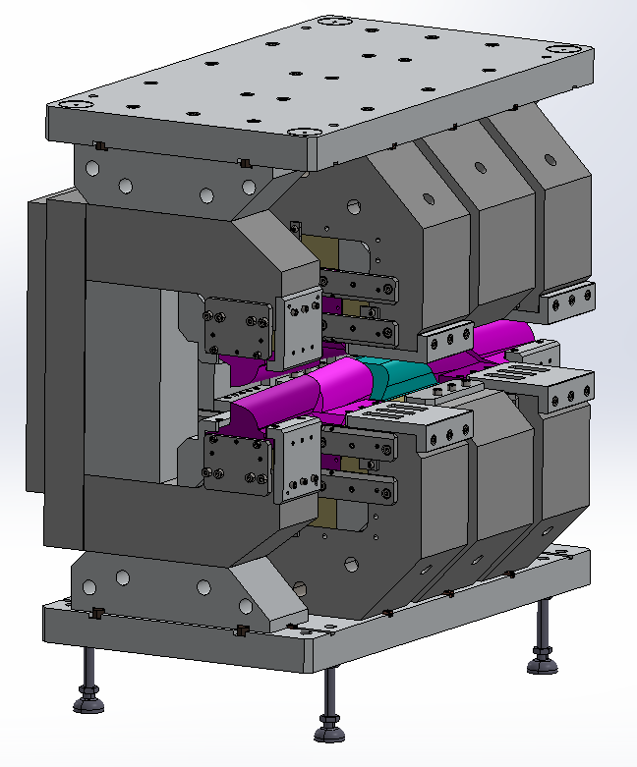
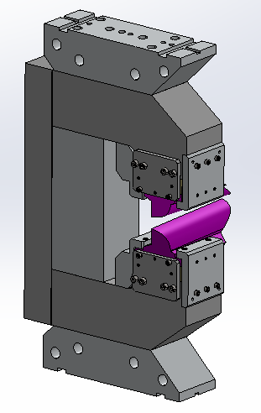
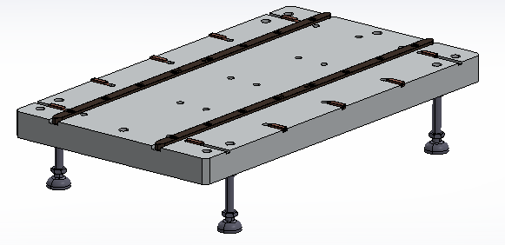
VADER: Final Mechanical Design
HF Module
MF Module
Fig. 6: Deformations in the HF module
Base with guides
Final assembly
LF Module

Slide 11
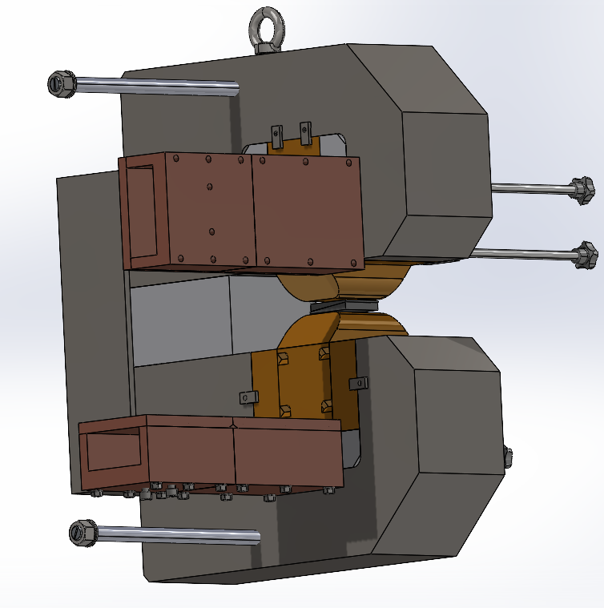
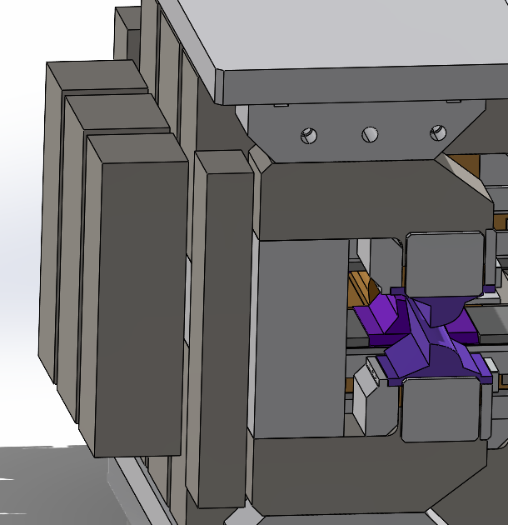
VADER vs CLIC Prototype: Main differences
PM blocks bigger, meaning higher forces. POM boxes redesigned (longer) and second one to carry block added
Moving parts of field regulation under much higher forces, guides reinforced and regulating screws include bronze ending to avoid fluency with time (instead of plastic in CLIC)

Slide 12
VADER: Timeline
Final manufacturing drawings - done on February 2025
Iterations for magnetic material selections during March 2025
From mid-April 2025, Kyma proceeded with procurement of components
Magnetic material delivery (expected during summer 2025) delayed due to shipping issues to September 2025
All parts machined and sent to KYMA on early October 2025
Assembly process is estimated to take ~2 weeks (procedure communicated by CIEMAT, based on CLIC prototype experience)
Estimated date for full fabrication: mid-October 2025 (end of this week!)
Measurements in Elettra for acceptance tests (bench/mole procured) end of October 2025 (next week!)

Slide 13
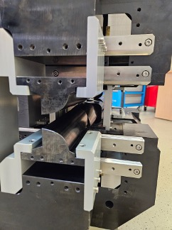
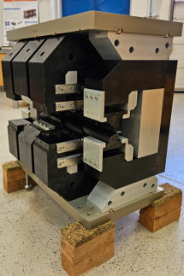
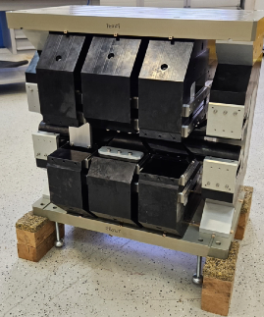
VADER: Assembly at KYMA
Mechanical assembly finished last week
High-field and low-field part assembled with magnets, will be followed by mid-field part, to be finalised end of this week

Slide 14
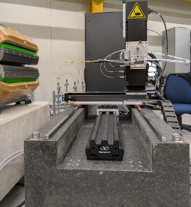
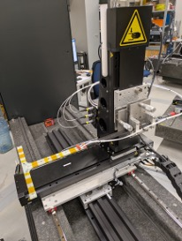
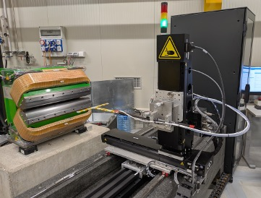
VADER: Measurements at ELETTRA
New Hall probe procured and delivered to ELETTRA
Measurement bench ready to receive magnet for measurements (next week)

Slide 15
VADER: Achievements
Specified longitudinally varying dipole with gradient for reducing horizontal emittance of Elettra upgrade SR by factor of 2
Designed advanced permanent magnet dipole with variable field and gradient including mechanical field trimming reaching all specs (sustainability!)
Adress various challenges/limitations with present/previous design
Magnet is in the procurement/fabrication face in KYMA (industrial partner) reaching TRL6 (Technology demonstrated in industrially relevant environment)
Outcome: Ready for series production and industrialization. Proposal included in EPITA to work on a wiggler for FCCee injectors.
Impact: Technology to be used in future low-emittance rings (light source SRs, damping rings for colliders such as FCC, etc…)

Slide 16

Thank you for your attention!

Slide 17
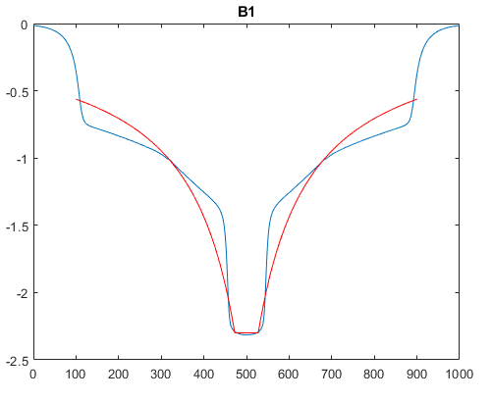
VADER: Final magnetic design
 | Tech Specs | Design
Magnet gap (mm) | 18 | 18
Peak field (T) | 2.3 | 2.3
Transverse grad. (T/m) | 17 | 15.2
Field quality (units, 10⁻⁴) | < 5 | < 7
Integrated field B1 (T.m) | 0.91 | 0.91
Field Trimming |  | +1%,-4%
Longitudinal gradient:

Slide 18
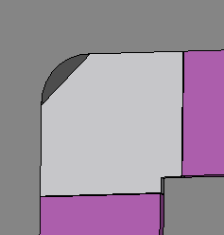
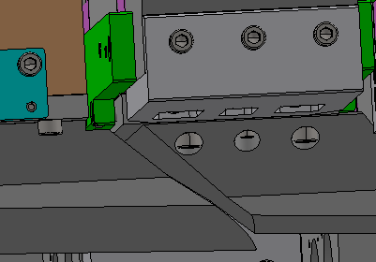
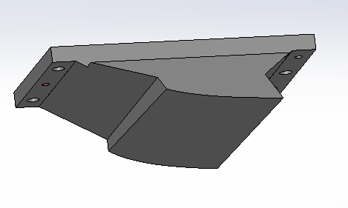
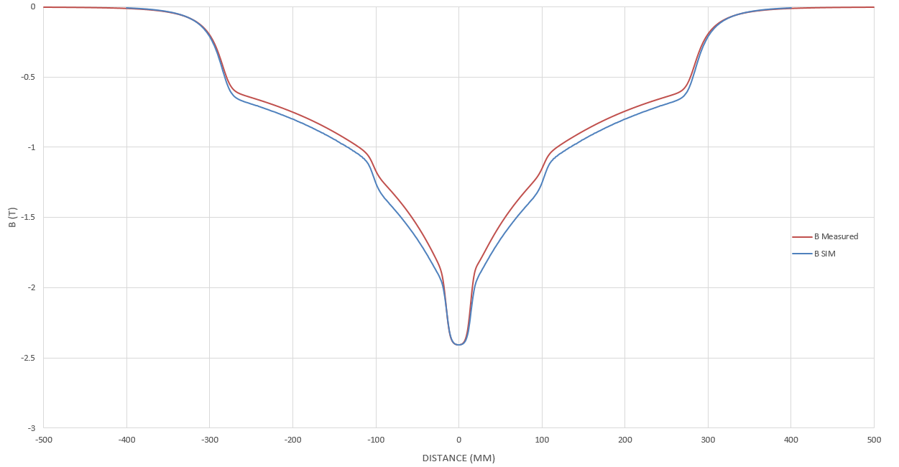
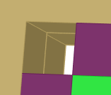
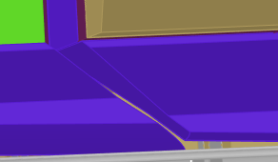

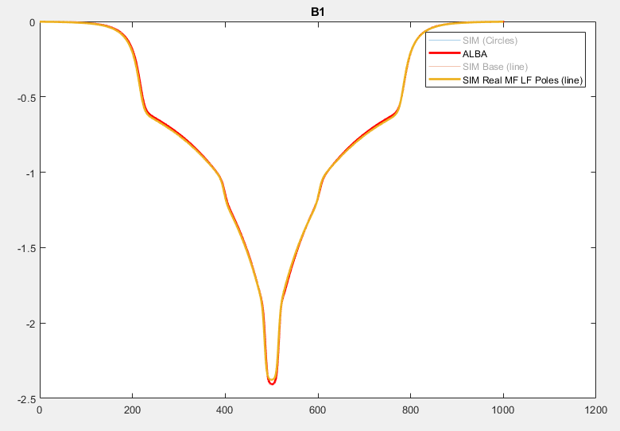
Resolving CLIC prototype issues for VADER
LF pole extrusion
6 mm HF & MF pole base expansion
MF pole extrusion
Discrepancy in CLIC prototype between simulations vs magnetic measurements: 4% lower integrated dipolar field
Various investigations: missing Armco heat treatment, misalignment, hysteresis, simulation error, etc.
Traced back to 3D mechanical model details not reflected Opera simulation model due to simplifications
All three simulated allow model matching perfectly magnetic measurements: 0.641T simulated vs 0.638T measured

Slide 19
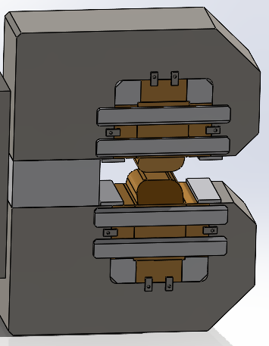
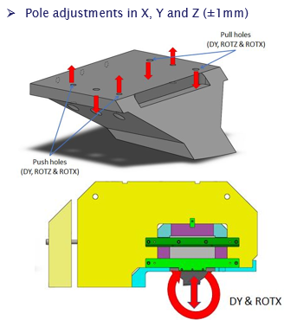
VADER vs CLIC Prototype: Main differences
Iron yokes formed by 3 main pieces instead of one, screwed from iron to iron across aluminium support block (before first assembly step)
In VADER, same pole adjustments in MF and LF modules present in CLIC except DY (vertical adjustment)

