Slide 1
Ongoing upgrades and outlook on ultra-low emittance rings
Riccardo Bartolini, DESY
I.FAST 5th Annual Meeting, CERN, 22.10.2025

Slide 2
Outline
Ongoing upgrades
Ultra-low emittance rings challenges
design and technology
Ultra-low emittance rings network
summary of IFAST activities in Task 7.2
Conclusions and future work

Slide 3
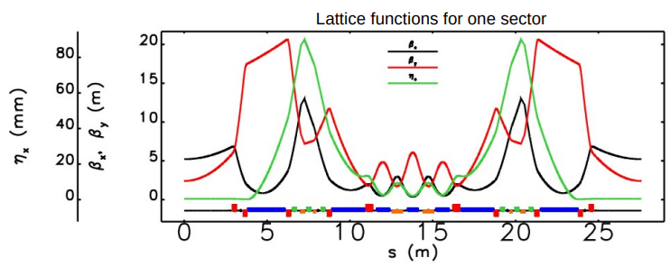
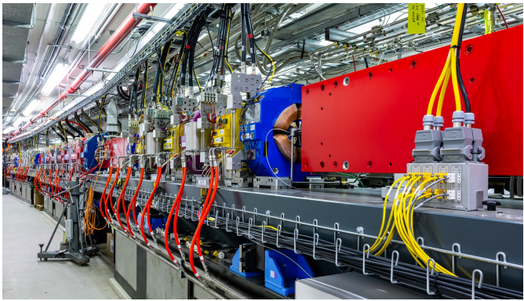
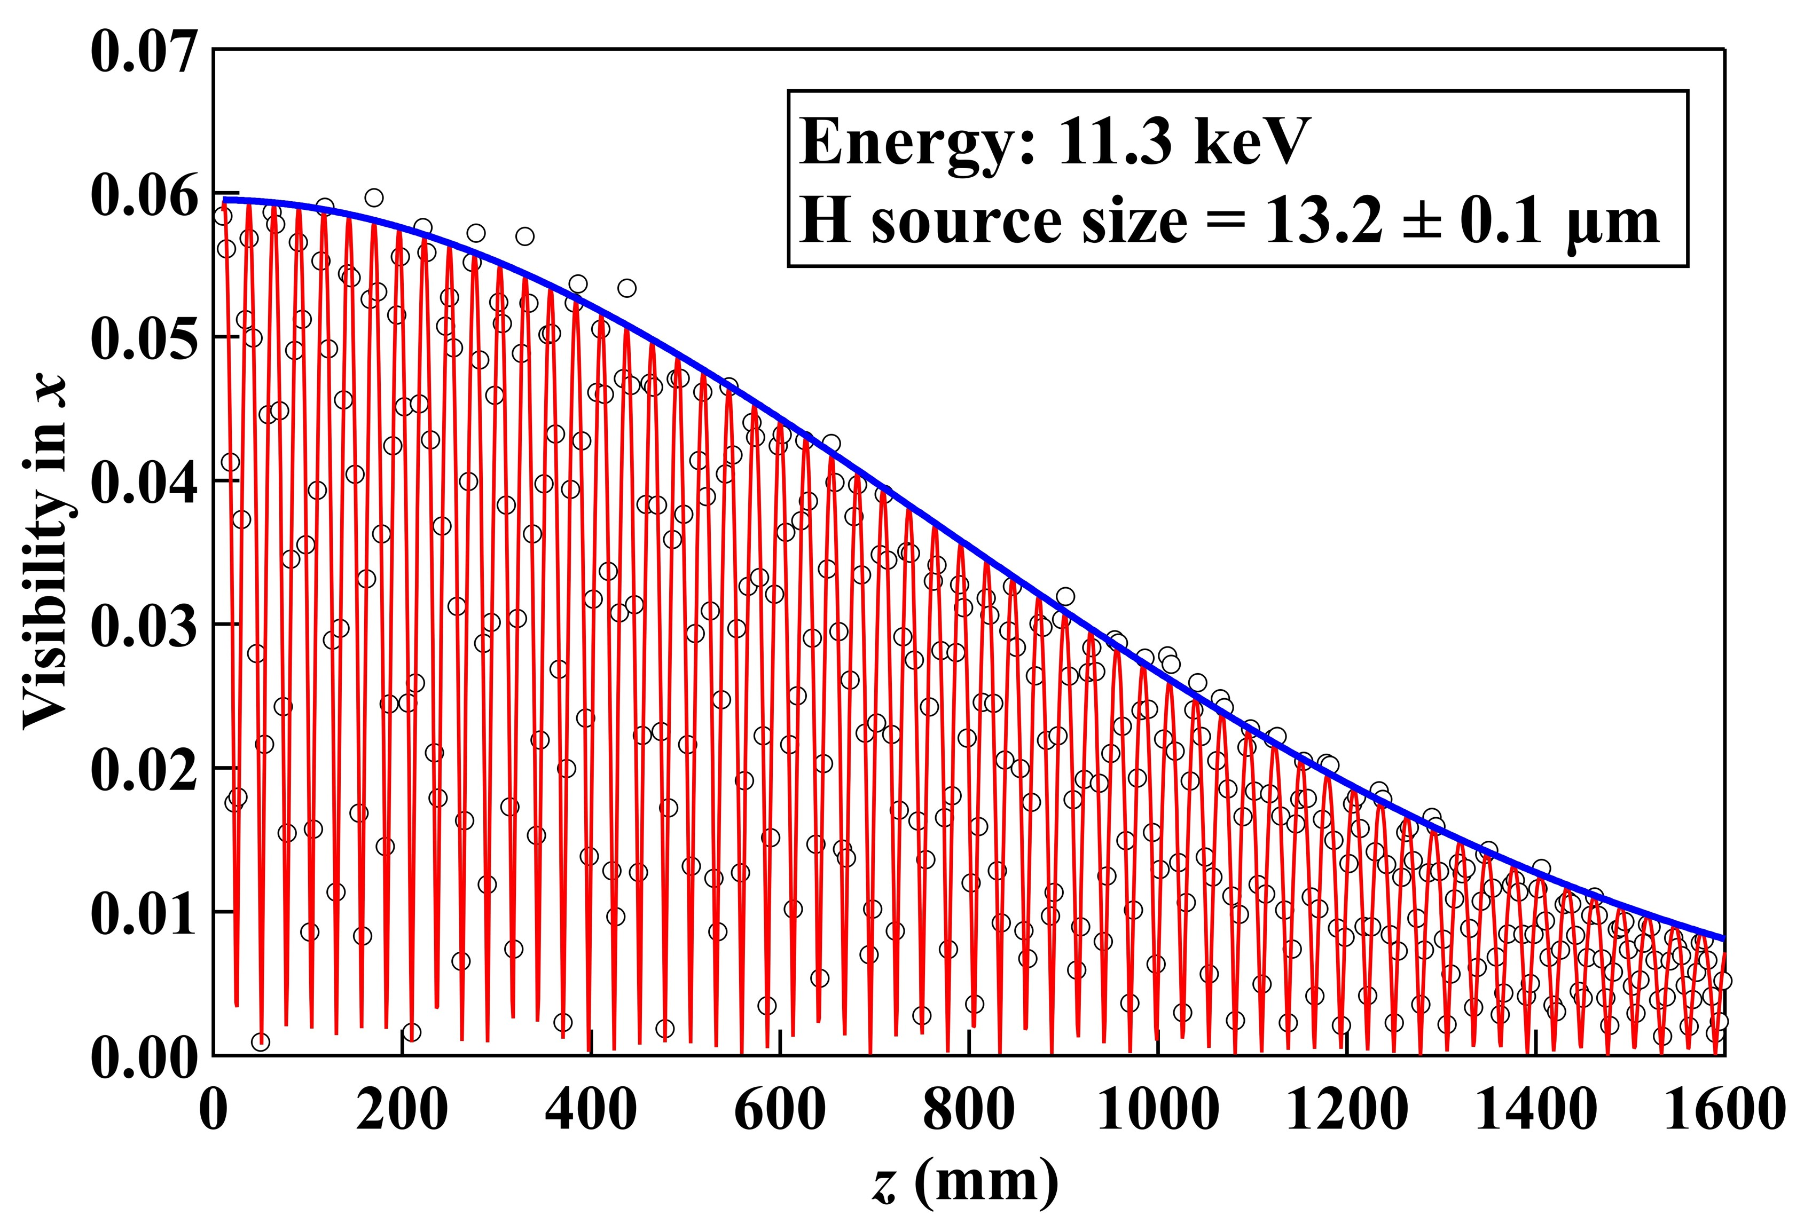
Harvesting successes with the projects launched in the last years
APS-U (Argonne, USA)
First stored beam April 2024
Nominal optics August 2024 (42 pm)
Nominal current 200 mA February 2025
Operation in full coupling 29 pm * 29 pm
working to reach specs in timing mode
(16 nC per bunch)

Slide 4
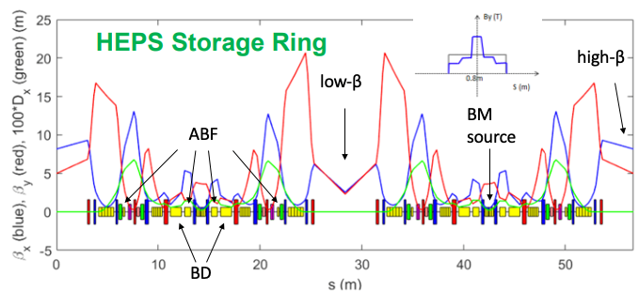
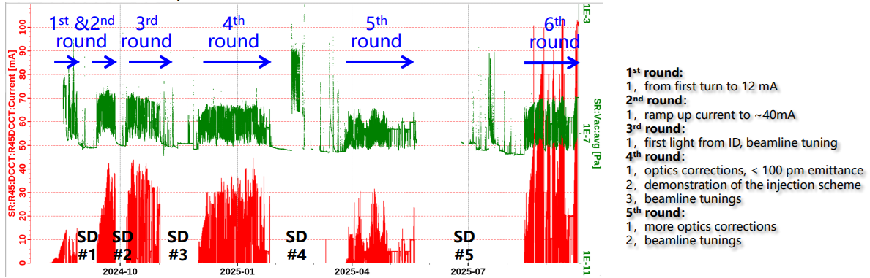
Harvesting successes with the projects launched in the last years
HEPS (Beijing, China)
First turn August 2024
40 mA in December 2024
current limited by RF system installed
Commissioning interleaved with installation
emittance larger than expected
57 pm vs 35 pm

Slide 5
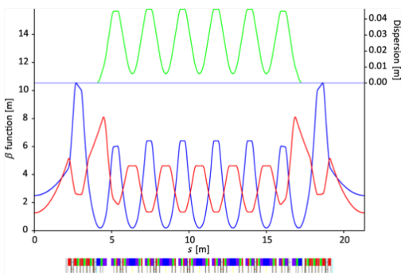
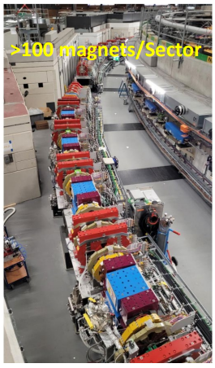
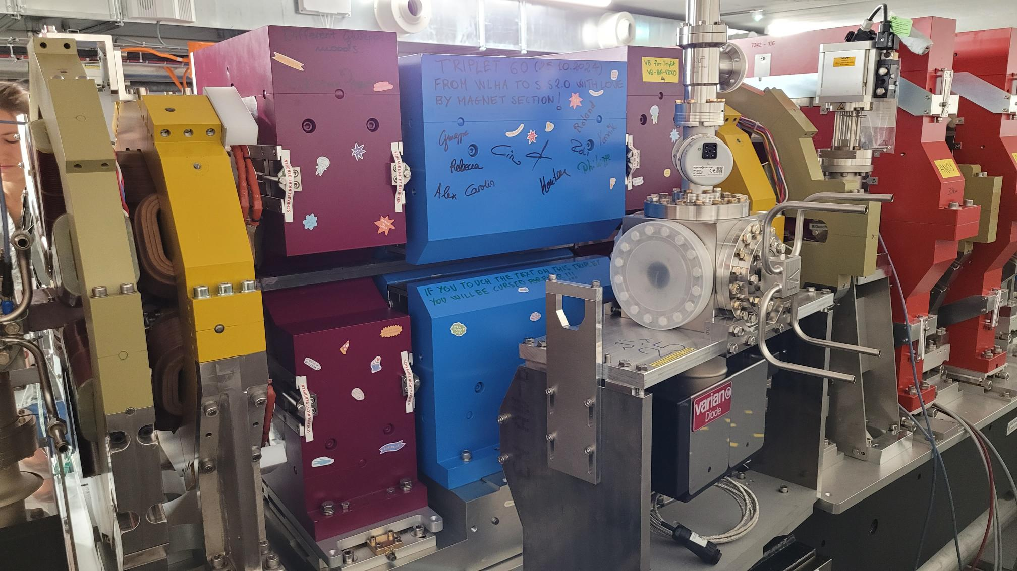
Harvesting successes with the projects launched in the last years
SLS-II (PSI, Switzerland)
first stored beam January 2025
optics corrected (130 pm)
full current 400 mA April 2025
7BA
extensive use of permanent magnets
(also for quadrupoles)
reduction of the energy consumption
(from 24 GWh/year to 17 GWh/year)
despite increase in operation energy
(from 2.4 GeV to 2.7 GeV)

Slide 6
Several other projects are in the execution phase
Elettra 2.0 in shutdown July 2025
Diamond II in shutdown December 2027
SPRing8-II (50 pm, 6GeV), funded
Korea-4GSR (58 pm, 4 GeV) funded
SOLEIL-II (83 pm, 2.75 GeV), partially funded
PETRA-IV funding expected 2026, shutdown in 2030
ALBA in prototype phase, shutdown in 2030
NSLS-III lattice and prototype phase

Slide 7
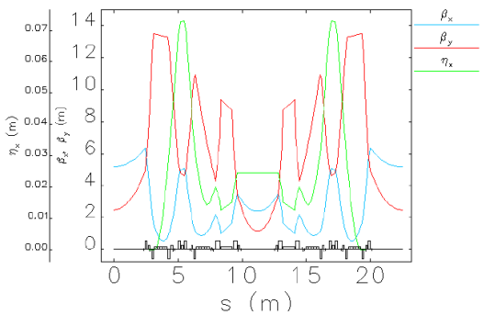
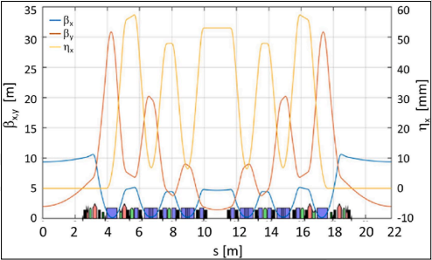
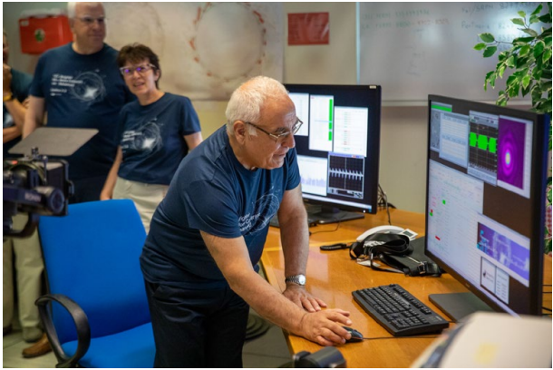
ELETTRA 2.0 and Diamond II – variants of 6BA
Elettra 2.0 will operate mostly at 2.4 GeV with an emittance of 212 pm-rad.
Shutdown since July 2025
Restart foreseen in Sep 2026
Diamond II will operate at 3.5 GeV with an emittance of 160 pm-rad.
Shutdown since December 2027
Restart foreseen in December 2028

Slide 8
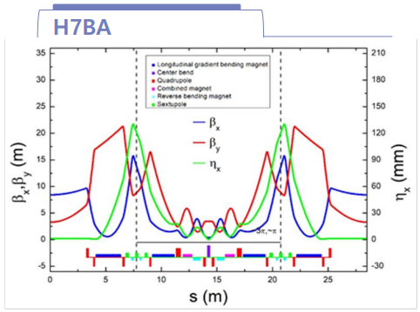
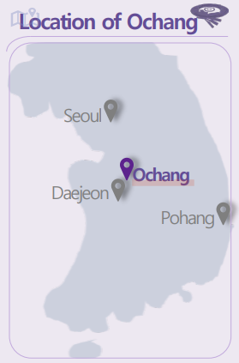
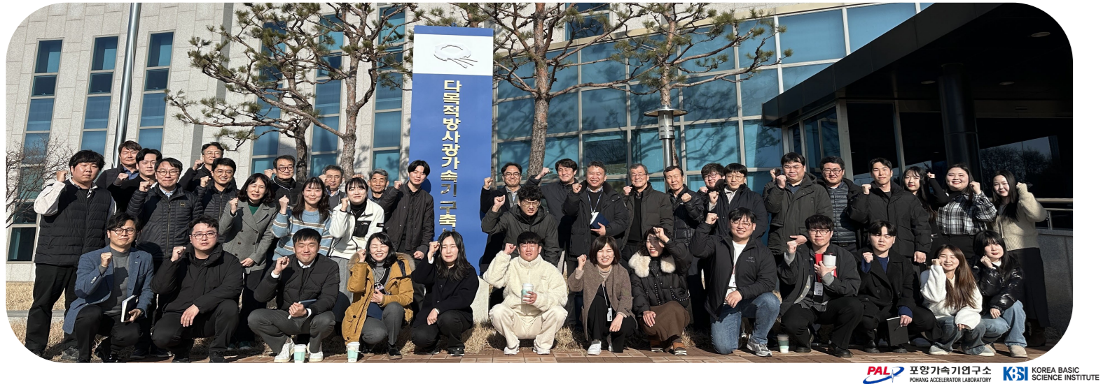
Korea 4th Generation Radiation Source (4GSR)
Green field facility located in Ochang
Beam Energy 4 GeV
Circumference 800 m
Beam Emittance 62 pm·rad
Injection scheme 4 Kicker bumps, off-axis, 2Hz
Installation starting in January 2029
First beam in January 2030

Slide 9
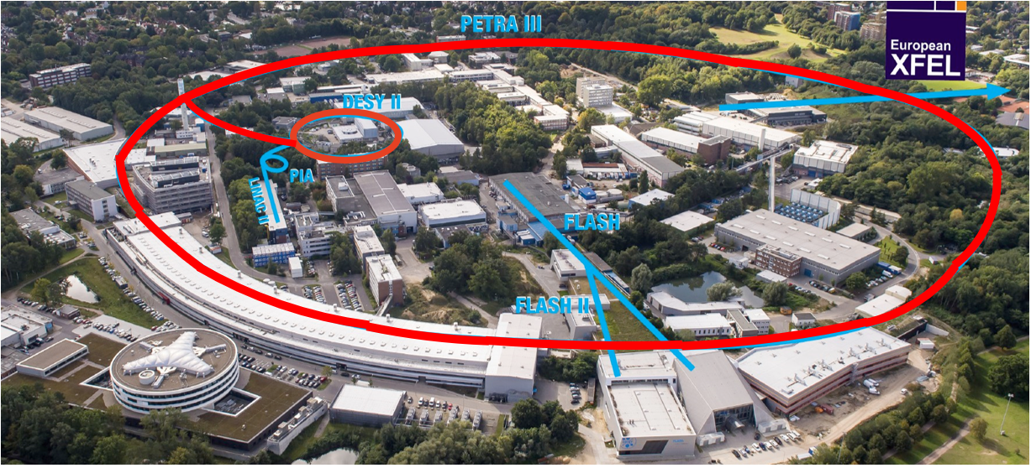
PETRA IV at DESY
Replacing PIII with an ultra-low emittance ring, adding a new Experimental Hall in two more octants. Replacing DESY II with a new low emittance booster
Ada Yonath Hall
Parameter | PETRA III
Energy [GeV] | 6
Circumference [m] | 2304
Emittance (hor./vert.) [nm] | 1.3 / 0.013
Total current [mA] | 100
PETRA III emittance 1300 pm
PETRA IV emittance 20 pm
12 pm * 12pm in full coupling
mode
65 times smaller
enabling > 500 times larger
X-ray beams brightness
Max von Laue Hall
Paul P. Ewald Hall

Slide 10
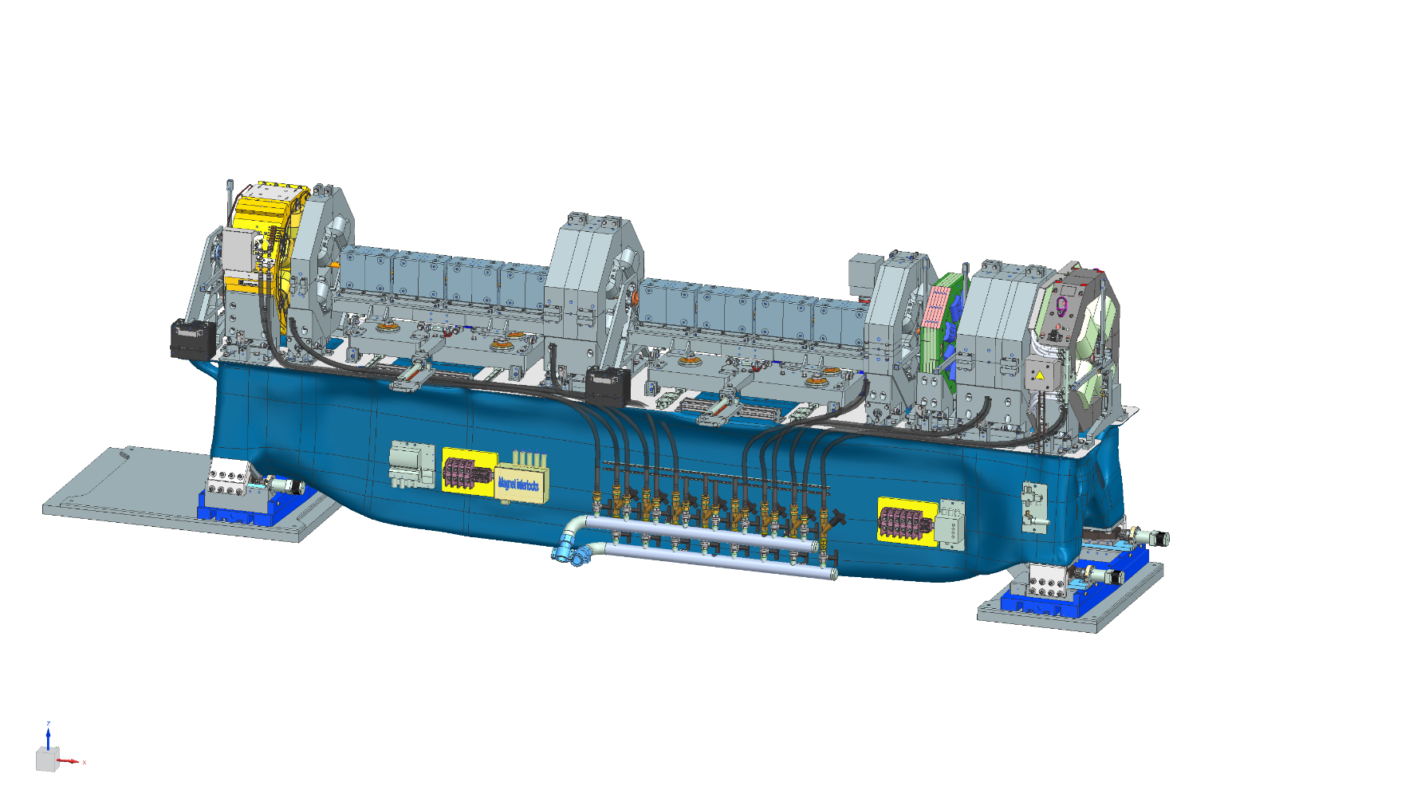
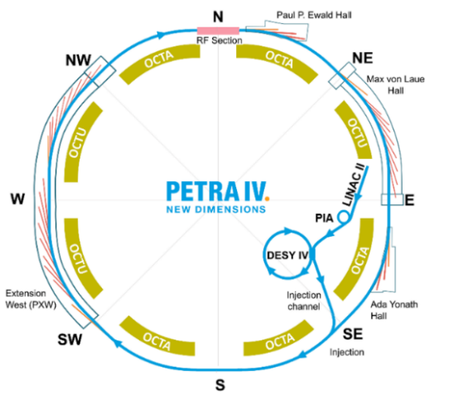
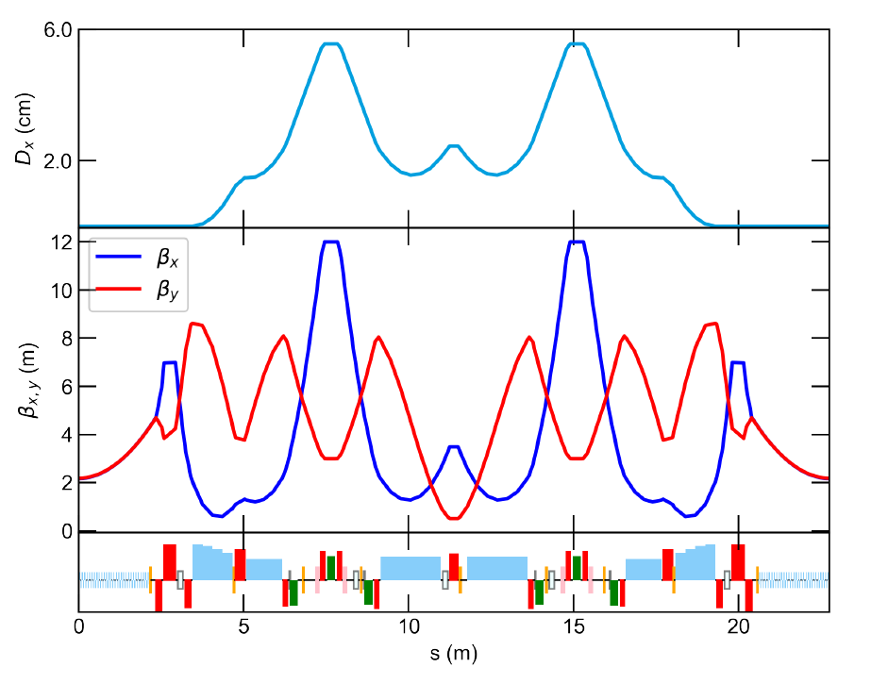
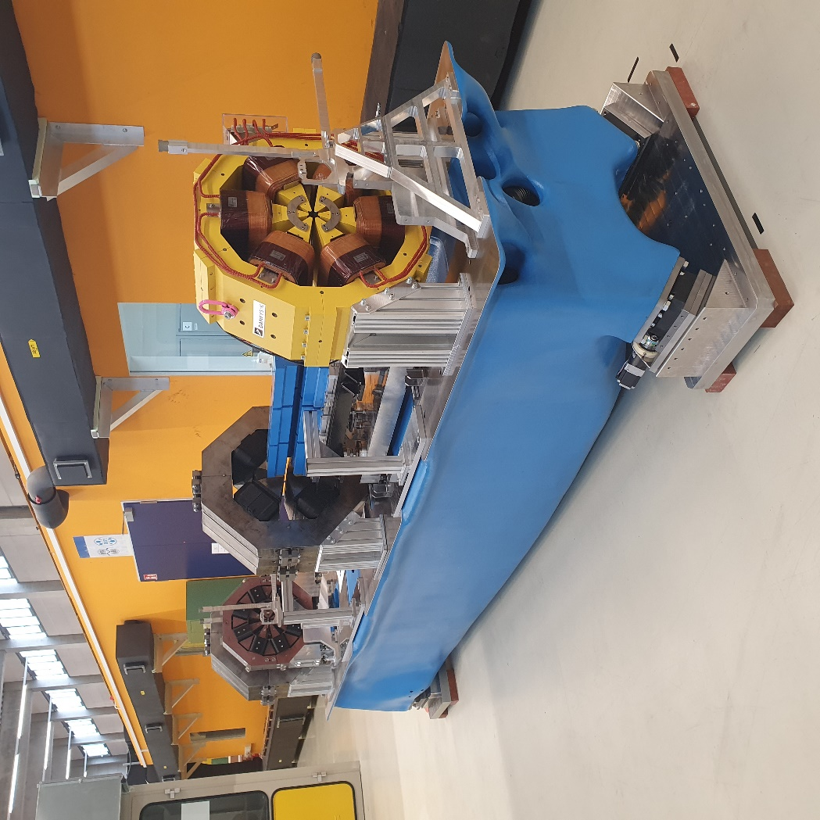
PETRA IV at DESY
The lattice is based on a novel cell structure (H6BA) that is replicated identical across all octants (72 cells)
Prototyping activity ongoing
Shutdown January 2030
2.5 year shutdown due to the large new experimental hall
Restart of operation July 2032

Slide 11
Challenges
The development of ultra-low emittance rings is underpinned by a number of accelerator physics science and technology advances:
Hybrid Multi-Bend Achromat design
Extensive use of permanent magnet - sustainability
HOM damped single cell cavities and SSA
Extensive use of NEG coated vacuum chambers
High voltage fast pulsers and ultra-fast kicker kickers

Slide 12
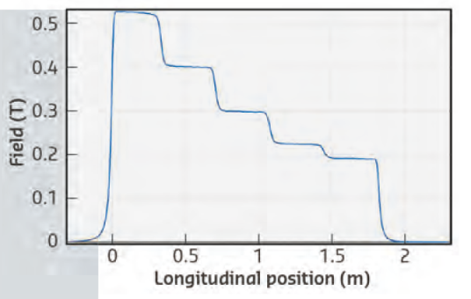
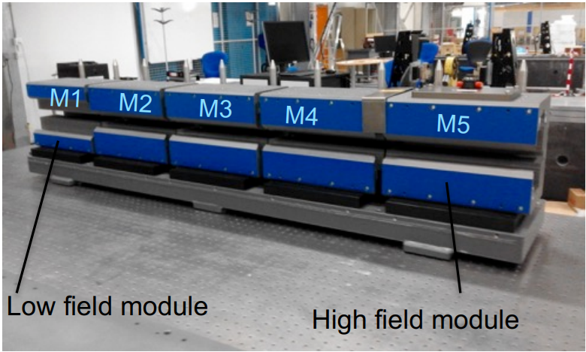
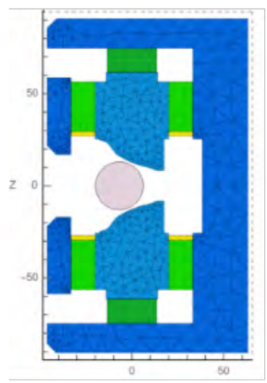
New magnets concepts
Extensive use of permanent magnet based dipoles pioneered at the ESRF-EBS in the longitudinal gradient dipoles
Similar route followed up and extended in many projects
Diamond II
Spring 8 – II
PETRAIV:
longitudinal and transverse gradient dipoles

Slide 13
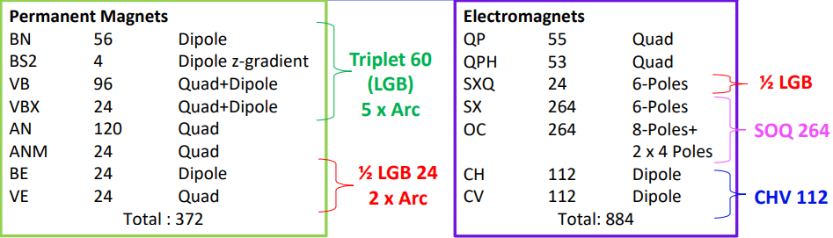
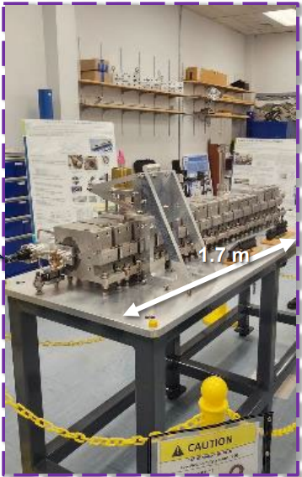
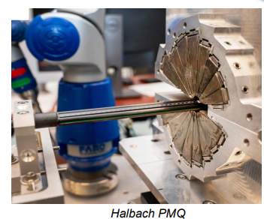
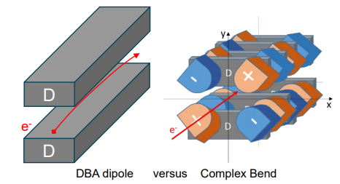
New magnets concepts
Extension to quadrupole (SLS-II and SOLEIL–II)
SOLEIL II
small magnet bore diameter (16 mm) and avery dense magnetic lattice.
110 T/m in 8 mm radius
Complex bends at NSLS-II

Slide 14
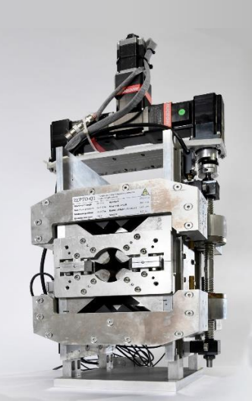
Permanent Magnet Quadrupoles in EPITA
The use of tunable permanent magnet based multipole elements is supported in the EPITA Project
STFC Daresbury
Kyma
DESY
Task 1: ZEPTO Performance Review & Accelerator Quadrupole Specification
Task 2: Modular ZEPTO Product Line Engineering

Slide 15
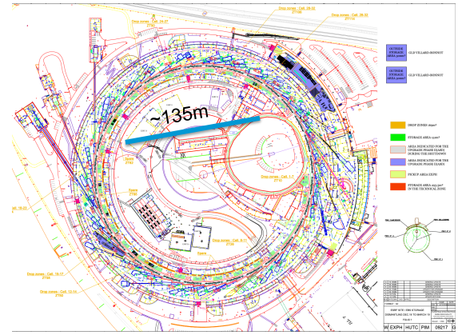
Alternative options for the pre-accelerator: the ESRF LINAC upgrade
Full energy injector with a 6 GeV LINAC
C-band
Cool structures (LN₂)
84 MV/m
~100 m length
4-10 Hz rep. rate
The shortest, cheapest and less consuming solution is a cryo C-band distrib. coupling acc. structure

Slide 16
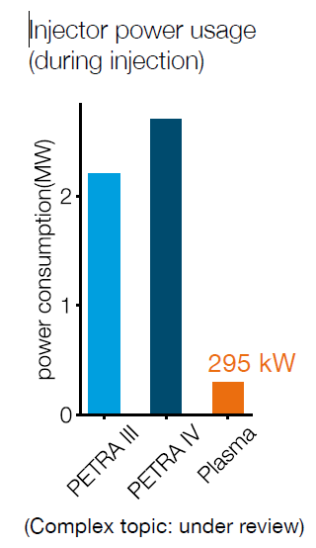
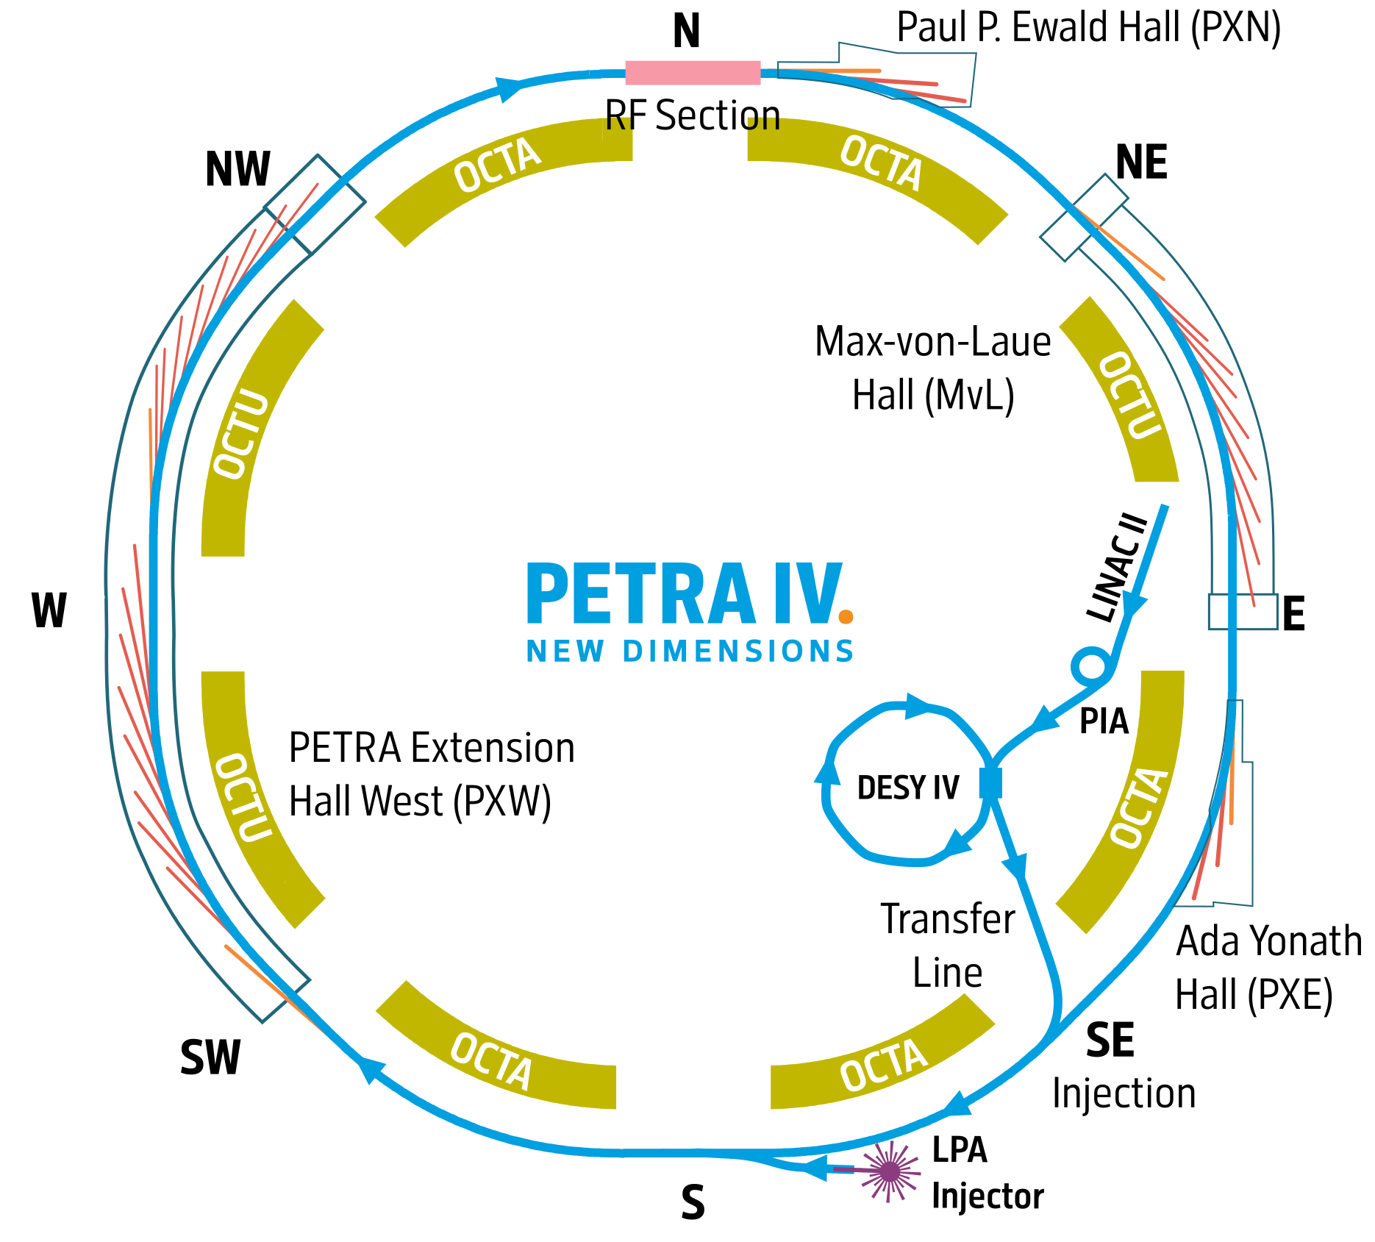
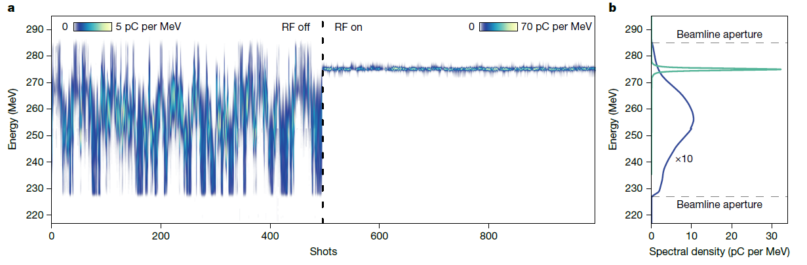
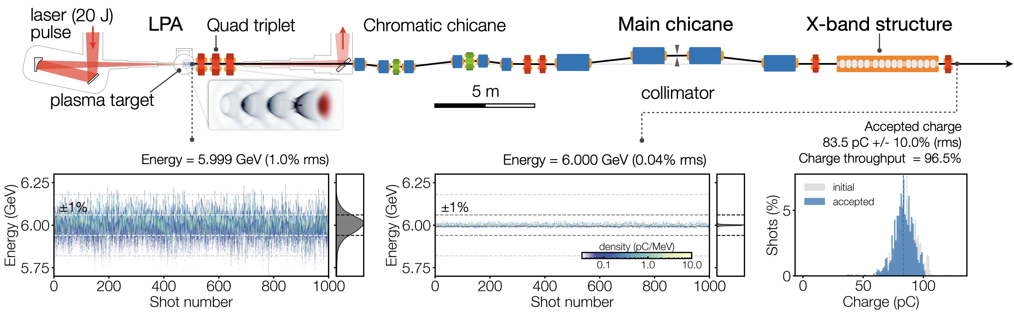
Alternative options for the pre-accelerator: LPA injector
Building on the strong R&D for the development of LPA at DESY, we propose to build a 6 GeV LPA injector for PETRA IV.
Challenges addressed with the RF dechirper experiment at LUX DESY and 450 MeV injection in DESY II by mid 2026
Nature , April 2025
Simulations courtesy
A. de la Ossa, S. Antipov

Slide 17
The Low Emittance Ring (LER) workshops
1th Low Emittance Rings Workshop, 12-15 January 2010 CERN – participants 70
https://ler2010.web.cern.ch/
2th Low Emittance Rings Workshop, 3-5 October 2011 Heraklion, Crete
https://lowering2011.web.cern.ch/
3th Low Emittance Rings Workshop 8-10 July 2013 Oxford University – participants 80
https://indico.cern.ch/event/247069/overview (EuCARD-2)
4th Low Emittance Rings Workshop, 17-19 September 2014, INFN-LNF Frascati – participants 67 https://agenda.infn.it/event/7766/ (EuCARD-2)
5th Low Emittance Rings Workshop, 15-17 September 2015 ESRF, Grenoble
https://indico.cern.ch/event/395487/overview (EuCARD-2)
6th Low Emittance Rings Workshop, 26-28 October 2016, Synchrotron SOLEIL
https://www.synchrotron-soleil.fr/en/events/low-emittance-rings-workshop-2016 (EuCARD-2)
7th LER Workshop, 15-17 January 2018 CERN
https://indico.cern.ch/event/671745/ (ARIES)
8th LER Workshop 26-30 October 2020 INFN-LNF Frascati (held remotely) (ARIES) – participants 160
https://agenda.infn.it/event/20813/overview
9th LER Workshop 13-16 February 2024 CERN (I-FAST) – participants 99
https://indico.cern.ch/event/1326603
10th LER Workshop 8-10 October 2025 DESY (I-FAST) – participants 93
https://indico.desy.de/event/49686/

Slide 18
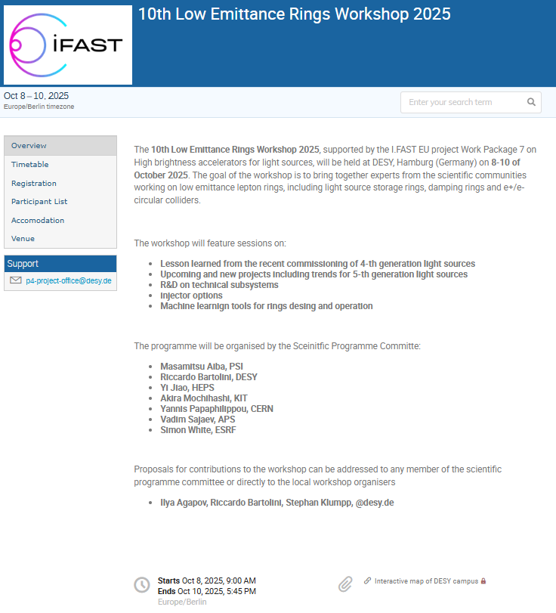
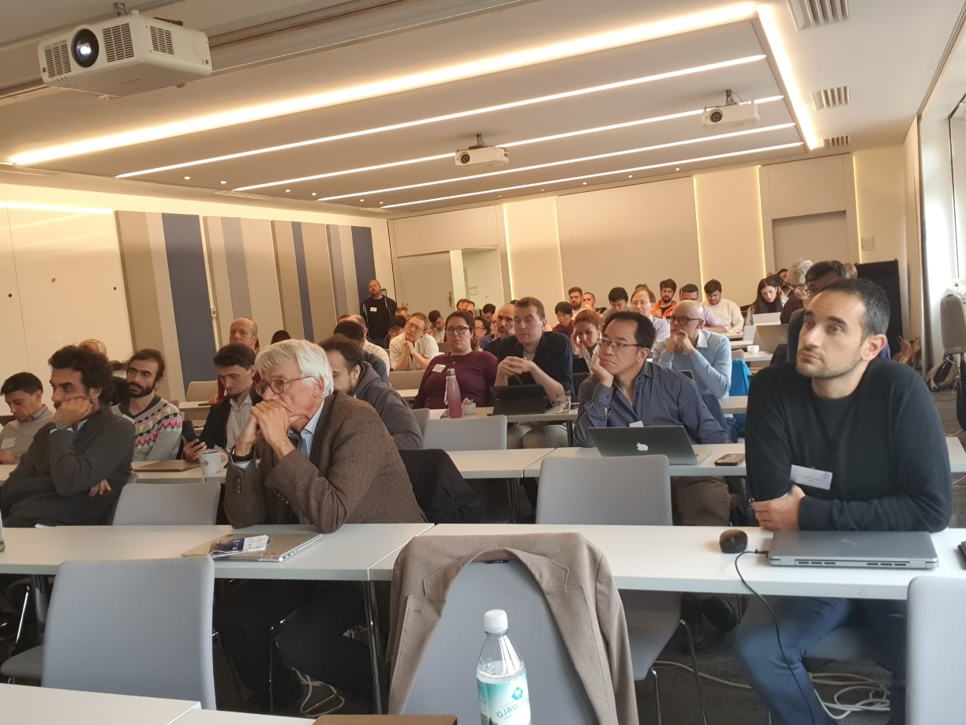
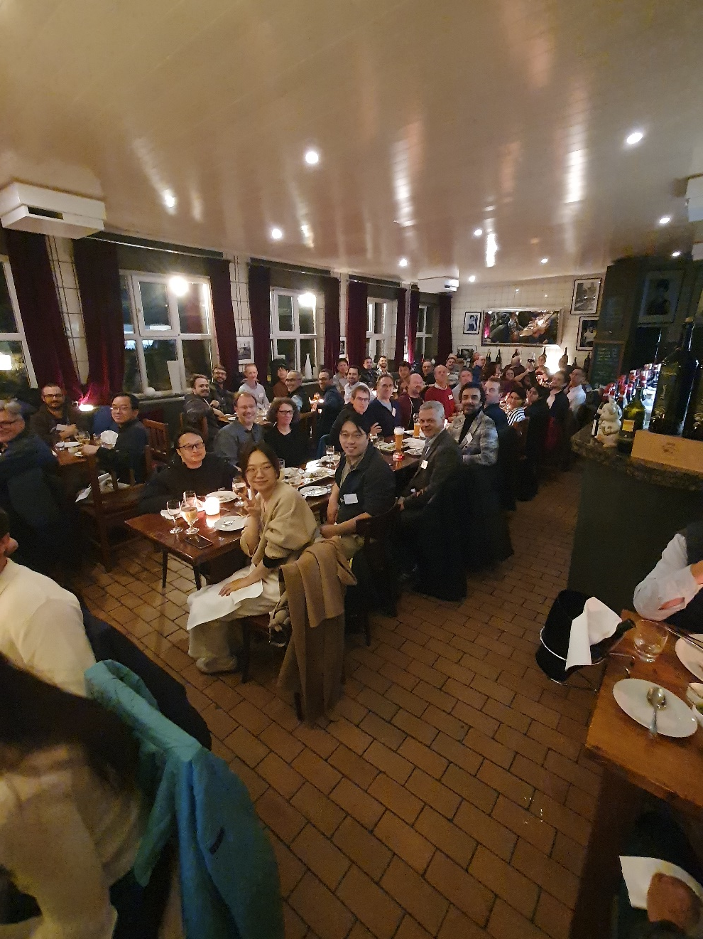
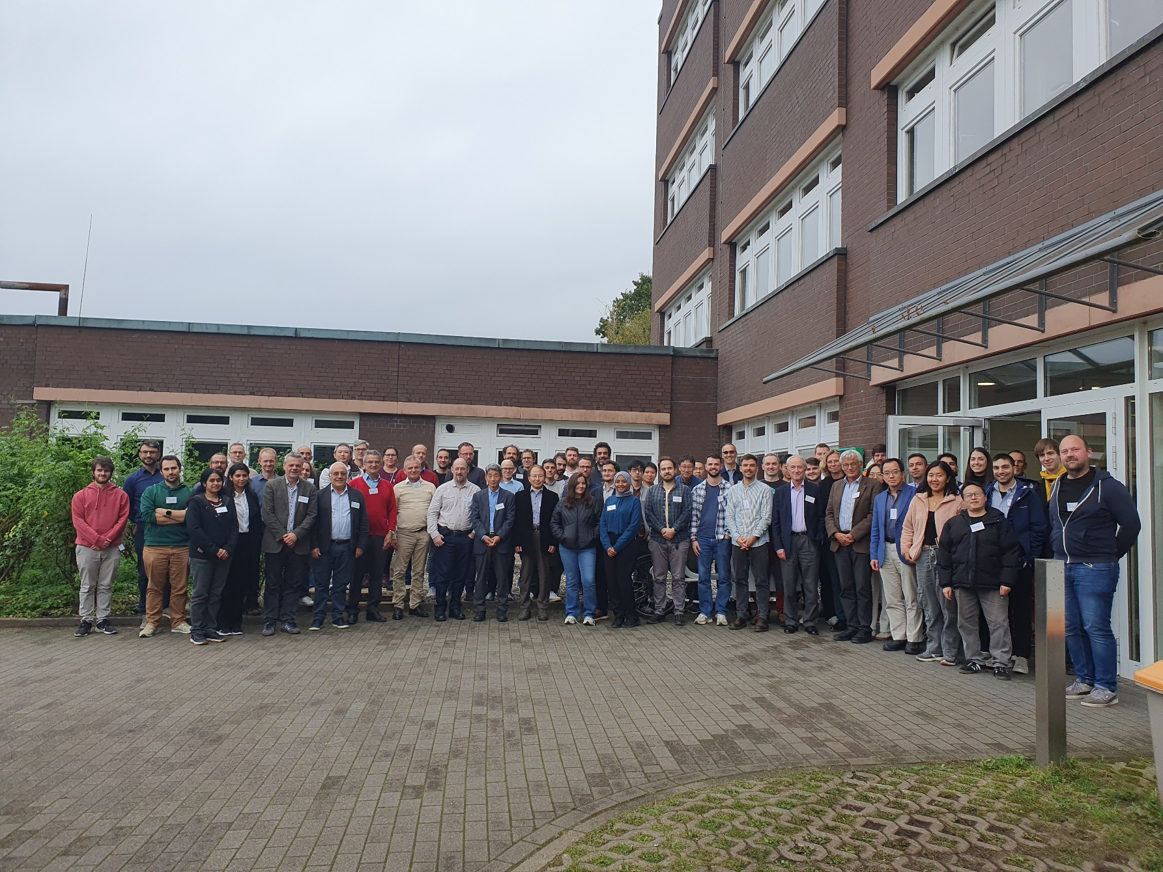
10th LER workshop at DESY 8th-10th Oct. 2025
The series will continue with
support from the labs:
2027 PSI
2028 ELETTRA
DESY/CERN/ESRF
https://indico.desy.de/event/49686/

Slide 19
Conclusions and perspectives
Ultra low emittance ring community is very active with several projects
being commissioned (APS-U, HEPS, SLS II)
funded (ELETTRA 2.0, Diamond II, KOREA-4GSR)
in TDR/CDR phase (PETRA IV, SOLEIL-II, ALBA-II, ..)
WP7 Task 7.2 has supported and fostered interactions in the community of ultralow emittance rings in the last 4 years, with about 15 workshops and experimental sessions

Slide 20
Special thanks to Y. Papaphilippou (CERN)
and
M. Vrenatar (CERN), A. Mochihashi (KIT),
M. Biagini (INFN), S. Guiducci (INFN)
R. Nagaoka (SOLEIL) and M. Böge (PSI)
Thank you for your attention!

