Slide 1
SAC Report Impact of I.FAST on Acc. Technologies
Michiko Minty, Carsten Welsch, and Akira Yamamoto
I.FAST Scientific Advisory Committee (SAC)
5th and final I.FAST meeting, 20-21 Oct. 2025

Slide 2
Outline
Overview
Highlights from I.FAST activities
High-level prototyping
Impact on accelerator technologies
Summary

Slide 3
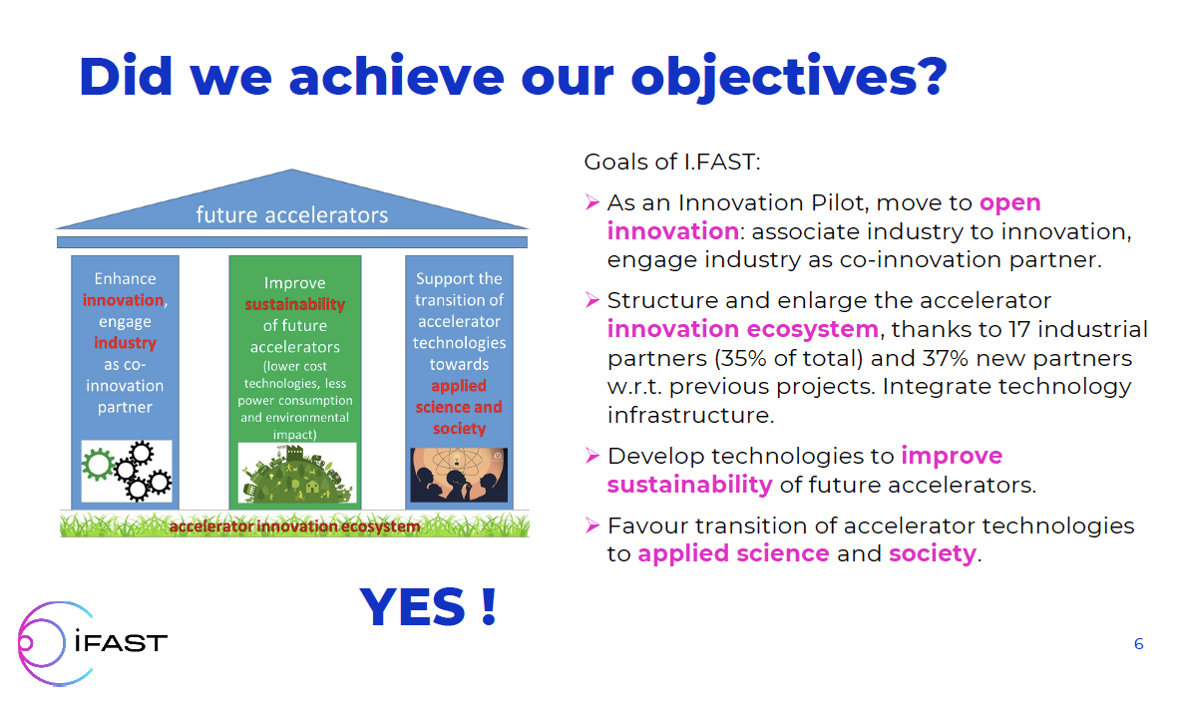
Courtesy: M. Vretenar

Slide 4
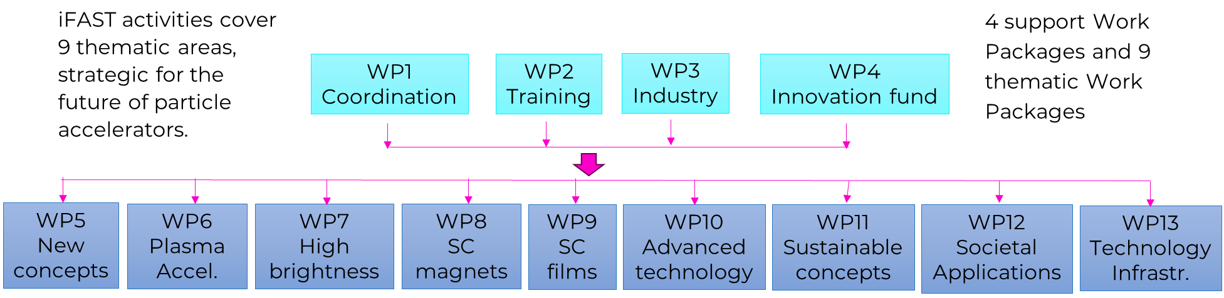
The structure of I.FAST
Mixture between exploratory work and prototyping of deep-tech technologies to higher TRL
new ideas
integration
new concepts
HTS
new techniques
additive manufacturing, ML
strategies
strategies
policy, procedures
exploratory work
slow extraction
targets, stabilization
deposition techniques
SC AM cavities
ML models
biohazards
med. cyclotron
SS RF amplifier
experimental activities
variable field dipole
combined function CCT magnet
Thin film
SRF
AM-RFQ
high-efficiency klystron
high-level prototyping
RF guns
variable-field PMQ
compactlight accelerator
HTS CCT magnet
SAC highlights high-level prototyping

Slide 5
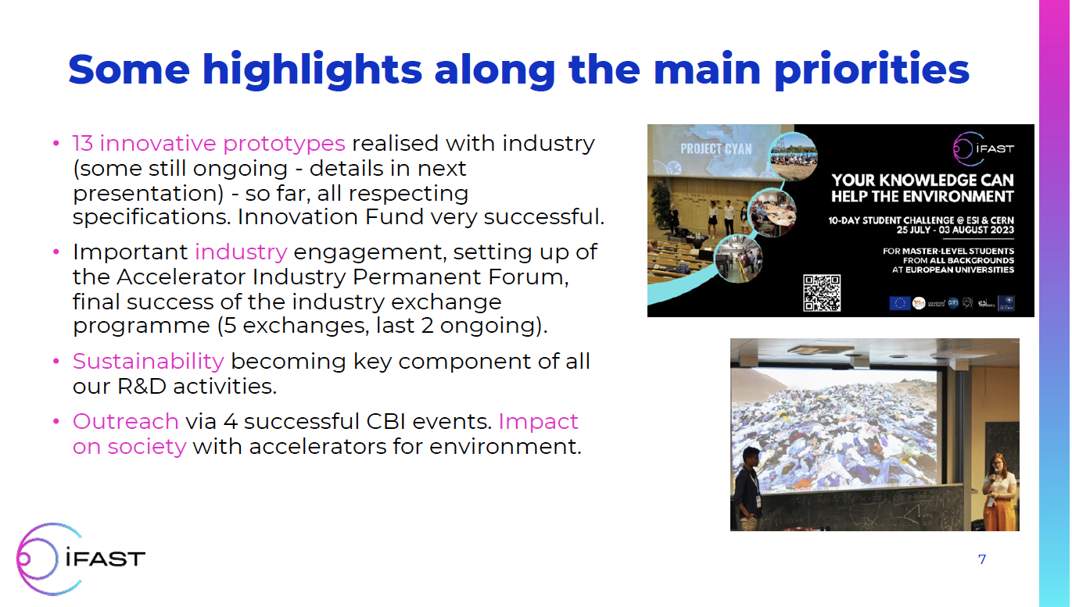
From M. Vretenar, 251021

Slide 6
I.FAST Technical Work Packages and Tasks
WP | PIl | Theme | Task | Task reports given in the 5th meeting | Session
1 | -- | Management, coordination, and dissemination
2 | I | Training, communications and outreach for accelerator science and technology in Europe | 2.1 2.2 2.3 | Management Communication and outreach Challenge-based innovation (CBI) w/ .. accelerators | 1-2 1-3 4-2
3 | I | Industry engagement | 3.1 | Coordination and industrial partnership support | 1-4
4 | I. II | Managing innovation, new materials | 4.? 4.3, -4 | Managing innovation, new materials Innovative beam windows for high-power accelerator applications | 3-2 4-5
5 | I . II | Strategies & Milestones for Acc. Research & Technologies | 5.1 5.2 | MUon colliders STrategy network (MUST) Pushing Accelerator Frontiers (PAF) | 2-1 2-2
6 | I, II | Novel p. accelerator concepts and technologies | 6.1 6.2 | Novel Accelerators Concepts and Technologies LASers for PLasma Accelerators | 1-4 1-5
7 | I, II | High Brightness Accelerators for Light Sources | 7.1 7.2 7.3 7.4 7.5 | Coordination & communication Variable Dipole for upgrade of ELETTRA storage R. Very high gradient RF Guns operating in the C-band RF technology Compact Light Prototype Accelerating Structure | 4.4 3-3 (---) 4.1
8 | I.II | Innovative superconducting | 8.5 8.6 | Construction of HTS CCT magnet demonstrator Development of ReBCO HTS nuclotron cable | 2-3 2-3
9 | I, II | Innovative superconducting thin film coated cavities | 9.1 | Strategy for Innovative SC Acc/ Cavities | 2-4
10 | I, II | Advanced Accelerator technologies | 10.1 10.2 | Coordination and communication Additive manufactured RFQ prototype: results and perspectives | 2-5 3-4
11 | II | Sustainable concepts and technologies | 11.1 11.2 11.3 | Sustainable Concepts for Acc. driven Res. Infrastructure High Efficiency Klystron Industrial Prototype Permanent Magnet Quad. & CF Mag/ for UL-Emit. R. | 2-6 (---) 4-3
12 | III | Social applications
13 | -- | Technology infrastructure
14 | -- | Ethics requirements

Slide 7
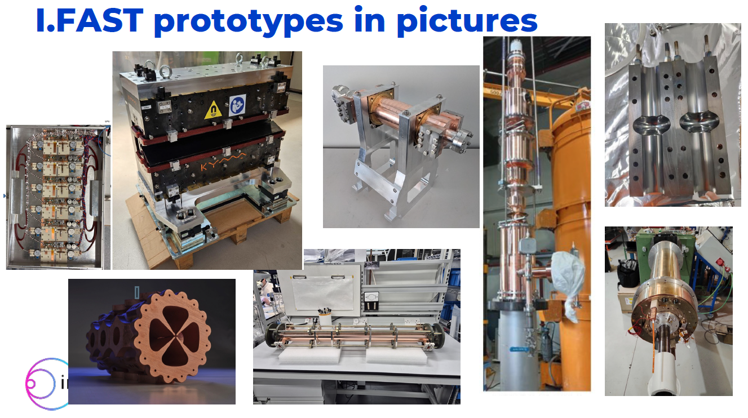
From M. Vretenar, 251021

Slide 8
Outline
Overview
Highlights from I.FAST activities
High-level prototyping
Impact on accelerator technologies
Summary

Slide 9

Highlighting High-level Prototyping
WP7: High Brightness Accelerators for Light Sources
Variable Dipole for upgrade of ELETTRA storage R.
Very high gradient RF Guns operating in the C-band RF technology
Compact Light Prototype Accelerating Structure
WP8: Innovative superconducting
Construction of HTS CCT magnet demonstrator
Development of ReBCO HTS nuclotron cable
WP9: Innovative superconducting thin film coated cavities
Strategy for Innovative SC Acc/ Cavities
WP10: Advanced Accelerator technologies
Additive manufactured RFQ prototype: results and perspectives
WP11: Sustainable concepts and technologies
High Efficiency Klystron Industrial Prototype
Permanent Magnet Quad. & CF Mag/ for Ultra-low Emittance Ring.

Slide 10
How did SAC consider impact?
Scientific / technical: new capabilities, methods and experimental results
Economic: efficiency gains, cost or time savings
Societal: broader benefits, sustainability or safety
Collaborative: partnerships or interdisciplinary collaboration
Capabilities: infrastructure, expertise or new institutional capability
Wider impact: publications, patents, workforce development or innovative training initiatives
We looked also into “lessons learned” and the planned “next steps”

Slide 11
WP7: High Brightness Accelerators for Light Sources
7.3. Longitudinally Variable Dipole of, VADER, Elettra, storage Ring
Achievements:
Industrial-prototype variable-field permanent-magnet dipole, enabling ultra-low-emittance rings w/o cryogenics.
Delivered 2.3 T peak field with 10 - 23 T/m gradient; lattice simulations show ~2× emittance reduction
Reached TRL 6; reusable magnet-design and measurement toolchain established.
Impact:
Power-free design reduces lifetime energy and maintenance costs; manufacturable at scale (KYMA).
Future: Finalize magnet qualification, integrate into Elettra 2.0, extend concept to damping-ring and ULER applications.

Slide 12
WP7: High Brightness Accelerators for Light Sources
7.4. Very high gradient RF Guns operating in the C-band RF technology
Achievements:
Established complete photocathode production/characterization chain for next-generation FEL and ERL injectors.
Demonstrated robust multi-alkali and semiconductor cathodes with improved quantum efficiency and >100 h lifetime under UHV.
Improved reliability and reduced replacement frequency, leading to lower downtime and cost, cathode-handling procedures transferable across labs.
Reduced toxic-material handling and activated-cesium waste; supports safer, cleaner cathode operations.
Impact:
Permanent photocathode test stands commissioned (CERN and INFN); trained new generation of injector physicists and surface scientists.
Future: Accelerate lifetime modelling, vacuum conditioning and industrial-grade sealed-cathodes for ERLs & XFELs.

Slide 13
WP8: Innovative Superconducting Magnets
8.5 Construction of Combined CCT Magnet Demonstrator based on LTS
Achievements:
Developed machining, magnet winding and impregnation methods ensuring mechanical stability, build to tolerances.
Constructed magnet with NbTi ropes + 1 copper strand.
Completed low voltage electrical tests.
Delivered magnet with 4T dipole and 5 T/m quadrupole.
Demonstrated magnet and validation tests: ramped at 0.2 - 0.4 T/s.
Impact:
Future application for compact and industrical SC magnets, such as medical beamline/applications.
Future: cryogenic qualification tests at Uppsala to validate design and demonstrate industrial scalability.

Slide 14
WP8: Innovative Superconducting Magnets
8.6 HTS CCT Magnet Demonstrator, and ReBCO HTS nuclotron cable
Achievements:
Developed infrastructure and expertise with custom tooling, winding, and assembly processes.
Constructed magnet with new layout using 2-tapes cable (980 A) with 20 HTS cables; completed HV tests up to 1 kV.
Demonstrated ramp validation to 0.4 T/s with AC losses compatible with 20 K conduction cooling system.
Delivered 4 T dipole for operation at 20 K (factor 5 higher power efficiency than at 4.5 K) .
Impact:
Potential to transform the field of superconducting magnet for particle accelerators and for other societal applications.
Established European Strategy Group to explore HTS magnets for accelerator, consolidated leadership in HTS magnet development; developed strong industrial partnerships with industry.
Future: cryogenic qualification tests at INFN-LASA

Slide 15
WP9: Thin-Film coated RF Cavities
9.1. Innovative Superconducting Accelerating Cavities
Achievements:
Established Europe-wide partnerships / interdisciplinary collaborations.
Collaborated closely with industry (with some external challenges which were successfully overcome).
Developed new capabilities in Nb3Sn cavity coating (at INFN and UKRI); delivered first prototype of 1.3 GHz.
Advanced surface engineering technologies (ALD and PVD deposition facilities).
Developed new laser treatment facility and documented the “lessons learned”.
Impact:
Sustainability for particle accelerators, lower construction (higher E) and operation cost (higher temp. and higher Q).
Future: RF testing of Nb3Sn coated cavity (STFC, CEA, H2B), coating of Cu cavities, tests of multilayer coatings and other SC materials, RF test of 1.3 GHz Nb-coated cavity irradiated by laser.

Slide 16
WP10: Advance Accelerator Technologies
10.2. Additive manufactured RFQ prototype: results and perspectives
Achievements:
First LPBF-Cu RFQ module (with one-step printing), vacuum-tight to 10⁻¹⁰ mbar·L·s⁻¹.
High-field tests up to 31 MV/m; path toward 40 MV/m target.
Validated the EM design; frequency shift understood & corrective plan in place.
Strong industry link through Rösler and training on advanced manufacturing finishing
Demonstrated feasibility in principle of joint-free RF structures, although significant challenges remain.
Developed post-processing treatment for inaccessible vane tips, reduced surface roughness from ~10 to ~ 1.7 microns.
Impact:
Enables compact, faster and potentially cheaper accelerator builds
Significant design freedom for integrated cooling/tuning features
Future: Results fed into EPITA plans: demonstrate > 85% of nominal Q-value at nominal design power, beam-validated advanced manufacture RFQ and IH-DTL.

Slide 17
WP11: Sustainable concepts and technologies
11.2. High Efficiency Klystron Industrial Prototype
Achievements::
400 MHz High Efficiency Klystron prototype demonstrated
It was already reported in the 4th annual meeting.
Impact:
The most critical impact for any future accelerator programs, and significant contribution to the sustainability.
Future: To be extended in EPITA.

Slide 18
WP11: Sustainable concepts and technologies
11.3. Permanent Magnet Quad. & CF Mag/ for Ultra Low Emittance Ring
Achievements:
Constructed combined function mright agnets with NdFeB permanent magnet blocks, with 0.6 T dipole field and 30 T/m gradient (Q).
Developed ‘ice cube’ tray non-magnetic folder blocks and robust mechanical structure design.
Impact:
Extreme sustainability and operational cost saving
Future: Prototype to be tested with beam. Modular production and further engineering.

Slide 19
Outline
Overview
Highlights from I.FAST activities
High-level prototyping
Impact on accelerator technologies
Summary

Slide 20
Summary (1/2)
The SAC congratulates excellent progress demonstrated by the I.FAST program during the period 2021-2025.
SAC would like to highlight in particular the efficient project management and coordination of this very large and diverse consortium.
The (near-full) completion of all WPs with 53 challenging deliverables is a major success, in particular in view of the significant challenges faced, including COVID, the war in Ukraine, and the global materials / cost crisis.

Slide 21
Summary (2/2)
I.FAST has successfully achieved its goals across the three pillars underpinning the development of future accelerators: open innovation, innovation ecosystem and improved sustainability.
The project has successfully transitioned novel accelerator technology to applied science and society, and stimulated industrial engagement (Industry Advisory Board, IAB), several successful workshops connected with I.FAST Annual Meetings and establishing the Accelerator science and technology Industry Permanent Forum (AIPF).
High-level prototypes were realized in several work packages, boosting existing accelerator technologies and future particle accelerator R&D programs.
The SAC welcomes the transfer and extensions of the most successful activities to the proposed Enabling Partnerships for Innovation & accelerator Technology Advancement project, EPITA.

Slide 22
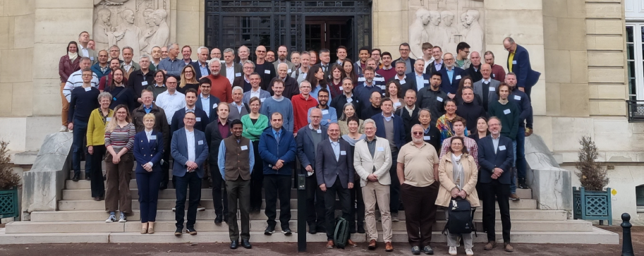
Acknowledgements
SAC would like to thank I.FAST team and all presenters for their very clear, focused and informative talks.
SAC appreciates I.FAST team accepting SAC’s feedback and reflecting it to the succeeding activities.
Special thanks go to Maurizo, Valerie, and the Local Organizers & Supports for this final I.FAST meeting successfully organized.

Slide 23
Backup

Slide 24
Agenda:
Courtesy: V. Brunner

Slide 25
Agenda:
Courtesy: V. Brunner

Slide 26
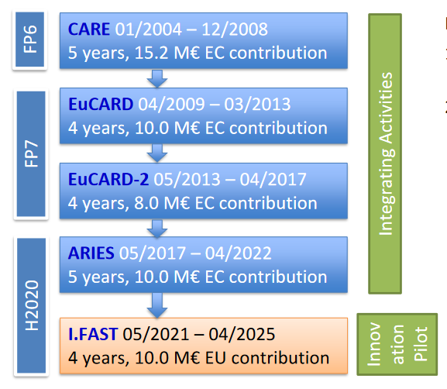
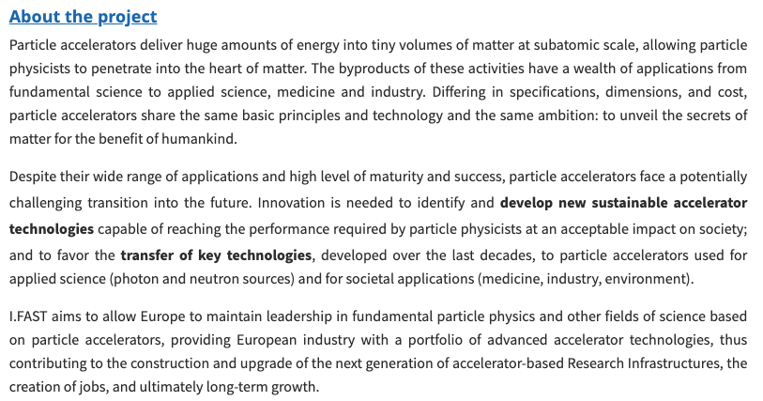
I.FAST Aiming at:
Courtesy: M. Vretenar

Slide 27
Courtesy: V. Brunner

Slide 28
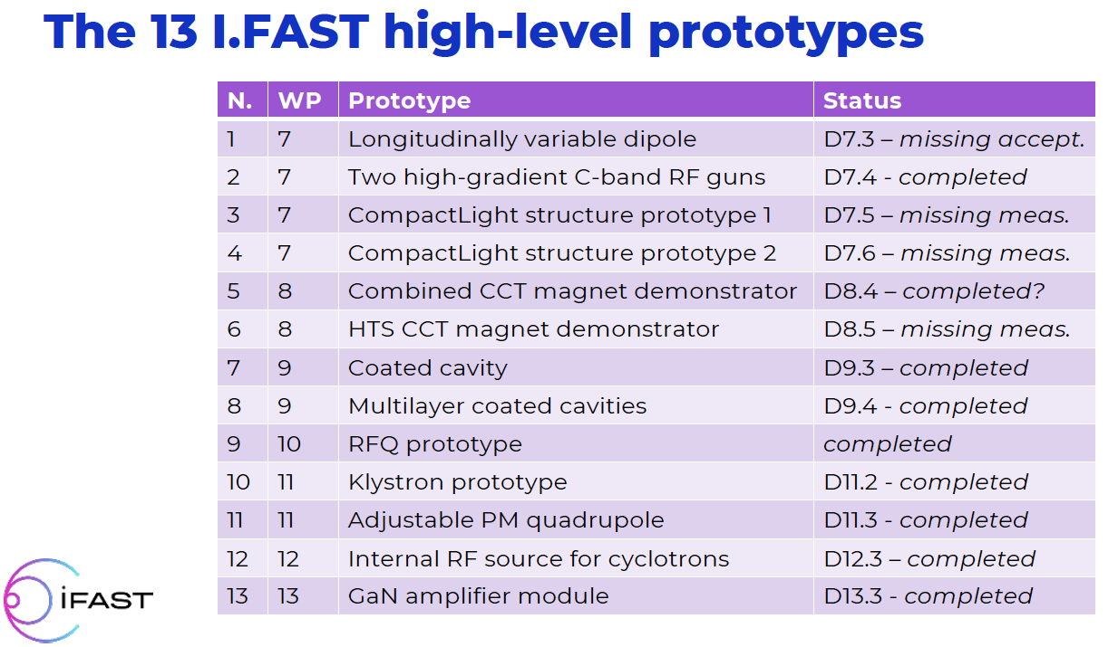
From M. Vretenar, 251021

Slide 29
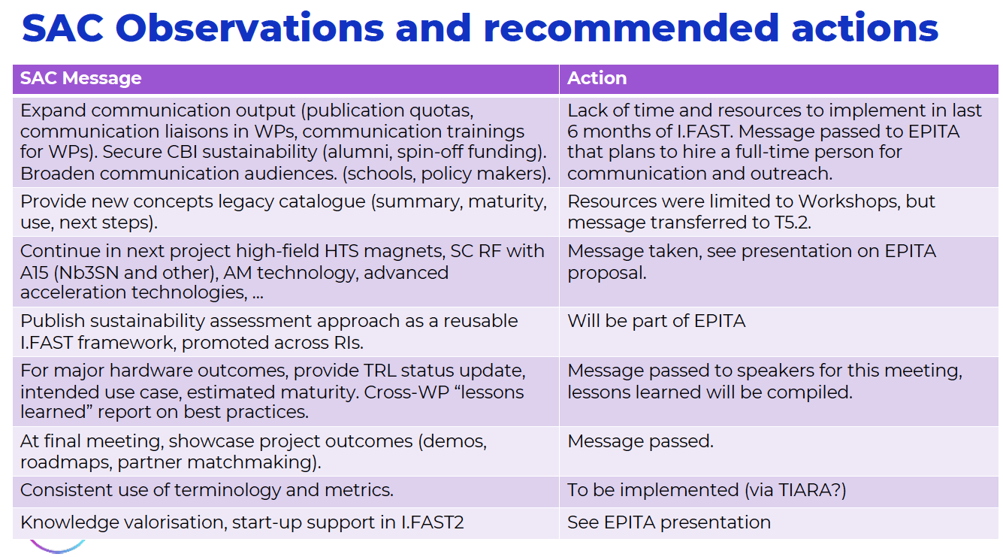
From M. Vretenar, 251021

