Slide 1
TASK 7.5: CompactLight Prototype Accelerating Structures
5th and final I.FAST Annual Meeting – CERN 21-22/10/25
G. D’Auria, Elettra – Sincrotrone Trieste

Slide 2
Outline
Project objectives
Prototypes construction:
Pre-prototype production process, mechanical and RF tests
Prototype construction
Results obtained
Lesson learned
TRL achieved and future perspectives
Impact
Acknowledgements

Slide 3






Project objective
Build and test two prototypes of the X-band (12 GHz) accelerating structure designed for the CompactLight (XLS) project, a new class of linac-driven FEL facility.
Deliverables:
D7.5: Construction and tests of the pre-prototype.
Development of production process and RF tests of the pre-prototype
D7.6: Construction and tests of the full prototype.
Production process analysis and validation, RF tests of the full prototype
Task 7.5 partners:

Slide 4
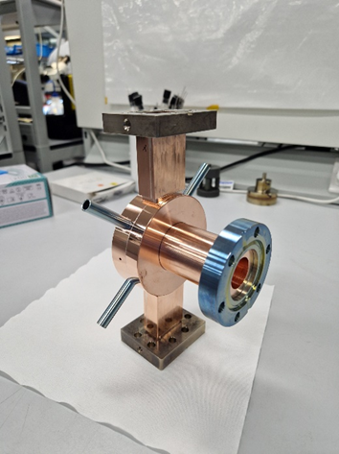
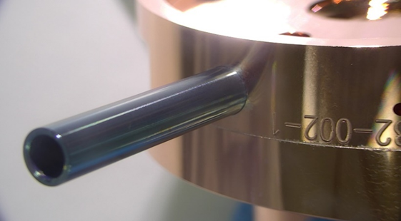
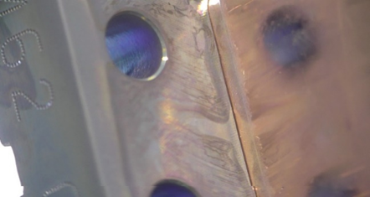
Pre-prototype construction
As was already reported at previous I.FAST meetings, we have experienced several problems. In particular:
the brazing of the RF couplers, that forced us to revise their design and brazing method and to launch the production of two new RF couplers
This led to a delay of more than one year in the brazing of the pre-prototype (and a very frustrating situation for everyone involved!)

Slide 5
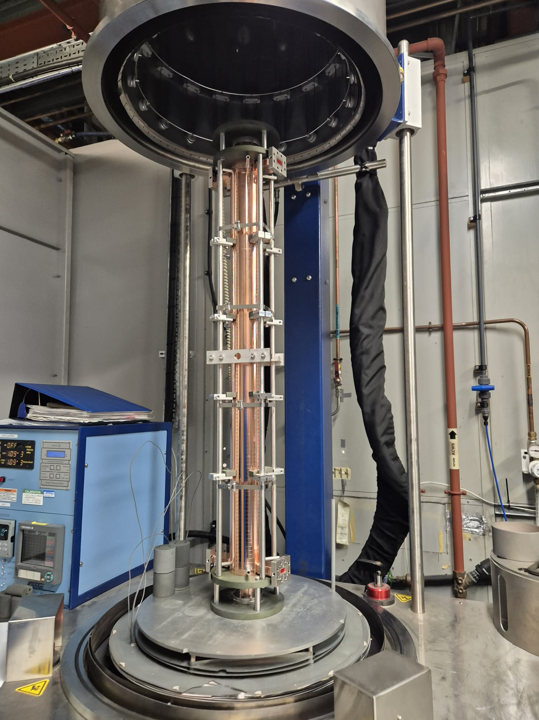
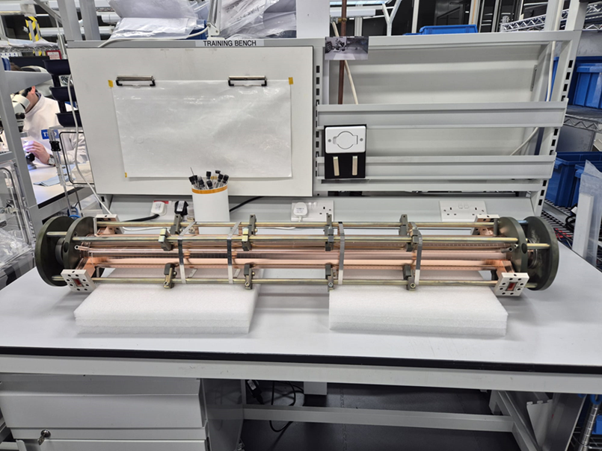
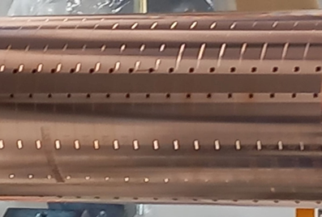
Brazing of the whole structure
The whole structure, with the two new RF couplers, was brazed mid of February 2025.
Following the braze run, the structure was tested using ultra-high vacuum leak checking equipment and was unfortunately shown to have a gross leak, coming from some of the braze channel vent holes!!!

Slide 6
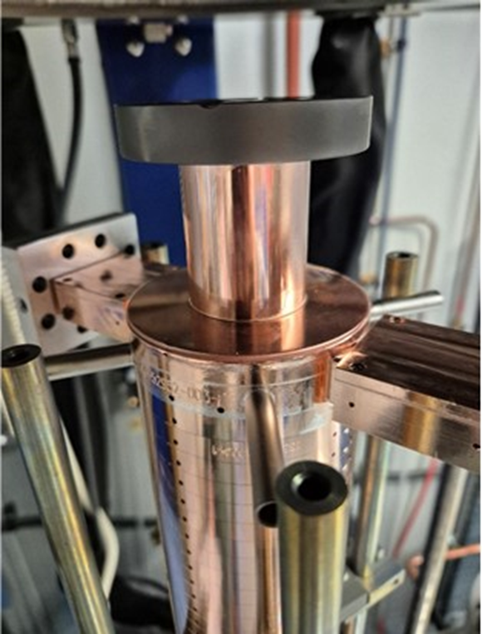

Inadequate compensation for copper expansion
In addition, the structure thermally expanded into its braze jig, during the brazing processs.
A mechanical deformation was detected on the wall of the RF coupler, with a potential impact on the RF functionality of the device.

Slide 7
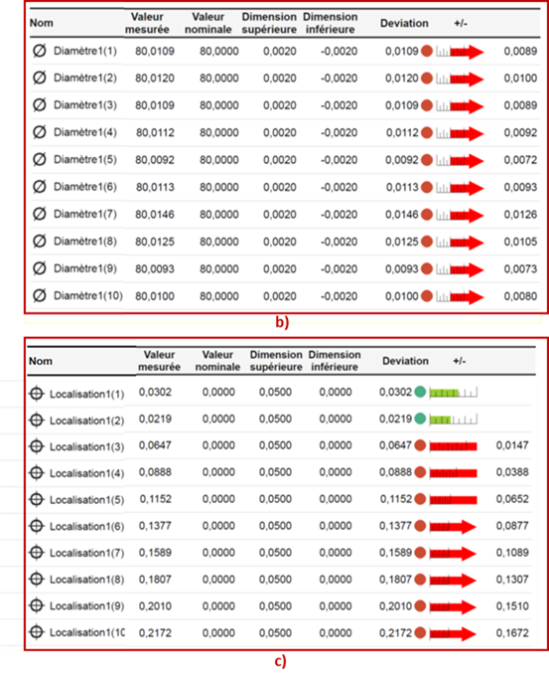
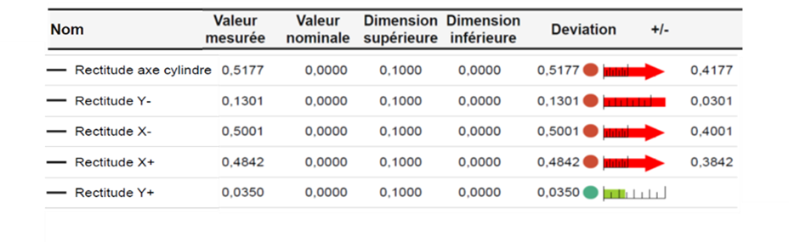
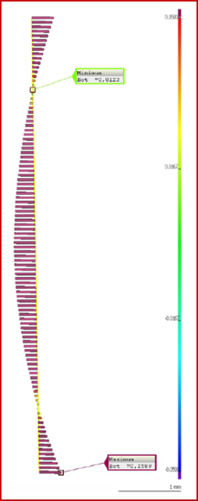
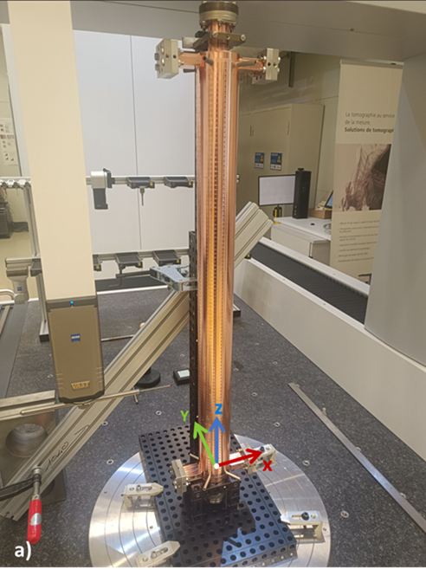
CERN metrology report
The structure’s axis revealed a clear “banana shape”, with a maximum deviation in the middle of up to 0.42 mm, almost 100 times higher than expected, that make the structure use rather problematic!
203 measurement points out of tolerance!

Slide 8
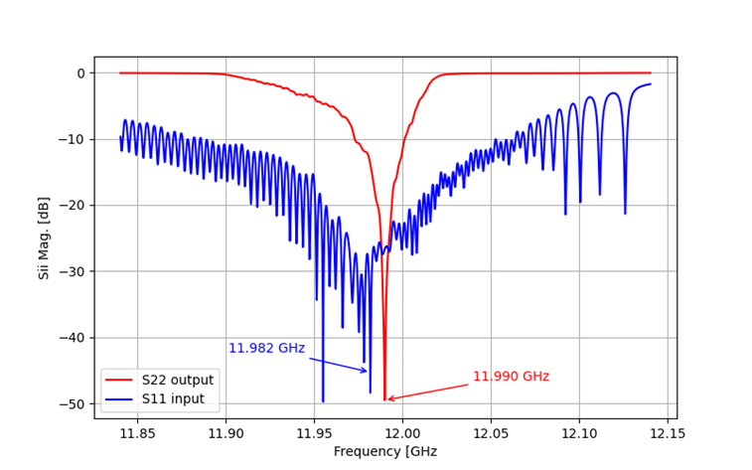
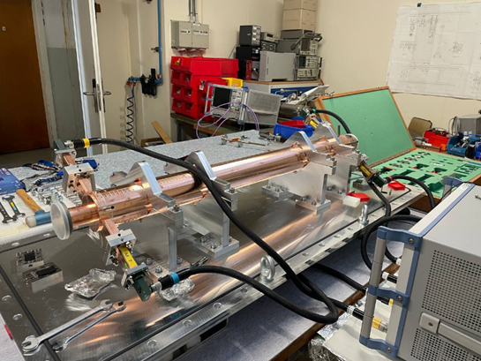
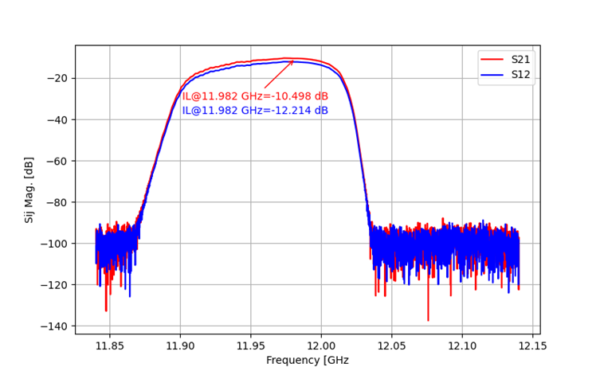
Low level RF measurements
Input and output
S parameters
(in reflection)
Input and output
S parameters
(in transmission)
The structure is quite well matched with a return loss >20 dB and an insertion loss of ≈10 dB

Slide 9
Results obtained
The construction of the first two CompactLight acceleration structures was carried out in several phases:
RF design evaluation
Cooling system design and thermal stabilization
Preparation of technical drawings for construction
Precision machining of cells
Brazing tests (few cells)
Brazing of the whole accelerating structures
Vacuum tests and RF characterization
While some phases went well, achieving the expected results on time, others encountered serious technical problems, resulting in technical non-conformities and significant delays.
Most of these issues were related to the construction of the pre-prototype, which was completed with almost two years of delay.

Slide 10
What went well and what didn’t go well: lesson learned
We did not experience any significant problem with:
the RF design of the structure and the development of the engineering drawings (including the design of the thermal stabilization system).
The precision machining of all the elementary cells was successful, achieving a high level of quality, accuracy and reliability in terms of production.
Most of the brazing tests, carried out on a reduced number of cells (3-5), also went well.
The activities that proved to be problematic, contributing to mechanical and vacuum issues, as well as delays in completing the various phases of the project, were:
the assembly of the entire structure before brazing (stacking of all the cells) and the use of the braze jig for lifting and rotating the whole structure for brazing.
The brazing process, the instability of the oven temperature and an inadequate compensation for copper expansion inside the jig during the brazing cycle.
A careful analysis of the processes and methods used for producing the pre-prototype, the effectiveness of the assigned roles, as well as the unexpected events occurred, led us to implement the necessary corrective actions for the second structure.

Slide 11
Second Prototype
All the mechanical parts of the second structure (RF cells, couplers, WG components) are ready to be brazed.
Due to the problems encountered in brazing the pre-prototype, to minimise risks, we have decided to braze the prototype at PSI (Zurich).
PSI is an I.FAST partner (task 7.5) with a proven experience in brazing these components (they have successfully brazed all the C-band structures for PSI FEL)
All the parts of the second structure will be shipped from CERN to PSI within this month and the structure will be brazed beginning of November.
We expect to complete the work, including the vacuum tests and the RF characterization, by November 20th.
The second deliverable, D7.6, can be released in December 2025.

Slide 12
TRL and MRL achieved and future perspectives
Most of the activities carried out for Task 7.5 are technically mature and have already been proven to be fully reliable at an industrial level.
These can be assessed with a TRL/MRL of at least 7.
In particular:
The EM codes currently available for the RF design of a structure are highly reliable, and have provided the operating parameters with great accuracy. This has eliminated the need of correction tools or frequency tuners on the structure.
The production process for cells is well established and does not present any particular risks. Micron-precision machining have ensured high levels of reliability and precision.
Currently, the most risky activities and bottlenecks in the entire construction process are those related to brazing techniques. These can be assessed with a TRL/MRL of 6 or lower. The entire process still requires further developments, studies and testing.

Slide 13
Impact
The CompactLight acceleration structure has been designed to provide a key component for compact accelerators capable of operating at high repetition rates (up to KHz regime).
These accelerators have a wide range of applications, from basic physics to biomedical applications, i.e. photon sources based on Inverse Compton Scattering (ICS), that can be considered a fundamental tool for high-resolution diagnostic imaging.
Currently, the scientific interest in these sources is rapidly growing due to their reduced size and costs, compared to their capabilities as a “tunable monochromatic X-ray source” for use in Mammography, K-edge imaging, Phase-contrast imaging…..
Aspects that have a significant social impact, with economic benefits for all the community.

Slide 14
Acknowledgements
I would like to thank all the partners involved in Task 7.5 for their precious contribution and constant support.
In particular, my gratitude goes to Pedro Morales Sanchez, who has followed the project with great enthusiasm and dedication throughout all its stages since the beginning.

Slide 15
Thank you!

